Slide 1

Qudit Quantum Computing
Peter Tirler
University of Innsbruck

Slide 2
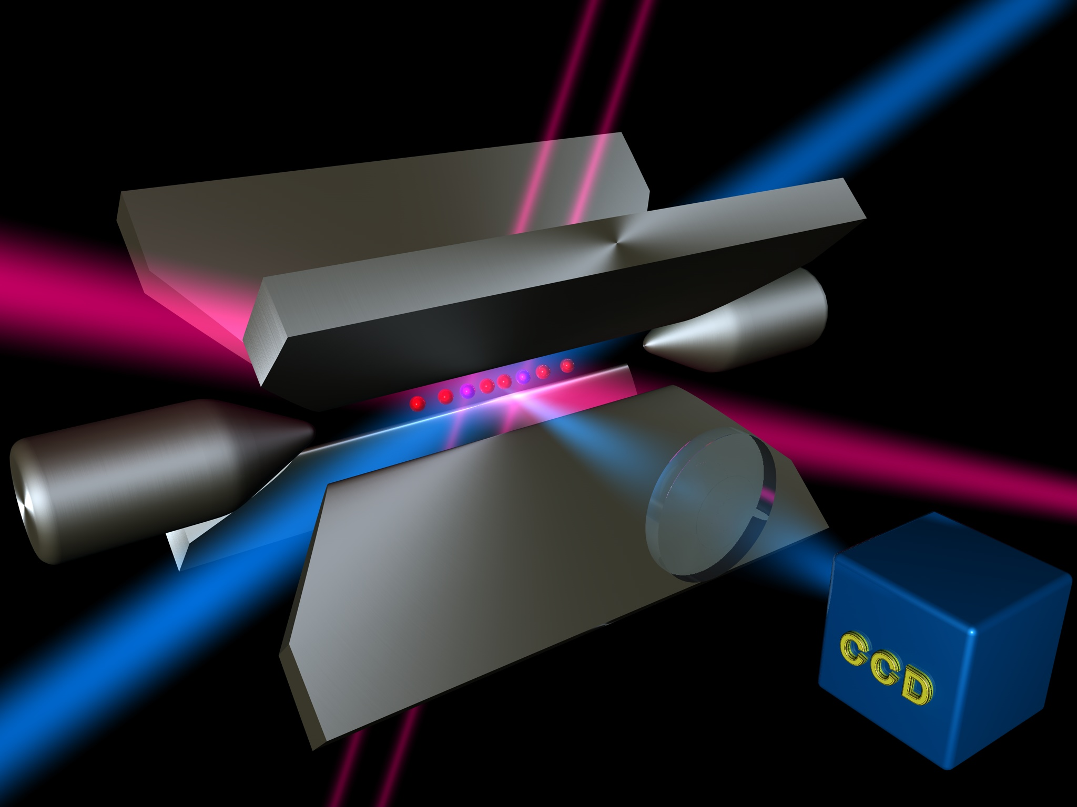
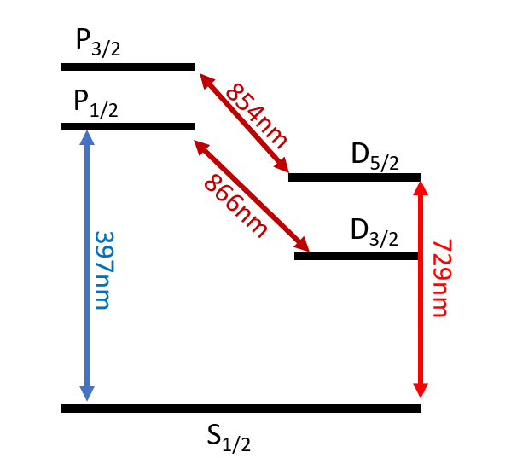
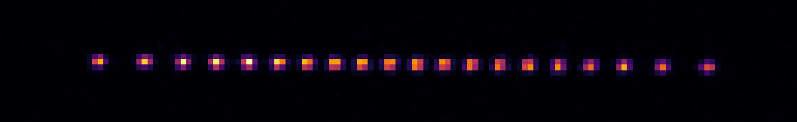
Quantum Computing with Trapped Ions
We trap multiple Calcium Ions in a Linear Paul Trap and store quantum information in their electronic levels, using lasers that drive the quadrupole transition.
Ca+
P. Schindler et al., New. J. Phys. 15, 123012 (2013)

Slide 3
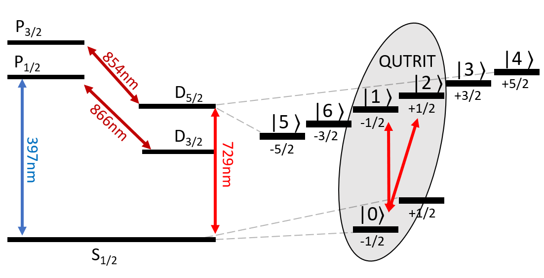
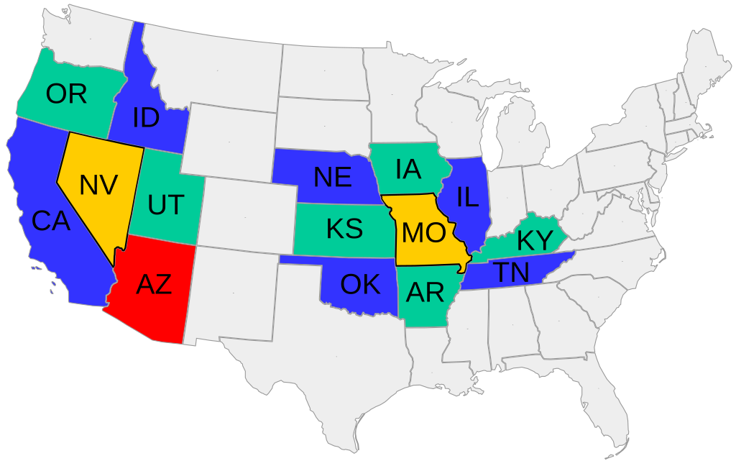
Qudit Quantum Information Processing
Instead of restricting us to a 2-dimensional subspace of the available Hilbert space, we store more information in one ion by using bigger subspaces.
Is this useful? - depends…
cmglee, Heitordp - CC BY-SA 4.0

Slide 4
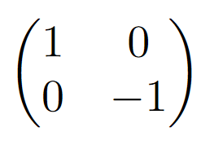
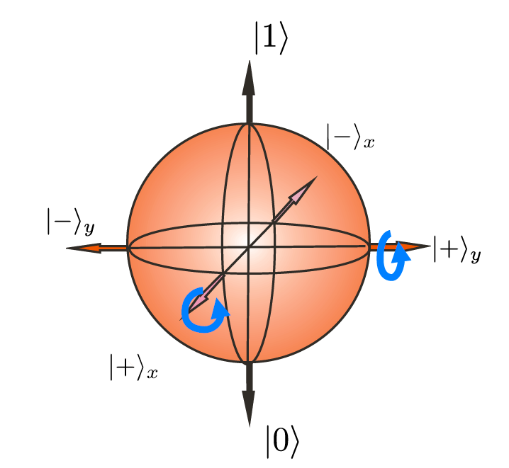
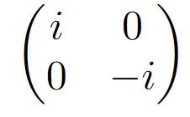
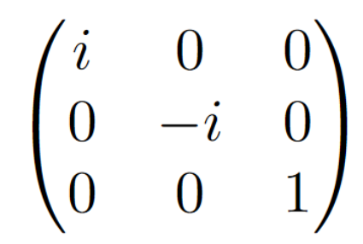
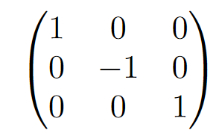
Intricacies of Qudit QIP I
Now we have to implement arbitrary unitaries on d-dimensional quantum systems. This can be done by decomposition into 2-level operations.
=
=
 | Ringbauer et al. Nat. Phys. 2022

Slide 5
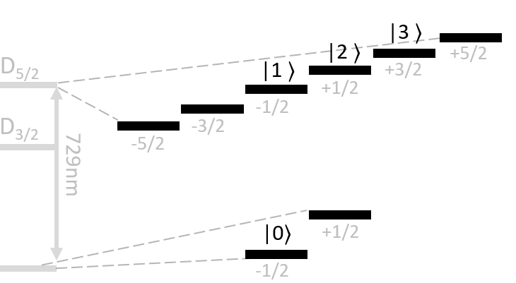
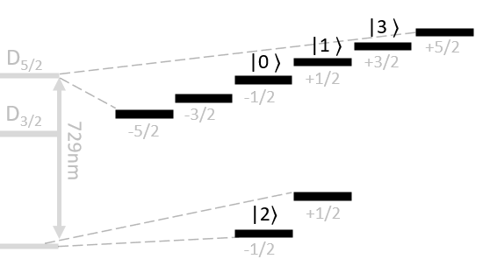

Intricacies of Qudit Quantum Computing II
Readout is always projective into „bright“ or „dark“. Since this is fundamentally qubit-based, d-dimensional readout has to be done iteratively, which creates overhead.
1
2
3

Slide 6
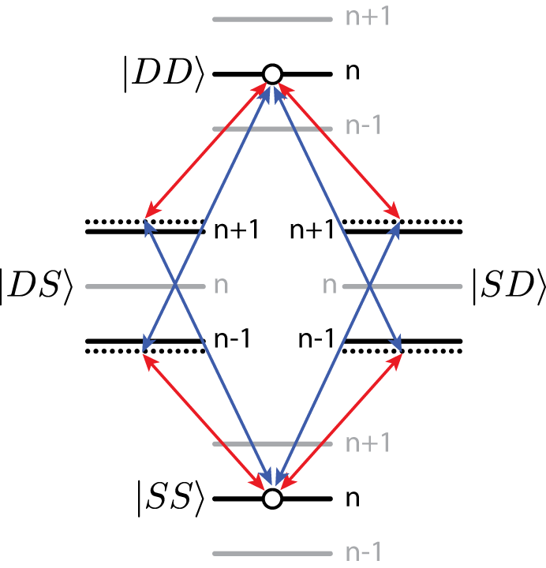
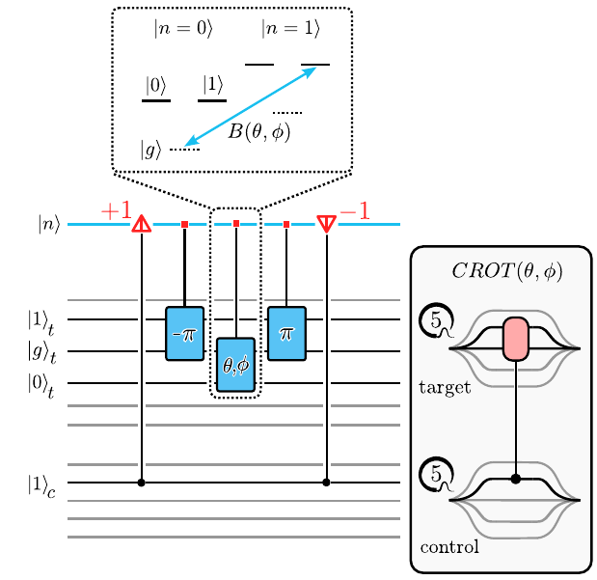
Intricacies of Qudit Quantum Computing III
Entangling gates are still universal, but not equivalent. This calls for multiple different entangling gates to be used for different applications. E.g:
Mølmer-Sørensen
Cirac-Zoller
Light Shift Gate
Meth et al. arXiv:2310.12110
K. Mølmer and A. Sørensen, PRL 82, 1835 (1999)

Slide 7
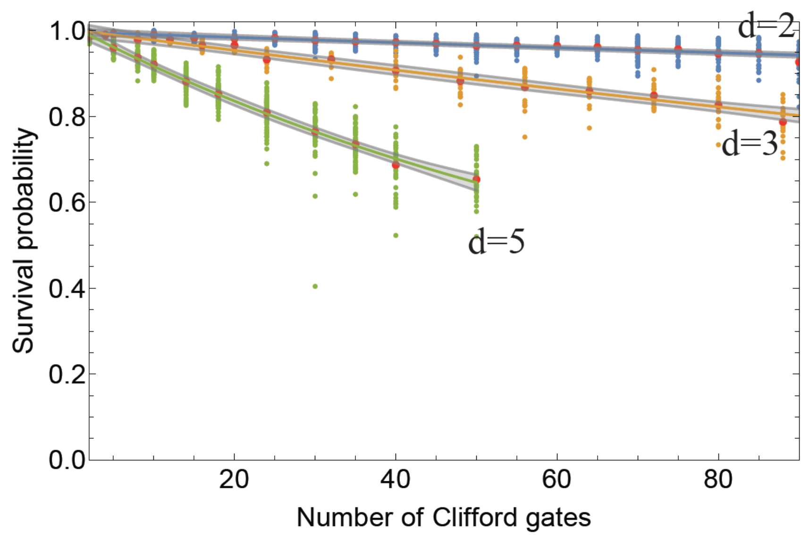
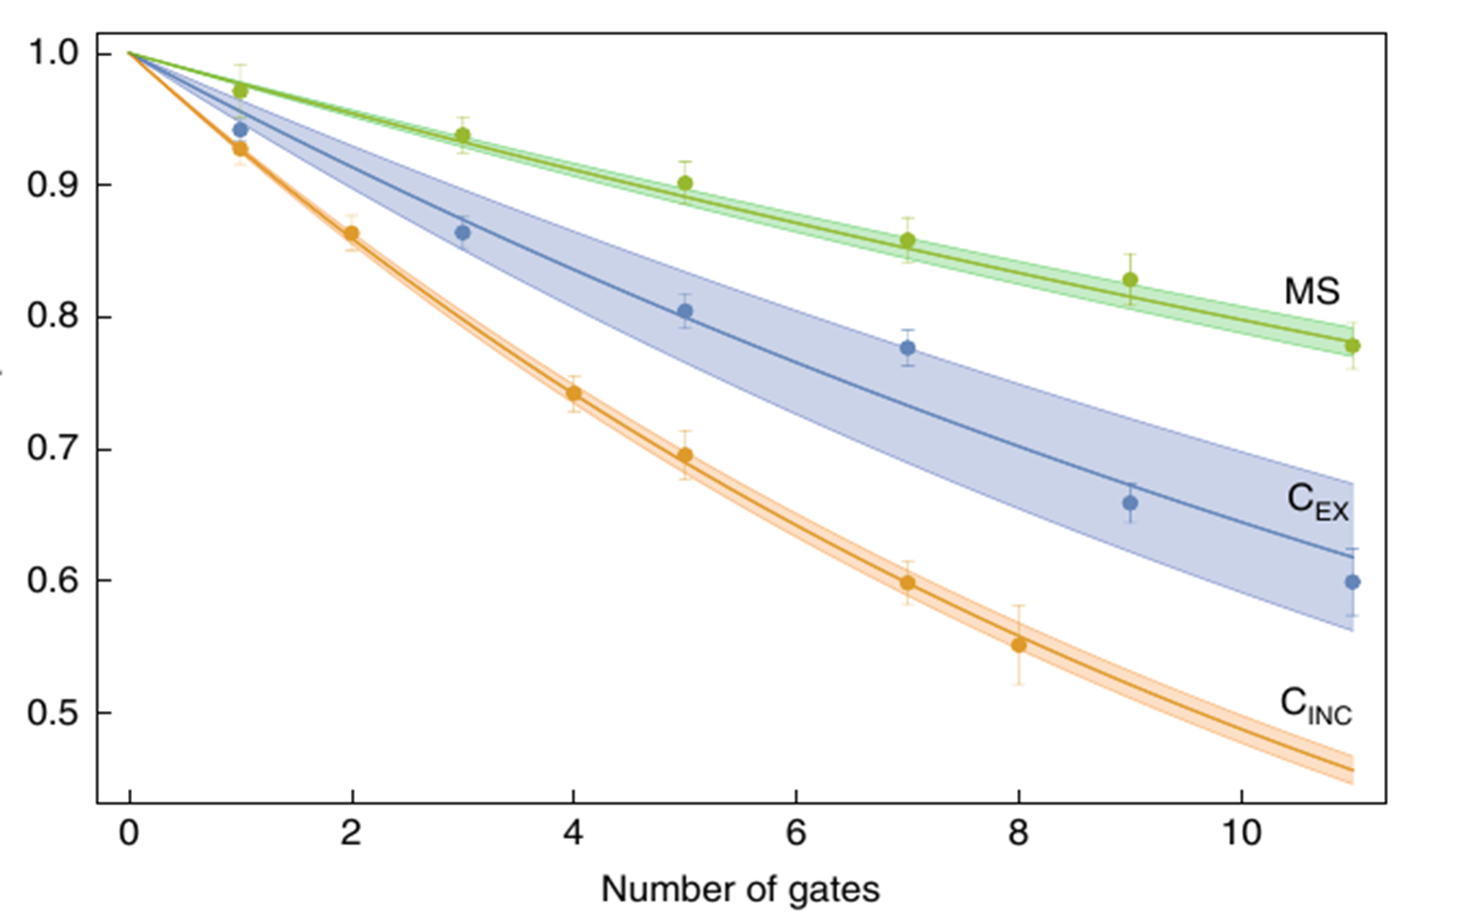
State of the Art
We can use an existing experiment in Innsbruck to benchmark qudit gates. Going to larger dimensions, the fidelity per pulse remains constant and gate fidelities scale accordingly.
Error rate: 2*10⁻⁴ per pi/2 pulse
 | Ringbauer et al. Nat. Phys. 2022

Slide 8
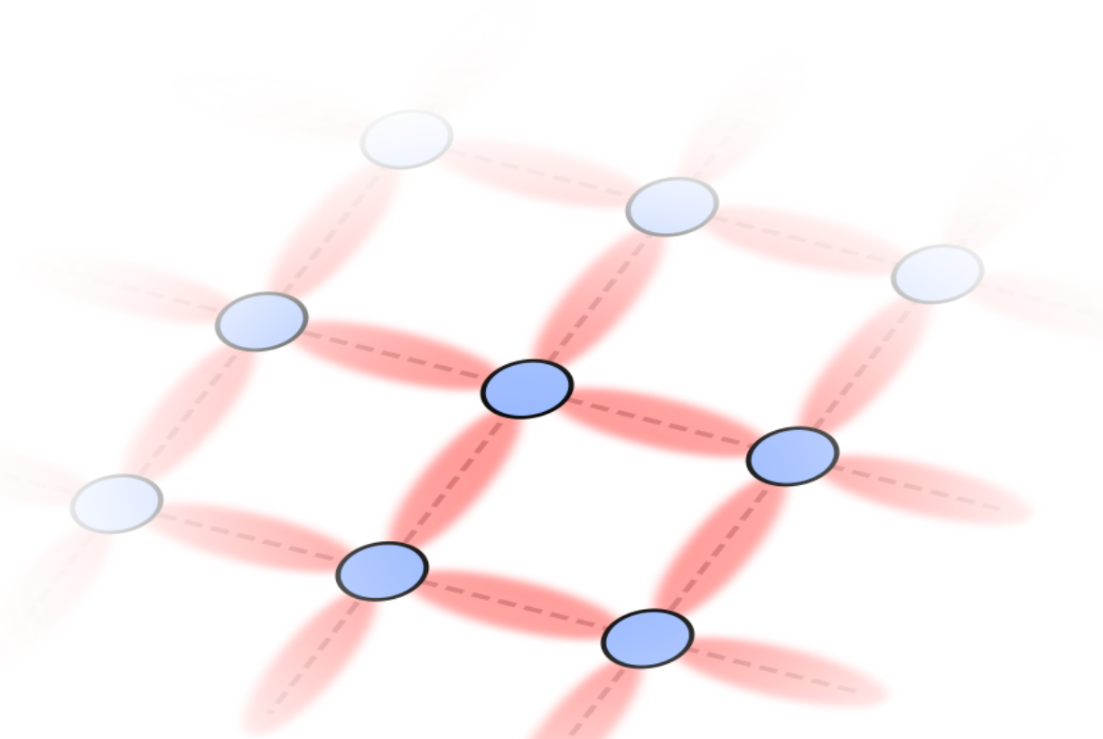
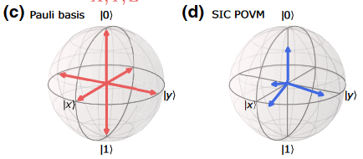
Is this useful?
Already, some problems are better suited for qudit-based computation. Examples that were demonstrated here in Innsbruck include single-setting tomography and quantum simulations of two-dimensional lattice gauge theories.
gauge field
matter
R. Stricker, et al., PRX Quantum 3, 040310 (2022)
M. Meth, et al., arxiv:2310.12110 (2023)

Slide 9
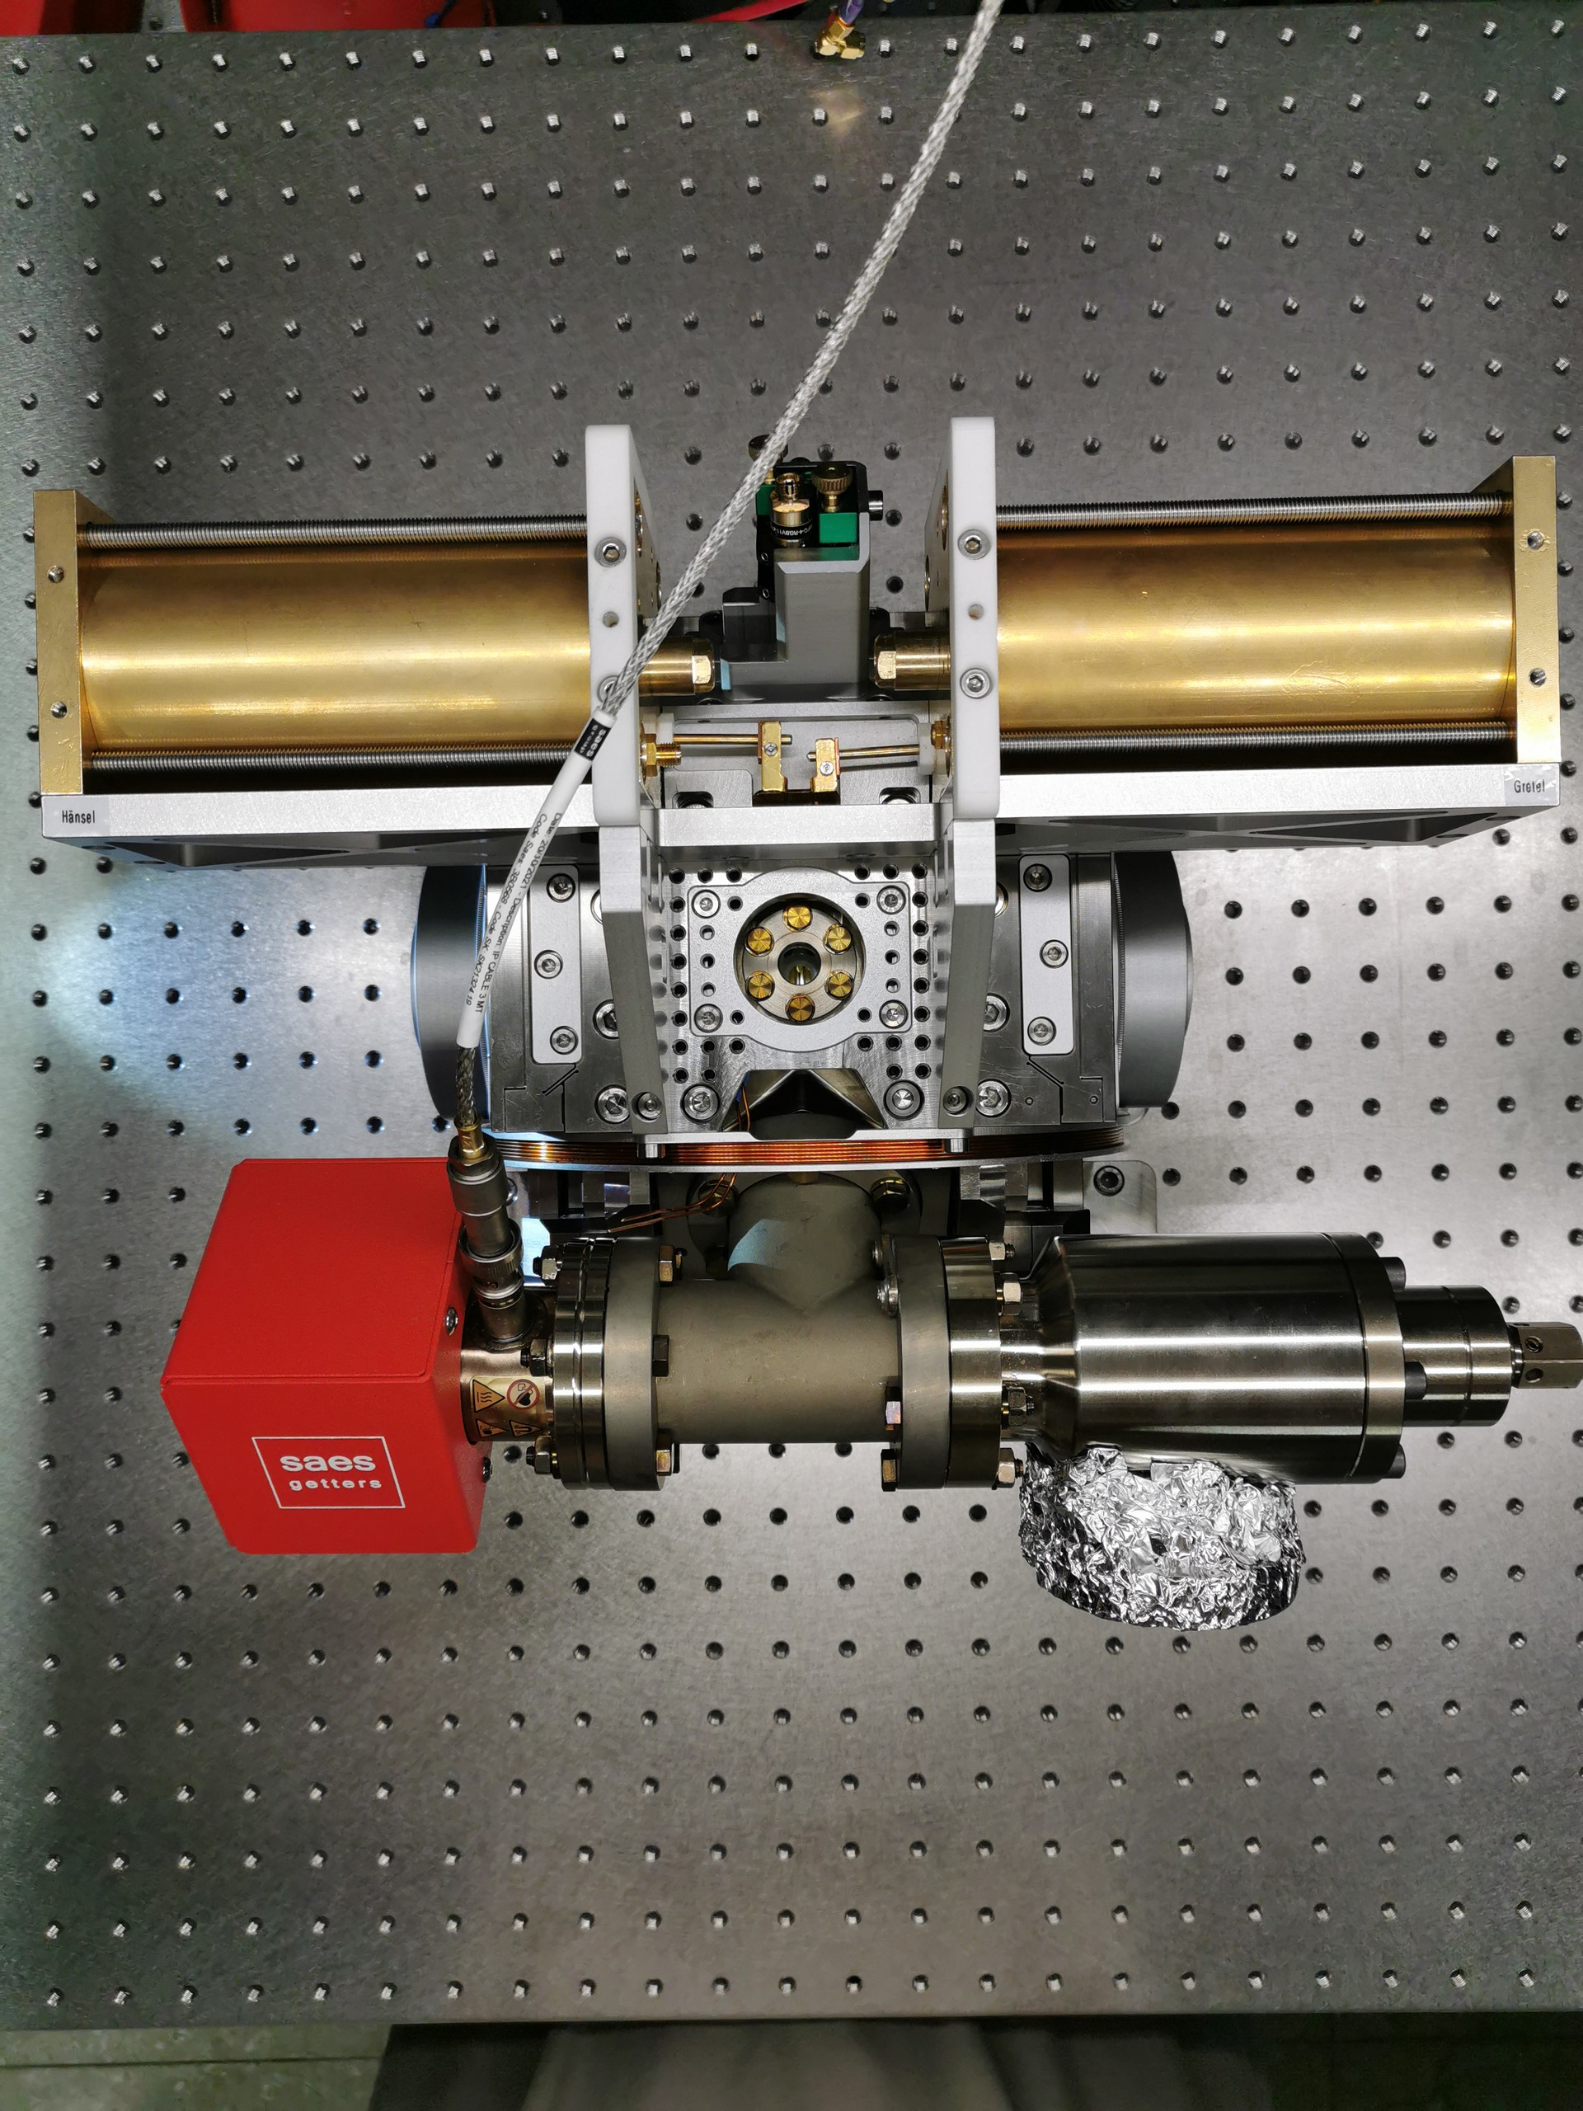
The Real World: Building a New Hardware Setup
Our current focus is to build a new experiment, that is specifically geared toward state-of-the-art QIP with qudits. This in particular includes:
Dual desonator drive
Two sided orthogonal addressing
High NA objective
Titanium Chamber

Slide 10
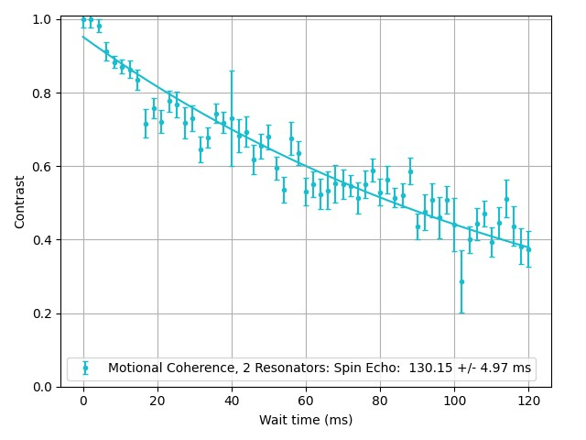
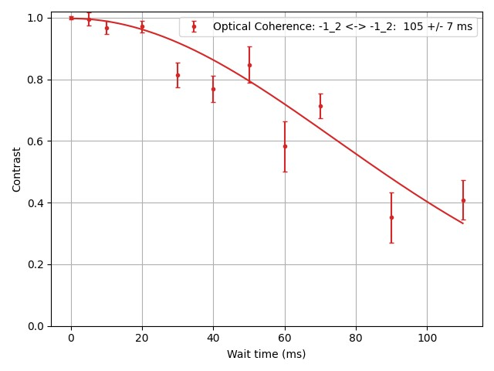


Current Status
We are currently installing a single ion addressing unit for the quadrupole laser
Motional Coherence: 130 ms
Optical Coherence: 105 ms
preliminary data

Slide 11
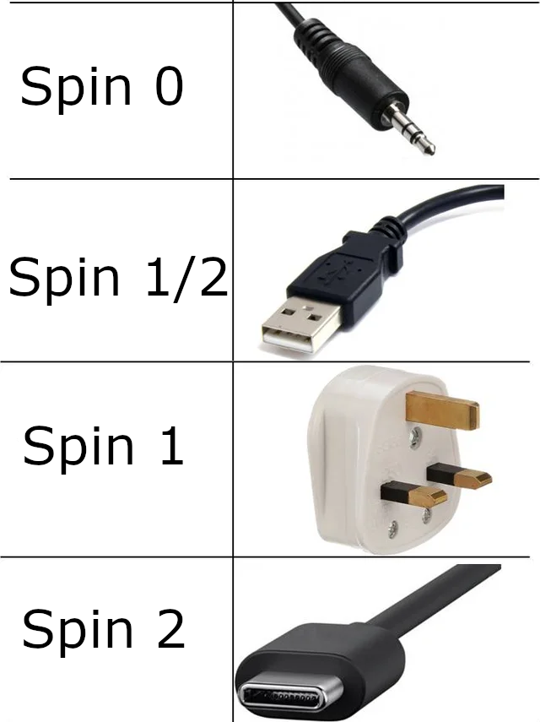
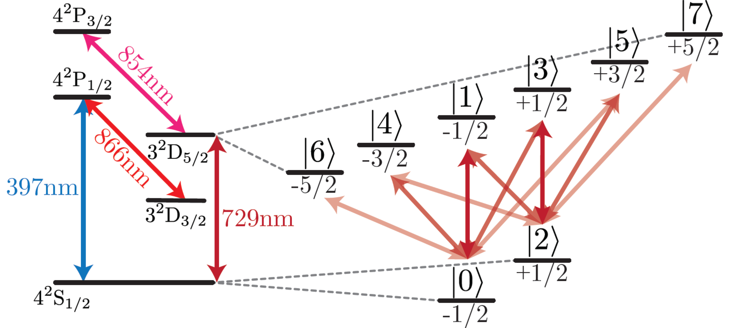
Future applications:
Quantum Simulation beyond spin ½
Developing a Qudit computing framework
Pushing the limits of what is classically simulatable
Credit: reddit u/Dabman2006

Slide 12
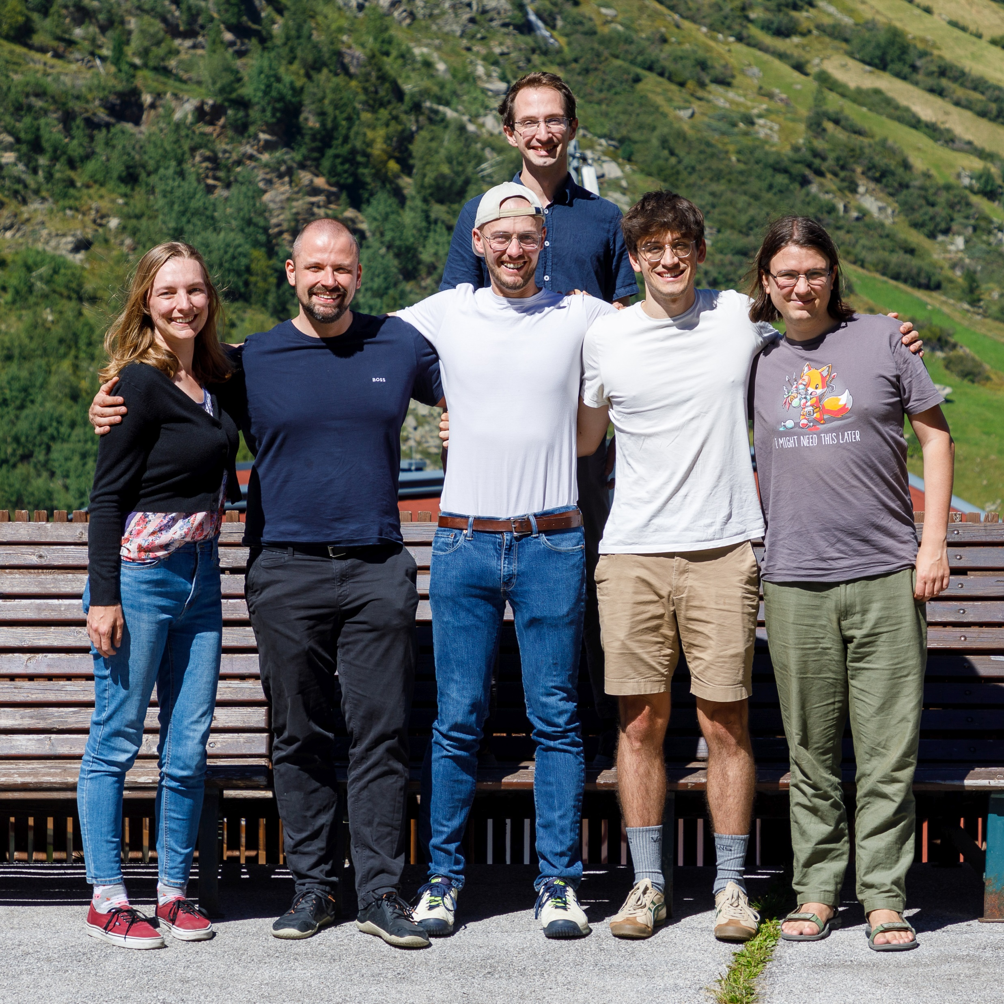
Thanks!

Slide 13
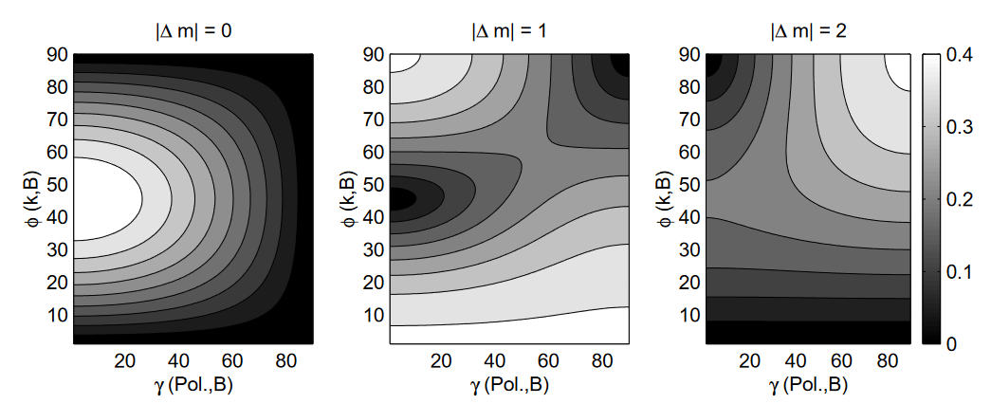
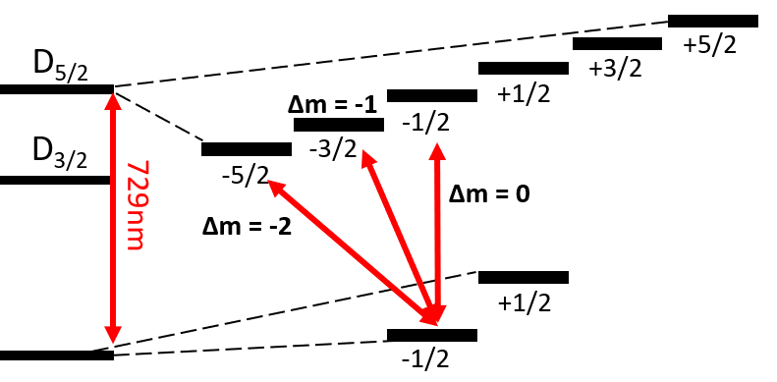
Problem 1: Magnetic field direction
For the direction of the quantisation axis, an equal coupling for all carriers has to be considered. This limits the set of available polarisation-dependent cooling schemes.
B-field
 | Christian Roos, PhD Thesis, 2000, University of Innsbruck

Slide 14
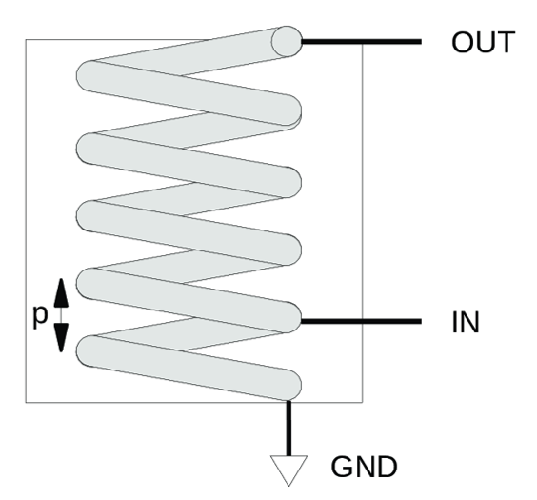
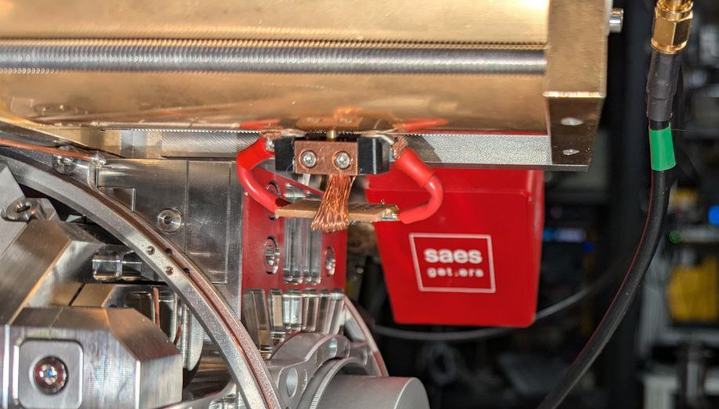
Problem 2: Dual Resonator Configuration
Degeneracy splitting of radial modes cannot be achieved with two helical resonators that galvanically connect the helix to the shield.
 | E. Martines et al. Applied Sciences, 2021

Slide 15
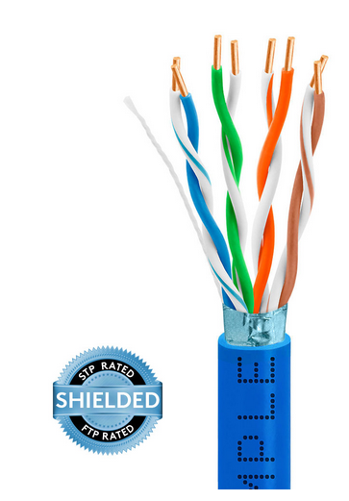
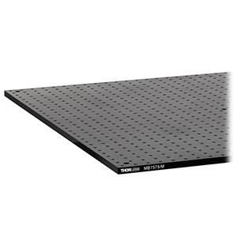
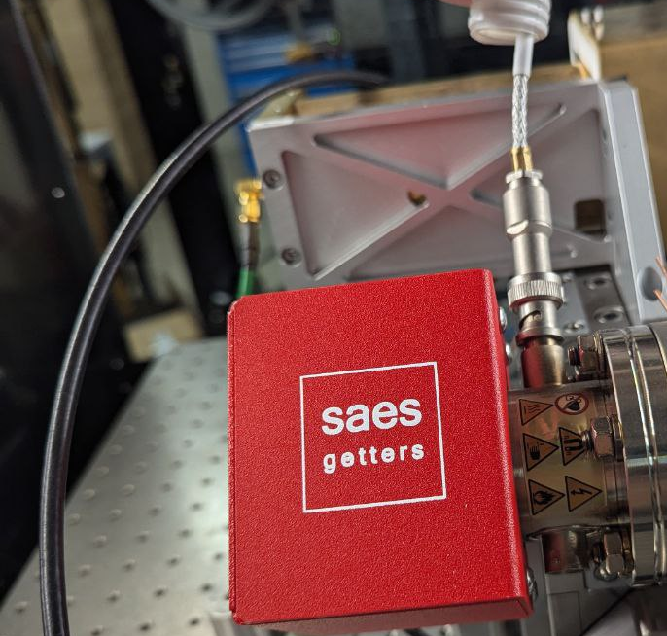
Problem 3: Coherences
Coherences are very sensitive to ground loops. Here‘s a list of friends we made over the last year:
https://www.thorlabs.com
https://www.cmple.com/wavenet

Slide 16
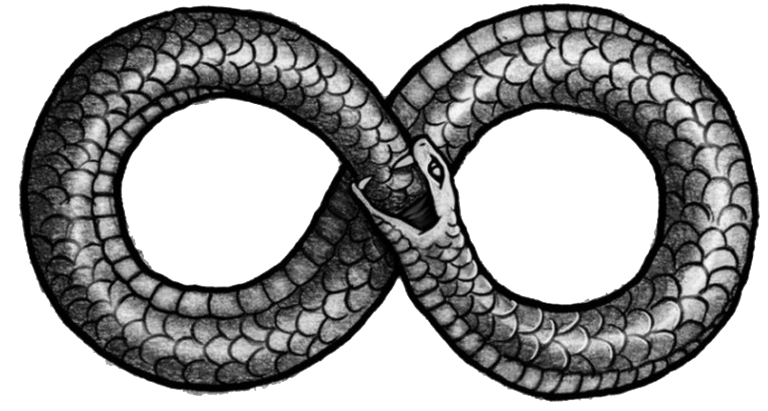
Problem 3: Coherences
Coherences are very sensitive to ground loops. Here‘s a list of lessons we learned over the last year:
Some are unavoidable
They like to mix and merge
Larger loops are worse

