Slide 1


Stimulated Raman 2-qubit logic gates in metastable trapped-ion qubits
Sean Brudney
ions.uoregon.edu

Slide 2
Talk outline
Motivation - The omg qubit scheme
Our qubit (m qubits in ⁴⁰Ca⁺)
Spontaneous Raman scattering models – old and “new”
Testing our Raman scattering model
Performing 2-qubit stimulated Raman gates in m qubits

Slide 3
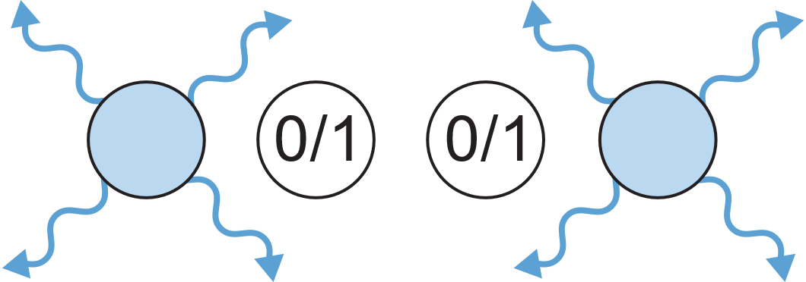
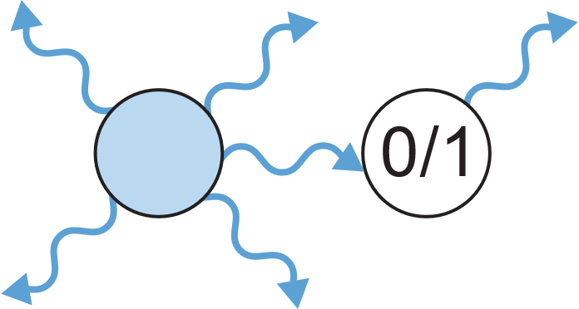
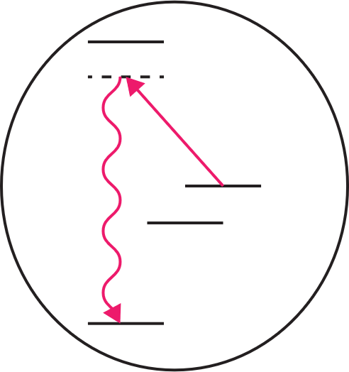
Technical hangups
- Many challenges for upscaling!
- Relevant to this talk:
Ground state cooling +
readout in ion crystals
Need separation of ion functions!
Cross-talk between ions during photon scattering
Need separate transitions for different operations!
Spontaneous photon scattering by far-detuned Raman beams
Fundamental limit to gate performance!
Normally addressed with multispecies chains
Alternative schemes?

Slide 4




Using omg
P_{3/2}
P_{1/2}
m qubits
P_{1/2}
m qubit (dark to cooling beams)
D_{5/2}
g qubits
D_{3/2}
g qubits (cooling, preparation, readout)
Some omg scheme advantages:
  Dual species functionality with one species (e.g., no need for mixed-species gates)
  Can switch qubit role mid-experiment
  More efficient cooling (all ions have same mass)
S_{1/2}
What gate fidelities are possible in m qubits?
D. T. C. Allcock et al. omg blueprint for trapped ion quantum computing with metastable states. Applied Physics Letters, 119:214002, 2021.

Slide 5
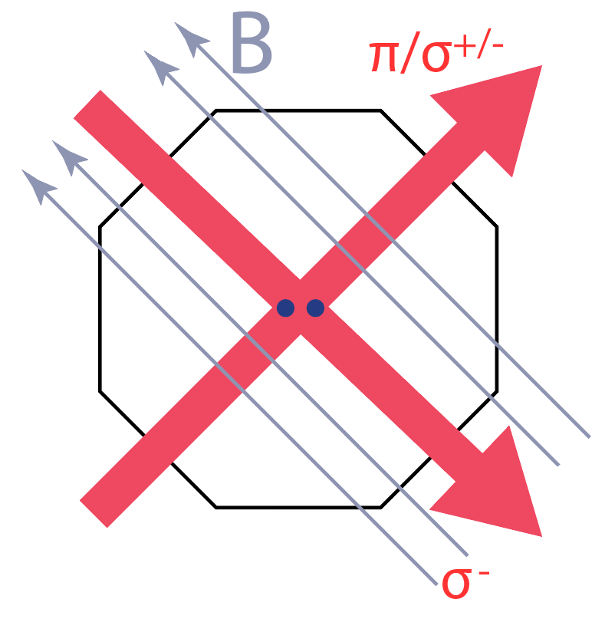
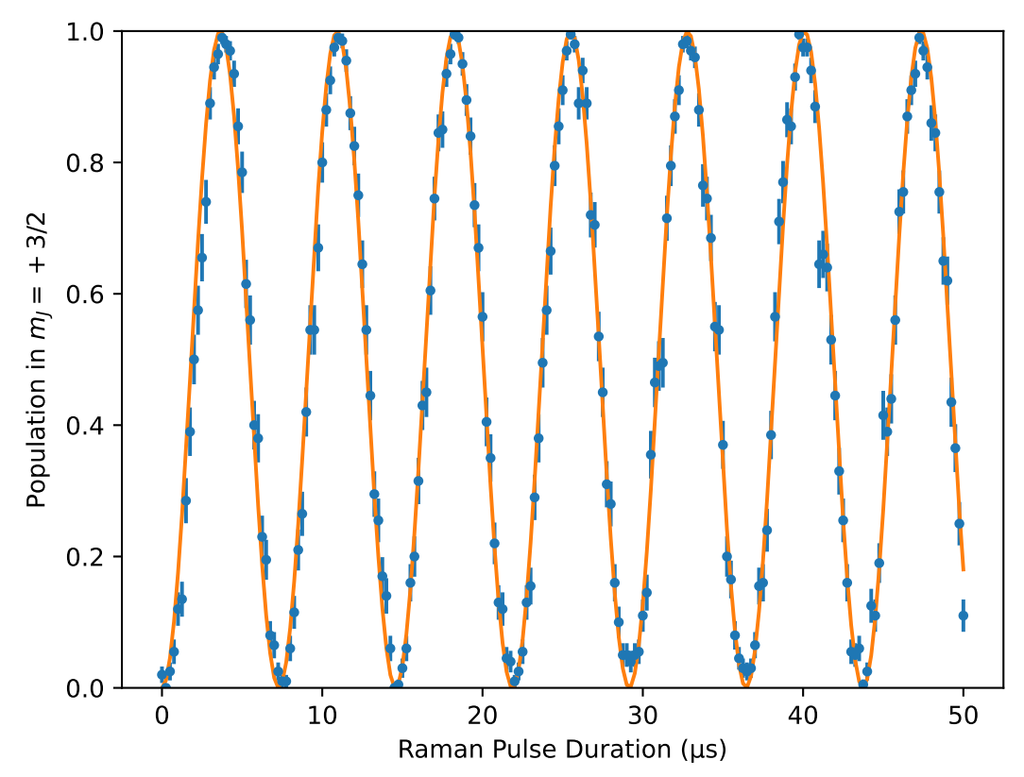
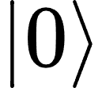
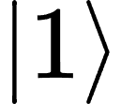
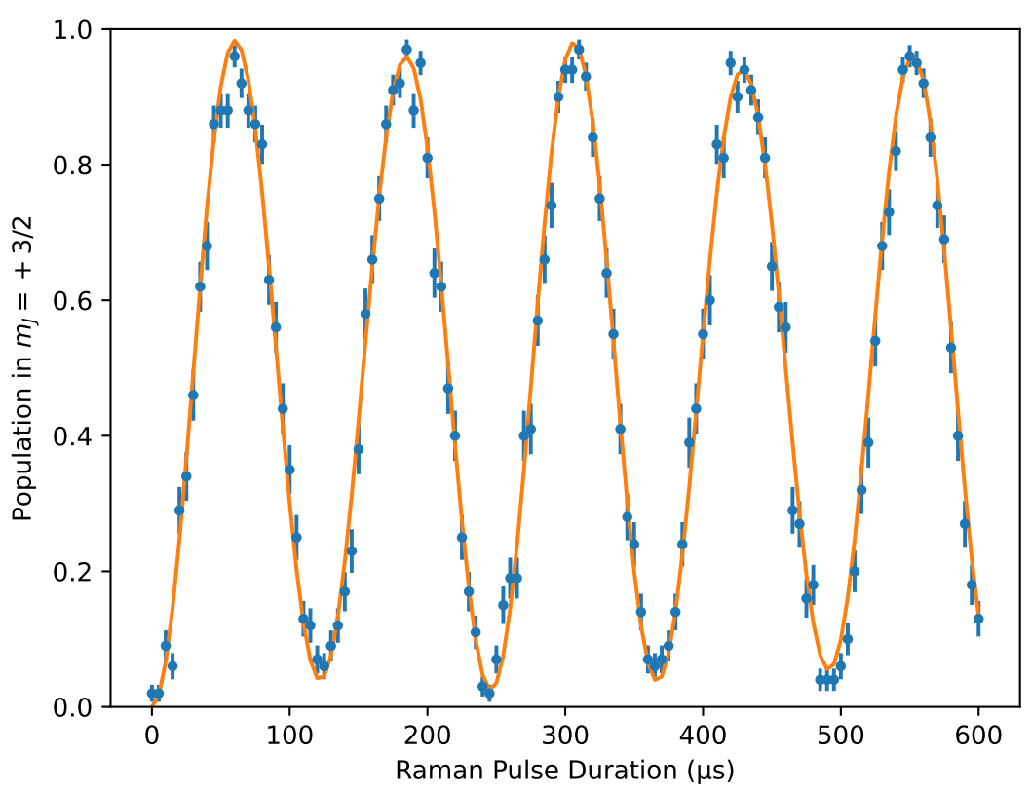

Implementing m qubits
Carrier
P_{3/2}
Carrier Rabi frequency: 134kHz
m = +3/2
43 THz
976 σ ⁻
854 σ ⁺
m = +5/2
D_{5/2}
976 π
Blue sideband
m = +3/2
Sideband Rabi frequency: 8.20 kHz, <n>: 0.04
Light shift
m = +1/2
Platform: m qubits in D_{5/2} in ⁴⁰Ca⁺
99.5% 1-ion SPAM fidelity (state prep via optical pumping)
Qubit control done using 976 nm Raman beams
$$η=0.060$$

Slide 6
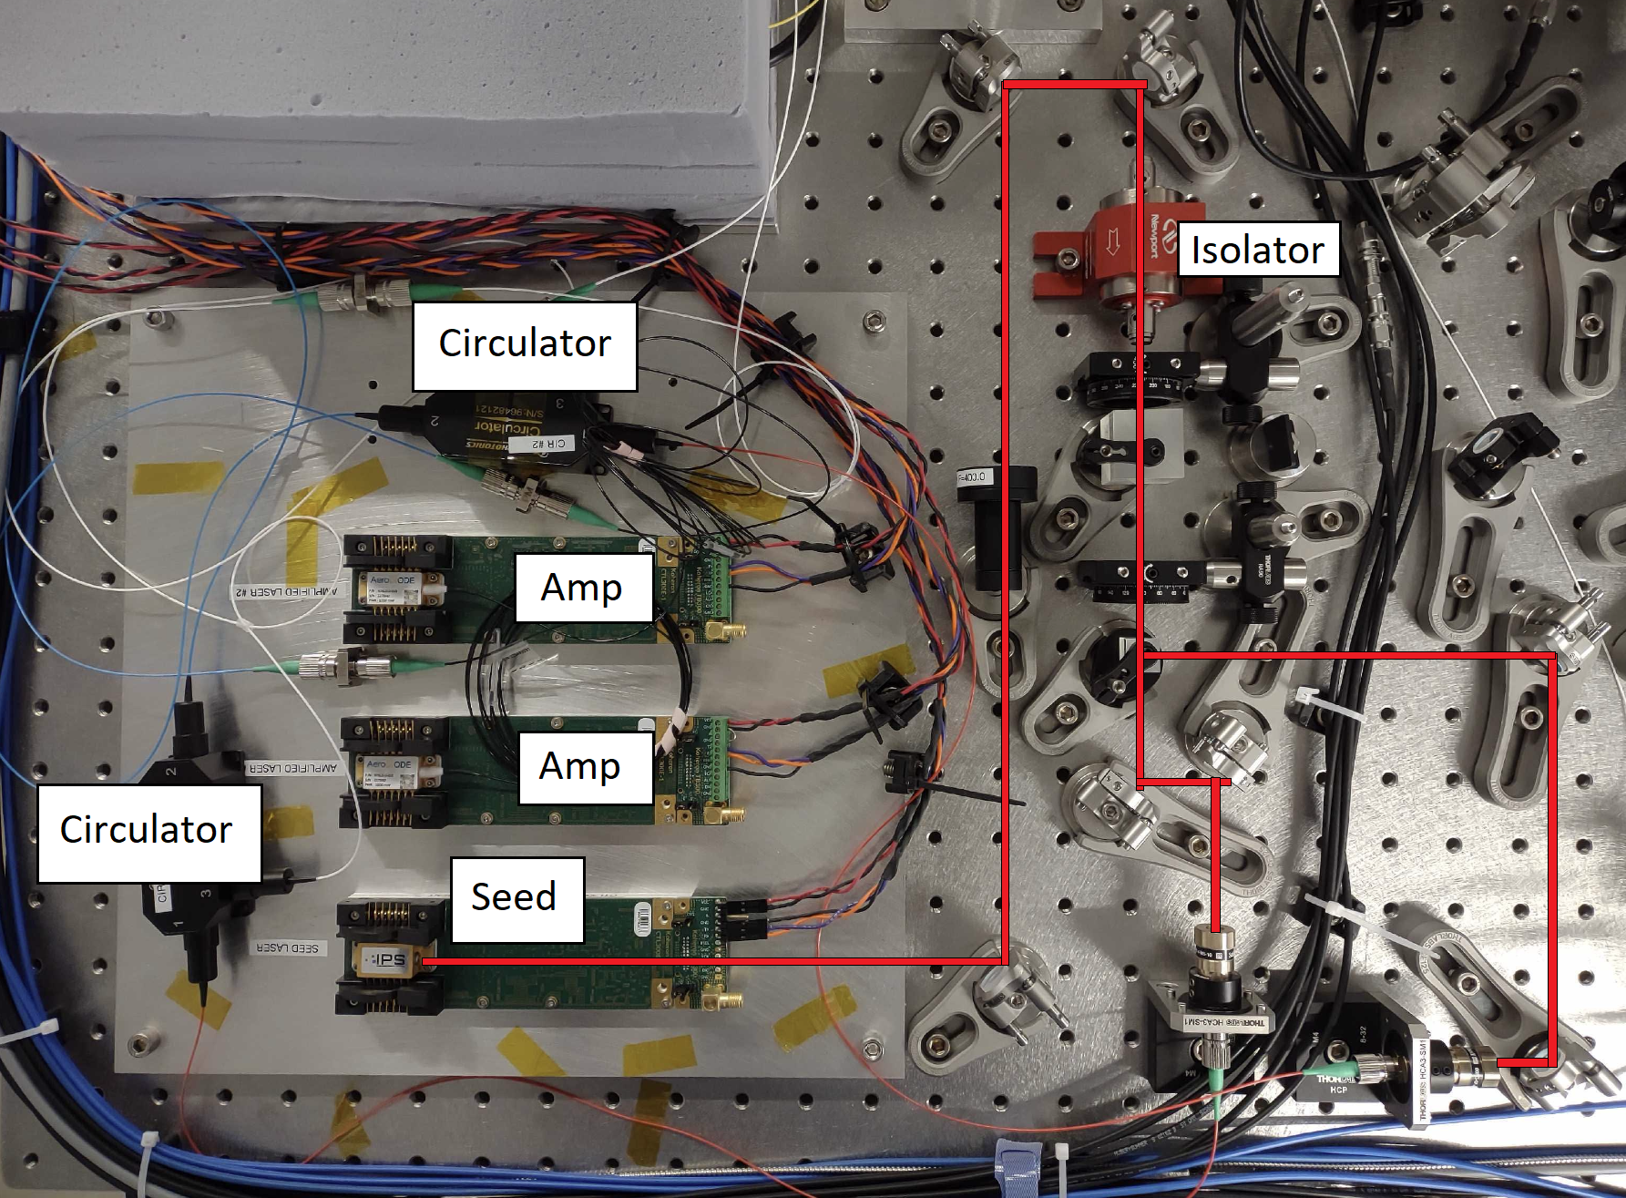
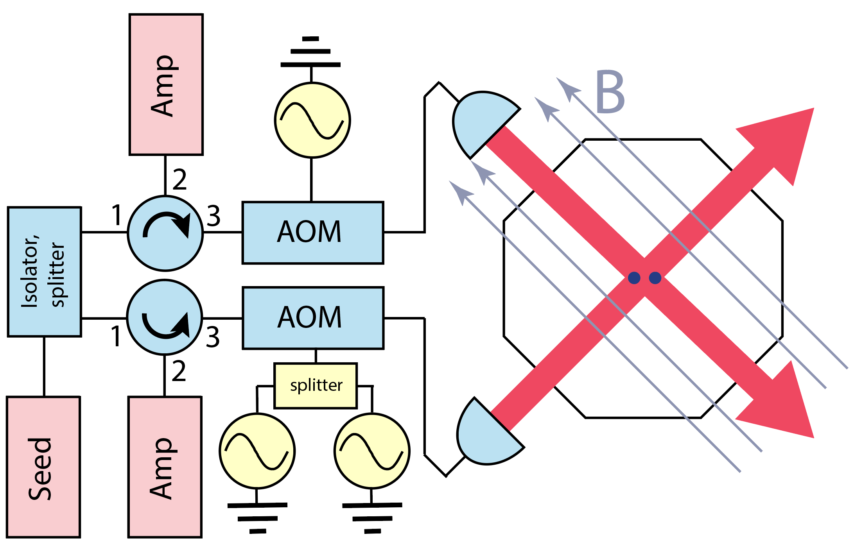
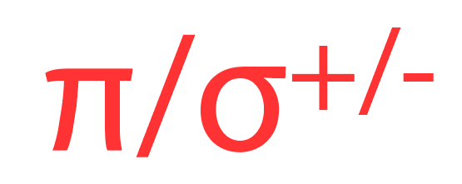
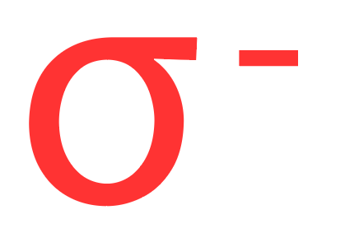
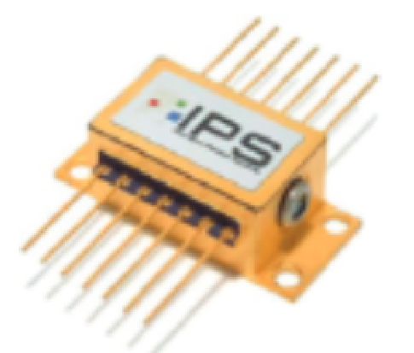
Our Raman lasers
For gates – Implemented a fiberized seed/amp laser setup [1]
Lasers are off-shelf 976 nm diode lasers (made for telecom applications):
Seed: 700 mW VHG-based ECDL
Amps: 1 W FP Diodes
Fiberized AOMs
Can get >0.2 W per beam at ion
Beams focused to ~30 μm dia.
[1] T Shimasaki et al. Injection-locking of a fiber-pigtailed high-power laser to an external cavity diode laser via a fiber optic circulator Rev. Sci. Instrum. 90, 056102 (2019)

Slide 7
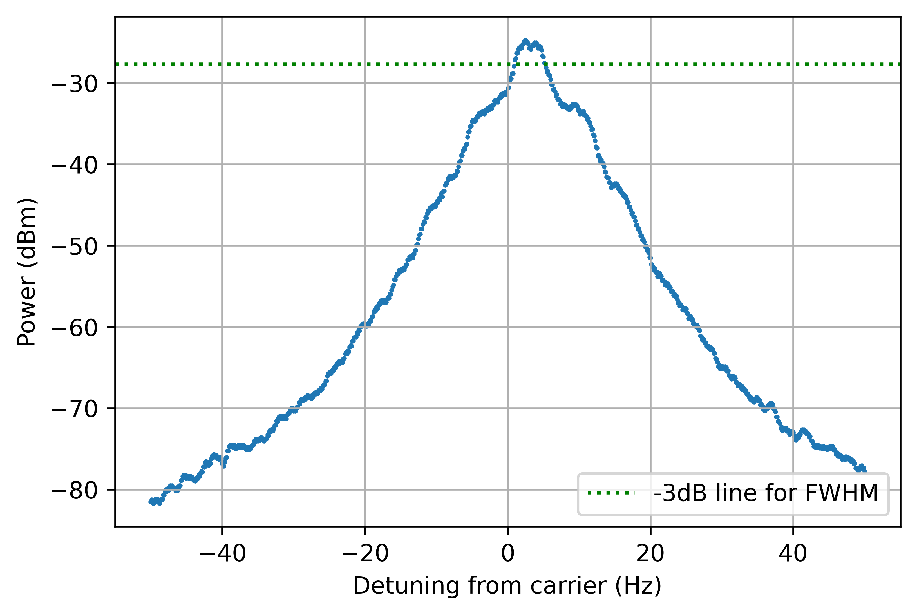
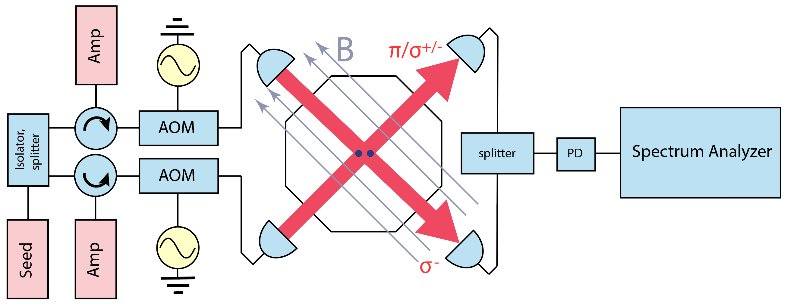
Beat note measurement
Injection diagnostic
Applied two tones separated by 1 MHz to two AOMs
FWHM of 4 Hz
Reliable and repeatable procedure for confirming injection
4 Hz

Slide 8

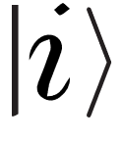
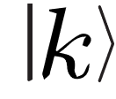
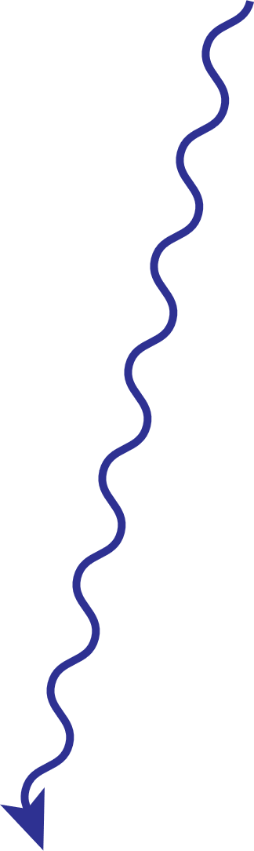
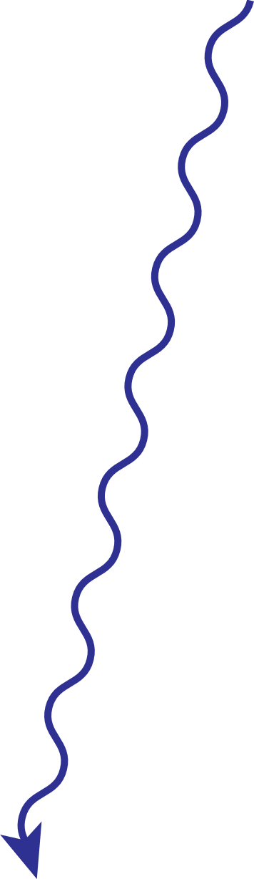




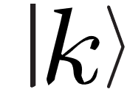


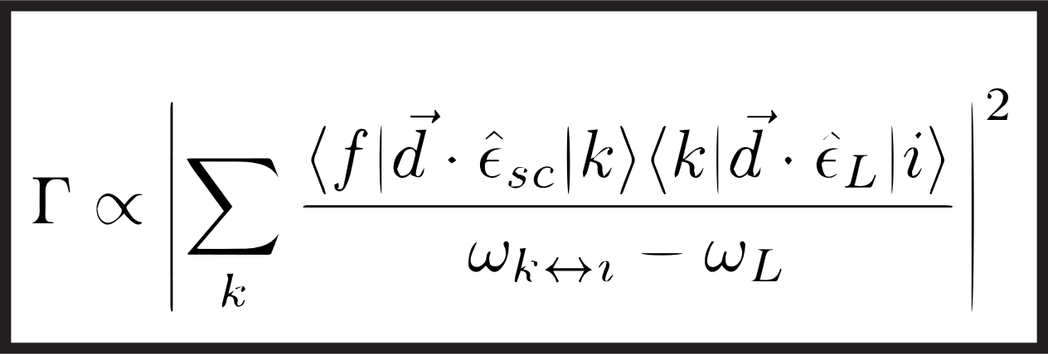
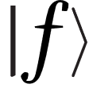
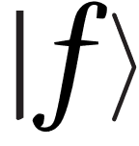
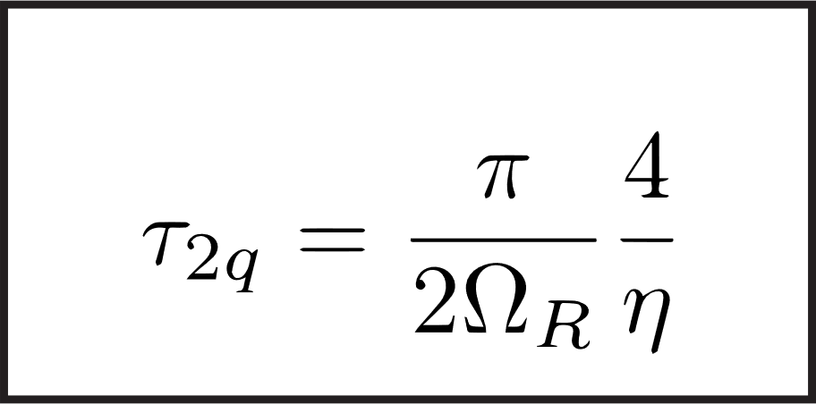
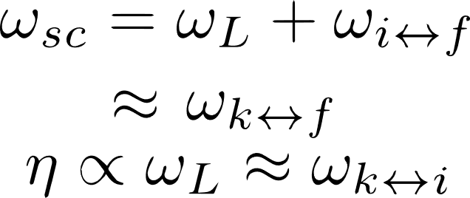
Raman scattering rate and error predictions
Simpler model [1]
More complete model [2]
Intermediate state
Qubit state
counter rotating Rabi flopping
Scattering Rate
spontaneous emission first processes
Two-qubit gate time
Final state
remove approximations
Rabi frequency
Lamb-Dicke parameter
[1] R. Ozeri et al. Errors in trapped-ion quantum gates due to spontaneous photon scattering. Phys. Rev. A, 75:042329, 2007
[2] I. D. Moore et al. Photon scattering errors during stimulated Raman transitions in trapped-ion qubits. Phys. Rev. A, 107:032413, 2023
Notes:
! Detuning dependence now included !

Slide 9
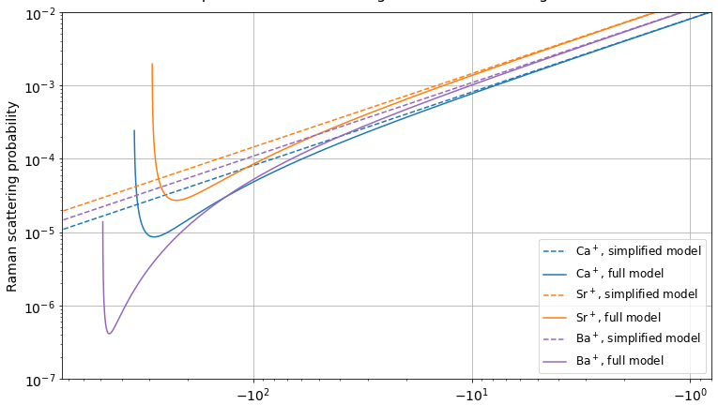
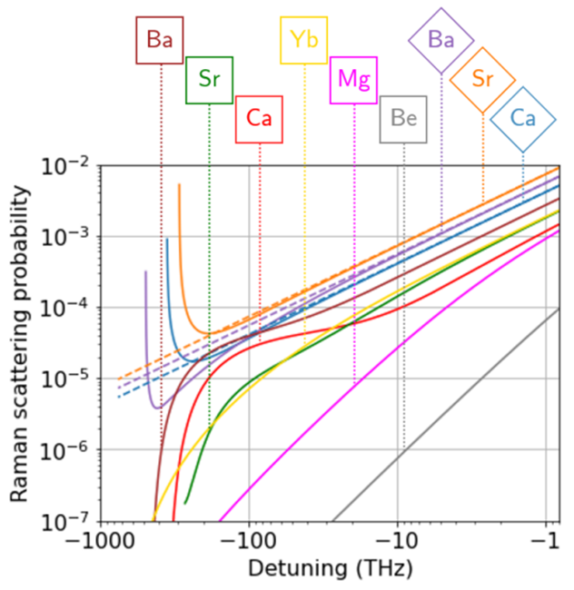
Raman scattering rate and error predictions
m qubit errors?
m qubits have error floor! Floor is below 10⁻⁴ at wavelengths with high-power lasers available
  For Ca⁺ the 10⁻⁴ error threshold is >963 nm
Lower errors trade off against higher power requirements
g qubit errors
Simplified spontaneous Raman scattering rate model [1], applicable near resonance, predicts fundamental error floor in 2-qubit Raman gate
More complete model developed by Moore et al. [2] has no error floor!
Raman scattering probability
Detuning (THz)
[1] R. Ozeri et al. Errors in trapped-ion quantum gates due to spontaneous photon scattering. Phys. Rev. A, 75:042329, 2007
[2] I. D. Moore et al. Photon scattering errors during stimulated Raman transitions in trapped-ion qubits. Phys. Rev. A, 107:032413, 2023

Slide 10
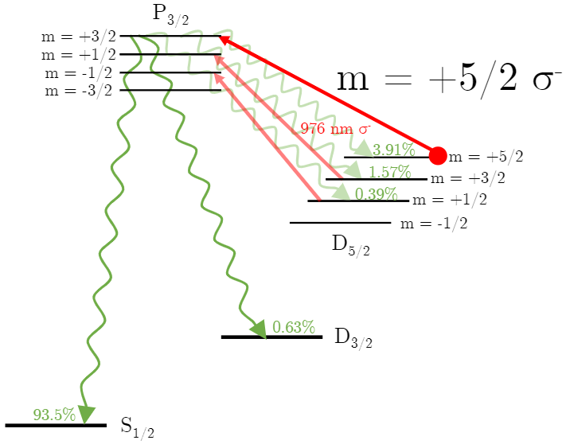
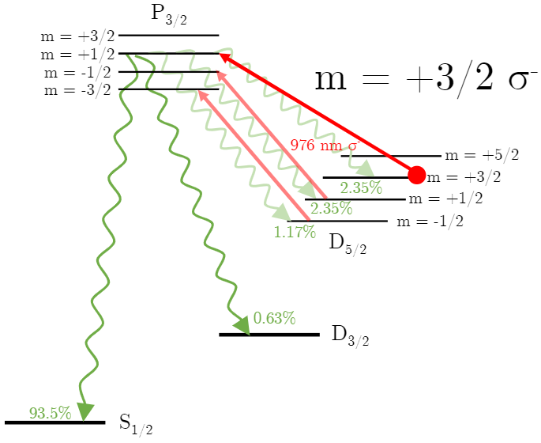
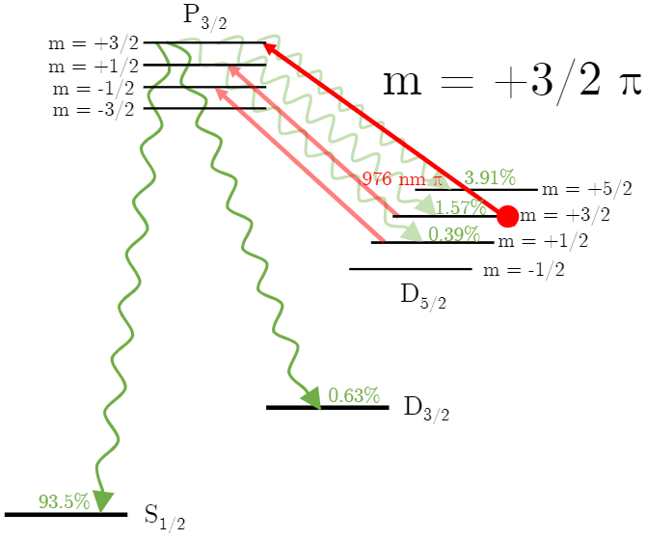
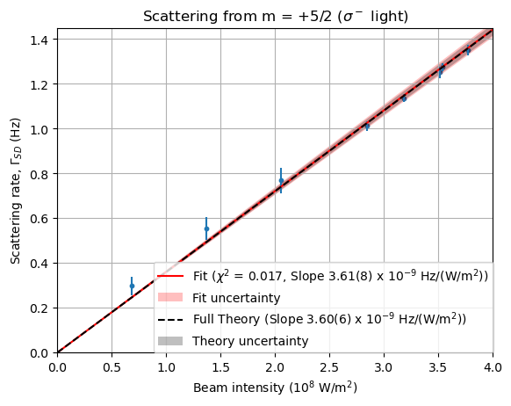
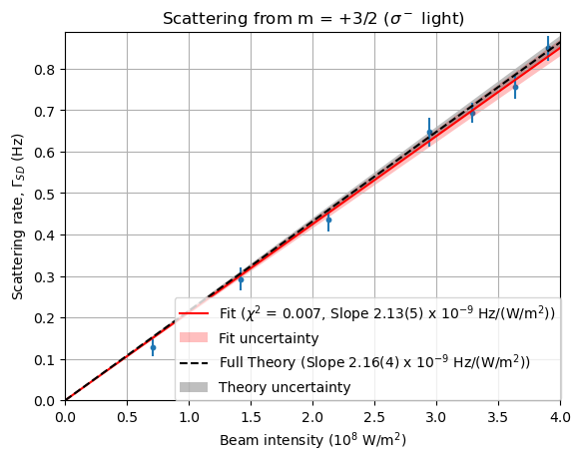
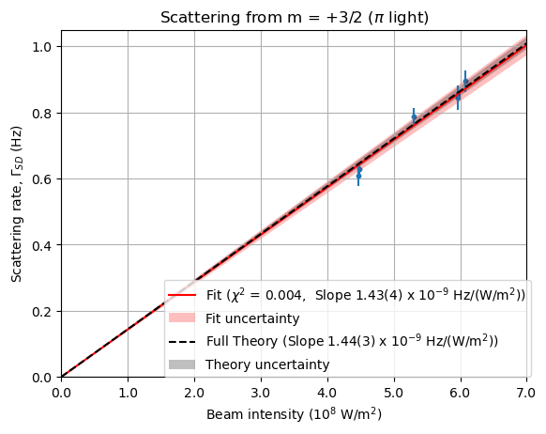
Raman scattering rate measurements
Key point – Model by Moore et al. [1] successfully verified in ⁴⁰Ca⁺
See also – Verification of model for g qubits in ¹³³Ba⁺ in collaboration with UCLA group [2]
[1] I. D. Moore et al. Photon scattering errors during stimulated Raman transitions in trapped-ion qubits. Phys. Rev. A, 107:032413, 2023
[2] M. Boguslawki et al. Raman Scattering errors in Stimulated-Raman-Induced Logic Gates in ¹³³Ba⁺. Phys. Rev. Lett., 131:063001, 2023

Slide 11
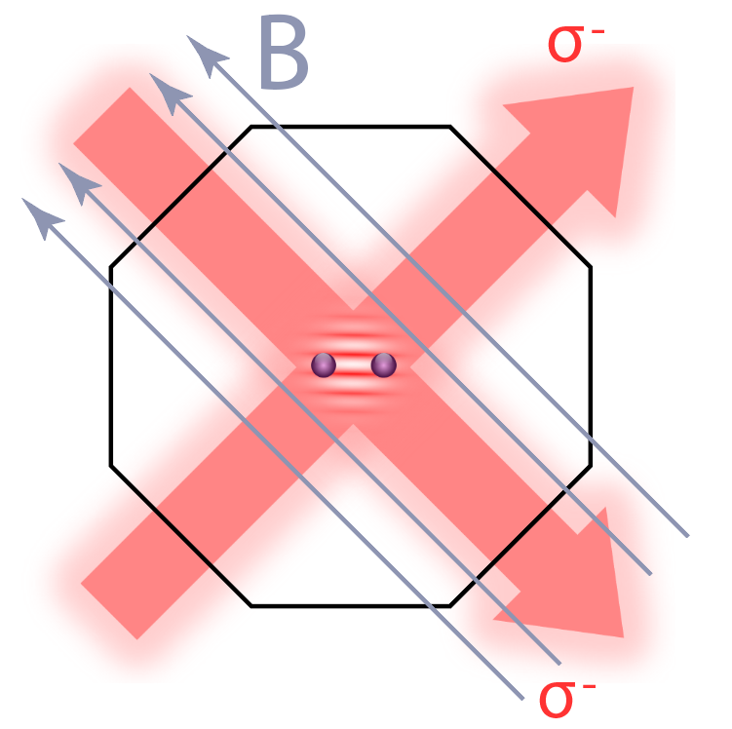
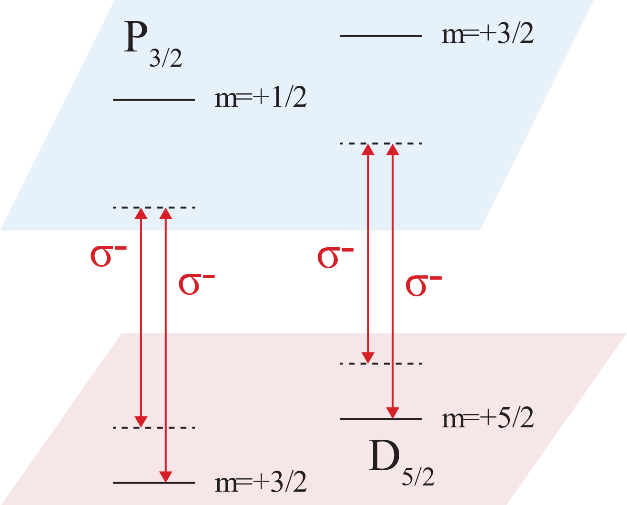
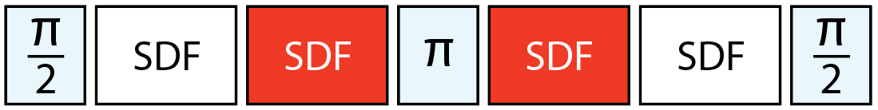
2-qubit gates with m qubits
Geometric phase gate (σ_{z})
Interference between Raman beams
→ Periodic intensity gradients
→ Spin-dependent forces
→ Spin-dependent geometric phases from
driving closed loops in phase space
→ Generation of non-separable states!
Our gate
p
4-loop σ_{z} gate on OOP radial mode
- W(1) in spin (Ramsey w/SE) [1]
- W(3) in motion
- ~400 μs gate time
x
400 μs
[1] D. Hayes et al. Coherent Error Suppression in Multiqubit Entangling Gates. Phys. Rev. Lett., 109:020503, 2012

Slide 12
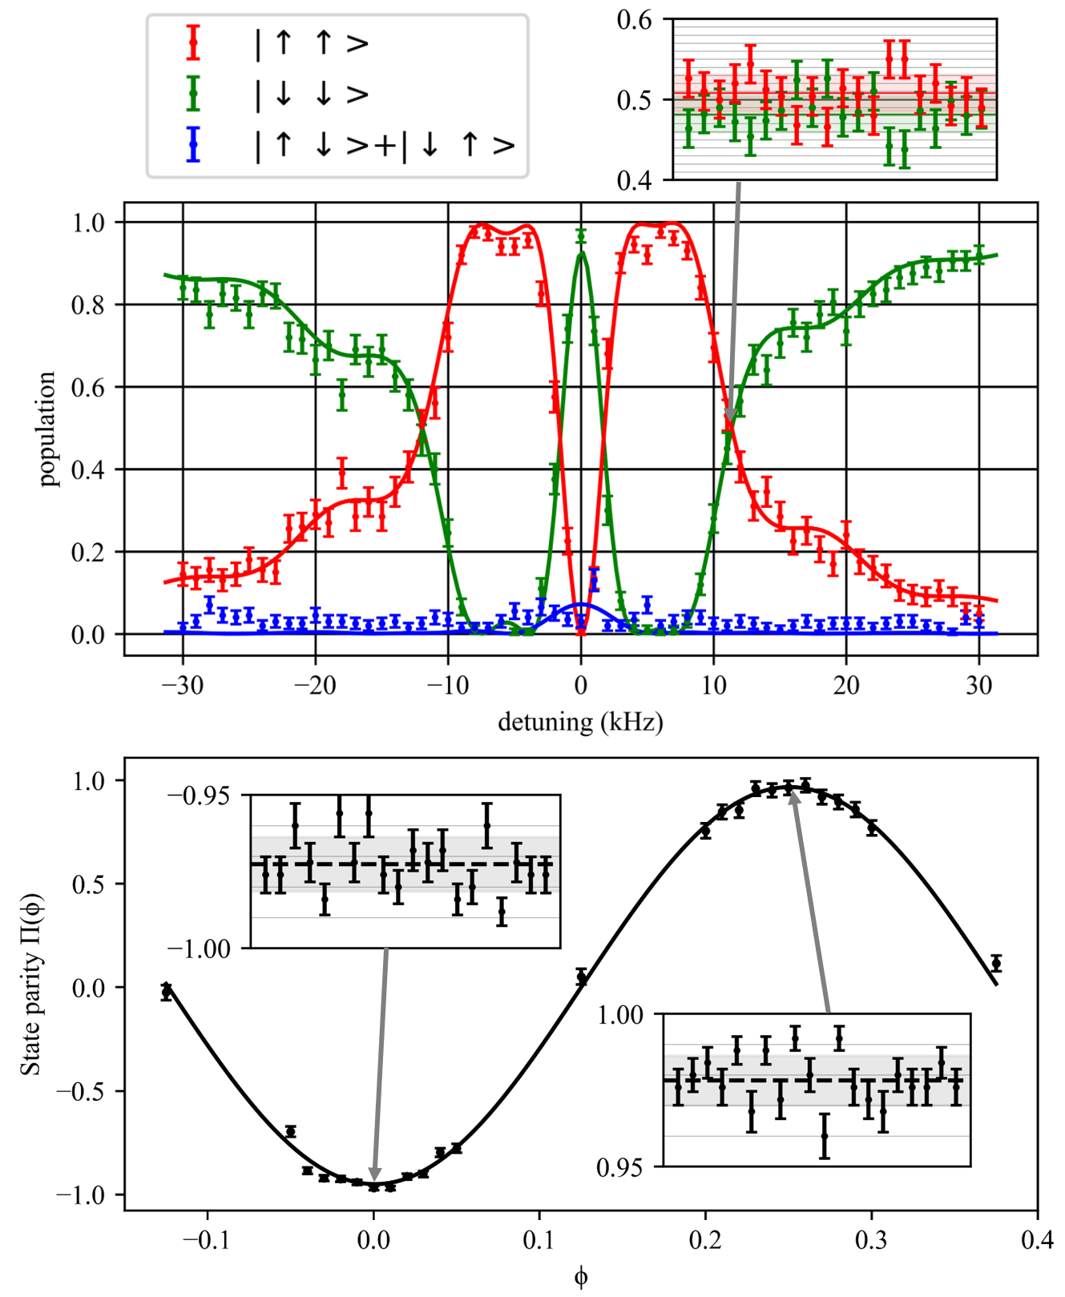
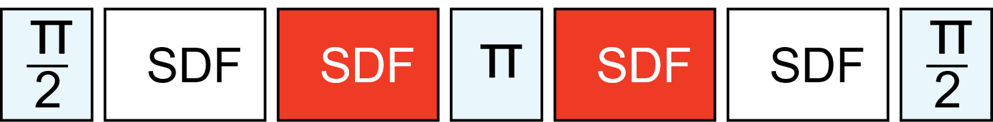
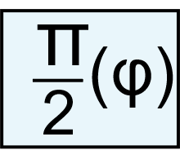
2-qubit gates with m qubits
Bell State Fidelity: 99.14(10)%
Including erasure errors: 98.56(10)%
Turns
Notes:
This is a measurement of the populations as a function of the detuning from the out of phase motional mode. Our operating point is where we achieve 50% population in up up and down down states near 11 kHz. To measure the fidelity of the entangled state, we add a pi/2 pulse to the end of the gate sequence and scan over the phase to obtain a parity fringe, the contrast of which is directly tied to the bell state fidelity.

Slide 13
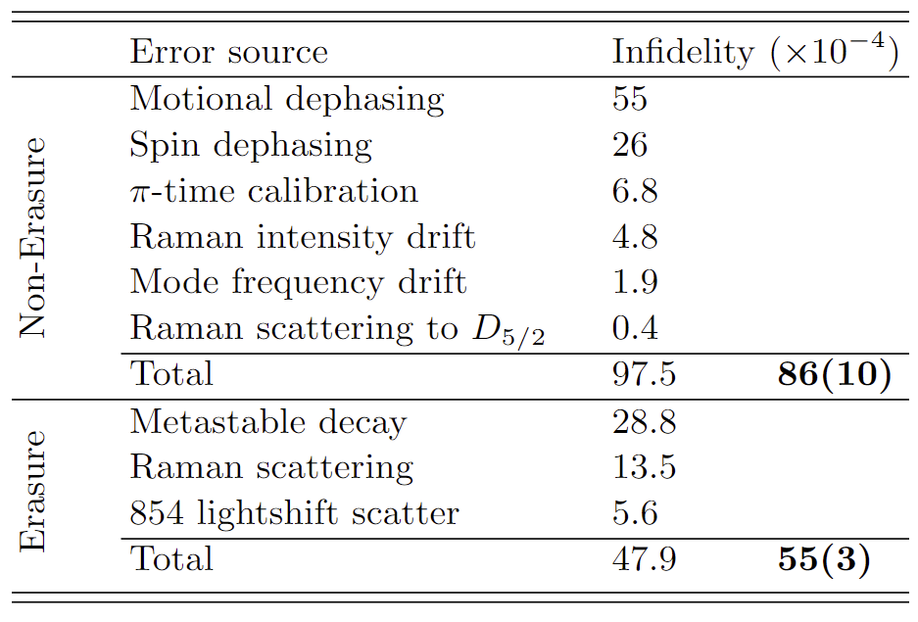
Error accounting
Results (SPAM subtracted)
Fidelity: 0.9914(10)
Before erasure error subtracted: 0.9856(10)
Errors
Leading error source: Dephasing (81 x10⁻⁴)
Next leading source: Erasure error (47.9 x10⁻⁴)
Q: How low does Raman scattering need to be in m qubits?
Reducing error?
Motional errors, natural lifetime decay?
  Faster gates and higher power lasers
Experimental design and qubit choice
  Erasure error from Raman scattering limit < 10⁻⁴

Slide 14
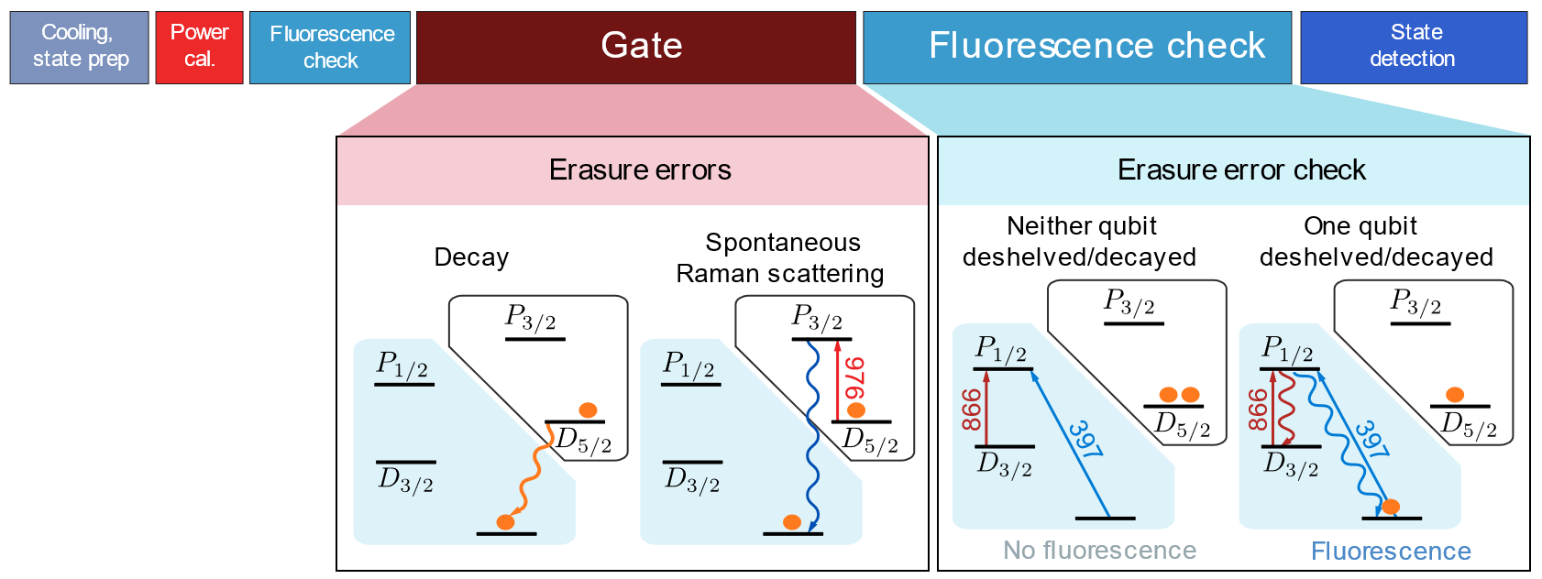
m qubit erasure error detection
Extra feature in m qubits
Raman scattering events put m qubit into ground states 95% of the time
Decay events can be checked for before doing full state detection
Most Raman scattering errors are erasure errors
Non-Erasure Raman scattering already < 10⁻⁴
Erasure errors easier to correct than Pauli errors! [1,2]
[1] Y. Wu et al. Erasure conversion for fault-tolerant quantum computing in alkaline earth Rydberg atom arrays. Nat. Comm., 13:4657, 2022
[2] M. Kang et al. Quantum Error Correction with Metastable States of Trapped Ions Using Erasure Conversion. PRX Quantum 4, 020358, 2023

Slide 15
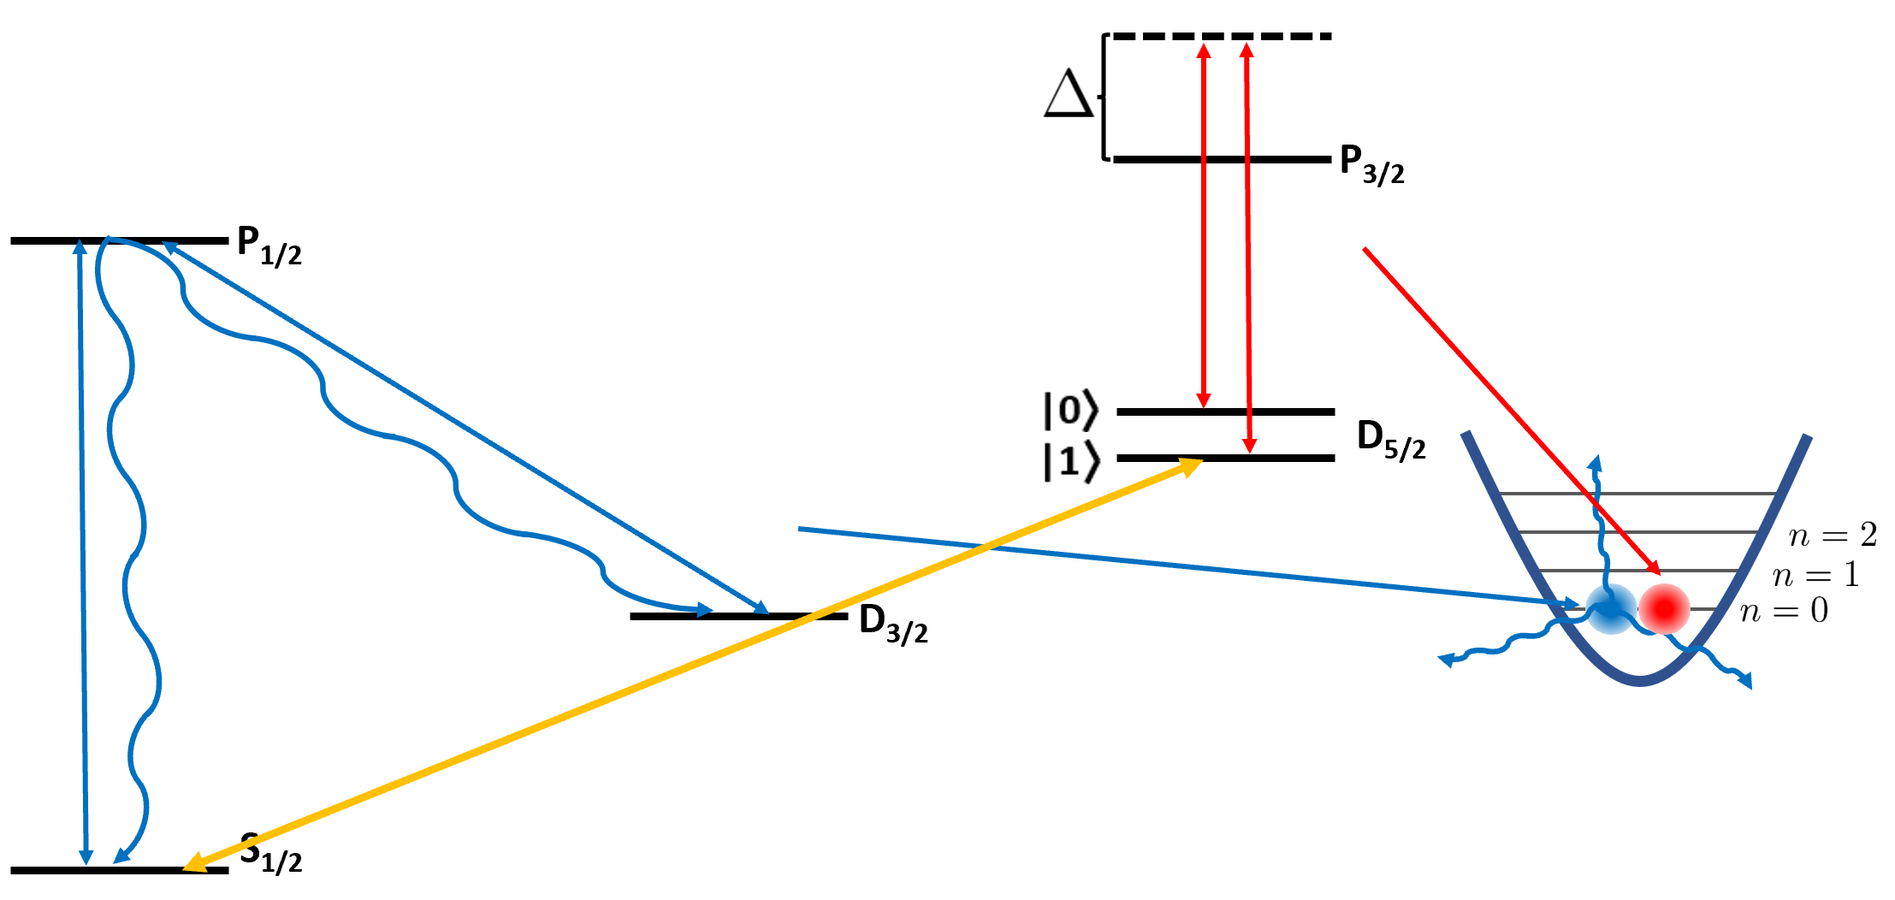
Next steps?
Testing the omg scheme
Experiments with mixed m and g qubit crystals
Narrow linewidth laser for driving optical transition in Ca⁺
Moving to ⁴³Ca⁺
Isotope with nuclear spin -> hyperfine splitting
No 854 lightshift laser -> No 854 lightshift scatter errors
Minimal sensitivity to B-field noise
  Clock qubits! -> Mølmer–Sørensen gates

Slide 16
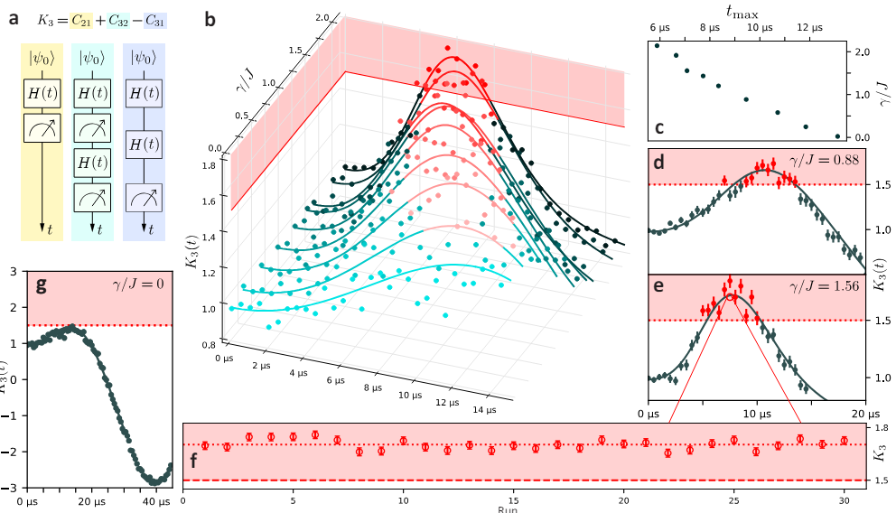
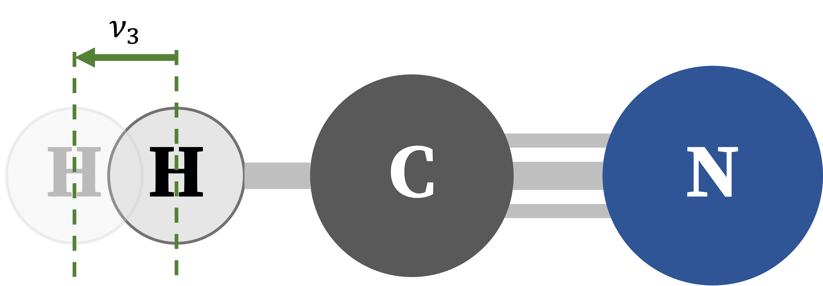
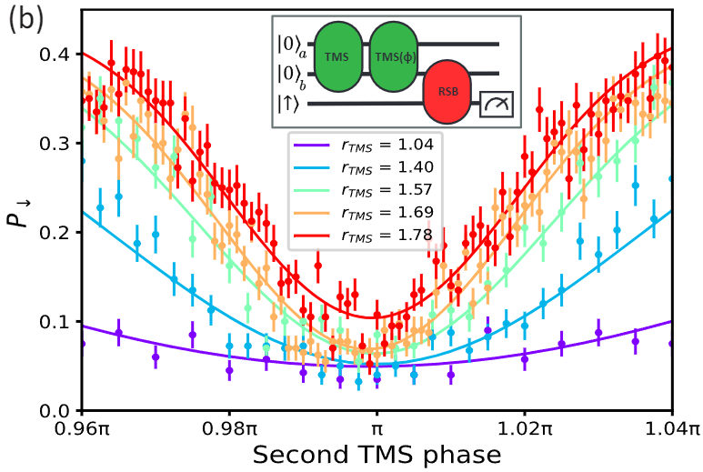
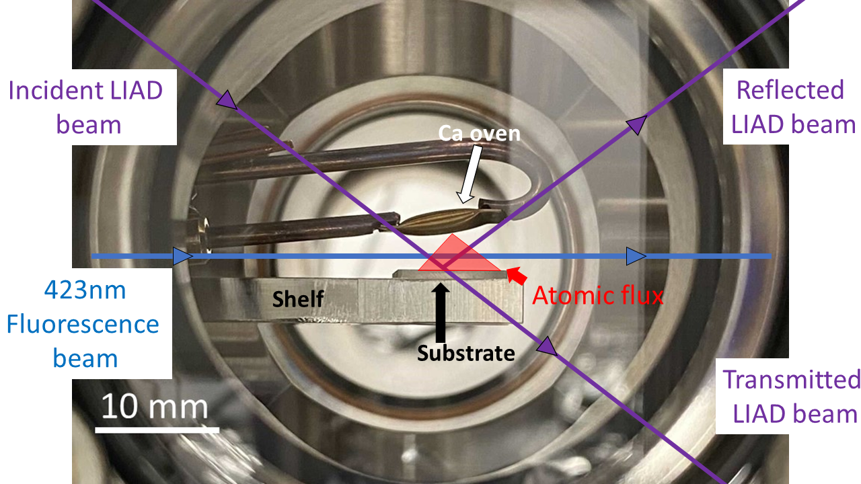
Oregon Ions Projects
SPUD: a dark matter search
Breaking quantum speed limit, arXiv:2304.12413
Motional mode squeezing, arXiv:2312.10847
LIAD: Light Induced Atomic Desorption

Slide 17

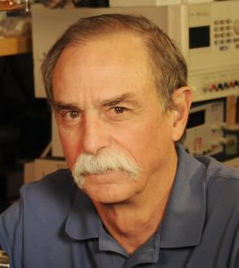
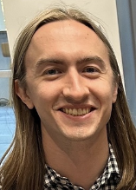
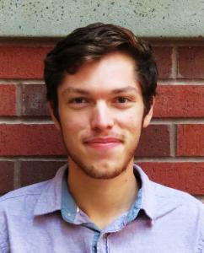
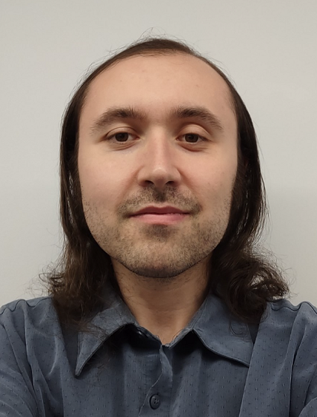











Oregon Ions
ions.uoregon.edu
PIs
Postdoc
Grad Students
Undergrad Student
David Allcock
Dr. Jameson
O’Reilly
(Dr.) Jeremy
Metzner
Sean Brudney
(Dr.) Daniel
Moore (IonQ)
Dave Wineland
Alex Quinn
Marcus Polk
Collaborators
Gabe Gregory
Oliver Miller
Evan Ritchie

Slide 18


976 Raman scattering limitations
Not fundamentally limited [1]
Could reach < 0.01%
Experimental design choices limited
σ⁻
vs
P_{3/2}
m = +3/2
σ⁻
Beam geometry and polarization impurities
976 σ ⁻
854 σ ⁺
, m = +5/2
D_{5/2}
976 π
, m = +3/2
Light shift
m = +1/2
Inefficient qubit states in D_{5/2}
Walsh modulations in phase space
[1] I. D. Moore et al. Photon scattering errors during stimulated Raman transitions in trapped-ion qubits. Phys. Rev. A, 107:032413, 2023
Notes:
976 raman scattering higher due to several factors/decisions (nonfundamental): choice of qubit states m=5/2 and 3/2 and CG values, orthogonal and mixed polarized beams to access carrier, 4 pulse phase gate vs 1 pulse to get around shorter decoherence time (add a diagram? Add to extra slide?)

Slide 19

Raman scattering rate and error predictions
Simplified spontaneous Raman scattering rate model, applicable near resonance, predicts fundamental error floor in 2-qubit Raman gate
g
m
m qubit errors?
m qubits have error floor! Floor is below 10⁻⁴ at wavelengths with high-power lasers available
  for Ca⁺ the 10⁻⁴ error threshold is >963 nm
Lower errors trade off against higher power requirements
Experimental goal – Testing scattering rate models in m qubits
Simplified scattering rate [1]
More complete model developed by Moore et al. [2]
976 nm
[1] R. Ozeri et al. Errors in trapped-ion quantum gates due to spontaneous photon scattering. Phys. Rev. A, 75:042329, 2007
[2] I. D. Moore et al. Photon scattering errors during stimulated Raman transitions in trapped-ion qubits. Phys. Rev. A, 107:032413, 2023

