Slide 1


An ion trap quantum processor with integrated ion-photon interface
Maoling Chu
ECCTI 2024

Slide 2

Contents
Ion trap - Quantum networks
Cavity-QED
System overview
  Trap design
  Oven design
Summary

Slide 3
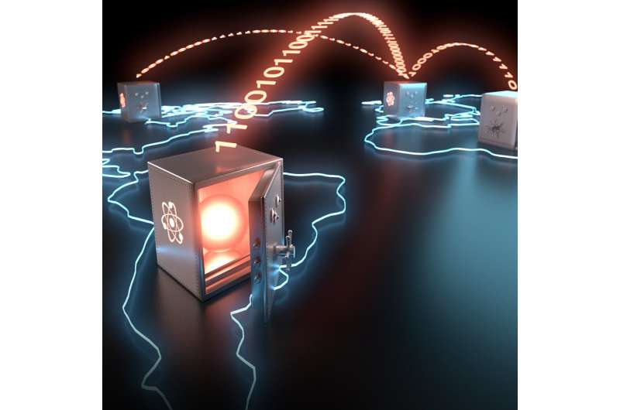
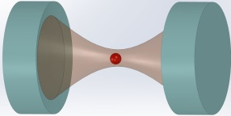
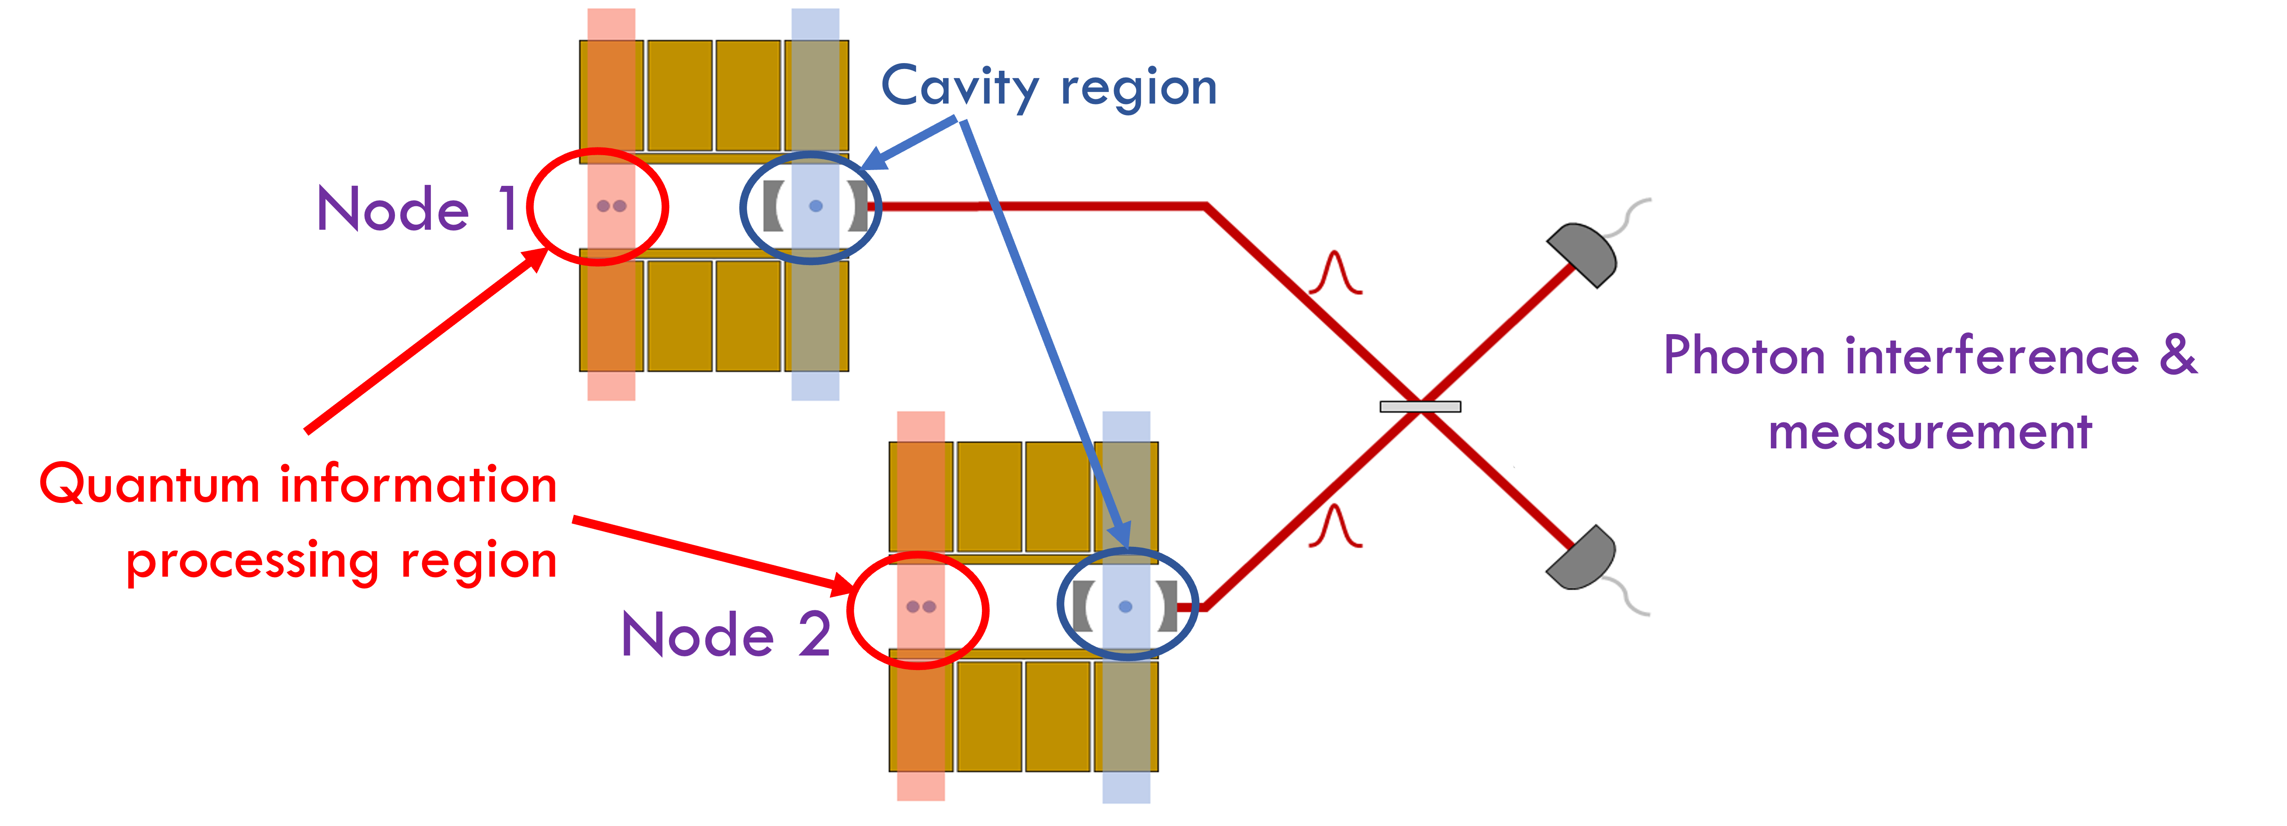
Ion trap - Quantum Networks
Stationary Qubit: Ions
High-fidelity Quantum Operation
Long coherence time
Easy to control
Disadvantage: Scalability limit
Interface
www.azoquantum.com
Flying Qubit: Photons
Low-loss transmission over long distances
Easy to perform reliable single-qubit gates
Multiple encoding possibilities
Notes:
In this process, the cavity is used to collect and enhance the photon.

Slide 4
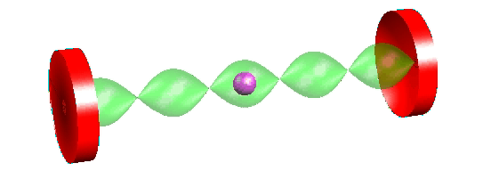
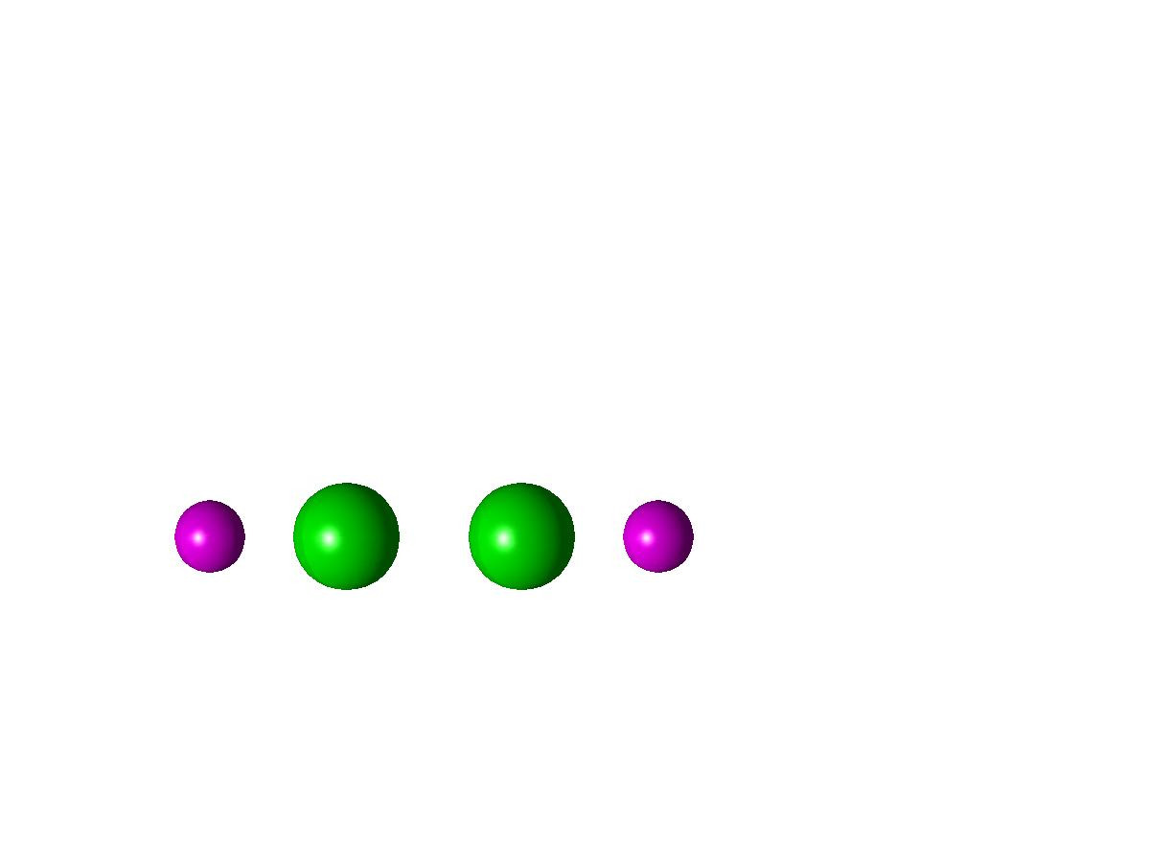
Cavity-QED
Mirror
Cavity-QED
provides a platform for a coherent interface between atoms (and ions…) and light.
ion
Cavity mode
Requirements:
Higher Fidelity and Higher Rate
Strong coupling is required to achieve these objectives.
Notes:
So, why do we use cavity? The reason we use cavity-QED

Slide 5
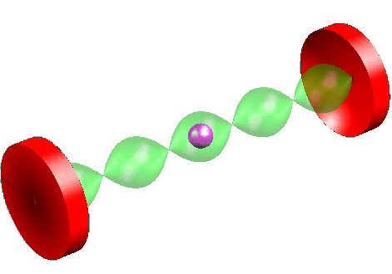
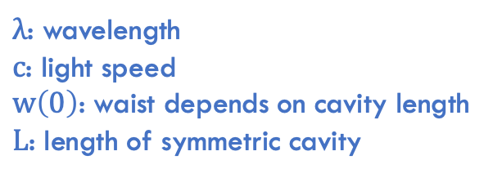

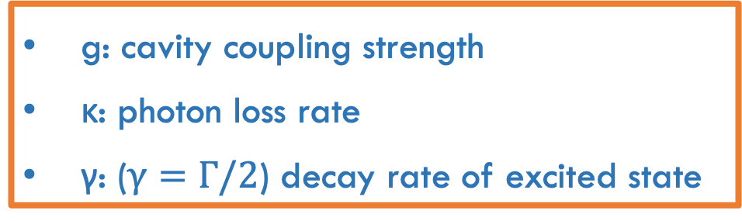

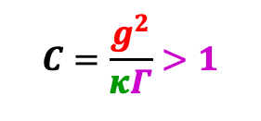



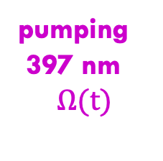
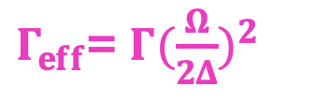
Cavity-QED with ⁴⁰Ca⁺
Single ⁴⁰Ca⁺ coupled to single optical cavity-mode.
P_{1/2}
g: cavity coupling strength
κ: photon loss rate
γ: ($γ=Γ/2$) decay rate of excited state
$$Δ$$
Cavity
866 nm
spontaneous
decay
κ
Γ
Cavity damping
2 photons resonance:
Strong coupling
g
$g_{eff}$= $g\frac{Ω}{2Δ}$
pumping
397 nm
$$Ω(t)$$
$$C=\frac{g^{2}}{κΓ}>1$$
$$g>κ,Γ$$
or
$Γ_{eff}$= $Γ({\frac{Ω}{2Δ})}^{2}$
D_{3/2}
$g_{eff}$
$$g_{0}=\sqrt{\frac{3λ^{2}c γ}{π^{2}L w{(0)}^{2}}}$$
$λ$: wavelength
$c$: light speed
$w\left(0\right)$: waist depends on cavity length
$L$: length of symmetric cavity
S_{1/2}
Short cavities!
Notes:
When on 2-photon resonance, the effective Raman Rabi-f is given by this formula. And the decoherence rate is given by this formula. This is why we need a large coupling strength. A large g allows us to drive this transition more quickly while suffering less decoherence.

Slide 6
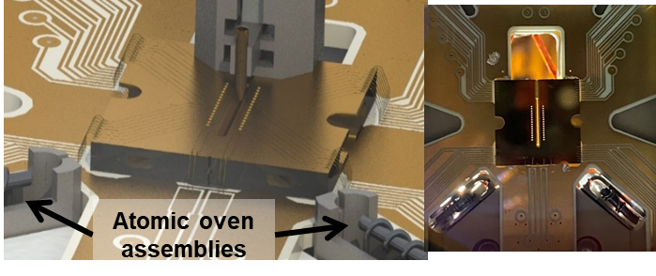
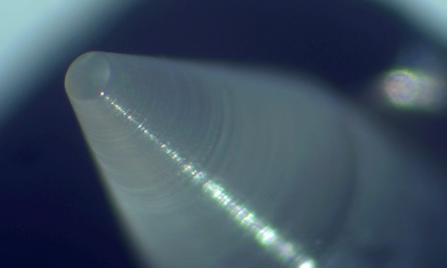
Strong coupling
High rates by using ions
strongly coupled to optical cavities
Short cavities (~100s μm) without interfering with ion trap
Micro-mirrors with ultra-low surface roughness and ellipticity, and high concentricity
Cavity module
compact multi-zone network node

Slide 7
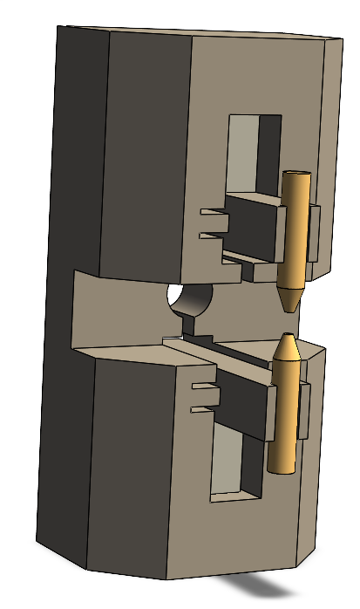

Cavity design
Mirror Characteristics:
Surface roughness:
Scattering loss:
Cavity finesse:
Birefringence:
<0.15 nm
4ppm
>600,000
<0.9% of the cavity linewidth
Piezo
Cavity Mirrors
Cavity length:
Cavity coupling $g_{0}$:
Cavity decay rate κ:
Atomic decay rate γ:
350-500 $µm$
17-20 MHz
3.5-4.5 MHz
11.5 MHz
Piezo
Notes:
The surface roughness is less than 0.15 nanometers, ensuring minimal light scattering.
The measured scattering losses are just 4 parts per million, which indicates the high quality of our mirror fabrication.
This results in a cavity finesse greater than 600,000, demonstrating high light reflection efficiency.
Furthermore, the birefringence is less than 0.9% of the cavity linewidth, ensuring stable polarization.

Slide 8
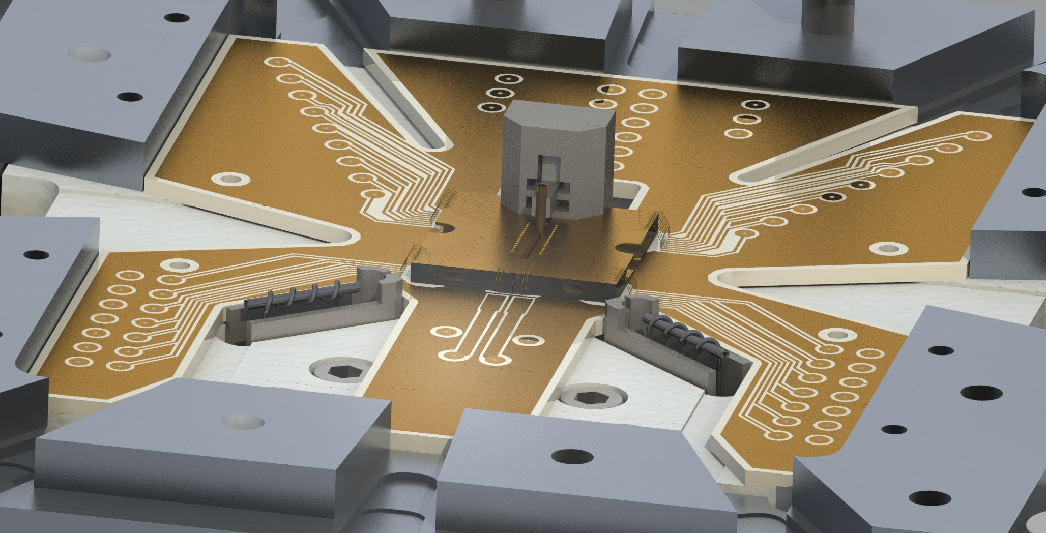
System overview
PCB
Cavity Module
Electrodes
2x Atomic ovens
10mm

Slide 9
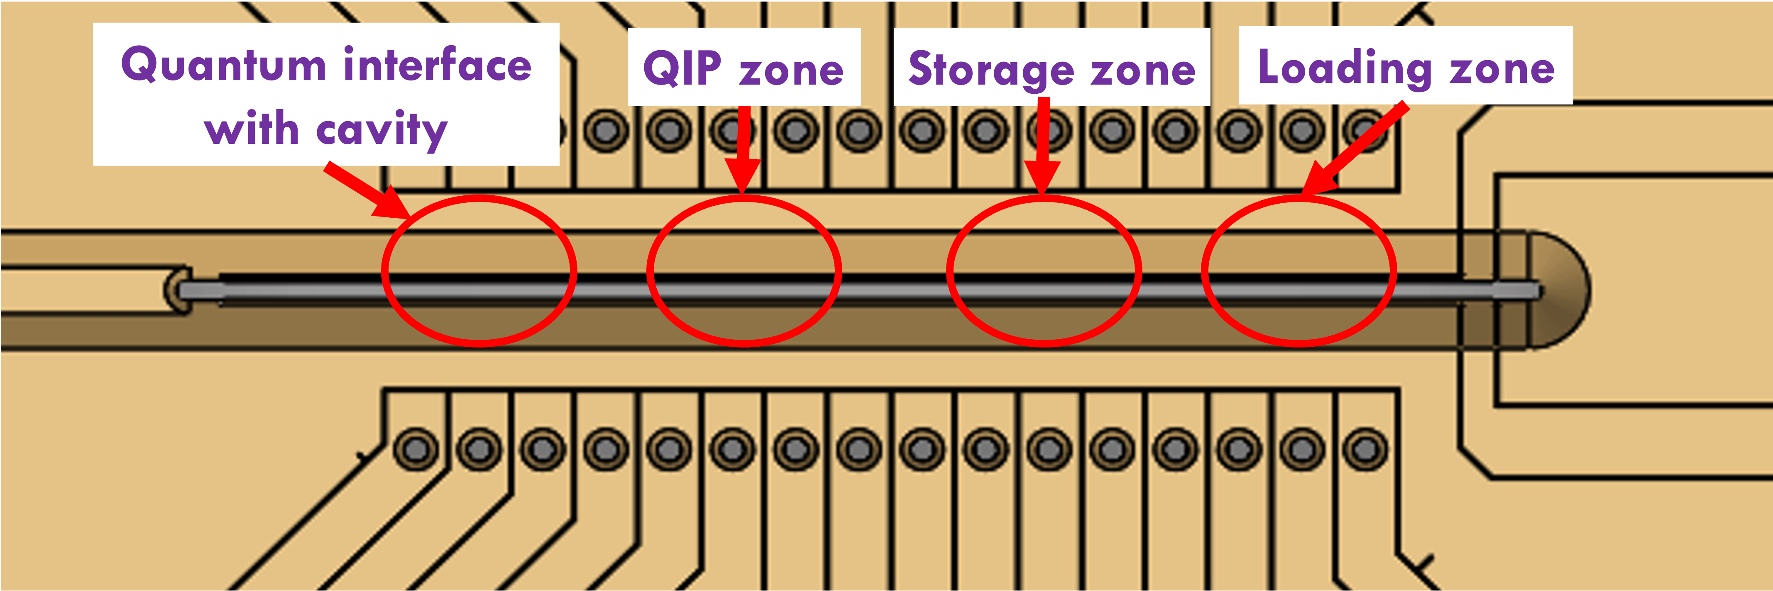
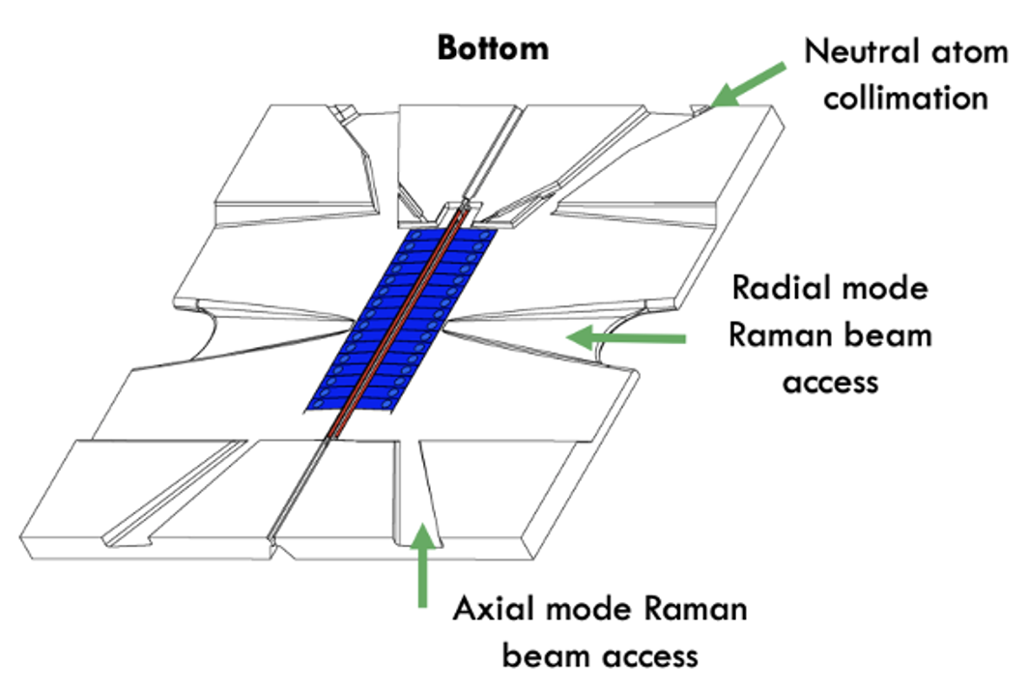
Trap design - function
Multi-zone design with regions for loading, ion storage, QIP and cavity QED.
Laser access along trap axis, radial axis, and Raman axis.

Slide 10
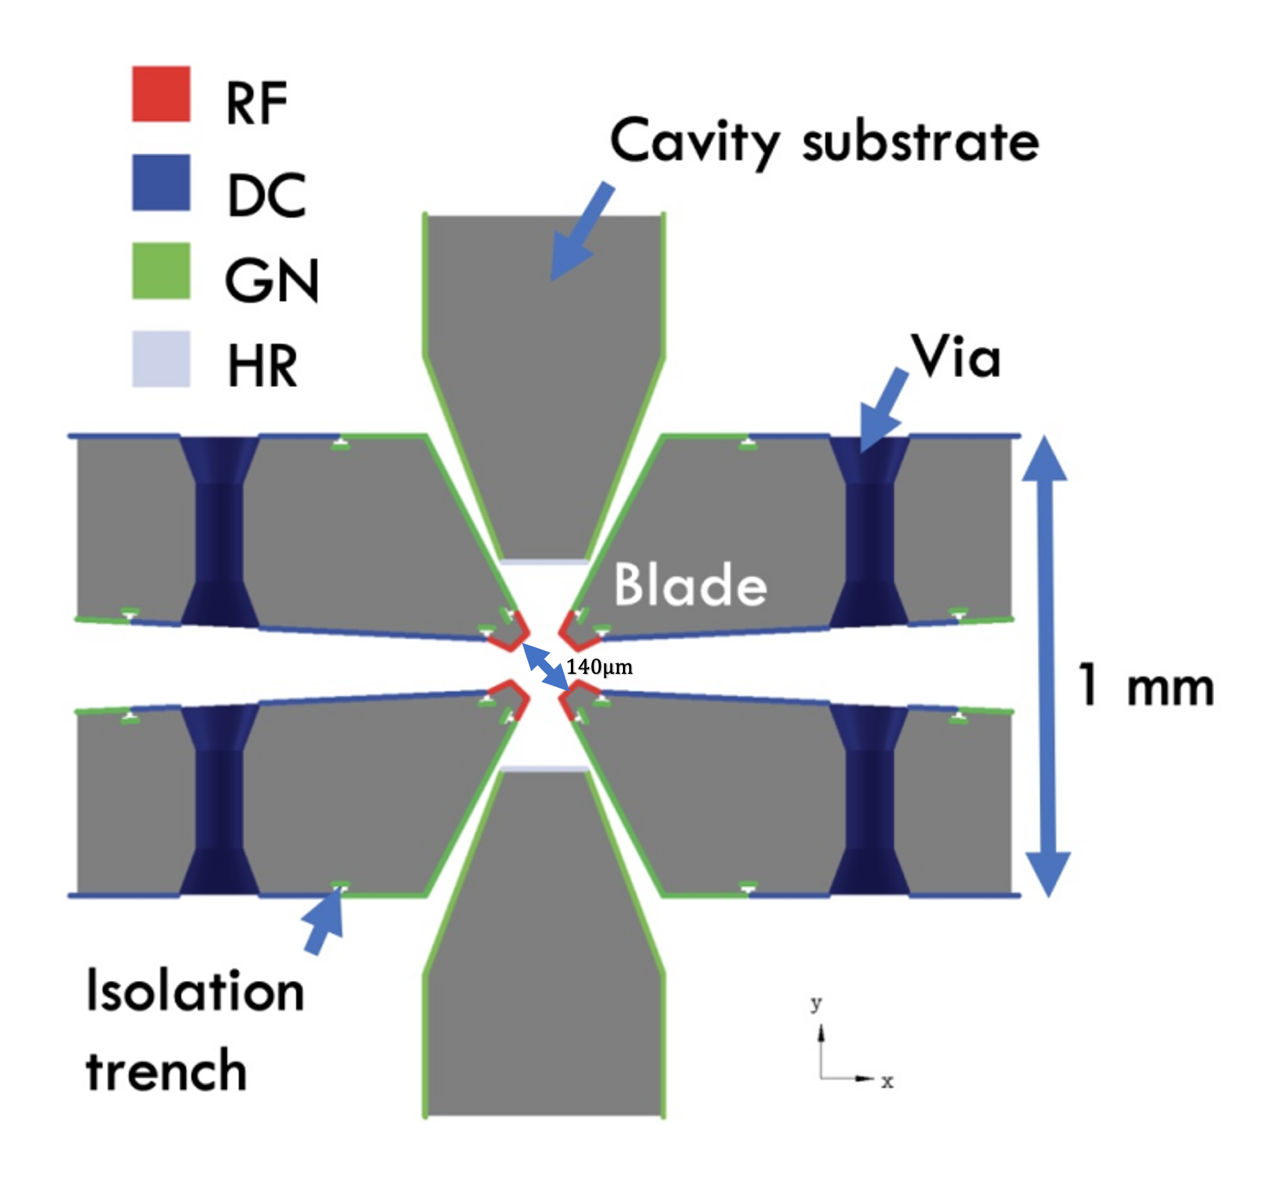

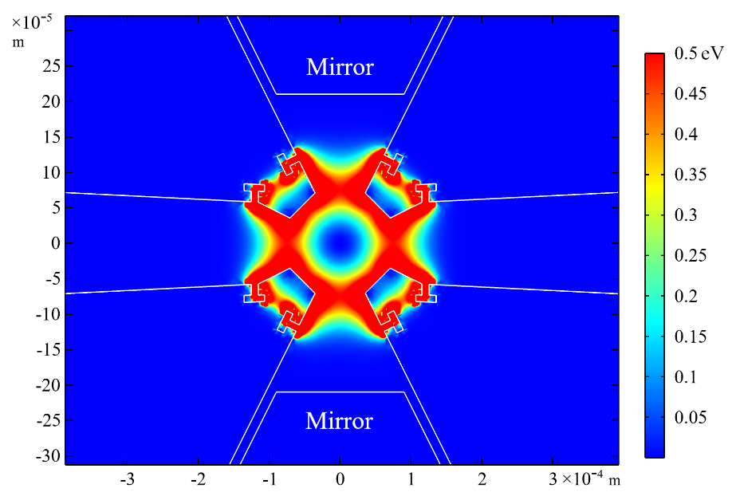
Trap design
3D trap design with good trap efficiency (Fused silica and coated with gold by Femtoprint with Selective Laser-Induced Etching).
Vias connect upper and lower surfaces of the chip.
16 DC electrodes and 1 RF electrode per blade.
4 RF electrodes independently controlled to align trap centre with cavity mode centre.
Trenches electrically isolate adjacent electrodes once coated.
Blades design to provide deep confinement and to shield ion from cavity mirror dielectrics.
Notes:
For our 3d trap design, Our 3D trap is designed using fused silica and coated with gold.
It is precisely fabricated using Femtoprint technology with Selective Laser-Induced Etching (SLIE).

Slide 11
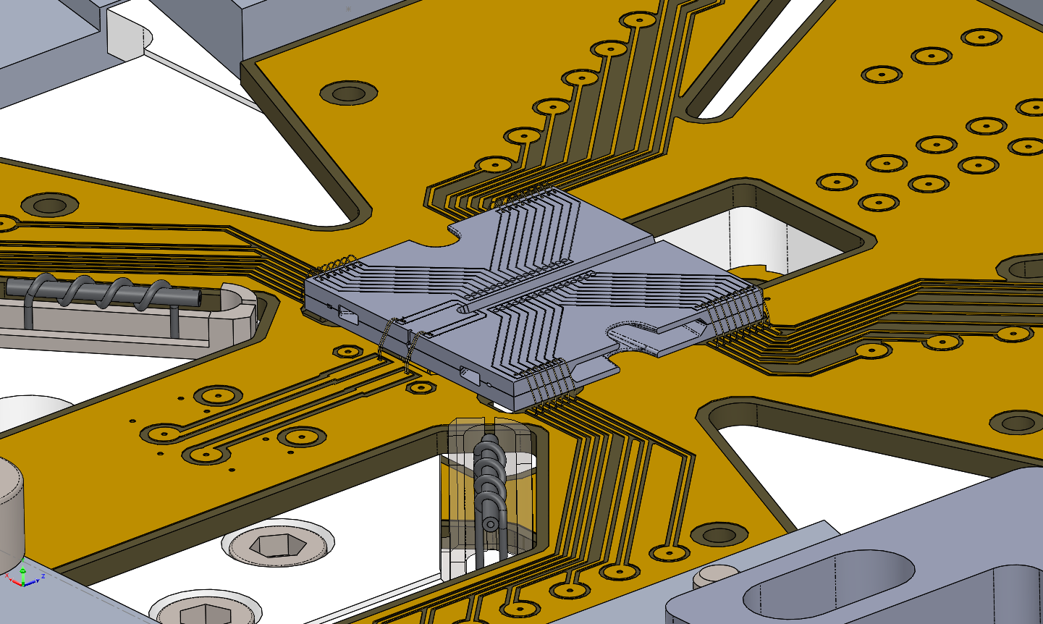
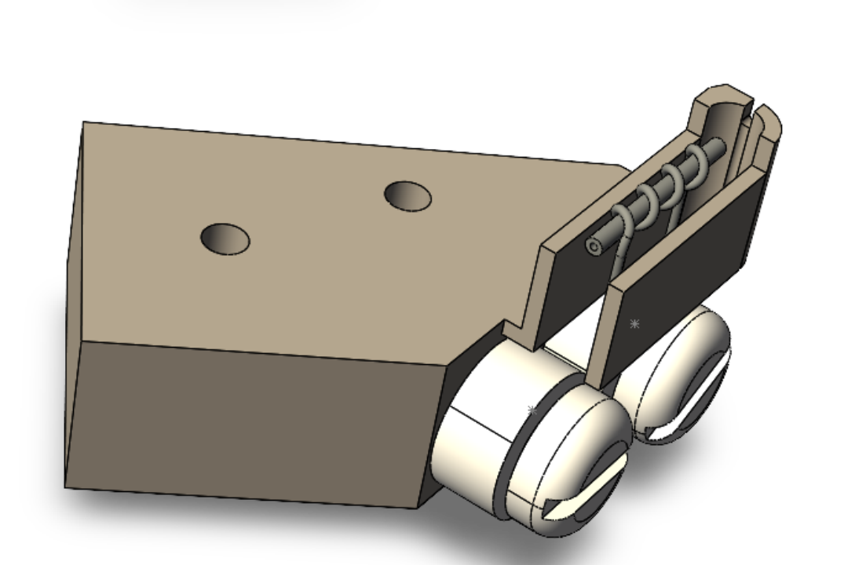
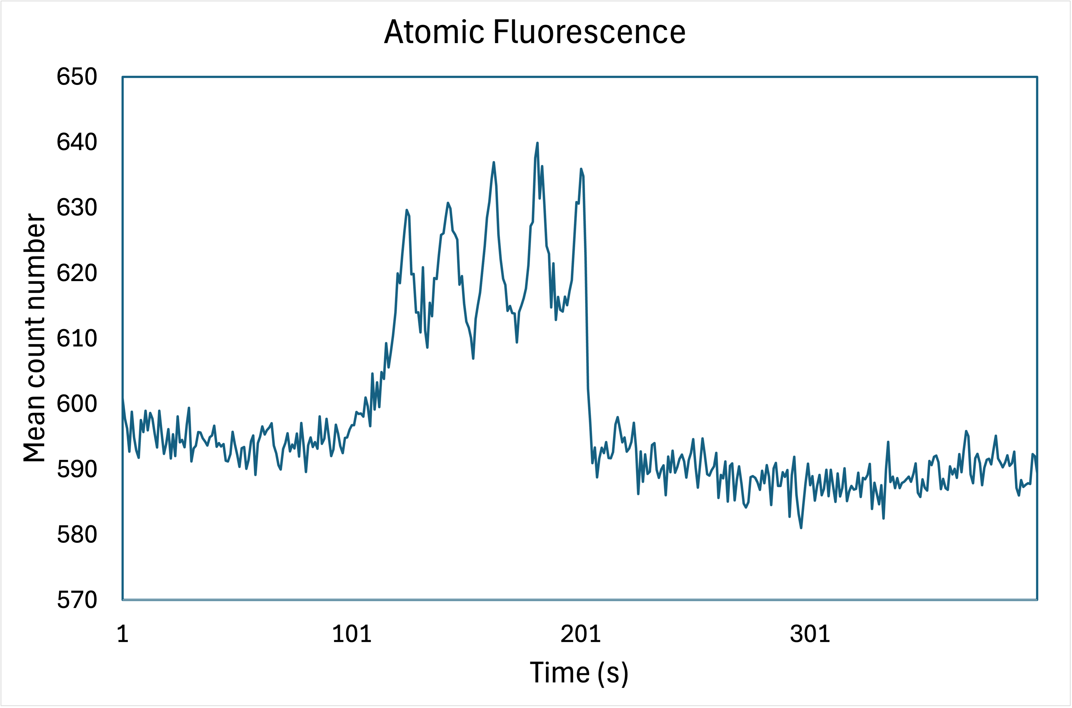
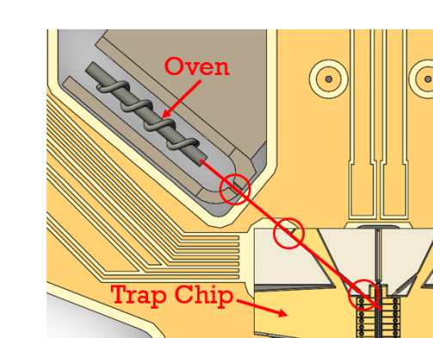
Oven and atomic fluorescence
⓵
Mount
⓷
Oven tube
Trap Chip
Ceramic screws
⓶
⓵
⓶
⓷

Slide 12

Future Work
Trap ions.
Make cavity and characterize and install.
Make ion photon entanglement.

Slide 13


Summary
We use cavity QED to interface ions and photons.
We're establishing a flexible system for remote ion-photon entanglement across a quantum network.
Ovens work and atomic fluorescence in the trap.
Notes:
To sum up, we use cavity-QED to interface ions and photons. And we are building a flexible system for remote ion-photon entanglement across a quantum network. And our ovens are aligned and we will trap soon.

Slide 14
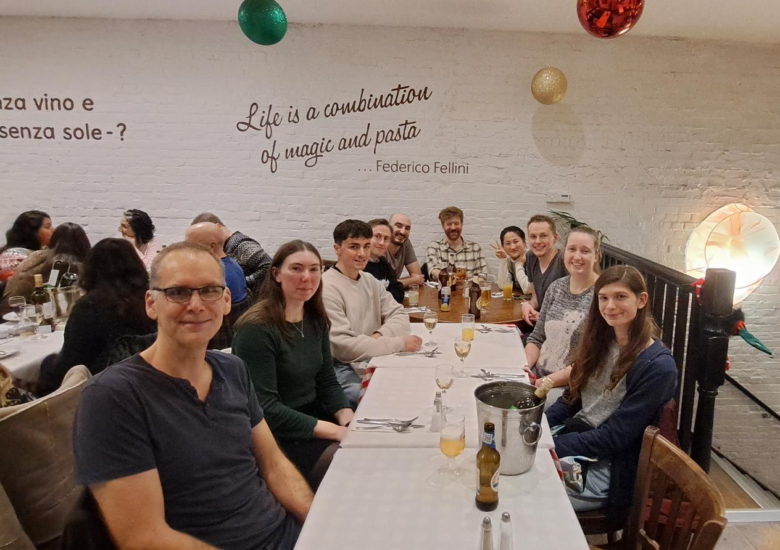



Thanks for listening!
PI:
Matthias Keller
Research Assistants:
Graham Stutter
Laura Blackburn
Sam Snowden
Tasha Bierrum
Xavier Fernandez Gonzalvo
PhD Students:
Adrien Amour
Amber Shepherd
Ian Ford
Maoling Chu

