Slide 1

Overcoming and harnessing non-commuting dynamics in trapped ions
Donovan Webb, Oana Bazavan, Sebastian Saner, Iver Oevergaard, Gabriel Araneda, David Lucas, Raghavendra Srinivas, Chris Ballance

Slide 2
Overview
Control of individual optical phases allow control over
non-commuting interactions.
MS gates have speed limit due to [SDF, Carrier] ≠ 0
Can create effective interactions which are difficult to directly drive [SDF1, SDF2] ≠ 0
Experimental control we need
Notes:
And… Use case #2: Hybrid quantum computing

Slide 3
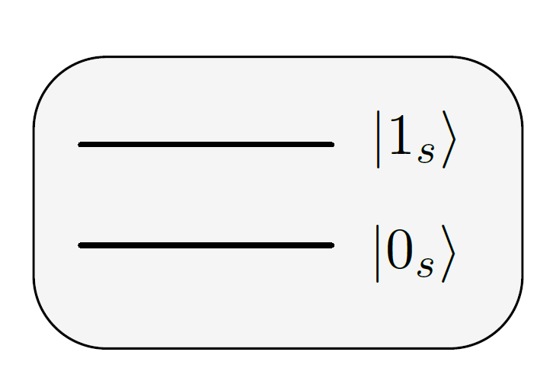
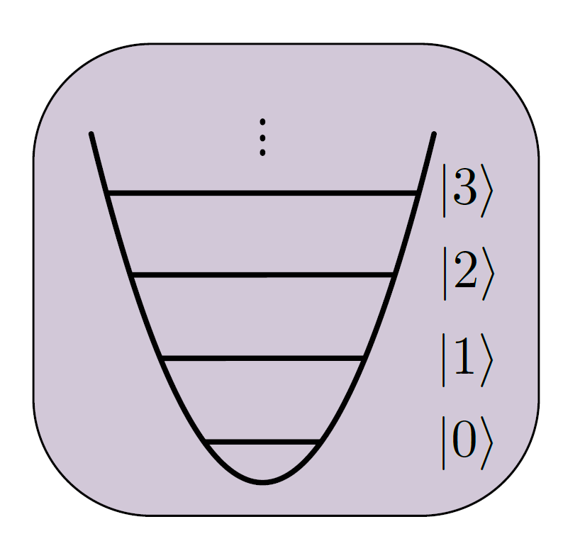
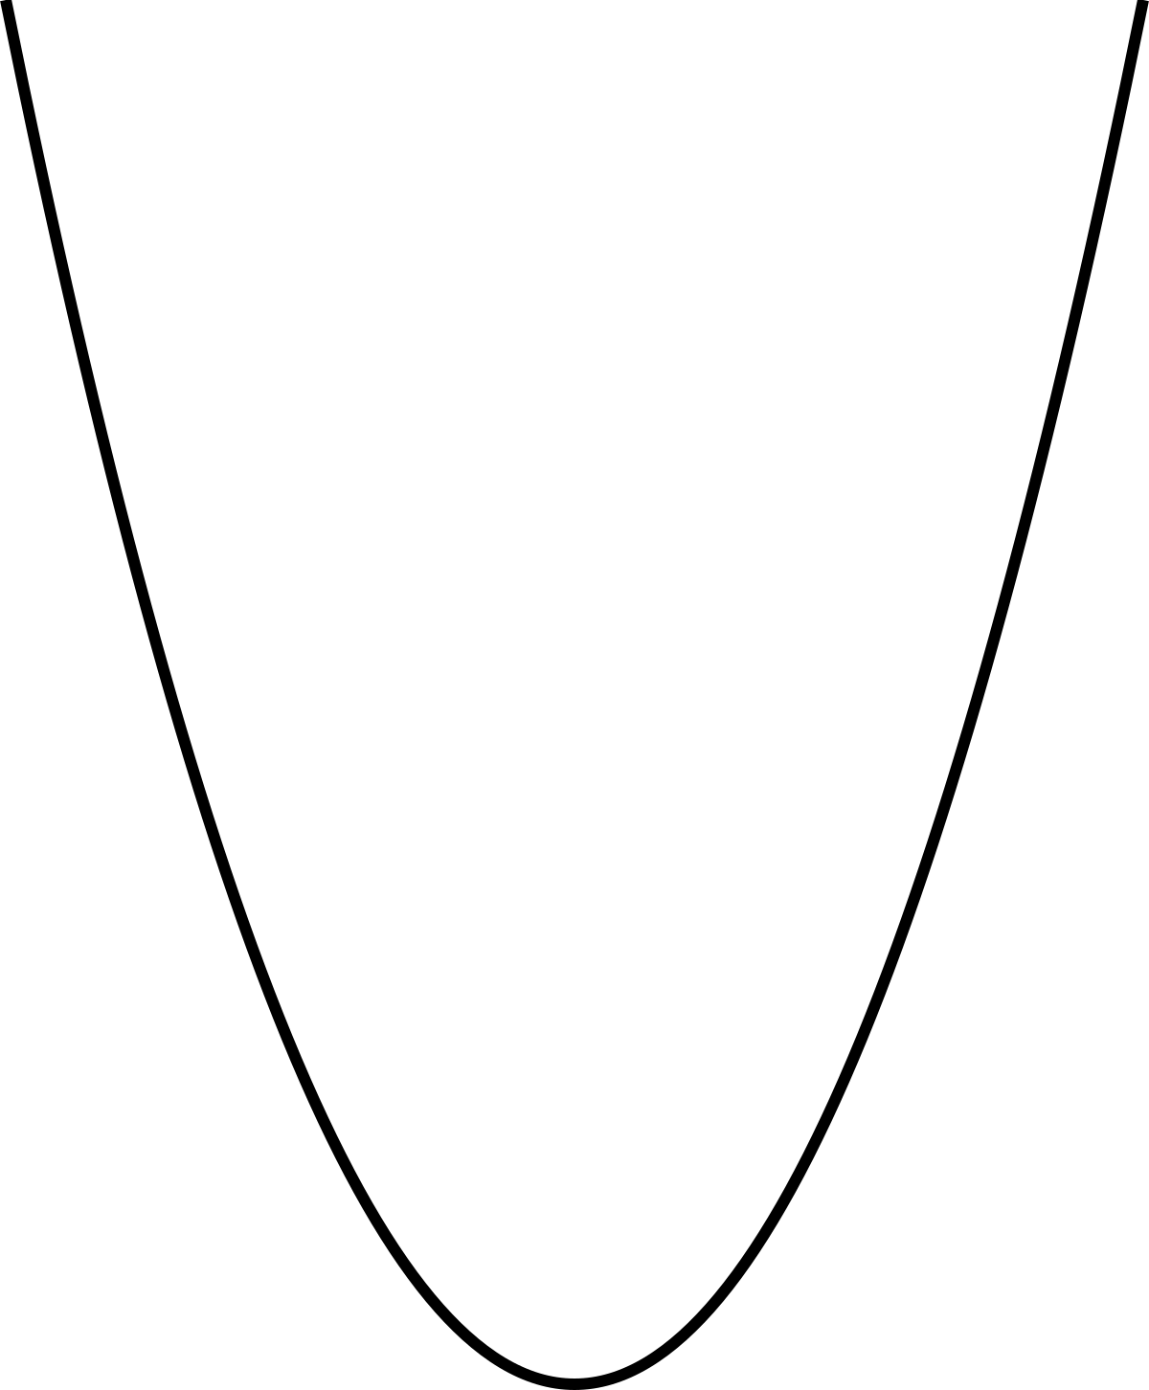
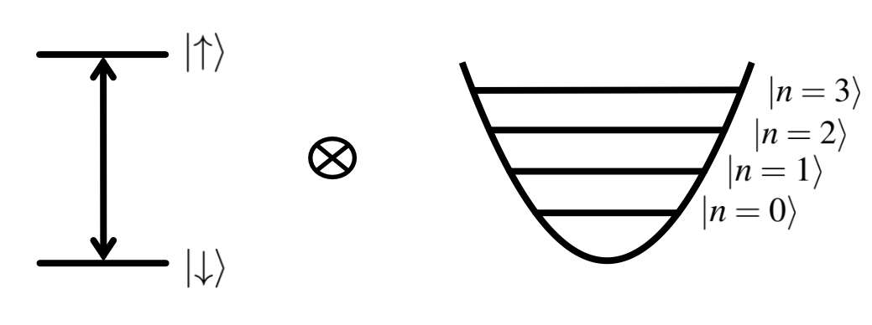
Hybrid System
Notes:
Our focus
Fast Entangling gates – can decorate previous slide with times for entangling using motion in smart way (geometric phase) arrow from motion to spin.
Using motion of ions to encode information CVQC – bosonic encoding – reverse arrow, now using spin in smart way (non-commuting)

Slide 4
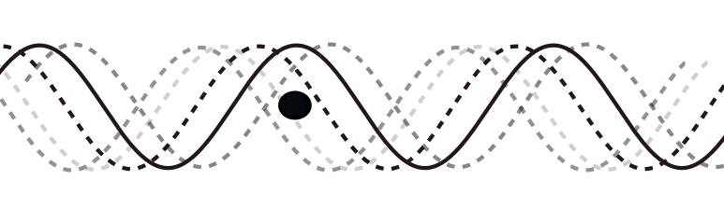
Control for Hybrid system
Frequency
Amplitude
Notes:
Diagram of experiment in center
We need
To interact with qubits using external drive fields i.e. microwave or laser
Frequency of drive field
Amplitude

Slide 5


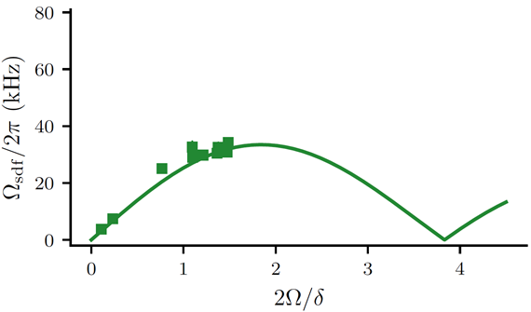
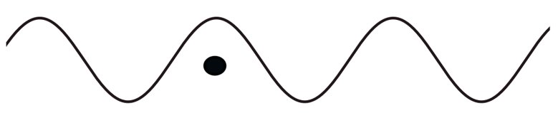
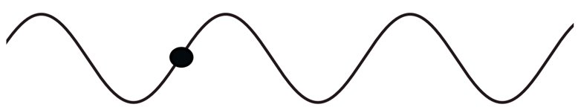
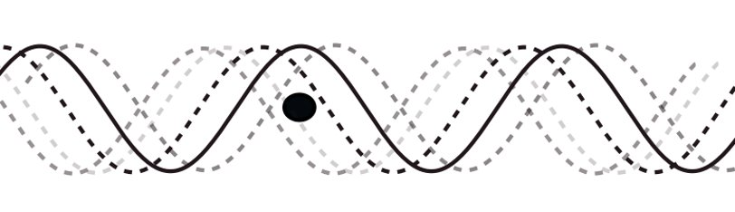
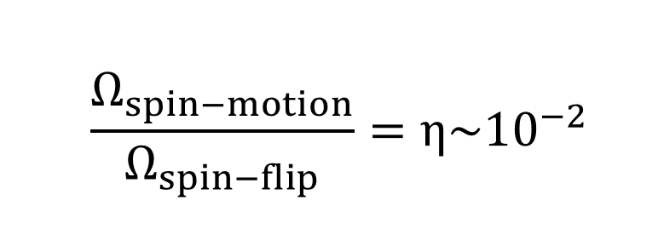
1) Fast MS Gates – Coherent errors
Max gate speed!
Spin Dependent Force
Coupling of motion and spin
Carrier term
Spin flips
∝ 1/(gate duration)
Travelling Wave:
Notes:
V. Quick motivation by saying
- when slow dominated by incoherent errors. i.e. spin/motional dephasing, heating
- when fast these errors are reduced but we start to drive coherent errors hard (e.g. stark shift, off res interactions) here we talk about carrier term
Issue
Carrier couples to gradient
Motional Sideband couples to grad-of-grad
Causes irremovable error using travelling waves
E-field structure for each ion
Standing wave to fix gradient of field seen at ion
High E intensity on each ion (fast interactions)
Single addressing

Slide 6
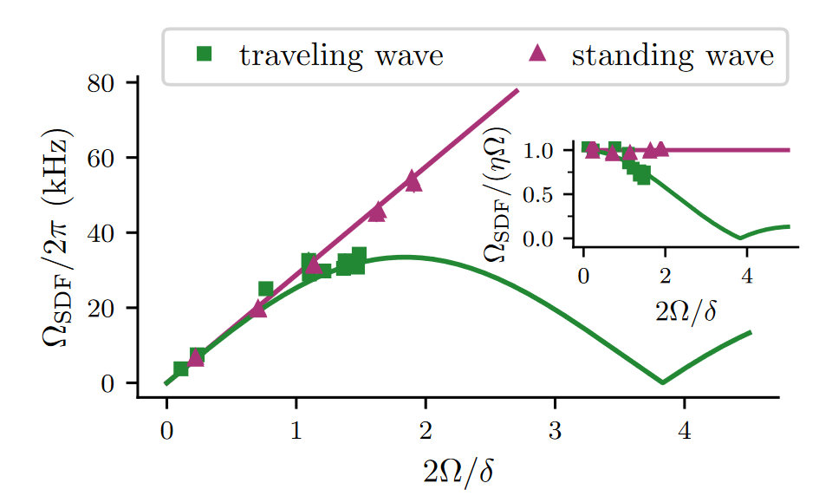
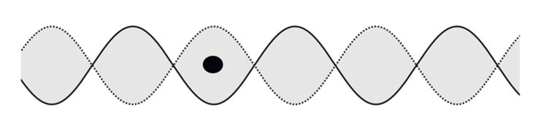
1) Fast MS Gates – Coherent errors
Max gate speed!
Spin Dependent Force
Coupling of motion and spin
Carrier term
Spin flips
∝ 1/(gate duration)
Standing Wave:
[1] S. Saner, O. Băzăvan et al., Phys. Rev. Lett. 131, 220601 (2023).
Notes:
Issue
Carrier couples to gradient
Motional Sideband couples to grad-of-grad
Causes irremovable error using travelling waves
E-field structure for each ion
Standing wave to fix gradient of field seen at ion
High E intensity on each ion (fast interactions)
Single addressing

Slide 7
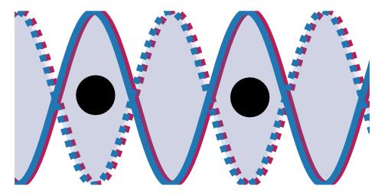
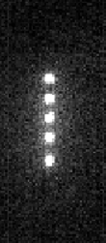

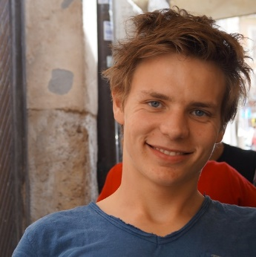
Entangling gates
On previous blade style trap
Power Limited
15 μs
Fixed Spacing
Oana Bazavan
Sebastian Saner
[1] S. Saner, O. Băzăvan et al., Phys. Rev. Lett. 131, 220601 (2023).

Slide 8
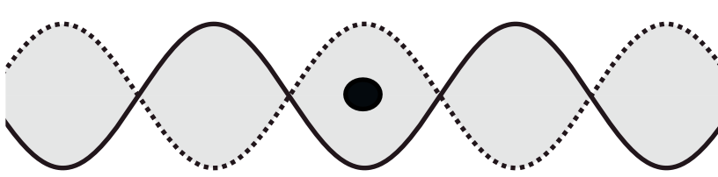
More Control
Frequency
Amplitude
Spatial E-field structure
Spatial phase
Standing wave
[1] Schmiegelow, C. T. et al. Phys. Rev. Lett. 116, 033002 (2016).
[2] Vasquez, A. R. et al., Phys. Rev. Lett. 130, 133201 (2022).
[3] S. Saner, O. Băzăvan et al., Phys. Rev. Lett. 131, 220601 (2023).
Single addressing
[4] Nägerl, H. C. et al. Phys. Rev. A 60, 145–148 (1999).
[5] Li, R.-R. et al. arxiv 2306.01307 (2023).
Notes:
E-field structure for each ion
Phase stabilisation at the ion
High E intensity on each ion (fast interactions)
Long ion chains
Spatial selectivity
Stable trap – low heating rate
What will this allow us to do?

Slide 9
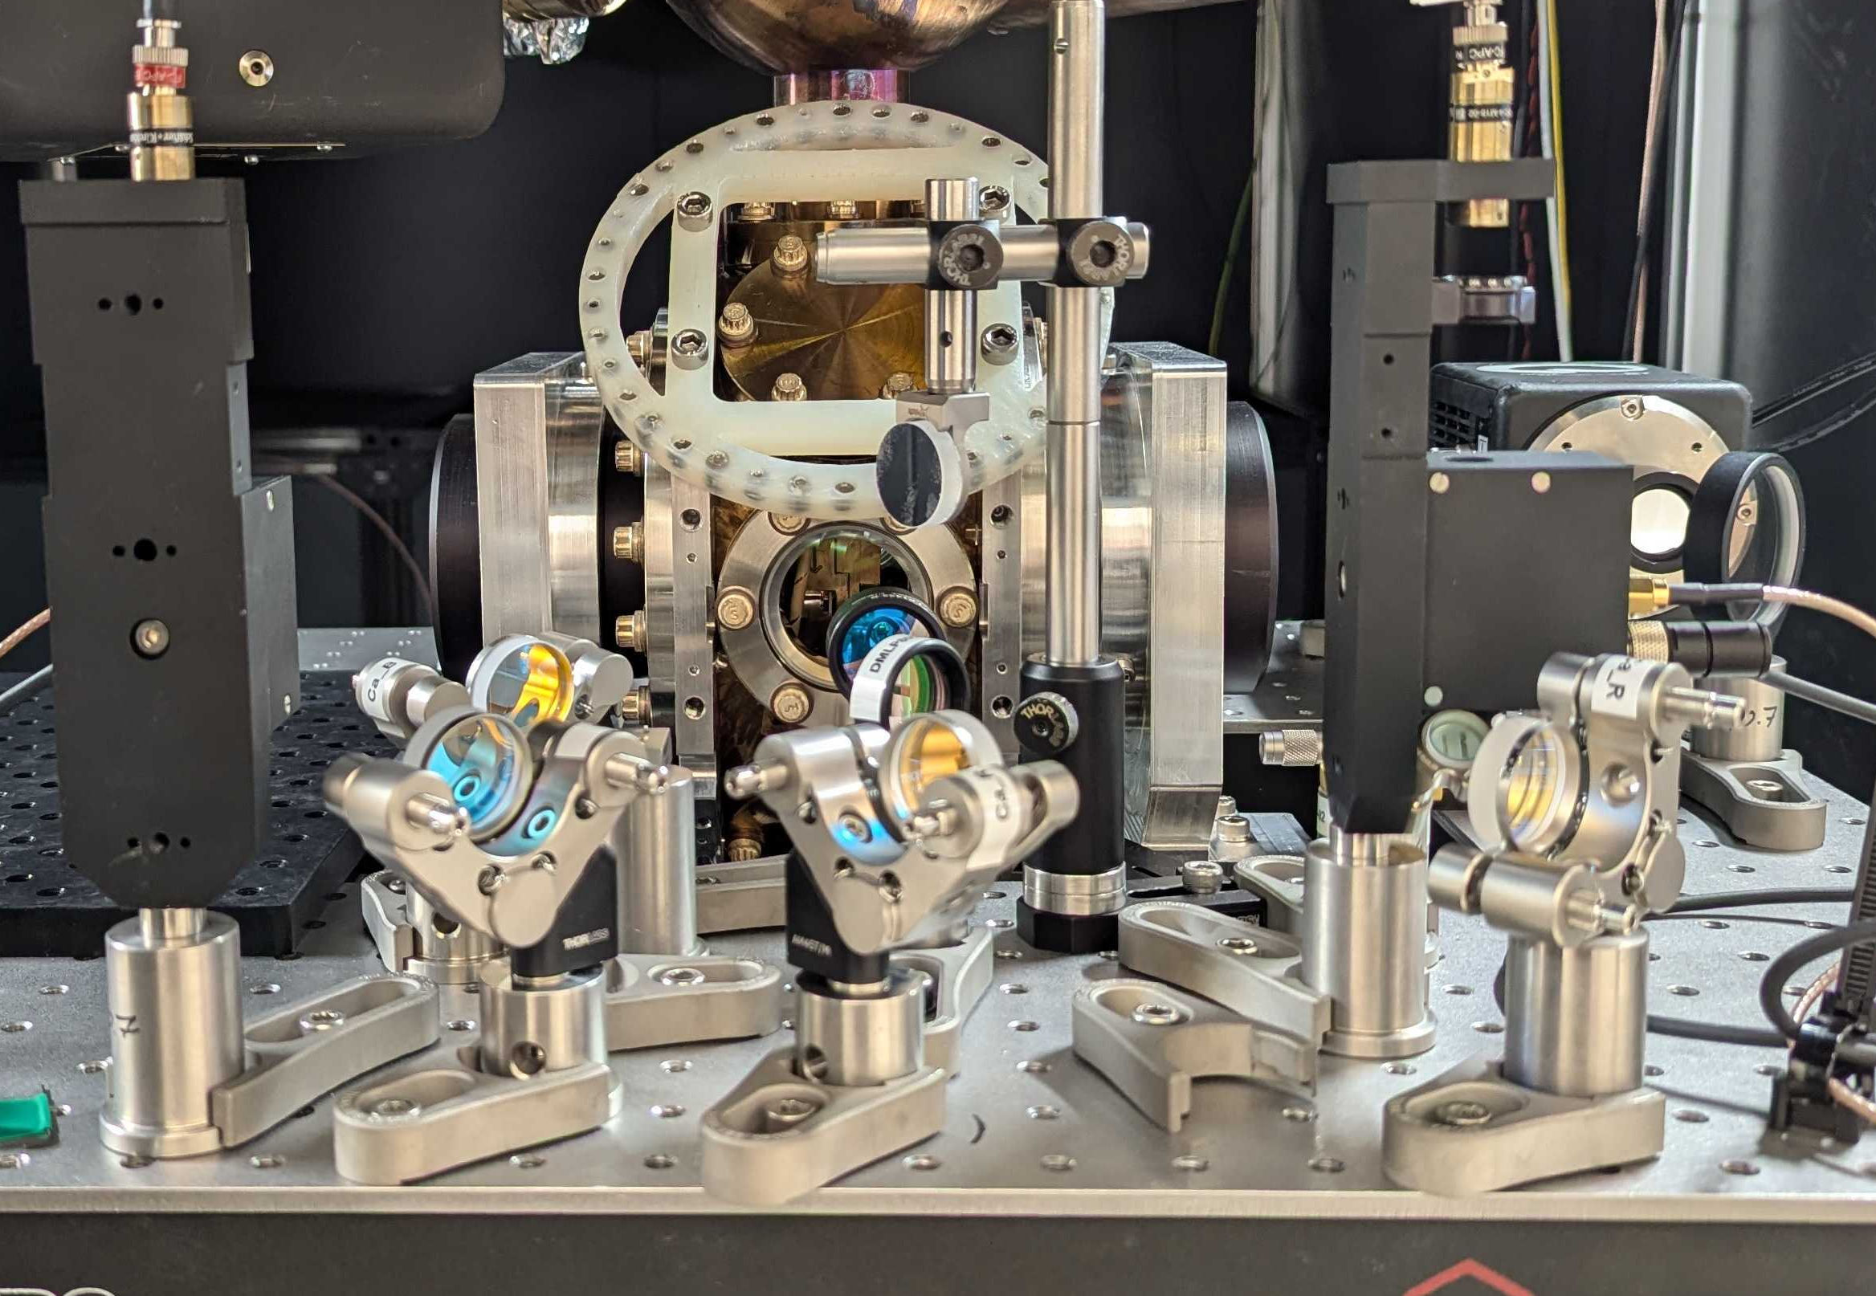
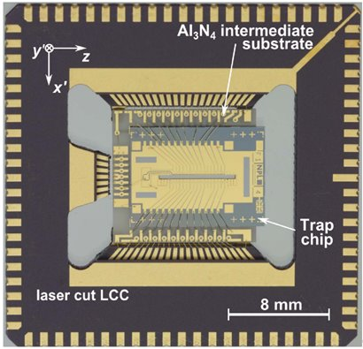


Standing wave in the lab + phase stabilisation
Dual Objectives
PD
$$∆φ$$
30 cm
$$φ$$
AOD
AOD
arm 1
arm 2
Stabilisation by interferometer
Two stage feedback
  Photodiode feedback (fast) λ/300
  Ion feedback (slow)
→ λ/100 combined @ ions
NPL Segmented Trap
[1] Wilpers, G., See, P., Gill, P. & Sinclair, A. G. Nature Nanotech 7, 572–576 (2012).

Slide 10
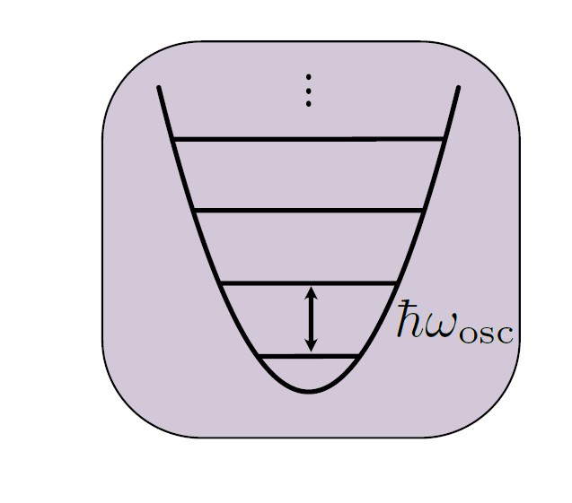
Toolkit for quantum information processing in the oscillator
system of a trapped ion

Slide 11
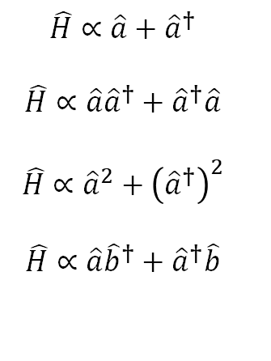
$$\hat{H}∝\hat{a}+{\hat{a}}^{†}$$
$$\hat{H}∝\hat{a}{\hat{a}}^{†}+{\hat{a}}^{†}\hat{a}$$
$$\hat{H}∝{\hat{a}}^{2}+{\left({\hat{a}}^{†}\right)}^{2}$$
$$\hat{H}∝\hat{a}{\hat{b}}^{†}+{\hat{a}}^{†}\hat{b}$$
displacement
rotation
Gaussian operations
squeezing
beam-splitter
Notes:
Point here is to define what some of these operations on the motion look like
Displacement is used often for geometric phase gates.
Squeezing can be used for enhanced sensitivity (in one quadrature)
Beam splitter -> More than one motional mode!

Slide 12

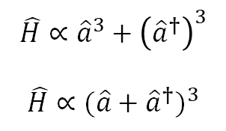
$$\hat{H}∝\hat{a}+{\hat{a}}^{†}$$
$$\hat{H}∝\hat{a}{\hat{a}}^{†}+{\hat{a}}^{†}\hat{a}$$
$$\hat{H}∝{\hat{a}}^{2}+{\left({\hat{a}}^{†}\right)}^{2}$$
$$\hat{H}∝\hat{a}{\hat{b}}^{†}+{\hat{a}}^{†}\hat{b}$$
displacement
rotation
Gaussian operations
squeezing
beam-splitter
Non-gaussian operations
$$\hat{H}∝{\hat{a}}^{3}+{\left({\hat{a}}^{†}\right)}^{3}$$
$$\hat{H}∝{(\hat{a}+{\hat{a}}^{†})}^{3}$$
trisqueezing
cubic phase
Notes:
Define Non-gaussian state -> link to similarity between Clifford+non-Clifford gates needed!
Reread preskill to check understanding of why we need this?

Slide 13
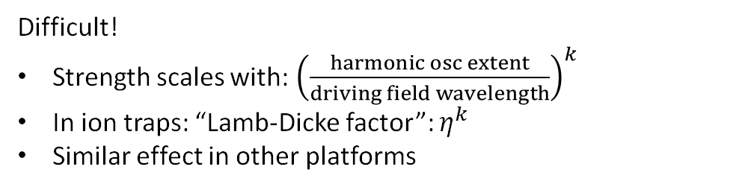
Difficult!
Strength scales with:${ \left(\frac{harmonic osc extent}{driving field wavelength}\right)}^{k}$
In ion traps: “Lamb-Dicke factor”: $η^{k}$
Similar effect in other platforms
Non-gaussian operations
$$\hat{H}∝{\hat{a}}^{3}+{\left({\hat{a}}^{†}\right)}^{3}$$
$$\hat{H}∝{(\hat{a}+{\hat{a}}^{†})}^{3}$$
trisqueezing
cubic phase

Slide 14
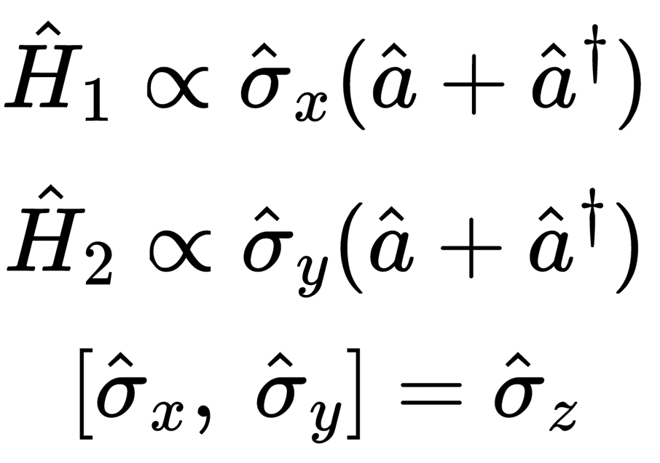


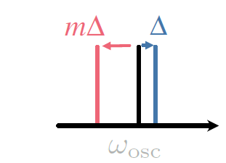
Hybrid Quantum Computing
Two simultaneous SDFs
SDFs do not commute
Set SDF detuning to access effective interactions
[1] Sutherland, R. T. & Srinivas, R. Phys. Rev. A 104, 032609 (2021).
[2] Băzăvan, O. et al. arxiv 2403.05471 (2024).

Slide 15
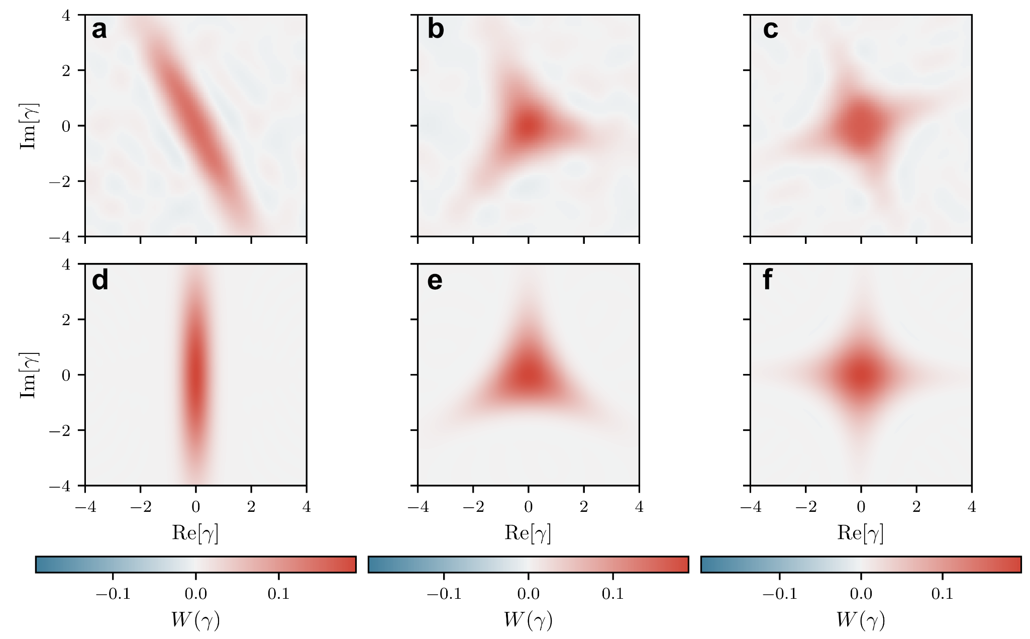
Creating higher order squeezed states
On previous blade style trap
Băzăvan, O. et al. arxiv 2403.05471 (2024).
m = -1
m = -2
m = -3
Tri-squeezing demonstrated prev. in photonic and superconducting cavity systems [1,2]
Quad squeezing: first time across any platform
Non-gaussian states
experiment
simulation
[1] Eriksson, A. M. et al. Nat Commun 15, 2512 (2024).
[2] Chang, C. W. S. et al. Phys. Rev. X 10, 011011 (2020).
Notes:
First time period! Example for qft sims cite alejandro, can be continued to increasing orders. More challenges for reconstruction

Slide 16


Hybrid quantum
Frequency
Amplitude
Phase
Spatial E-field structure
Absolute phase
Relative phase of SDFs
PD
$$∆φ$$
$$φ$$
AOD
AOD
arm 1
arm 2
SDF₂
SDF₁

Slide 17
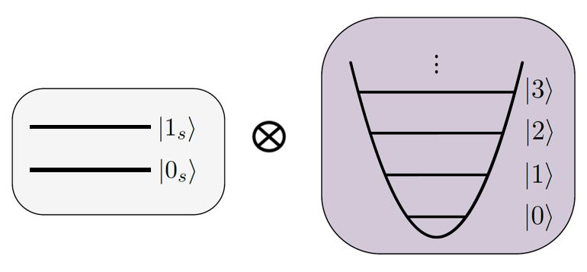
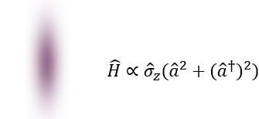
Outlook
1us entangling gates
Fast gates on multi-ion chain
Demonstrate full CVQC gate set
Longer chain -> more modes!
Boson simulations (Z2 gauge theories)

Slide 18
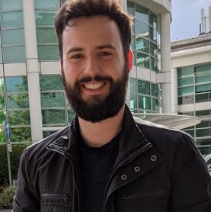
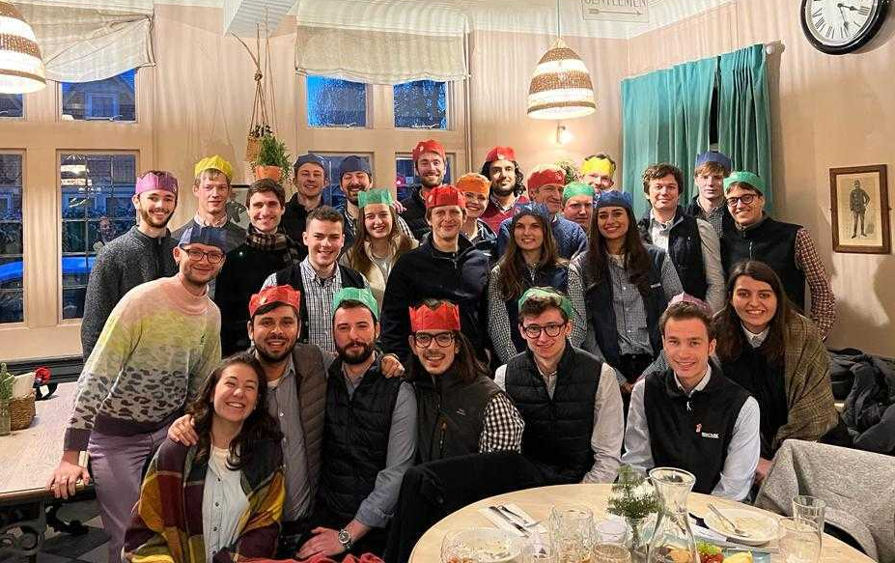
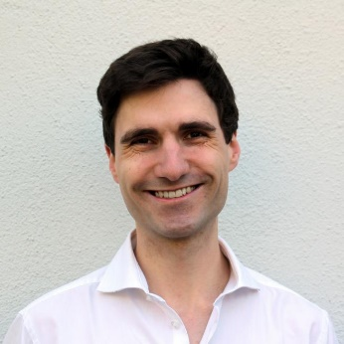

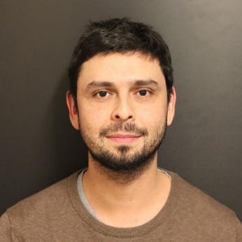
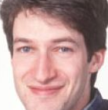
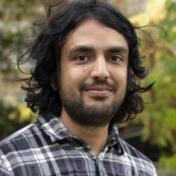




The team
Oana Bazavan
Sebastian Saner
Donovan Webb
Peter Drmota
Mariella Minder
Gabriel Araneda
David Lucas
Raghavendra Srinivas
Chris Ballance
+ Iver Oevergaard (Graduate student)
+ Lavender Foo (Summer project)

Slide 19
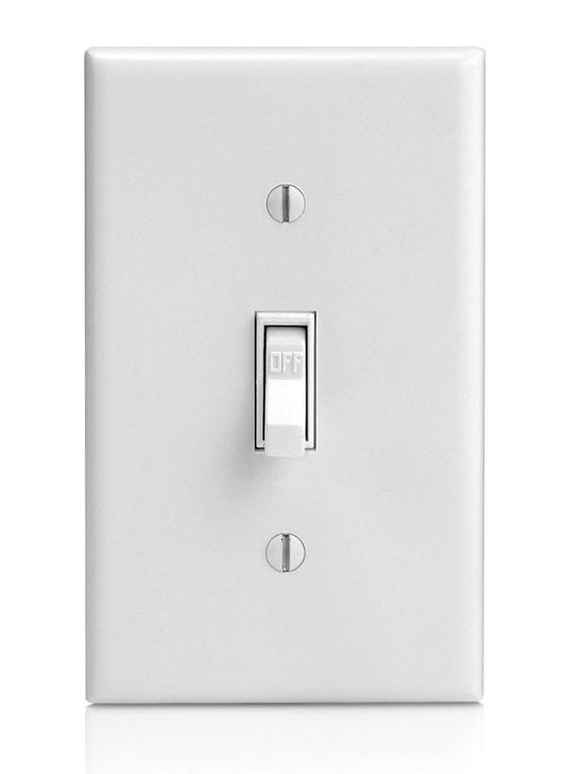
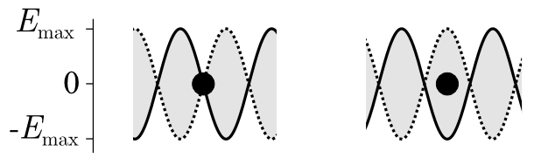
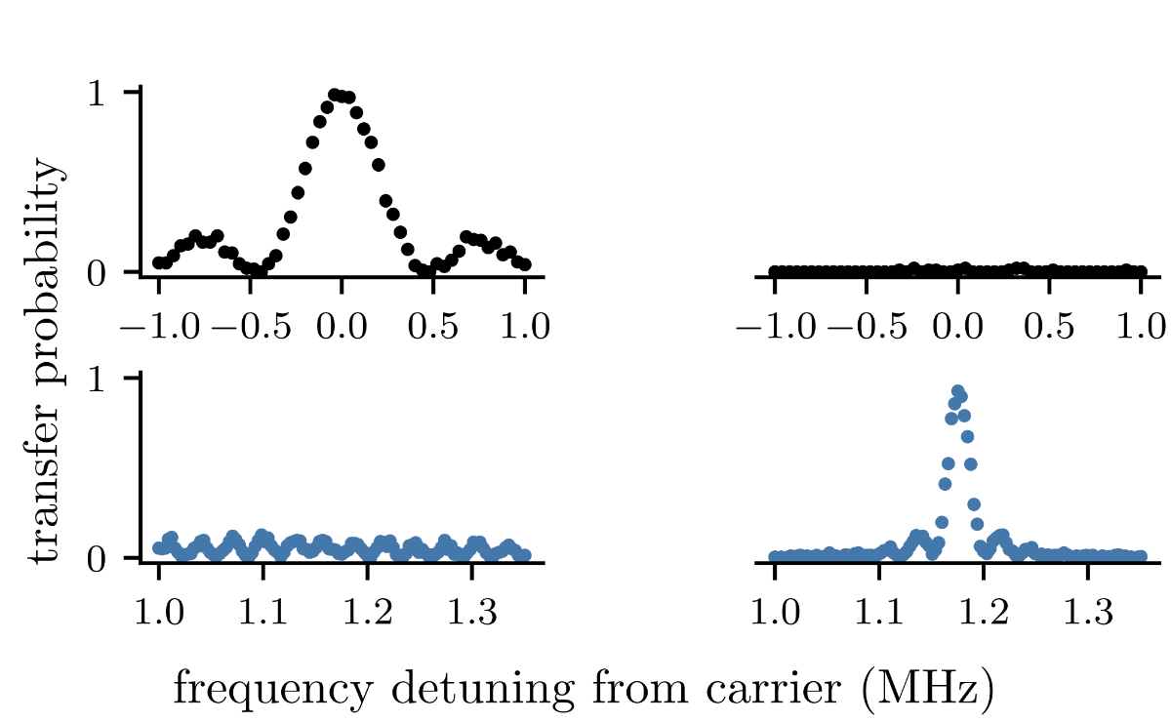
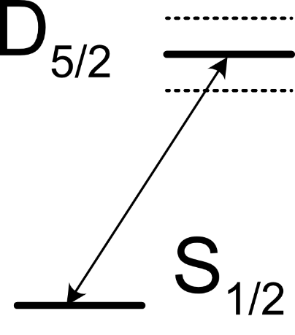
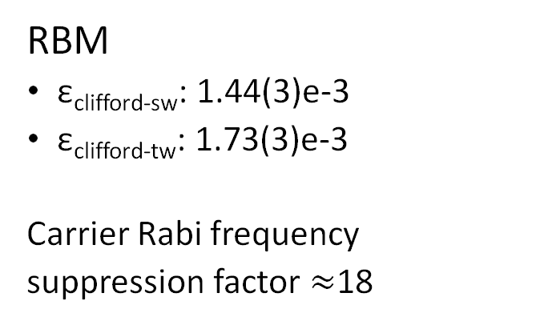
Standing-wave Physics
RBM
ε_{clifford-sw}: 1.44(3)e-3
ε_{clifford-tw}: 1.73(3)e-3
Carrier Rabi frequency
suppression factor $≈$18
carrier
resonance
blue sideband
resonance

Slide 20
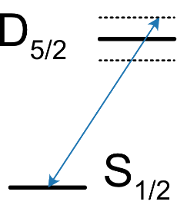
Standing-wave Physics
RBM
ε_{clifford-sw}: 1.44(3)e-3
ε_{clifford-tw}: 1.73(3)e-3
Carrier Rabi frequency
suppression factor $≈$18
carrier
resonance
blue sideband
resonance

Slide 21
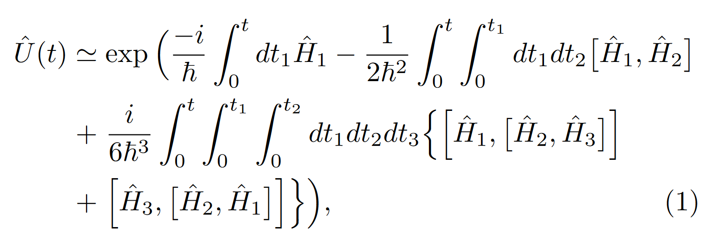
Magnus expansion
c.f. geometric phase accumulation

