Slide 1












Cycle Error Reconstruction on a Trapped Ion Quantum Computer
Robert Freund, Nicholas Fazio, Christian Marciniak, Debankan Sannamoth, Robin Harper, Alex Steiner, Ivan Pogorelov, Lukas Postler, Stephen D. Bartlett and Thomas Monz
€
SFB
$
Notes:
Good day!
Working in Ibk
Same as previous experiment
Quantum Computer
Fidelitites not perfect
Characterise errors via cycle error reconstruction

Slide 2






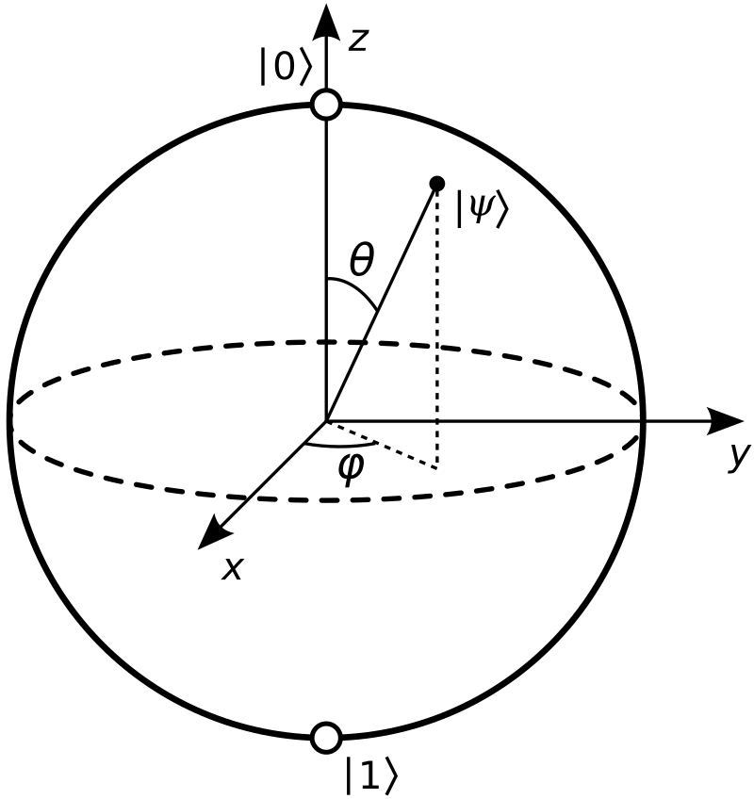
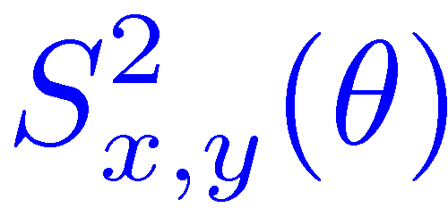

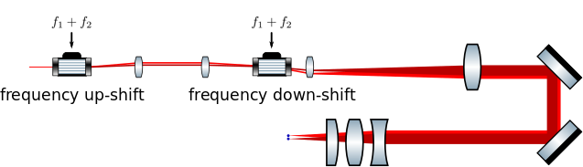
AQTION
Pogorelov, PRX Quantum 2, 020343 (2021)
Individual (and parallel) local operations
Single qubit errors e. g.:
Dephasing (detuning)
Over/Underrotations
⁴⁰Ca⁺
D_{5/2}
resonant
manipulation
off-resonant
manipulation
+
+
+
S_{1/2}
Two qubit errors e.g. :
Over/Underrotations
Motional dephasing
τ = 20μs
F > 99%
Local Mølmer- Sørensen entangling gate
Simultaneous addressing of multiple ions
+
+
+
+
τ = 200μs
F ~ 99%
Notes:
Ion chain around 16 ions
Individual addressing
Single qubit gates -> resonant pulses
Two qubit gates -> MS gates
Single qubit errors
Dephasing -> probability of Z
Over and underrotations -> probability of X/Y
In modern day Innsbruck we have a number of setups of course but one of our main workhorses is the AQTION compact quantum computer you can see here. It‘s quantum out of the the proverbial box in as much that the entire quantum computer is contained in two standard industrial 19‘‘ server racks. You can read a lot of the detail in this publication here, but we are quite happy with the performance overall. It is amazing to see how the field has evolved and indeed progressed in the 3 odd years since we published this.
I would like to highlight here that the compactness we were aiming for does not come at the cost of performance, and we have had a particular focus on is maintenance and tuning automation. We have automated calibration suites that keep the machine at its performance with a duty cycle of above 80% working routinely with up to 16 ions in full connectivity and everything necessary for a full physical and indeed logical universal gate set. With the strong international push for example by Quantinuum it‘s no longer the best around, but it‘s certainly doing pretty well for itself still.

Slide 3
Challenge
How large are the errors for one gate?
Where do the errors come from?
16 qubit register
Little information
Few measurements
All information
Many measurements
Notes:
Error for one specific gate/combination of gates?
Origin?
16 qubit register
spectrum

Slide 4
Outline
Characterization of Errors
  Randomized benchmarking
  Quantum Process Tomography
Noise
  Description
  Characterization
Cycle Error reconstruction
  Method
  Results
Summary and Outlook

Slide 5
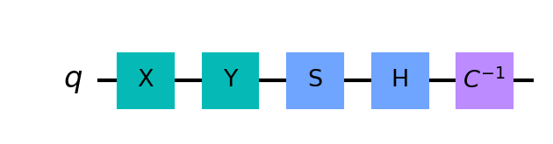
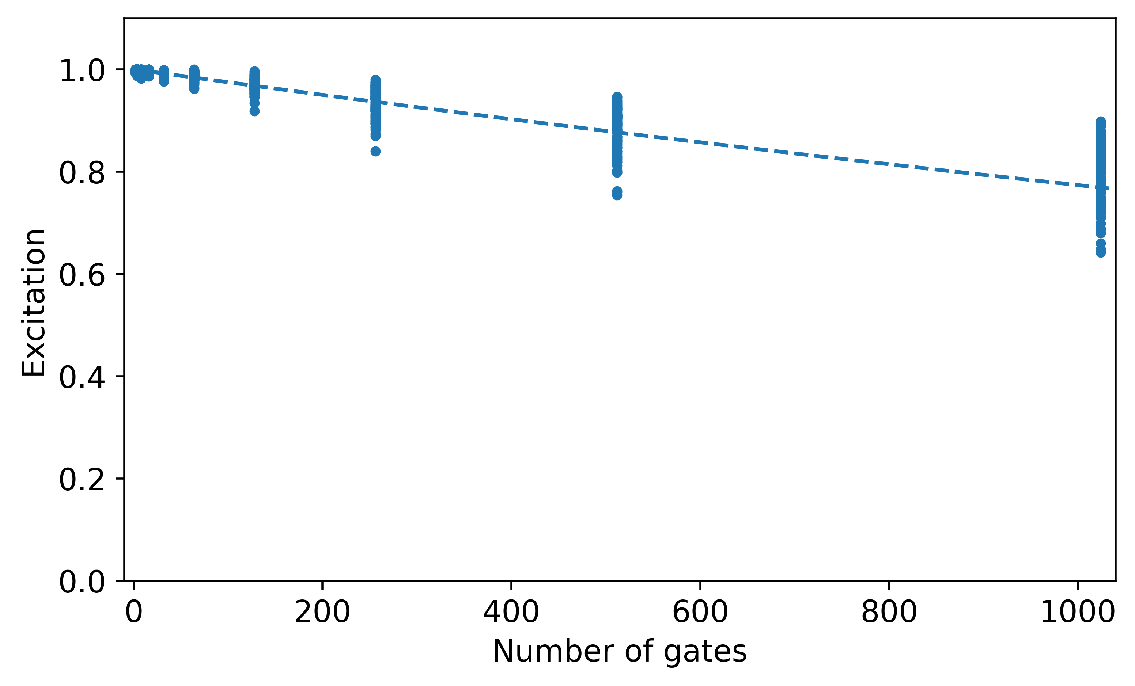
Characterization of Errors
Knill, Phys. Rev. A 77, 012307 (2008)
Randomized Benchmarking:
Magnify error by repetitions
Draw random Clifford gates
Robust to SPAM
Around 100 measurements per length
C
Disadvantages:
Extract average error per Clifford gate
No information about origin
N-qubit Clifford gates needs to decompose into 2- qubit gates
Notes:
Characterize an average clifford gate
Draw many gates from clifford group and apply after each other
Magnify error
Add inverse
Overlap between inital and final
Fit exponential -> extract average gate fidelity
Offset is SPAM
100 different sequences for each length are sufficient to reduce the error below 1 %
Few measurements
But:
No specific gate specified
No info about origin
Now: characterize a specific gate/process

Slide 6
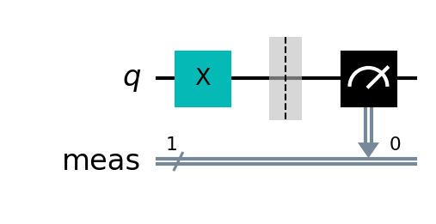


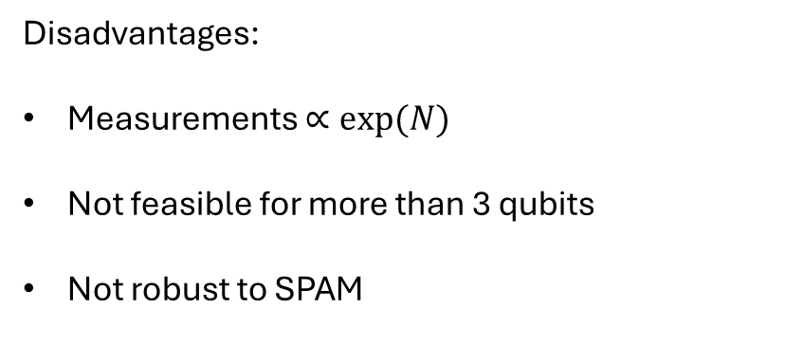
Characterization of Errors
Quantum Process Tomography:
Determine state after process for each basis state
Extract full information
Disadvantages:
Measurements $∝exp⁡(N)$
Not feasible for more than 3 qubits
Not robust to SPAM
Notes:
Prepare different initial states
Apply process/gate
Measure in several basis
For 1 qubit -> X and Y and Z
Extract full process matrix
Can we characterize one specific process with RB?

Slide 7
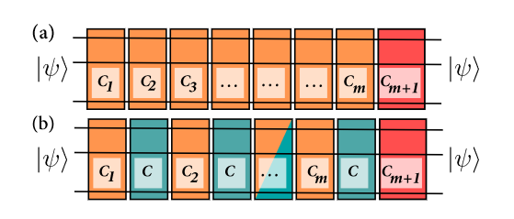
Characterization of Errors
Magesan, Phys. Rev. Lett. 109, 080505 (2012)
Interleaved randomized benchmarking:
Randomized benchmarking with
Inserting gate C in between random gates
Extract gate error of C
Disadvantages:
No information about origin
N-qubit Clifford gates needs to decompose into 2- qubit gates
Systematic errors
Many more characterization methods !!!
Notes:
Characterize gate C
First normal RB
Insert C in between
Converges to the error of C when random cliffords are perfect
This is in between in the spectrum
But: No information about origin!

Slide 8
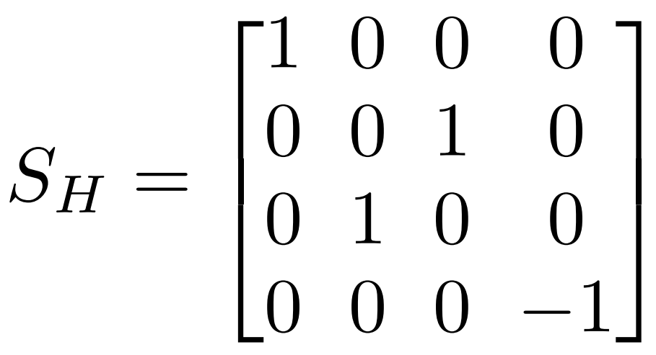
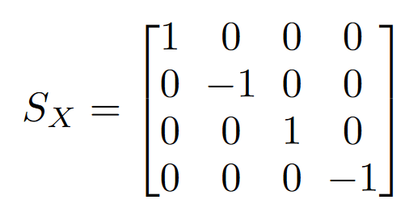
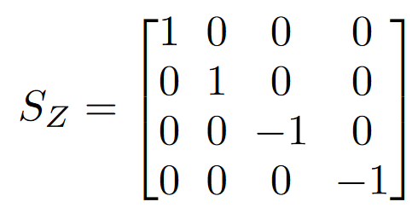

Noise
Completely-positive trace-preserving (CPTP) maps:
$$ρ →ε\left(ρ\right)$$
Written in Pauli transfer matrix:
$ε\left(ρ\right)=S_{ε} |ρ⟩⟩$ with $|ρ⟩⟩=\left(\begin{matrix}1 \\ <X> \\ \begin{aligned}<Y> \\ <Z>\end{aligned}\end{matrix}\right)$
Examples:
Notes:
Noise can be described with CPTP
Mapping of density matrix
Map is given by matrix
density matrix is vector of expectation values X, Y, Z

Slide 9

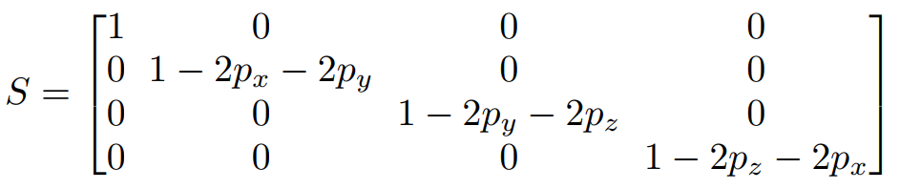
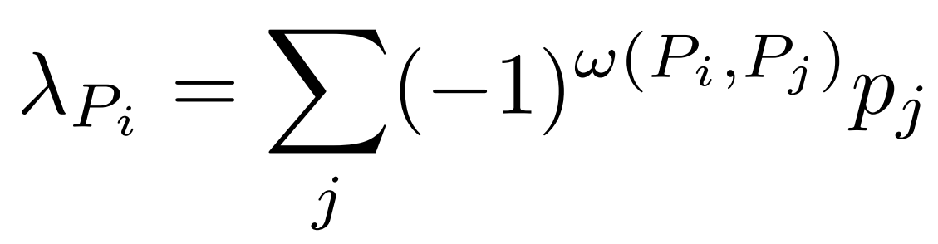
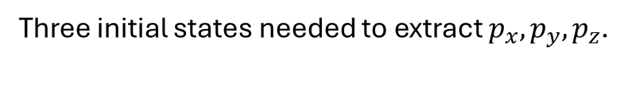
Noise
Arbitrary single-qubit pauli channel:
Three initial states needed to extract $p_{x}, p_{y}, p_{z}$.
Notes:
Assume: Only pauli errors happen with probability p
Matrix is diagonal
Determine eigenvalues with certain initial states
Derive probabilities px,.py,pz
Relation for n-qubit system
Arbitrary noise is not Pauli

Slide 10
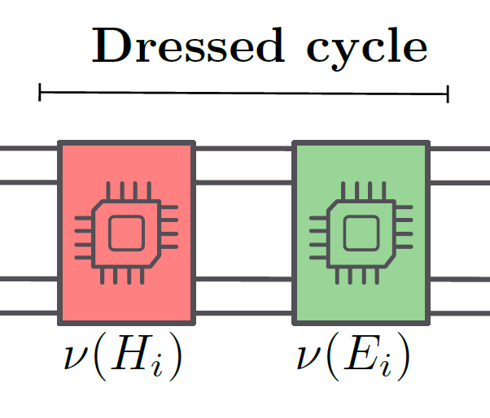
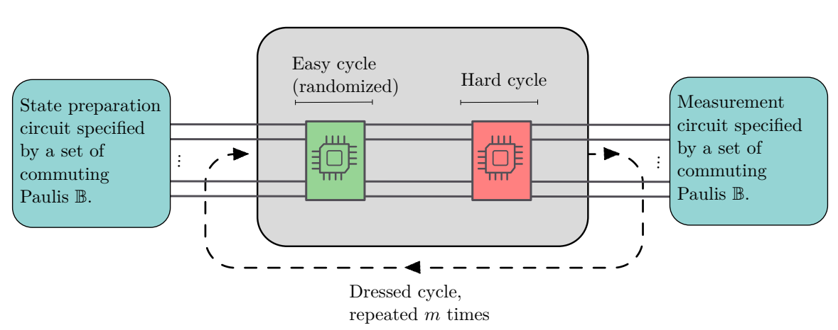
Cycle Error Reconstruction
Carignan-Dugas et al, arXiv: 2303.17714
Randomized compiling transforms arbitrary noise channel to Pauli error channel
Robust to state preparation and measurement errors (SPAM)
Magnify error rate of hard cycle by repititons
Notes:
Add to the gate we want to characterize (red) a random pauli gate (green)
Transforms arbitrary noise channel to Pauli error channel while conserving fidelity
Repeat dressed cycle similar to RB
Prepare different initial state to determine eigenvalues
Postprocessing derives probabilities
But: repitions come with a drawback

Slide 11
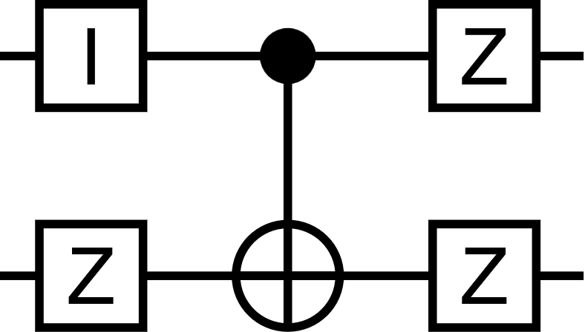
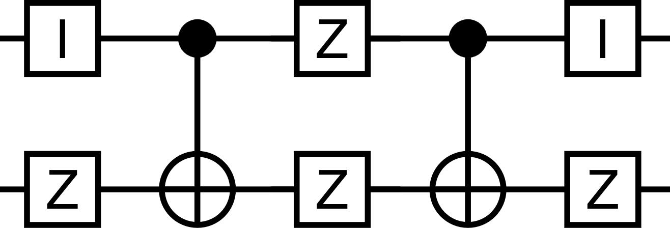
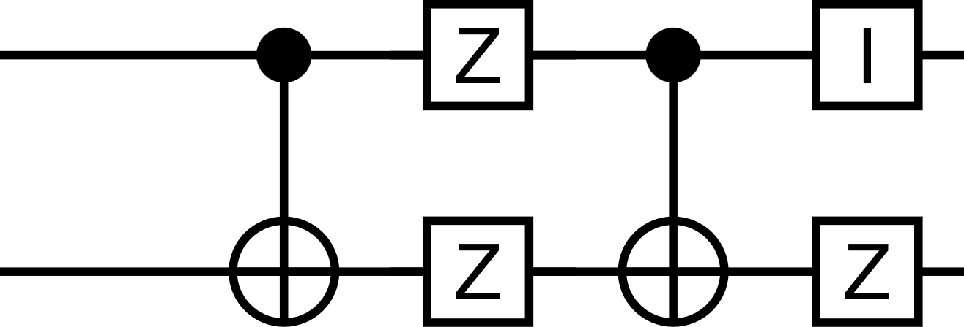
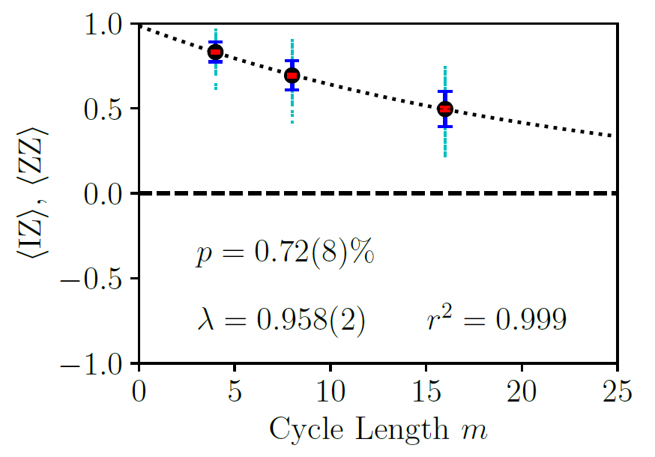
Cycle Error Reconstruction
Repetition comes with a drawback: Orbits
IZ turns to ZZ
Same result from
Instead of
Marginal per orbit:
Notes:
If IZ happens before CNOT -> ZZ
Cant distinguish IZ from ZZ
Dont extract probabilities but marginals -> geometric mean over probailities of IZ and ZZ
Exponential fit

Slide 12
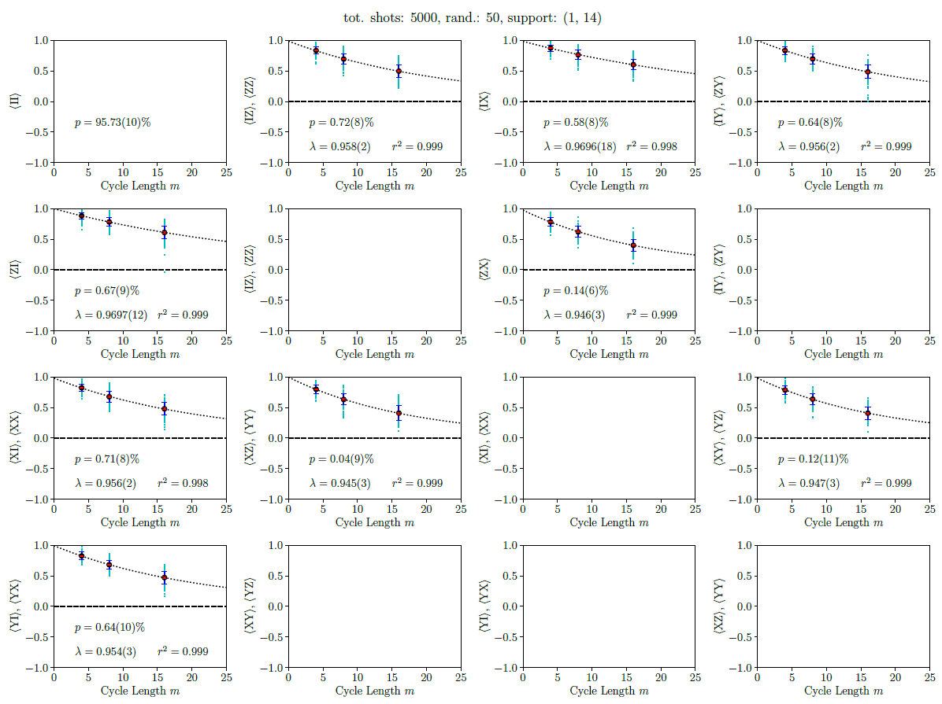
Cycle Error Reconstruction
Notes:
Fit all orbits
Extract probability of no error happening

Slide 13
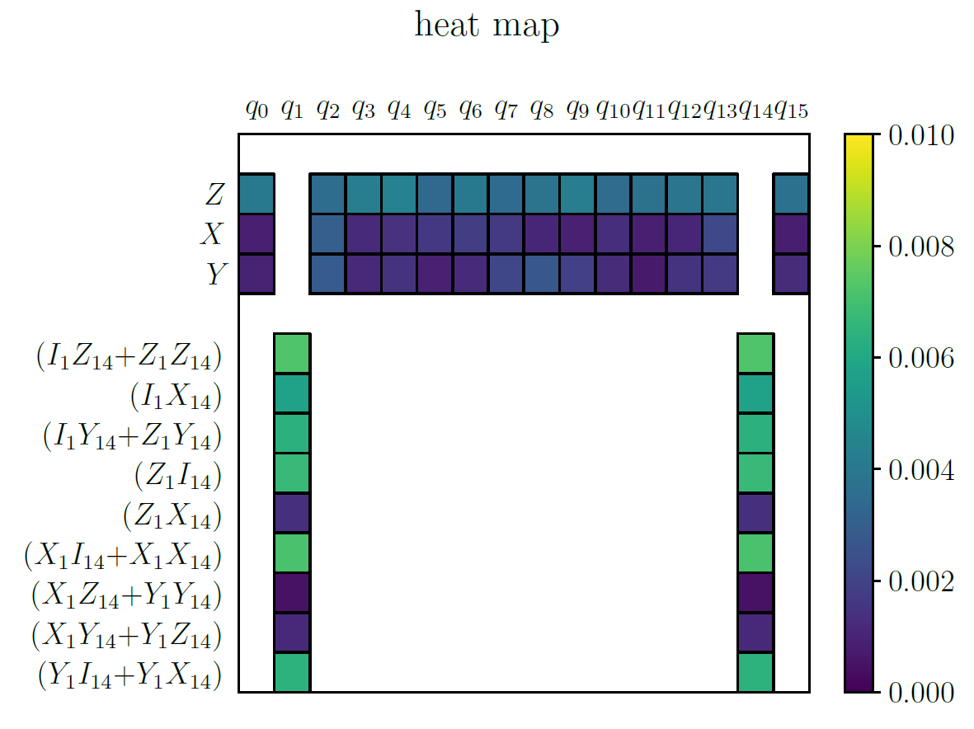
Cycle Error Reconstruction
Notes:
Probabilities are colors
Orbits y axis
In parallele characterization of errors on idling qubits
Characterize crosstalk -> q2 compared to q4
Z error dominant -> dephasing

Slide 14
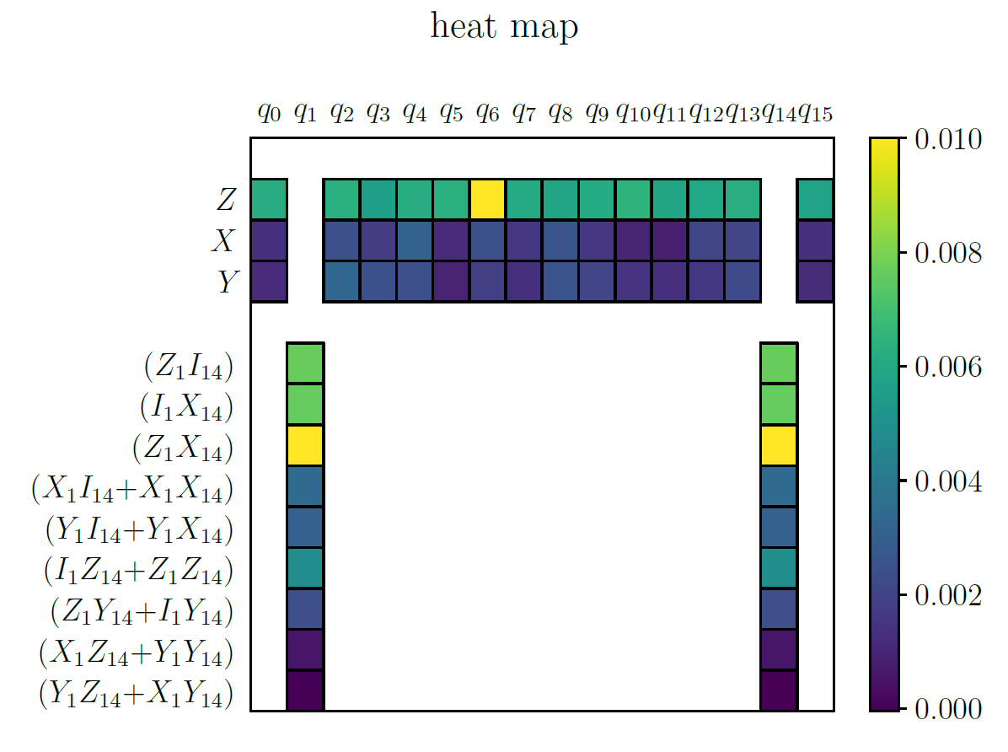
Cycle Error Reconstruction
Notes:
Once higher Z error on qubit
Dephasing -> detuning
Resonant pulse not resonant

Slide 15
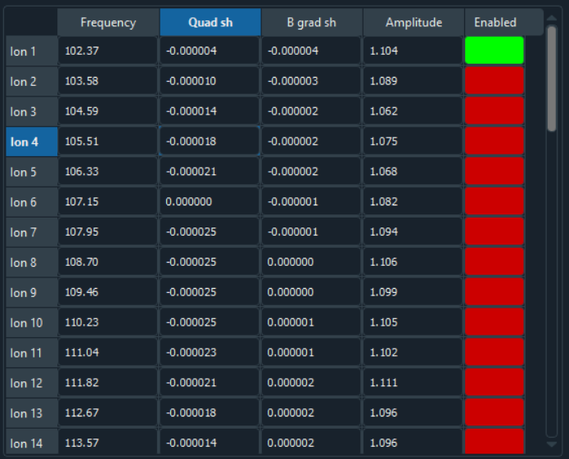
Cycle Error Reconstruction
Notes:
Frequency corrections was faulty for the individual ions
We knew where the error comes from, could check especially for detuning!
Showed utility of CER

Slide 16
Summary and Outlook
Advantages of CER over QPT and RB
Characterization of CNOT including crosstalk (16 qubits)
Showed utility of CER to determine origin of errors
Characterize gadgets:
  7 CNOTs and 14 qubits
  CER: around 6000 different sequences
How do errors scale from 1 CNOT to N-CNOTs?
Notes:
CER
I hope, I could convince you of utility of CER

Slide 17
Towards FT gadget benchmarking
Aim: Benchmark FT gadgets and circuit
A suitable method should:
Not scale (poorly) with the physical gadget size
Provide contextual information including crosstalk
Provide diagnostic utility to identify important error channels
RB
QPT, GST
Little information
All information

Slide 18



Why?
$$|1⟩$$
Quantum Computing
Oscillator influences fidelity P:
$$P=\frac{1}{2}[1+e^{⁡−χ}]$$
$$χ=\frac{1}{π}\sum_{j}{\int_{0}^{∞}{\frac{S_{j}\left(ω\right)}{ω^{2}}F_{j}\left(ω\right) dω}}$$
Spectral density $S_{j}\left(ω\right)$ and filter function $F_{j}(ω)$ for process $j$
LO
$$|0⟩$$
Notes:
Talking

Slide 19
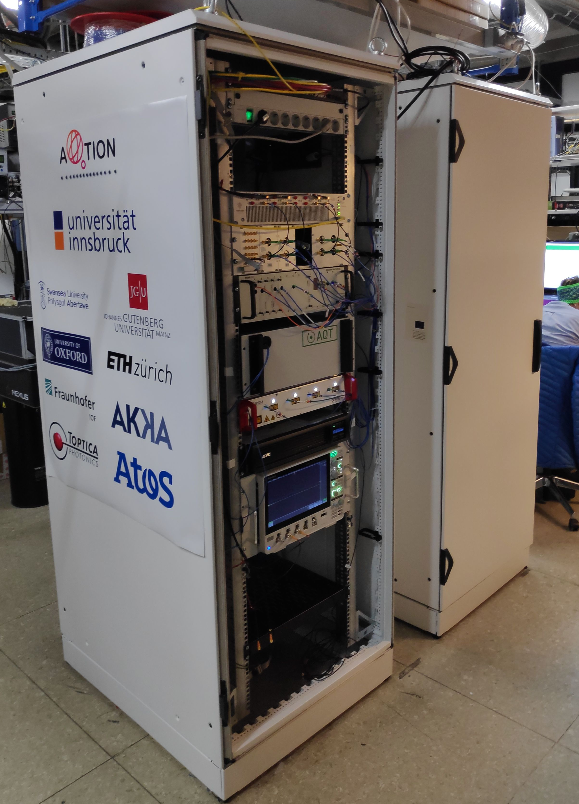
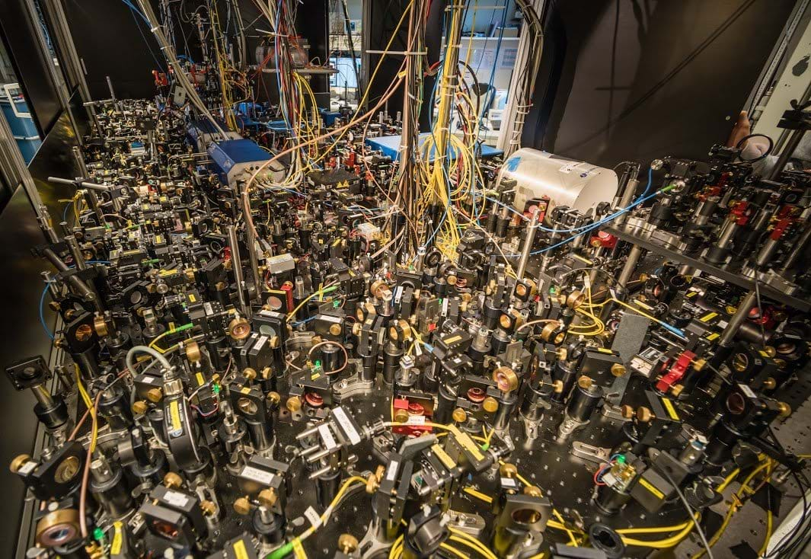
AQTION
Pogorelov, PRX Quantum 2, 020343 (2021)
19
Notes:
Advanced quantum computing with Trapped IONs
Our project is called aqtion. The main idea was to make a transition from the lab environment to smth more industrial.
You can see conventional lab environment on the left and our setup on the right.
We wanted our setup to be more compact, modular, remotely controllable as much as possible. Ideally, in a long-term it should be standing somewhere in a data center and act a QC node without high maintenance requirements.
As you can see the setup sits in 2 19-inch racks. The current setup doesn’t need any special environment, cryo or water cooling. You just need a power plug and a LAN cable to make it work.
Except for these rack integration goals, the focus of this setup is to work with medium-long chains (20-30 ions) and investigate performance limitations there.
I won’t be going to much into details of how the setup works but just give you some overview.
Scalable ion trap quantum computing
Compact setup in standard 19” rack
Based on commercial modules
Automated operation
Hardware independent programming
Scalable trap architectures
Optical links for remote entangling

Slide 20
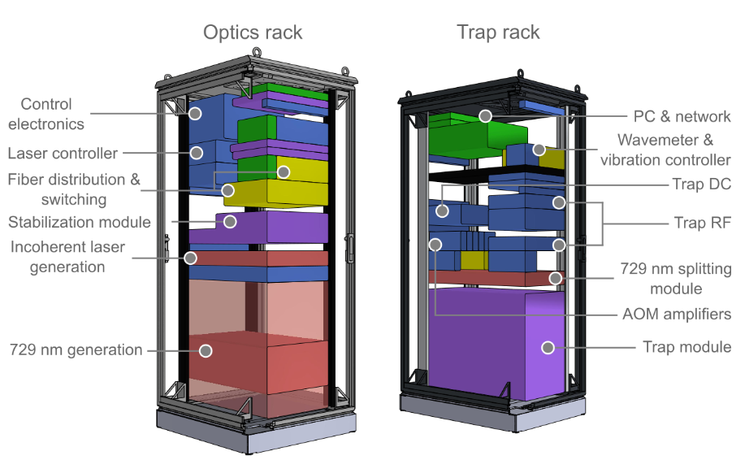
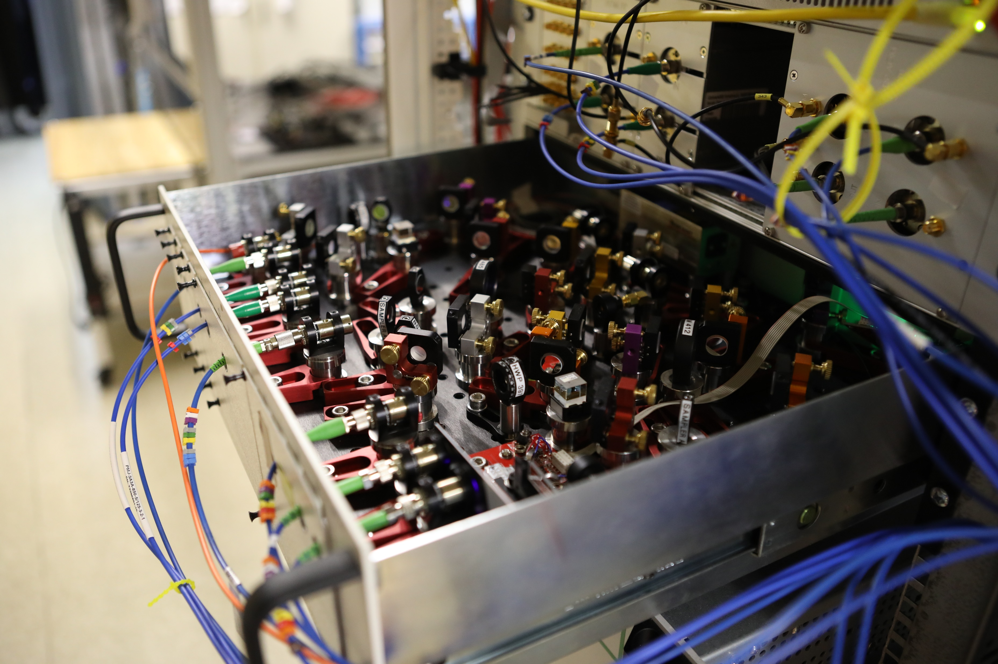
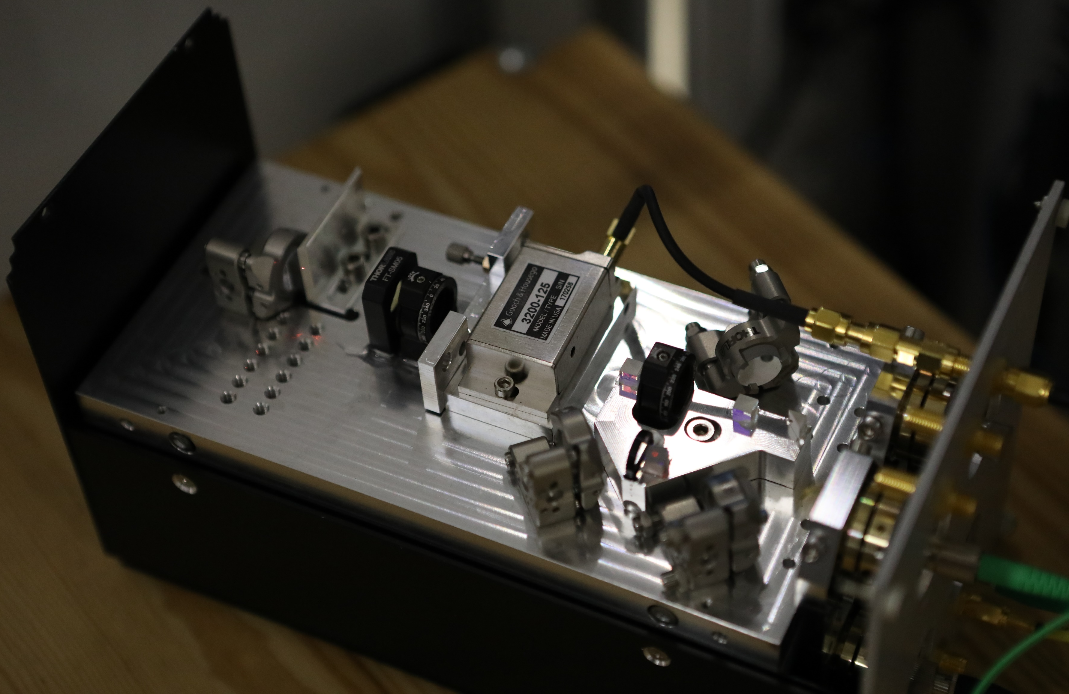
AQTION
Pogorelov, PRX Quantum 2, 020343 (2021)
Notes:
Let’s take a glance inside our racks.
Here you can see an example of compactness, all the optics is small and lives on such a rack-compatible breadboard.
Some optics is packed into modular plug-in units, like in the picture. They can be maintained separately without disturbing the rest of the setup.

Slide 21
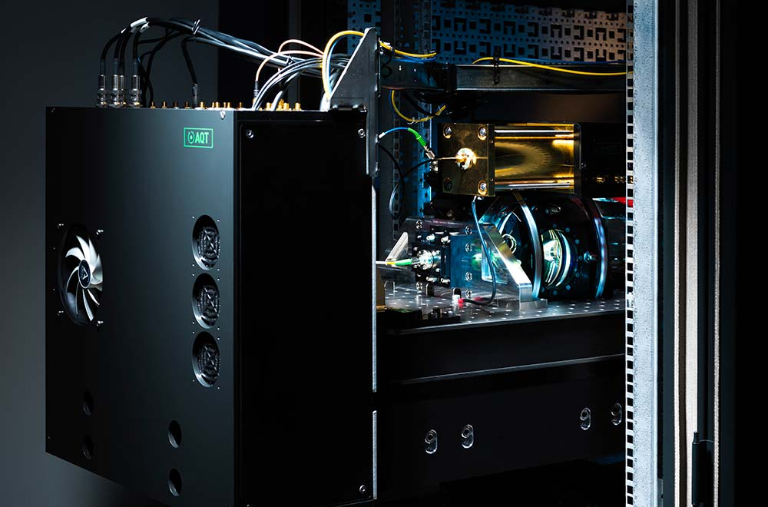
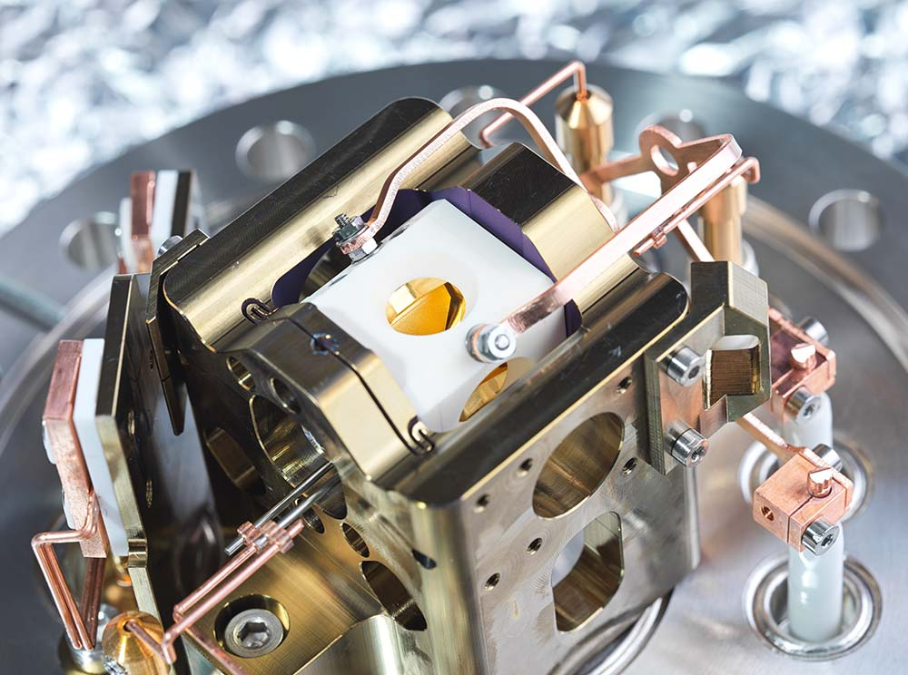
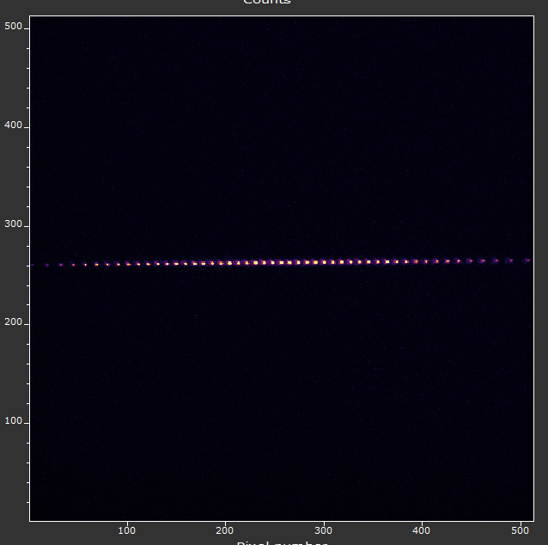
AQTION
Pogorelov, PRX Quantum 2, 020343 (2021)
Notes:
The heart of the system is the trap and it lives here inside this trap drawer inside the vacuum chamber.
This drawer sits on an active vibration isolation platforms instead of an optical table like in conventional setups.
The trap itself is quite small, around cm, you can see it in the picture.
But all the action is happening inside the trap where ions sit.

Slide 22
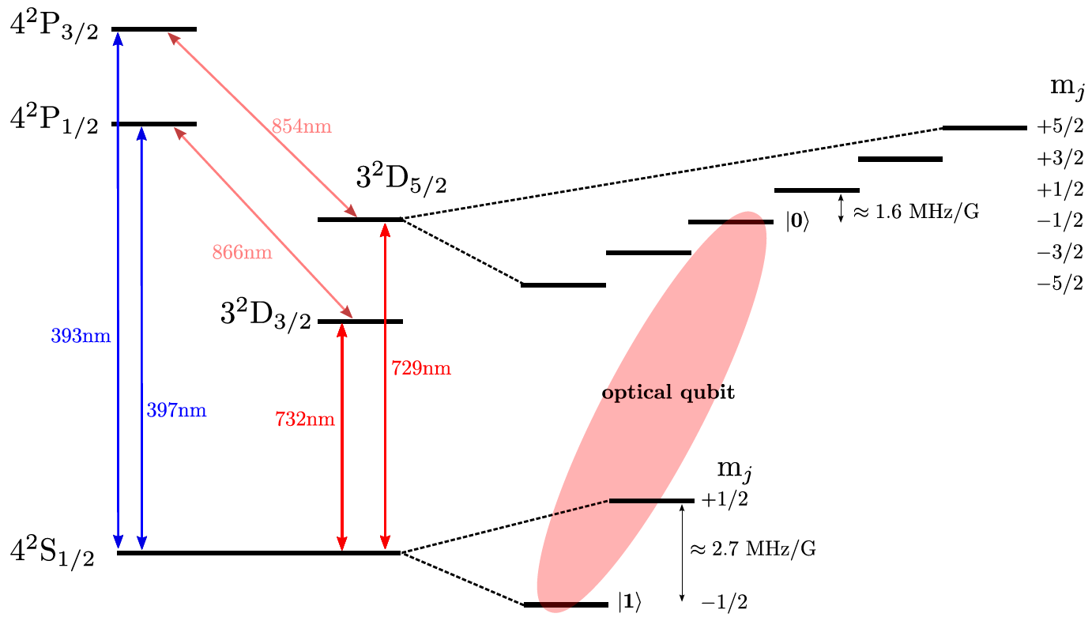
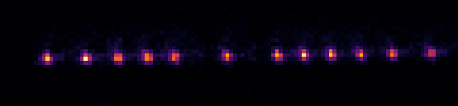
⁴⁰Ca⁺
D. Nigg, PhD thesis (2017)
Qubit types:
Optical
Zeeman
Hyperfine
Notes:
We trap Ca40+ ions and here is electronic levels’ structure.
To control our ions we use lasers.
Our qubit is encoded in long-living D 5/2 level and S ½ ground level, the transition is 729 nm and requires narrow-line laser. Such a qubit type is called optical qubit.
For doppler cooling and detection we use short-living P ½ level. The transition is 397 nm.
When our qubit is in 1 state it appears as bright ion on the camera, while when it is in the 0 state it is not involved in this transition and is dark.

Slide 23
Errors
General quantum operators are written in completely-positive trace-preserving (CPTP) maps:
Uncoherent Errors:
sth
Notes:
100 different sequences for each length are sufficient to reduce the error below 1 %
Improvement:
Specify error of one gate/process
Characterize where the error is coming from

