Slide 1
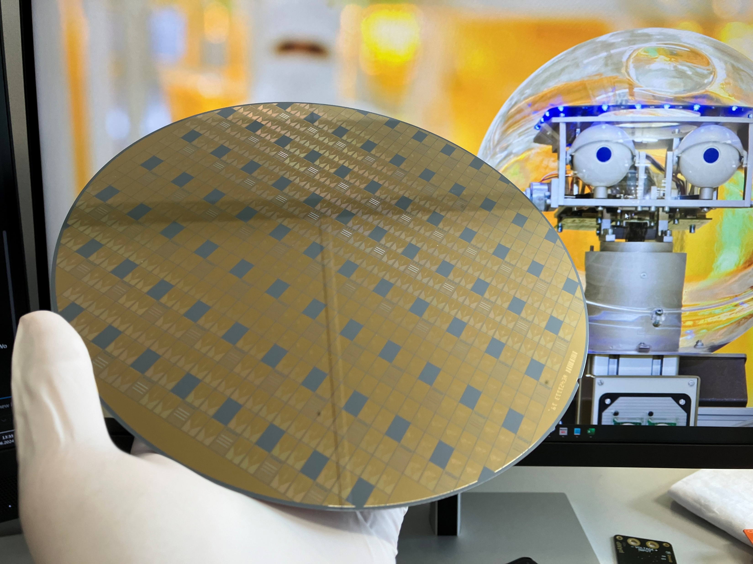

Scaling of Micro-Fabricated Penning Ion Traps
Kilian Hanke
Tobias Sägesser, Silke Auchter, Nina Megier , Matthias Dietl,
Shreyans Jain, Pavel Hrmo, Yingying Cui, Matteo Simoni, Clemens Rössler, Daniel Kienzler, Yves Colombe,
Jonathan Home

Slide 2
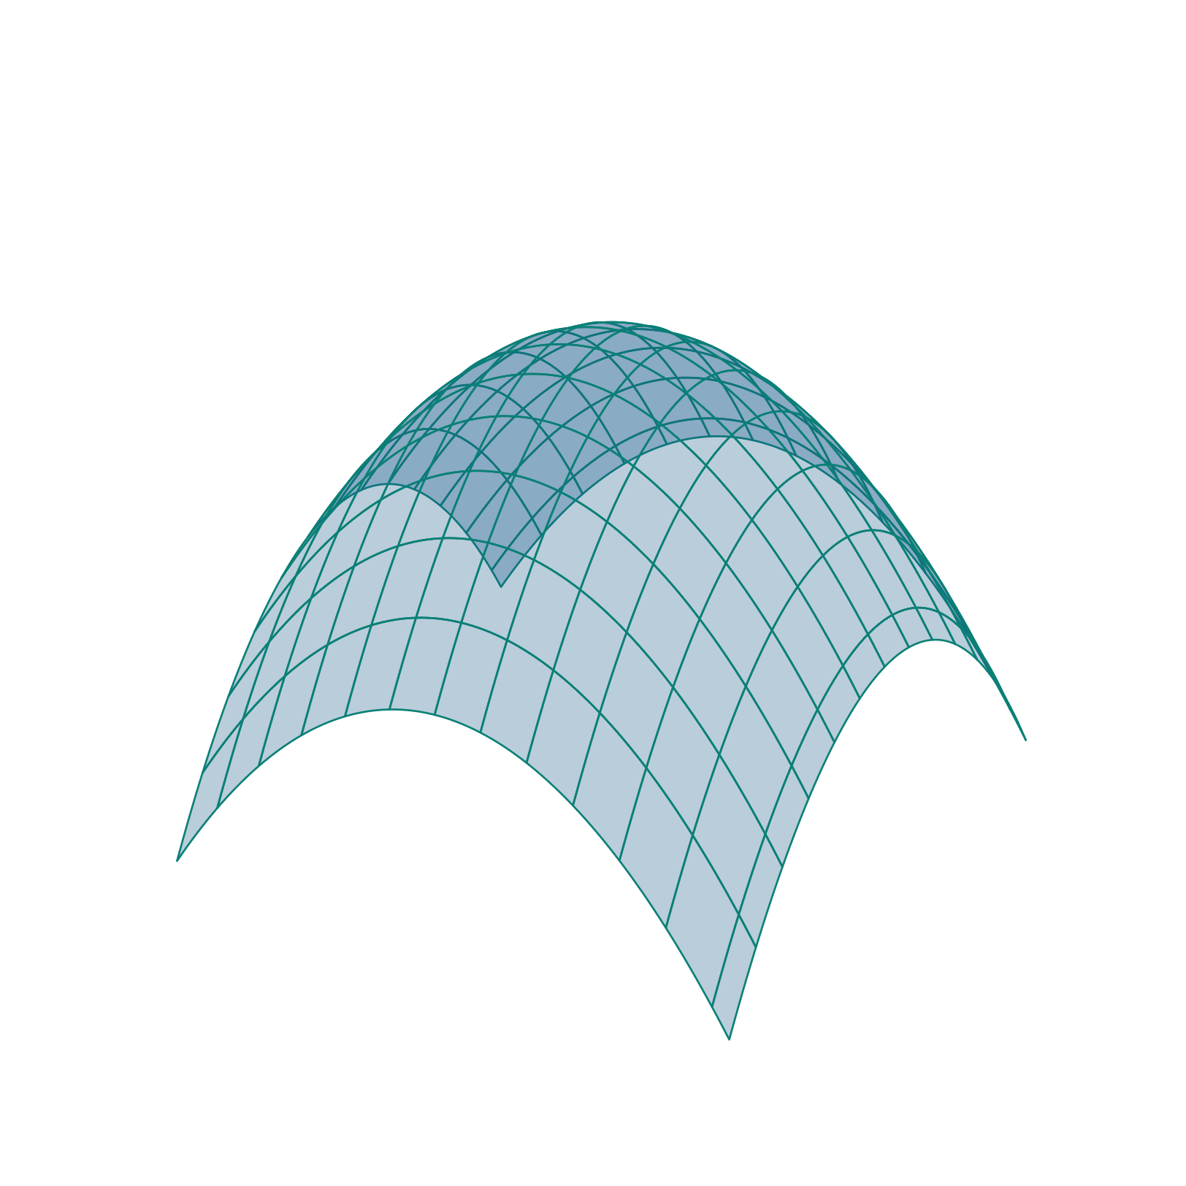
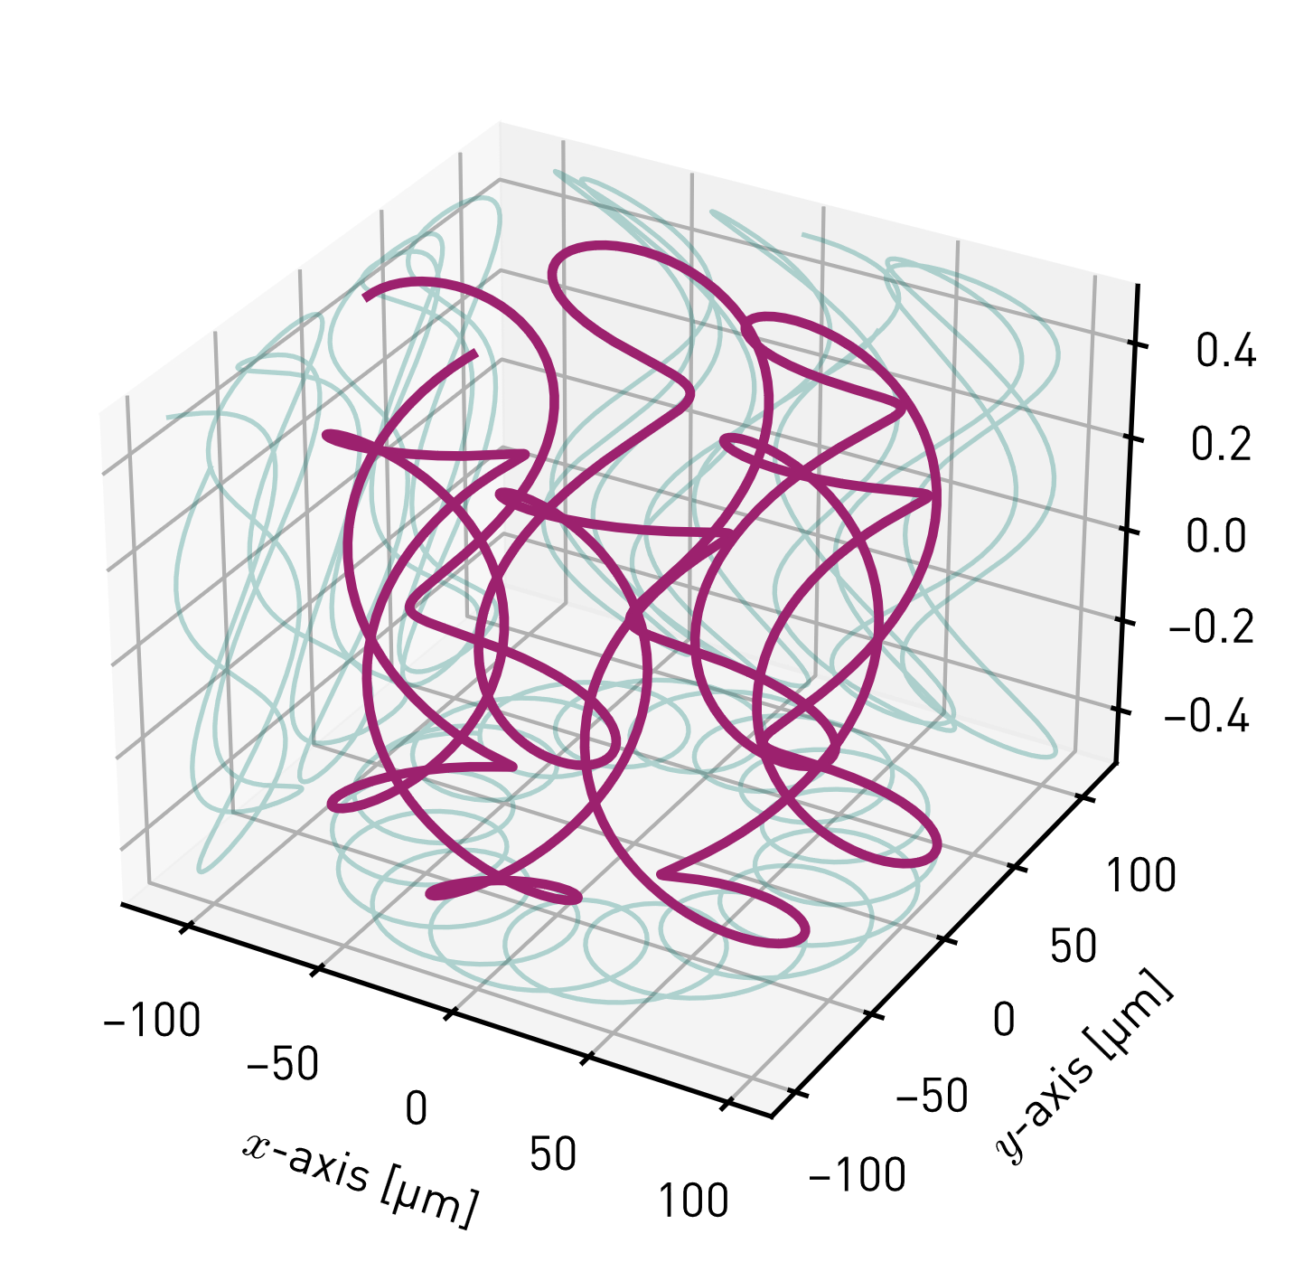








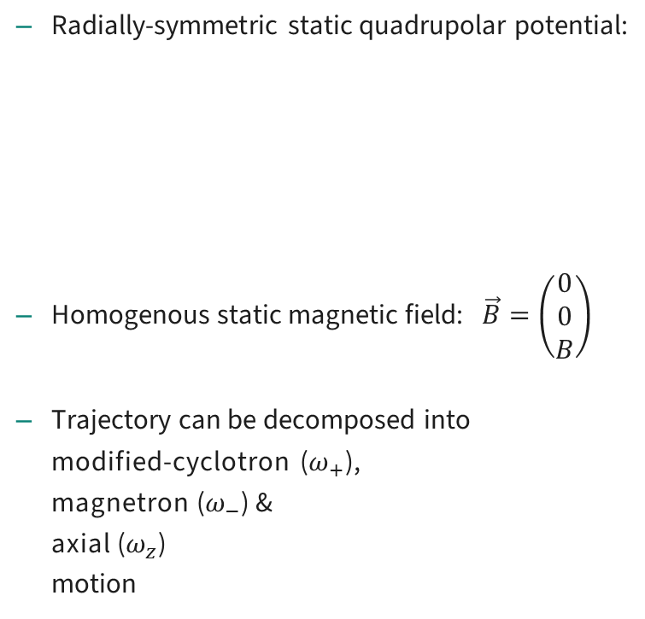






Penning traps – quick review
$$\vec{B}$$
$${Φ(x, y)|}_{z=0}$$
Radially-symmetric static quadrupolar potential:
Homogenous static magnetic field: $\vec{B}=\left(\begin{matrix}0 \\ 0 \\ B\end{matrix}\right)$
Trajectory can be decomposed into
modified-cyclotron ($ω_{+}$),
magnetron ($ω_{−}$) &
axial ($ω_{z}$)
motion
$$Φ=\frac{1}{2}V_{0}\left( z^{2} − \frac{x^{2}+y^{2}}{2} \right)$$
$$y$$
harmonic well
anti-confining potential
$$x$$
$$x$$
$$ω_{+}$$
$$y$$
$$r_{+}$$
$$r_{−}$$
$$z$$
$$ω_{−}$$
$$y$$
$$x$$

Slide 3
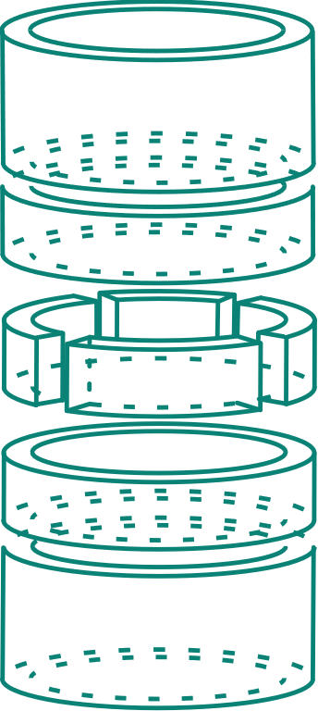
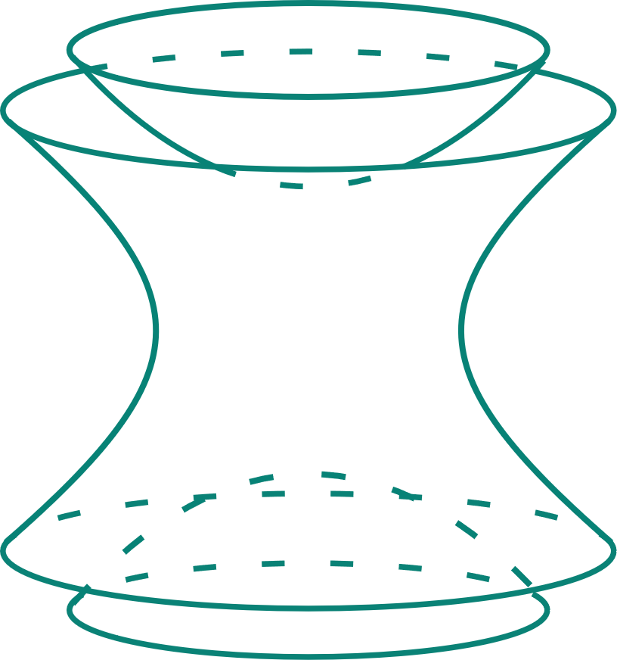
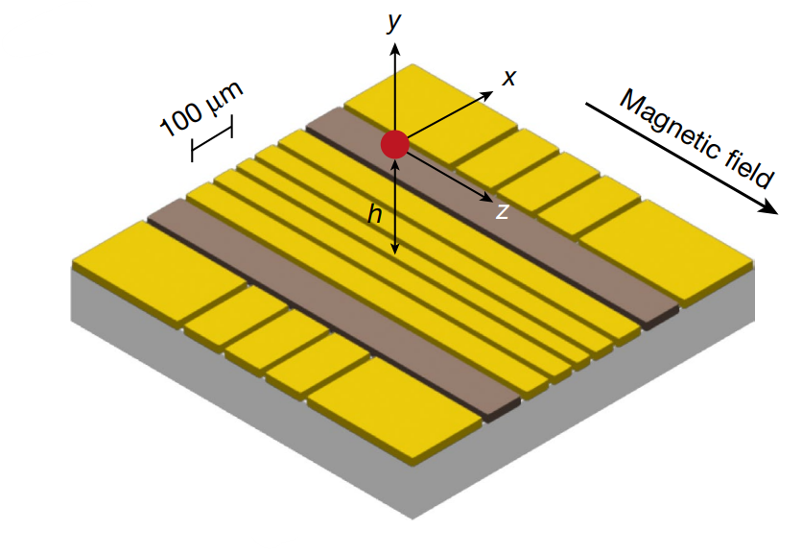












Penning traps – macroscopic to micro-fabricated
$$\vec{B}$$
$$\vec{B}$$
$$y$$
$$x$$
$$z$$
$$\vec{B}$$
$$z$$
$$y$$
adapted from [Jain2024]
$$z$$
$$y$$
$$x$$
$$x$$
Ideal Penning Trap
Simplified Penning Trap
(incl. axialization electrodes)
Planar Penning Trap
(incl. axialization electrodes)
[Hendricks2008] Hendricks et al. (2008) Laser cooling in the Penning trap: an analytical model for cooling rates in the presence of an axializing field
[Stahl2004] S. Stahl et al. (2004). A planar Penning trap. European Phys. Journal D Vol. 32
[Jain2020] S. Jain et al. (2020). Scalable Arrays of Micro-Penning Traps for Quantum Computing and Simulation. Phys. Rev. X 10, 031027

Slide 4
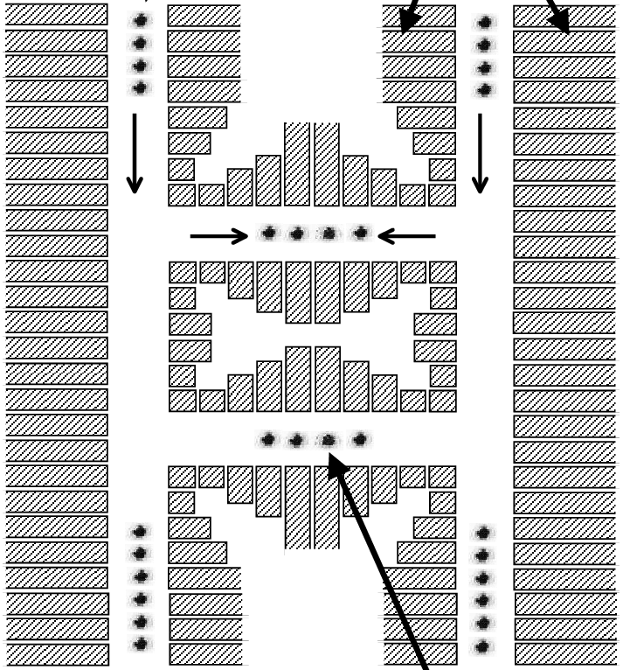
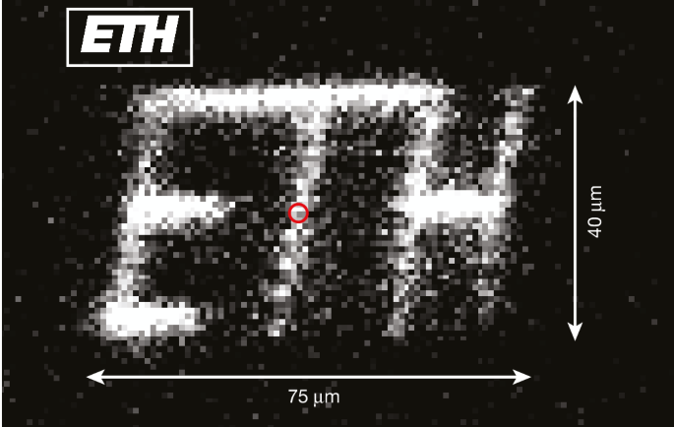
Why Penning traps might be a good alternative.
Full 3D transport
No more high power RF
Not restricted to RF nulls i.e., grid of RF nulls
No need for junctions
  Saves chip area
  No engineering of complicated geometry
RF voltages on the order of 1 V instead of 100 V
Reduced dissipation on chip
→ potentially lower heating rate
Usage of silicon substrate more feasible
→ easier to handle in industrial CMOS fab
No need for resonator circuit
Paul-trap: QCCD
Penning: full 2D transport
RF loss
Substrate
[Kielpinski2002]
[Jain2024]
[Kielpinski 2002] Kielpinski D, Monroe C, Wineland DJ. Architecture for a large-scale ion-trap quantum computer. Nature. 2002. doi: 10.1038/nature0078

Slide 5
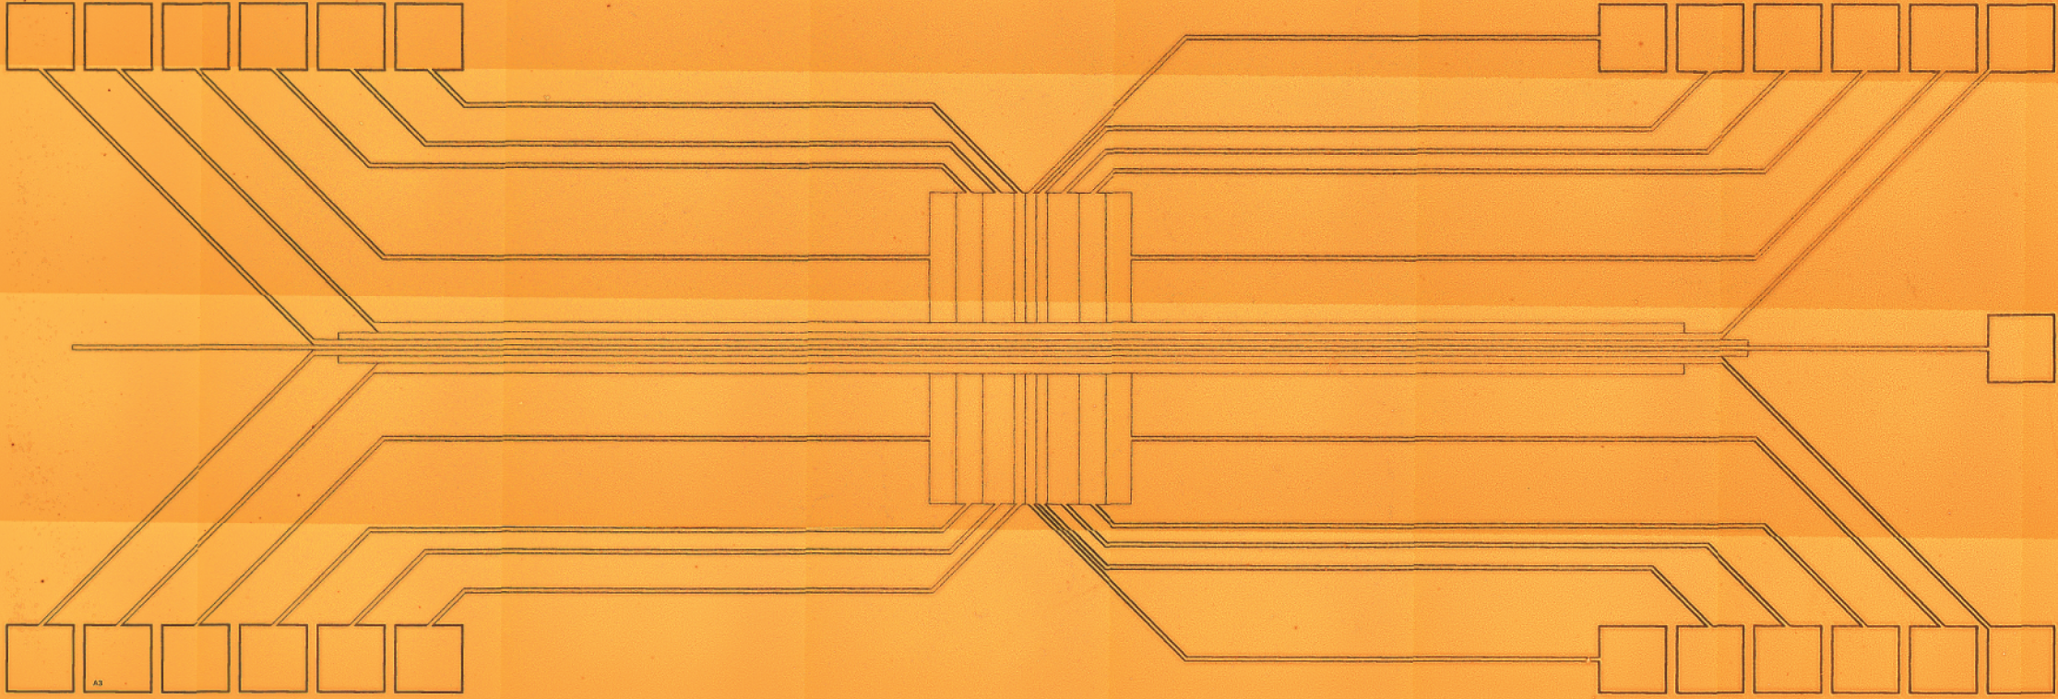

Penning Trap Experiment, TIQI, ETH
[Jain2024]
First surface-electrode Penning ion trap:
  Fabricated by PTB
  Single layer
  12 µm gold metallization
  Sapphire substrate
  25 electrodes
3 T magnetic field
Single ⁹Be⁺ ion
First micro-fabricated Penning ion trap. Fabricated by Amado Bautista-Salvador at PTB.

Slide 6
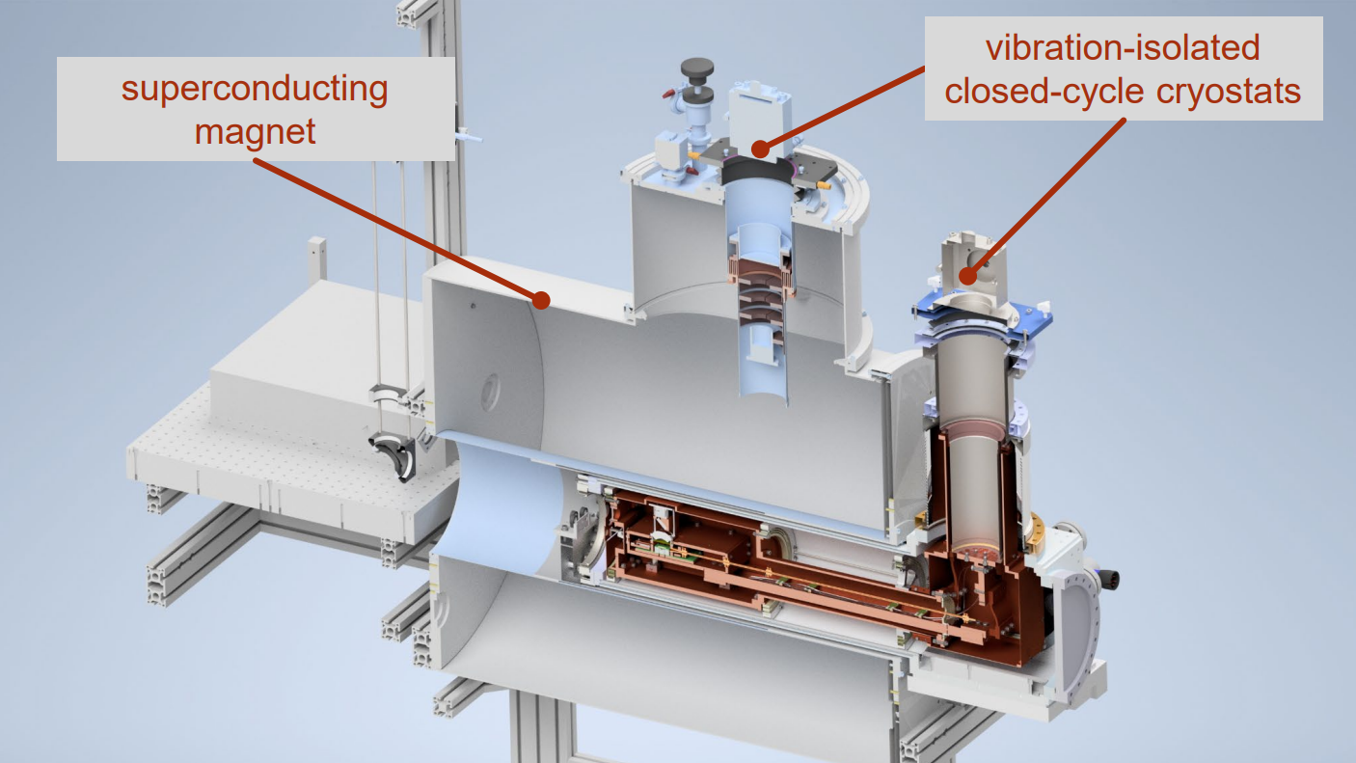
optical access
Courtesy of Tobias Sägesser
50 cm

Slide 7
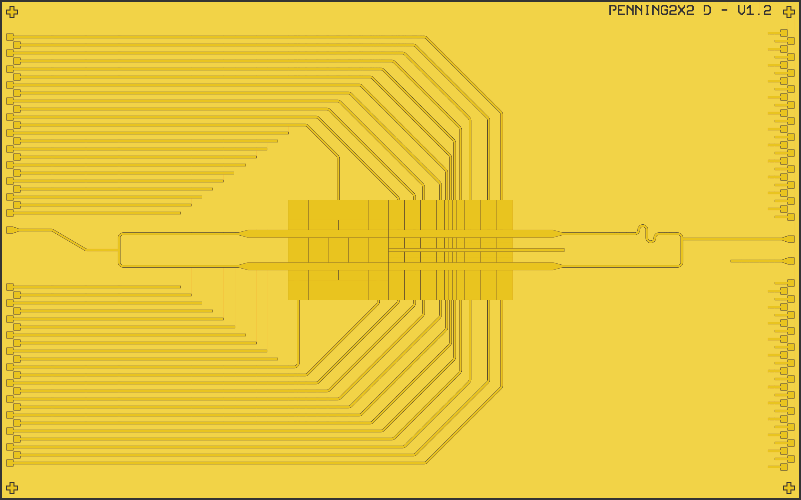
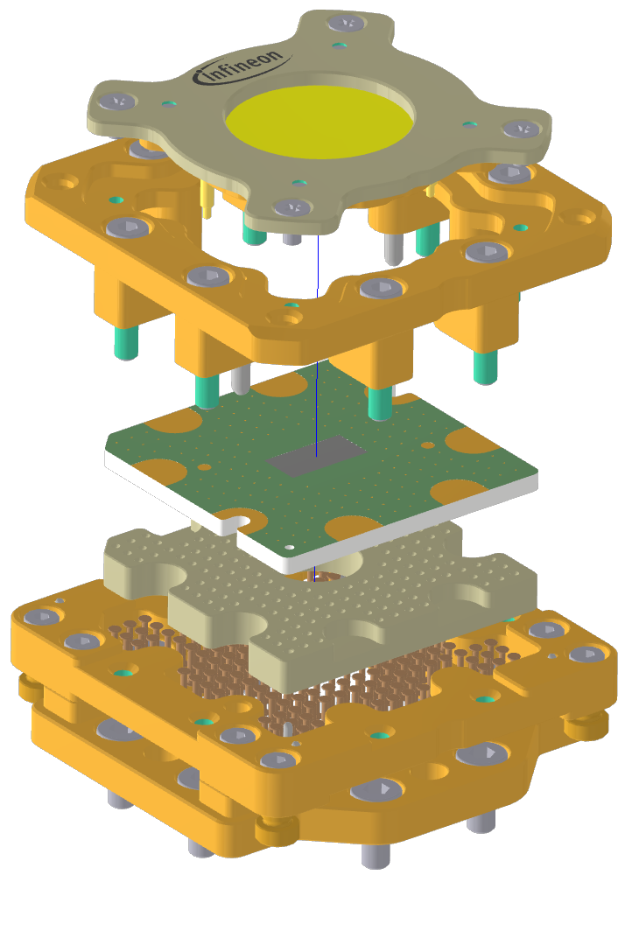
Next generation of the Penning ion trap
8 mm
2.25 mm
5 mm
1 mm

Slide 8
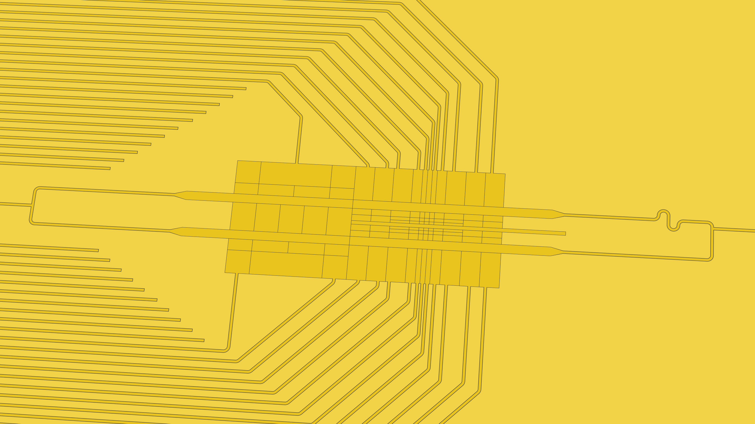

Slide 9
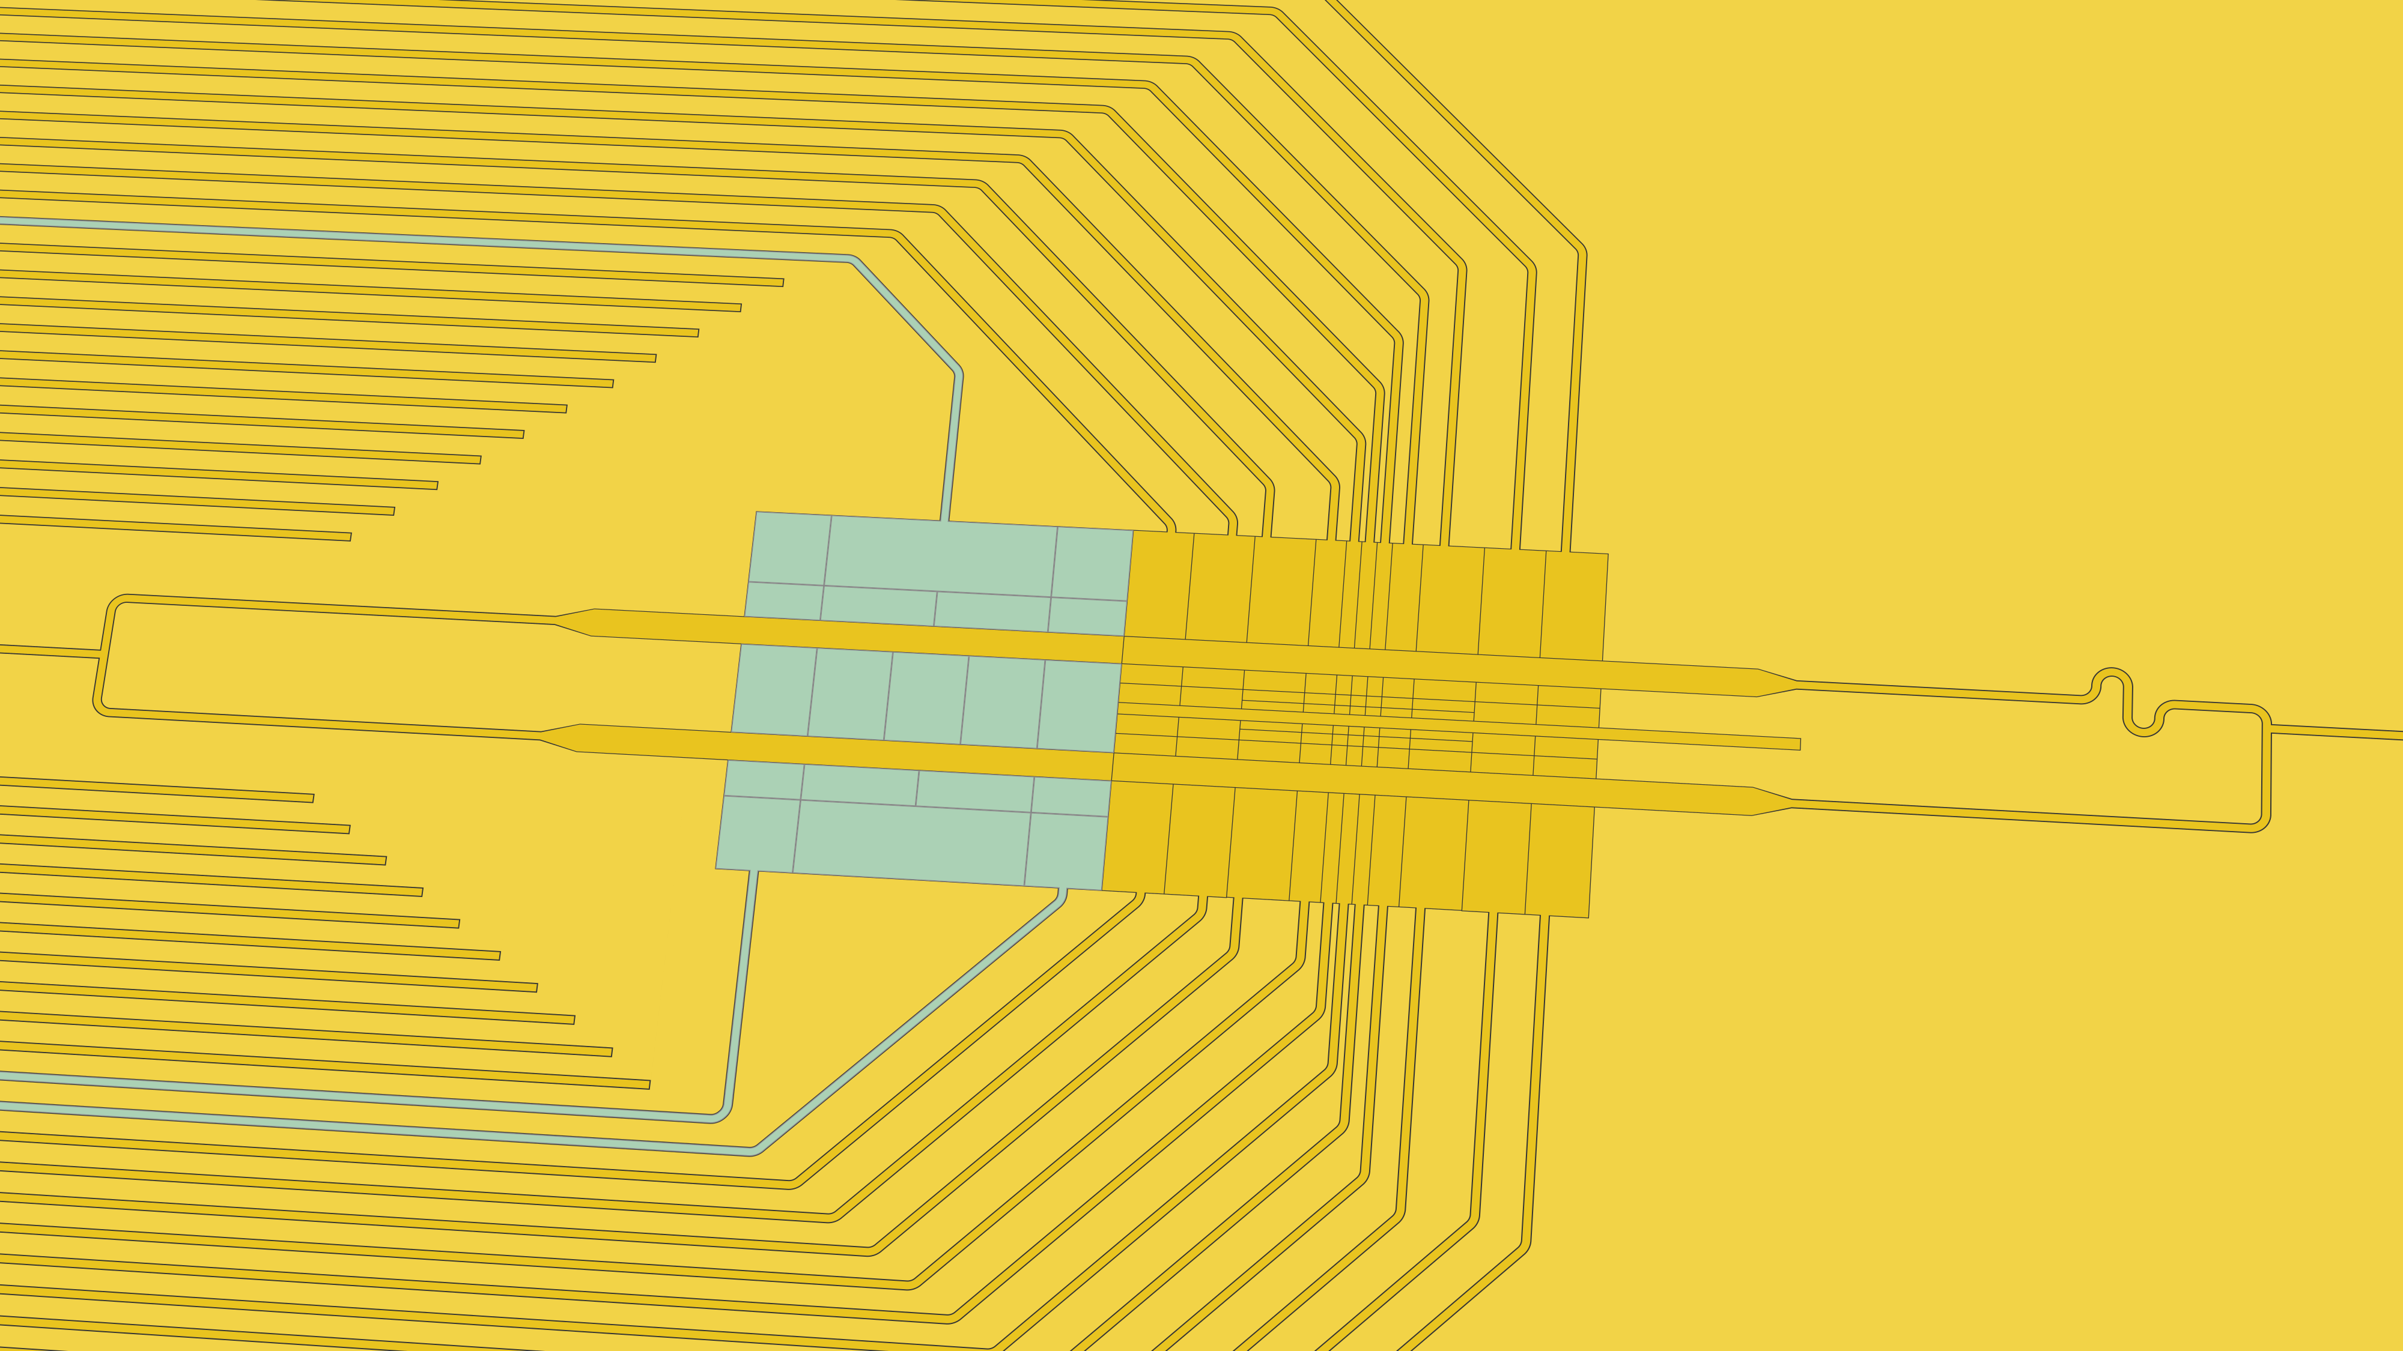
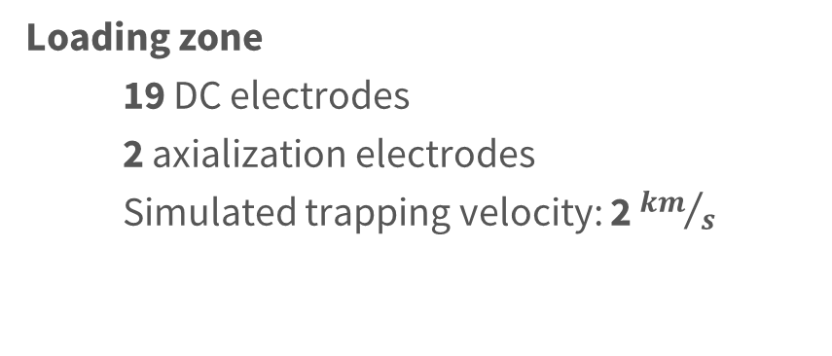
Loading zone
  19 DC electrodes
  2 axialization electrodes
  Simulated trapping velocity: 2 ${km}/s$

Slide 10
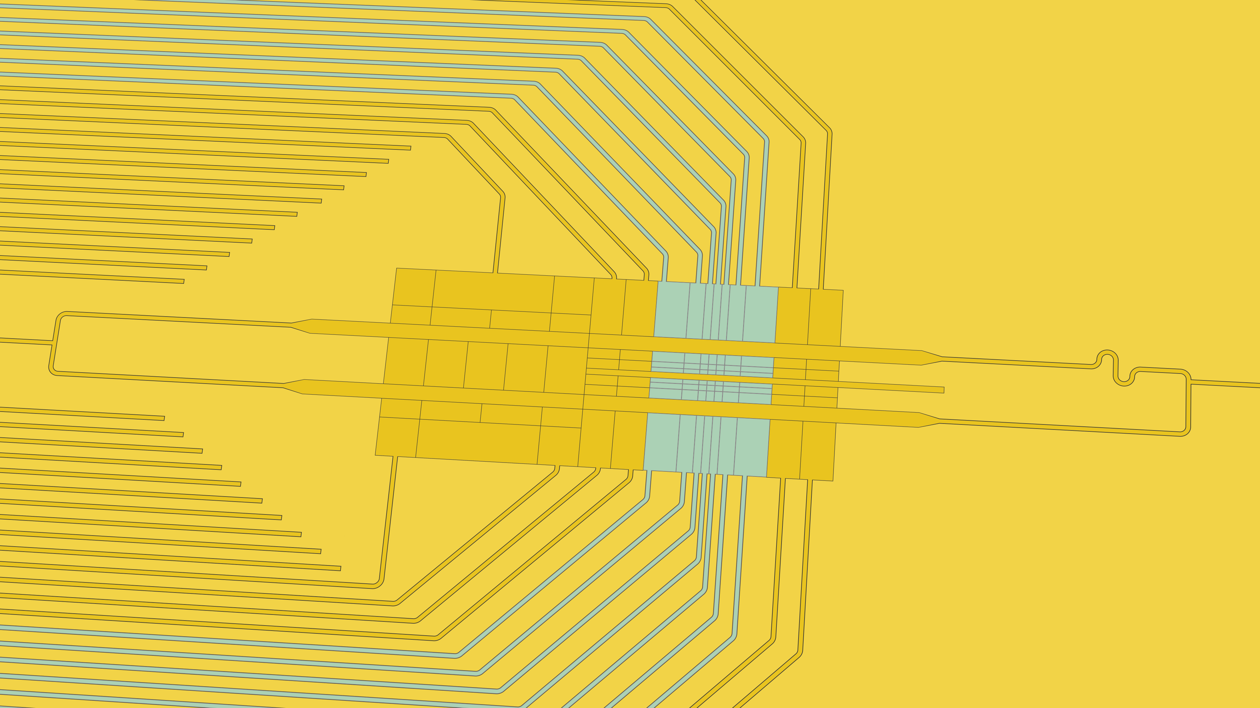
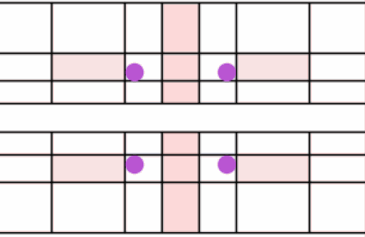
Working zone
  Goal: trap 2x2 grid of ⁹Be⁺ ions
  56 DC electrodes
  min. 25 µm x 40 µm in size
  3 axialization electrodes
Courtesy of Tobias Sägesser

Slide 11
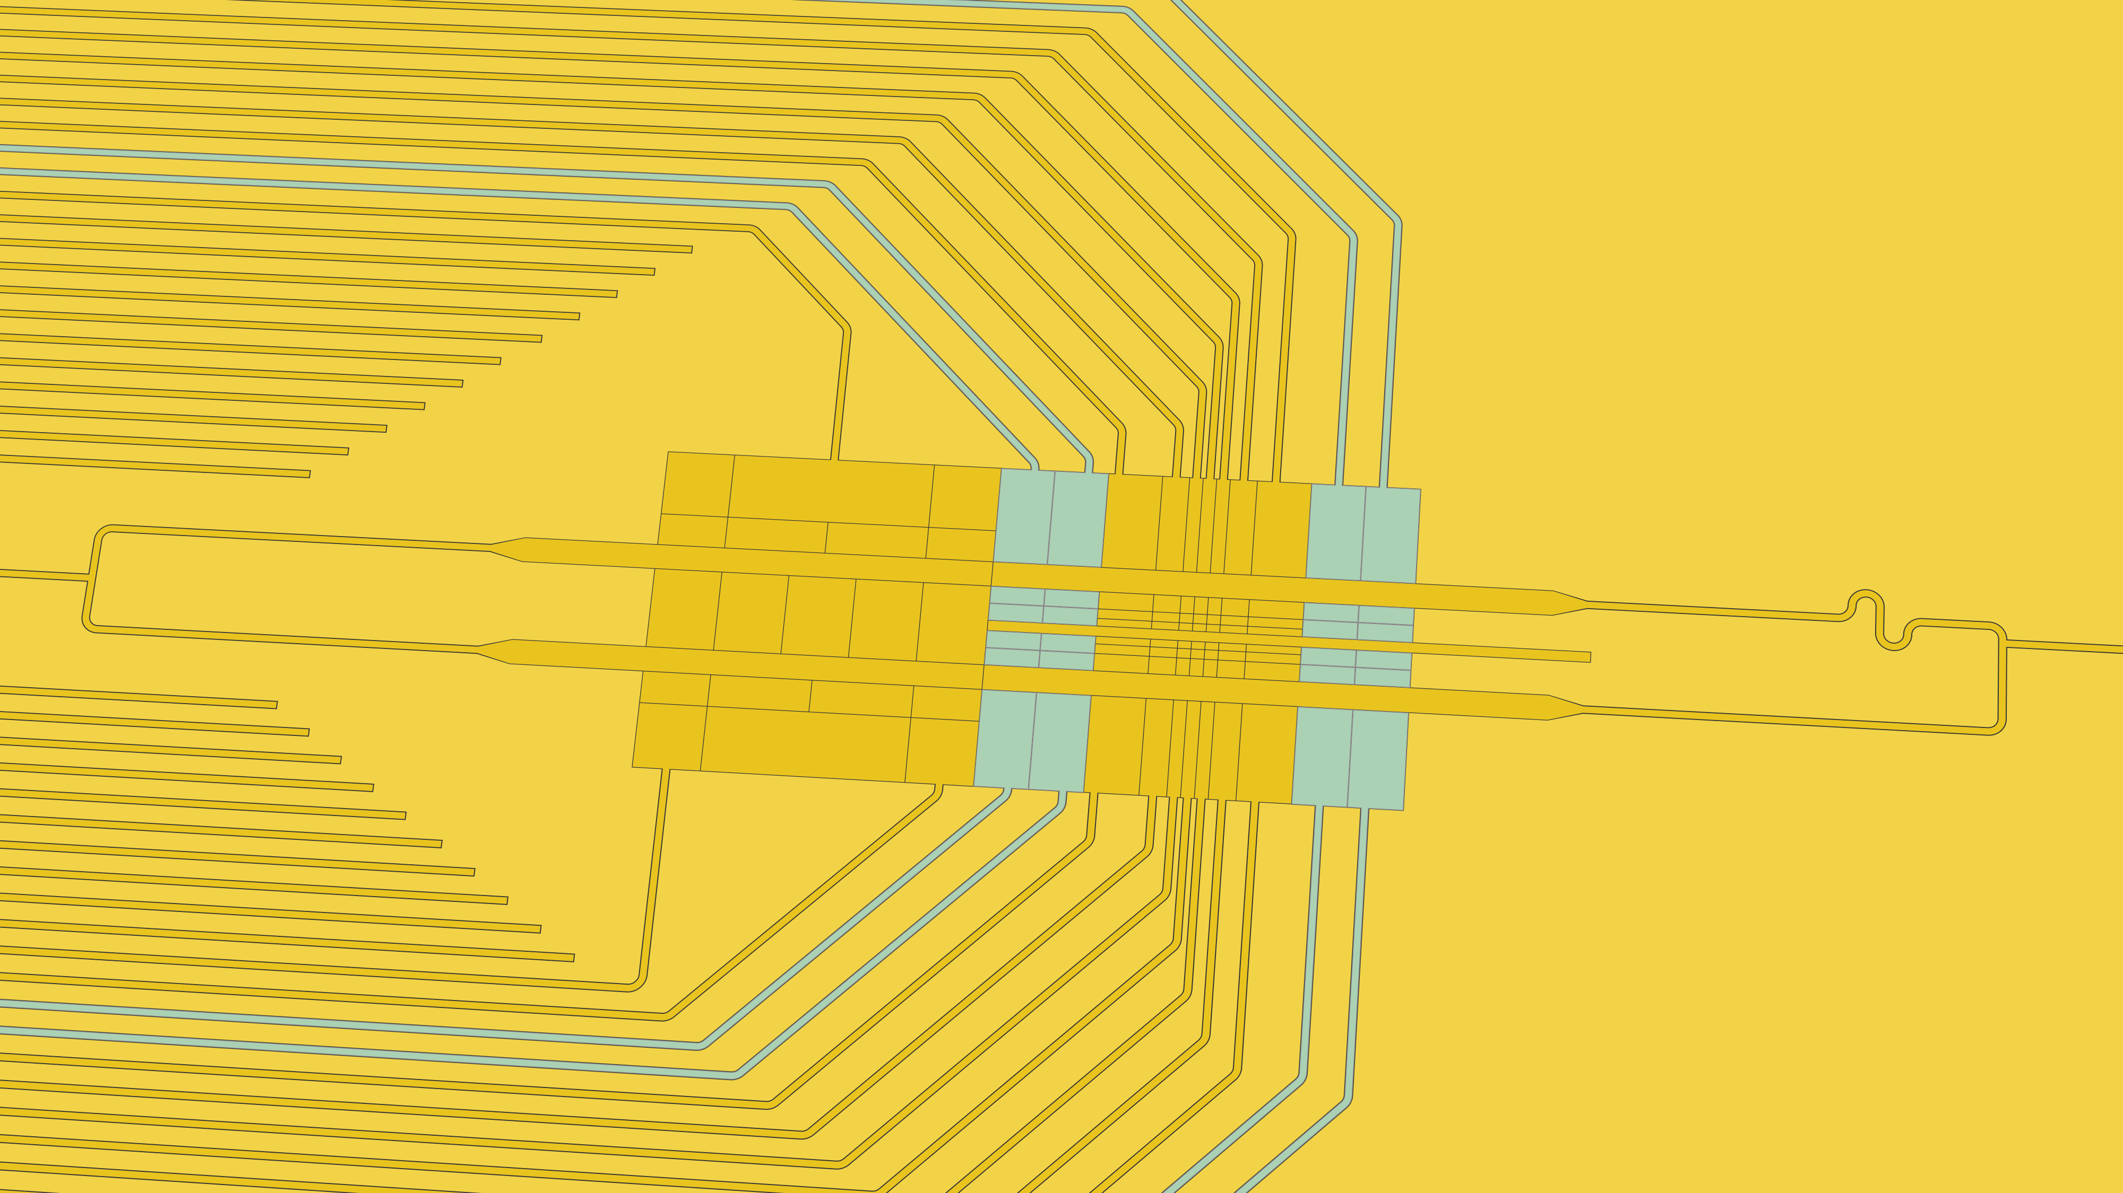
Intermediate zone
  24 DC electrodes
  Transport: loading → working zone
  & stray-field compensation

Slide 13
Layer stack
MC
Substrate: silicon
Metallization: aluminum
  3 structured metal layers
  1 shielding layer
Planarized dielectric layers
Tungsten plugged vias (tbd.)
Si
SiOx
Al
W

Slide 14
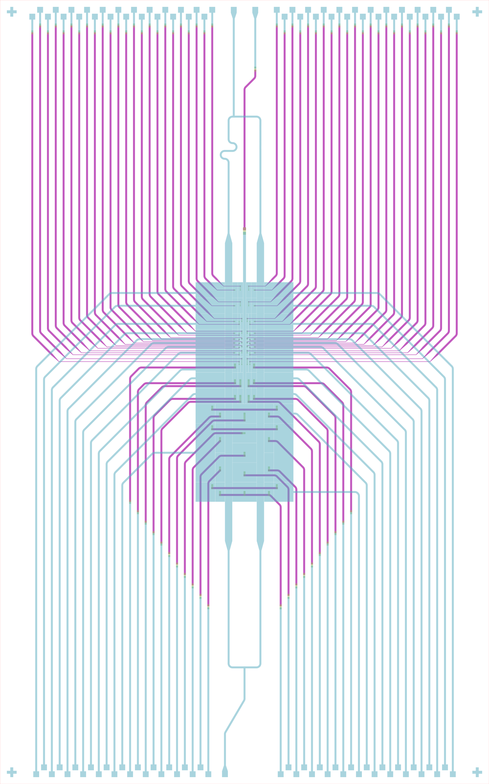
Steps towards scalable ion trap design software
Number of electrodes increases rapidly:
  2020 (PTB): 25 electrodes
  2024: 104 electrodes
  202x: ~1000 electrodes?

Slide 15
Steps towards scalable ion trap design software
Issue: manual routing becomes unfeasible
Solution: programmatic chip layout
Foundation: KQCircuits [Heinsoo2023]
  Python package for superconducting circuit design
  Extends KLayout
  Developed by IQM
We added features for ion trap design
  Multi-layer routing incl. vias
  Electrode structures
[Heinsoo2023] J. Heinsoo et al. (2023). KQCircuits. 10.5281/ZENODO.4944796

Slide 16
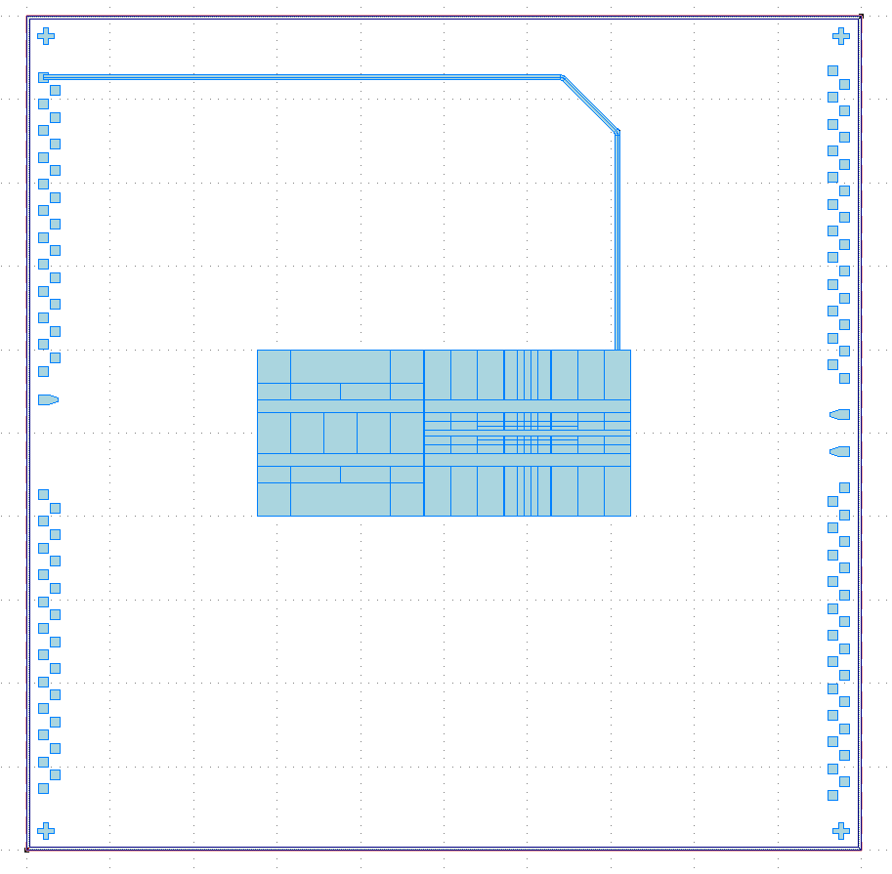
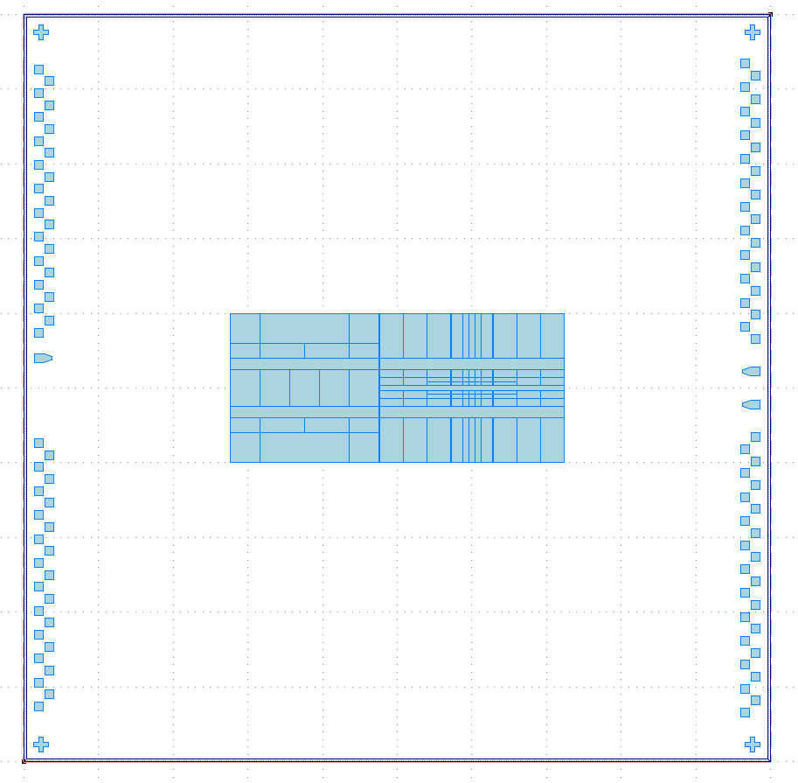
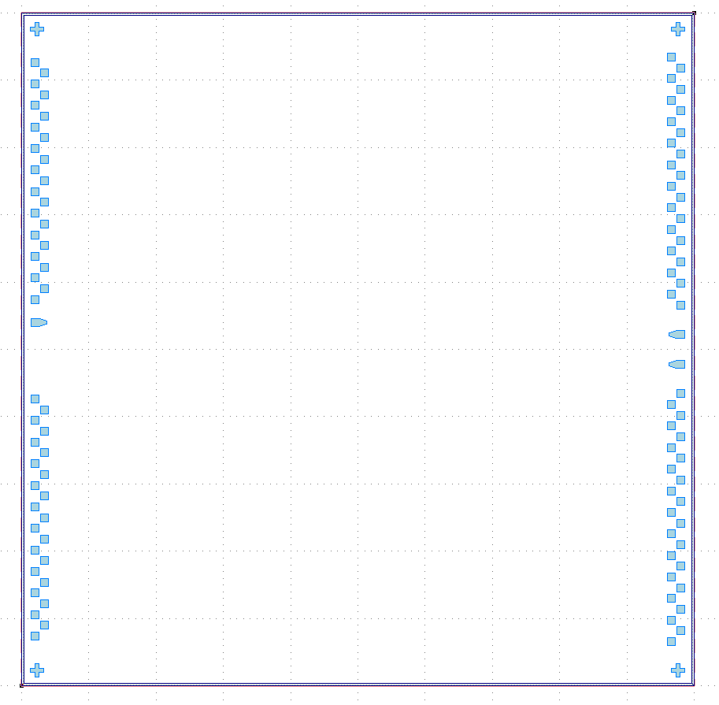
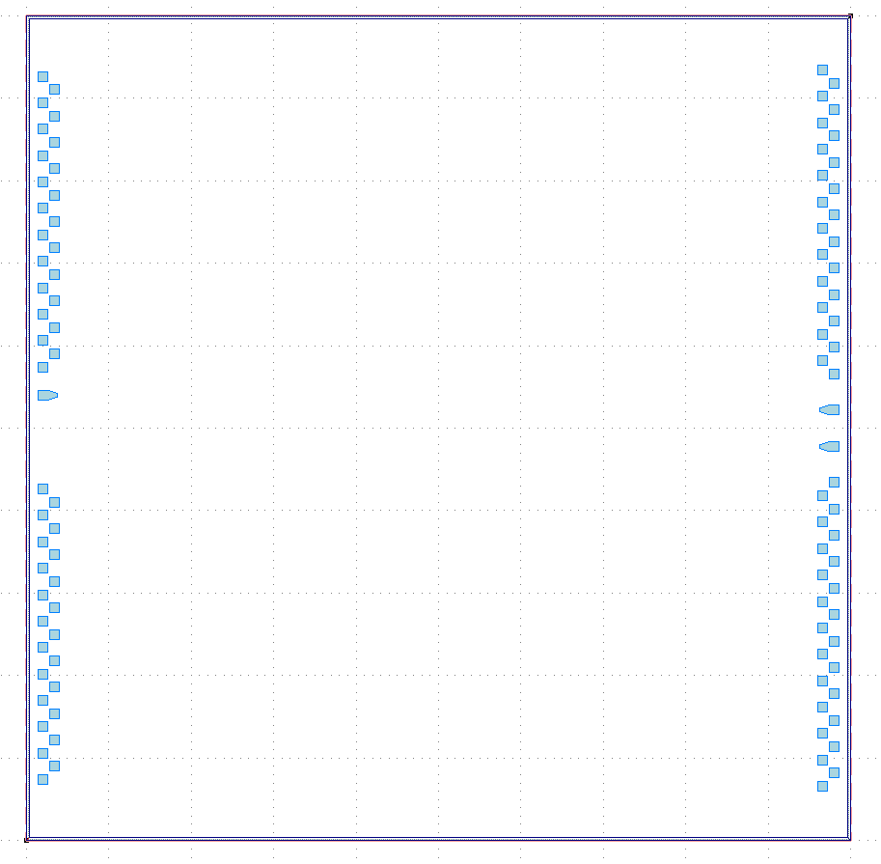

Steps towards scalable ion trap design software
Issue: manual routing becomes unfeasible
Solution: programmatic chip layout
Foundation: KQCircuits [Heinsoo2023]
  Python package for superconducting circuit design
  Extends KLayout
  Developed by IQM
We added features for ion trap design
  Multi-layer routing incl. vias
  Electrode structures
45°
[Heinsoo2023] J. Heinsoo et al. (2023). KQCircuits. 10.5281/ZENODO.4944796

Slide 17
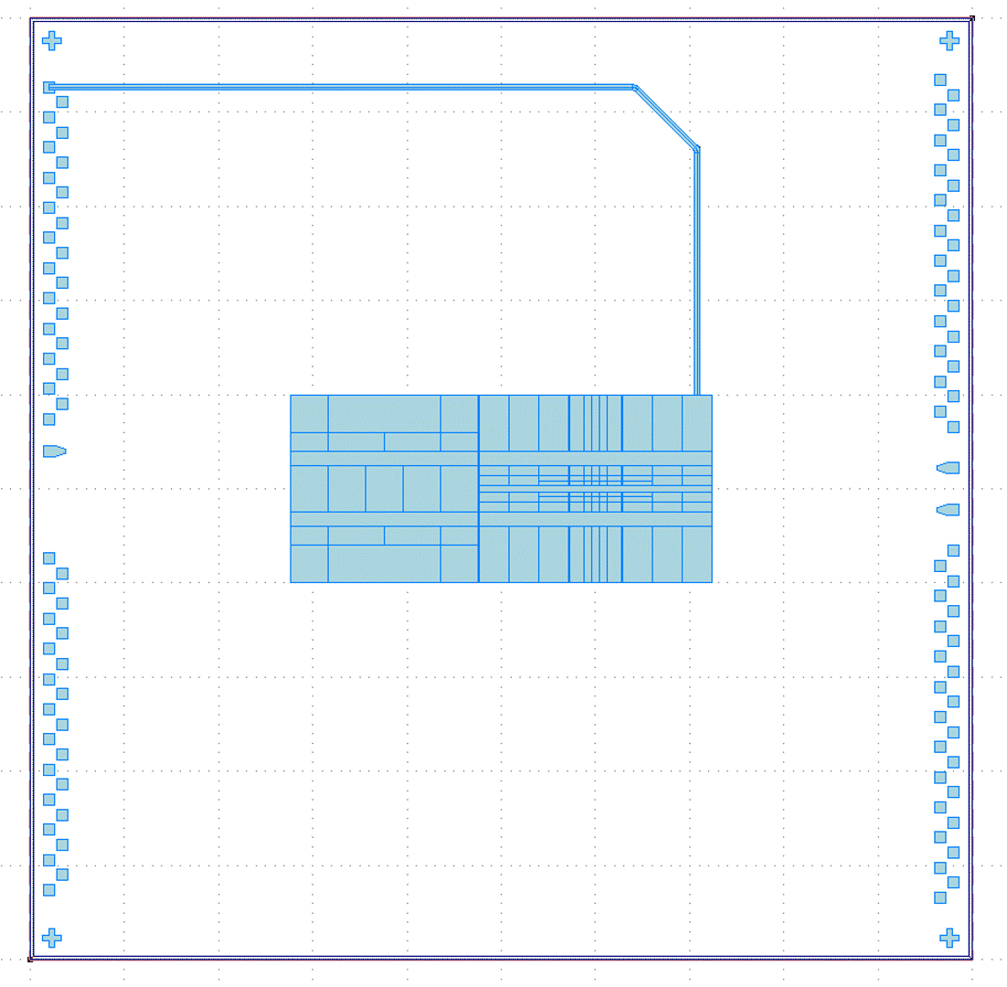
Steps towards scalable ion trap design software
Issue: manual routing becomes unfeasible
Solution: programmatic chip layout
Foundation: KQCircuits [Heinsoo2023]
  Python package for superconducting circuit design
  Extends KLayout
  Developed by IQM
We added features for ion trap design
  Multi-layer routing incl. vias
  Electrode structures
[Heinsoo2023] J. Heinsoo et al. (2023). KQCircuits. 10.5281/ZENODO.4944796

Slide 18
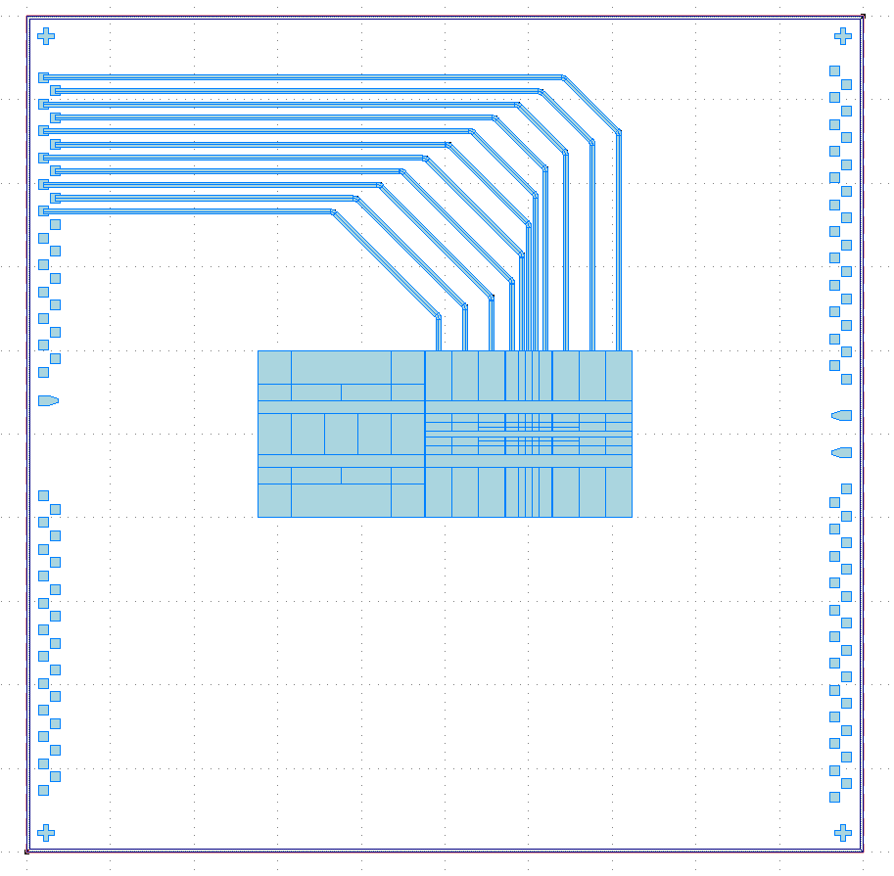
Steps towards scalable ion trap design software
Issue: manual routing becomes unfeasible
Solution: programmatic chip layout
Foundation: KQCircuits [Heinsoo2023]
  Python package for superconducting circuit design
  Extends KLayout
  Developed by IQM
We added features for ion trap design
  Multi-layer routing incl. vias
  Electrode structures
[Heinsoo2023] J. Heinsoo et al. (2023). KQCircuits. 10.5281/ZENODO.4944796

Slide 19

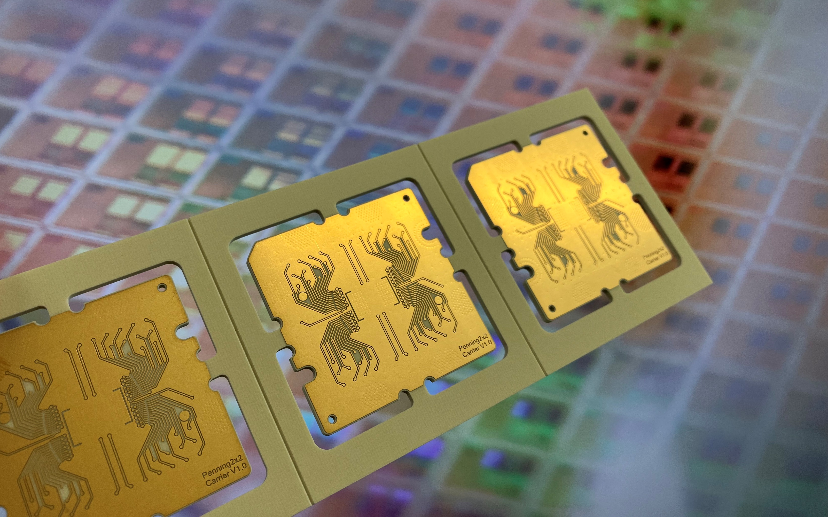

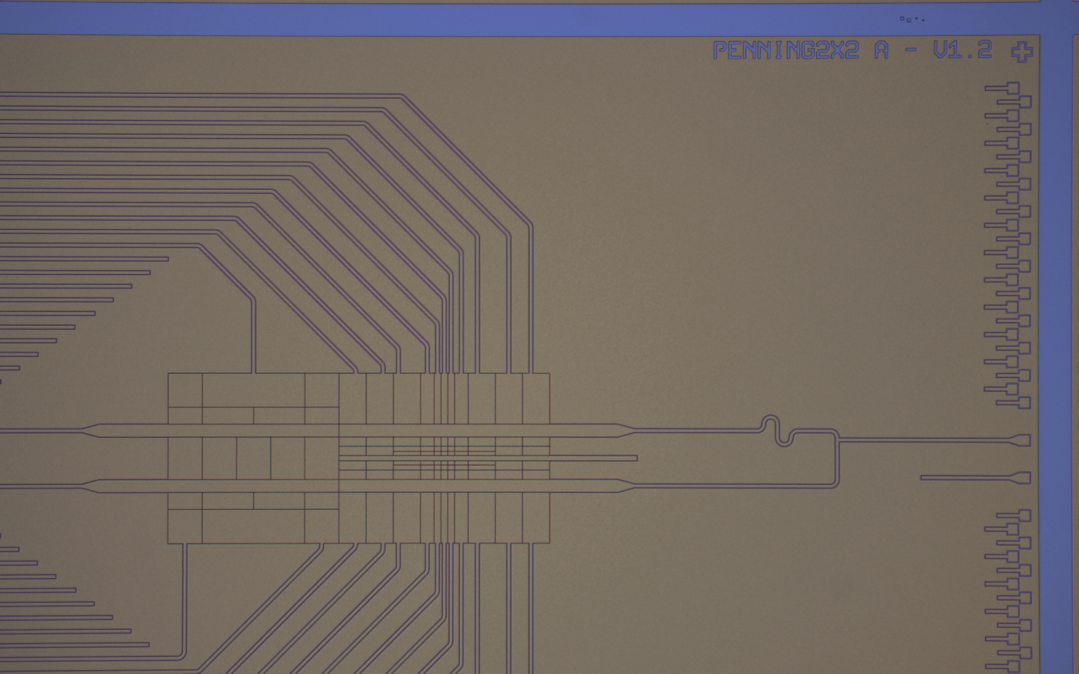
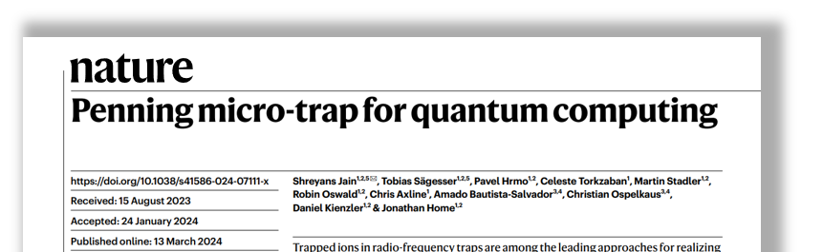

Summary & Outlook
Micro-fabricated Penning traps provide promising alternative to Paul traps
  Full 3D transport capabilities
  No high-power RF
Next trap is currently in fabrication at Infineon Villach
  2x2 grid of ⁹Be⁺ ions
  Silicon substrate on multi-layer stack
Routing of high electrode numbers requires algorithm based routing
Outlook: Installation of new trap until end of 2024
For more details: Check out the paper & feel free to reach out.
Chip carrier PCB
Prerunner wafer
Prerunner chip

Slide 20



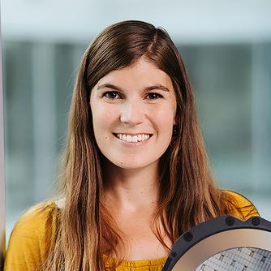









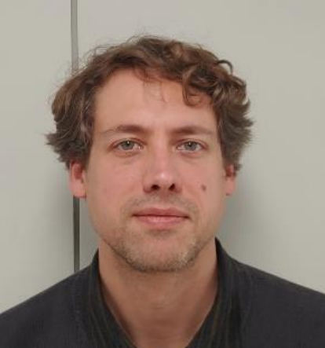
Thanks to the whole team!
Tobias Sägesser
Shreyans Jain
Nina Megier
Silke Auchter
Matthias Dietl
Pavel Hmro
Matteo Simoni
Yingying Cui
Yves Colombe
Clemens Rössler
Prof. Jonathan Home
Daniel Kienzler

Slide 21
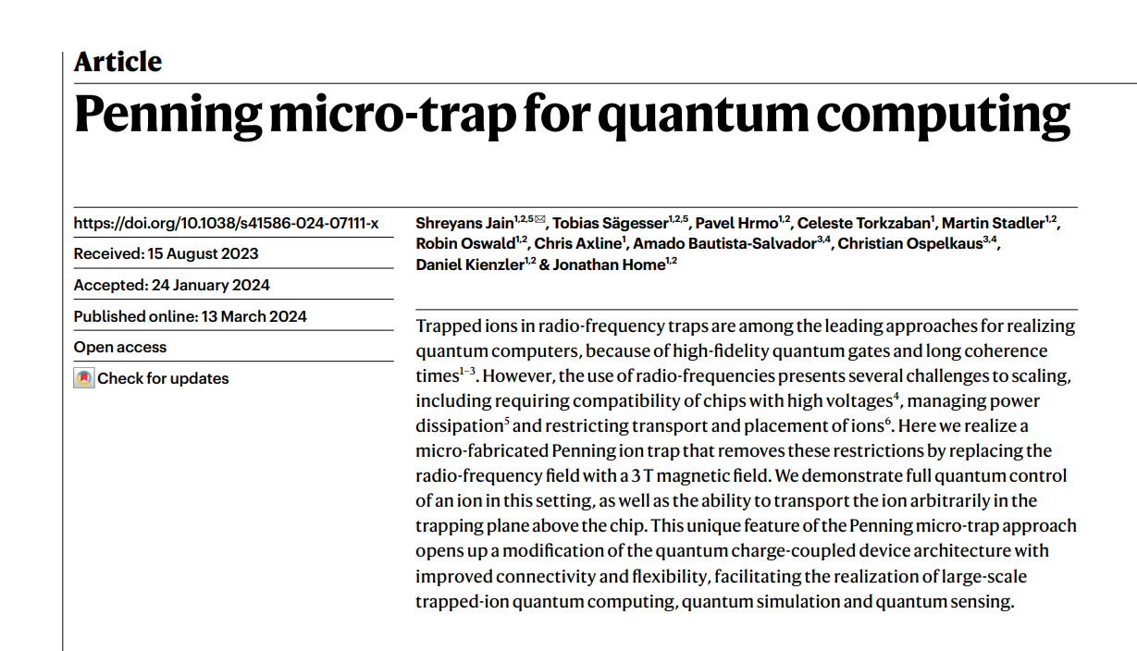


For more details:
Check out the paper & feel free to reach out e.g.,
kilian.hanke@infineon.com

Slide 22
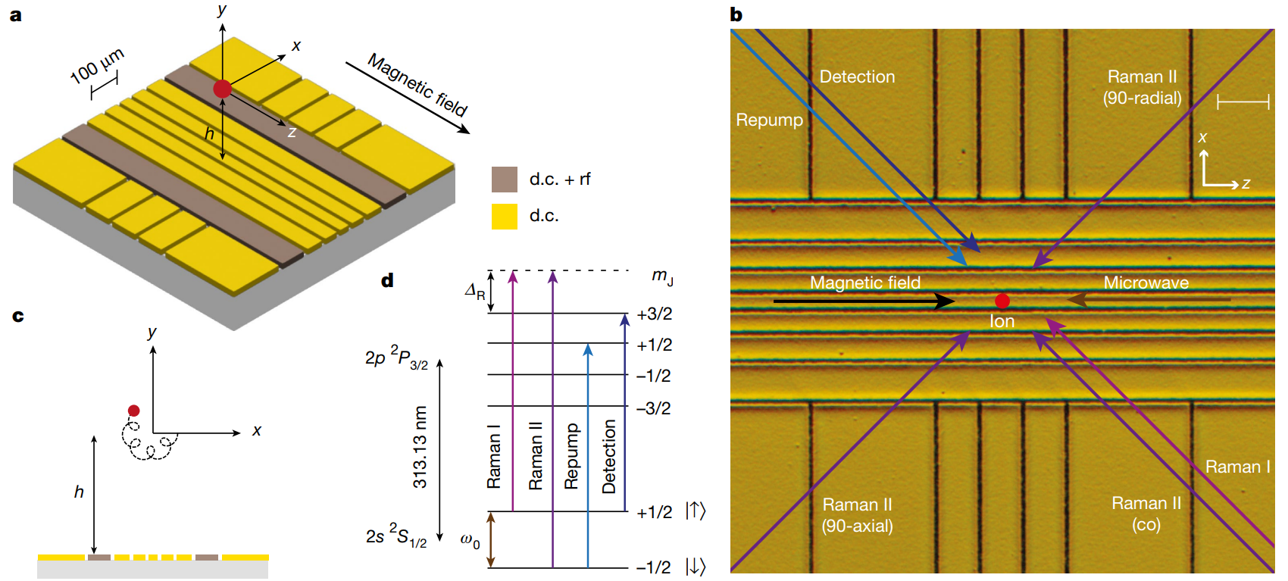
Raman beams are used to address the different transitions.

Slide 23
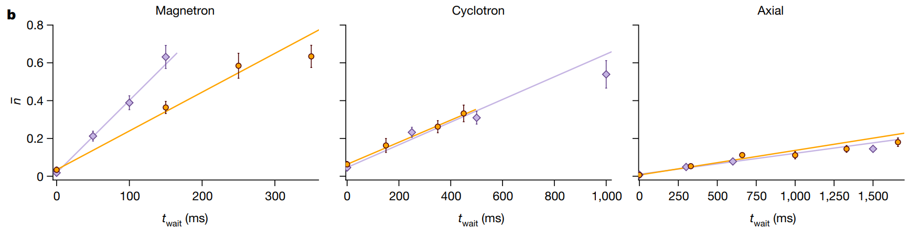
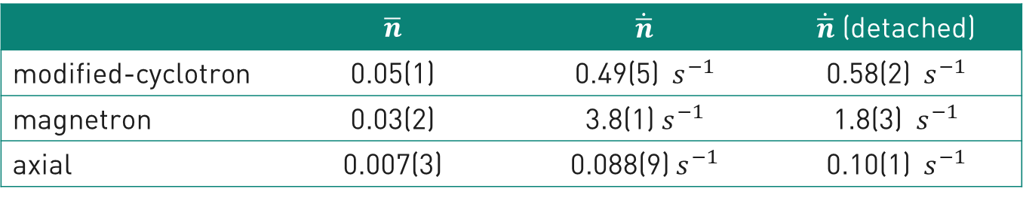
Motional coherence is reduced significantly, when the electrodes are disconnected during the measurement.
$$x$$
$$ω_{+}$$
$$y$$
$$r_{+}$$
 | $$\overline{n}$$ | $$\dot{\overline{n}}$$ | $\dot{\overline{n}}$ (detached)
modified-cyclotron | 0.05(1) | 0.49(5) $s^{−1}$ | 0.58(2) $s^{−1}$
magnetron | 0.03(2) | 3.8(1) $s^{−1}$ | 1.8(3) $s^{−1}$
axial | 0.007(3) | 0.088(9) $s^{−1}$ | 0.10(1) $s^{−1}$
$$r_{−}$$
$$ω_{−}$$

Slide 24
The choice of ⁹Be⁺ ion was made due to the simple structure and advantageous mass for Penning traps.
Pro:
High mass:
  High-frequency for same strength of trapping potential
  Lower magnetic field strength required for Penning trap
  Lower Doppler limit
Relatively simple electronic structure
Only two wavelengths required: 313 nm & 235 nm?
Contra:
Has nucler spin
Transitions are UV
Ground state qubit is in MW regime (~80 GHz)

Slide 25

Kilian Hanke
Tobias Sägesser
Shreyans Jain
Nina Megier
Silke Auchter
Matthias Dietl
Pavel Hmro
Matteo Simoni
Yingying Cui
Yves Colombe
Clemens Rössler
Prof. Jonathan Home
Daniel Kienzler

Slide 26
The Team
Kilian Hanke
Tobias Sägesser
Shreyans Jain
Nina Megier
Silke Auchter
Matthias Dietl
Pavel Hmro
Matteo Simoni
Yingying Cui
Yves Colombe
Clemens Rössler
Prof. Jonathan Home
Daniel Kienzler

Slide 27
Penning Trap Experiment, TIQI, ETH - Setup
Single ⁹Be⁺ ion
3 T magnetic field from superconducting coils
First Surface-electrode Penning trap:
  Fabricated by PTB
  single layer
  12 µm gold metallization
  Sapphire substrate
  25 electrodes
[Jain2024]
First micro-fabricated Penning ion trap. Fabricated by Amado Bautista-Salvador at PTB.

Slide 28
Penning Trap Experiment, TIQI, ETH - Results
Full quantum control of single ion
Transport in 2D plane
Heating rates
Spin coherence
  Vibrations
  Magnetic field fluctuations
[Jain2024]
[Jain2024] S. Jain, T. Sägesser, P. Hrmo et al. (2024). Penning micro-trap for quantum computing. Nature 627, 510–514

Slide 29
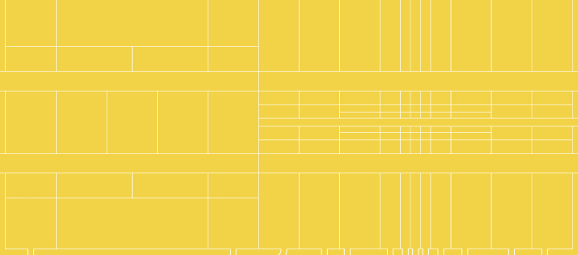
Current status of chip Penning traps
Socket 2.0 Assembly

Slide 30
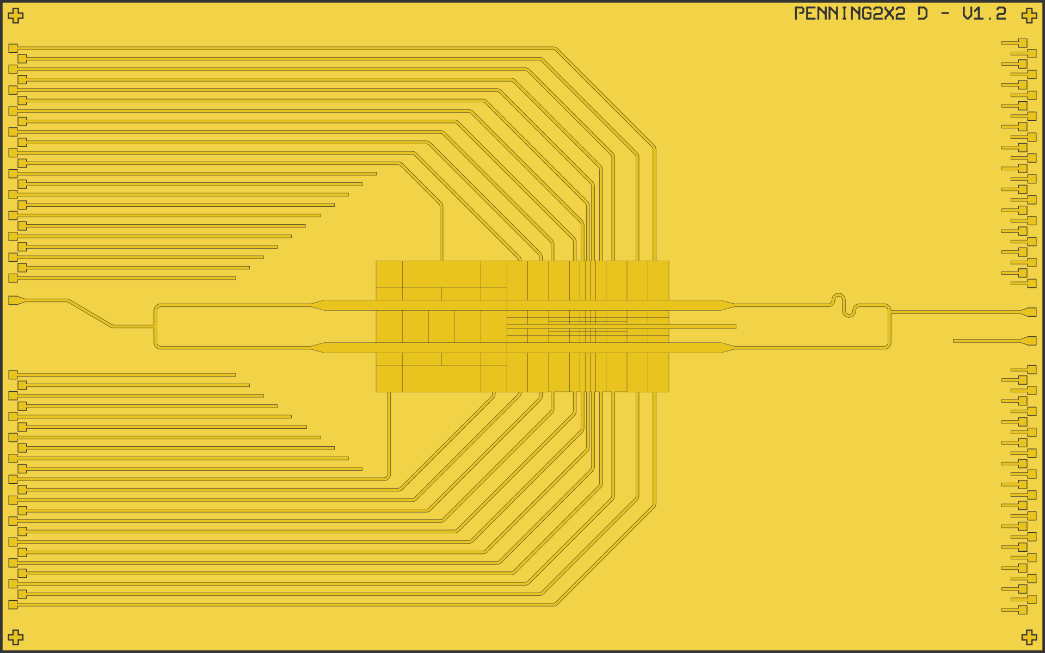
Current status of chip Penning traps
Silicon substrate
Pure Al metallization
1 unstructured shielding layer
3 structured routing & electrode layers
Planarized dielectric layers
(tbd.) tungsten plugged vias
Si
SiOx
Al
W

Slide 31

Axialization electrodes
  5 electrodes
  3 RF signals
  phase matched routing

Slide 32
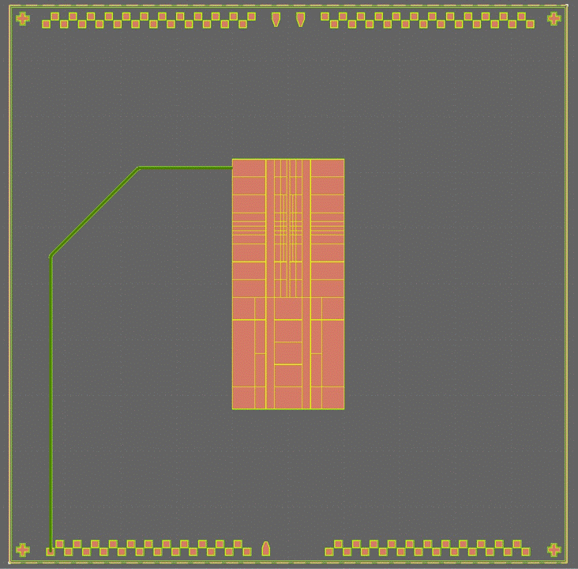
Towards scalable trap design software
straight = (cell_refs["port_LZ_DC1,3_n“], (1, 0.74))
for el_ref, launcher_ref in electrode2launcher.items():
intersect1 = compute_intersection_from_direction(…)
intersect2 = compute_intersection_from_direction(…)
self.insert_cell(WaveguideComposite,
nodes=[
Node(launcher_ref),
Node(intersect1),
Node(intersect2),
Node(el_ref),
],
**waveguide_dc_wide_params,
)
Number of electrodes increases rapidly:
  2020 (PTB): 25 electrodes
  2024: 104 electrodes
  202x: ~1000 electrodes?
Issue: manual routing is unfeasible
Solution: programmatic chip layout
Foundation: KQCircuits [Heinsoo2023]
  Python package for superconducting circuit design
  Extends KLayout
  Developed by IQM
Added features for ion trap design
  Multi-layer routing incl. vias
  Electrode structures
[Heinsoo2023] J. Heinsoo et al. (2023). KQCircuits. 10.5281/ZENODO.4944796

