Slide 1
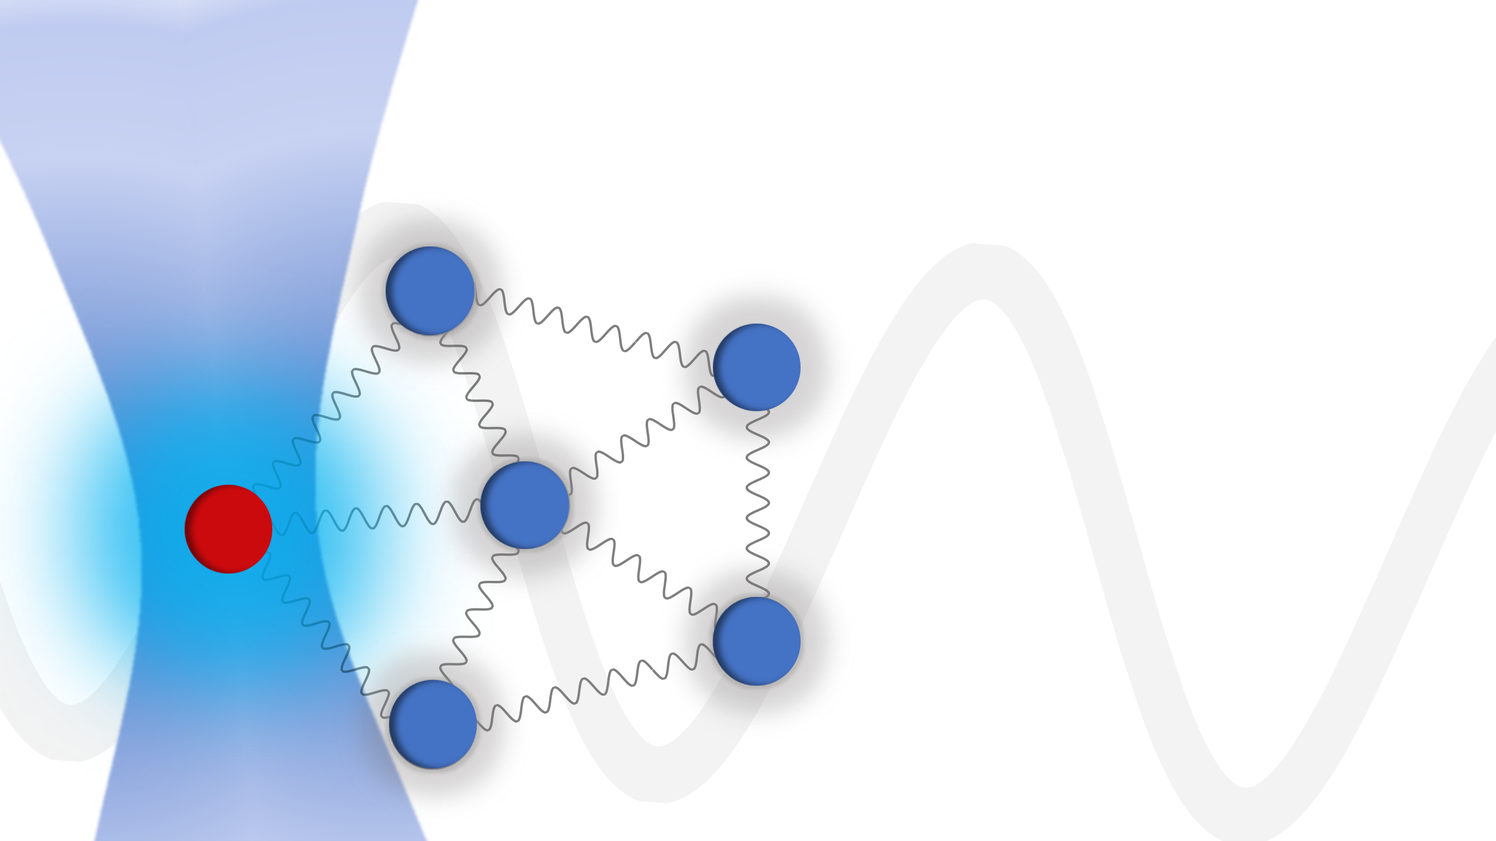
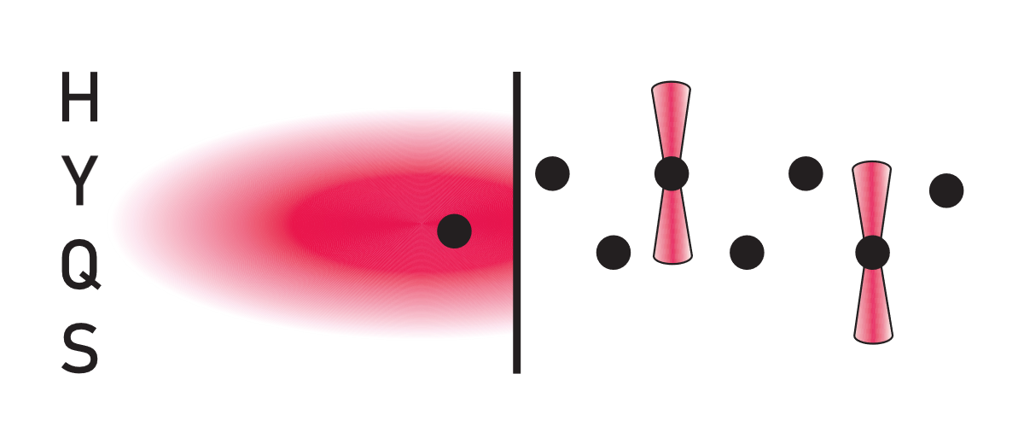

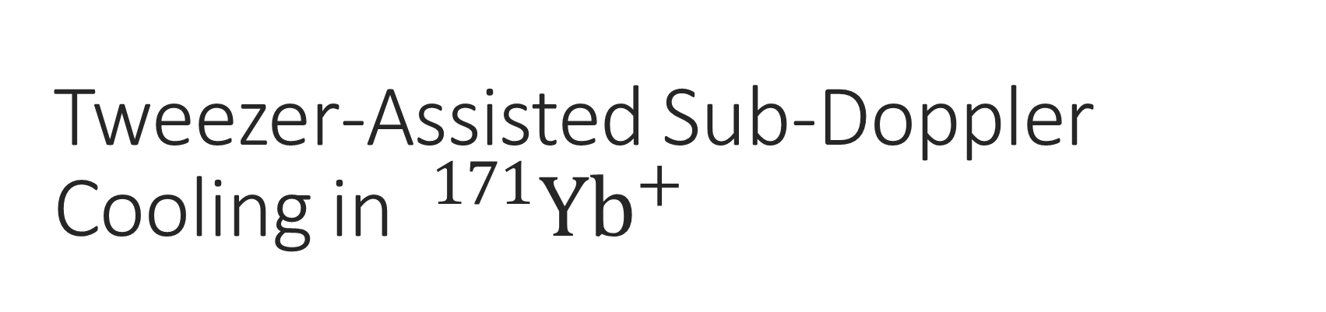
Tweezer-Assisted Sub-Doppler
Cooling in $^{171}Yb^{+}$
Bas Gerritsen, Liam Bond, Robert Spreeuw, Arghavan Safavi-Naini, Rene Gerritsma

Slide 2
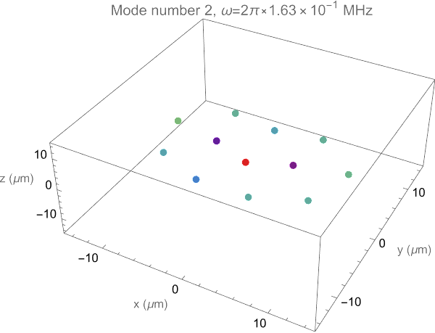
Introduction
  Trapped ions
    Metrology
    Atom-ion
    Quantum simulation
    Quantum computation
  Manipulation of vibrational modes

Slide 3
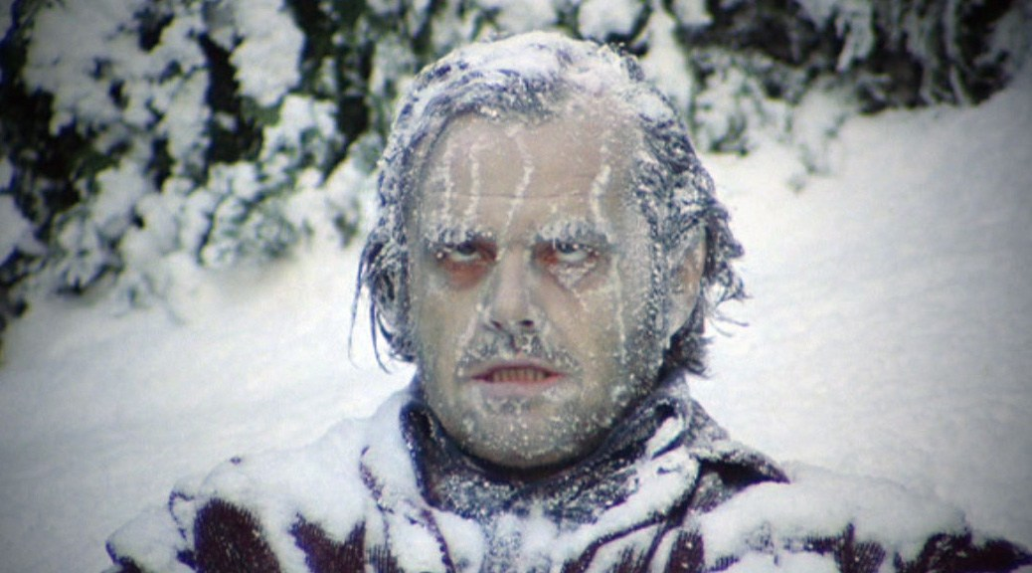
Introduction
  Trapped ions
    Metrology
    Atom-ion
    Quantum simulation
    Quantum computation
  Manipulation of vibrational modes

Slide 4
Introduction
  Trapped ions
    Metrology
    Atom-ion
    Quantum simulation
    Quantum computation
  Manipulation of vibrational modes
  Ground state preparation

Slide 5
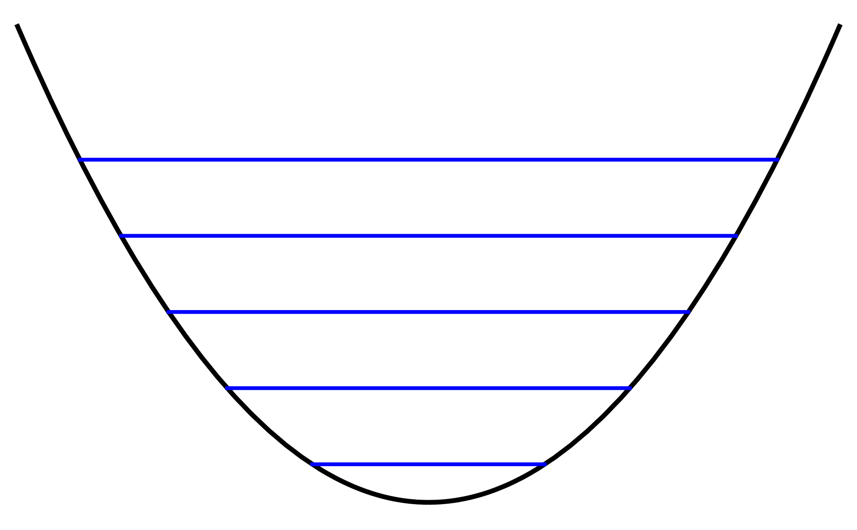
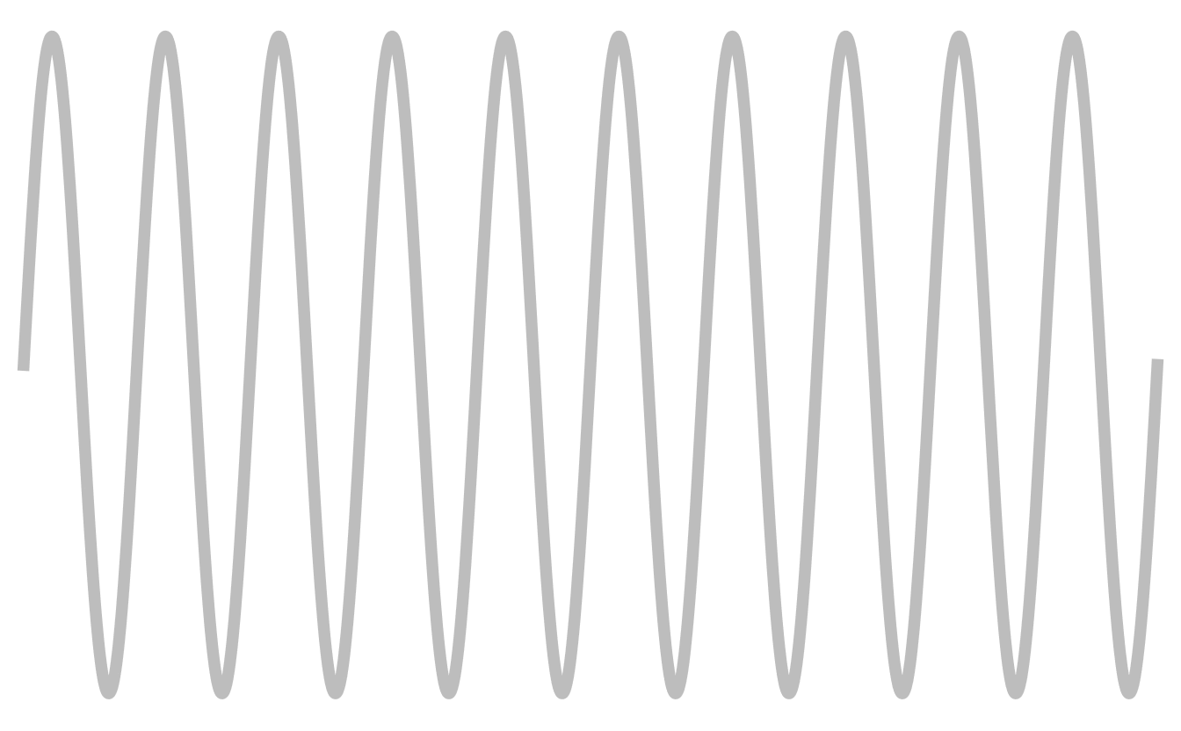

Laser Cooling Methods
  Resolved sideband cooling
    Requires L-D, $Γ≪ω_{p}$

Slide 6
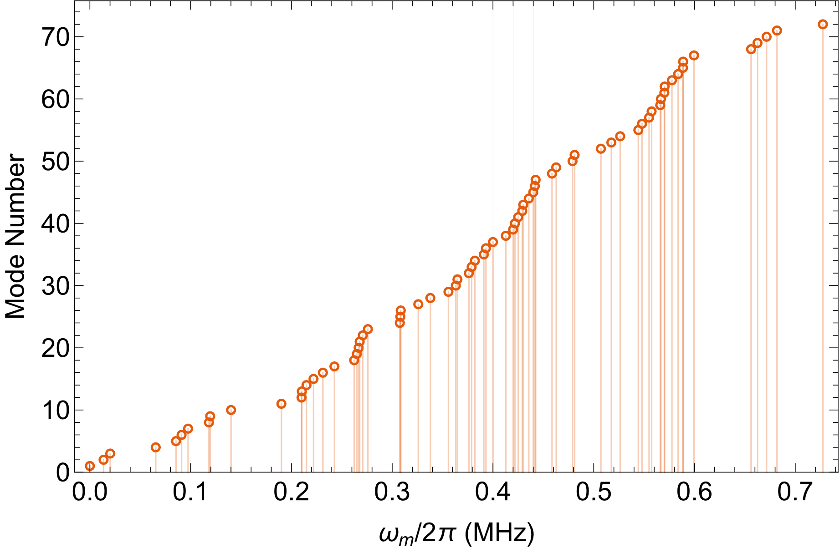

Laser Cooling Methods
  Resolved sideband cooling
    Requires L-D, $Γ≪ω_{p}$
    Many modes in a large crystal

Slide 7

Laser Cooling Methods
  Resolved sideband cooling
    Requires L-D, $Γ≪ω_{p}$
    Many modes in a large crystal
  EIT cooling
    Limited bandwidth

Slide 8
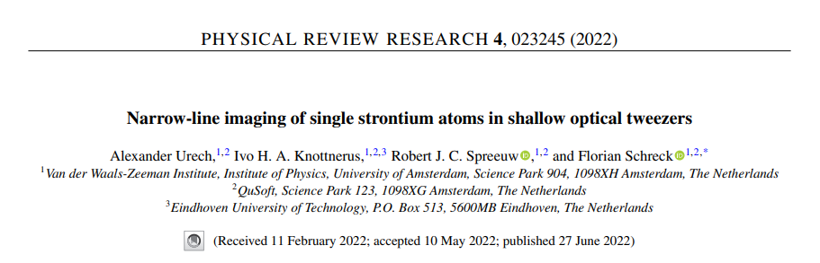
Laser Cooling Methods: Sisyphus
[1]

Slide 9
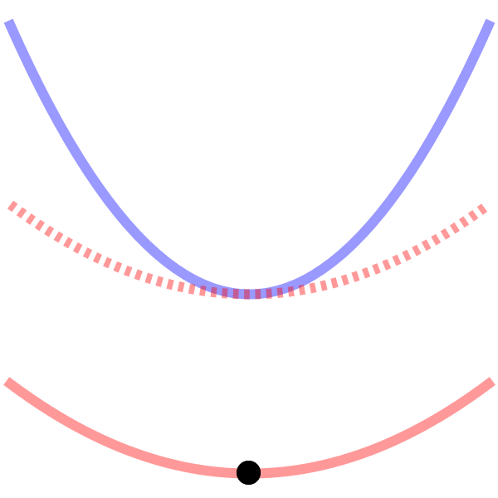




Laser Cooling Methods: Sishyphus
Lose energy during decay
1. State dependent potential
$ω_{e}>ω_{g}$
2. Resolved sidebands
$Γ≪ω_{e}$
3. Selective excitation
$$ω_{e}$$
$$ΔE(x)$$
$$ω_{g}$$

Slide 10


Laser Cooling Methods: Sishyphus
Lose energy during decay
1. State dependent potential
$ω_{e}>ω_{g}$
2. Resolved sidebands
$Γ≪ω_{e}$
3. Selective excitation
$$ω_{e}$$
${\hat{x}}_{1}^{2}$ couples modes
${\hat{x}}_{1}^{2}$ couples modes
$$ΔE(x)$$
$$ω_{g}$$
$${\hat{x}}_{1}=\sum_{m=1}^{N}{L_{0,m}{\left(e_{1}^{m}\right)}^{−1}({\hat{a}}_{m}^{†}+{\hat{a}}_{m}^{ })}$$
Notes:
Note: modes are also coupled in sideband or EIT cooling, but because they need to be in L-D regime, the x^2 factors are heavily surpressed, here we can make the coupling as strong as we’d like.

Slide 11
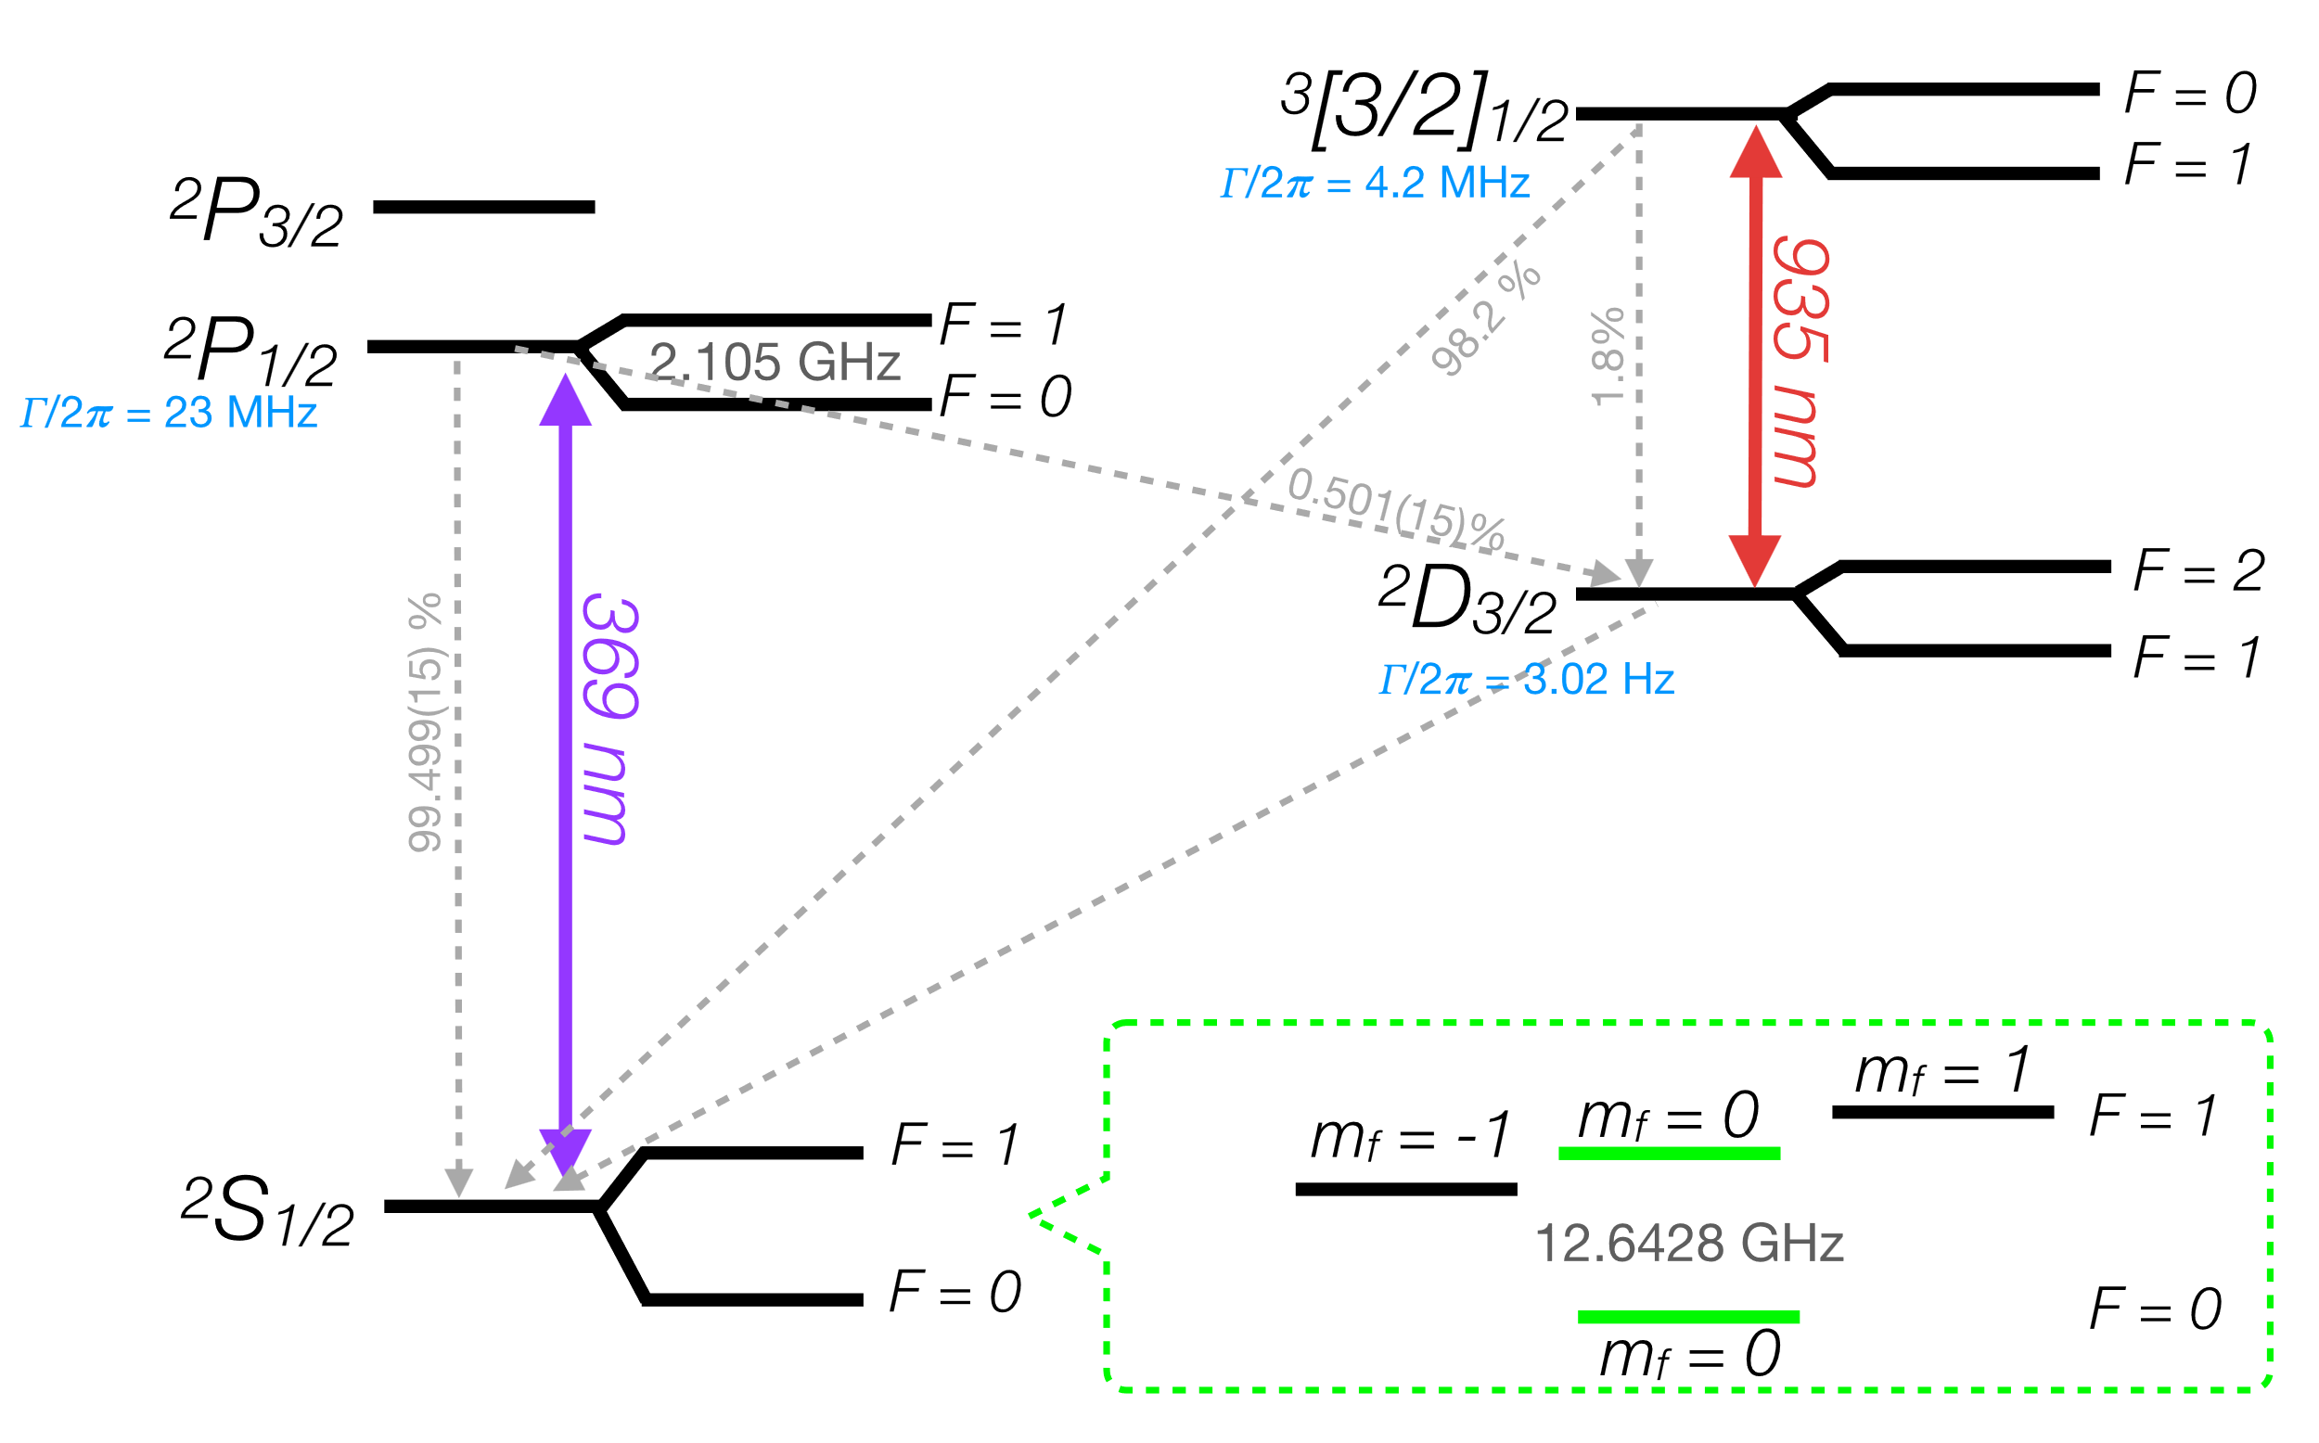

Cooling Scheme
Satisfy criteria in $^{171}Yb^{+}$?
Put level scheme here!
Notes:
No states of right lifetime -> need three and quench
Want enough squeezing -> near resonant tweezer
Excitation can be done by same beam if near resonant
Minimize scattering to mF=0 excited state and potential for mF=0 ground state -> blue detuning

Slide 12


Cooling Scheme
Satisfy criteria in $^{171}Yb^{+}$?
$$\left.|e\right\rangle$$
$$\left.|g\right\rangle$$
Notes:
No states of right lifetime -> need three and quench
Want enough squeezing -> near resonant tweezer
Excitation can be done by same beam if near resonant
Minimize scattering to mF=0 excited state and potential for mF=0 ground state -> blue detuning

Slide 13

Cooling Scheme
Satisfy criteria in $^{171}Yb^{+}$?
$$\left.|i\right\rangle$$
$$\left.|e\right\rangle$$
$$\left.|g\right\rangle$$
Notes:
No states of right lifetime -> need three and quench
Want enough squeezing -> near resonant tweezer
Excitation can be done by same beam if near resonant
Minimize scattering to mF=0 excited state and potential for mF=0 ground state -> blue detuning

Slide 14

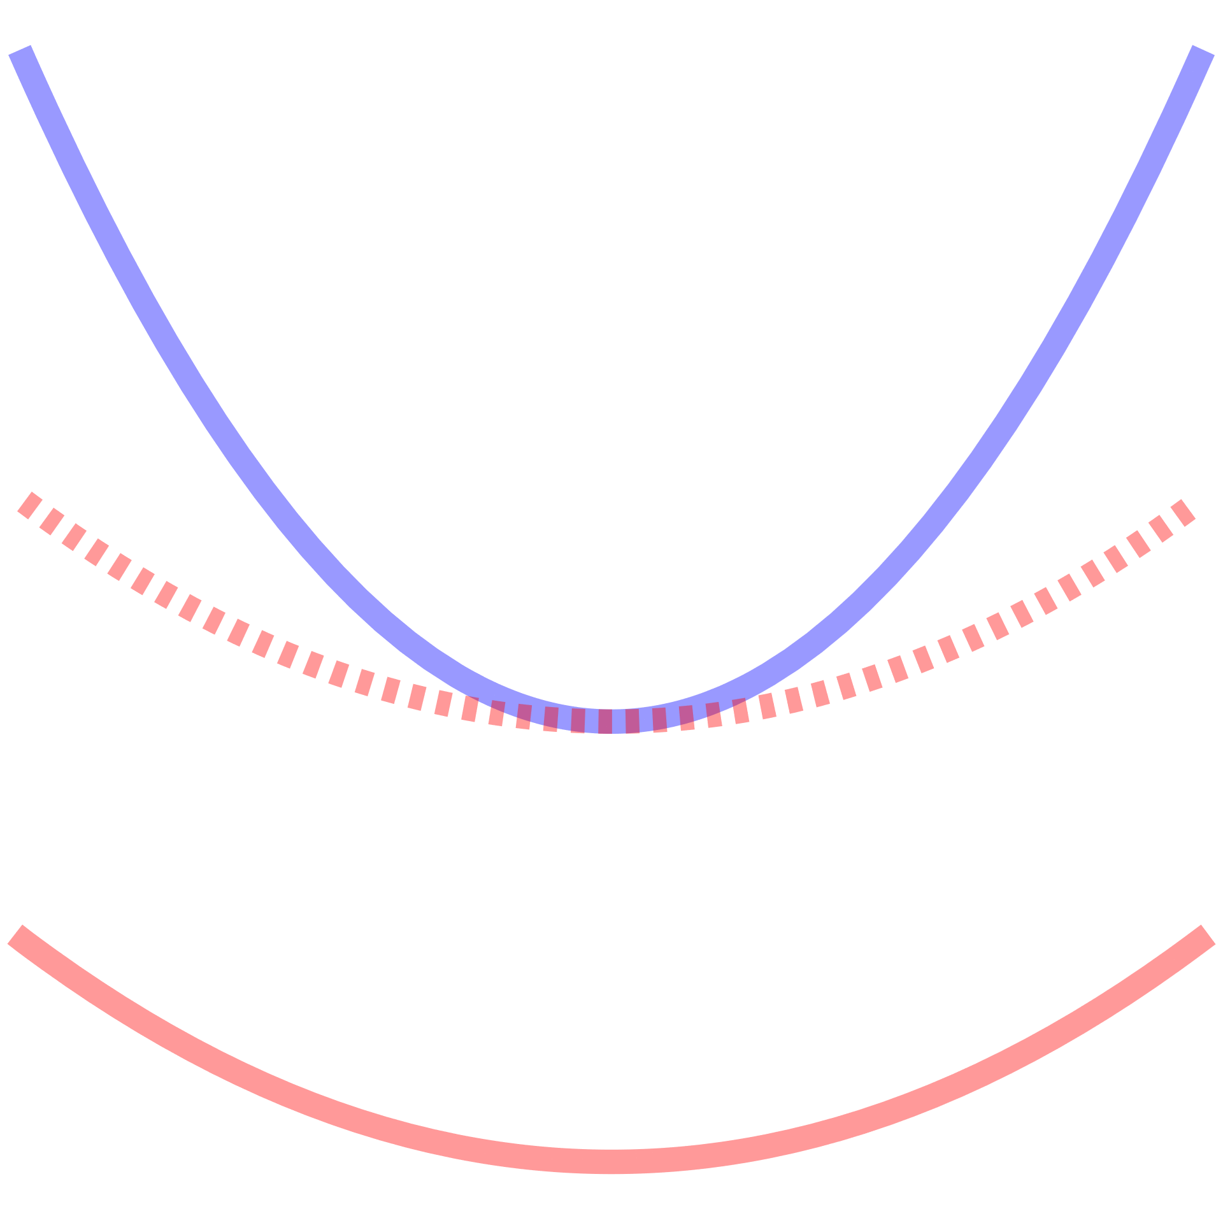






Cooling Scheme
Satisfy criteria in $^{171}Yb^{+}$?
$$\left.|i\right\rangle$$
$$\left.|i\right\rangle$$
$$Γ$$
$$ω_{T}∝\sqrt{P/Δ_{L}}$$
$$Ω_{L}′$$
$$\left.|e\right\rangle$$
$$\left.|e\right\rangle$$
$$\left.|g\right\rangle$$
$$\left.|g\right\rangle$$
Notes:
No states of right lifetime -> need three and quench
Want enough squeezing -> near resonant tweezer
Excitation can be done by same beam if near resonant
Minimize scattering to mF=0 excited state and potential for mF=0 ground state -> blue detuning

Slide 15

Cooling Scheme
Satisfy criteria in $^{171}Yb^{+}$?
$$\left.|i\right\rangle$$
$$\left.|i\right\rangle$$
$$Γ$$
$$ω_{T}∝\sqrt{P/Δ_{L}}$$
$$Ω_{L}′$$
$$\left.|e\right\rangle$$
$$\left.|e\right\rangle$$
$$Ω_{μ}$$
$$\left.|g\right\rangle$$
$$\left.|g\right\rangle$$
Notes:
No states of right lifetime -> need three and quench
Want enough squeezing -> near resonant tweezer
Excitation can be done by same beam if near resonant
Minimize scattering to mF=0 excited state and potential for mF=0 ground state -> blue detuning

Slide 16
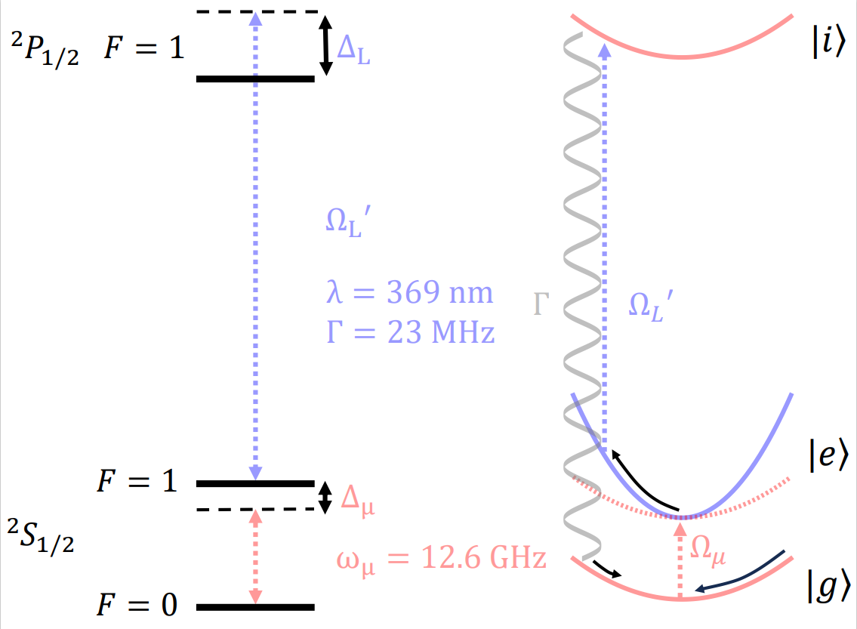

Modelling: Toy model
Approximate and simplify
  3-level ion
  No $m_{F}$ substructure

Slide 17

Modelling: Toy model
Approximate and simplify
  3-level ion Adiabatically eliminate $|\left.i\right\rangle$
  No $m_{F}$ substructure

Slide 18

Modelling: Toy model
Approximate and simplify
  2-level ion
  No $m_{F}$ substructure

Slide 19
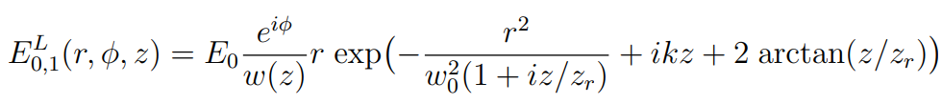
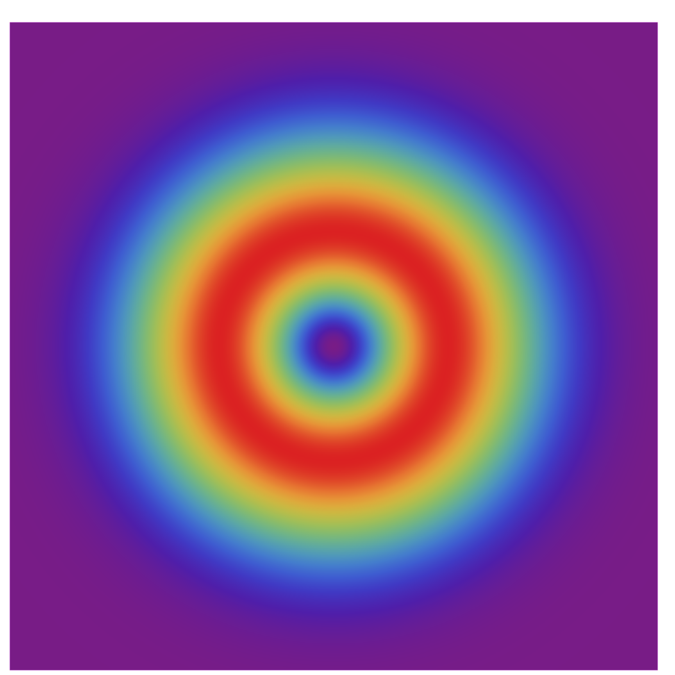
Modelling: Hamiltonian
Approximate and simplify
  2-level ion
  Hollow “donut mode” tweezer

Slide 20
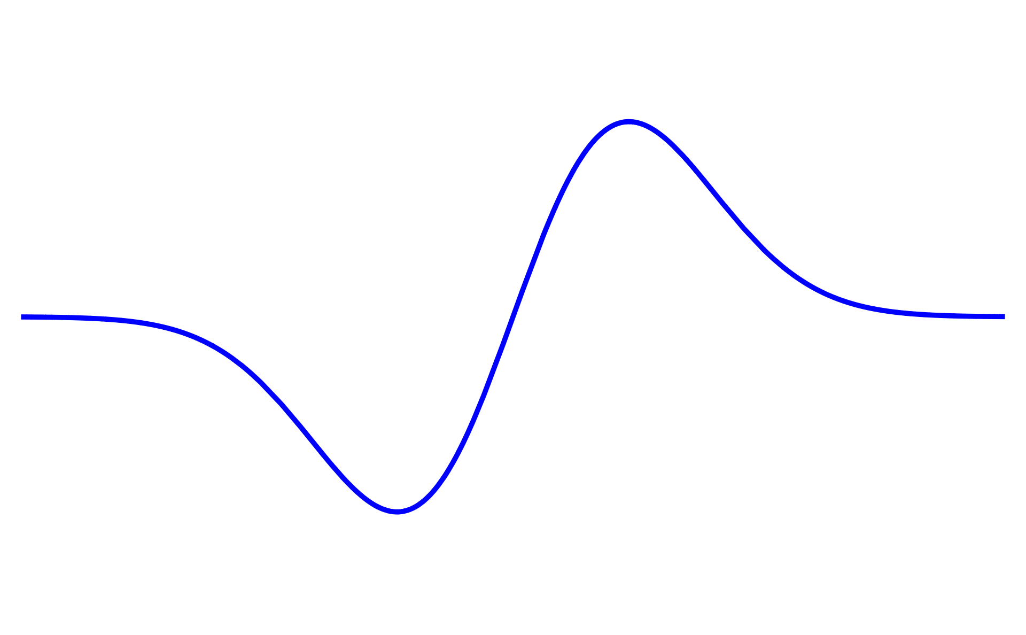
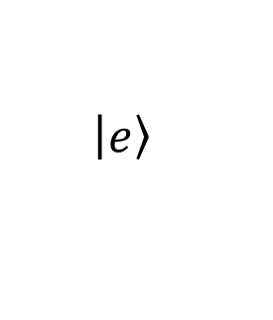
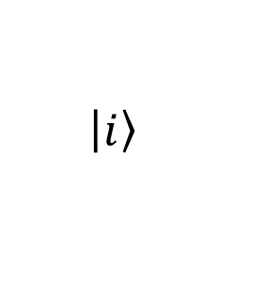




Modelling: Hamiltonian
Approximate and simplify
  2-level ion
  Hollow “donut mode” tweezer
    $H_{tw}=$ $\frac{{{Δ_{L}(Ω}_{L}^{′})}^{2}}{4Δ_{L}^{2}+Γ^{2}}{\left.|e\right\rangle \left\langle \left.e\right|\right.\hat{x}}_{1}^{2}$
$$\left|\left.i\right\rangle \right.$$
$$Δ_{L}$$
$$Ω_{L}′$$
$$λ=369 nm$$
$$Γ=23×2π MHz$$
$$\left|\left.e\right\rangle \right.$$

Slide 21

Modelling: Hamiltonian
Approximate and simplify
  2-level ion
  Hollow “donut mode” tweezer
    $H_{tw}=$ $\frac{{{Δ_{L}(Ω}_{L}^{′})}^{2}}{4Δ_{L}^{2}+Γ^{2}}{\left.|e\right\rangle \left\langle \left.e\right|\right.\hat{x}}_{1}^{2}$
$$\left|\left.i\right\rangle \right.$$
$$Δ_{L}$$
Perpendicular to
optical axis
$$Ω_{L}′$$
$$λ=369 nm$$
$$Γ=23×2π MHz$$
$$\left|\left.e\right\rangle \right.$$

Slide 22

Modelling: Hamiltonian
Approximate and simplify
  2-level ion
  Hollow “donut mode” tweezer
    $H_{tw}=$ $\frac{{{Δ_{L}(Ω}_{L}^{′})}^{2}}{4Δ_{L}^{2}+Γ^{2}}{\left.|e\right\rangle \left\langle \left.e\right|\right.\hat{x}}_{1}^{2}$
$$\left|\left.i\right\rangle \right.$$
$$Δ_{L}$$
Potential & “lifetime”
$∝{\hat{x}}_{1}^{2}$
$$Ω_{L}′$$
$$λ=369 nm$$
$$Γ=23×2π MHz$$
$$\left|\left.e\right\rangle \right.$$

Slide 23
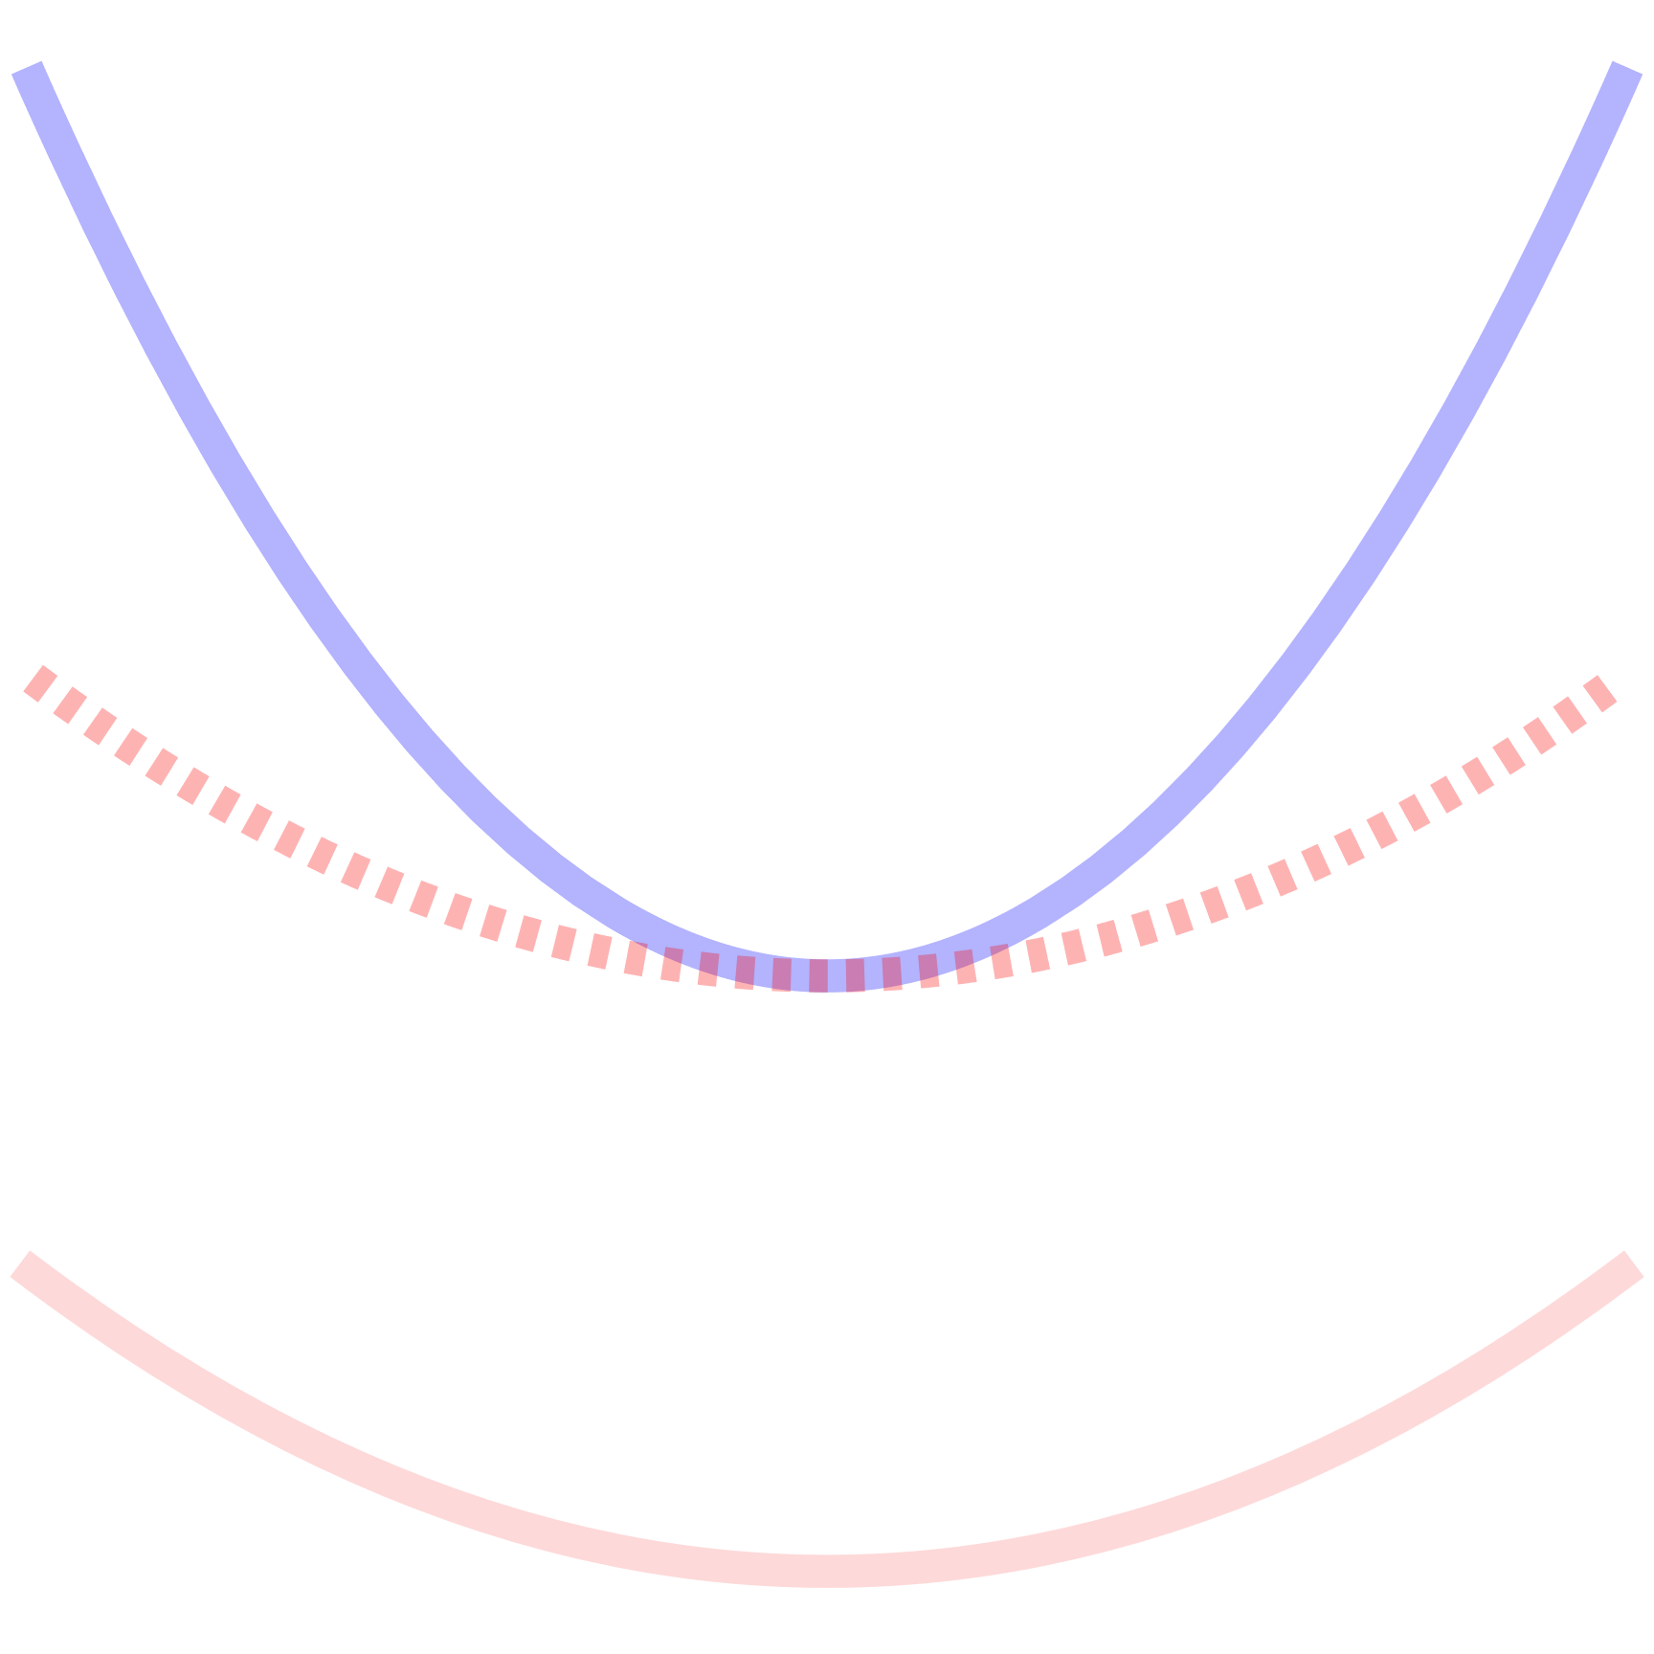
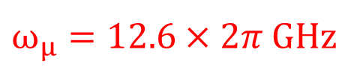





Modelling: Hamiltonian
Approximate and simplify
  2-level ion
  Hollow “donut mode” tweezer
    $H_{tw}=$ $\frac{{{Δ_{L}(Ω}_{L}^{′})}^{2}}{4Δ_{L}^{2}+Γ^{2}}{\left.|e\right\rangle \left\langle \left.e\right|\right.\hat{x}}_{1}^{2}$
  Microwaves
    $\frac{1}{2}Ω_{μ}{\hat{σ}}_{x }+Δ_{μ}|\left.g\right\rangle \left\langle g\right.|$
$$\left|\left.e\right\rangle \right.$$
$$Δ_{μ}$$
$$Ω_{μ}$$
$$\left|\left.g\right\rangle \right.$$
$ω_{μ}=12.6×2π$ GHz

Slide 24
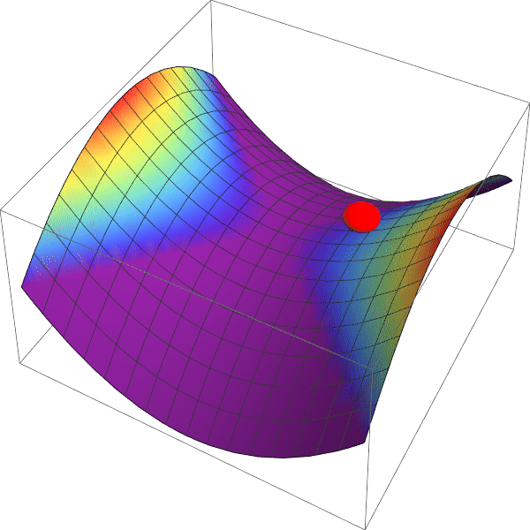

Modelling: Hamiltonian
Approximate and simplify
  2-level ion
  Hollow “donut mode” tweezer
    $H_{tw}=$ $\frac{{{Δ_{L}(Ω}_{L}^{′})}^{2}}{4Δ_{L}^{2}+Γ^{2}}{\left.|e\right\rangle \left\langle \left.e\right|\right.\hat{x}}_{1}^{2}$
  Microwaves
    $\frac{1}{2}Ω_{μ}{\hat{σ}}_{x }+Δ_{μ}|\left.g\right\rangle \left\langle g\right.|$
  Paul Trap
    $ω_{P}$(${\hat{a}}^{†}\hat{a}+\frac{1}{2})$ → truncate

Slide 25

Modelling: Hamiltonian
Approximate and simplify
  2-level ion
  Hollow “donut mode” tweezer
    $H_{tw}=$ $\frac{{{Δ_{L}(Ω}_{L}^{′})}^{2}}{4Δ_{L}^{2}+Γ^{2}}{\left.|e\right\rangle \left\langle \left.e\right|\right.\hat{x}}_{1}^{2}$
  Microwaves
    $\frac{1}{2}Ω_{μ}{\hat{σ}}_{x }+Δ_{μ}|\left.g\right\rangle \left\langle g\right.|$
  Paul Trap
    $ω_{P}$(${\hat{a}}^{†}\hat{a}+\frac{1}{2})$ → truncate
${H=ω}_{P}$(${\hat{a}}^{†}\hat{a}+\frac{1}{2})+\frac{1}{2}Ω_{μ}{\hat{σ}}_{x}+Δ_{μ}\left|\left.g\right\rangle \left\langle g\right.\right|+\frac{{{Δ_{L}(Ω}_{L}^{′})}^{2}}{4Δ_{L}^{2}+Γ^{2}}{\left.|e\right\rangle \left\langle \left.e\right|\right.\hat{x}}_{1}^{2}$

Slide 26
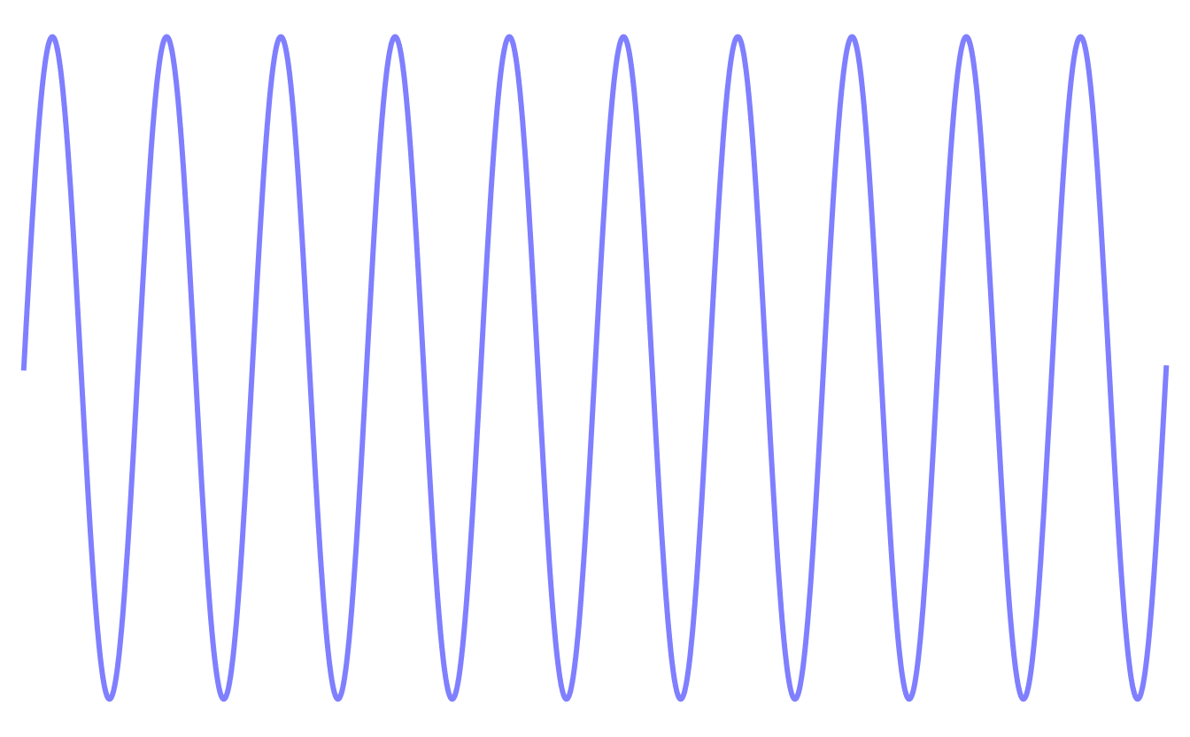

Modelling: Jump operators
  Describe spontaneous emission
  Adiabatically eliminated $|\left.i\right\rangle$
  $Γ_{eff}∝{\hat{x}}_{1}^{2}$

Slide 27
Modelling: Jump operators
  Describe spontaneous emission
  Adiabatically eliminated $|\left.i\right\rangle$
  $Γ_{eff}∝{\hat{x}}_{1}^{2}$

Slide 28
Modelling: Jump operators
  Describe spontaneous emission
  Adiabatically eliminated $|\left.i\right\rangle$
  $Γ_{eff}∝{\hat{x}}_{1}^{2}$

Slide 29

Modelling: Jump operators
  Describe spontaneous emission
  Adiabatically eliminated $|\left.i\right\rangle$
  $Γ_{eff}∝{\hat{x}}_{1}^{2}$
  ${\hat{c}}_{eff,1}=\frac{{iΩ}_{L}^{′}}{2iΔ_{L}−Γ}\sqrt{Γ(u)/3}{\hat{x}}_{1}\left.e^{−iku{\hat{x}}_{1}}|g\right\rangle \left\langle \left.e\right|\right.$

Slide 30

Modelling: Jump operators
  Describe spontaneous emission
  Adiabatically eliminated $|\left.i\right\rangle$
  $Γ_{eff}∝{\hat{x}}_{1}^{2}$
  ${\hat{c}}_{eff,1}=\frac{{iΩ}_{L}^{′}}{2iΔ_{L}−Γ}\sqrt{Γ(u)/3}{\hat{x}}_{1}\left.e^{−iku{\hat{x}}_{1}}|g\right\rangle \left\langle \left.e\right|\right.$
  ${\hat{c}}_{eff,2}=\frac{{iΩ}_{L}^{′}}{2iΔ_{L}−Γ}\sqrt{2Γ(u)/3}{\hat{x}}_{1}e^{−iku{\hat{x}}_{1}}\left.|e\right\rangle \left\langle \left.e\right|\right.$

Slide 31
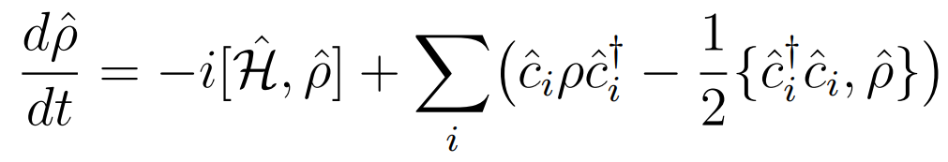
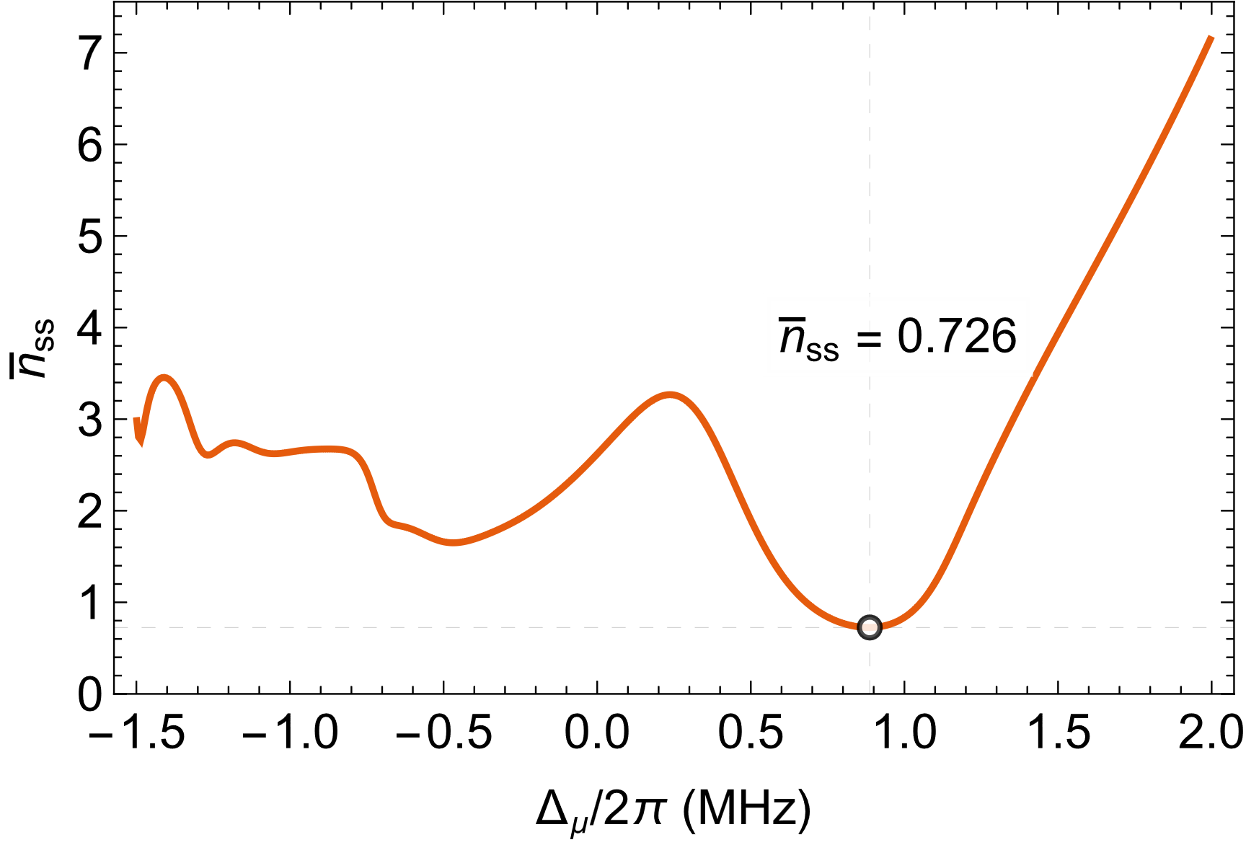
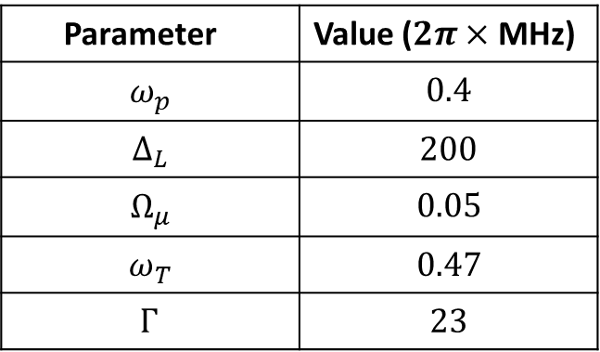
Results: single ion
Closely matches 8-level model
= 0
Parameter | Value ($2π×$MHz)
$$ω_{p}$$ | $$0.4$$
$$Δ_{L}$$ | $$200$$
$$Ω_{μ}$$ | $$0.05$$
$$ω_{T}$$ | $$0.47$$
$$Γ_{ }$$ | $$23$$
  $$T_{ss}≈28 μK$$

Slide 32
Results: single ion
Closely matches 8-level model
= 0
Parameter | Value ($2π×$MHz)
$$ω_{p}$$ | $$0.4$$
$$Δ_{L}$$ | $$200$$
$$Ω_{μ}$$ | $$0.05$$
$$ω_{T}$$ | $$0.47$$
$$Γ_{ }$$ | $$23$$
  $${\overline{n}}_{Doppler}≈12.2$$
  $$T_{ss}≈28 μK$$

Slide 33
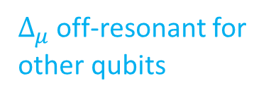
Results: single ion
Closely matches 8-level model
= 0
Parameter | Value ($2π×$MHz)
$$ω_{p}$$ | $$0.4$$
$$Δ_{L}$$ | $$200$$
$$Ω_{μ}$$ | $$0.05$$
$$ω_{T}$$ | $$0.47$$
$$Γ_{ }$$ | $$23$$
$Δ_{μ}$ off-resonant for
other qubits
  $$T_{ss}≈28 μK$$

Slide 34

Results: single ion
How about the cooling rate?

Slide 35

Results: single ion

Slide 36

Results: single ion

Slide 37
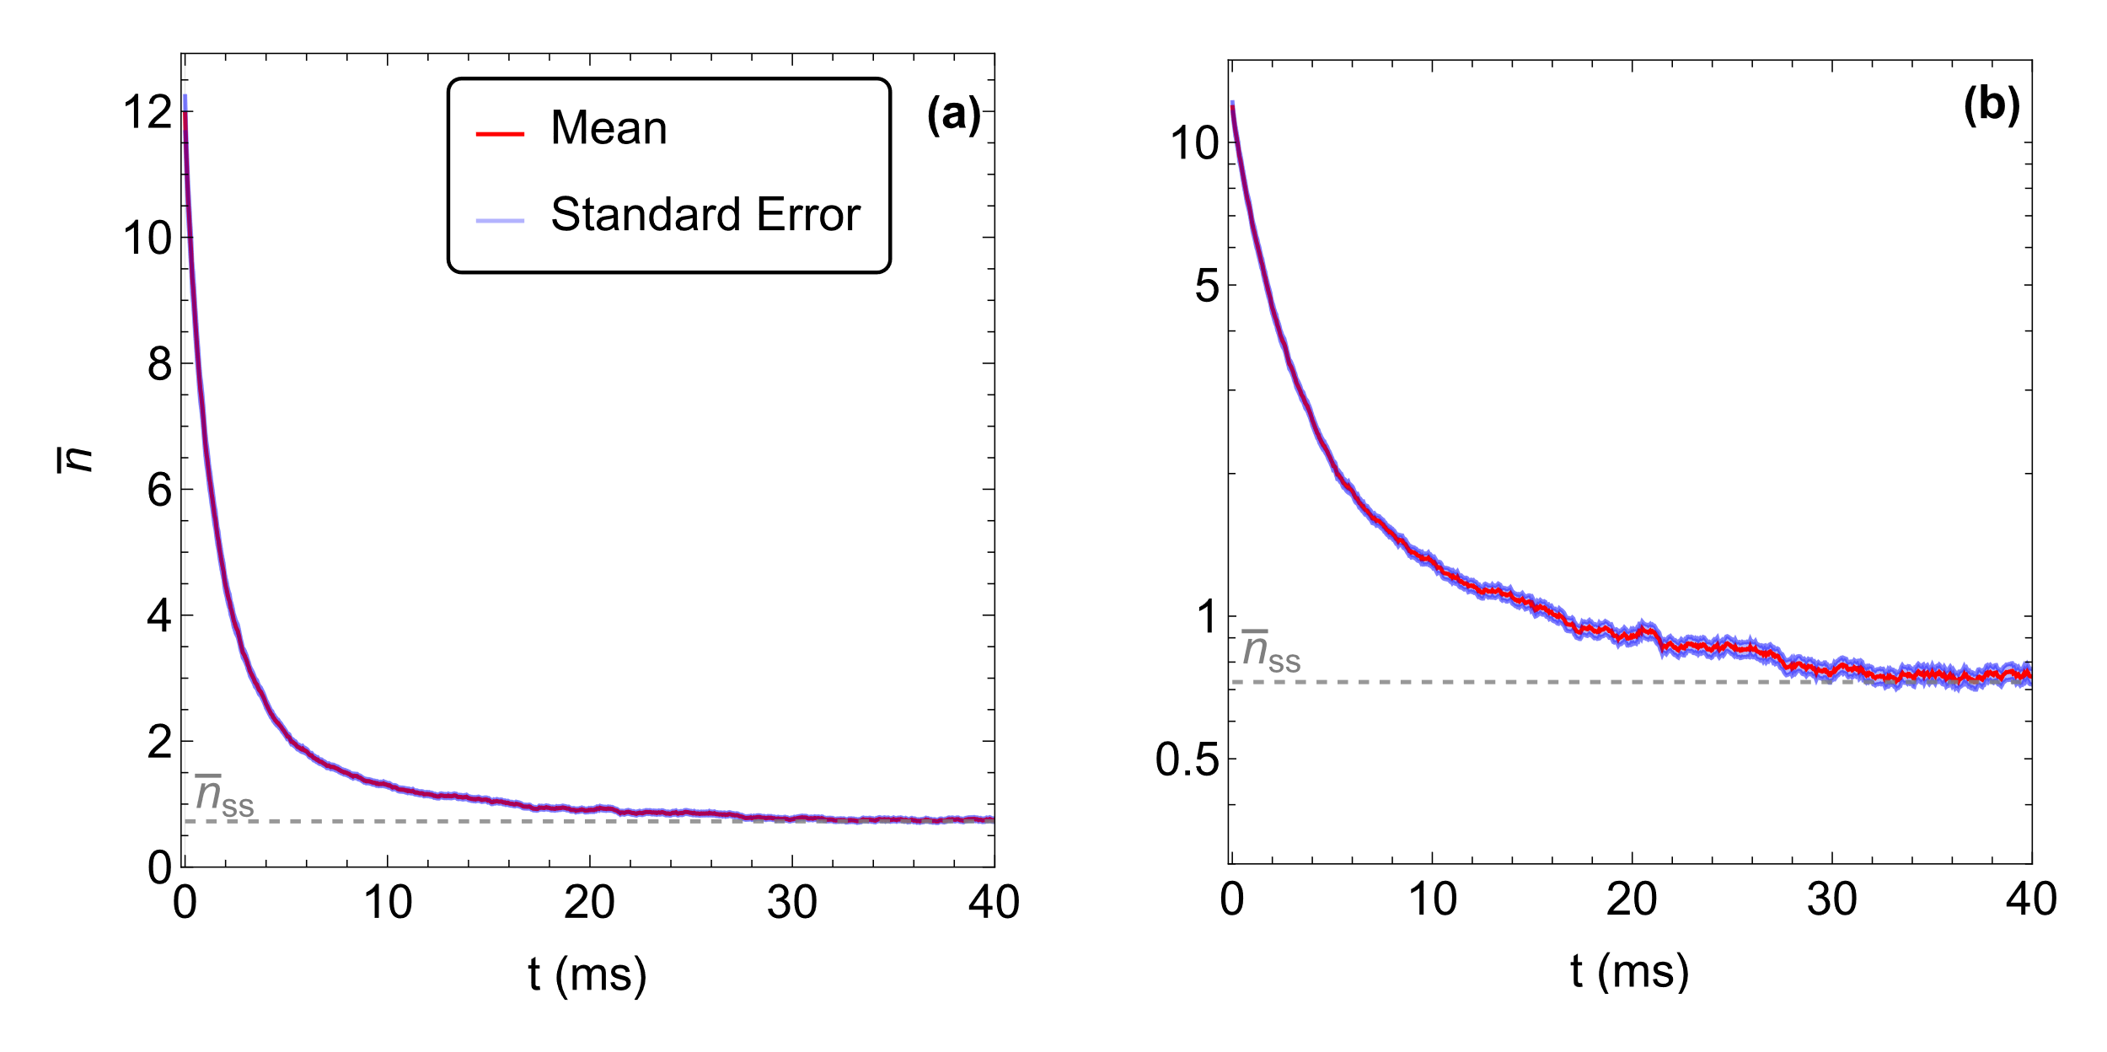



Results: single ion
  $\overline{n}\left(t=0\right)=12.2$
  Monte-Carlo wavefunction
$ω_{T}=0.47×2π$ MHz
$$n_{max}=100$$

Slide 38
Modelling: More ions!

Slide 39
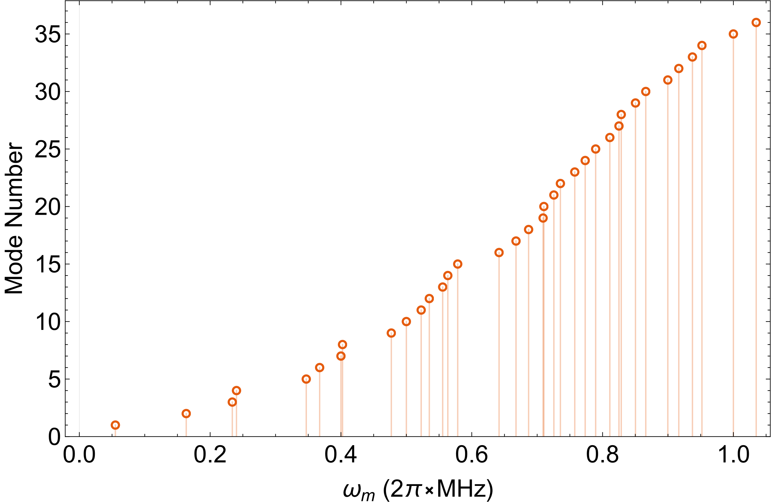

Modelling: More ions!

Slide 40
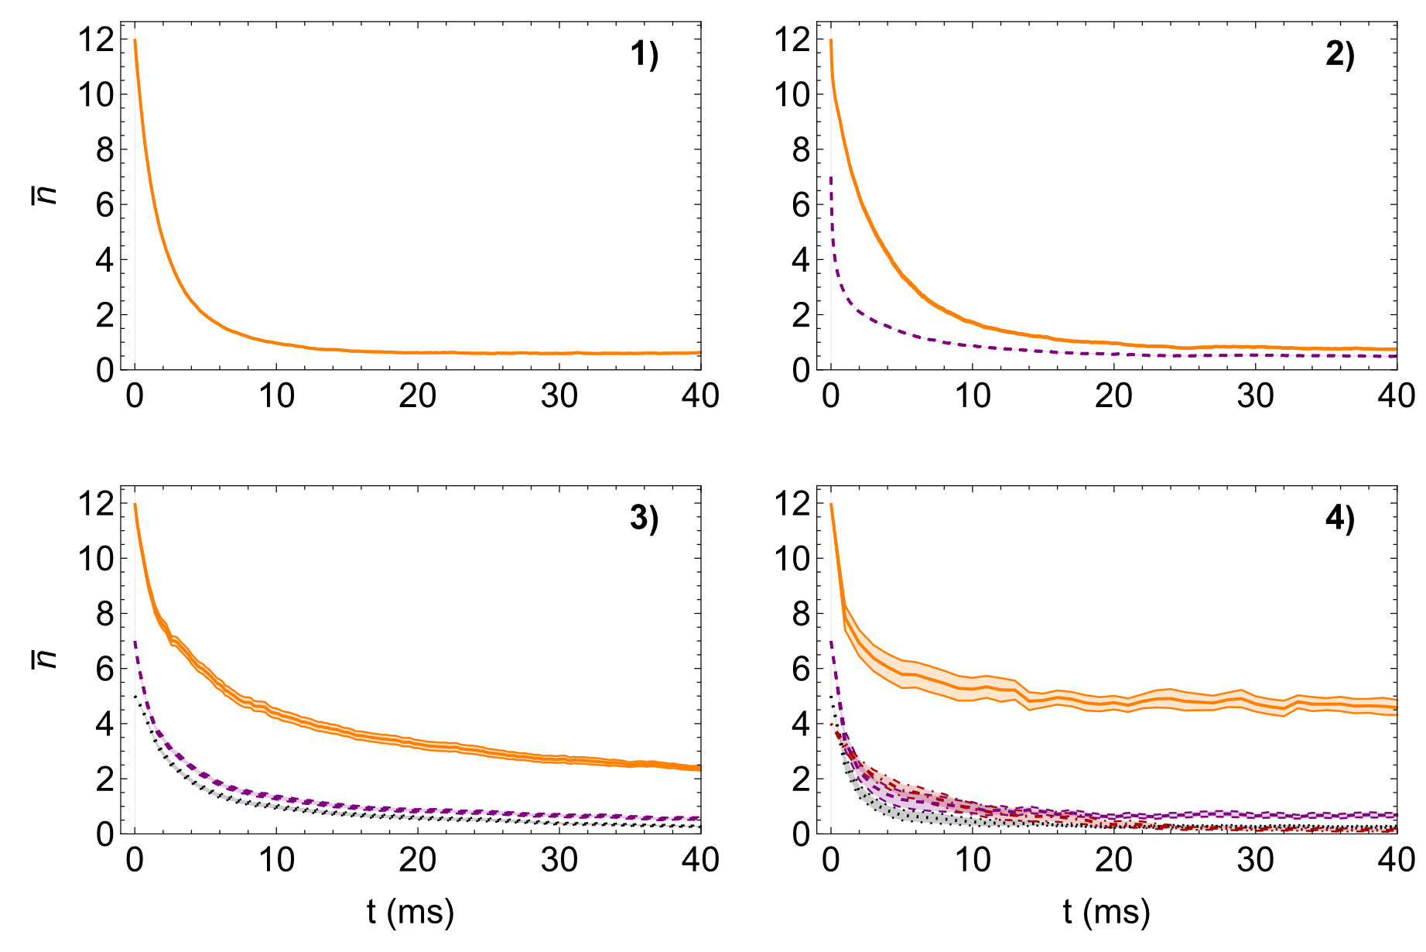
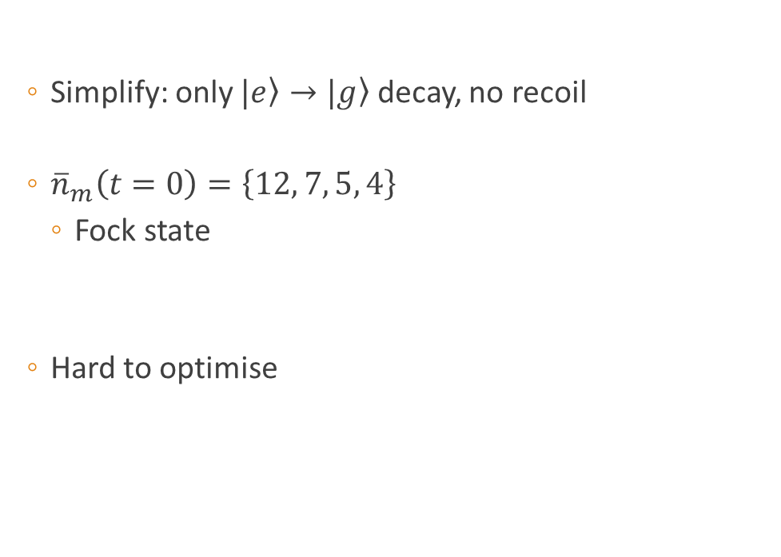
Results: More ions
  Simplify: only $|\left.e\right\rangle →|\left.g\right\rangle$ decay, no recoil
  ${\overline{n}}_{m}\left(t=0\right)=\left\{12, 7, 5, 4\right\}$
    Fock state
  Hard to optimise
$$ω_{T}=0.77×2π MHz$$

Slide 41
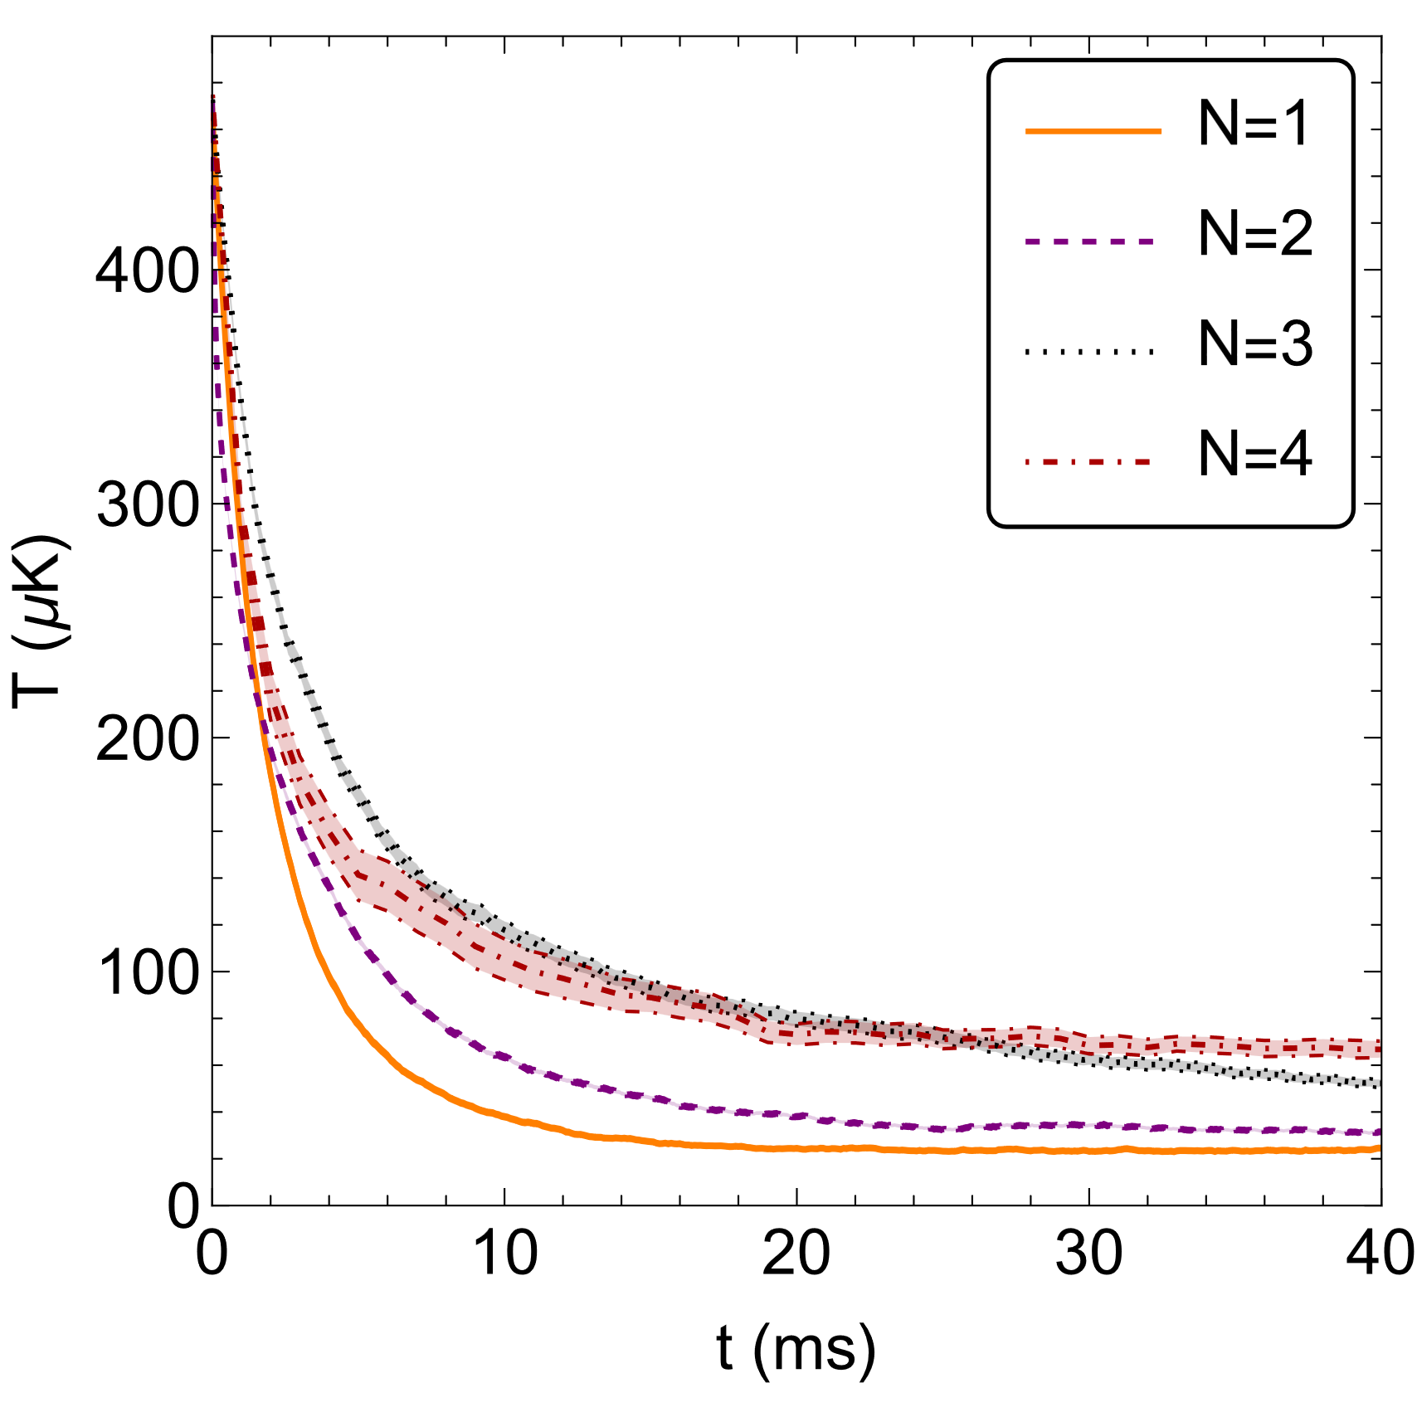
Results: More ions
  Simplify: only $|\left.e\right\rangle →|\left.g\right\rangle$ decay, no recoil
  ${\overline{n}}_{m}\left(t=0\right)=\left\{12, 7, 5, 4\right\}$
    Fock state
  Hard to optimise
$$ω_{T}=0.77×2π MHz$$

Slide 42
Conclusion
  Novel sub-Doppler cooling method
    Hollow tweezer + microwaves
    Cooling perpendicular

Slide 43

Conclusion
  Novel sub-Doppler cooling method
    Hollow tweezer + microwaves
    Cooling perpendicular
  Single ion ${\overline{n}}_{ss}≈0.73,$ $T_{ss}≈28 μK$
  Up to four ions $T_{ss}<100 μK$

Slide 44

Conclusion
  Novel sub-Doppler cooling method
    Hollow tweezer + microwaves
    Cooling perpendicular
  Single ion ${\overline{n}}_{ss}≈0.73,$ $T_{ss}≈28 μK$
  Up to four ions $T_{ss}<100 μK$
  Optimisation is hard for larger crystals

Slide 45

Conclusion
  Novel sub-Doppler cooling method
    Hollow tweezer + microwaves
    Cooling perpendicular
  Single ion ${\overline{n}}_{ss}≈0.73,$ $T_{ss}≈28 μK$
  Up to four ions $T_{ss}<100 μK$
  Optimisation is hard for larger crystals
  NGS or hybrid DTWA: rate scaling? [3]
[3] L. J. Bond, B. Gerritsen, J. Minář, J. T. Young, J. Schachenmayer and A. Safavi-Naini, (2024), arXiv:2407.02617

Slide 46

Conclusion
  Novel sub-Doppler cooling method
    Hollow tweezer + microwaves
    Cooling perpendicular
  Single ion ${\overline{n}}_{ss}≈0.73,$ $T_{ss}≈28 μK$
  Up to four ions $T_{ss}<100 μK$
  Optimisation is hard for larger crystals
  NGS or hybrid DTWA: rate scaling? [3]
  Implementation new experiment
[3] L. J. Bond, B. Gerritsen, J. Minář, J. T. Young, J. Schachenmayer and A. Safavi-Naini, (2024), arXiv:2407.02617

Slide 47


Acknowledgements
Project supervisors: Rene Gerritsma
Arghavan Safavi-Naini, Robert Spreeuw
Tweezer experiment
Rima Schüssler
Matteo Mazzanti
Clara Robalo Pereira
Louis Gallagher
Zeger Ackerman
Nella Diepeveen
Yb⁺/Li mixtures
Egor Kovlakov
Eleanor Trimby
Ilango Maran
Nella Diepeveen
Theory
Liam Bond
Bas Gerritsen
Katya Fouka
Jeremy Young
Lorenzo Oghittu
Bas Gerritsen, b.gerritsen@uva.nl

Slide 48
Questions?
?
?
?
?
?
?
?
Bas Gerritsen, b.gerritsen@uva.nl

Slide 49


Results: single ion
  Tweezer pointing error?
$${\hat{x}}_{1}→{\hat{x}}_{1}+x_{mis}𝟙$$

Slide 50


Results: single ion
  Tweezer detuning?
  Sweep detuning @ constant $ω_{T}$

Slide 51

Results: single ion
  Tweezer detuning?
  Sweep detuning @ constant $ω_{T}$

Slide 52




  $n(t=0)=12$
    Fock state
  Hard to optimise
  Speedup: Multiple tweezers
    $τ_{c.o.m}$ reduced from 1.45ms to 0.25ms
$ω_{T}=0.71×2π$ MHz
$$n_{max}=15$$
  $$T_{ss}≈38 μK$$

Slide 53




Modelling: Jump operators
  Simplify: Discretise 1D emission
    Match $\left\langle δp\right\rangle$, $\left\langle δp^{2}\right\rangle$
$$\overset{⃑}{x}$$
[4]

Slide 54


Modelling: More ions!
$$H=\frac{1}{2}Ω_{μ}{\hat{σ}}_{x}+Δ_{μ}\left|\left.g\right\rangle \left\langle g\right.\right|+\frac{{{Δ_{L}(Ω}_{L}^{′})}^{2}}{4Δ_{L}^{2}+Γ^{2}}{\left.|e\right\rangle \left\langle \left.e\right|\right.\hat{x}}_{1}^{2}+\sum_{m}{ω_{m}\text{(}{\hat{a}}_{m}^{†}{\hat{a}}_{m}^{ }+\frac{1}{2})}$$
$${\hat{x}}_{1}=\sum_{m=1}^{N}{L_{0,m}{\left(e_{1}^{m}\right)}^{−1}({\hat{a}}_{m}^{†}+{\hat{a}}_{m}^{ })}$$

Slide 55


Results: 3-level model
  Doppler limit $\overline{n}=12.2$, $T_{D}=470 μK$
  Integrate master equation!
H-O level n

Slide 56




Results: 3-level model
  Dynamics?
  Doppler limit $\overline{n}=12.2$, $T_{D}=470 μK$
  Integrate master equation!

Slide 57
Monte-Carlo Wavefunction Method
  Integrate master equation?

Slide 58

Monte-Carlo Wavefunction Method
  Integrate master equation?

Slide 59
Monte-Carlo Wavefunction Method
  Integrate master equation?
“recycling”

Slide 60

Monte-Carlo Wavefunction Method
  Integrate master equation?
“recycling”
Quantum jumps

Slide 61


Monte-Carlo Wavefunction Method
  Propagate $|\left.ψ\right\rangle$
  When $^{ } =r$
[4]

Slide 62


Monte-Carlo Wavefunction Method
  Propagate $|\left.ψ\right\rangle$
  When $^{ } =r$
    Select jump operator
[4]

Slide 63


Monte-Carlo Wavefunction Method
  Propagate $|\left.ψ\right\rangle$
  When $^{ } =r$
    Select jump operator
    Jump!
[4]

Slide 64
Monte-Carlo Wavefunction Method
  Propagate $|\left.ψ\right\rangle$
  When $^{ } =r$
    Select jump operator
    Jump!
[4]

Slide 65


Monte-Carlo Wavefunction Method
  Propagate $|\left.ψ\right\rangle$
  When $^{ } =r$
    Select jump operator
    Jump!
  Continue propagating
[4]

Slide 66


Monte-Carlo Wavefunction Method
  Propagate $|\left.ψ\right\rangle$
  When $^{ } =r$
    Select jump operator
    Jump!
  Continue propagating
  Average expectation values
[4]

Slide 67

Monte-Carlo Wavefunction Method

Slide 68



Extra: 8-level model
$ω_{T}=0.77×2π$ MHz
$$n_{max}=15$$

Slide 69


Extra: 8-level model
$$n_{max}=25$$

Slide 70



Extra: 8-evel model, rotate $ϵ_{L}$
$ω_{T}=0.77×2π$ MHz
$$n_{max}=15$$
$${ θ}_{m,y}=−10°$$

