Slide 1

All-Electronic Control for Scalable, High-Fidelity
Ion-Qubits
MARIUS WEBER
8 JULY 2024
Innsbruck, Austria
Notes:
This is a 15 minute talk
Hi, I’m Marius and I’m here from Oxford Ionics to present some of our recent work using all-electronic control, so where we manipulate qubit state without using lasers, to operate ion-qubits at high fidelity and a in a way that has a clear path for scaling into a QCCD architecture.

Slide 2
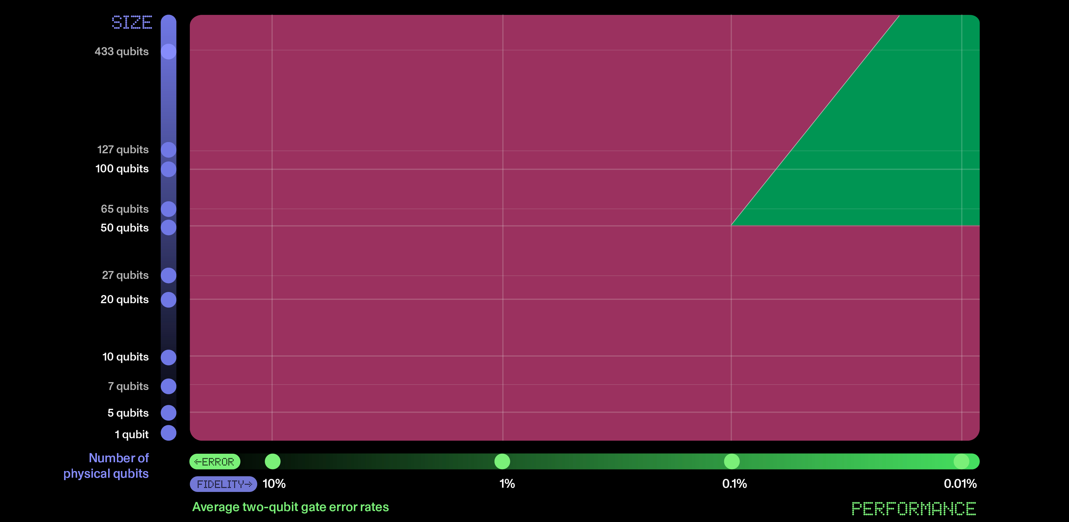




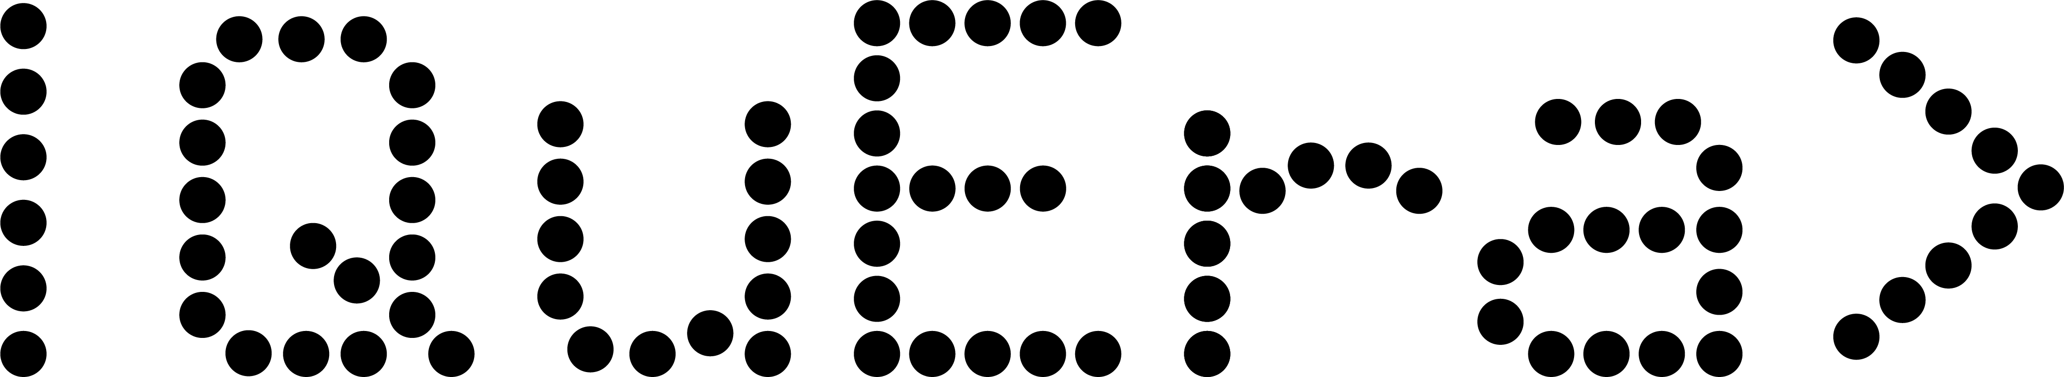

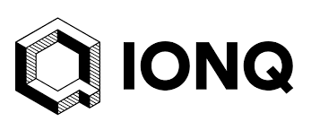
Quantum Computing: Two key ingredients
Notes:
To get a useful quantum computer there are two key ingredients: the number of qubits in your processor and the reliability of performing logic operations with those qubits.
And you really want to have good performance in both of these. Simply having a large device without good reliability leads to answers are wrong or require very large error correction overheads. And on the other hand, it is feasible to simulate few-qubit devices, even if they have high fidelity. Therefore, the scaling advantages of a quantum computer only payoff after a certain device size.
So, there is an interesting zone in the top right that can solve new problems reliably. Where we need both low error rates around the 1e-4 range and ~100 qubits.
(click)
Looking at where various architectures are today, no one has managed to produce a device that preforms in this regime. However, ion-based devices come closest. Notably several planforms are successfully increasing system size. However, improving logic fidelity is much less common.
(click)
At Oxford Ionics, we focus a lot on having high reliability qubit control that we can then scale up into these large and reliable devices

Slide 3
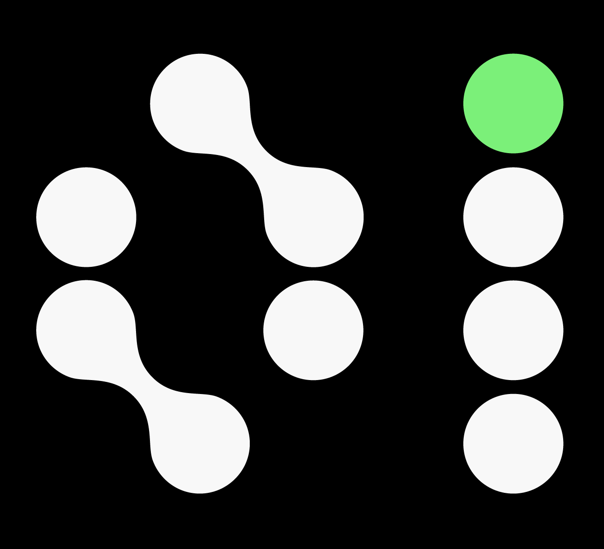
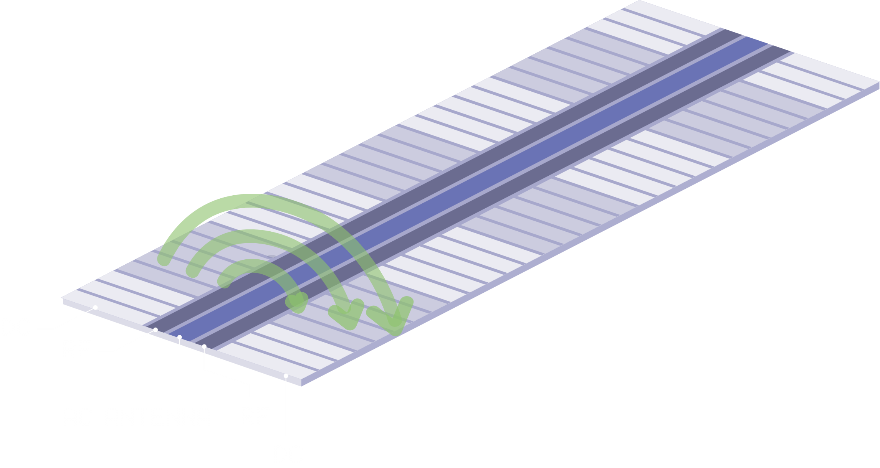
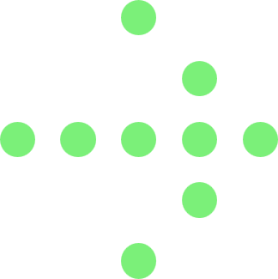

Why All-Electronic Control?
Great quantum-logic performance
Ions are great qubits
No photon scattering errors
Stable, low noise sources readily available
Scaling to many qubits
Easily integrated into trap
Well established gates
Global parallel control
B
LASER
I₀ cos ωt
Notes:
And we think all-electronic control is key to unlocking this performance.
Essentially, there are three reasons why we can achieve better fidelity using all electronic control of ions.
As we all know, ions make great qubits
By combining ions with all electronic control, we avoid photon scattering errors which degrade the quality of the qubits during logic operations
Microwave and radio sources with good stability and low noise are readily available.
But beyond quality of logic operations, all-electronic control also helps us scale to large QCCD devices as
Humans have gotten pretty good at integrating electronics into chips
While this integrated electronic approach compatible with well established gates
We can use global parallel control where a single logic drive can perform operations on many qubits in parallel.

Slide 4
A crash course of our electronic control
1-qubit logic gates, addressing, and 2-qubit logic gates
Notes:
Now you might say that’s all well and good… But how does this work in practice?
So I’d like to give a brief crash course of the how electronic control works in our current systems. By taking a closer looking at addressing of 1 qubit logic operations, as well as our two-qubit gates

Slide 5
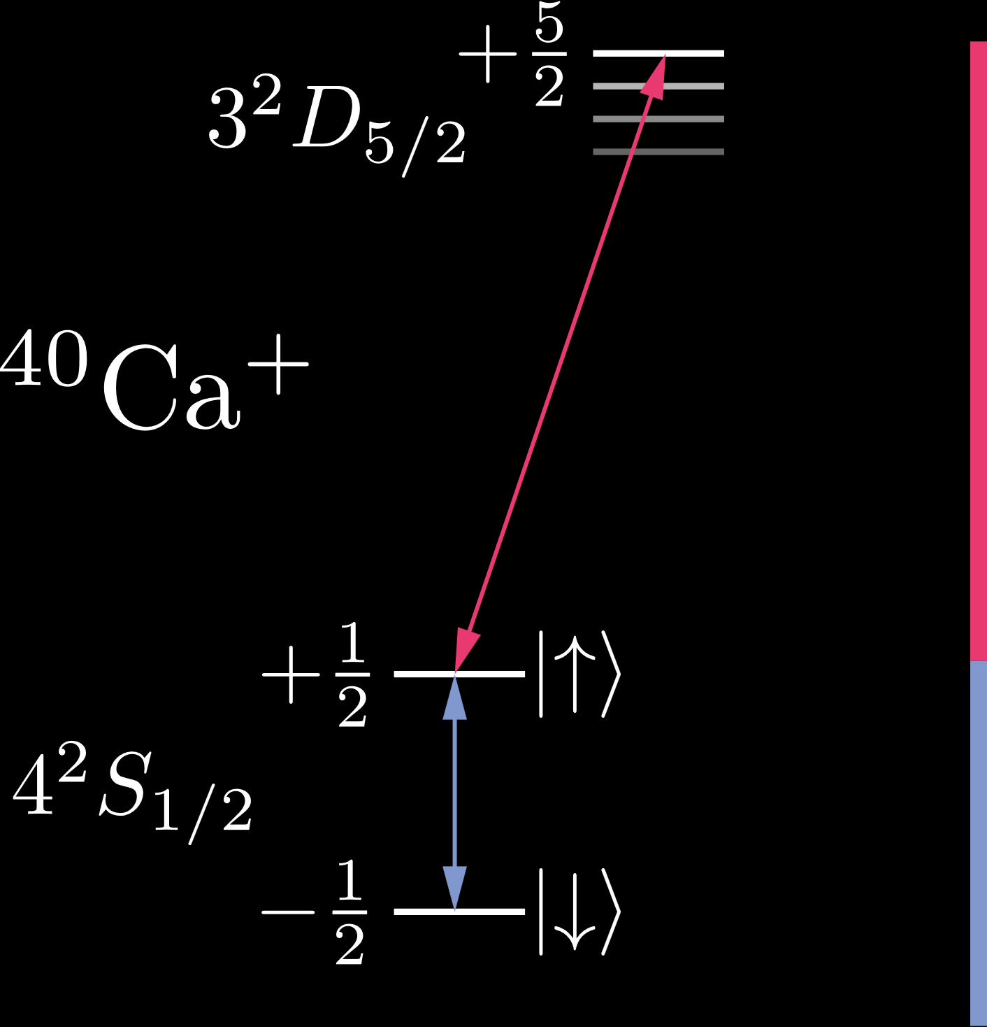

Our system
Near-field microwaves
Trap integrated antenna
High field gradient (>100 T/m per A)
Control signals near qubit frequency
Cryogenic traps
Very low heating rates
(~ 1 quanta / s in radial com modes)
Reduced resistance
Larger current for given input power
SHELVING
729 nm
QUBIT
240 MHz
ADDITIONAL LOW-POWER LASERS FOR COOLING AND REPUMPING
Notes:
We use the Ca40+ ion which has a two-level ground state which, because of our applied static magnetic field, is split by 240 MHz. And we can do shelving readout using the optical quadrupole transition to the D5/2 level
We choose to manipulate our qubit electronically and for this we use the nearfield microwave approach. Where we use trap integrated structures to generate oscillating magnetic fields that are near the qubit frequency.
We also choose to operate our systems cryogenically which enables very low heating rates and lower power dissipation from integrated microwave electronics.

Slide 6
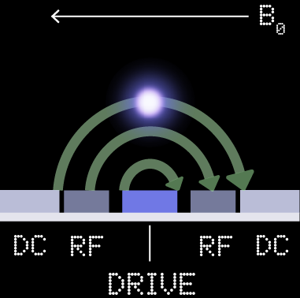






Road to selective operations
Partial nulling in the near field
$$+\frac{1}{2}$$
$$π$$
$$σ$$
$$−\frac{1}{2}$$
B
$$σ$$
$$σ$$
LASER
I₀ cos ωt
Notes:
One of the challenges when using near-field microwaves is making the microwave driven operations selective. Because the wavelength of microwaves is much larger than the distance between ions we can’t simply focus down the radiation on the desired ions.
However, because of the long wavelength, we can thing of magnetic field generated by the antenna structure within our chip as we would in magneto-statics. And this allow us to play some nice tricks to get selective ion control.
So if we consider a conductor running along the top of our chip like in the picture on the right, we can use the right-hand rule to to see that there will be a circulating magnetic field as sown here on the left.
We choose to set up the quantisation axis of our qubit in the plane of the chip perpendicular to the antenna. When we now recall how linear fields decompose into sigma and pi polarised fields for the ion, we notice that above the antenna the microwave field is entirely pi-polarised while it gains increasing sigma character as the ion is displaced to the sides.
As our Calcium 40 qubit is a sigma transition, this means we ideally get no microwave field coupling to our qubits when they sit in a plane above the antenna.

Slide 7


Position dependent Rabi-frequency
Controlling 1-Qubit rotations through DC electrodes
Y
X
B
0
0.3
DC
DC
0.2
Z
Rabi frequency (2π MHz)
DC
DC
$$π$$
Y
0.1
DC
DC
0.0
$$σ$$
-0.5
0.0
0.5
1.0
1.5
2.0
2.5
3.0
3.5
RF
RF
DC
RF
RF
DC
Position along y-axis (μm)
DRIVE
DRIVE
Notes:
Looking at this in the lab this expectation is confirmed by the data. And what we can see in the figure on the right is us taking an ion and moving it side to side relative to the pseudo-potential null. We then look at microwave driven Rabi oscillations at each of these positions and plot the observed Rabi-frequency.

Slide 8
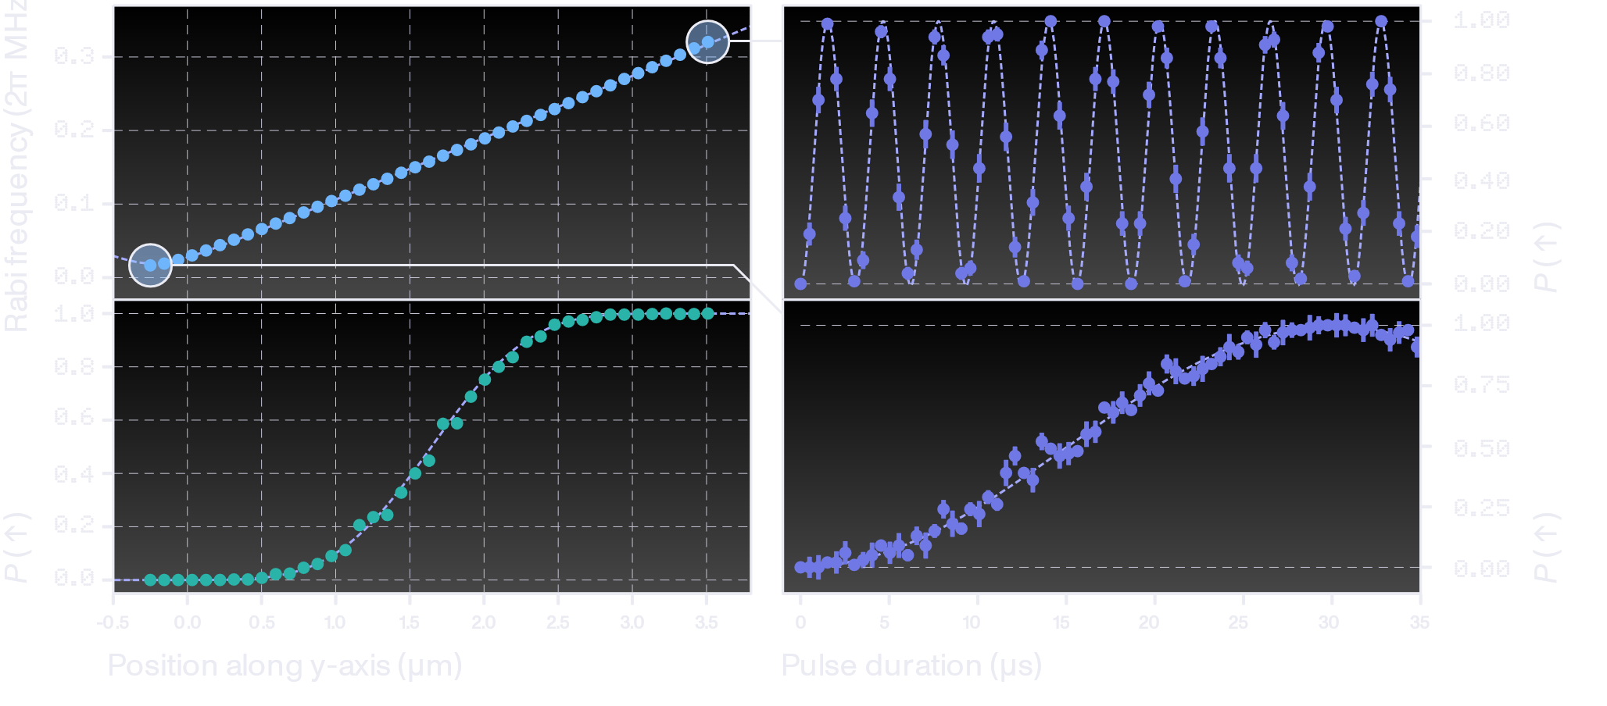
Selective 1Q logic operations
Addressing logic operations
Notes:
Looking at the two extreme positions we see roughly a 20 fold difference in Rabi-frequency generated by controlling the ion-position. If we took a naïve approach of hiding an ion at the minimum and performing a pi pulse at the extreme point, this would lead to a hiding error of ~0.5%. But because this is all coherent, there are many ways of improving on this. One way of doing this is using composite pulses such as SK1 pulses which result in a sharper transition from addressed to hidden logic operations.

Slide 9
Measured 1Q logic performance
Running 1QRB in 7 zones
7 ACTIVE, 0 HIDDEN
1 ACTIVE, 6 HIDDEN
0 ACTIVE, 7 HIDDEN
1
2
3
4
5
6
7
1
2
3
4
5
6
7
1
2
3
4
5
6
7
zones
P_{Clifford} ≥99.999%
P_{cross-talk} ≤0.0003%
Notes:
Using this combination of partial nulling and positioning of the ions using the DC electrodes, which are intrinsic to the QCCD architecture, we have performed randomised benchmarking of the single qubit logic fidelity in 7 zones.
We find that with our models of the trap this approach “just works”.
Without any calibration of crosstalk of well-positions we find error probabilities of better than 1e-5 per Clifford in all zones and configurations. Further, crosstalk to hidden ions was smaller than 3e-6 in all cases.

Slide 10
But we also need two-qubit gates!
We can parallelise & address individual qubits…
Notes:
But as we all know a quantum processor needs to perform both single and two-qubit gates. So how does that work in our systems?

Slide 11





How do we do two-qubit gates
Near field microwave & spin dependent forces
$$E$$
0.3
$$|+>$$
0.2
$$ℏΩ$$
Rabi frequency (2π MHz)
$$|−>$$
0.1
0.0
-0.5
0.0
0.5
1.0
1.5
2.0
2.5
3.0
3.5
$$Ω$$
Position along y-axis (μm)
SEE E.G.
C. Ospelkaus et al., Phys. Rev. Lett. 101, 090502 (2008)
Notes:
As it turns out we can use the same microwave amplitude gradient we already used for single qubit addressing to drive two-qubit gates.
This can be understood within the dressed state picture of the microwave drive. When the ion is undergoing resonant Rabi-oscillation, the dressed states of the qubit become the plus and minus states which are on the equator of the Bloch sphere. Crucially these eigen states are separated by an energy corresponding to the frequency of Rabi-oscillation. As this Rabi-frequency varies quickly with position, the energy of the dressed states also varies as the ion is displaced .
This position and spin dependent potential results in there being a spin-dependent force on the ions which we then use to drive traditional Molmer-Sorenson geometric phase gates on pairs of qubits within a single potential well.

Slide 12
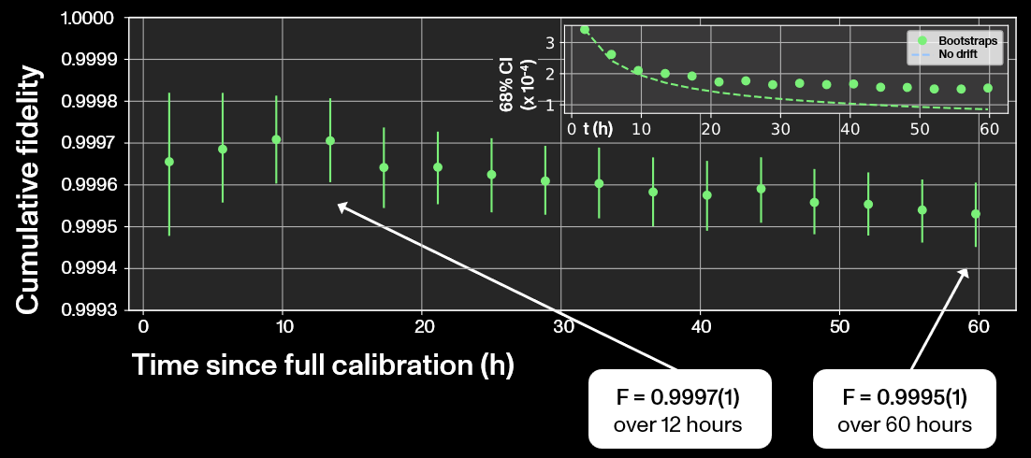
99.97% Fidelity
The best Bell-state ever measured?
Notes:
Using this spin dependent force to drive Molmer-Sorensen two-qubit gates we measure a spam corrected bell-state fidelity of 99.97(1)%, averaged over 12 hours.
To our knowledge is the highest fidelity bell state ever measured, including those produced using error correction approaches.
It is also worth noting that over this entire time, the only system parameter that was being recalibrated was the frequency of the motional mode used to perform the gate.
Running for longer time-periods without performing a more complete calibration sees a gradual decrease in the fidelity. However, even averaging over 60 hours without a full calibration, we still get a bell-state fidelity of 99.95(1)%

Slide 13
99.97% Fidelity
The best Bell-state ever measured?
Limited by qubit frequency instability
No fundamental limitations at the 10⁻⁴ level
Ongoing work to measure fidelity via randomised benchmarking
Notes:
We believe the fidelity measured here is limited by the qubit-frequency stability of our field sensitive Zeeman-qubit.
So there are no fundamental limits in sight at the 1e-4 error level.

Slide 14
But does it scale to truly large devices?
So we have world class logic operations…
Notes:
Within our all-electronically controlled systems we combine single qubit gate and hiding fiedelities below 1e-5 error levels and the worlds best two-qubit gates.

Slide 15
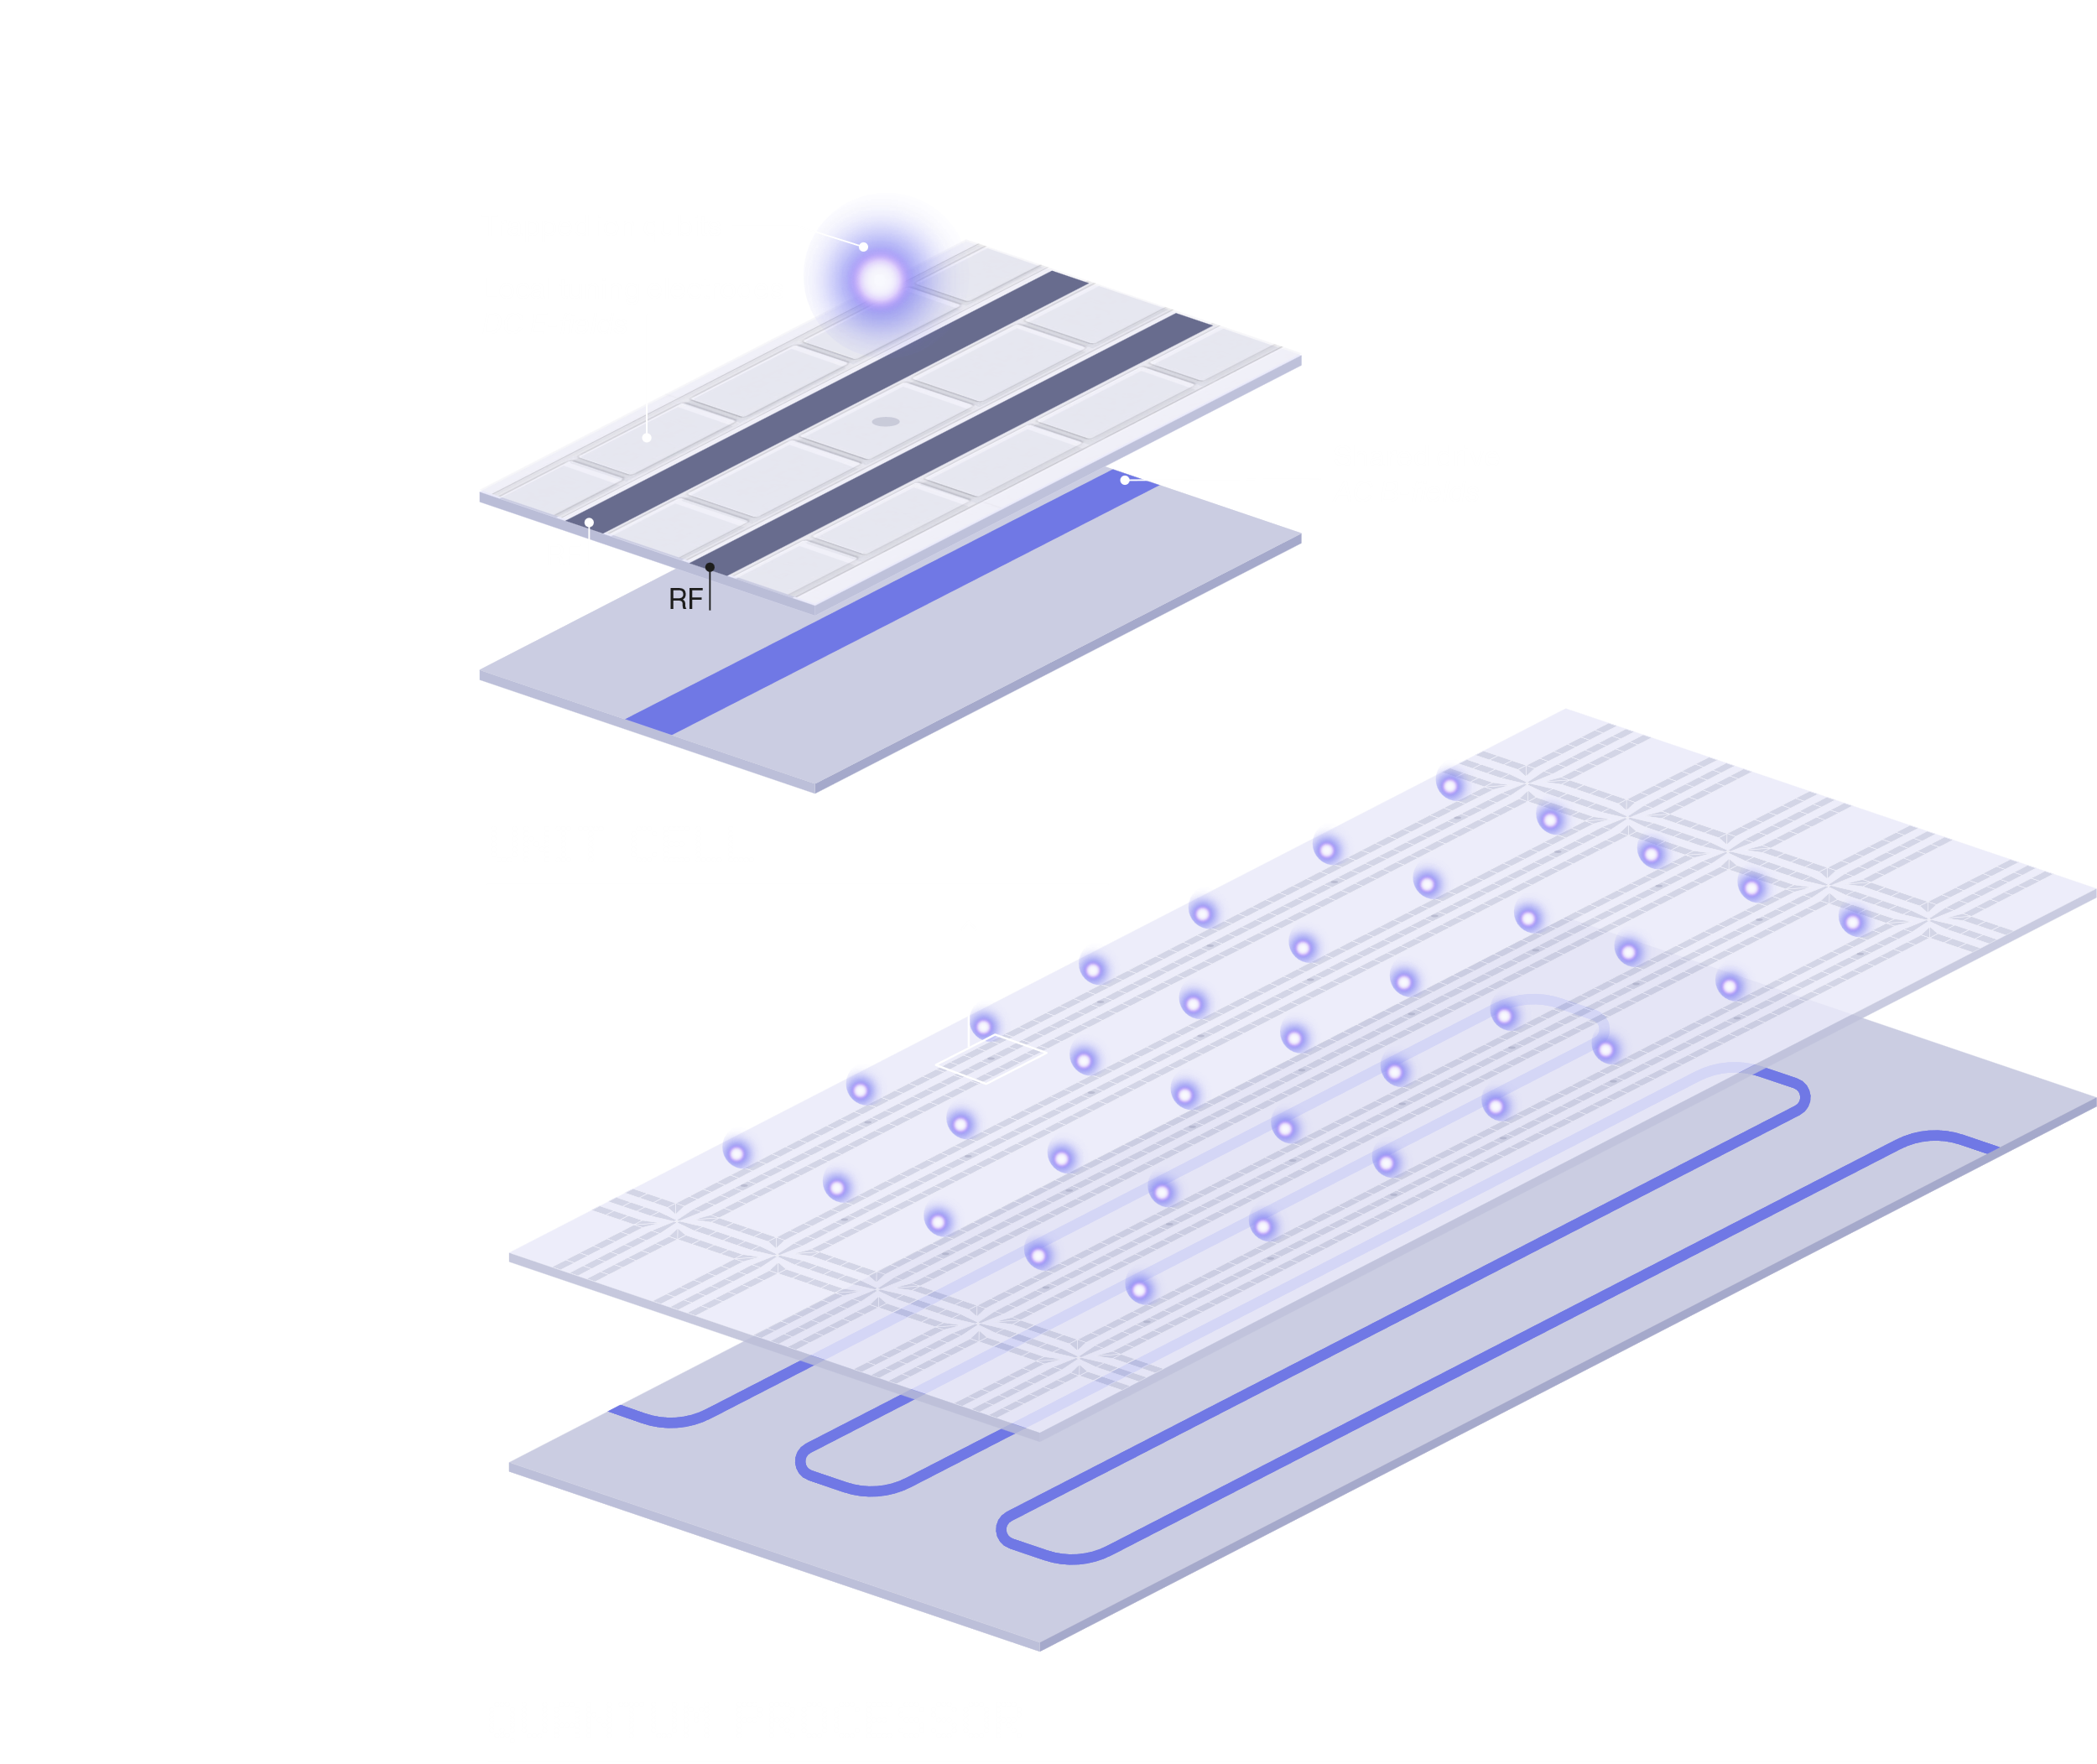
Unit Cells in a QCCD
Global parallel control
Challenge of unit cell in QCCD architecture
  Power consumption
  Footprint
  IO count
Challenging per unit cell logic control
  No per-cell Modulator footprints
  (optical or microwave)
Challenge of scaling slow-down
  No need to serialise gates on different ions
Challenge of power consumption
  Few high current sources/integrated modulators
Notes:
When one starts thinking about building devices for 100s of qubits in QCCD architecture one finds that one probably wants to have some kind of unit cell within which logic operations can be performed that is repeated many times over the trap. Power consumption, footprint and the number of available Ios to the chip are significant constraints on how such a unit cell can be built. This becomes especially scary when you start thinking about needing to add logic signals into each zone (be they optical or electronic).
(click)
In our case, by using global parallel control we can, avoid needing to incur a large per-cell footprint associated with integrated signal modulators.
Further, we can perform gates in parallel across large areas of the chip and thereby avoid a slowdown associated with serialising logic operations in a few logic zones.
Finally using global parallel control enables us to use very few large current sources and modulators
Unit cell considerations – logic control per unit cell is hard
Not slow as you get bigger -> parallel
Global parallel control as the answer

Slide 16
Quantum Computing: Two key ingredients
Notes:
So having demonstrated world class quantum logic we are now in a great position for scaling to increasing qubit numbers and there are exciting times ahead!

Slide 17
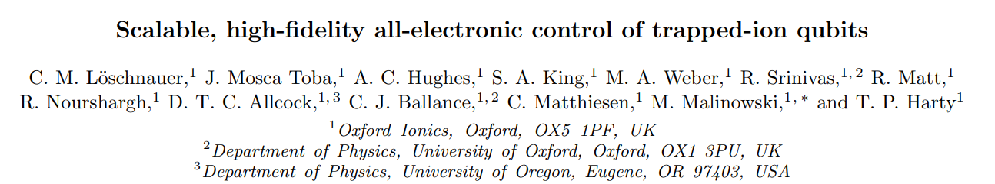
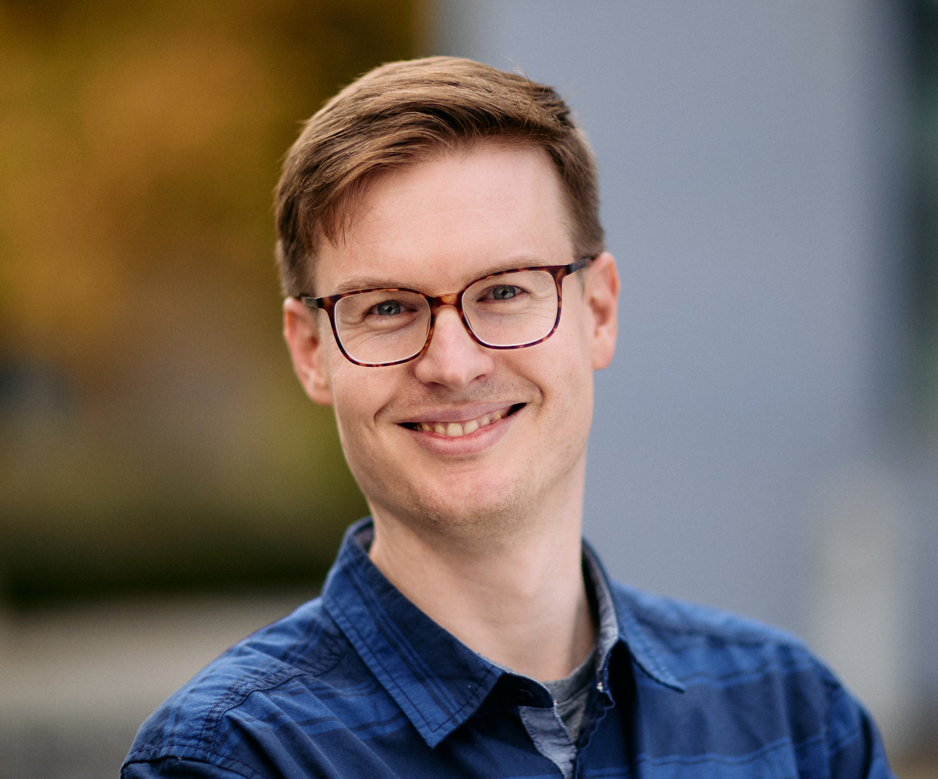
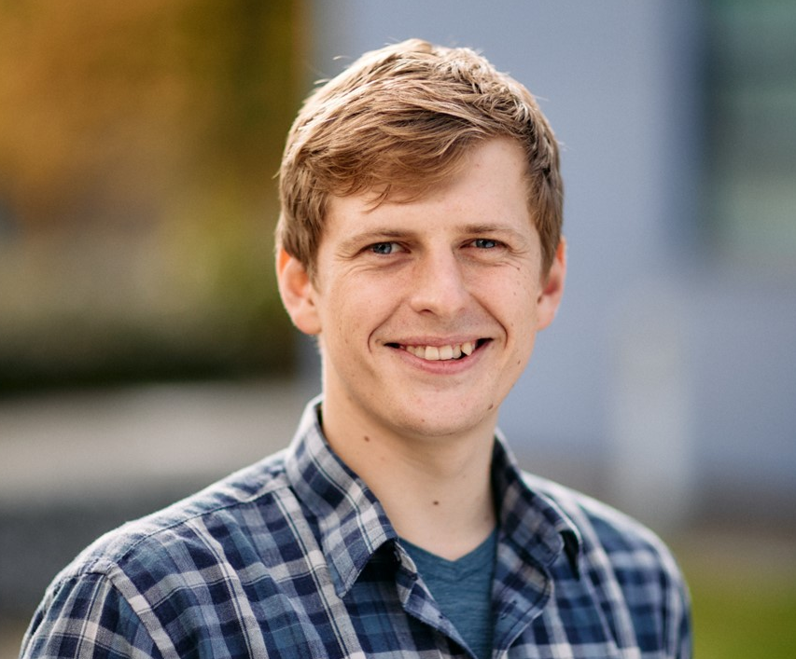
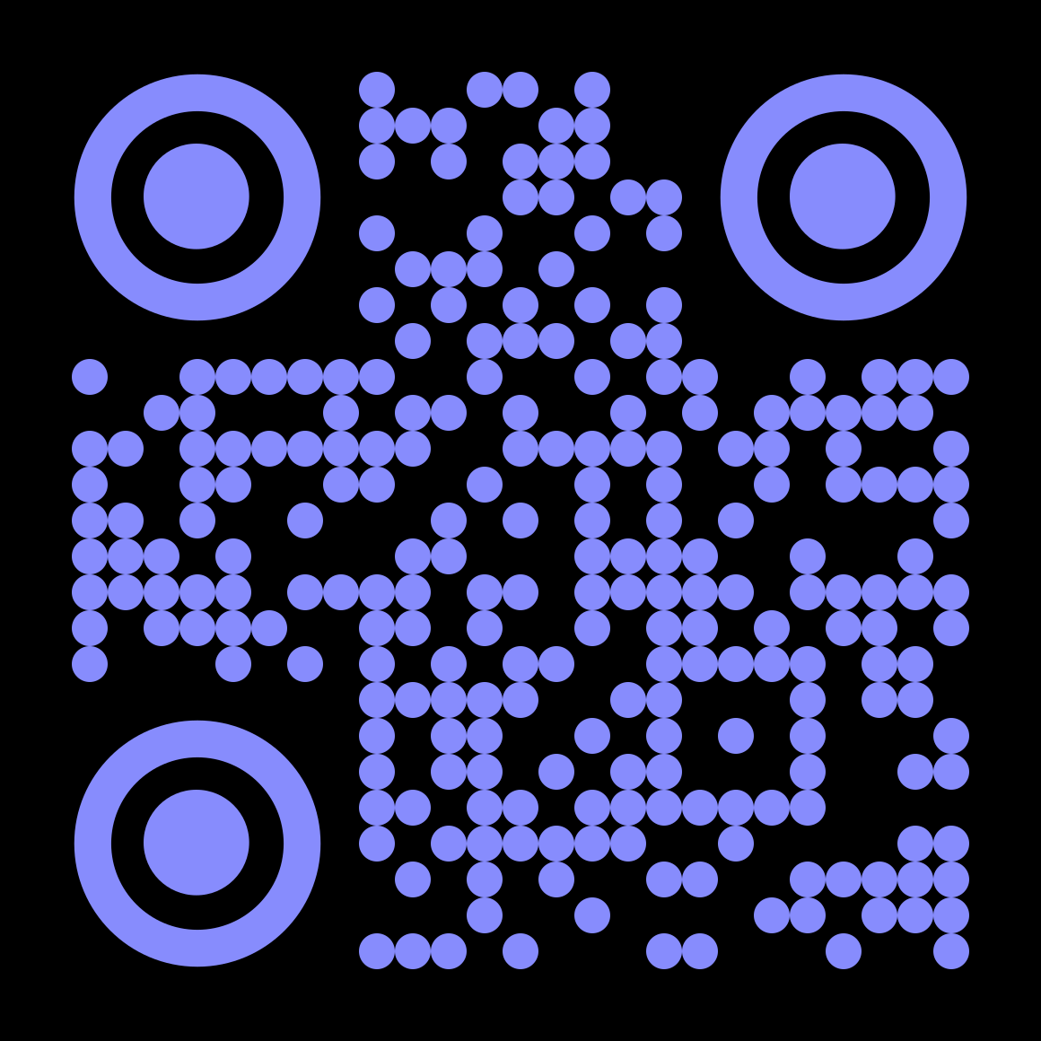
Thanks for listening
Where can you find the team this week?
Grab us for a chat:
Get in touch:
info@oxionics.com
careers@oxionics.com
Website: oxionics.com
Clemens Matthiesen
Science Team Lead
Marius Weber
Quantum Scientist

Slide 19
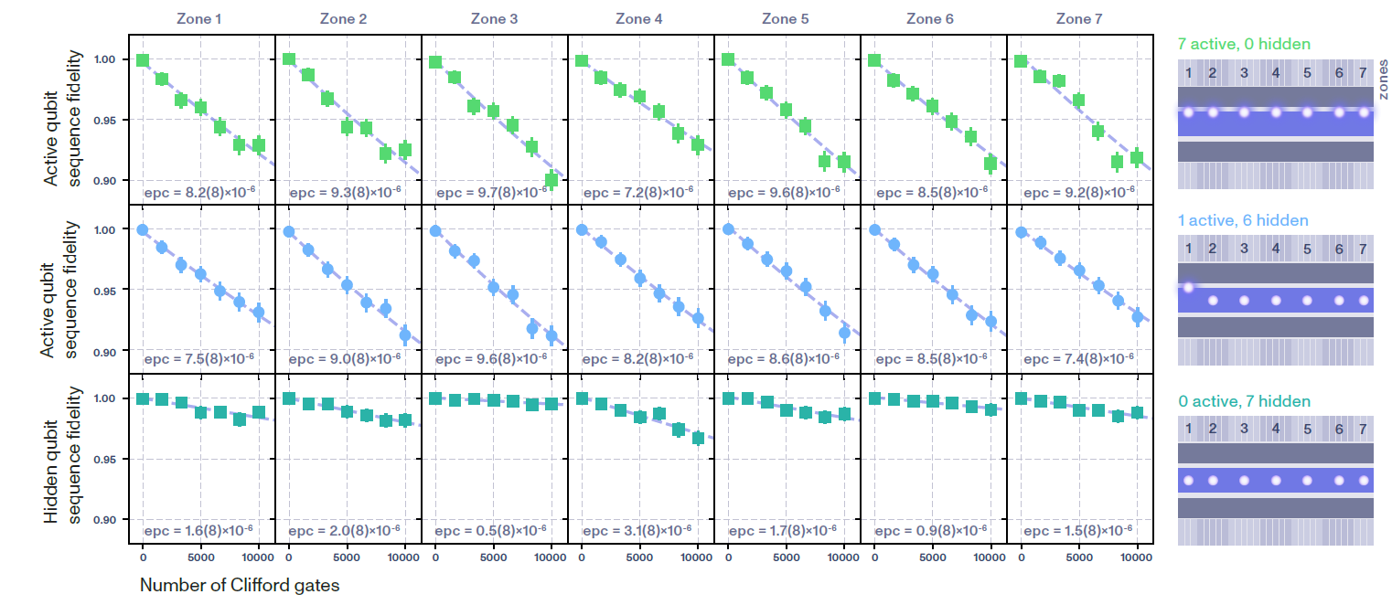
1 Qubit logic measurements

Slide 20
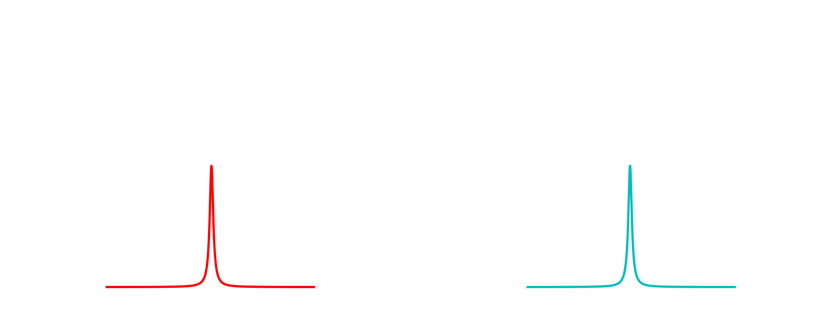
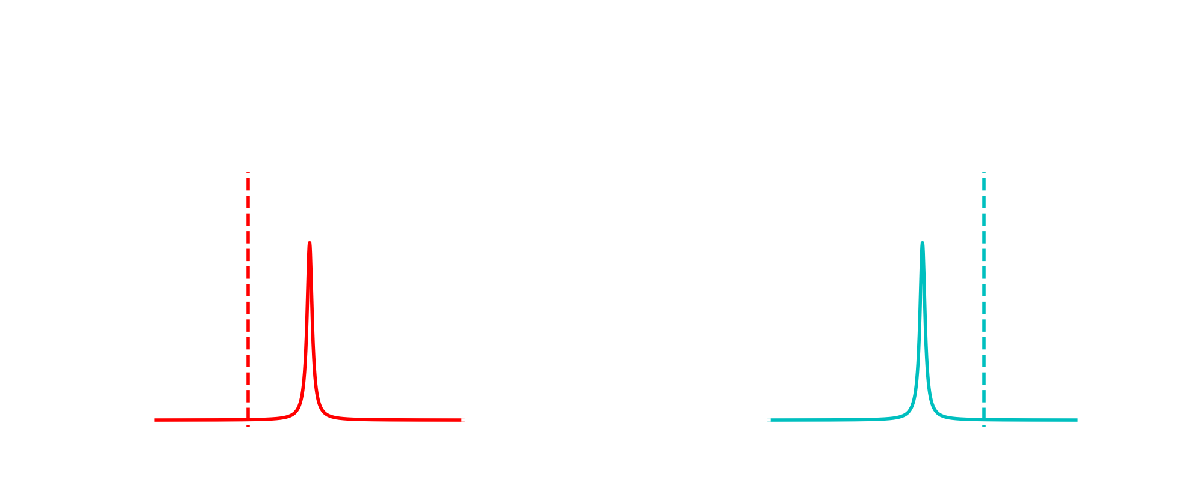
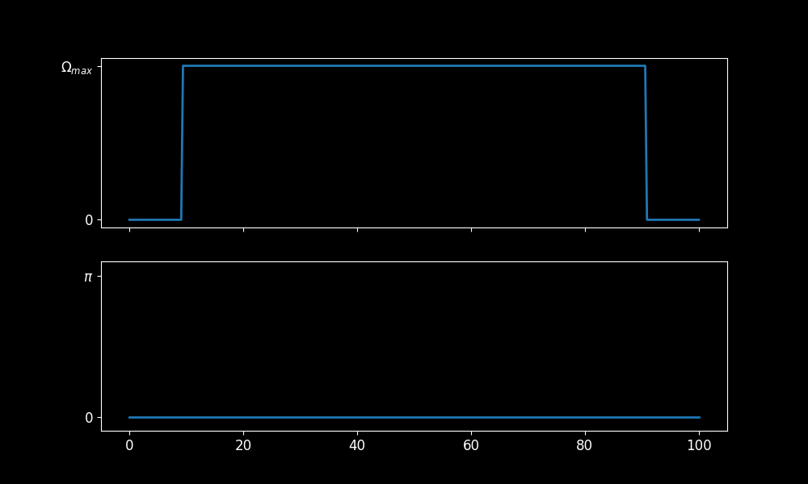
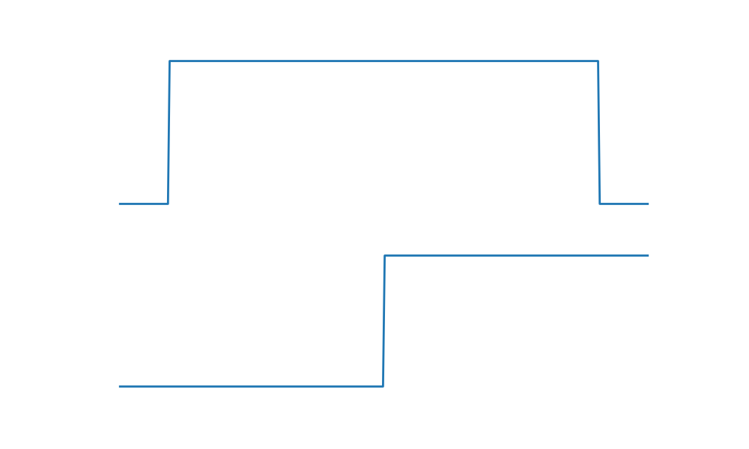
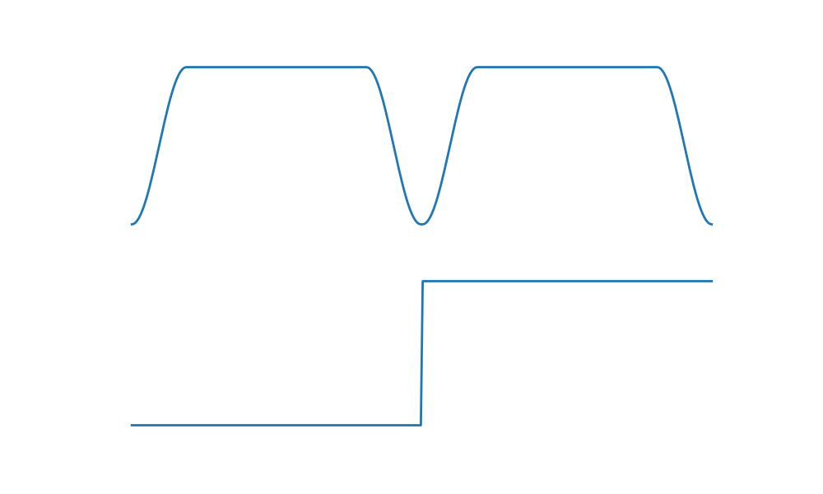
Fast entangling gates
Two-loop Mølmer–Sørensen gate
Walsh-1 modulation to reduce sensitivity to changes in motional frequency
Pulse shaping to reduce residual excitation from off-resonant coupling
Duration 120 μs
Rabi frequency
SEE E.G.
D. Hayes et al., Phys. Rev. Lett. 109, 020503 (2012)
G. Zarantonello et al., Phys. Rev. Lett. 123, 260503 (2019)
Phase difference between tones
Time (μs)
Notes:
For the data presented here, the two-qubit gate was implemented through the Molmer-Sorensen scheme. We apply two tones to the microwave electrode, with frequencies such that they are symmetrically detuned from the motional sidebands of the mode used to mediate the gate interaction.
In its simplest form, a single square pulse with appropriate duration and detuning could be used. But we exploit advances made in the last decade to reduce sensitivity.
In particular, we drive two loops in phase space in combination with Walsh-1 modulation to reduce sensitivity to changes in motional frequency. We implement this by flipping the phase difference between the two tones after the first loop.
Additionally, we shape the edges of our pulses to reduce errors from off-resonant coupling to the carrier transition and spectator modes.
The large mw gradient in our trap results in a two-qubit gate Rabi frequency of more than 6 kHz, which translates to a two-loop gate duration of around 120 us.

Slide 21
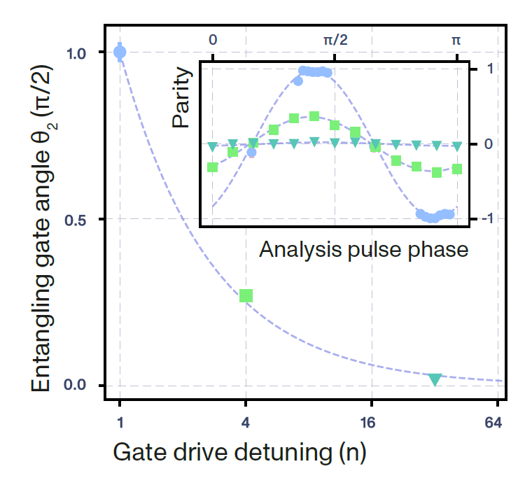
2 Qubit gate addressing

Slide 22
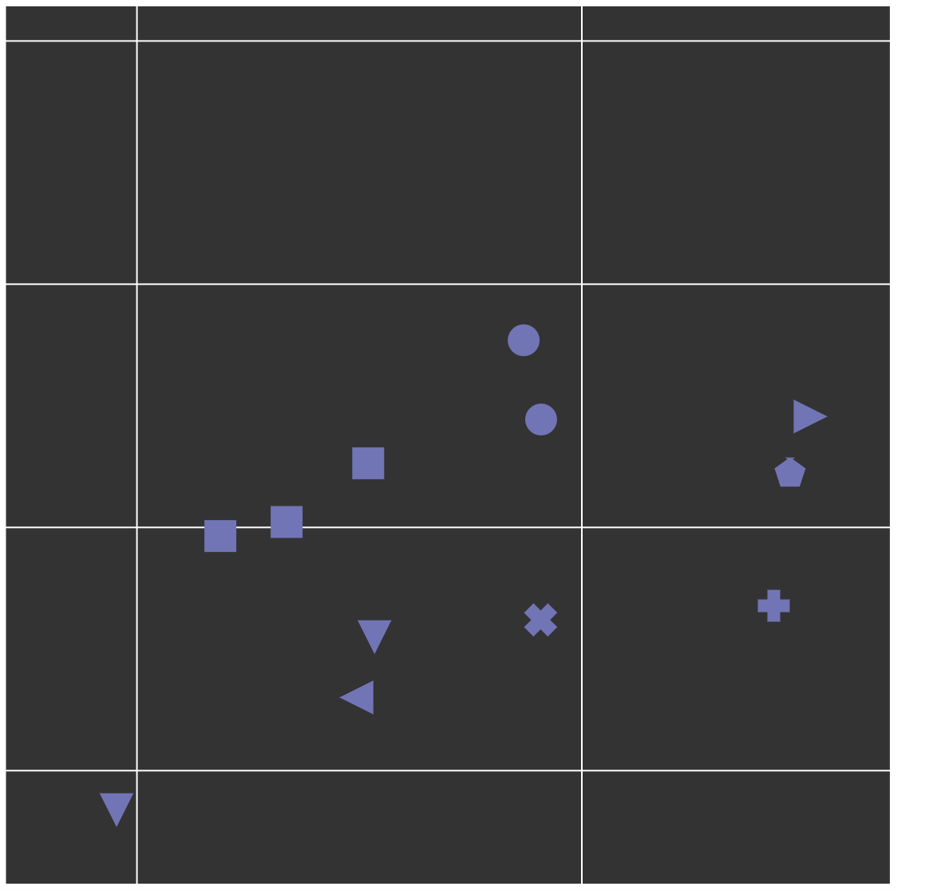

99.97% Fidelity
Mw-driven two-qubit gates
(lower bound of CI)
0.9999
Oxford 2016
Sussex 2016
Hannover 2019a
Hannover 2019b
NIST 2021a
NIST 2021b
Siegen 2023
Oxford 2023
Siegen 2024
Oxford Ionics 2024
0.999
0.99
Bell-state
fidelity
0.9
100
1000
Gate duration (μs)
Notes:
Let’s go back to the plot shown earlier to put our result into context. We have demonstrated that fast, very high-fidelity gates are possible in our architecture. Limitations to speed are currently technical, expect that further improvements are possible.

Slide 23
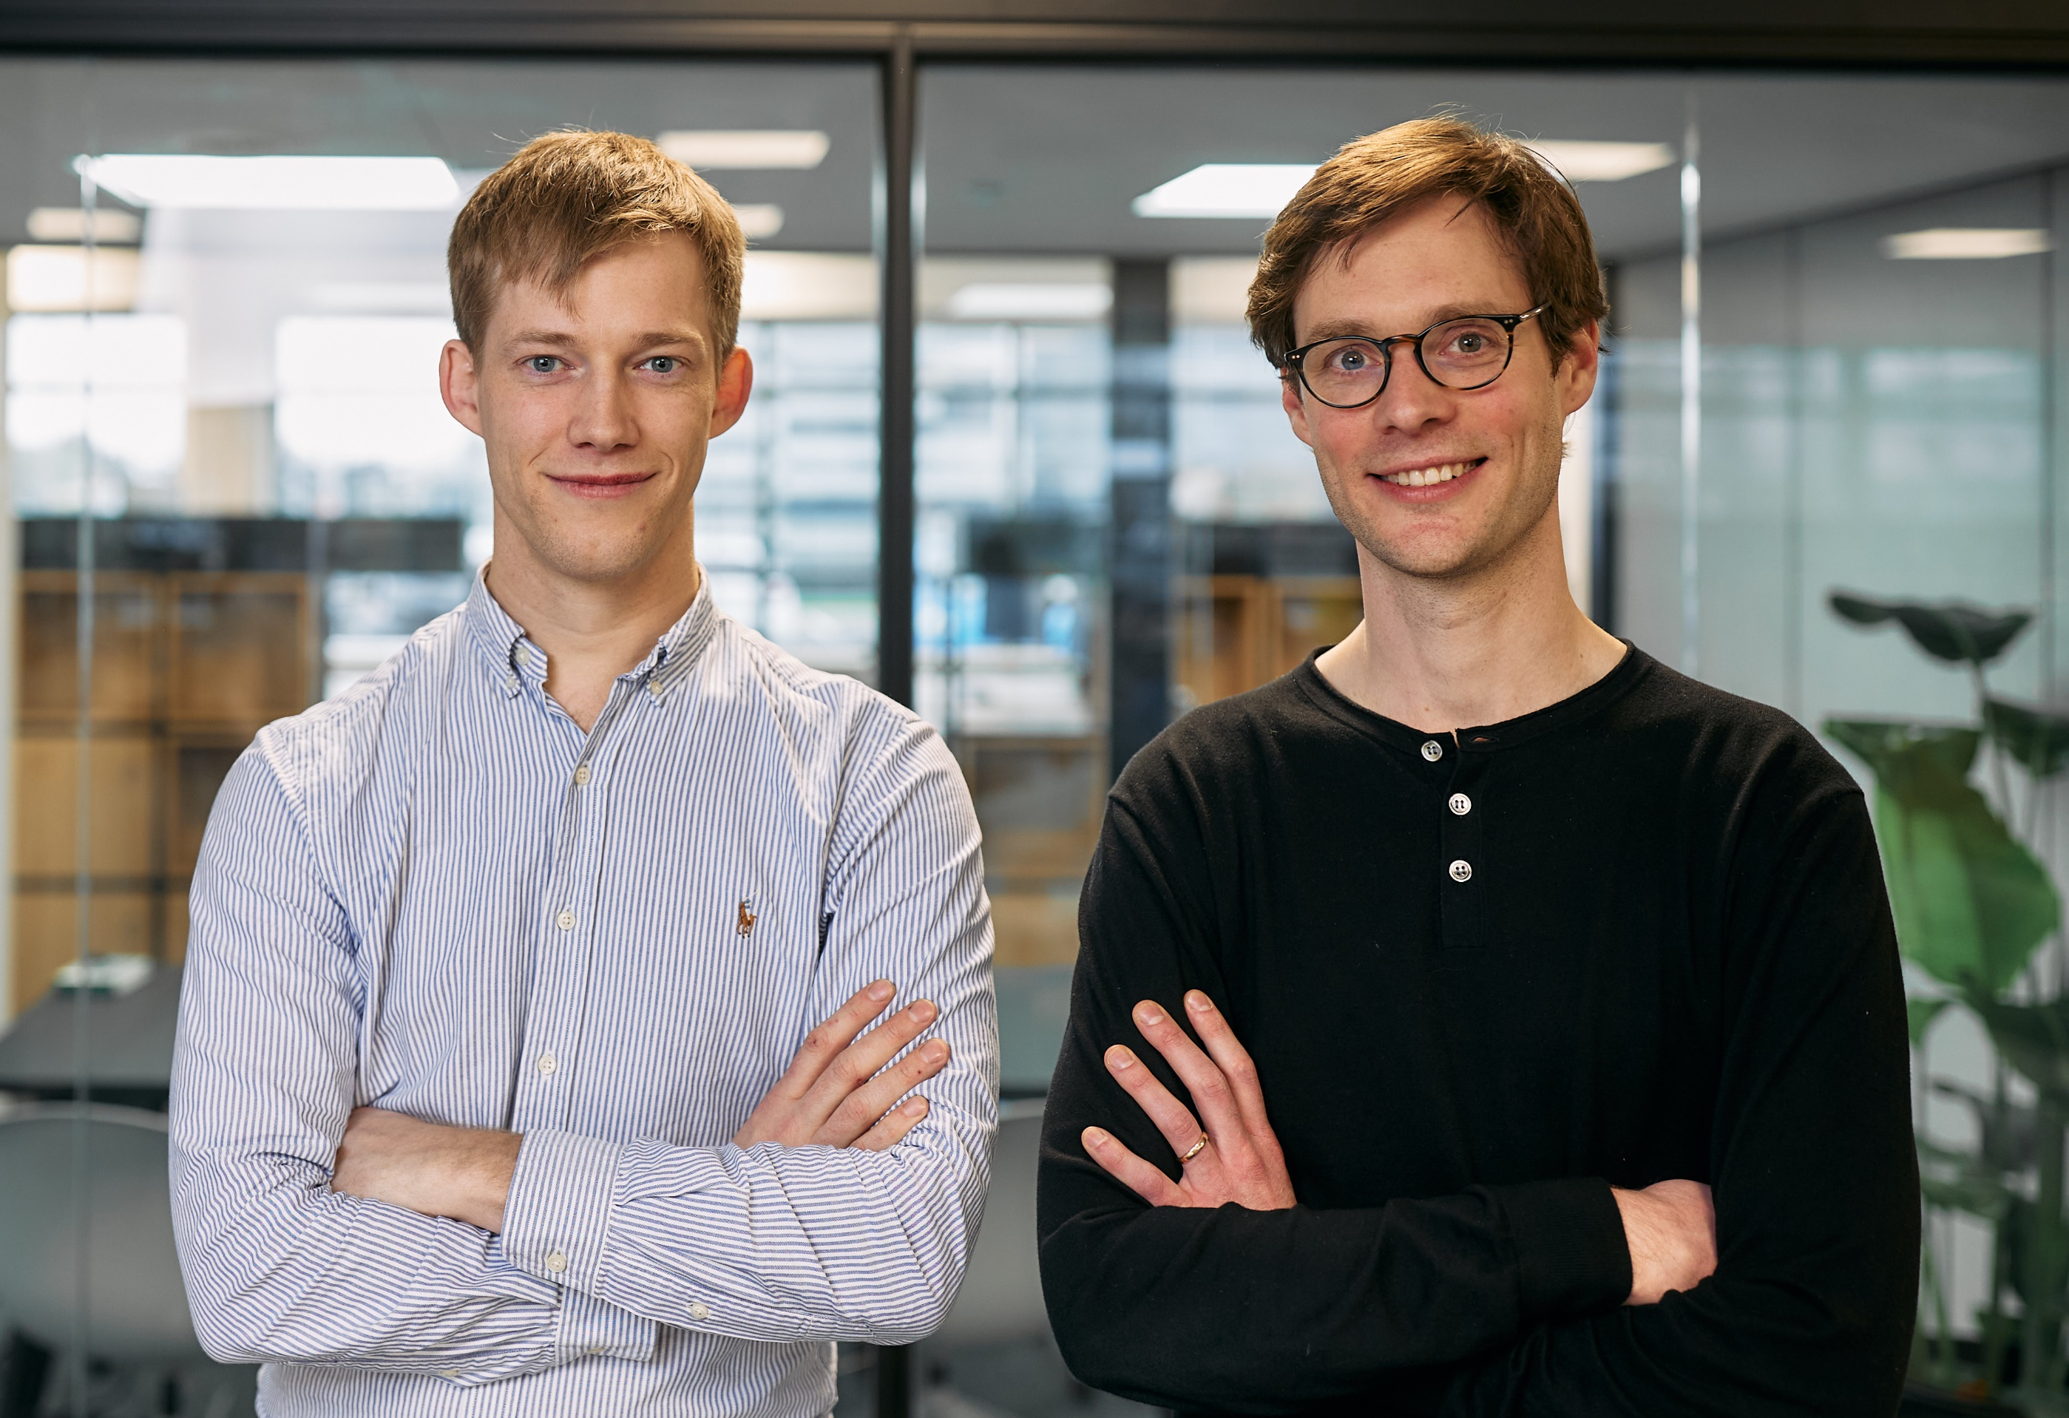
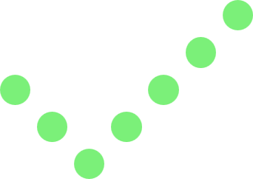
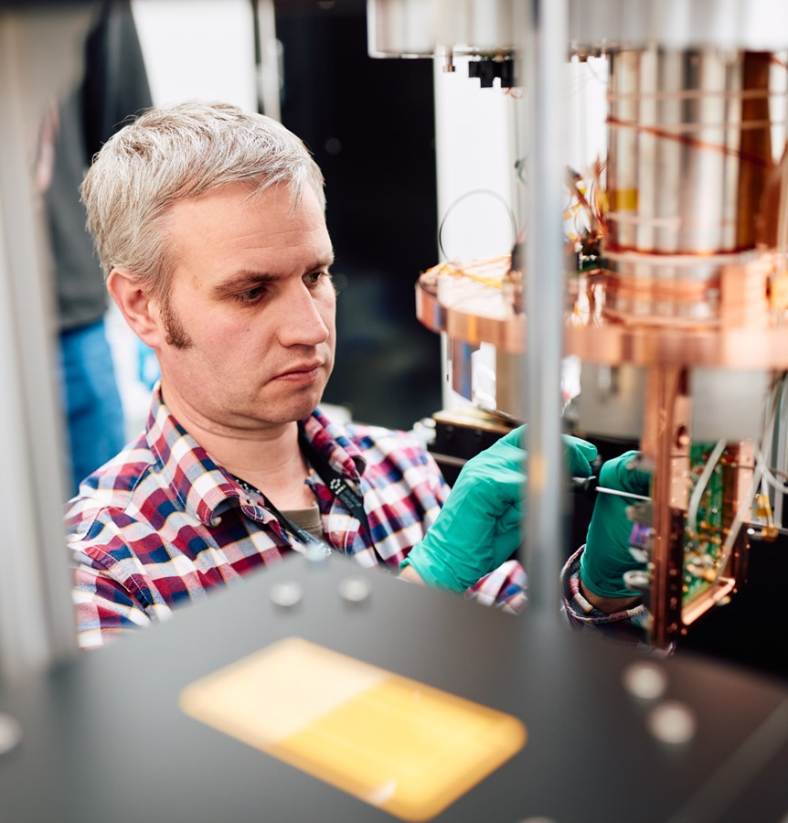
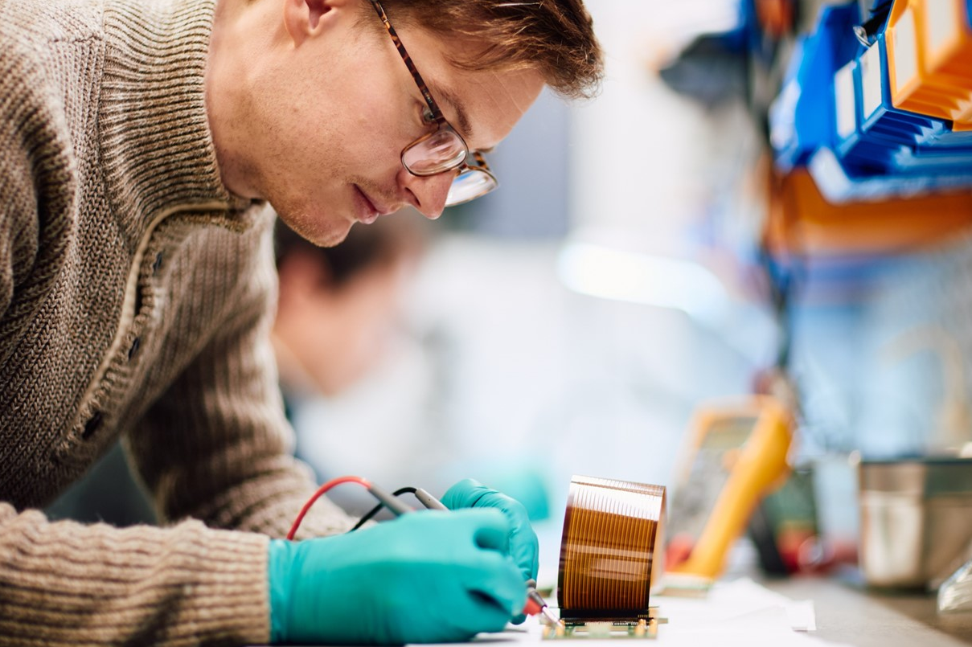

WHO WE ARE
Oxford Ionics
Founded in 2019 by Chris Ballance and Tom Harty
Based on trapped-ion research at the University of Oxford
> $45 M raised to date
Team of 50 worldwide, HQ and hardware labs in Oxford
US office coming soon!
Notes:
But first, who are we….
We’re a quantum computing company that developed from the oxford university trapped ion lab and have been steadily growing since 2019 to a team of just over 50 people to date.

Slide 24
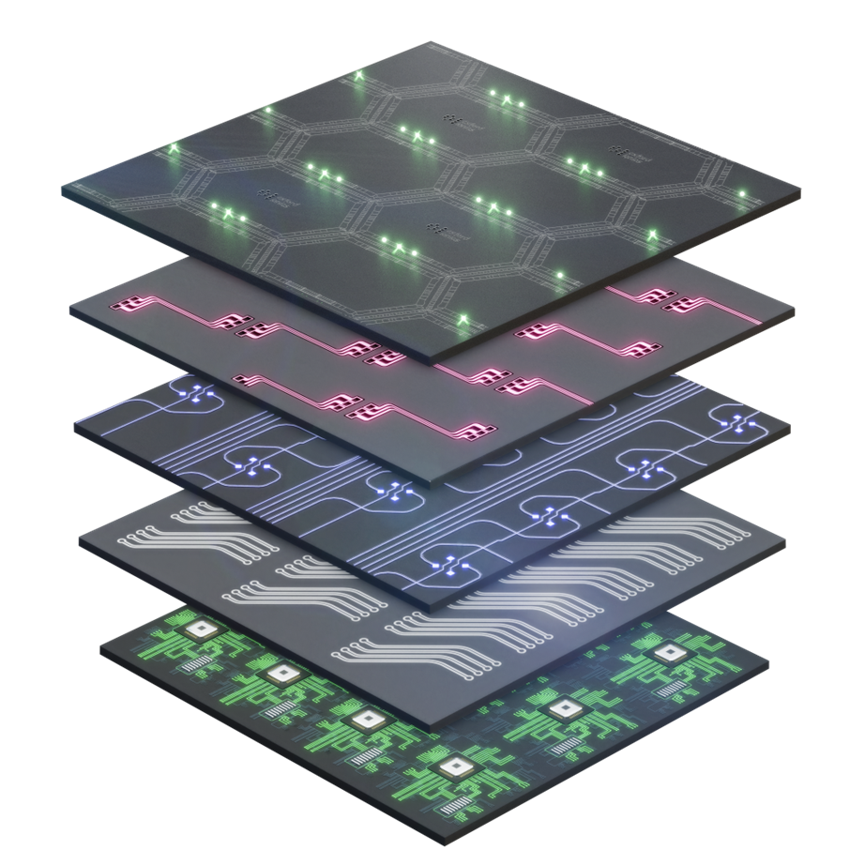

WHAT WE DO
World-leading technology
We use the best qubits: trapped ions
INTEGRATED ELECTRODES
allow for all-to-all connectivity
and local control
We have gates with the lowest errors:
laser-free microwave gates
INTEGRATED ANTENNAS
allow for high-fidelity parallel quantum gates
Our architecture is scalable:
QCCD
INTEGRATED PHOTONICS
eliminates laser alignment and complex free-space optics
We are industrially integrated with standard manufacturing processes:
Partnered with Infineon
INTEGRATED ELECTRONICS
removes the I/O bottlenecks plaguing quantum computers
Notes:
Ions are best qubits because: highest two-qubit gate fidelities (also single-qubit fidelity?) and coherence to date
PHRASE IN A WAY THAT’S TRUE, BUT ALSO ENTHUSIASTIC
Error sources well understood, no surprises – every ion loaded is a perfect qubit from nature
To realise our vision of integrated …., we partner with Infineon …
2D connectivity
COMBINE ALL THESE TO MAKE SCALABLE DEVICE

Slide 25
Our demonstration systems
Demonstrating all electronic control
Near-field “microwaves”
  Coupling to the qubit state
Cryogenic trap
  Very low heating rates
  (~ 1 quanta / s in radial com modes @40 µm)
  Reduced resistance
  Larger current for given input power
Ion: ⁴⁰Ca⁺
  Chosen for simplicity of structure
SHELVING
729 nm
QUBIT
240 MHz
ADDITIONAL LOW-POWER LASERS FOR COOLING AND REPUMPING

Slide 26
Laser-free entangling gates
FAST AND HIGH-FIDELITY

