Slide 1
Early Career Conference in Trapped Ions 2024
Innsbruck

Slide 2
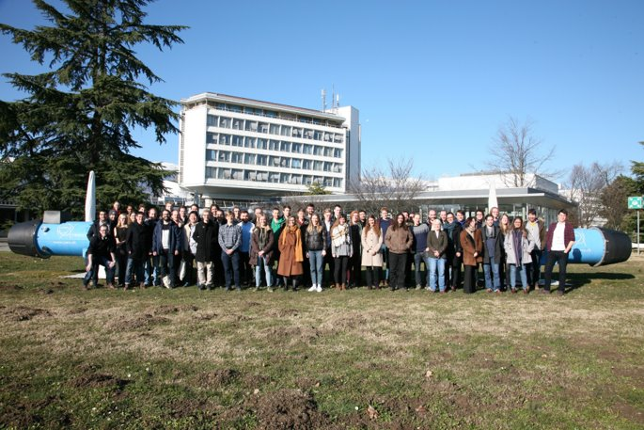
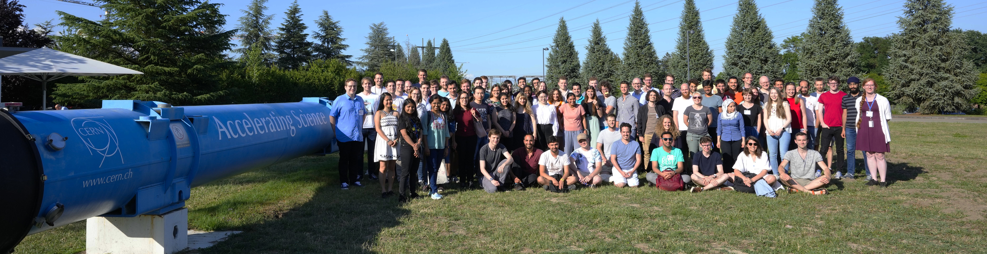
Overview
2020
  65 Participants
  34 Speakers
  18 Posters
2022
  88 Participants
  42 Speakers
  42 Posters
2024
  121 Participants
  53 Speakers
  59 Posters

Slide 3

Safety
General emergency number: 112

Slide 4

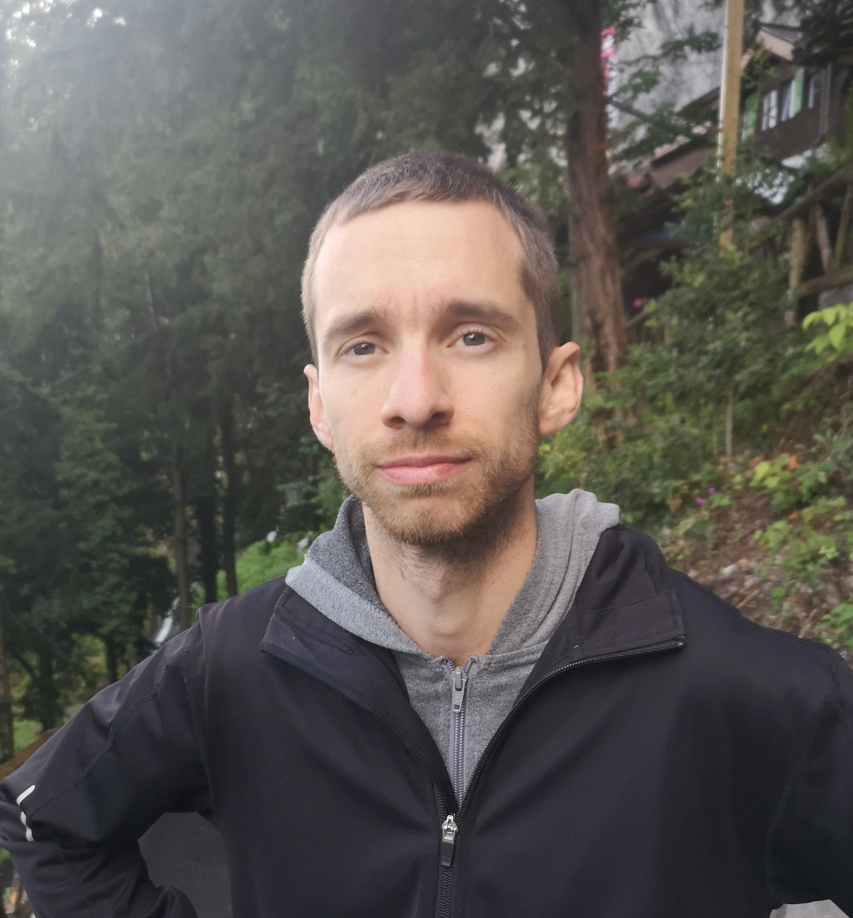
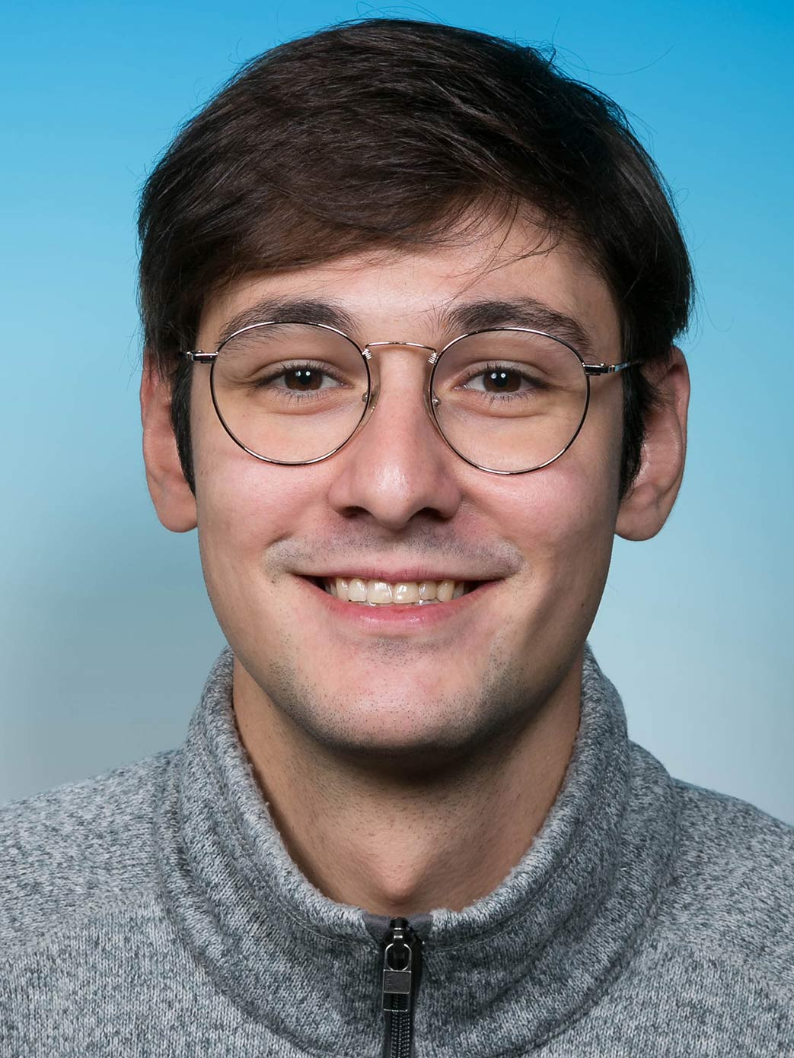
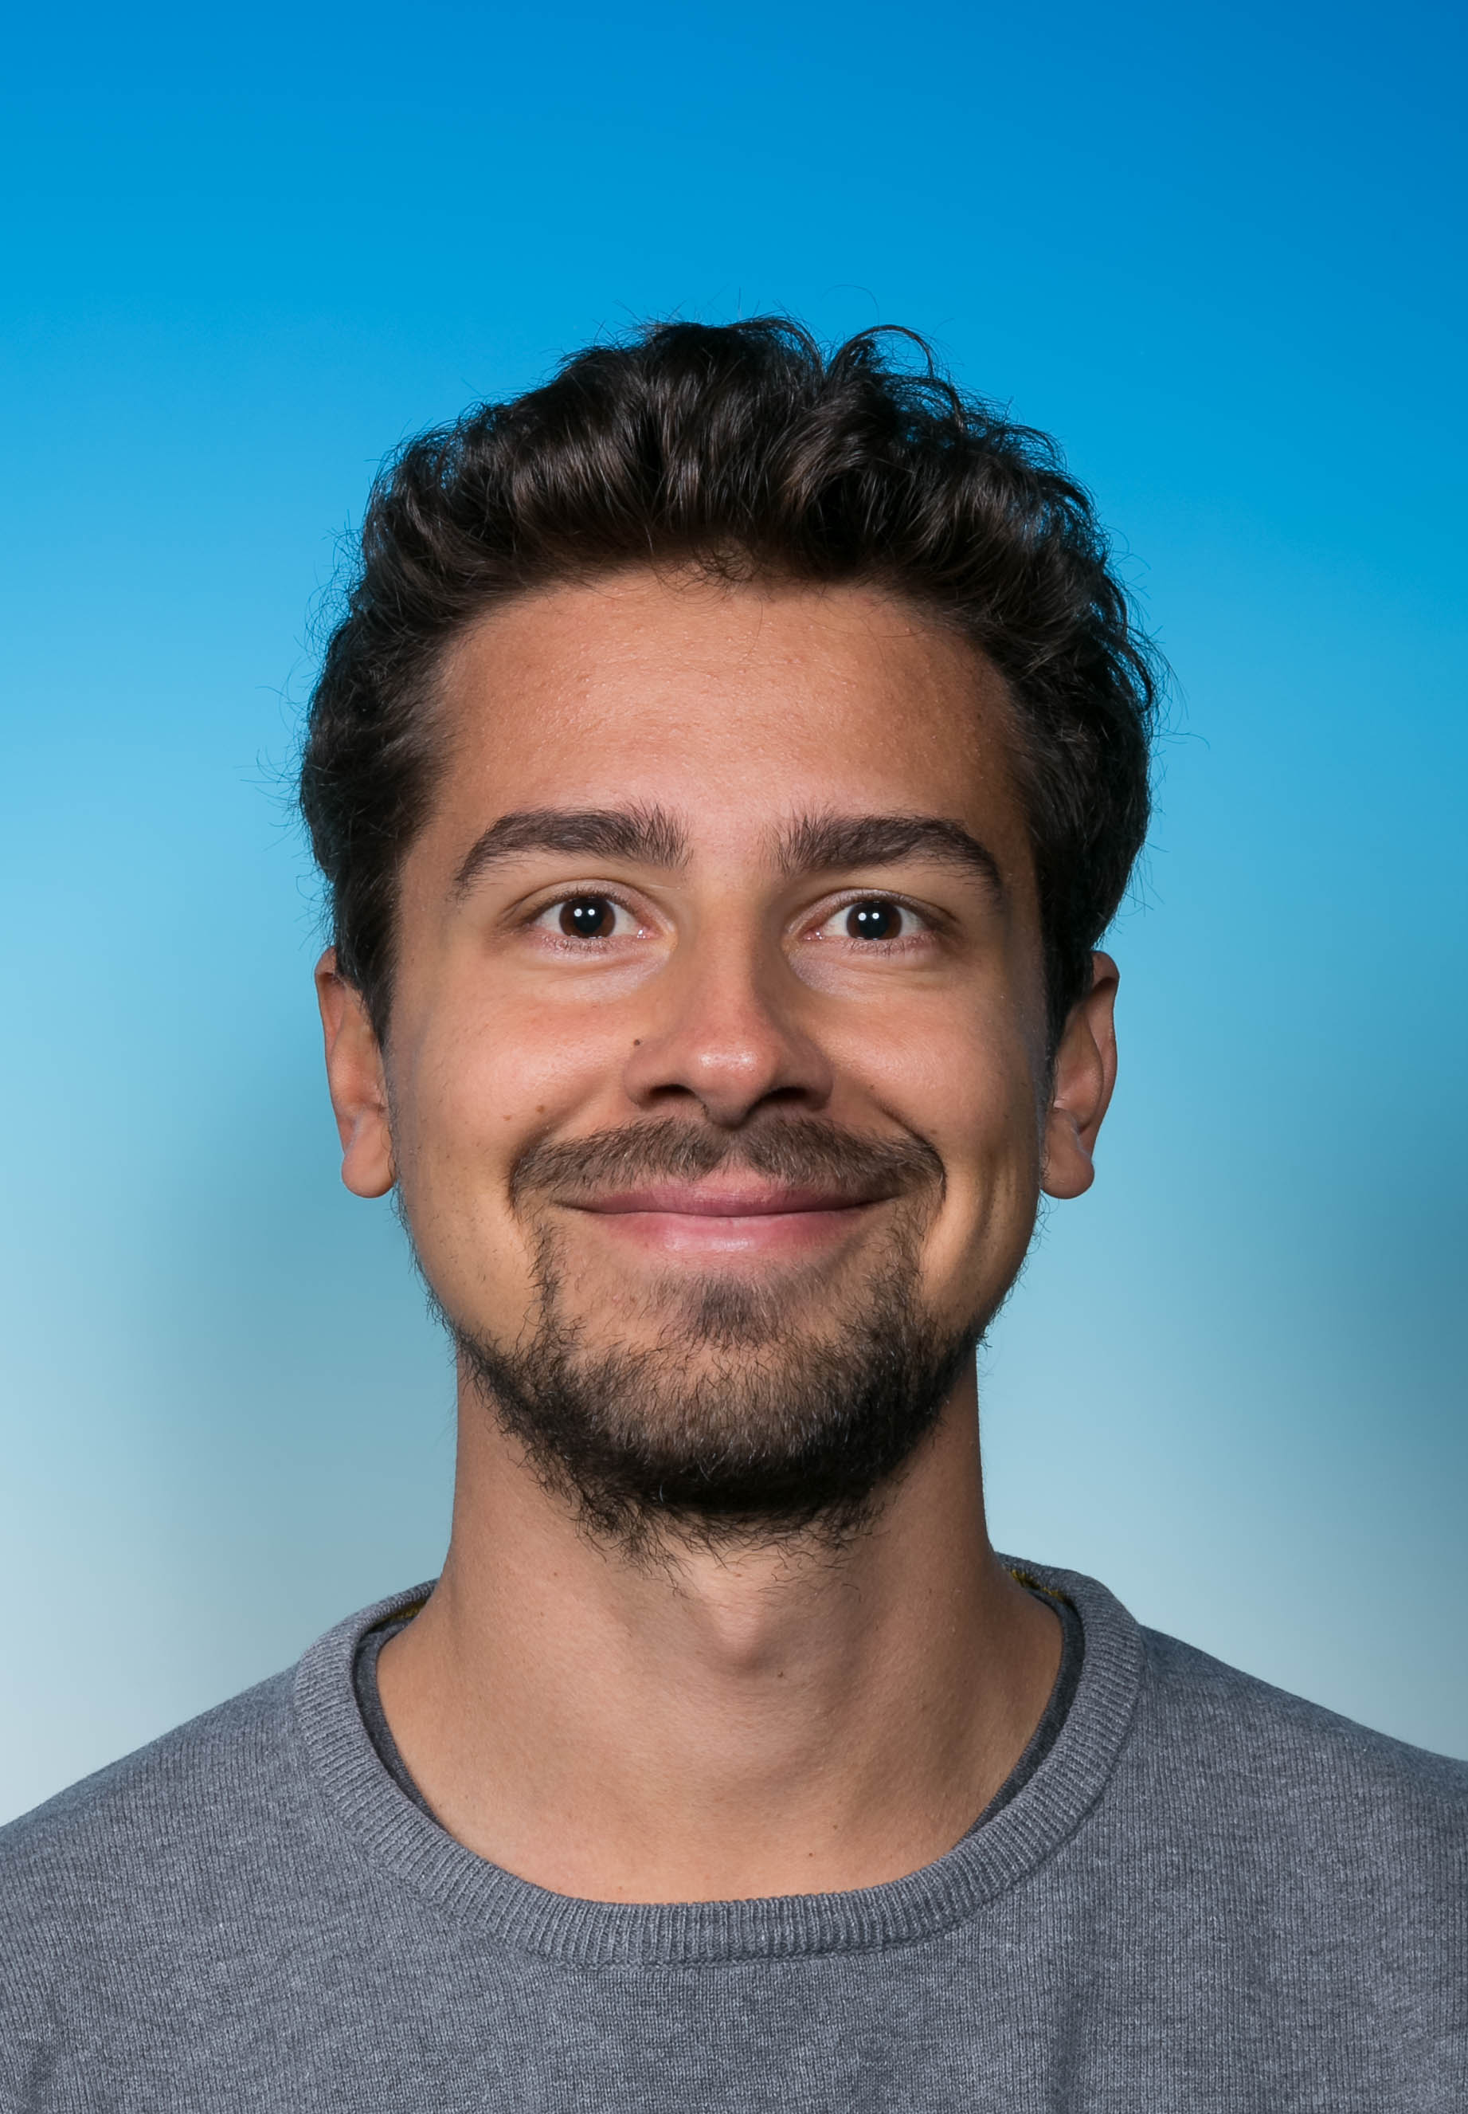
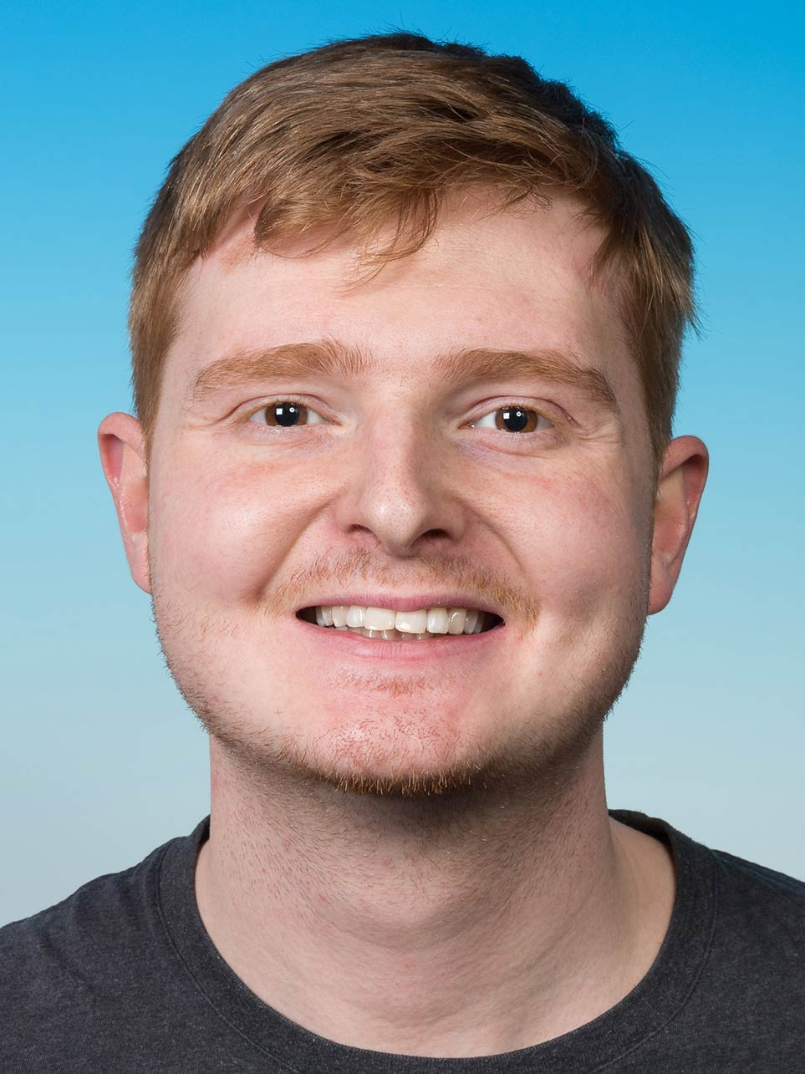
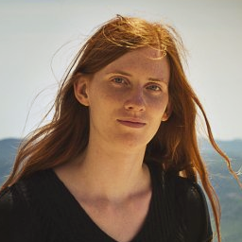
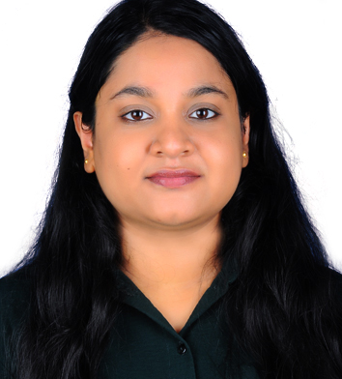
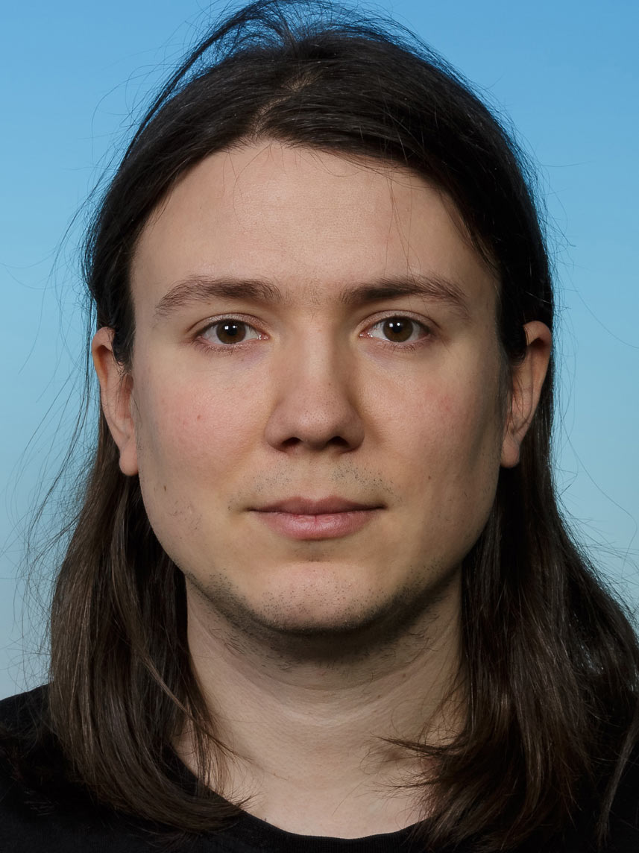
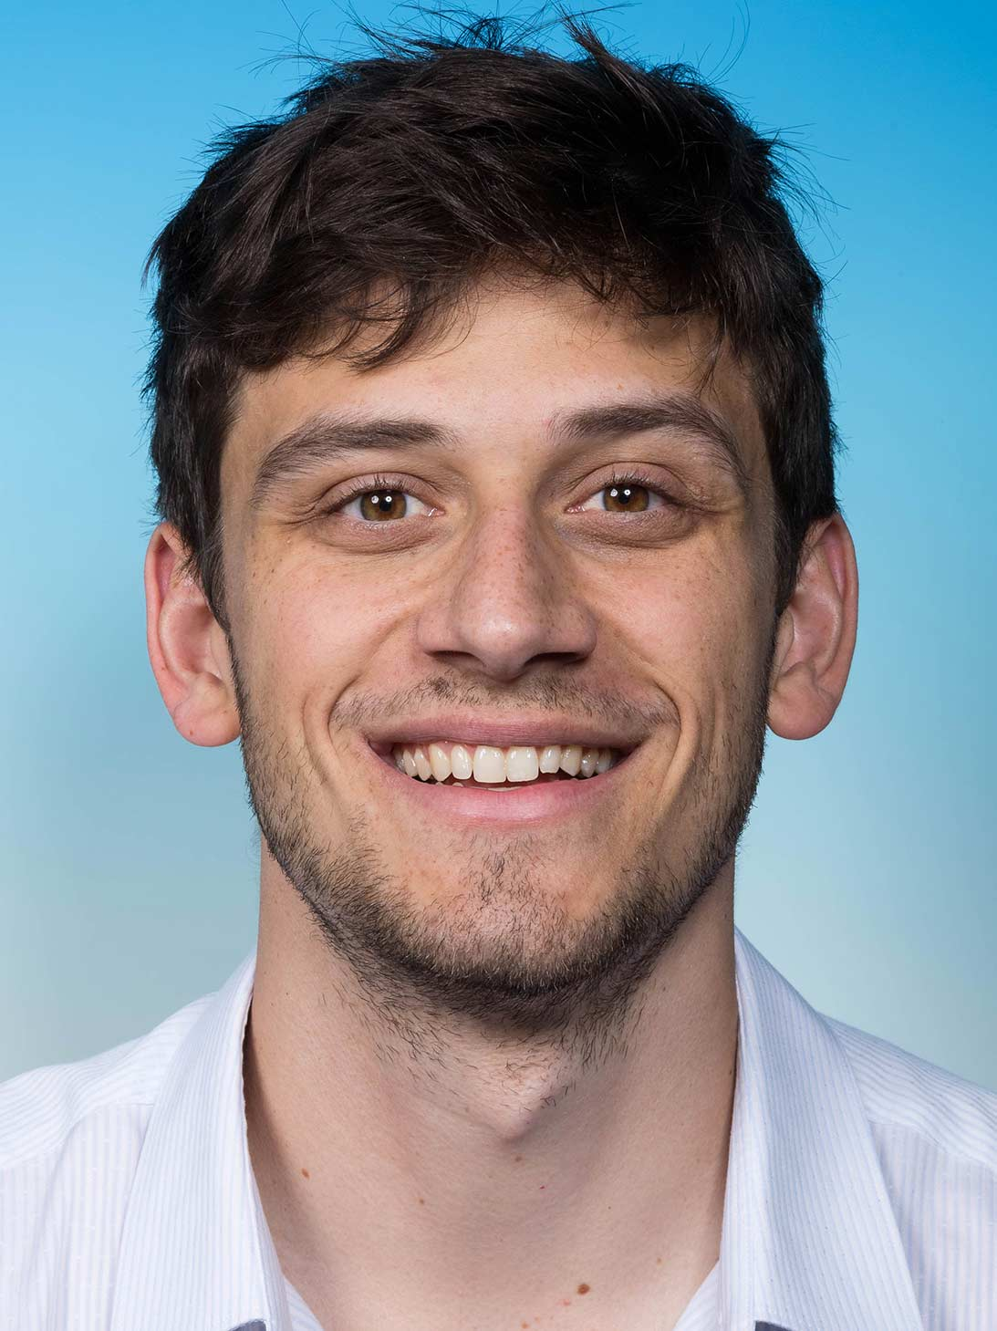
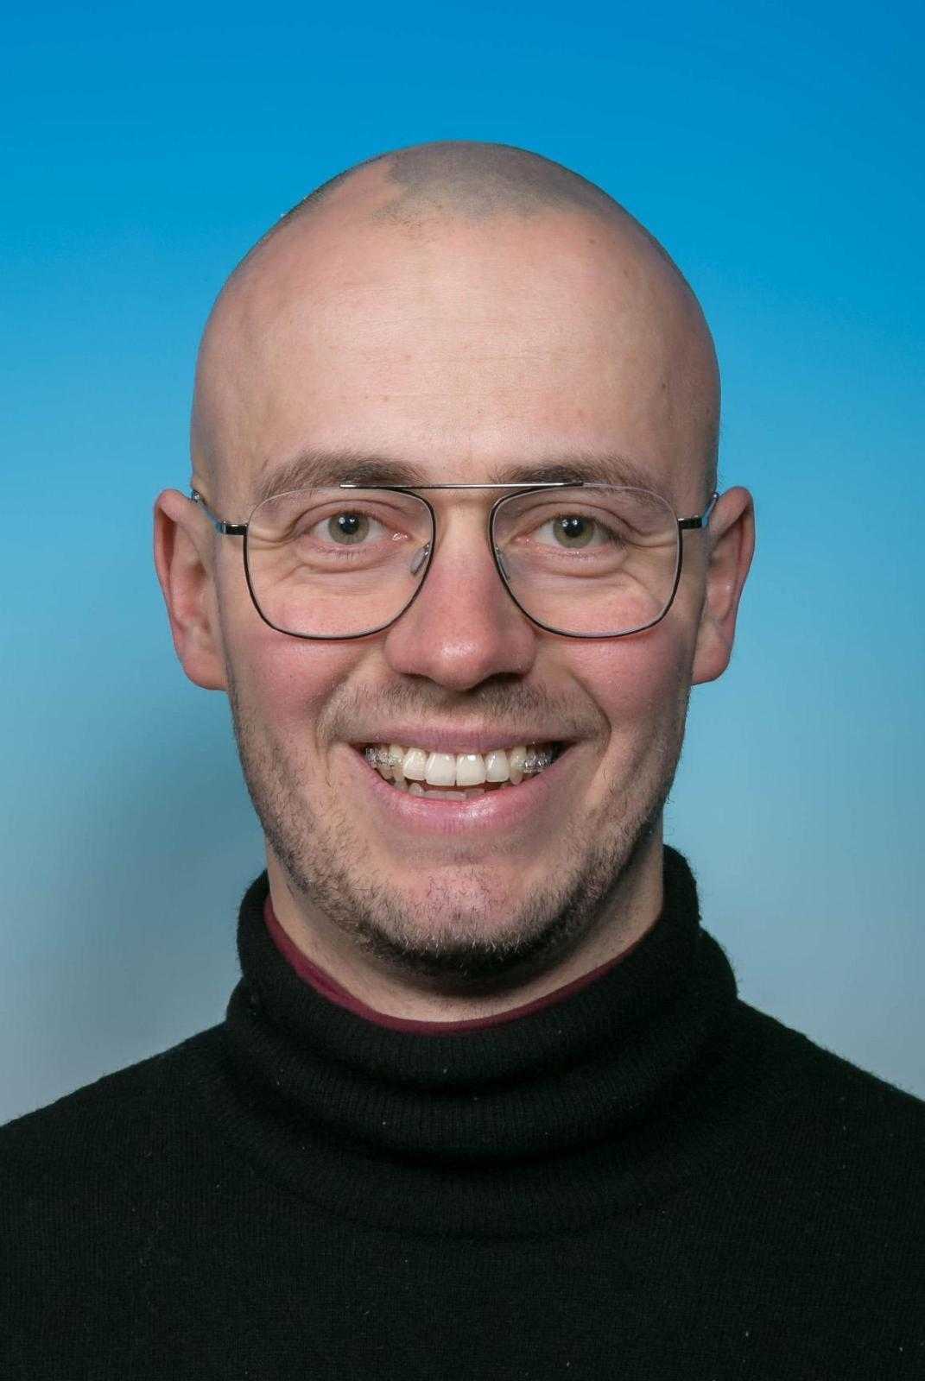
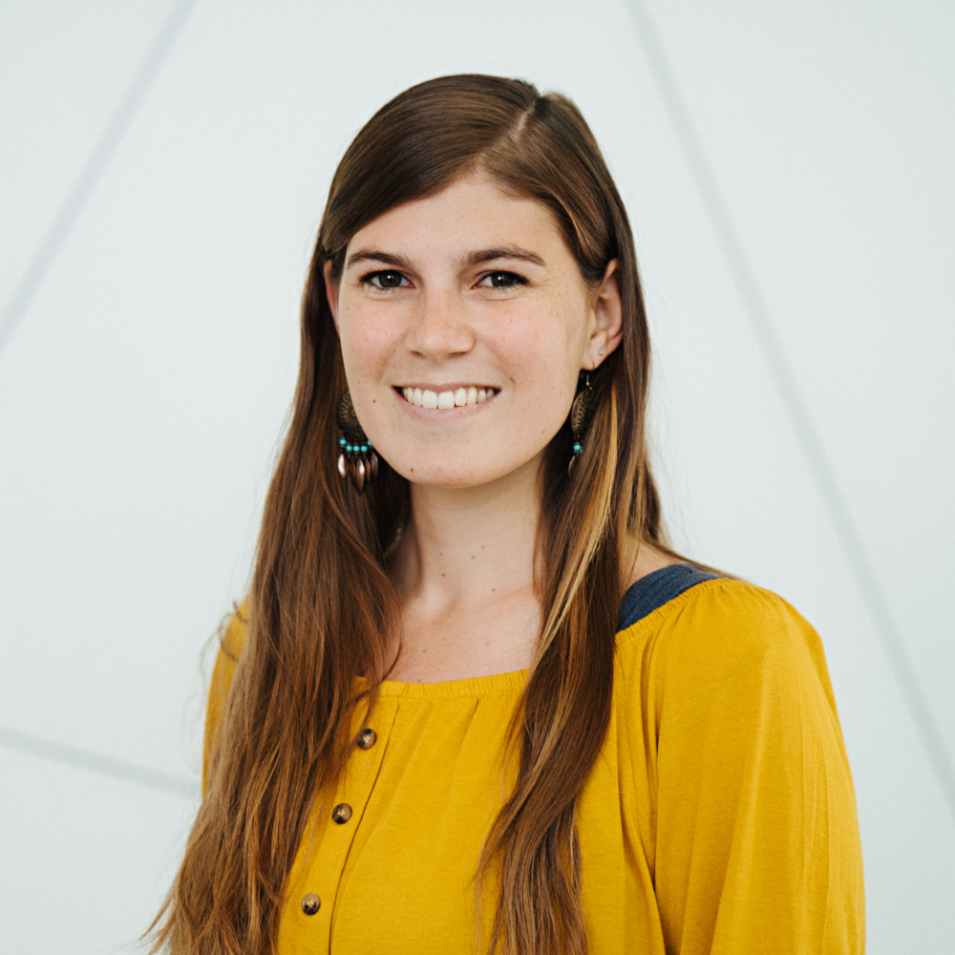
Organization committee
Simon Lechner
(CERN)
Elise Wursten
(RIKEN)
Tommaso Faorlin
Fabian Anmasser
Armin Winkler
Silke Auchter
(Infineon)
Sruthi Purushu Melath
Lukas Gerster
Manuel John
Peter Tirler

Slide 5
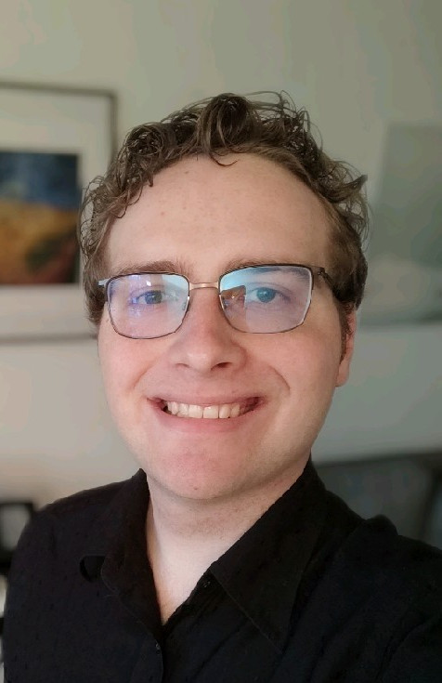
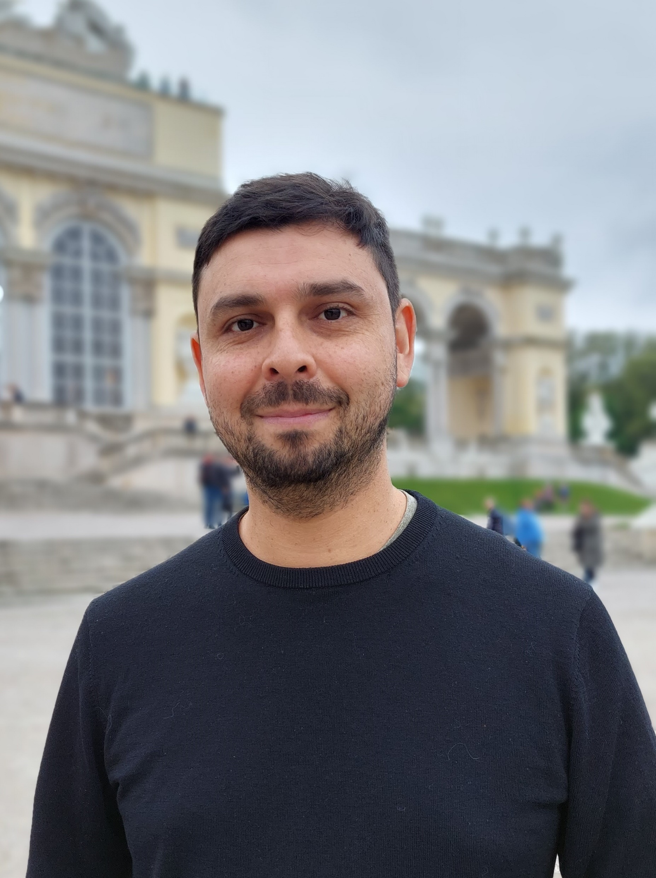
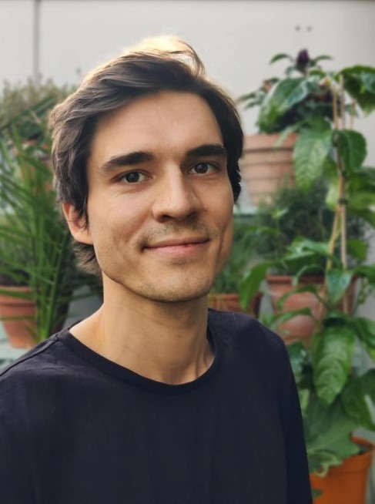
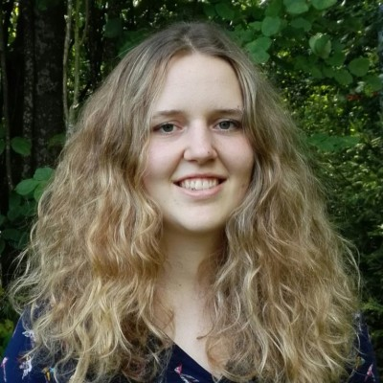
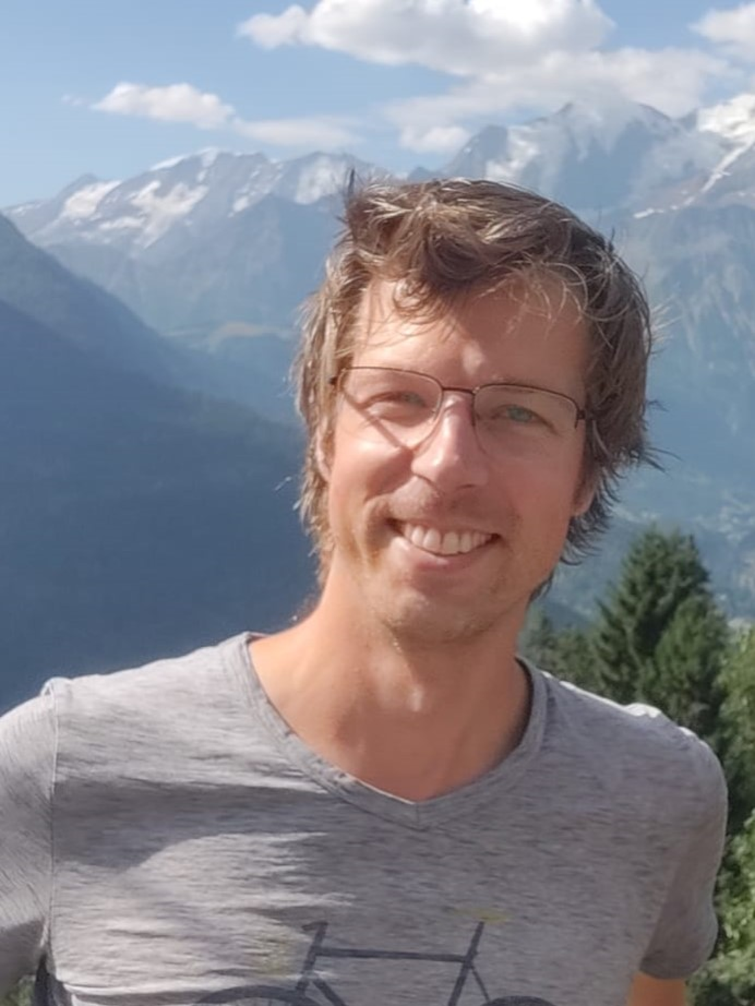
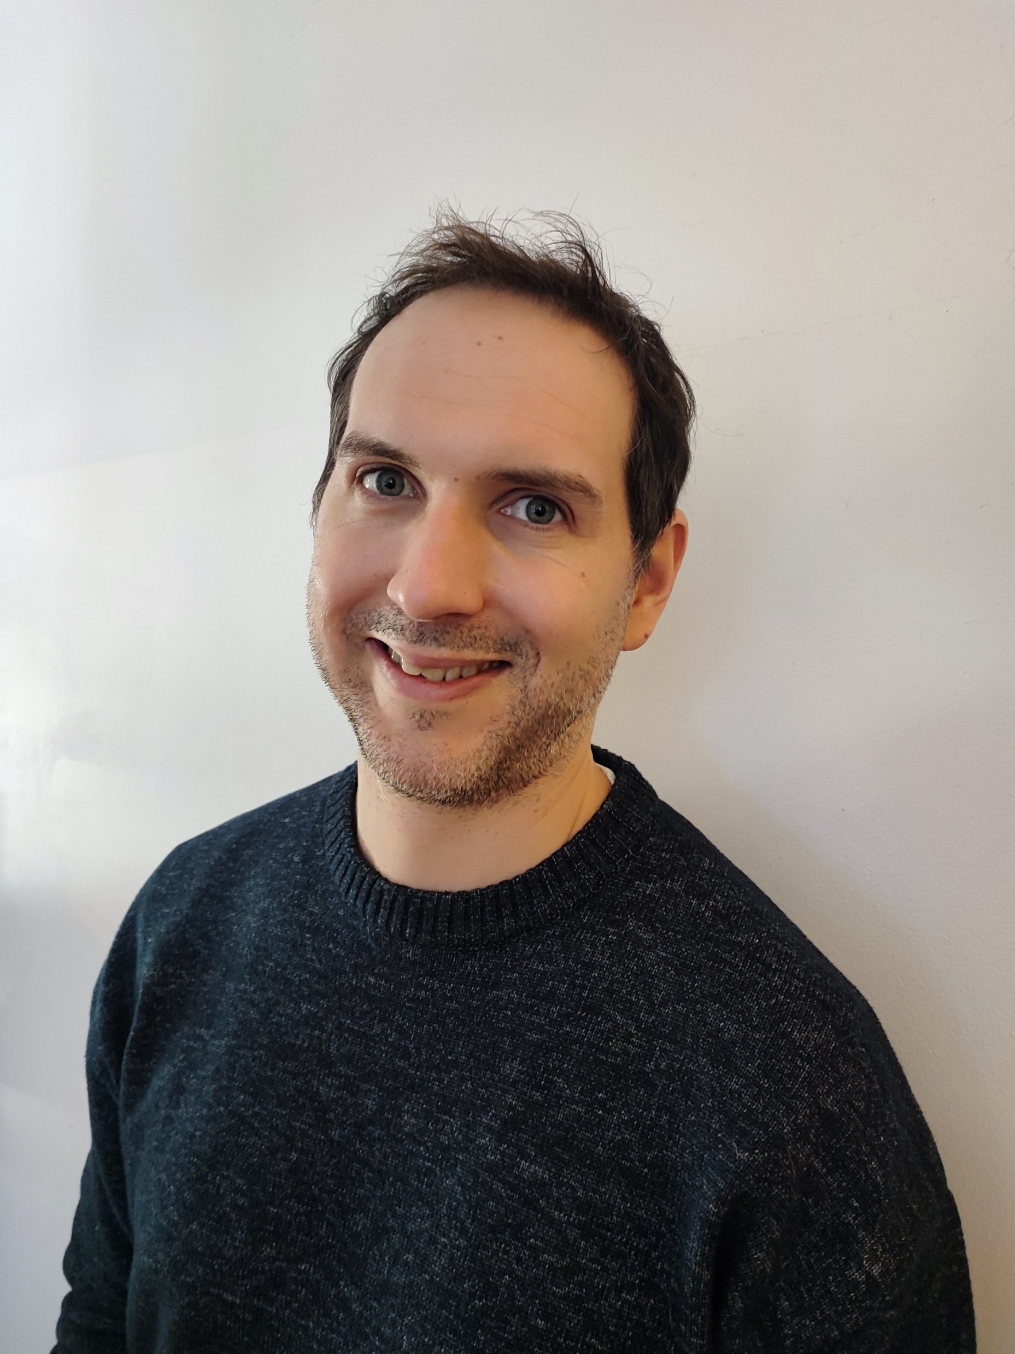
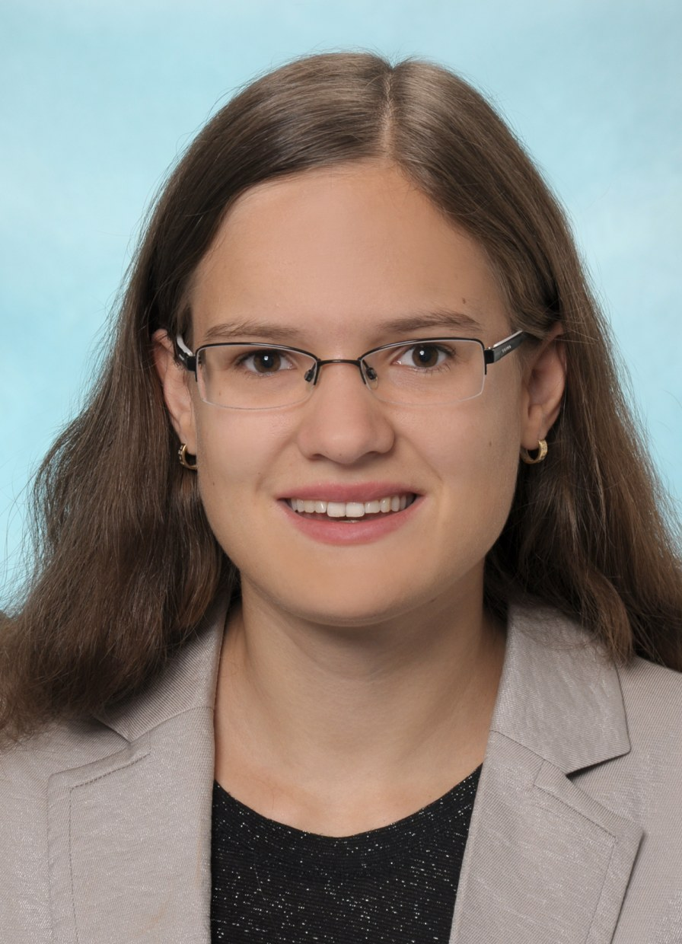





Scientific committee
Martin
Steinel
Gabriel
Araneda
Dominik
Kiesenhofer
Marion
Mallweger
Janko
Nauta
Eric
Endres
Franziska
Maier

Slide 6


ECCTI 2024 TIMETABLE
FRI:
Antimatter
Coffee Break
Quantum Information
MON:
MON:
Welcome
Nuclear Physics
Coffee Break
Quantum Info
Sponsor Talk
TUE:
Antimatter
Coffee Break
Quantum Technologies
WED:
Quantum Tech
Sponsor Talk
Coffee Break
Molecular Spectroscopy
THU:
Nuclear Physics
Coffee Break
Precision Spectroscopy & Atomic Clocks
09:00 – 09:20
09:00 – 10:12
Morning:
2 sessions
09:20 – 10:30
09:30 – 10:30
10:12 – 10:32
09:00 – 10:30
09:00 – 10:30
10:30 – 11:00
10:30 – 11:00
10:32 – 11:00
10:30 – 11:00
10:30 – 11:00
11:00 – 12:12
Lunch:
Lab Tours
12:12 – 12:35
11:00 – 12:45
11:00 – 12:30
11:00 – 12:30
11:00 – 12:30
Quantum Simulation
Coffee Break
Invited Talk: Rainer Blatt
Social Event/Conference Hike
L U N C H B R E A K
Invited Talk: David Wineland
Coffee Break
Poster Session
Skill Session: Jean-Luc Doumont
Coffee Break
Poster Session
Quantum Information
Coffee Break
Skill Session: Jean-Luc Doumont
Labtours 13:45 – 14:15
Labtours 13:45 – 14:15
Labtours 13:45 – 14:15
Labtours 13:45 – 14:15
Afternoon:
1 session / skill/poster session / invited talks
14:00 – 16:00
14:30 – 16:15
14:30 – 16:20
16:00 – 16:30
14:30 – 16:30
16:30 – 17:00
16:15 – 16:45
16:20 – 16:45
16:45 – 18:15
16:30 – 18:45
17:00 – 18:45
16:45 – 18:45
14:00 - Open End

Slide 7
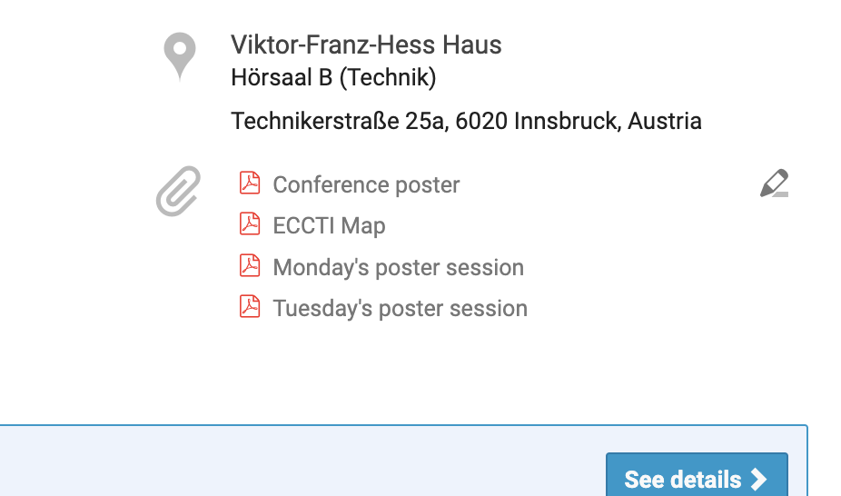

Poster sessions
Where? Outside this hall, check the number of your stand
Posters should be hung before the first session in the morning or during coffee break and need to be removed by the next morning, respectively
  Monday: 16:30 – 18:45
  Tuesday: 16:30 - 18:45
Only Tesa Powerstrip can be used to secure posters (provided by us)
A select panel of judges will visit the posters. Prizes:
  3 x 300€ for the best three posters announced during conference dinner
Notes:
Tommaso

Slide 8
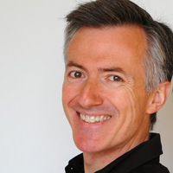
Skill Sessions by Jean-luc Doumont
Structuring your research paper
  Tu 14:30 – 16:30
Critical thinking for constructive conversation
  We 16:45 – 18:45
Notes:
Elise

Slide 9
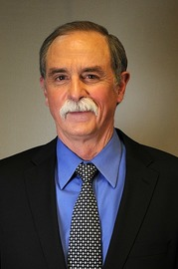
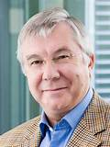
Invited Talks
Seminar by Nobel-laureate David Wineland
  Atomic Clocks and Einstein Relativity
  Mo 14:00 – 16:00
Colloquium by Rainer Blatt
  Quantum computation with trapped ions
  Th 16:45 – 18:15
Notes:
?

Slide 10
Lab Tours
Tuesday, Wednesday, Thursday, Friday from 13:45 to 14:15
The meeting point is outside this lecture hall
There are 10 different experiments to choose from
  Information sheet on the lecture hall door, have a look
  Sign up for the tour you are interested in with your name, sheet also on door
  Maximum number of people per tour is 10
Notes:
Armin

Slide 11
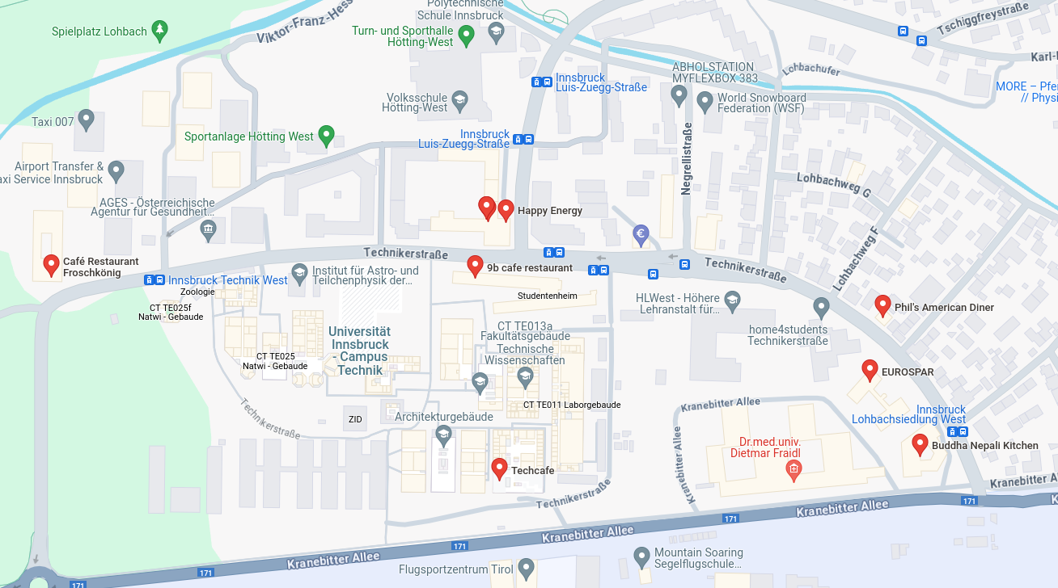
Lunch Options
Froschkönig - €€ - Restaurant
9B Café - €€ - Restaurant
Techcafe - € - Restaurant
Phil's American Diner - €€ - Restaurant
Buddha Nepali Kitchen - € - Restaurant
MPreis - € - Supermarket
Spar - € - Supermarket
Baguette - € - Bakery
Bäcker Ruetz - € - Bakery
Happy Energy - € - Döner/Pizza
Reserved for Monday lunch
6/8
9
10
1
2
4
7
5
Many options within a few minutes of walking
3
We are here
Notes:
Lukas

Slide 12
Conference Dinner
Conference Dinner is on Thursday at 19:00 at "Gasthaus Planötzenhof"
We go there directly after Rainer Blatt's talk in the afternoon
How to get there:
  Take the public Bus (K-line) to Sadrach, then 15 minutes walk
  If you think you need assistance, just let some of us know
Notes:
Peter

Slide 13
Green Event
ECCTI 2024 is a green event, certified via the "Österreichisches Umweltzeichen"
We encourage all participants to act in an environmentally-friendly way were possible, so e.g:
  Within Innsbruck use public transport, it works very well (Welcome Card from Hotel)
  While at the conference, try separating your waste appropriately (waste bins in front of lecture hall)
  Avoid non-necessary waste-generation where possible
  If you have any questions, ask!

Slide 14
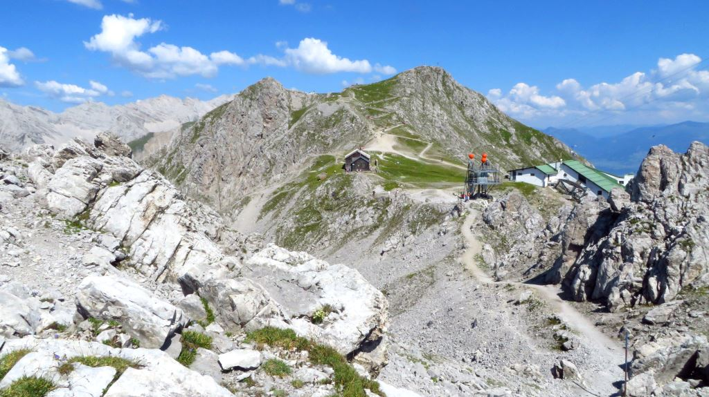
Social Activity – Discover the Austrian Alps
Cable car up to Hafelekar
Fr 14:15
Around 2h
Stunning view of the Alps
Sign up on the sheets on the table
Notes:
?

Slide 15
Practical Information for Speakers and Audience
Upload your slides to Indico before the start of your session or bring a USB stick to the lecture hall
Session chair will keep watch of the time, you will get warning signs at 5, 2 and 0 min remaining.
Timeslots:
  18min: 15min + 3min for questions
  22.5min: 19min + 3.5min for questions
  25min: 21min + 4min for questions
  27min: 23min + 4min for questions
Sit back, relax and enjoy the conference!

Slide 16
Practical Information
Wifi: eduroam
Conference photo: Wednesday before lunch
Jobs offers to eccti24@uibk.ac.at --> will be displayed during lunch breaks
Please sign the attendance sheet if you haven't done yet

Slide 17
















Sponsors

