Slide 1
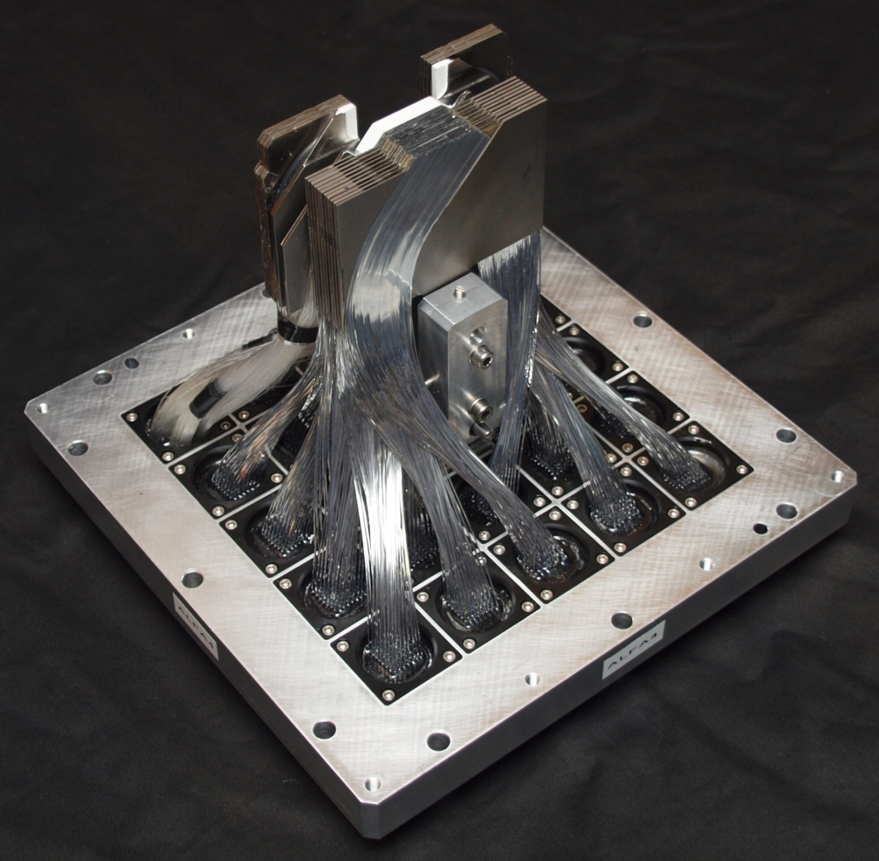
Design and construction of
ALFA fibre detector

Slide 2
Construction of fibre detectors shared by:
JLU Giessen → Fibre tracking modules, mechanics and final assembly
Desy Hamburg → Metrology of fibre plates and MAPMTs
Desy Zeuthen → Triggers
LIP Lisbon → Fibres machining, coating and characterisation
HUB Berlin → Machining of Ti substrates
CERN → Design, prototyping work, fibre coating, fibre end machining quality check, final adjustments and metrology.
PH/DT was also in charge of assembly and integration of RP stations, motor control, vacuum, tunnel installation, …
PH/DT contribution from:
Adrian, Alessandro, Christian, Claude, Jerome, Luc, Miranda, Patrick, Sune, Sylvain, Thomas, Tonio, Xavier...
Thanks to Hasko and Sune providing most of the illustrations for the slides

Slide 3
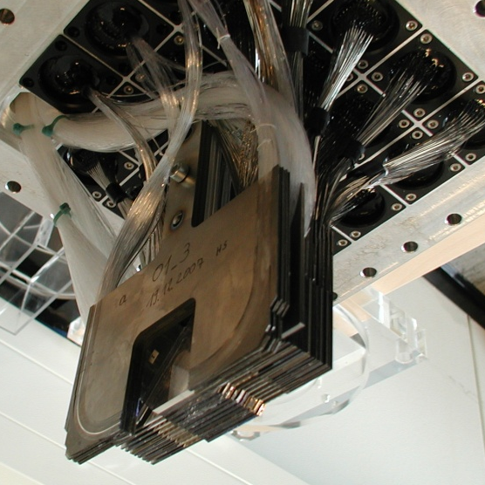
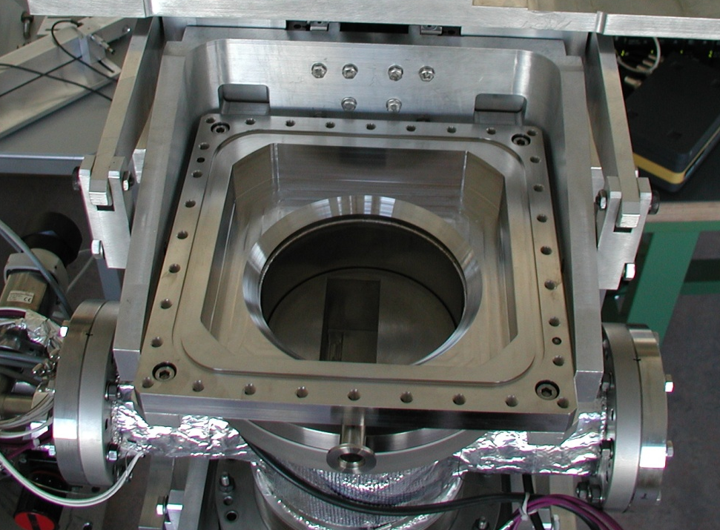
  Requirements
● Detector size 30 x 30 mm²
● No dead edge zones
● Resolution σ_{x} =σ_{y} ~ 30 μm
● Uniform trigger/detection efficiency
● Compatibility with operation in vacuum
● Easy and quick to install and remove
● Moderate radiation hardness
(detector removed during high-L runs)
● Relative position of upper and lower detector
to be known within ~10 μm precision
Must fit inside Roman Pots !
(RP stations developed for TOTEM)

Slide 4
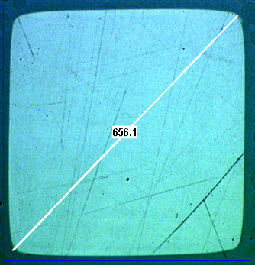
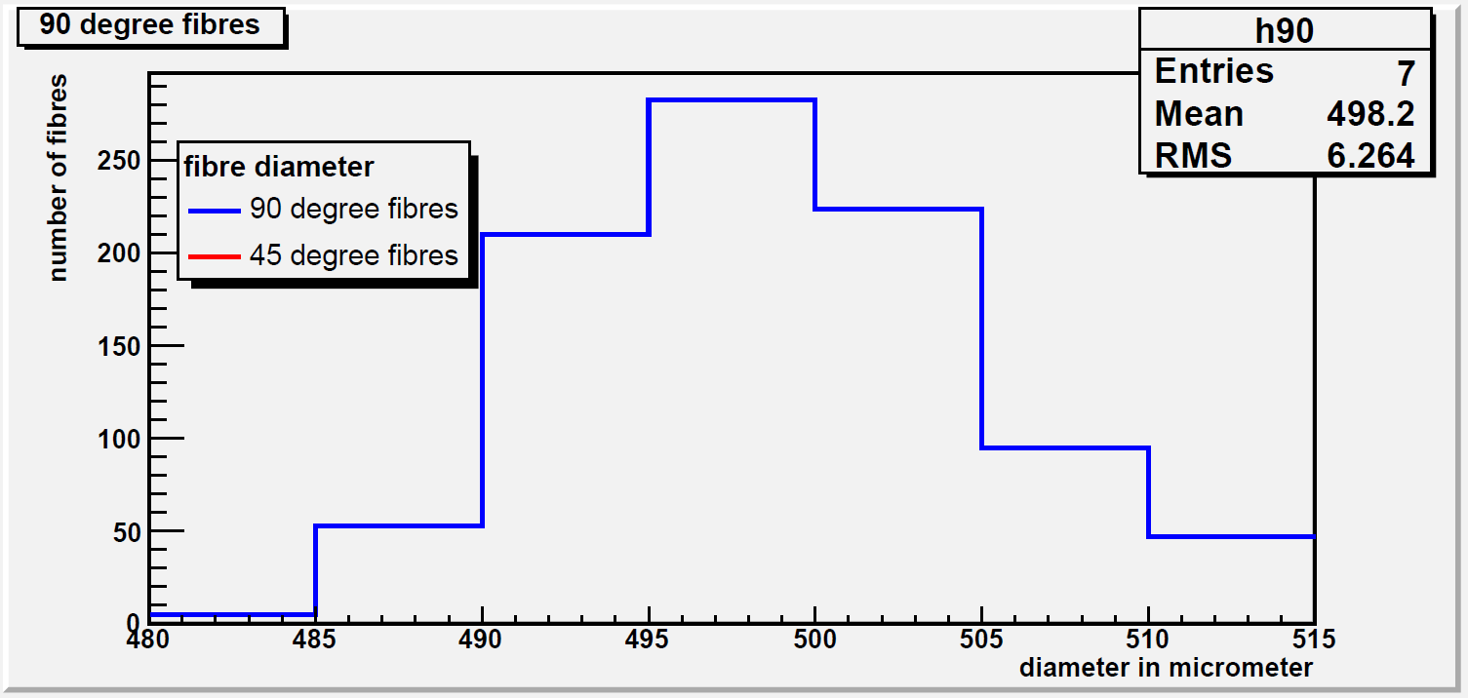
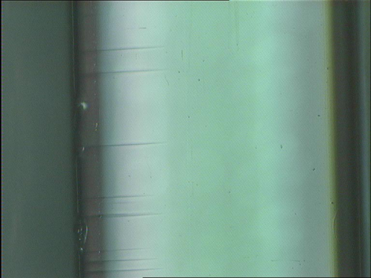
Scintillating fibers
Light yield is critical!
Type Kuraray SCSF 78
MAPMT
R7600-00-M64
Core PS
Cladding PMMA
Machined fibre end, well positioned wrt MAPMT
500 μm
10μm
No clear fibre !
the scintillating fibre is routed directly to the MAPMT
Absorption length measured:
120 – 170 cm
500 μm
Specified dimensional tolerance ±2%
Large bending radius to avoid cracks
Cracks on the surface of a fiber after a few minutes bending at R = 15 mm.
Aluminium side coating
Mirror coating

Slide 5
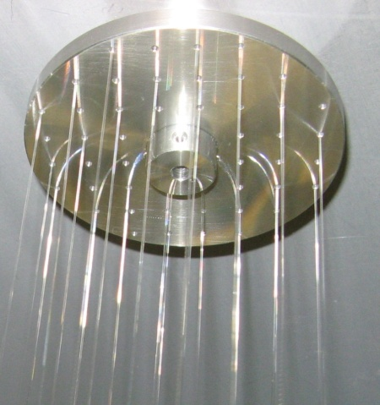
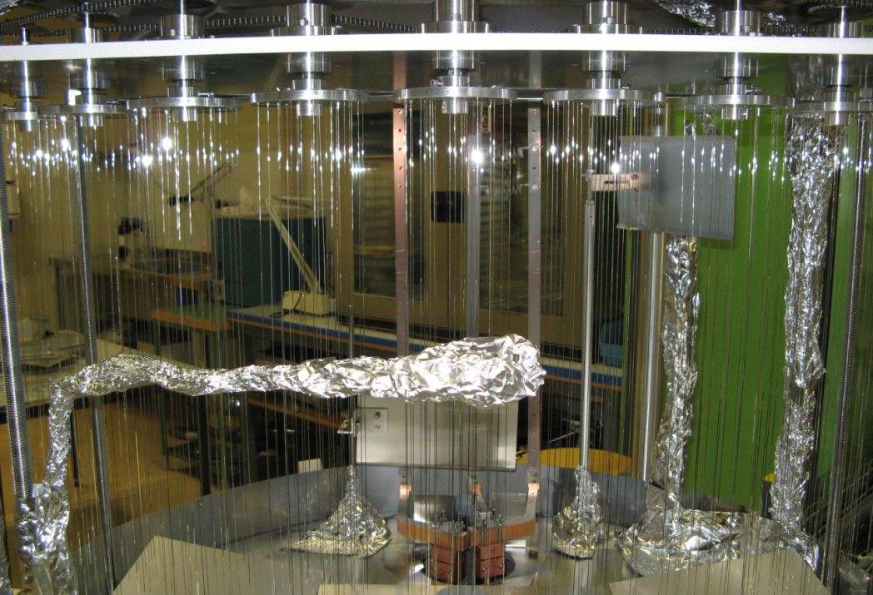
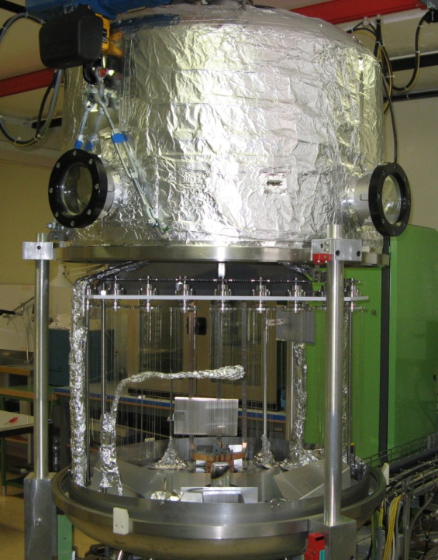
Fibers conditioning
● Fibre end is machined and aluminum coated by sputtering at LIP Lisbon
  ● Fibre body is aluminum coated by evaporation at CERN
  ● Fibre dimensions are measured to allow a selection

Slide 6
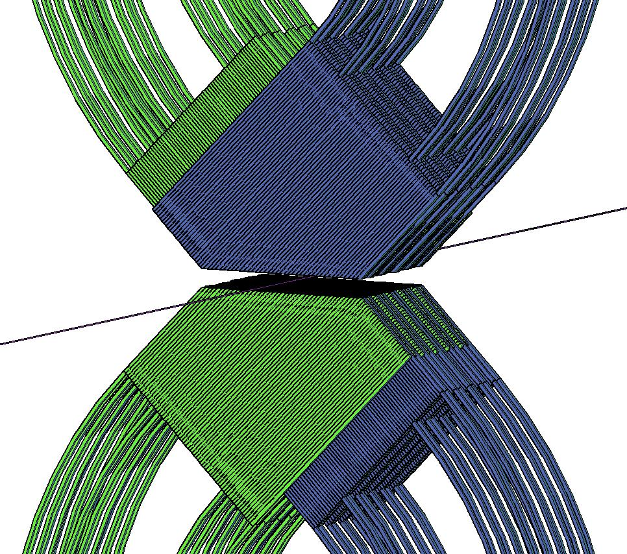

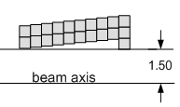
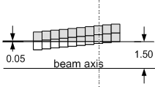
Layout of scintillating fibres
10 planes of U and V fibres staggered by 1/10 of fiber pitch
→ larger fibres bending radius highest edge sensitivity
Al coating:
● Suppression of cross talk
● Reflector on sides of 45° cut fibres
● Reflector on ends of 90° cut fibres
U
V
Central view :
On scale, fibres detectors close to beam position
(10-15 σ ~1.5mm)
150 μm
200 μm
Black surface
1.15 mm
Beam (φ~100μm)
Pot window
XY configuration rejected !
Poor edge sensitivity
Small fibre bending radius

Slide 7
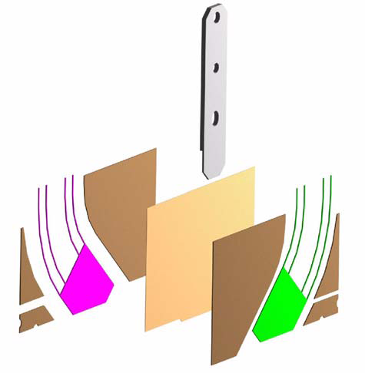
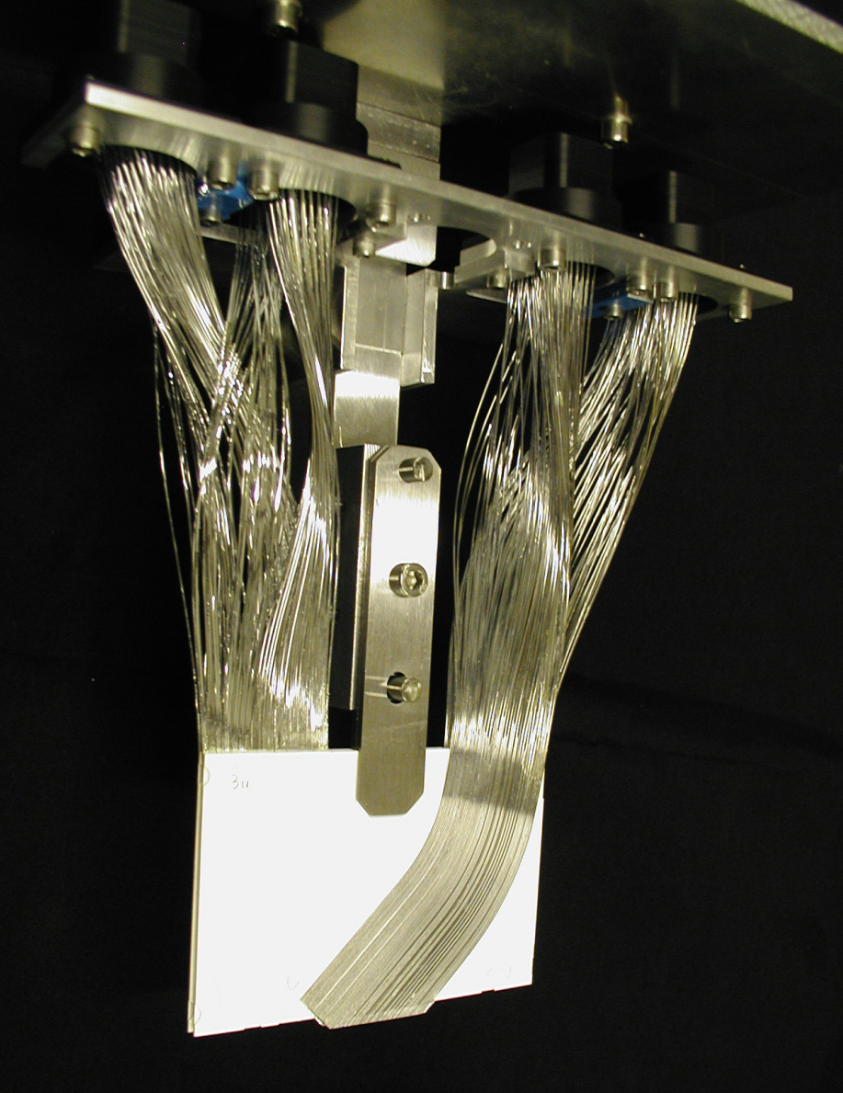
Design of first prototype
U and V fibre layers (64 fibres each )glued on two sides of a thin ceramic substrate
Support arm with reference and alignment precision pin holes
Ceramic precision wedge glued on the central ceramic plate
Ceramic substrate 170 mm thick
● Staggering given by accurate positioning of the support arm on the fibre plates

Slide 8
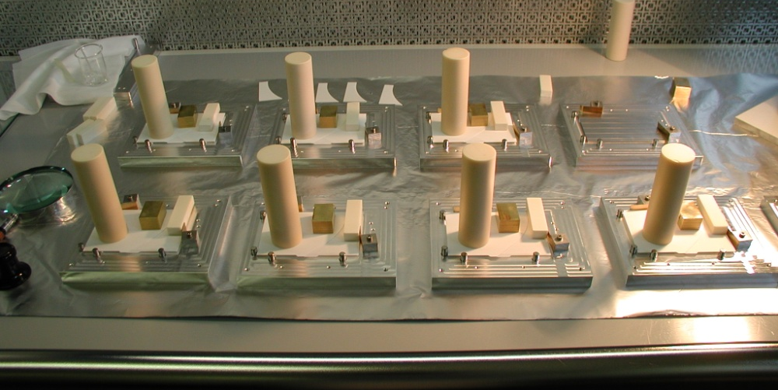
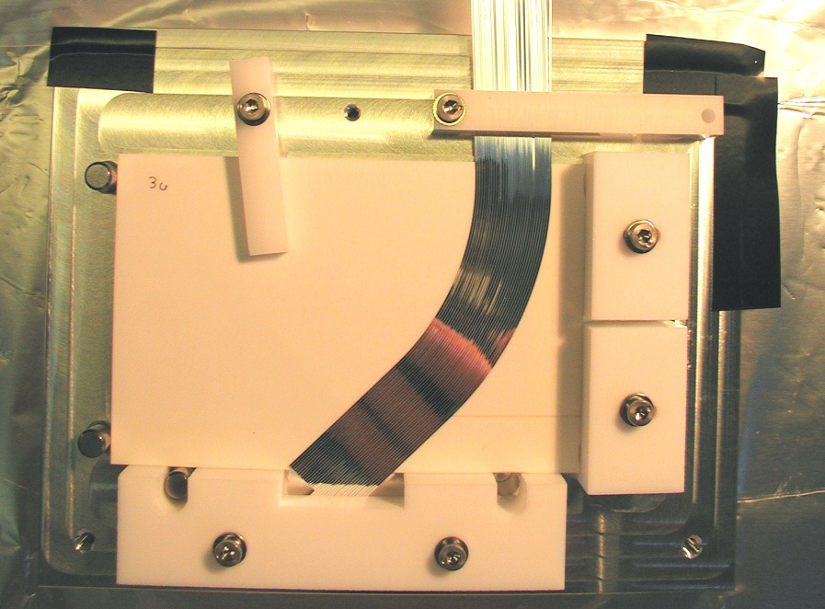
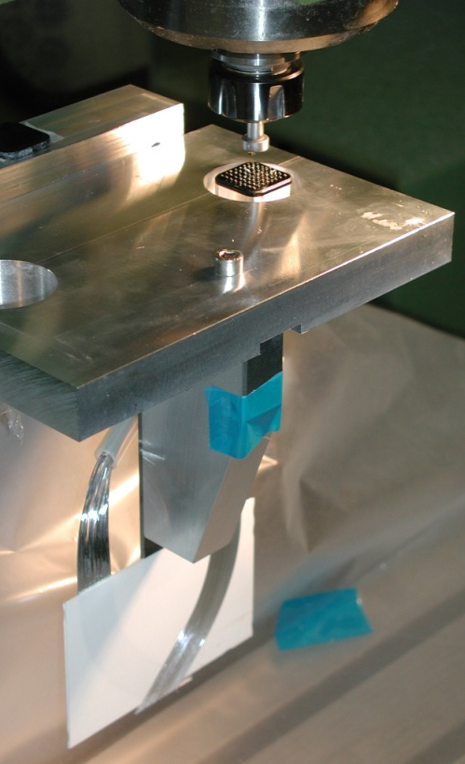
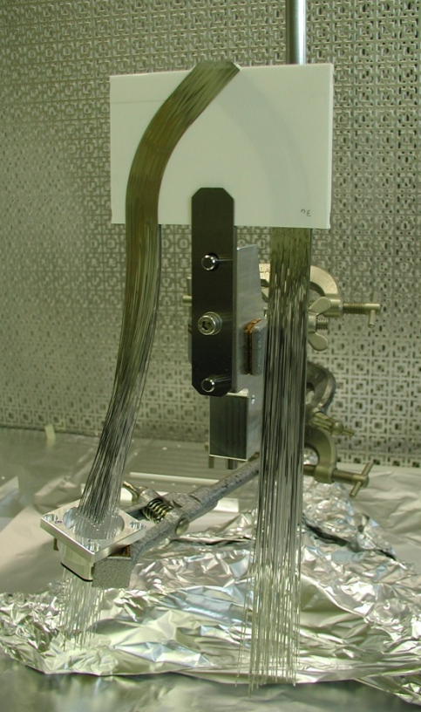
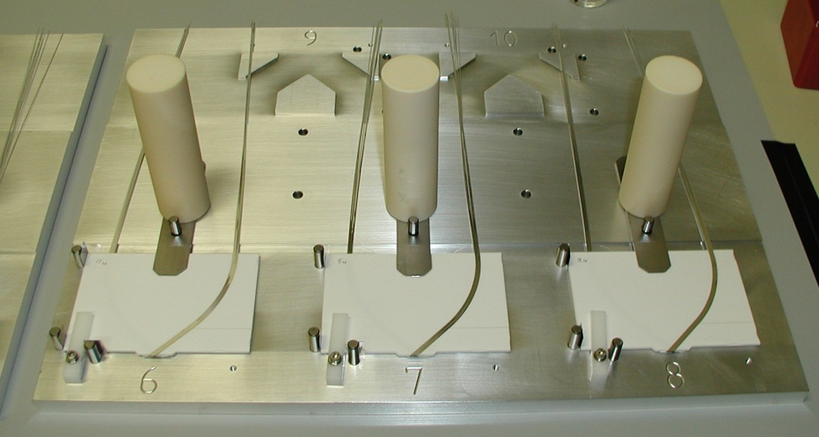
Prototype construction

Slide 9
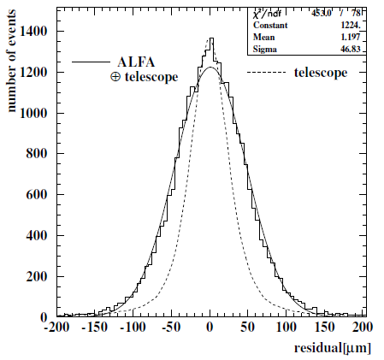
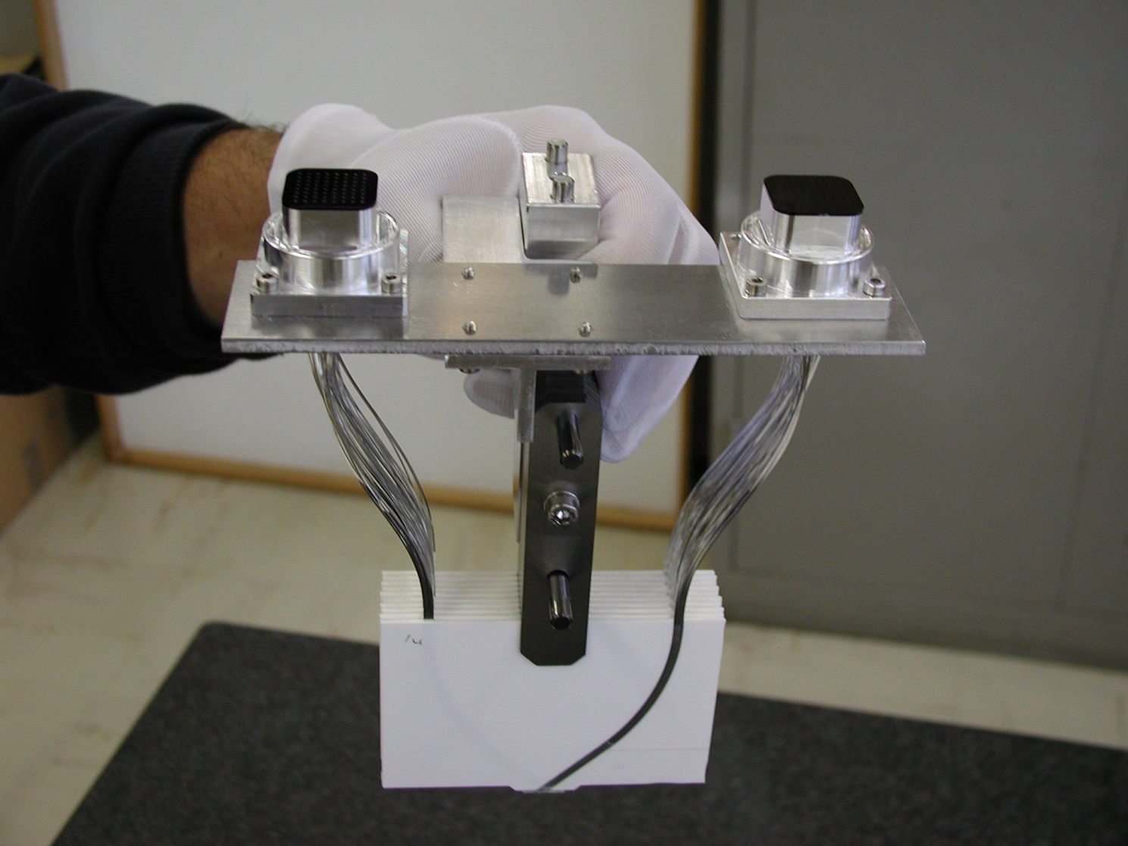
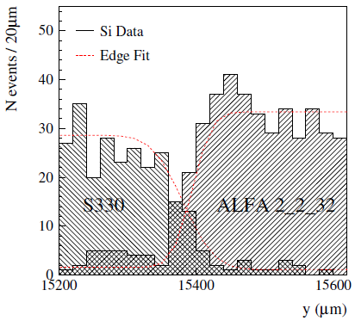
Concept validation in test beam

Slide 10
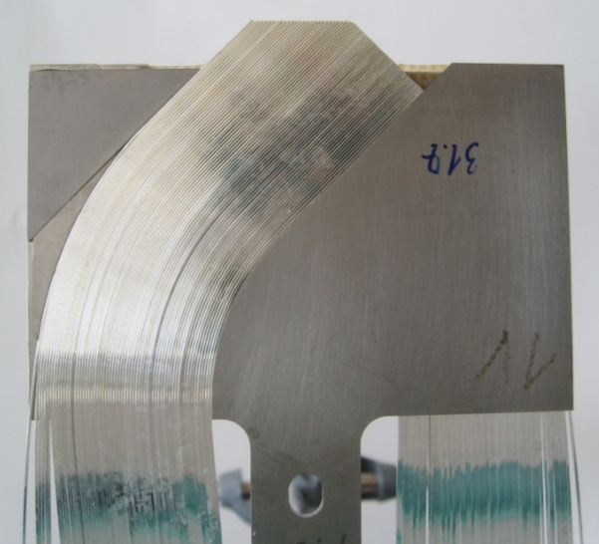
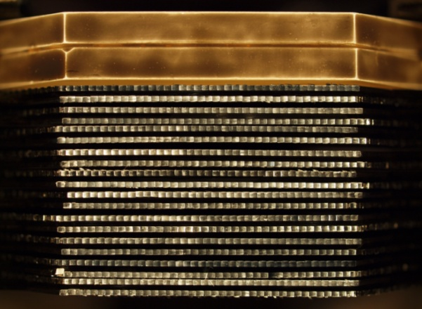
The ALFA fiber detector
Main detector fiber plate:
Main detector
(10 fibre plates)
Staggered fiber planes:
Construction of 8+2(spares) fiber detectors:
→ 100 fiber plates → 12800 fibers !

Slide 11
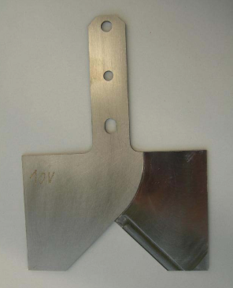
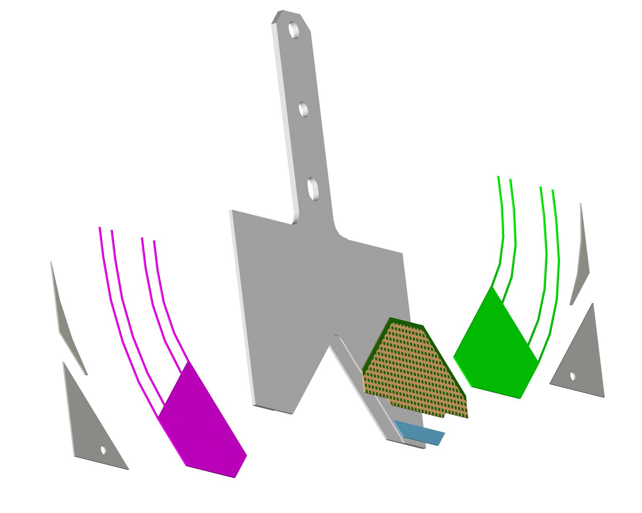
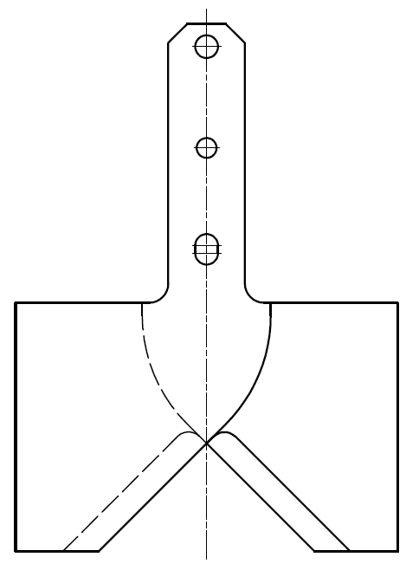
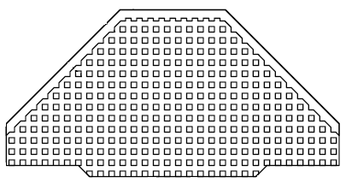
Design of Fibre plates
● Based on precision machining of a titanium substrate
Overall substrate thickness
(2mm +0 -0.15mm)
Overall substrate flatness
(± 0.1mm)
Reference and alignment pin holes
(φ6 +0.01 +0.005mm)
Angle of reference edges (45 ± 0.01 deg.)
300μm G10 subsrate + 100μm polyimid pad coating on both sides
(Promote insertion of glue by capillarity)
Offset for staggering
(± 0.005mm)
Step for fiber gluing
  (0.75±0.05mm)

Slide 12
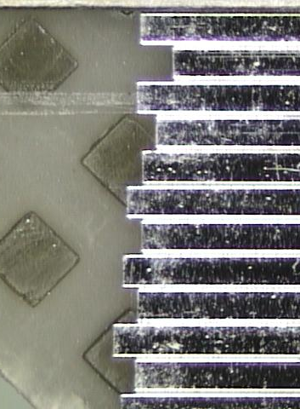
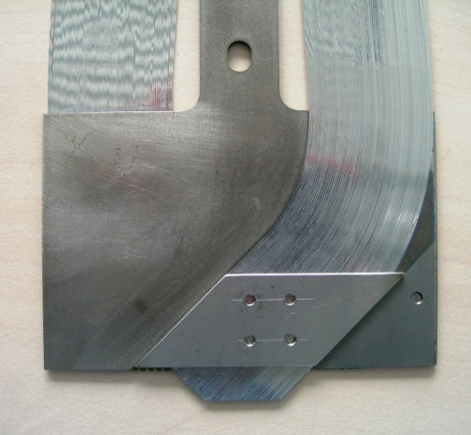
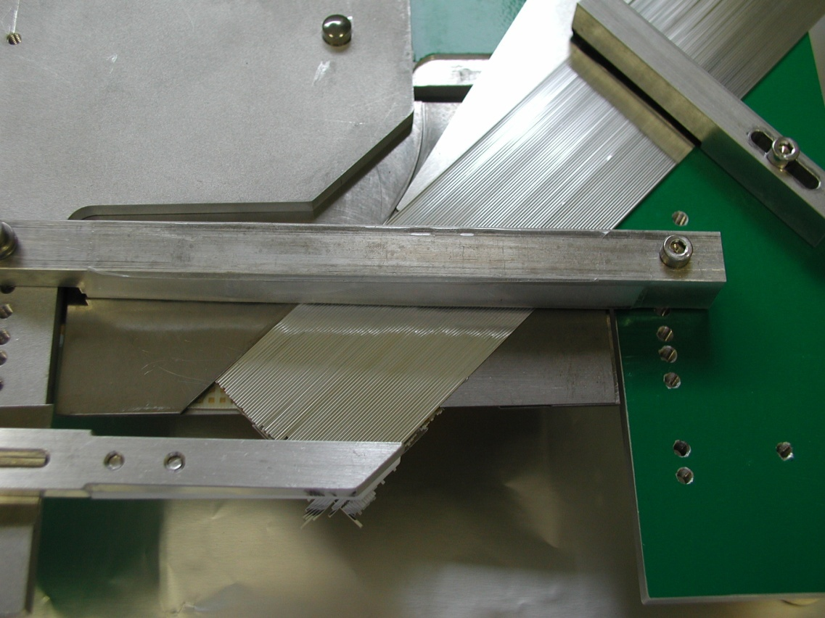
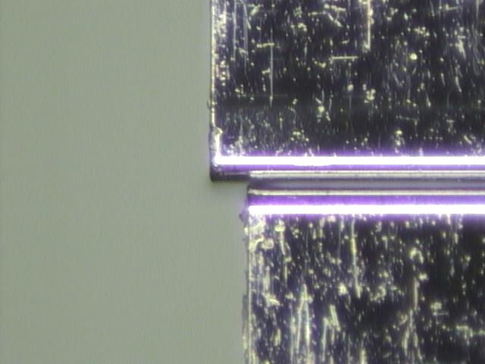
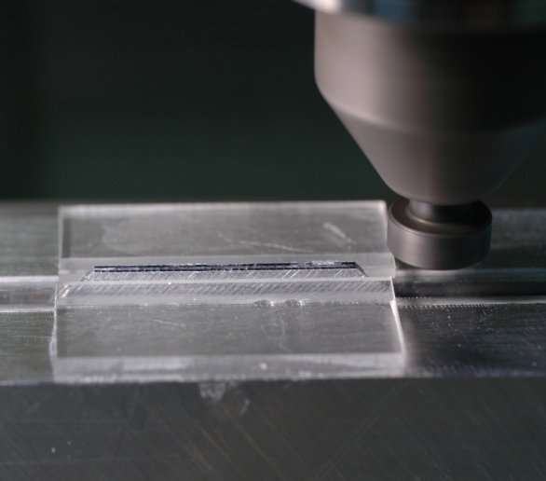
Assembly of fibre plates
1) Selection of fibres
2) Fibre positioning (straight, U+V)
3) Glue fibres in crossing area
4) Bend fibres to 45° + glue
5) Metrology
6) Fiber ends machining
Fiber ends machining at CERN

Slide 13
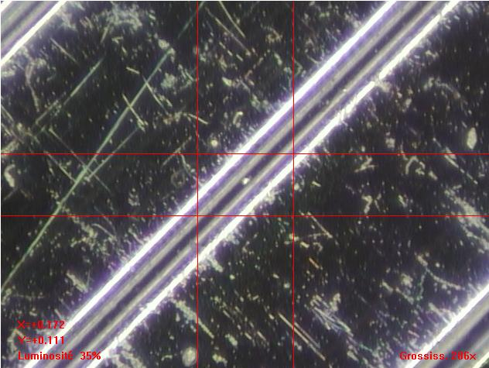
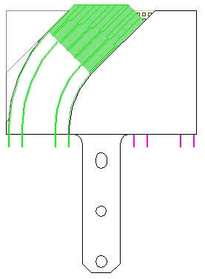
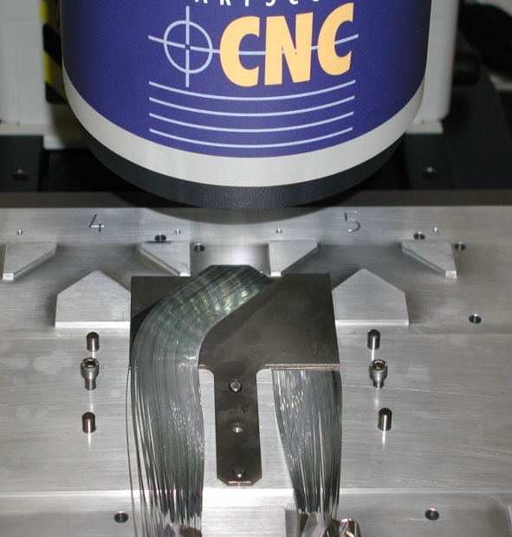
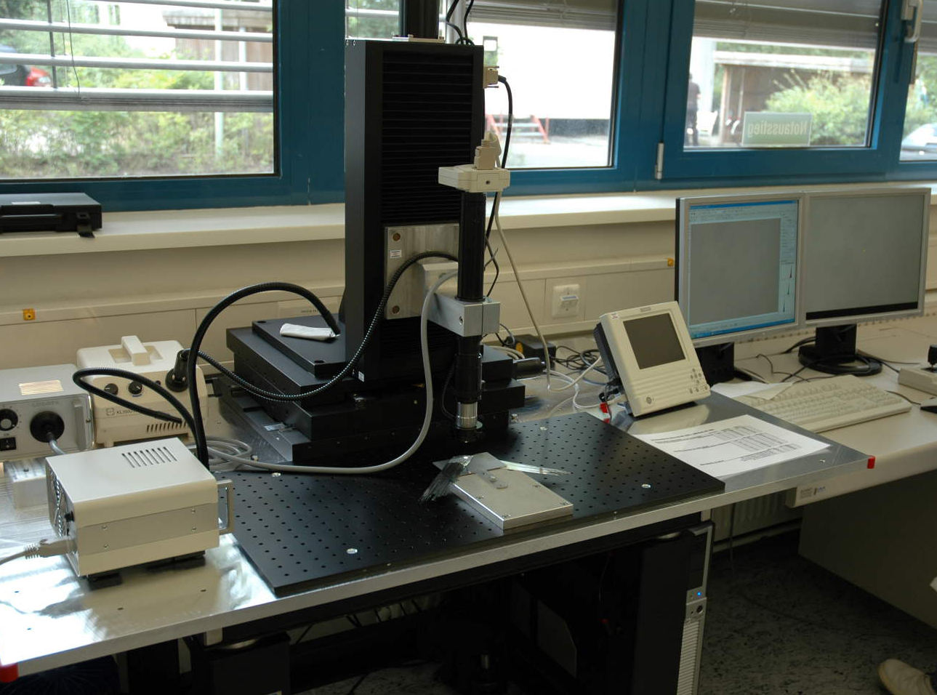
Metrology
Determine the fibre equations (ax+b) needed for space point reconstruction.
Fibre positioning accuracy has a direct impact on the spatial resolution.
E
D
C
B
fiber #1
point (X,Y)
A
side U
fiber #1
Y
origin (0,0)
X
Metrology for prototyping work done at CERN
Metrology for serial production done at DESY HH

Slide 14
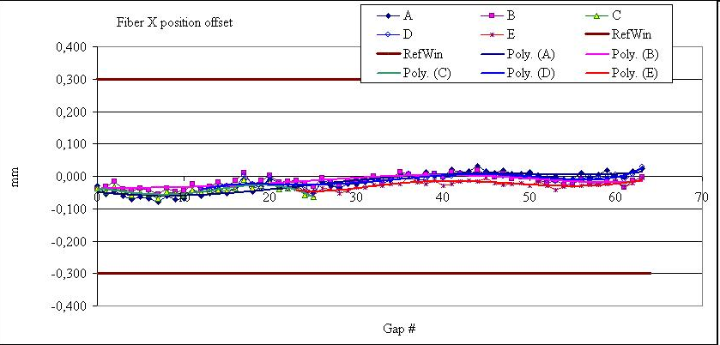
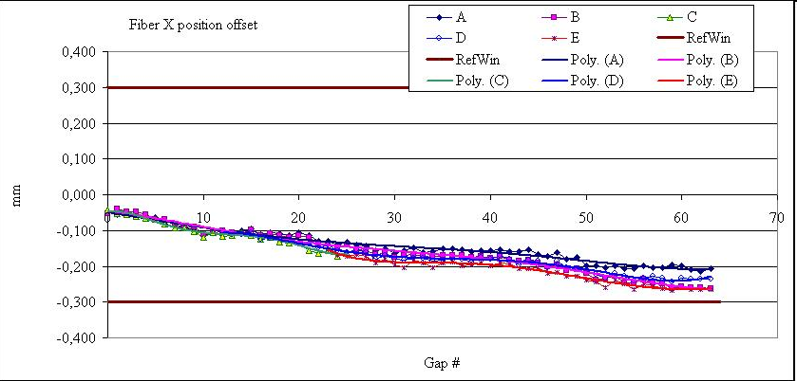
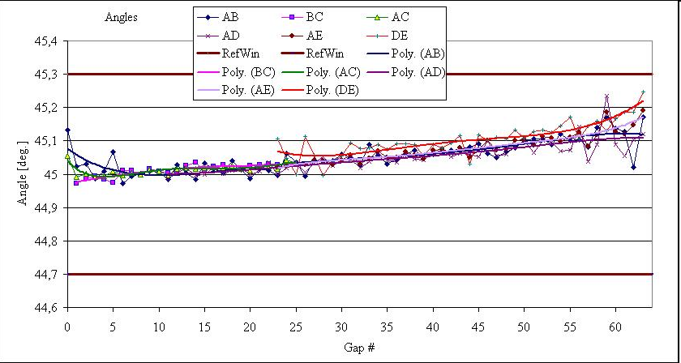
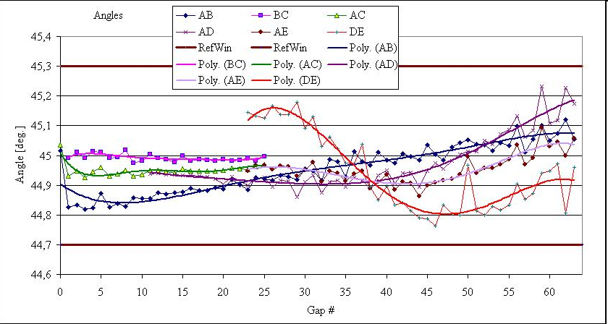
Metrology
typical good modules
rare bad modules

Slide 15
Assembly
Procedure:
Before we assemble a detector consisting of 10 Plates we run a G4 Monte Carlo
simulation (Prague) of elastic scattering events through the detector using the
measured fibre positions as input (real geometry). Then the resolution is
calculated and if good (~30 µm) this configuration is actually assembled.
series production
Detector | Proto2 | A10 | A11
Resolution [µm] | 32 | 28 | 27

Slide 16
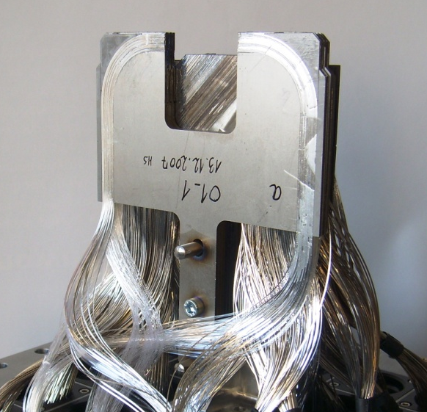
The overlap detector
Overlap detector
Construction of 8+2(spares) fiber detectors: → 30 fiber plates → 1800 fibers !

Slide 17
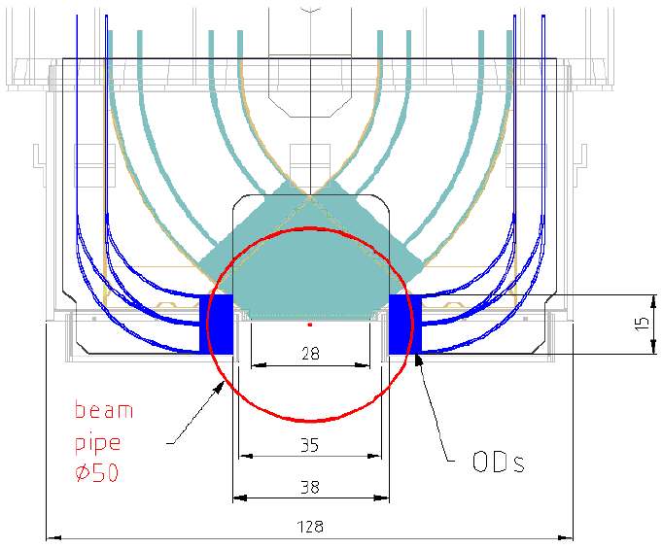
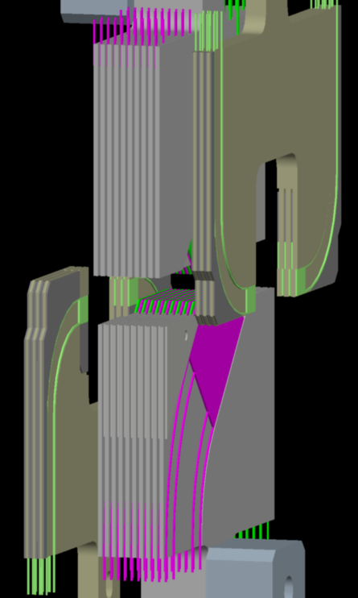
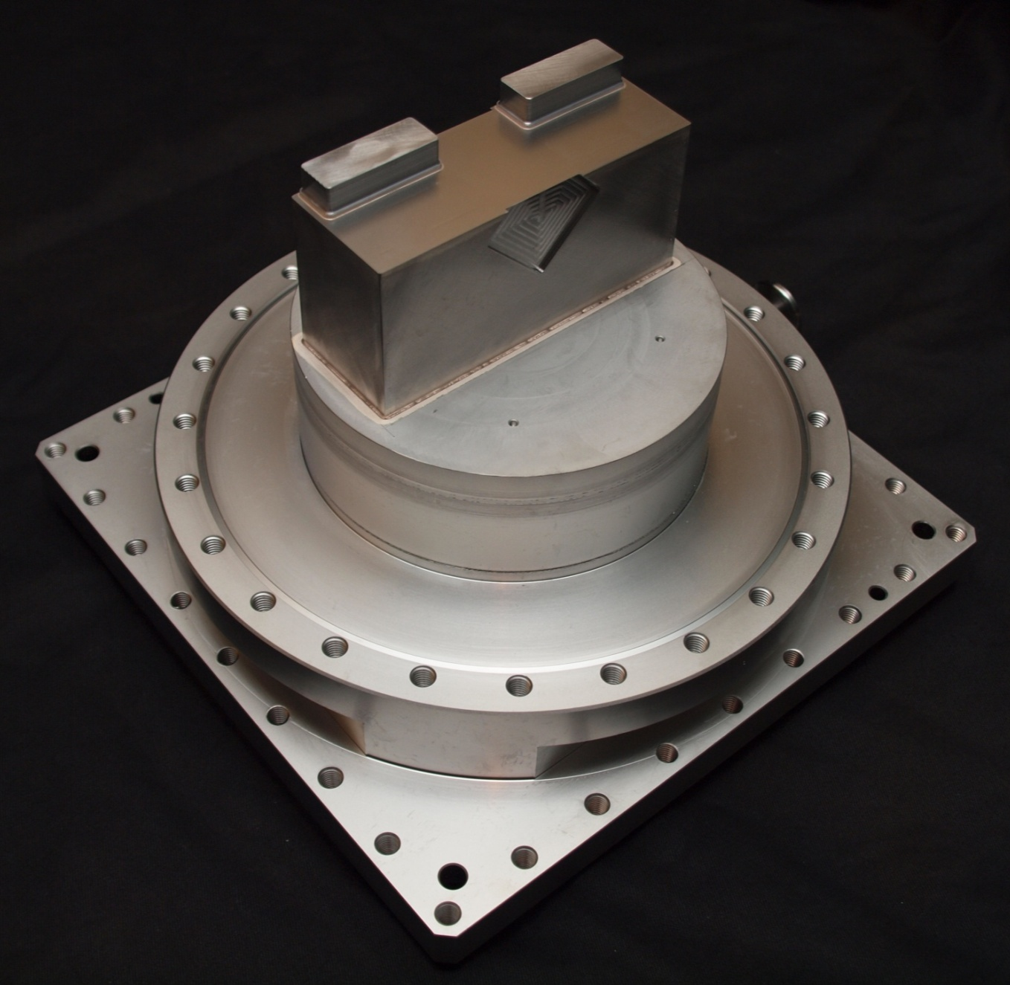
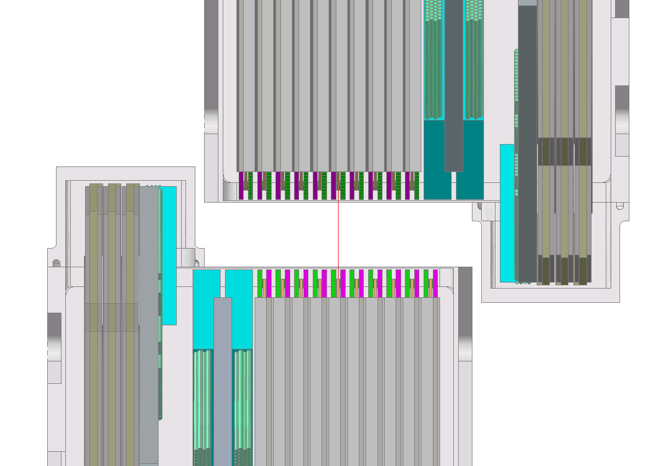
Overlap detectors
Determine the vertical distance between up and down detectors
Accuracy < 10 mm with large number of tracks recorded
3 planes of horizontal fibres staggered by 1/3 of fibre pitch
Extrusions for overlap detectors
Beam halo

Slide 18
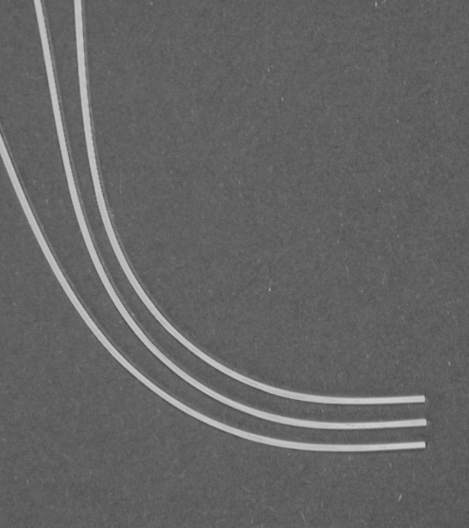
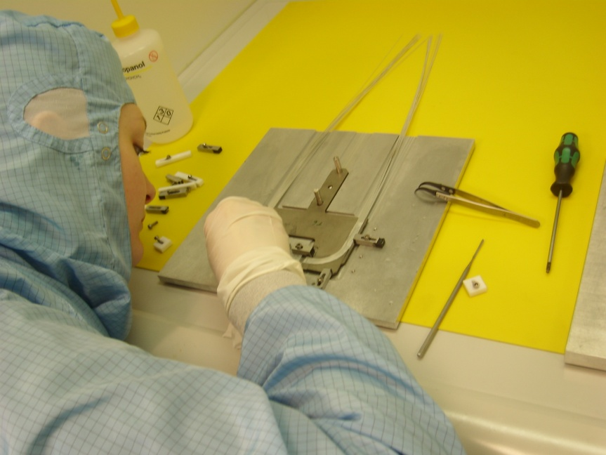
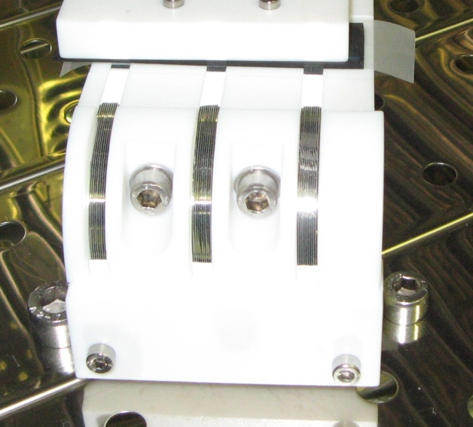
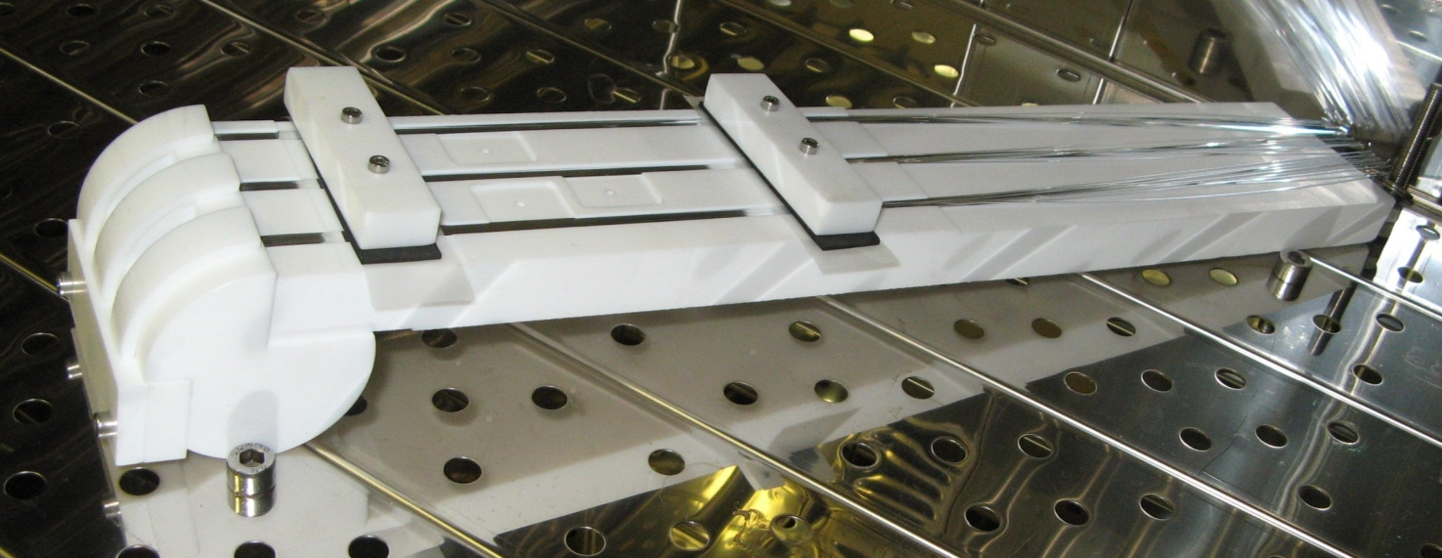


Assembly of overlap fibre plates
1) Hot bending of fibers at 80 -90 °C
2) Fibre positioning (straight, horizontal)
3) Glue fibres on Ti substrate
4) Metrology

Slide 19

Trigger tiles
Overlap trigger tiles
Titanium substrate
Main trigger tiles
2 main
trigger tiles
2 overlap trigger tiles
Standard plastic scintillator technology. Two independently read tiles suppress noise or give redundancy.
Light transport to PMT by means of clear fibres.
• Tiles define active surface of detector. Positioning precision of main trigger tile is as important as fibre positioning.

Slide 20





Detector assembly
  (10 tracking modules, 3 overlaps and 2 triggers)
  • Fiber and trigger plates aligned on an adjustable support arm equipped with precision pins.
  • Routing of 1460 fibres and trigger lightguide bundles to connectors
  • Mounting LED and PT100 sensors
  • Gluing fibres and lightguides in the connectors
  • Machining & polishing of connectors
Adjustable support arm:
Reference and alignment
pin holes
Feedthrough for test LEDS and temperature sensors

Slide 21

Detector adjustment and metrology
• Check the overall dimensions of the fibre detector
• Adjustment of the detector position relative to the base plate ( best fit into individual pot)
→ edge 150μm from pot window!
• Accurate measurement of the detector position
Detector reference & alignment pins
Alignment pin hole
Base plate reference surface
Reference pin hole

Slide 22




Detector final survey
• Survey spheres (mirrors) mounted directly on the detectors
• 3 survey points used on each detector (4th backup survey point)
• Same survey points on all detectors
• The survey point have be measured ±10μm in the coordinate system of the detector/Roman Pot (TESA 3D metrology)

Slide 23


Insertion into Roman Pot

Slide 24










MAPMTs
HAMAMATSU R7600-00-M64
Grid of 8x8 anodes, size 2x2mm² pitch 2.3mm
→ Anode grid not centred to the metal case !
Plastic shims to compensate for the misalignment of the anode grid
23 MAPMTs per module
HV divider and front-end electronics (PMF) attached to the pins
Accurate positioning inside the μ−metal frame. Anode grid aligned to the fibres connector.

Slide 25


Photo-detector module
Photo-detector module under black box
Kapton flat cable (readout)
PMFs
MAPMTs
Roman Pot
μ-metal frame
Spring loaded bracket

Slide 26



Installation of the photo-detector module in the LHC tunnel

Slide 27

Survey in tunnel
Survey of fibre detectors in the LHC coordinate system with a laser tracker

