Slide 1


DT Science-Techno Tea
DT News CJ
DT Annual Report 2010 CJ
Measurement of the LHC Luminosity André Braem, Matthieu Heller
with Scintillating Fibre Detectors in Roman Pots
8 April 2011

Slide 2
  DT Personnel
  New fellow. Matthieu Heller (1 January), ATLAS ALFA and AX-PET, supervisor CJ.
  New LD job opened: Electronics/mechanics technician, bondlab & QART lab (replacement A. Guipet). CP B or C. Deadline for applications: 10 April
  Job description prepared for LD job: Eng/Phys. Upgrade of irradiation facilities. First 2 years financed by FP7 AIDA. Anticipated replacement of M. Glaser.
  Retirement of Hans Taureg. RD51 and safety. End of contract Feb 2012, but lots of holidays.
  Retirement of André Braem. Thin Film and Glass, ALFA, AX-PET, … End of contract: Aug 2011, lots of holidays. New project leader of TFG Lab: Thomas Schneider.
  Scintillator activities: Continuous demand, 1-2 jobs per month. New devices, modifications, repairs. Raphael Dumps replaced Adrian Folley as technician in charge.
  New projects
  ATLAS nSQP: Preparation of a possible repair of ATLAS pixel detector. Reason: Lifetime of VCSEL (LASER) diodes may be shorter than expected. Diodes are mounted inside the detector and can’t be accessed. → Full rebuild of Service Quarter Panels for possible exchange during shutdown 2013/14. DT contributes with 3-4 FTE. P. Charra, P. Brunel, X. Pons, … Activity led by Mar Capeans.

Slide 3
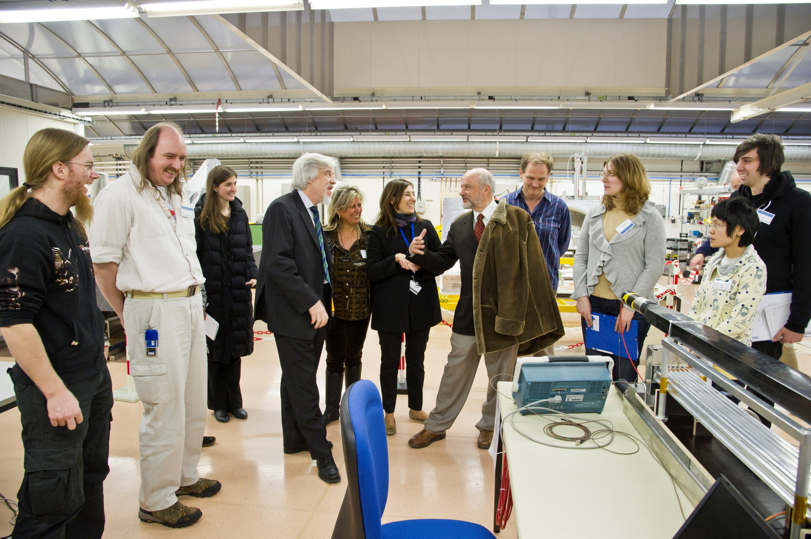
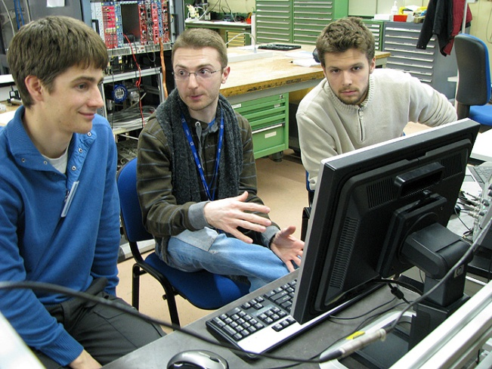
  Other DT activities
  EDIT 2011 School “Excellence in Detectors and Instrumentation Technologies”
  88 students from all over the world. DT people involved in gas, photon and silicon detector lectures and lab activities. T. Gys, M. Capeans, L. Ropelewski, M. Villa, M. Moll, H. Danielsson, A. Honma et al., CJ. Good support by technicians. Renovated former mechanical workshop of A. Ferrand.
Fermilab DG Pier Oddone and CERN DG Rolf Heuer visit the gas detector lab in B154.
Marco Villa explains the principle of gaseous detectors.

Slide 4
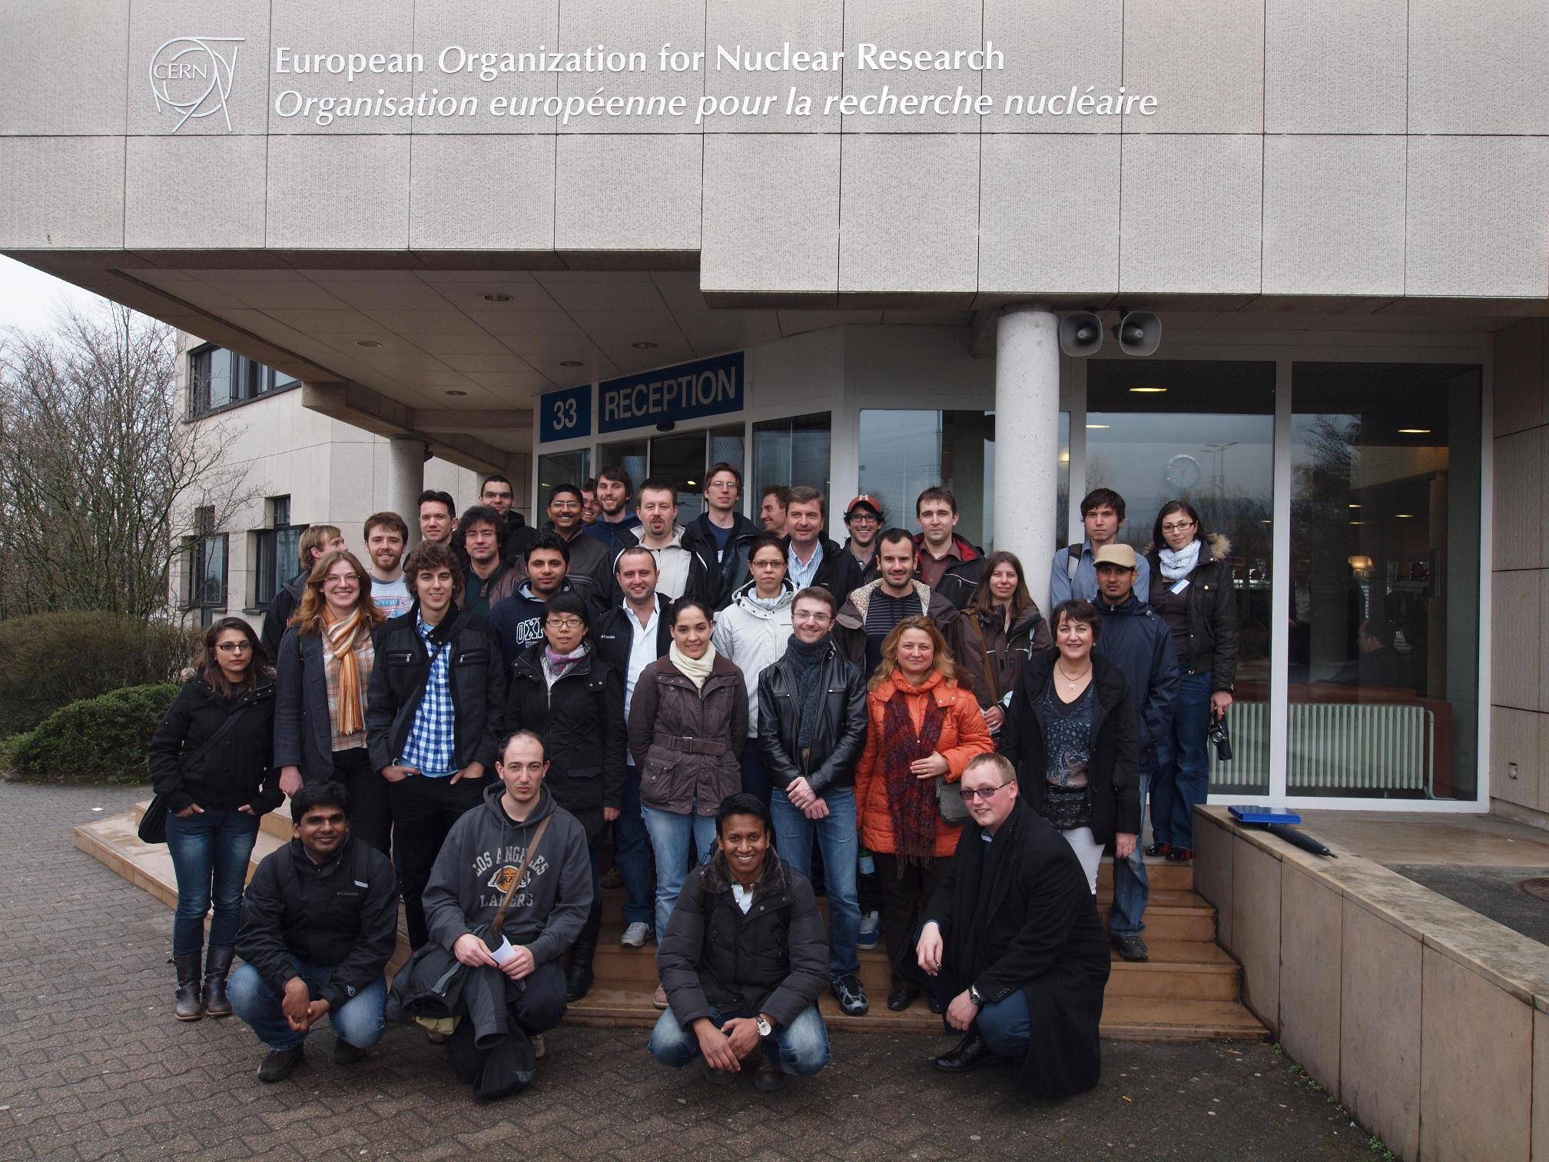
MC-PAD network training event, 16-18 March, 35 students.
Re-used gas and photodetector labs. Nice success.
Several DT and external colleagues served as tutors and lecturers.
MC-PAD is a fully EU funded Marie Curie network on particle detectors. 22 positions. 5 fellows at CERN. 4.7 M€.

Slide 5
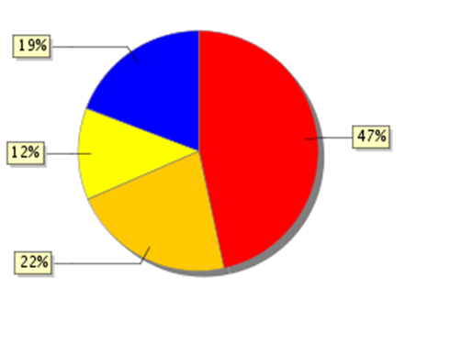
Distribution of ‘regular’ steps
(144 for 72 eligible staff)
DT MARS 2011
Wait for supervisor assessment
Wait for
GL assessment
73 documents
Fully ready
18%
Documents not yet completed
The PH department leader has still a reserve of 40 steps.
→ 7-8 for DT ?
5 SB change proposals (in CP B, C, D)
1 CP change proposal (to A to B)
3 CP change proposals (Ec to Fa)
2 CP change proposals (Fb to Fc)
In addition DT proposes 11 premiums of 1000 CHF each, mainly related to TOTEM and ALFA installation work and service over Christmas.
All documents must be completed on 15 April.

Slide 6
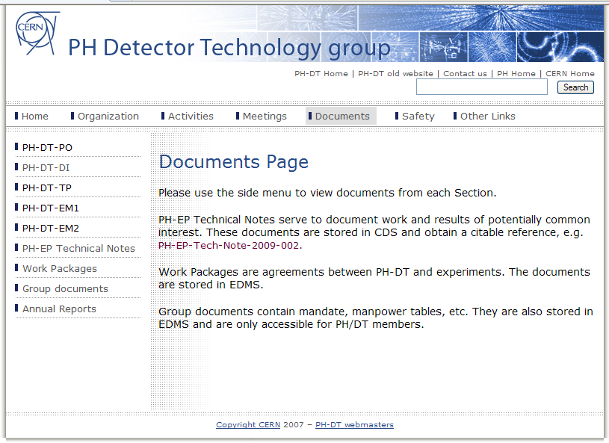
DT Annual Report 2010
www.cern.ch/ph-dep-dt

