Slide 1
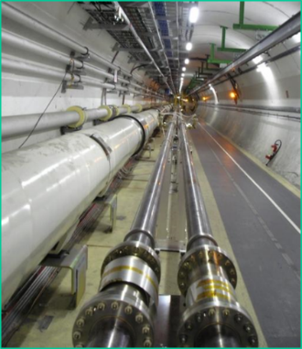
Visit of Zanon R&I
P.Costa Pinto, M.Taborelli
Non-Evaporable Getter (NEG) materials
NEG thin films for particle accelerators
Production of Ti-Zr-V NEG thin films

Slide 2
1- Non-Evaporable Getter materials (NEG)
Working principle
Active surface for pumping
Temperature
Oxide layer
Oxygen in the film
Activation temperature
RT
NEG
Time
Molecules pumped on the surface: CO, O₂, H₂O, CO₂, N₂.
H₂ is dissociated on the surface and diffuses into the bulk.
Not pumped: noble gases and CH₄ (at room temperature)

Slide 3

2- NEG thin films for particle accelerators: motivation
Vacuum pumping in long narrow pipes (typical in accelerators) is limited by conductance
P(x)
P_{max}
x
P(0)
2R
P(0)
Distributed outgassing
x
pump
S
L
S
pump
$$P_{max}∝\frac{Q_{total}}{C}∝Q_{total}\frac{L}{R^{3}}$$

Slide 4

2- NEG thin films for particle accelerators: motivation
Vacuum pumping in long narrow pipes (typical in accelerators) is limited by conductance
Non Evaporable Getters can provide distributed pumping along the vacuum chamber
P(x)
P_{max}
x
P(0)
P(0)
Distributed outgassing and pumping
x
S
L
S
$$P_{max}∝\frac{Q_{total}}{C}∝Q_{total}\frac{L}{R^{3}}$$

Slide 5
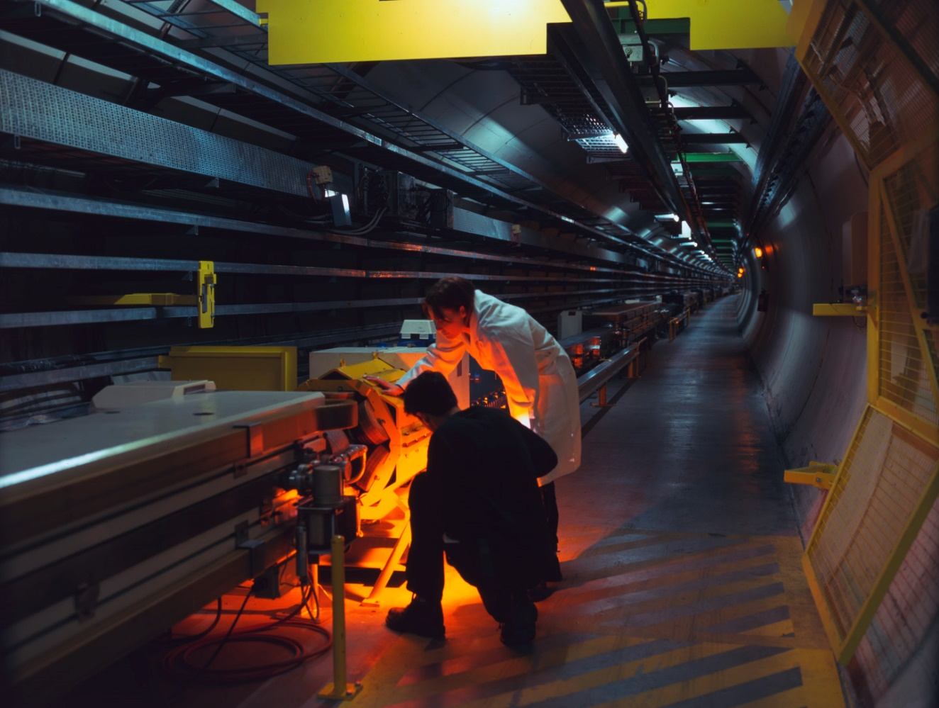
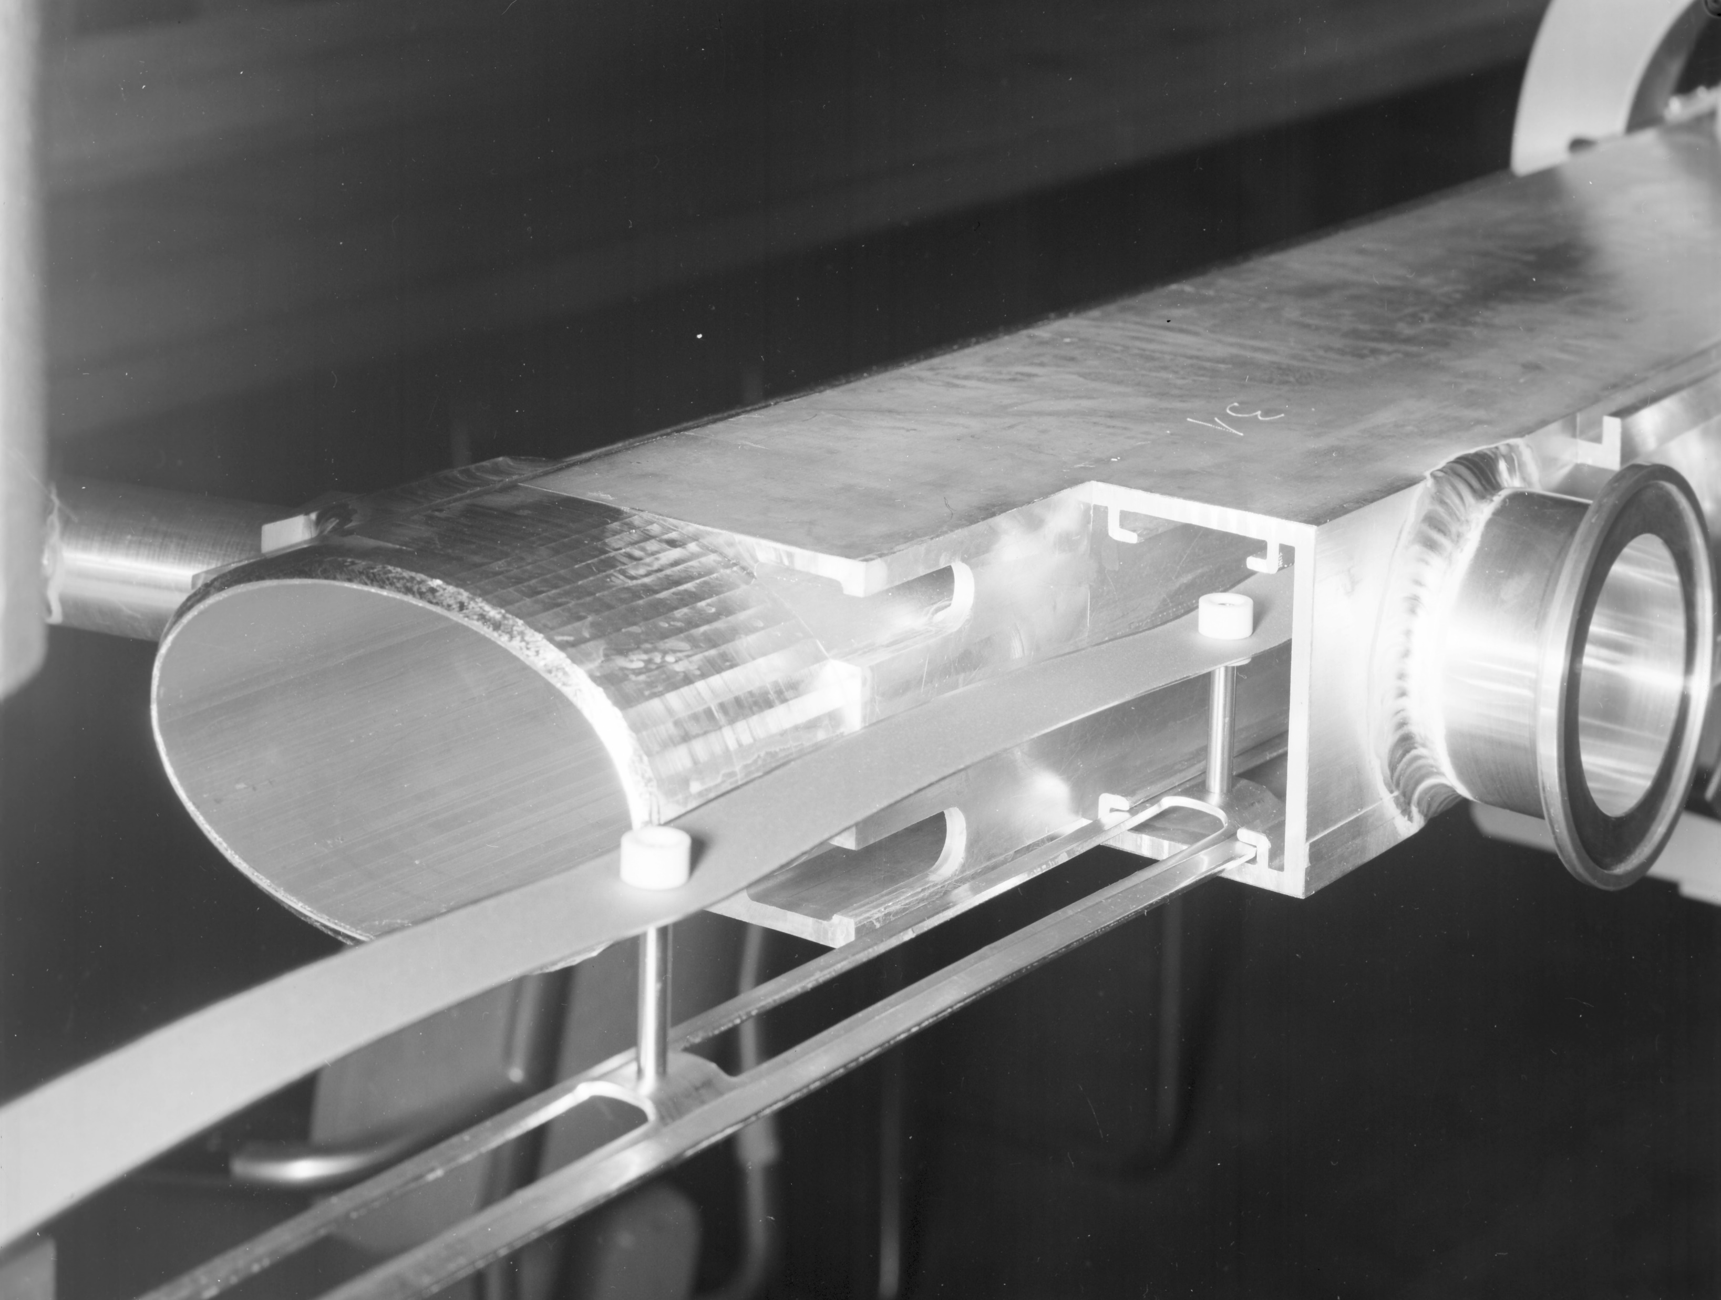
2- NEG thin films for particle accelerators: history
Vacuum pumping in long narrow pipes (typical in accelerators) is limited by conductance
Non Evaporable Getters can provide distributed pumping along the vacuum chamber: “bulk” NEG on resistive heated strips as first accelerator application
The LEP (Large Electron Positron collider, 27 km) was pumped by NEG strips (SAES st101) (1985 – 2001)
Beam pipe
NEG strip (SAES)

Slide 6
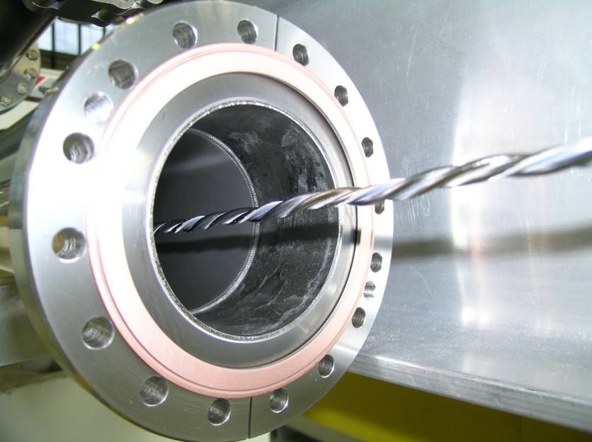
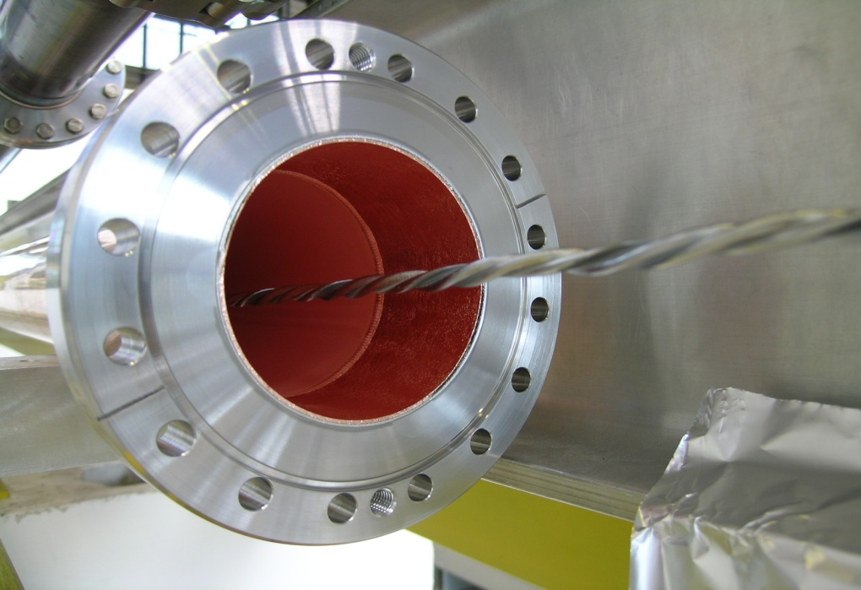
2- NEG thin films for particle accelerators: history
Idea: from the strip to a thin film covering the entire chamber surface
However, strips activated at 740C (later another composition at 400C)….
Before coating
after coating
Beam pipe
NEG strip (SAES)

Slide 7
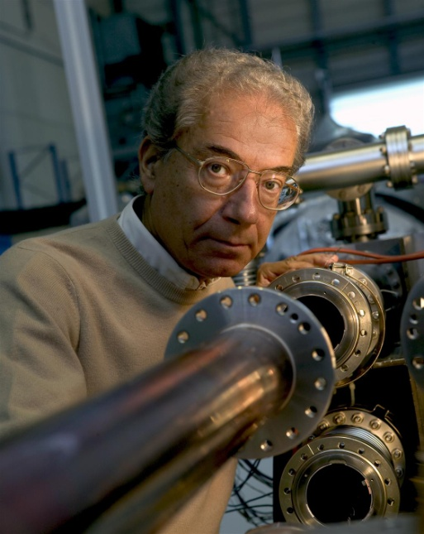
2- NEG thin films for particle accelerators: history
Idea: from the strip to a thin film covering the entire chamber surface
However, strips activated at 740C (later another composition at 400C)….
Before coating
after coating
Cristoforo Benvenutti

Slide 8
2- NEG thin films for particle accelerators: more than just pumping
after coating
Advantages:
Global distributed pumping speed;
Low particle induced desorption
Low secondary electron emission

Slide 9
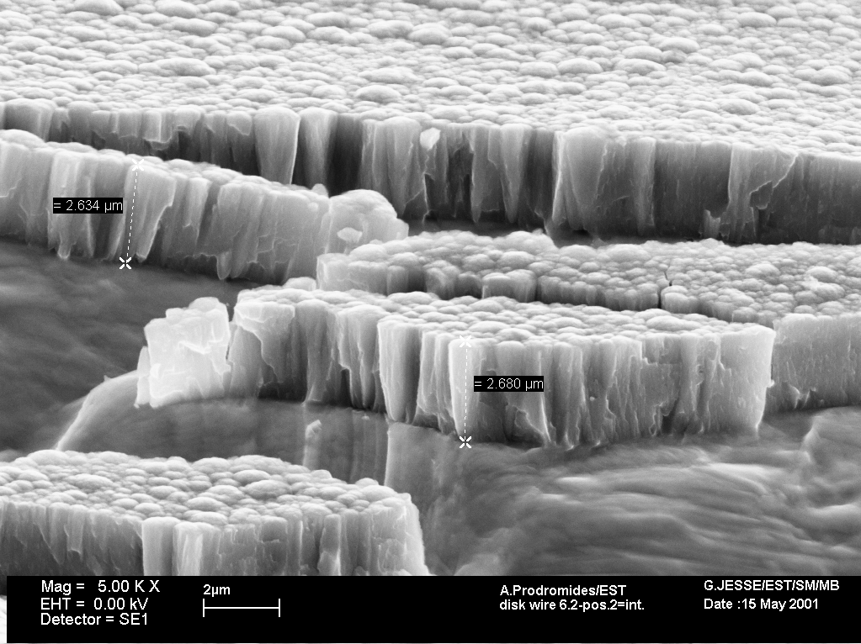
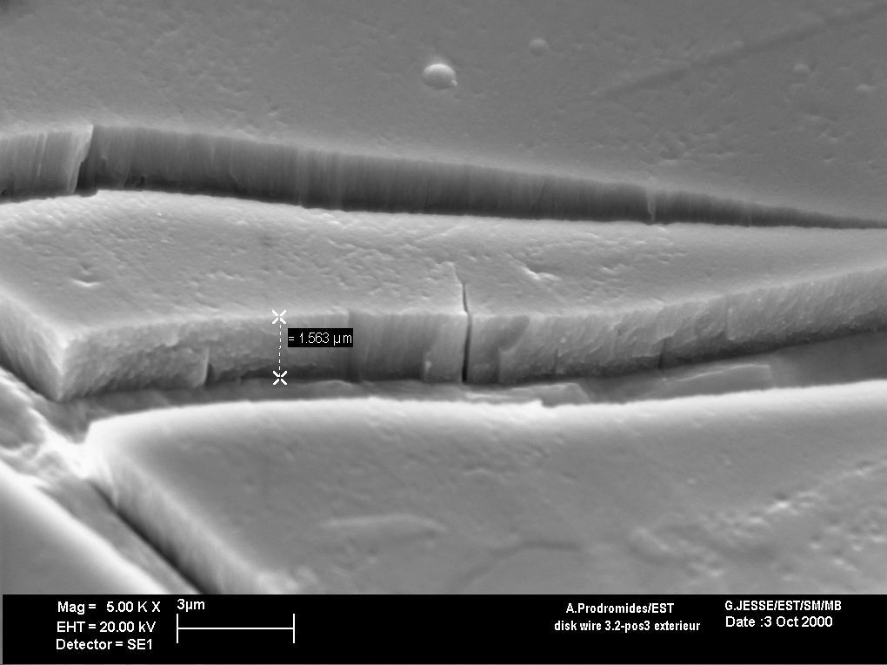
2- NEG thin films for particle accelerators: sticking probability
Sticking probability for distributed pumping: some structure effect
coated at 100ºC
coated at 300ºC
Surface capacity (CO) ~8x10¹⁴ molecules/cm²
Surface capacity (CO) ~7x10¹⁵ molecules/cm²
activation | Sticking coefficient H₂ _{min ~max} | Sticking coefficient CO _{min ~max} | Surface capacity for CO [molecules/cm²]
24 h@180º C | 2x10⁻³ ~ 9x10⁻³ | 0.5 ~ 1 | 3x10¹⁴ ~ 8x10¹⁴ («standard») > 5x10¹⁵ for rough films
2 h@230º C | 8x10⁻³ | 0.45 | 3x10¹⁴ ~ 6x10¹⁵
24 h@230º C | 5x10⁻³ ~ 2x10⁻² | 0.6 ~ 1
24 h@250º C | 6x10⁻³ ~ 3x10⁻² | 0.6 ~ 1
LHC

Slide 10
2- NEG thin films for particle accelerators: Secondary Electron Yield
Low Secondary Electron Yield (SEY) for anti-multipacting (or anti e-cloud)
as received
after 2h @ 120ºC
after 2h @ 160ºC
after 2h @ 200ºC
Threshold for electron multipacting in the LHC ~1.3

Slide 11
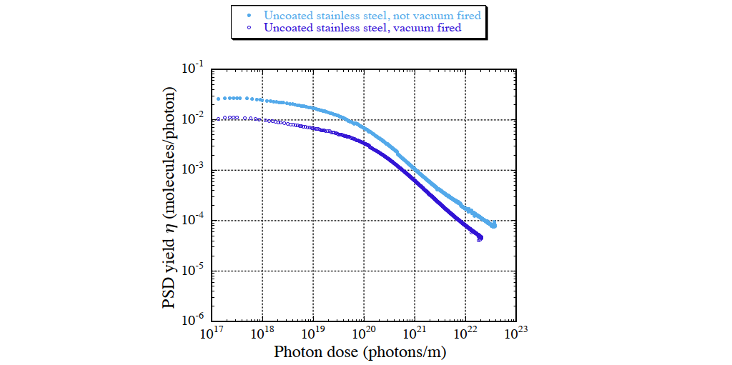
2- NEG thin films for particle accelerators: PSD
Low Photon Stimulation Desorption yield (PSD)
To limit dynamic outgassing
Courtesy from Yasunori Tanimoto, KEK

Slide 12
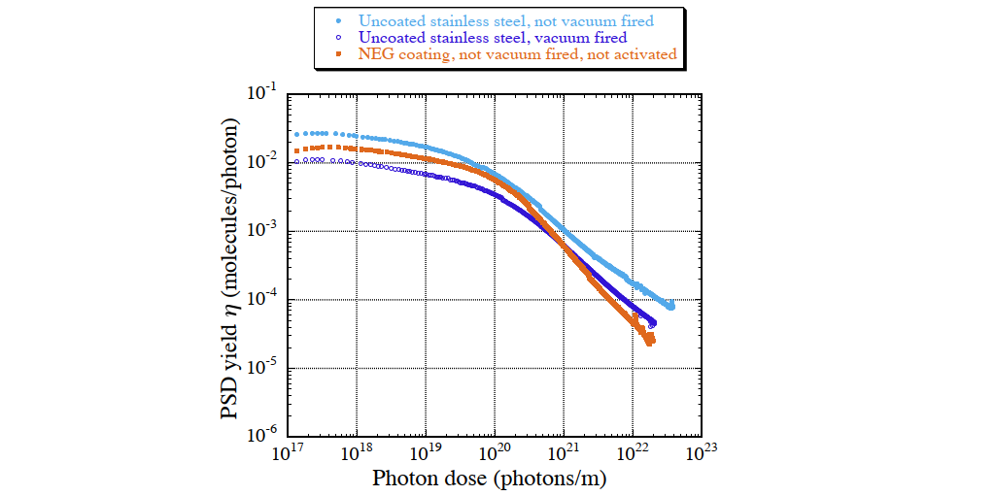
2- NEG thin films for particle accelerators: PSD
Low Photon Stimulation Desorption yield (PSD)
To limit dynamic outgassing
Courtesy from Yasunori Tanimoto, KEK

Slide 13
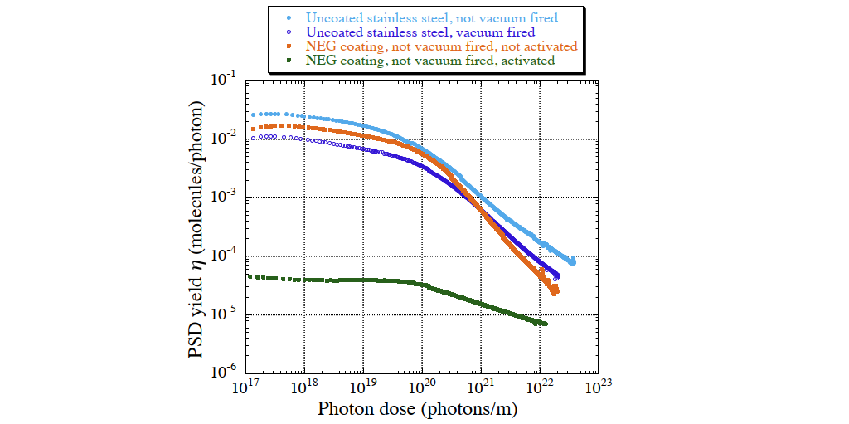
2- NEG thin films for particle accelerators: PSD
Low Photon Stimulation Desorption yield (PSD)
To limit dynamic outgassing
Courtesy from Yasunori Tanimoto, KEK

Slide 14
3- NEG thin films for particle accelerators: activation
Activation time and temperature must be compatible with the application.
For vacuum chambers it must be compatible with the material of the chamber (change of mechanical properties with temperature)
Temperature
Activation temperature
RT
Time

Slide 15
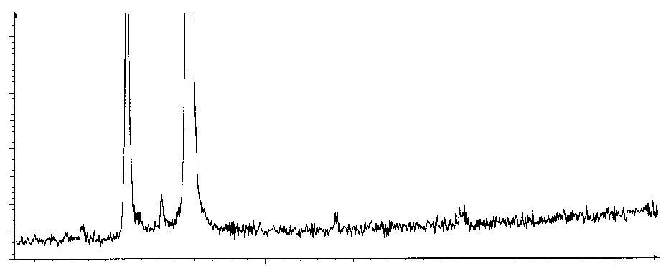
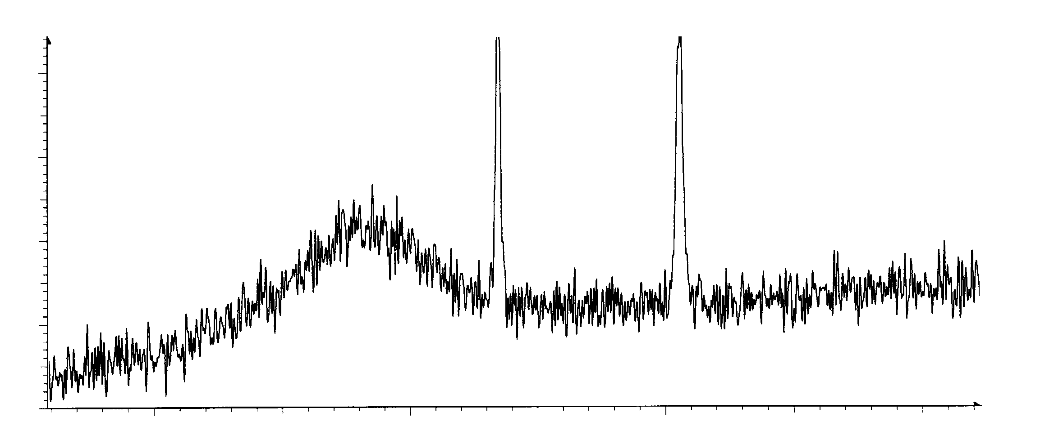
3- The Ti-Zr-V NEG thin film: composition & activation
Ti-Zr-V with activation temperature 180 ºC.
Composition diagram (at.%)
Ti-Zr-V
Large crystals
grain size ≥ ~100 nm
Substrate
XRD intensity (a.u.)
30
40
50
60
Θ (degrees)
Ti-Zr-V
Substrate
Nanocrystalline
grain size < 5 nm
XRD intensity (a.u.)
Good activation
30
40
50
60
Θ (degrees)
~Ti₃₃-Zr₃₃-V₃₃ +/-20% acceptable

Slide 16
3- The Ti-Zr-V NEG thin film: composition & activation
Ti-Zr-V with activation temperature 180 ºC: can be applied on copper and aluminium alloy chambers.
Composition diagram (at.%)
Large crystals
grain size ≥ ~100 nm
Malyshev et al. reported lower activation temperature for the quaternary alloy Ti-Zr-V-Hf,
J. Vac. Sci. Technol. A 2014, 32, 061601
Nanocrystalline
grain size < 5 nm
Good activation
~Ti₃₃-Zr₃₃-V₃₃ +/-20% acceptable

Slide 17
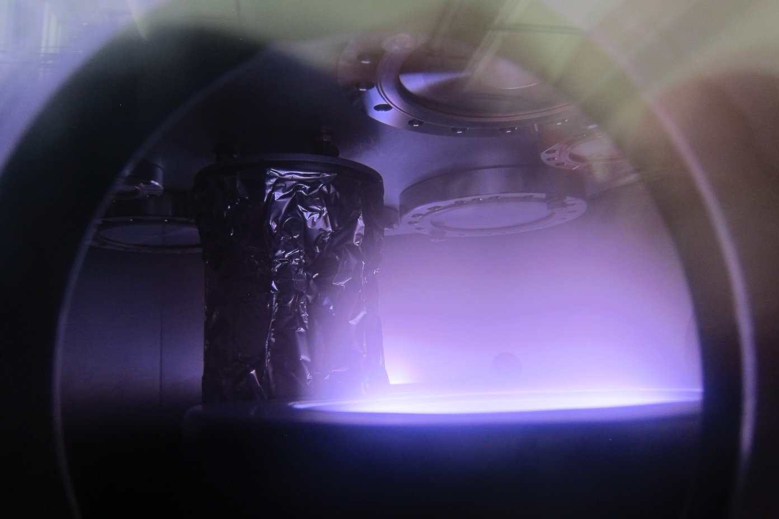
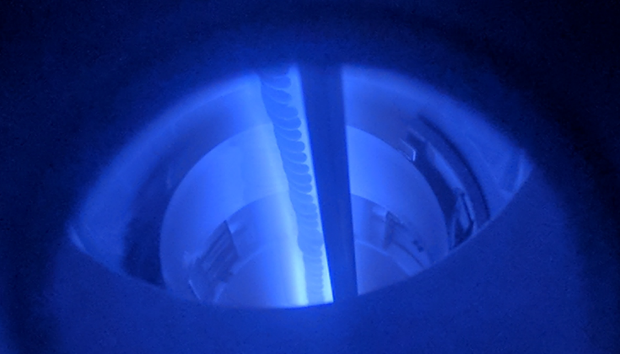
3- Production of Ti-Zr-V NEG thin films
Produced by sputtering
Planar magnetron
(TiZrV alloy targets available)
Cylindrical magnetron sputtering
(multiwire targets; alloy targets not available)
intertwisted wires of Ti, Zr and V
Glow discharge
Vacuum chamber

Slide 18
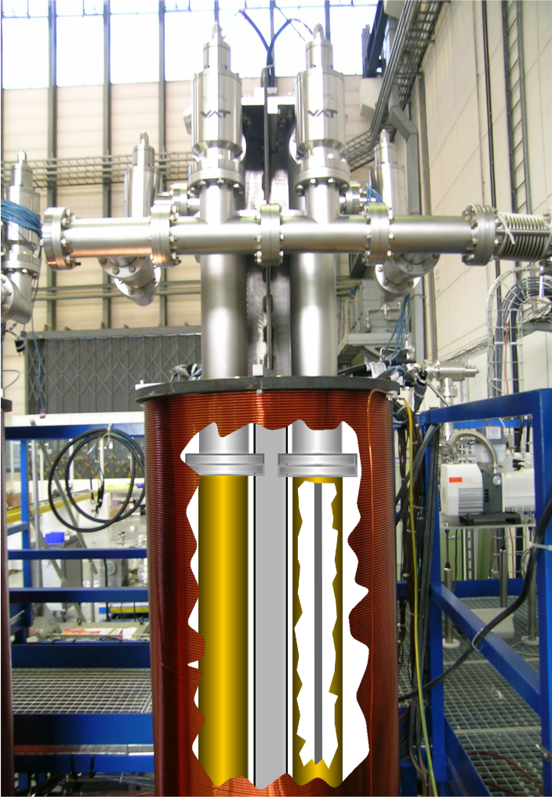
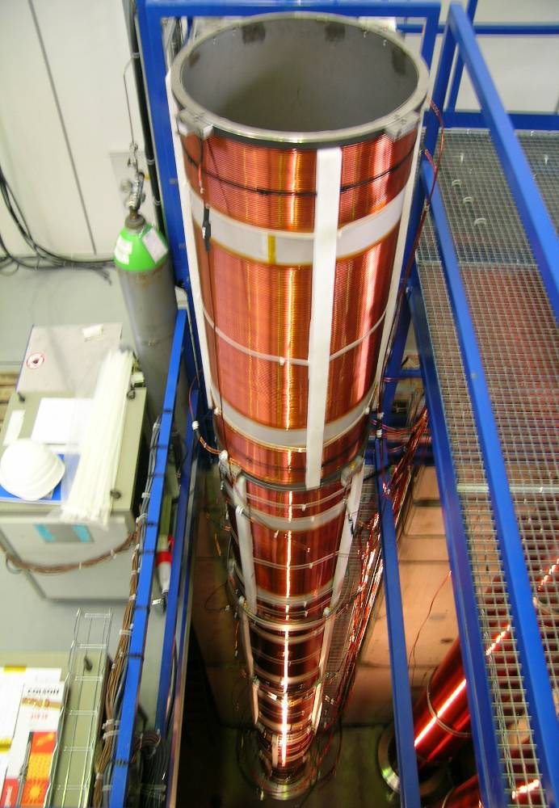
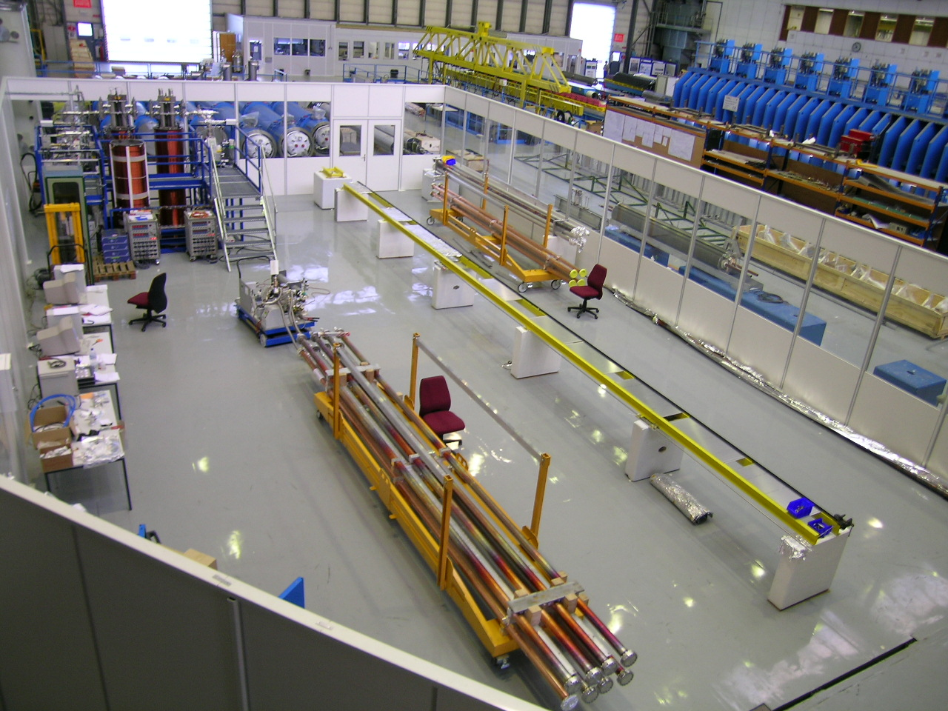
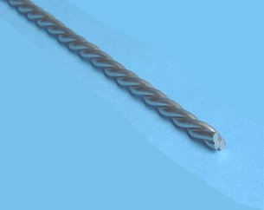
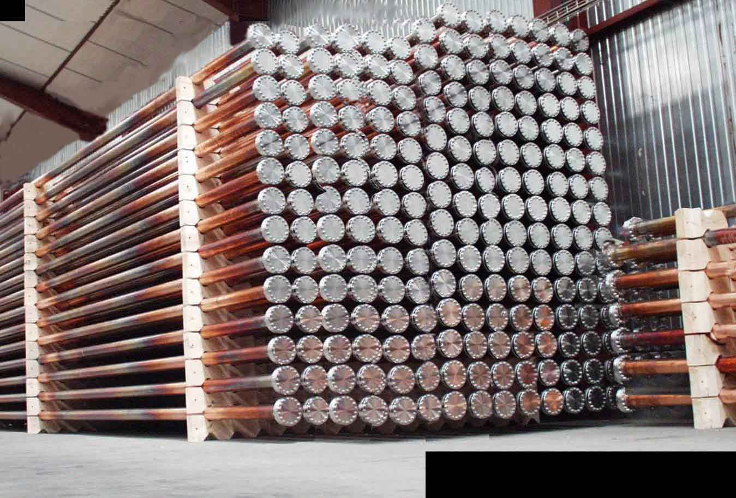
3- Production of Ti-Zr-V NEG thin films
Large scale production: more than 3 km of beam pipes in the LHC
3mm wires of Ti, Zr and V

Slide 19
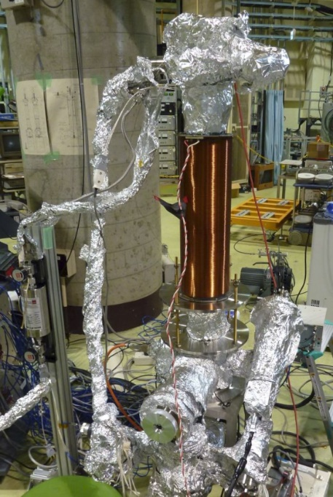
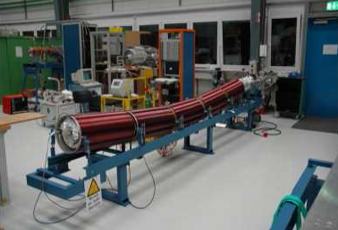
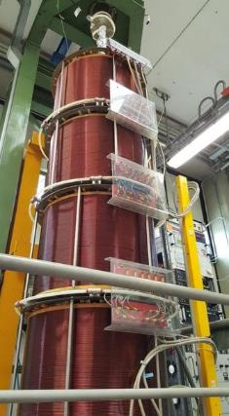
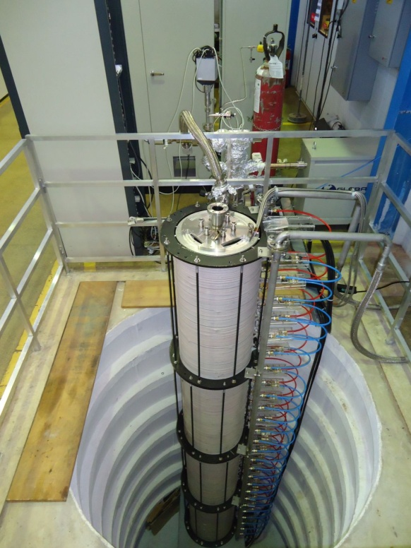
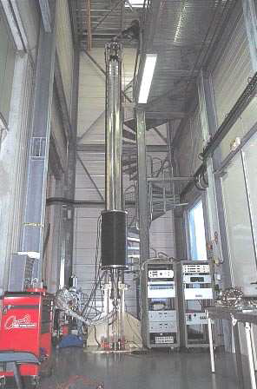
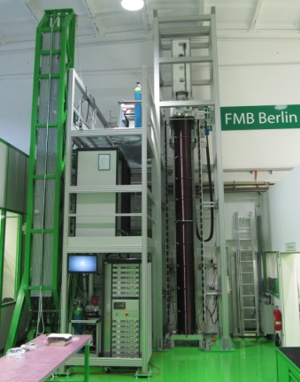
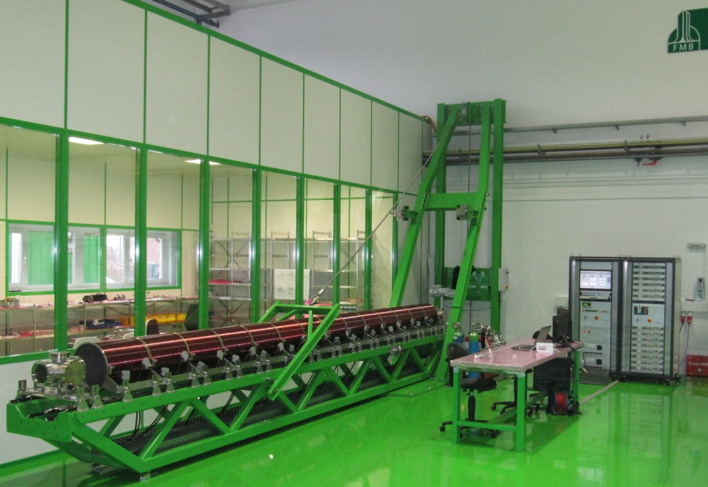
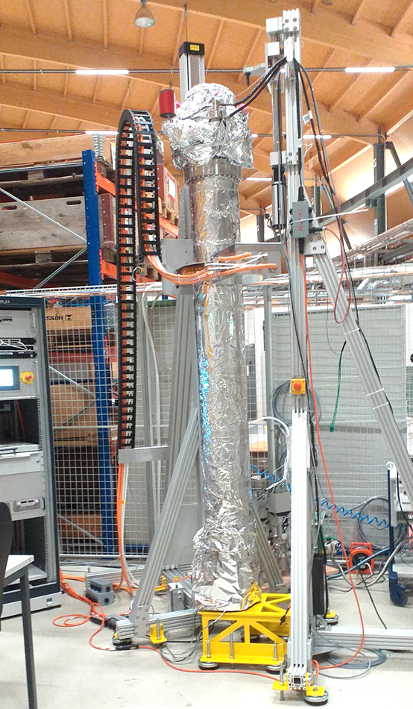
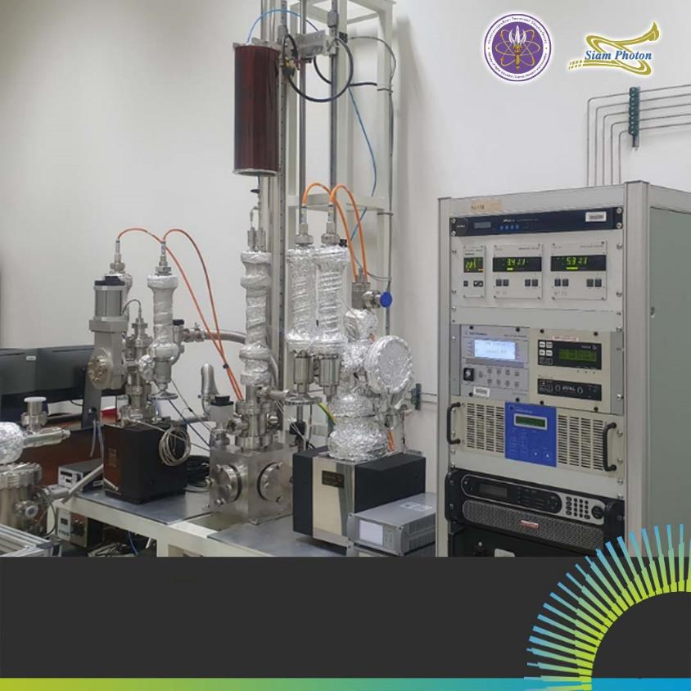
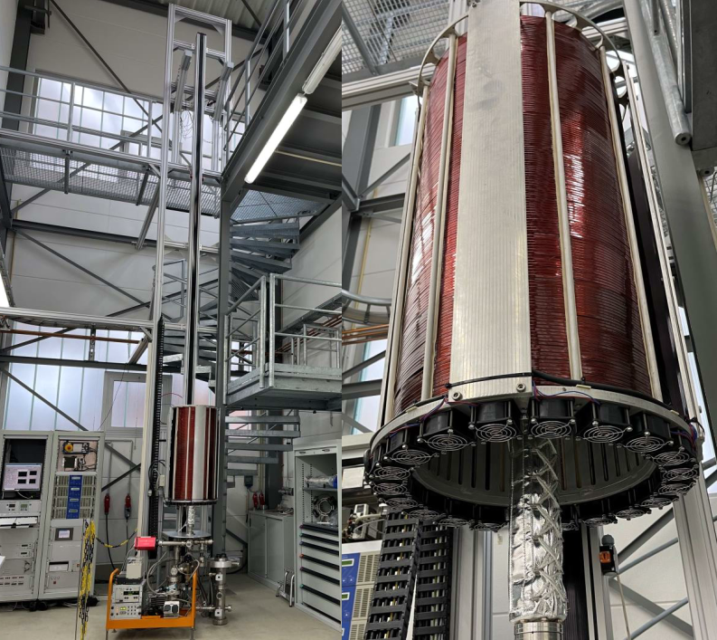
3- Production of Ti-Zr-V NEG thin films
Produced world wide
GSI (Germany)
LNLS (Brazil)
ESRF (France)
KEK (Japan)
Widely
used in synchrotron light sources
SAES getters
(Italy)
PSI
(Switzerland)
FMB Berlin (Germany)
Thai Synchrotron
DESY

Slide 20
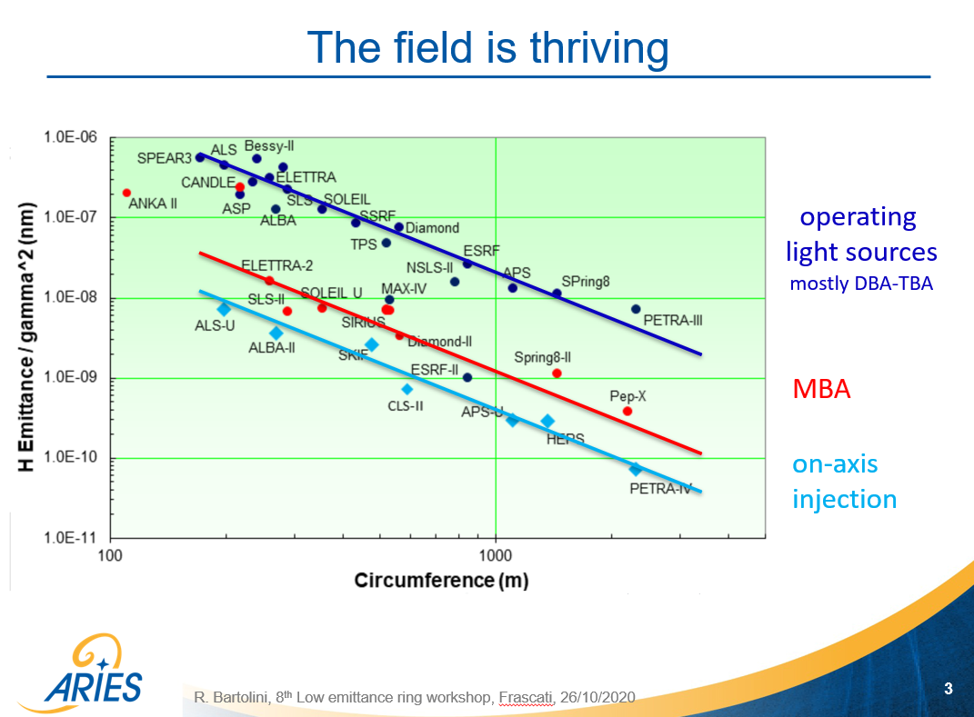
3- Production of Ti-Zr-V NEG thin films
Synchrotron light sources
Source: “8th Low Emittance Rings Workshop”, Oct. 26-30, 2020, Frascati (held remotely), R. Bartolini, DESY
https://agenda.infn.it/event/20813/timetable/#all.detailed

Slide 21
3- Production of Ti-Zr-V NEG thin films
Key challenges
Thickness uniformity
Adhesion
Narrow
&
Complex
Beam pipes

Slide 22
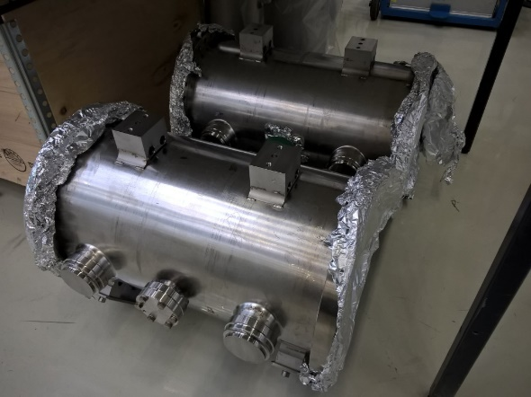
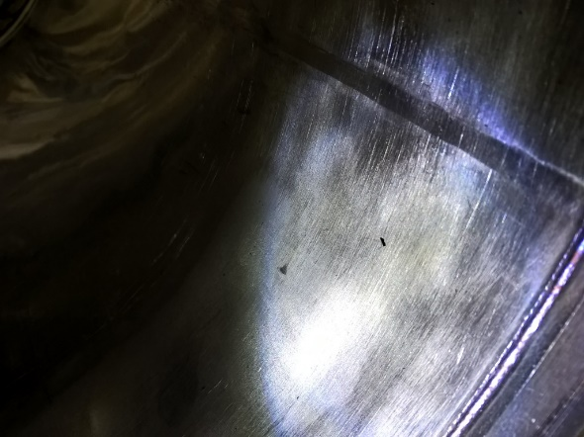
3- Production of Ti-Zr-V NEG thin films
Key challenges
Adhesion: requires surface treatment adapted to each substrate (copper, stainless steel, aluminium).
Peel-off can occur in thermally affected areas

Slide 23
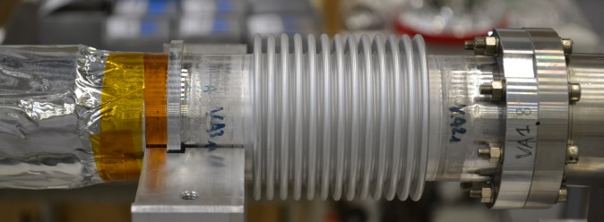
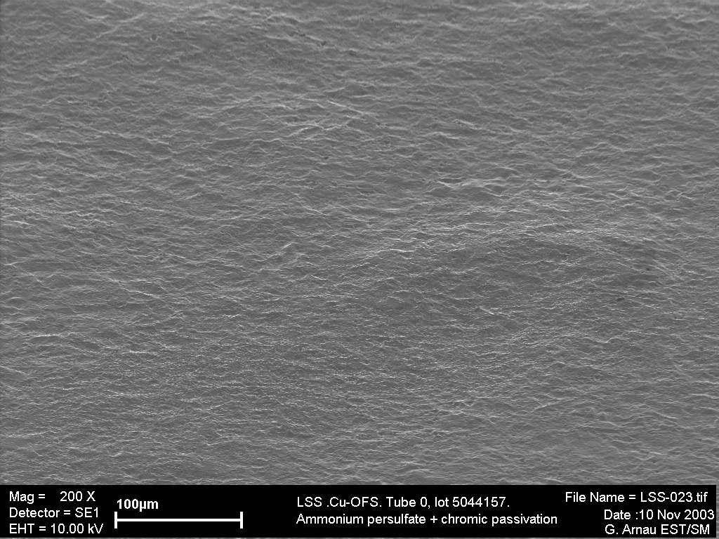
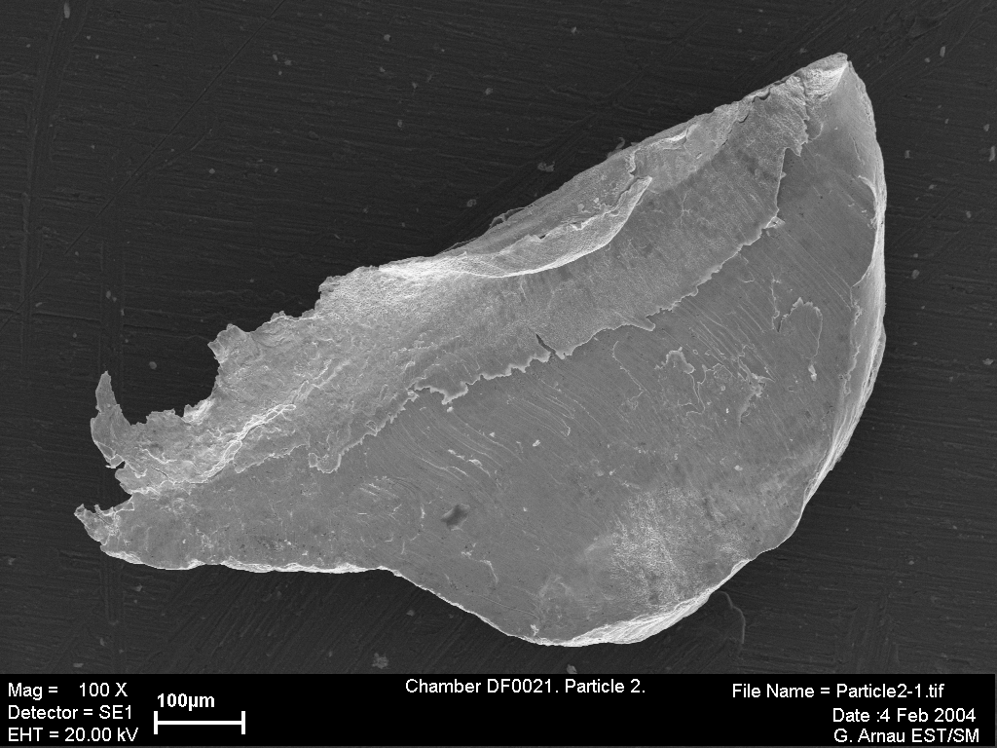
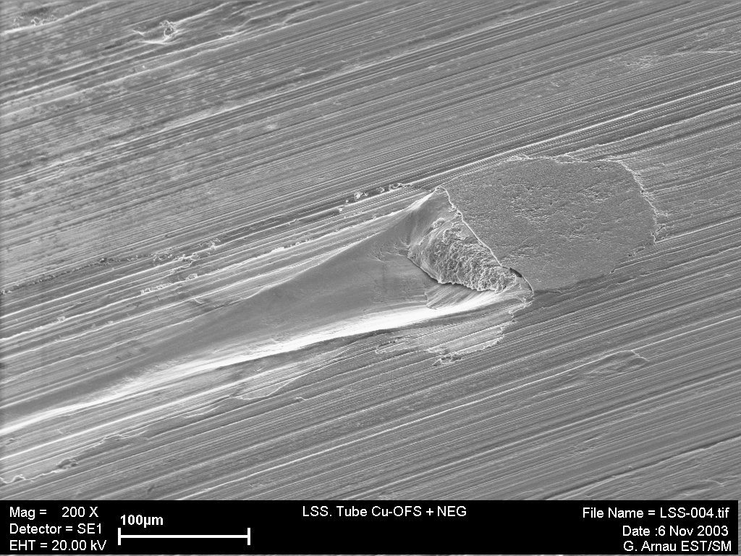
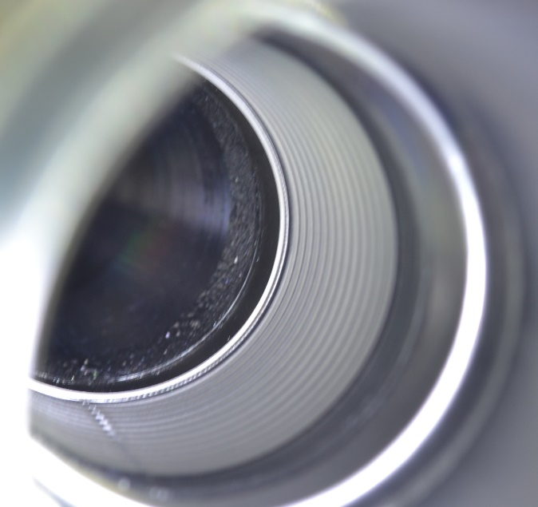
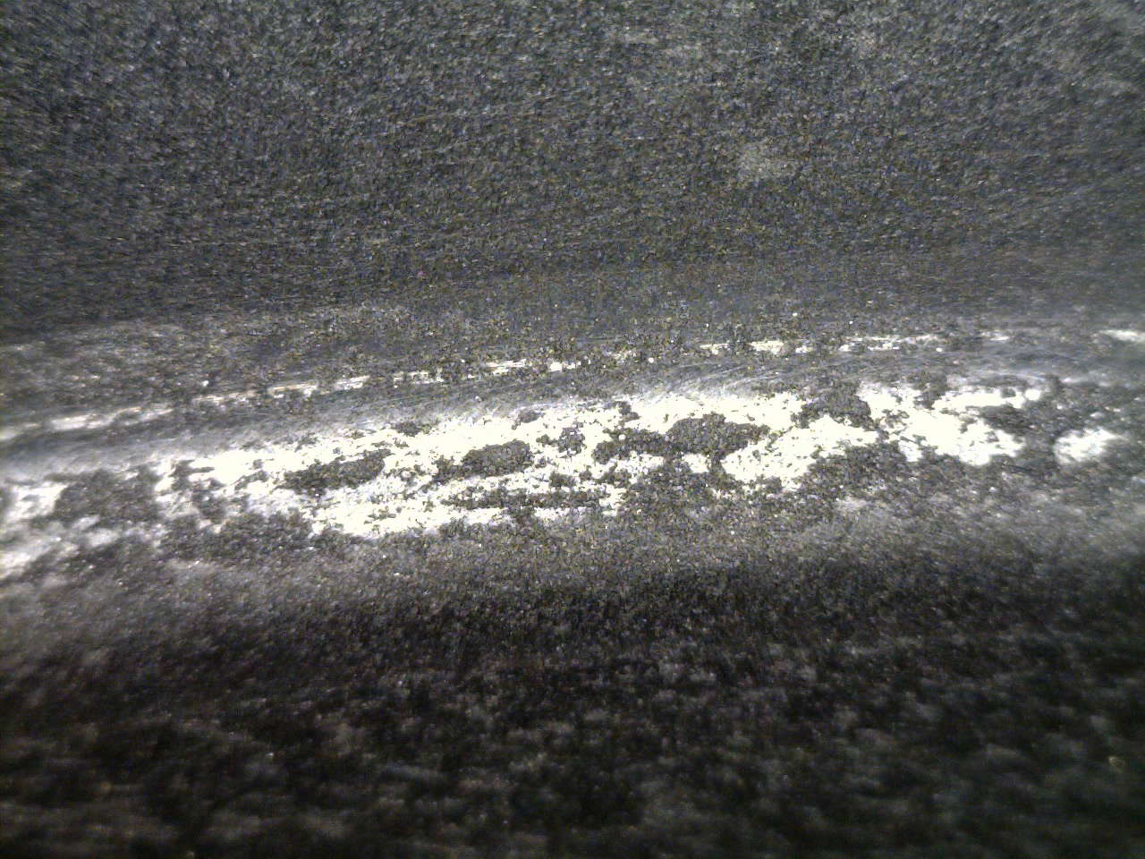
3- Production of Ti-Zr-V NEG thin films
Key challenges
Adhesion: requires surface treatment adapted to each substrate (copper, Stainless steel, aluminium).
Peel-off can occur in thermally affected areas
Peel off can occur on surfaces milled with specific parameters
Coating and thermal cycle can reveal surface defects
(copper incrustations due to defective extruding tool)

Slide 24
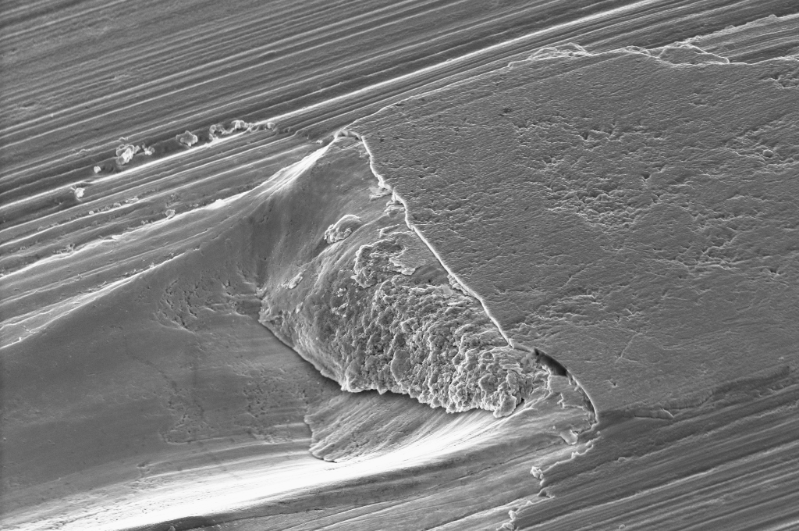
3- Production of Ti-Zr-V NEG thin films
Key challenges
Adhesion: requires surface treatment adapted to each substrate (copper, Stainless steel, aluminium).
Peel-off can occur in thermally affected areas
Peel off can occur on surfaces milled with specific parameters
Coating and thermal cycle can reveal surface defects
(copper incrustations due to defective extruding tool)
Surface preparation is crucial
(etching by wet chemistry or ion bombardment, sometimes followed by thermal treatments)

Slide 25
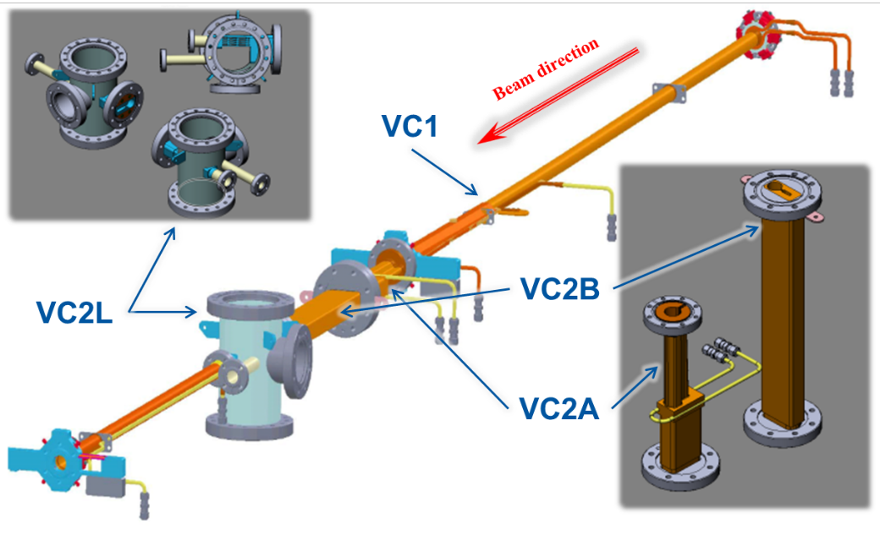
3- Production of Ti-Zr-V NEG thin films
Key challenges
Adhesion: requires surface treatment adapted to each substrate (copper, stainless steel, aluminium).
Beam pipes for synchrotron light sources becoming narrower and complex.
MAXIV

Slide 26
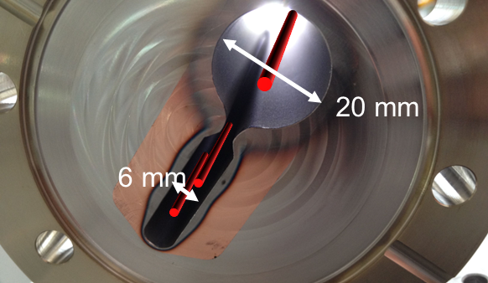
3- Production of Ti-Zr-V NEG thin films
Key challenges
Adhesion: requires surface treatment adapted to each substrate (copper, Stainless steel, aluminium).
Beam pipes for synchrotron light sources becoming narrower and complex.
Increasing demand on the uniformity of the thickness.
Minimal thickness for functionality: 150 nm
Maximal thicknesses (beam impedance):
LHC: > 1.5 μm
ELETTRA2: 500 nm
SLS2: 400 nm
FCC –ee: 200 nm
MAXIV

Slide 27
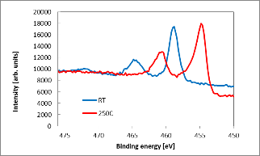
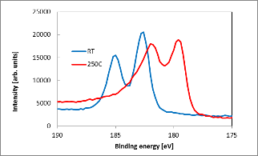
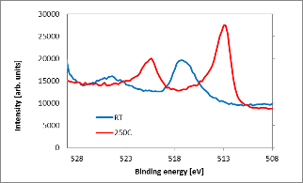
3- Production of Ti-Zr-V NEG thin films: quality control
Ti
monitoring activation process by X-ray Photoemission Spectroscopy:
Decrease of O on the surface
Reduction of the oxides of all the metals: the surface is metallic and reactive
Zr
O decrease
V

Slide 28
Summary
NEG thin films can provide distributed pumping, reduced electron multiplication and low particle induced outgassing.
These thin films are produced by sputtering from alloy targets (planar magnetron) or intertwisted wire targets.
Surface preparation is crucial.
Many of the 4th generation synchrotron light sources require extensive use of NEG thin films.
Key challenges include adhesion, narrow and complex chambers, restriction on maximal thicknesses accepted in some accelerators.

Slide 29
THANK YOU FOR YOUR ATTENTION
QUESTIONS?

Slide 30
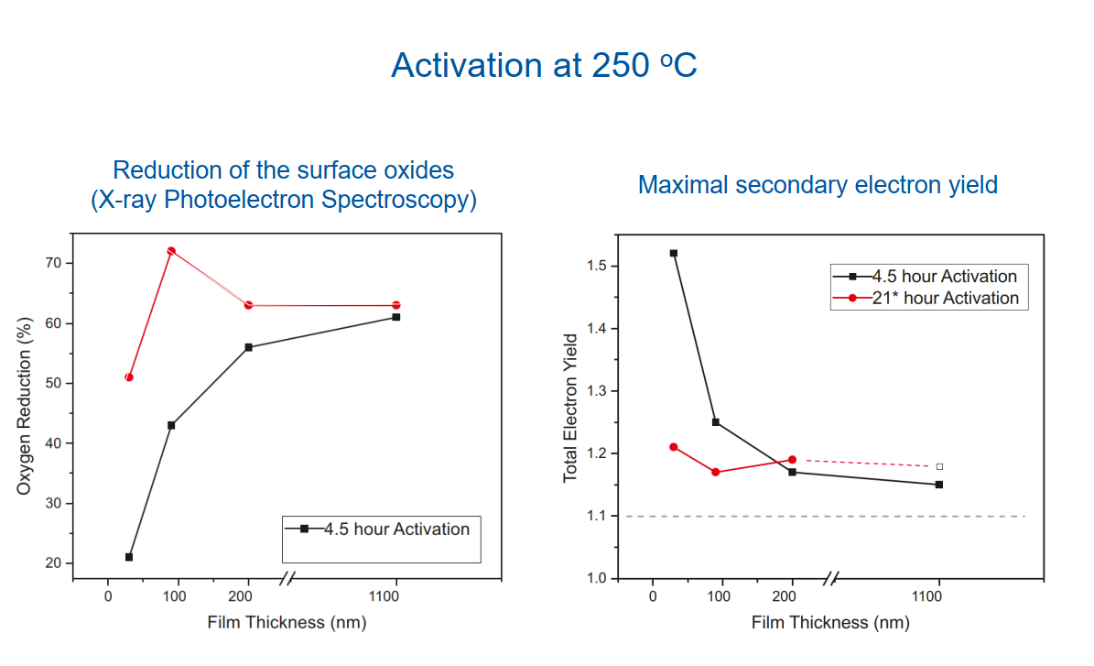
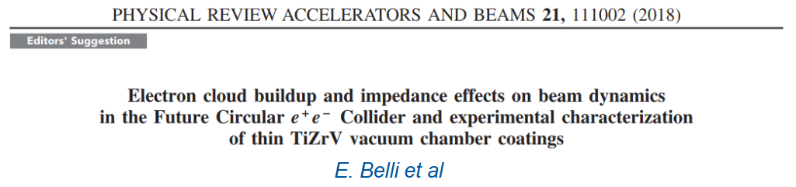
Thickness effect
4 activation cycles at 250C

Slide 31
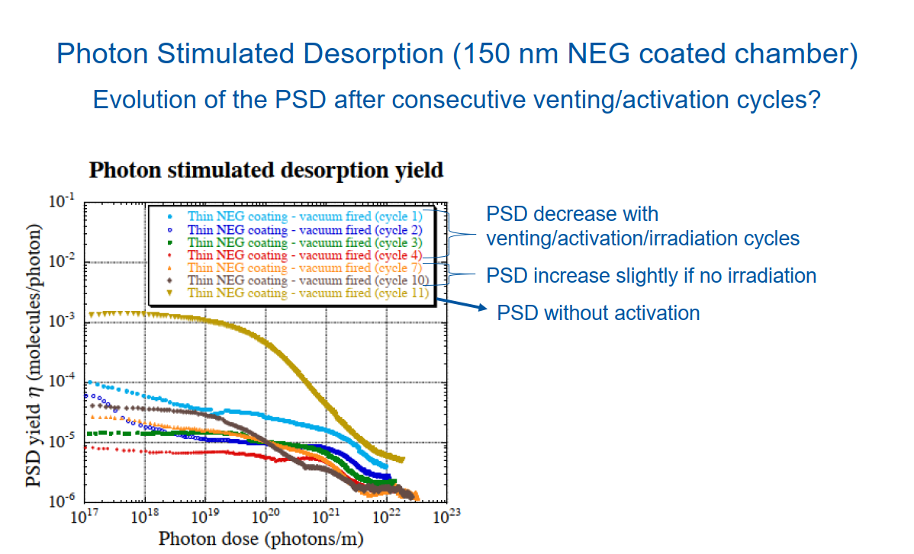
Thickness effect
Y.Tanimoto, M.Ady, P.Costa Pinto
Measured at KEK photon factory

Slide 32
Aging of TiZrV: role of the coating thickness
Equivalent to 1 ion pump of 100 l/s every meter!
From P.Chiggiato

