Slide 1


picoTDC and FERS system
Carlo Tintori (c.tintori@caen.it)
picoTDC meeting @ CERN – January 25th, 2024

Slide 2

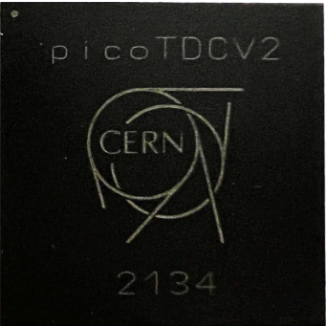
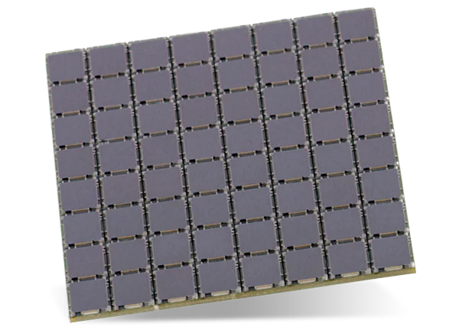

Building around the picoTDC
Multi-board Synchronization
T-ref
DAQ
Readout
Interfaces
Front-End
make the picoTDC ready for the application!
Infrastructure
(power, clock, config…)

Slide 3
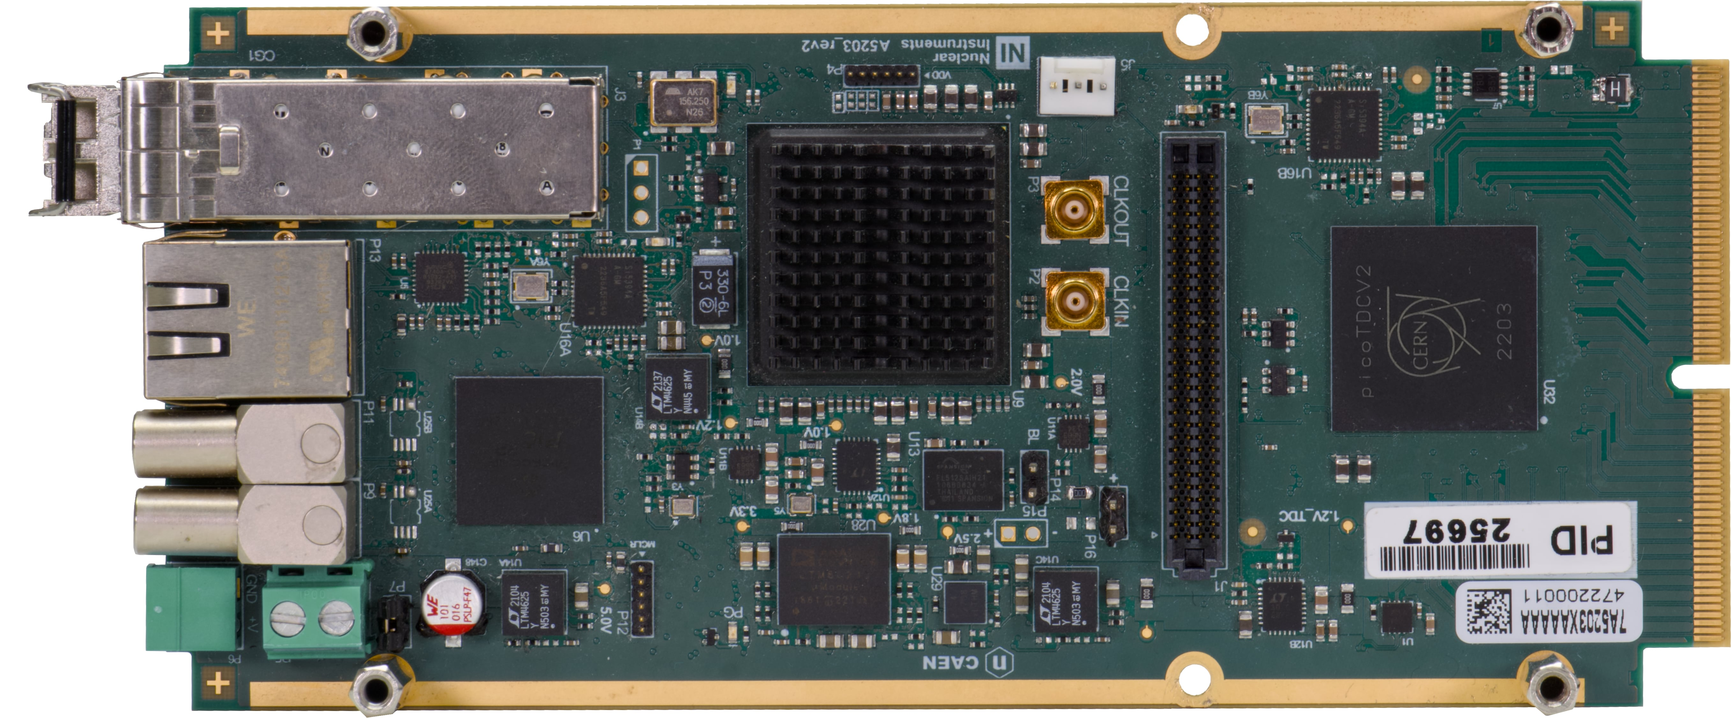
FERS A5202: 64/128 channel TDC
Clk In/Out
uC
+12V
2 In + 2 Out
LVDS
inputs
Eth/USB
TDlink:
Data+Sync
picoTDC-1
(64 ch)
to picoTDC-2
(128 ch)
FPGA

Slide 4
Technical Specifications
TDC: 64/128 channels, LSB = 3.125 ps, dynamic range = 56 bit (extended by FPGA)
Acquisition modes: Common Start/Stop (Tref=Ch0), Trigger Matching, Streaming
Readout: Direct: Eth/USB (slow); TDlink + Concentrator: 1/10 GbE or USB 3.0 (up to ~300 MB/s)
FPGA ToT filter: rejects pulses if ToT < LowCut or ToT > HighCut (remove noise, DCR, saturation…)
Throughput: tested up to ~64 Mcps/board (without filters)
Synchronization: up to 128 boards (16k channels) synchronized by Concentrator via TDlink (fibers).
Sync to GPS (White Rabbit soon) on Concentrator. Auxiliary Clock Daisy Chain for better timing.
DeltaT Resolution ^{(*)} :
  Same board: typ 5 ps RMS
  Board to board (with clock cables): ~8 ps RMS
  Board to board (without clock cables): ~20 ps RMS
(*) Tested with A5256. Pulse: 0.5 Vpp, 0.8 ns rise time

Slide 5
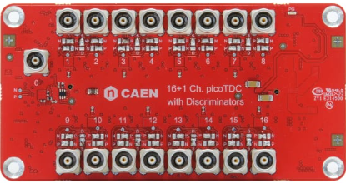
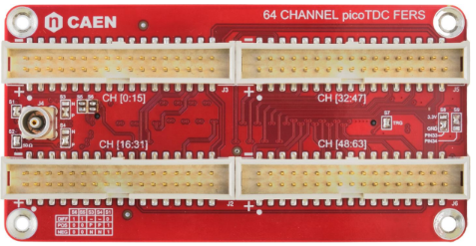
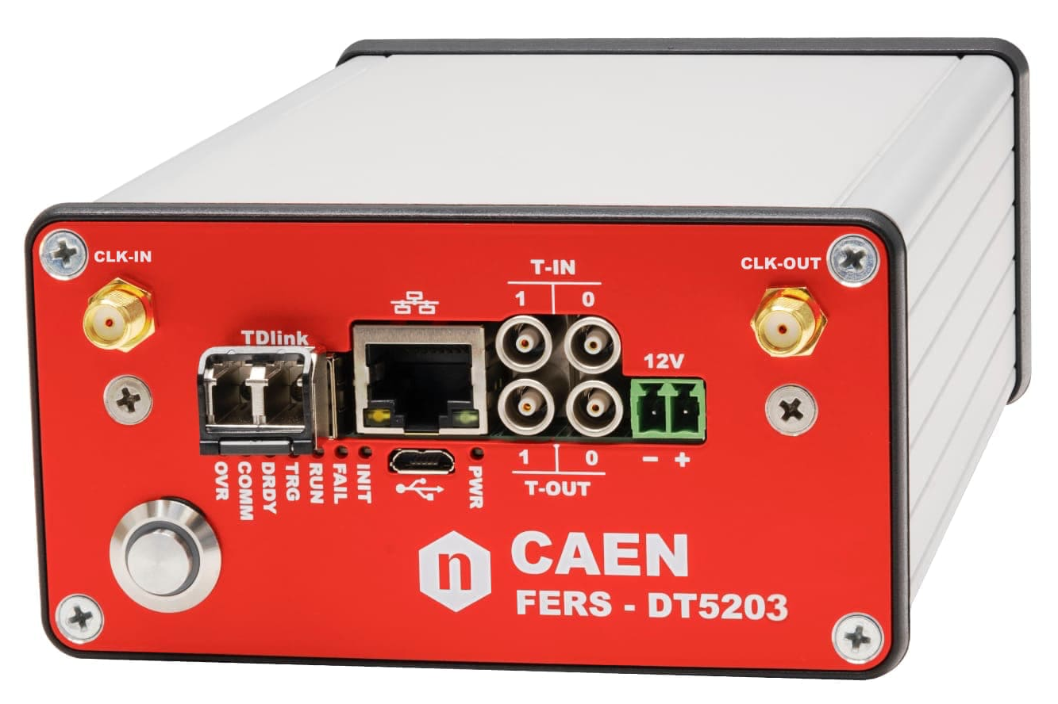
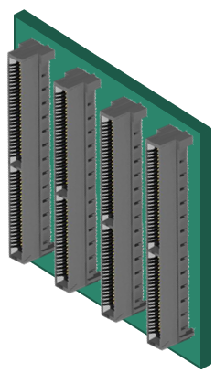
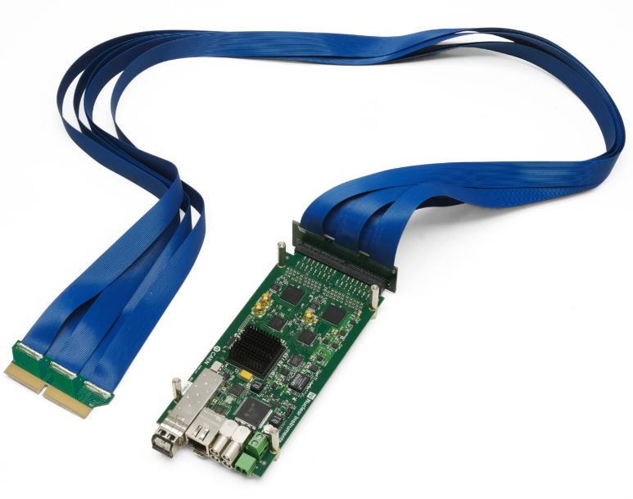
Input Adapters and Front-End
A5256: Edge Discriminators
A5255: Mechanical adapter (+ Tref)
Back Panel
Front Panel
Custom Flange
A5260: Remotization cable
naked A5203
Detector and
Front-End

Slide 6
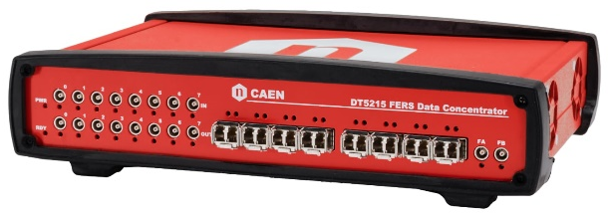

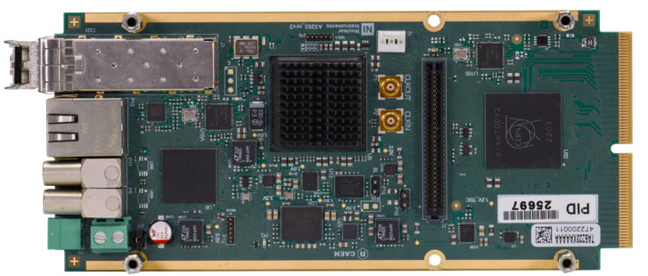
FERS-5200 architecture
Large Readout Systems:
1/10G Eth
USB 3.0
1 TDlink => up to 16 FERS (daisy chain)
1 DT5215 => 128 FERS = 8k/16k channels
10/100M Eth
USB 2.0
Global Time
Janus SW
Desktop Evaluation Setup:
Low Cost, Plug & Play
3.125 Gb/s TDlink
Custom Flange
Readout
+
Slow Control
+
Synchronization
Easy ASIC integration on FERS

Slide 7


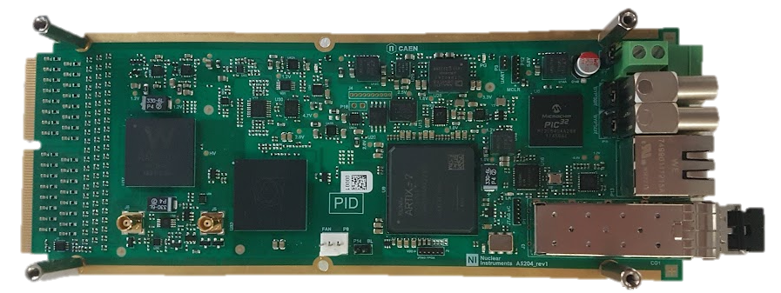
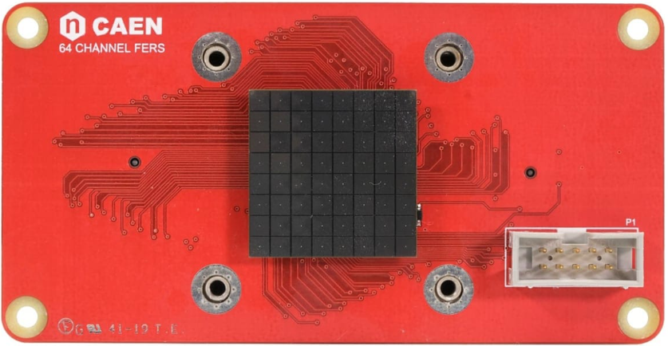
A5204: Radioroc + picoTDC
64 channel all-in-one readout for SiPM: preamp + shapers + peak-ADC + discriminator + TDC + HV bias.
Radioroc self-triggers connected in parallel to TDC (for timing) and FPGA (for counting/triggering)
Dynamic Range: 2000 p.e.
Shaping Time: 20÷1200 ns (for Peak ADC)
HV: 20÷80 V pos, 10 mA
Timing Resolution: 55 ps @ 1 p.e.
PHA by ToT: 1 % linearity up to 2000 p.e.
Same PCB compatible with:
Psiroc (GEM, Silicon Strips): A5205
Liroc (LIDAR): A52xx
Radioroc
picoTDC
FPGA

Slide 8

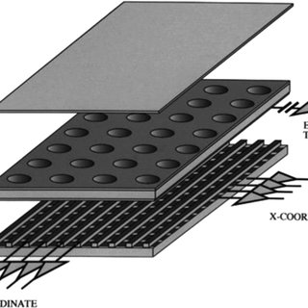


FERS Roadmap
GEMs, Si strip
3 ps TDC
and other low gain detectors
Weeroc Radioroc +
CERN picoTDC
Weeroc Citiroc
A5202
A5204
A5203
A5205
CERN picoTDC
Weeroc Psiroc +
CERN picoTDC
SiPM
SiPM high-res.

Slide 9
Test Results:
use of ToT for Walk Correction and Energy Reconstruction

Slide 10
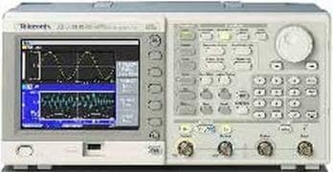
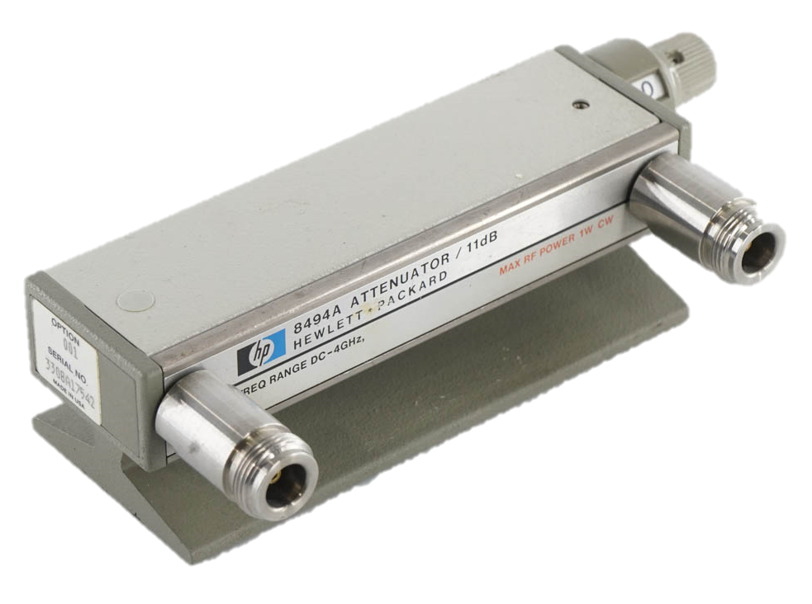
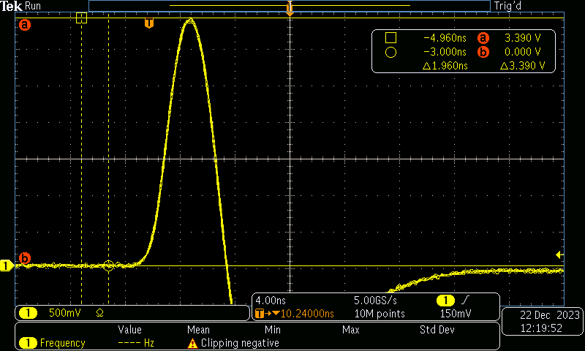
Test Setup
Step Attenuator
DT5203+A5256
AFG 3252
Janus SW
Pulse: Amp = 3.85 V, Rise = ~2.5 ns
Start on Ch0 with fixed amplitude. Stop on Ch1 and Ch2 (dual threshold) with variable amplitude (max = 3.85 V). Delay = 13 ns.
Sweep: acquire ToT and ΔT at different amplitudes (from 0 to
54 dB, 3 dB step)
Fit points and build ToT-Walk and ToT-Ampl curves
Use curves to correct Walk from ToT (replace CFD)
Use curves to get Amplitude from ToT (make ADC from TDC)

Slide 11
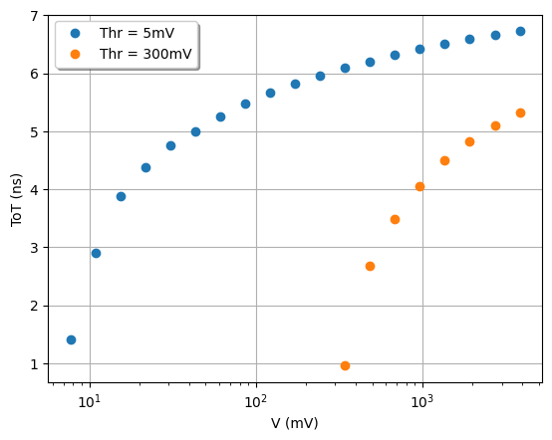
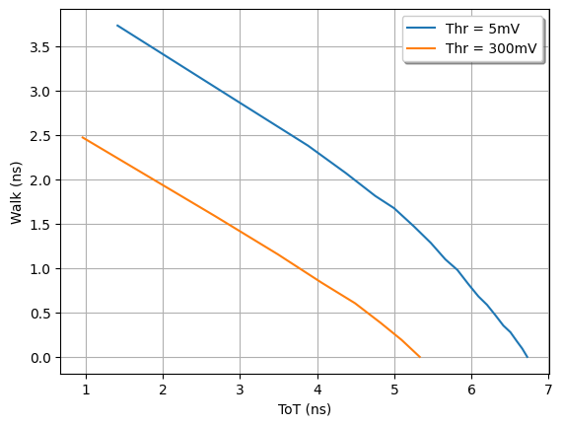
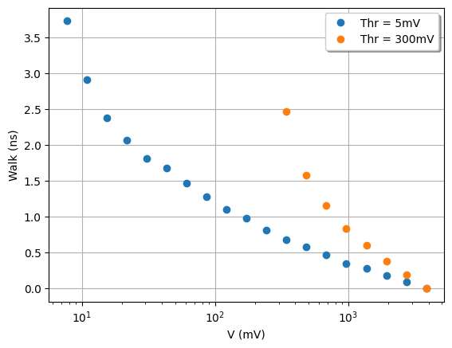
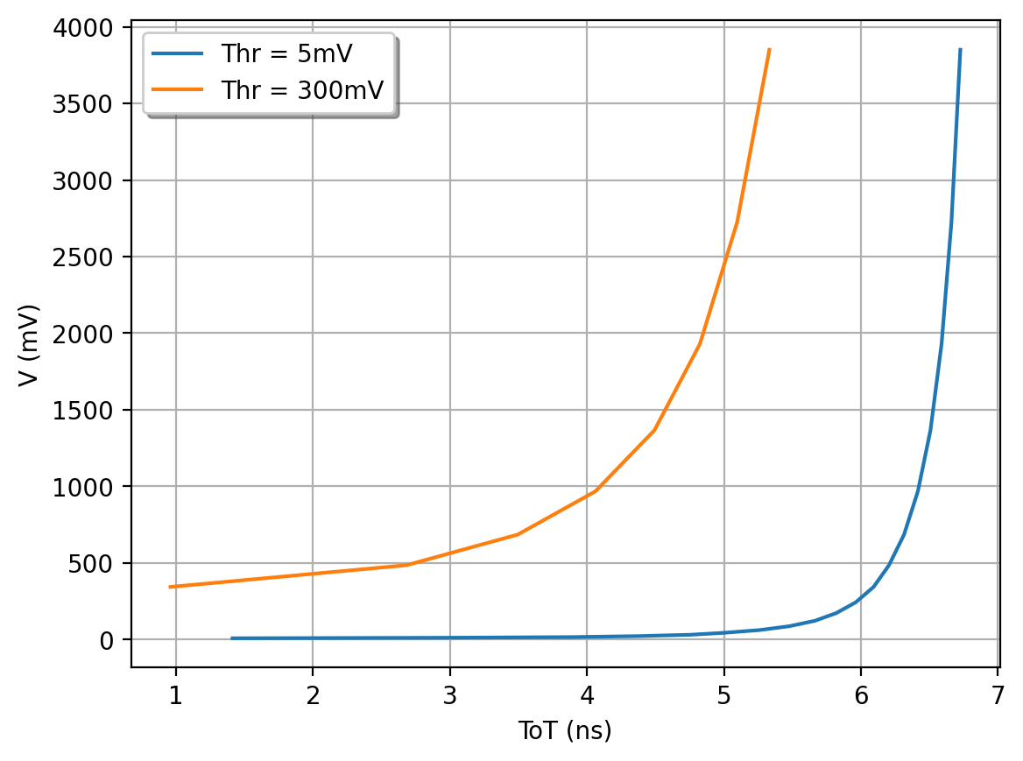
Calibration curves (Low-Thr = 5 mV, High-Thr = 300 mV)
Amp-ToT
ToT-Walk
Poly-Fit
Amp-Walk
ToT-Amp

Slide 12
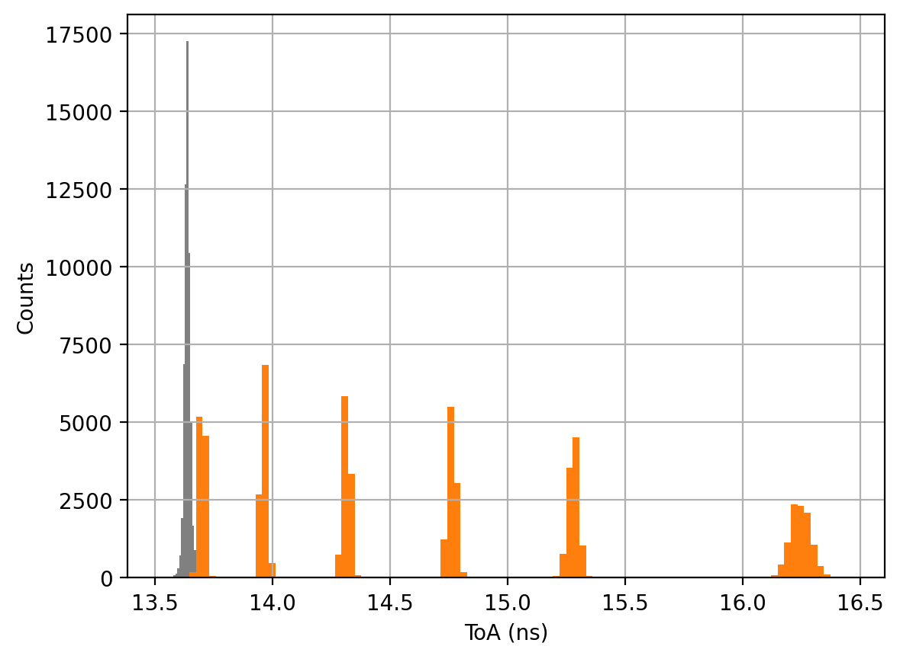
Walk Correction
Acquired pulses at 6 different amplitudes over a 50 dB dynamic range
The walk causes ~2 ns spread on ΔT:
6 separate peaks appear on the histogram. Timing resolution totally destroyed!
ΔT corrected by ToT using a 5th order polynomial fit of the ToT-Walk points taken at lower threshold (5 mV)
Corrected ΔT histogram presents one single peak:
18 ps RMS over 50 dB dynamic range
Walk Corrected Peak: σ=18 ps
3850 mV
1217 mV
385 mV
122 mV
38 mV
12 mV
ΔT (ns)

Slide 13
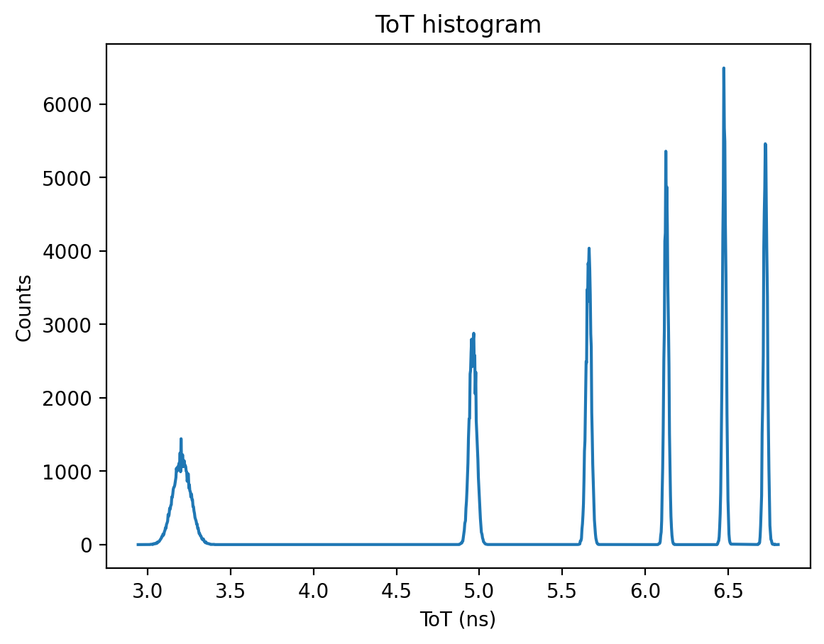
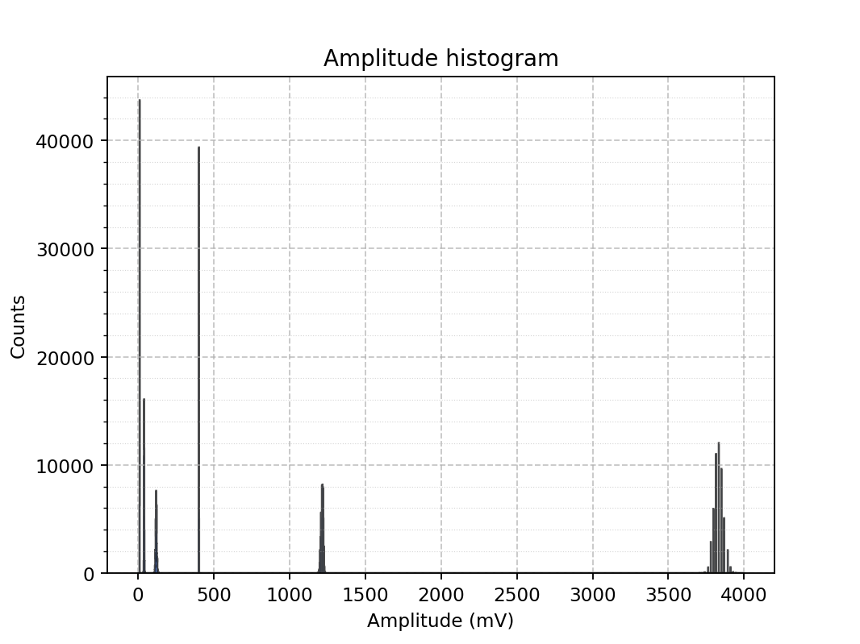
Amplitude Reconstruction
1217
Thr = 5 mV
385
3850
12 mV
122
385 mV
Ampl | Centroid | Sigma | Rel Res % | INL %FSR
12.2 | 11.3 | 0.1 | 1.1 | -0.16
38.0 | 41.1 | 1.3 | 3.1 | -0.05
121.8 | 120.9 | 4.0 | 3.3 | -0.14
385.0 | 403.0 | 0.4 | 0.1 | +0.39
1217.5 | 1215.4 | 7.6 | 0.6 | +0.00
3850.0 | 3831.0 | 29.4 | 0.8 | -0.03
38
12
ToT-Amp
Vin > 300 -> use High Thr curve (orange)
Vin < 300 -> use Low Thr curve (blue)
38 mV
3850 mV
122 mV
1217 mV

Slide 14
Conclusions
The walk correction (mimic CFD) is possible even with a single threshold, with excellent results:
18 ps RMS on a 50 dB dynamic range
The amplitude reconstruction (mimic ADC) requires at least 2 thresholds (2 TDC channels).
Linearity = ~0.4%. Resolution = ~3%. Possible improvement with a more accurate threshold setting
Problem: how to build the calibration curves in a real case?
  If possible, use test pulse to generate outputs with known amplitude
  Acquire pulses with a waveform digitizer and emulate the amplitude sweep in software. Need a precise model of the discriminator.
  Machine learning ???
Next steps:
  Sweep emulation of the pulse generated by the pulse generator
  Test with real preamps and detectors

Slide 15
Use Case:
Picotech ProVision PET scanner

Slide 16
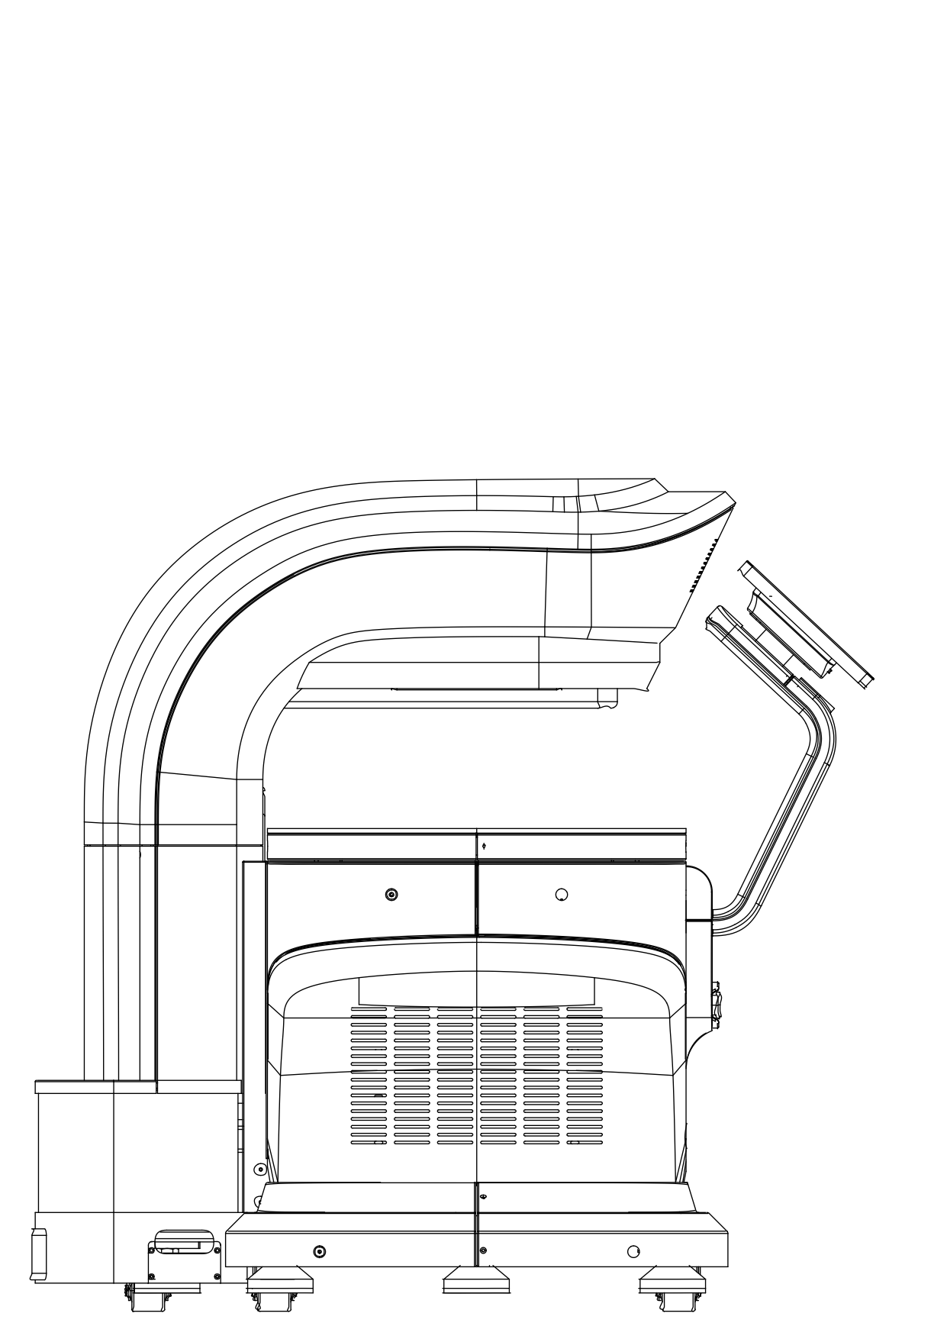
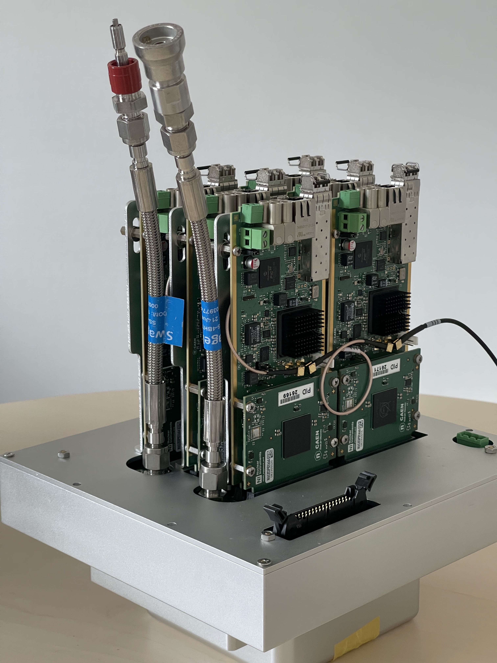
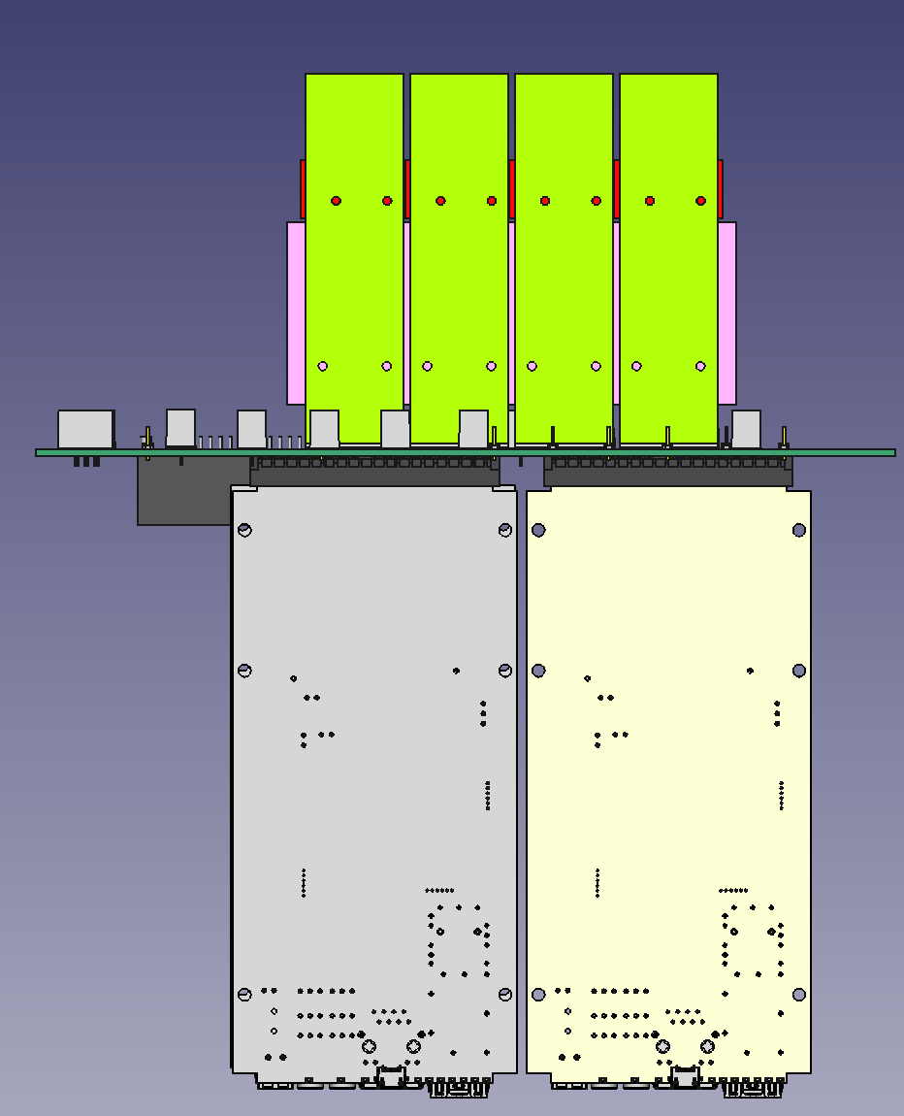
Picotech ‘ProVision’ PET scanner
picoTDC
2 detectors: each detector uses 12 picoTDC ASICs (768 channels)
need precise timing and TOT measurement
Need a system without any deadtime

Slide 17
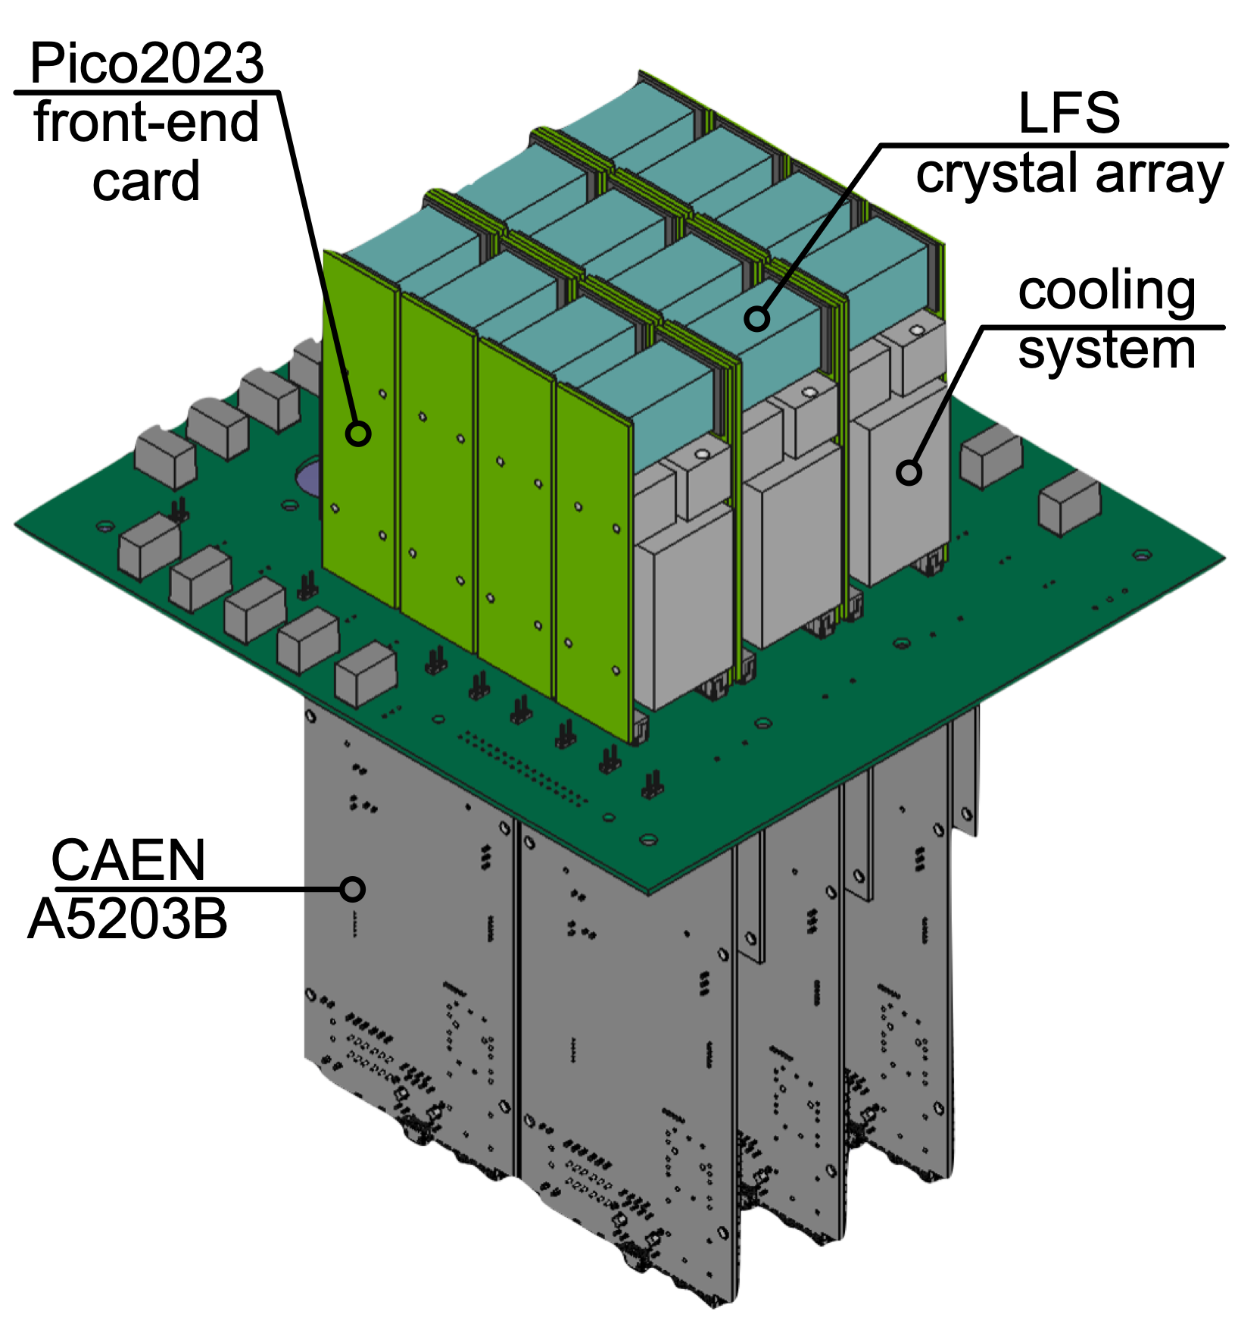
Some details of the Picotech detector module
Pico2023 8 channel differential amplifier-discriminator with amplitude encoded into pulse width

Slide 18
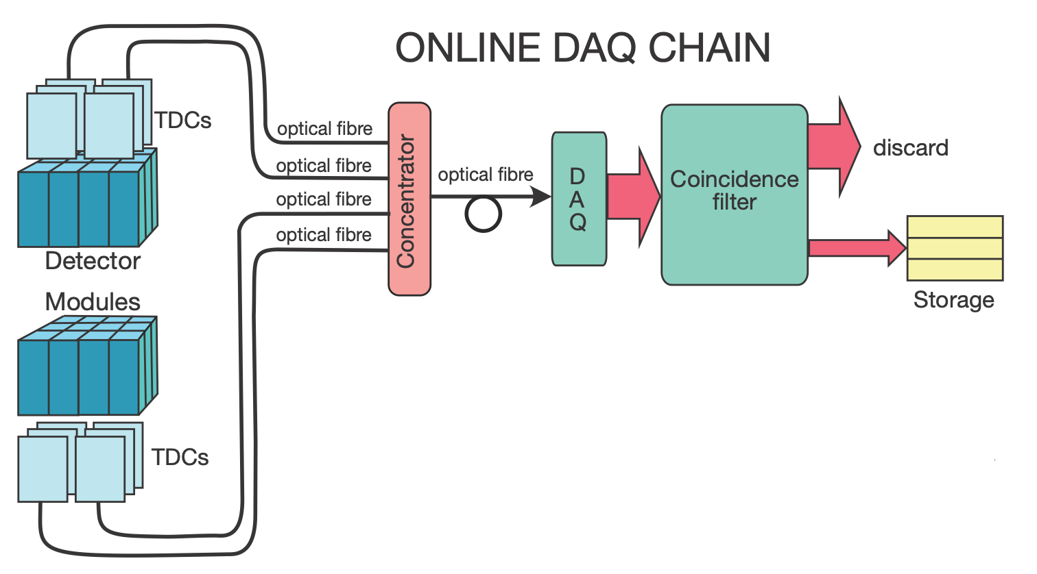
Readout architecture
(software coincidence trigger)
to do : incorporate coincidence filter in concentrator unit
Need low threshold for precise timing, however SiPMs are noisy - therefore introduce TOT cut of 96 ns (any pulse shorter than 96 ns rejected) - use paired mode readout of picoTDC and reject small TOT in TDC cards.

Slide 19
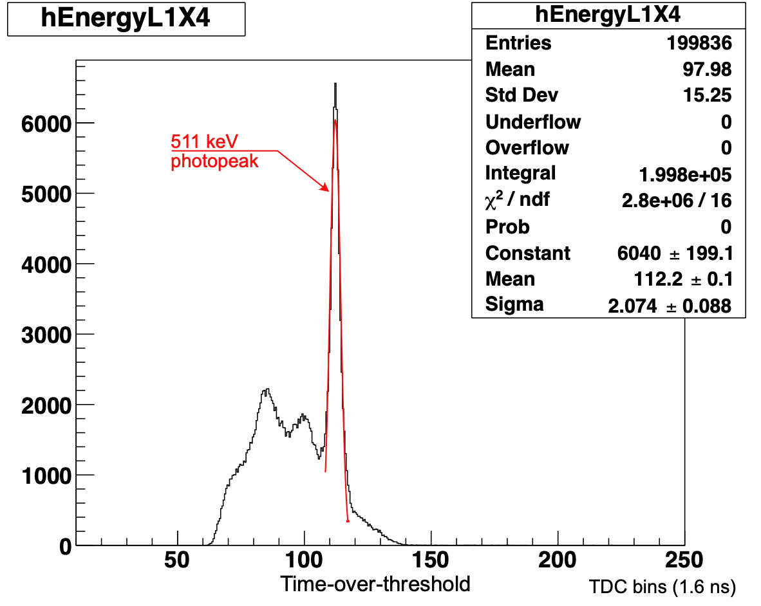
‘Paired mode’ readout of picoTDC
19 bit time with 8 bit width (TOT) (timing lsb 3.125 ps ;ΤΟΤ 1.6 ns bins)
[note 2¹⁹ x 3.125 ps = 1.638 μs - internal trigger period on A5203 card]
‘Empty’ region thanks to TOT filter

Slide 20
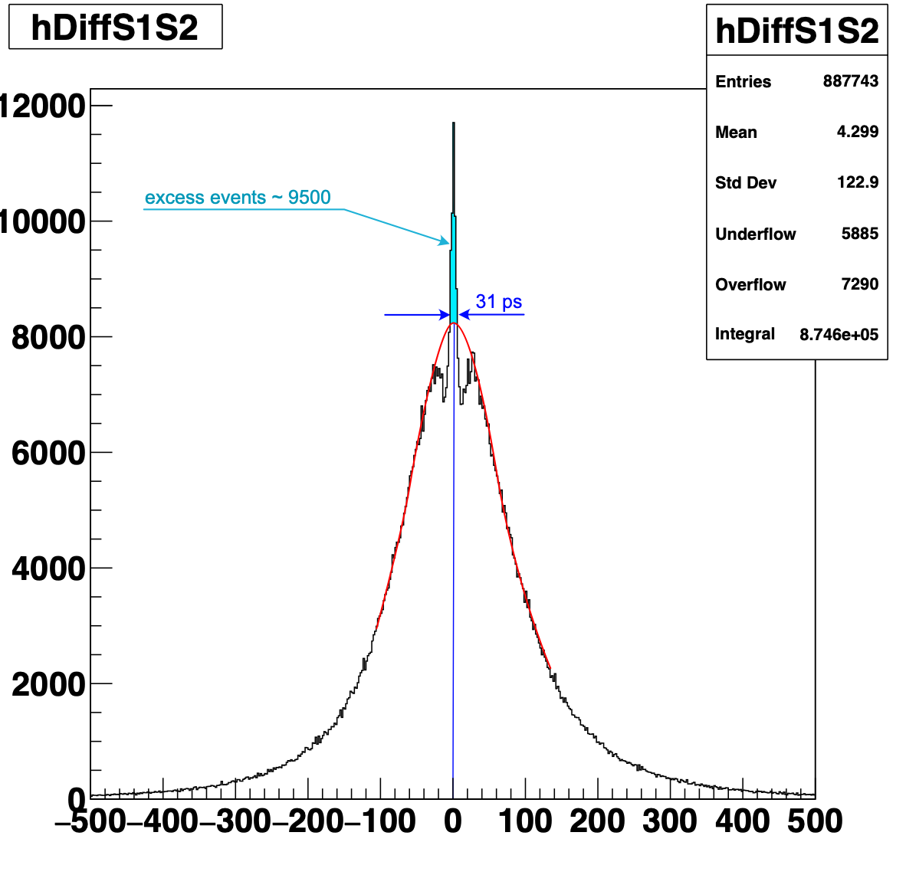
Crosstalk
~ 4% of events where two channels fire within +- 90 ps … there can be an average shift of ~ 30 ps (later channel made earlier)
Time channel 1 - Time channel 2
Possible causes
front-end electronics
PCB/cables transporting signals
picoTDC
study in progress
Tdc bins (3.125ps)

Slide 21

Thank you for your attention

Slide 22
Backup slides

Slide 23
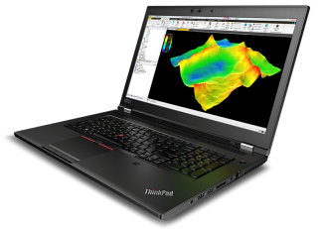
FERS-5200: generic block diagram
Direct Connect: easy but slow (~2 MB/s)
up to 128 FE cards
ETH 10/100T
USB 2.0
DETECTOR SPECIFIC
COMMON INFRASTRUCTURE
ASIC:
PREAMP
SHAPER
DISCRIM
ADC
ACQ
LOGIC
READOUT
INTERF
TRIGGERS
MEM
Concentrator
DT5215
1 GbE
TDC
TDlink
10 GbE
USB 3.0
CONFIG
SYNC
HV BIAS
External Sync
(GPS, ExtClk, etc)
A5204
TDlink: Multi-board Readout + Sync + Config
Up to 300 MB/s

Slide 24
A5204: block diagram

