Slide 1


IBS calculations for the CLIC Damping Rings and the Swiss Light Source
F. Antoniou, Y. Papaphilippou
TIARA meeting, 11 April 2011
Many thanks to A. Streun, M. Aiba & M. Boege,
SLS, PSI

Slide 2
Outline
The CLIC Damping Rings lattice
  Parameters
  Layout
  IBS calculations
The Swiss Light Source lattice
  Parameters
  IBS - Energy scan
  IBS - Bunch charge scan
  Measurement considerations

Slide 3
The CLIC Damping Rings
Parameters | 1GHz | 2GHz
Energy [GeV] | 2.86
Circumference [m] | 427.5
Energy loss/turn [MeV] | 4.0
RF voltage [MV] | 5.1 | 4.5
Stationary phase [°] | 51 | 62
Natural chromaticity x / y | -115/-85
Momentum compaction factor | 1.3e-4
Damping time x / s [ms] | 2.0/1.0
Number of dipoles/wigglers | 100/52
Cell /dipole length [m] | 2.51 / 0.58
Dipole/Wiggler field [T] | 1.0/2.5
Bend gradient [1/m2] | -1.1
Phase advance x / z | 0.408/0.05
Bunch population, [e9] | 4.1
IBS growth factor x/z/s | 1.5/1.4/1.2
Hor./ Ver Norm. Emittance [nm.rad] | 456/4.8 | 472/4.8
Bunch length [mm] | 1.8 | 1.6
Longitudinal emittance [keVm] | 6.0 | 5.3
Space charge tune shift | -0.10 | -0.11
The latest DR lattice (CDR version)
  2 RF options at 1 and 2 GHz with the 1 GHz option as the baseline
IBS effect calculated with the Piwinski formalism

Slide 4
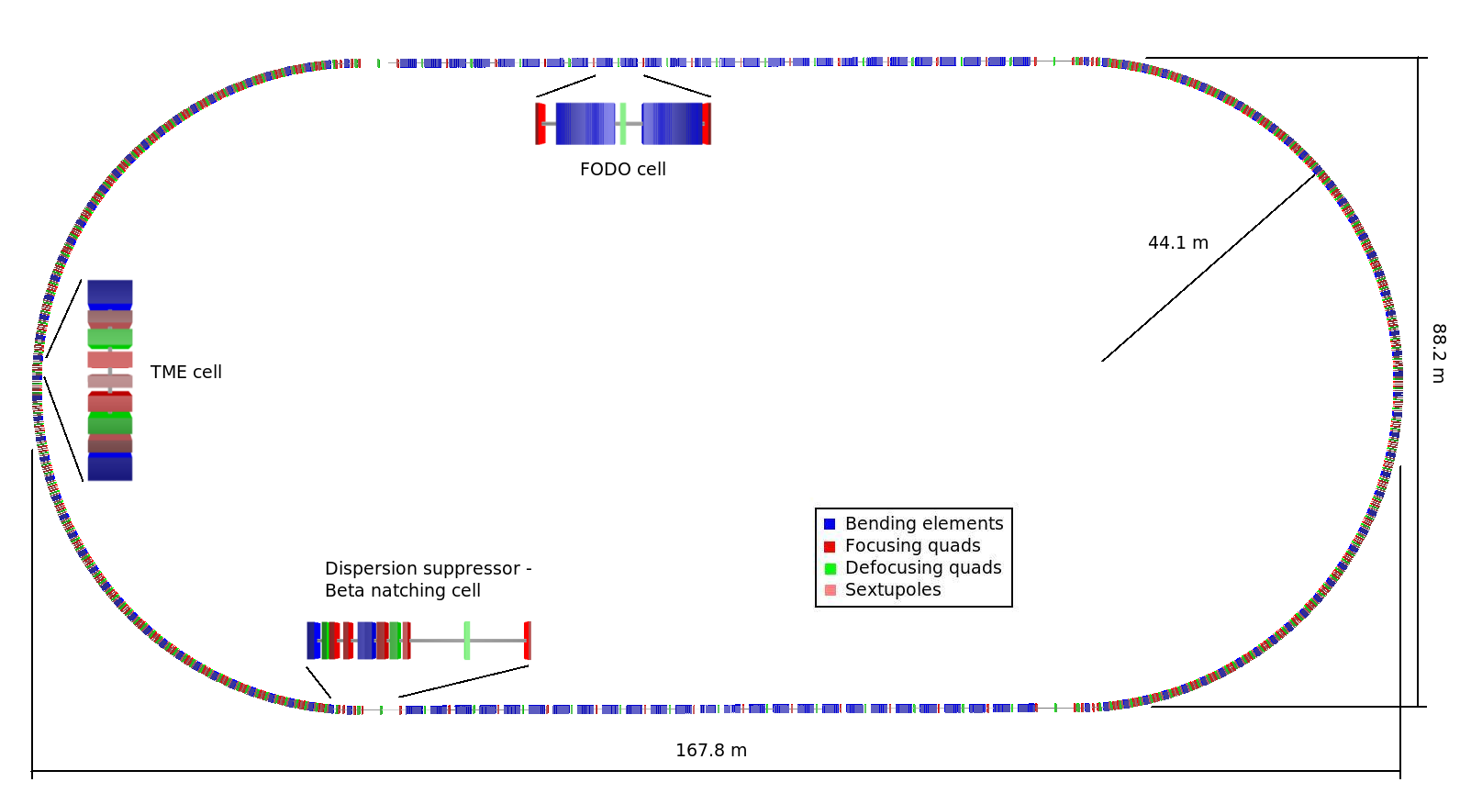
DR layout
Racetrack shape with
  96 TME arc cells (4 half cells for dispersion suppression)
  26 Damping wiggler FODO cells in the long straight sections (LSS)
  Space reserved upstream the LSS for injection/extraction elements and RF cavities

Slide 5
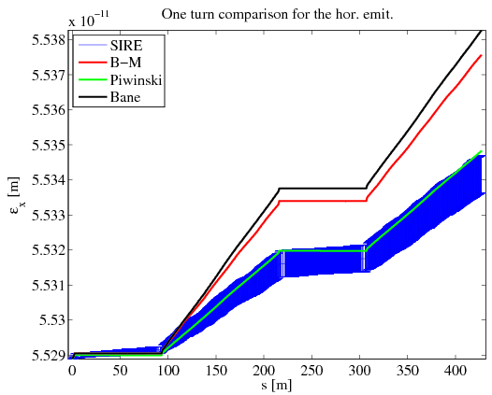
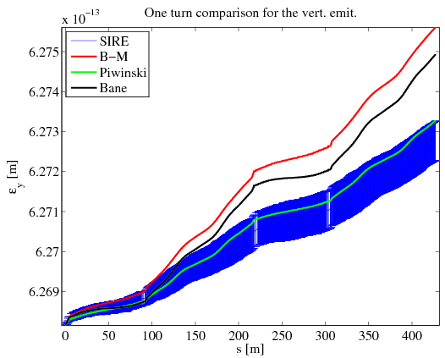
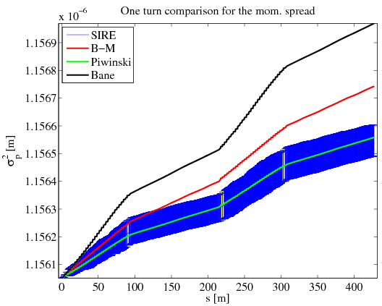
SIRE Benchmarking with theories
Comparison of SIRE results (dark-blue) and Bjorken-Mtingwa (red), Piwinski (green) and Bane (light-blue) theories
One turn behavior of the horizontal (top) and vertical (bottom,left) emittance and energy spread (down, right). For the SIRE results the 1σ error bars are also shown.
SIRE and Piwinski in very good agreement
Same trend on the emittance evolution!

Slide 6
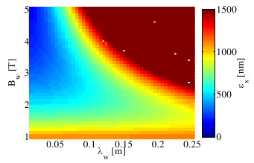
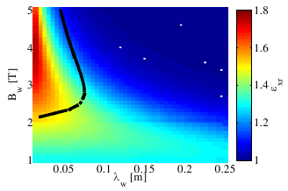
IBS effect – Scan on wiggler characteristics
Steady-state emit. (top) and steady-state to zero-current emit. Ratio (bottom), for constant output long. emit.
Interested in regions where the output emittance lower than the target one (500 nm hor. and 5 nm vert.) and also the effect of IBS is not strong
The black curves indicates the 500nm steady state horizontal emittance
The requirements are met for high wiggler field and moderate wiggler period

Slide 7
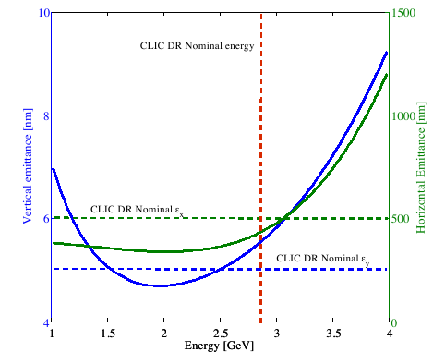
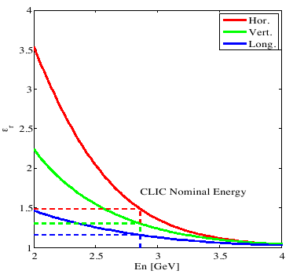
IBS effect – Scan on Energy
Ratio between steady state and zero current emittances (indicates the IBS effect) for constant longitudinal emittance.
Steady-state normalized horizontal and vertical emittances for constant output longitudinal emittance.

Slide 8
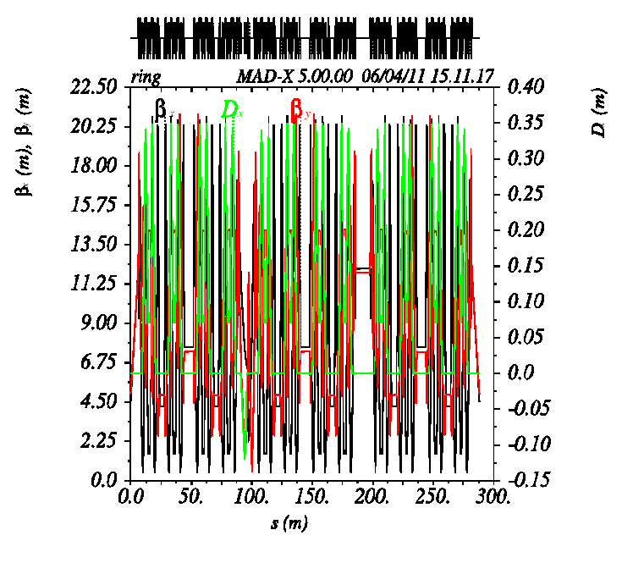
The SLS lattice
Parameter | Value
Energy [GeV] | 2.411
Circumference [m] | 288
Energy loss/turn [MeV] | 0.54
RF voltage [MV] | 2.1
Mom. Comp. factor | 6.05e⁻⁴
Damping times h/v/l [ms] | 8.59/8.55/4.26
Hor. emittance [nm rad] | 5.6
Vert. emittance [pm rad] | 2
Bunch length [mm] | 3.8
Energy spread [%] | 0.086
Thanks to A. Streun and M. Aiba for providing the lattice
Random misalignments were added in order to get the 2 pm vertical emittance

Slide 9
IBS calculations for the SLS
The Piwinski formalism was used in order to calculate the IBS effect in the SLS lattice
For the nominal energy (2.411 GeV) and the nominal bunch current (400/390 mA/bunch or 6 x10⁹ e-/bunch) no effect is predicted.
Scanning on the energy for different bunch currents and different zero current vertical emittances and on the bunch charge for different energies and different vertical emittances is performed.
We consider that the optics remain the same and the longitudinal emittance is kept constant for all cases.
In the plots the zero index indicates the zero current emittances wile the rest the steady state emittance (with IBS)

Slide 10
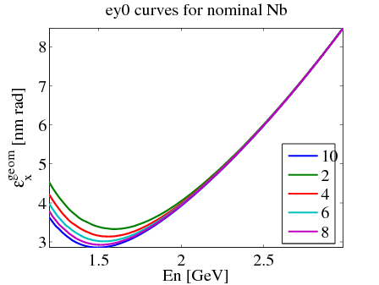
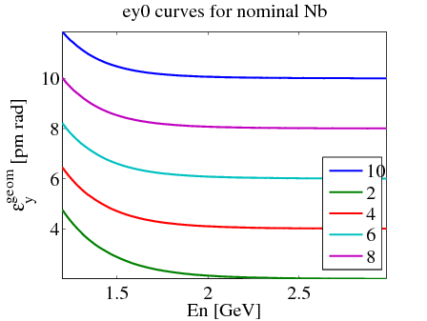
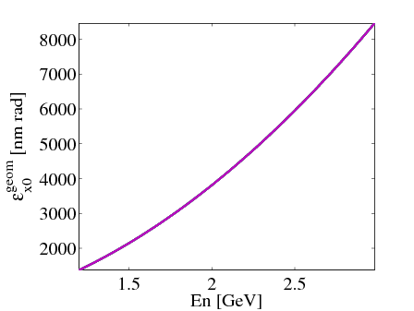
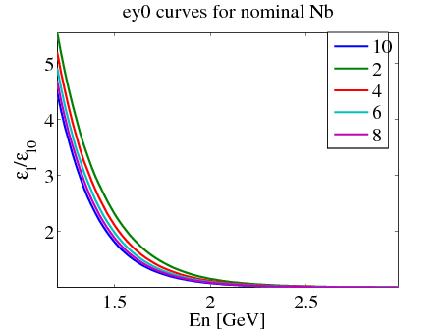
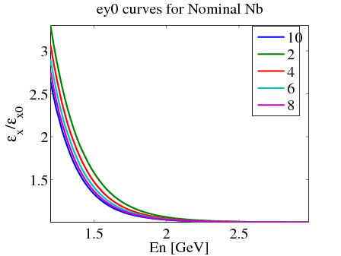
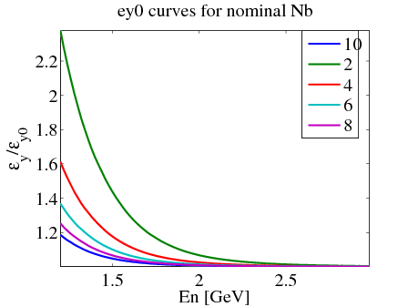
IBS effect – Energy Scan (1)

Slide 11
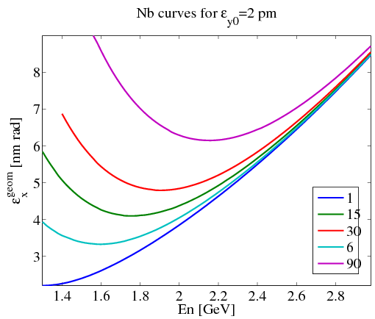
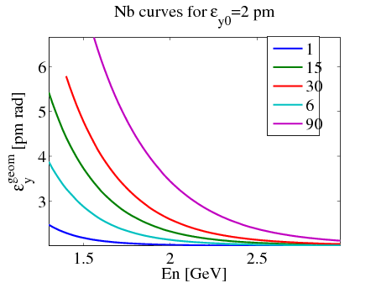
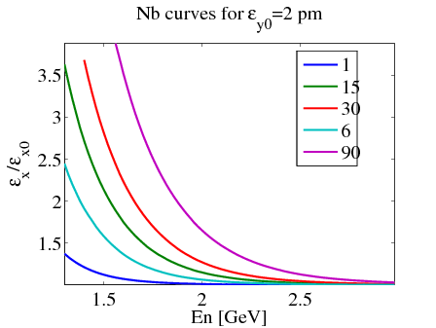
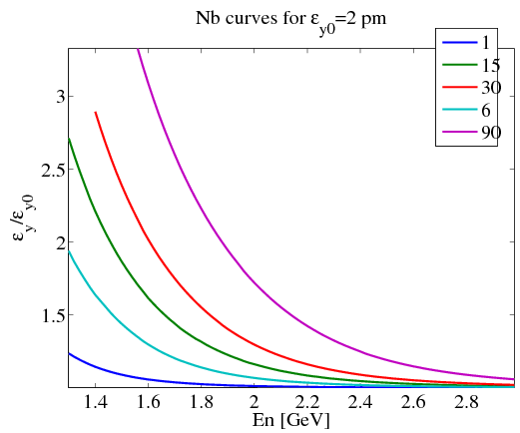
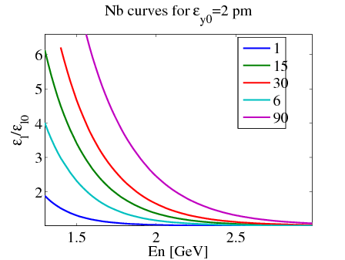
IBS effect – Energy Scan (2)

Slide 12
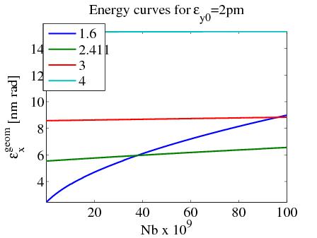
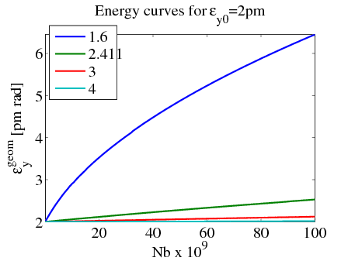
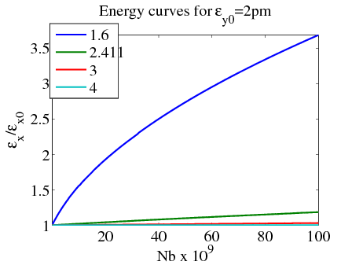
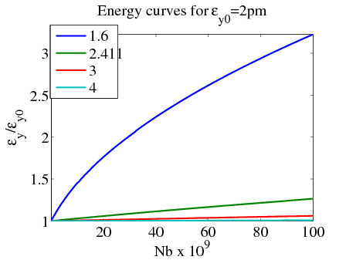
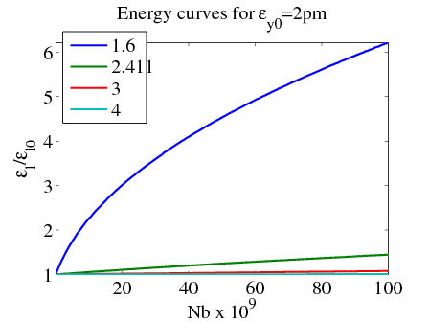
IBS effect – Bunch charge scan (1)

Slide 13
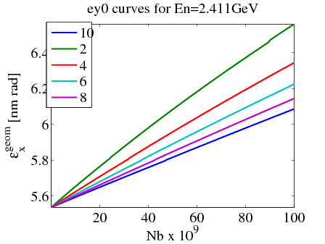
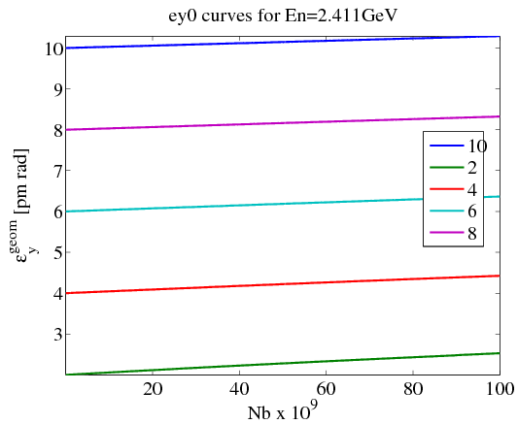
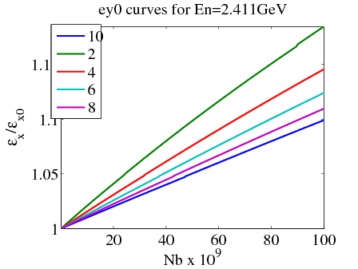
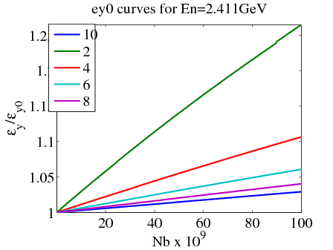
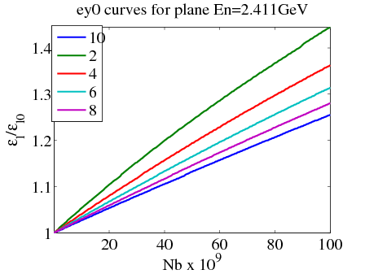
IBS effect – Bunch charge scan (2)

Slide 14
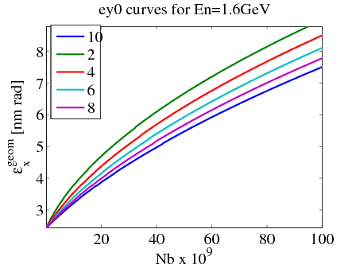
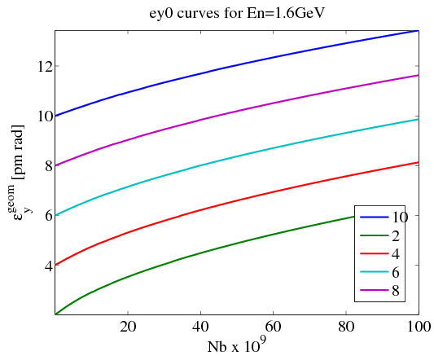
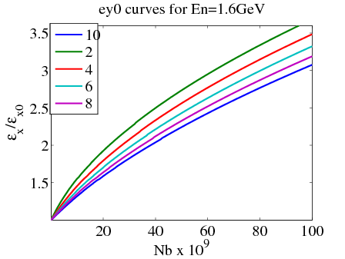
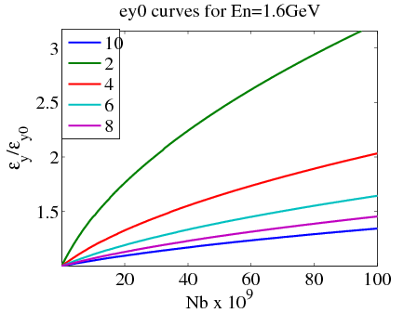
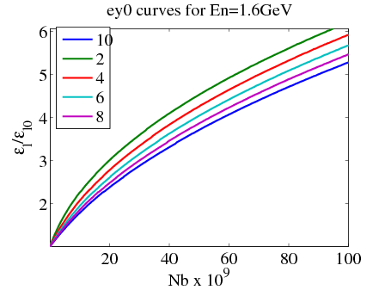
IBS effect – Bunch charge scan (3)

Slide 15
IBS effect in numbers
Table 1 (top): Values calculated at En=1.6 GeV @ nominal bunch current
Table 2 (bottom): Values calculated at En=2.411 GeV @ nominal bunch current
εy0 [pm rad] | εx [nm rad] | εxr | εyr | εlr
2 | 3.33 | 1.37 | 1.3 | 1.86
4 | 3.15 | 1.29 | 1.12 | 1.71
6 | 3.05 | 1.25 | 1.07 | 1.61
8 | 2.97 | 1.22 | 1.04 | 1.55
10 | 2.92 | 1.198 | 1.03 | 1.498
εy0 [pm rad] | εx [nm rad] | εxr | εyr | εlr
2 | 5.56 | 1.013 | 1.0018 | 1.033
4 | 5.54 | 1.01 | 1.007 | 1.026
6 | 5.531 | 1.008 | 1.004 | 1.021
8 | 5.525 | 1.007 | 1.003 | 1.019
10 | 5.521 | 1.006 | 1.002 | 1.016

Slide 16
Possibilities and limitations of measurements (1)
In our previous meeting (29-30 March at SLS/PSI) the SLS colleagues described the possibilities and limitations of measurements of the IBS effect at the SLS
The theoretical predictions indicate that the effect could be measured at the SLS but not for the nominal lattice and beam.
  The effect is visible at lower energies and/or higher bunch current
In order to disentangle the effect from other collective effects → run the machine in one bunch mode (or multi-bunch with empty backets). However the one bunch mode with higher current not trivial as:
  The orbit is not measured exactly
  The BPMs are calibrated for the full current full train -> recalibration of the BPMs will be needed
  For very high currents -> saturation of the electronics
  The current measurement not very precise

Slide 17
Possibilities and limitations of measurements (2)
There is the possibility to use the 3rd harmonic cavity in bunch shortening mode but:
  The RF cavity needs to be retuned
  Very sensitive system
Already tried the optics for lower energy at 1.6 GeV!! The effect there according to theory can be visible even at nominal current. However again not trivial:
  Different temperature of the machine -> Not exact measurement of the orbit
  Recalibration of BPMs is needed
  Retuning of the RF cavity needed in order to be able to go at nominal current
It is better to try to measure the effect in the horizontal plane
  Easier to detect
  A small difference in the vertical plane is not clear where it comes from

Slide 18
Backup slides
Formalisms for classical IBS theories

Slide 19
Bjorken-Mtingwa

Slide 20
Piwinski

Slide 21
Bane’s high energy approximation
Bjorken-Mtingwa solution at high energies
Changing the integration variable of B-M to λ’=λσ_{H}²/γ²
Approximations
  a,b<<1 (if the beam cooler longitudinally than transversally )→ The second term in the braces small compared to the first one and can be dropped
  Drop-off diagonal terms (let ζ=0) and then all matrices will be diagonal

