Slide 1
Low-disruptive renovation processes using integration of prefabricated solutions for energy-efficient buildings
HORIZON-CL5-2024-D4-01-01
Call Assessment
Roy Pennings

Slide 2
Summary: how Horizon Europe grants work (1)
Competitive Calls for proposals: anywhere between 5-100 consortium applications. Notification after 5 months. 2 projects will be funded. Project duration: 3-4 years; €5 Million total budget.
All partners sign the grant agreement; each partner is only responsible for its own share.
Collaborative projects: mix of industry + academia; delivering step-change improvement.
Deliverables are contractual obligations, but grant = effort-based, not result-based.
Work-load consists of: technical work, reporting of results, consortium meetings, EC-reviews, dissemination/exploitation activities + cost administration.
Funding: all direct project costs (hours, materials, equipment, consumables, travel) is funded 100% (but only real costs, no markup!). Total: €3,75M direct cost + €1,25M overhead cost. Direct cost must be justified (but very light time-sheets).
Funding schedule: 50% at project start, max 25% at 1st review, 20% at 2nd review, 5% at final project close.

Slide 3
Summary: how Horizon Europe grants work (2)
Competitive Call = beauty contest. Highest value for money + best credible proposition wins. EC = our client! They look for a solution to a political problem. We present the solution!
Project needs to be positioned as: unique, timely, meeting urgent need, addressing all scope elements (and beyond), present tangible (expected) results, have exploitation strategy.
Grant proposal =/= tender; text must still be rooted in scientific approach.
End-stage TRL6-8 means: upscaling of technology that is out of prototyping => building market potential.
Evaluators will read proposals within 1 hour: to-the-point, tables, graphs & pictures.
Consortium must be scientifically credible & top-level, able to credibly build/influence market uptake of solutions at European scale.
Proposal should reflect some degree of spread: in content (e.g. application and transferability potential) , but also in consortium composition.

Slide 4
Responding to EC political need
In line with the EC Strategic Plan: to contribute to the “Efficient and sustainable use of energy, accessible for all is ensured through a clean energy system and a just transition”, notably through:
Climate Neutrality Innovations: Technological and socio-economic breakthroughs for achieving climate neutrality and the transition to zero pollution of the building stock by 2050, based on inclusive and people-centric R&I.
Industry Energy Efficiency and Emission Reduction: Increased energy efficiency in industry and reduced Greenhouse Gas emissions and air pollutant emissions through recovery, upgrade and/or conversion of industrial excess (waste) heat and through electrification of heat generation.

Slide 5
Expected Call Outcomes
Rapid On-site Construction: Reduction of on-site construction activities to 1-2 days per dwelling/building unit
Economic Efficiency: Cost reduction of at least 25% compared to conventional renovation processes
Environmental and Health Consciousness: Significant reduction of dust, noise, and waste on the construction site
Minimized Occupant Disturbance: Significant reduction in occupant disturbance during the renovation
Enhanced Indoor Comfort: Improved levels of occupancy comfort (e.g., Indoor Air Quality and Indoor Environmental Quality) after renovation
Biodiversity Preservation: Reduction of negative impacts of renovation on biodiversity

Slide 6
Scope of the Call
Scope Overview:
Low-Disruptive Processes: Emphasizing low-disruptive renovation processes using prefabricated modules that are quick and easy to apply, vital for increasing the renovation rate of the European building stock.
End-to-End Workflow: Covering the entire workflow from design, offsite manufacture, and installation to compliance checking on-site and strategies for maintenance, operation, and end of life.

Slide 7
Key Proposal Components
Streamlined Renovation Processes: Develop streamlined processes for deep energy-efficient renovation to at least NZEB performance levels using prefabricated modules.
Technology Utilization: Use relevant available technologies to reduce quality gaps between off-site manufacturing and on-site deployment.
Integration of Solutions: Develop processes for seamless integration of prefabricated solutions into a variety of existing constructions.
Minimization of Disturbance: Ensure processes minimize disturbance for building owners, tenants, and users, significantly reducing on-site construction time and impact.
Demonstrations Across Typologies: Include at least three demonstrations covering different building categories and various building typologies.
Attractive Retrofitting Processes: Demonstrate less-disruptive retrofitting processes that are more attractive and cost-effective.
Target TRL Achievement: Activities are expected to achieve TRL 6-8 by the end of the project.

Slide 8
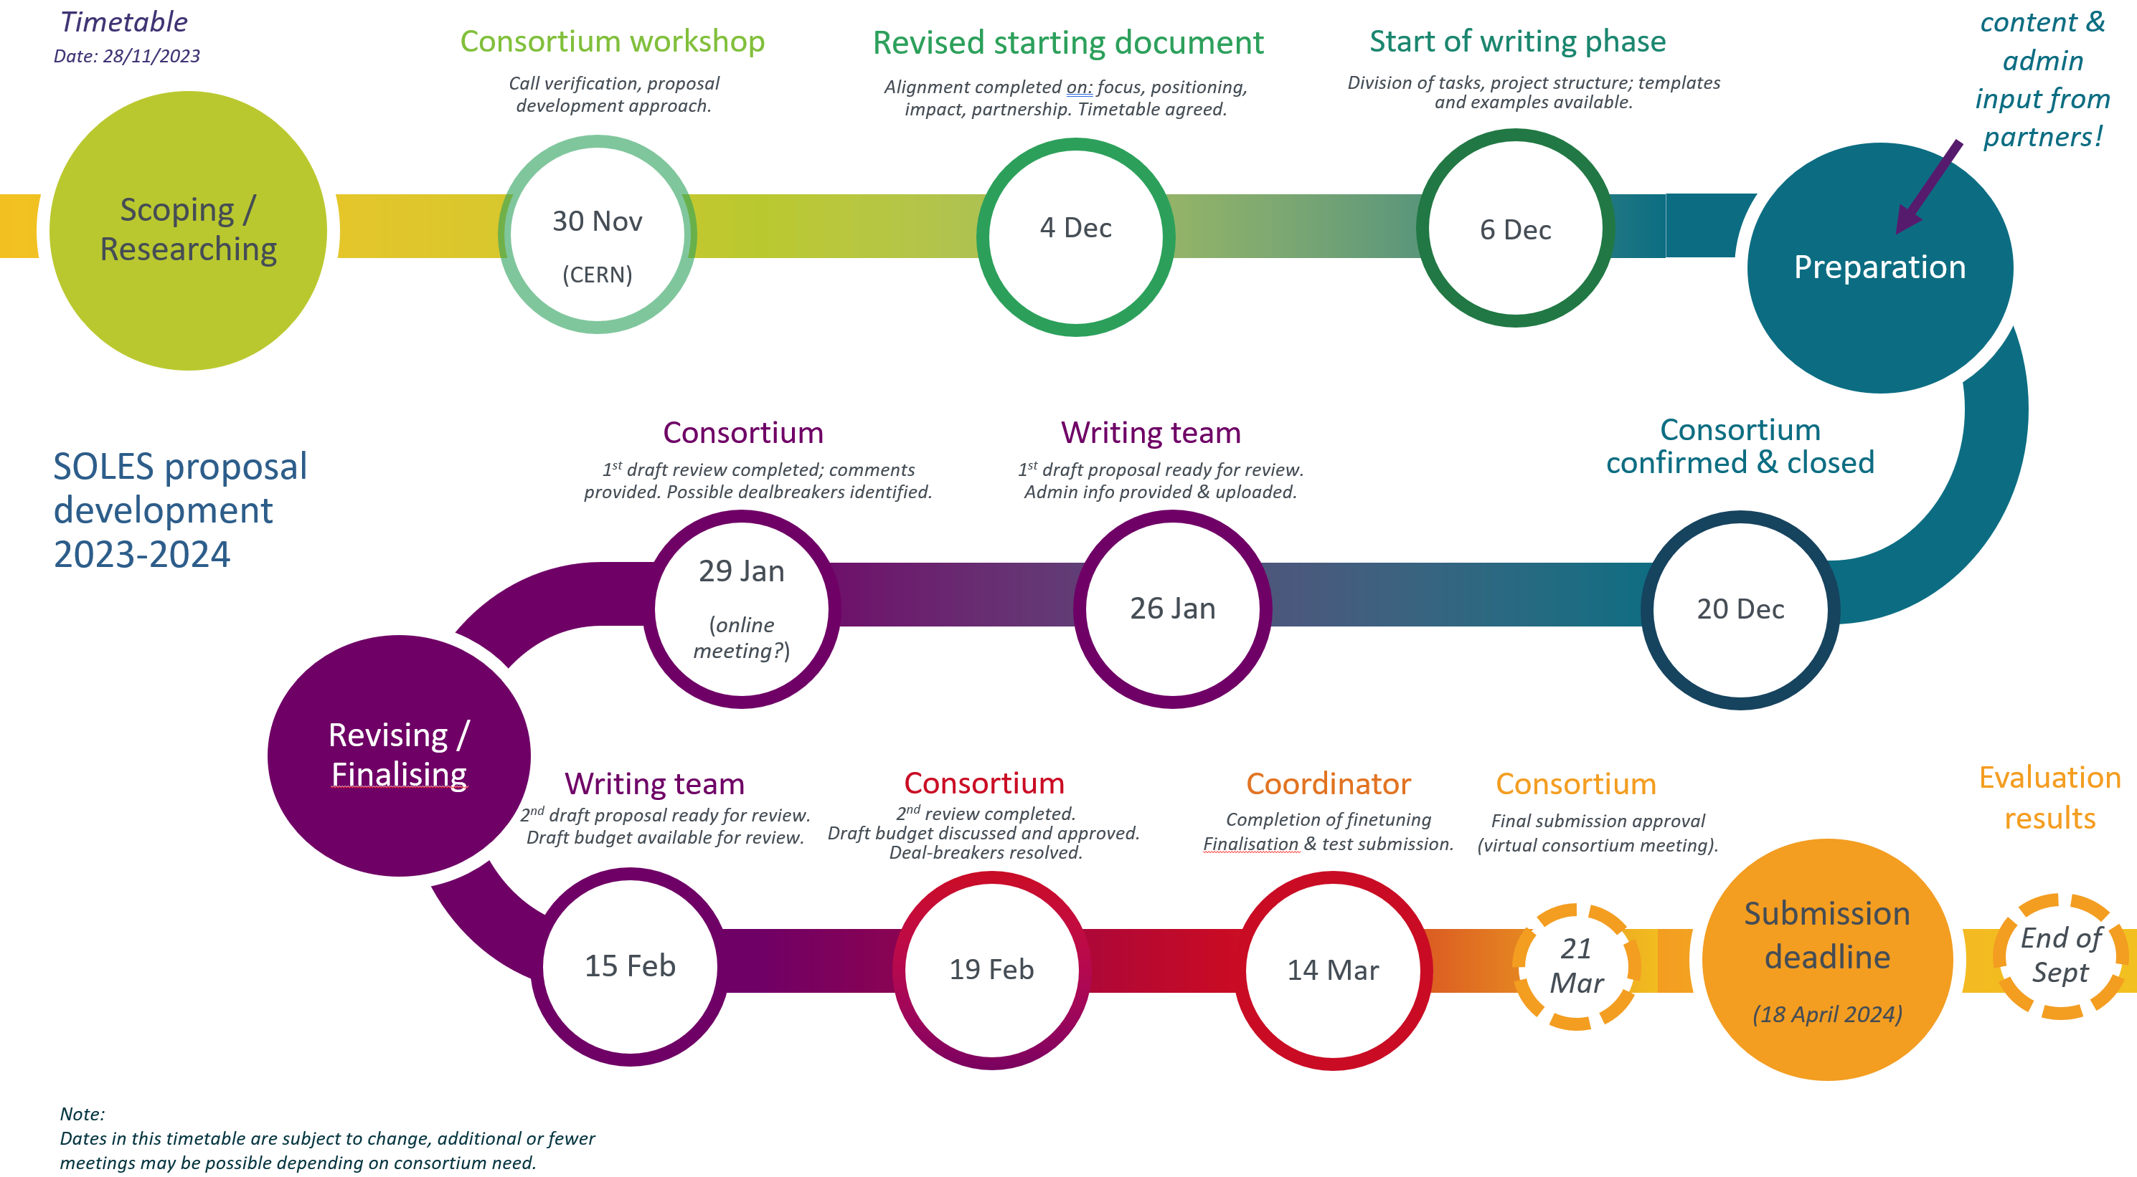
Proposed time-table

Slide 9
Proposal approach
Central writing team develops draft and finetunes proposal.
Partners actively respond to requests for content input. Input to be provided as extended bullet points (incl. references).
Partners provide tangible/quantified data where possible.
Partners sign up for one or more Work Packages. Work packages have 3-6 Tasks. WPs have WP-leader; each task has task-leader. WP-leaders elaborate content of WP tasks.
Partners perform reviews at requested times. Possibly action needed during weekends/evenings/holidays.
Partners show flexibility during budget discussions.

Slide 10
Required admin data
PIC registration code: 10 minutes work (https://ec.europa.eu/info/funding-tenders/opportunities/portal/screen/how-to-participate/participant-register) + nominate contact point.
Average gross monthly salary (anonymised!) of staff (categories).
Estimations of cost for equipment, materials/consumables, sub-contracting in the project.
Researcher-data (where applicable): ORCID (https://orcid.org/)

