Slide 1
Environmental Stress Cracking of Thermoplastic Polyimide Wires

Slide 2
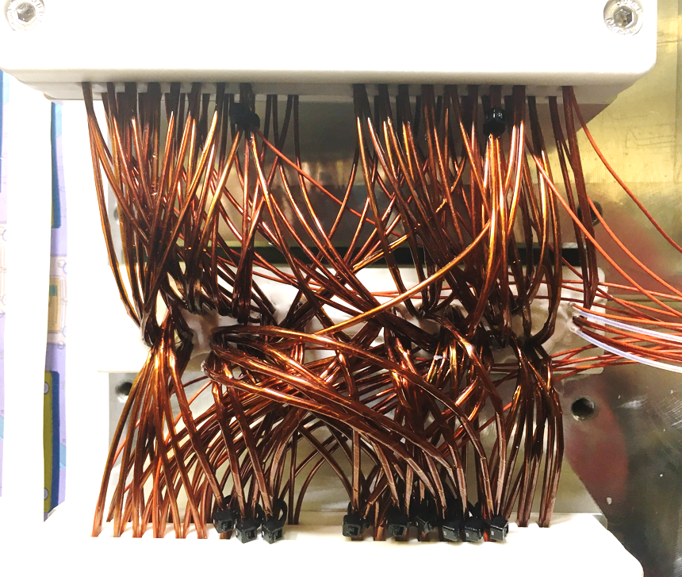
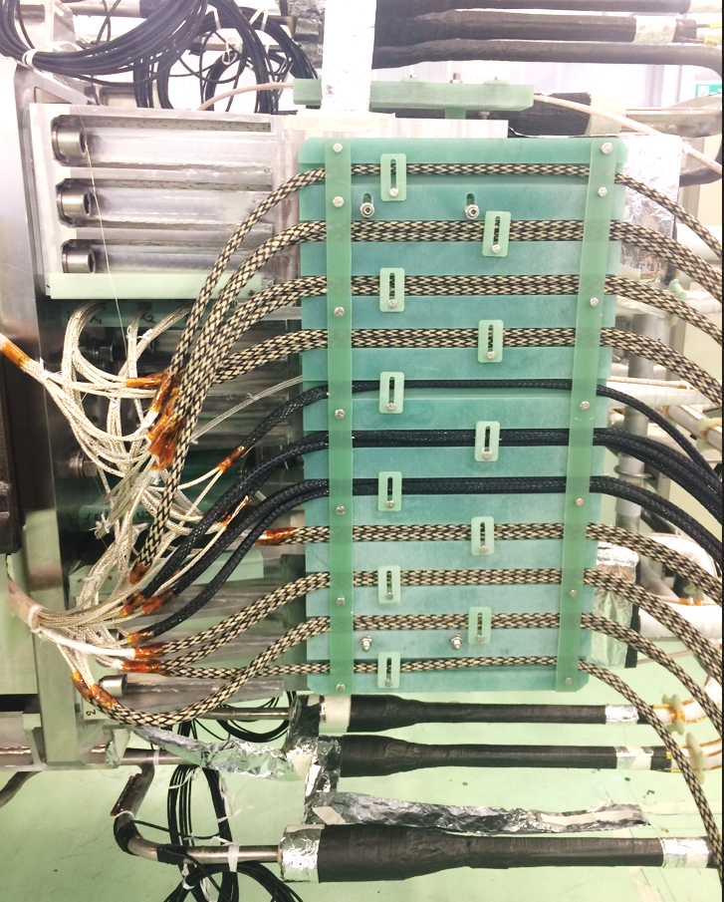
High voltage wires in superconducting magnets
HV wires are a fundamental part of superconducting magnet systems:
  Voltage taps for quench detection
  Magnet wires and leads
Magnet wires connection box
Polyimide is often the first choice for the HV insulation of wires operating under demanding environmental and operating conditions in HEP and Fusion machines
Quench detection wires in ITER TF coil terminal

Slide 3
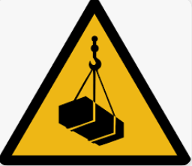
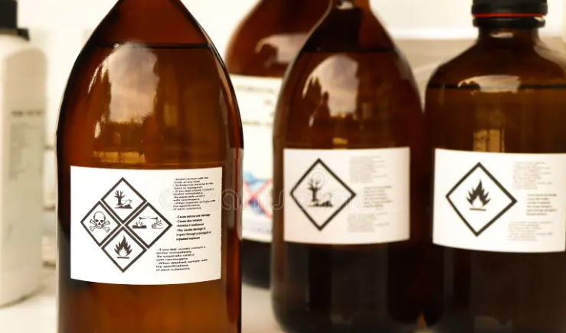
Failure mechanisms of HV wires
  Pinching / Handling at installation
  Thermomechanical stresses at operation
  High Voltage
  Environmental Stress Cracking (ESC)
ESC is the premature initiation of cracking of a plastic due to the simultaneous action of stress/strain and the contact with a fluid
Externally applied
Residual from manufacturing process
Moisture
Chemicals

Slide 4
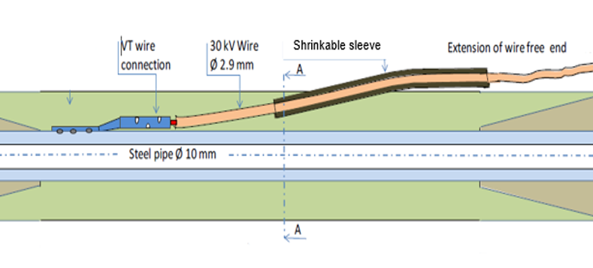
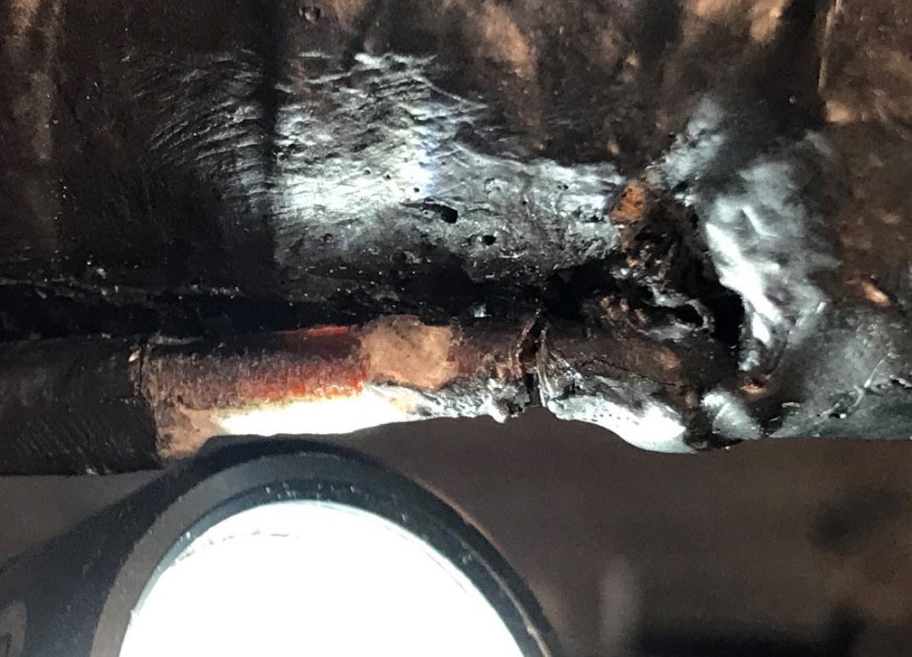
ESC on TPI wires for quench detection
ESC may arise at the extraction point of high voltage wires from the coil insulation
Amorphous plastic - Thermoplastic Polyimide (TPI)
Exposure to Chemical / Fluid (epoxy/hardener system) + Temperature (epoxy curing stage)
Strain/stress (residual, wire routing, operational loads)
Among other studies, it is worthy to mention:
ESC of TPI wires exposed to epoxy & cyanate-ester blend (D. Evans, unpublished)
ESC of Kapton wires in water at elevated temperatures (C.J. Wolf & D.L. Fanter)

Slide 5
Wires and Epoxy Systems
This study investigates the compatibility of thermoplastic polyimide (TPI) wires with a range of epoxy systems commonly utilized in superconducting magnet systems
Thermoplastic polyimide (TPI) wire
Resin systems (RT curing systems)
TPI thickness: 0.9 ± 0.1 mm
Processing: continuous extrusion
Two layouts:
Mix | Epoxy | Hardener | Accelerator
A | jER 807 | Jeffamine D230 | -
B | jER 807 | Baxxodur EC 302 | Acc 400
C | Araldite GY 282 | Jeffamine D 400 | Acc 400
D | Araldite DBF | HY 951 | -
E | EpoPro 275 A | EpoPro 275 B | -
F | EE 4215 | HD 3561 | -
G | Stycast 2850 FT | 24 LV | -
W1
Single Layer TPI
W2
Double Layer TPI

Slide 6
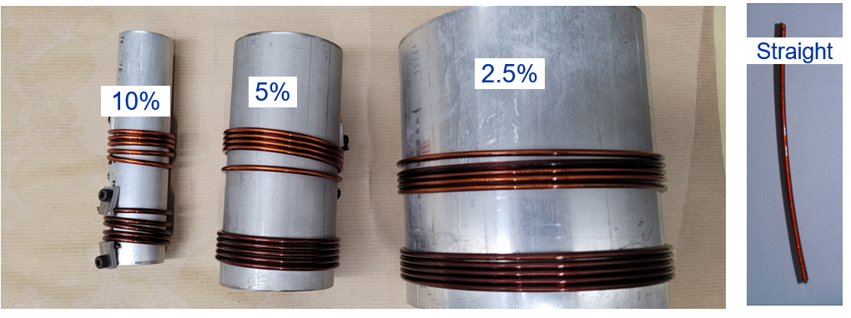
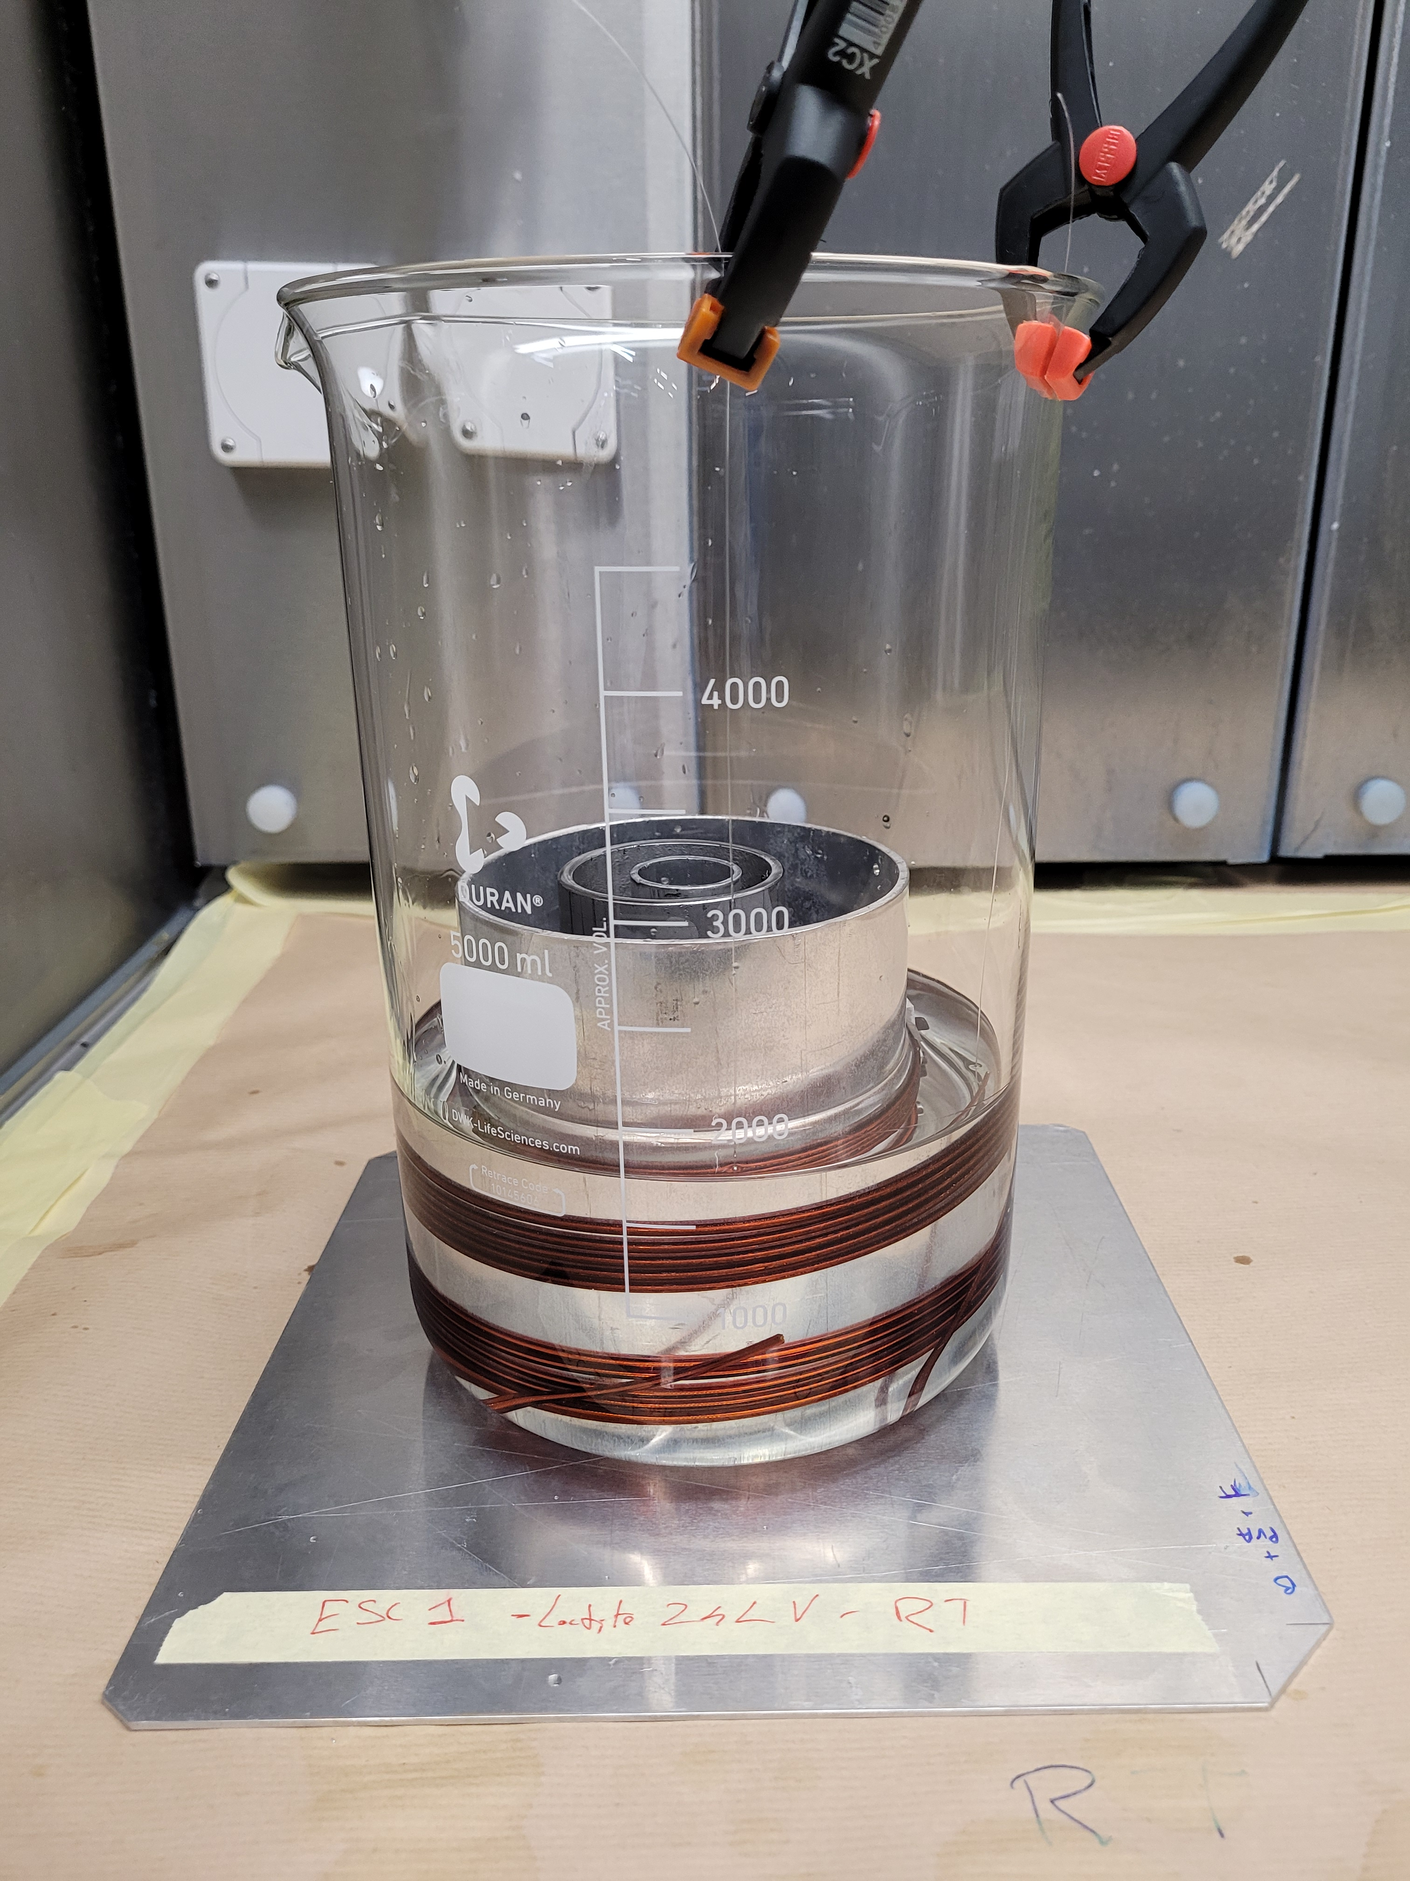
I ) Immersed mandrel test
Assess the effect of amine-based hardeners (strong bases > 10 pH)
Compare time-to-crack-onset (TTCO)
Determine the ESC accelerating factors (strain, temperature, time)
Four strain levels:
0%, 2.5%, 5%, 10%
Two temperatures:
Room Temperature and 60 ℃
Six hardener types:
D230, D400, HY951, EpoProB, HD3561, LV24

Slide 7
Time-to-crack-onset (TTCO)
HARDENERS
 | T [°C] | Strain [%] | D 230 | D 400 | HY 951 | Epo ProB | HD 3561 | 24 LV
W1 | RT | 0
 |  | 2.5 | 96h
 |  | 5 | 2h
 |  | 10 | 2h
 | 60 | 0
 |  | 2.5 | 2h |  | 4h |  |  | 9h
 |  | 5 | 2h | 2h | 4h | 2h | 24h | 2h
 |  | 10 | 2h | 2h | 4h | 2h | 96h | 9h
W2 | RT | 0
 |  | 2.5
 |  | 5 | 48h
 |  | 10
 | 60 | 0
 |  | 2.5 | 2h |  | 96h
 |  | 5 | 2h |  | 96h | 96h
 |  | 10 | 2h |  |  | 36h
WIRE TYPE

Slide 8
Time-to-crack-onset (TTCO)
HARDENERS
 | T [°C] | Strain [%] | D 230 | D 400 | HY 951 | Epo ProB | HD 3561 | 24 LV
W1 | RT | 0
 |  | 2.5 | 96h
 |  | 5 | 2h
 |  | 10 | 2h
 | 60 | 0
 |  | 2.5 | 2h |  | 4h |  |  | 9h
 |  | 5 | 2h | 2h | 4h | 2h | 24h | 2h
 |  | 10 | 2h | 2h | 4h | 2h | 96h | 9h
W2 | RT | 0
 |  | 2.5
 |  | 5 | 48h
 |  | 10
 | 60 | 0
 |  | 2.5 | 2h |  | 96h
 |  | 5 | 2h |  | 96h | 96h
 |  | 10 | 2h |  |  | 36h
1)
Crack onset can be very rapid
WIRE TYPE

Slide 9
Time-to-crack-onset (TTCO)
HARDENERS
 | T [°C] | Strain [%] | D 230 | D 400 | HY 951 | Epo ProB | HD 3561 | 24 LV
W1 | RT | 0
 |  | 2.5 | 96h
 |  | 5 | 2h
 |  | 10 | 2h
 | 60 | 0
 |  | 2.5 | 2h |  | 4h |  |  | 9h
 |  | 5 | 2h | 2h | 4h | 2h | 24h | 2h
 |  | 10 | 2h | 2h | 4h | 2h | 96h | 9h
W2 | RT | 0
 |  | 2.5
 |  | 5 | 48h
 |  | 10
 | 60 | 0
 |  | 2.5 | 2h |  | 96h
 |  | 5 | 2h |  | 96h | 96h
 |  | 10 | 2h |  |  | 36h
1)
Crack onset can be very rapid
2)
Temperature and strain are accelerating factors
WIRE TYPE

Slide 10
Time-to-crack-onset (TTCO)
HARDENERS
 | T [°C] | Strain [%] | D 230 | D 400 | HY 951 | Epo ProB | HD 3561 | 24 LV
W1 | RT | 0
 |  | 2.5 | 96h
 |  | 5 | 2h
 |  | 10 | 2h
 | 60 | 0
 |  | 2.5 | 2h |  | 4h |  |  | 9h
 |  | 5 | 2h | 2h | 4h | 2h | 24h | 2h
 |  | 10 | 2h | 2h | 4h | 2h | 96h | 9h
W2 | RT | 0
 |  | 2.5
 |  | 5 | 48h
 |  | 10
 | 60 | 0
 |  | 2.5 | 2h |  | 96h
 |  | 5 | 2h |  | 96h | 96h
 |  | 10 | 2h |  |  | 36h
1)
Crack onset can be very rapid
2)
Temperature and strain are accelerating factors
WIRE TYPE
3)
D230 vs Stycast (HD3561 and 24LV)

Slide 11
Time-to-crack-onset (TTCO)
HARDENERS
 | T [°C] | Strain [%] | D 230 | D 400 | HY 951 | Epo ProB | HD 3561 | 24 LV
W1 | RT | 0
 |  | 2.5 | 96h
 |  | 5 | 2h
 |  | 10 | 2h
 | 60 | 0
 |  | 2.5 | 2h |  | 4h |  |  | 9h
 |  | 5 | 2h | 2h | 4h | 2h | 24h | 2h
 |  | 10 | 2h | 2h | 4h | 2h | 96h | 9h
W2 | RT | 0
 |  | 2.5
 |  | 5 | 48h
 |  | 10
 | 60 | 0
 |  | 2.5 | 2h |  | 96h
 |  | 5 | 2h |  | 96h | 96h
 |  | 10 | 2h |  |  | 36h
1)
Crack onset can be very rapid
2)
Temperature and strain are accelerating factors
WIRE TYPE
3)
D230 vs Stycast (HD3561 and 24LV)
4)
Insulation layout counts

Slide 12
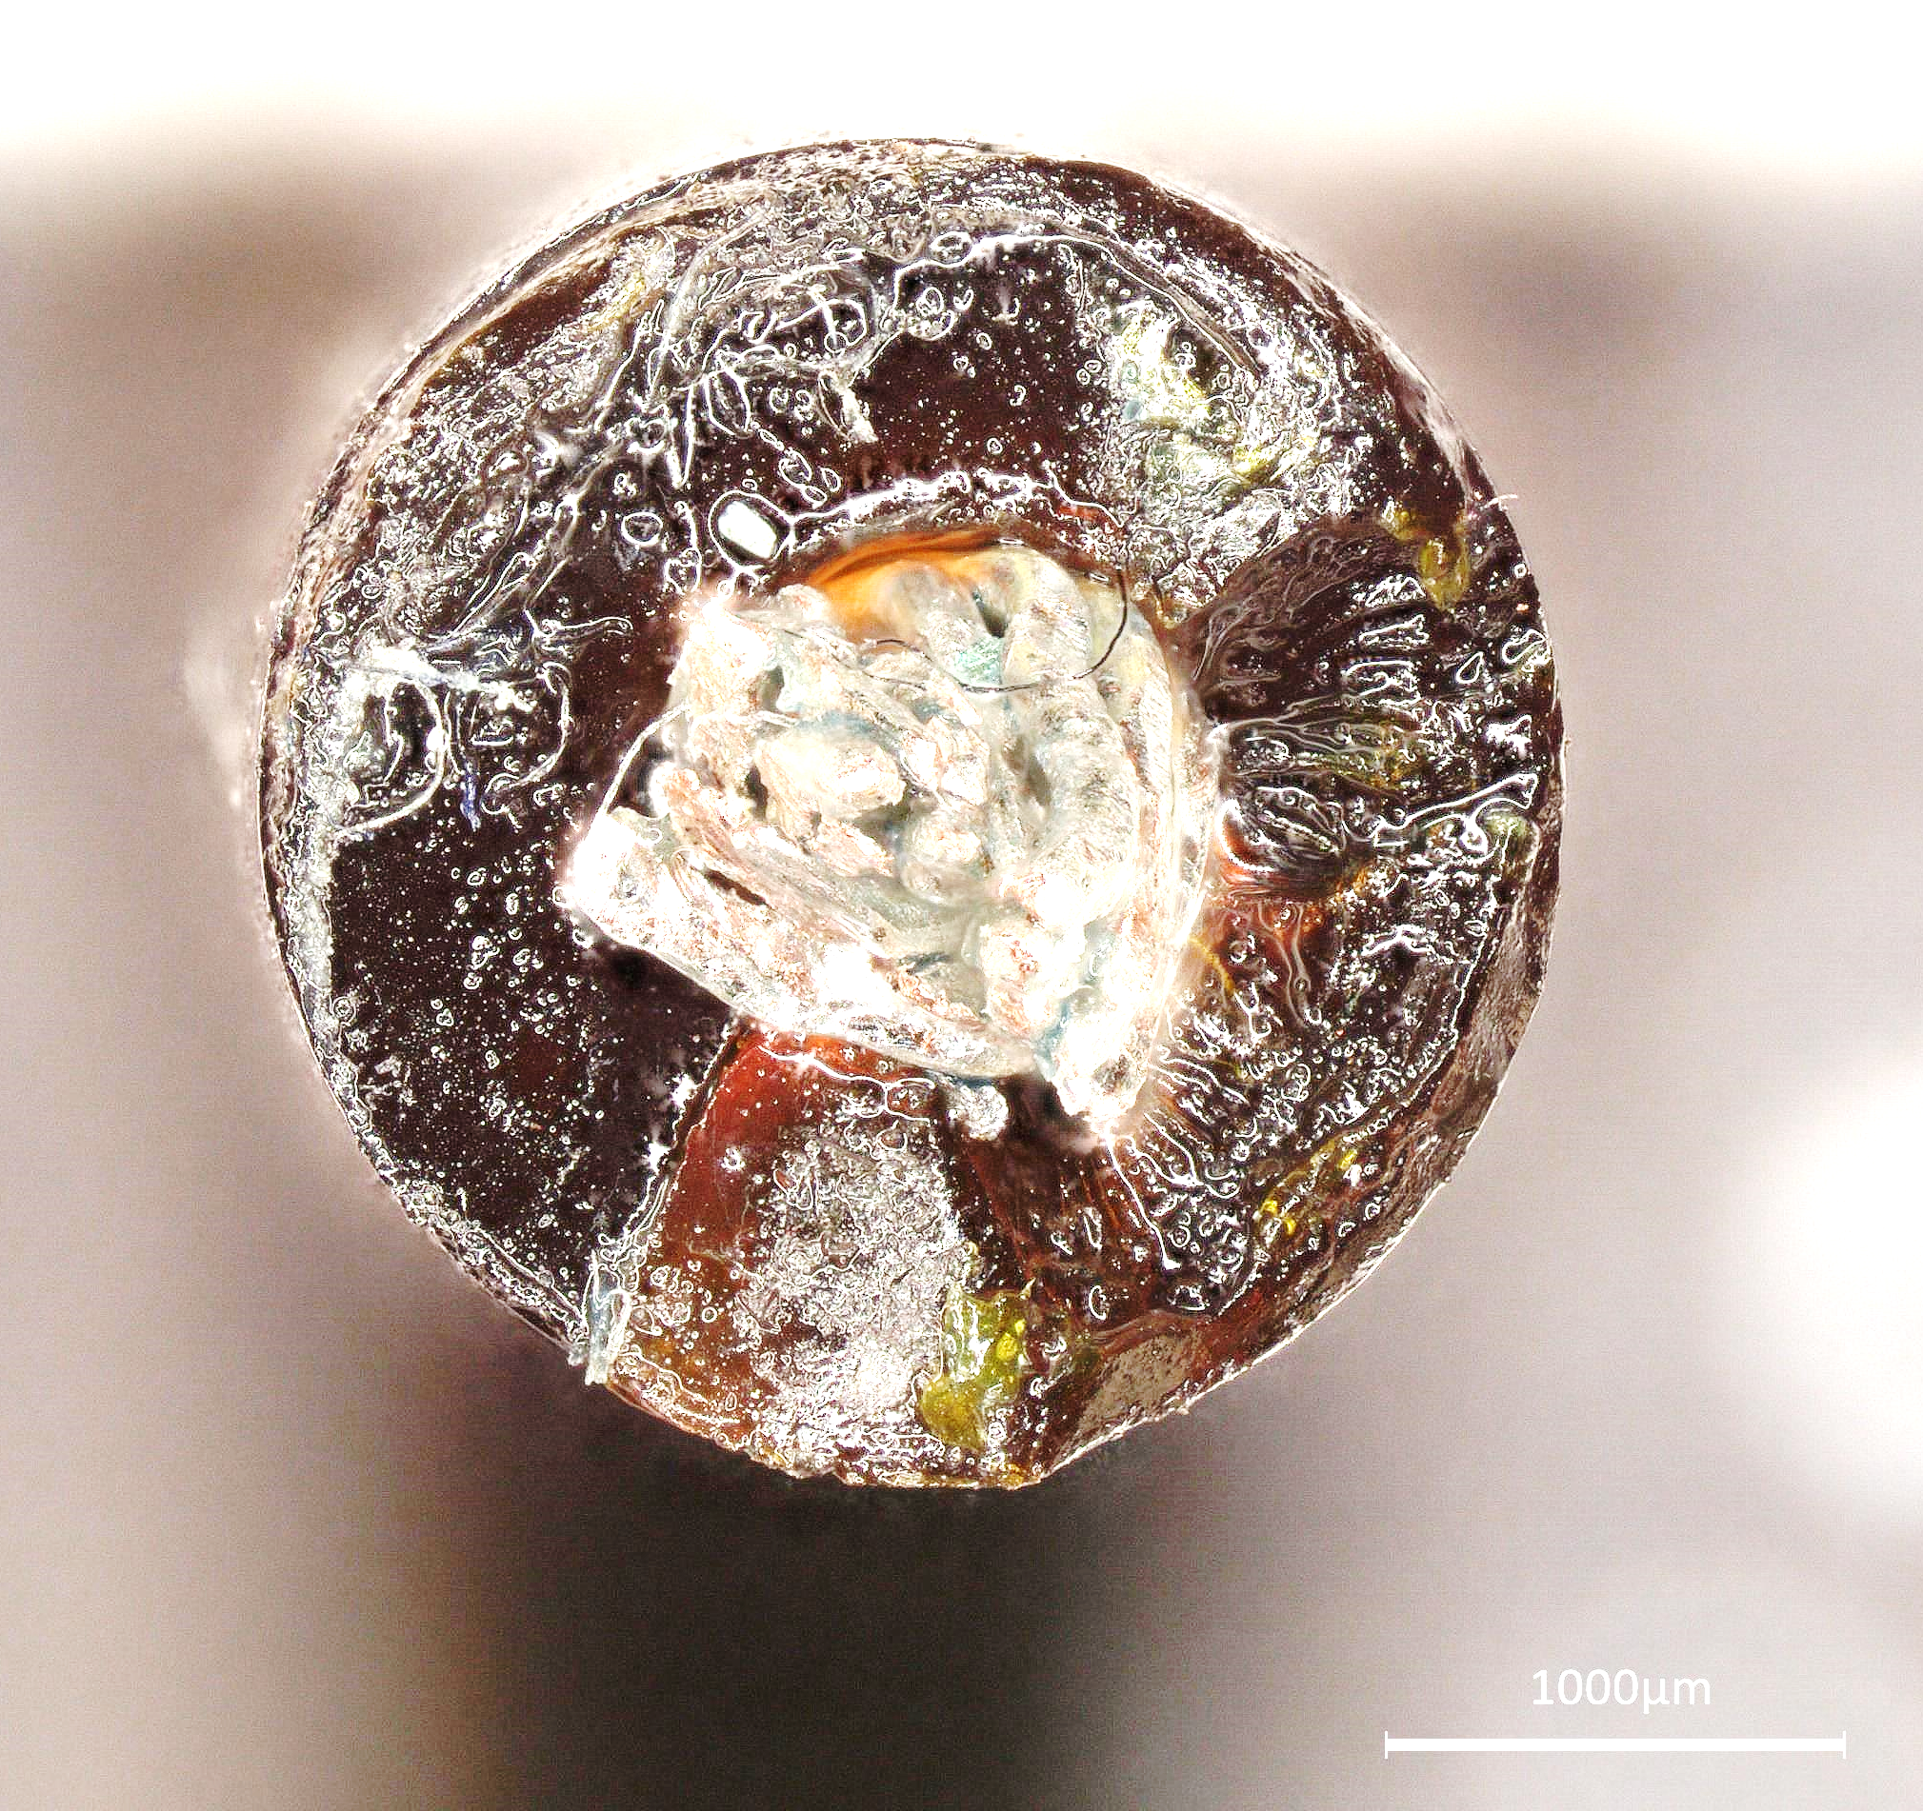
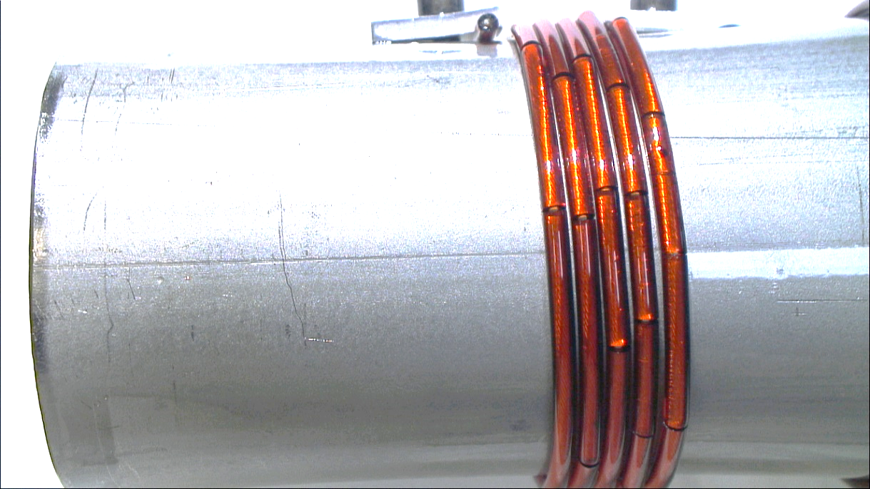
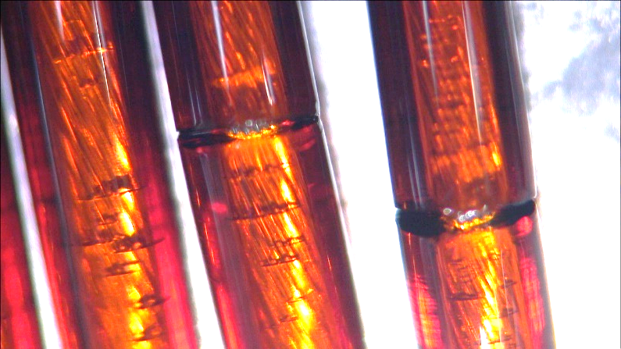
Crack appearance
I) Azimuthal sub-superficial crazes appeared in the bulk of the TPI under tensile stress
II) Often the fracture surface covered the entire cross-section of the wire

Slide 13
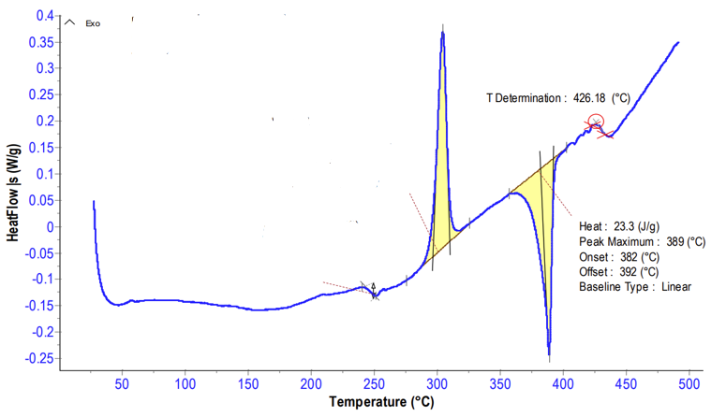
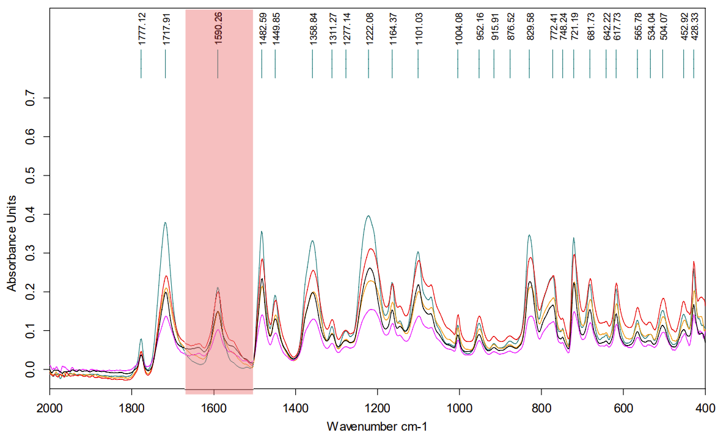
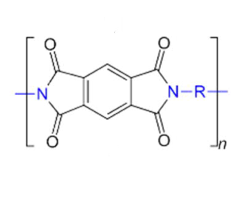
Comparative analysis of “aged ” and “virgin” samples
Cold crystallization 304 ℃
Differential Scanning Calorimetry (DSC)
Very similar thermal phenomena for all virgin and aged samples
Typical behavior of amorphous TPI
No major morphological changes
T glass 249 ℃
T melting 389 ℃
Fourier Transform Infrared Spectroscopy (FTIR)
Peaks corresponding to amide groups at 1639 cm−1 (symmetric stretching of C=O in the amide group) and 1534 cm−1 (stretching of C–N and bending of N–H in the amide group)
Indication of the imide-ring opening
Possible alkaline hydrolysis

Slide 14
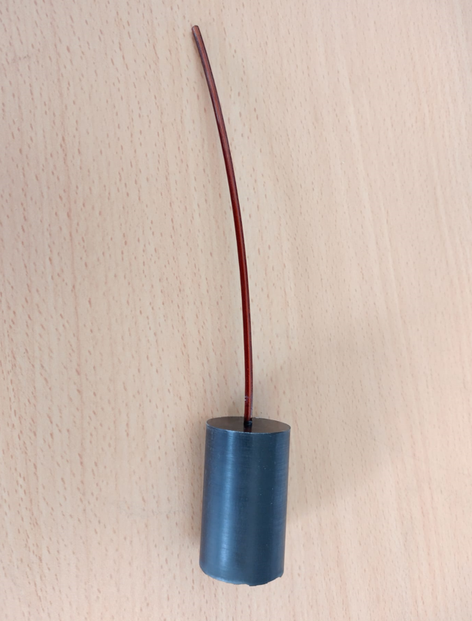
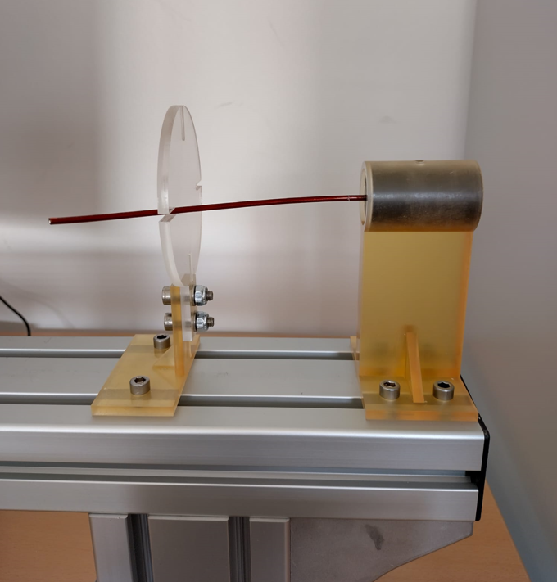
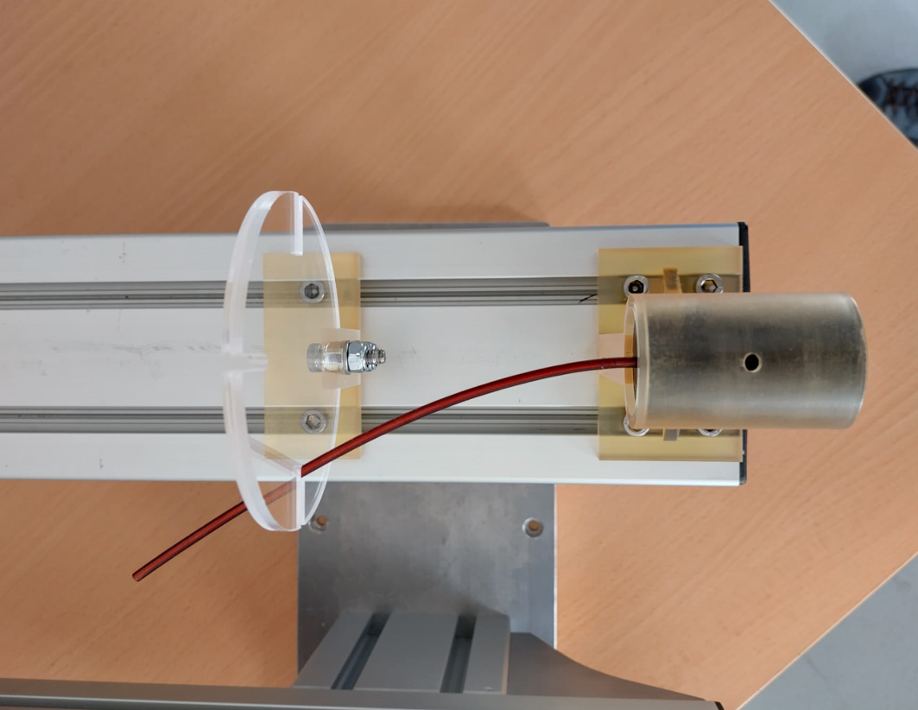
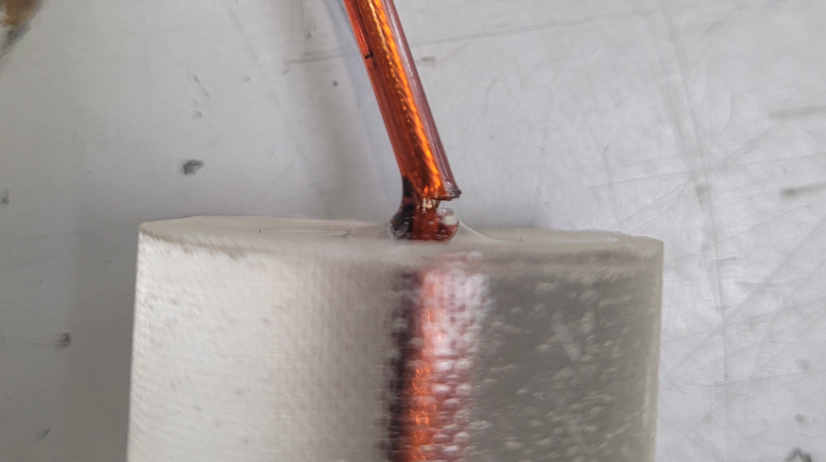
II ) Encapsulated wire bending test
The test aimed to compare the failure rate at bending of wires encapsulated in the epoxy mix
The encapsulated wire samples were prepared to reproduce the recommended proportion of chemicals and curing times
Samples were tested in a dedicated jig in four orthogonal directions
Bending was repeated once per week till rupture

Slide 15
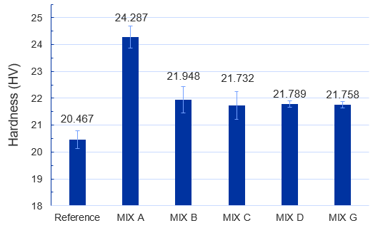
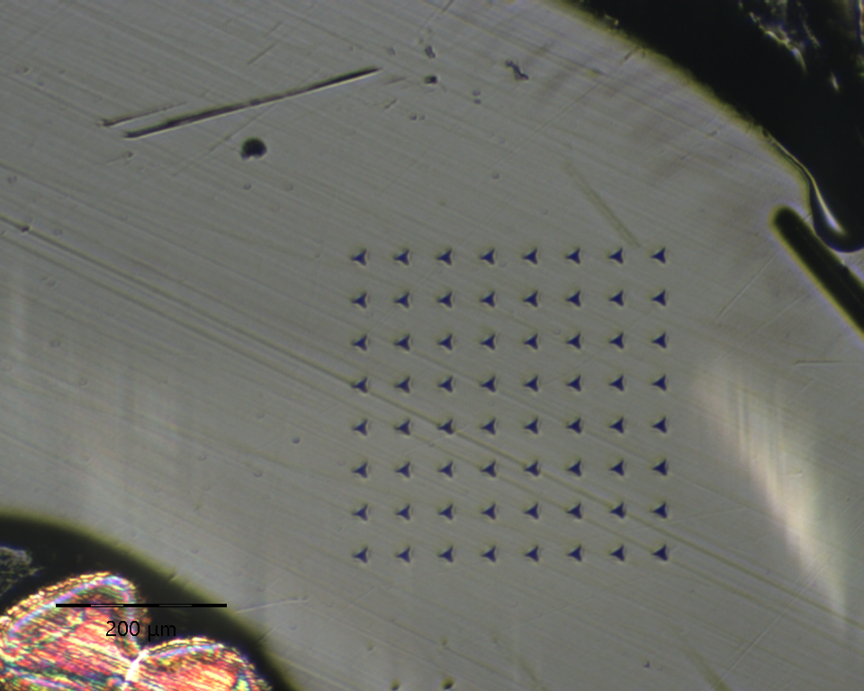
Failure rates at bending
D230
Stycast
Failure rates at bending
 | A | B | C | D | E | F | G
W1 | 6/6 | 1/6 | 1/3 | 2/3 | 0/3 | 1/3 | 0/3
W2 | 6/6 | 0/6 | 0/3 | 1/3 | 0/3 | 0/3 | 0/3
Results pretty aligned with the outcome of the immersed mandrel test:
Lower failure rate for the wires W2 (two-layer insulation)
High failure rate of mix A (D230)
Hardness (nanoindentation)
Increase of hardness with respect to the reference value measured on a virgin sample:
+ 18% for mix A (D230)
+ 7% for other mixes

Slide 16
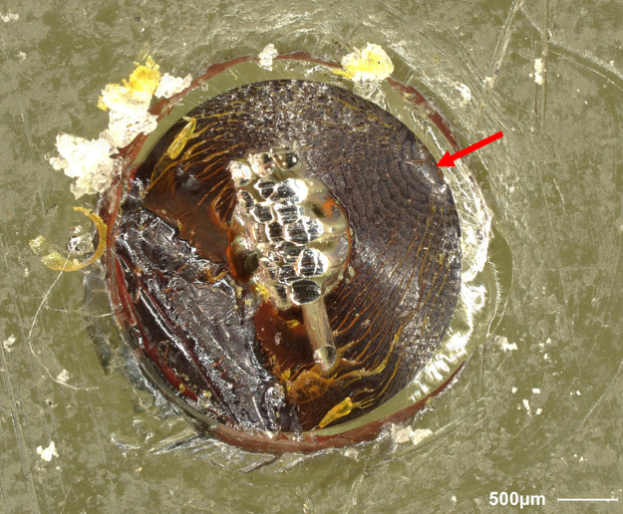
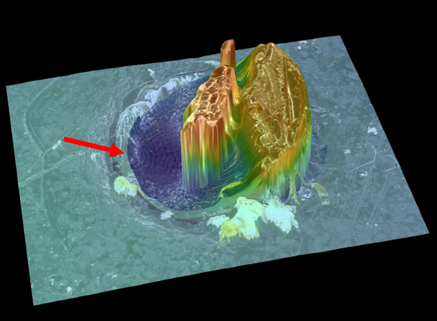
Fracture surface of encapsulated wire
Crack propagates from the wire / epoxy interface
More aggressive hardeners may etch the TPI surface causing micro-defects
crack initiation

Slide 17
Conclusions
ESC appears in TPI wires exposed to amine-hardeners. Rapid crack onset (few hours), aggravated at temperatures of 60 ℃
Even in low concentration, the hardeners causes physical changes in TPI that may promote cracking
To mitigate the risk of ESC great caution must be given to the selection of materials (wire insulation, epoxy systems, etc.) and the wire insulation layouts

Slide 18
Thank you

