Slide 1
MON_FPGA Backend
Cyril Drancourt, Won Chao Chen and J.P. Martin

Slide 2
Backend system specifications
Gather the monitoring data from 60 or more MON_FPGA monitoring controllers
  One serial stream per MON_FPGA, LVDS signaling, 10 - 100 Mb/sec. (actual : 80 Mb/sec)
    Bit rate upper limit : CAT6 cable length ; Lower limit : RJ45 isolation transformers
  Packet size : 64 bytes
  One complete readout cycle => 20 packets
  Effective burst rate per stream (4b-10b decoded): 4 Mbytes/sec
  Average sustained data rate 640 bytes/sec
The front-end data for each MON_FPGA reflects the content of I2C port expanders and ADCs in 18 module
This content shall be mirrored every 2 seconds or less to a backend system acting as an OPC-UA server system
  Backed can be distributed for convenience
  Accessible to WIN_CC clients over the network

Slide 3

Early backend implementation for the users
Single link
LISSY
WIN_CC client
MON_FPGA
I2C
I2C
ILK_FPGA
PYNQ-Z2
MIRROR
memory
CPU
(OPC_UA)
linkOUT
OUT_DPM
Rx
DESER
clk
linkIN
IN_DPM
Tx

Slide 4
Extension to multiple channels
RJ45
(8)
16-port interface card
FMC
FMC
Backend
ZCU104 (firmware development)
ZEDBOARD(firmware development)
EMP (production)
LISSY
LISSY
RJ45
(8)
16-port interface card
FMC
Backend
ZCU104 (firmware development)
ZEDBOARD(firmware development)
EMP (production)
RJ45
(8)
FMC
LISSY
RJ45
(8)

Slide 5
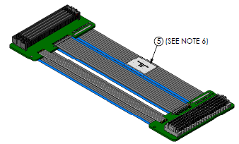
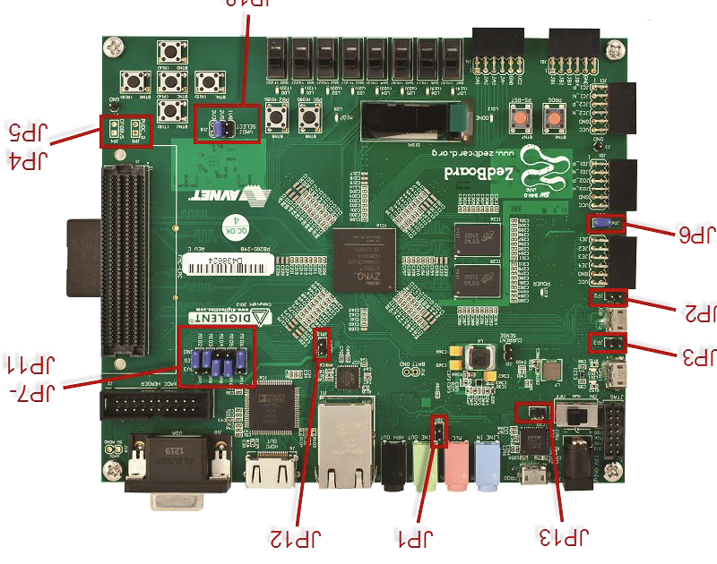
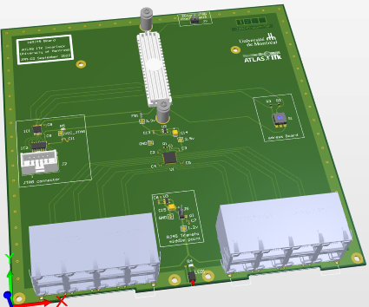
16RJ45 Board application
On X17 (Montreal experiment)
with Zboard
Samtec Flex Cable Male-Female FMC connectors
LPC type (4 rows, 160 contacts)
Already buy (JP, 1 piece)
16RJ45 Board
ZBoard
RJ45 link
to MonFPGA Board
Atlas ITK interlock meeting
18 october 2022
Cyril.Drancourt@umontreal.ca

Slide 6
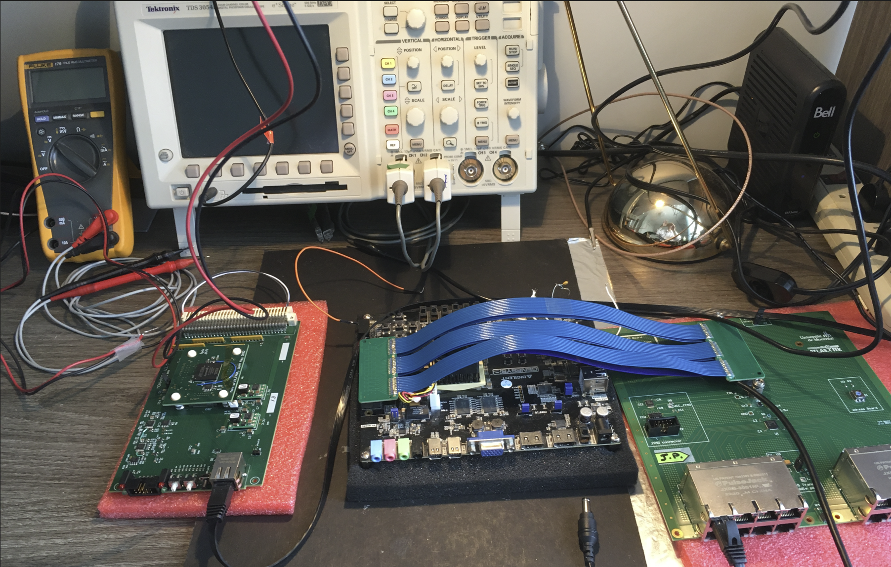
Test bench, with one MON_FPGA (Cyclone I prototype)

Slide 7
Design considerations
The average input rate is very low : 1280 bytes every 2 seconds per port
The peak input rate is presently 4 Mbytes/sec per port
All the front-ends can transmit simultaneously
The 20 packets arrive in rapid succession (at the end of the MON_FPGA I2C cycles) in each port
  ~ 2 Mbytes/sec during packet bursts per port
  Even at 4 Mbytes/sec , it takes 82 milliseconds to receive the MON_FPGA data burst
The transfer rate from the multiplexer buffer to the CPU is fast
  32-bit bus at 50 MHz or more
  102.4 µs to transfer the data from 16 ports at full bus speed
Conclusions
The input DPMs need to be only 20 packets deep
The input DPMs are read sequentially by the multiplexer, but the transfer rate to the CPUs is still much faster than the input rate
A multi-event buffer could be added after the multiplexer to deal with possible latency in the software (unlikely, with the bare-metal real-time CPUs available in Ultra-Scale FPGAs)

Slide 8
Backend simplified firmware block design
linkOUT
OUT_DPM
CPU
DESER
linkIN
IN_DPM
MPX
XFER CTRL
Multi event buffer
(double port)
16 instances
linkOUT
OUT_DPM
DESER
linkIN
IN_DPM

Slide 9
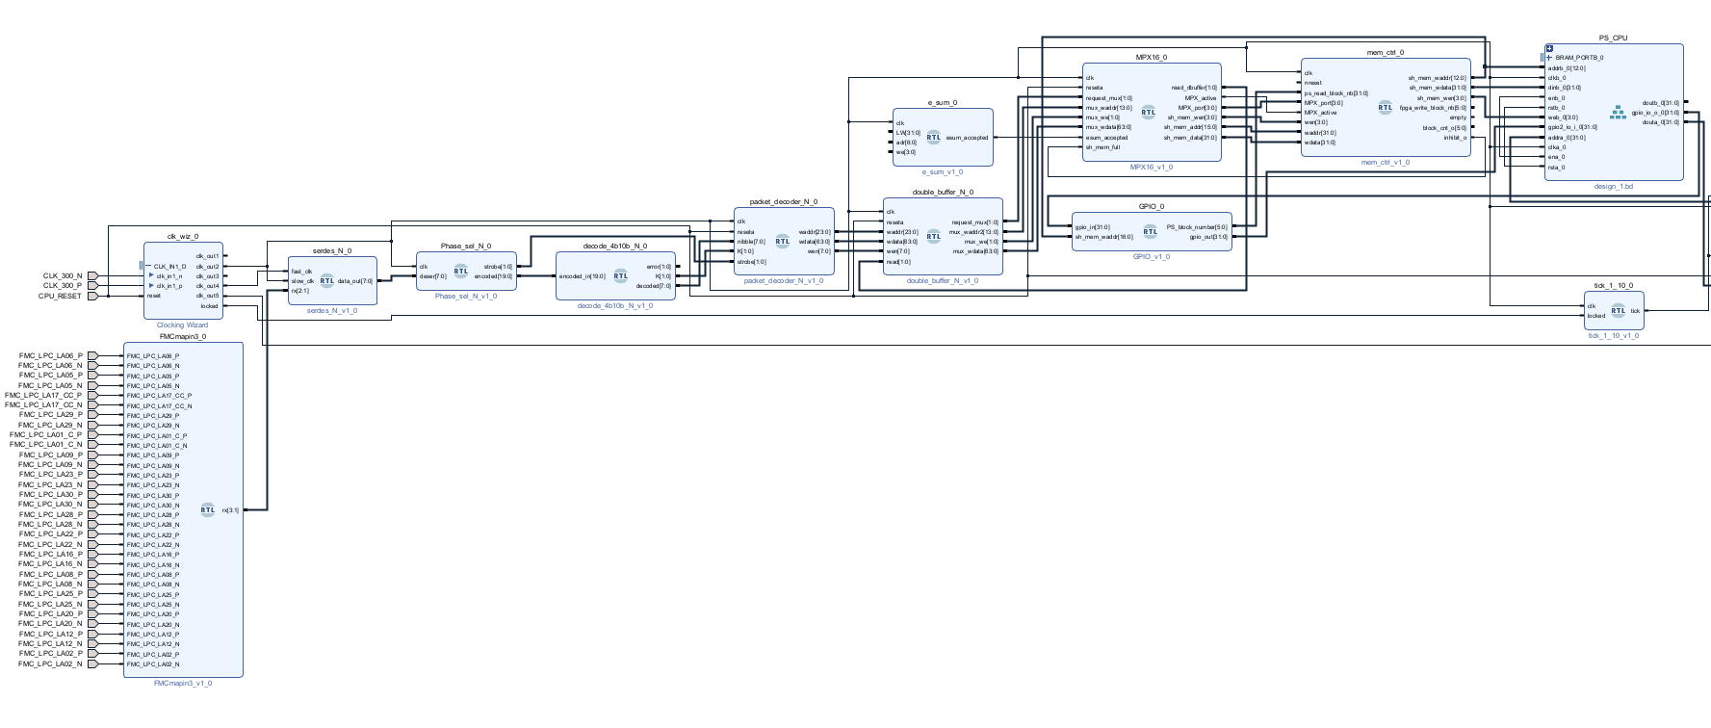
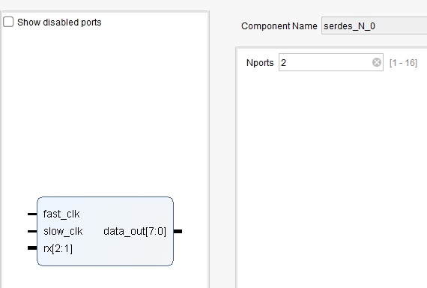
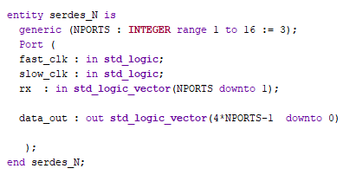
Implementation of the input portion on ZCU104; N=2 instances
(Vivado block design)
N instances of these blocks, N=2 example

Slide 10
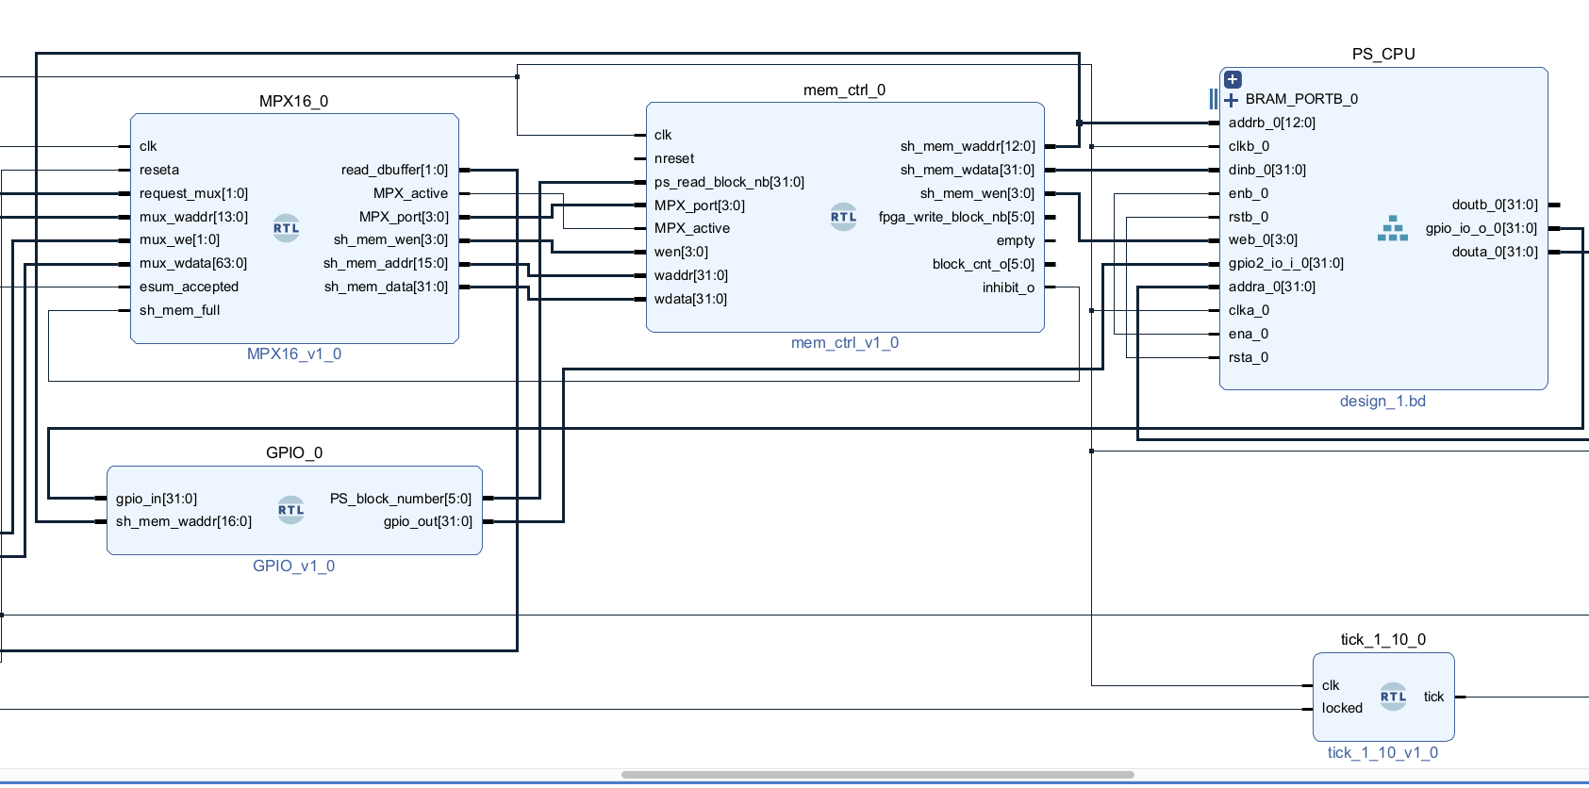
Implementation of the multiplexing scheme
Pointer from PS
Pointer to PS

Slide 11
Status of the development
~1 year of user’s experience with the one port PYNQ-Z2 setups
16-port interface card works as planned. No issues so far.
  5 prototype units built
Preliminary firmware work done with an ultra scale development board:
  Multiplexing scheme tested (FPGA portion) with ChipScope
  Tested for Nports > 1 (=2)
  Need to get familiar with the multi processor system
    Adapt the software memory space to multiple front-end images
    Support multiple instances of back-end devices
    Maximum number of ports per back-end device = 16
    Distributed OPC_UA server

