Slide 1


16RJ45 Board Status
18/10/2022
Application :
      ATLAS ITK interlock upgrade for CERN
      X17 experiment in Montreal laboratory
      Others in study
By Cyril Drancourt, University of Montréal
1

Slide 2
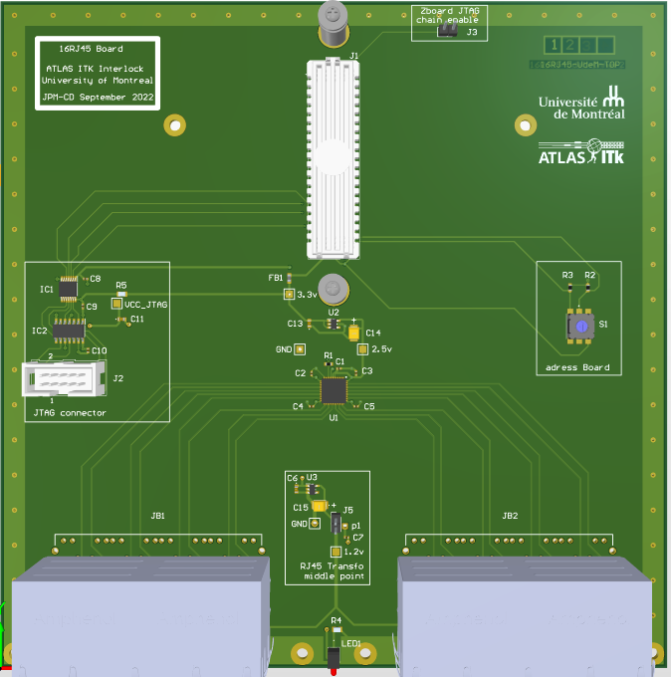
16RJ45 Board, University of Montreal
3D View CAD (Altium)
Atlas ITK interlock meeting
18 october 2022
Cyril.Drancourt@umontreal.ca

Slide 3
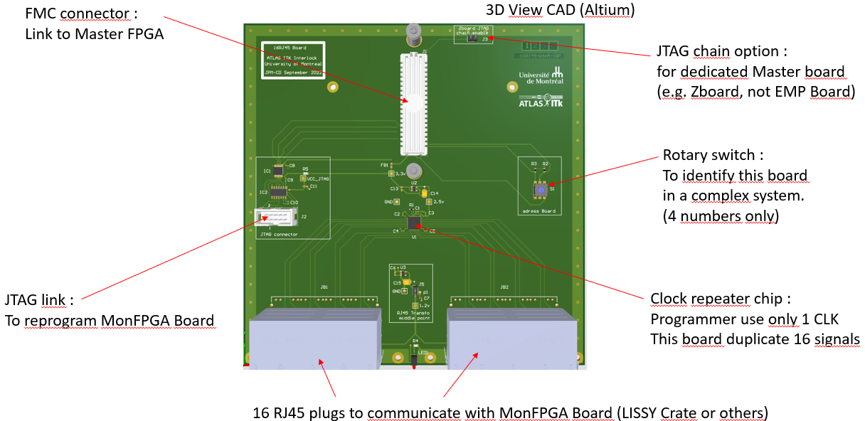
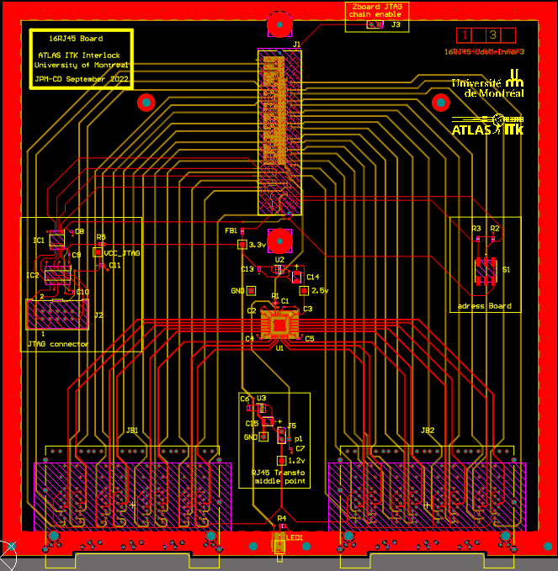
16RJ45 Board
Manufacture
Some details:
190 mm x 190 mm
4 cupper layers on CAD
Halogen free materials
16 RJ45 link for 16 MonFPGA Board (i.e. 16 LIZZY crate for ITK interlock)
Galvanic transmission on RJ45
2 bits identification for 16RJ45 board
JTAG master connector on 16RJ45 board to program MonFPGA
4 layers : 2 signals, 2 ground planes
Atlas ITK interlock meeting
18 october 2022
Cyril.Drancourt@umontreal.ca

Slide 4
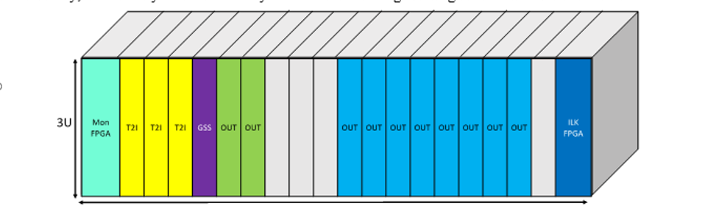
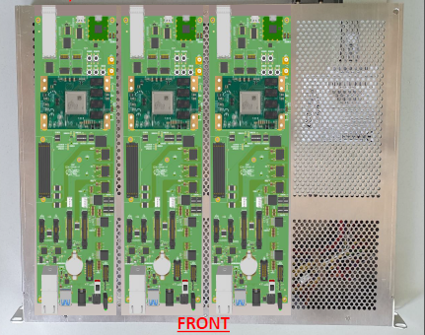
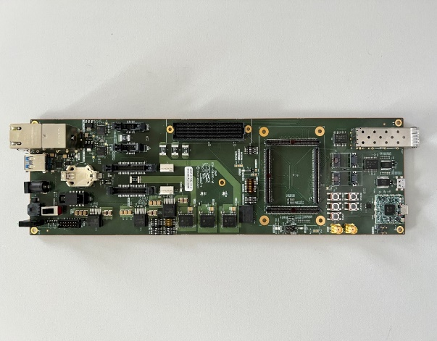
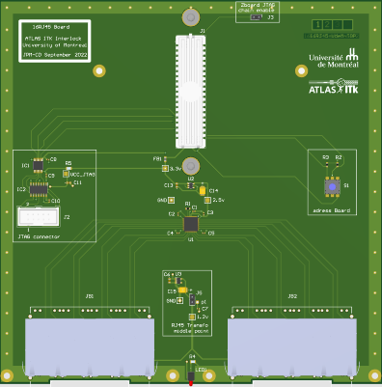
16RJ45 Board application
On ATLAS ITK Interlock
LIZZY Crate (x16)
16x RJ45 Cables (Cat6)
FMC link
EMP Crate
EMP
Board
x16
16RJ45 Board
Atlas ITK interlock meeting
18 october 2022
Cyril.Drancourt@umontreal.ca

Slide 5
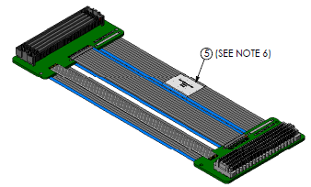
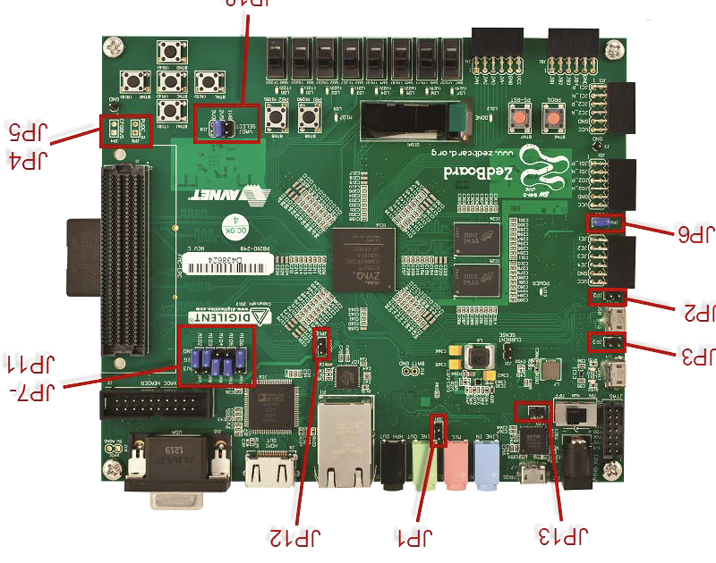
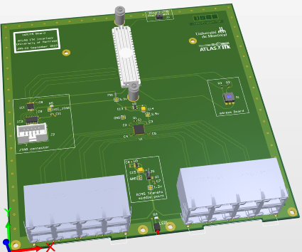
16RJ45 Board application
On X17 (Montreal experiment)
with Zboard
Samtec Flex Cable Male-Female FMC connectors
LPC type (4 rows, 160 contacts)
Already buy (JP, 1 piece)
16RJ45 Board
ZBoard
RJ45 link
to MonFPGA Board
Atlas ITK interlock meeting
18 october 2022
Cyril.Drancourt@umontreal.ca

Slide 6
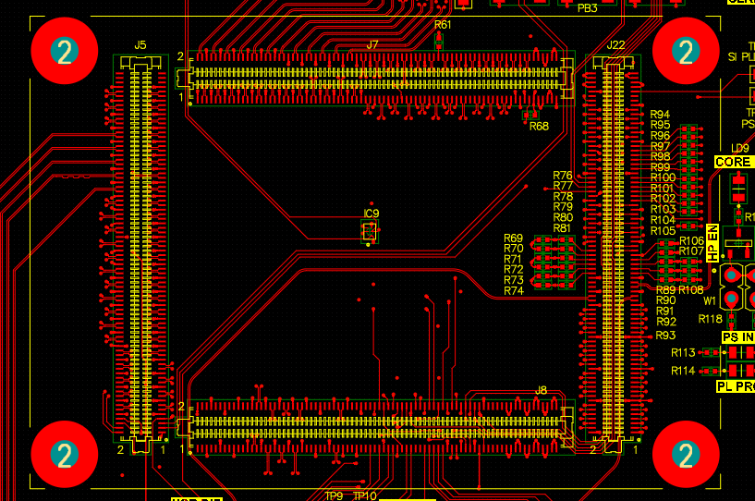
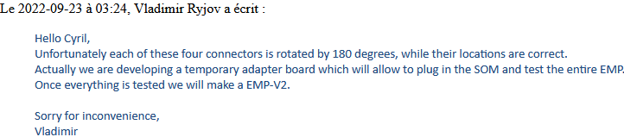
EMP bugg with Trenz Mezzanine
Schematic follow mean :
J7 EMP = J1 Trenz
J5 EMP = J4 Trenz
J1 Trenz
J7 EMP
J4 Trenz
J5 EMP
Pin 1
Pin 1
TOP view CAD
EMP Altium CAD
BOTTOM Picture
Trenz documentation : TRM-TE0807-03-v.27-06_10_2021.pdf (fig2 page8)
EMP must have adapter to receive Trenz Mezzanine FPGA
16 RJ45 User Manual
06/10/2022
Cyril.Drancourt@umontreal.ca

Slide 7
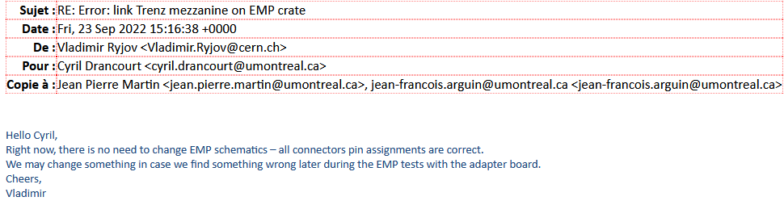
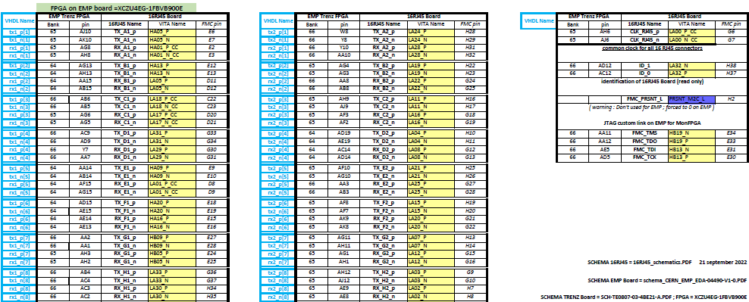
16RJ45 Board link - RJ45 assignment
For ITK interlock experiment with Trenz FPGA pin – OK
Atlas ITK interlock meeting
18 october 2022
Cyril.Drancourt@umontreal.ca

Slide 8
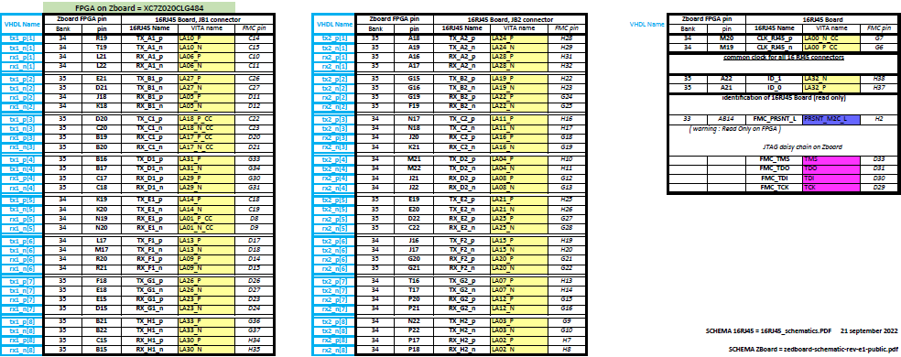
16RJ45 Board link - RJ45 assignment
For Test in Montreal (X17) with Zboard FPGA pin – OK
Atlas ITK interlock meeting
18 october 2022
Cyril.Drancourt@umontreal.ca

Slide 9
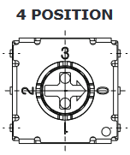
16RJ45 identification
FPGA Master :
EMP(Trenz Mezzanine)
or Zboard
16RJ45 Board
FMC
connector
ID x2
S1
2bits
Switch
rotary
VAdj
1 KΩ
GND
The 16RJ45 board can be
identified by the position of rotary swith (4 possibilitys) on it.
4 boards 16RJ45 can be detected in a same electronic system.
EMP Trenz FPGA
Pin AD12 | ID_1
Pin AC12 | ID_0
Identification reading by FPGA
Switch position | Bit ID_1 | Bit ID_0
0 | 0 | 0
1 | 0 | 1
2 | 1 | 0
3 | 1 | 1
Zboard FPGA
Pin A22 | ID_1
Pin A21 | ID_0
Atlas ITK interlock meeting
18 october 2022
Cyril.Drancourt@umontreal.ca

Slide 10
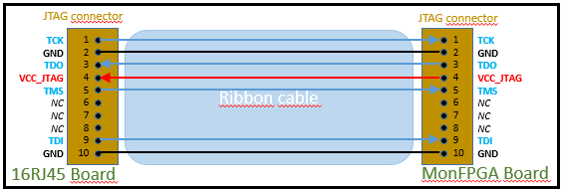
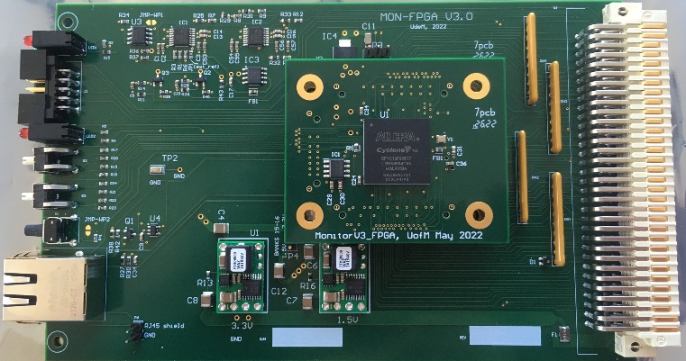
JTAG on 16RJ45 to programming MonFPGA board in remote acces
16RJ45 Board
JTAG Master :
EMP or Zboard
Remote acces
FMC link
computer
JTAG Ribbon cable ,
Power supply
Goal :
The JTAG connector on 16RJ45 Board
offer the possibility to reprogram (firmware)
by remote acces the MonFPGA Board.
*** Using in development state ***
Power supply
MonFPGA Board
Atlas ITK interlock meeting
18 october 2022
Cyril.Drancourt@umontreal.ca

Slide 11
16RJ45 status
PCB ………………………………………………………………..………. : OK (6 PCB ready on 14 oct 2022)
Assembling (5 PCB)…………….....……………………………….. : in progress (wait 1 component -17oct2022)
Additionnal component for ITK …………..………….………. : Samtec Flex cable in order (delay = end october)
(
Additionnal component for X17 ………….………….………. : OK (Samtec Flex cable low density version)
User documentation ………………………………………….…... : OK (For ITK and X17)
Firmware to ITK on EMP FGPA (Trenz mezzanine) …… : t.b.d.
Firmware to X17 experiment (Montreal with Zboard) : t.b.d.
→→ Debug test on X17 material (MonFPGA+Zboard)
Atlas ITK interlock meeting
18 october 2022
Cyril.Drancourt@umontreal.ca

