Slide 1
Update an MDI IR Dimensions for Magnets and Cryostats
John T. Seeman
SLAC National Accelerator Laboratory
December 11, 2023
FCCee MDI Meeting

Slide 2
Topics covered
QC1/2 transverse position of quadrupole and support components in the cryostat.
Initial features for IR magnet cryostat ends
Thank you for recent help from:
P. Tavares Coulinho Borges de Sousa, M. Boscolo, S. DeBarger, A. Foussat, M. Koratzinos, N. Ohuchi, B. Parker, M. Sullivan, F. Zimmermann

Slide 3
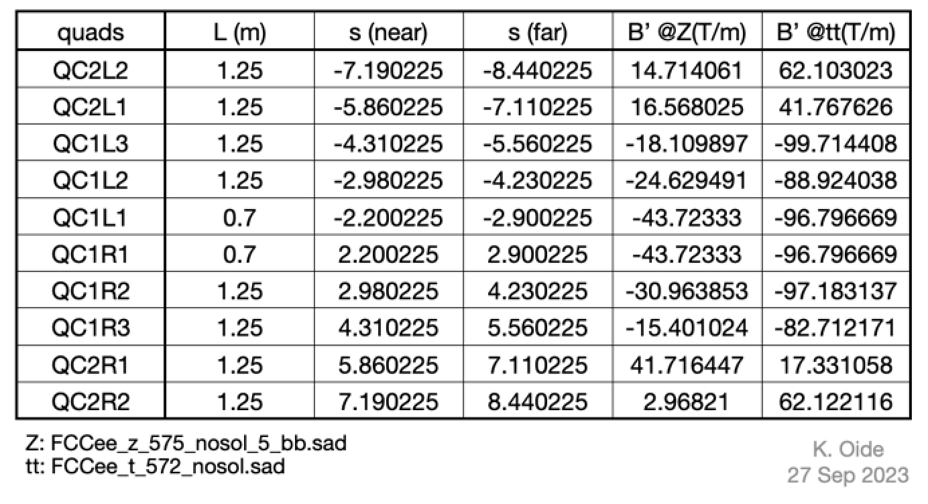
FCCee IR magnet locations, lengths and strengths (K. Oide)

Slide 4
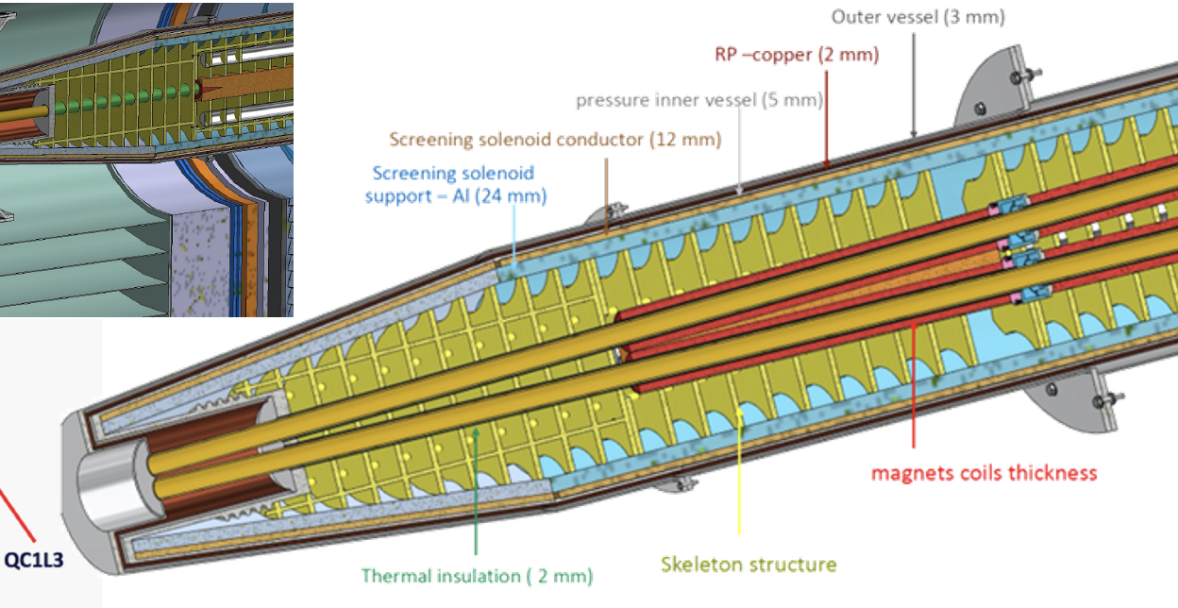
Some cryo-stat dimensions
Cross section
views
M. Koratzinos, M. Boscolo

Slide 5
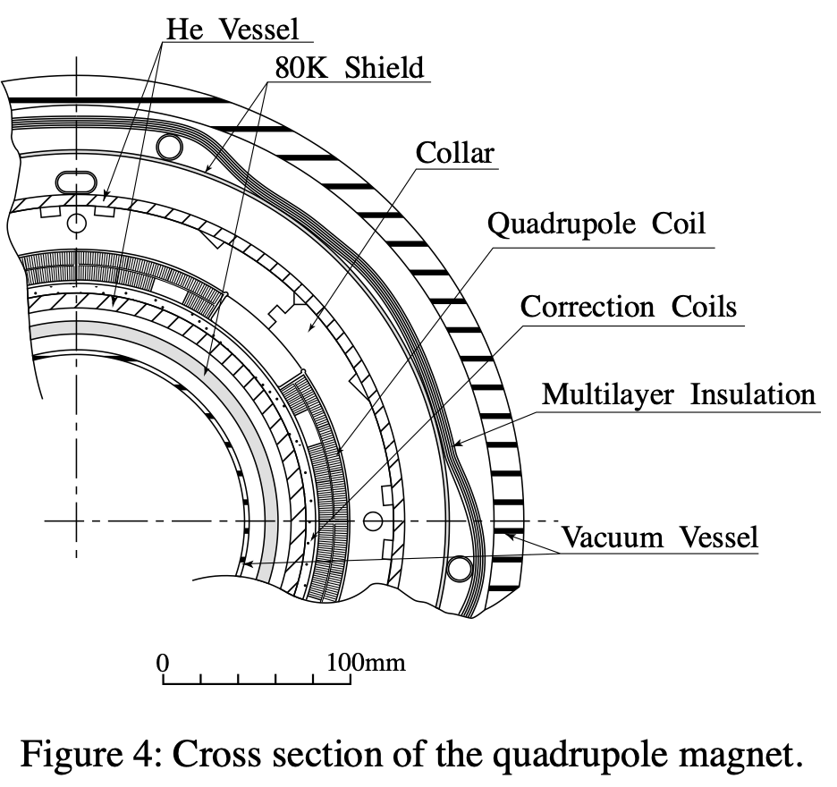
KEKB Cryostat view showing magnet and cryo layers

Slide 6
IR Magnet Cross Section View (front and end of each magnet)
Beam centroids
Cryostat vacuum walls
Magnet coils
.
Cryostat outer
support
Cryostat He walls
And heat shield walls
Beam vacuum walls
J. Seeman Nov 4, 2023

Slide 7
Standard Stainless Wall Thicknesses (S. DeBarger, SLAC)
The standard stainless steel wall thicknesses that SLAC would use for vacuum vessels: (The wall can be a little thinner if for vacuum only.)
Tube OD Wall thickness
Up to 0.75 inch (<19 mm) 0.035 inch (0.9 mm)
1 to 3 inch (<76 mm) 0.065 inch (1.7 mm)
4 to 5 inch (<127 mm) 0.083 inch (2.1 mm)
6 to 10 inch(<254 mm) 0.120 inch (3.0 mm)

Slide 8
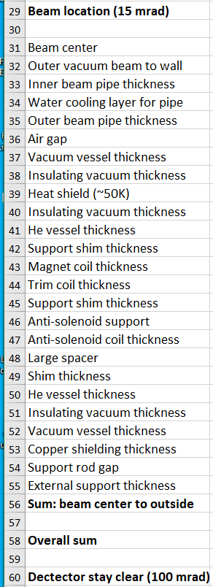
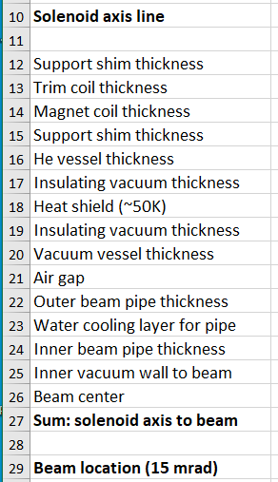
Component dimensions

Slide 9
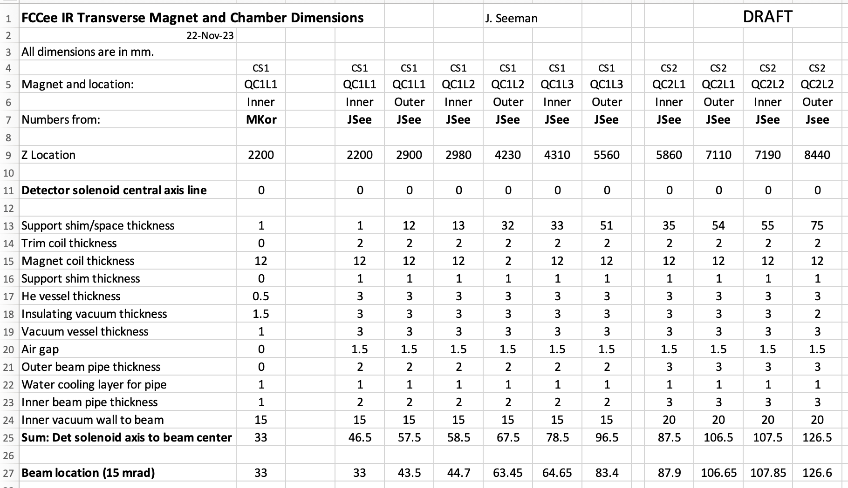
Draft distances from Detector Solenoid axis to Beam axis for QC1 and QC2

Slide 10
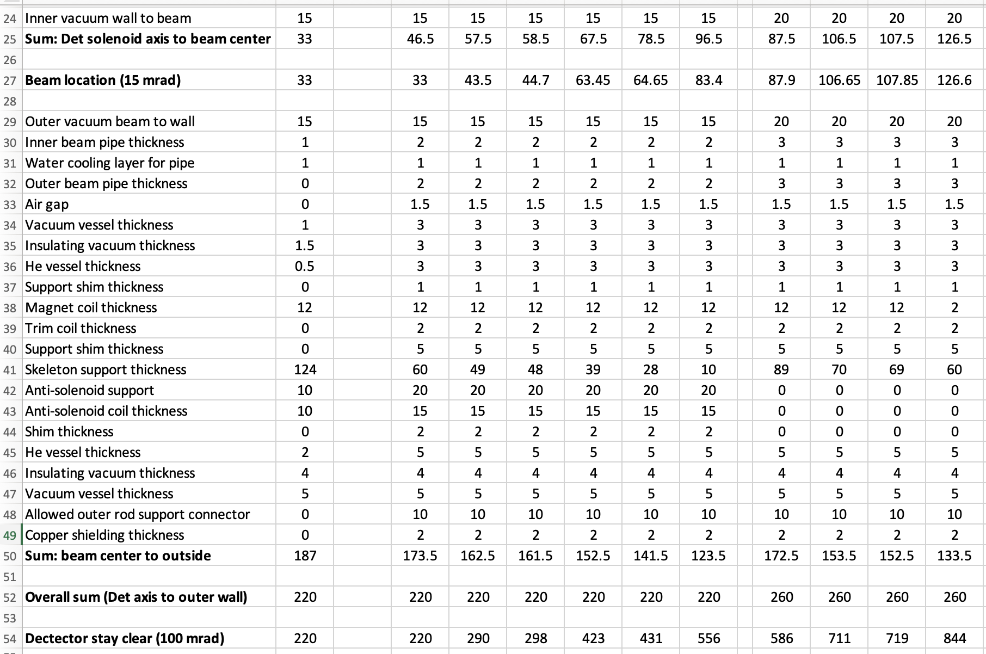
Draft distances from beam location to outer cryostat wall at QC1 and QC2

Slide 11
FCCee IR magnet longitudinal locations, lengths, and strengths (K. Oide)
QC1 to QC2 is 30 cm.
K. Oide is available to discussion any needed changes.

Slide 12
Option 3 (Leading Candidate):
IR QC1 and QC2 in different cryostats but one integrated raft (not to scale)
QC1-1
QC1-2
QC1-3
QC2-1
QC2-2
3.36 m
~1.5 m
2.58 m

Slide 13
Possible fixes to QC1 and QC2 radial and longitudinal space issues
Combine several of the various beam pipe and cryostat walls to keep the magnet locations fixed.
    Compromises the integrity of the cryostats.
    Likely increases the cryogenic heat load.
    Leak checking issues.
Keep the IP crossing angle the same:
Move QC1 away from IP about 0.8 m. (2.2 m to 3.0m)
Move QC2 away from IP about (0.8 +1.2 =) 2.0 m. (5.86 m to 7.86 m)
Minimum betay* increases a little.
Peak luminosity decreases some (few %).
C) Increase full crossing angle from 30 mrad to 40 mrad:
Move QC1 away from IP about 0.03 m. (2.2 m to 2.23 m) (add a Lumi-Cal gap)
Move QC2 away from IP about (0.03 +1.2 =) 1.23 m. (5.86 m to 7.09 m)
Quadrupole strengths are reduced.
Minimum betax* increases.
Beam line components move transversely in the tunnel for both beams.
Wider tunnel in some locations.

Slide 14
Needed functions for the space between QC1 and QC2
Beam pipes
e+ and e- BPMs
Cantilevered support(s)
Vibration control
Two cryostat end caps
Cryogenic ports and disconnects
Magnet leads
Alignment
Instrumentation
Magic flange controls and access
Vacuum disconnects

Slide 15
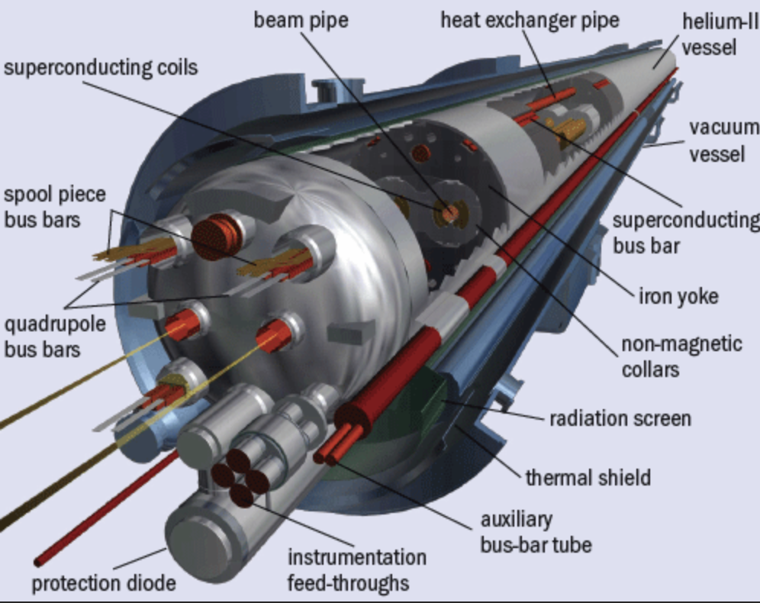
LHC dipole cryostat end showing end port
Magnet at
1.9 K

Slide 16
Longitudinal cryostat dimensions: Needed functionality?
How are the cryostats terminated at the ends of the magnets?
What utilities must enter and exit the cryostat?
How do the beam diagnostics enter and exit?
How do the mechanical supports contain the magnetic forces?
Which cryostat vessels need to be placed under vacuum for leak checking?
He and vacuum vessels?
How are the internal components supported and aligned?

Slide 17
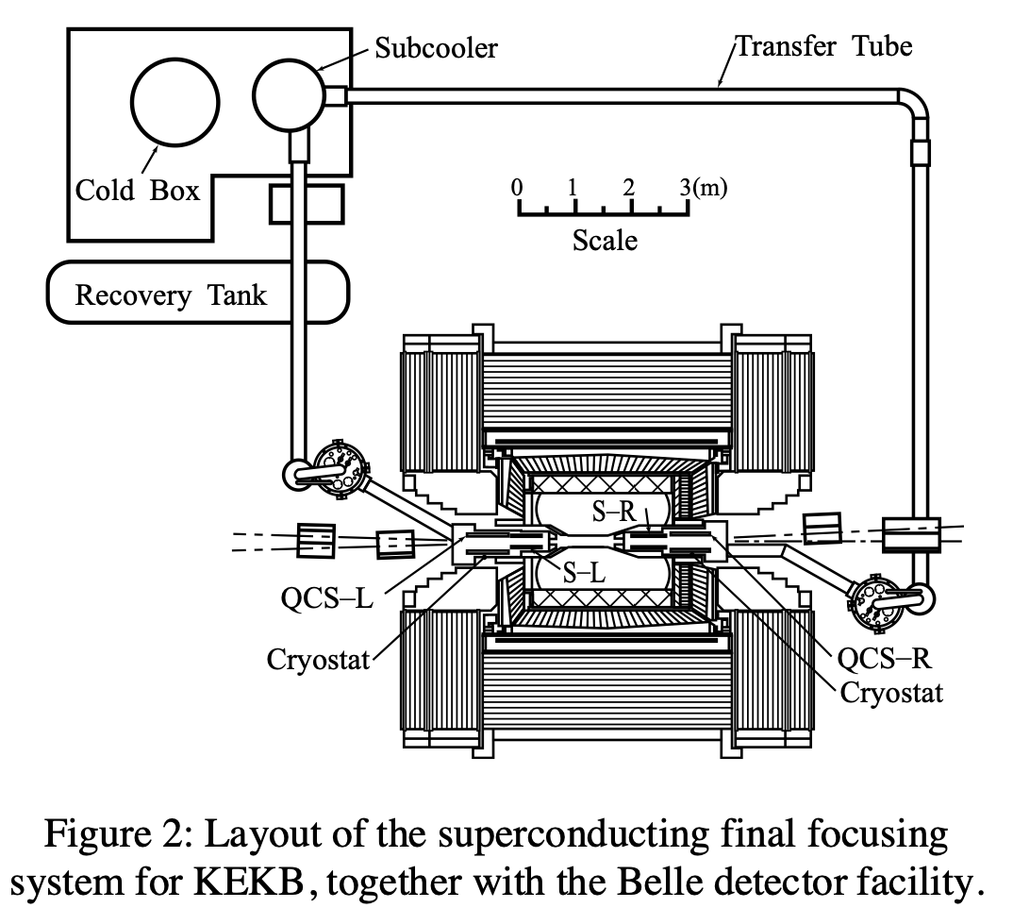
KEKB Cryo Layout

Slide 18
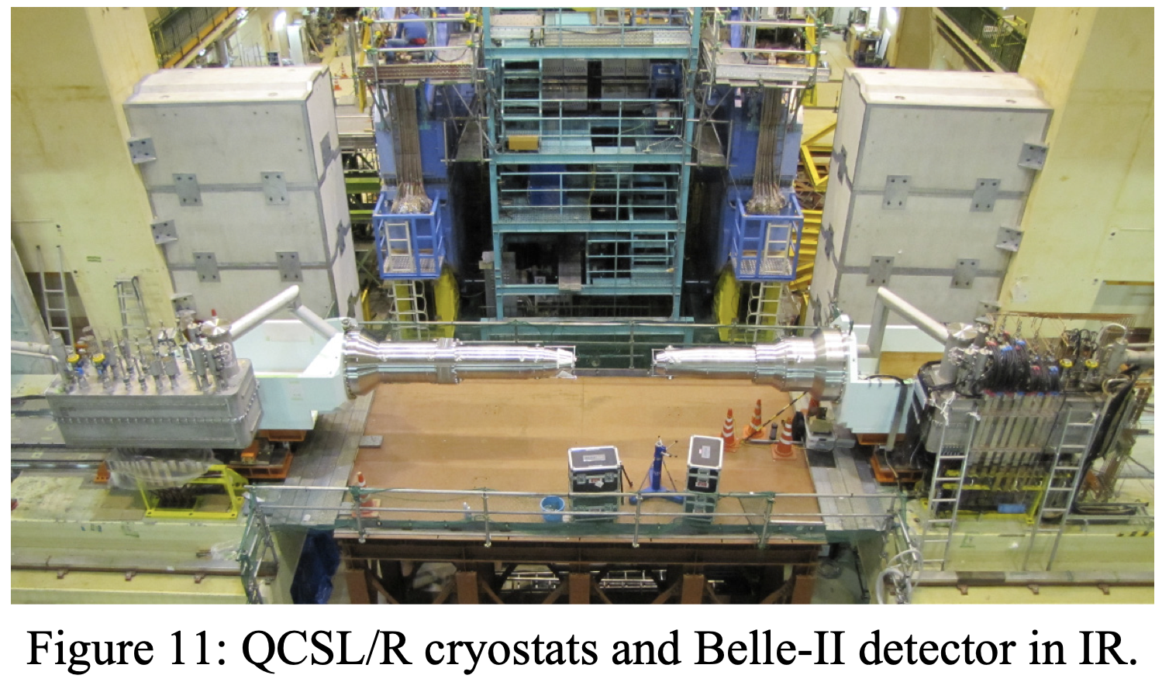
SuperKEKB IR Cryostats

Slide 19
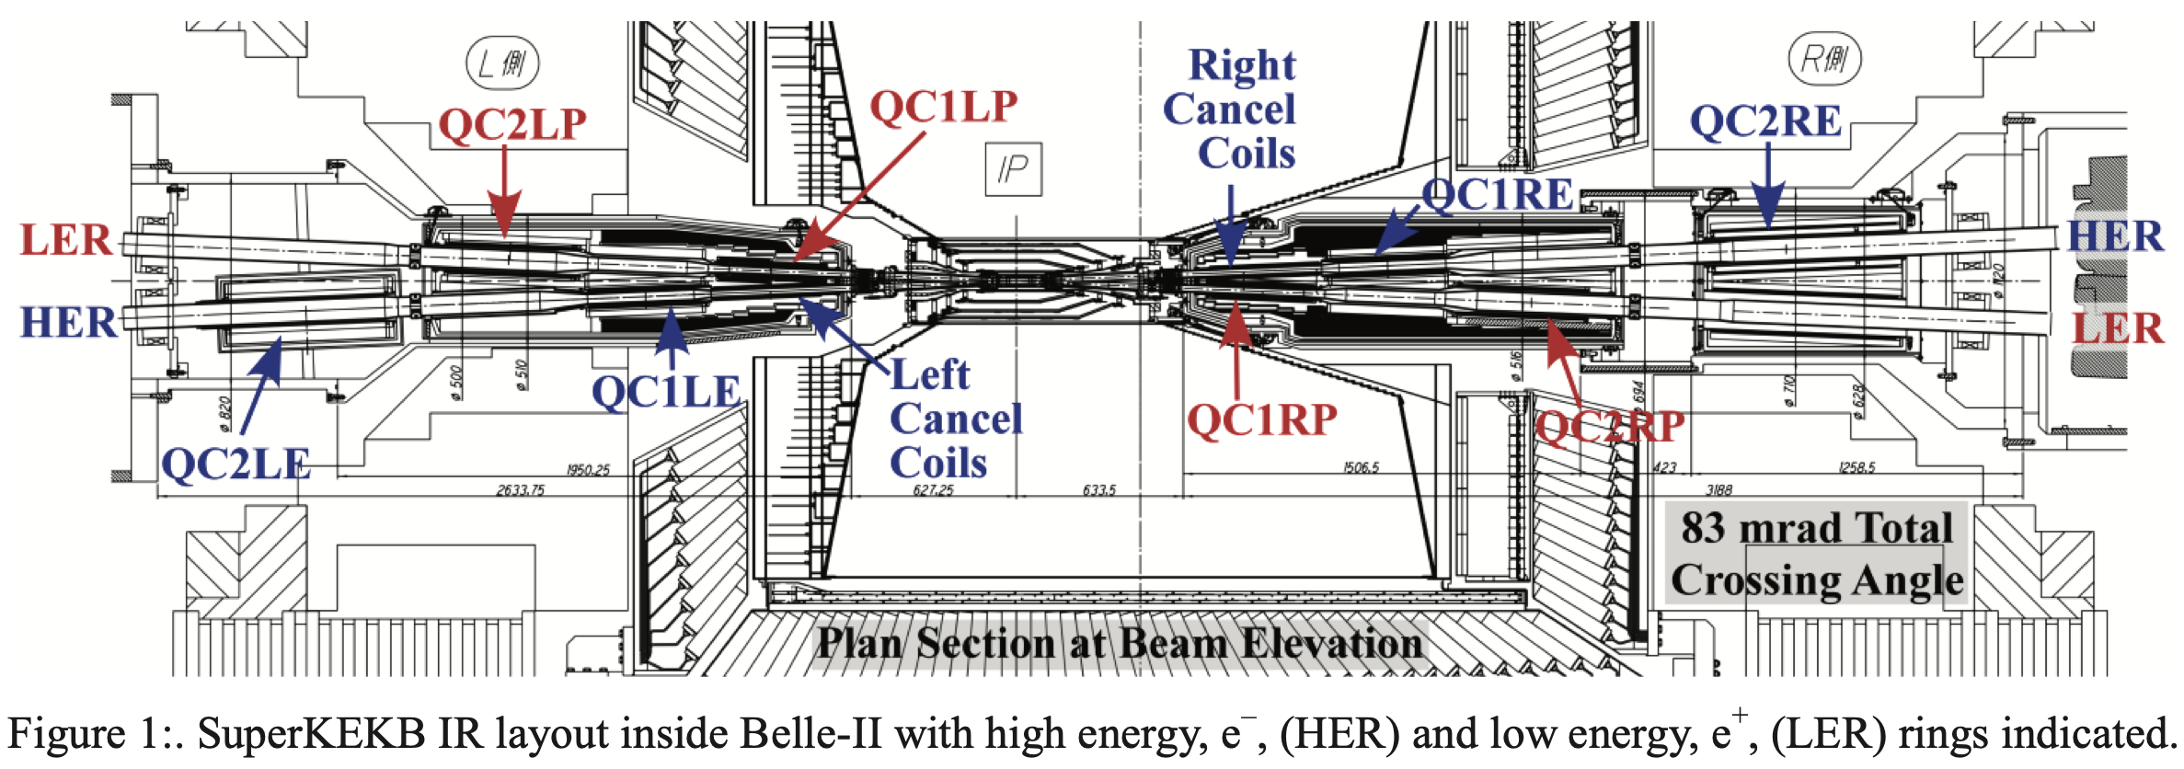
Overall SuperKEKB IR Layout

Slide 20
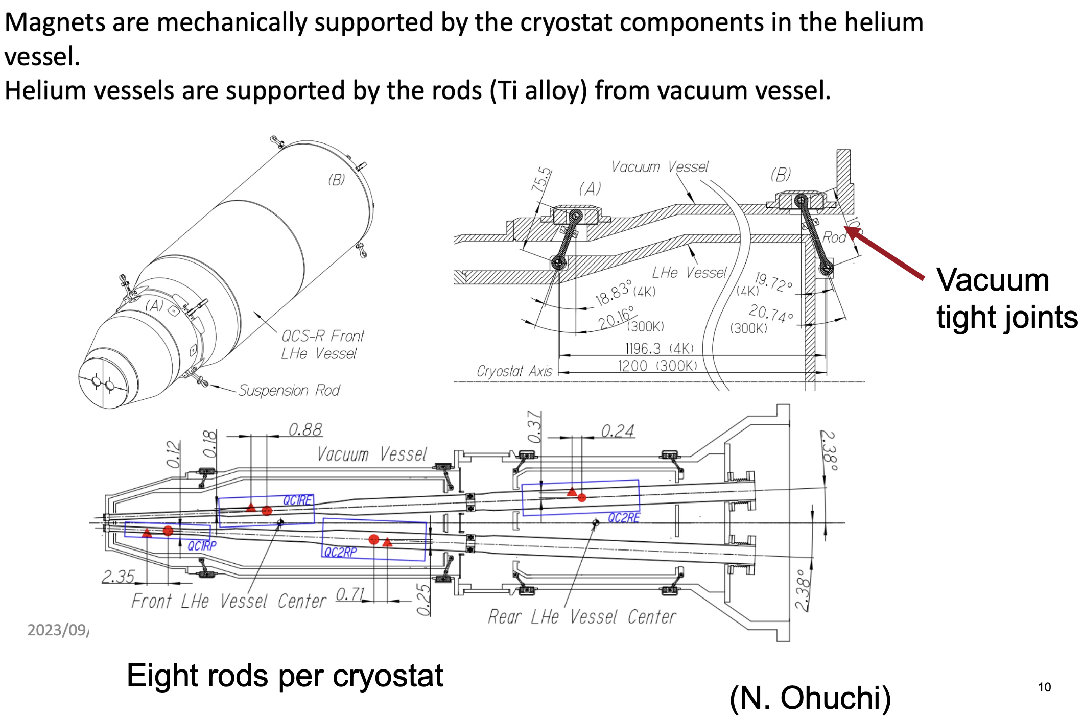
SuperKEKB IR Cryostat

Slide 21
Cryostat Tolerances
A few tolerances:
Belle-2 solenoid 1.5 T
Magnets to be located to +/- 50 microns.
Helium vessel aligned to +/- 200 microns.
Quad correction coils rotate quad fields by +/-10 mrad.
Fields good to ~10⁻⁴ at 1 cm radius.
Higher field multipoles measured and compensated with direct windings.
Provide many correction coils.

Slide 22
Thank you for your attention!
Again, thank you to many people for inputs!

Slide 23
Option 1: IR QC1 and QC2 in one cryostat and raft (not to scale)
Cryo
QC1-1
QC1-2
QC1-3
QC2-1
QC2-2
← IP 2.2 m
Support
6.24 m
2 m

Slide 24
Option 2: IR QC1 and QC2 in different cryostats and rafts (not to scale)
QC1-1
QC1-2
QC1-3
QC2-1
QC2-2
3.36 m
1.5 m
2.58 m
1.5 m

