Slide 1
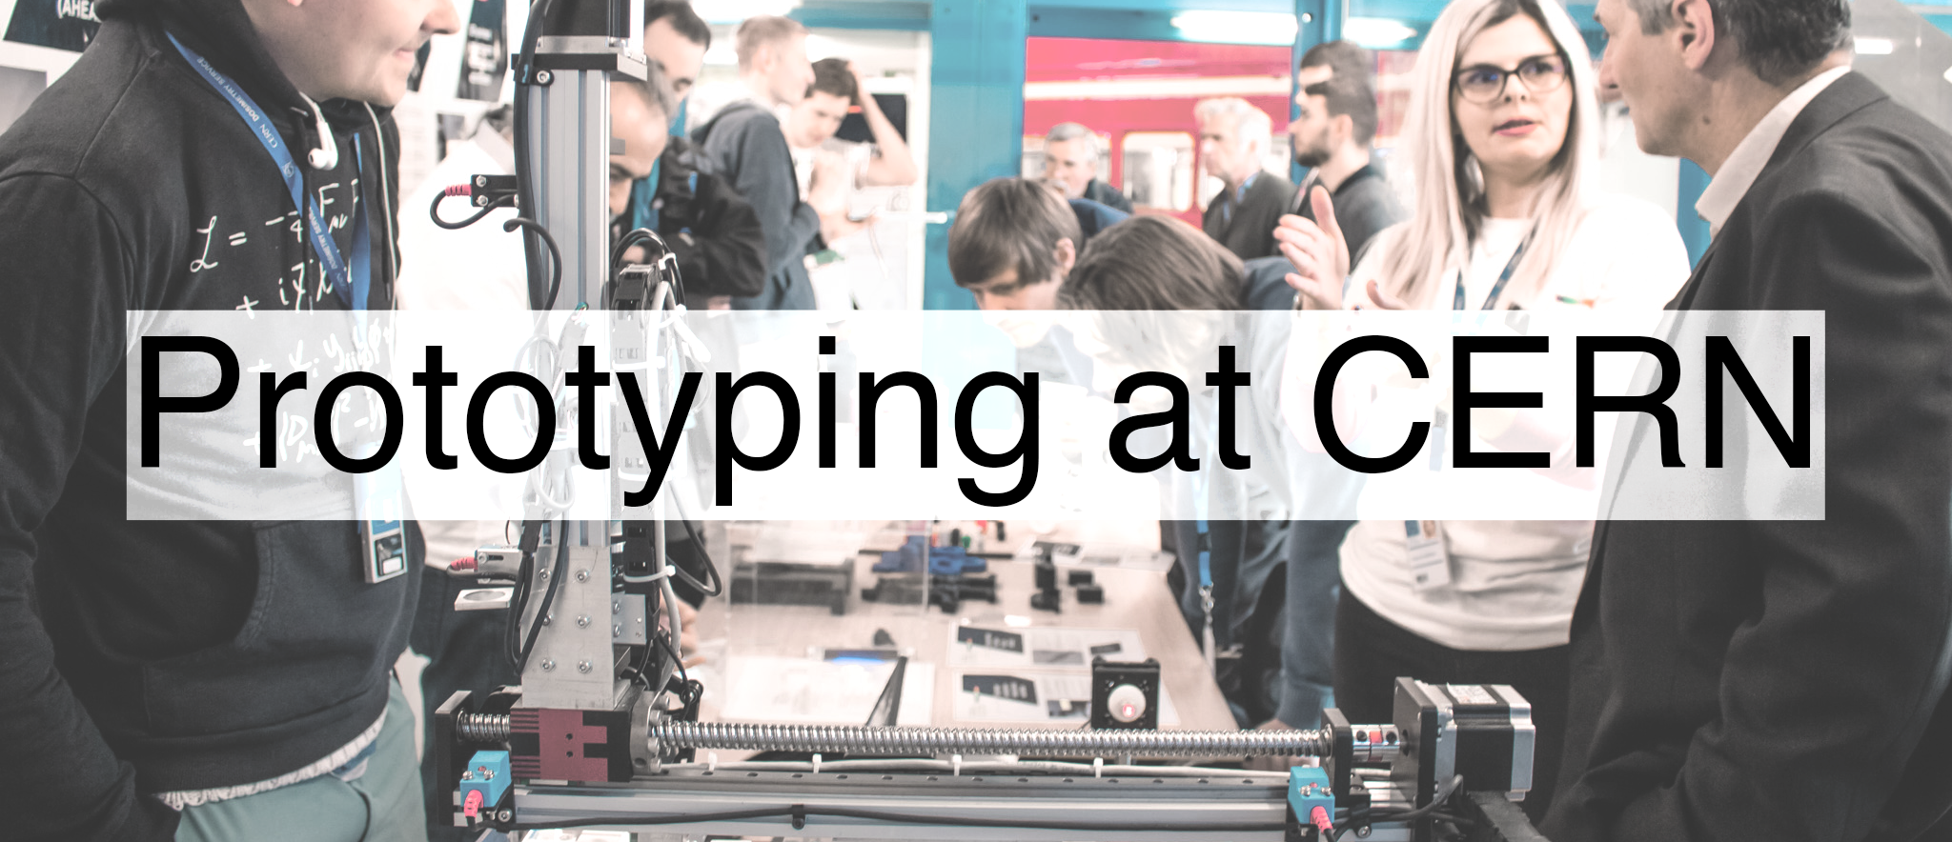

Slide 2
ideasquare.cern/prototyping

Slide 3
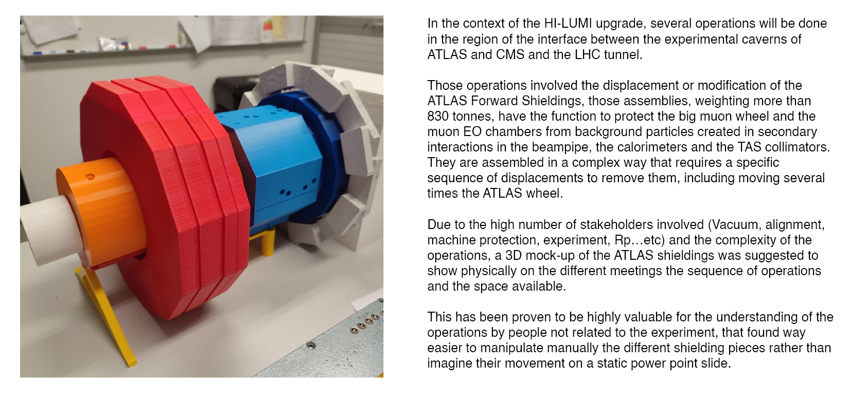


ATLAS Forward Shielding Mock Up for HL-WP8
CERN IdeaSquare

Slide 4
The South African Consortium of Air Quality Monitoring (SACAQM) AI_r system - solving the affordability problem with AI-powered IoT
CERN IdeaSquare

Slide 5
LHC Vlead Tester Box
CERN IdeaSquare

Slide 6
3D printed base for Cryogenics CHARM radiation campaign
CERN IdeaSquare

Slide 7
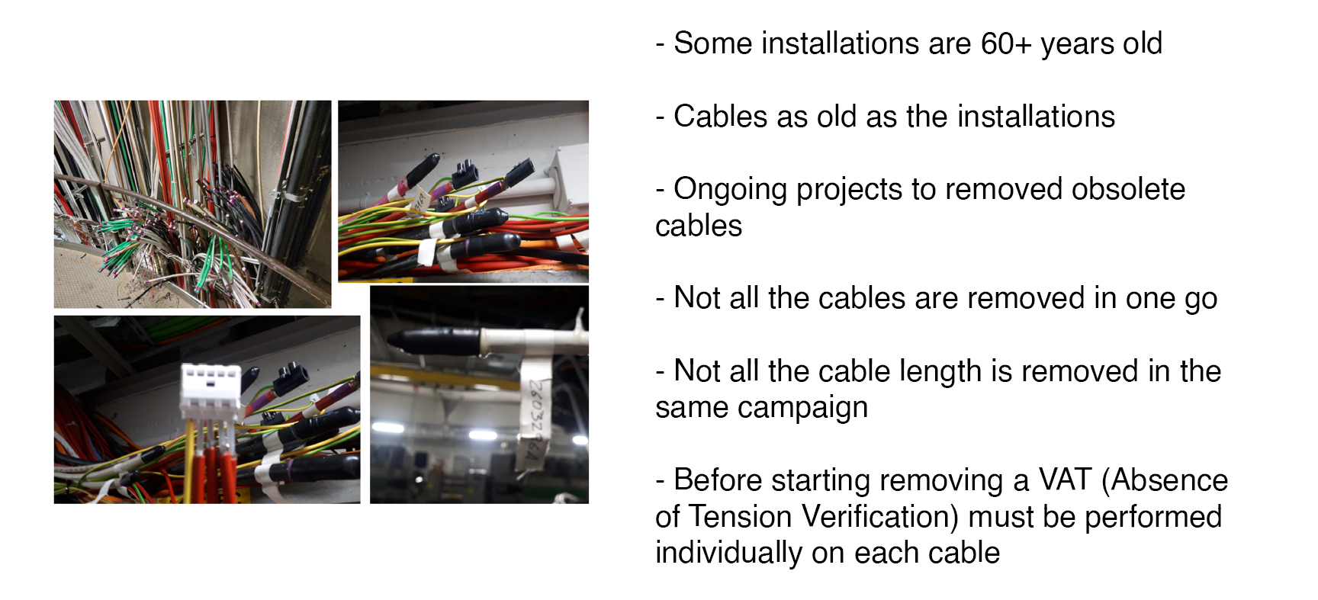
Cable protection project
CERN IdeaSquare

Slide 8
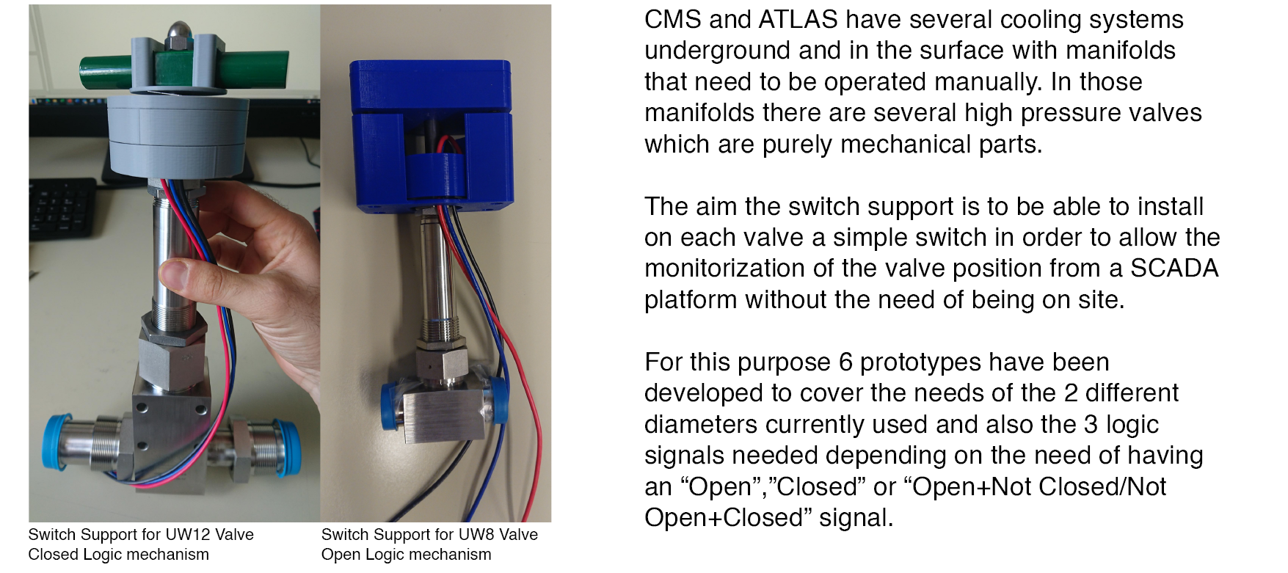
Switch Support for High Pressure valves
CERN IdeaSquare

Slide 9
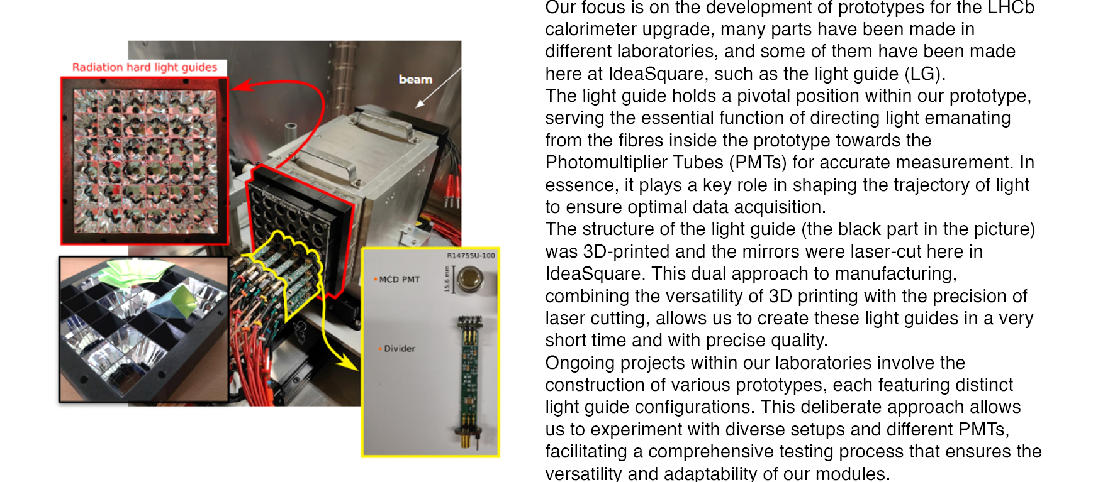
Light guide development for ECAL LHCb upgrade
CERN IdeaSquare

Slide 10
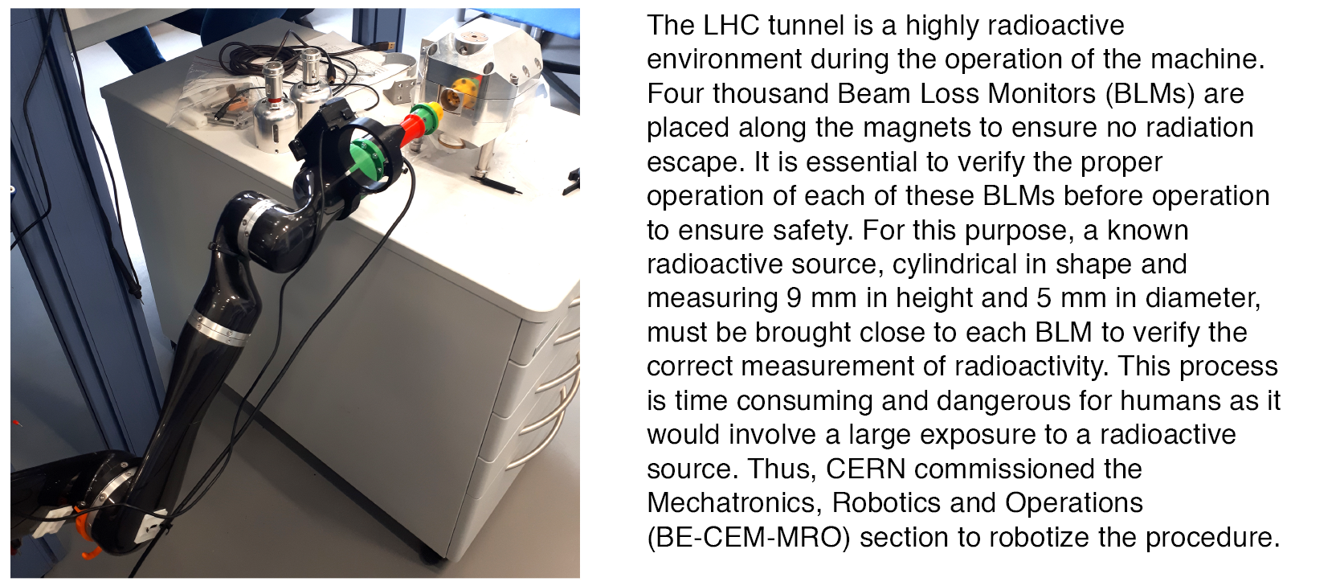
Design and validation of a safe mechatronic system for the handling of radioactive sources
CERN IdeaSquare

Slide 12
