Slide 1
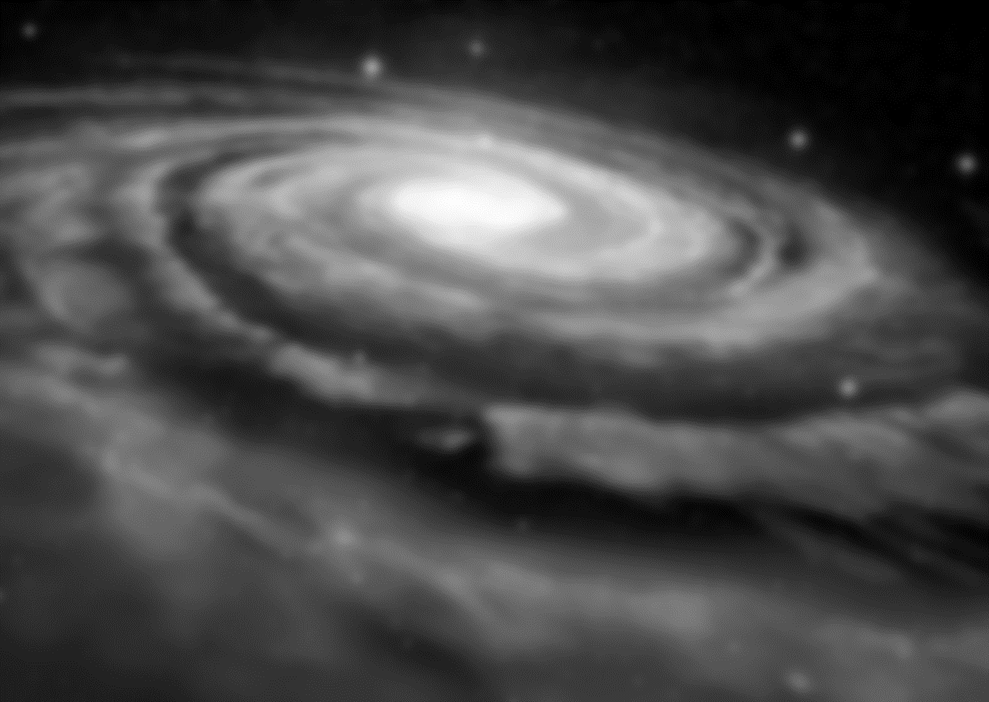

Universidad Complutense de Madrid
Facultad de Ciencias Matemáticas
Wednesday, July 24, 2024
Beyond dark matter: Constraining hyperconical-relativistic MOND-like model to galaxy cluster RAR observations
Dr. Robert Monjo i Agut
Department of Algebra, Geometry and Topology
Complutense University of Madrid
with the collaboration of
Dr. Indranil Banik
Scottish Universities Physics Alliance, University of Saint Andrews,
North Haugh, Saint Andrews, Fife, KY16 9SS, UK
Notes:
Hello good afternoon. In this talk, we will talk on the main aspects of the hyperconical modified gravity and its observational constraint with galaxy rotation curves and galaxy cluster radial acceleration.
1

Slide 2
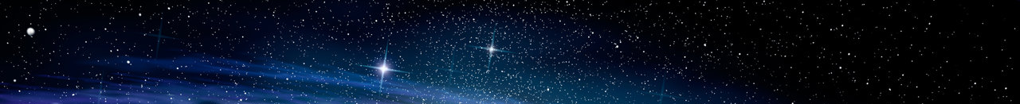

Robert Monjo: Beyond dark matter: Constraining hyperconical-relativistic MOND-like model
Contents
15.
Motivation
  Dynamical embedding
  Previous results at a cosmic scale
Approach:
  Hyperconical modified gravity
  Observational data
Results: Fictitious acceleration of...
  Galaxies
  Clusters
Final remarks
Notes:
The talk is structured with a brief reminder of key background points, a description of the approach considered and the observed data used, to finally introduce the results on spacetime, galaxies and clusters, ending with final remarks.
As you know…
2

Slide 3
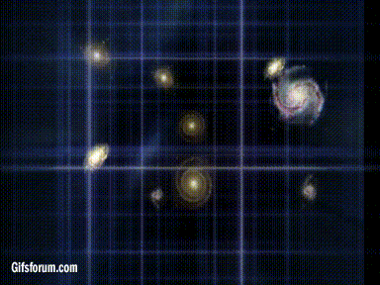
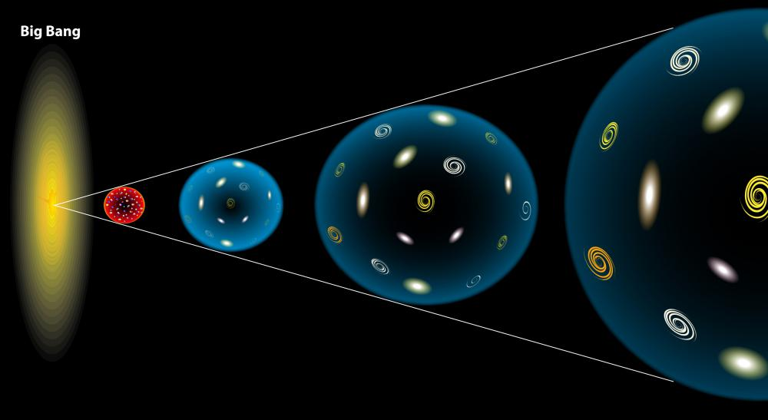
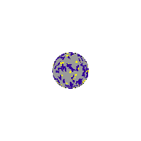
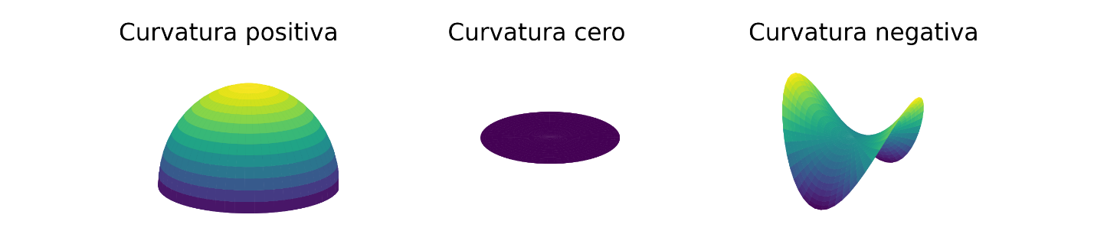

Robert Monjo: Beyond dark matter: Constraining hyperconical-relativistic MOND-like model
Motivation: Embedding and projection
3
of Lorentzian manifolds
15.
Intrinsic perspective
Extrinsic perspective
u
z
xy
(Pseudo-) Riemannian manifolds
Embedding in flat spacetimes
Friedman-Lemaitre-Robertson-Walker metric
GR
a(t)
K > 0
K = 0
K < 0
Local GR
Notes:
As you know, there are two geometrical perspectives: the intrinsic (typically studied in Riemannian and pseudo-Riemannian geometry) and the extrinsic of classical geometry. Both perspectives describe the same geomertrical objects: the manifols.
We analyse the dynamical embedding of the Lorentizan manifolds, that is taking into account the spacetime as a dynamical system

Slide 4
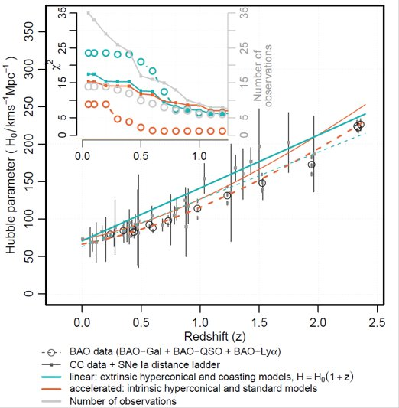



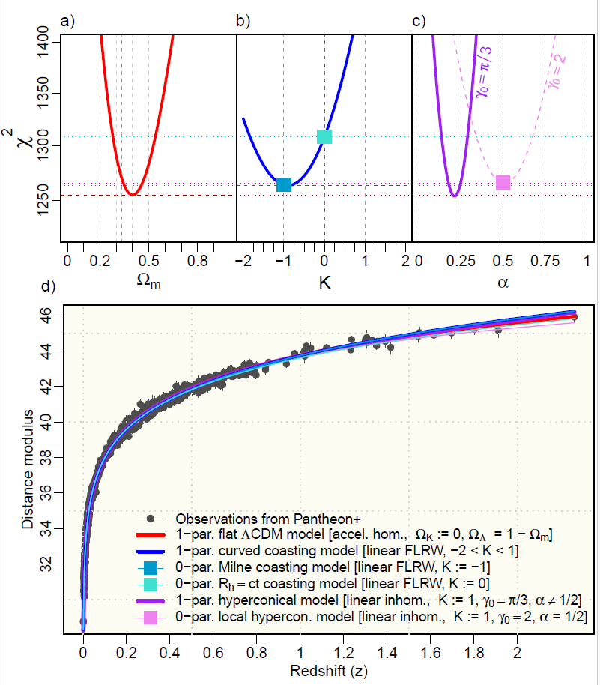
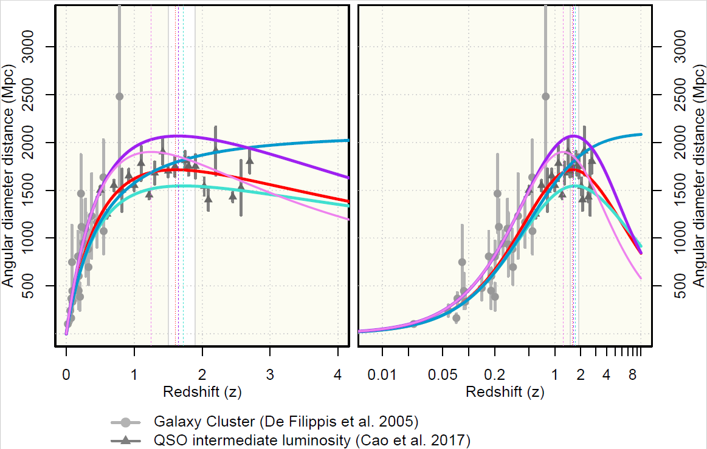

Robert Monjo: Beyond dark matter: Constraining hyperconical-relativistic MOND-like model
Previous results
Expansion rate (H)
4
at a cosmic scale
Monjo, R. (2024): ApJ 967, 66, 10.3847/1538-4357/ad3df7
15.
Lumninosity distance
Angular diameter distance
Model discrepancy (χ²) for dist. modulus with Pantheon+ (1,550 SNe Ia data)
Notes:
1,550 distinct Type Ia supernovae (SNe Ia) pairs of redshift and luminosity distance (modulus)
Source: Pantheon+ data of 1,701 light curves corresponding to 1,550 distinct SNe Ia (Scolnic et al.2022; Brout et al. 2022).
51 measurements of expansion rate
Cosmic chronometers (CC: 34)
Type-Ia SNe distance ladder (Ladder: 3)
Radial BAO size from several approaches:
Galaxy distribution (BAO-Gal:7),
redshift space distortions from eBOSS quasars (BAO-QSO: 4)
Lymann-α forest (BAO-Lya: 3).
4

Slide 5
Robert Monjo: Beyond dark matter: Constraining hyperconical-relativistic MOND-like model
Contents
15.
Motivation
  Dynamical embedding
  Previous results at a cosmic scale
Approach:
  Hyperconical modified gravity
  Observational data
Results: Fictitious acceleration of...
  Galaxies
  Clusters
Final remarks
Notes:
5

Slide 6
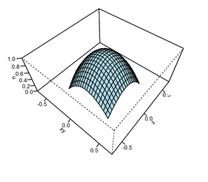
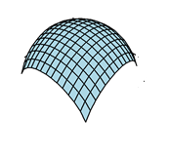

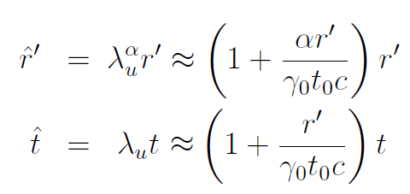
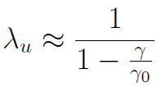
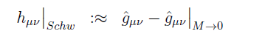
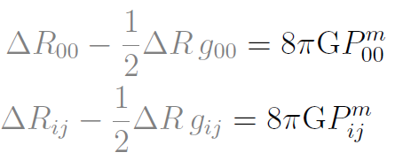
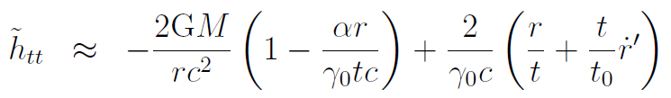
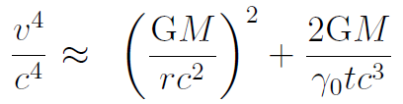

Robert Monjo: Beyond dark matter: Constraining hyperconical-relativistic MOND-like model
HMG model
Monjo, R & C-S, R. (2023) CQG 40, 195006. 10.1088/1361-6382/aceacc ​
Monjo, R (2023) CQG 40, 235002. 10.1088/1361-6382/aceacc ​ ​
Monjo, R. (2024): ApJ 967, 66, 10.3847/1538-4357/ad3df7
15.
Hyperconical metric
Cosmic projection
Hyperconical modified gravity (HMG)
Local GR + cosmic projection
but now with:
Milgromian acceleration
Baryonic Tully-Fisher relation (BTFR) and the mass-discrepancy acceleration relation (MDAR)
1-parameter HMG model: γ₀ = constant
2-parameter HMG model: γ₀ = f(geometry of the system, that is: γ_{center} and ε_{Η})
Notes:
γ_{U} ≈ $π$/3 ↦ γ₀ ≈ 2$π$/3 ≈ 2
1-parameter (γ₀)
2-parameter (γ_{max}, ε_{Η})
6

Slide 7
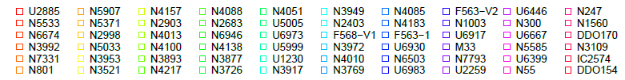
Robert Monjo: Beyond dark matter: Constraining hyperconical-relativistic MOND-like model
Observational data
15.
10 galaxy clusters: Radial Acceleration Relation
Range: 0.033 < z < 0.090
Rotation curves (distances; observed and Keplerian speeds)
Source: HIghest X-ray FLUx Galaxy Cluster Sample (HIFLUGCS; Li et al. 2023)
60 high-quality rotation curves
Range: 0.00022 < z < 0.028
Radial acceleration relationship (RAR)
Source: Spitzer Photometry and Accurate Rotation Curves (SPARC; McGaugh et al. 2007, 2016)
Features: Galaxies filtered to well-measured intermediate radii (Lelli et al. 2019).
Notes:
We started with the most simple manifolds, with positive spatial curvature (hypercone) and the equivalent for negative and null spatial curvature:
Moving reference frames produce
7

Slide 8
Robert Monjo: Beyond dark matter: Constraining hyperconical-relativistic MOND-like model
Contents
15.
Motivation
  Dynamical embedding
  Previous results at a cosmic scale
Approach:
  Hyperconical modified gravity
  Observational data
Results: Fictitious acceleration of...
  Galaxies
  Clusters
Final remarks
Notes:
8

Slide 9
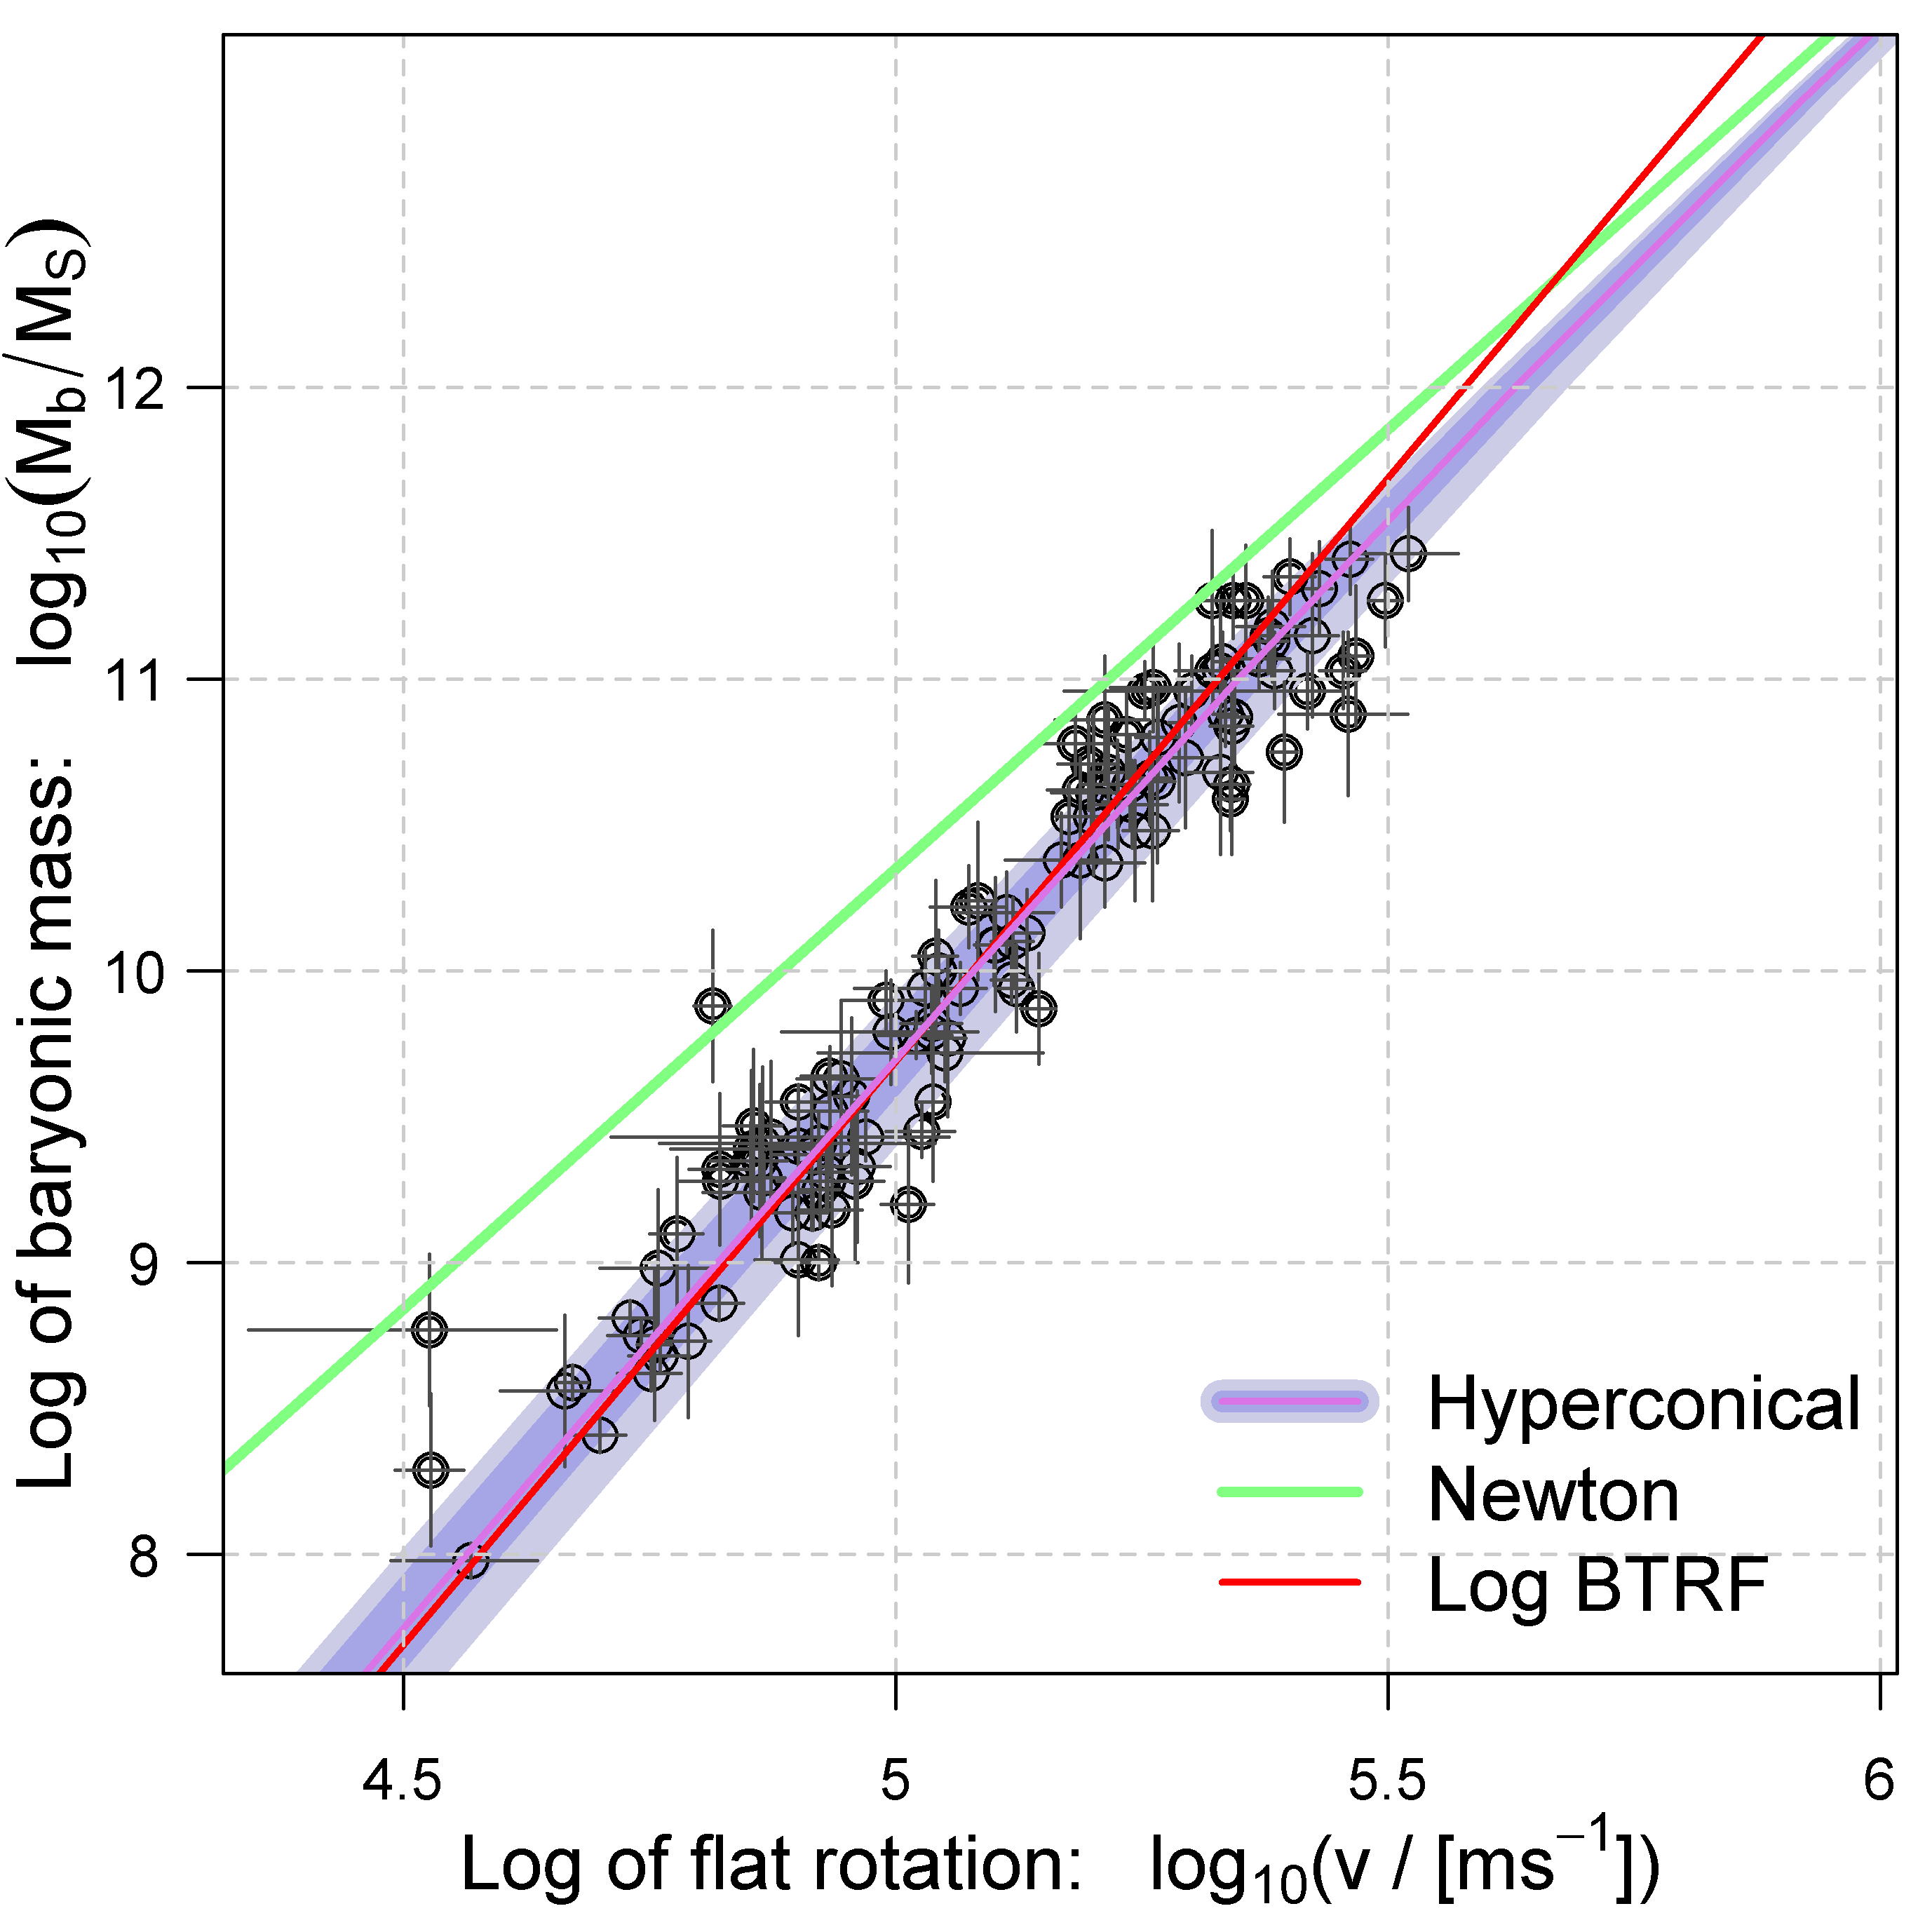
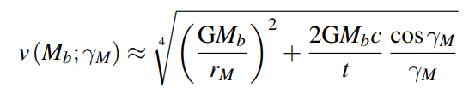
Robert Monjo: Beyond dark matter: Constraining hyperconical-relativistic MOND-like model
Results for galaxies
9
Monjo, R. (2023): CQG 40, 235002, 10.1088/1361-6382/ad0422 ​
15.
Fictitious cosmic acceleration for maximum galaxy rotation velocity
MDAR modeling. Fitting of the hyperconical model to the baryonic Tully–Fisher (BTRF) relation with v(M_{b}) for 123 galaxies
DOI:10.1088/1361-6382/ad0422
Mass-discrepancy acceleration relation (MDAR)
GM_{b}a₀
Milgromian acceleration
a₀ = (2c/t)·cosɣ_{M} /ɣ_{M}
Notes:
Kinetic Sunyaev-Zel'dovich effect : distortion of the microwave background radiation (CMB) due to the inverse Compton effect (interaction between photons and electrons). It is used to analyze perturbations in the density of the universe
LTB : Lema^tre-Tolman-Bondi
10 Killing vectors: 3 angular rotations (global symmetries) + 1 temporal translation (global conformal static) + 3 spatial translations (local comoving ) + 3 three Lorentz boosts (local ordinary).
9

Slide 10
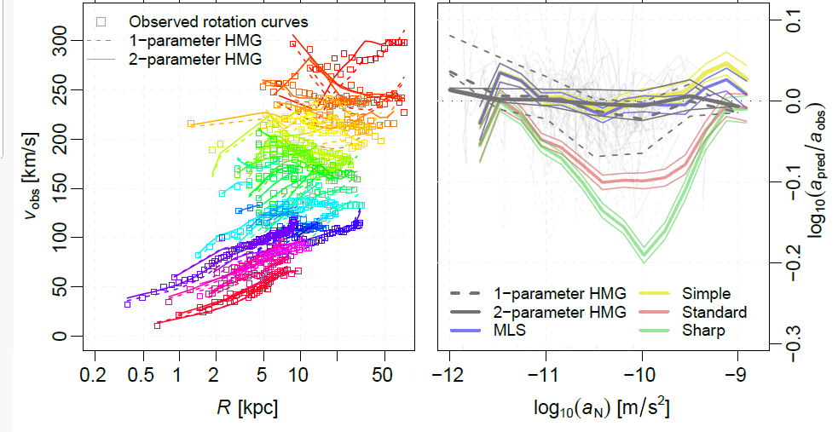
Robert Monjo: Beyond dark matter: Constraining hyperconical-relativistic MOND-like model
Results for galaxies
Monjo, R. (2023): CQG 40, 235002, 10.1088/1361-6382/ad0422 ​
Monjo, R. & Banik, I. (2024): MNRAS. (under review)
15.
Fictitious cosmic acceleration for galaxy rotation curves
Left: Fitting of 60 galaxy rotation curves according to the HMG model with 1 parameter (dashed lines) or 2 parameters (continuous lines).
Right: Performance of the 1- and 2-parameter HMG model for the ratio of
predicted (apred) and observed (aobs) centripetal acceleration for the 60 galaxies (light gray lines) and comparison with MOND interpolation functions (MLS, simple, standard, and sharp functions, fitted to 153 suitable galaxies): as in Fig.23 of Banik et al. (2023)
Banik et al. 2023. MNRAS, 527, 4573 10.1093/mnras/stad3393
Notes:
10

Slide 11
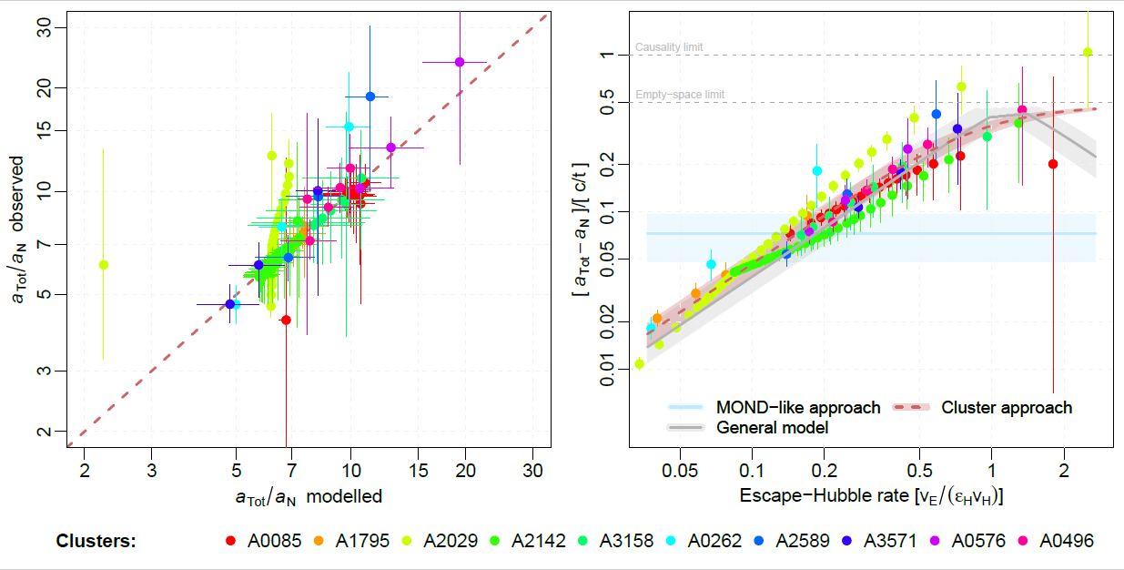
Robert Monjo: Beyond dark matter: Constraining hyperconical-relativistic MOND-like model
Results for clusters
Monjo, R. & Banik, I. (2024): MNRAS. (under review)
15.
Fictitious cosmic acceleration for galaxy clusters
RAR modelling with HMG for total vs. Newtonian acceleration.
Left: Individual
fitting with 2 parameters.
Right: Global fitting according to three models:
MOND-like constant
Fixed 1-par general model
Fixed 2-par Cluster model
Notes:
Kinetic Sunyaev-Zel'dovich effect : distortion of the microwave background radiation (CMB) due to the inverse Compton effect (interaction between photons and electrons). It is used to analyze perturbations in the density of the universe
LTB : Lema^tre-Tolman-Bondi
10 Killing vectors: 3 angular rotations (global symmetries) + 1 temporal translation (global conformal static) + 3 spatial translations (local comoving ) + 3 three Lorentz boosts (local ordinary).
11

Slide 12
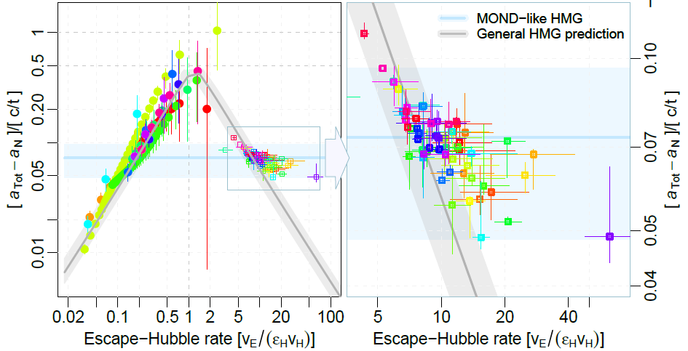
Robert Monjo: Beyond dark matter: Constraining hyperconical-relativistic MOND-like model
Discussion
Monjo, R. & Banik, I. (2024): MNRAS. (under review)
15.
Fictitious cosmic acceleration for galaxy dynamics
Left: Global fitting of the 10 galaxy clusters.
Right: Zoom in on the theoretical prediction made for galaxies.
ε_{H} = 56
Notes:
12

Slide 13
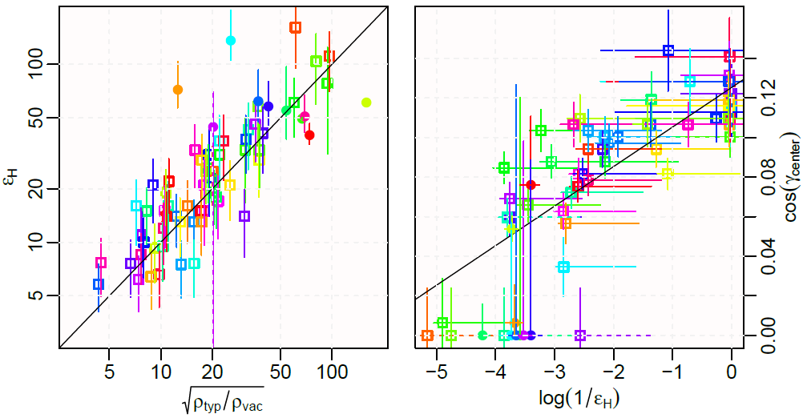
Robert Monjo: Beyond dark matter: Constraining hyperconical-relativistic MOND-like model
Discussion
Monjo, R. & Banik, I. (2024): MNRAS. (under review)
15.
Fictitious cosmic acceleration for galaxy dynamics
Model parameters fitted to the 60 high-quality galaxy rotation curves (squares), empirical relationships (black
lines), and comparison with the fitting to the RAR data of 10 clusters (circles).
Notes:
xx
13

Slide 14
Robert Monjo: Beyond dark matter: Constraining hyperconical-relativistic MOND-like model
Contents
15.
Motivation
  Dynamical embedding
  Previous results at a cosmic scale
Approach:
  Hyperconical modified gravity
  Observational data
Results: Fictitious acceleration of...
  Galaxies
  Clusters
Final remarks
Notes:
14

Slide 15
Robert Monjo: Beyond dark matter: Constraining hyperconical-relativistic MOND-like model
Final remarks
15.
Extrinsic perspective
Intrinsic perspective
(1)
Hypercone
(hypersphere with (c=1)-linear expansion
Moving frame
(observer)
Space-time deformation: inhomogeneity
(metrics)
(2)
Projected radially-inhomog. metric
Apparently accelerated flat metric
(3)
ADM + conserved Noether currents lead to the Hubble flux and a “local general relativity”.
(4)
Prediction of specific values of fictitious acceleration assimilable to cosmic dark matter-energy.
(5)
Fictitious acceleration in galaxies and galaxy clusters: Hyperconical modified gravity (HMG)
(6)
The dark matter of the "galactic halos" can also be explained with our HMG model.
(7)
Future works:
Modeling CMB and BBN
Growth and dynamics of larger cosmic structures
Notes:
Arnowitt-Deser-Misner
10 Killing vectors: 3 angular rotations (global symmetries) + 1 temporal translation (global conformal static) + 3 spatial translations (local comoving ) + 3 three Lorentz boosts (local ordinary).
15

Slide 16
Thanks to Prof. Stacy McGaugh & Prof. Pengfei Li for the data
and
Thank you very much for your attention
References:​
Monjo, R. & Banik, I. (2024): MNRAS. (under review)
Monjo, R. (2024): ApJ 967, 66, 10.3847/1538-4357/ad3df7
Monjo, R. (2023): CQG 40, 235002, 10.1088/1361-6382/ad0422 ​
Monjo, R. & Campoamor-Stursberg R. (2023) CQG 40, 195006. 10.1088/1361-6382/aceacc ​
Monjo, R. & Campoamor-Stursberg R. (2020). CQG 37, 205015. 10.1088/1361-6382/abadaf ​
Monjo, R. (2018). PRD 98, 043508 10.1103/PhysRevD.98.043508 ​
Monjo, R. (2017). PRD 96, 103505. 10.1103/PhysRevD.96.103505
Notes:
16

