Slide 1





Thermodynamics of the universes admitting isotropic radiation
Salvador Mengual Sendra
with J. J. Ferrando and J. A. Sáez
Departament d’Astronomia i Astrofísica
Universitat de València
Spanish and Portuguese Relativity Meeting EREP 2024
4
Coimbra, 22nd of July 2024

Slide 2
1.- Motivation
Perturbation theory of Friedman-Lemaître-Robertson-Walker models seems to provide a good explanation of the observed degree of inhomogeneity in the Universe. BUT sometimes, an analysis outside the perturbative regime is required.
  Non-linear effects of the Einstein field equations could be critical in the structure formation.
  Many studies have been devoted to providing exact inhomogeneous models.
The conformally flat solutions of the Barnes-Stephani metrics are the Stephani universes, which were obtained as the flat class of irrotational and shear-free perfect fluid space-times with nonzero expansion.
  They can also be characterized as the space-times verifying a weak cosmological principle without any hypothesis on the energy tensor.
Do these inhomogeneous universes model realistic physical fluids?
Salvador Mengual Sendra
Coimbra, 22nd of July 2024
1

Slide 3
2.- Macroscopic conditions for physical reality
Mathematical solutions to Einstein equations
Physically admissible solution
Physical reality conditions.
Perfect fluid
Local thermal equilibrium
Energy conditions
Positivity conditions
Compressibility conditions
Salvador Mengual Sendra
Coimbra, 22nd of July 2024
2

Slide 4


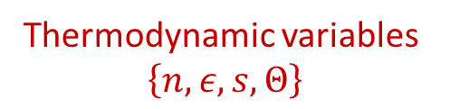
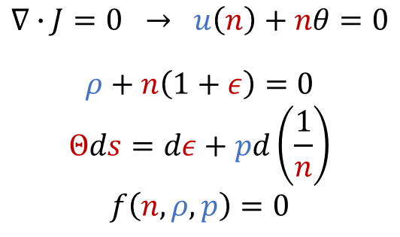


2.- Macroscopic conditions for physical reality
Perfect fluid Einstein equations: $G_{μν}≡R_{μν}−\frac{1}{2}g_{μν}R=\frac{8πG}{c^{4}}T_{μν}$ with $T≡\left\{u,ρ,p\right\}$, $∇∙T=0$
H$ydrodynamic variables$
Local thermal equilibrium
$$T$$
Thermodynamic variables
$\left\{n, ε, s, Θ\right\}$
$$T_{F}$$
$$∇∙J=0 → u\left(n\right)+nθ=0$$
$$ρ+n\left(1+ε\right)=0$$
$$Θds=dε+pd\left(\frac{1}{n}\right)$$
$$f\left(n, ρ, p\right)=0$$
evolution
[1] B. Coll, J. J. Ferrando, and J. A. Sáez, Gen. Relativ. Gravit. 49, 66 (2017).
Perfect fluid in l.t.e.
S: $dχ∧dρ∧dp=0, χ≡\frac{u\left(p\right)}{u\left(ρ\right)}=c_{s}^{2}$
Salvador Mengual Sendra
Coimbra, 22nd of July 2024
3

Slide 5





2.- Macroscopic conditions for physical reality
Perfect fluid Einstein equations: $G_{μν}≡R_{μν}−\frac{1}{2}g_{μν}R=\frac{8πG}{c^{4}}T_{μν}$ with $T≡\left\{u,ρ,p\right\}$, $∇∙T=0$
H$ydrodynamic variables$
Local thermal equilibrium
$$T$$
Thermodynamic variables
$\left\{n, ε, s, Θ\right\}$
$$F$$
$$T_{F}$$
$$∇∙J=0 → u\left(n\right)+nθ=0$$
$$ρ+n\left(1+ε\right)=0$$
$$Θds=dε+pd\left(\frac{1}{n}\right)$$
$$f\left(n, ρ, p\right)=0$$
$$F_{T}$$
fluid
evolution
$$\left\{n, ε, s, Θ\right\}$$
Perfect e-m tensor evolving in l.t.e.
Salvador Mengual Sendra
Coimbra, 22nd of July 2024
3

Slide 6
2.- Macroscopic conditions for physical reality
Mathematical solutions to Einstein equations
Physically admissible solution
Physical reality conditions.
Perfect fluid
Local thermal equilibrium
Energy conditions
Positivity conditions
Compressibility conditions
Salvador Mengual Sendra
Coimbra, 22nd of July 2024
4

Slide 7
2.- Macroscopic conditions for physical reality
Mathematical solutions to Einstein equations
Physically admissible solution
Physical reality conditions.
Perfect fluid
Energy conditions
Positivity conditions
Compressibility conditions
Salvador Mengual Sendra
Coimbra, 22nd of July 2024
4

Slide 8








2.- Macroscopic conditions for physical reality
Energy conditions
Positivity conditions
Compressibility conditions
[2] B. Coll, J. J. Ferrando and A. Sáez, Phys. Rev. D 101, 064058 (2020).
$$Θ>0,$$
E:
$$−ρ<p≤ρ$$
P:
$$0<χ<1,$$
$$ρ>n>0$$
$H_{1}$:
$$\left(ρ+p\right)\left(χ{χ^{′}}_{p}+{χ^{′}}_{ρ}\right)+2χ(1−χ)>0$$
$H_{2}$:
$$2nΘ>\frac{1}{{s′}_{ρ}}$$
Salvador Mengual Sendra
Coimbra, 22nd of July 2024
5

Slide 9













3.- Thermodynamic Stephani universes
[3] C. Bona and B. Coll, Gen. Relativ. Gravit. 20, 279 (1988).
Metric:
Hydrodynamic variables:
Speed of sound in the fluid:
Thermodynamic schemes:
$$Ω≡\frac{w}{2z}L ,$$
$$L≡\frac{R(t)}{1+b\left(t\right)w} ,$$
$$w≡\frac{2z}{1+\frac{ε}{4}r^{2}} ,$$
$$ds^{2}=−α^{2}dt^{2}+Ω^{2}(dx^{2}+dy^{2}+dz^{2});$$
$$α≡R∂_{R}lnL ,$$
$$r^{2}≡x^{2}+y^{2}+z^{2},$$
$$ε=0,±1$$
$$ρ=\frac{3}{R^{2}}\left({\dot{R}}^{2}+ε−4b^{2}\right),$$
$$p=−ρ−\frac{R}{3}\frac{ρ′(R)}{α}$$
$$c_{s}^{2}=χ\left(ρ,p\right)=π+\frac{1}{3}+\frac{1}{3}\left(π+1\right)\left[\left(π+1\right)A_{1}\left(ρ\right)+A_{2}\left(ρ\right)\right] , π≡p/ρ$$
$$n\left(ρ,p\right)=\frac{{(1+b w)}^{3}}{N(w)R^{3}},$$
$$Θ\left(ρ,p\right)=\frac{\left(ρ+p\right)R^{3}[N^{′}\left(w\right)\left(1+b w\right)−3N\left(w\right)b]}{s′(w){(1+b w)}^{4} },$$
$s\left(ρ,p\right)=s\left(w\right)$,
$$w=w\left(ρ,p\right)≡\frac{π+1−a\left(R\right)}{\left(π+1\right)\left[Rb^{′}\left(R\right)−b\left(R\right)\right]+a\left(R\right)b\left(R\right)},$$
$$a=a\left(R\right)≡−\frac{Rρ′(R)}{3ρ}$$
Salvador Mengual Sendra
Coimbra, 22nd of July 2024
6

Slide 10




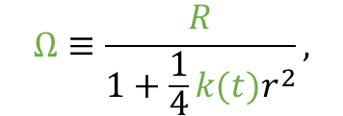











4.- Imposing physical qualities
Ideal gas equation of state:
Good behavior at high temperatures:
Compatible with isotropic radiation:
Spherical symmetry:
$$p=\tilde{k}nΘ$$
$$χ(ρ,p)=χ\left(π\right)≠π$$
$$A_{1}\left(ρ\right)=c_{1} ,$$
$$A_{2}\left(ρ\right)=c_{2}$$
[1] B. Coll, J. J. Ferrando, and J. A. Sáez, Gen. Relativ. Gravit. 49, 66 (2017).
Synge gas
$$χ(ρ,p)=χ_{Synge}\left(π\right)$$
$$χ\left(1/3\right)=1/3$$
$$9+16A_{1}\left(ρ\right)+12A_{2}\left(ρ\right)=0$$
[4] S. Mengual, J. A. Sáez and J. J. Ferrando, Phys. Rev. D. 106, 124032 (2022).
$$σ=0,$$
$$d\left[a−\frac{1}{3}θu\right]=0$$
$$b\left(R\right)=b_{1}R+b_{2} ,$$
$$A_{1}\left(ρ\right)=0$$
[5] C. A. Clarkson and R. K. Barrett, Class. Quantum Grav. 16, 3781 (1999).
$$ρ=\frac{3}{R^{2}}\left({\dot{R}}^{2}+k\right)$$
$$ds^{2}=−α^{2}dt^{2}+Ω^{2}[dr^{2}+r^{2}(dθ^{2}+\sin^{2}θ dφ^{2})];$$
$$Ω≡\frac{R}{1+\frac{1}{4}k(t)r^{2}},$$
[6] S. Mengual, J. A. Sáez and J. J. Ferrando, Phys. Rev. D. XX, XXXXX (2024).
$$α≡R∂_{R}lnΩ$$
$$b→k/4$$
$$w→r^{2}$$
Salvador Mengual Sendra
Coimbra, 22nd of July 2024
7

Slide 11









4.- Imposing physical qualities
$$A_{1}\left(ρ\right)=c_{1} ,$$
$$A_{2}\left(ρ\right)=c_{2}$$
$$9+16A_{1}\left(ρ\right)+12A_{2}\left(ρ\right)=0$$
$$b\left(R\right)=b_{1}R+b_{2} ,$$
$$A_{1}\left(ρ\right)=0$$
$$ρ=\frac{3}{R^{2}}\left({\dot{R}}^{2}+k\right)$$
$$b→k/4$$
$$w→r^{2}$$
Salvador Mengual Sendra
Coimbra, 22nd of July 2024
7

Slide 12







5.- Spherically symmetric ultrarelativistic gas with isotropic radiation
Metric:
Hydrodynamic variables:
Speed of sound in the fluid:
Thermodynamic schemes:
$$ds^{2}=−α^{2}dt^{2}+Ω^{2}[dr^{2}+r^{2}(dθ^{2}+\sin^{2}θ dφ^{2})];$$
$$Θ\left(ρ,p\right)=\frac{π}{\tilde{k}\left|1−3π\right|{(π+1)}^{3} },$$
$$c_{s}^{2}=χ\left(ρ,p\right)=(9π+1)/12 , π≡p/ρ$$
$$p=−ρ−\frac{R}{3}\frac{ρ′(R)}{α}$$
$$ρ=\frac{3}{R^{2}}\left({\dot{R}}^{2}+k_{1}+k_{2}R\right),$$
$$Ω≡\frac{R}{1+ (k_{1}+k_{2}R)r^{2}/4},$$
$s\left(ρ,p\right)=s_{0}−\tilde{k}\ln{[ρ{(1−3π)}^{4}]}$ ,
$$n\left(ρ,p\right)=ρ\left|1−3π\right|{(π+1)}^{3},$$
$$α≡R∂_{R}lnΩ$$
Salvador Mengual Sendra
Coimbra, 22nd of July 2024
8

Slide 13







5.- Spherically symmetric ultrarelativistic gas with isotropic radiation
Metric:
Hydrodynamic variables:
Speed of sound in the fluid:
Thermodynamic schemes:
$$ds^{2}=−α^{2}dt^{2}+Ω^{2}[dr^{2}+r^{2}(dθ^{2}+\sin^{2}θ dφ^{2})];$$
$$Ω≡\frac{R}{1+ (k_{1}+k_{2}R)r^{2}/4},$$
$$α≡R∂_{R}lnΩ$$
$$ρ=\frac{3}{R^{2}}\left({\dot{R}}^{2}+k_{1}+k_{2}R\right),$$
$$p=−ρ−\frac{R}{3}\frac{ρ′(R)}{α}$$
$$c_{s}^{2}=χ\left(ρ,p\right)=(9π+1)/12 , π≡p/ρ$$
$$n\left(ρ,p\right)=ρ\left|1−3π\right|{(π+1)}^{3},$$
$$Θ\left(ρ,p\right)=\frac{π}{\tilde{k}\left|1−3π\right|{(π+1)}^{3} },$$
$s\left(ρ,p\right)=s_{0}−\tilde{k}\ln{[ρ{(1−3π)}^{4}]}$ ,
Salvador Mengual Sendra
Coimbra, 22nd of July 2024
8

Slide 14
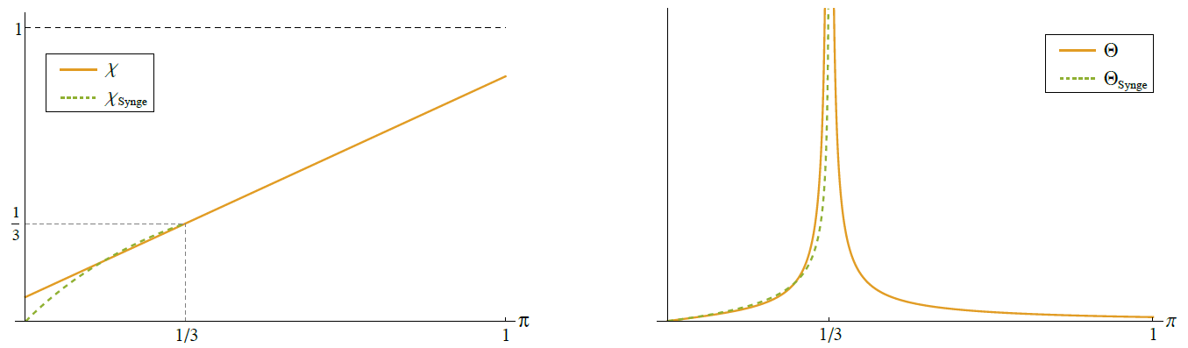








5.- Spherically symmetric ultrarelativistic gas with isotropic radiation
Physical reality conditions:
$H_{1}$:
$$0<χ<1,$$
$$Θ>0,$$
$$\left(ρ+p\right)\left(χ{χ^{′}}_{p}+{χ^{′}}_{ρ}\right)+2χ(1−χ)>0$$
E:
$$0<p≤ρ$$
P:
$$ρ>n>0$$
$H_{2}$:
$$2nΘ>\frac{1}{{s′}_{ρ}}$$
[6] S. Mengual, J. A. Sáez and J. J. Ferrando, Phys. Rev. D. XX, XXXXX (2024).
Salvador Mengual Sendra
Coimbra, 22nd of July 2024
9

Slide 15
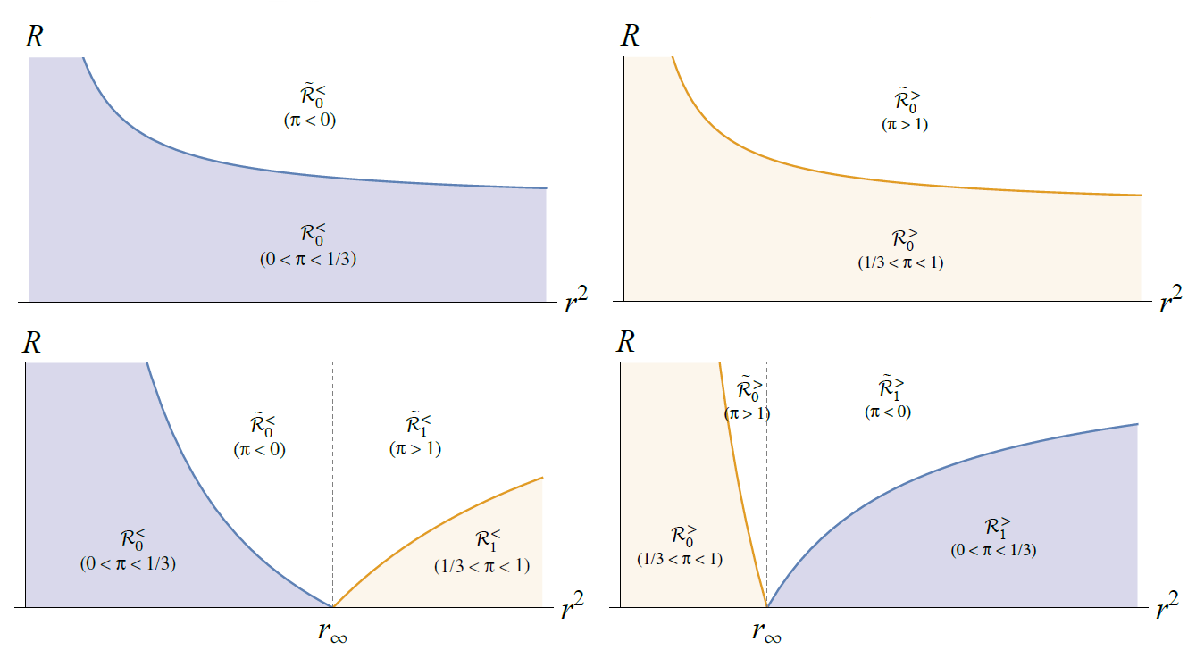




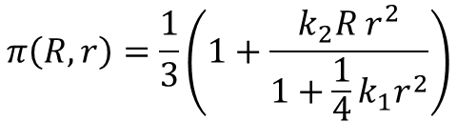
5.- Spherically symmetric ultrarelativistic gas with isotropic radiation
Physical reality conditions and spacetime domains of the singular
models $a=a\left(R\right)≡−\frac{Rρ^{′}\left(R\right)}{3ρ}=constant$:
$$π\left(R,r\right)=\frac{1}{3}\left(1+\frac{k_{2}R r^{2}}{1+\frac{1}{4}k_{1}r^{2}}\right)$$
$$k_{2}<0$$
$$k_{2}>0$$
$$k_{1}≥0$$
$$k_{1}<0$$
[6] S. Mengual, J. A. Sáez and J. J. Ferrando, Phys. Rev. D. XX, XXXXX (2024).
Salvador Mengual Sendra
Coimbra, 22nd of July 2024
10

Slide 16
6.- Conclusions and future work
We considered a family of exact inhomogeneous models, the Stephani universes.
We studied different physically significant qualities and imposed all of them.
We studied the resulting subfamily and saw that there exist spacetime domains where they fulfill all the physical reality conditions.
Some of them may model a spherically symmetric spacetime inhomogeneity caused by an ultrarelativistic gas compatible with a decoupled test inhomogeneous radiation fluid isotropic as measured by the comoving observer.
  Parameter values for observed inhomogeneities?
  Matching conditions?
  Noncomoving observer?
Salvador Mengual Sendra
Coimbra, 22nd of July 2024
11

Slide 17
THANK YOU!
QUESTIONS?
Salvador Mengual Sendra
with J. J. Ferrando and J. A. Sáez
Departament d’Astronomia i Astrofísica
Universitat de València
Spanish and Portuguese Relativity Meeting EREP 2024
4
Coimbra, 22nd of July 2024

