Slide 1

On cosmological clustering
of Gravitational Wave Events
José Fonseca
Instituto de Astrofísica e Ciências do Espaço, Universidade do Porto
jose.fonseca@astro.up.pt
Based on
JCAP08(2023)050 - arxiv:2304.14253
JCAP05(2024)095 - arXiv:2309.04391
In collaboration with Stefano Zazzera, Tessa Baker and Chris Clarkson
EREP 2024 - Coimbra - 23/07/2024

Slide 2
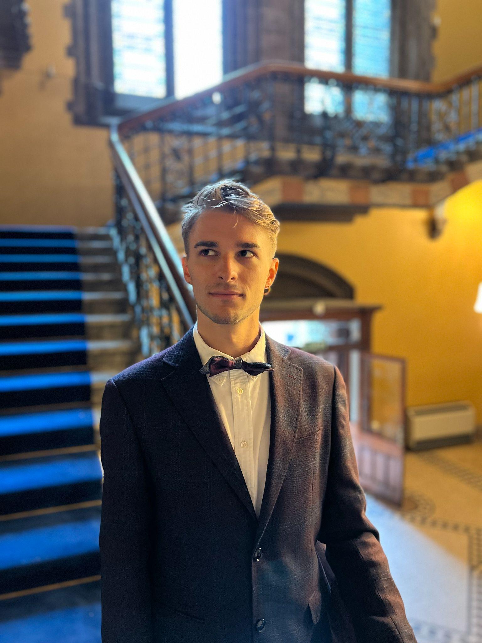
On cosmological clustering
of Gravitational Wave Events
José Fonseca
Instituto de Astrofísica e Ciências do Espaço, Universidade do Porto
jose.fonseca@astro.up.pt
Stefano Zazzera
Based on
JCAP08(2023)050 - arxiv:2304.14253
JCAP05(2024)095 - arXiv:2309.04391
In collaboration with Stefano Zazzera, Tessa Baker and Chris Clarkson
EREP 2024 - Coimbra - 23/07/2024

Slide 3
Motivation
JOSÉ FONSECA - IA U. PORTO
Can we use transient events as DM tracers?
EREP24 - Coimbra - 23/07/2024

Slide 4
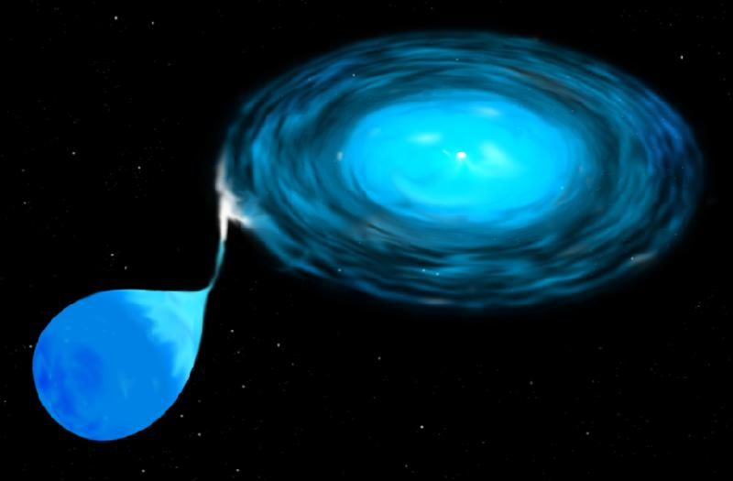

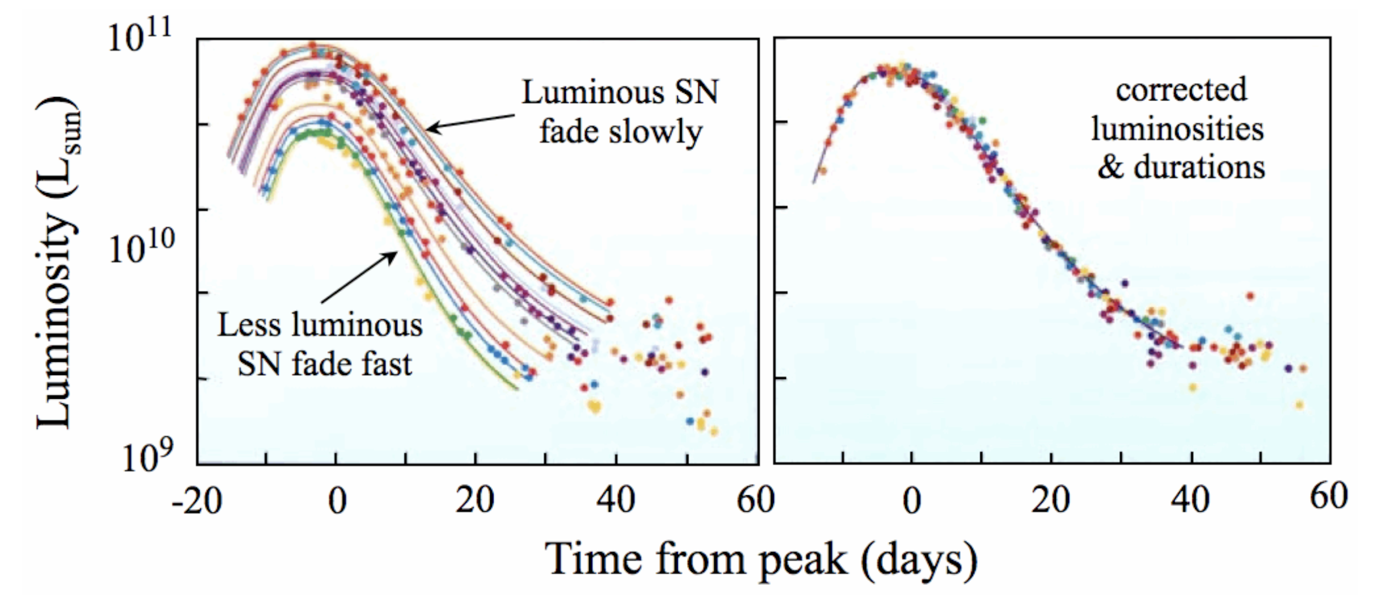
Motivation
JOSÉ FONSECA - IA U. PORTO
Can we use transient events as DM tracers?
SNeIa
LSST expects 10⁷ over 10yrs up to z=4
EREP24 - Coimbra - 23/07/2024

Slide 5
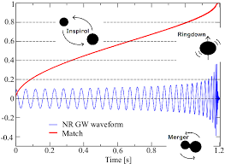

Motivation
JOSÉ FONSECA - IA U. PORTO
Can we use transient events as DM tracers?
SNeIa
GW
YES!
Several works have done for when redshift is known (see eg Scelfo et al 2018, etc);
Libanore et al (2021), angular power spectra with first corrections to the density contrast;
Namikawa et al (2021), in 3D space;
LSST expects 10⁷ over 10yrs up to z=4
EREP24 - Coimbra - 23/07/2024

Slide 6
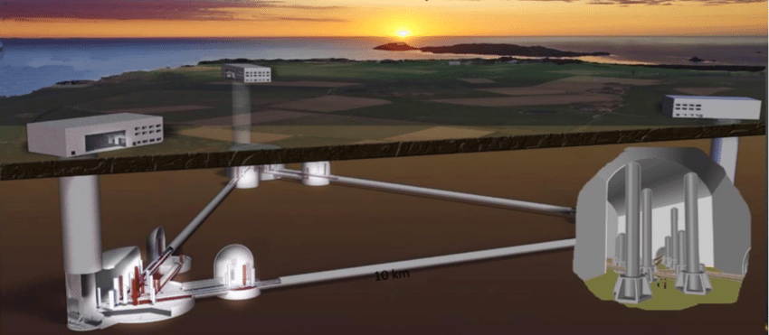

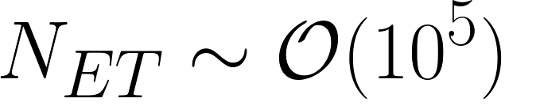

Motivation
JOSÉ FONSECA - IA U. PORTO
Can we use transient events as DM tracers?
GW
YES!
Several works have done for when redshift is known (see eg Scelfo et al 2018, etc);
Libanore et al (2021), angular power spectra with first corrections to the density contrast;
Namikawa et al (2021), in 3D space;
Next Generation surveys:
EREP24 - Coimbra - 23/07/2024

Slide 7
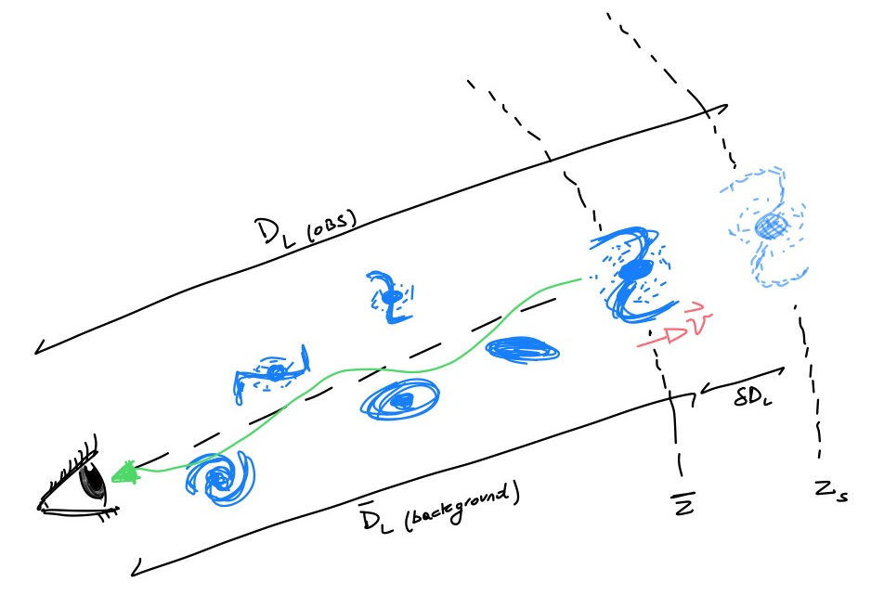
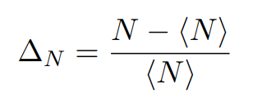
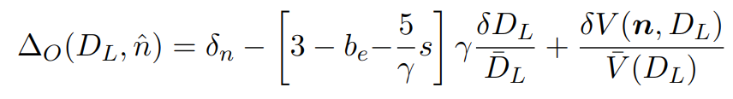

Which density contrast do we observe?
JOSÉ FONSECA - IA U. PORTO
Density contrast
Expand
For the volume perturbation we followed Bonvin&Durrer (2011)
Credit: Stefano Zazzera
JCAP08(2023)050 - arxiv:2304.14253
EREP24 - Coimbra - 23/07/2024

Slide 8
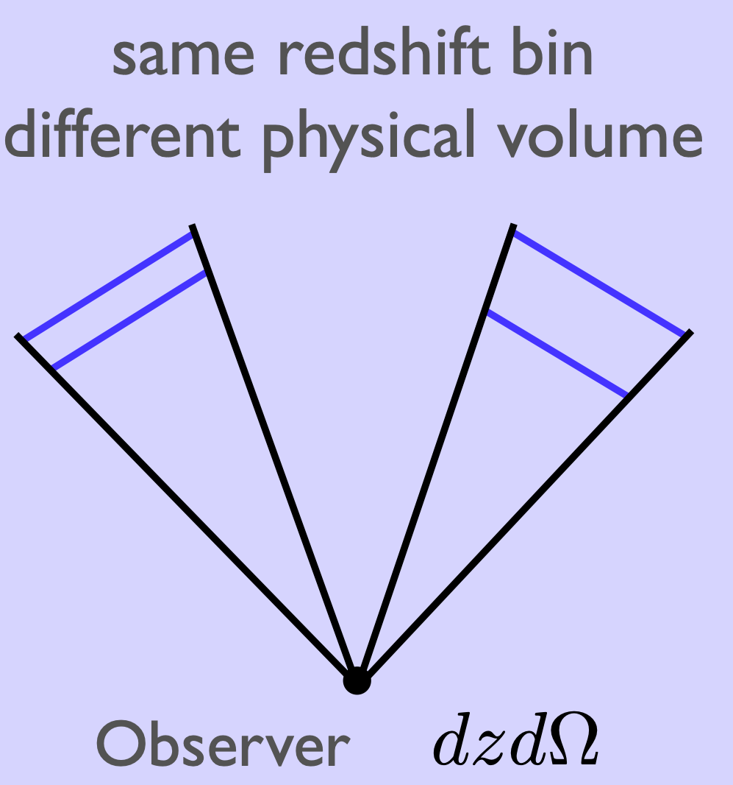
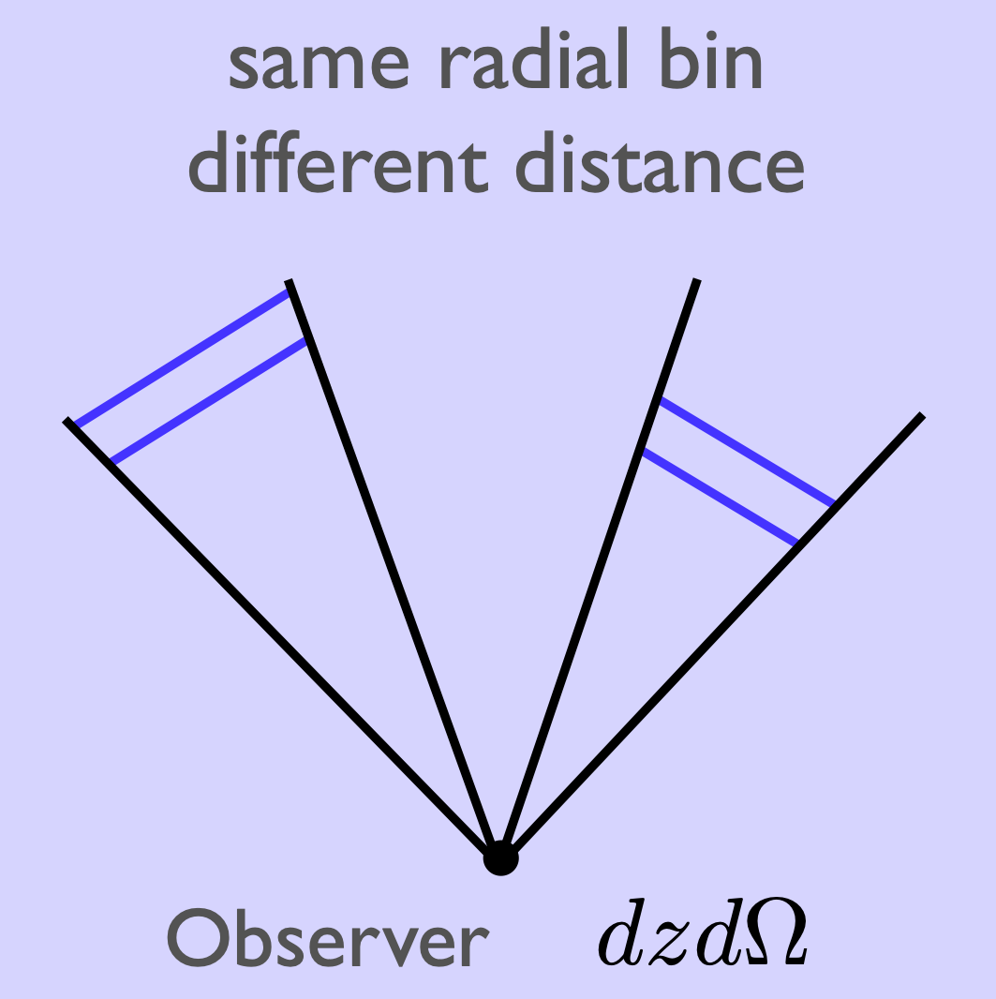
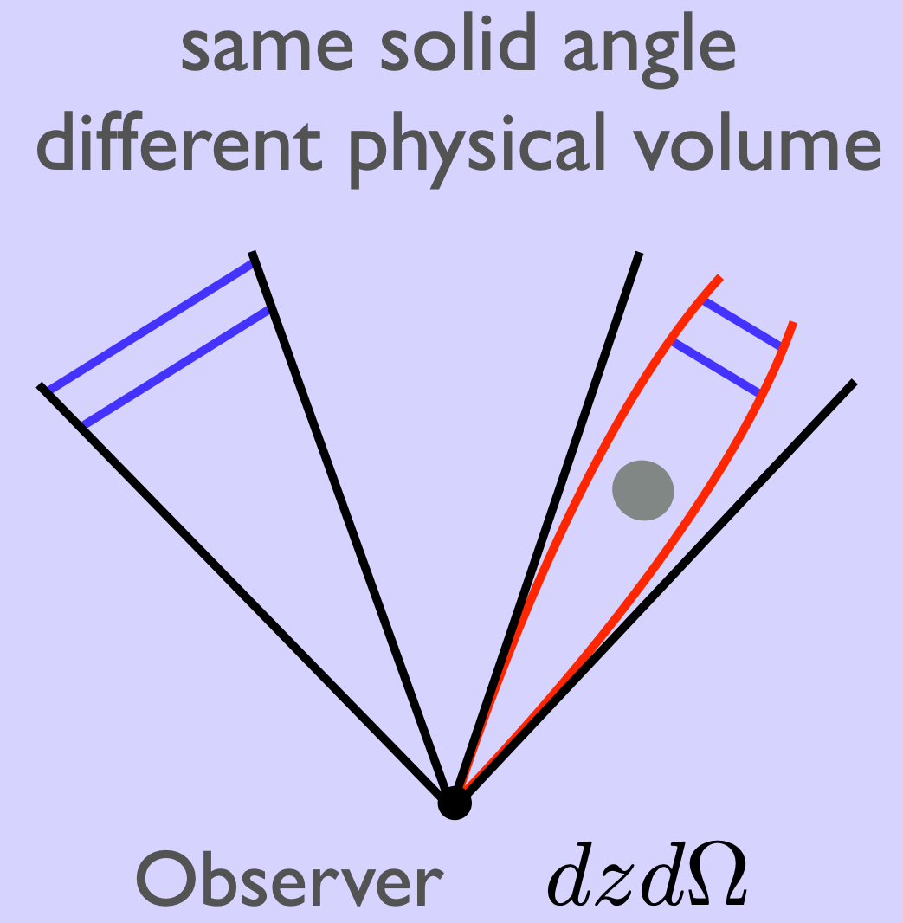
Which density contrast do we observe?
JOSÉ FONSECA - IA U. PORTO
Credit: Camille Bonvin
See Challinor & Lewis 2011, Bonvin & Durrer 2011 for full derivation
EREP24 - Coimbra - 23/07/2024

Slide 9
Which density contrast do we observe?
JOSÉ FONSECA - IA U. PORTO
Luminosity Distance Perturbation
Note that we do not measure redshift - therefore different from Bertacca et al (2018);
The perturbation is with respect to a background afine parameter which we can take as the background redshift;
Agrees with Sasaki (1987), Pyne & Birkinshaw (2004), Hui & Greene (2006).
Credit: Stefano Zazzera
JCAP08(2023)050 - arxiv:2304.14253
EREP24 - Coimbra - 23/07/2024

Slide 10
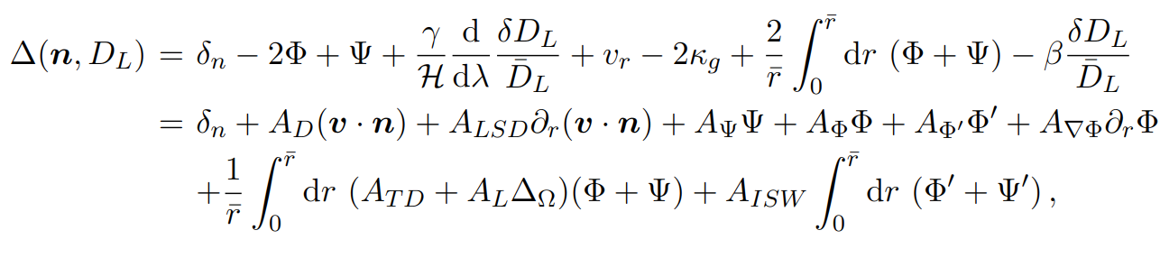
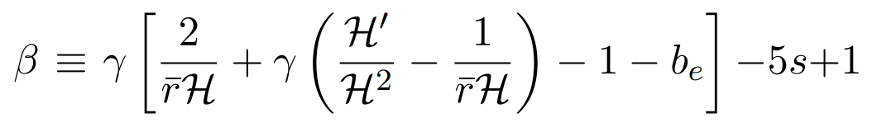
Which density contrast do we observe?
JOSÉ FONSECA - IA U. PORTO
Density contrast
JCAP08(2023)050 - arxiv:2304.14253
EREP24 - Coimbra - 23/07/2024

Slide 11
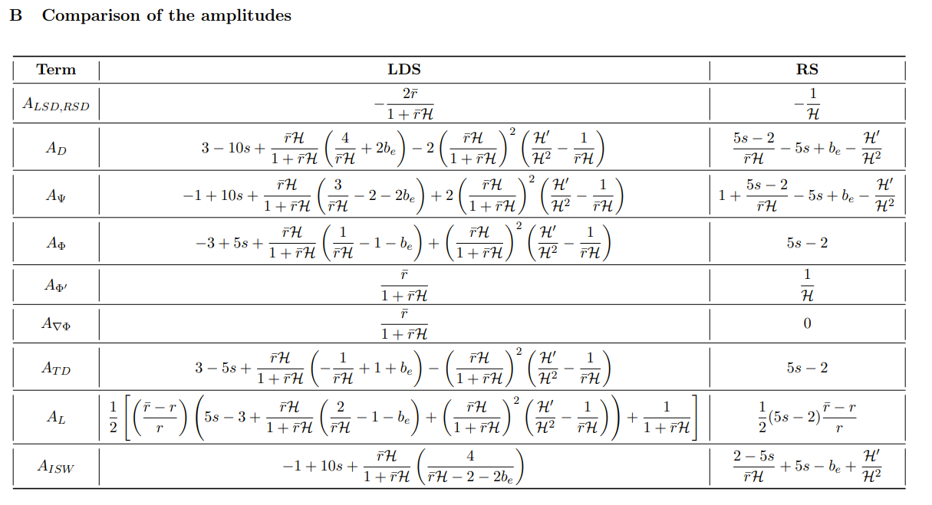
JOSÉ FONSECA - IA U. PORTO
We changed CAMB to compute the angular power in LD space.
JCAP08(2023)050 - arxiv:2304.14253
EREP24 - Coimbra - 23/07/2024

Slide 12
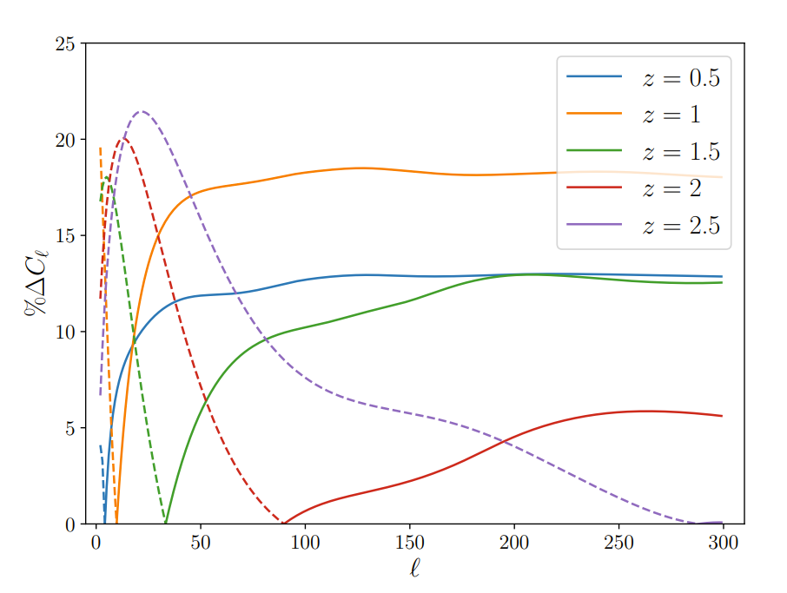
Differences between LD and z spaces
broad selection function
We cannot use the z expression for LD space
JCAP08(2023)050 - arxiv:2304.14253
EREP24 - Coimbra - 23/07/2024

Slide 13
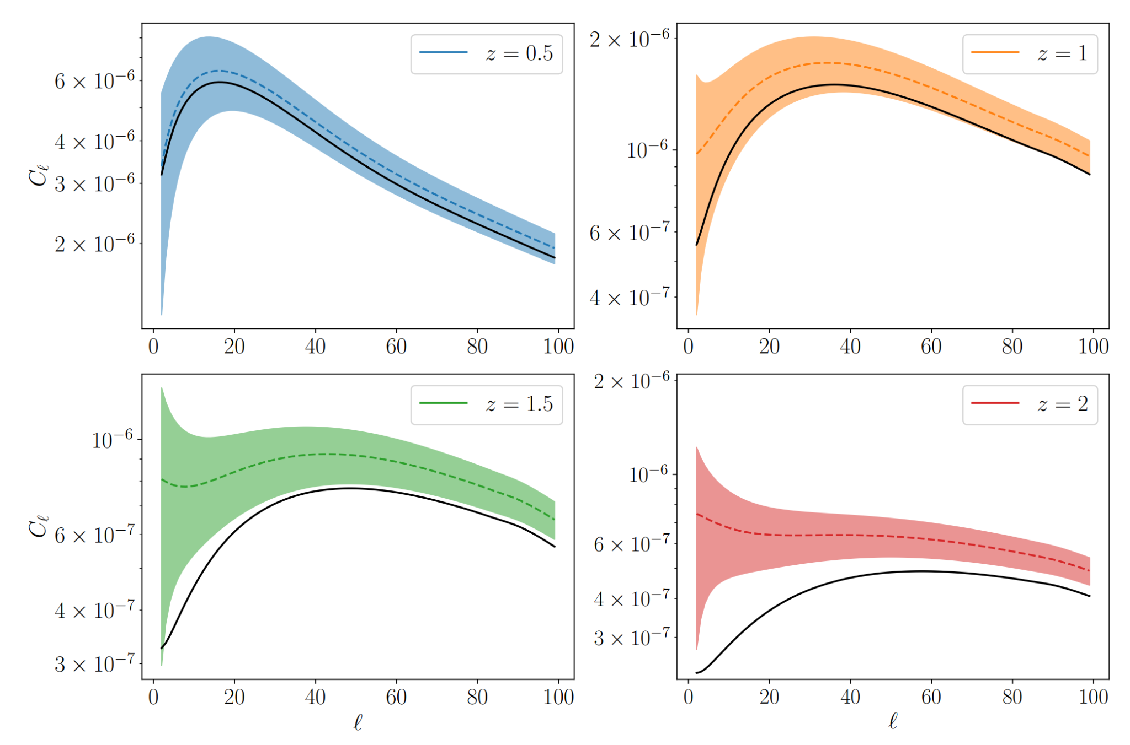
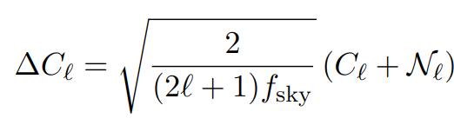
"Cosmic Variance limit" with respect to density only
JCAP08(2023)050 - arxiv:2304.14253
EREP24 - Coimbra - 23/07/2024

Slide 14
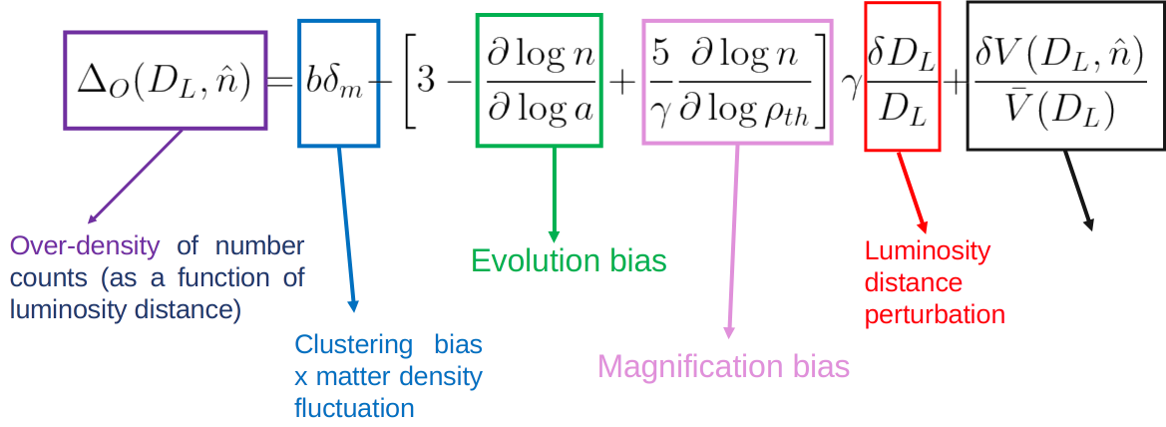
The biases
JOSÉ FONSECA - IA U. PORTO
EREP24 - Coimbra - 23/07/2024

Slide 15
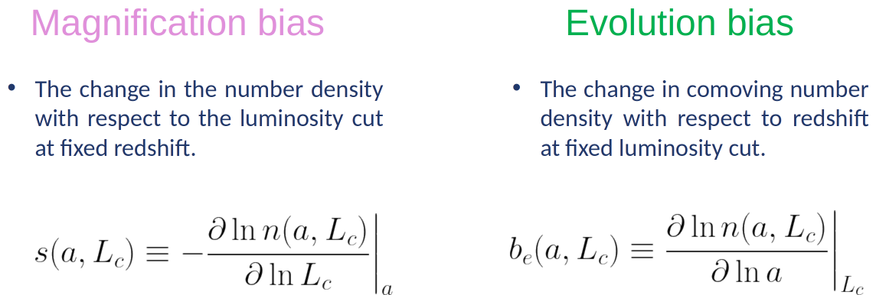
The biases
JOSÉ FONSECA - IA U. PORTO
JCAP05(2024)095 - arXiv:2309.04391
EREP24 - Coimbra - 23/07/2024

Slide 16
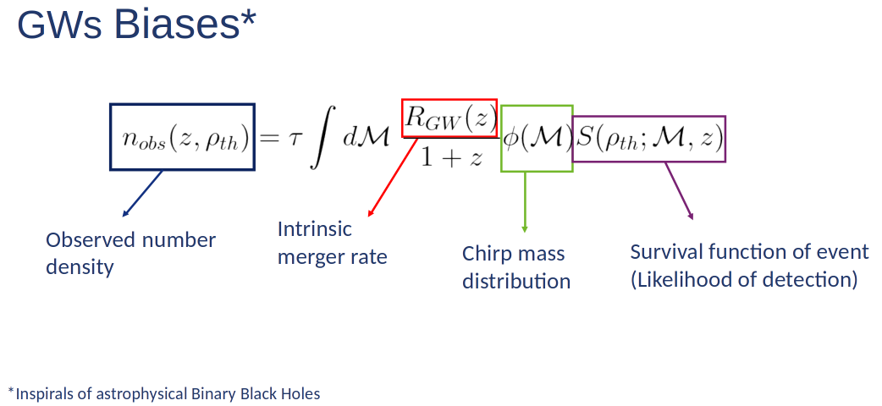
JOSÉ FONSECA - IA U. PORTO
JCAP05(2024)095 - arXiv:2309.04391
EREP24 - Coimbra - 23/07/2024

Slide 17
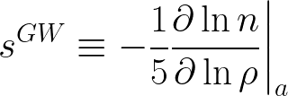
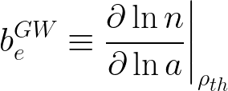
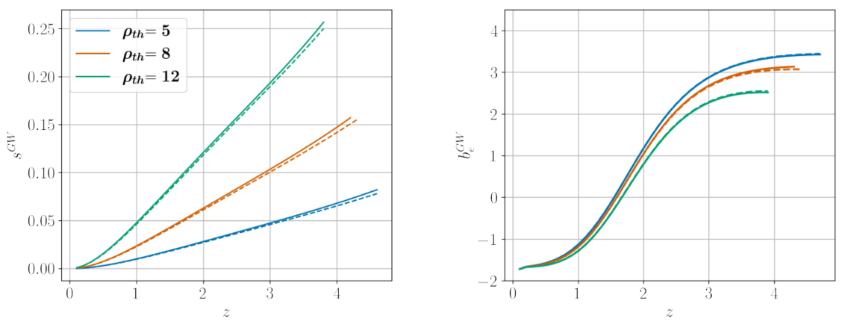
JOSÉ FONSECA - IA U. PORTO
JCAP05(2024)095 - arXiv:2309.04391
EREP24 - Coimbra - 23/07/2024

Slide 18
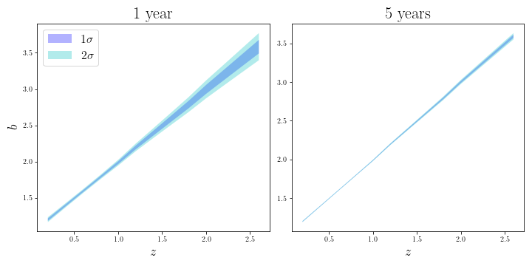


Clustering bias
JOSÉ FONSECA - IA U. PORTO
Constraints from cross-correlations between an ET-like and LSST-like surveys
EREP24 - Coimbra - 23/07/2024

Slide 19
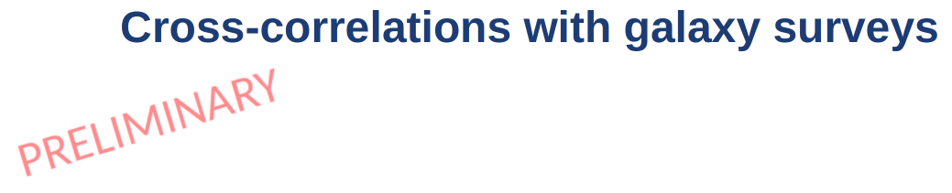
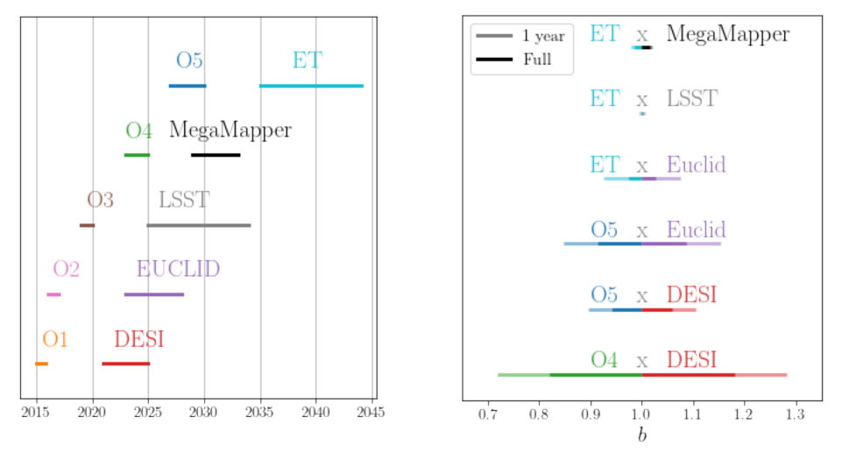
JOSÉ FONSECA - IA U. PORTO
EREP24 - Coimbra - 23/07/2024

Slide 20

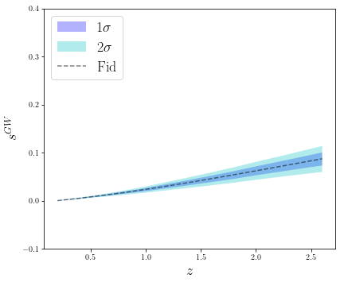
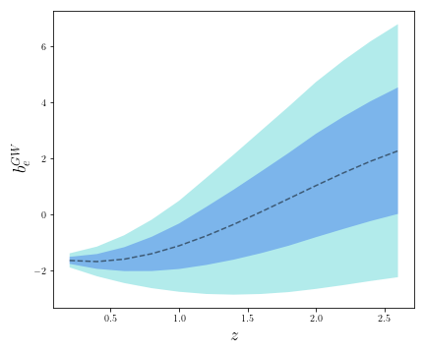
EREP24 - Coimbra - 23/07/2024

Slide 21
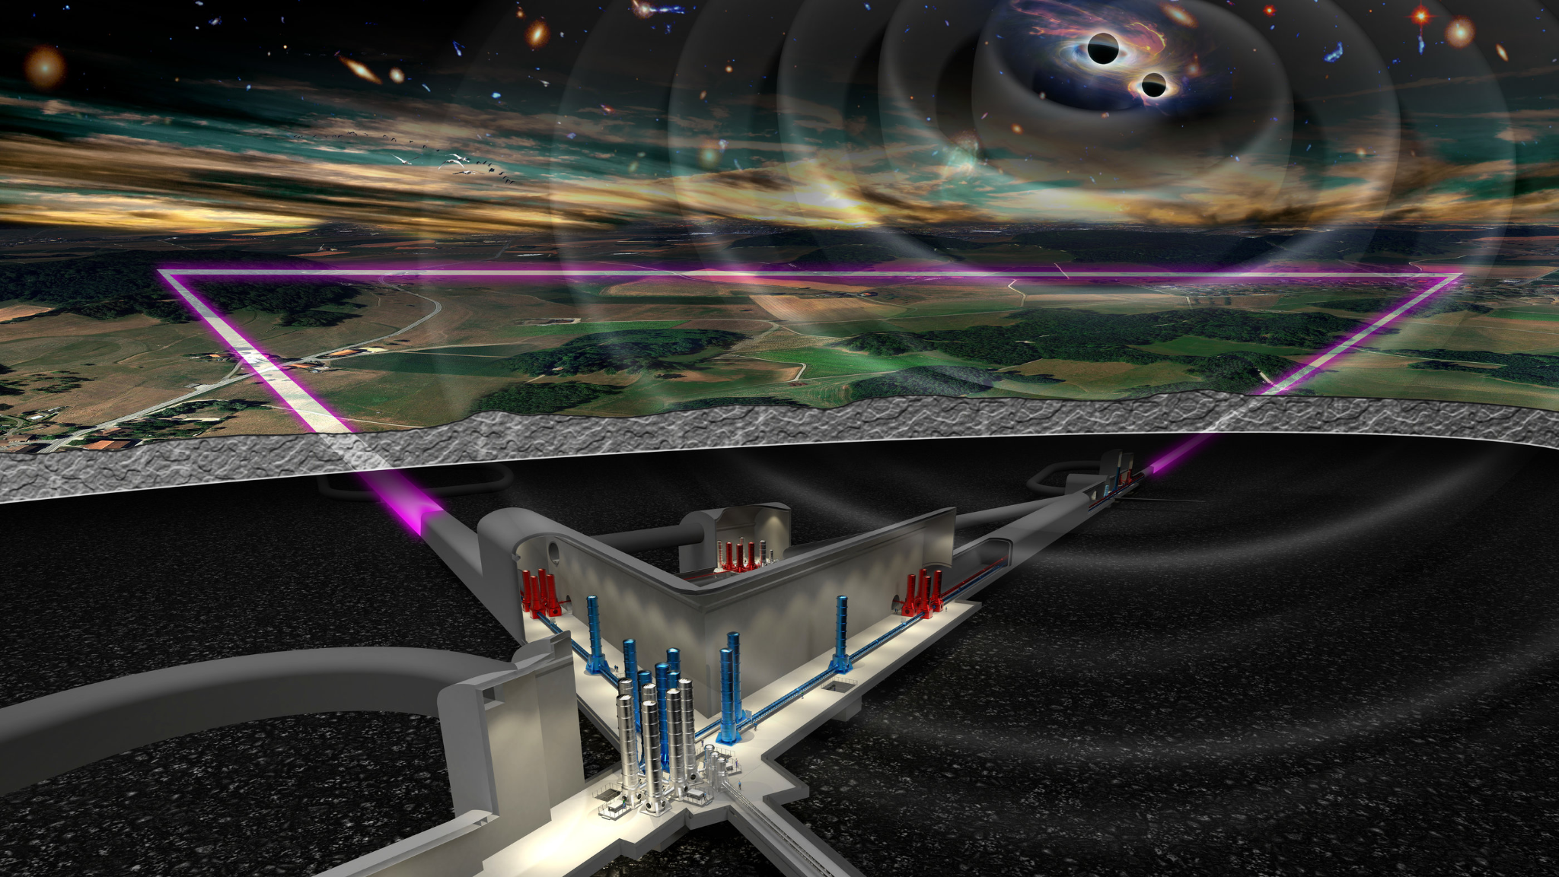

Summary
JOSÉ FONSECA - IA U. PORTO
In the coming years one may start using transient events as tracers of Dark Matter. We considered transients for which we can only determine their luminosity distance;
We have computed the density contrast in Luminosity Distance Space and rederived the luminosity distance perturbation in an FLRW universe and implemented it in CAMB;
Modelling the biases for GWs will help us use them as LSS tracers;
Cross-correlations with galaxies will be able to constrain BBHs population bias parameters and help us understand their evolution.
EREP24 - Coimbra - 23/07/2024

