Slide 1
Quasinormal mode spectrum of
AdS black hole with
Robin boundary condition
Keiju Murata (Ninoh University,Japan)
with S.Kinoshita, T.Kozuka, K.Sugawara

Slide 2
Toy example

Slide 3
Ordinary wave equation with Robin boundary condition (BC)
Robin BC
Robin
Dirichlet
x

Slide 4
Parameter space of
Robin boundary conditions
Dirichlet
Neumann
Dirichlet
Identified
Parameter space is topologically S^1.

Slide 5
Robin parameter
1 to 1 correspondence
between points S^1 and
Robin boundary conditions.
N
D

Slide 6
Eigen frequencies for Dirichlet and Neumann boundary conditions
N
D
Robin
Dirichlet
x

Slide 7
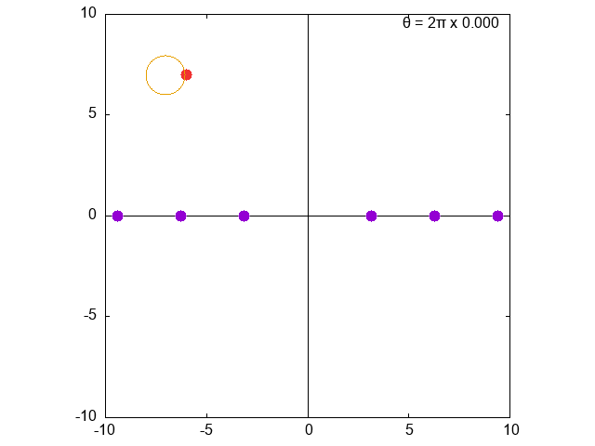
Spectrum for Robin
●The eigen frequency does not come back original point after θ=0→2π. (Holonomy)
● n-th over tone → (n-1)-th over tone.
● Fundamental tones are swept out to infinity in the complex plane.
●Instability for
N
D

Slide 8
Is the instability consistent with the energy conservation?
BC is doing work.
is conserved.
For κ<0, the boundary can store
unbounded negative energy.
Instability

Slide 9
Quasi-normal modes (QNM) of Sch-AdS4 with Robin BC

Slide 10
Setup
Sch-AdS4
z=0: Infinity, z=1: Horizon
Scalar field
Near infinity
Robin BC at infinity

Slide 11
Why Robin?
Motivation from AdS/CFT
Robin BC
Double trace deformation of CFT
Papadimitriou 07, Witten 01, Berkooz 01, Muck 02, Minces 02, Sever&Shomer 02,
Aharony, Berkooz & Katz 05, Dlitzur et al 05, Gubser&Klebanov 02, Hartman&Rastelli 06, Diaz&Dorn 07
●Phase transition of thermal deformed QFT.
●Time scale of the thermalization.
QNM

Slide 12
Motivation in GR
New instability which originates from boundary condition.
Katagiri&Harada 20
Dynamics of gravity under Robin BC.
Bizon et al, 20
Final fate of instability.
New black hole solutions.
Harada, Ishii, Katagiri, Tanahashi 23

Slide 13
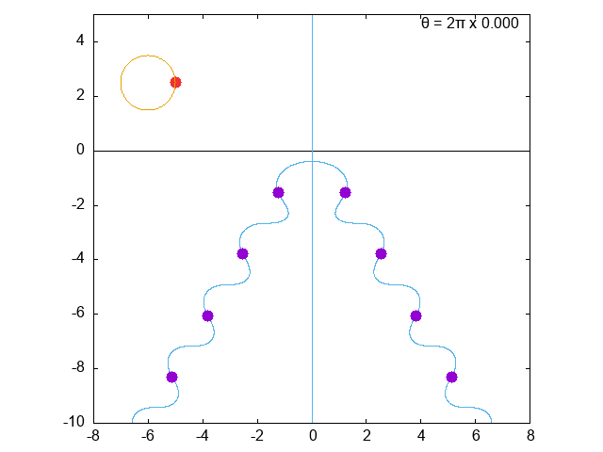
Spectrum
Pseudo-spectral method
Based on Mathematica Summer School on Theoretical Physics
Yaffe’s mathematica note
●The eigen frequency does not come back original point after θ=0→2π. (Holonomy)
● n-th over tone → (n-1)-th over tone.
● Fundamental tones are swept out to infinity in the complex plane.
N
D

Slide 14
Instability
N
D
222.4°
Instability

Slide 15
Consistent with energy conservation?
is conserved.
For κ<0, there can be unstable.

Slide 16
Summary
QNM of scalar field in Sch-AdS4 under Robin BC was studied.
There is holonomy in QNM spectrum.
Unstable for θ>222.4°
●future work
Dynamic after the instability?
What is the final fate?
Charged or rotating BHs?

Slide 19
Setup
Sch-AdS4
z=0: Infinity, z=1: Horizon
Scalar field
Near infinity
Robin BC at infinity
For -9/4<μ^2<-5/4, total energy is finite even for Robin BC.
Breitenlohner&Freedman 82, Ishibashi&Wald 04

Slide 20
Mode function
From the Dirichlet
boundary condition at x=1,
Robin
Dirichlet
x
From the boundary condition at x=0
Its solutions are eigen frequencies.

Slide 21
Eigen frequecies
Bizon et al, 20
There is a root at ω=0 and
a>1 : 2 real roots
a=1 : double root at ω=0
a<1 : No real roots
Where have eigen frequencies
gone for a<1?
complex plane

Slide 22
Pure imaginary eigenfrequency
a<1 : Two pure imaginary solutions
Unstable for

Slide 23
Instability
N
D
222.4°
Instability
New thermal phase in the deformed CFT?
What is the final fate in the gravity side?

