Slide 1
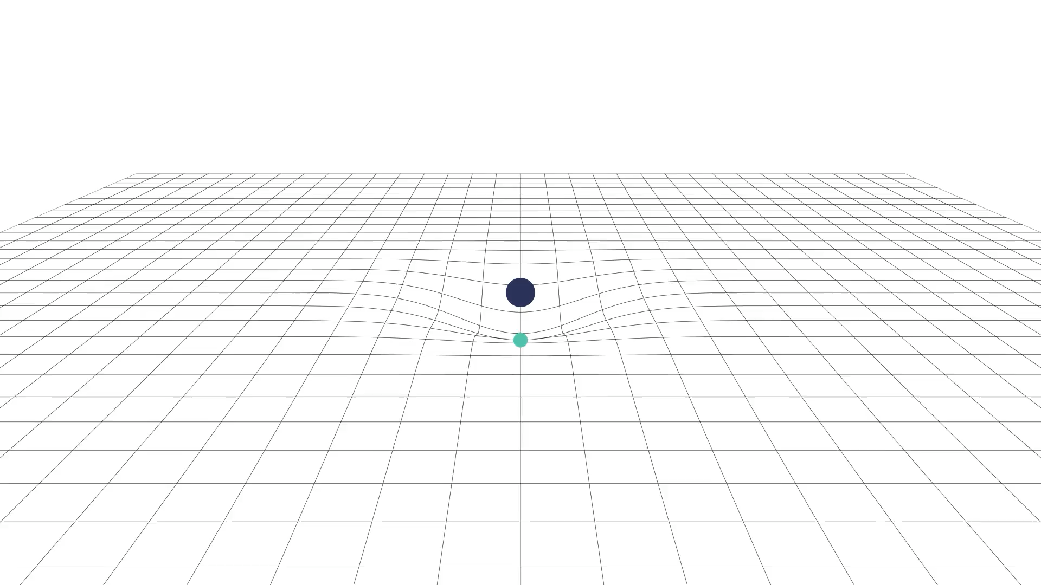

Work in progress
EREP 2024
Coimbra | July 23, 2024
2407.xxxxx
The Galactic Center
as a gravitational laboratory
Riccardo Della Monica

Slide 2
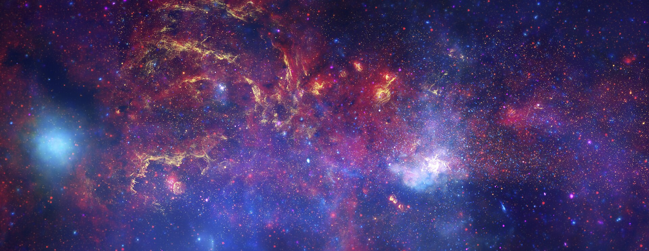
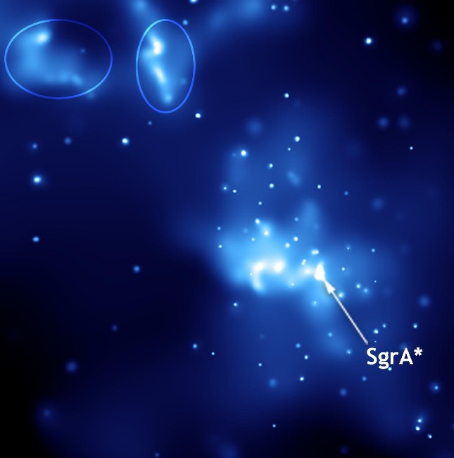

1
The Galactic Center
The Galactic Center
Sagittarius A
Hubble Space Telescope, the Spitzer Space Telescope, and the Chandra X-ray Observatory (2009)

Slide 3
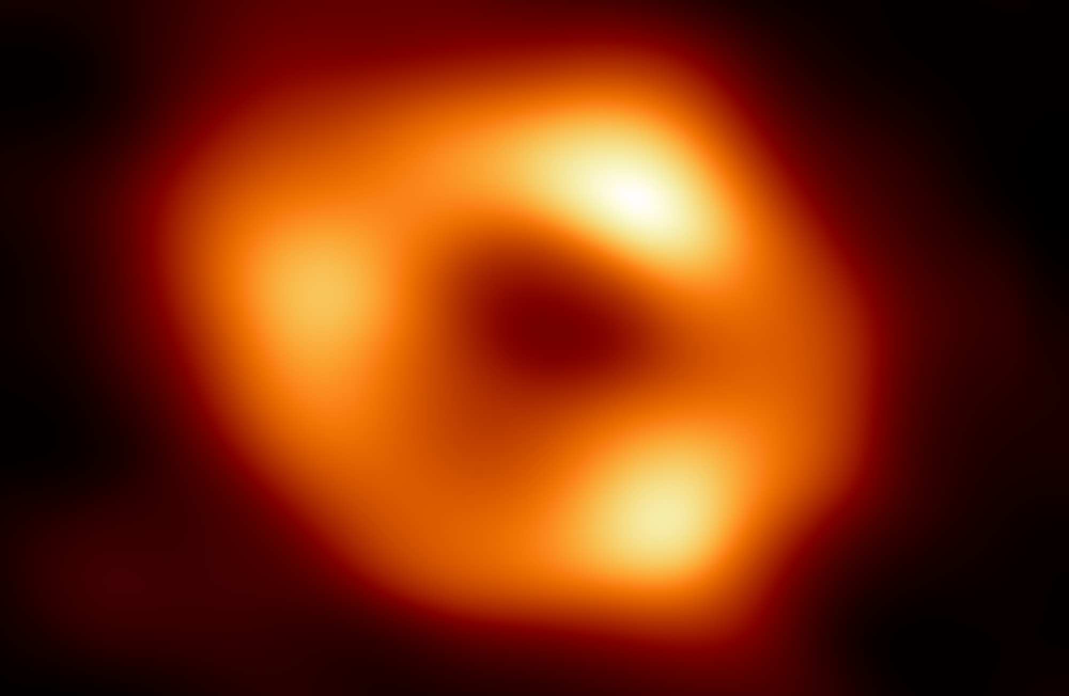
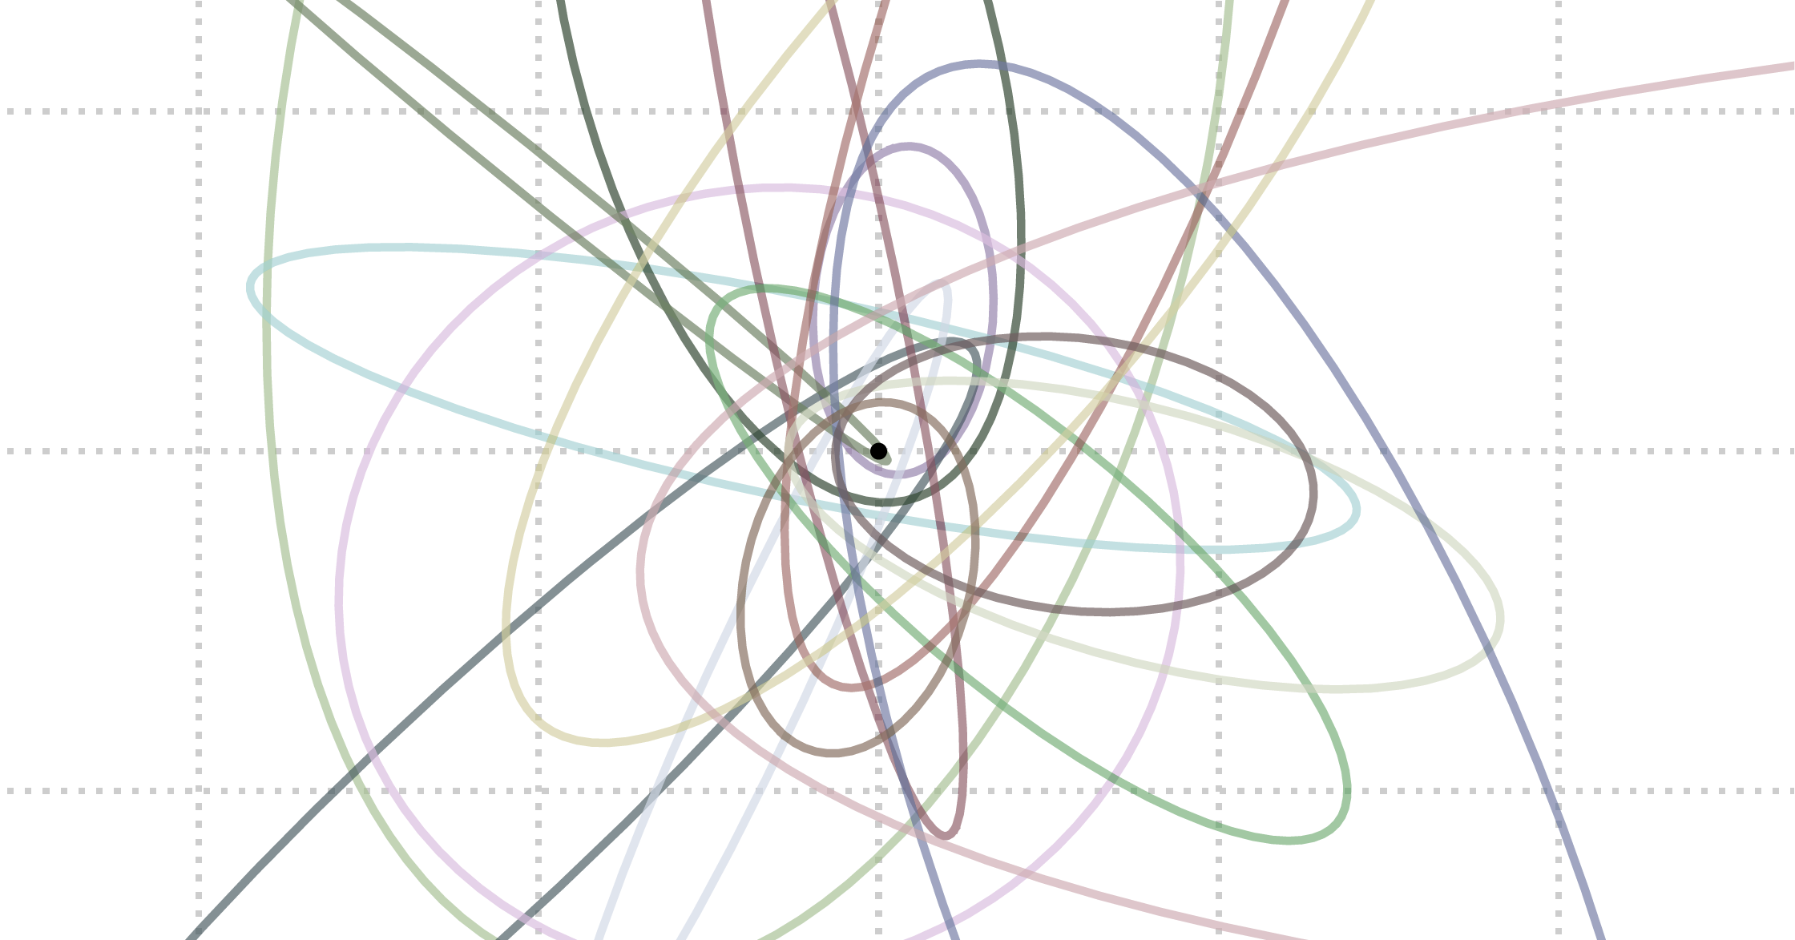
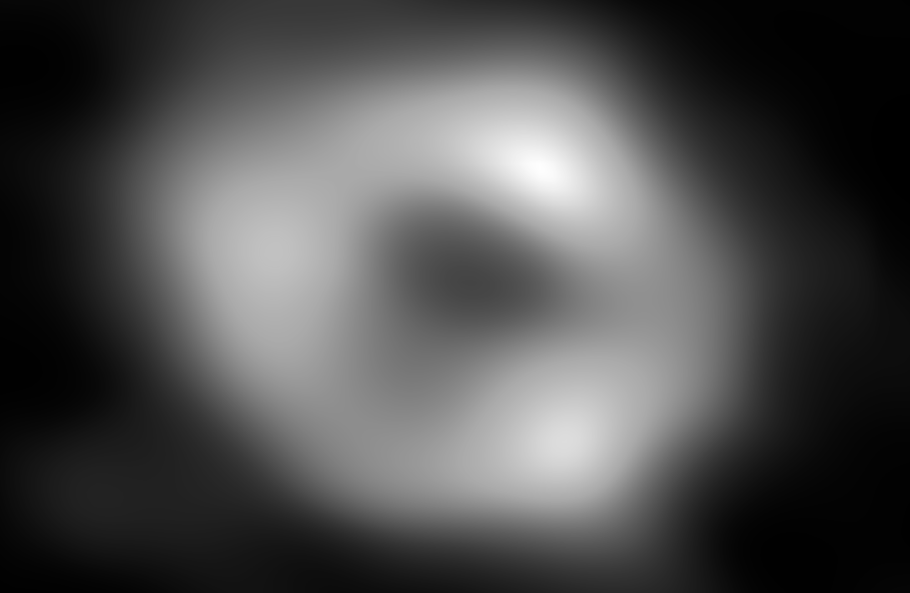
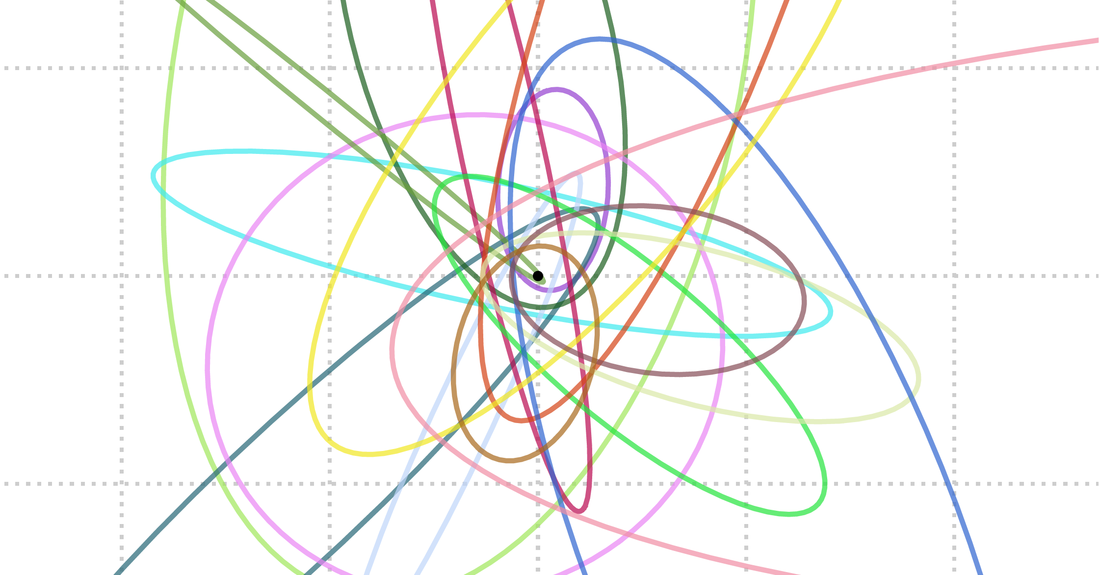
2
The Galactic Center
S-stars
Black Hole shadow
The Galactic Center represents a unique laboratory to probe gravity
Orbital precession
Gravitational redshift
Gravitational lensing
SEE KARIM’s TALK LATER
Future prospects
Closer S-stars
Pulsars
We are moving to an era of precision astronomy in the Galactic Center

Slide 4
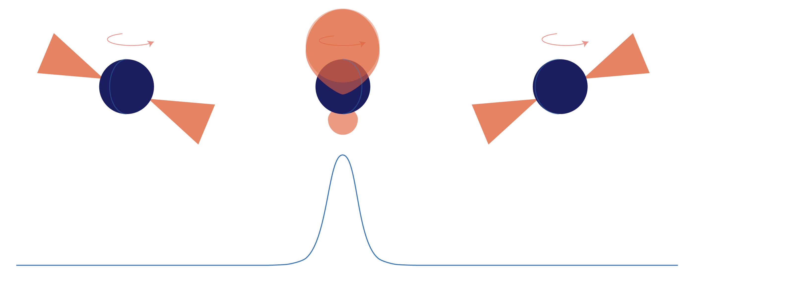
3
Galactic Center pulsars
Pulsars
Cosmic precision-clocks
Stability of one part in 10¹⁵

Slide 5
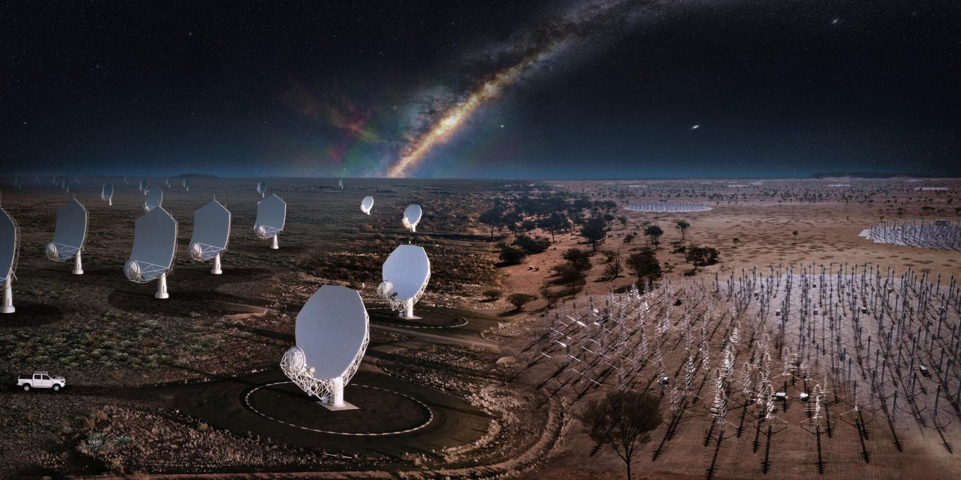
3.
Tests At The Galactic Center With Pulsars
Pulsars
Cosmic precision-clocks
Stability of one part in 10¹⁵

Slide 6
3.
Tests At The Galactic Center With Pulsars
Pulsars
Major scientific goal of future facilities like Squared Kilometer Array (SKA) that promise not only to be able to detect them but also to perform timing analysis.

Slide 7

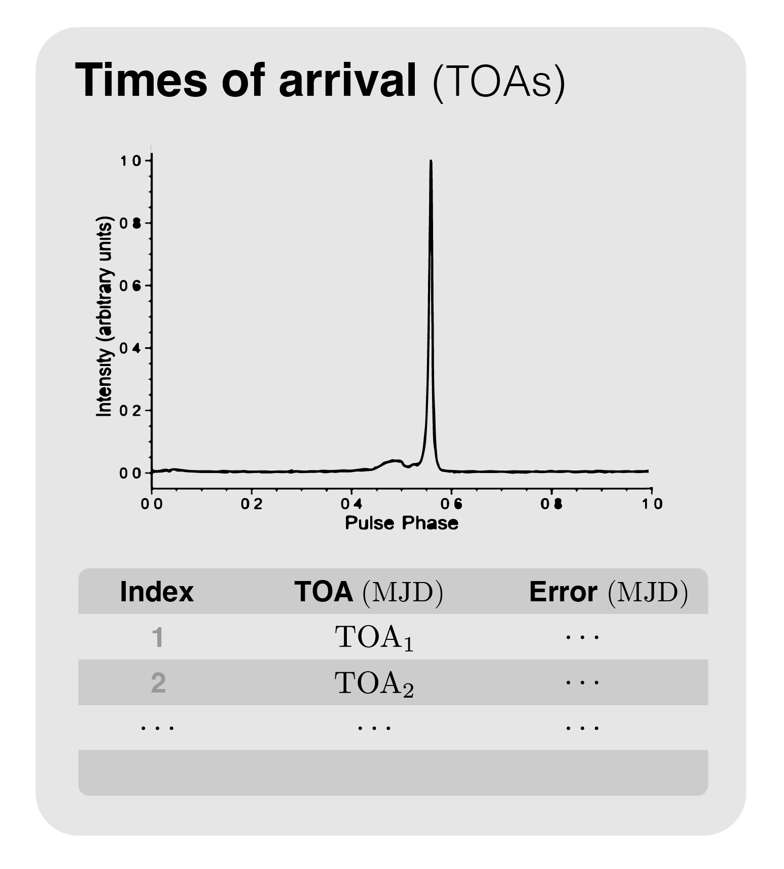
4
Modeling pulsar observables
Pulsars data
Classical effects
Special relativity
General relativity

Slide 8
5
Modeling pulsar observables
What is usually done…
Consider a Keplerian orbit with orbital parameters
and compute the post-Keplerian evolution of this parameter from a post-Newtonian approximation
GR effects
on the trajectory
Use post-Newtonian approximations for all the different delays, assuming that the total delay is a linear sum of the single effects.
GR effects
on the photons
Hobbs et al. (2006)
Damour & Deruelle (1986)
Blandford & Teukolsky (1976)
Classical effects
Special relativity
General relativity

Slide 9
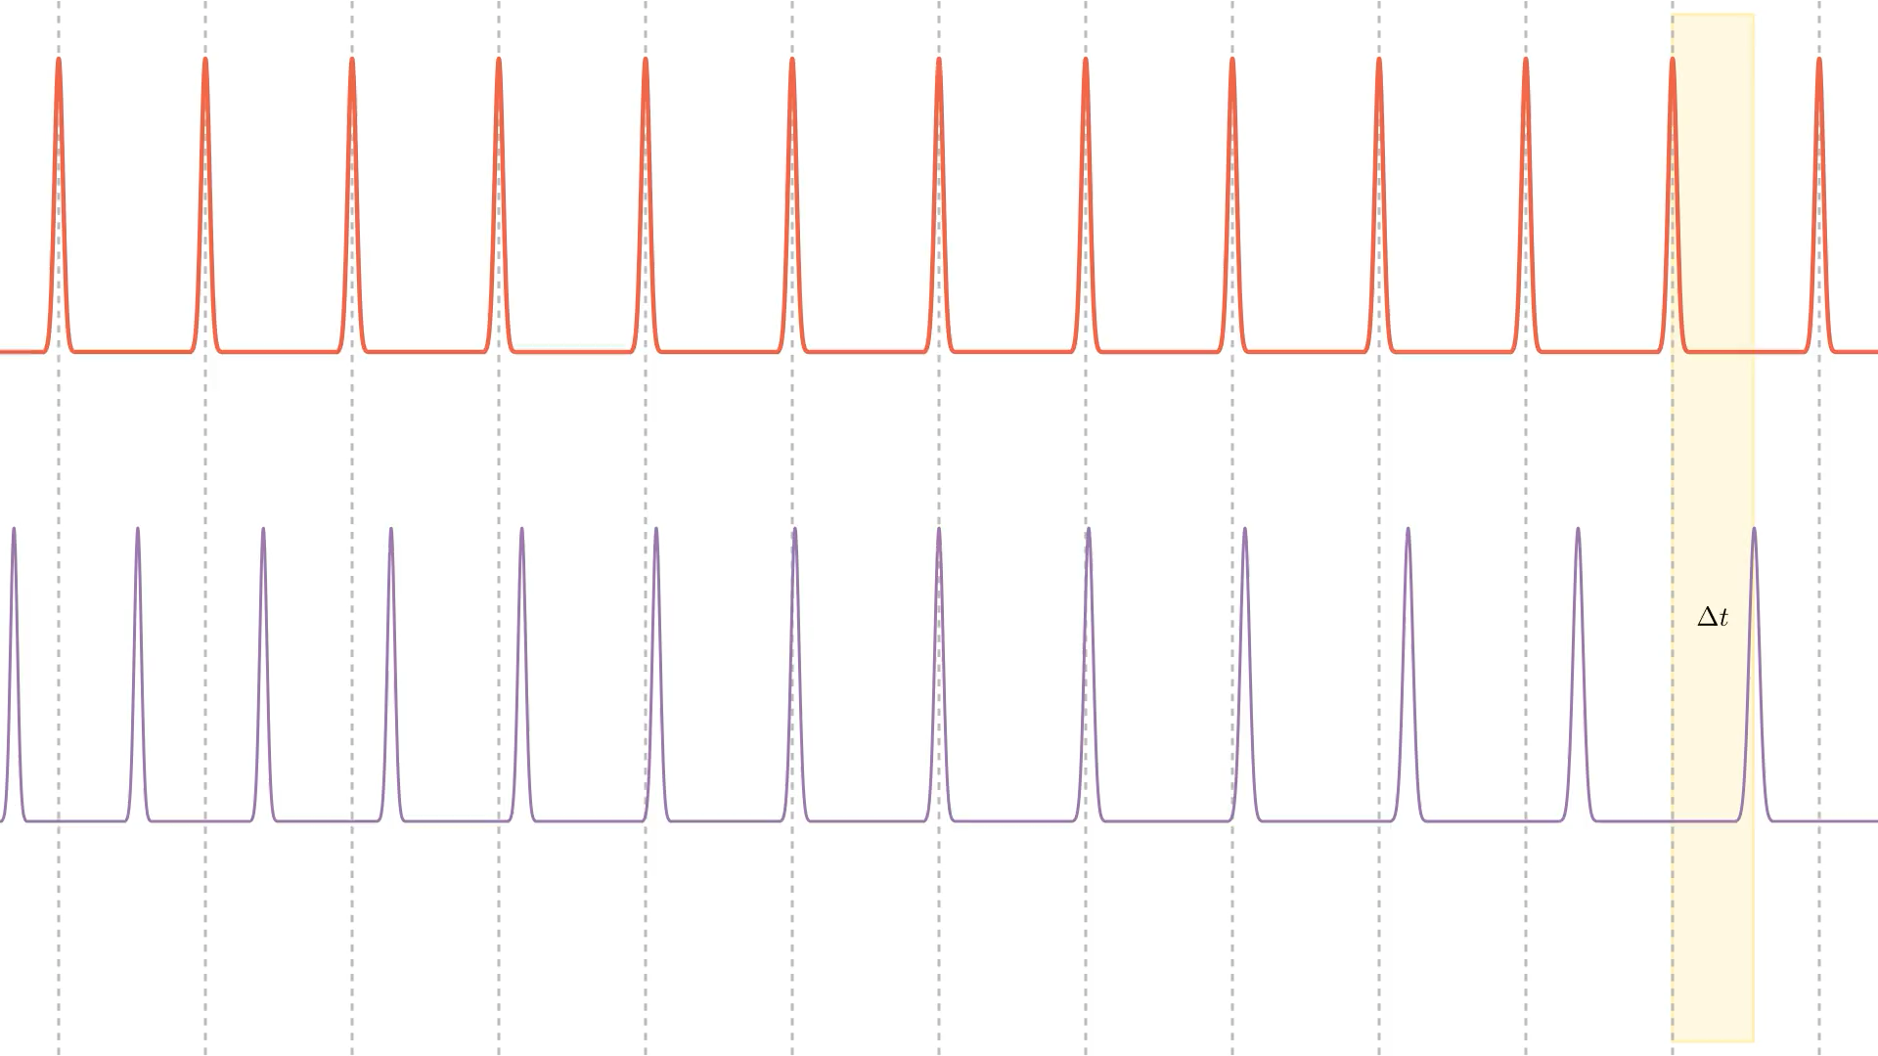
3.
5
Modeling pulsars times of arrival and residuals
Modeling pulsar observables
What is usually done…
Consider a Keplerian orbit with orbital parameters
and compute the post-Keplerian evolution of this parameter from a post-Newtonian approximation
GR effects
on the trajectory
Use post-Newtonian approximations for all the different delays, assuming that the total delay is a linear sum of the single effects.
GR effects
on the photons
Hobbs et al. (2006)
Damour & Deruelle (1986)
Blandford & Teukolsky (1976)

Slide 10
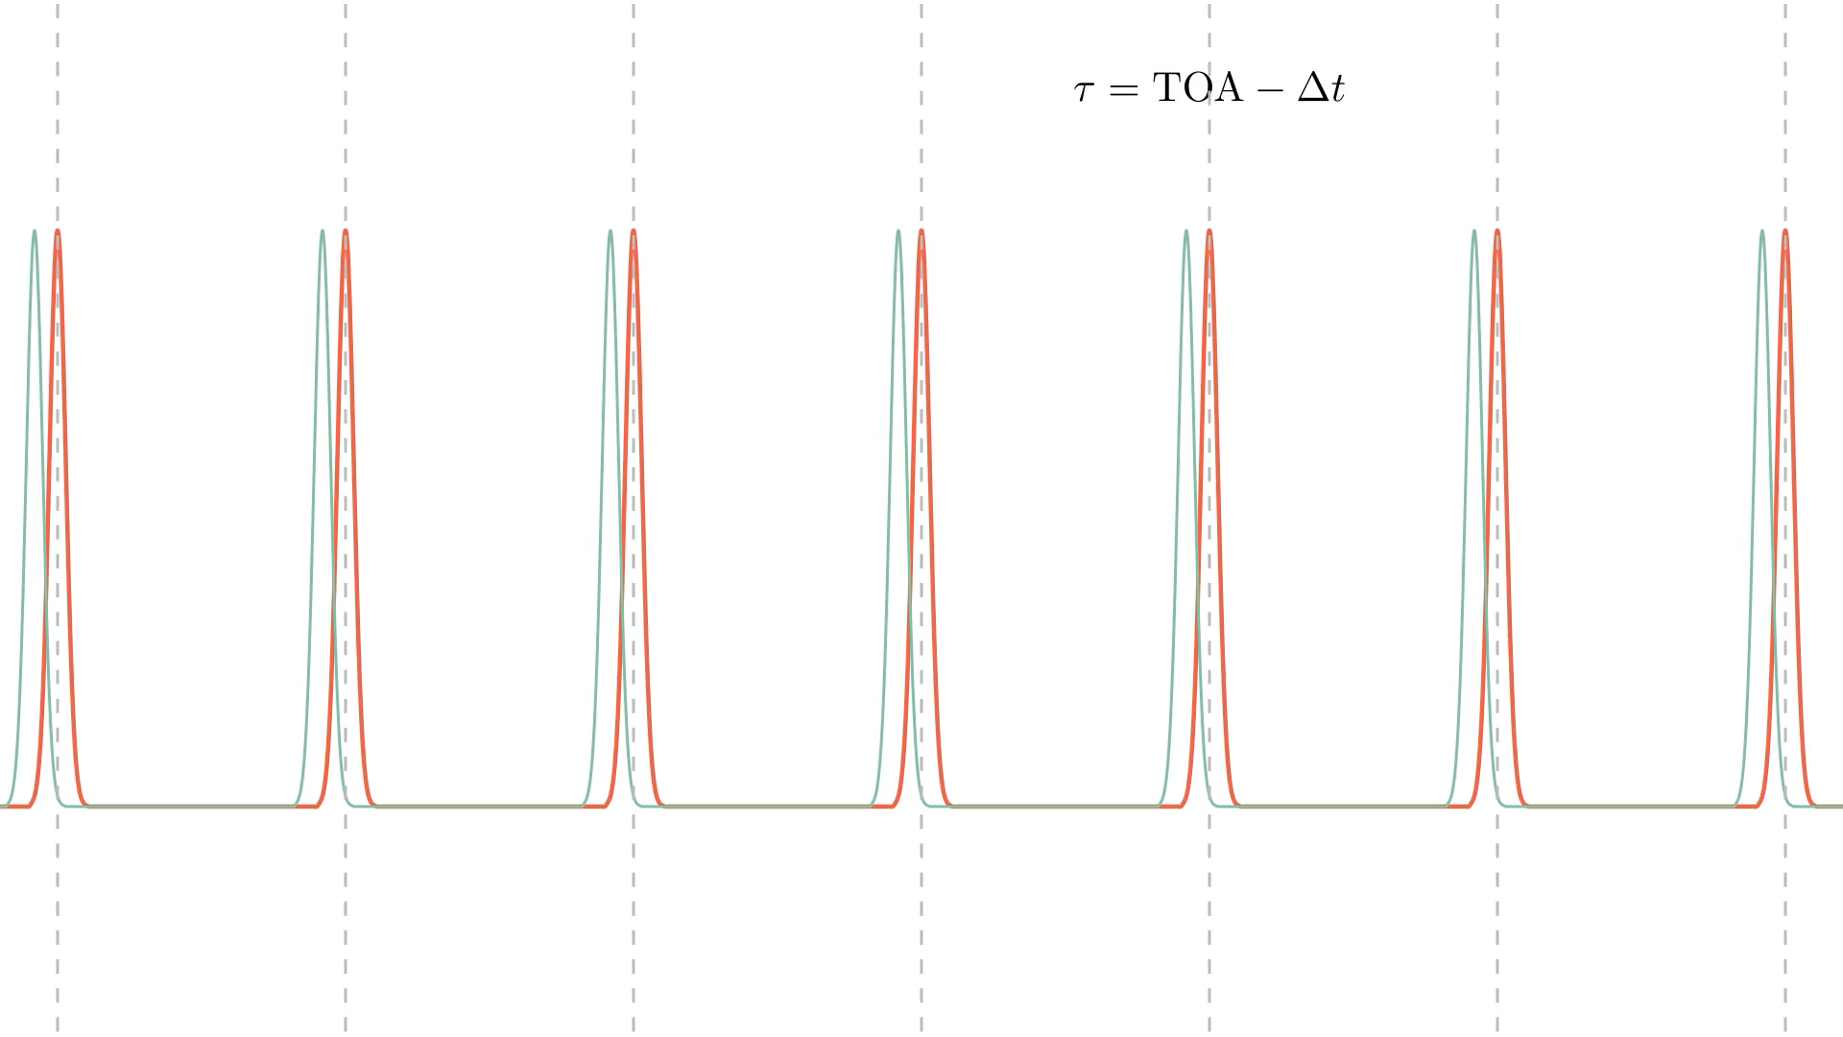
3.
5
Modeling pulsars times of arrival and residuals
Modeling pulsar observables
What is usually done…
Consider a Keplerian orbit with orbital parameters
and compute the post-Keplerian evolution of this parameter from a post-Newtonian approximation
GR effects
on the trajectory
Use post-Newtonian approximations for all the different delays, assuming that the total delay is a linear sum of the single effects.
GR effects
on the photons
Hobbs et al. (2006)
Damour & Deruelle (1986)
Blandford & Teukolsky (1976)

Slide 11
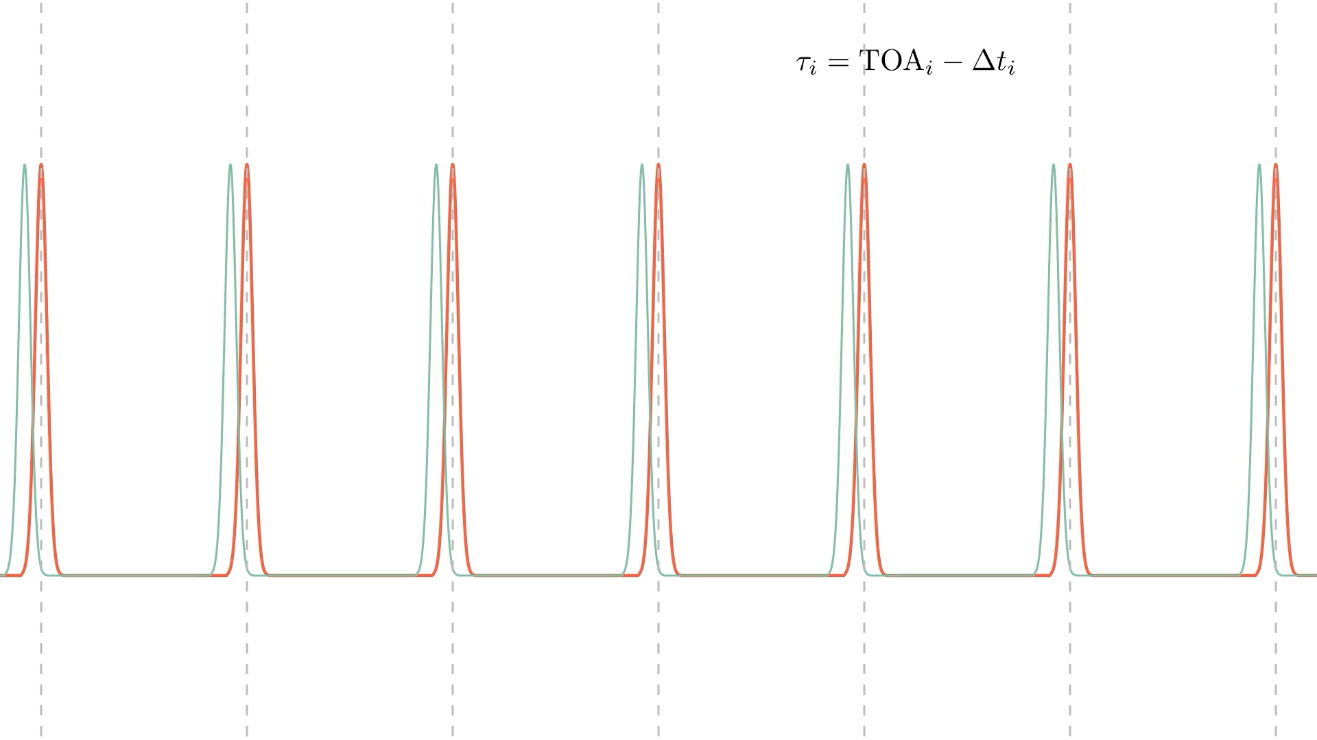
3.
3.
5
Modeling pulsars times of arrival and residuals
Modeling pulsars times of arrival and residuals
Modeling pulsar observables
What is usually done…
Consider a Keplerian orbit with orbital parameters
and compute the post-Keplerian evolution of this parameter from a post-Newtonian approximation
GR effects
on the trajectory
Use post-Newtonian approximations for all the different delays, assuming that the total delay is a linear sum of the single effects.
GR effects
on the photons
Hobbs et al. (2006)
Damour & Deruelle (1986)
Blandford & Teukolsky (1976)

Slide 12
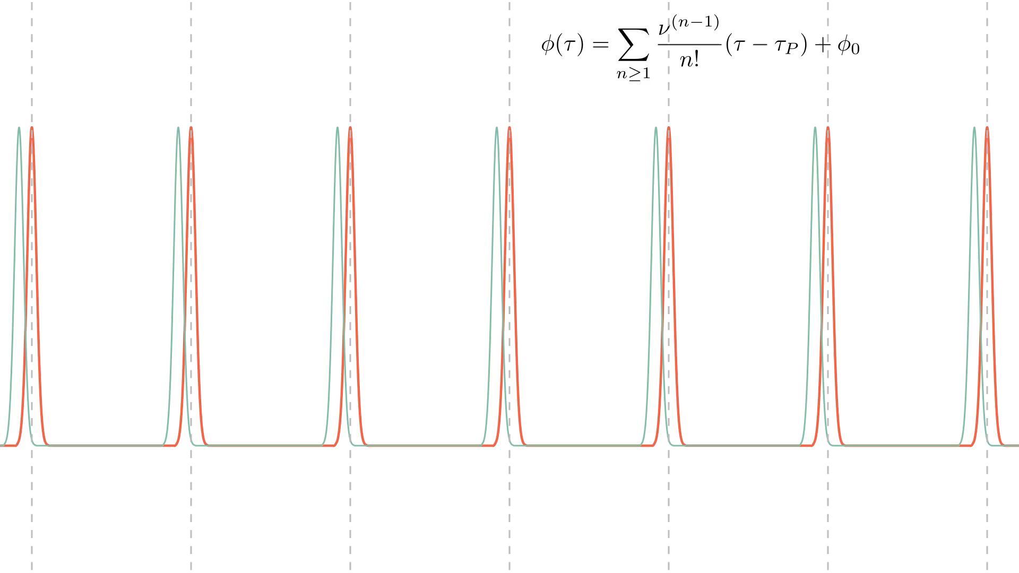
3.
3.
5
Modeling pulsars times of arrival and residuals
Modeling pulsars times of arrival and residuals
Modeling pulsar observables
What is usually done…
Consider a Keplerian orbit with orbital parameters
and compute the post-Keplerian evolution of this parameter from a post-Newtonian approximation
GR effects
on the trajectory
Use post-Newtonian approximations for all the different delays, assuming that the total delay is a linear sum of the single effects.
GR effects
on the photons
Hobbs et al. (2006)
Damour & Deruelle (1986)
Blandford & Teukolsky (1976)

Slide 13
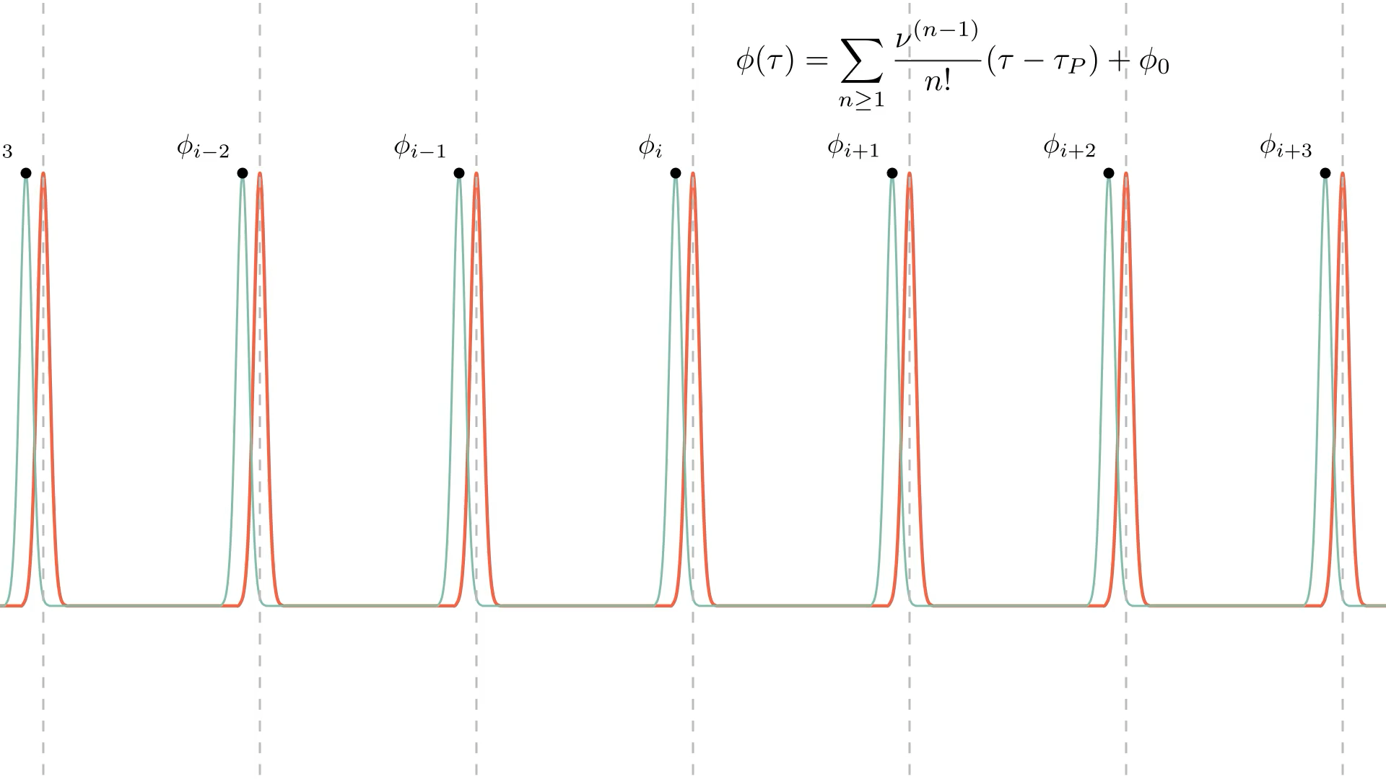
3.
3.
5
Modeling pulsars times of arrival and residuals
Modeling pulsars times of arrival and residuals
Modeling pulsar observables
What is usually done…
Consider a Keplerian orbit with orbital parameters
and compute the post-Keplerian evolution of this parameter from a post-Newtonian approximation
GR effects
on the trajectory
Use post-Newtonian approximations for all the different delays, assuming that the total delay is a linear sum of the single effects.
GR effects
on the photons
Hobbs et al. (2006)
Damour & Deruelle (1986)
Blandford & Teukolsky (1976)

Slide 14
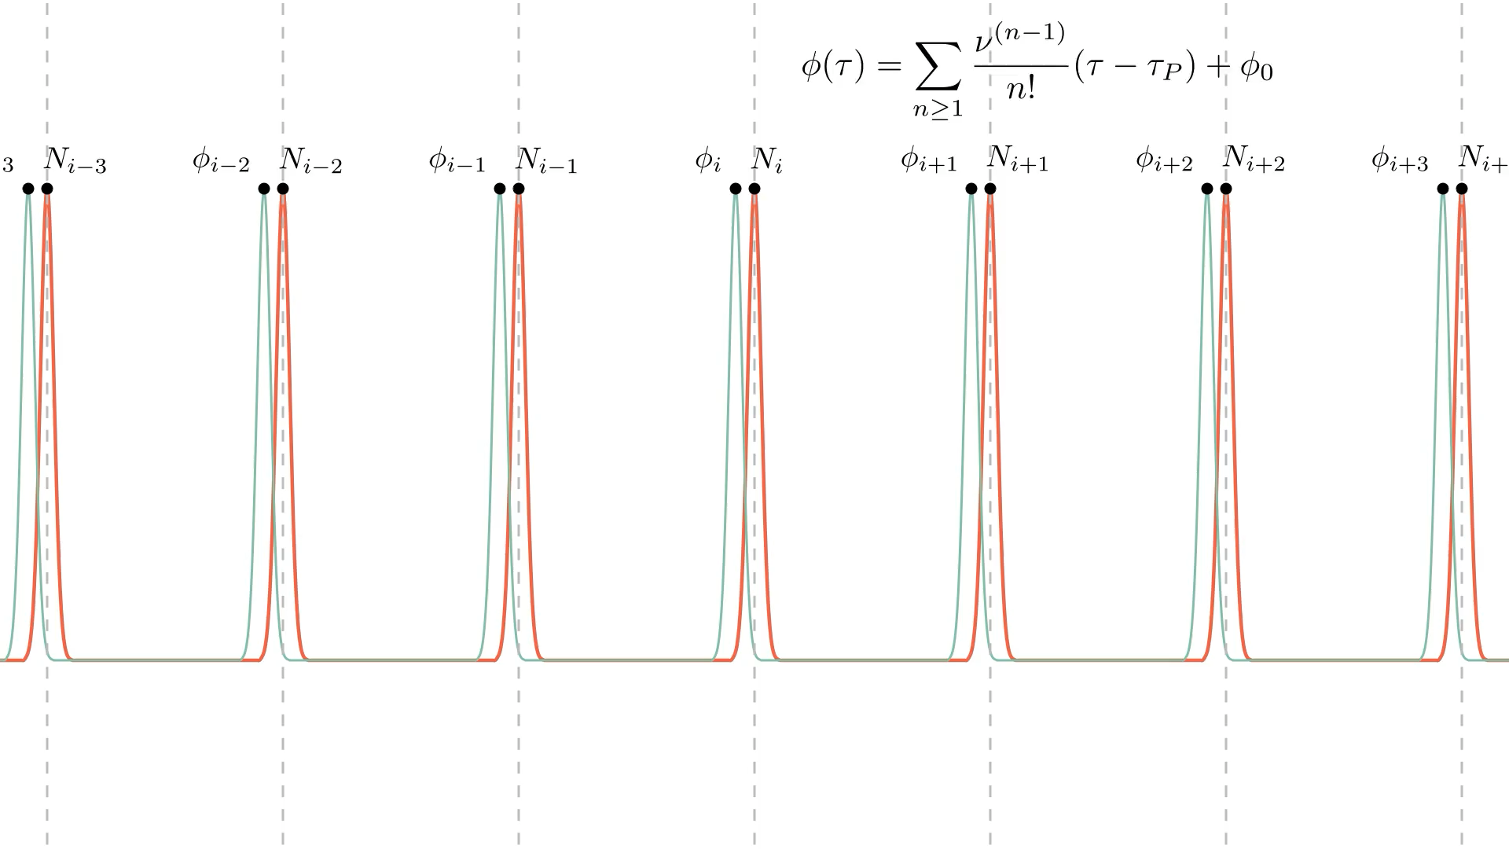
3.
3.
5
Modeling pulsars times of arrival and residuals
Modeling pulsars times of arrival and residuals
Modeling pulsar observables
What is usually done…
Consider a Keplerian orbit with orbital parameters
and compute the post-Keplerian evolution of this parameter from a post-Newtonian approximation
GR effects
on the trajectory
Use post-Newtonian approximations for all the different delays, assuming that the total delay is a linear sum of the single effects.
GR effects
on the photons
Hobbs et al. (2006)
Damour & Deruelle (1986)
Blandford & Teukolsky (1976)

Slide 15
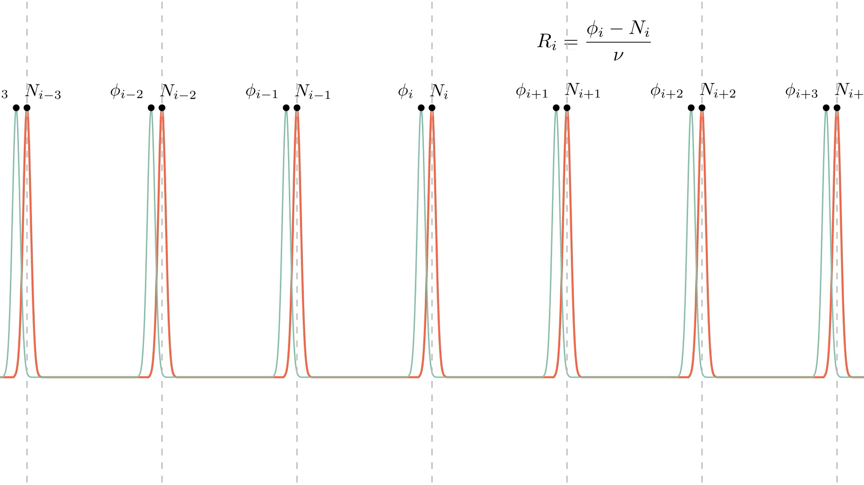
3.
3.
5
Modeling pulsars times of arrival and residuals
Modeling pulsars times of arrival and residuals
Modeling pulsar observables
What is usually done…
Consider a Keplerian orbit with orbital parameters
and compute the post-Keplerian evolution of this parameter from a post-Newtonian approximation
GR effects
on the trajectory
Use post-Newtonian approximations for all the different delays, assuming that the total delay is a linear sum of the single effects.
GR effects
on the photons
Hobbs et al. (2006)
Damour & Deruelle (1986)
Blandford & Teukolsky (1976)

Slide 16
3.
3.
5
Modeling pulsars times of arrival and residuals
Modeling pulsars times of arrival and residuals
Modeling pulsar observables
What is usually done…
What should be done
Consider a Keplerian orbit with orbital parameters
and compute the post-Keplerian evolution of this parameter from a post-Newtonian approximation
GR effects
on the trajectory
Integrate the geodesic equations for a time-like geodesic describing the motion of a test particle in the BH space-time
Use post-Newtonian approximations for all the different delays, assuming that the total delay is a linear sum of the single effects.
Emitter-observer problem
Find the null geodesic that connects emitter and observer
GR effects
on the photons
Relativistic propagation time
Hobbs et al. (2006)
Damour & Deruelle (1986)
Blandford & Teukolsky (1976)
Integrate the geodesic equations for such null geodesic to get the actual photon path in the BH space-time

Slide 17
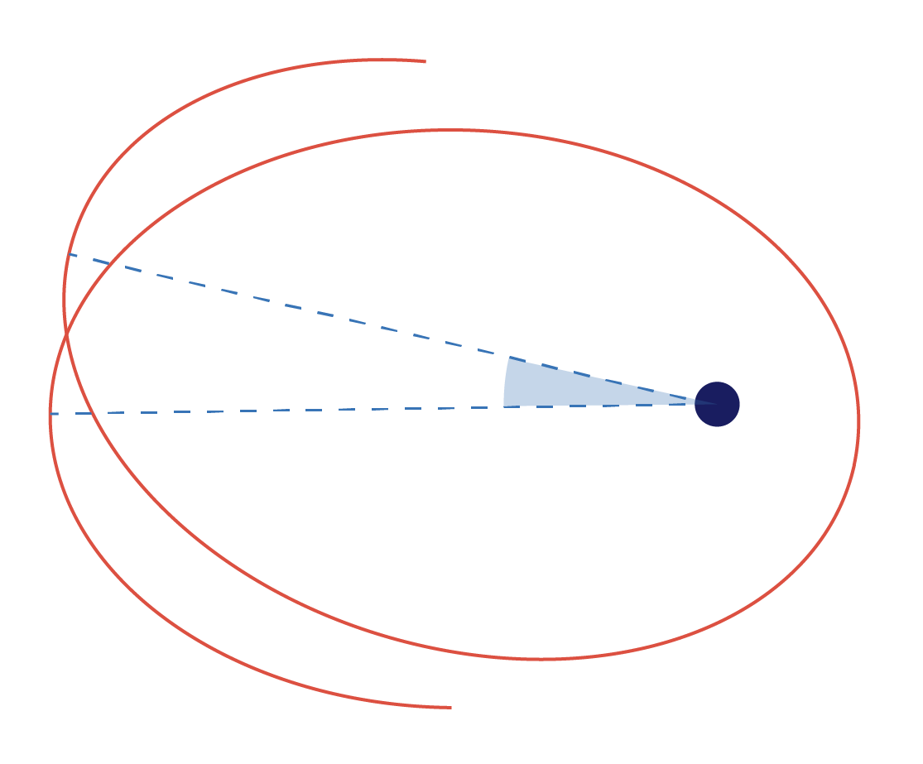

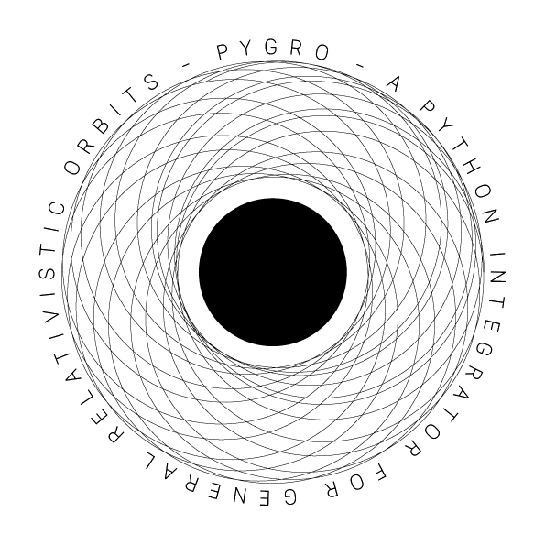

3.
Modeling pulsars times of arrival and residuals
Integrate
the pulsar orbit
Find the connecting photon
Compute
the propagation time
PyGRO
a Python integrator for General Relativistic Orbits
In any given asymptotically-flat spherically symmetric space-time
https://github.com/rdellamonica/pygro

Slide 18
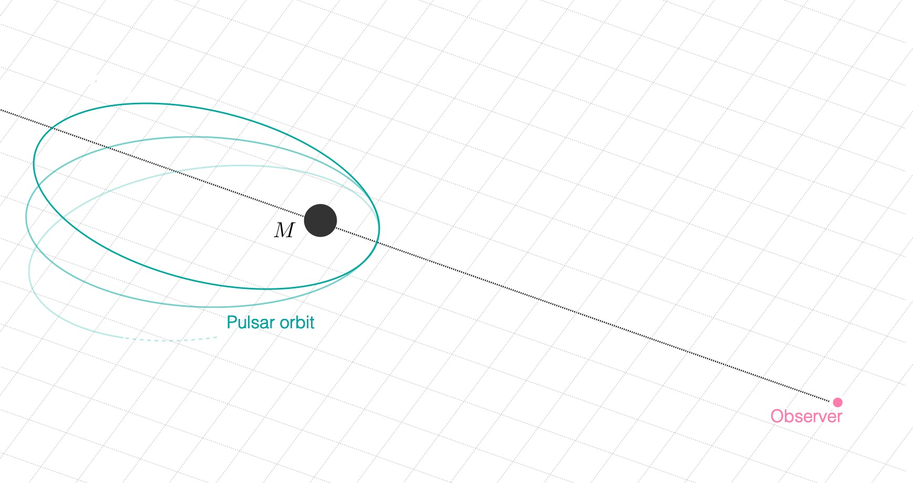
3.
Modeling pulsars times of arrival and residuals
Integrate
the pulsar orbit
Find the connecting photon
Compute
the propagation time

Slide 19
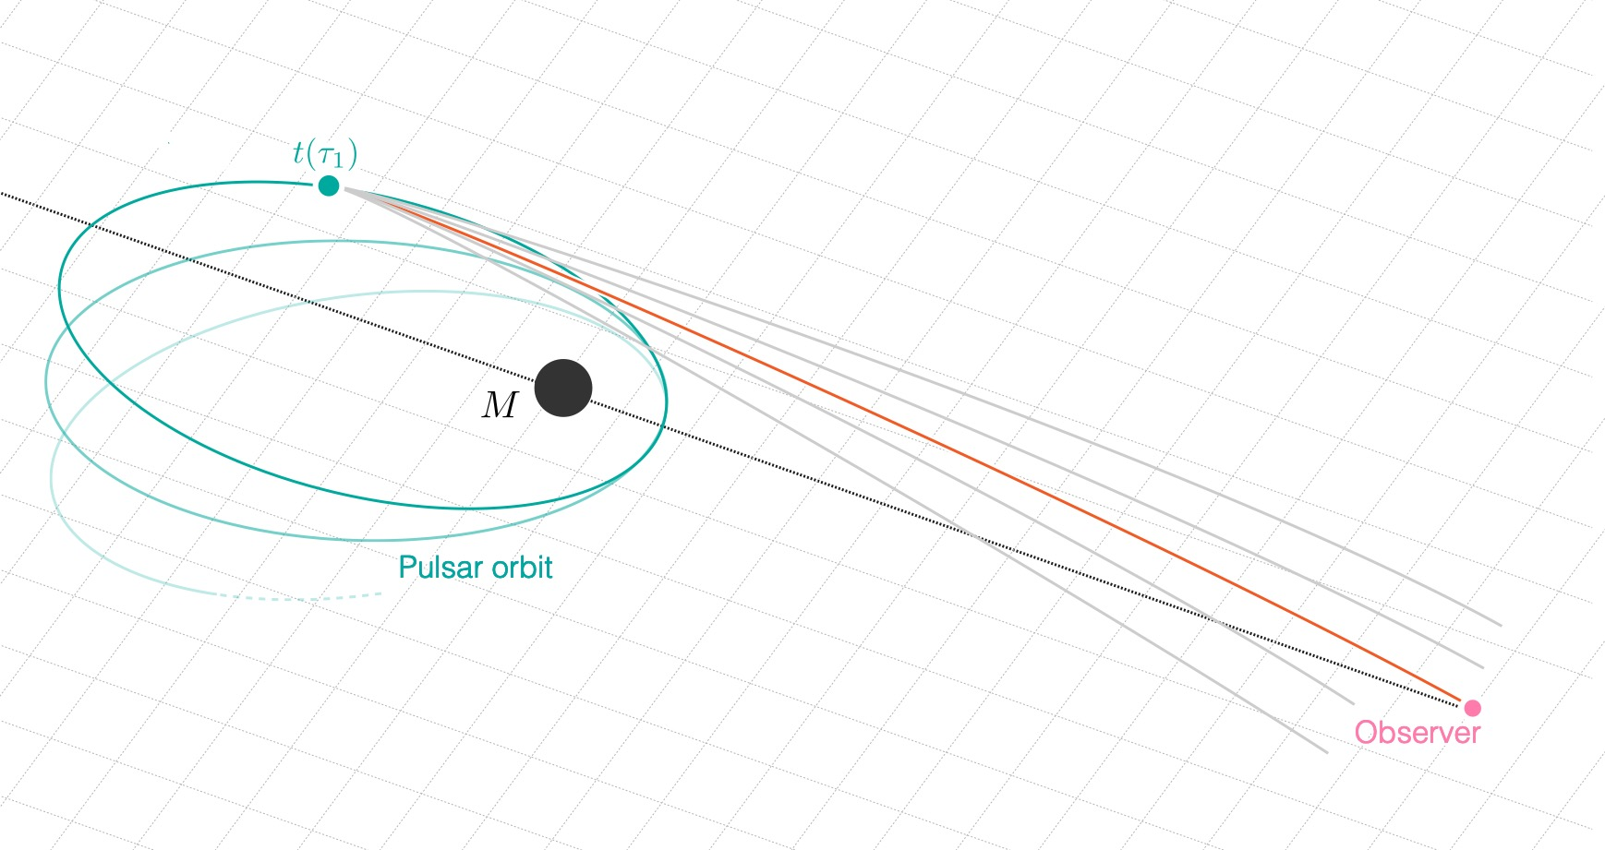
3.
Modeling pulsars times of arrival and residuals
Integrate
the pulsar orbit
Find the connecting photon
Compute
the propagation time
Given an emission point
Solve numerically for b

Slide 20
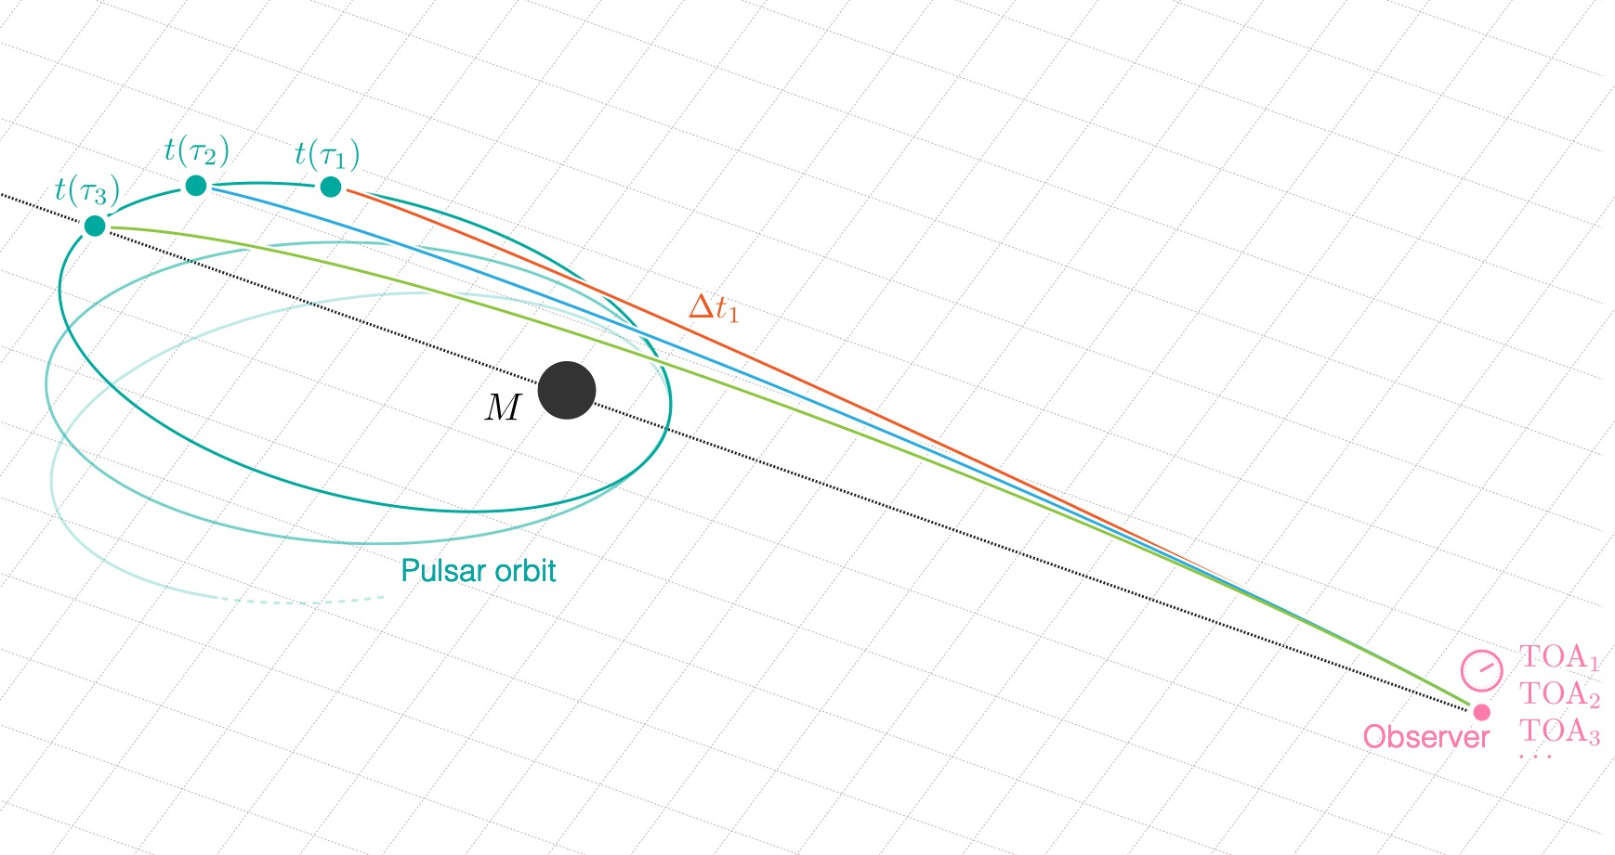
3.
Modeling pulsars times of arrival and residuals
Integrate
the pulsar orbit
Find the connecting photon
Compute
the propagation time
Once the impact parameter is known we can integrate the propagation time numerically

Slide 21
3.
Modeling pulsars times of arrival and residuals
Integrate
the pulsar orbit
Find the connecting photon
Compute
the propagation time
Timing model
Once the impact parameter is known we can integrate the propagation time numerically
Direct
Indirect

Slide 22
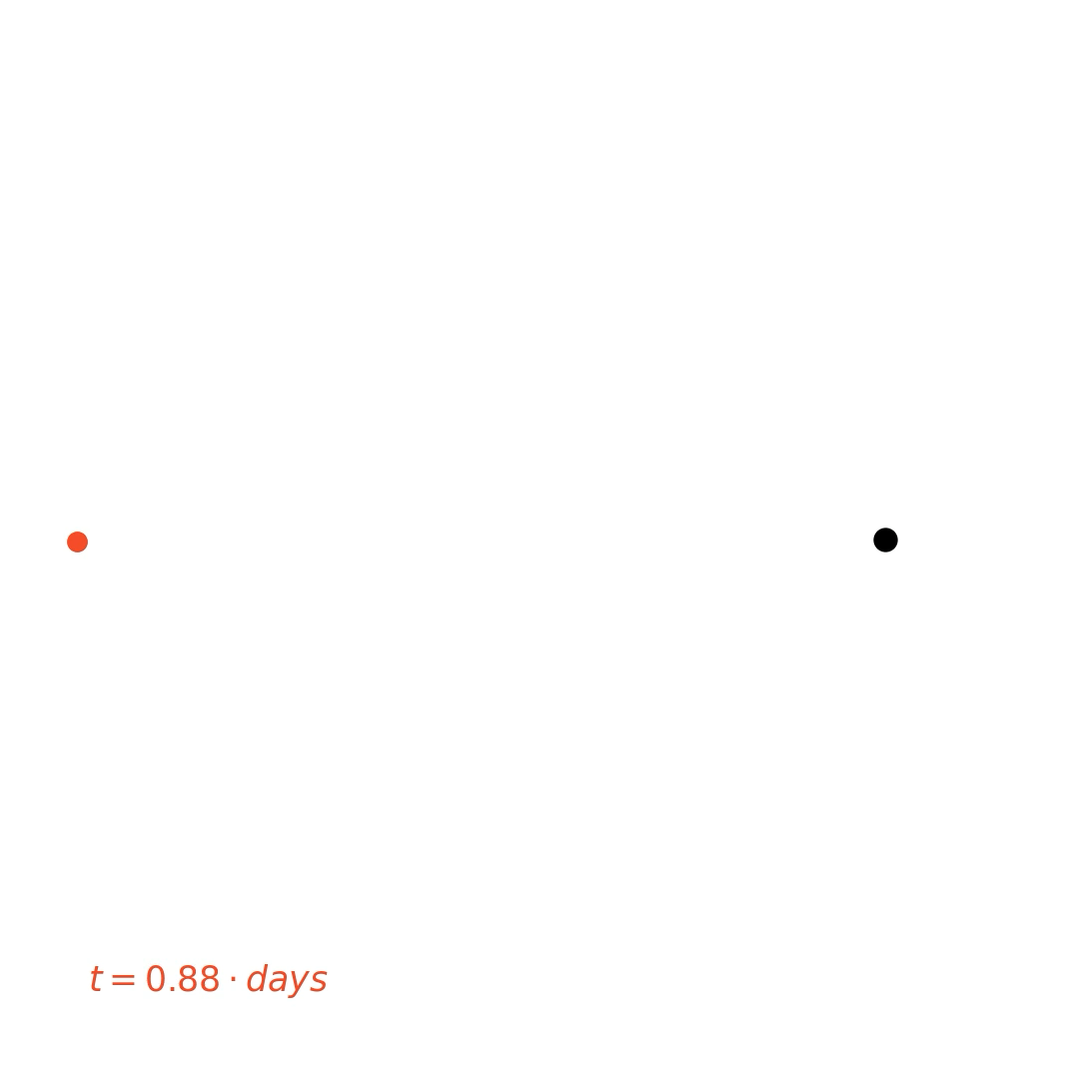

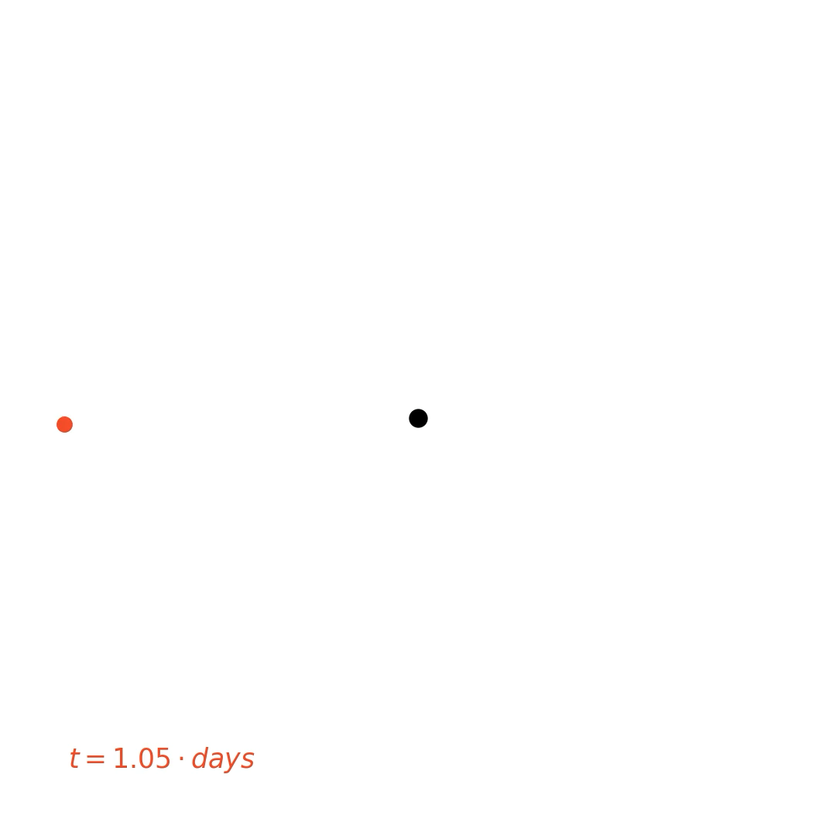
3.
Sensitivity of timing residuals to the spacetime metric
315 AU
75 AU
9 AU
Toy 1
Toy 2
Toy 3
Increasingly extreme orbital features
Toy 0

Slide 23
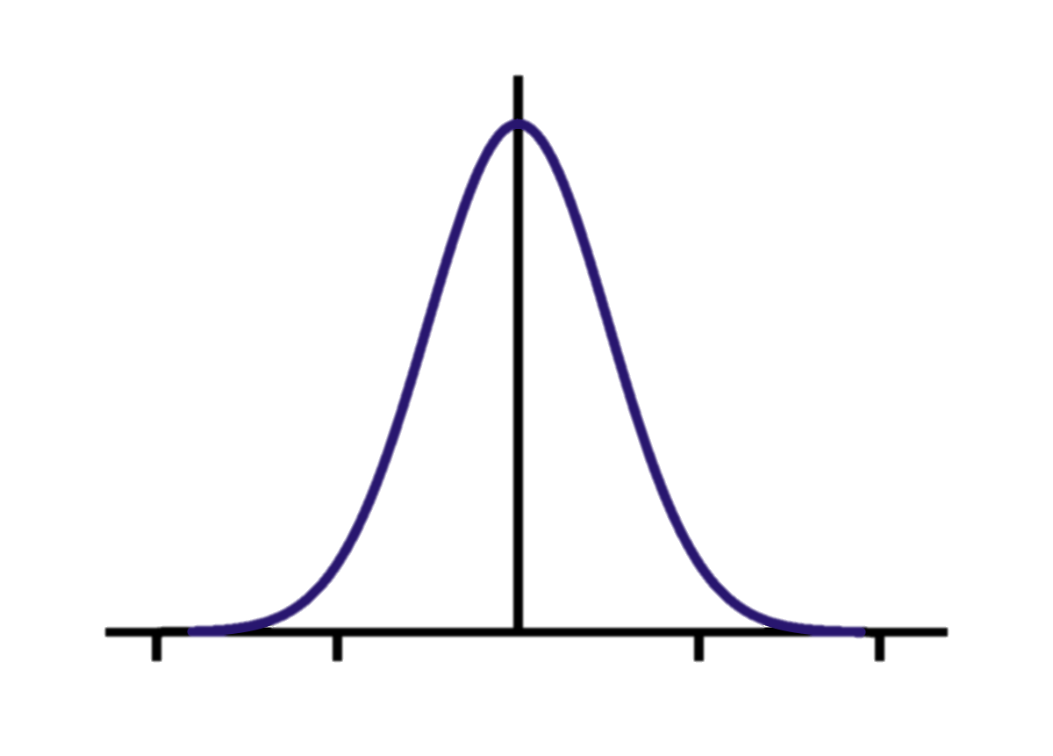
3.
Future prospects: testing black hole spacetimes with pulsar timing
Toy 2
Timing model
Gaussian noise
Mock catalogue
of TOAs

Slide 24
3.
Future prospects: testing black hole spacetimes with pulsar timing

Slide 25
3.
Future prospects: testing black hole spacetimes with pulsar timing

Slide 26
3.
Future prospects: testing black hole spacetimes with pulsar timing

Slide 27
3.
Future prospects: testing black hole spacetimes with pulsar timing
Amplitude of the residuals

Slide 28
3.
Future prospects: testing black hole spacetimes with pulsar timing
Subset of parameters
Timing model
Inverted timing model
Likelihood
Samples of the relation
Spline interpolation
MCMC analysis

Slide 29
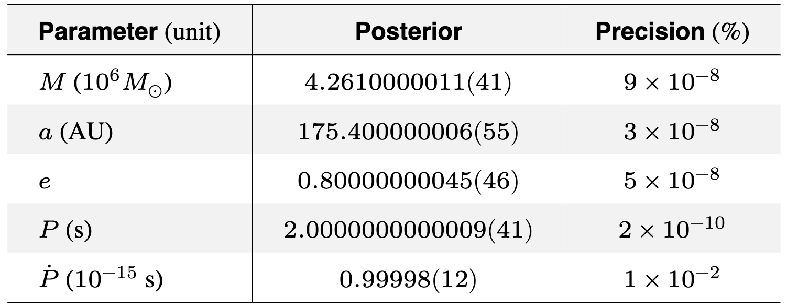
3.
Future prospects: testing black hole spacetimes with pulsar timing

Slide 30
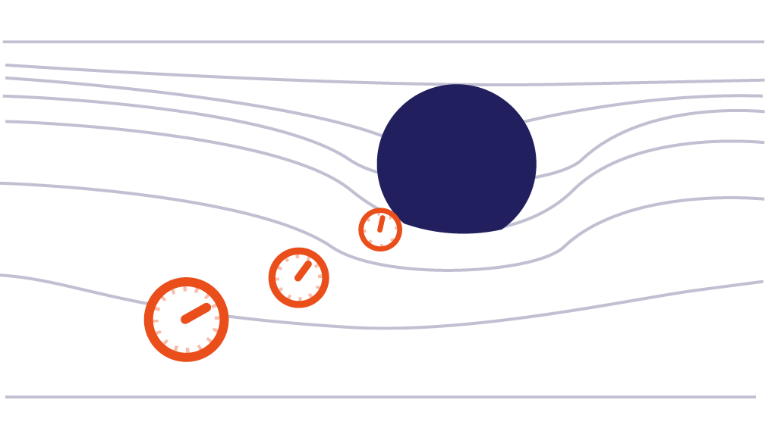
Conclusions
Python Integrator for
General
Relativistic
Orbits
Time-like
Pulsars at Galactic Center
Timing analysis of Galactic Center pulsars on relativistic orbits (T < 10 yr) with accuracy of 100 microseconds as promised by next observational facilities enables unprecedented constraints
Null
All relativistic effects are self-consistently included in the integrated observables
Nature and physical properties of Sgr A*
Underlying theory of gravity
Limitation
Future prospects
We have limited ourselves to spherically symmetric models
Extend the methodology to assign initial conditions both for time-like and null particles to axisymmetric spacetime
Publish, document and maintain PyGRO as an open-source Python package for the benefit of the community
With future observations the spin of Sgr A* cannot be neglected
No
Hair
Theorem

Slide 31
Thank you
for your attention

