Slide 1




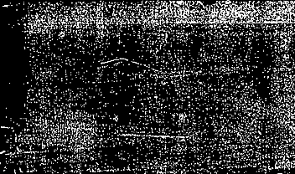
ATLaS + CMS Top Cross sections
Joe Boudreau
University of Pittsburgh
On behalf of the ATLAS and CMS collaborations.

Slide 2
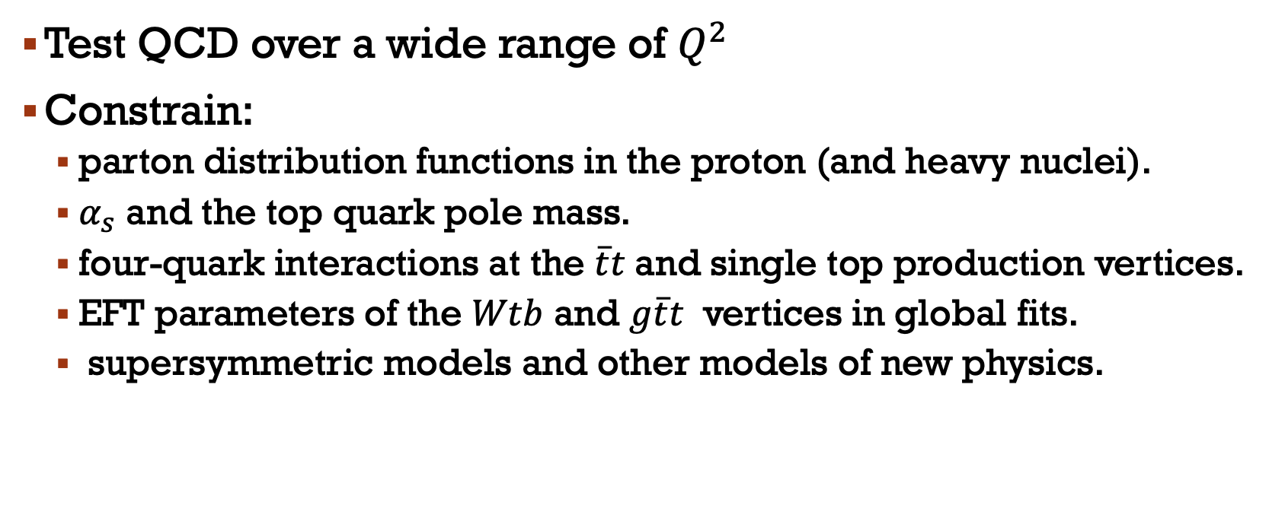

Why measure $\overline{t}t$& single top cross sections?
Test QCD over a wide range of $Q^{2}$
Constrain:
  parton distribution functions in the proton (and heavy nuclei).
  $α_{s}$ and the top quark pole mass.
  four-quark interactions at the $\overline{t}t$and single top production vertices.
  EFT parameters of the $Wtb$ and $g\overline{t}t$ vertices in global fits.
  supersymmetric models and other models of new physics.

Slide 3
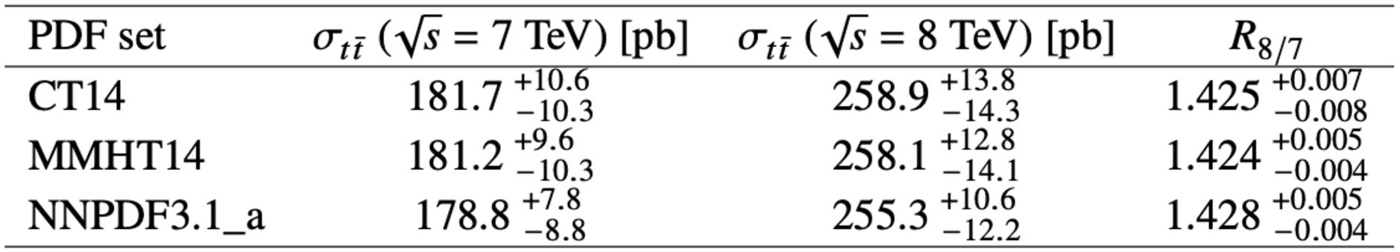

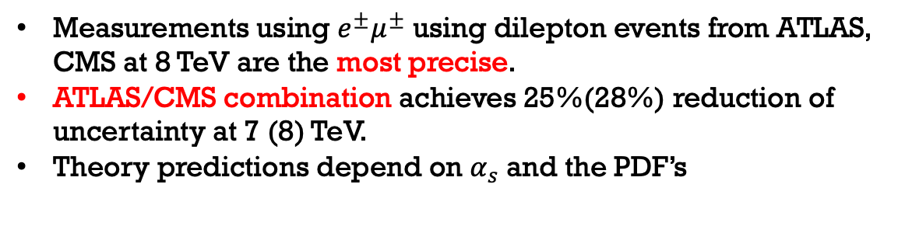
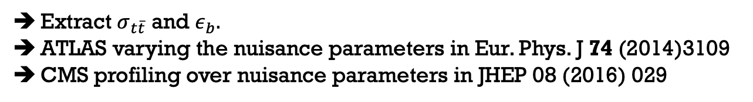
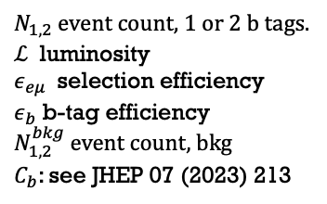
7 and 8 TeV $\overline{t}t$ cross section
Measurements using $e^{±}μ^{±}$ using dilepton events from ATLAS, CMS at 8 TeV are the most precise.
ATLAS/CMS combination achieves 25%(28%) reduction of uncertainty at 7 (8) TeV.
Theory predictions depend on $α_{s}$ and the PDF’s
Nuisance parameters
Double-tag method:
$N_{1,2}$ event count, 1 or 2 b tags.
$ℒ$ luminosity
$ε_{eμ}$ selection efficiency
$ε_{b}$ b-tag efficiency
$N_{1,2}^{bkg}$ event count, bkg
$C_{b}$: see JHEP 07 (2023) 213
Cross sections
Extract $σ_{t\overline{t}}$ and $ε_{b}.$
ATLAS varying the nuisance parameters in Eur. Phys. J 74 (2014)3109
CMS profiling over nuisance parameters in JHEP 08 (2016) 029
JHEP 07 (2023) 213 | $\overline{t}t$ XS, ATLAS CMS combination | 7, 8 TeV | 5, 20 fb⁻¹ | pp

Slide 4
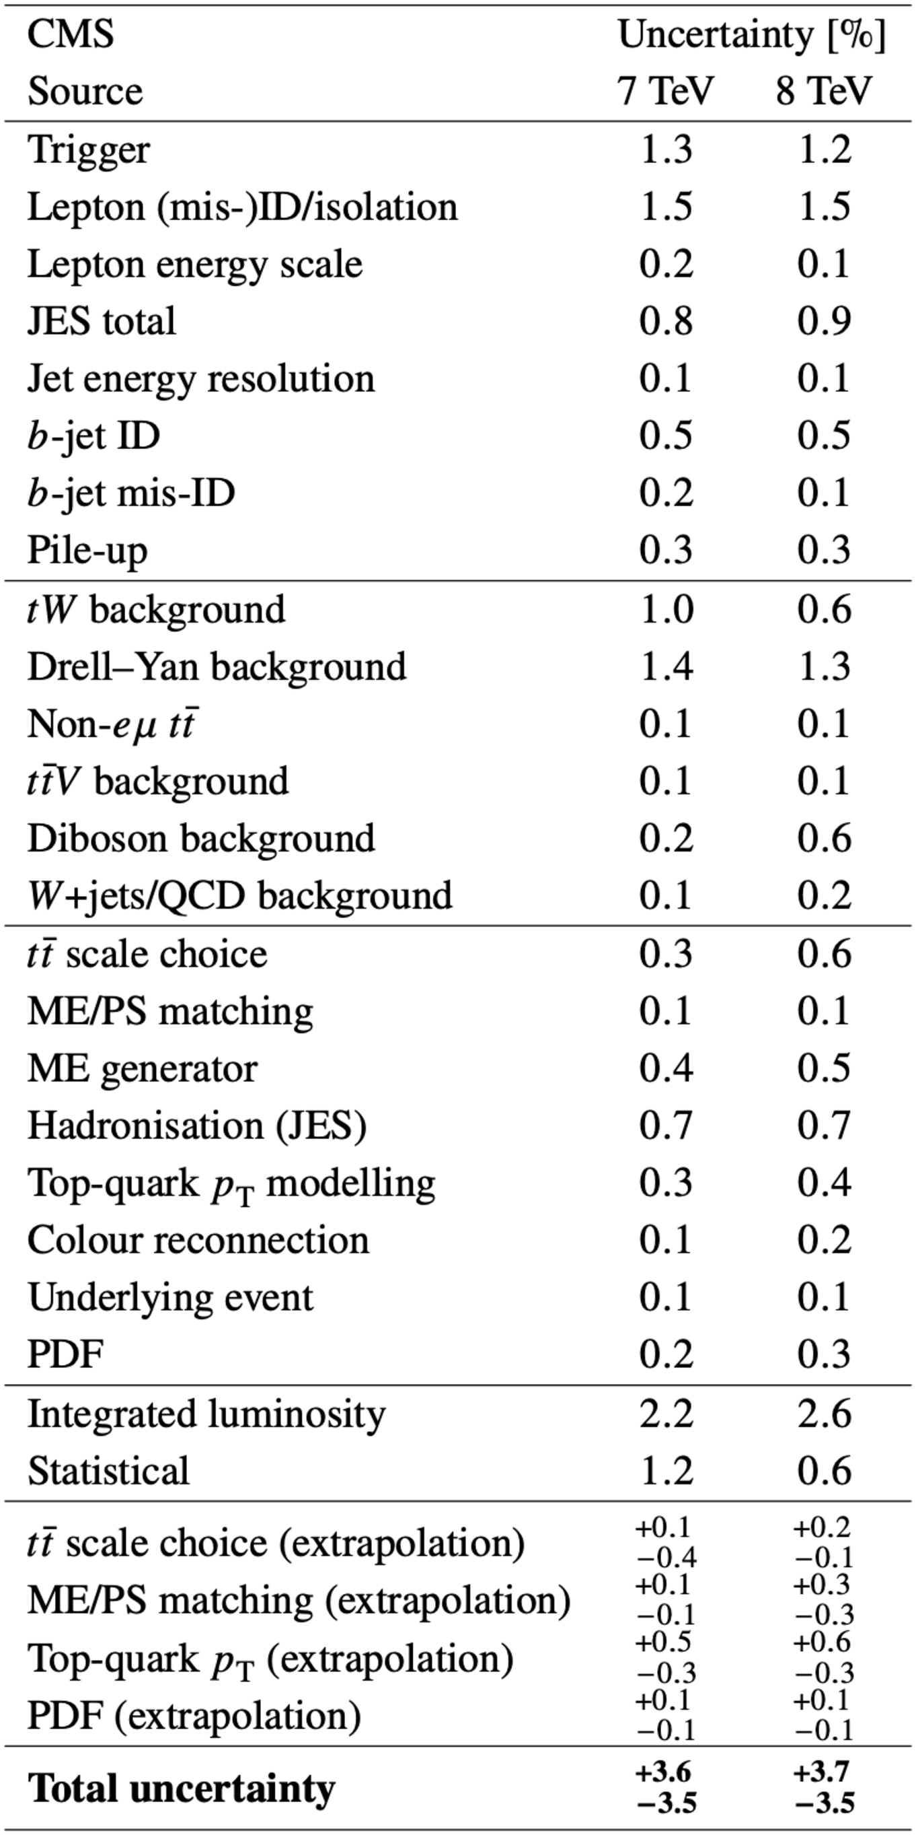
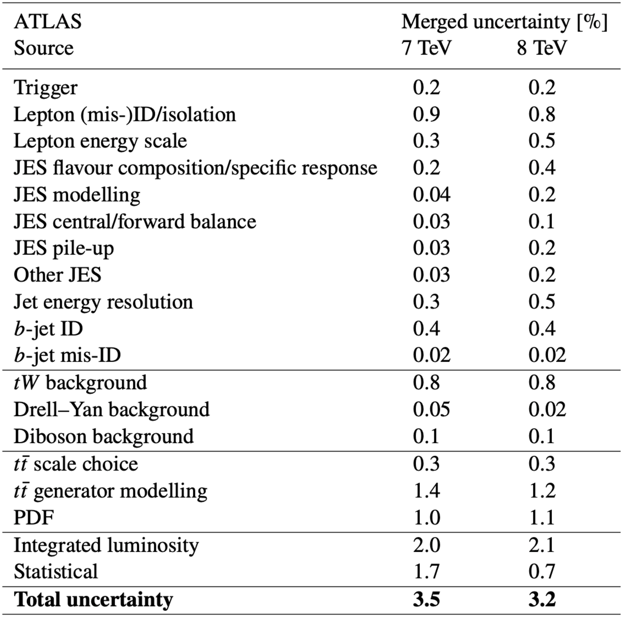

Systematic uncertainties
Total uncertainties comparable beween ATLAS/CMS.
Both dominated by Luminosity uncertainty.
JHEP 07 (2023) 213 | $\overline{t}t$ XS, ATLAS CMS combination | 7, 8 TeV | 5, 20 fb⁻¹

Slide 5
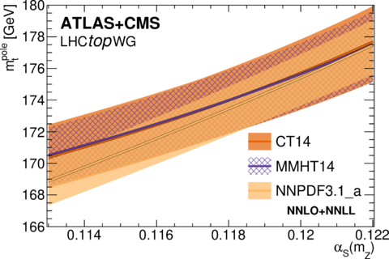
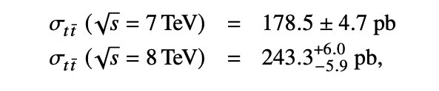
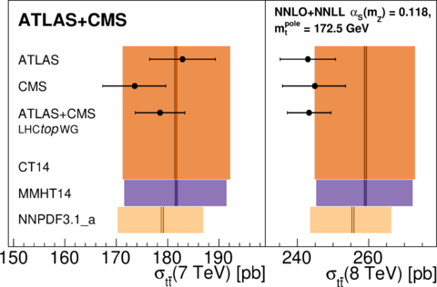
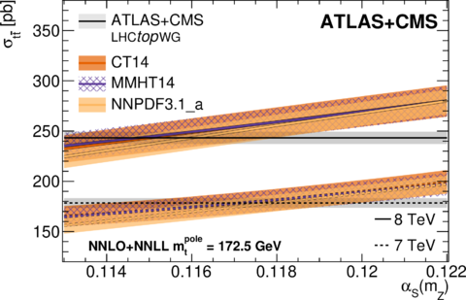
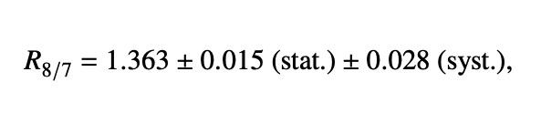
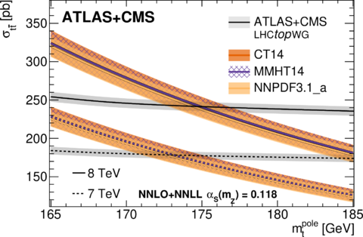
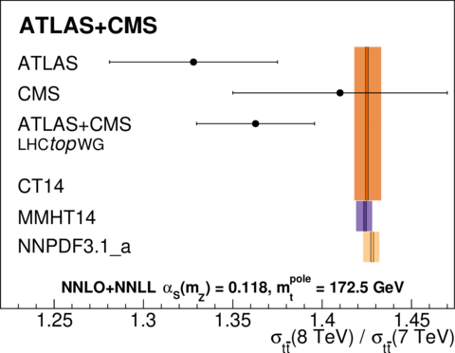
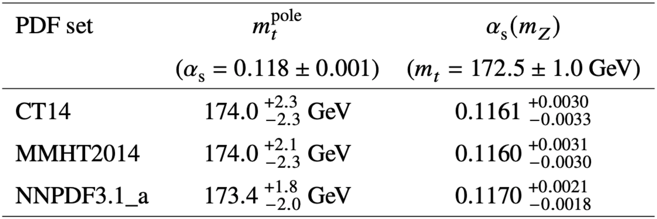

Combined results
Correlation: $ρ=41\%$
JHEP 07 (2023) 213 | $\overline{t}t$ XS, ATLAS CMS combination | 7, 8 TeV | 5, 20 fb⁻¹

Slide 6
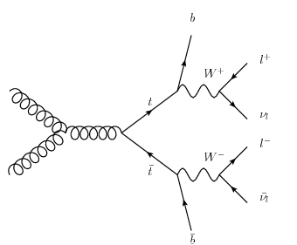
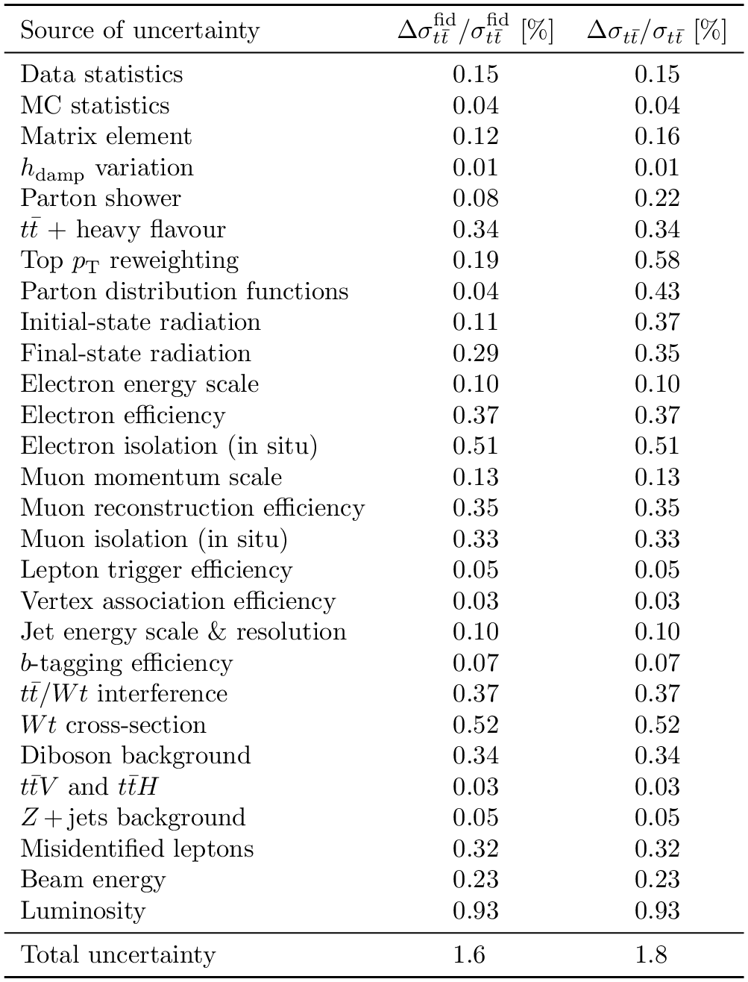
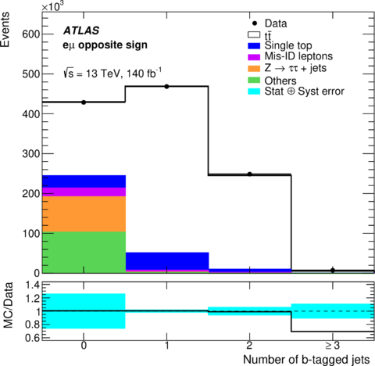
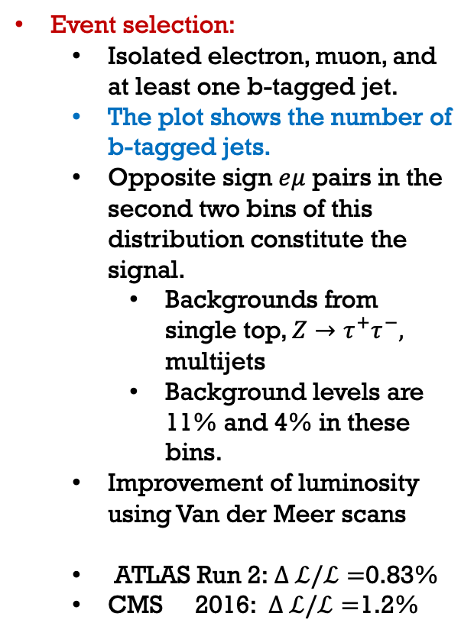

$t\overline{t}$cross section, 13 TeV, $e^{±}μ^{∓}$ eventS
Event selection:
  Isolated electron, muon, and at least one b-tagged jet.
  The plot shows the number of b-tagged jets.
  Opposite sign $eμ$ pairs in the second two bins of this distribution constitute the signal.
    Backgrounds from single top, $Z→τ^{+}τ^{−},$ multijets
    Background levels are 11% and 4% in these bins.
  Improvement of luminosity using Van der Meer scans
  ATLAS Run 2:$∆ ℒ/ℒ=$0.83%
  CMS 2016:$∆ ℒ/ℒ=$1.2%
JHEP 07 (2023) 141 | $\overline{t}t$ XS, dileption, differential | 13 TeV | 140 fb⁻¹

Slide 7
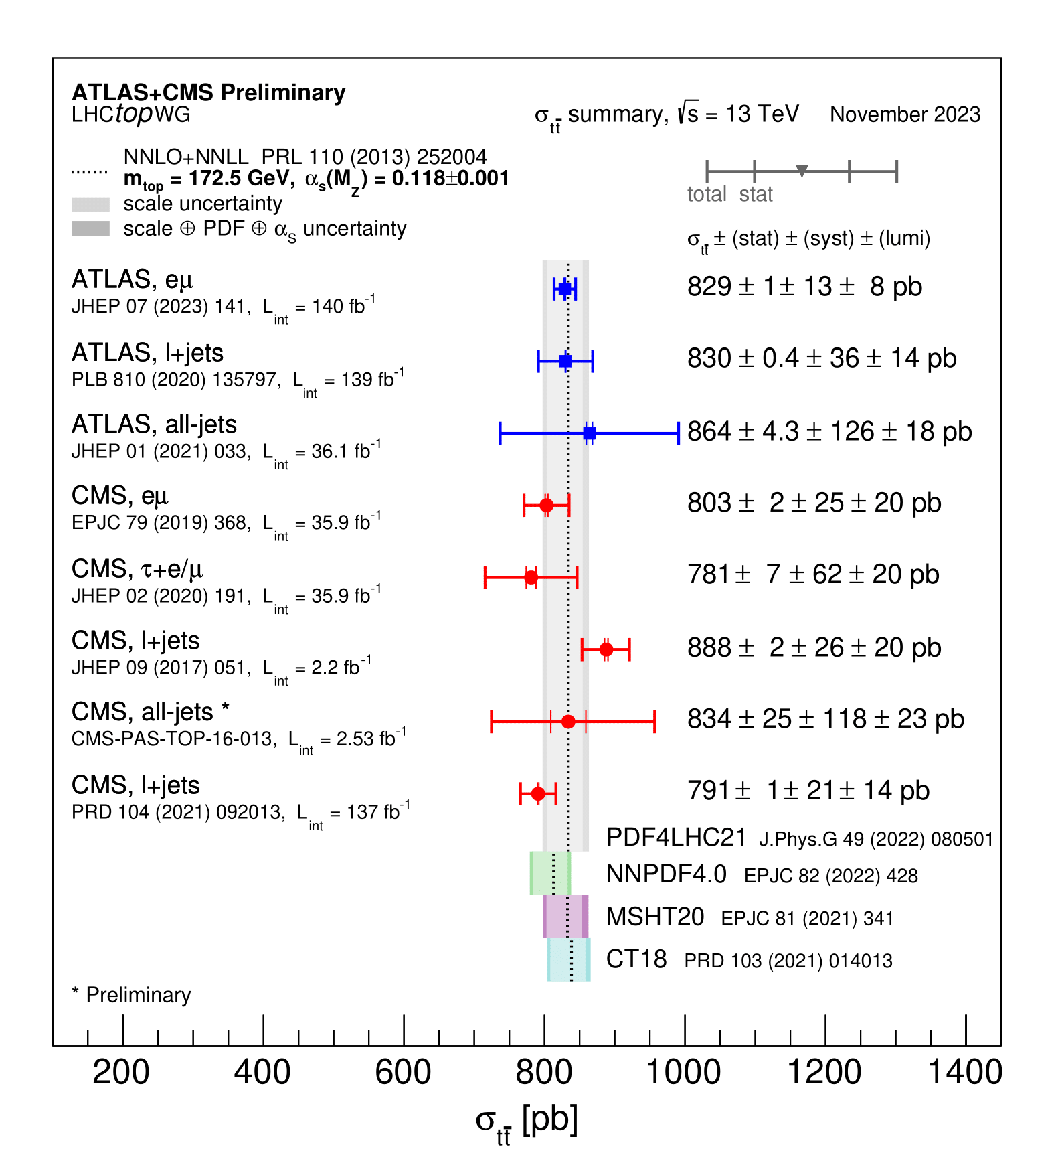
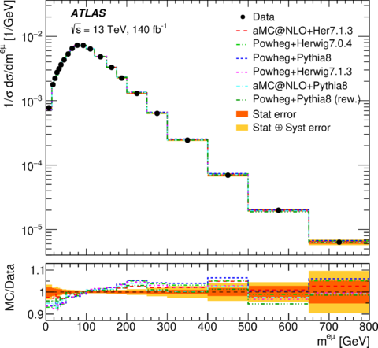
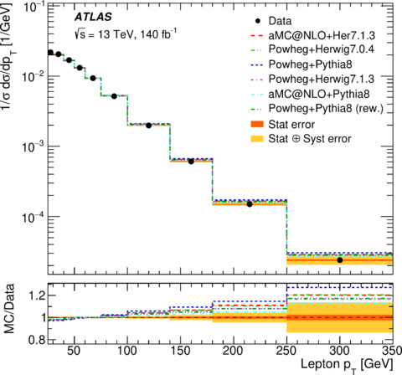

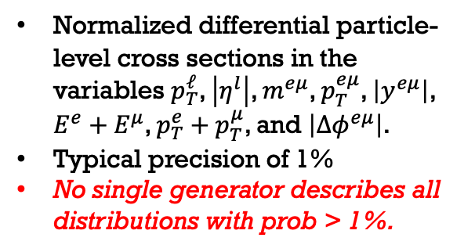

Results $e^{±}μ^{∓}$ eventS
Fiducial cross section and inclusive cross sections at $√s$= 13 TeV
  $σ_{\overline{t}t}^{fid}=10.53±0.02$(stat)$±0.13\left(syst\right)±0.10\left(lumi\right)±0.02 (beam)$ pb
  $σ_{\overline{t}t}=829±1$(stat)$±13\left(syst\right)±8\left(lumi\right)±2 (beam)$ pb
  This is the most precise measurement at 13 TeV
Normalized differential particle-level cross sections in the variables $p_{T}^{ℓ}$, $\left|η^{l}\right|$, $m^{eμ}$, $p_{T}^{eμ}$, $\left|y^{eμ}\right|$, $E^{e}+E^{μ}$, $p_{T}^{e}+p_{T}^{μ}$, and $\left|Δφ^{eμ}\right|$.
Typical precision of 1%
No single generator describes all distributions with prob > 1%.
JHEP 07 (2023) 141 | $\overline{t}t$ XS, dileption, differential | 13 TeV | 140 fb⁻¹

Slide 8
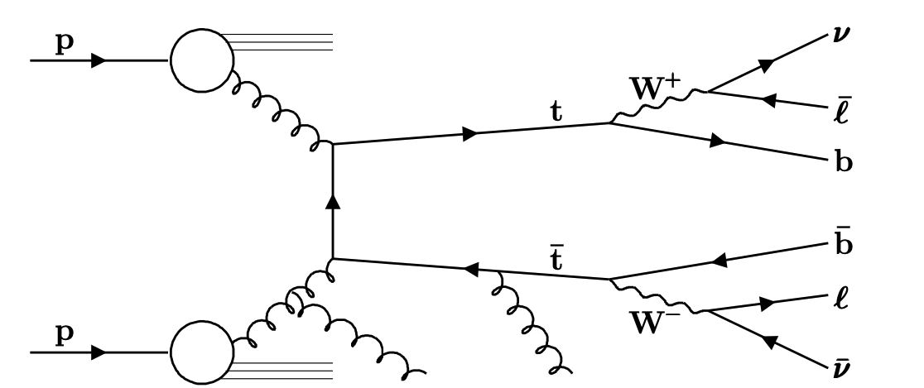
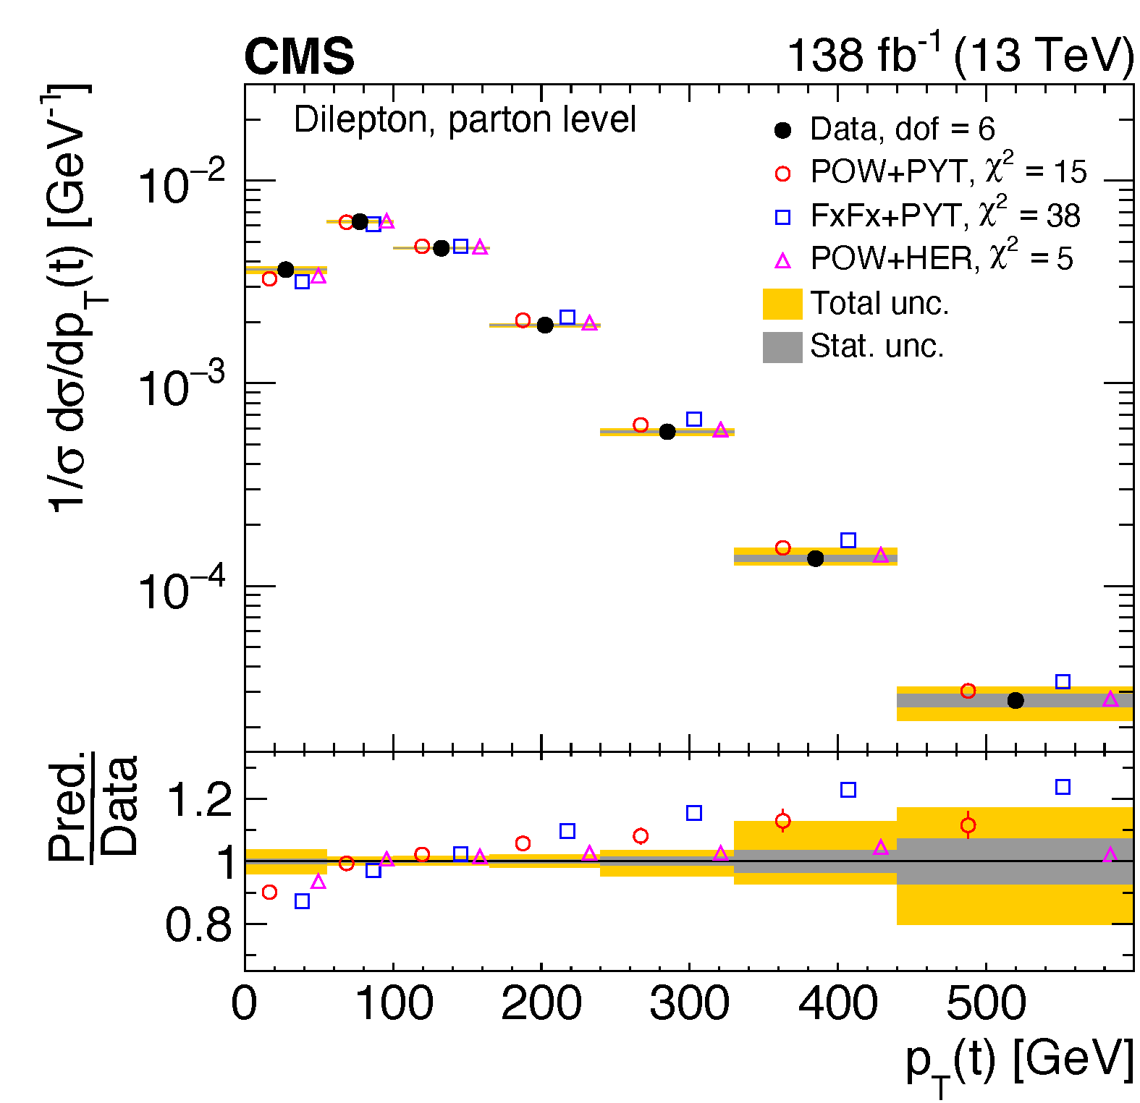
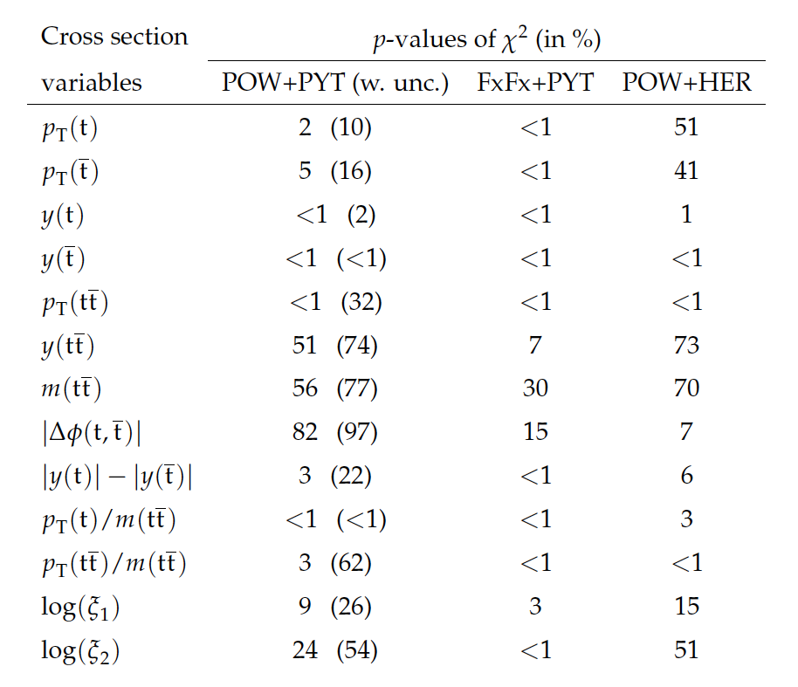
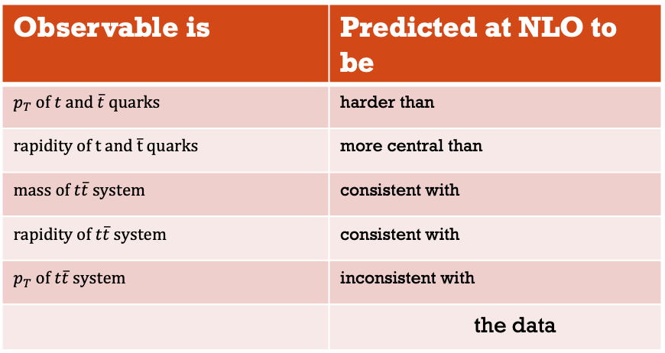
Differential distributions in dilepton events with additional jets
Observable is | Predicted at NLO to be
$$p_{T} of t and \overline{t} quarks$$ | harder than
$$rapidity of t and \overline{t} quarks$$ | more central than
$mass of t\overline{t} system$ | consistent with
$rapidity of t\overline{t} system$ | consistent with
$$p_{T} of t\overline{t} system$$ | inconsistent with
 | the data
More than 250 single and double differential cross sections are reported on at particle and parton level.
Tabulated data available in HEPData.
arXiv:2402.08486 | $\overline{t}t$ XS, dilepton, differential | 13 TeV | 138 fb⁻¹

Slide 9

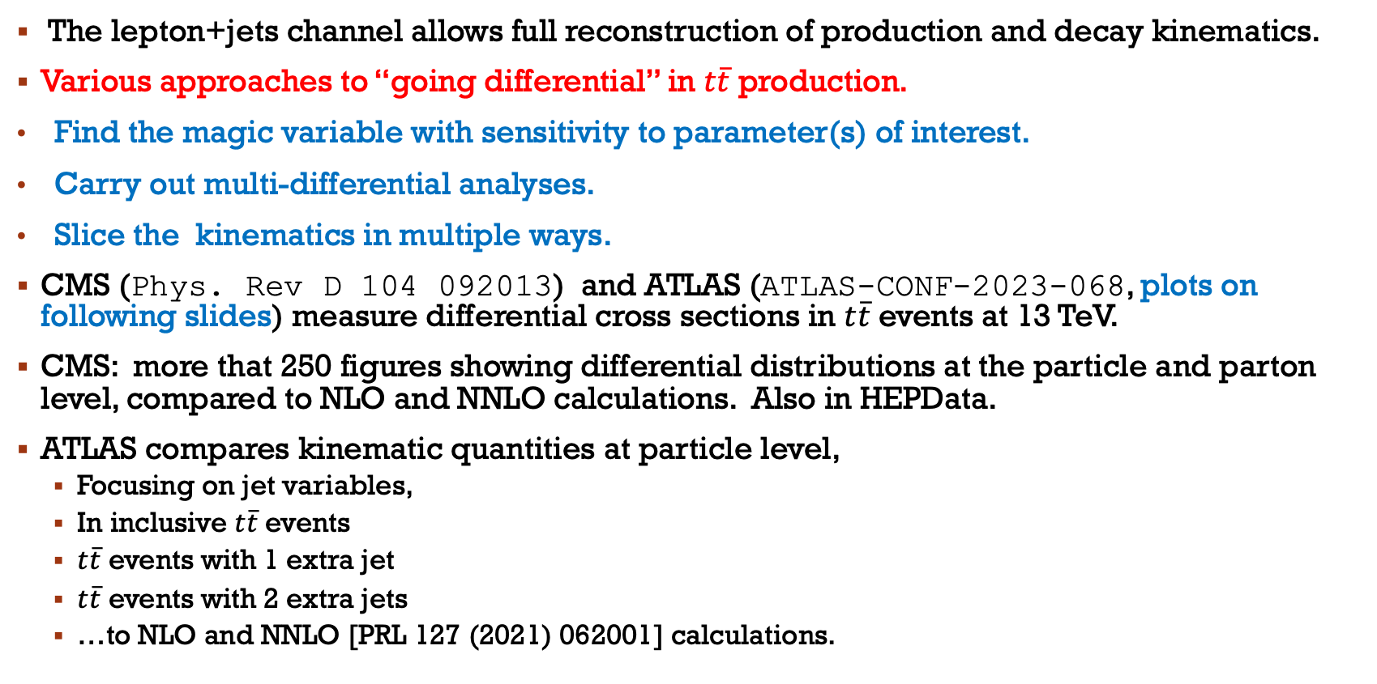

$t\overline{t}$Differential cross sections, lepton+ jets
The lepton+jets channel allows full reconstruction of production and decay kinematics.
Various approaches to “going differential” in $t\overline{t}$ production.
Find the magic variable with sensitivity to parameter(s) of interest.
Carry out multi-differential analyses.
Slice the kinematics in multiple ways.
CMS (Phys. Rev D 104 092013) and ATLAS (ATLAS-CONF-2023-068, plots on following slides) measure differential cross sections in $t\overline{t}$ events at 13 TeV.
CMS: more that 250 figures showing differential distributions at the particle and parton level, compared to NLO and NNLO calculations. Also in HEPData.
ATLAS compares kinematic quantities at particle level,
  Focusing on jet variables,
  In inclusive $t\overline{t}$ events
  $t\overline{t}$ events with 1 extra jet
  $t\overline{t}$ events with 2 extra jets
  …to NLO and NNLO [PRL 127 (2021) 062001] calculations.
ATLAS-CONF-2023-068

Slide 10
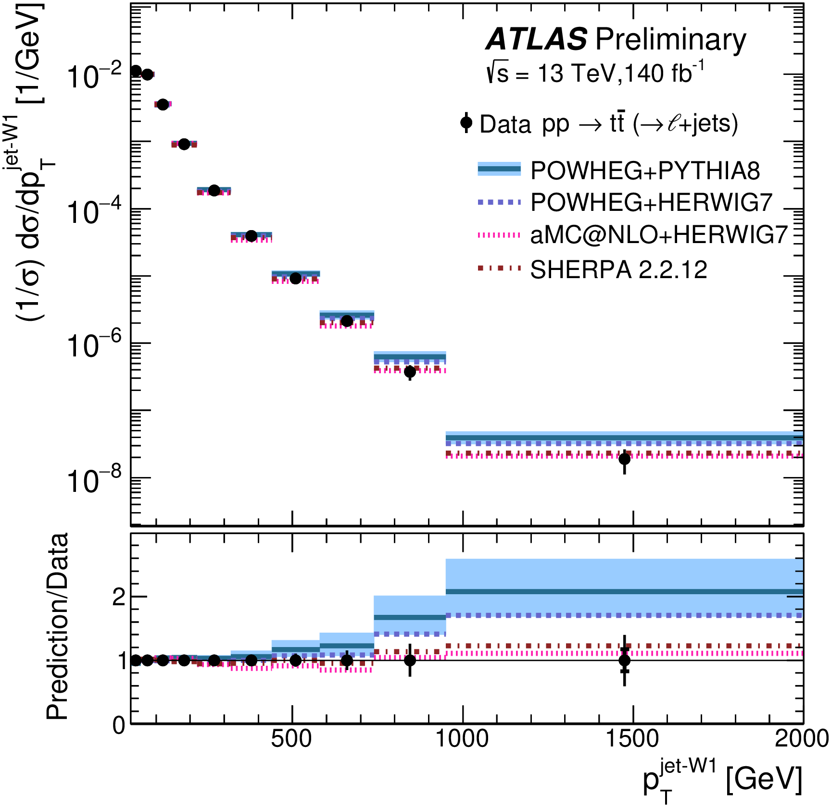
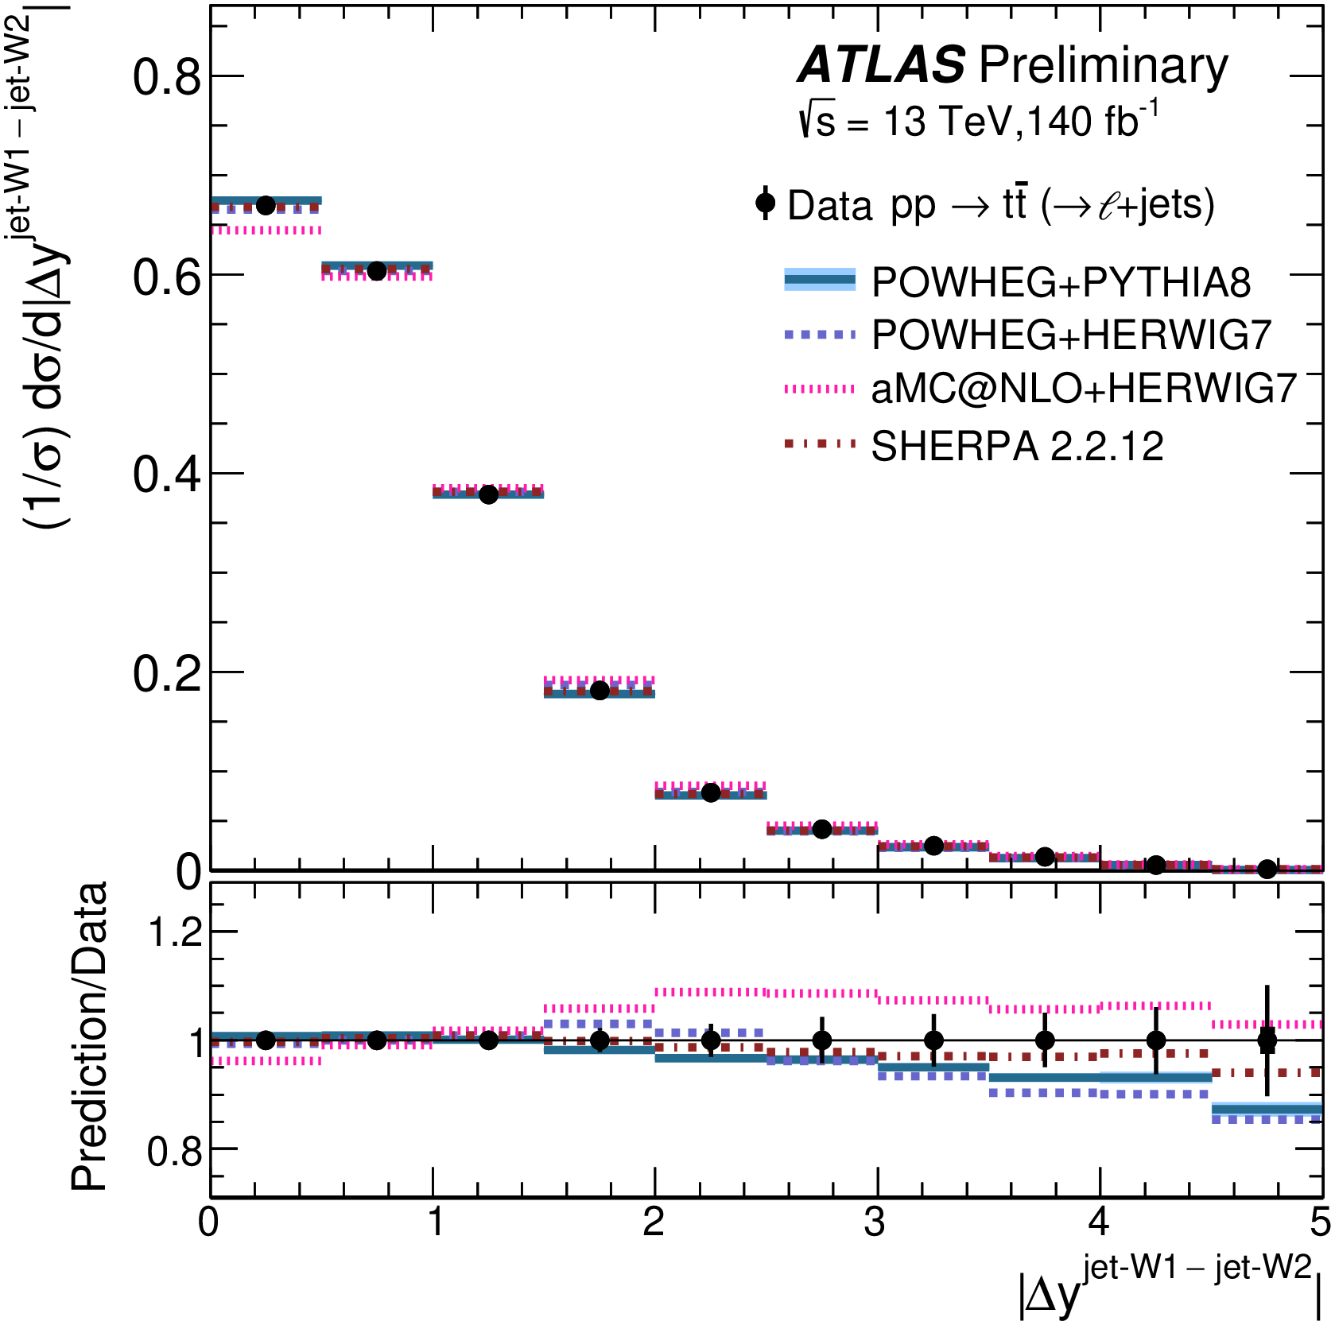
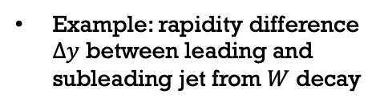
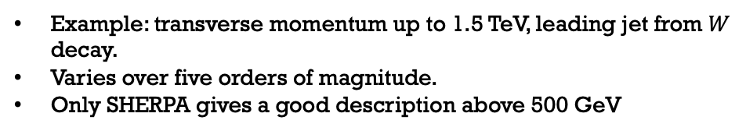
Normalized differential distributions, jets from W boson decay on the hadronic side, $t\overline{t}$ inclusive events compared to NLO simulation
Example: transverse momentum up to 1.5 TeV, leading jet from $W$ decay.
Varies over five orders of magnitude.
Only SHERPA gives a good description above 500 GeV
Example: rapidity difference $Δy$ between leading and subleading jet from $W$ decay
ATLAS-CONF-2023-068 | $\overline{t}t$ Diff cross sections $ℓ$+jets | 13 TeV | 140 fb⁻¹

Slide 11
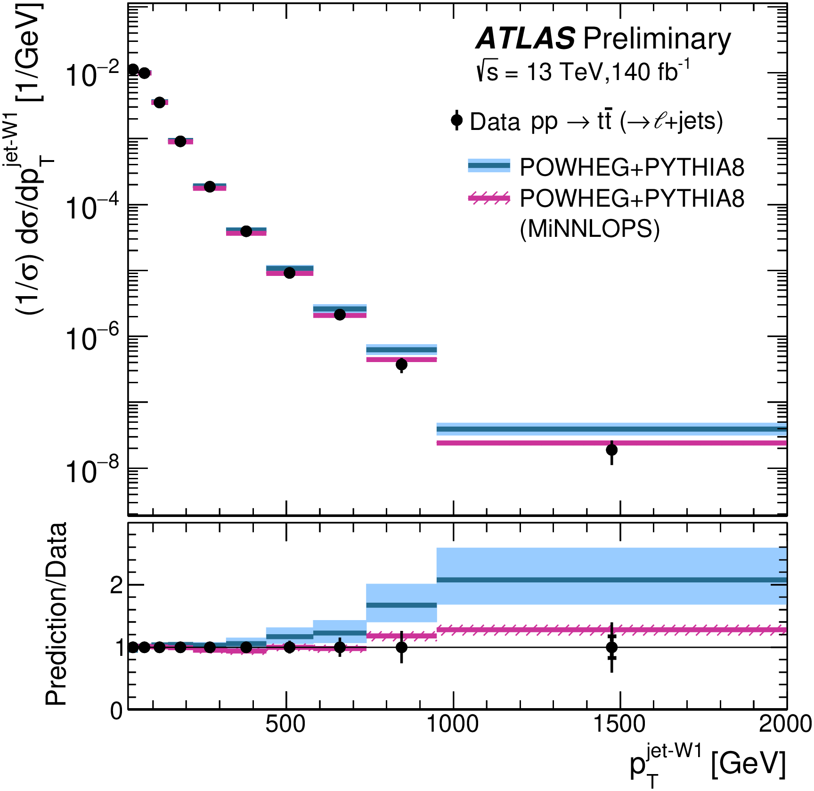
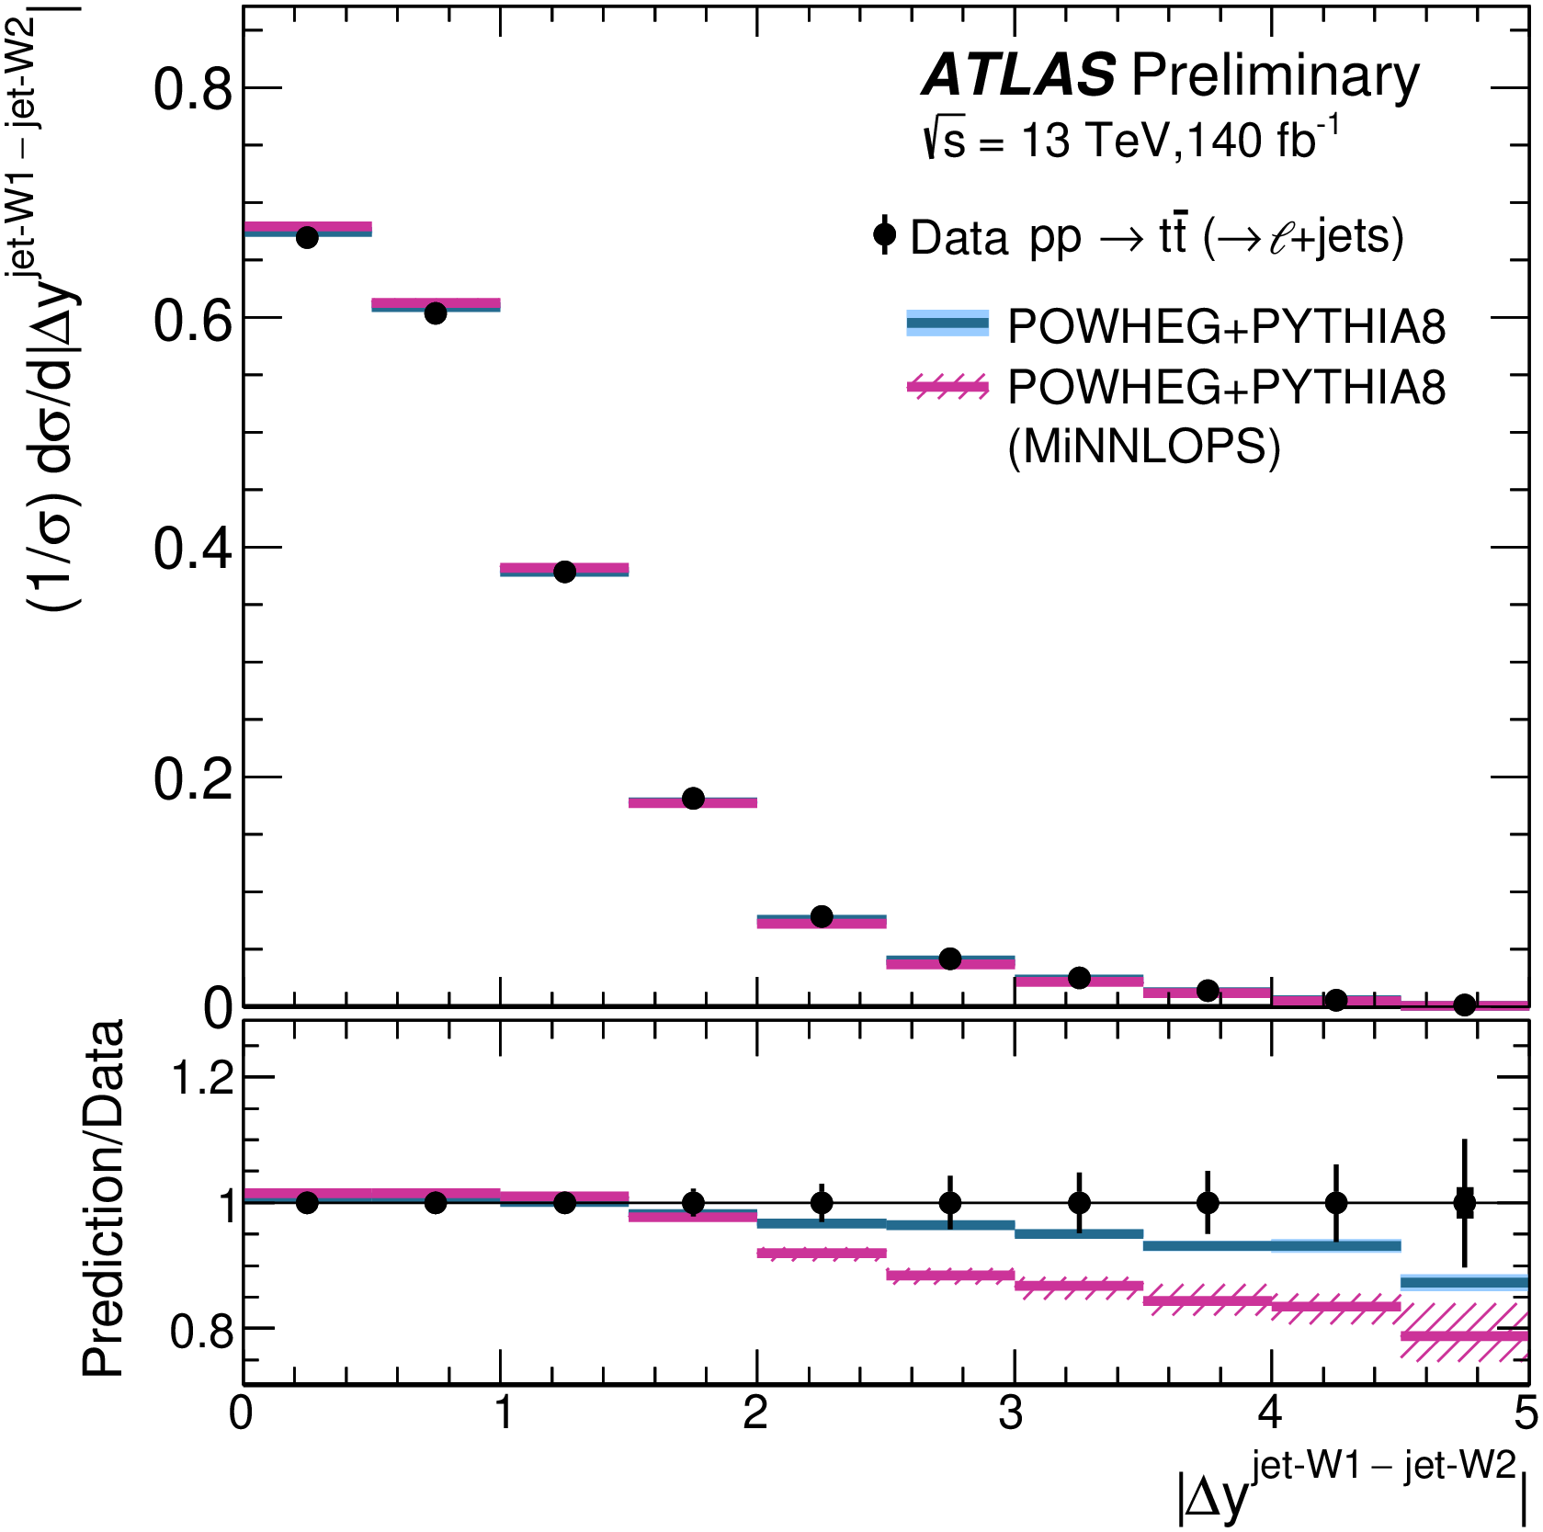

Normalized differential distributions, jets from W boson decay on the hadronic side,$t\overline{t}$ inclusive events compared to NLO and NNLO simulation
NNLO gives a more precise prediction and better agreement with the data..
However shows discrepancy with the $Δy$ distribution.
ATLAS-CONF-2023-068 | $\overline{t}t$ Diff cross sections $ℓ$+jets | 13 TeV | 140 fb⁻¹

Slide 12
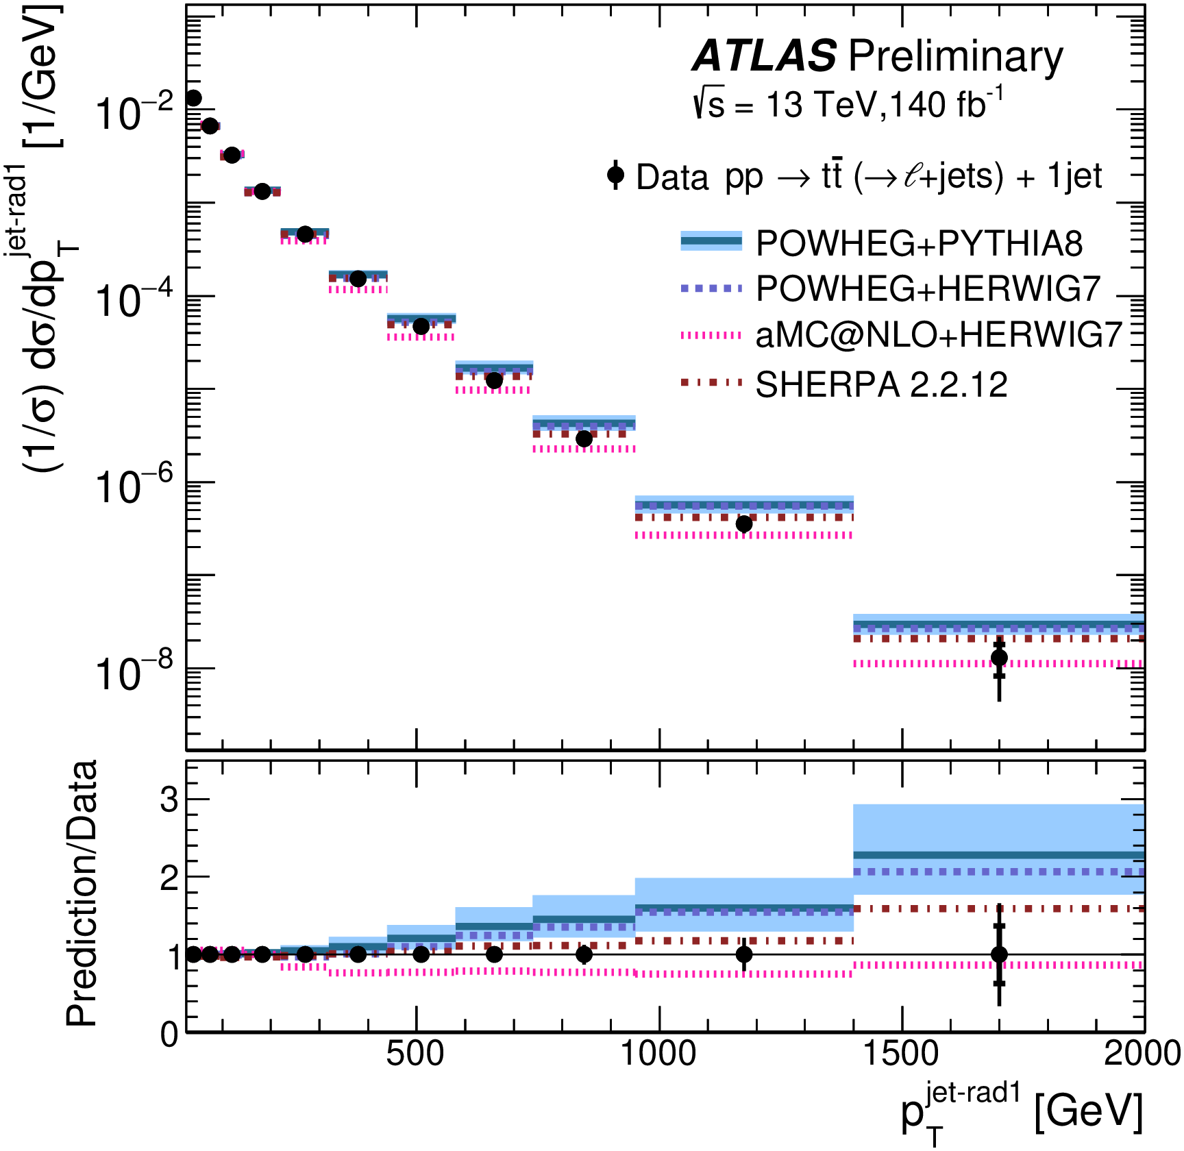
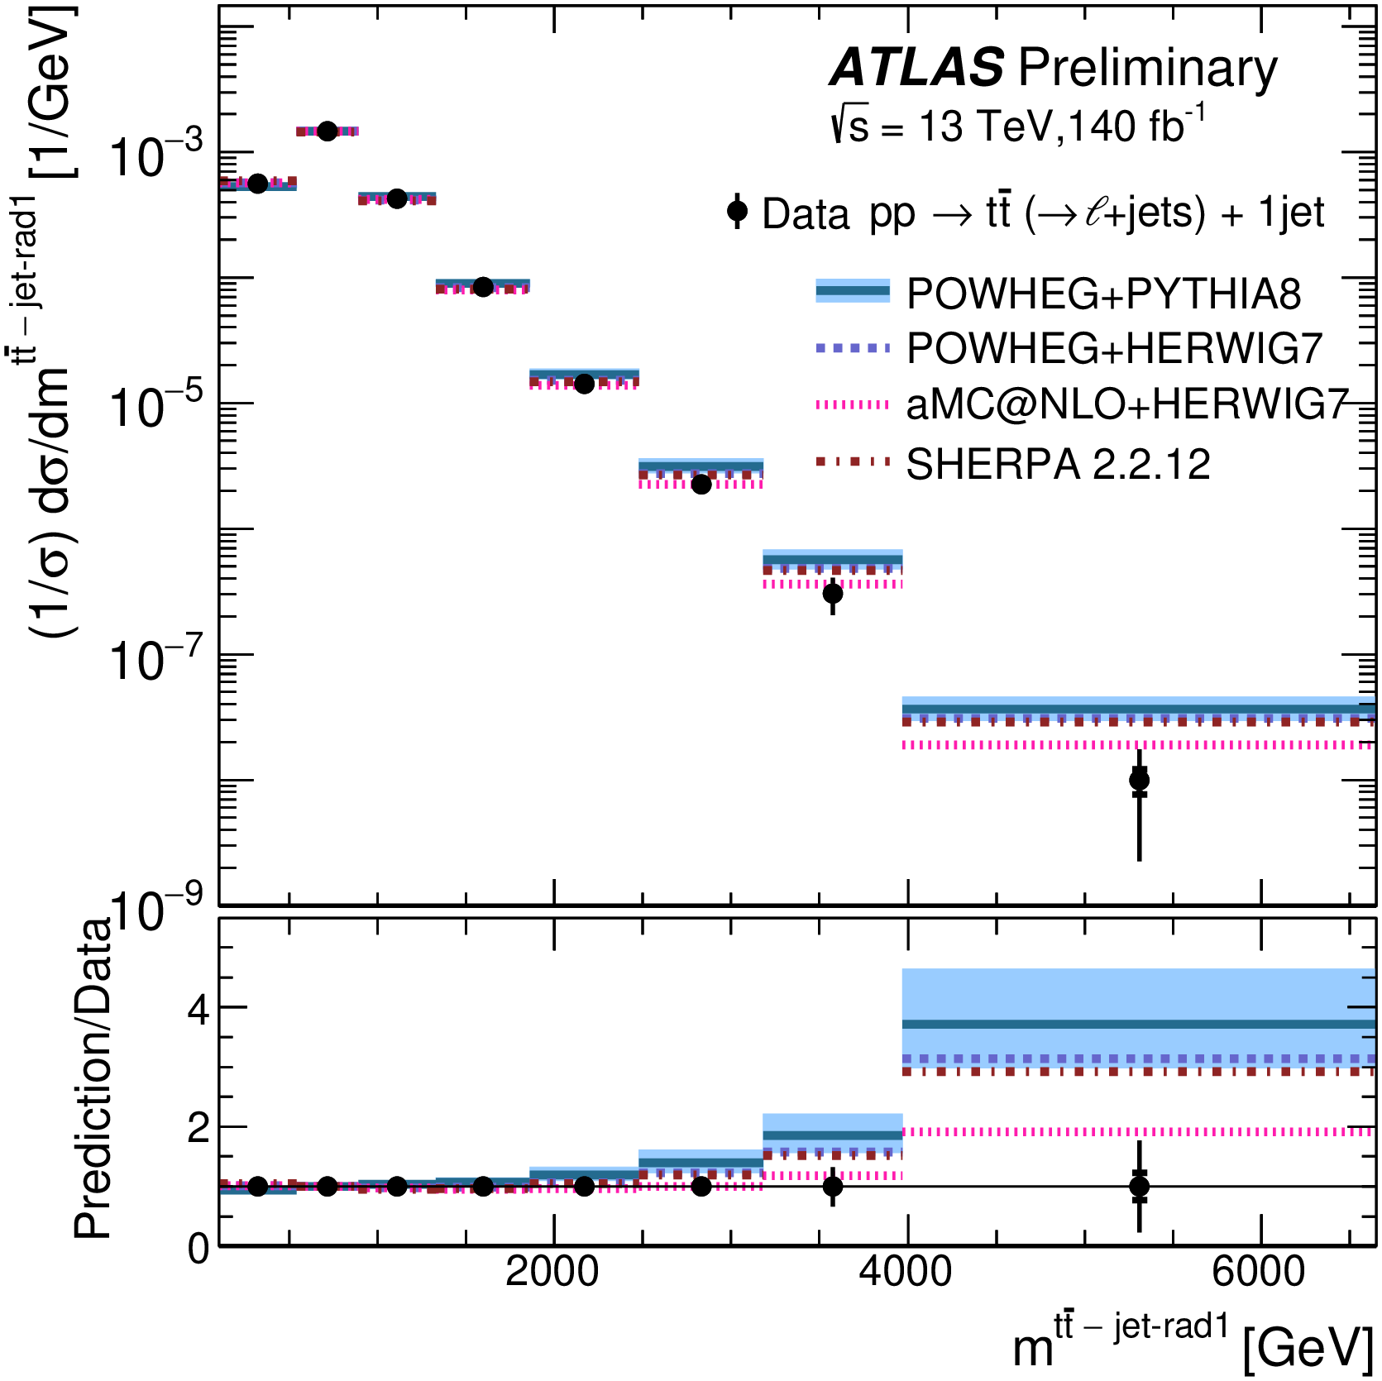
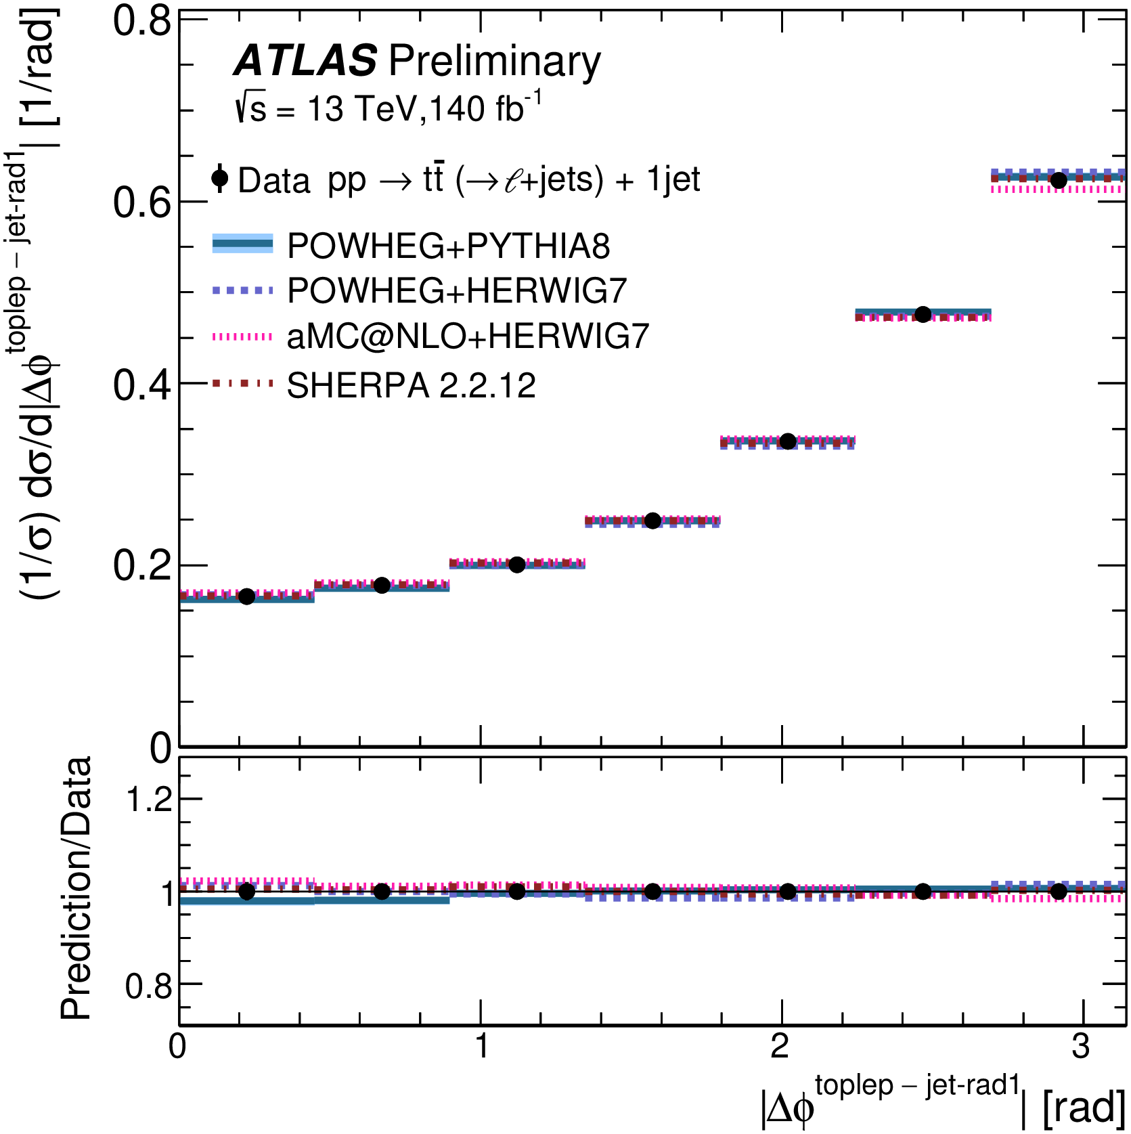
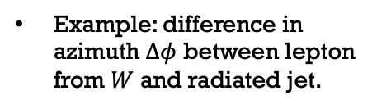
Normalized differential distributions, extra gluon jet, $t\overline{t}$ + 1 jet events compared to NLO simulation
Example: transverse momentum up radiated jet.
Varies over six orders of magnitude.
POWHEG+PYTHIA8 gives poor description above 500 GeV
Example: mass of the (top + jet) system
Varies over five orders of magnitude
Example: difference in azimuth $Δφ$ between lepton from $W$ and radiated jet.
ATLAS-CONF-2023-068 | $\overline{t}t$ Diff cross sections $ℓ$+jets | 13 TeV | 140 fb⁻¹

Slide 13
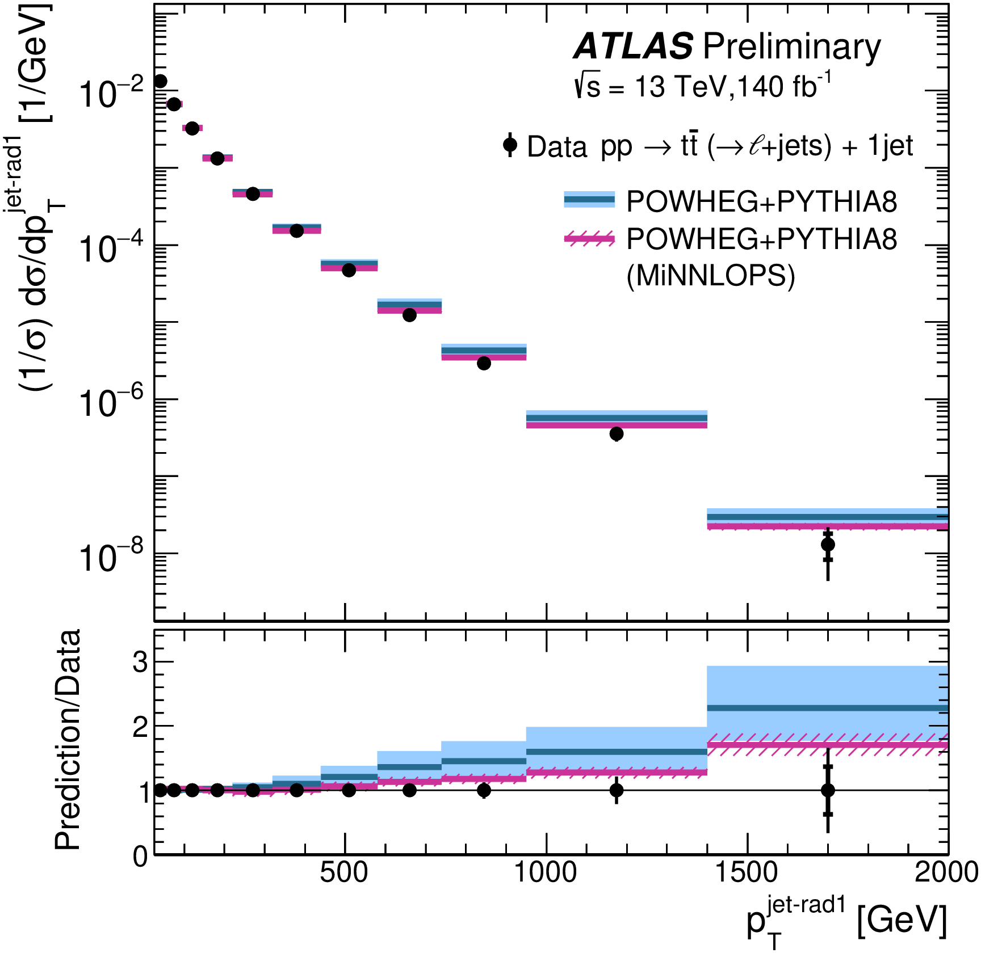
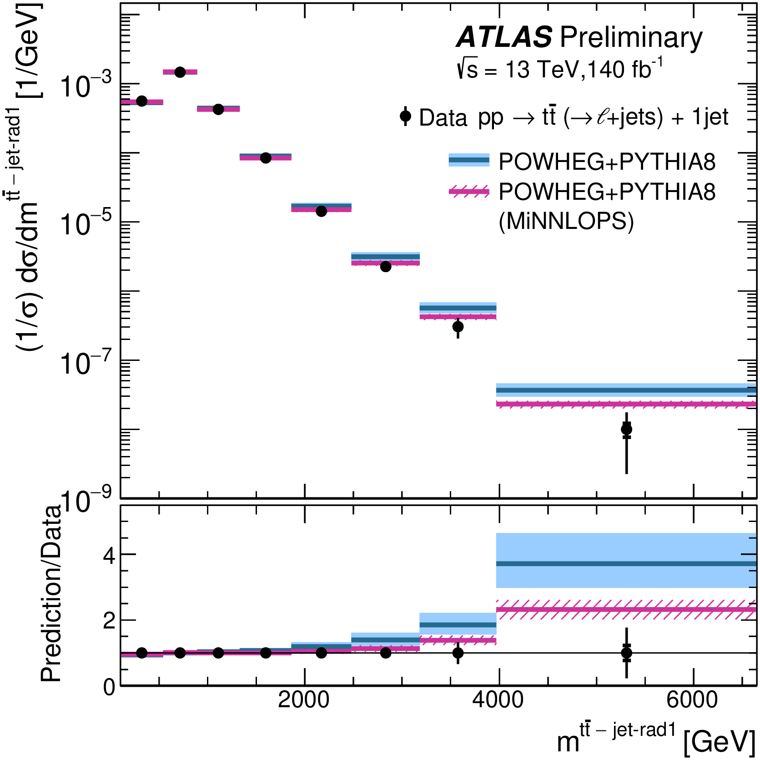
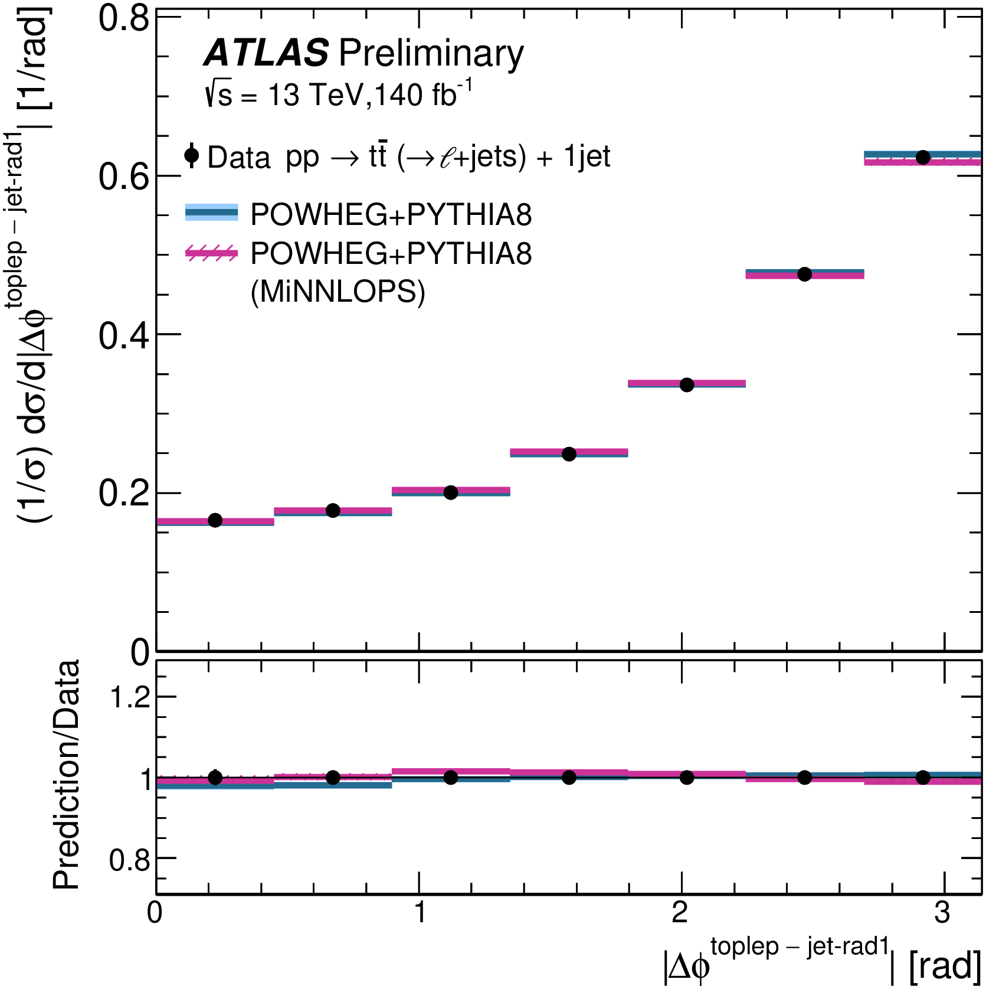
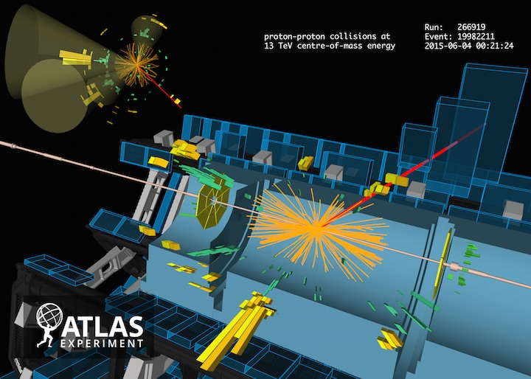
Normalized differential distributions, extra gluon jet,$t\overline{t}$ +1 jet events compared to NLO and NNLO simulation
NNLO gives a more precise prediction and better agreement with the data..
And one learns that gluon radiation tends to arise far from the lepton from $W$decay
ATLAS-CONF-2023-068 | $\overline{t}t$ Diff cross sections $ℓ$+jets | 13 TeV | 140 fb⁻¹

Slide 14
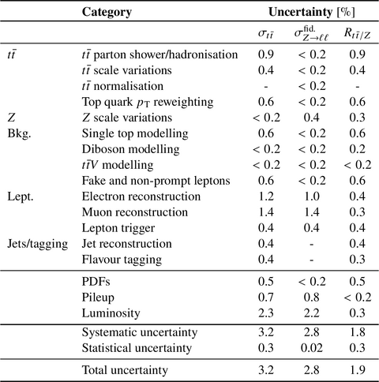
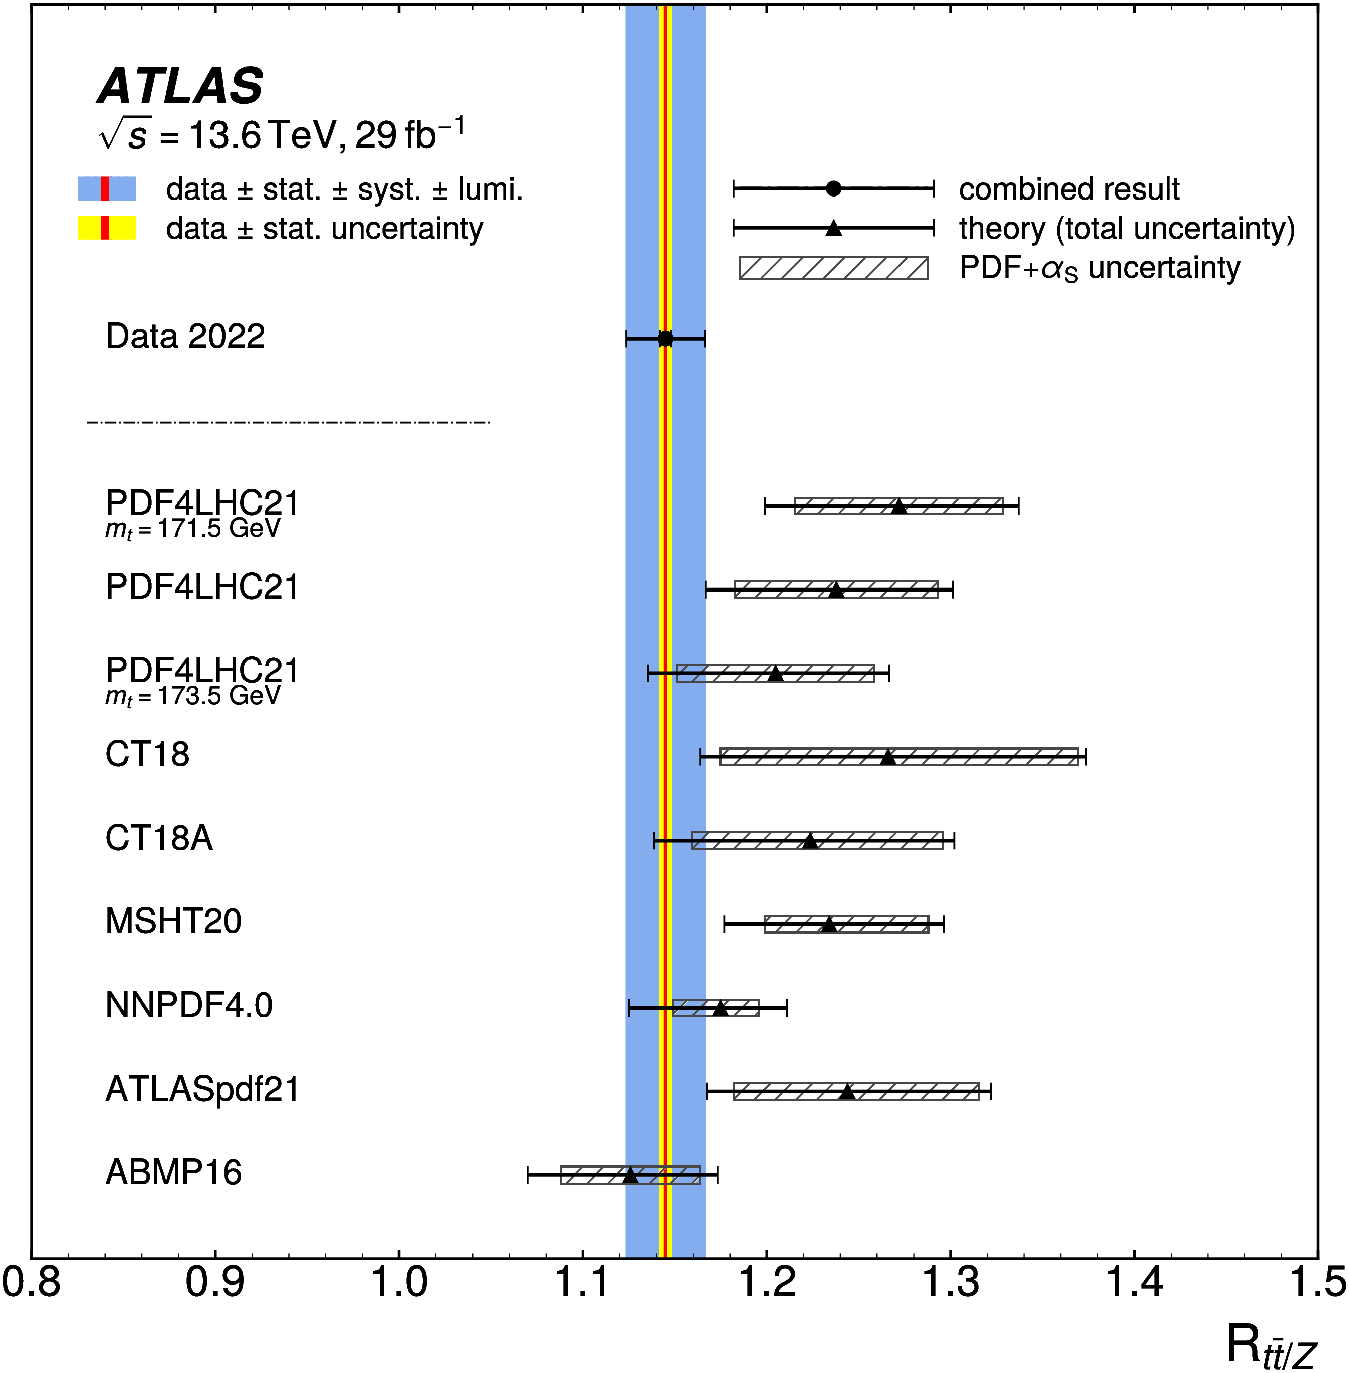

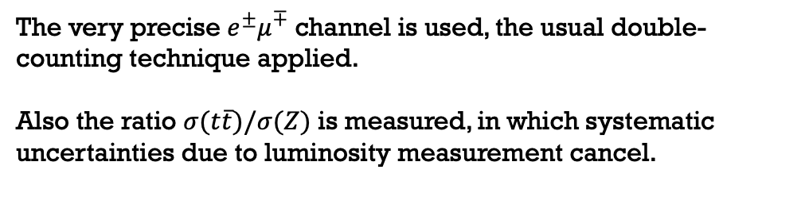


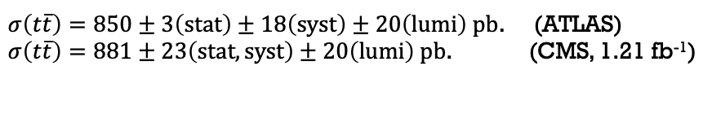
Run 3: $√s$=13.6 TeV
Run 3 $σ(t\overline{t})$ at $√s$=13.6 TeV is the highest energy measurement of top quark pair production cross section.
Theory expectation: increase of 12% in the cross section between 13 and 13.6 TeV.
The very precise $e^{±}μ^{∓}$ channel is used, the usual double-counting technique applied.
Also the ratio $σ(t\overline{t})/σ(Z)$ is measured, in which systematic uncertainties due to luminosity measurement cancel.
$σ\left(t\overline{t}\right)=850±3\left(stat\right)±18\left(syst\right)±20\left(lumi\right) pb$. (ATLAS)
$σ\left(t\overline{t}\right)=881±23\left(stat,syst\right)±20\left(lumi\right) pb$. (CMS, 1.21 fb⁻¹)
$$R_{t\overline{t}/Z}=1.145±0.03\left(stat\right)±0.021\left(syst\right)±0.002(lumi)$$
Cf. Theory: $σ\left(t\overline{t}\right)={924}_{−40}^{+32} pb$
Cf. Theory: $R_{t\overline{t}/Z}={1.238}_{−0.071}^{+0.063}$
Phys. Lett. B 848 (2024) 138376 | ($\overline{t}t$ XS)/ (Z XS) | 13.6 TeV | 29 fb⁻¹
Notes:
The discrepancy in the cross section is about 1.5 sigma.

Slide 15
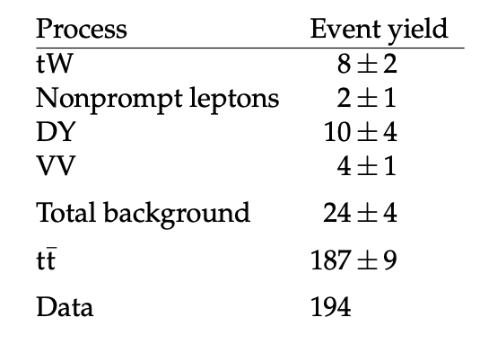





Run 2: $√s$=5.02 TeV
302 pb⁻¹ of data at $√s$= 5 TeV was collected during Run 2.
$q\overline{q}$ initiated events are 25% of the cross section (Cf. 11% at $\sqrt{s}=13 TeV$)
Expected cross section (NNLO+NNLL) $σ_{t\overline{t}}={69.5}_{−3.1}^{+2.9} pb$
This is a low statistics measurement; using only $e^{±}μ^{∓}$ events CMS selected:➔
  JHEP 04 (2022) 144
New cross section measurement at 5 TeV from CMS:
* uses lepton+jets (CMS-PAS-TOP-23-005)
* combines with $e^{±}μ^{∓}$ ( JHEP 04 (2022) 144)
Lepton+jets (CMS-PAS-TOP-23-005)
$$σ\left(t\overline{t}\right)=61.4±1.6{\left(stat\right)}_{−2.6}^{+2.7}\left(syst\right)±1.2\left(lumi\right) pb$$
Combined with $e^{±}μ^{∓}$ from JHEP 04 (2022) 144
$$σ\left(t\overline{t}\right)={61.2}_{−1.5}^{+1.6}{\left(stat\right)}_{−2.3}^{+2.6}\left(syst\right)±1.2\left(lumi\right) pb$$
CMS-PAS-TOP-23-005 | $\overline{t}t$ XS | 5.02 TeV | 0.302 fb⁻¹
Notes:
Discrepancy, about 1.8 sigma

Slide 16





Summary $σ\left(t\overline{t}\right) vs. √s$
ATLAS and CMS both provide measurements at 5, 7, 8, 13, and 13.6 TeV.
LHC Top working group combinations are published at 7 and 8 TeV
All measurements in agreement with the standard model. (The ATLAS measurement at 13.6 TeV is low by 1.5 sigma; CMS measurement at 5.02 by about 1.8 sigma).
Also noteworthy: measurement of $σ\left(t\overline{t}\right)$ in p-Pb collisions at $√s$=8.16 TeV (both experiments).
See also CMS Phys. Rev. Lett. 119 (2017) 242001. (p-Pb collisions)
And note that CMS has observed top quark pair production in Pb-Pb collisions! Phys Rev. Lett. 119 (2017) 242001
ATLAS-CONF-2023-063

Slide 17


Electroweak production of single top quarks
The production and decay is via the Wtb vertex
Sensitive to V_{tb}
At 13 TeV:
Cross section for t-channel production is 25% that of $t\overline{t}$
for tW production is 10% that of $t\overline{t}$
for s-channel production, 1.2% that of $t\overline{t}$
Signals are noisier than for $t\overline{t}$, imposing data-driven estimation of W+jets, $t\overline{t}$ backgrounds

Slide 18




Single-top t-channel production
$t$-channel production from up and down quarks leads to more top than antitop in this channel.
This depends on the u/d quark fractions in the proton
$Wtb$ vertex mediates both the production and decay process
Four quark interactions or extra Higgs couplings can also be lurking
They are parameterized in EFT coefficients $C_{Qq}^{3,1}$ and $C_{φQ}^{3}$

Slide 19




$t$-Channel cross section @ 13 TeV
$$f_{LV}\left|V_{tb}\right|=1.015±0.031$$
(improved precision of 30%,
relative to Run 1 ATLAS+CMS
in JHEP 05 (2019) 088)
2 signal regions by lepton charge.
2 control regions defined by inverting the $E_{T}^{miss}>30$ cut for:
Electrons in Barrel
Electrons in Endcap
Event counts in these regions considered in fit.
2 control regions defined by inverting angular cut between jet and muon for:
Muons
$Δφ\left(μ,p_{T}^{miss}\right)$ considered in fit.
arXiv:2403.02126 | $t$-channel XS | 13 | 140

Slide 20








Interpretation
Constrain PDF’s
(u/d ratio in proton)
Constrain CKM matrix elements
V_{ts}, V_{td}, V_{tb}
Summary, ATLAS & CMS measurement of t-channel production
set limits on four-quark operator $C_{Qq}$
$$f_{LV}\left|V_{td}\right|<0.23 \left(95\%\right)$$
$$f_{LV}\left|V_{ts}\right|<0.58 \left(95\%\right)$$
Limits on EFT coefficients
$$−0.37 <C_{Qq}^{3,1}<0.06$$
$$−0.87<C_{φQ}^{3}<1.42$$
LHC top working group summary plots
arXiv:2403.02126 | $t$-channel XS | 13 | 140

Slide 21





Single top production, $tW$ channel
JHEP 07 (2023) 046
$tW$ channel is not observed at the Tevatron
Both strong and weak processes are involved.
$\overline{t}t$ production interferes with the signal; two schemes may be employed to remove the effect:
  Diagram removal (DR)
  Diagram subtraction (DS)
Alternately, study the $\overline{b}b\overline{ν}νℓ^{+}ℓ^{−}$ final state with all interference effects accounted for.
(Diagrams which are/ interfere with with $\overline{t}t$ production)

Slide 22


$tW$ Channel in CMS
13 TeV
138 fb⁻¹ of data in Run II used
Dilepton $e^{±}μ^{∓}$ events are used
Three regions defined
  1 jet, 1 b-tagged jet with significant signal fraction
  2 jets, 1 b-tagged jet with significant signal fraction
  2 jets, 2 b-tagged jets with little signal, constrains the $\overline{t}t$ background.
The three distributions on this page are input to a maximum log likelihood fit.
JHEP 07 (2023) 046 | tW XS | 13 TeV | 138 fb⁻¹

Slide 23





$tW$ Channel in CMS
13.6 TeV
34.7 fb⁻¹ of data in Run 3 used
Dilepton $e^{±}μ^{∓}$ events are used
Three regions defined
  1 jet, 1 b-tagged jet with significant signal fraction
  2 jets, 1 b-tagged jet with significant signal fraction
  2 jets, 2 b-tagged jets with little signal, constrains the $\overline{t}t$ background.
The three distributions on this page are input to a maximum log likelihood fit.
CMS-PAS-TOP-23-008 | tW XS | 13.6 TeV | 34.7 fb⁻¹

Slide 24



$tW$ Associated production at $\sqrt{s}=13$TeV
$$σ\left(tW\right)=79.2±0.9{\left(stat\right)}_{−8.0}^{7.7}\left(syst\right)±1.2\left(lumi\right) pb$$
Cf. Theory $σ\left(tW\right)=71.7±1.8\left(scale\right)±3.4 \left(α_{S},PDF\right) pb$ [aNNLO+aN³LL]
P-values for differential distributions:
JHEP 07 (2023) 046 | tW XS | 13 TeV | 138 fb⁻¹

Slide 25




$tW$ Associated production at $\sqrt{s}=13.6$TeV
$$σ\left(tW\right)=84.1±2.1{\left(stat\right)}_{−10.2}^{+9.8}\left(syst\right)±3.3\left(lumi\right) pb$$
Cf. Theory $σ\left(tW\right)={87.9}_{−1.9}^{+2.0}\left(scale\right)±2.4 \left(α_{S},PDF\right) pb$ [aNNLO+aN³LL]
P-values for differential distributions:
CMS-PAS-TOP-23-008 | tW XS | 13.6 TeV | 34.7 fb⁻¹

Slide 26

S-channel electroweak production
Low expected cross section at LHC ($σ^{SM}={10.32}_{−0.36}^{+0.40 }$ pb @ 13 TeV)
  Anomalies could indicate $W^{′}$, $b^{′}$ or $H^{+}$ production or modified couplings
But favorable conditions at the Tevatron led to observation in 2014 [Phys. Rev. Lett. 112 (2014) 231803]
Previously measured at $√s$=7 TeV(CMS), 8 TeV (CMS, ATLAS)
At 13 TeV, ATLAS measures the cross section using the lepton+jets final state
  Main backgrounds are $\overline{t}t$ and $W$+jets
  A Matrix Element based discriminant is used to separate signal (based on calculable probability densities)
  Normalization of the W+jets background and $t\overline{t}$ background is determined from control regions.

Slide 27



Cross section measurement:
Discriminent is based on likelihood for process $H_{proc}∈${signal, $\overline{t}t$, $W$+jets}, conditional on final state particle kinematic quantities $X,$ those being $p_{T}$ and $η$
$σ={8.2}_{−2.9}^{+3.5}$ pb
Cf. NLO Prediction
$σ={10.32}_{−0.36}^{+0.40}$ pb
Parton-level cross sections $dσ/dΘ$ from analytic calculation.
Transfer functions $T$ from simulation
Computed for signal, top and W+jets backgrounds.
The likelihood ratio is used as the discriminant, $P\left(S|X\right)$
JHEP 06 (2023)191 | s-channel | 13 TeV | 139 fb⁻¹
Notes:
3.3 standard deviations from zero.

Slide 28


Summary of single top quark production cross sections
LHC top working group summary plots
and ATL-PHYS-PUB-2024-006
Latest new
(CMS)
New point from ATLAS@ 5 TeV, arXiv:2310.01518

Slide 29

Conclusions
Cross section measurements of $t\overline{t}$ and single top t, tW, and s-channel production have been carried out at 5, 7, 8, 13, and 13.6 GeV in pp collisions and also p-Pb collisions at 8 TeV.
These measurements are in agreement with the standard model.
  Uncertainties of less than 2% have been obtained, thanks to improvements in lumi measurement.
  Dominant uncertainty is still luminosity, whose error has reached sub-percent level.
  Differential measurements indicate softer p_{T} distributions than NNLO predictions
The most common interpretation of these results is in terms of $α_{s}\left(M_{Z}\right),$the top quark pole mass $m_{T}^{pole}$, and PDF parameters (for strong production of $t\overline{t})$.
Single top production measures $\left|f_{LV}V_{tb}\right|$ (for electroweak production of single top), with further interpretation in terms of EFT coefficients, CKM matrix elements, four-quark interactions.
Top production cross sections in $p−Pb$collisions are described in ATLAS-CONF-2023-063 and in Phys. Rev. Lett. 119 (2017) 242001

Slide 30

TABLE of contents
Experiment | Reference | Description | Energy [TeV] | $\int{ℒ}dt$ [fb⁻¹] | Slide #
ATLAS, CMS, TOP WG | JHEP 07 (2023) 213 | $\overline{t}t$ XS, ATLAS CMS combination | 7, 8 | 5, 20 | 3-5
ATLAS | JHEP 07 (2023) 141 | $\overline{t}t$ XS, dileption, differential | 13 | 140 | 6-7
CMS | arXiv:2402.08486 | $\overline{t}t$ XS, dileption, differential | 13 | 138 | 8
ATLAS | ATLAS-CONF-2023-068 | $\overline{t}t$ Diff cross sections $ℓ$+jets | 13 | 140 | 10-13
ATLAS | Phys. Lett. B 848 (2024) 138376 | ($\overline{t}t$ XS)/ (Z XS) | 13.6 | 29 | 14
CMS | CMS-PAS-TOP-23-005 | $\overline{t}t$ XS | 5.02 | 0.302 | 15
ATLAS,CMS | ATLAS-CONF-2023-063; Phys. Rev. Lett. 119 (2017) 242001 | $\overline{t}t$ XS, PB collisions | 8.16 | 165$×{10}^{−6}$ 174$×{10}^{−6}$ P+Pb | 15
ATLAS | arXiv:2403.02126 | $t$-channel XS | 13 | 140 | 19-20
ATLAS | arXiv:2310.01518 | $t$-channel XS | 5.02 | 0.255 | 28
CMS | JHEP 07 (2023) 046 | tW XS | 13 | 138 | 22,24
CMS | CMS-PAS-TOP-23-008 | tW XS | 13.6 | 34.7 | 23,25
ATLAS | JHEP 06 (2023)191 | s-channel | 13 | 139 | 26

Slide 31
backup

Slide 32



Digression on Luminosity Measurement
  ATLAS uses LUCID II detector,
    charge-integrating Cerenkov light detector 17m from IP
    active material is the quartz fibers and the quartz photomultiplier windows.
    Gain monitored with ²⁰⁷Bi sources for stability of relative luminosity measurement
    The Run 2 Luminosity error is 0.83%. Cf. 1.9% (8 TeV)
CMS uses HF
  Hadronic Forward Calorimeter
  Steel w/ quartz fibers.
And Pixel detector, Pixel Luminosity Telescope, and Fast Beam Condtions Monitor.
Run 2 Luminosity of 1.2% precision achieved (Cf. 1.9% at 8 TeV)
However stability issues, and beam-beam interactions may increase this to over 2%.
  Absolute luminosity determined through Vandermeer scans at low lumi.
40 Mhz
from beam instrumentation
$$ℒ_{b}=\frac{fn_{1}n_{2}}{2πΣ_{x}Σ_{y}}$$
Convolved
Beam sizes
From VDM scan
Eur Phys. J. C. 81 (2021) 800
arXiv: 2212.09379
Notes:
The plot shows the “visible interaction rate” vs beam separation in x.

Slide 33
Differential and double-differential cross sections in lepton+jets mode.
Parton level comparisons include POWHEG (NLO) and MATRIX (NNLO) w / significantly smaller errors.
$\overline{t}t$ Diff cross sections $ℓ$+jets | 13 TeV | 140 fb ⁻¹ | Phys. Rev D 104 09201

Slide 34

Most distributions agree with
  Powheg+Pythia
  Powheg+Herwig
  MG5_aMC@NLO+Pythia
Top Quark $p_{T}$distributions softer than most NLO predictions
Jet multiplicies and related observables are not well predicted by Powheg+Herwig and MG5_aMC@NLO+Pythia
Tabulated data available in HEPData
$σ_{t\overline{t}}=791±1\left(stat\right)±21\left(syst\right)±14\left(lumi\right) pb$

Slide 35

What caN BE DONE WITH THIS WEALTH OF INFORMATION?
Lepton+jets mode, 35.9 fb⁻¹ of data at 13 TeV.
Eur. Phys. J. C. 80 (2020) 658
Double and triple-differential cross sections are analyzed.
From the triple-differential cross section in the variables $M\left(t\overline{t}\right)$, $y(t\overline{t})$, and $N_{jets}$ CMS determines
$α_{s}\left(M_{Z}\right)={0.1135}_{−0.0017}^{+0.0021}$
$m_{t}^{pole}=170.5±0.8 GeV$
High precision extractions
In CMS’s Phys. Rev. D 104 (2021) 092013 (previous page) , such interpretations are left to the theoretical community.

Slide 36

Multijet background determination
Multijet backgrounds estimated using
“jet-electron” MC-based method for electrons.
“anti—muon” data-based method for muons.
Fits to $E_{T}^{miss}$ (electron) or $m_{T}^{W}$ (muon) used to set normalization.
Shown for all four regions for electrons
Shown for signal region only for muons ➔
Most bkg is removed by cuts.
JHEP 06 (2023)191 | s-channel | 13 TeV | 139 fb⁻¹

