Slide 1
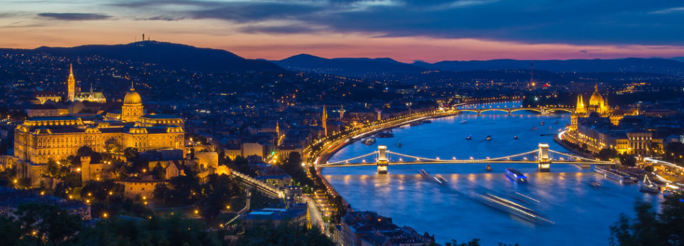
XII BGL Conference Budapest, 2024 May 1-3
Non-Euclidean Geometry in
Modern Physics and Mathematics
MTA Domus Collegium Hungaricum Vendégház
H-1146 Budapest, Abonyi utca 10.

Slide 2
NON - EUCLIDEAN GEOMETRY
IN MODERN PHYSICS AND MATHEMATICS
XII Bolyai - Gauss - Lobachevsky Conference,
Budapest, Domus Collegium Hungaricum
of the Hungarian Academy of Sciences,
May 1 - 3 2024
Quantum "dots" and non-Euclidean crystallography
on the 200th anniversary of János Bolyai’s absolute geometry
Emil MOLNÁR,
Budapest University of Technology and Economics,
Department of Algebra and Geometry

Slide 3

Quantum "dots" and non-Euclidean crystallography
on the 200th anniversary of János Bolyai’s absolute geometry
Emil MOLNÁR,
Abstract
My ~40 years old paper [1] in References had got a surprising actuality in the Chemistry Nobel Prize 2023 awards for the three Laureates:
Alexey YEKIMOV, Luis E. BRUS and Moungi G. BAWENDI.
Of course, the present author of that paper could not guess that time the actuality and importance that was an incidental consequence of my erroneous paper [2], intended to construct an infinite series of non-orientable compact hyperbolic manifolds, as a polyhedral tiling series in the Bolyai-Lobachevsky hyperbolic space H³. Fortunately, I observed and improved the mistake soon. Namely, those constructions were not manifolds because the two fixed points as punctures, where point reflections (central inversions) occur in the symmetry group of the tricky polyhedral tilings.
But these singular points, as "quantum dots" e.g. for copper and chlorine ions, respectively, in glass (silicon) fluid cause light effects (by "electron jumping-leaping") whose colours might depend on the sizes of crystal particles. That means, the mistake was much more interesting than the original intention that can be reached easily later!
XII BGL Conference 2024, Budapest
Abstract
My ~40 years old paper [1] had got a surprising actuality in the Chemistry Nobel Prize 2023 awards for the three Laureates:
Alexey EKIMOV, Luis E. BRUS and Moungi G. BAWENDI.
Of course, the present author of that paper could not guess that time the actuality that was an incidental consequence of my erroneous paper [2], intended to construct an infinite series of non-orientable compact hyperbolic manifolds, as a polyhedral tiling series in the Bolyai-Lobachevsky hyperbolic space H³. Fortunately, I observed and improved the mistake soon. Namely, those constructions were not manifolds because the two fixed points as punctures, where point reflections (central inversions) occur in the symmetry group of the tricky polyhedral tilings.
But these singular points, as "quantum dots" e.g. for copper and chlorine ions, respectively, in glass (silicon) fluid cause light effects (by "electron jumping-leaping") whose colours might depend on the sizes of crystal particles. That means, the mistake was much more interesting than the original intention that can be reached easily later!
XII BGL Conference 2024, Budapest

Slide 4
References
[1] Molnár, E., Twice punctured compact Euclidean and hyperbolic manifolds and their two folds coverings, Colloquia Math. Soc. J. Bolyai, 46. Topics in Differential Geometry, Debrecen (Hungary), 1984, 883- 919.
[2] Molnár, E., An infinite series of compact non-orientable 3-dimensional space forms of constant negative curvature, Ann. Global Anal. Geom., Vol. 1. No. 3, (1983), 37-49; Errata in Vol. 2, No. 2, (1984), 253-254.
[3] International Tables for Crystallography, Vol. A: Space-Group Symmetry, Ed. Theo Hahn, First Edition 1983, Fifth Edition 2002, Corr. Reprint 2005, Vol. A1: Symmetry Relations between Space Groups, Eds. Hans Wondratschek and Ulrich Müller, First Edition 2004.
[4] The Nobel Prize in Chemistry 2023. The Royal Swedish Academy of Sciences has decided to award the Nobel Prize in Chemistry 2023 to Moungi G. Bawendi, Louis E. Brus and Alexey Yekimov “for the discovery and synthesis of quantum dots”, PRESS RELEASE, 4 October 2023.
[5] Molnár, E., On non-Euclidean crystallography, some football manifolds, Structural Chemistry, 23/4, (2012), 1057-1069.
[6] Molnár, E. – Szirmai, J., Symmetries in the 8 homogeneous 3-geometries, Symmetry Cult. Sci., 21/1-3 (2010), 87-117.
[7] Molnár, E.–Szirmai, J., Inﬁnite series of compact hyperbolic manifolds, as possible crystal structures. Matematički Vesnik, 72, 3, (2020), 257-272.
[8] Molnár, E. – Szirmai, J., Dense ball packings by tube manifolds as new models for hyperbolic crystallography, Matematički Vesnik 76, 1–2 (2024), 118–135, Available online 24.02.2024, 1-18.
[9] Vinberg, E. B. (Ed.), Geometry II. Spaces of Constant Curvature, Springer Verlag Berlin - Heidelberg - New York - London - Paris - Tokyo - Hong Kong - Barcelona - Budapest, 1993.
[10] Wolf, J. A., Spaces of Constant Curvature, McGraw-Hill,New York, 1967, (Russian translation: Izd. ”Nauka” Moscow, 1982).
XII BGL Conference 2024, Budapest

Slide 5
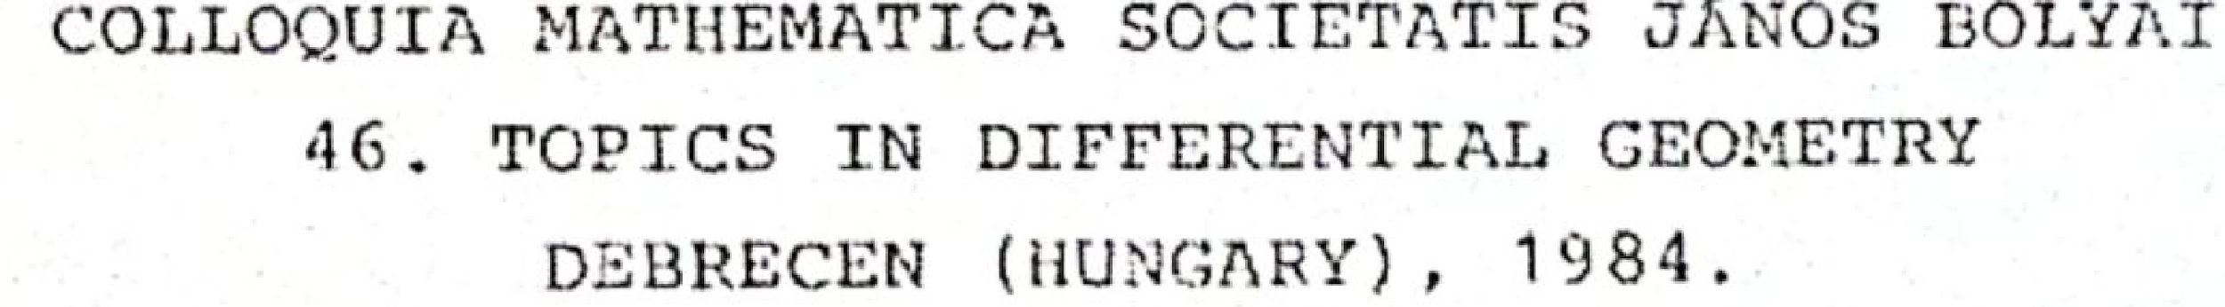
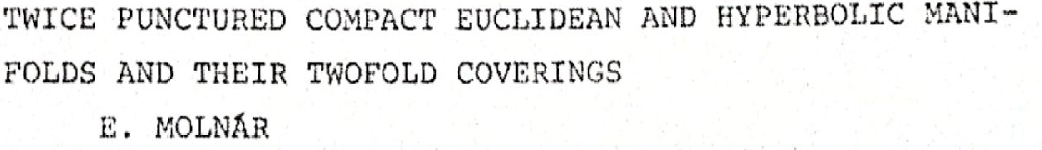
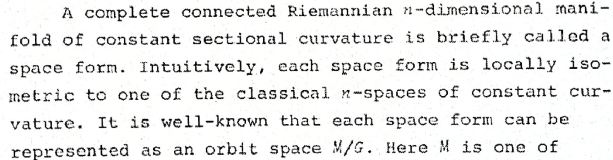
COLLOQUIA MATHEMATICA SOCIETATIS JÁNOS BOLYAI
46. TOPICS IN DIFFERENTIAL GEOMETRY
DEBRECEN-HAJDÚSZOBOSZLÓ (HUNGARY), 1984.
XII BGL Conference 2024, Budapest

Slide 6
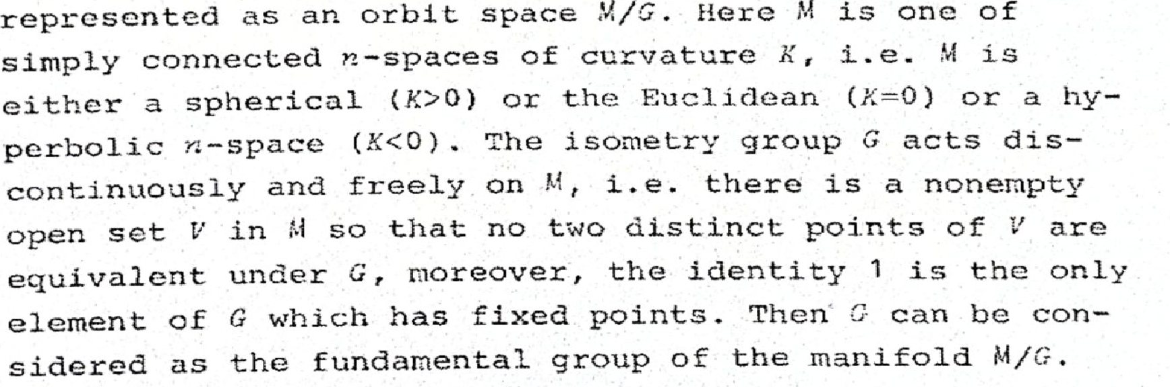
Manifold (cont) and “twice punctured manifold”
There are „manifolds” which have two exceptional singular points with „ball neighbourhood, but its centrally opposite points are glued together”. Such a fundamental group G has two singular orbits, i.e. M/G is „twice punctured”.
XII BGL Conference 2024, Budapest

Slide 7
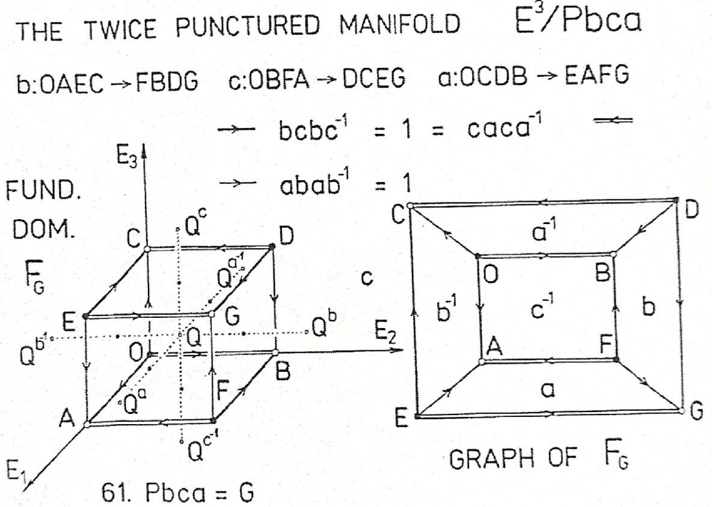
Orientation preserving transforms:
1 (x¹, x², x³); identity
s₁ (½ + x¹, ½ - x², -x³);
screw
s₂ (-x¹, ½ + x², ½ - x³);
motions
s₃ (½ - x¹, -x², ½ + x³);
Orientation reversing transforms:
-1 (-x¹, -x², -x³); point
reflection
b (½ - x¹, ½ + x², x³); OAEC =: b⁻¹ →
FBDG =: b
glide
c (x¹, ½ - x², ½ + x³);
reflections
a (½ + x¹, x², ½ - x³)
6. Euclidean example
g
Super group occurs: 205. Pa3⁻ =: G~, if F_{G} is a cube with 3-rotations!?!
XII BGL Conference 2024, Budapest

Slide 8
To 61. Pbca = G in Figure of former dia 6
The fundamental domain (asymmetric unit) F_{G} of 61. Pbca = G geometrically describes this group, in the orthorhombic coordinate system OE₁E₂E₃, where the lengthes of basis vectors |OE_{i} := e_{i}| = a_{i} (i = 1, 2, 3) are given parameters (by measuring the material crystal, to be determined). An orthorhombic lattice ⋀_{G} of G are given by integer coordinate triple to the identity transform 1 (as linear part). As we know (in our conventions), each
∝(A, a) ∈ G can be given by a mapping ∝: X ↦ XA + a =: X∝
with A as linear integer unimodular matrix to the basis (e_{i} = OE_{i}) above, and the broken part a, as symbolically indicated in dia 6, the position vector is OX = X = x^{i}e_{i} (summing convention).
Assume that O, D, E, F are G-equivalent point reflection centres, say with copper (Cu) ion parts, so are G, A, B, C with Chlorine (Cl) ion parts, so that the fundamental cube F_{G} contain also central silicon (Si) atoms and 2-2 ones at the opposite face pairs of F_{G} equivalent by glide reflections b, c, a, respectively. Imagine that this 1:1:7 proportions of Cu, Cl, Si can form crystal particles with appropriate cube size, and this particles float in a silicon fluid that freezes. The singularities in near Cu and Cl ions cause electron “jumping-leaping” with light effects, i.e. quantum dots.
XII BGL Conference 2024, Budapest

Slide 9
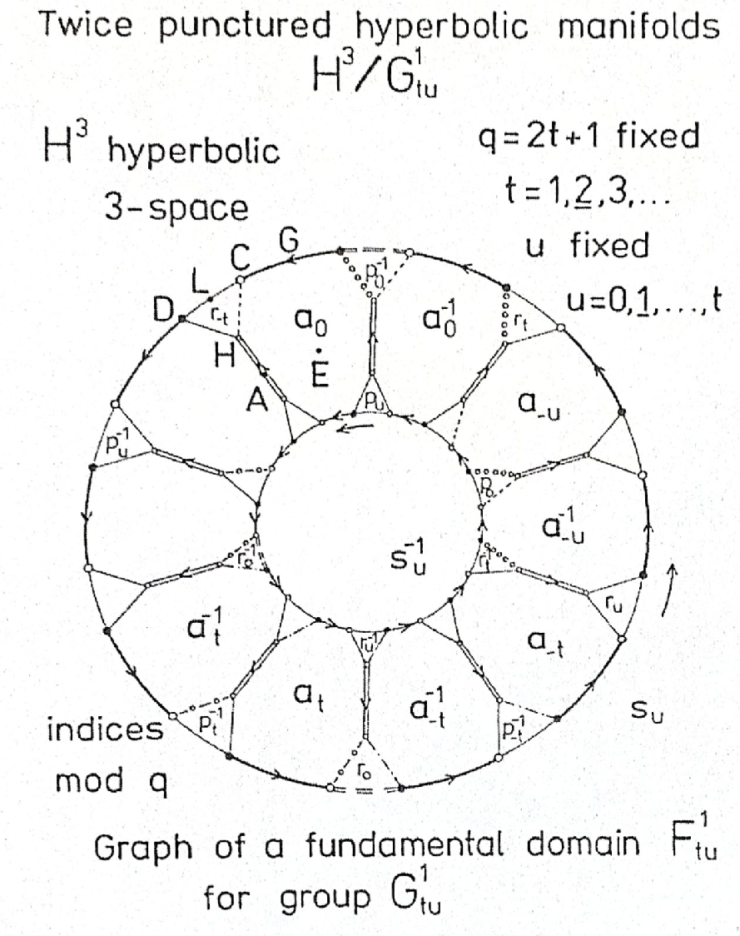
Fundamental domain F¹_{tu} of G¹_{tu}
Generators:
a_{i} (-t ≤ i ≤ +t) glide reflections, a_{i} : a_{i}⁻¹ → a_{i}
p_{i} (-t ≤ i ≤ +t) screw motions, p_{i} : p_{i}⁻¹ → p_{i}
r_{i} (-t ≤ i ≤ +t) screw motions, r_{i} : r_{i}⁻¹ → r_{i}
s_{u} (0 ≤ u ≤ t) screw motion
Altogether: 3q + 1 = 6t +3 generators
_{Relations}
_{To arrowed edges in Table 1}
e.g. ⇒ a_{-t}a_{-t}…a₀a₀…a_{+t}a_{+t} =1 identity
e.g. ooo> a₀p₀a_{-u}⁻¹ r_{t} = 1
The equivalence classes C (Cu) and D (Cl)
are reflections centres with half ball neighbourhood, i.e punctures for quantum dots..
The other point classes (orbits, e.g. for G, E, A, H, L, … for Si atoms) have ball neighbourhood, as at manifolds.
The proportions depends on parameter q = 2t +1.
We have infinitely many hyperbolic possibilities.
The minimal one with t =1, q = 3 is
extremely interesting for realizations!?
..
_{p}
XII BGL Conference 2024, Budapest

Slide 10
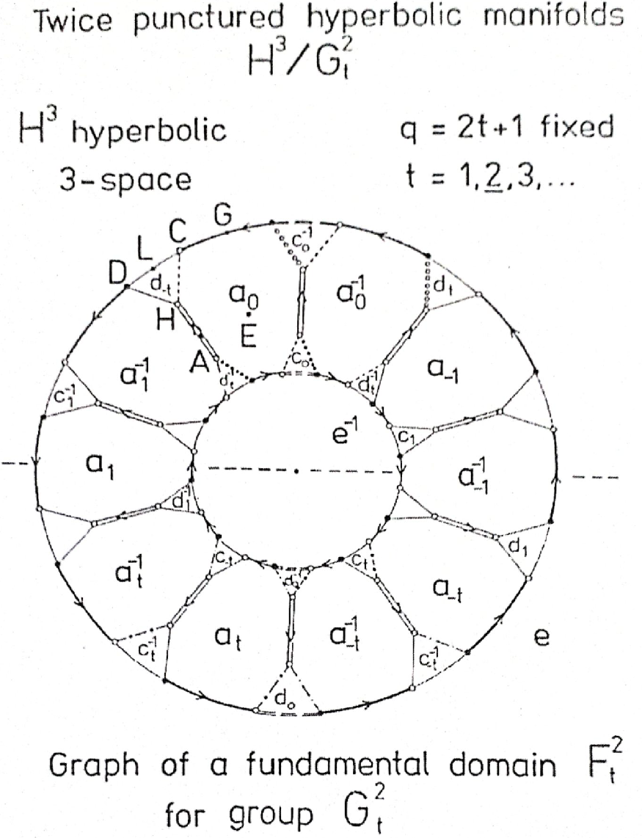
Fundamental domain F²_{t} of G²_{t} (u = 0)
Generators:
a_{i} (-t ≤ i ≤ +t) glide reflections, a_{i} : a_{i}⁻¹ → a_{i}
c_{i} (-t ≤ i ≤ +t) glide reflections, c_{i} : c_{i}⁻¹ → c_{i}
d_{i} (-t ≤ i ≤ +t) glide reflections, d_{i} : d_{i}⁻¹ → d_{i}
e (0 ≤ u ≤ t) glide reflection
Altogether: 3q + 1 = 6t +3 generators
_{Relations}
_{To arrowed edges in Table 1}
e.g. ⇒ a_{-t}a_{-t}…a₀a₀…a_{+t}a_{+t} =1 identity
e.g. ooo> a₀c₀a₀⁻¹d_{t} = 1
The equivalence classes C (Cu) and D (Cl) are
reflection centres with half ball neighbourhood, i.e punctures for quantum dots.
An integer parameter u with 0 ≤ u ≤ t can be introduced
for other (non-isometric) manifolds,
similarly as before.
The (projective) metric comes later
on Bolyai - Lobachevsky geometry!
XII BGL Conference 2024, Budapest

Slide 11
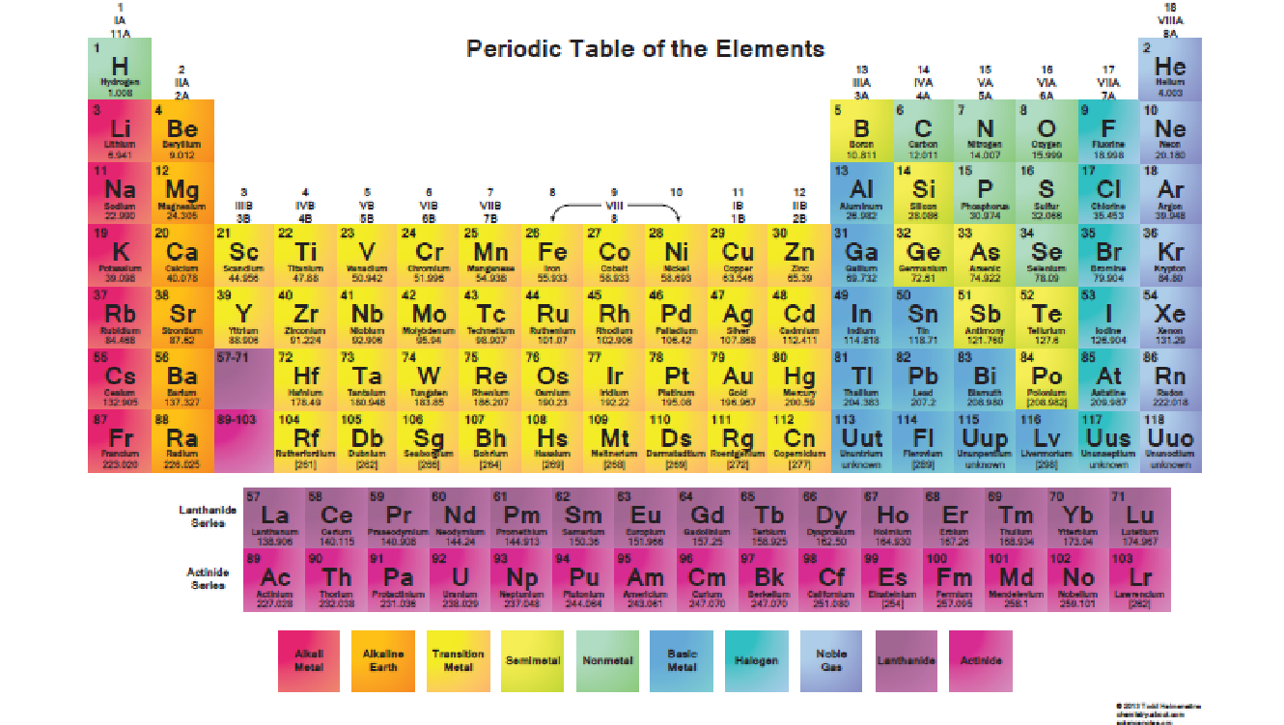
XII BGL Conference 2024, Budapest

Slide 12
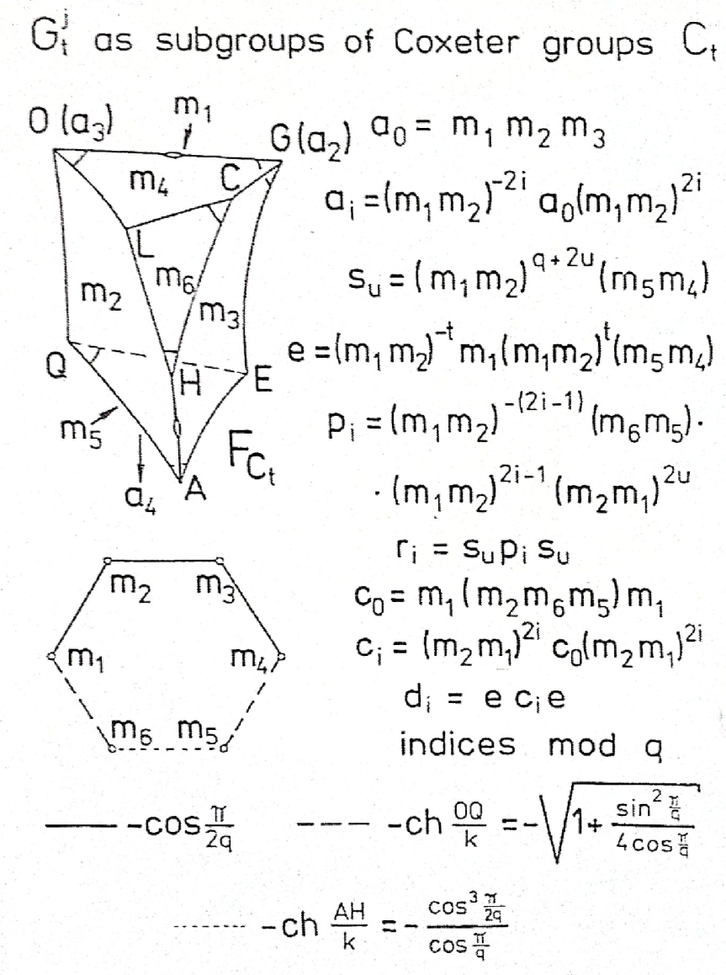
Reflection group C_{t} and its fundamental domain as truncated orthoscheme, generators for G¹_{tu} and G²_{t}; some distances for Coxeter diagram
The orthoscheme projective coordinate simplex A₀A₁A₂A₃ ~ b⁰b¹b²b³ will be described in the real (left) vector 4-space V⁴ (for points X(X = X^{i}A_{i} ~ cX) and its dual (right) form space V₄ (for planes u(u = b^{j}u_{j} ~ uc) , by the symmetric
Coxeter – Schläfli matrix (b^{ij}) = <b^{i}, b^{j}> = (cos(π – β^{ij})),
first for angles β^{ij} = (ㄥb^{i}b^{j}) with (ㄥb^{i}b^{i}) = π,
then for distances by the inverse (b^{ij})⁻¹ =: (A_{ij}) =: <A_{i}, A_{j}> and
cosh(XY/k) = - <X, Y>/(<X, X><Y, Y>)^{½}
is the distance of points X and Y. Here k = (-1/K) is the universal unit distance of the hyperbolic space H³, K is the constant negative sectional curvature. In nano size k has to be “measured” (determined).
The Periodic Table of the Elements gives important information!
The mathematical details can be found in the References, e.g. [1, 8].
In our Figure the doubly truncated orthoscheme comes from the nowadays coordinate simplex above from [8], but here we used the previous notations of paper [1]: A₂ → a₃ for point O, A₁ → a₂ for point G,
A₃ → a₄ for outer point A₃, whose polar plane a₃ is m₅ here, A₀ is outer point whose polar plane a₀ is denoted by m₆ here. The simplex planes
b⁰, b¹, b², b³ are denoted by m₁, m₂, m₃, m₄ now.
XII BGL Conference 2024, Budapest

Slide 13
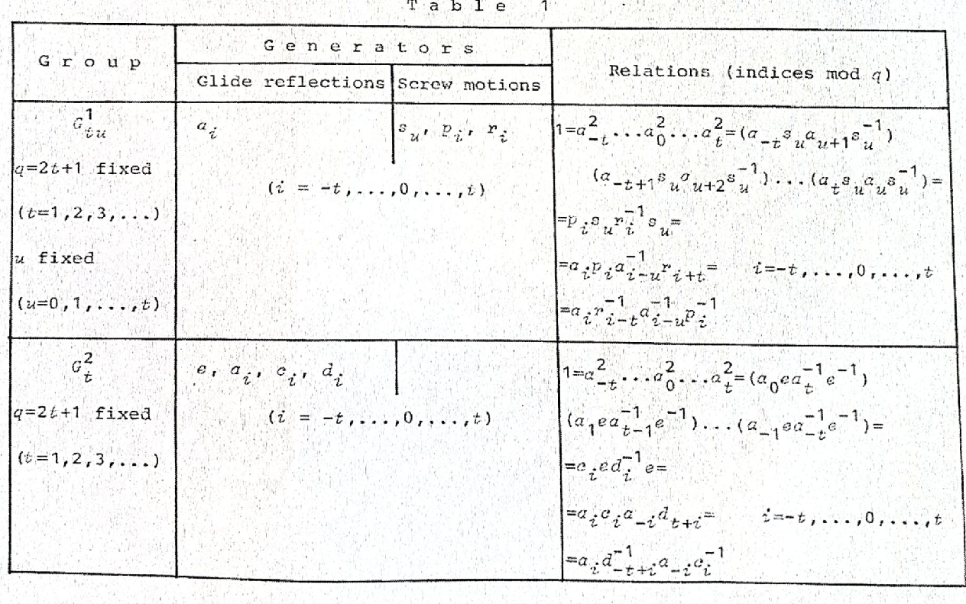
Presentations of fundamental groups G¹_{tu} and G²_{t} by generators and defining relations to figures
XII BGL Conference 2024, Budapest

Slide 14
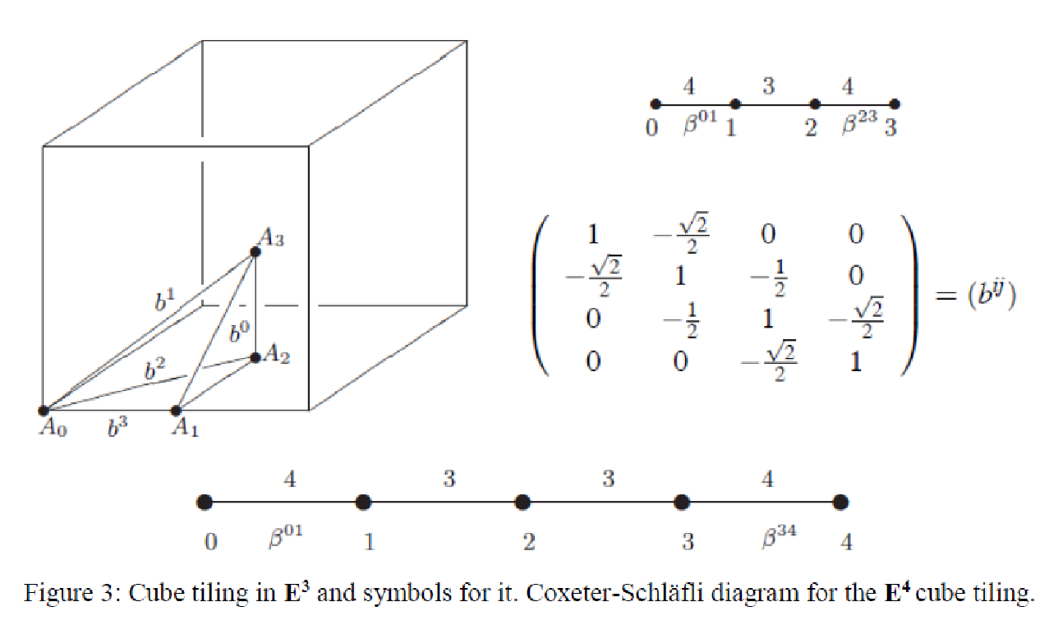
The Euclidean cube tiling and its characteristic orthoscheme (4, 3, 4),
Coxeter-Schläfli diagram, matrix (for later projective metric)
XII BGL Conference 2024, Budapest

Slide 15
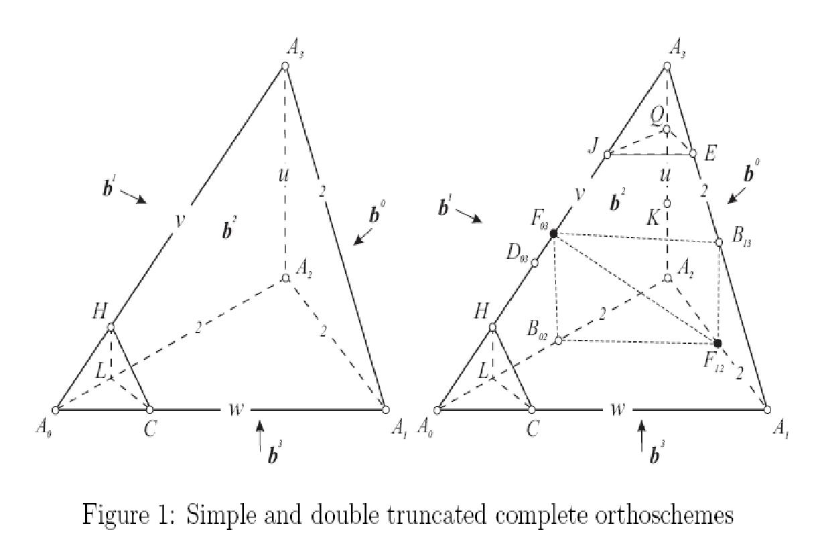
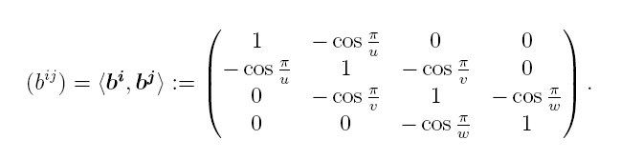
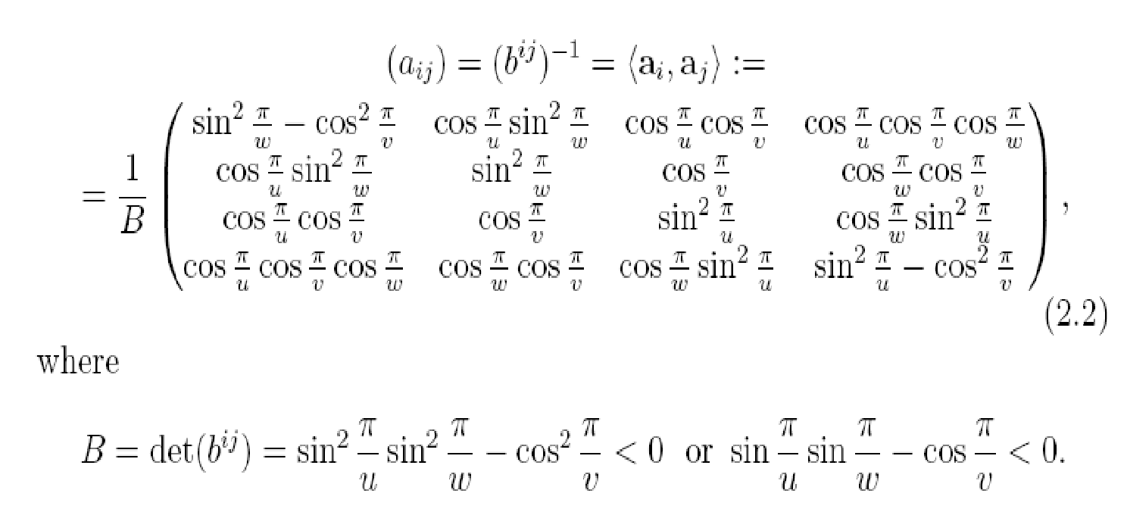
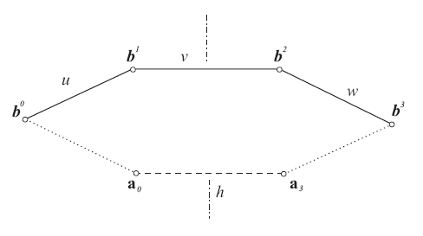
Coxeter-Schläfli matrix and its inverse for orthoscheme (u, v, w(=u)) and
for “trunc-simplices”. Scalar products for forms (planes) and vectors (points)
XII BGL Conference 2024, Budapest

Slide 16
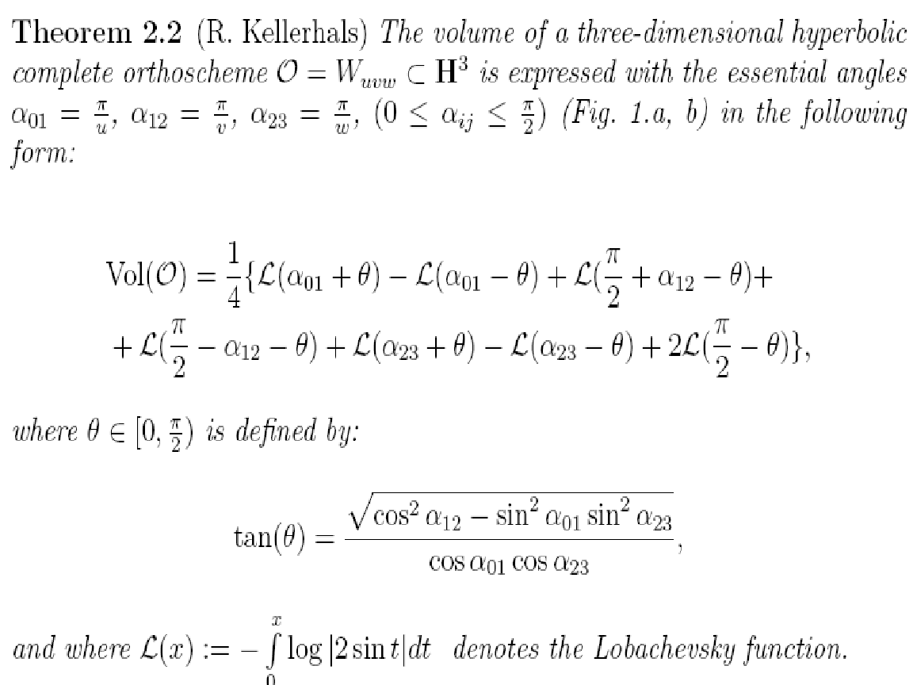
The Volume of the orthoscheme by N. I. Lobachevsky ideas
with generalization of R. Kellerhals
XII BGL Conference 2024, Budapest

Slide 17
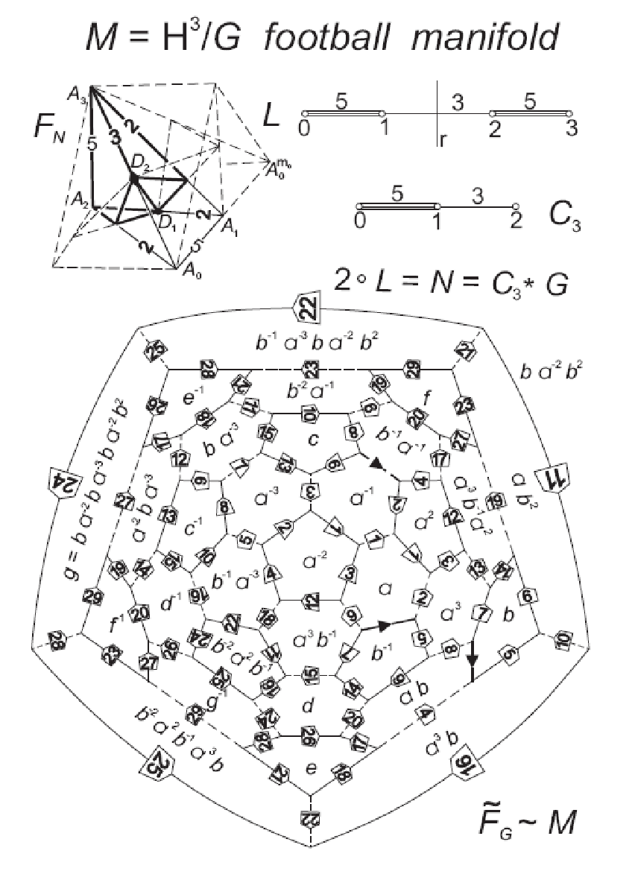
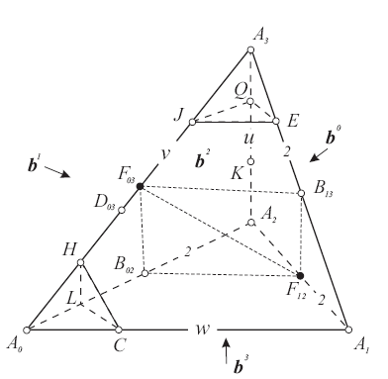
The football polyhedron {5, 6, 6} from the half orthoscheme (5, 3, 5)
Trunc-simplex (u, v, w = u) with
(1/u) + (1/v) < ½; then
A₀ and A₃ are outer
vertices with
truncating
polar planes
a₀ resp. a₃
E. Molnár, Two hyperbolic football manifolds. In: Proceedings of International Conference on
Differential Geometry and Its Applications, Dubrovnik Yugoslavia, 1988. 217–241.
E. Molnár, On non-Euclidean crystallography, some football manifolds, Struct Chem (2012) 23:1057–1069
XII BGL Conference 2024, Budapest

Slide 18
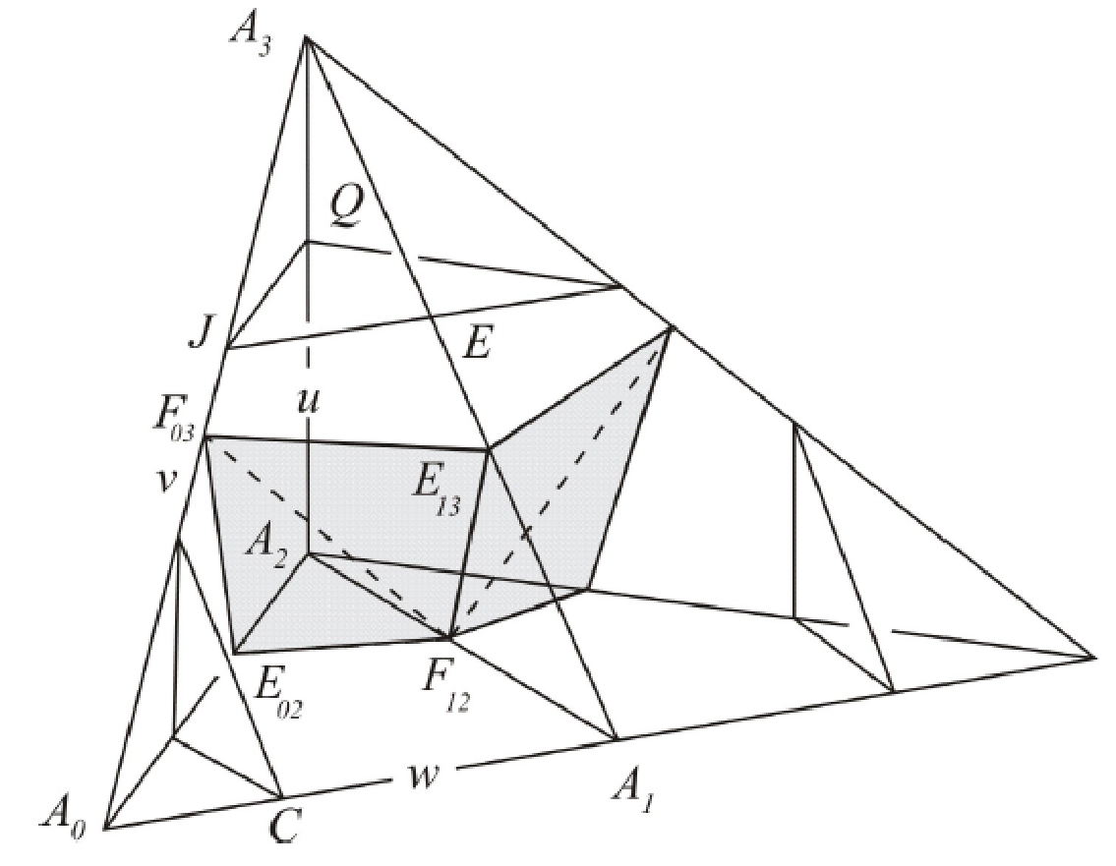
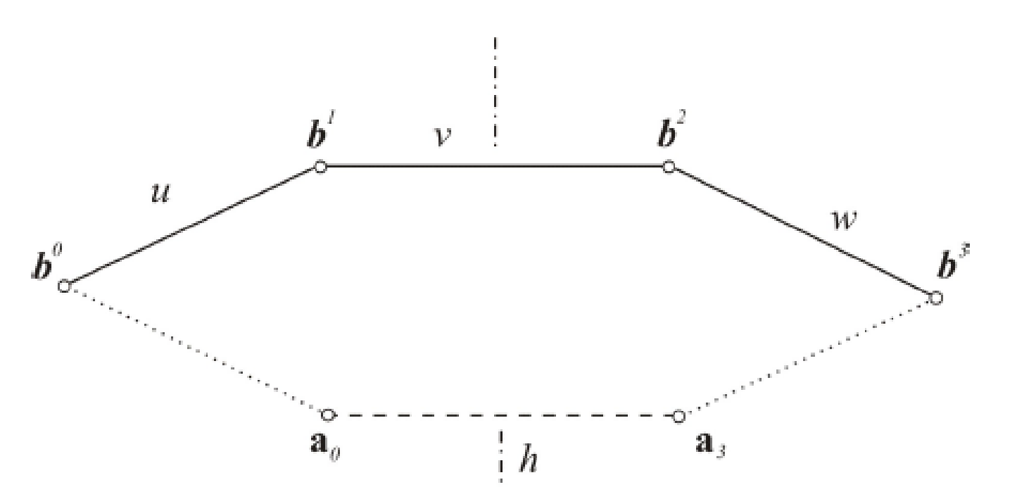
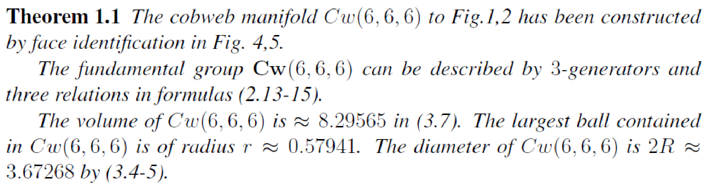
Construction of cobweb (or tube) manifolds from
half trunc-orthoscheme, by 2z = u = v = w ≧ 6
XII BGL Conference 2024, Budapest

Slide 19
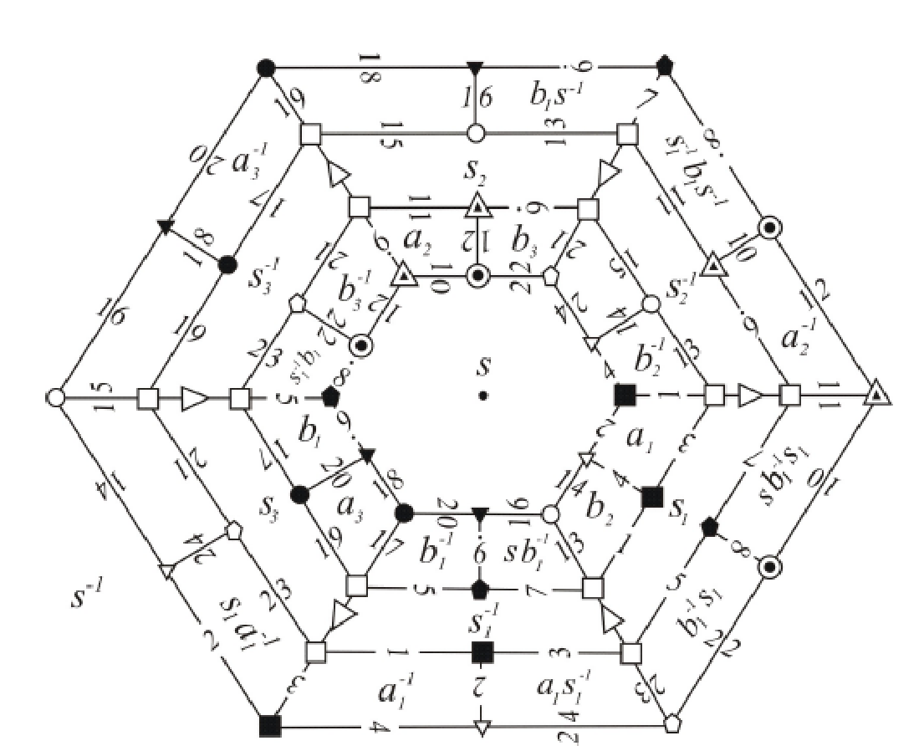
Construction of cobweb (tube) manifold Cw(6) by tricky
face pairing identifications from D-V cell of previous point Q
XII BGL Conference 2024, Budapest

Slide 20
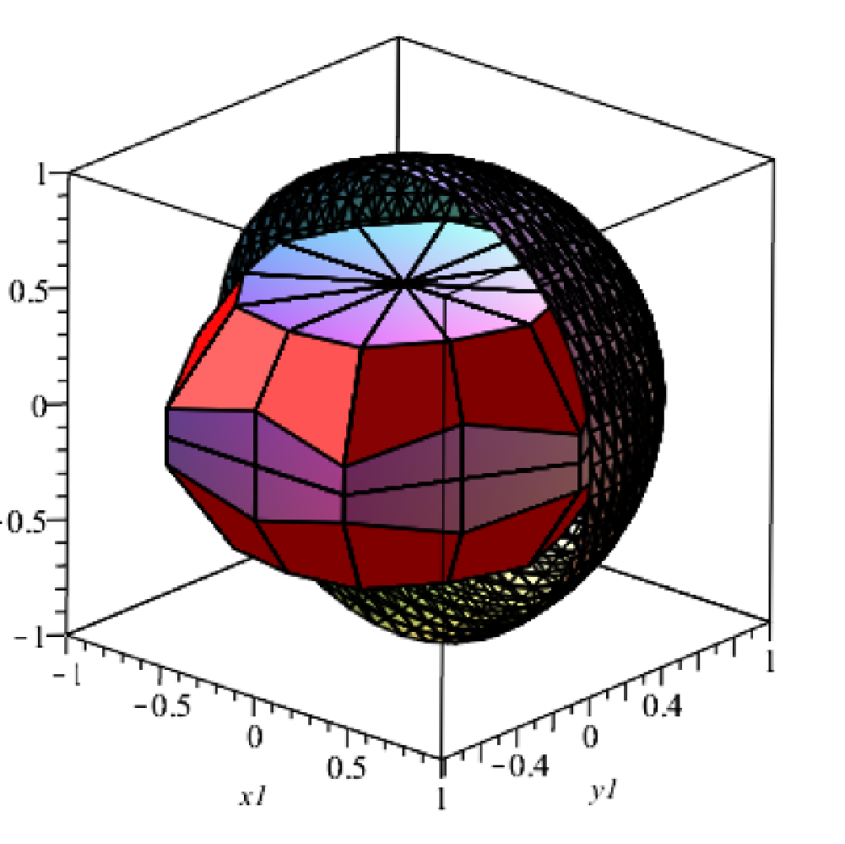
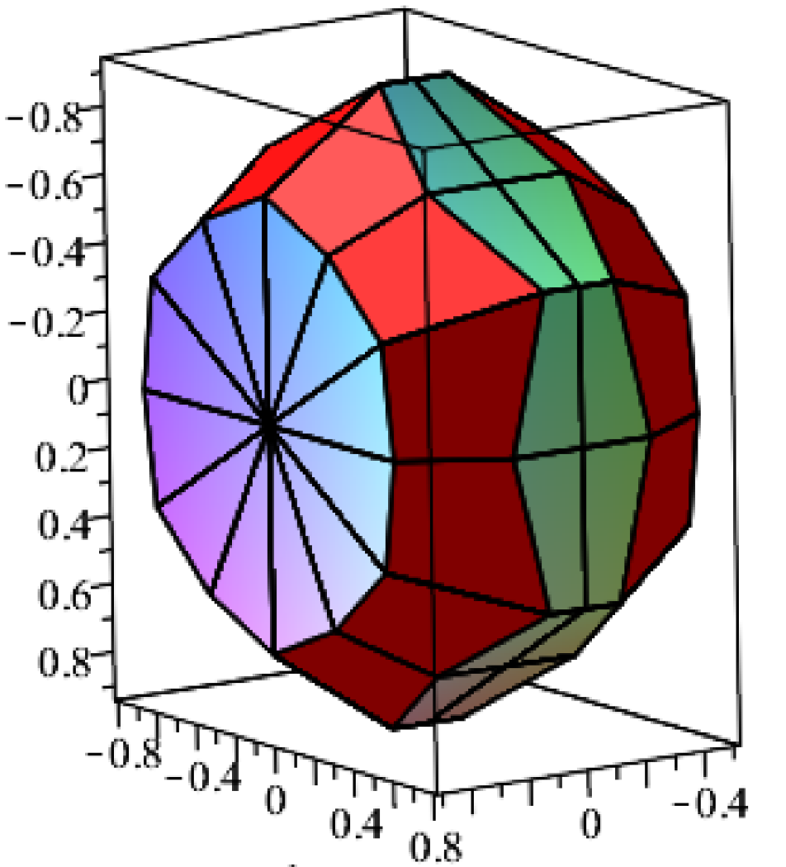
Animation of cobweb manifolds Cw(6) in B-C-K model of H³
XII BGL Conference 2024, Budapest

Slide 21
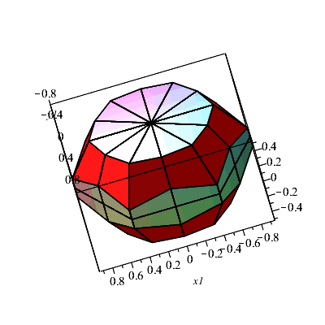
Animation of Cw(6) manifold
XII BGL Conference 2024, Budapest

Slide 22
Many Thanks to my Colleagues Dr. István PROK and Dr. Jenő SZIRMAI for scientific collaborations, to Dr. Ede BENDE and Acad. István HARGITTAI
for Chemistry consultations,
to Dr. Jenő SZIRMAI for assisting preparation
of this presentation.
Thank you for kind Attention!
XII BGL Conference 2024, Budapest

Slide 23
XII BGL Conference Budapest, 2024 May 1-3
Non-Euclidean Geometry in
Modern Physics and Mathematics
MTA Domus Collegium Hungaricum Vendégház
H-1146 Budapest, Abonyi utca 10.

