Slide 1
What is the physical and philosophical consequence of Hilbert's famous theorem, according to which Bolyai-Lobachevskii plane geometry cannot be implemented globally as internal geometry of a surface in 3-dimensional space?
Róbert Oláh-Gál,
Sapientia Hungarian University of Transylvania, Faculty of Economics, Socio-Human Sciences and Engineering,
Miercurea-Ciuc

Slide 2
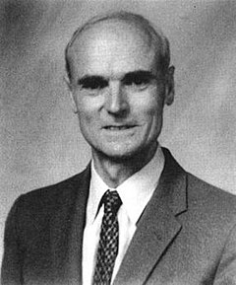
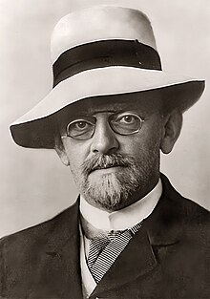
In my presentation, I would like to draw the audience's attention to two important papers in the history of science.The first is on Hilbert's very important theorem, which he published in Grundlagen der Geometrie, the second is on one of Coxeter's interesting but less cited papers.
David Hilbert
Harold Scott MacDonald "Donald" Coxeter
Born: 23 January 1862,Königsberg or Wehlau, Kingdom of Prussia
Died: 14 February 1943 (aged 81), Göttingen, Germany
Born: 9 February 1907 London, England,
Died: 31 March 2003 (aged 96), Toronto, Ontario, Canada

Slide 3
Hilbert published the perfect system of Euclidean geometry in 1901. As Hilbert mentioned, many people did not even understand why this monumental work was needed at the beginning of the 20th century. On the other hand, Hilbert, who is also the creator of the formalist mathematical philosophical trend, felt the need to finally clarify the system of Euclidean geometry after 2000 years. This was required by the formalist worldview itself, in order to place the mathematical structure of the world on an absolutely logically pure basis. Of course, in this monumental work, Hilbert also laid the logical foundations of Bolyai-Lobacevskii's geometry.

Slide 4
And he gifted the mathematical community with one more great theorem, namely his theorem that there is no complete surface with negative constant curvature in 3-dimensional space! Today, in the language of modern differential geometry, we formulate this as saying that the Bolyai-Lobachevskiy plane cannot be embedded in 3-dimensional space.What does this mean? In my opinion, this means that Bolyai-Lobacevskii geometry is not realized in 3-dimensional space! Of course, many people do not like this strong statement: because what does mathematical existence mean? However, we are working with these concepts step by step. If someone says that he has found a right-angled 3-angle in which the Pythagorean theorem is not true, we immediately think that something is wrong with the person making the statement. Well, it's similar to when someone says that some gadget works according to Bolyai-Lobacevsky geometry in 3-dimensional space. Because such a gadget does not exist!

Slide 5
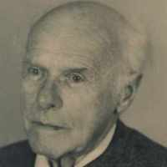
This was built, this table, the chairs on which the honored participants sit, were designed based on Euclidean geometry. But they cannot make a chair based on Bolyai-Lobachevskiy geometry. This is what Hilbert's famous theorem means.
Of course, in quantum mechanical dimensions, it might be possible there... Because in the infinite, countable dimensional, separable Euclidean space, Bolyai-Lobachevskii geometry can already be realized. (Because Ludwig Bieberbach proved this).
Ludwig Georg Elias Moses Bieberbach
Born: 4 December 1886, Goddelau, Grand Duchy of Hesse, German Empire
Died: 1 September 1982 (aged 95), Oberaudorf, Upper Bavaria, West Germany

Slide 6
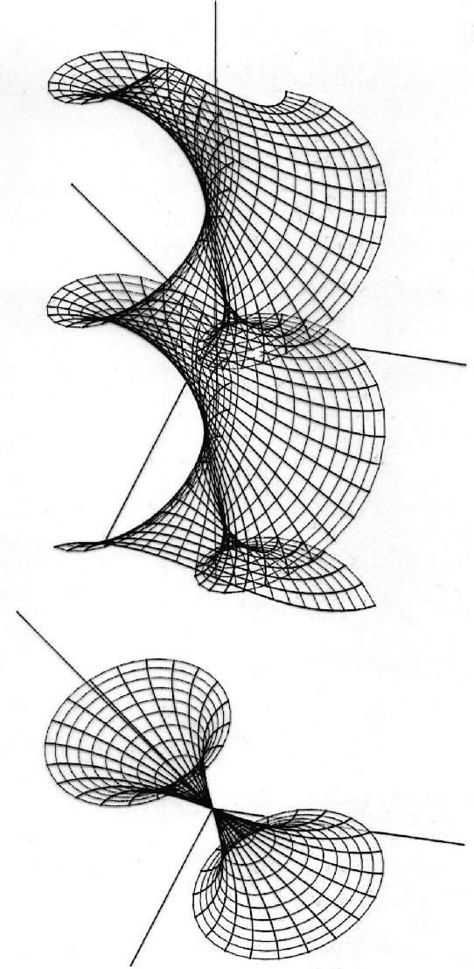
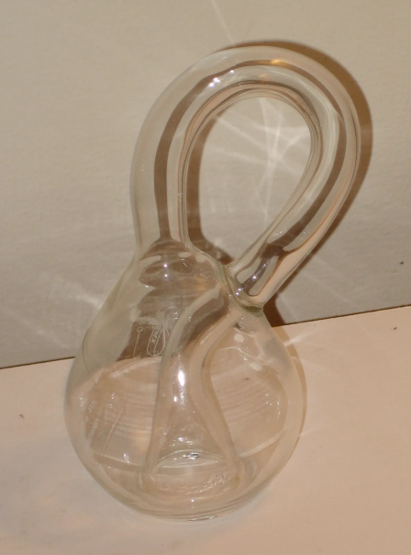
Mathematics is an exact science, its statements are true a priori, there are no exceptions. So, no matter how depressing it is, Bolyai-Lobachevskii geometry is not realized in its entirety in the 3-dimensional Euclidean space. Let me give you a not-so-good analogy: just as the Klein bottle cannot be realized in 3-dimensional space, Bolyai-Lobachevskii's planar geometry cannot be realized either.
Klein bottle (Nonorientable)

Slide 7
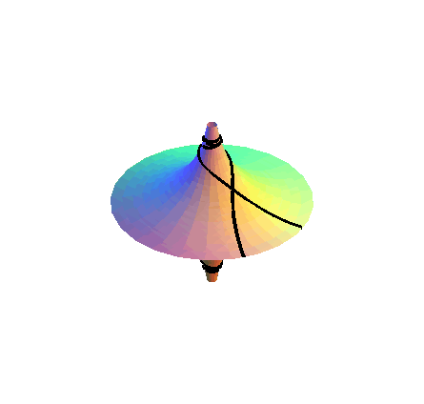
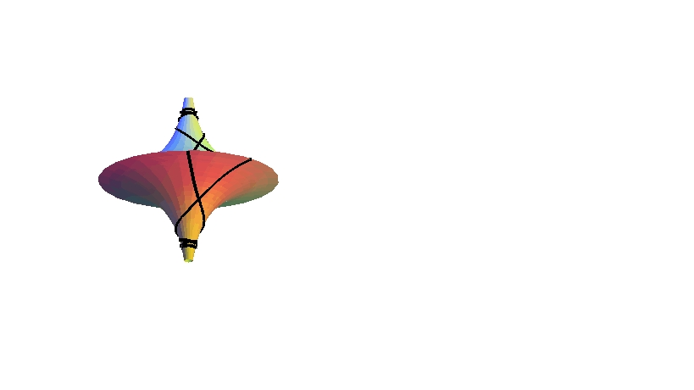
It was not by chance that Hilbert included this theorem in his Grundlagen der Geometrie. He knew, felt and understood the importance and epistemological background of this proposition.
Unfortunately, we forgot about this later! (Note that on the pseudosphere and on all surfaces with negative constant curvature, the Bolyai-Lobachevskii plane geometry is realized in a small (very small range).

Slide 8
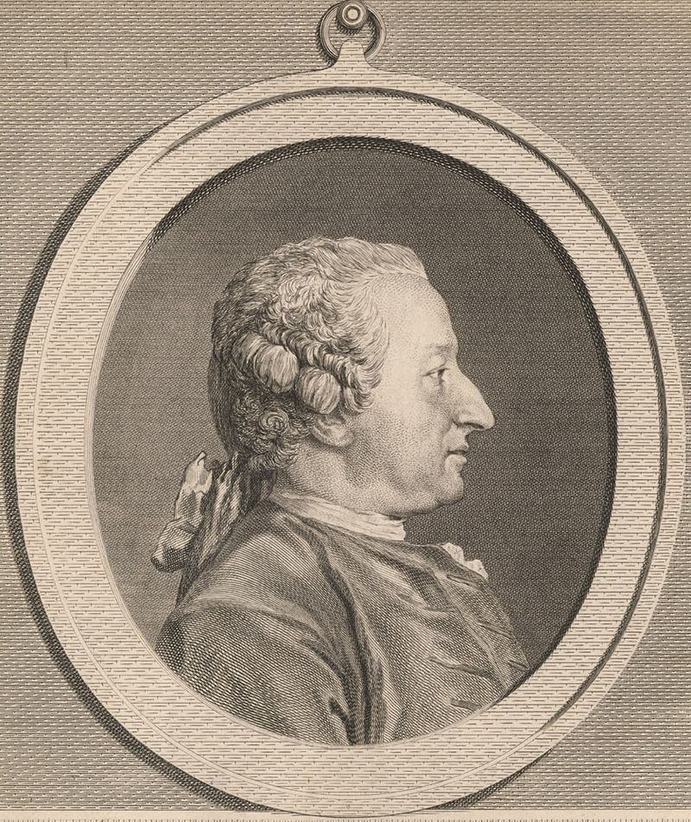
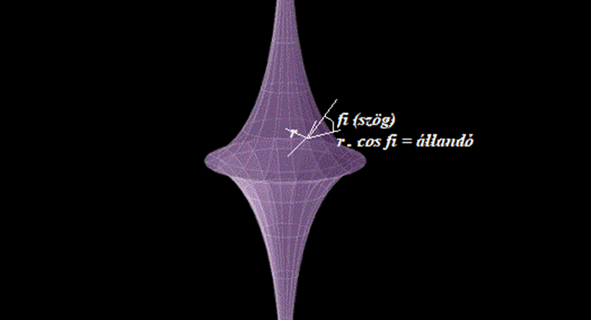
Alexis Claude Clairaut (French pronunciation: [alɛksi klod klɛʁo]; 13 May 1713 – 17 May 1765) was a French mathematician, astronomer, and geophysicist. He was a prominent Newtonian whose work helped to establish the validity of the principles and results that Sir Isaac Newton had outlined in the Principia of 1687. Clairaut was one of the key figures in the expedition to Lapland that helped to confirm Newton's theory for the figure of the Earth. In that context, Clairaut worked out a mathematical result now known as "Clairaut's theorem". He also tackled the gravitational three-body problem, being the first to obtain a satisfactory result for the apsidal precession of the Moon's orbit. In mathematics he is also credited with Clairaut's equation and Clairaut's relation.
According to Clairaut's theorem: the radius on the surface of rotation multiplied by the elevation angle of the geodetic will be CONSTANT! With this, we follow the path of the geodetics.

Slide 9
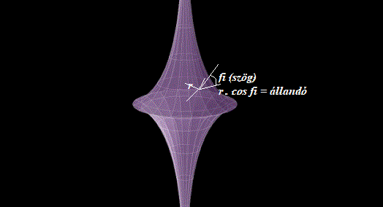
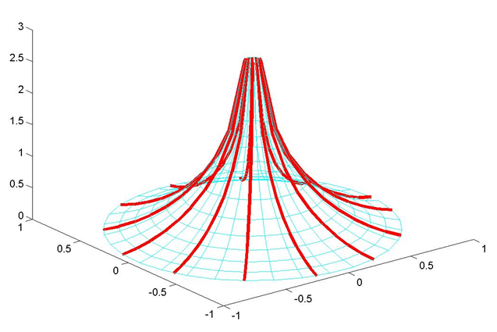
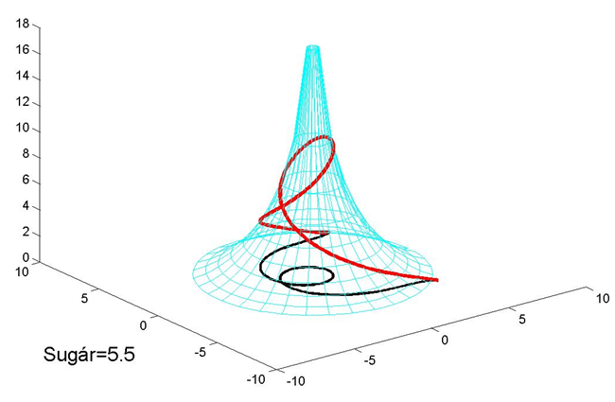
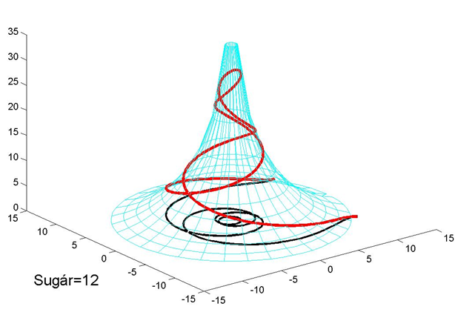

Slide 10
Isn't the name of this conference Bolyai-Lobachevskii-Gauss? Unfortunately, we didn't hear or talk about how Gauss got here. Or where are the German colleagues who would defend Gauss or explain Gauss's position regarding the discovery of non-Euclidean geometry.

Slide 11
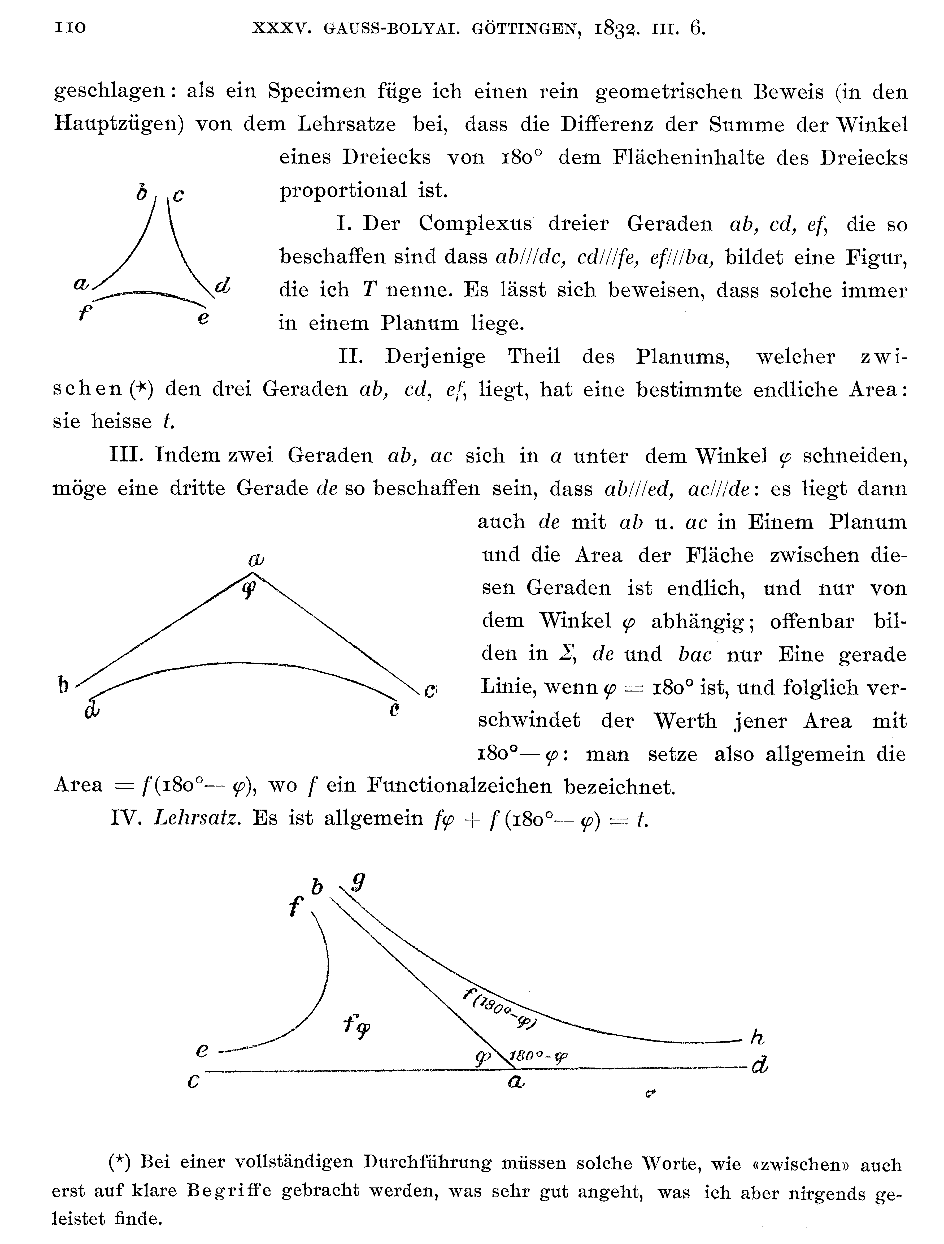
Let's look at the facts: Gauss's letter written in March 1832, the picture of which I am showing, and which he wrote to Farkas Bolyai, really testifies to such a great expertise and knowledge of the subject that we must say that only someone who had already thoroughly immersed himself could give such a professional answer in the subject!

Slide 12
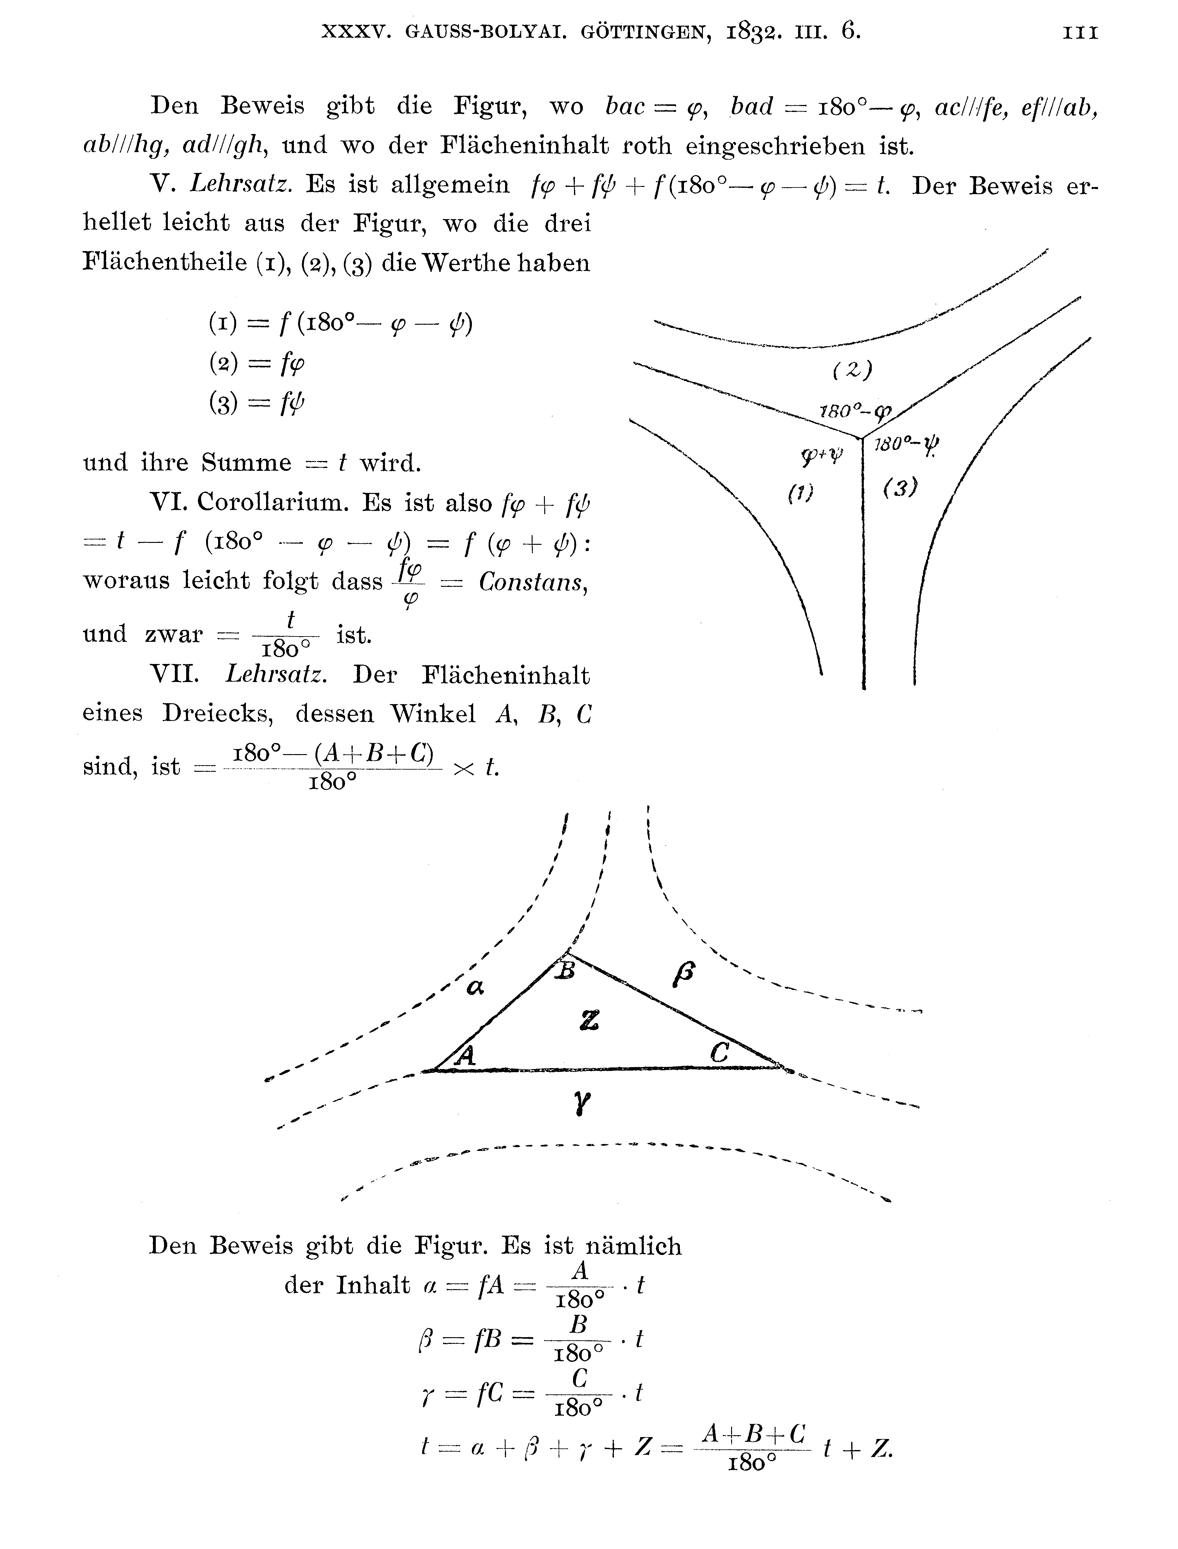

Slide 13
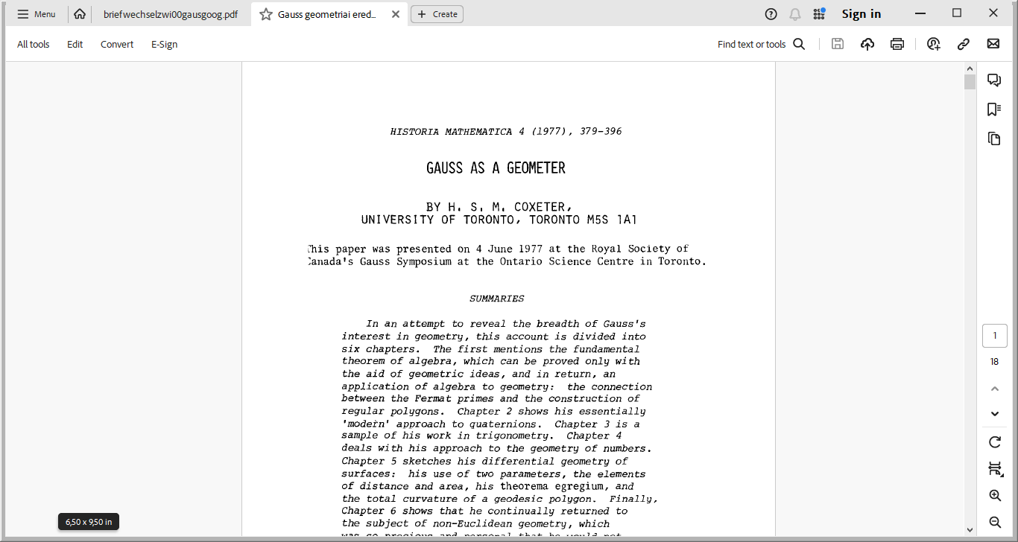
And it is not only us Hungarians who say this, but one of the excellent constructive geometers of the 20th century, the Canadian COXETER, also says this. COXETER also believes that Hungarians should be proud of this letter and not interpret it with a negative sign.

Slide 14
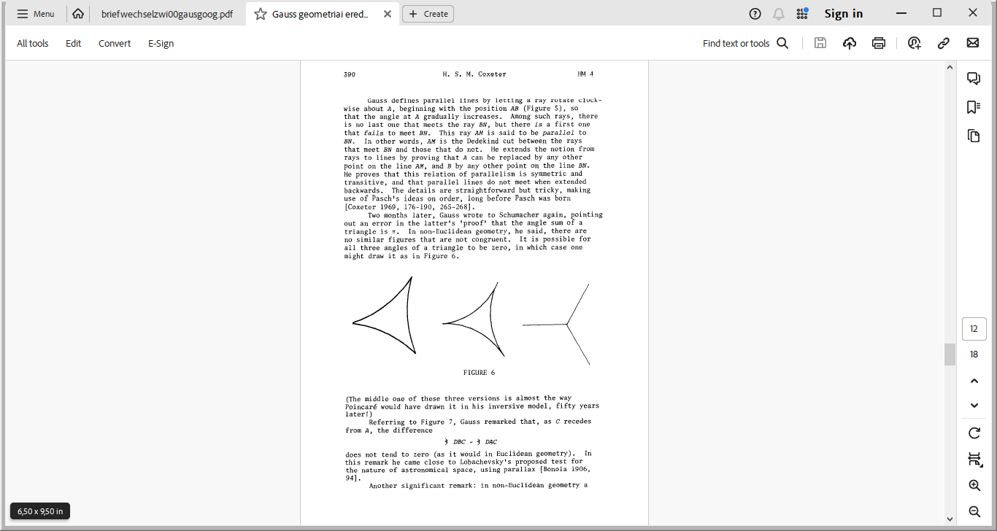

Slide 15
Indeed, Gauss writes that he is very happy that his good friend's son is the one who preceded him in this discovery! Furthermore, Gauss gave the names hypercycle and paracycle. And we can say that Gauss's comment is decisive, that although the area of the triangle on the hyperbolic plane can be derived very easily, its spatial analogy, the cubic content of the tetrahedron, is already hopelessly difficult. And indeed, the derivation of the cubic content of the tetrahedron was only given long after the death of Lobacsevskij and János Bolyai!

Slide 16
The volume of given tetrahedra in hyperbolic and spherical space is determined by their solid angles. The relationship is given by the Murakami–Yano formula. Since in Euclidean geometry, the angles of the tetrahedron are defined only to the extent of similarity, the formula cannot be applied in Euclidean space.
Murakami, Jun & Yano, Masakazu (2005), "On the volume of a hyperbolic and spherical tetrahedron", Communications in Analysis and Geometry 13 (2): 379–400, MR2154824, ISSN 1019-8385,

Slide 17
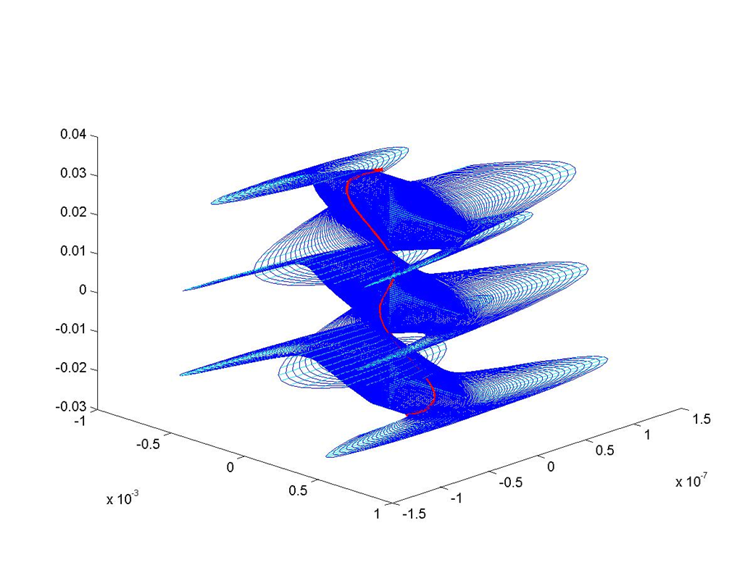
Finally, some interesting pictures that can only be illustrated with computer graphics: The hyperbolic plane can be embedded in the 6-dimensional Euclidean space, as Danilo Blanusa, a Croatian mathematician, showed in 1955.
The Russian mathematician Efimov generalized Hibert's theorem by proving that not only a complete surface with negative constant curvature does not exist in 3-dimensional space, but also a complete surface in 3-dimensional Euclidean space whose curvature Sup K(u,v) < 0 does not exist. So the curvature supremum is strictly less than zero.

Slide 18
Danilo Blanusa's complete hyperbolic plane in 6-dimensional Euclidean space! Attention, this is a computer option to project from 6 dimensions into 3 dimensions. This is just an illustration of what computer graphics can do
The entire hyperbolic plane does not fit in 3-dimensional Euclidean space!

Slide 19
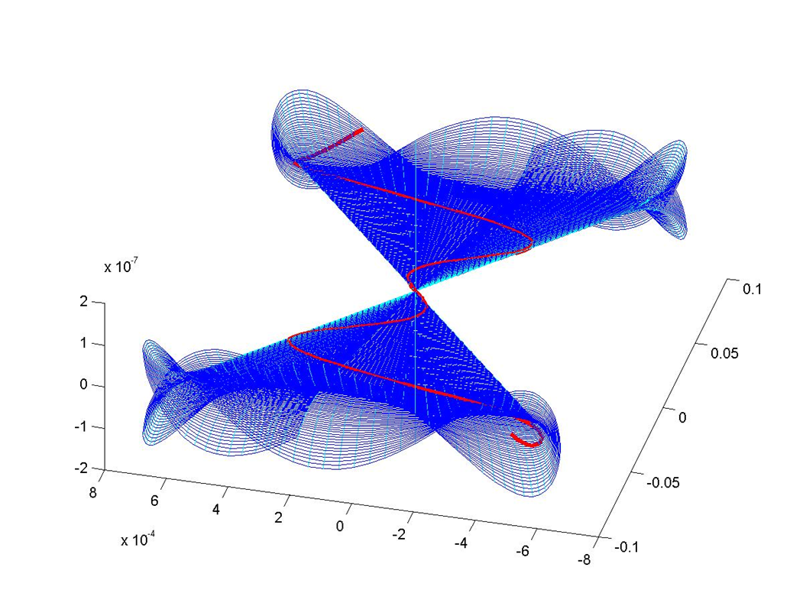
An immersion of Balnusa's former embedding into 5-dimensional Euclidean space (author's implementation)

Slide 20

The embedding of a region of the Bolyai plane into the 4-dimensional Euclidean space and its parallel projection into the 3-dimensional space. Implementation of OGR.
My edit!

Slide 21
Thank you very much for your respectful attention!

