Slide 1
Error Tolerances, Girder Errors and long range errors from a beam dynamics point of view
The message of this presentation is, for an HMBA-like upgrade project:
Girder-Girder == Magnet-Magnet
IF ANY, USE SIMULATED SURVEYs INSTEAD OF GIRDER-GIRDER and LONG RANGE ERRORS
S.M.Liuzzo, ESRF, Grenoble, 27th June 2023, on behalf of the beam dynamics group

Slide 2
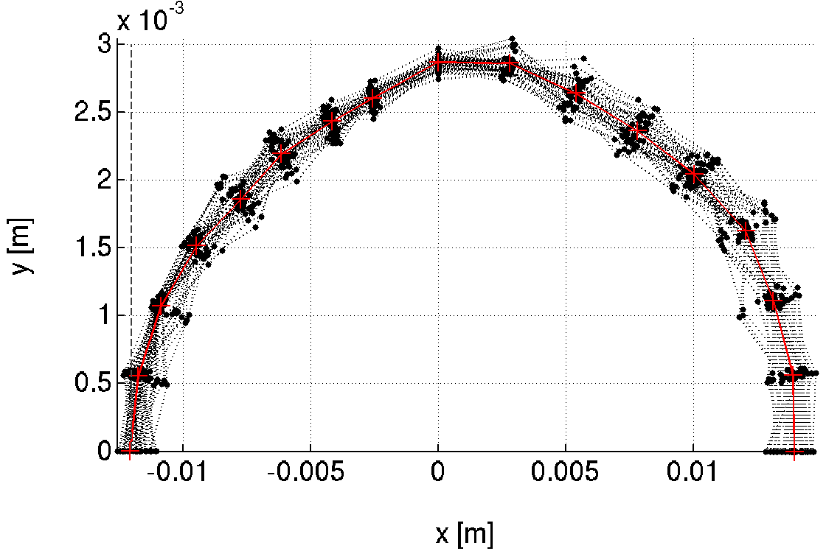
Tolerance estimates objective
Septum
2 main parameters to achieve,
Absolute values depend on facility layout.
TARGET
Injected
beam
-10mm (-8.1mm @INJECTION)
~100% Injection Efficiency
>10h
Touschek Lifetime
@ 200mA uniform, 5pm
Also :
Emittance variation < 2pm
Feasible correction strengths
Orbit < 100um rms
etc…

Slide 3
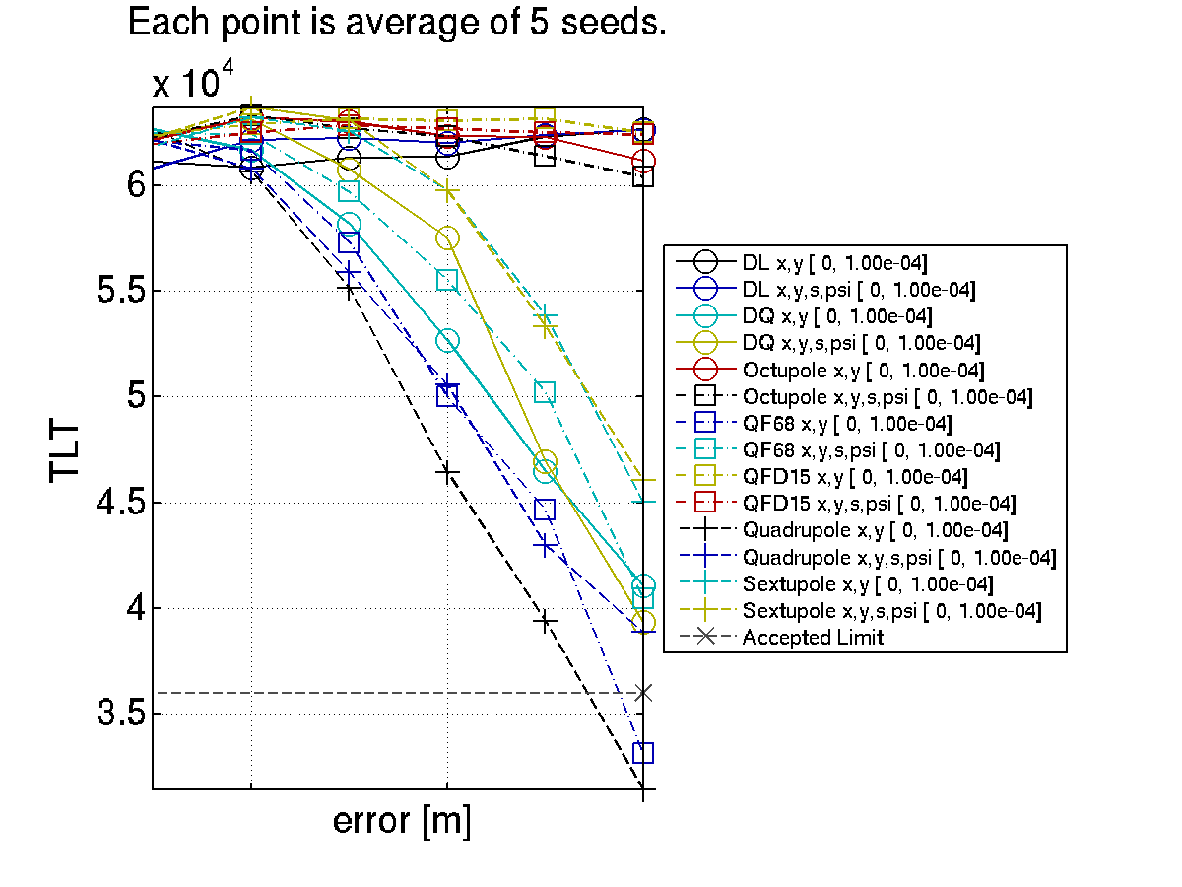
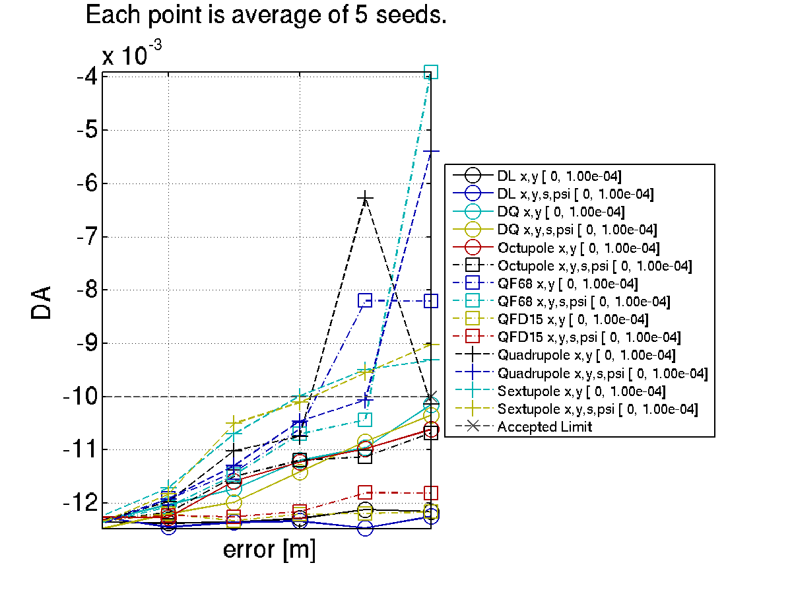
LifEtime and dynamic apertures vs error sources
How tolerances were defined
A CLUSTER is crucial for this analysis. Each error set to analyze requires 1CPUx4h
17h
The line where I should have placed it.
DA=-10mm
Lifetime = 10h
10h
The line where I should have placed it.
Sext. Alignment do more on DA than on TLT ;
Moderate gradient are irrelevant compared to high gradient ;
Etc. etc.
How to determine the ”tolerance” ? ➔ DRAW A LINE (relative impact of each error), RESCALE globally.
CAoPAC Workshop l GSI, Darmstadt 10-13 March 2015 l S.M.Liuzzo

Slide 4
Comparable tolerance table
How tolerances were defined
In RED
The worst crossing of the “line” for each performance parameter
DQ (combined function dipoles) behave as quadrupoles concerning errors. Evident the impact on vertical dispersion compared to the other quadrupoles (defocussing quadrupoles).
Quadrupoles have large impact on orbit and horizontal dispersion, also in this case, lifetime and DA are strongly affected. QF6 and QF8 are dominant.
Sextupoles have the largest impact on DA, they are also the strongest source of beta-beating and emittance as expected.
Octupoles influence is limited compared to quadrupole and sextupoles, nevertheless they do have an impact on DA. Their effect on lifetime is very small.
Rotations up to 100urad have impact on the various parameters but limited.

Slide 5
Tolerable random errors
How tolerances were defined
Each error, on each magnet family, is studied individually looking at the dependence of DA, lifetime, emittances and all relevant parameters vs error amplitude.
Required: | DX | DY | DS | DPSI | DK
 | μm | μm | μm | μrad | 10^-4
DL | >100 | >100 | 1000 | 500 | 10
DQ, QF[68] | 70 | 50 | 500 | 200 | 5
Q[DF][1-5] | 100 | 85 | 500 | 500 | 5
SFD | 70 | 50 | 500 | 1000 | 35
OF | 100 | 100 | 500 | 1000
Sextupoles and high gradient quadrupoles are the most relevant limitations, nevertheless, this alignment specifications are currently achievable.
(DX=DY=60μm, 84 μm between two magnets).

Slide 6
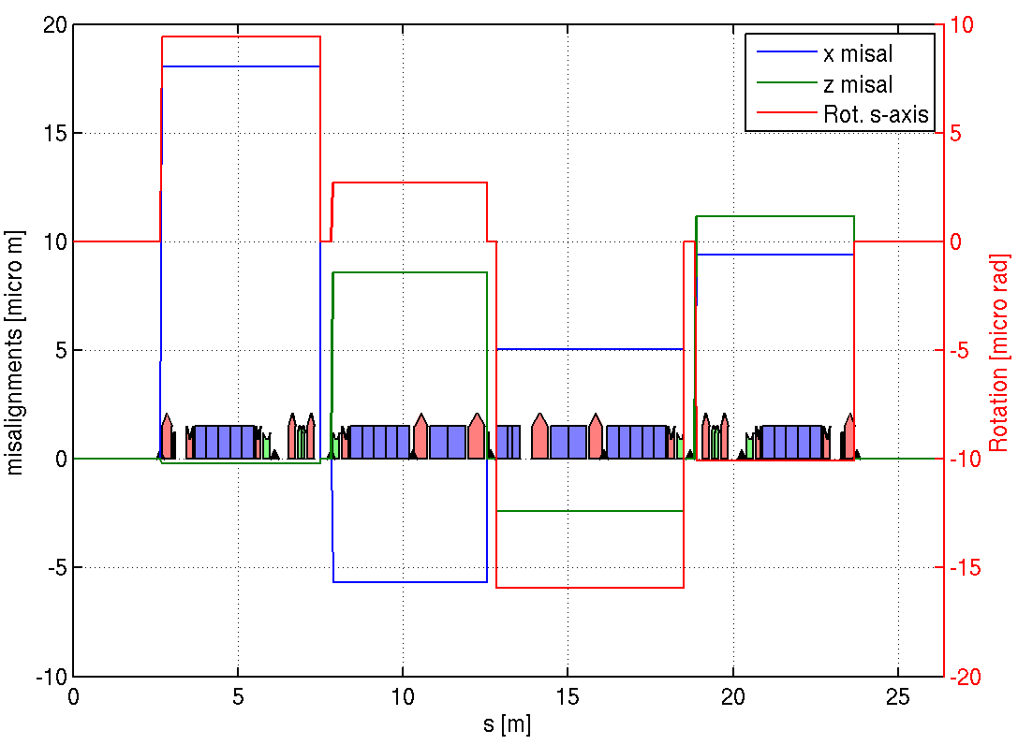
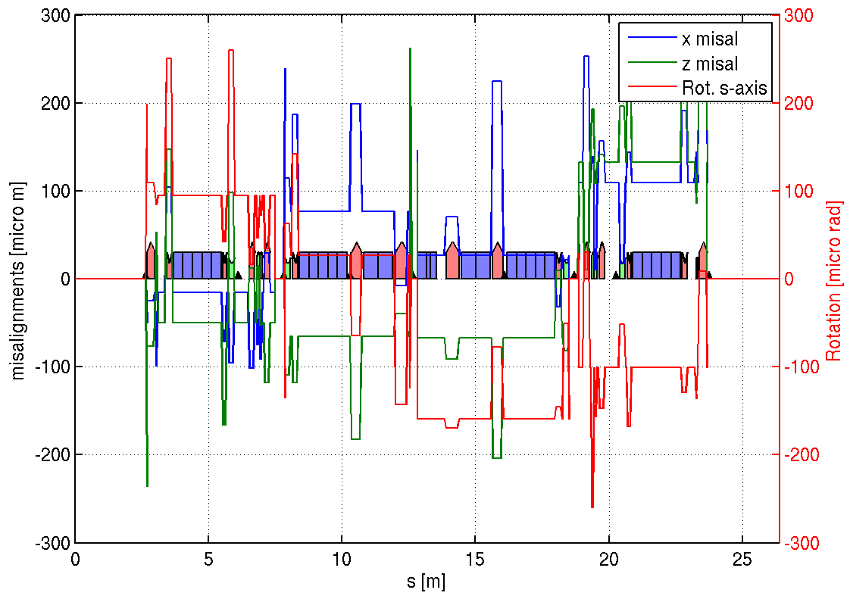
Girder Errors
How
GIRDER
tolerances were defined
Girder displacements and rotations
Girder displacements and rotations
+ random errors Quad. and Sext.
4 girders, BPMs are moved with the girder.
l 30-31 May 2014 l S.M.Liuzzo

Slide 7
Dynamic aperture @S3 septum vs errors for s28A + RDT correction
How
GIRDER
tolerances were defined
-20%
All is NOT the sum of each error
26/07/2013
l WP1 ESRF upgrade l May 2014 l S.M.Liuzzo

Slide 8
error values for a reduction of 20% of Hor. Dynamic Aperture @S3
How
GIRDER
tolerances were defined
RDT correction
Strong impact of quadrupole errors
No influence on emittances

Slide 9
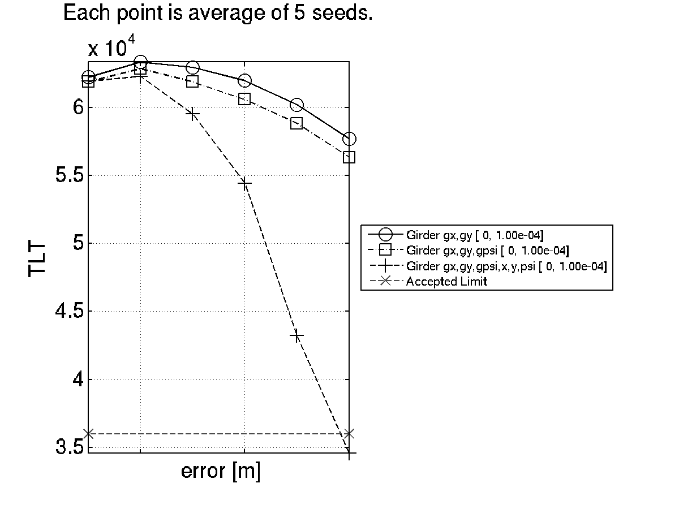
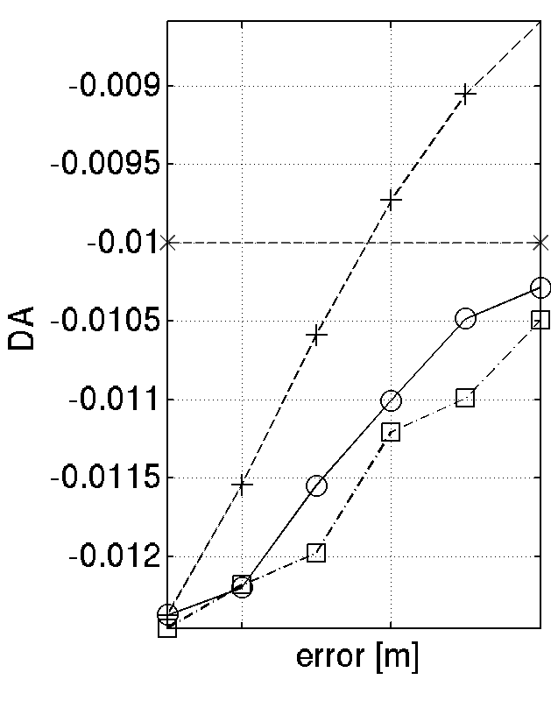
Girder Errors
How
GIRDER
tolerances were defined
Hor. DA @ QFI, X0.81 to scale at S3,
8mm required at S3, 10mm accepted at QFI
Girders+Magnets
17h
girders
BAD
Girders+Magnets
In terms of DA girders and magnet alignment approx. sum up. In terms of lifetime, magnets+girder have a stronger impact.
Girders only
(g) Stands for girder errors,
no (g), are quadrupole and sextupole individual misalignments
10h
GOOD

Slide 10
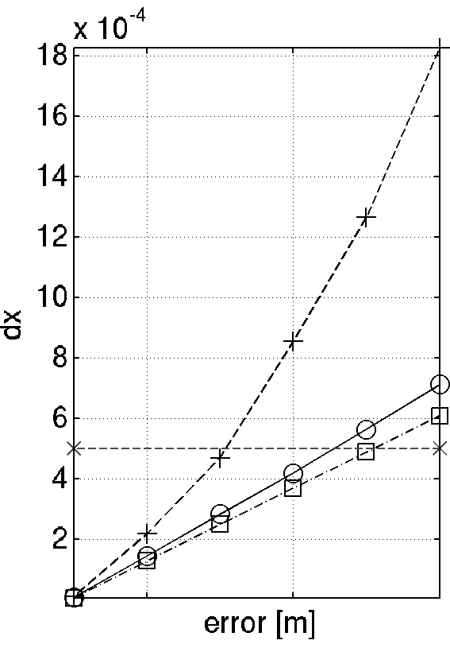
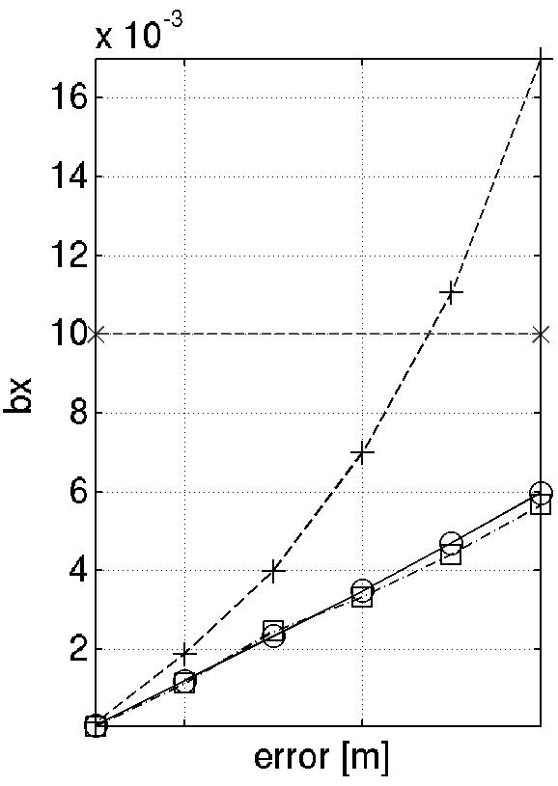
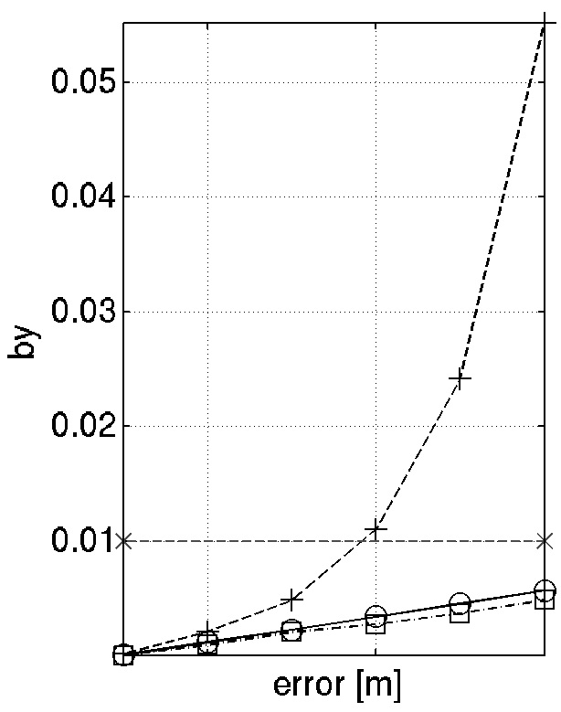
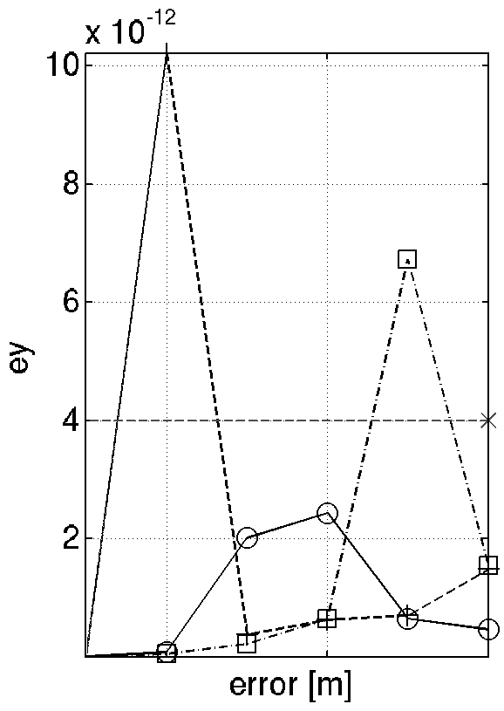
Summary Table of Girder Errors
Commissioning-like correction sequence to get these data
Cluster, Average over several (10) error seeds.
Computing cluster
(g) Stands for girder errors, no g, are quadrupole and sextupole individual misalignments
How
GIRDER
tolerances were defined

Slide 11
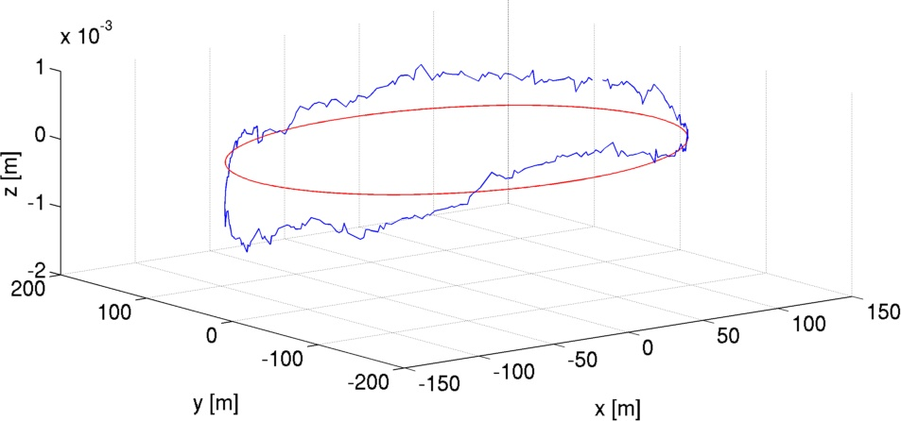
The measured position of the lattice
How
GIRDER
tolerances were excluded
This is where the machine is. Let’s use this information!
nominal
current
ESRF 1994-2018
EBS 2019-?? We placed EBS where the old SR used to be. Everyone is happy.

Slide 12
Survey errors PLUS random errors
How GIRDER
tolerances were excluded
D.Martin, G.Gatta
The blue curve represents the current ESRF storage ring position.
The x symbols are the interpolated positions on this curve for the S28A lattice.
BPM are positioned on the same curve.
DX and DZ and girder rotations are applied.
Errors are ramped in steps of 20% up to the nominal value.
Added random errors to account for unknown magnetic center position
Random Gaussian DX DY in quadrupoles and sextupoles on top of the survey errors.
l ESRF Upgrade l June 2014 l S.M.Liuzzo

Slide 13
Long range errors
How
GIRDER
tolerances were excluded
Error “waves” applied to the lattice: DX, DY, Rotations for quad and sext.
Correction performed for each frequency and amplitude set as:
Open trajectory correction
Orbit correction
RDT correction
storage ring survey data
simulated 1st harmonic,
10 years AGO!
Simulations performed on the OAR asd cluster, 8h-600cpu
26/07/2013

Slide 14
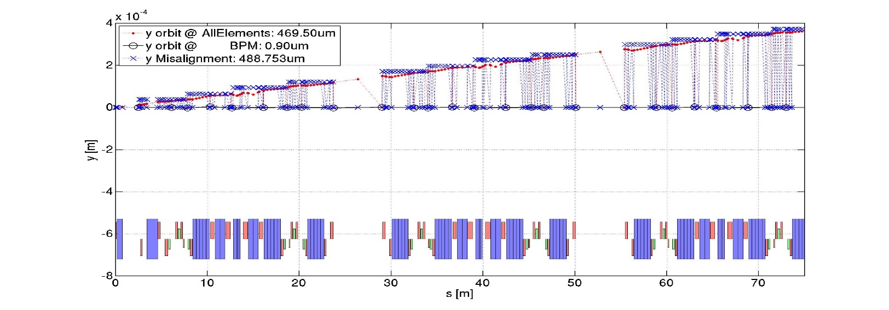
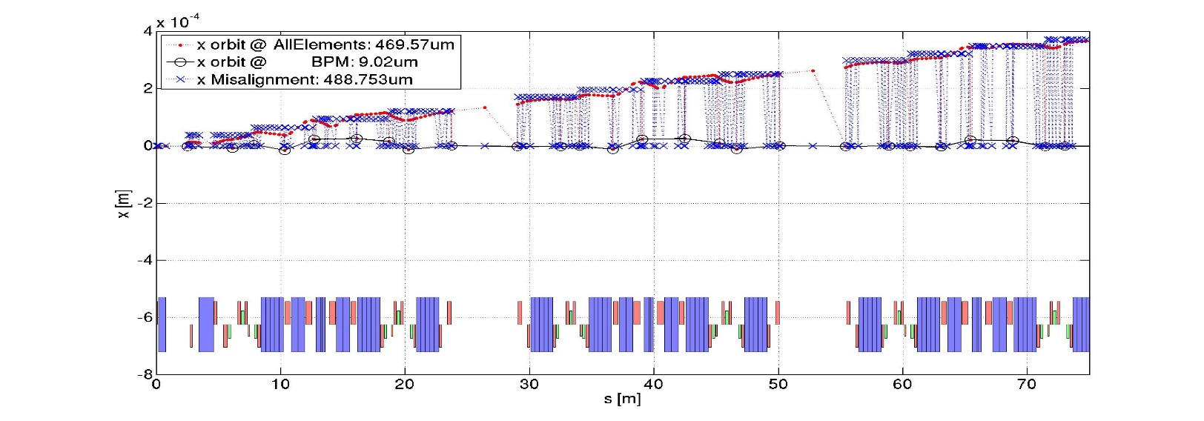
displacements and global tilt
--------------------------------------------------
------ total std corrector values applyed --------
------ --------
HK (288) [1/m]: 0.00e+00 -> 1.06e-04
VK (288) [1/m]: 0.00e+00 -> 1.19e-04
SK (288) [1/m2]: 0.00e+00 -> 0.00e+00
QK (514) [1/m2]: 0.00e+00 -> 0.00e+00
HKL (288) [rad]: 0.00e+00 -> 1.08e-05
VKL (288) [rad]: 0.00e+00 -> 8.25e-06
SKL (288) [T/m]: 0.00e+00 -> 0.00e+00
QKL (514) [T/m]: 0.00e+00 -> 0.00e+00
------ --------
------ residual orbit and dispersion --------
------ --------
OH (288) [m]: 3.78e-05 -> 9.02e-06
OV (288) [m]: 1.48e-04 -> 9.05e-07
DH (288) [m]: 3.80e-04 -> 1.18e-04
DV (288) [m]:1.38e-03 -> 3.33e-04
BBH (288) %: 0.9 -> 0.3
BBV (288) %: 0.6 -> 0.3
PhH (288) : 2.09e-02 -> 1.75e-02
PhV (288) : 1.70e-02 -> 1.07e-02
------ --------
------ tune and emittance --------
------ --------
Qx [0.580]: 0.580 -> 0.580
Qy [0.620]: 0.619 -> 0.619
EX [147.528 pm]: 147.506 -> 147.545
EY [0.000pm]: 0.986 -> 0.049
------ --------
--------------------------------------------------
----- ----- -- -- -- -- ------ -----
initial (ex, ey): 147.53, 0.00,
errors (ex, ey): 147.51, 0.99,
corrected (ex, ey): 147.54, 0.05,
Freq 1, every 32

Slide 15
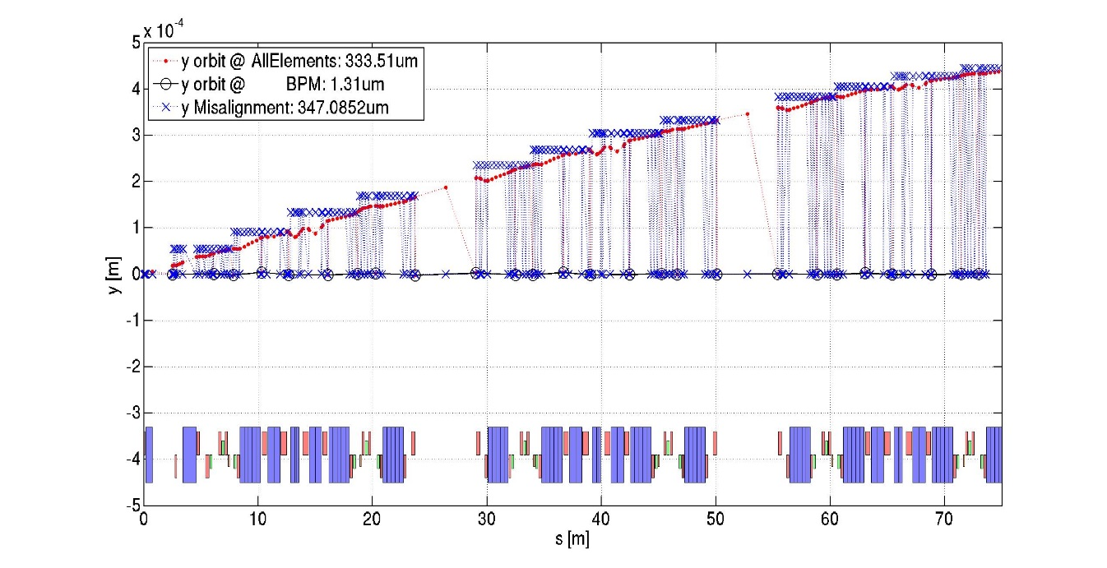
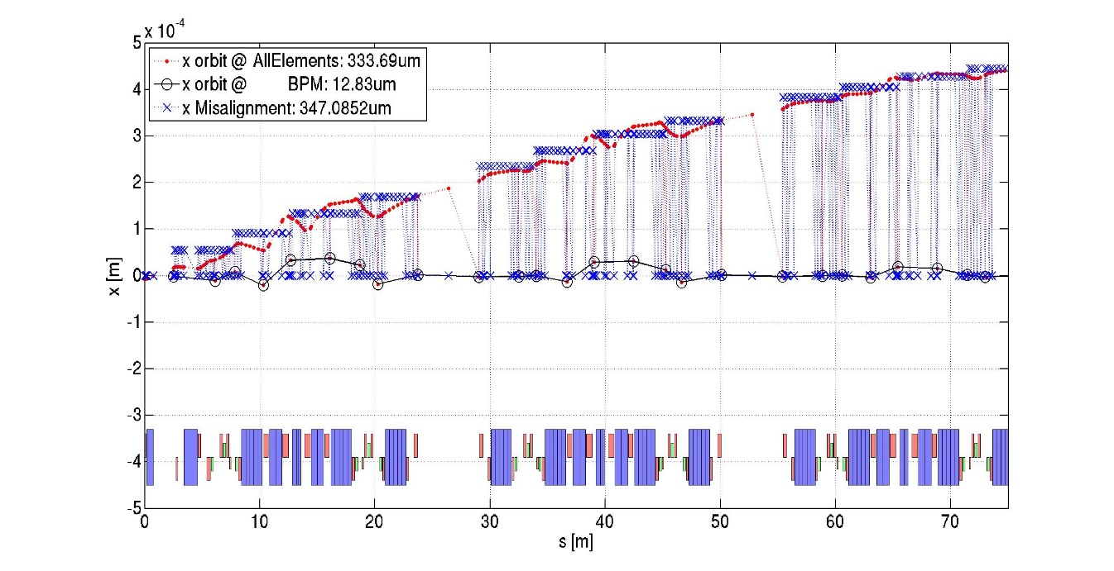
every 16 cells
--------------------------------------------------
------ total std corrector values applyed --------
------ --------
HK (288) [1/m]: 0.00e+00 -> 1.51e-04
VK (288) [1/m]: 0.00e+00 -> 1.68e-04
SK (288) [1/m2]: 0.00e+00 -> 0.00e+00
QK (514) [1/m2]: 0.00e+00 -> 0.00e+00
HKL (288) [rad]: 0.00e+00 -> 1.54e-05
VKL (288) [rad]: 0.00e+00 -> 1.17e-05
SKL (288) [T/m]: 0.00e+00 -> 0.00e+00
QKL (514) [T/m]: 0.00e+00 -> 0.00e+00
------ --------
------ residual orbit and dispersion --------
------ --------
OH (288) [m]: 6.01e-05 -> 1.28e-05
OV (288) [m]: 2.61e-04 -> 1.31e-06
DH (288) [m]: 5.95e-04 -> 1.75e-04
DV (288) [m]:2.41e-03 -> 5.84e-04
BBH (288) %: 1.4 -> 0.5
BBV (288) %: 0.9 -> 0.5
PhH (288) : 1.77e-02 -> 1.28e-02
PhV (288) : 1.42e-02 -> 8.11e-03
------ --------
------ tune and emittance --------
------ --------
Qx [0.580]: 0.579 -> 0.580
Qy [0.620]: 0.618 -> 0.619
EX [147.528 pm]: 147.487 -> 147.563
EY [0.000pm]: 2.806 -> 0.137
------ --------
--------------------------------------------------
Freq 2, evry 16 cells

Slide 16
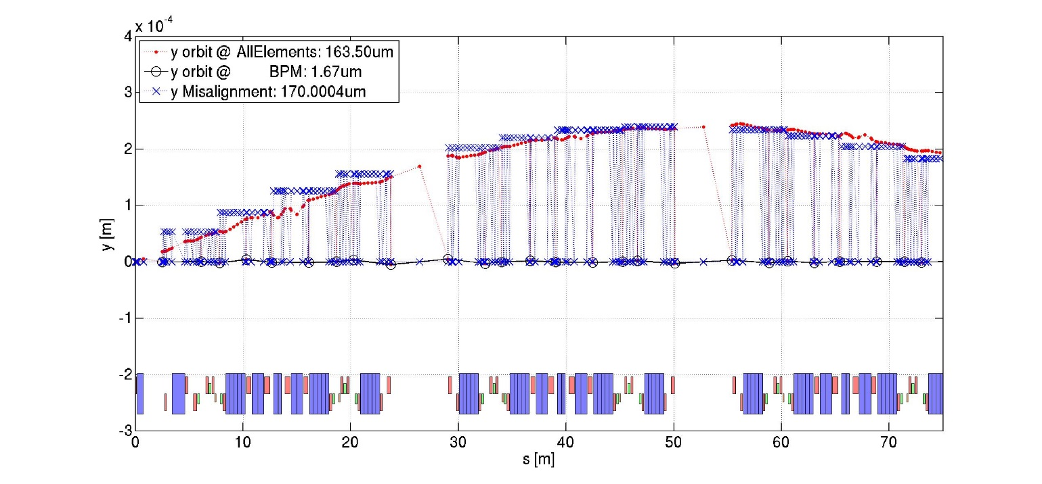
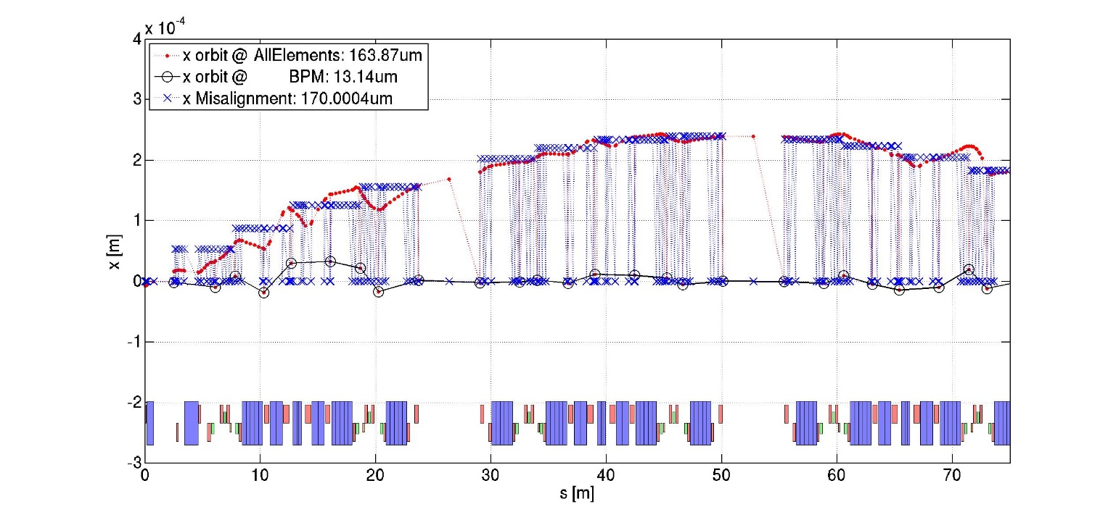
every 8 cells
--------------------------------------------------
------ total std corrector values applyed --------
------ --------
HK (288) [1/m]: 0.00e+00 -> 1.37e-04
VK (288) [1/m]: 0.00e+00 -> 1.63e-04
SK (288) [1/m2]: 0.00e+00 -> 0.00e+00
QK (514) [1/m2]: 0.00e+00 -> 0.00e+00
HKL (288) [rad]: 0.00e+00 -> 1.54e-05
VKL (288) [rad]: 0.00e+00 -> 1.14e-05
SKL (288) [T/m]: 0.00e+00 -> 0.00e+00
QKL (514) [T/m]: 0.00e+00 -> 0.00e+00
------ --------
------ residual orbit and dispersion --------
------ --------
OH (288) [m]: 8.79e-05 -> 1.31e-05
OV (288) [m]: 1.35e-03 -> 1.67e-06
DH (288) [m]: 2.59e-03 -> 2.61e-04
DV (288) [m]:1.02e-02 -> 3.12e-03
BBH (288) %: 3.9 -> 0.5
BBV (288) %: 2.2 -> 0.5
PhH (288) : 2.95e-02 -> 6.91e-03
PhV (288) : 2.13e-02 -> 5.69e-03
------ --------
------ tune and emittance --------
------ --------
Qx [0.580]: 0.574 -> 0.580
Qy [0.620]: 0.612 -> 0.619
EX [147.528 pm]: 147.077 -> 147.596
EY [0.000pm]: 67.039 -> 4.014
------ --------
--------------------------------------------------
----- ----- -- -- -- -- ------ -----
initial (ex, ey): 147.53, 0.00,
errors (ex, ey): 147.08, 67.04,
corrected (ex, ey): 147.60, 4.01,
Freq 4, every 8 cells

Slide 17
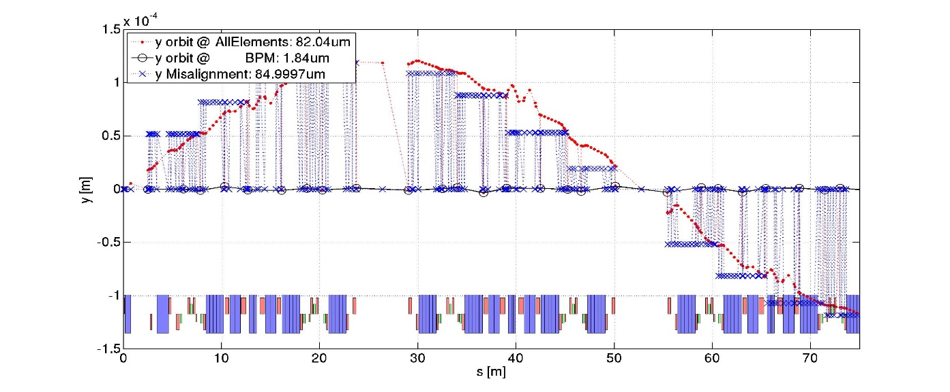
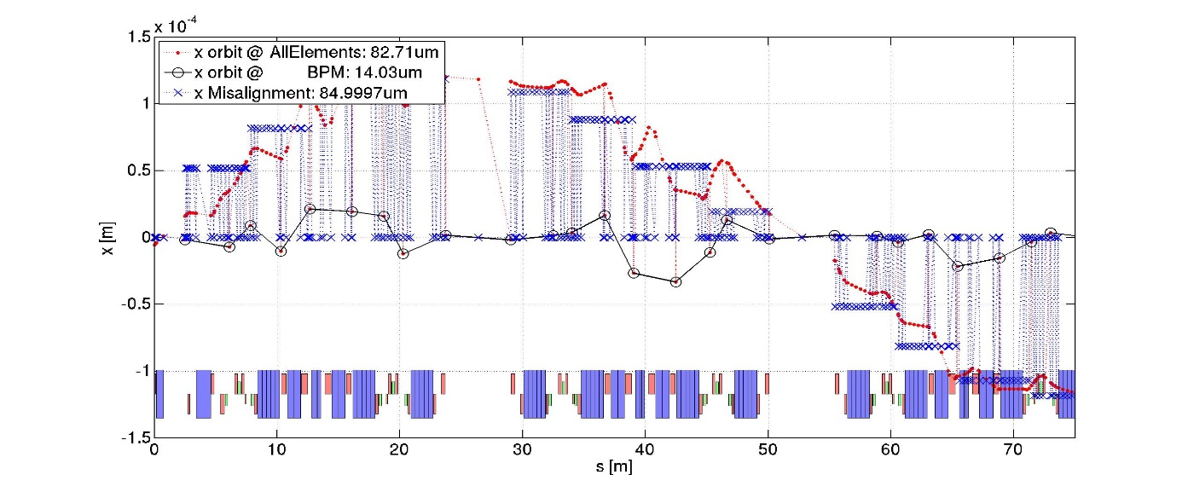
every 4 cells
--------------------------------------------------
------ total std corrector values applyed --------
------ --------
HK (288) [1/m]: 0.00e+00 -> 1.24e-04
VK (288) [1/m]: 0.00e+00 -> 1.63e-04
SK (288) [1/m2]: 0.00e+00 -> 0.00e+00
QK (514) [1/m2]: 0.00e+00 -> 0.00e+00
HKL (288) [rad]: 0.00e+00 -> 1.59e-05
VKL (288) [rad]: 0.00e+00 -> 1.14e-05
SKL (288) [T/m]: 0.00e+00 -> 0.00e+00
QKL (514) [T/m]: 0.00e+00 -> 0.00e+00
------ --------
------ residual orbit and dispersion --------
------ --------
OH (288) [m]: 6.11e-05 -> 1.40e-05
OV (288) [m]: 1.37e-04 -> 1.84e-06
DH (288) [m]: 7.00e-04 -> 2.83e-04
DV (288) [m]:1.72e-03 -> 3.68e-04
BBH (288) %: 3.8 -> 2.4
BBV (288) %: 1.8 -> 2.5
PhH (288) : 2.23e-02 -> 1.34e-02
PhV (288) : 1.19e-02 -> 1.38e-02
------ --------
------ tune and emittance --------
------ --------
Qx [0.580]: 0.583 -> 0.580
Qy [0.620]: 0.622 -> 0.620
EX [147.528 pm]: 147.809 -> 147.692
EY [0.000pm]: 1.477 -> 0.133
------ --------
--------------------------------------------------
----- ----- -- -- -- -- ------ -----
initial (ex, ey): 147.53, 0.00,
errors (ex, ey): 147.81, 1.48,
corrected (ex, ey): 147.69, 0.13,
Freq 8, every 4 cells

Slide 18
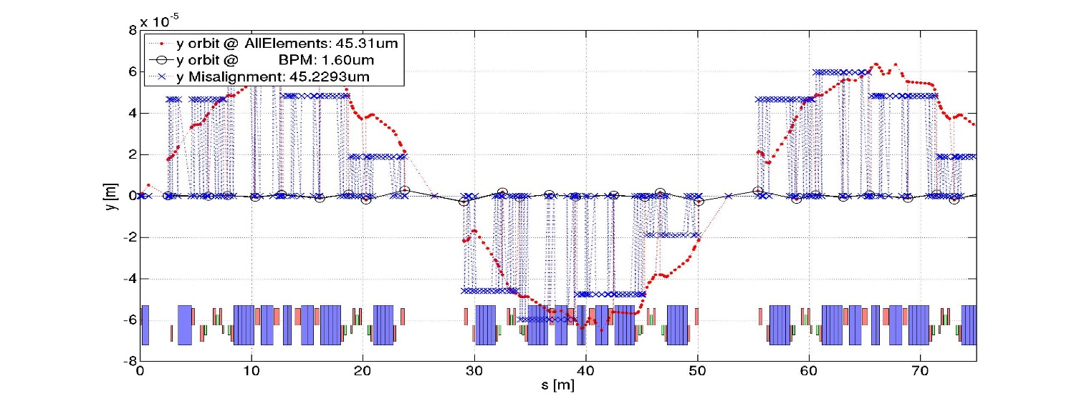
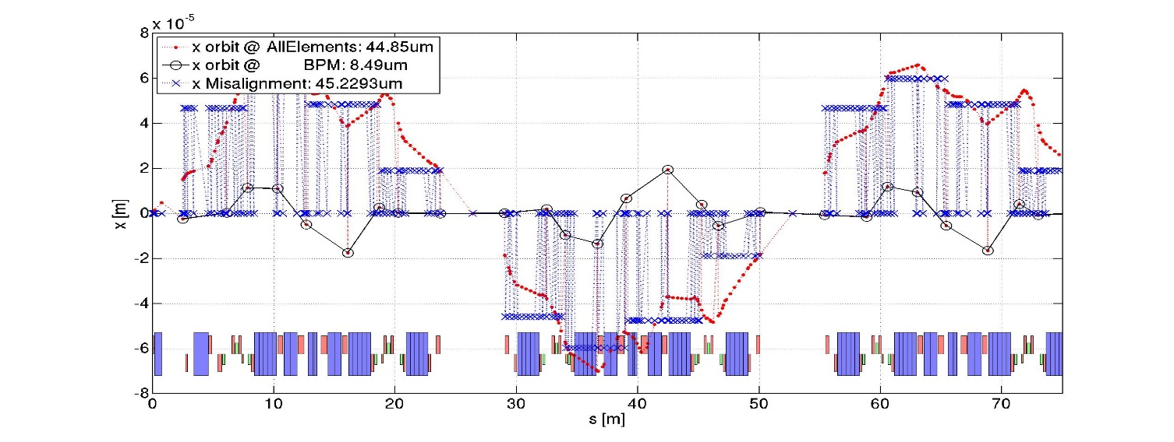
Misalignment pattern, every 2 cells
--------------------------------------------------
------ total std corrector values applyed --------
------ --------
HK (288) [1/m]: 0.00e+00 -> 1.05e-04
VK (288) [1/m]: 0.00e+00 -> 5.10e-05
SK (288) [1/m2]: 0.00e+00 -> 0.00e+00
QK (514) [1/m2]: 0.00e+00 -> 0.00e+00
HKL (288) [rad]: 0.00e+00 -> 1.07e-05
VKL (288) [rad]: 0.00e+00 -> 6.21e-06
SKL (288) [T/m]: 0.00e+00 -> 0.00e+00
QKL (514) [T/m]: 0.00e+00 -> 0.00e+00
------ --------
------ residual orbit and dispersion --------
------ --------
OH (288) [m]: 4.93e-05 -> 8.49e-06
OV (288) [m]: 3.13e-05 -> 1.60e-06
DH (288) [m]: 5.04e-04 -> 3.98e-04
DV (288) [m]:3.92e-04 -> 1.69e-04
BBH (288) %: 1.1 -> 0.6
BBV (288) %: 0.8 -> 0.2
PhH (288) : 7.76e-03 -> 2.97e-03
PhV (288) : 9.02e-03 -> 3.40e-03
------ --------
------ tune and emittance --------
------ --------
Qx [0.580]: 0.582 -> 0.579
Qy [0.620]: 0.616 -> 0.622
EX [147.528 pm]: 147.483 -> 141.513
EY [0.000pm]: 0.301 -> 13.404
------ --------
--------------------------------------------------
----- ----- -- -- -- -- ------ -----
initial (ex, ey): 147.53, 0.00,
errors (ex, ey): 147.48, 0.30,
corrected (ex, ey): 141.51, 13.40,
Freq 16, Every 2 cells

Slide 19
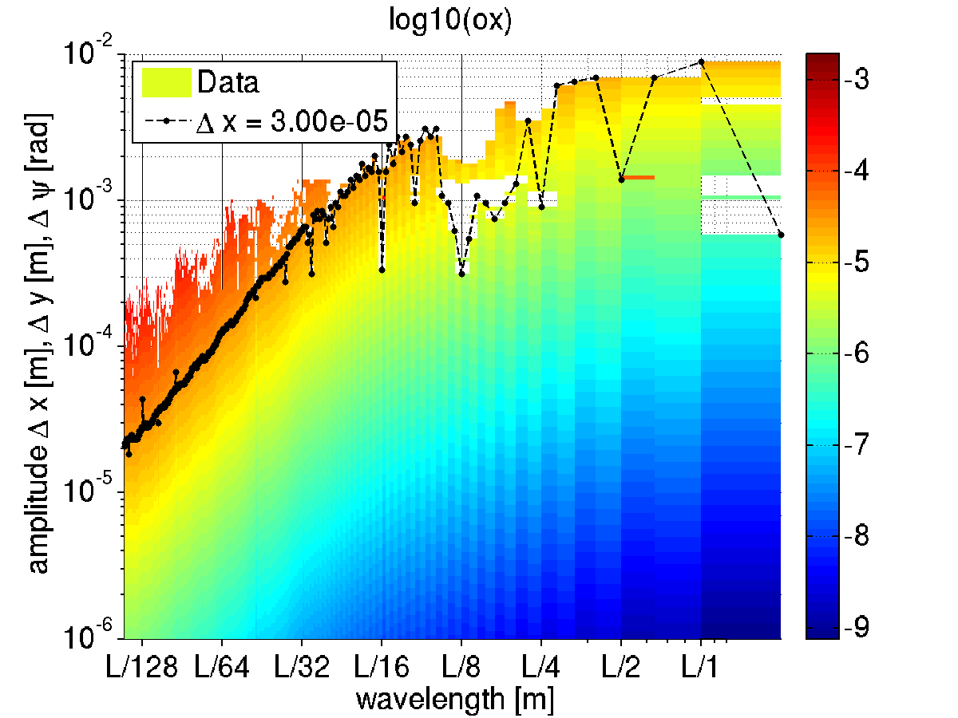
Long range errors: error envelope function
How
GIRDER
tolerances were excluded
Impact of error “waves” on horizontal orbit
At a wavelength of L/128~6m
30um errors amplitude give
30 um residual orbit distortion.
At a wavelength of L/2~422m
7mm errors amplitude give
30 um residual orbit distortion.
SLOW, LARGE VARIATIONS HAVE LIMITED IMPACT ON THE OPTICS
26/07/2013

Slide 20
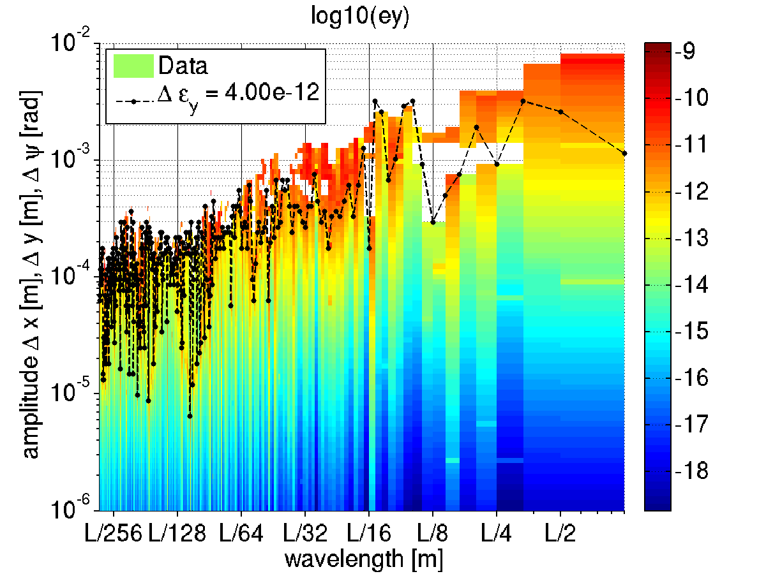
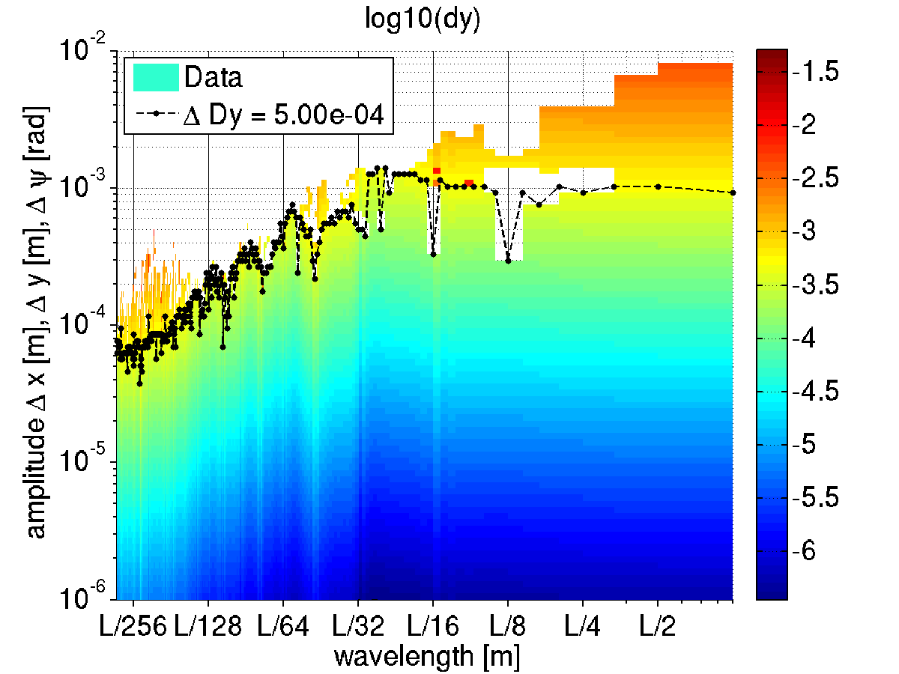
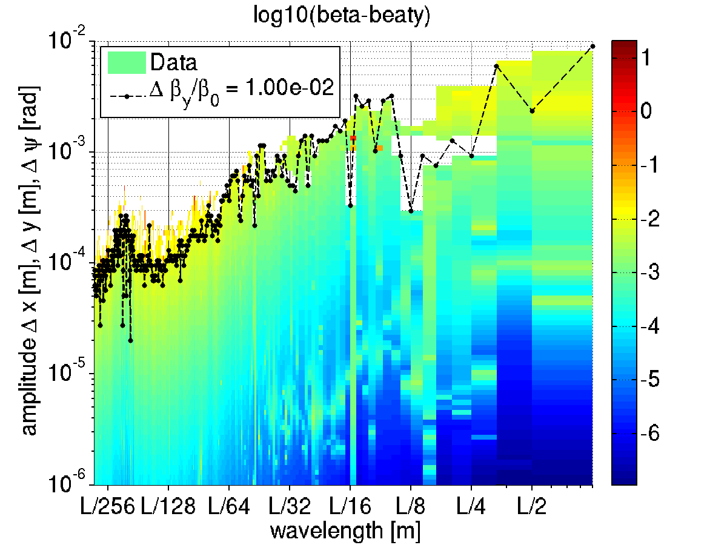
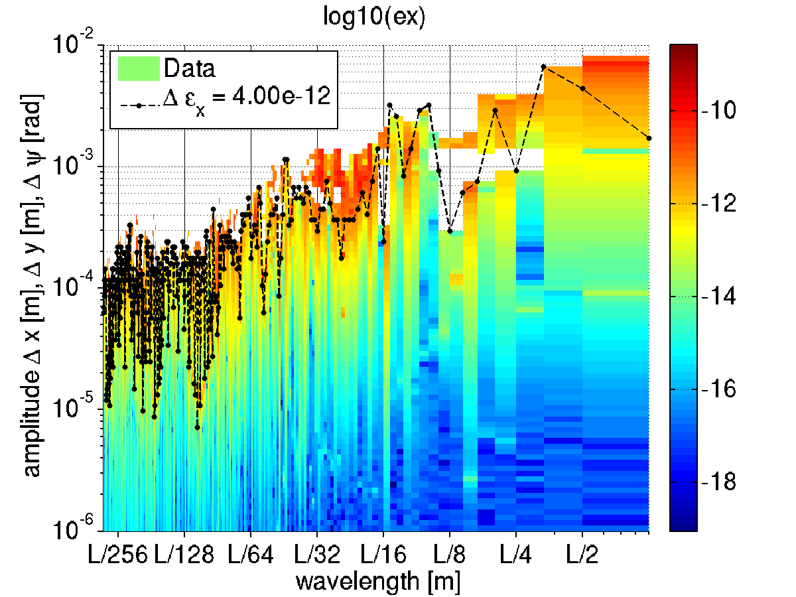
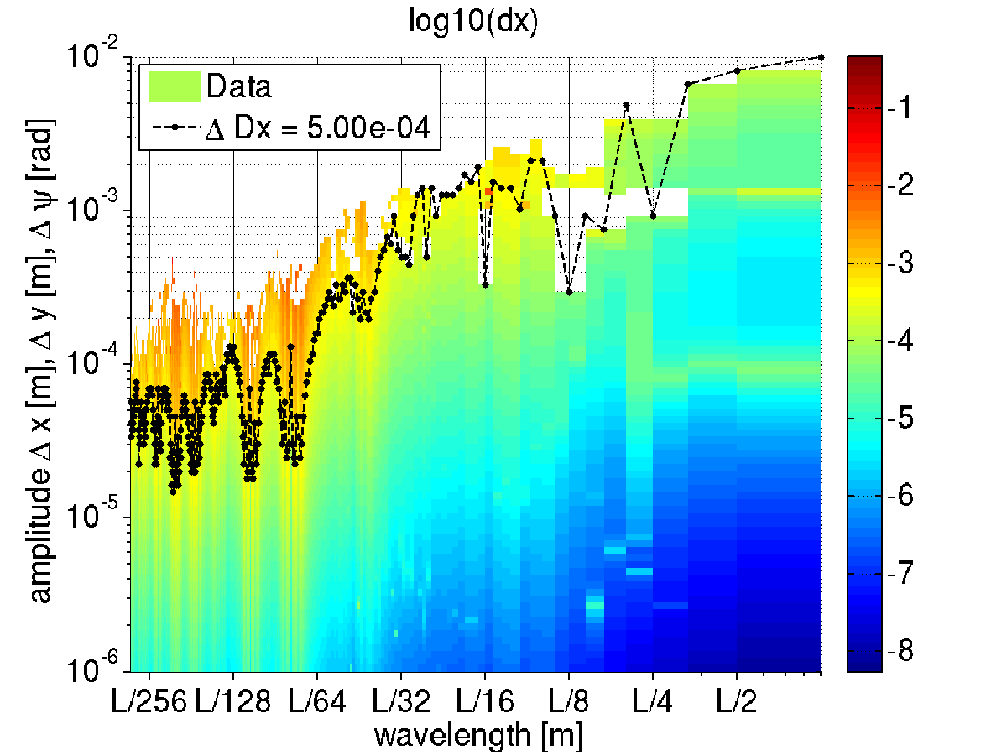
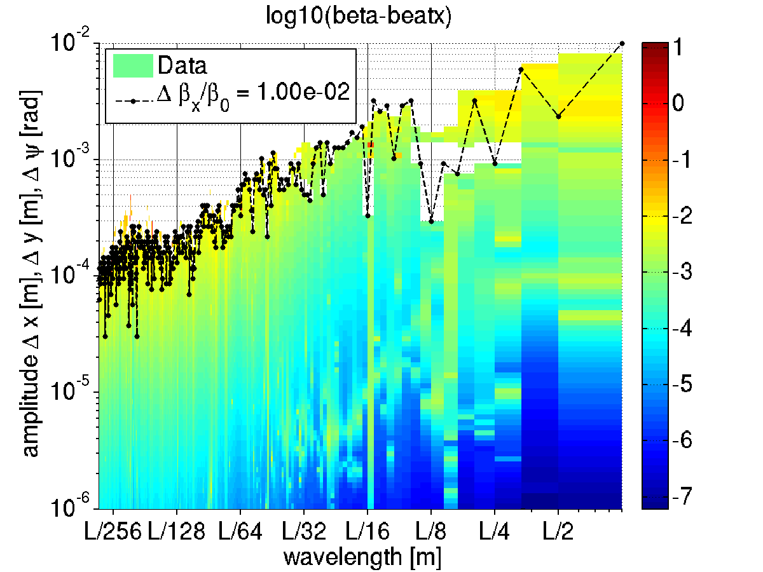
Emittance, dispersion and beta-beating vs wavelength
How
GIRDER
tolerances were excluded

Slide 21
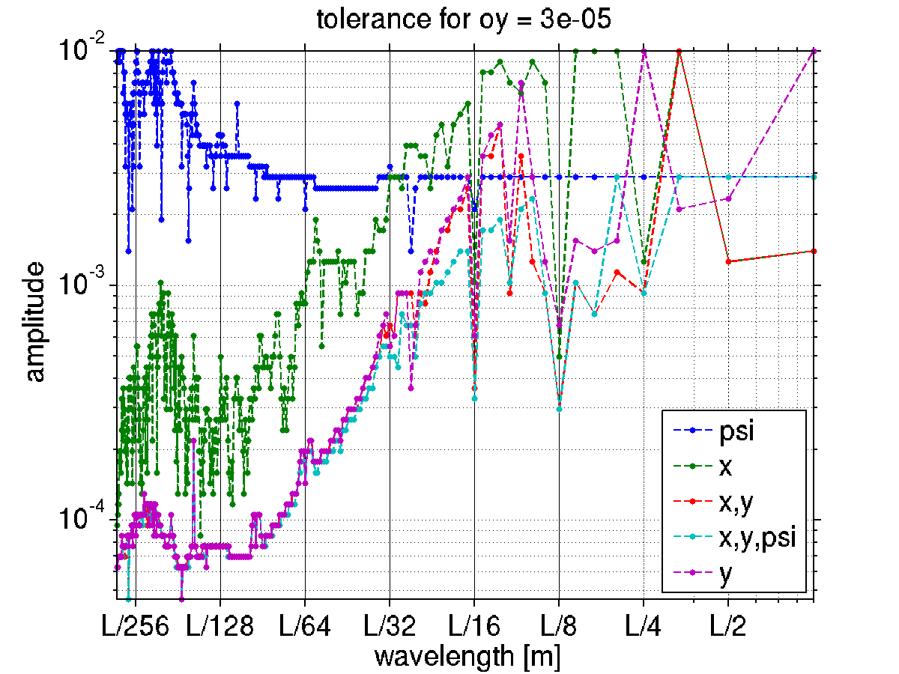
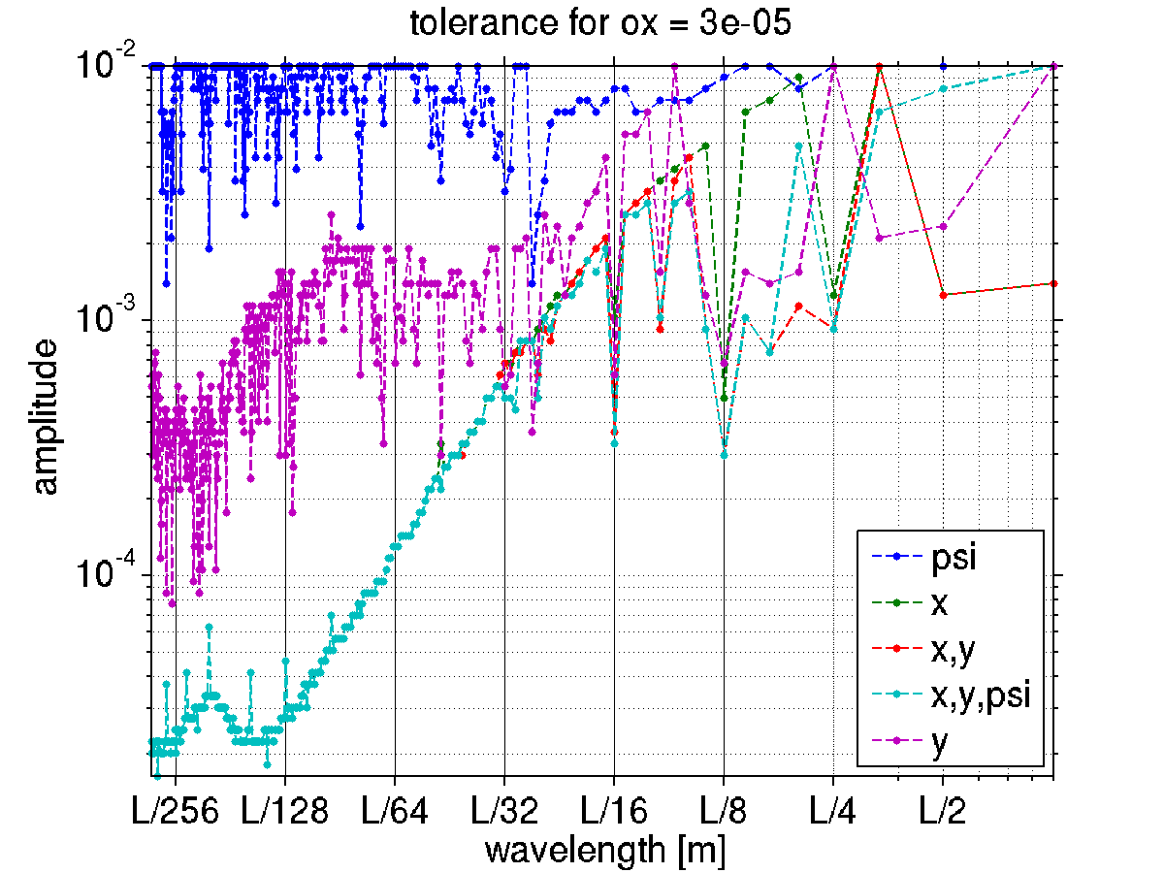
Comparison of various Error Sources to obtain 30 um orbit

Slide 22
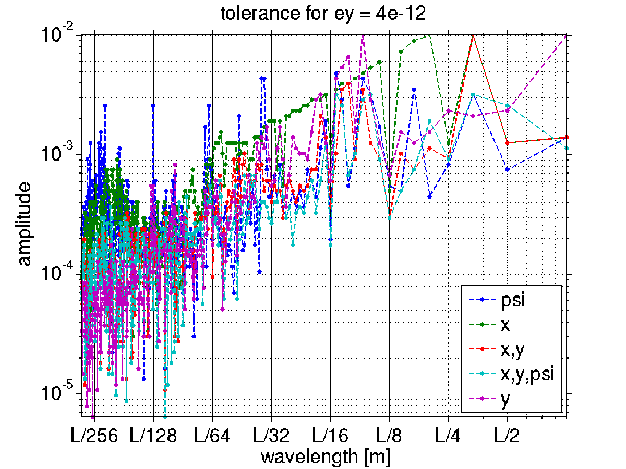
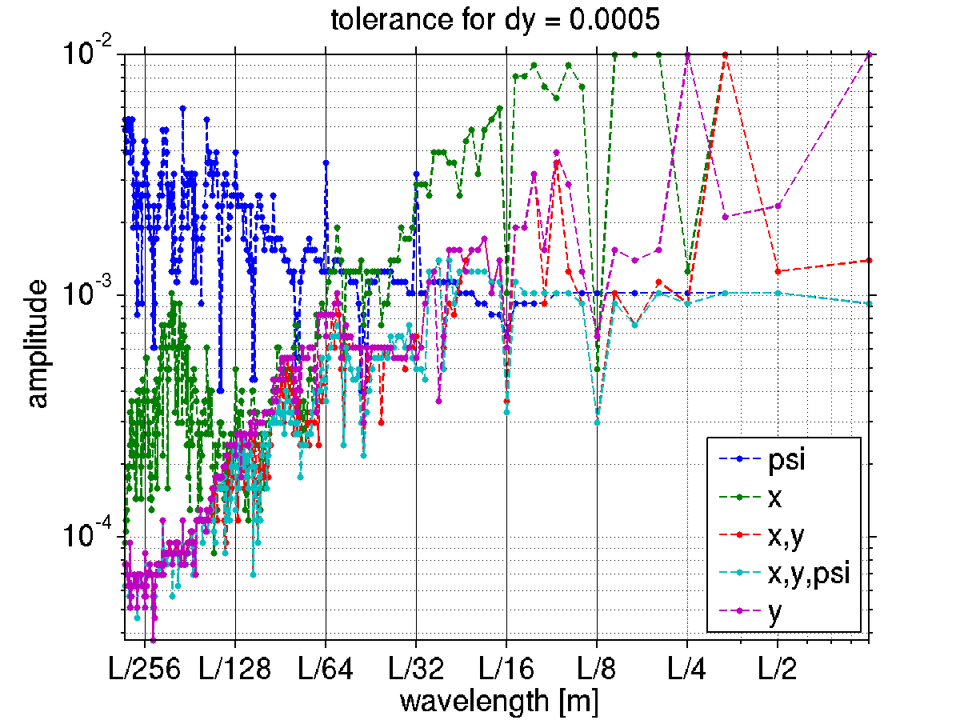
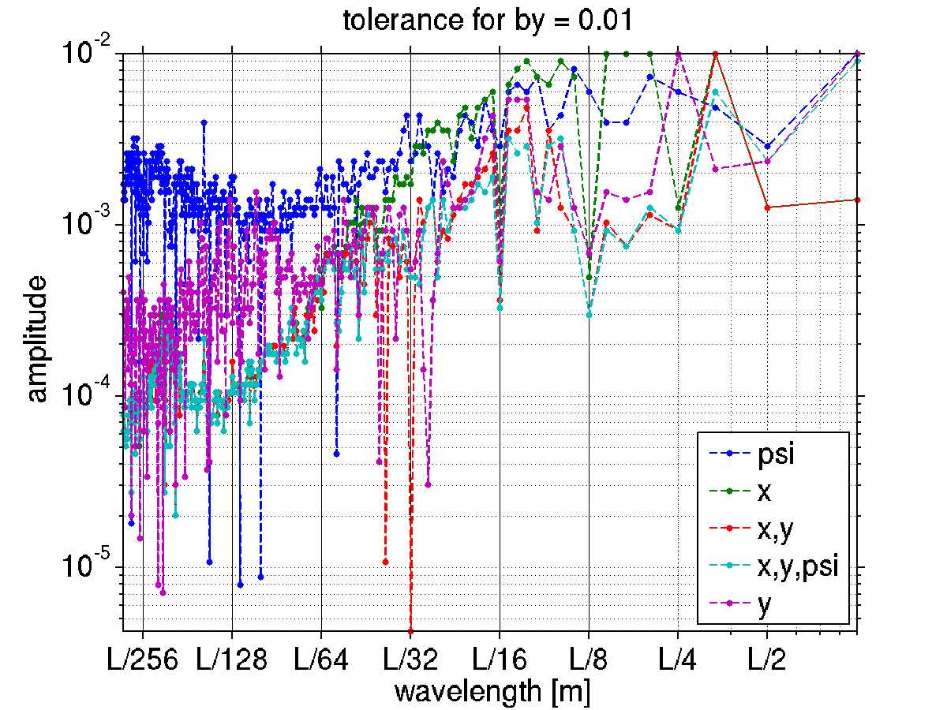
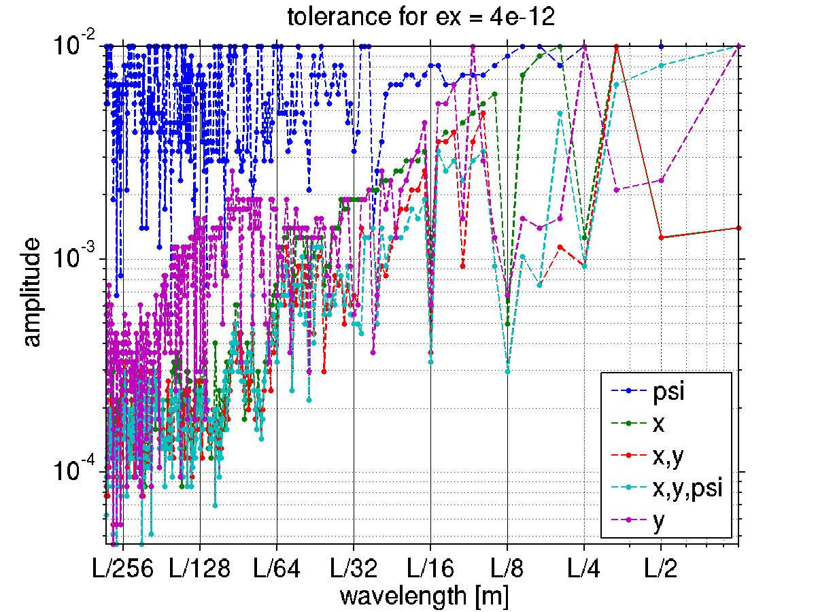
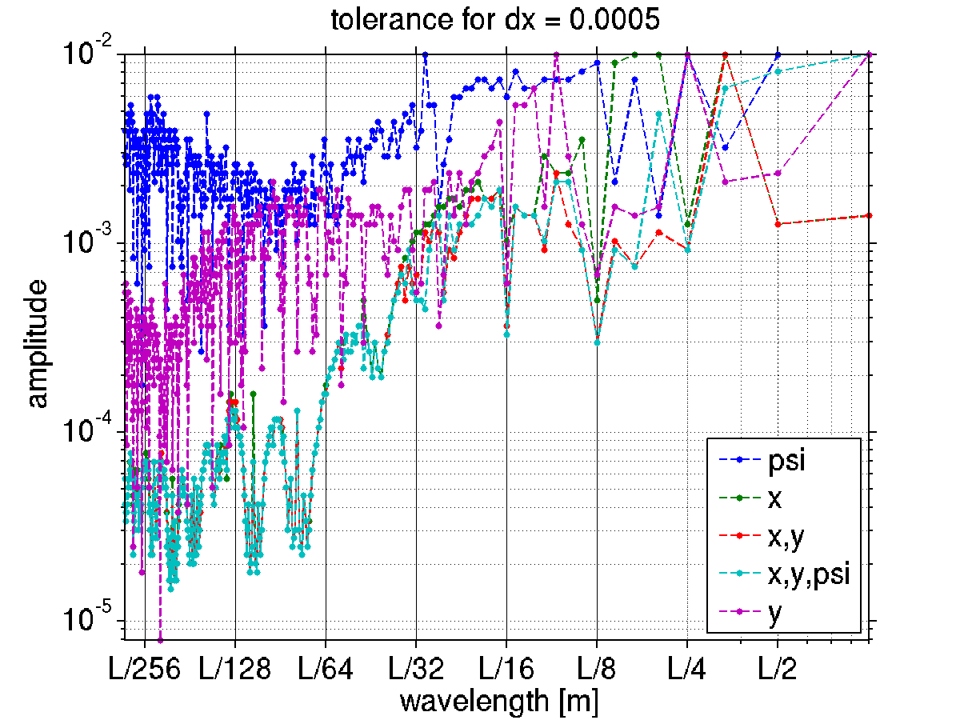
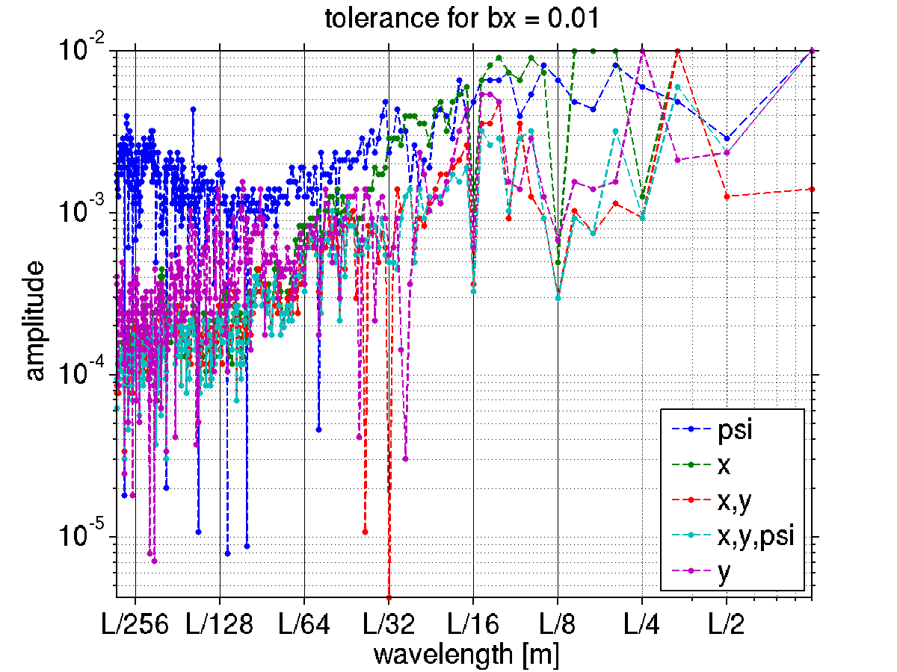
Comparison of various Error Sources (other parameters)

Slide 23
DRAFT table of tolerable rms of error distributions
Error (S28 Table) | TDS value | New value
Dipole DPSI | 300 mrad | Splitted
Dipole DX | 50 μm | Splitted
Dipole DY | 50 μm | Splitted
Quadrupole DX | 50 μm | Splitted
Quadrupole DY | 100 μm | Splitted
Quadrupole DPSI | 350 μrad | Splitted
Sextupole DX | 50 μm | 70
Sextupole DY | 75 μm | 50
Sextupole DPSI | - | 500 μrad
Girder DX | 50 μm | Removed
Girder DY | 50 μm | Removed
Girder DPSI | 200 μrad | Removed
BPM X-offset | 50 μm | Separated
BPM Y-offset | 50 μm | Separated
Dipole DK0/DK0 | 10 10⁻⁴ | 10 10⁻⁴
Quadrupole DK1/K1 | 5 10⁻⁴ | 5 10⁻⁴
Sextupole DK2/K2 | 35 10⁻⁴ | 35 10⁻⁴
Error (S28 Table) | TDS value | New value
DL DPSI | 300 | 500 μrad
DL DX | 50 | 100 μm
DL DY | 50 | 100 μm
DL DS | - | 1000 μm
DQ and QF6-8 DPSI | 300 | 200 μrad
DQ and QF6-8 DX | 50 | 50 μm
DQ and QF6-8 DY | 50 | 70 μm
DQ and QF6-8 DS | - | 500 μm
Octupole DX | - | 100 μm
Octupole DY | - | 100 μm
Octupole DPSI | - | 500 μrad
Octupole DS | - | 1000 μm
Q [D-F] [1-5] DPSI | 350 | 500 μrad
Q [D-F] [1-5] DX | 50 | 100 μm
Q [D-F] [1-5] DY | 100 | 85 μm
Q [D-F] [1-5] DS | - | 500 μm
Sextupole DS | - | 1000 μm
DS = longitudinal displacement
DX = radial displacement
DY = vertical displacement
DPSI = rotation about beam axis
Girder errors replaced by smooth wave summing first 4 long wavelengths with 0.6mm amplitude.

Slide 24
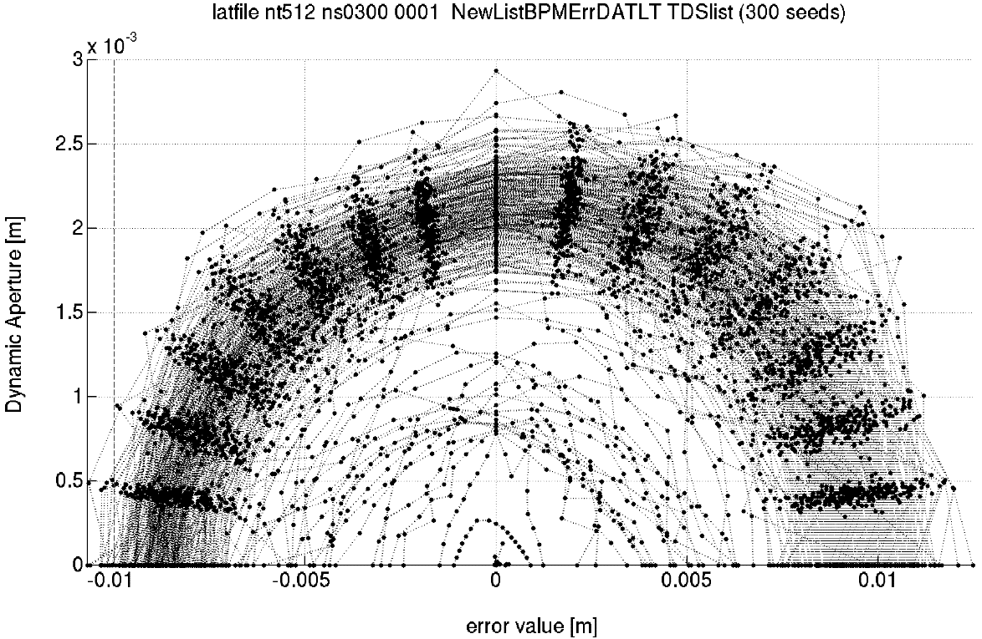
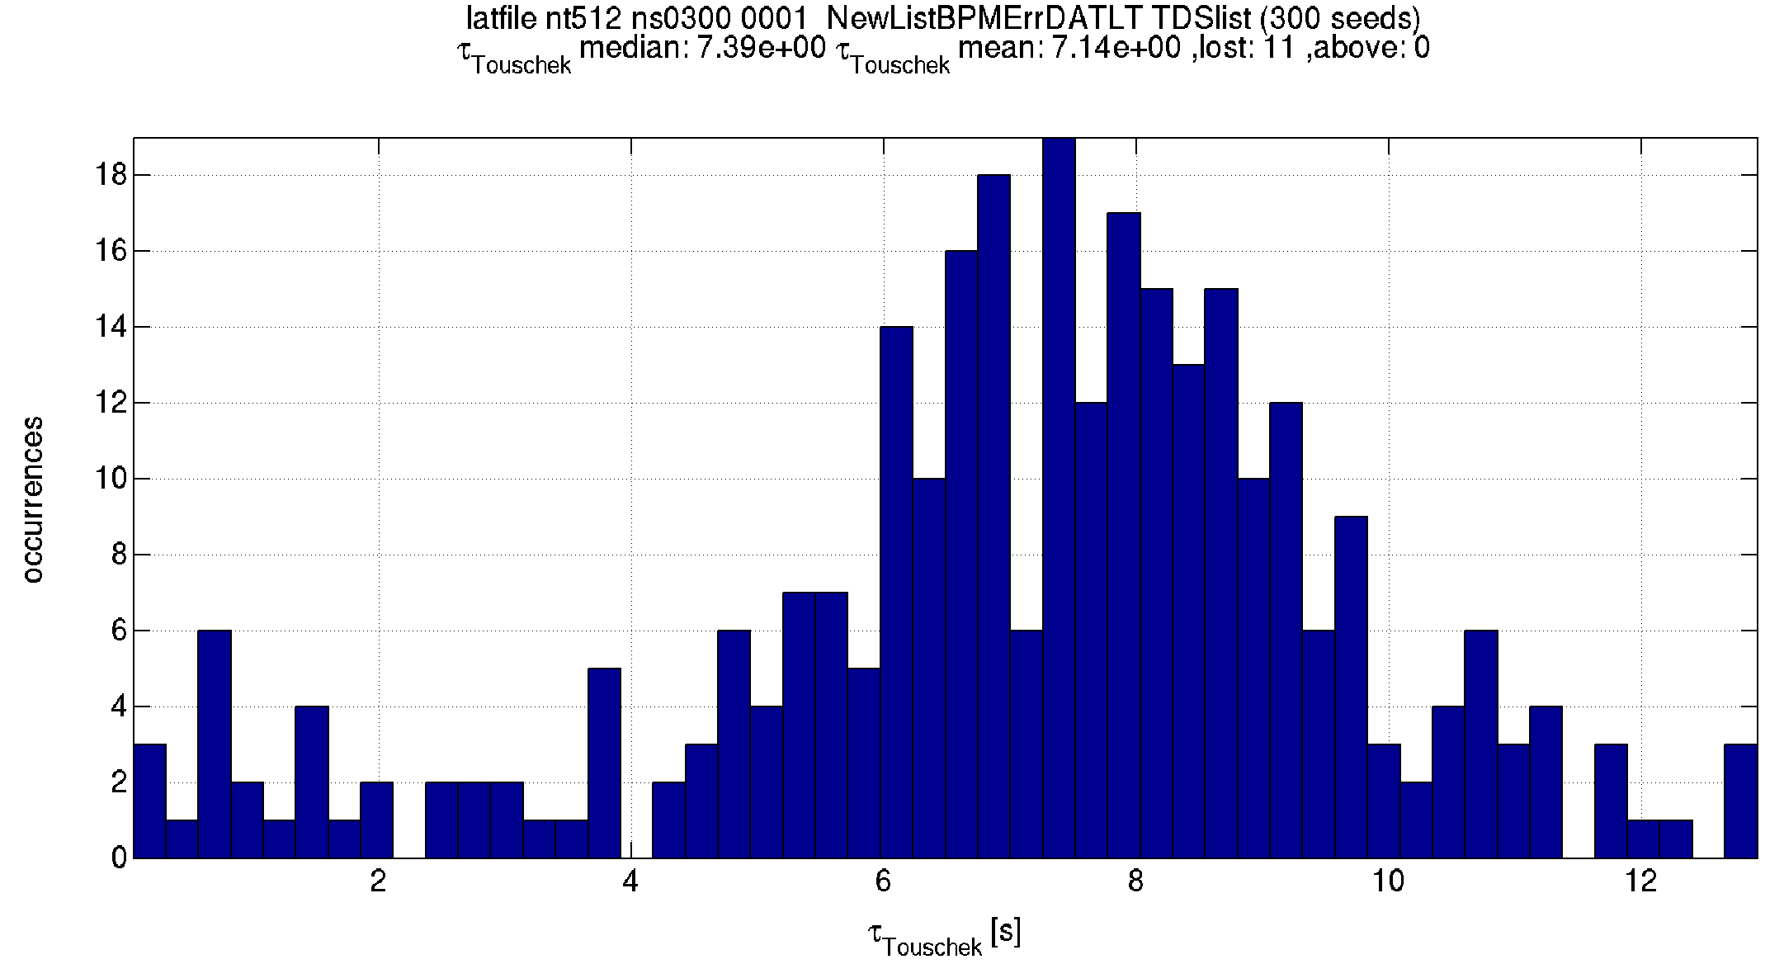
d.A. and lifetime: Table above + waves + Bpm errors 50 um rms
“Closed” continuous waves
DA about 7mm at S3 septum.
Some seeds have bad DA and some are lost. Work in progress to recover them. this may change the above list of tolerable errors.
Lifetime is about 7h.

Slide 25
The measured position of the lattice
How
GIRDER and LONG RANGE
tolerances were excluded
This is where the machine is. Let’s use this information!
nominal
current
ESRF 1994-2018
EBS 2019-?? We placed EBS where the old SR used to be. Everyone is happy.

Slide 26
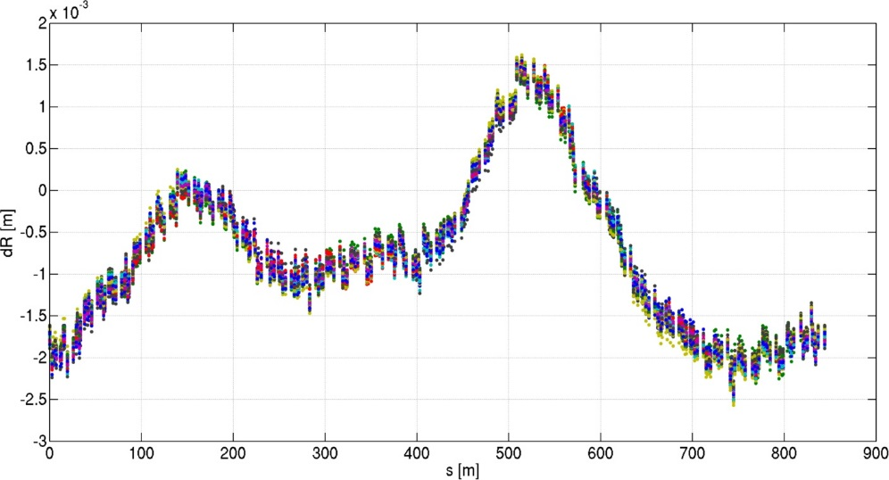
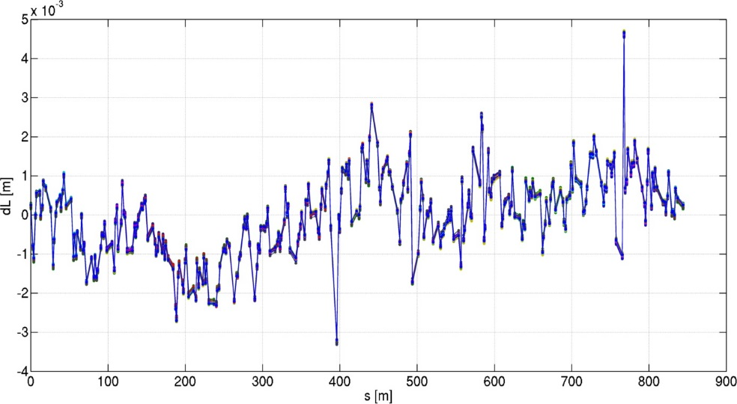
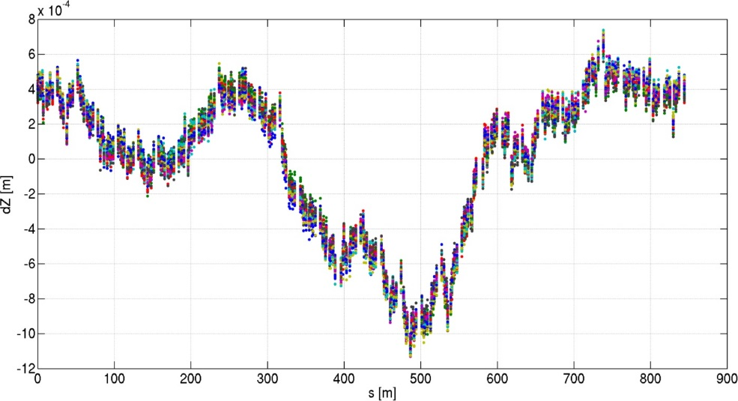
Simulated survey errors current positions (from ALGE group)
How
GIRDER and LONG RANGE
tolerances were excluded
WHERE WILL THE SR BE
if we remove it and reinstall it?
horizontal
Longitudinal (electrons path)
50 cases
D.Martin, G.Gatta
D.Martin, G.Gatta
DATA from ALIGNMENT GROUP
Simulated survey errors about the current position of the lattice.
Rotations are random, but for a 21urad systematic outward tilt.
Data provided in 320 points for the current lattice.
vertical
D.Martin, G.Gatta
IDEA by P.Raimondi
26/07/2013

Slide 27
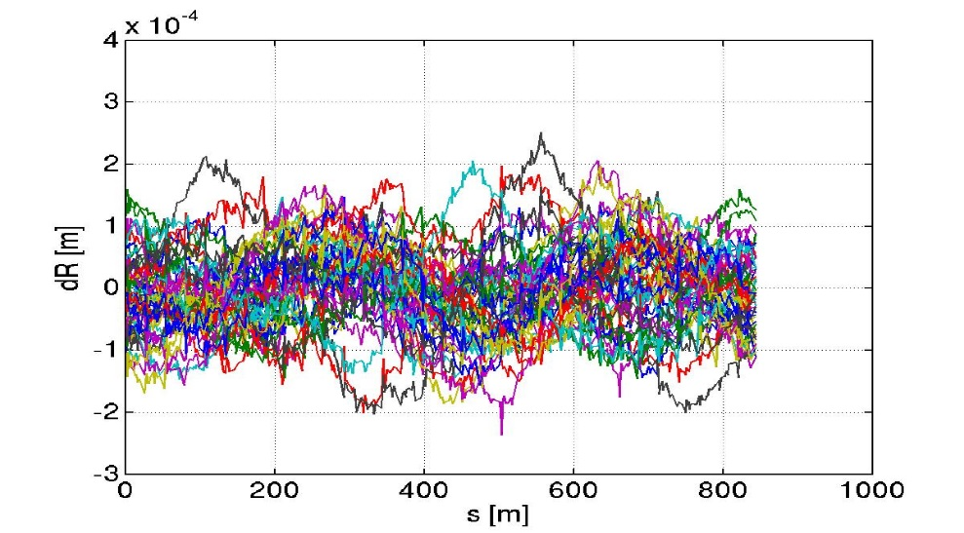
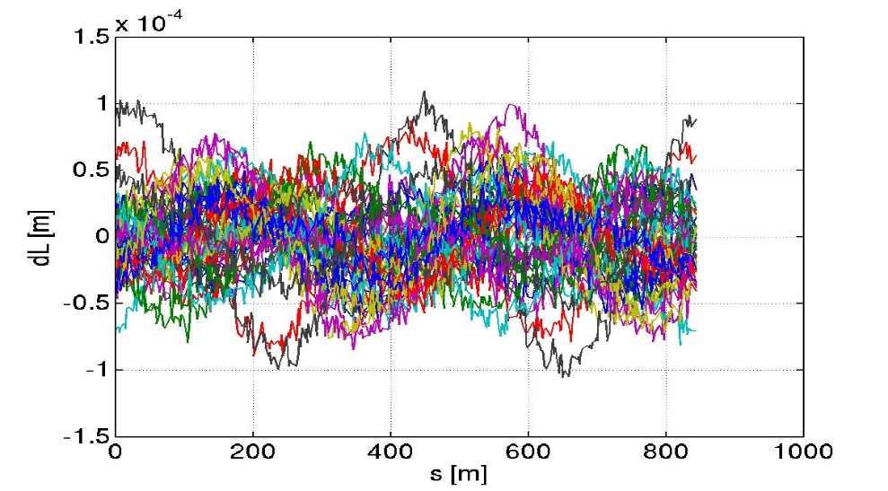
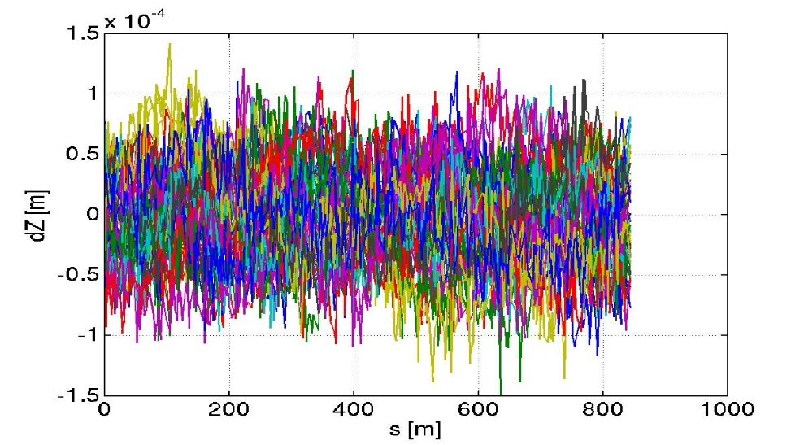
Simulated survey errors nominal positions (from ALGE group)
How
GIRDER and LONG RANGE
tolerances were excluded
D.Martin, G.Gatta
horizontal
Longitudinal (electrons path)
D.Martin, G.Gatta
DATA from ALIGNMENT GROUP
Simulated survey errors about the nominal position of the lattice.
Rotations are random, but for a 21urad systematic outward tilt.
Data provided in 320 points for the current lattice.
vertical
D.Martin, G.Gatta
PREVIOUS

Slide 28
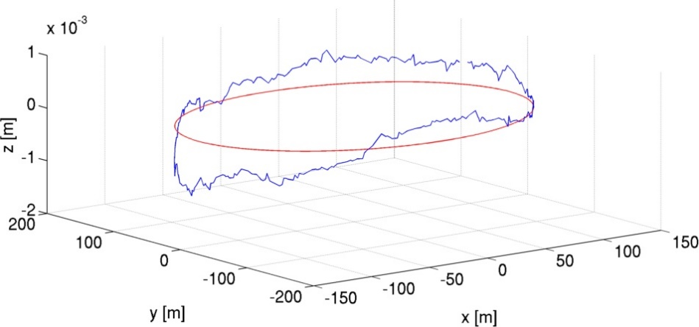
Dynamic aperture and lifetime
How
GIRDER and LONG RANGE
tolerances were excluded
The above curves are interpolated to set the errors in the S28A lattice.
On the blue curve
nominal
current
Lifetime: 16.6h
range:[16.4 17.1]
MEASURED SURVEY + simulated alignment errors
SET IN THE LATTICE
AND TESTED FOR DA/LIFETIME AFTER CORRECTION
TARGET
-10mm (-8.1mm @S3)
26/07/2013

Slide 29
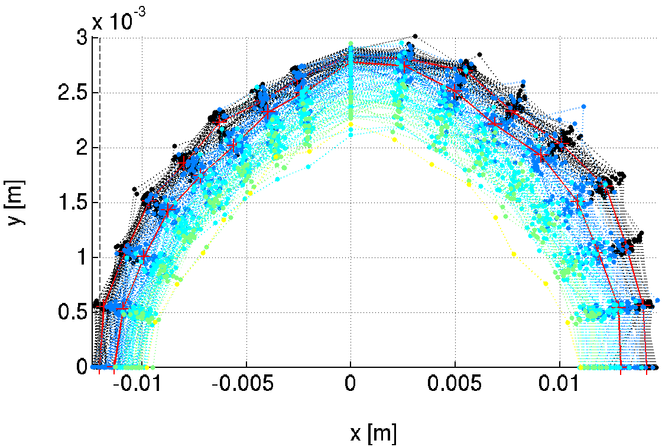
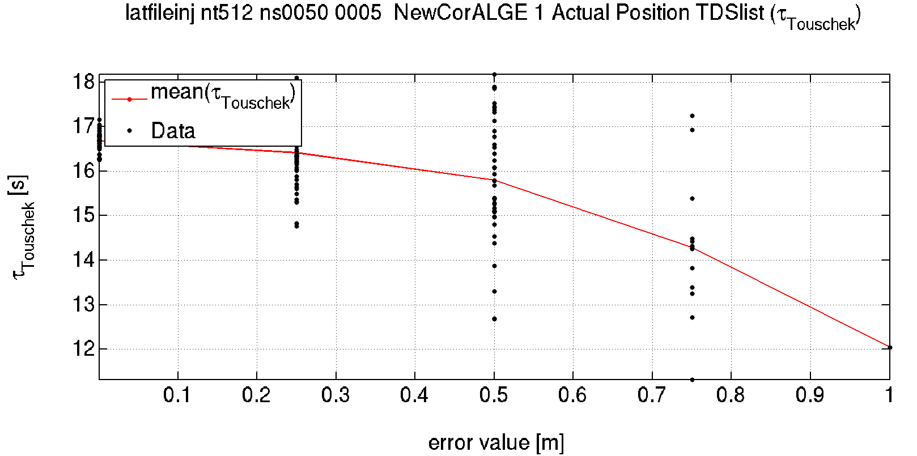
Additional Random errors
How
GIRDER and LONG RANGE
tolerances were excluded
Additional random errors are still required to describe the error on the position of the magnetic centers of the magnets.
Increasing random errors
Lifetime goes from 16.6h to about 12h with many lost seeds and increasing range.
TARGET
-10mm (-8.1mm @S3)
As above + RANDOM ERRORS SET IN THE LATTICE
AND TESTED FOR DA/LIFETIME AFTER CORRECTION

Slide 30
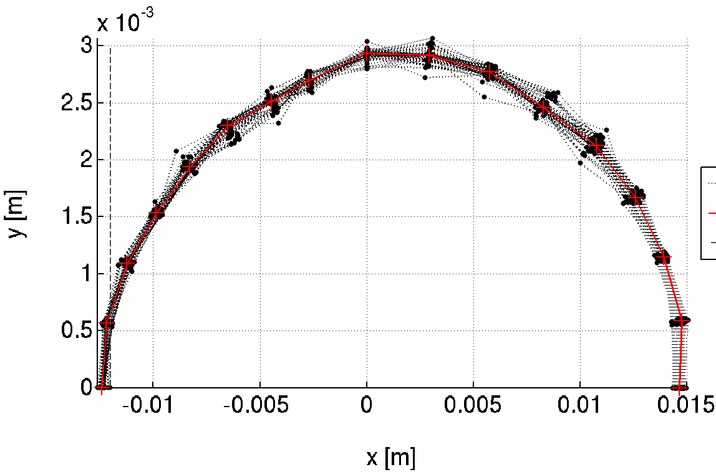
Dynamic aperture and lifetime
How
GIRDER and LONG RANGE
tolerances were excluded
The above curves are interpolated to set the errors in the S28A lattice.
On the red curve
nominal
current
Lifetime: 16.7h
range:[16.6 17]
IDEAL SURVEY SET IN THE LATTICE
AND TESTED FOR DA/LIFETIME AFTER CORRECTION
TARGET
-10mm (-8.1mm @S3)

Slide 31
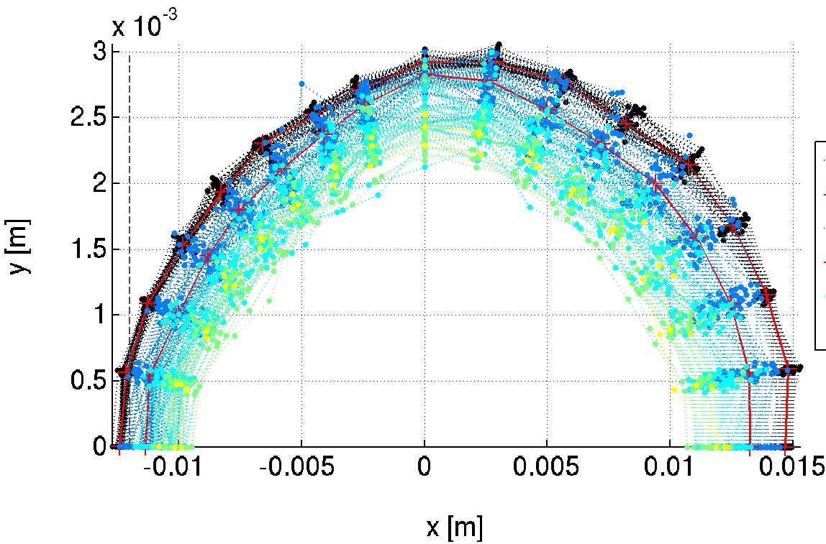

Additional Random errors
How
GIRDER and LONG RANGE
tolerances were excluded
Additional random errors are still required to describe the error on the position of the magnetic centers of the magnets.
Increasing errors
Lifetime goes from 16.7h to about 13h with many lost seeds and increasing range.
TARGET
-10mm (-8.1mm @S3)
IDEAL SURVEY + RANDOM ERRORS SET IN THE LATTICE
AND TESTED FOR DA/LIFETIME AFTER CORRECTION

Slide 32

X-ray beam position at ID (60 meters) : decision to place the new SR where the old was.
All ID are assumed to be at 60m from the source.
The position of the beam after 60m is very similar for ESRF and S28A considering the current survey measurement.
The position if the ring was aligned on the reference circumference would be about (0,0) for al ID.
S28
ESRF
“on theory geom”.
Good choice. During commissioning (Jan2019): ALL beamlines but one could see the x-ray beam at the white beam viewers at very first Front End opening.
Current (simulated) position of the X-ray at the beamline
position of the X-ray at the beamline for S28A on the same survey
4TH APAC 2014

Slide 33
In practice
Conclusion
We have no specific beam dynamics interest in the girder-girder tolerance themselves.
Those are not precisely defined among different groups and may lead to lack of understanding.
From beam dynamics, we can say that: large, slow, smooth, variations of position are not detrimental.
In order to model the lattice at the location where it will be installed, we included in all “predictive” (DA, LT, IE,etc) simulations the Simulated Survey Position provided by the alignment group.
From a beam dynamics point of view, as long as magnet-magnet tolerances (actually, single magnets rms position errors) are achieved at every location in the machine, including between magnets standing on neighboring girders, we will get the foreseen Dynamic Aperture and LIFETIME.
We let the alignment group decide how to achieve this requirement.
For ESRF-EBS It worked extremely well, largely exceeding expectations/simulations.
From steerers/orbit data
Achieved magnet-to-magnet
25-55 μm
Expected magnet-to-magnet
60-70 μm
rms DX DY
alignment

Slide 34
Tolerable random errors
Conclusion
What girder-girder tolerances did you use?
Required: | DX | DY | DS | DPSI | DK
 | μm | μm | μm | μrad | 10^-4
DL | >100 | >100 | 1000 | 500 | 10
DQ, QF[68] | 70 | 50 | 500 | 200 | 5
Q[DF][1-5] | 100 | 85 | 500 | 500 | 5
SFD | 70 | 50 | 500 | 1000 | 35
OF | 100 | 100 | 500 | 1000
60
Many simulations for 1 number needed
How far can be two magnets on opposite sides of the ring?
GIRDERS
SAME AS worst case MAGNET-MAGNET
Long range
Survey simulations
Sextupoles and high gradient quadrupoles are the most relevant limitations, nevertheless, this alignment specifications are currently achievable.
(DX=DY=60μm, 84 μm between two magnets).

Slide 35
conclusions
The definition of alignment tolerance can be done in a quasi deterministic way, to give relative impact on final parameters of each source of errors. Finally this is NOT directly usefull for alignment. Unless some specification is really demanding, everything will be alignment to the minimum value found: one single number.
Running Girder-to-girder simulations is also not really useful. For compact machines girder-to-girder is the same as magnet-to-magnet. Using simulated Survey data is more realistic, simpler and efficient.
Large, slow, SR position variations are not an issue for beam dynamics. Magnet to magnet is what really counts.
For upgrade project using the measured positions of the SR and hypothetical positions after dismantling and reinstallation, shares well the contribution of alignment and magnet center fiducialization error sources. Simulations of the measured survey may be included in the model simply, sparing a lot of time and effort, and simplifying the communication among colleagues.

Slide 36
BACKUP

Slide 37
Comparable tolerance table
How tolerances were defined
This table provides a deterministic way to compare error impact on lattices.
It is used also to asses the performances of correction schemes and correction algorithms
Further reduction of this data is needed to provide a tolerance table.

Slide 38


definition of a List of tolerable errors
How tolerances were defined
Compare magnet groups for the same error
Compare error sources for the same magnet group
beta beating = 1%
Hor. Disp. = 1mm
Tolerated errors

Slide 39


error amplitude giving 30um orbit after correction vs wavelength
Amplitude is X, Y and rotation about s (rad) simultaneously

Slide 40



Estimated Alignment is better then expected/required from tolerances !
Correction strengths in the SR:
Simulations: 0.26 % std(quad gradients),
~160μrad, ~120μrad, std(H V steerers)
Today: 0.2 % std(quad gradients),
~ 65μrad, ~30μrad, std(H V steerers)
From simulations the estimated SR alignment errors are:
H 30-45 μm, V 20-55 μm
After optics corrections: Δβ/β_{H,V} = 1.5 ± 1 % ,
Δη_{H,V} = 1.0 ± 0.1 mm
IPAC 2021

Slide 41
Girder to girder: an historical exchange after >2 years of PhD simulations
Dear Alignment group colleagues,
we would like the girders to have an alignment error of
78.656 μm rms in the X plane
73.421 μm rms in the Y plane
Thank you
Best regards
Beam Dynamics
Dear Beam Dynamics colleagues,
What do you mean?
2 girders one at the injection and one on the opposite side of the SR should be aligned within 75 μm?
We think it would be better to meet and discuss.
Could you give us the tolerated alignment envelope over 10cm, 1m, 10m, 100m, 1km?
By the way, X for us is the longitudinal direction.
Thank you
Best regards
Alignment
Lesson learnt:
TALK with YOUR COLLEAGUES BEFORE RUNNING YEARS OF SIMULATIONS
Dear Alignment colleagues,
Indeed, we would appreciate a meeting on the topic.
Best regards
Beam Dynamics
In purpose missing “Thank you”

Slide 42
Girder to girder: an historical exchange after >1month of simulations
Dear Alignment group colleagues,
we would like the girders to have an alignment error in the transverse plane with
L/1-L/8 wavelengths and up to 2mm amplitude on a closed trajectory.
Thank you
Best regards
Beam Dynamics
Dear Beam Dynamics colleagues,
What do you mean?
What do you mean by “wavelength”?
We think it would be better to meet and discuss.
Could you give us the tolerated girder-to-girder alignment envelope over 10cm, 1m, 10m, 100m, 1km?
What about the longitudinal direction, X?
Thank you
Best regards
Alignment
Lesson learnt:
TALK again with YOUR COLLEAGUES BEFORE RUNNING YEARS OF SIMULATIONS
Dear Alignment colleagues,
Indeed, we would appreciate a meeting on the topic.
Beam Dynamics
In purpose missing “Thank you”
In purpose missing “best regards”

Slide 43
Girder to girder: an historical exchange after >1month of simulations
Dear Alignment group colleagues,
Thanks to the simulated SR positions you provided we can say that the SR may be aligned on the theoretical survey or on a smooth line interpolating the existing measured positions, without detriment on the final beam performances.
Thank you
Best regards
Beam Dynamics
Dear Beam Dynamics colleagues,
That is great news!
Thank you
Best regards
Alignment
Notice the disappearance of the word “girder” from the conversation.
Lesson learnt:
speak the same language or
find an interpret or
first think and discuss what would be the easiest for everyone.

