Slide 1

Programs and applications
Francis KLUMB
27/06/2021

Slide 2
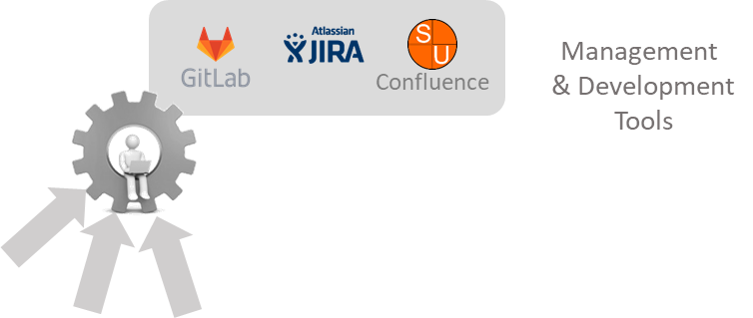
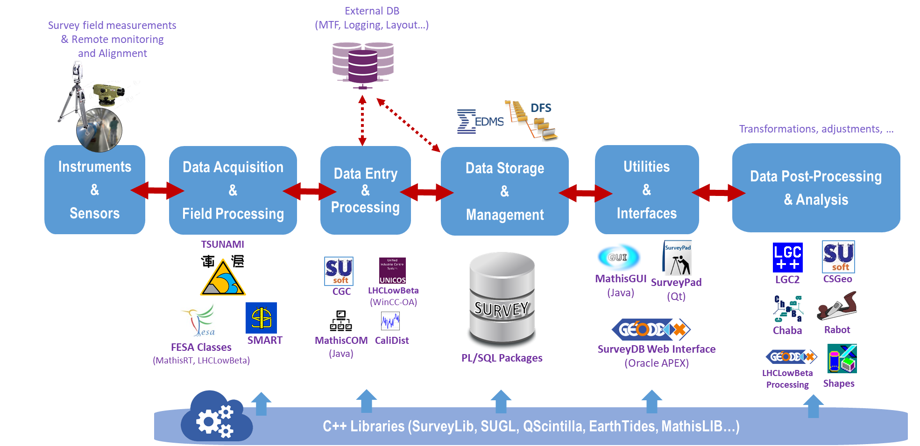

CERN Survey Software

Slide 3
Data
Acquisition

Slide 4

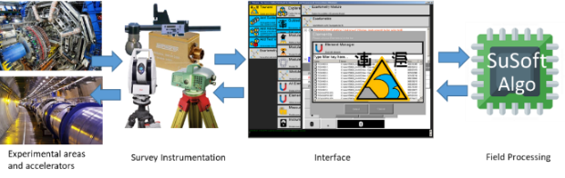
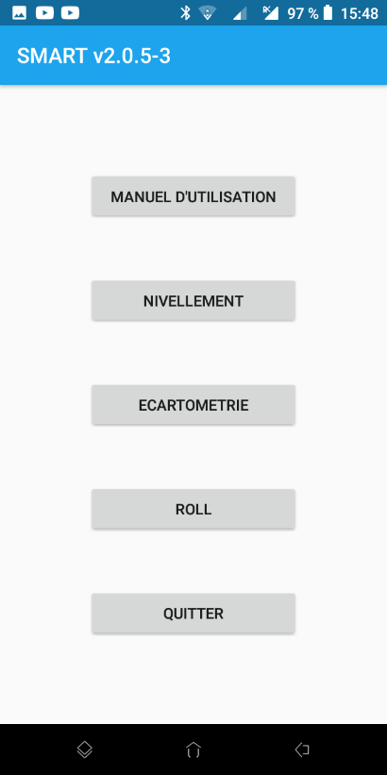
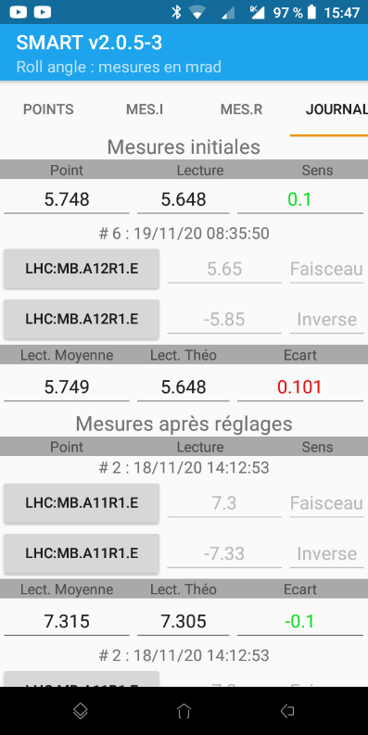
Survey Software – Data Acquisition
TSUNAMI
(The Survey Unified Notebook for Alignment and Measurement Interventions)
Built for Windows OS (manufacturers external libraries!)
C# .NET developments (IDE: Visual Studio)
SMART
In house developments
Not a long calm river…
Mobile phone Android App (Java for Android developments , IDE: Android Studio)
Used for specific measurements in the tunnel

Slide 5
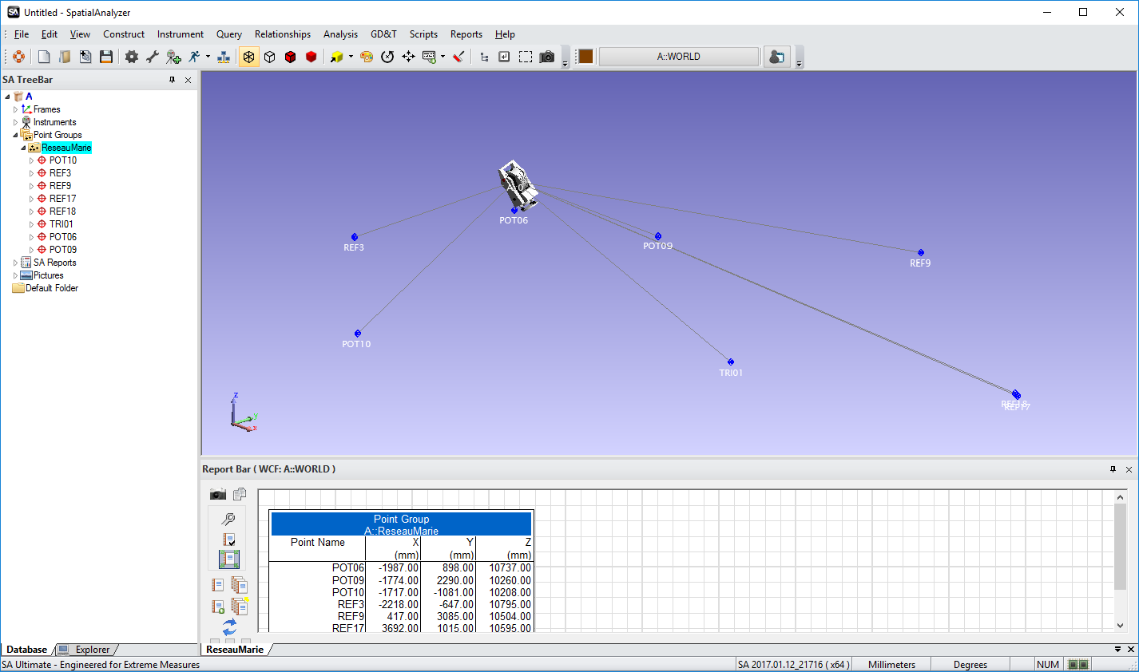
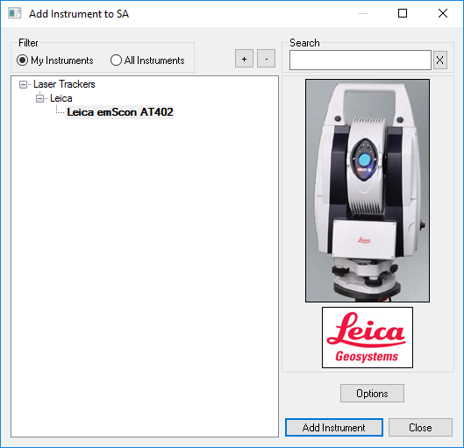
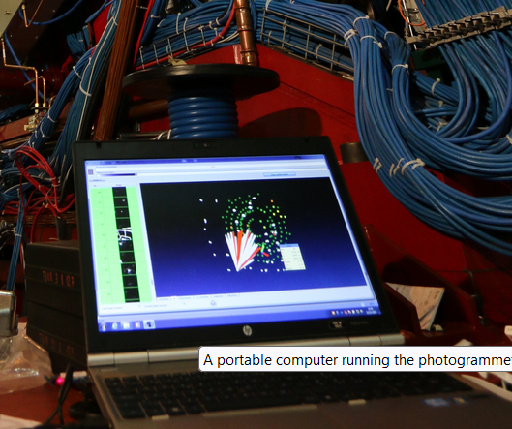
Survey Software – Data Acquisition
SpatialAnalyzer ® (SA)
AICON Software ® for Photogrammetry
Commercial software:
How to integrate them better with our different in-house software ?

Slide 6
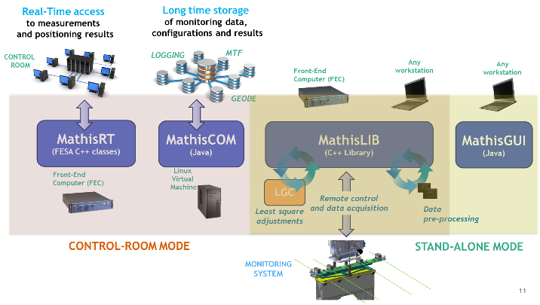
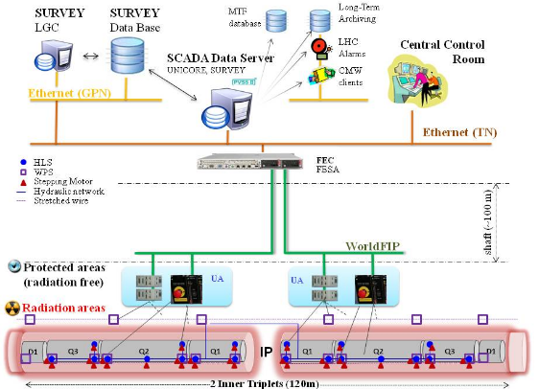
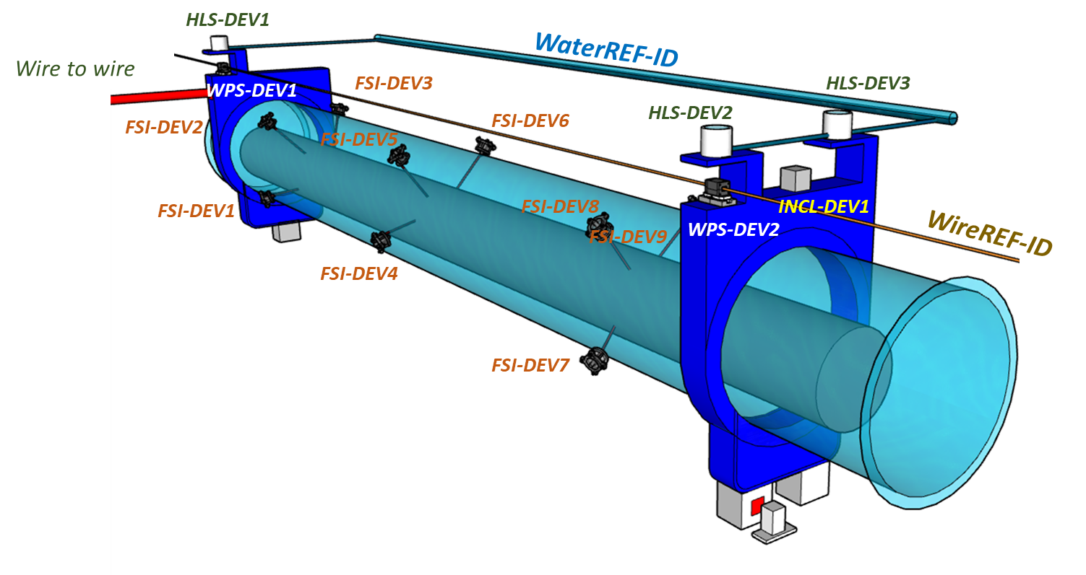
Survey Software – Data Acquisition
In house developments for alignment & monitoring systems
LHC Inner-Triplets Alignment
MATHIS (Monitoring and Alignment Tracking for the HIE-Isolde Software)
HL-LHC (FRAS Project)

Slide 7
Data Storage

Slide 8

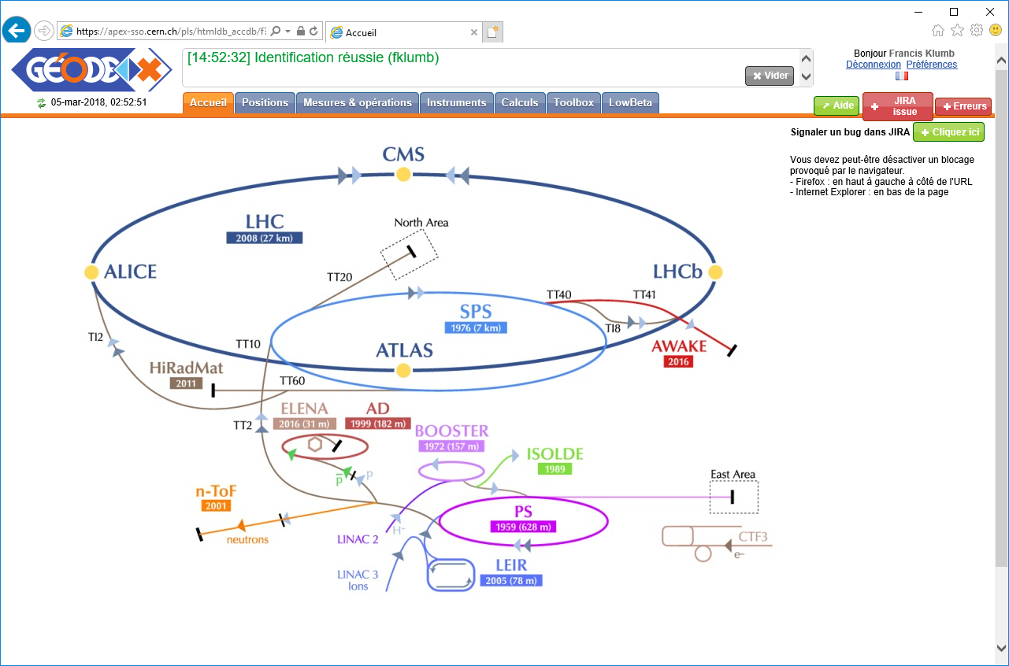
Survey Software – Database and Geode
  Survey DB is a crucial part of the Survey activities workflow,
  and all maintenance and development fully done within our group!
  Theoretical positions of all beams at CERN in CCS (CERN Coordinate System),
SURVEY
GEODE
  Real positions of the networks geodetic points in CCS,
  Deviations of all aligned components from their theoretical position,
Long-term maintenance and improvements!
  Measurements related to the installation and alignment of accelerators components,
  Instruments data necessary for those measurements.
Notes:
Comme vous le savez, nous avons aussi la charge de la base de données Survey et de son interface GEODE, qui constituent un axe central de nos activités Survey. Comme vous le voyez sur le graphe, GEODE a connu de multiples évolutions depuis sa création au milieu des années 80, suivant les versions successives des produits Oracle, comme Oracle Forms puis APEX. Une longue histoire donc de plus de 35 ans! Ce qui, sur l’échelle de temps informatique est une « éternité », et qui nous poussera dans les années à venir à nous poser et prendre un moment pour étudier les futurs choix technologiques.
A ce propos, le projet MAlT au CERN, qui nous incite de plus en plus à nous affranchir des licences imposées par les grandes sociétés commerciales (dont Oracle fait partie!), et à nous tourner vers des solutions open-source (donc sans licence commerciale), nous demandera de réfléchir de manière plus générale au choix des futures technologies informatiques utilisées par la section.

Slide 9
Data processing

Slide 10
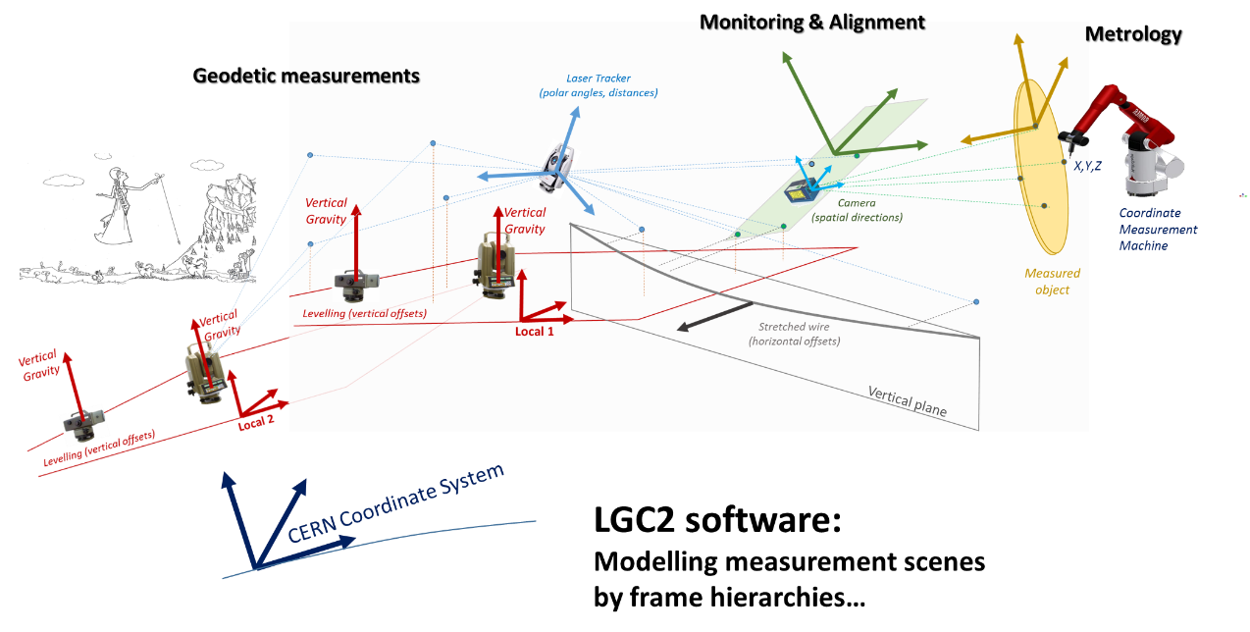
Survey Data processing software
LGC Statistical Adjustment Software = Main kernel of the Survey Data Processing!
Measurements, constraints,…
Parameters estimation
(points coordinates, elements positions, offsets w.r.t. nominal,…) including data analysis criteria
Should we make it open-source ?

Slide 11
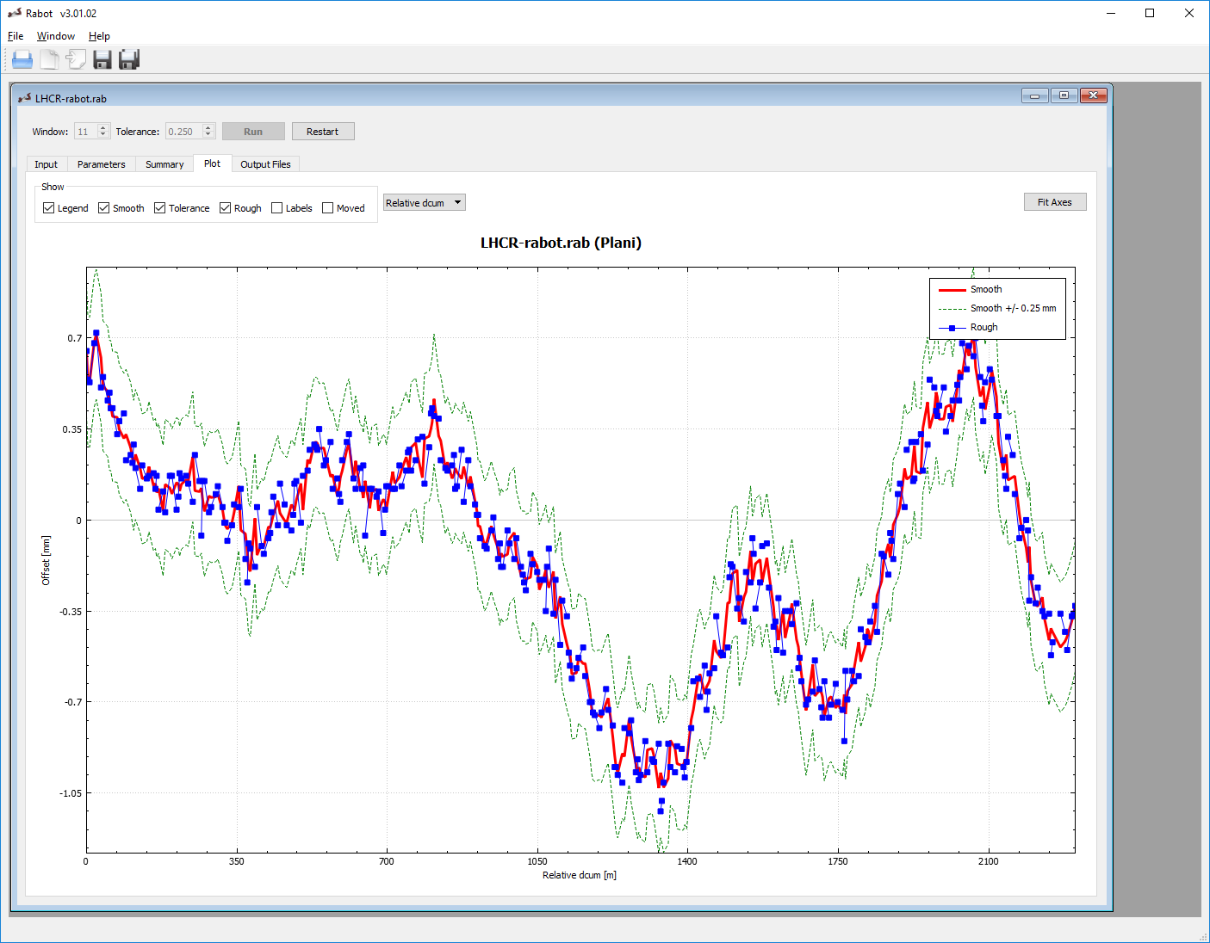
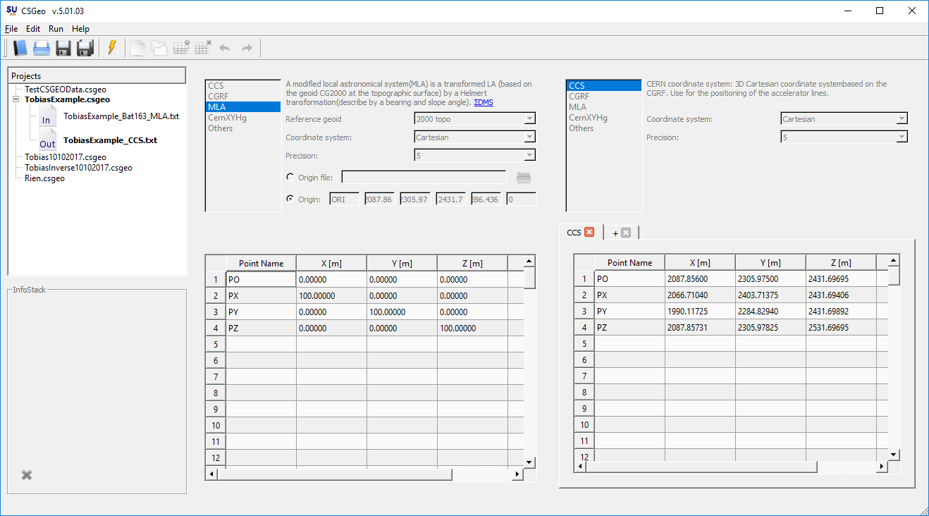
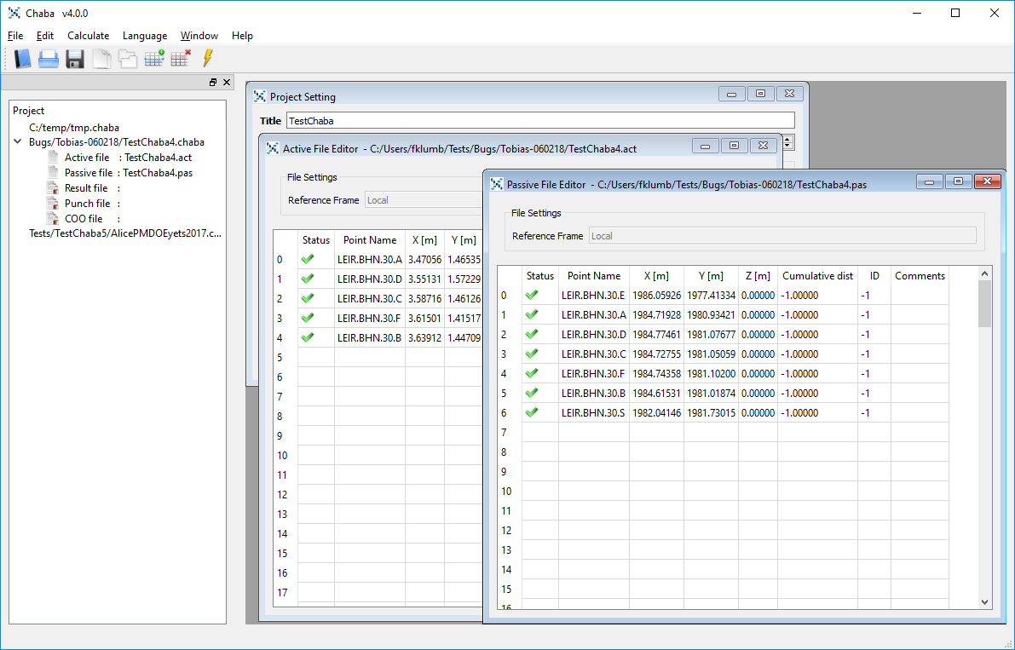
Survey Data processing software
Rabot
CSGeo
CHABA
Various input & output formats !
C++ developments (extensively based on CMake for cross-platform purposes!)

Slide 12
User Interfaces

Slide 13

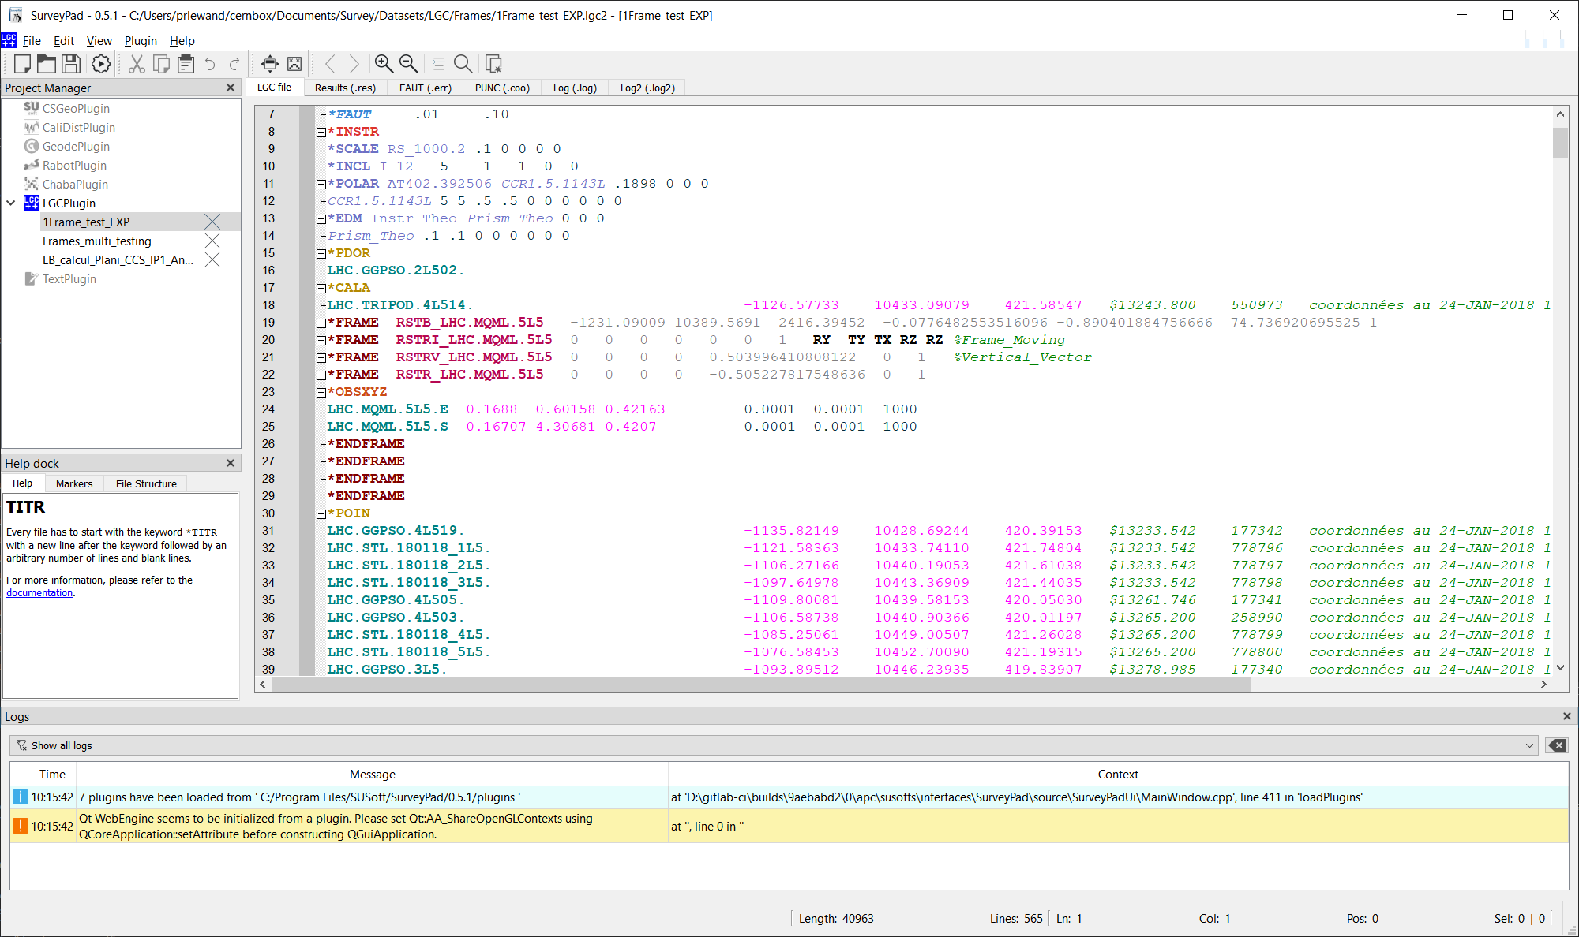
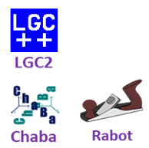

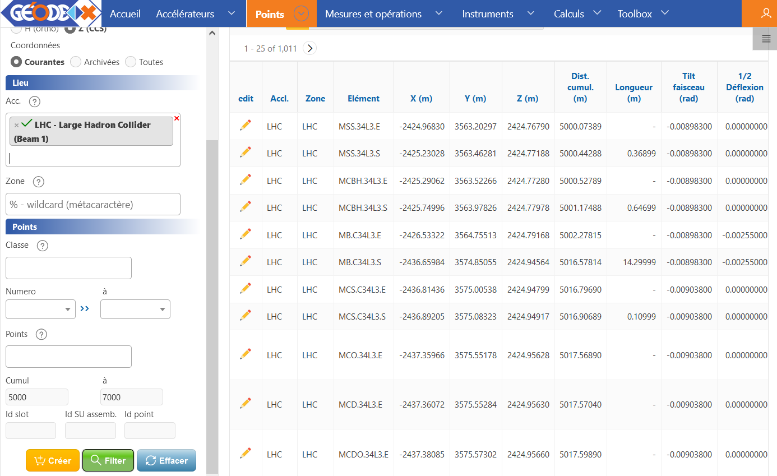
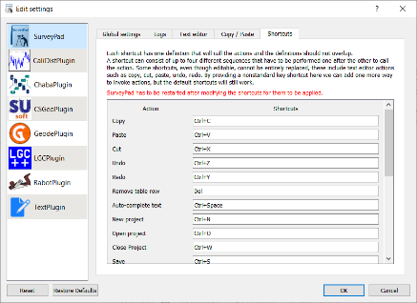

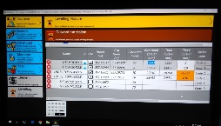
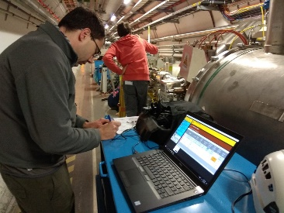
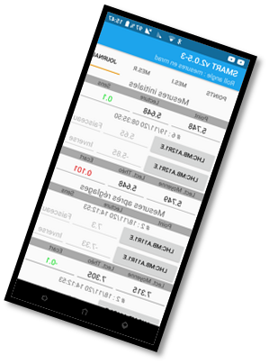
Survey Data processing software
SurveyPad : Advanced data editor and unified processing GUI
Survey
GEODE
Input data files
(formatted texts)
…
7 Data Processing
Plugins today
Currently introducing HTML reports & graphics !
TSUNAMI / SMART

Slide 14
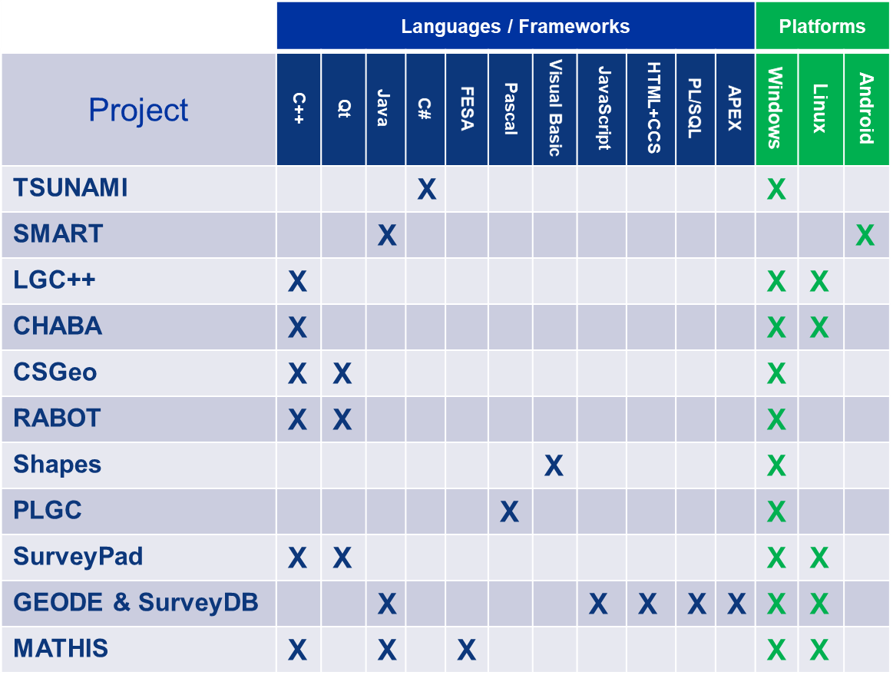
Development environments & Frameworks
Too many technologies for a small team!
x
x
+ Python

Slide 15
Development tools &
organization

Slide 16
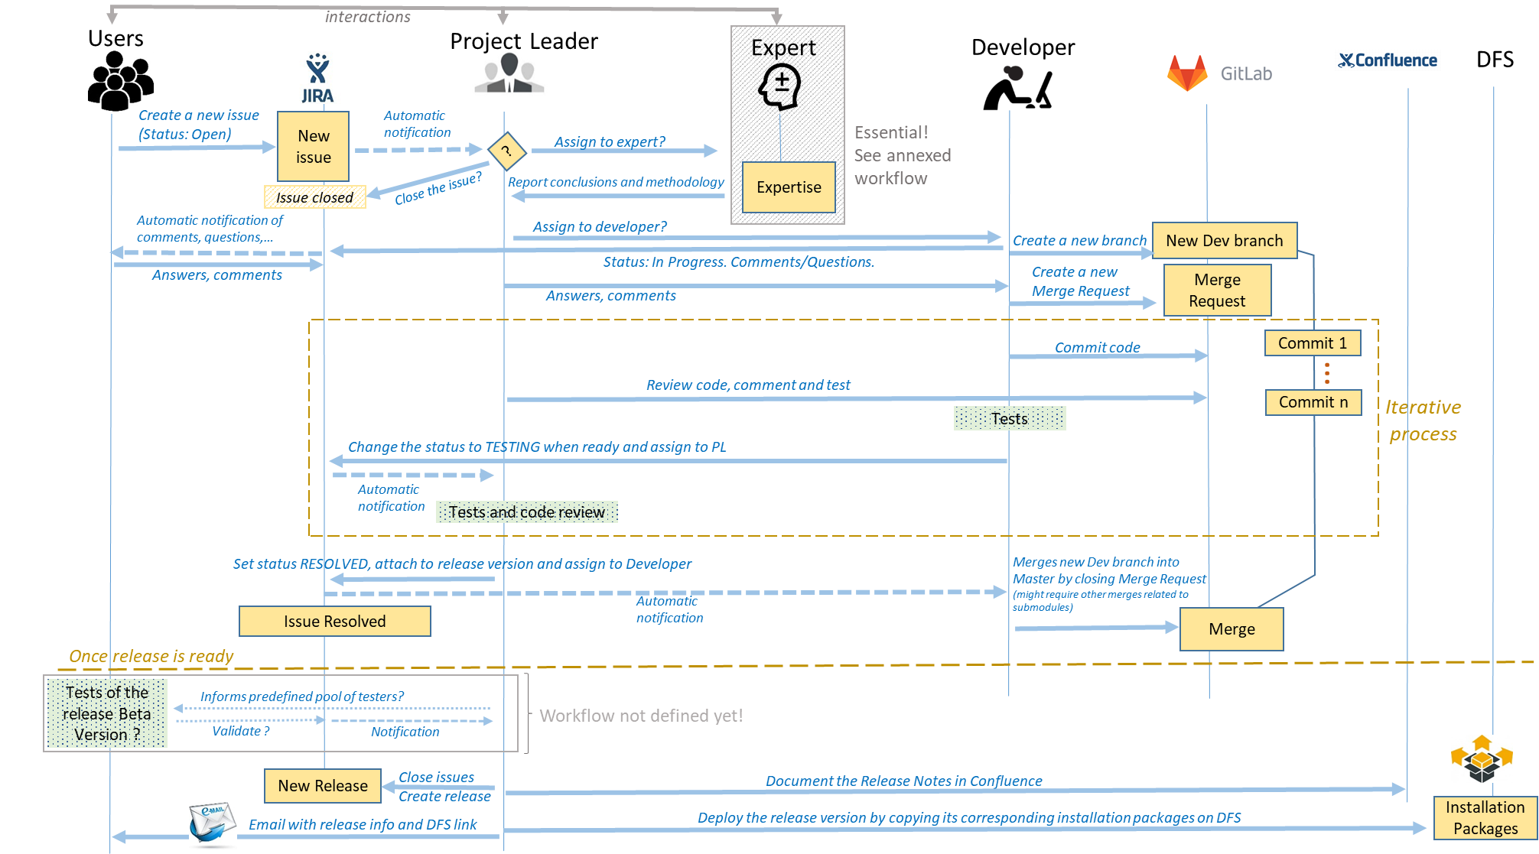
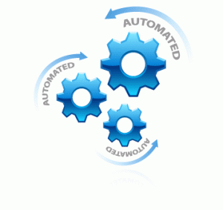
Development workflow & Quality Assurance
Automated tests
Continuous Integration tools (CI/CD)

Slide 17
Discussion topics
In house developments? How ? Which resources and organization? Testing procedures and QA? Collaboration with external institutes or universities?...
Commercial solutions fully meet the needs? Some integration in existing IT infrastructures?
Publication of results: structured reports with graphics? Web-based dissemination ?
How to better share knowledge ? Make LGC open source?

Slide 18
LGC - Least Square Data Processing
LGC2 Main Software and test protocols:
~31’000 lines of C++ code
SurveyLib Library
~48’000 lines of C++ code
LGC 2
SurveyLIB Library
Geodetic transformations
Least Square Models
Mathematical objects & operations
…
Two major releases per year

Slide 19



LGC - Least Square Data Processing
Last versions improved for monitoring system needs (HL-LHC Project)
  Calculation speed!
  Automated analysis and detection of outliers
  Export structured output data (serialization)

Slide 20
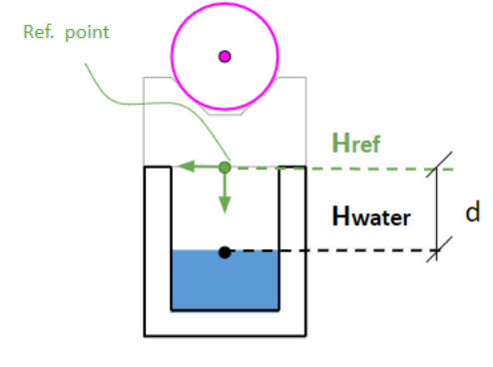
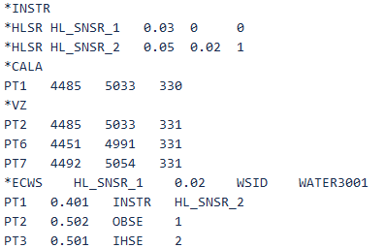
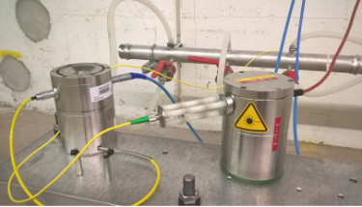
LGC - Least Square Data Processing
Integration of new observation types
  Hydrostatic Levelling System (HLS) measurements (*ECWS keyword)
  Wire Positioning System (WPS) v2.6, June 2023.
Sensors definition
Observations

Slide 21
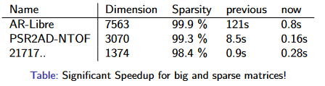
LGC - Least Square Data Processing
LS Mathematical Models homogenization and consolidation
Drastic improvement of calculation time
  Speeded up by a factor of 2 to 150 between v2.4 and v2.5: meets now FRAS alignment requirements!

Slide 22

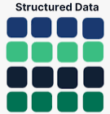
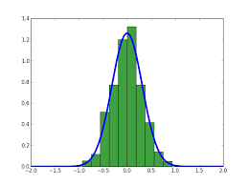
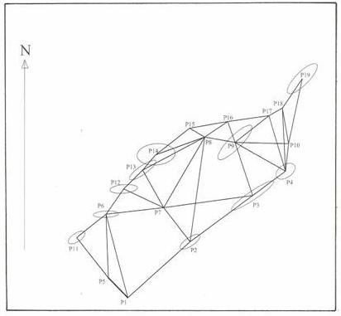
Data processing software - LGC
Structured output data object file (JSON)
Basis for coming
Graphics & Structured reports in SurveyPad !
TEXT
JSON
Output files
*.res
*.err
*.coo
…
Data serialization

