Slide 1
Permanent monitoring systems
Hélène Mainaud Durand
27 June 2023

Slide 2
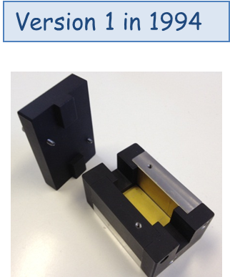
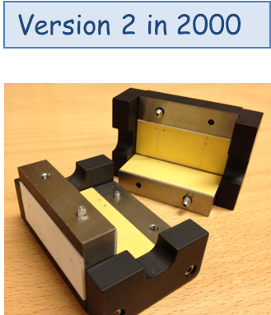
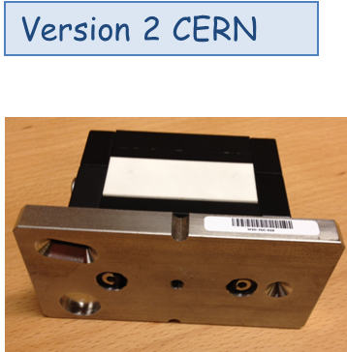
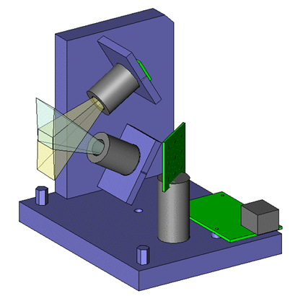
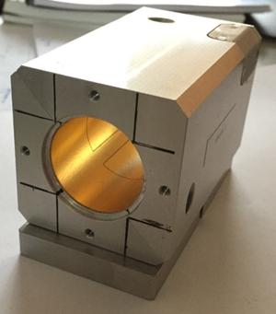
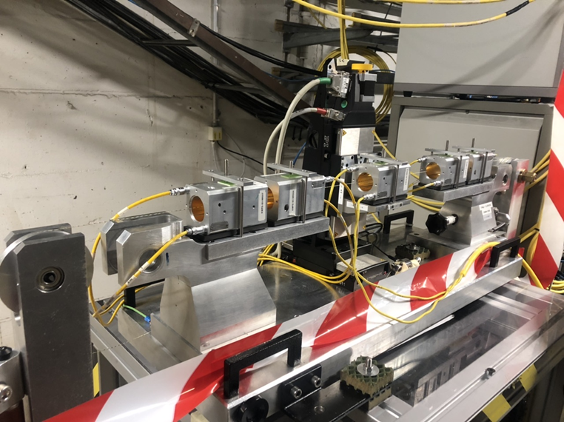
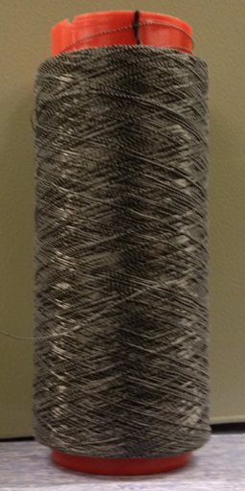
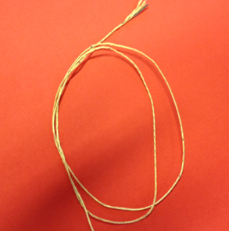
WPS sensors: challenges
Optical version
Version 2023
Calibration benches & associated software
Wires (homogenous conductivity)
Wire modelization
Wire stretching + wire stretchers
→ R&D: towards low cost, no calibration, cables replaced by optical fibers

Slide 3
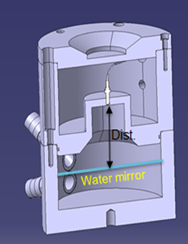
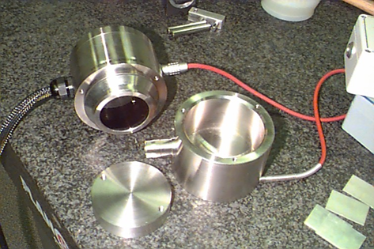
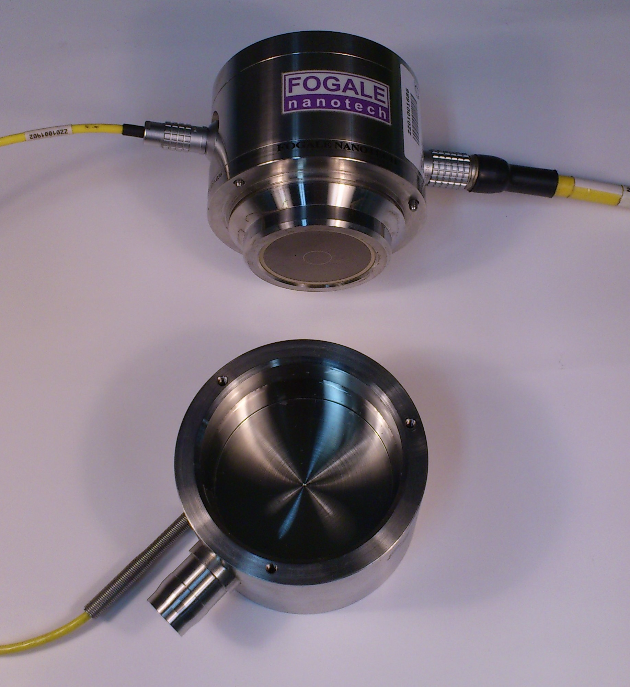
HLS sensors: challenges
FSI-based version
Capacitive-based version
Calibration benches & associated software
Capacitive-based version: length of cables, calibration
FSI-based version: vibrations

Slide 4
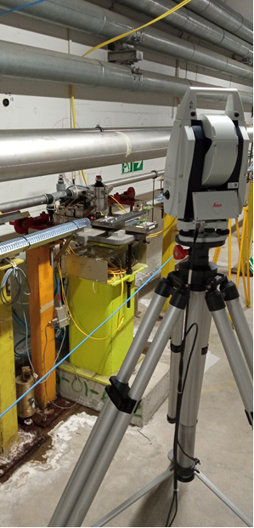
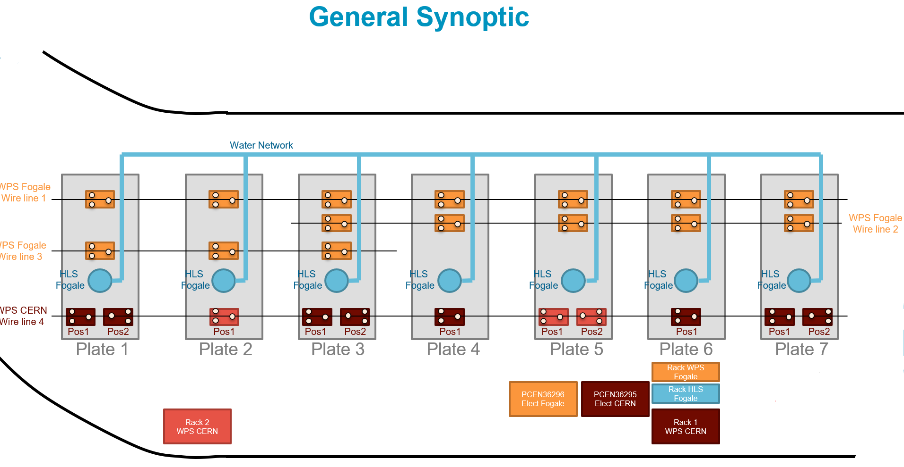
Permanent monitoring systems
Specific line in the TT1 tunnel to validate alignment systems

Slide 5
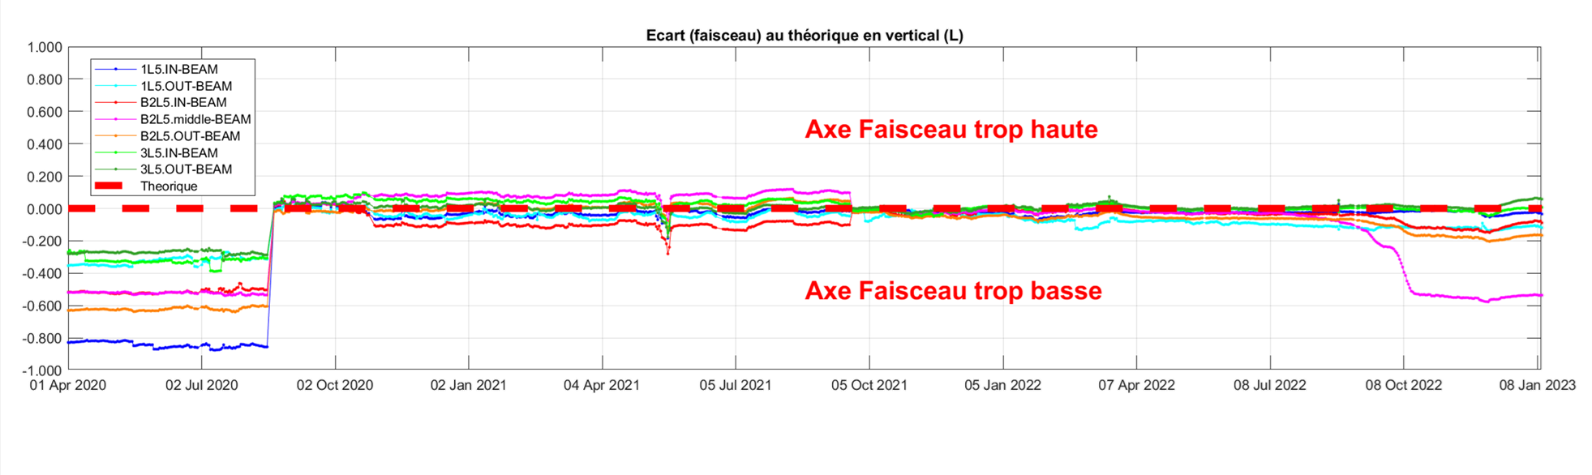
Data analysis…

Slide 6
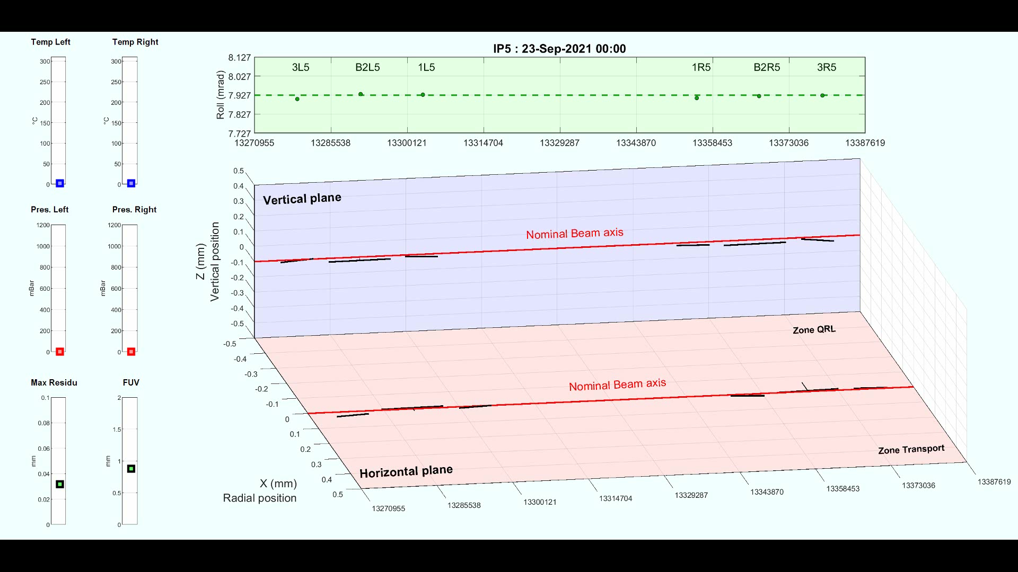
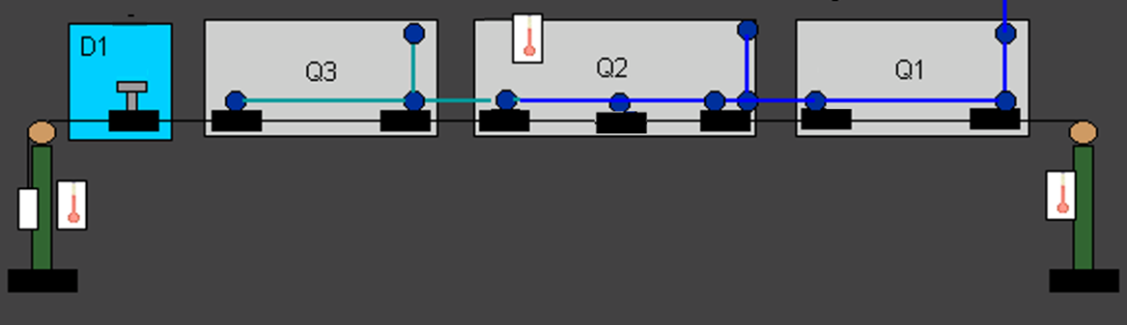
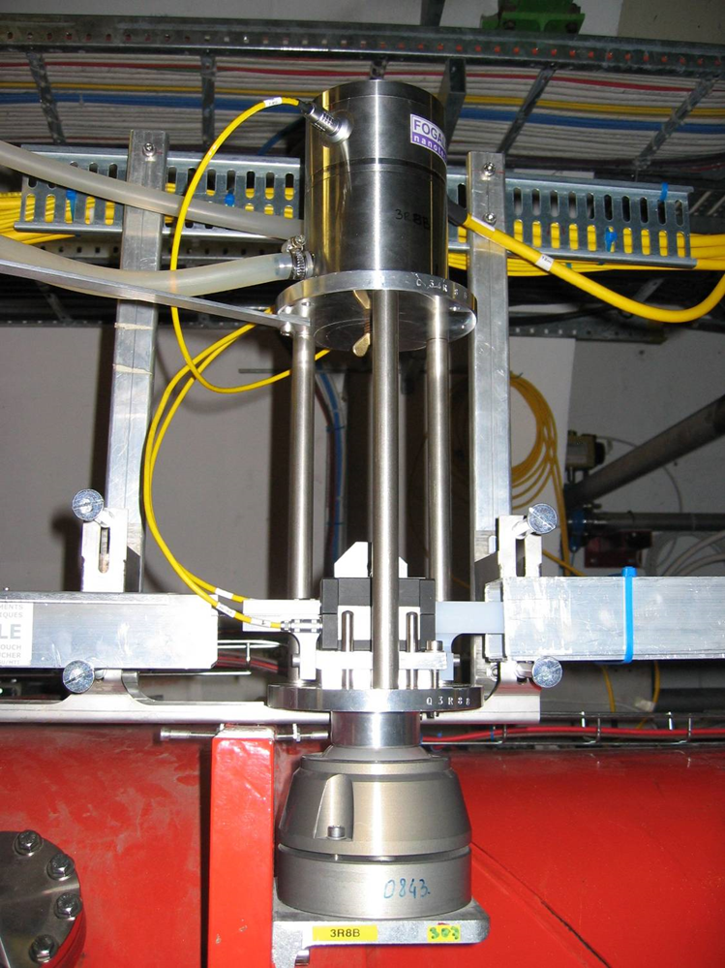
L5 triplet according to HLS and WPS sensors
Long term data (since Sept. 2021)

Slide 7
Permanent monitoring systems
Questions:
Needs and requirements from other labs on alignment sensors
Software for acquisition, treatment and analysis of data
What are the corrections to be performed (tidal effects, sag, etc.)?
How to get rid of calibrations?
How to manage the huge quantity of data?
How to give physicists results that are relavant for them?

Slide 8
Permanent monitoring systems
Is there a possibility for sharing and perhaps development of a common sensor, qualification means?

