Slide 1
MD #11067 – Beam Loss Patterns with Ions and Crystal Collimation
S.Morales for SY-BI-BL
MD Participants: E.Calvo, M.D’Andrea, S.Morales, M.Rakic, B.Salvachua
21/11/2023 LSWG on Ion Run MD results

Slide 2
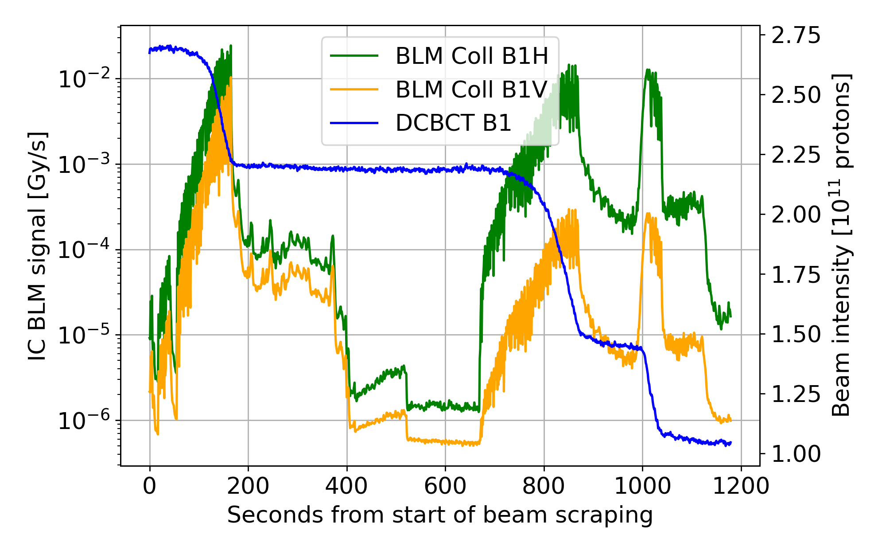
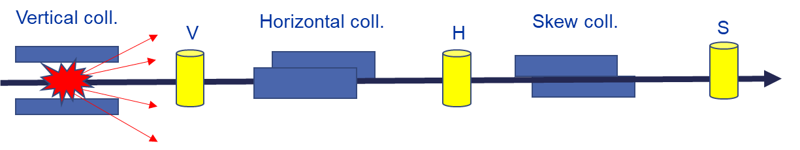
MD#6950 – Study of beam loss patterns for improving online BLM diagnostics
Calibration of the BLM system (Gy/s to protons/s)
  Based on the analysis of the BLM detector signals for different well-defined beam loss scenarios
  Proton impacts on the jaws of the primary B1 and B2 betatron and off-momentum collimators
  Beam loss scenarios reproduced by controlled beam scraping on single collimators
  To be repeated after every change in settings or long technical stop
Data useful for both IC BLM and dBLM studies

Slide 3
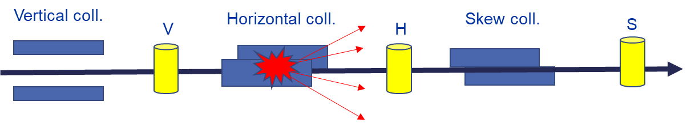
MD#6950 – Study of beam loss patterns for improving online BLM diagnostics
Calibration of the BLM system (Gy/s to protons/s)
  Based on the analysis of the BLM detector signals for different well-defined beam loss scenarios
  Proton impacts on the jaws of the primary B1 and B2 betatron and off-momentum collimators
  Beam loss scenarios reproduced by controlled beam scraping on single collimators
  To be repeated after every change in settings or long technical stop
Data useful for both IC BLM and dBLM studies

Slide 4
MD #11067: Beam Loss Patterns with Ions and Crystal Collimation
Calibration of the BLM system (Gy/s to ions/s)
  Based on the analysis of the BLM detector signals for different well-defined beam loss scenarios
    Crystal collimator acting as primary now -> Completely different loss patterns!
  Ion impacts on the jaws of the primary B1 and B2 off-momentum collimators in IP3
  Ion losses from crystal collimation in IP7
  Beam loss scenarios reproduced by controlled beam scraping on single collimators
First scraping exercise with crystal collimation -> Useful to understand and improve the scraping process!
Crystal coll V.
V
Scraping in IR7 performed in two different ways:
Optimizing crystals at the start of the scraping - Amorphous
Optimizing crystals at the start of the scraping and every 0.5 sigma – Keep the channeling conditions

Slide 5
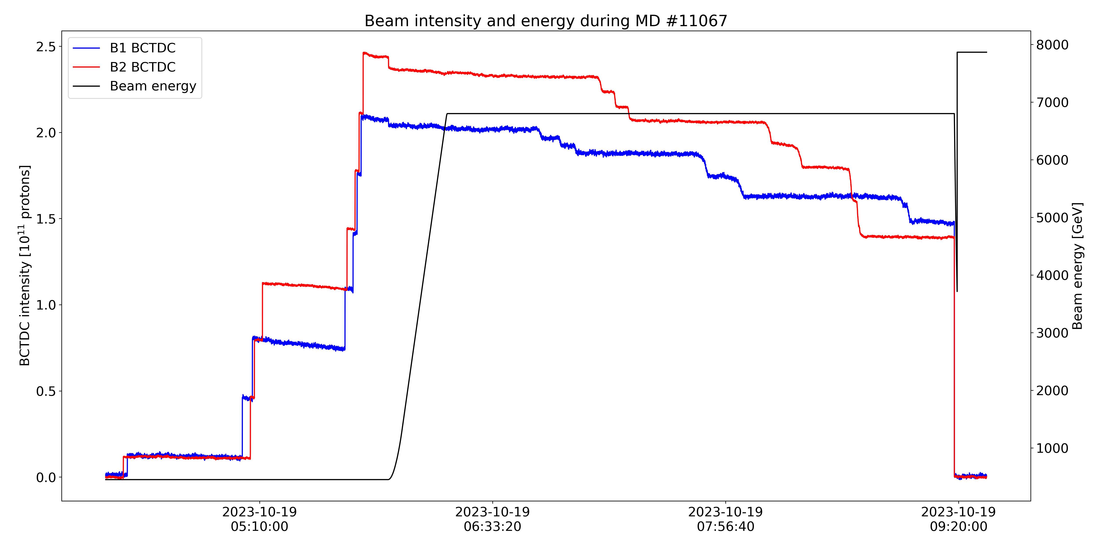
Summary of MD #11067 – 19/10/2023
IR7 scraping crystal optimizing at start
Injecting…
IR3 scraping
IR7 scraping crystal optimizing at start and every 0.5 sigmas
Beam dump due to electrical perturbation!
19 bunches B1, 21 bunches B2 -> Well below SBF
Masked BLMs, BPMs, collimator movements and collimators limits (TCPs, crystal collimators, IP2 TCLDs)

Slide 6
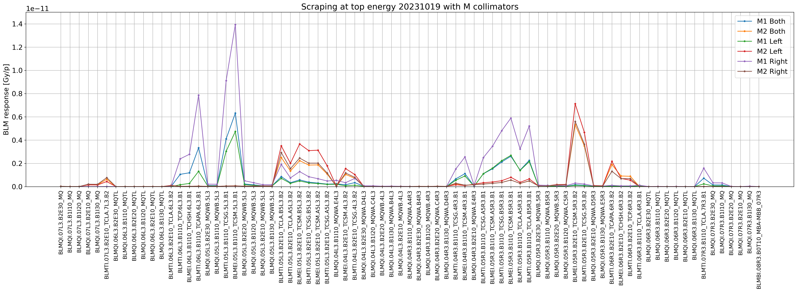
Summary of MD #11067 – 19/10/2023
Scraping with different jaws of off-momentum collimators (IP3)
B1
B2
IP3

Slide 7
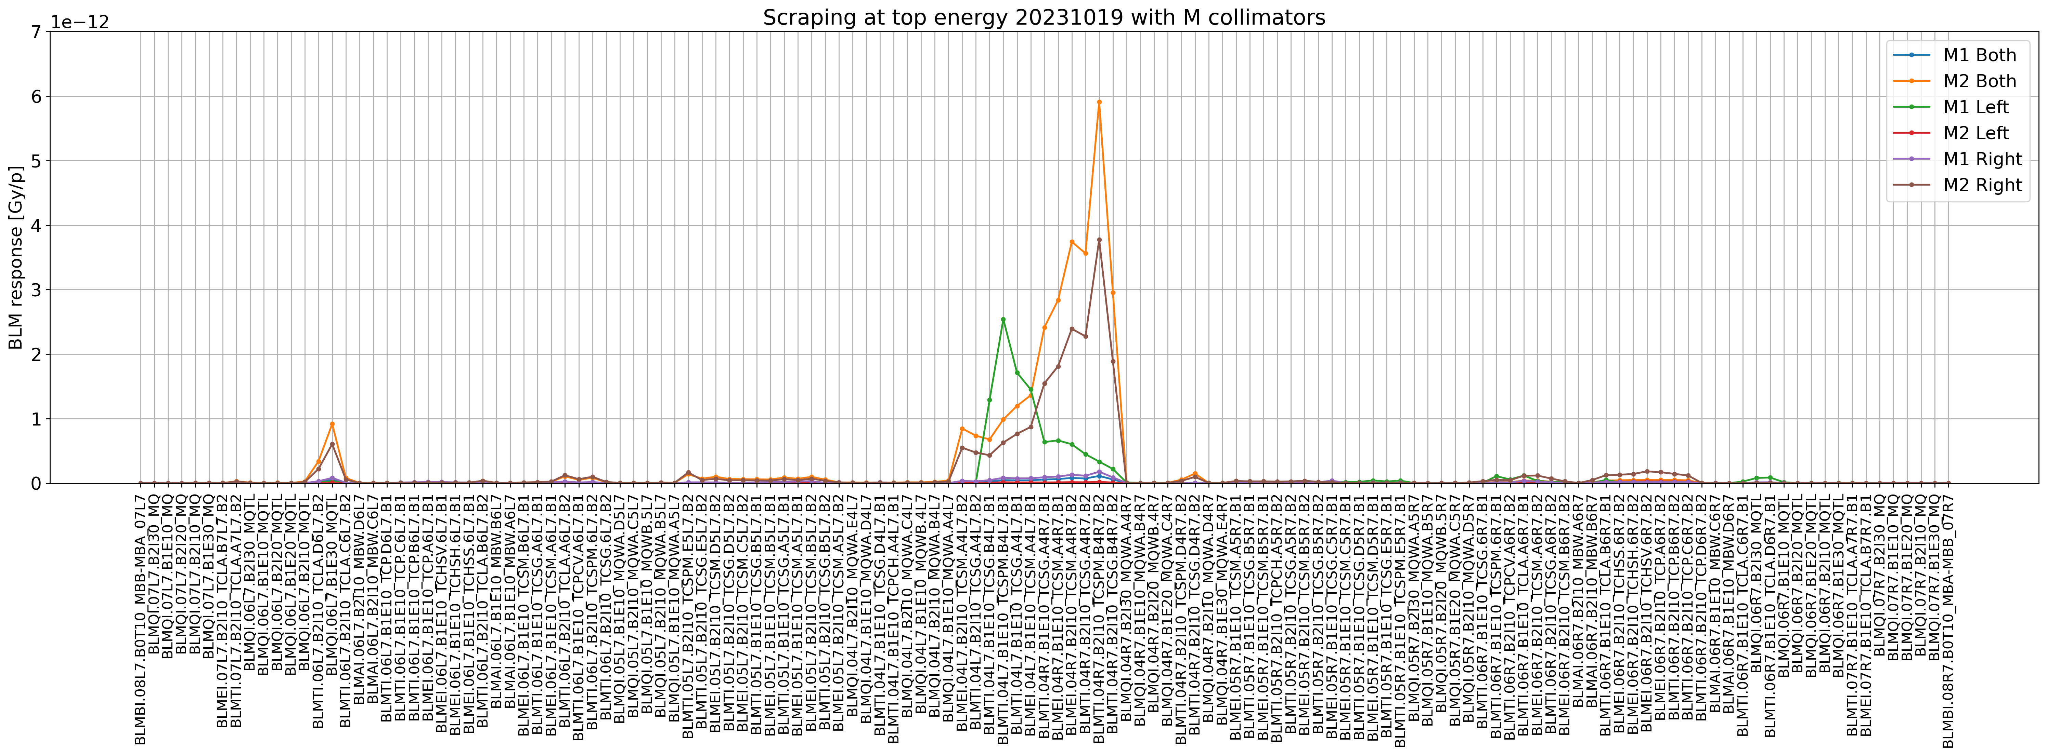
Summary of MD #11067 – 19/10/2023
Scraping with different jaws of off-momentum collimators (IP3)
B1
B2
IP7

Slide 8
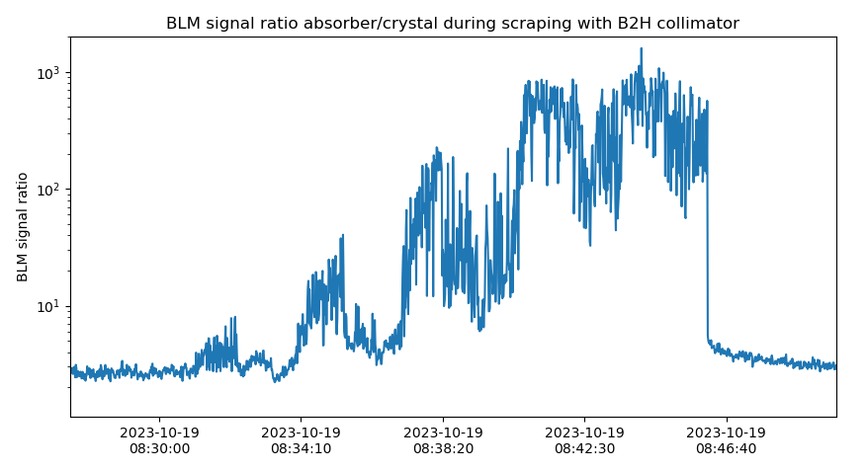
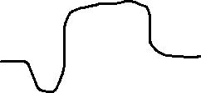
Summary of MD #11067 – 19/10/2023
VR
AM
AM
Analysing on-going to understand the crystal collimator situation during each scraping!
CH
Crystal collimator angle
Opt.
Opt.
Opt.
Opt.
Opt.

Slide 9
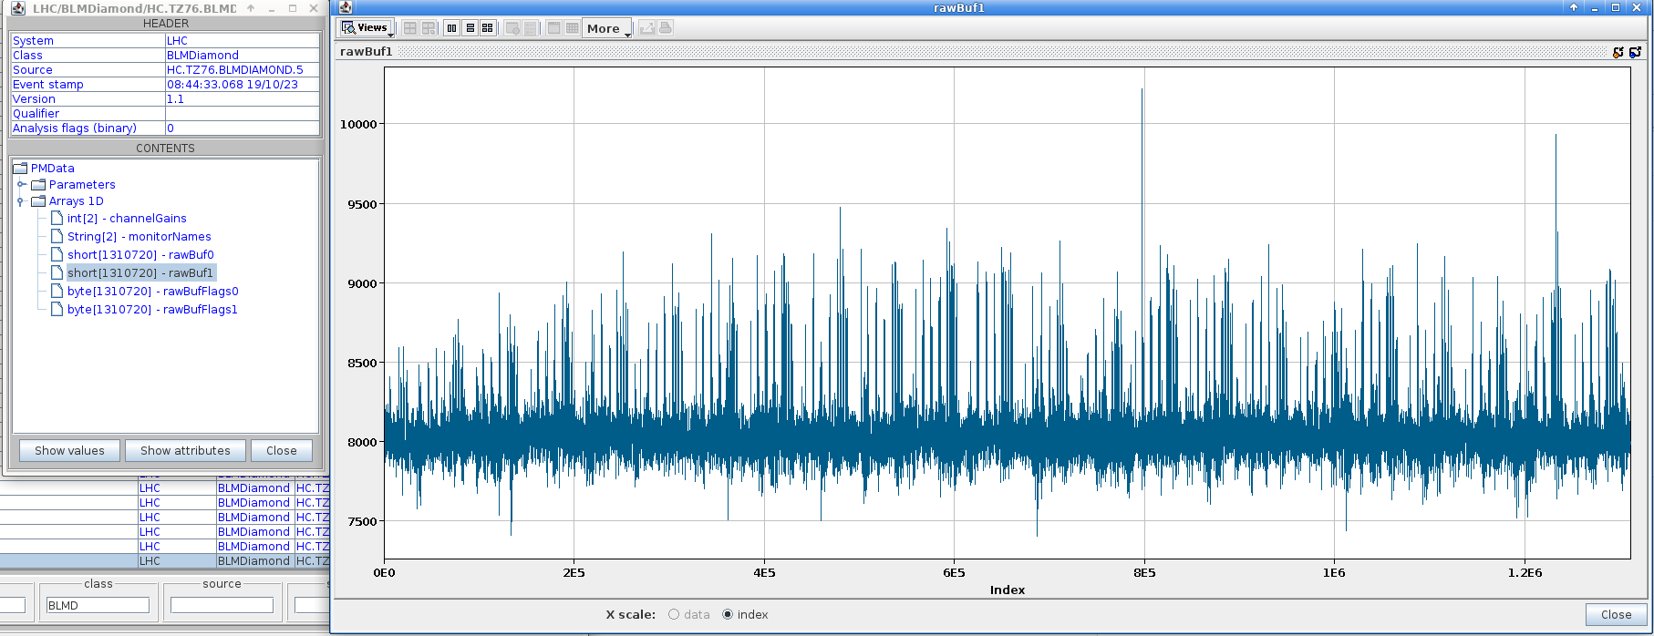
Summary of MD #11067 – 19/10/2023
dBLM capture data (650MHz) taken during the test, here during B2H crystal optimization!

Slide 10
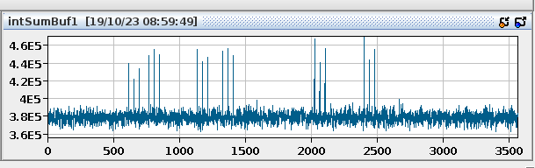
Summary of MD #11067 – 19/10/2023
dBLM bunch-by-bunch (1Hz) data available, here during B1H crystal optimization!

Slide 11
Summary of MD #11067– 19/10/2023
Waited ~2 hours to start injecting, still could not receive all requested injections
IR3 scraping successfully performed with the left, right and both jaws independently
IR7 scraping with crystal collimators performed in two ways:
  First attempt optimizing the crystals at the start of the scraping, losing the channeling conditions at some point and scraping in amorphous – Useful data as well for the calibration!
  Second attempt optimizing the crystals at the start of the scraping, and every 0.5 sigmas scraped in order to keep the channeling conditions
  Lost the beam due to an electric perturbation during B1V crystal collimator scraping – could not finish MD
We had received the request to perform beam scraping with the IR2 TCLDs, could not do it either
Very interesting data, analysis on-going!

