Slide 1

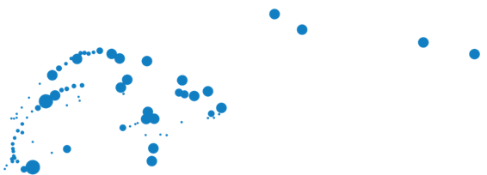
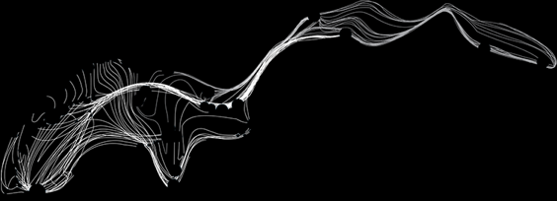


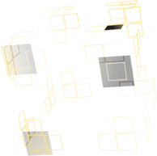

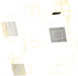



UNIVERSITY OF TWENTE.
Measurement and FE modelling critical transverse loading limits of REBCO round cables for fusion
A. Nijhuis^{1,3} ,G. Anniballi¹, J. Rietberg¹, N. van Dusschoten¹, A. Kario^{1,7}, V.J. Ellenbroek^{1,2},
R. Lübkemann³, J. Leferink³, C. Soyarslan², A.H. van den Boogaard², J.D. Weiss⁴, K. Radcliff ⁴, D.C. van der Laan⁴, H. Jin⁵, C. Zhou^{1,5}, W. Yu⁵, J.G. Qin⁵, E. Garibaldi⁶, M. Breschi⁶
¹ University of Twente, Faculty of Science & Technology, Enschede, The Netherlands
² University of Twente, Faculty of Engineering Technology, Enschede, The Netherlands
³ Foundation SuperACT, Hengelo, The Netherlands
⁴ Advanced Conductor Technologies, Boulder, CO & University of Colorado, Boulder, CO, USA
⁵ Institute of Plasma Physics, Chinese Academy of Sciences, China
⁶ University of Bologna, Bologna, Italy
⁷ CERN, Geneva, Switzerland
ASIPP
CCA Workshop 2025, CERN, 12 Mar 2025

Slide 2

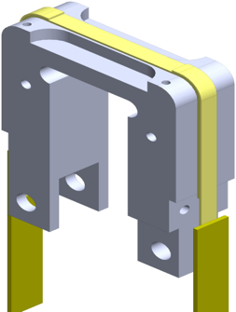
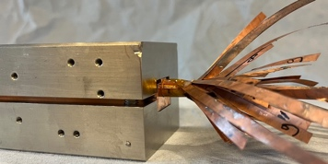
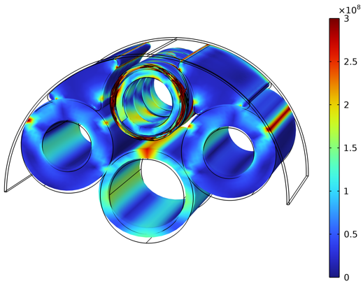
Conductor design optimization
Single tape I_{c} – mech. load testing
Axial tensile stress, I_{c} & mech. props.
Axial tensile & compressive strain, I_{c} & ε_{irr}
TransverseStress σ_{irr}
Winding angle, I_{c} & min. diam.
Cable cyclic load testing Twente Press
Critical current/loadI_{c}(F)
Transverse stiffness d(F)
Inter tape contact resistance R_{c}
FE cable model
Materials
Design
UNIVERSITY OF TWENTE.

Slide 3

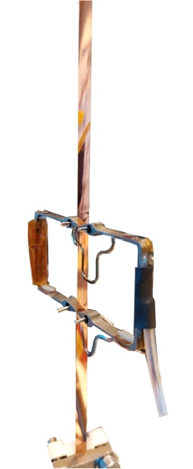
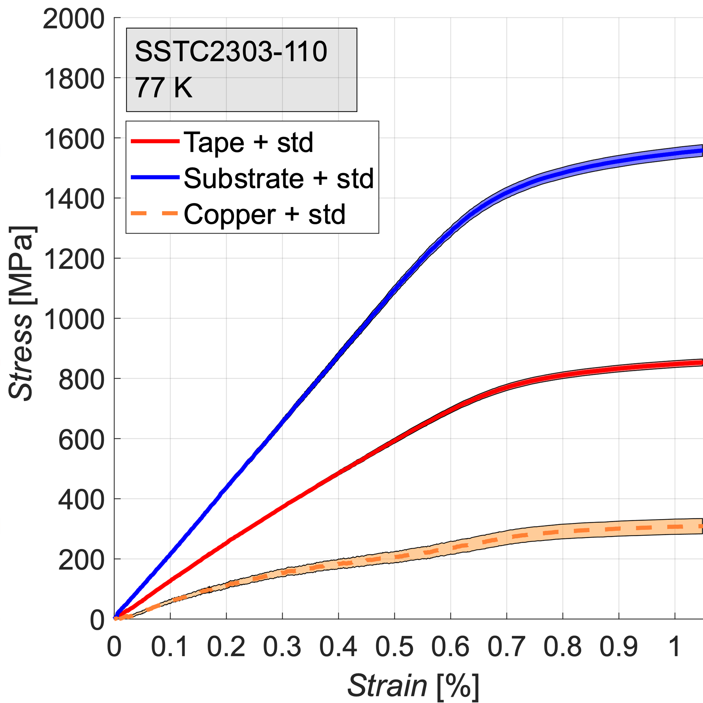
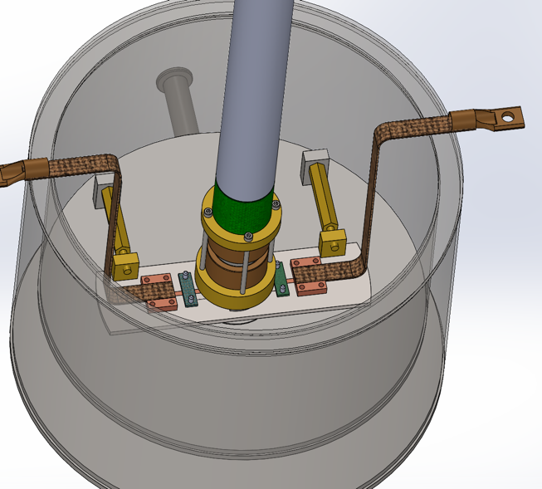
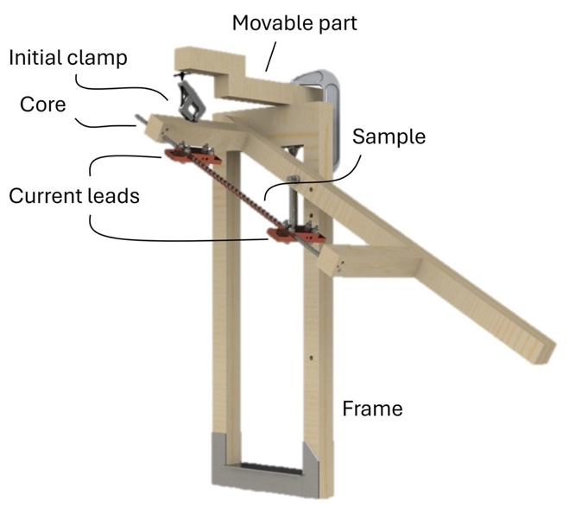
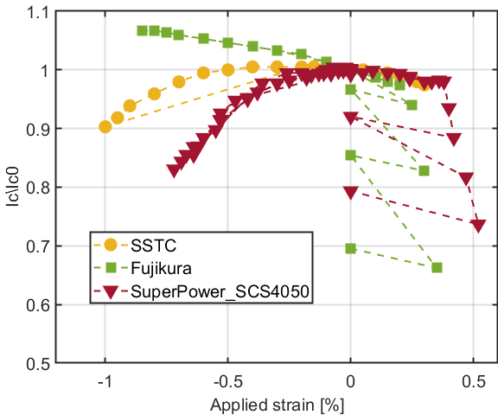
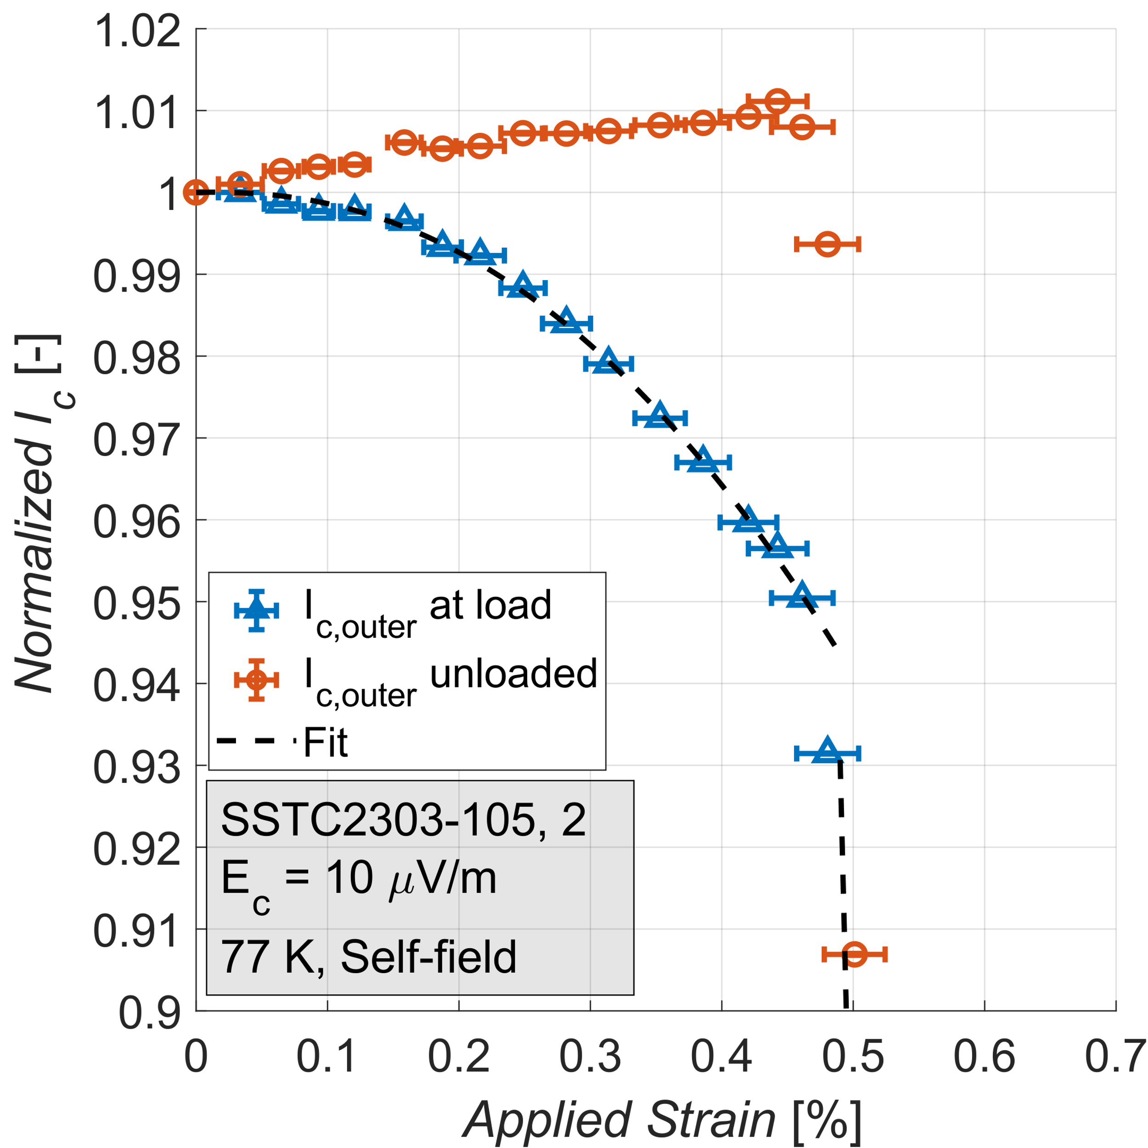
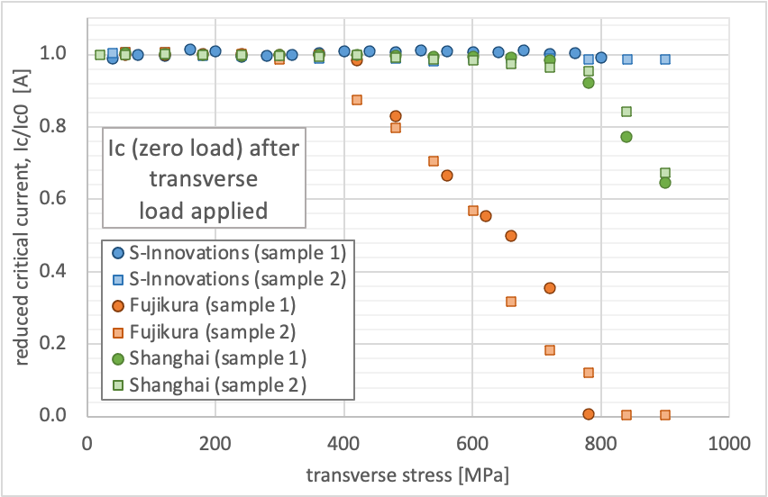
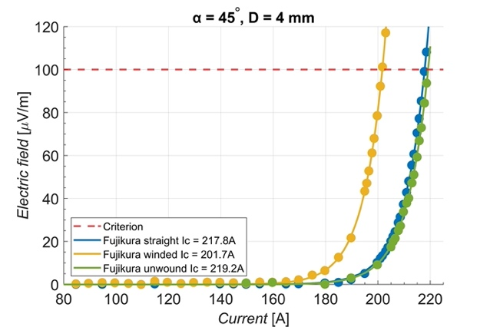
Single tape: I_{c} – mechanical testing
U-Spring axial tensile & compressive strain I_{c}(B,T,ε)
Axial tensile stress, mechanical properties, I_{c} & ε_{irr}
Transverse stress, I_{c} & σ_{irr} (77 K)
Winding angle I_{c} & min core diam. (77 K)
UNIVERSITY OF TWENTE.

Slide 4
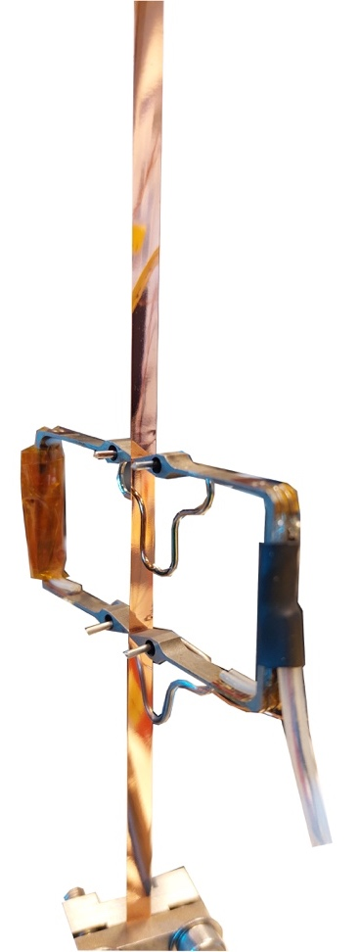
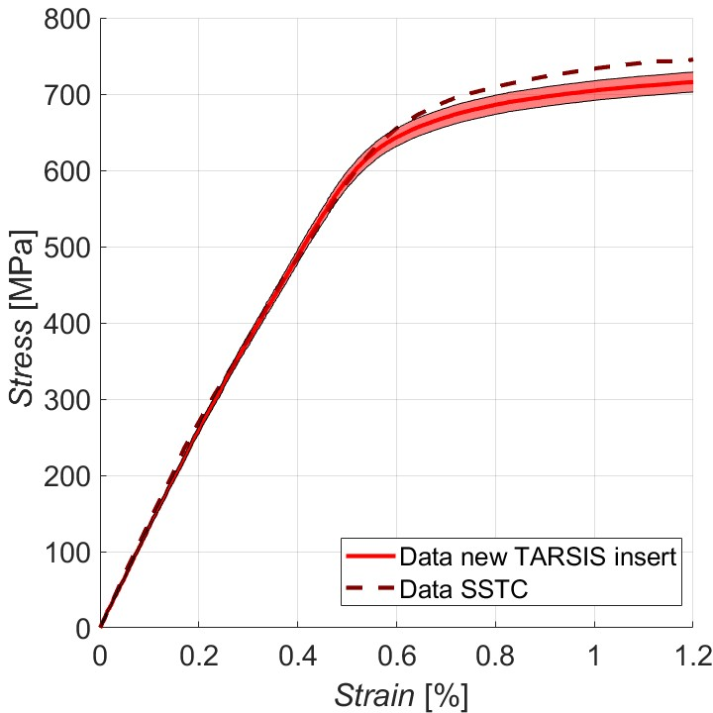
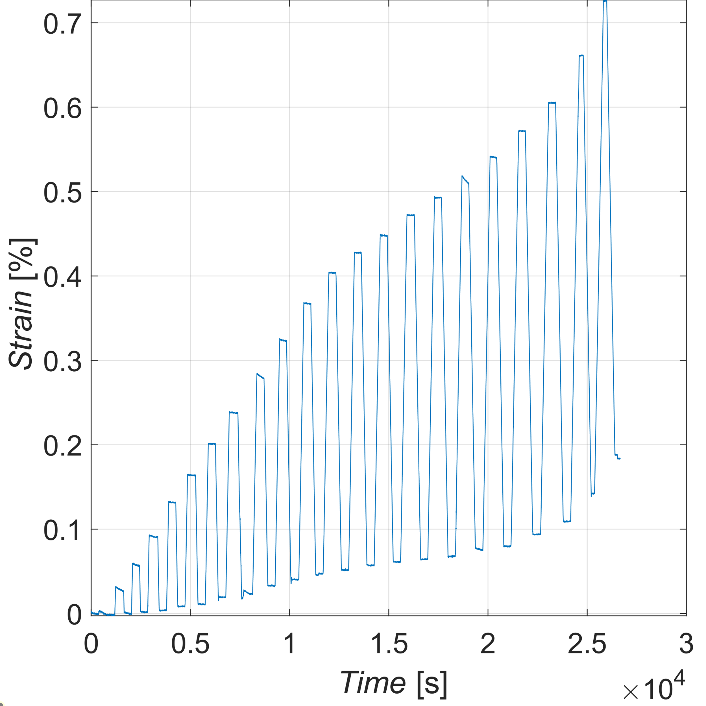
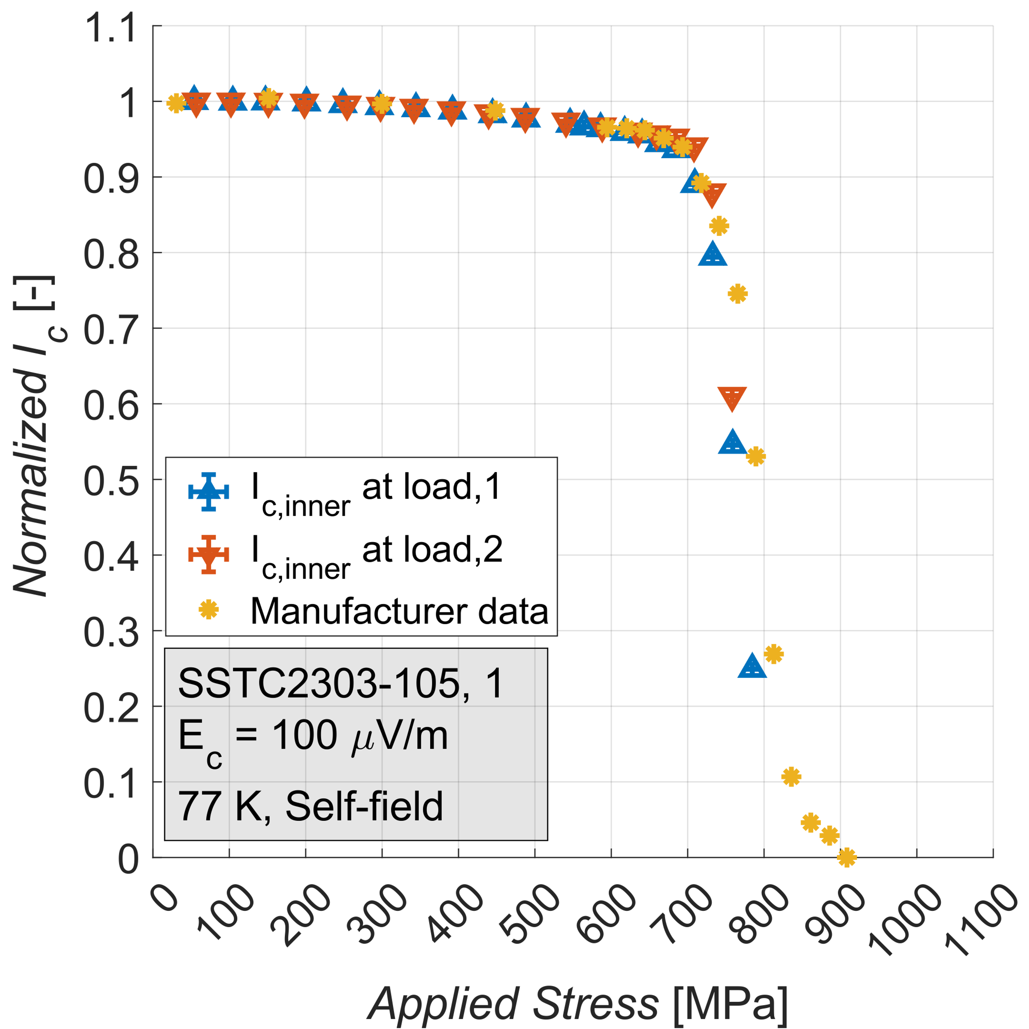
Axial tensile strain: setup
Comparison data manufacturer
Tape | t_{Substrate} [𝜇m] | t_{Copper} [𝜇m] | I_{c} [A]
SSTC | 52 | 22 | 186
Fujikura | 49 | 25 | 204
Faraday | 39 | 13 | 162
Substrate : Hastelloy, width = 4 mm
Goal:
Stress-strain properties, I_{c} & irreversibility limit for tensile axial strain
5 MPa
UNIVERSITY OF TWENTE.

Slide 5
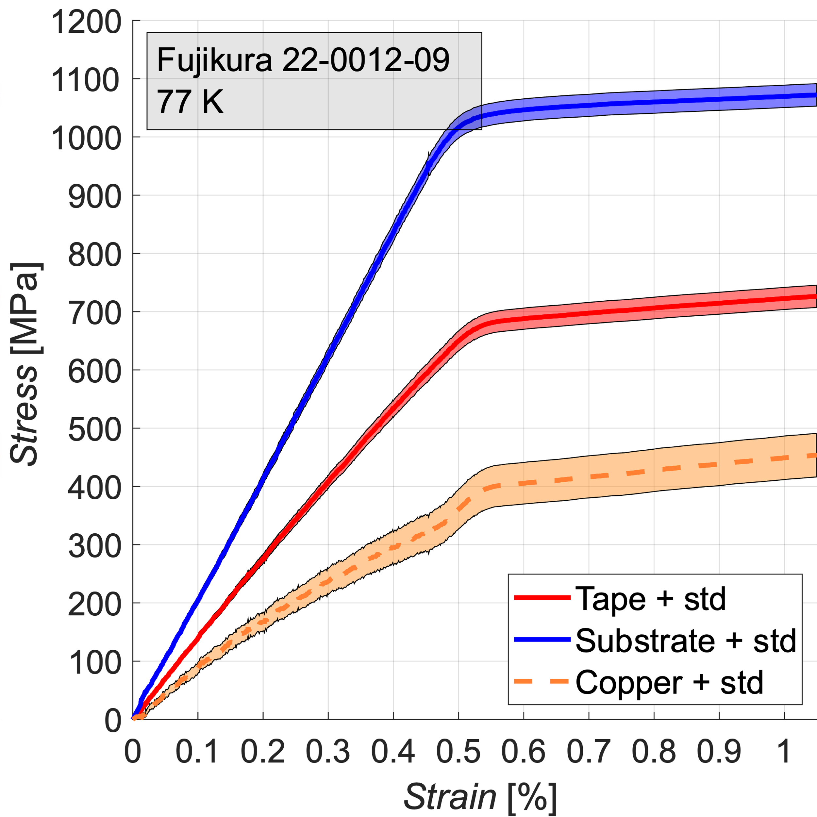
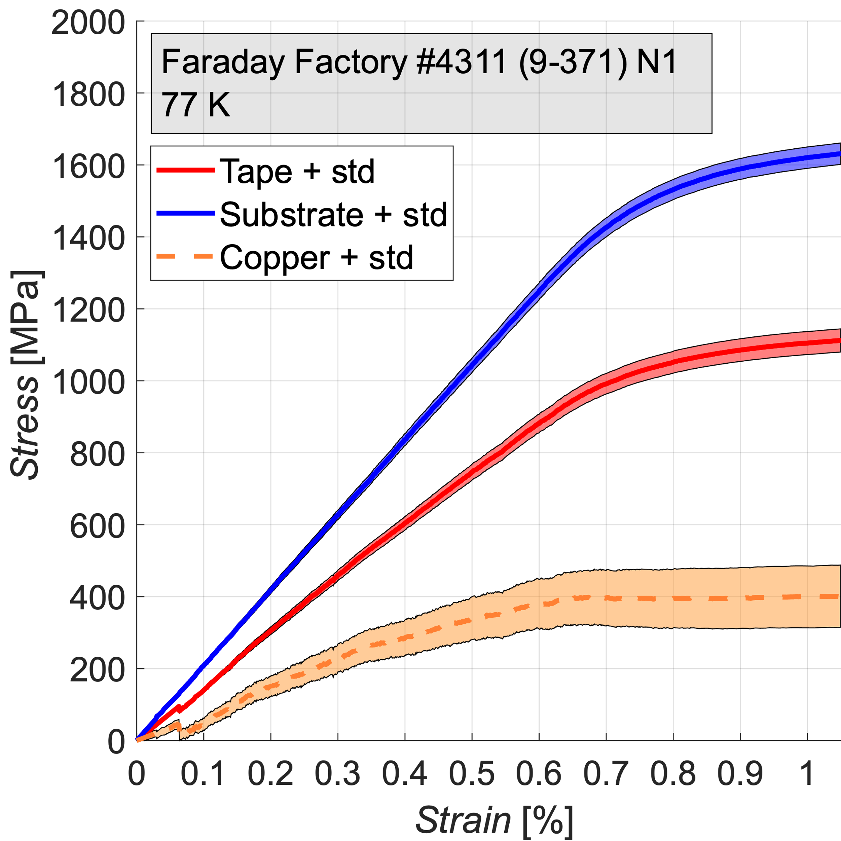
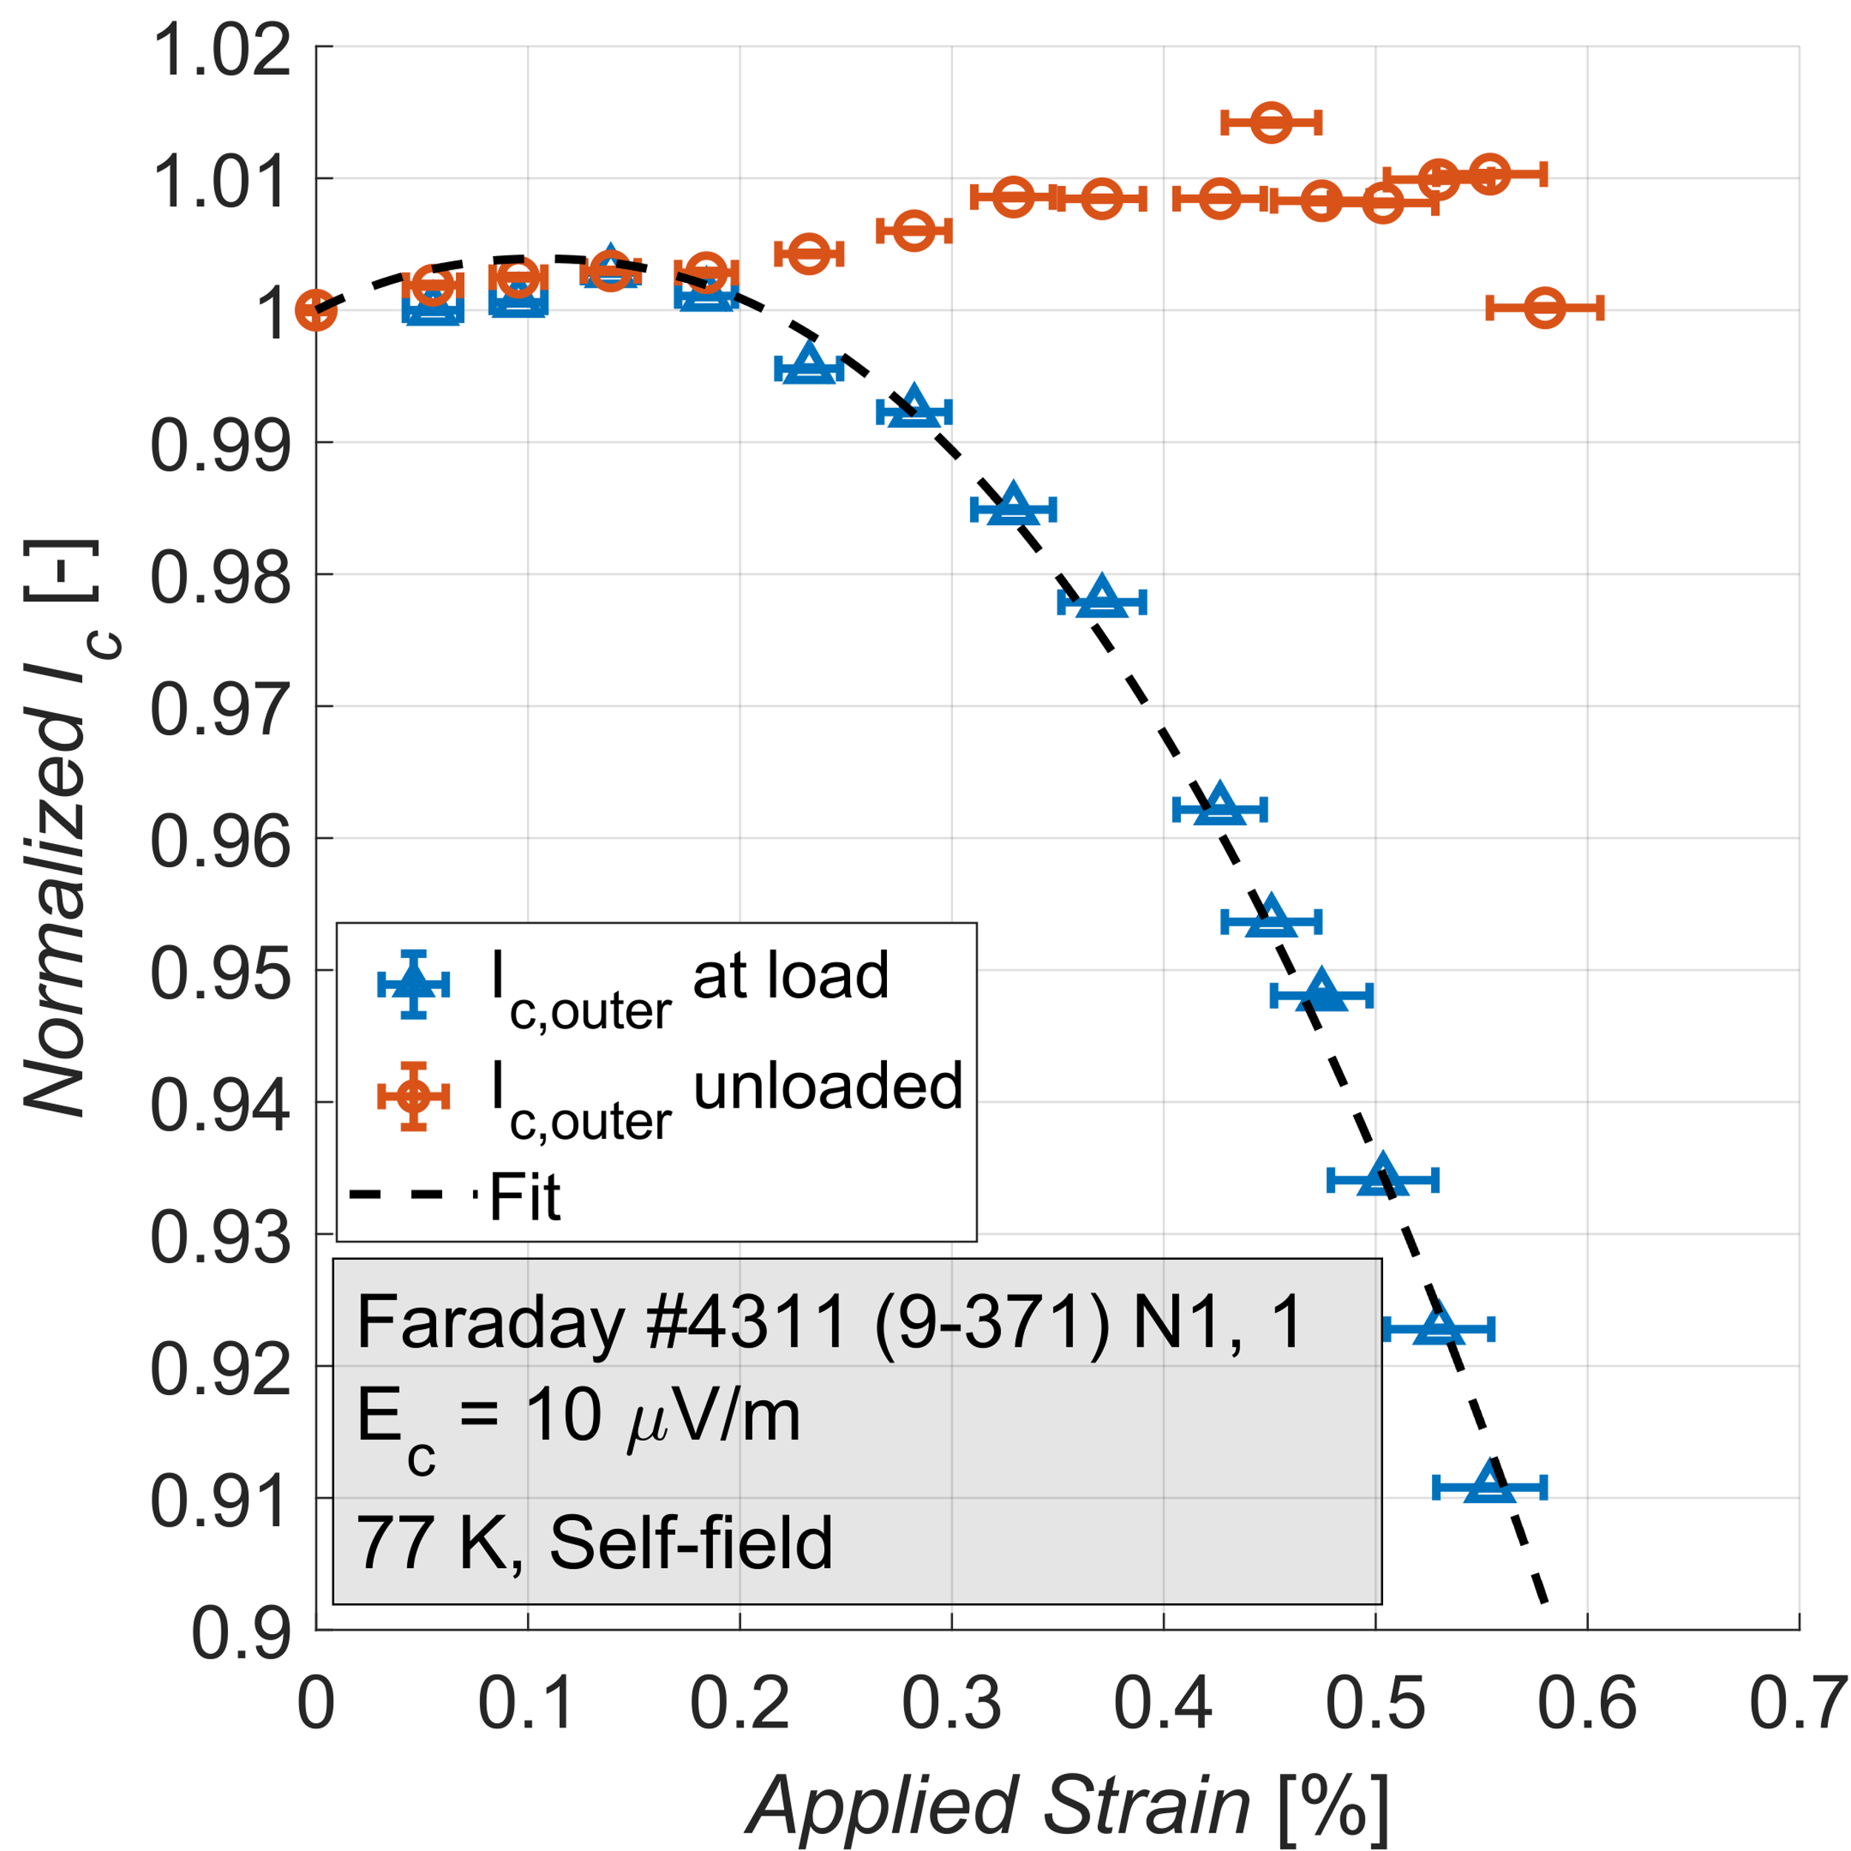
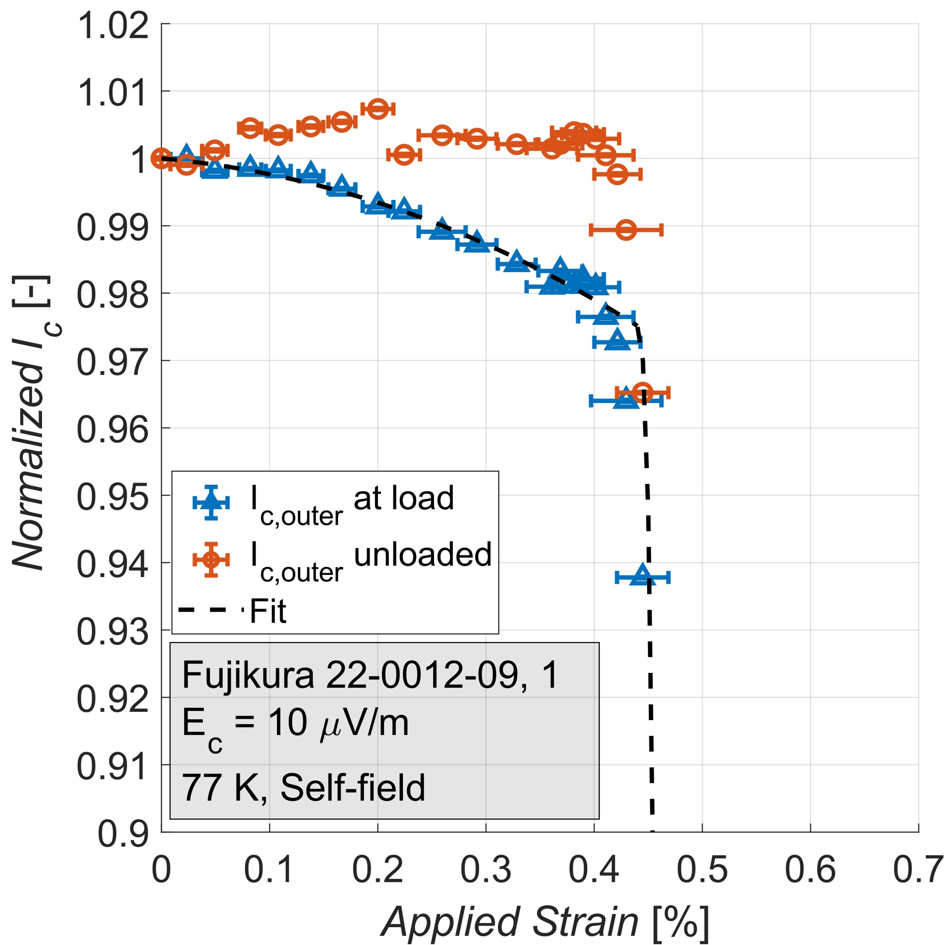
Axial tensile Stress-Strain curves & I_{c}(𝜖)
Axial tensile Stress-Strain curves
Tape | E [GPa] | 𝜎_{ys} [MPa]
SSTC | 125 | 600
Fujikura | 135 | 621
Faraday | 150 | 875
Tape | 𝜖_{irr}[%] | 𝜎_{irr} [MPa]
SSTC | 0.48 | 709
Fujikura | 0.43 | 626
Faraday | 0.58 | 900
UNIVERSITY OF TWENTE.

Slide 6
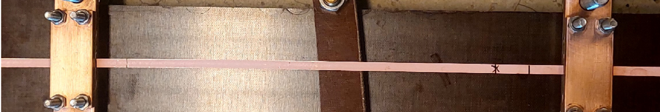
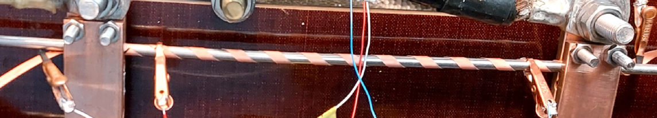
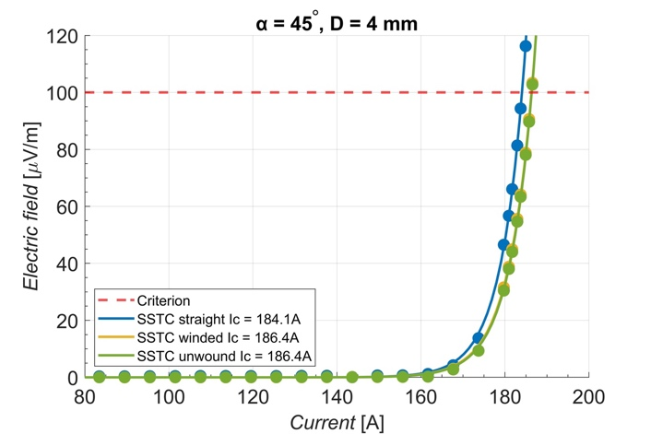

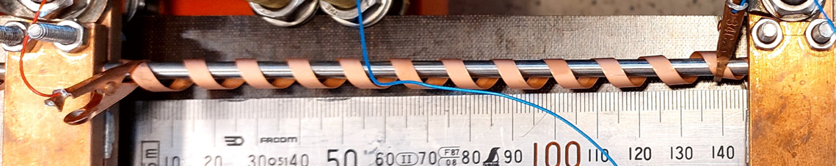
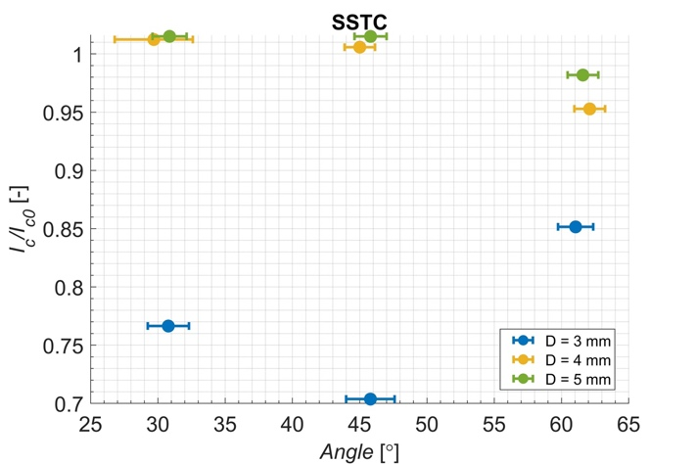
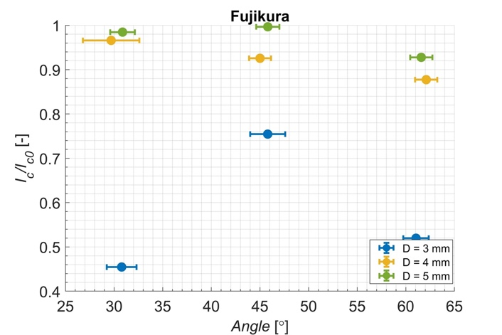
Winding performance
Minimum winding radius (irreversibility limits)
Verification of current retention/reduction
3 winding diameters (3, 4 and 5 mm)
3 winding angles (30°, 45° and 60°)
REBCO layer faces core
  Straight
  Wound
  Relaxed
SSTC retains 100% Ic, wound at 45° on 4 mm former.
Fujikura shows Ic-reversible reduction (7%).
I_{c} wound is normalized with I_{c0} of initial straight configuration.
Critical core diameter >3 mm, critical angle < 60° for standard tape dimensions.
UNIVERSITY OF TWENTE.

Slide 7
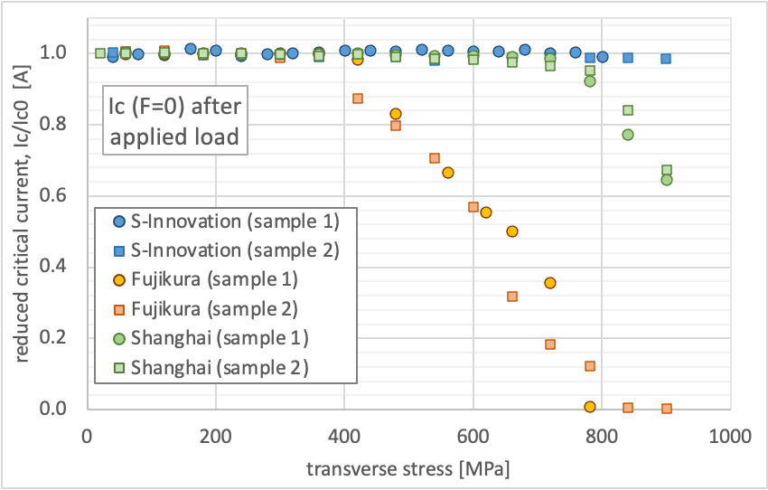
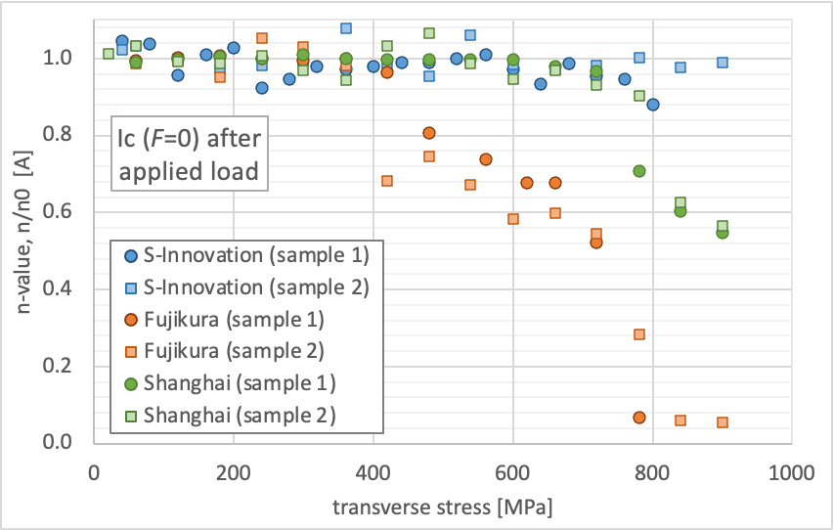
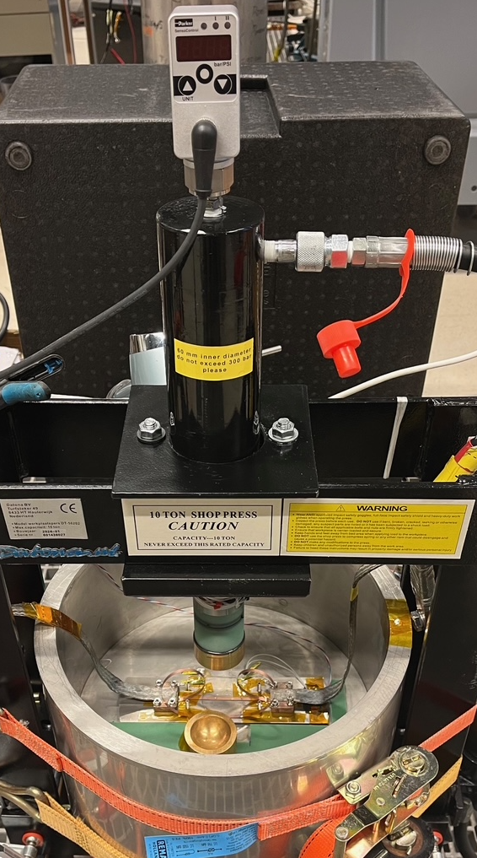
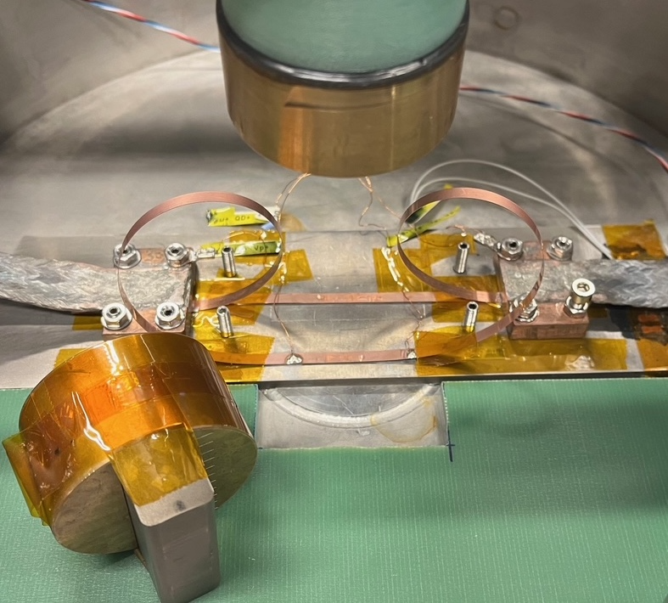
Transverse load (10 x 4 mm²)
I_{c}/I_{c0} and n/n₀ at zero load after applied stress.
Tape | 𝜎_{irr} [MPa]
S-Innovation | > 900
Fujikura, 22-0012-09 | 400
SSCT, ST2903-105 | 750
UNIVERSITY OF TWENTE.

Slide 8
Conductor design optimization
Single tape I_{c} – mech. load testing
Axial tensile stress, I_{c} & mech. props.
Axial tensile & compressive strain, I_{c} & ε_{irr}
Transverse
Stress σ_{irr}
Winding angle I_{c} & min. diam.
Cable cyclic load testing Twente Press
Critical current/loadI_{c}(F)
Transverse stiffness d(F)
Inter tape contact resistance R_{c}
FE cable model
Materials
Design
UNIVERSITY OF TWENTE.

Slide 9
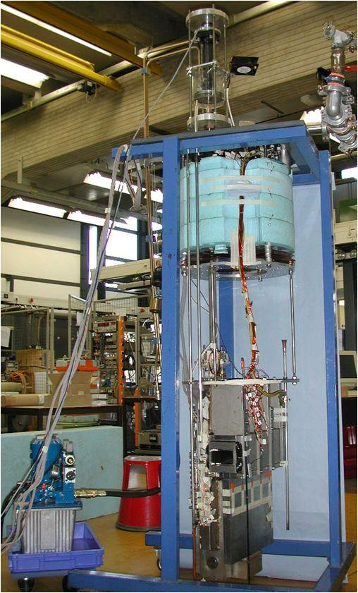
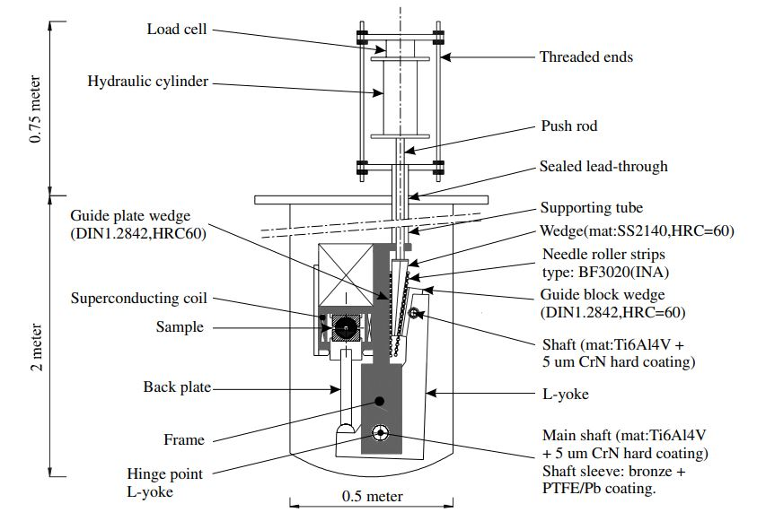
Transverse load: Twente Cable Press
Hydraulic press based on principle of lever mechanism and wedge
Sample length: 400 mm
Measuring: I_{c}, R_{c}, force, displacement and AC loss (only at 4.2 K).
T-operating temperatures: 4.2 and 77 K
UNIVERSITY OF TWENTE.
9

Slide 10
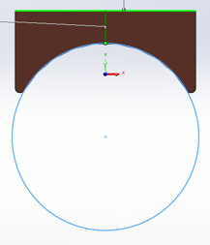
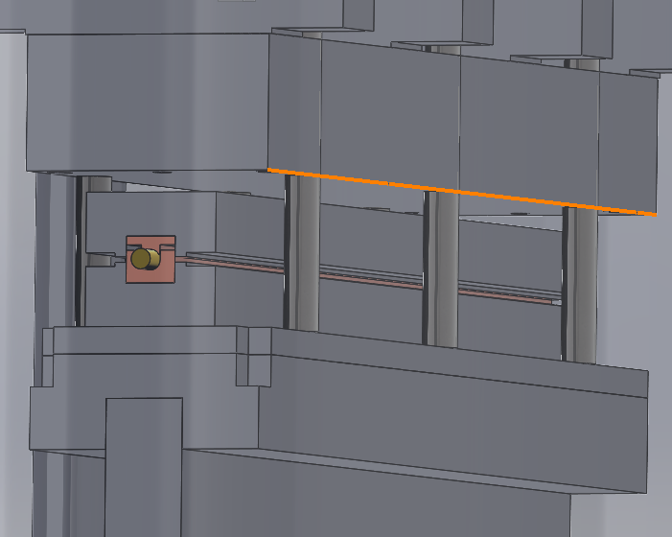
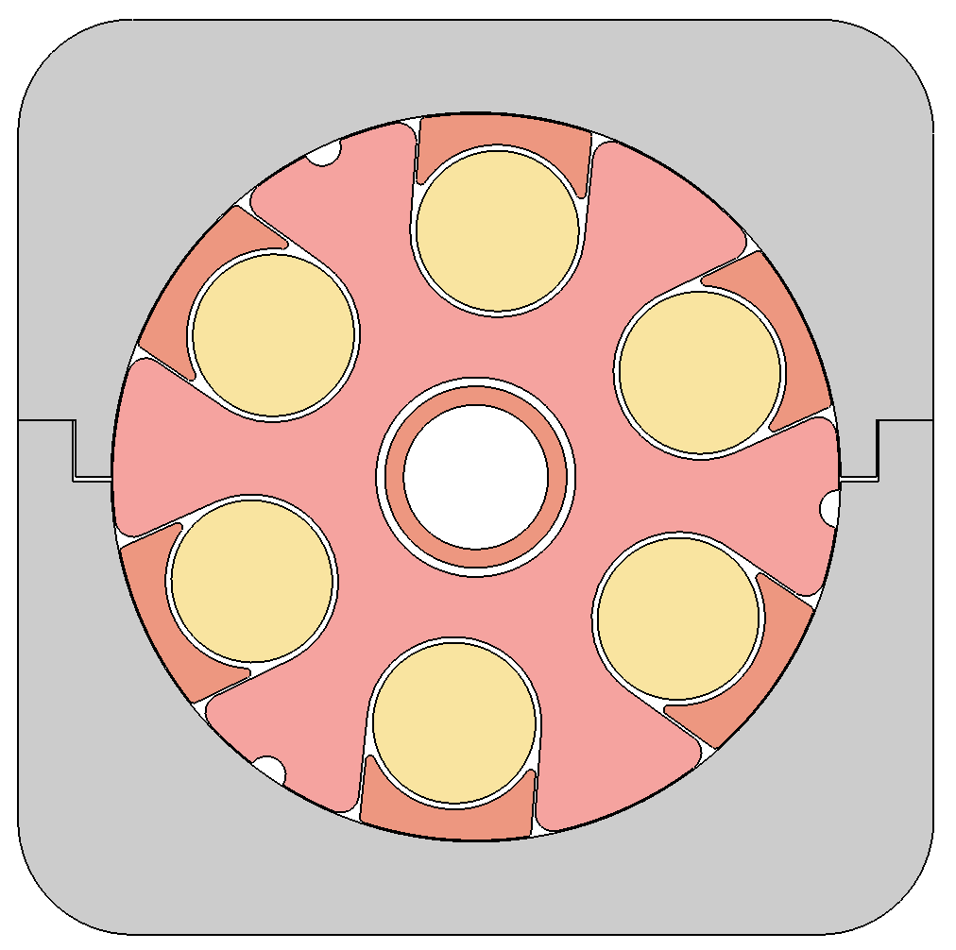
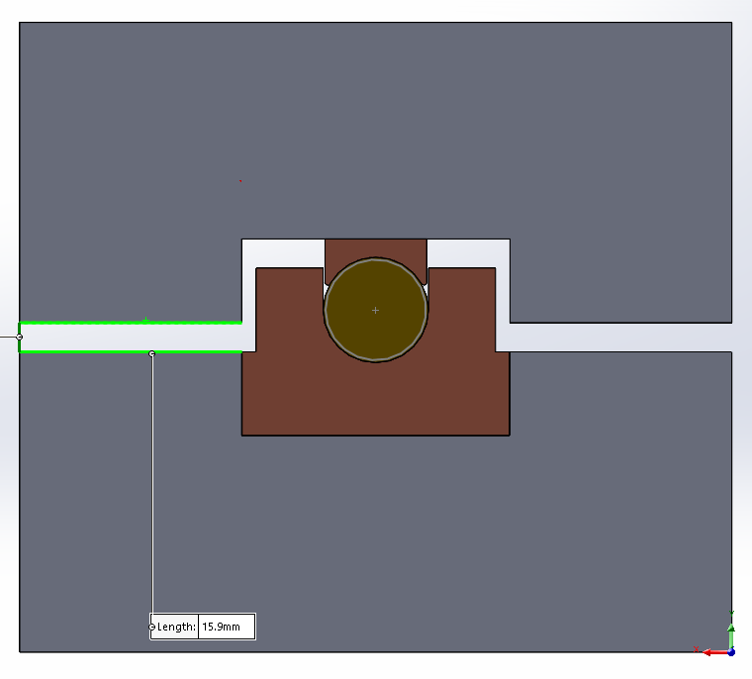
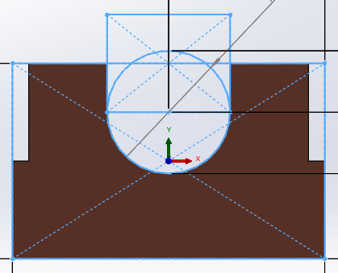
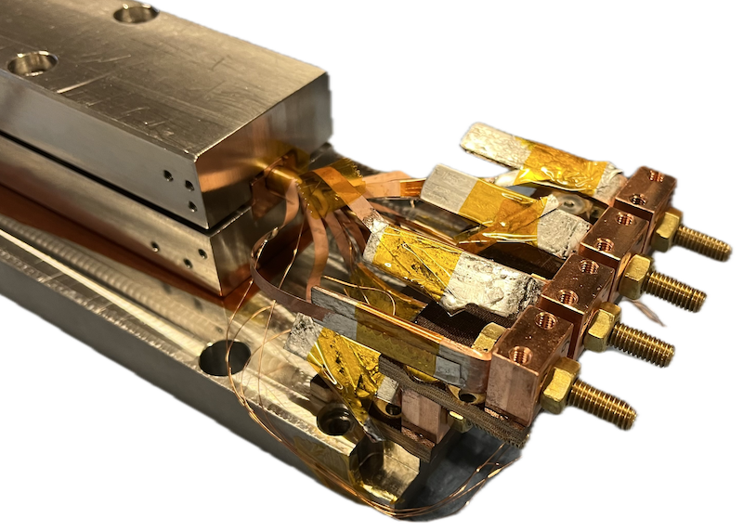
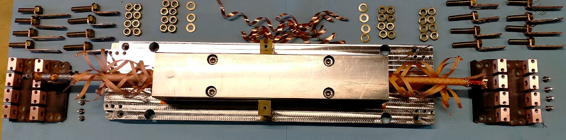

ACT CORC©-CICC Twente Press test sample
Extruded C101 Cu Keystones
Cu keystone
SS support
7 mm
OD
Central cooling tube
Machined C110 Cu support
CORC© cable used in ACT Sultan sample with 36 tapes, OD of 7.04 mm (including thin plastic tube) in groove with 7.54 mm.
Selected tapes (8) for critical current and inter-tape contact resistance measurements.
UNIVERSITY OF TWENTE.
10

Slide 11
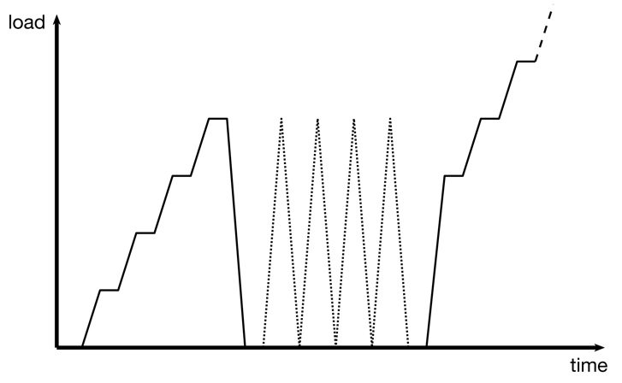
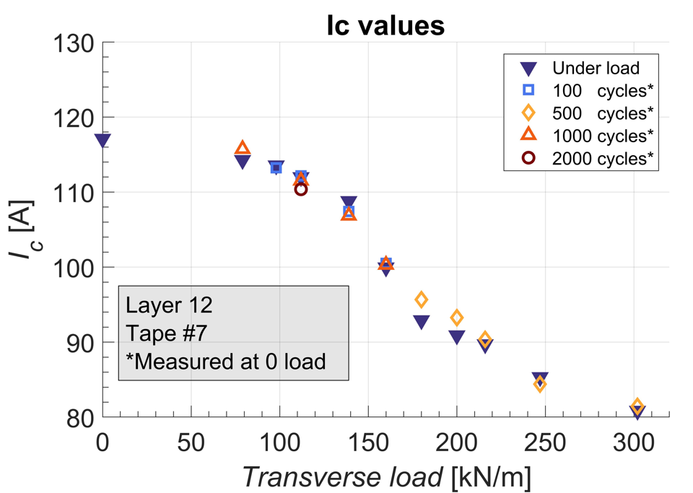
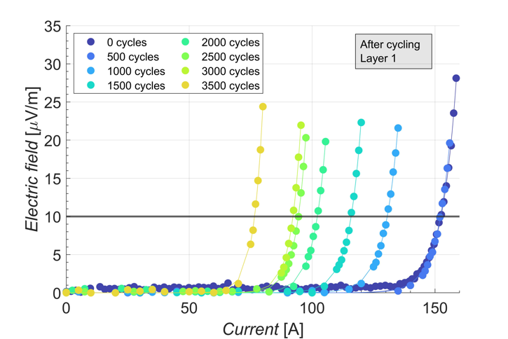
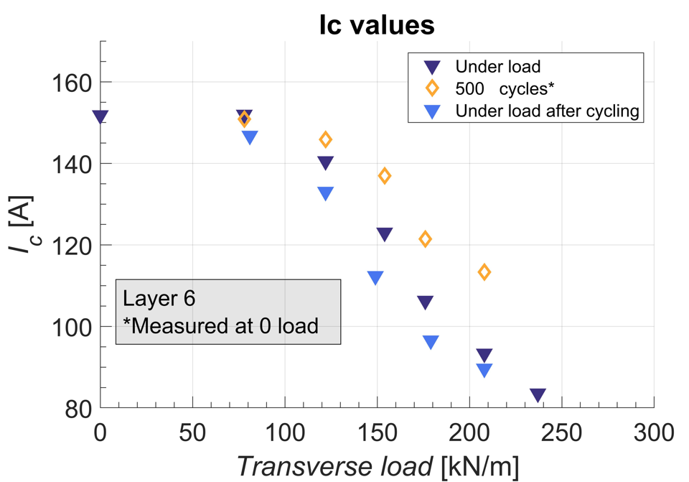
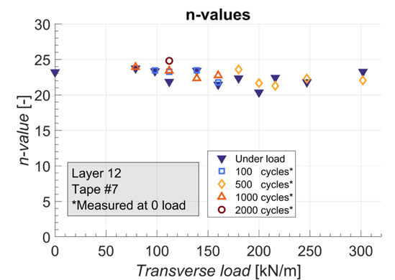
CORC© Twente Press ACT samples #1 & 2
Sub-cable parameters both samples
Tape Manufacturer | SuperPower
SC Tapes | 36
Tape width | 4 mm
Tape thickness | 63 μm
Substrate thickness | 50 μm
Copper thickness | 5 μm
Spacing | 0.5 mm
Core | Cu Rod
Core OD | 5.34mm
Strain window | [-1.3%, 0.45%]
ACT sample #1
ACT sample #2
9,000 cycles successive F-increases
(E_{c}=10 μV/m), n-value (22-21)
Irreversible degradation = critical load (CL):
Both ACT samples CL~ 100 kN/m.
UNIVERSITY OF TWENTE.
11

Slide 12
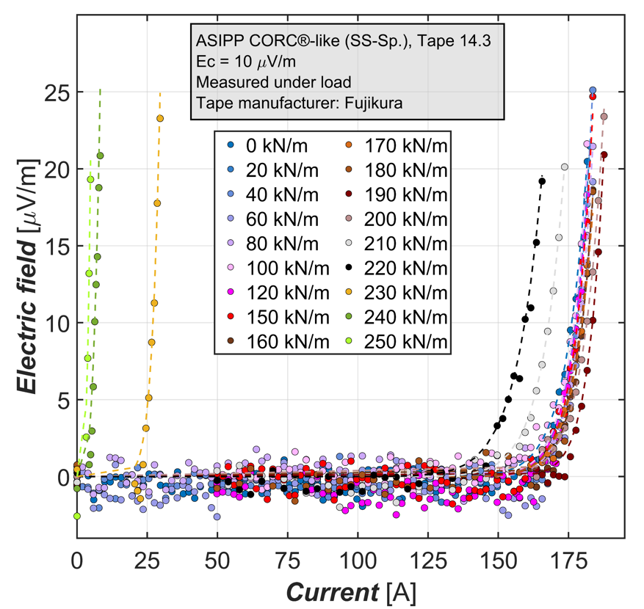
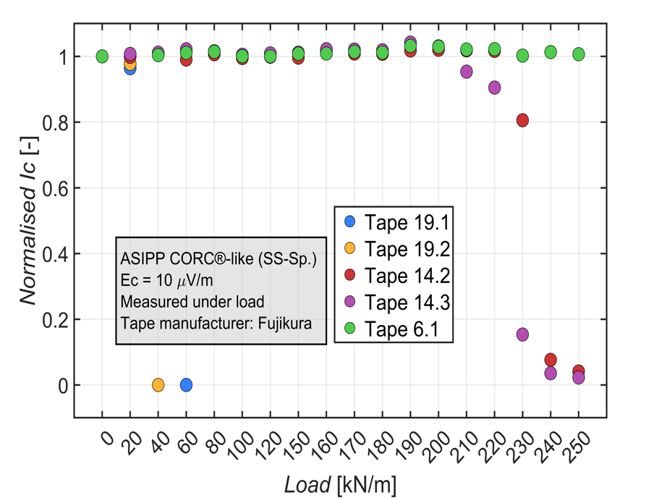
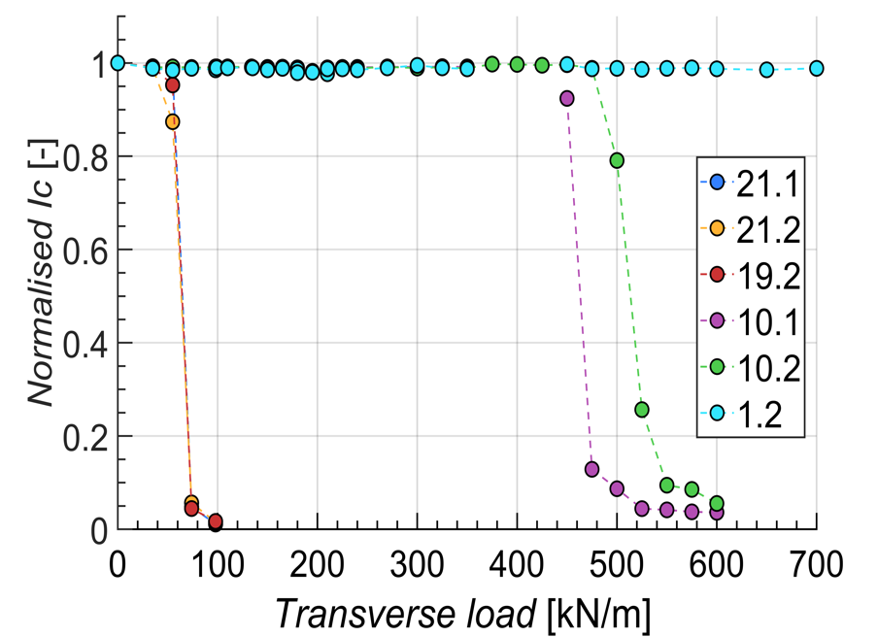

Twente Press ASIPP sample #1 & #3
Main parameters ASIPP
ASIPP Sultan # | #3 | #1
tape supplier | SSTC | SSTC
Cu Core OD | 4.0 mm | 4.6 mm
SC tape layer | 16 | 22
tape No. layer | 2x3 Cu+ SC(2x4+3x8+4x4)+4x2 Cu | SC(2x4+3x7+ 4x11)+4x1 Cu
tape No. | 48 | 73
winding angle | 33.5-49° | 36.5-56°
gap | ~0.6 mm | 0.4 mm
OD | ~8.6 mm | 9.6 mm
width | 4 mm | 4 mm
thickness | 0.1 mm | 0.1 mm
Ic @ 77K,SF | 160 -210 A | 160-190 A
ASIPP sample #3
ASIPP sample #3, degradation for spiral at 210 kN/m (x6 = 1260 kN/m). Solid core 450 kN/m (x6=2700 kN/m).
Degradation ACT samples ~ 90 kN/m < (x6 = 540 kN/m).
Main difference with ATC samples:
radius Cu profile matches to cable.
No plastic tube around cable.
Solid Cu core
ASIPP sample #1
UNIVERSITY OF TWENTE.
12

Slide 13








ACT #1 & 2, ASIPP #1 & 3 (spiral), Press F(d)
ACT #1
ACT #2
ASIPP #3
ASIPP #1
“The greater the winding pre-tension force, the smaller the helical curvature radius”
K. Wang, Y. Gao, W. Luo, Y. Zhou, A. Nijhuis, Nonlinear contact behavior of HTS tapes during pancake coiling and CORC cabling, Supercond. Sci. Technol. 34 (2021) 075003 https://doi.org/10.1088/1361-6668/abf710
12 layers
12 layers
16 layers (SS spiral)
22 layers
Two stiffness regimes:
space/layer - sample | ACT #1 | ACT #2 | ASIPP #3 | ASIPP #1
(D_{cab} – D_{core})/(2N)-t [μm] | 11.6 | 11.6 | 48 | 9.5
d_{meas}/(2N)-t [μm] | 5.0 | 6.3 | 31 | 17.0
UNIVERSITY OF TWENTE.
13

Slide 14


Outer layer damage Press test
ACT cables: tightly wound, less layers then ASIPP, Cu groove and key-stone have larger radius than cable (stress concentration). Thin plastic tube around cable.
r-Cu-groove
ASIPP cables: Inner layers withstands 800 kN/m, homogeneous contact.
More loosely wound (groove radius matches cable’s), early degradation outer squeezed tape layers (→ bending).
r-cable
Tapes are squeezed towards open space at sides.
Tapes are squeezed towards open space at sides.
Space needed for cable to “breath” due to voids from anticlastic winding effect.
Remedies:
Tighter winding of tapes to reduce voids.
Outer Cu (ASIPP) or plastic tube (ACT) for tape containment.
UNIVERSITY OF TWENTE.
14

Slide 15

Contact resistance results: R_{c}(F)
Contact resistance: initial R_{c} and after 3,000 cycles, 2 to 10 𝜇𝛺m in all conductors (under load).
R_{c} evolution with cycling in qualitative agreement (peak).
UNIVERSITY OF TWENTE.
15

Slide 16
Conductor design optimization
Single tape I_{c} – mech. load testing
Axial tensile stress, I_{c} & mech. props.
Axial tensile & compressive strain, I_{c} & ε_{irr}
Transverse
Stress σ_{irr}
Winding angle I_{c} & min. diam.
Cable cyclic load testing Twente Press
Critical current/loadI_{c}(F)
Transverse stiffness d(F)
Inter tape contact resistance R_{c}
FE cable model
Materials
Design
UNIVERSITY OF TWENTE.

Slide 17




Model validation – experimental data
ACT single CORC© experiment with transverse anvil loading.
Parameters
Tapes | 12
Layers | 6
Tape width | 3 mm
d-Tape | 44 μm
d- Substrate | 30 μm
d-Copper | 5 μm
Gap spacing | 0.5 mm
Core | Cu/SS rod
Strain window | [-1.3 %, 0.45 %]
SS core
Cu core
NCR = no current sharing between tapes.
PCR = perfect current sharing between tapes.
Good match irreversibility limits:
model versus experiment
D.C. van der Laan et al, 2018 Supercond Sci Technol 32, DOI:10.1088/1361-6668/aae8bf
D.C. van der Laan et al 2019 Supercond. Sci. Technol. 32 015002
D.C. van der Laan, private communication.
UNIVERSITY OF TWENTE.

Slide 18




ASIPP CICC MD; Gap $\sim$1 and $\sim$0.5 mm
F
F
Gap spacing = 1 mm
Gap spacing = 0.5 mm
Reducing gap reduces voids and bending - significantly improving performance.
UNIVERSITY OF TWENTE.

Slide 19


Model results – ASIPP MC single cable
ACT cable model validation results compared with 0.5 and 1.0 mm Cu tube.
Strain distribution with 0.5 mm Cu-wall thickness.
Outer copper tube around cable & solid Cu core: 500 kN/m.
UNIVERSITY OF TWENTE.

Slide 20





Mechanical & EM Load (BL)
Displacement (μm) for Mech Load and Electromagnetic Load at 200 kN/m.
Difference between body load (EM) and mechanical load (flat anvil) for different tape thicknesses and gap sizes.
Critical transverse EM load < mechanical load (30%).
UNIVERSITY OF TWENTE.
20

Slide 21









Model – ASIPP MC samples
0.6 mm gap
Modest improvement
SS spiral
Original gap 1.3 mm
Cu-keystones
SS spiral
0.6 mm gap
Cu-keystones
SS spiral
0.6 mm gap
Cu-keystones
Solid Cu core
Critical force:
MC Sultan #1: $\sim$ 400 kN/m
MC 1.3 mm gap, Cu-keystones:$\sim$ 600 kN/m
MC 0.6 mm gap, Cu-keystones: $\sim$ 1,000 kN/m
MC 0.6 mm gap, solid core:$\sim$ 1,300 kN/m
IxB CS | I [kA] | B [T] | F(IxB) [kN/m]
ASIPP | 42 | 20 | 840
EU-DEMO | 60 | 18 | 1080
UNIVERSITY OF TWENTE.
21

Slide 22
Summary
(New) setups for characterizing mechanical and electrical properties of REBCO tapes.
Round cable FE model validated.
Critical transverse load CORC®-like cables after cycling (4 samples) varies from 90 to 450 kN/m.
Observations to be further optimized for CICC with round cable:
  void fraction - winding tension – winding angle - # tape layers
  space for tape bending (breathing) and cable containment
UNIVERSITY OF TWENTE.

Slide 23
Short term plans
Testing mechanical and electrical properties of REBCO tapes different manufacturers.
Design optimization (number of layers, void fraction, tape bending etc).
Cable tests (I_{c}, R_{c}, d) under cyclic loading in Twente Press:
  ACT-cable with matching cable and Cu-groove radii.
  ASIPP-cable within Cu-tube.
  Stacked tape conductors (+ modeling).
UNIVERSITY OF TWENTE.

Slide 24
Thank you!
UNIVERSITY OF TWENTE.

Slide 25




Model results – ASIPP MC sample #1
Cu tube
Sub-cable Parameters
Tape Manufact. | Fujikura
SC Tapes | 36
Simulated Tapes | 9
Tape width | 4 mm
d-tape | 110 μm
d-substrate | 50 μm
d-copper | 23 μm
Gap spacing | 1.3/1.6 mm
Core | SS Spiral
Strain window | [-1.3, 0.29 %]
Prediction & SULTAN T_{cs} reduction coincide.
Irreversibility:
MD: $\sim$ 200 kN/m.
MC with copper tube: $\sim$ 500 kN/m.
UNIVERSITY OF TWENTE.
25

Slide 26





Model prediction - SULTAN results (ASIPP)
Tcs@40kA, 10.85T
Test in April 2023
80 kA
26

Slide 27


Inter-tape friction
Axial strain at 1000 kN/m EM load.
For ff=0.2, tapes do not move due to contact friction with tapes underneath and above.
Tapes slide due to EM load. Gap is reduced and near tape edges irreversibility limit 0.3% is exceeded.
friction factor 0.2
friction factor =zero
UNIVERSITY OF TWENTE.
27

Slide 28






Local transverse load and tape Cu-layer thickness
Critical load REBCO tape for different Cu layer thickness: 1 mm anvil width.
1 mm width pushing heads were used.
K. Ilin, K.A . Yagotintsev, C. Zhou, P. Gao, J. Kosse, S.J . Otten, W.A.J. Wessel, T.J . Haugan, D.C . van der Laan and A. Nijhuis 2015 Experiments and FE modeling of stress–strain state in RECO tape under tensile, torsional and transverse load, Supercond Sci Technol 28 055006 [10.1088/0953-2048/28/5/055006]
UNIVERSITY OF TWENTE.

Slide 29

Press testing profile
UNIVERSITY OF TWENTE.
29

