Slide 1



Pinning Mechanisms, Lengthwise Fluctuations, and Flux Jumps in REBCO Coated Conductors:
A Torque Magnetometry Study up to B = 45 T
Jan Jaroszynski
CMS/DC Field user support
NSF/DMR-1644779 and 2128556
PIs: Gregory Boebinger
and Kathleen Amm

Slide 2
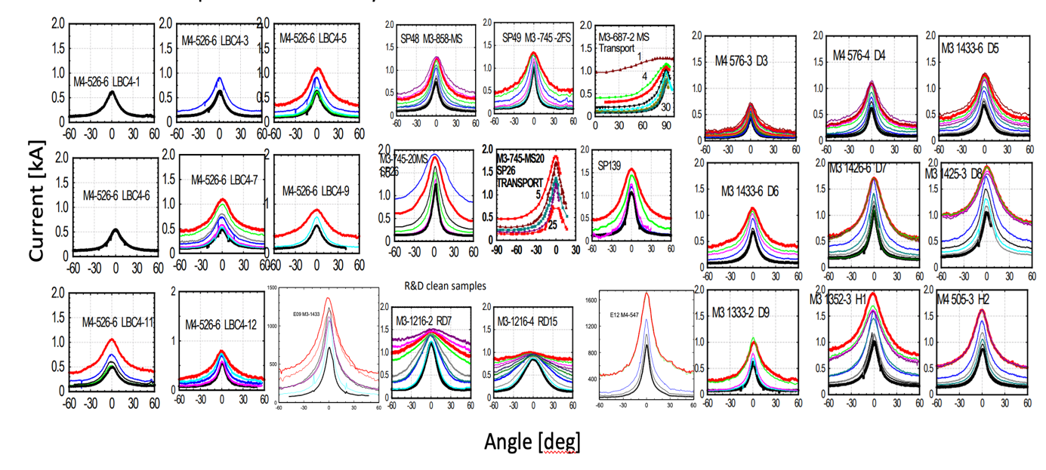
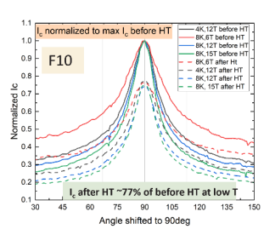
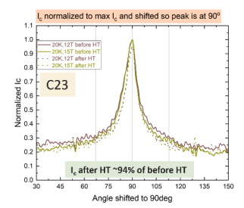
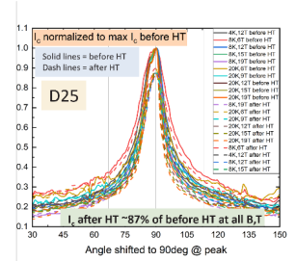
200+ samples assessed at high fields (5-31 and ≤45 T) and different temperatures
It takes ~10 min to measure Ic vs angle at one B, T

Slide 3
If you are interested we can help:
CFS
NHMFL 40 T
NHMFL LittleBigCoil
AMPeers/UT Houston
HTSI
SuperPower
Faraday (as SuperOx)
Shanghai
Fujikura
Tokamak Energy
Proxima
UKIFS
Type One Energy
and others approaching
NHMFL user program:
This four month period (Jan-May)
9 weeks of magnet time in 31 T resistive magnet
for REBCO CC, mainly torque
NHMFL users
Next application deadline:
March 21st
jaroszy@magnet.fsu.edu

Slide 4
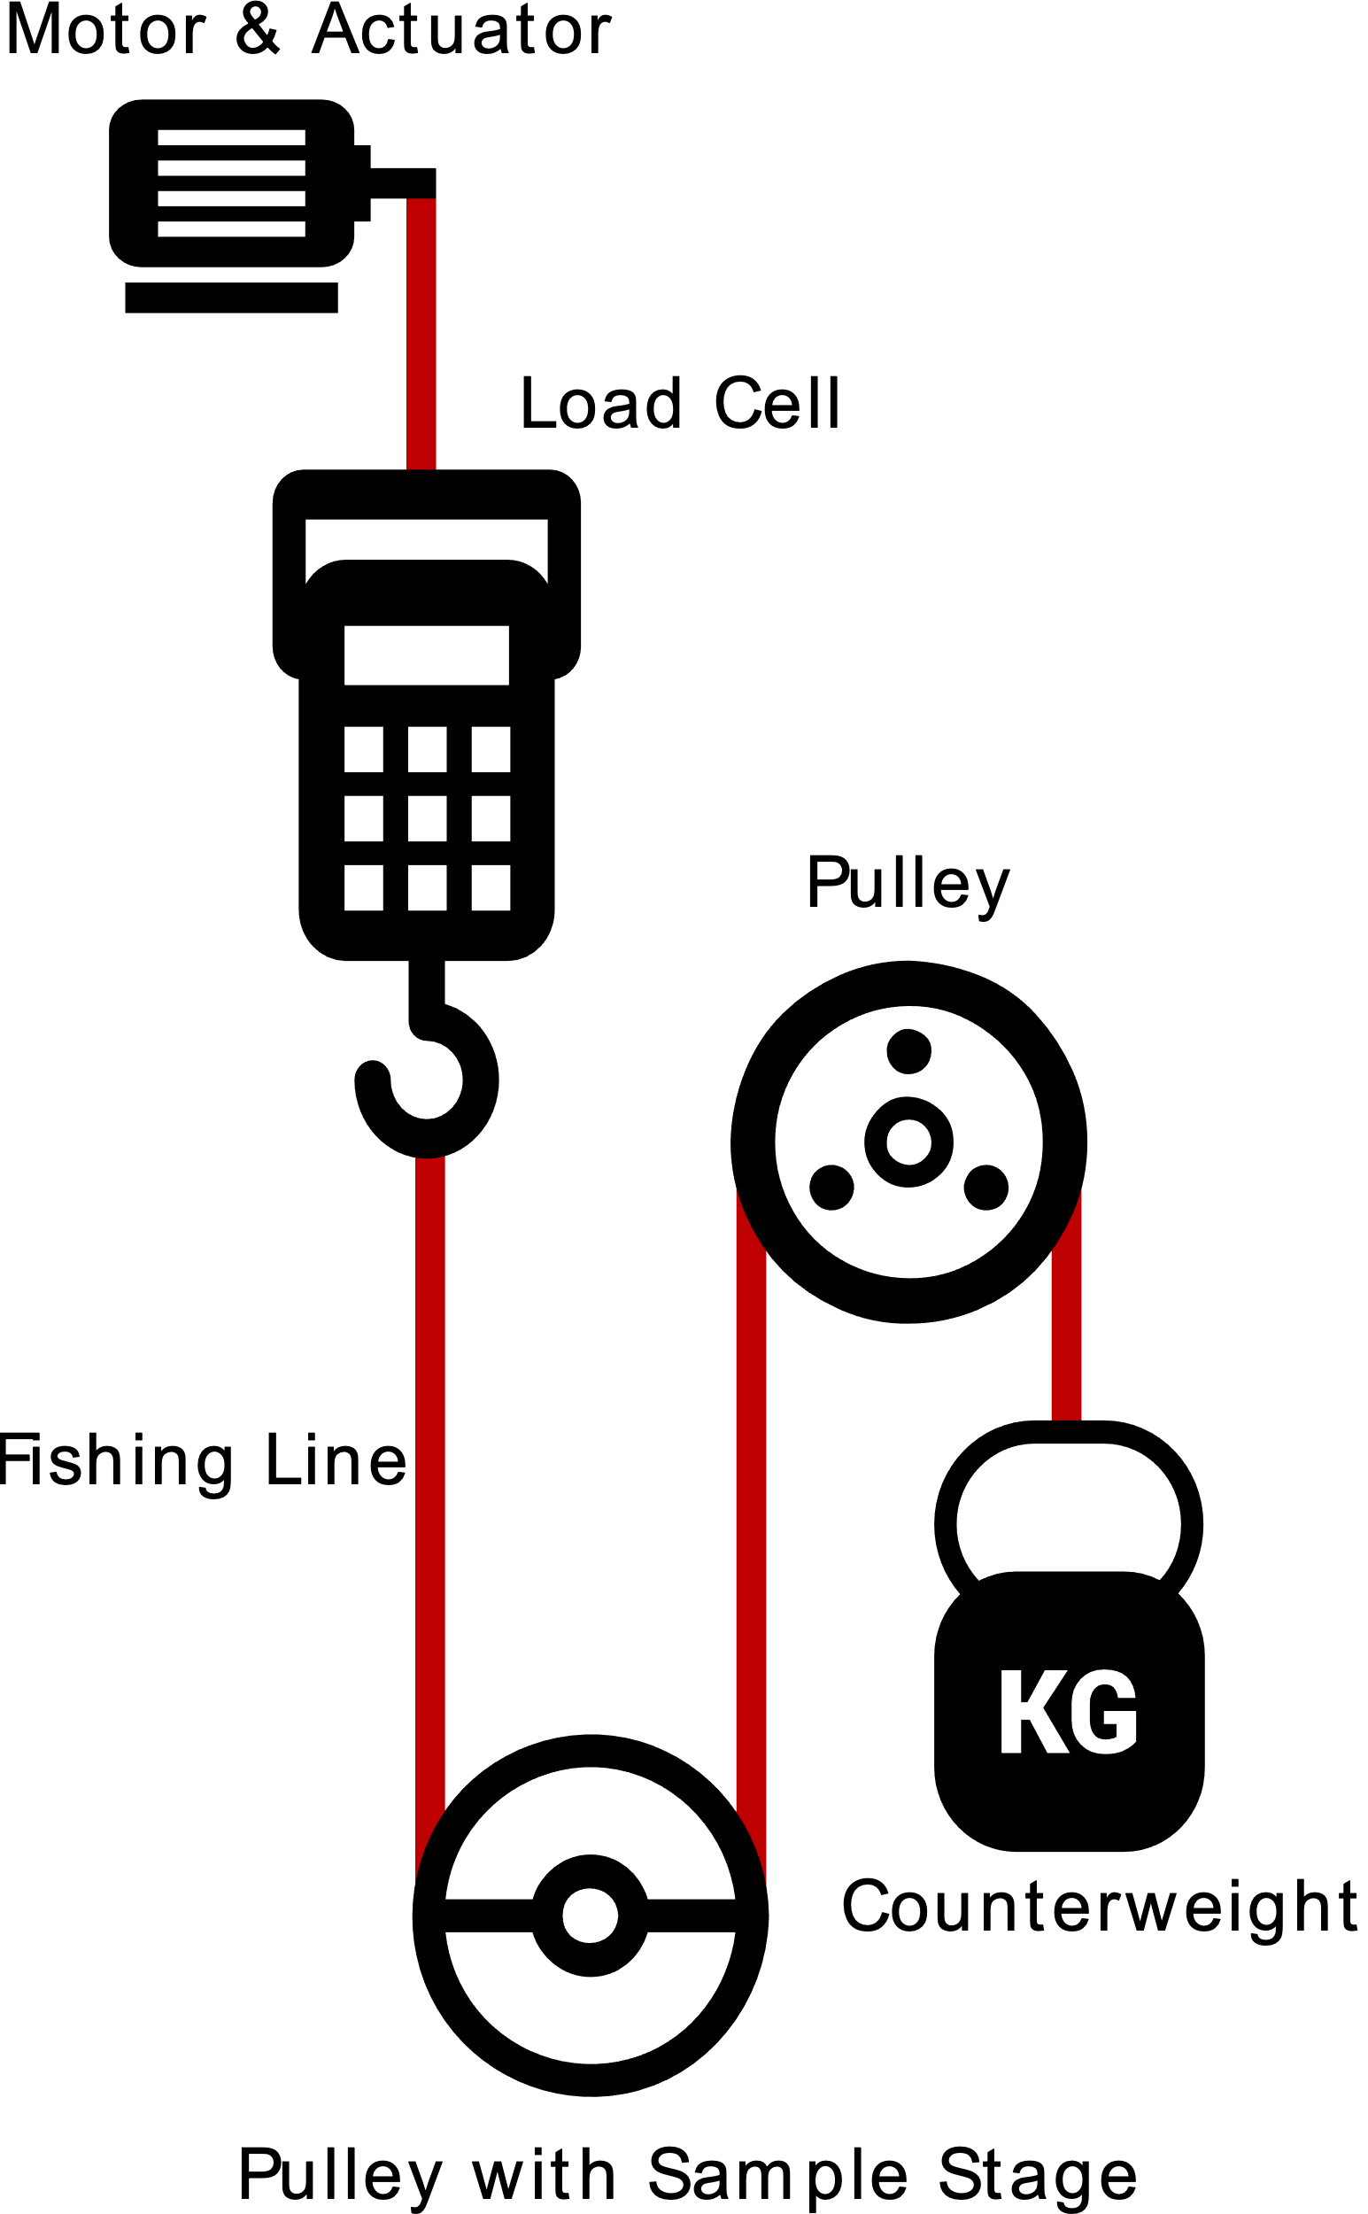
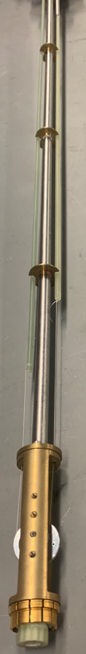
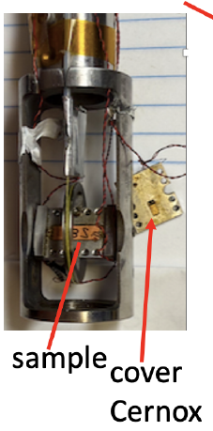
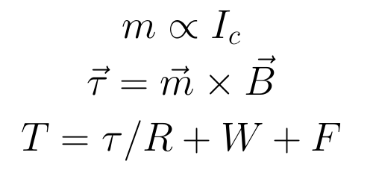
Torque magnetometer
Griffin’s
View:
screening currents,
=> magnetic moment m
PPMS version
J. Jaroszynski, A-M Constantinescu, A. Xu, A. Francis, G. Miller, T. Murphy, and D. Larbalestier SuST 2022, arXiv 2025
US Patent 12,181,540

Slide 5
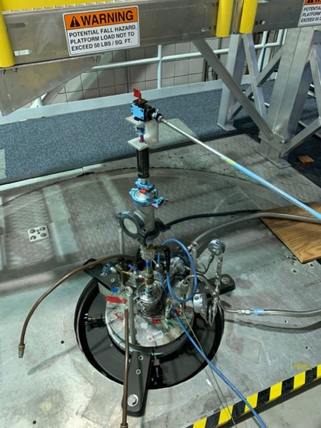
5 - 45 T measurements: no change in trend
B||ab
60° off ab
In the 45 T hybrid magnet

Slide 6


vs. T: exponential, stretched exponential around the ab plane
$\sim exp[$-(T/T₊)^{n}$] strong$
$\sim exp$(-T/T₀) weak
6
6
6

Slide 7
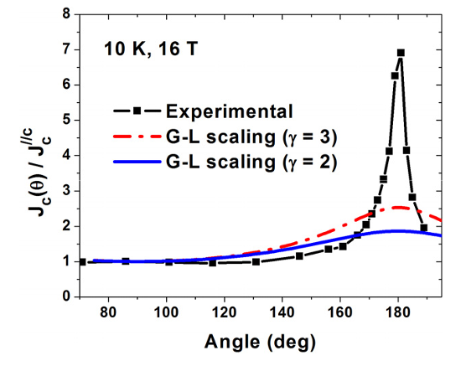
Weak and strong pinning separation
there is no shortage of options for fitting Ic!
Z. Chen et al. 2009

Slide 8
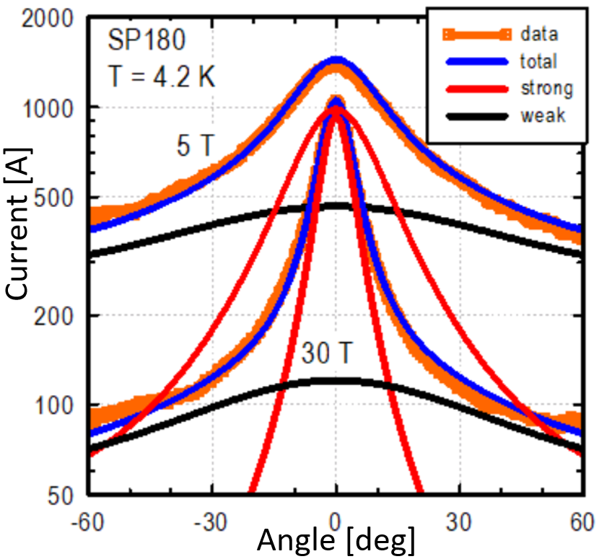
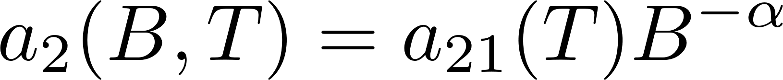
Weak and strong pinning:
Multi component fits:
strong
weak
=> N.M. Strickland et al. 2022, N.J. Long et al. 2013

Slide 9
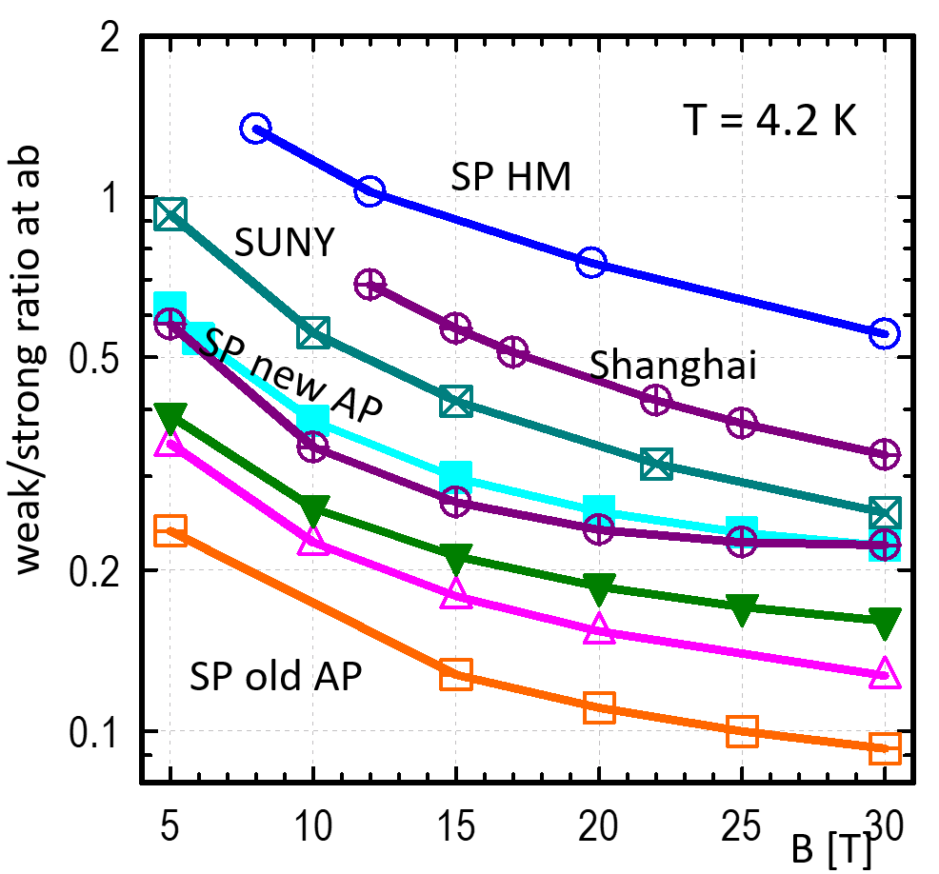
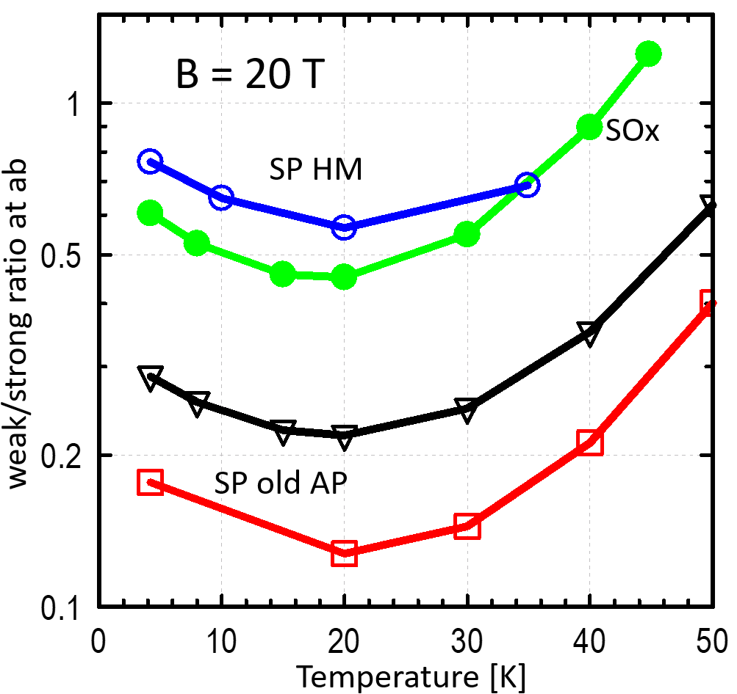
More weak pinning in recent production!
weak/strong pinning ratios in old/new production:
B||ab
B||ab

Slide 10
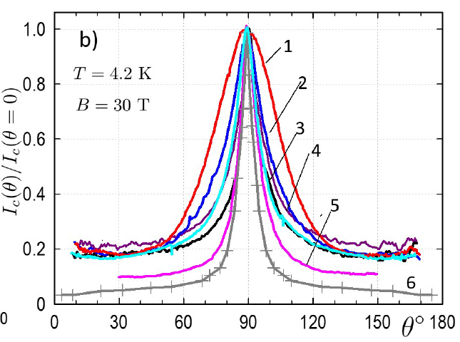
All modern samples: low anisotropy ~5
MORE WEAK PINNING
1. 15 % BZO R&D
2-4 typical modern production
(Shanghai, FF, SuperPower)
5-6 SuperPower: old AP and no BZO
Low (~5) anisotropy and wide peak
are typical nowadays: more weak pinning

Slide 11
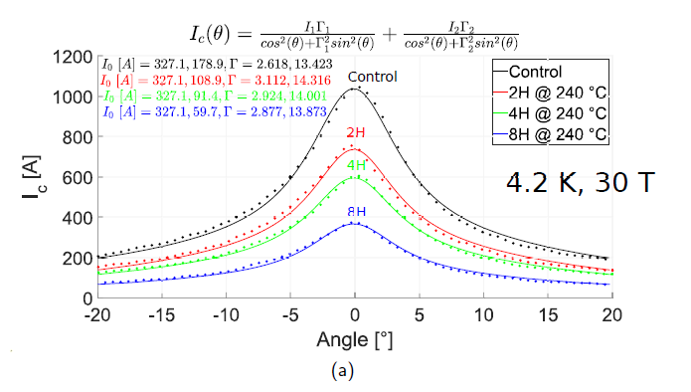
Strong pinning can be modified:
More heat time
weak
strong
G. Bradford PhD thesis, heat treatment:

Slide 12
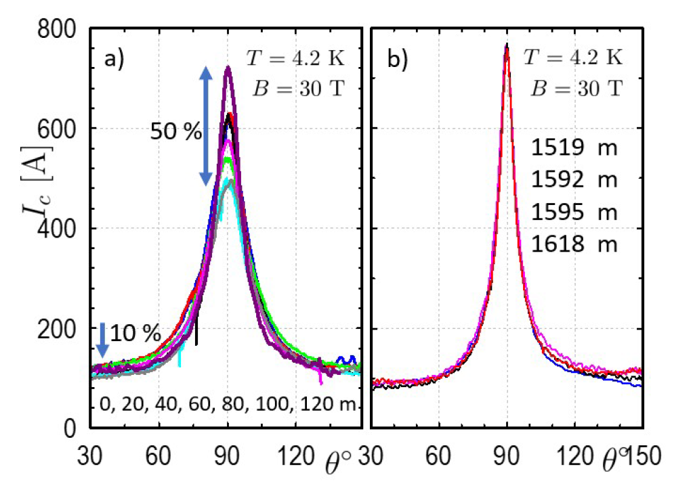
Lengthwise Ic variations: strong pinning mainly
edge slit
large variations at the ab plane
(strong pinning)
stronger at edge slit
different slitting? 2-4-4-2
central slit
12 mm
edge
4-4-4
central
2-4-4-2

Slide 13
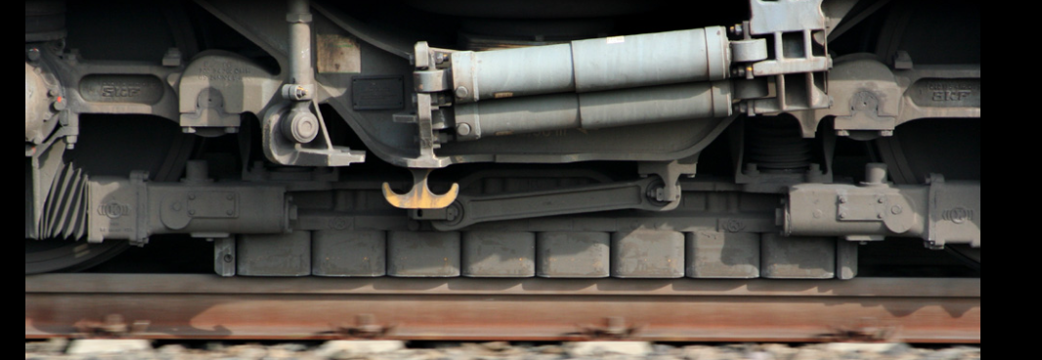
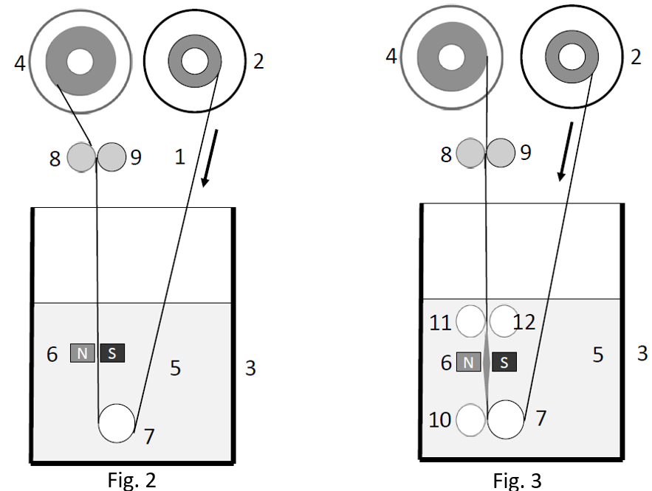
Force/torque reel-to-reel magnetometer at T=20 K B=5 T
no clear correspondence between 77 K and low T
Like eddy current brakes
Patent pending
13
13
13

Slide 14
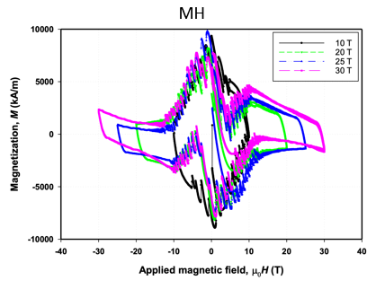
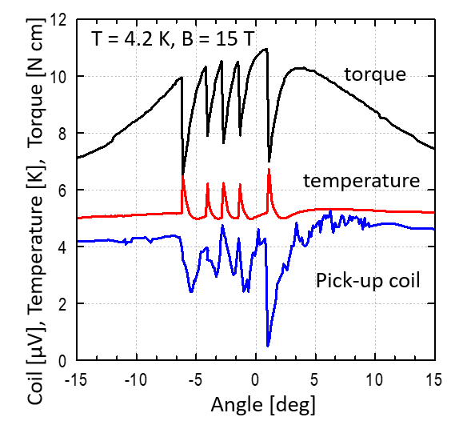
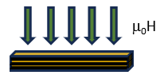

Flux jumps in thick samples
B||c
single sample:
rotation in field
60 sample stack
Field sweep
T. Grag et al. IEEE TAS 35 (2025)

Slide 15






Many thanks:
Anca-Monia
Constantinescu
2014-2017, 2022
Aixia Xu
2007-2012
2021->
Valeria Braccini
2009-2010
Ashleigh Francis
2020-2023
Griffin Bradford, Jun Lu, Rastislav Ries
George Miller, Tim Murphy, and David Larbalestier
NHMFL User Collaboration Grants Program
-Fast fatigue and current assessment in REBCO coated conductors
-Advancing lengthwise assessment of REBCO tapes using force
magnetometry
NSF/DMR-1644779 and 2128556
PI: Gregory Boebinger and Kathleen Amm

Slide 16
SUMMARY
torque magnetometry: massive angular Ic(B,T,θ) characterization
phenomenology of angular Ic at low T becomes quite clear
in modern samples weak pinning dominates=> low anisotropy
lengthwise fluctuation: at the edges, mainly strong pinning at ab
heat treatment modifies anisotropy and lengthwise changes
flux jumps observed in thick REBCO films

