Slide 1



Welcome back !

Slide 2
Technical visit
We are preparing a visit to CERN technical and historical accelerator infrastructure for:
Friday 14 March, 8:30 – 11:00
You can register on the indico site of the CCA (https://indico.cern.ch/event/1347361/), and you will receive a mail from the local organizers pointing to the form
We have capacity for 30 visitors in 3 groups.
Register swiftly to secure your place !

Slide 3

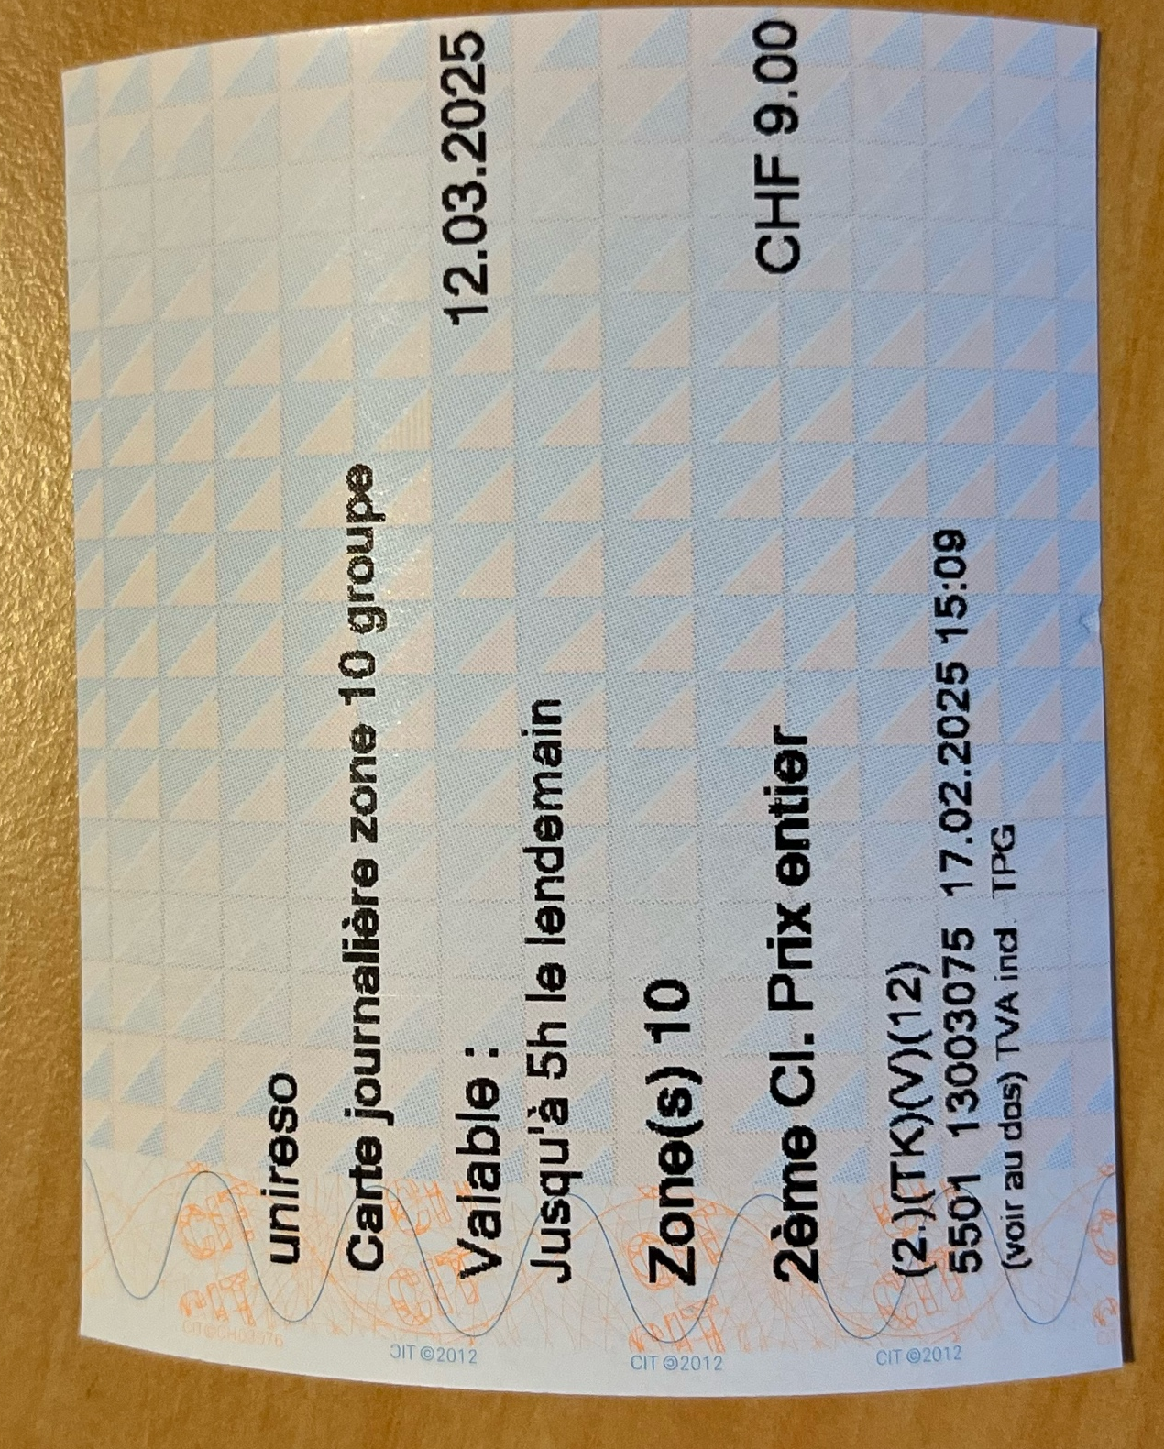
Social dinner
The CCA-2025 social dinner will take place on
Wednesday 13th March 2024 7:30 PM
at
Edelweiss Restaurant in Geneva.
Please bring your meeting badge with you
For those departing from CERN, we advise you to take the tram 18 from CERN to Gare Cornavin, then walk 10 minutes to the restaurant. The journey takes around 35 minutes.
We will meet at 6.30 on the Esplanade des Particules (in front of the tram stop) to take the 6.41 PM tram and go together to the restaurant.

