Slide 2
https://indico.cern.ch/event/1426610/
Thu, 4 Jul 2024
Time and duration : Doors open at 7.00 p.m. Event starts at 7.30 p.m. Duration: 2h
• Location: Auditorium Sergio Marchionne, CERN Science Gateway
• Admission: Free of charge, but registration is required for in-person attendance.
• Refreshments: At the Big Bang Café until 7.30 p.m.
https://indico.cern.ch/event/1426610/registrations/106599/

Slide 3
Oliver:
My question is whether or not systematic miss classification of events is a large problem in particle detectors. And if so, what the major sources of miss classification are ?

Slide 4
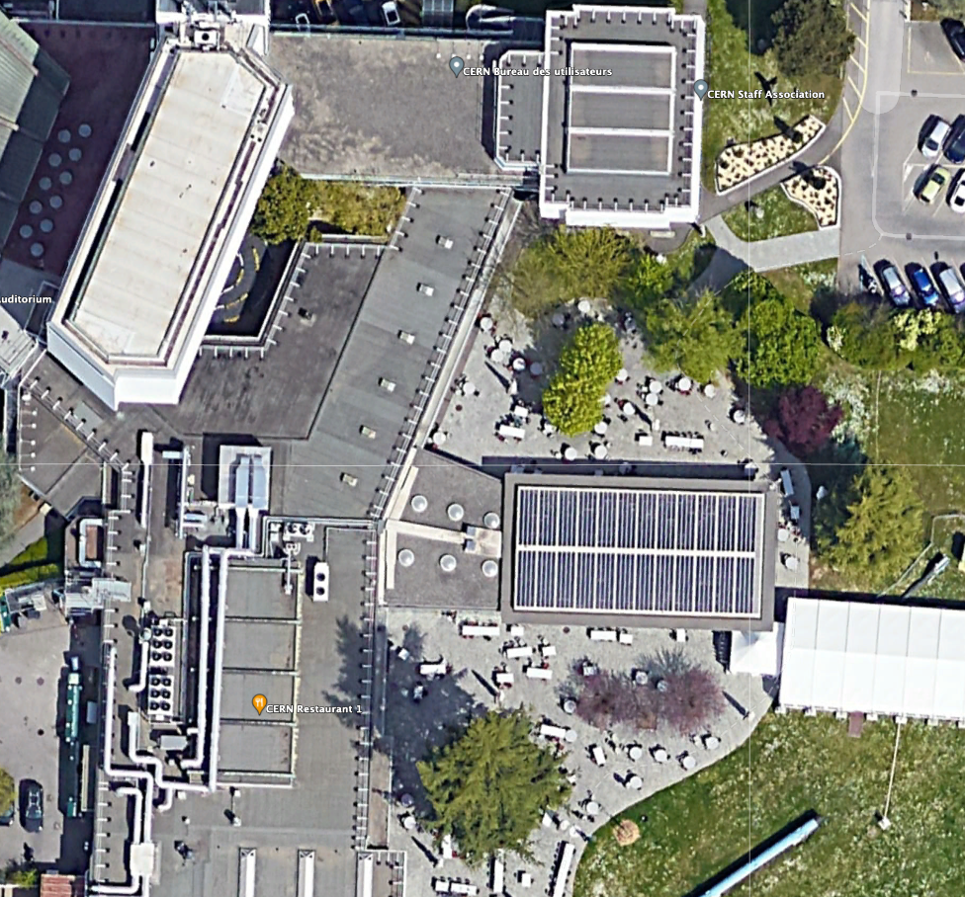
Tomorrow (Friday) 14:30

Slide 5
Particle Detectors
Summer Student Lectures 2024
Werner Riegler, CERN, werner.riegler@cern.ch
History of Instrumentation ↔ History of Particle Physics
The ‘Real’ World of Particles
Interaction of Particles with Matter
Tracking Detectors, Calorimeters, Particle Identification
Detector Systems

Slide 6
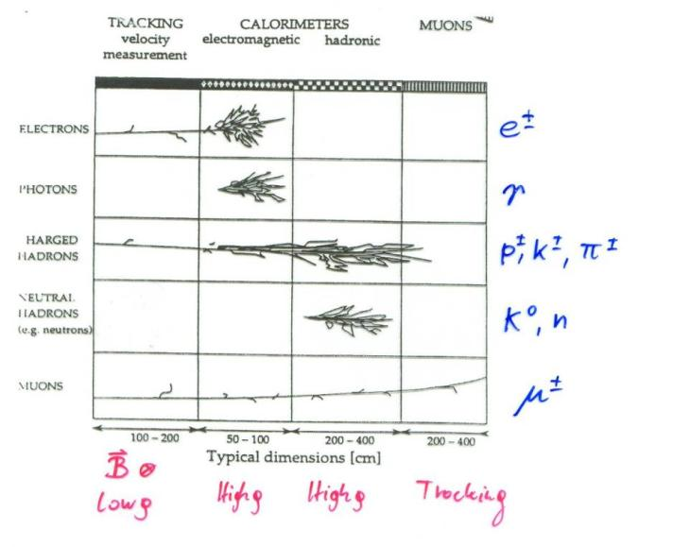
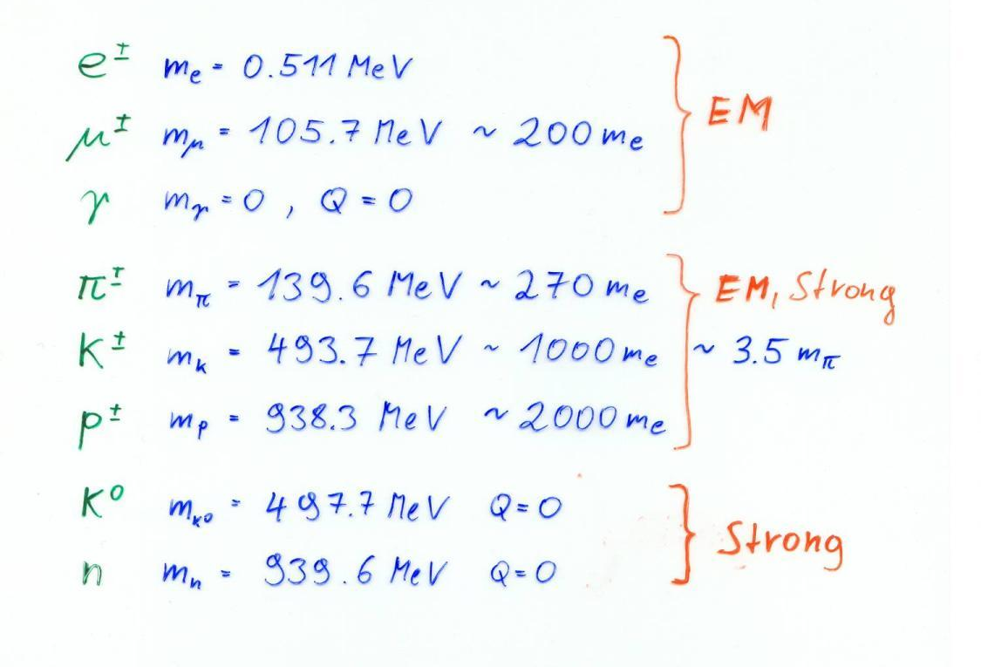
We have to know the details about all interactions to design our detectors !

Slide 7
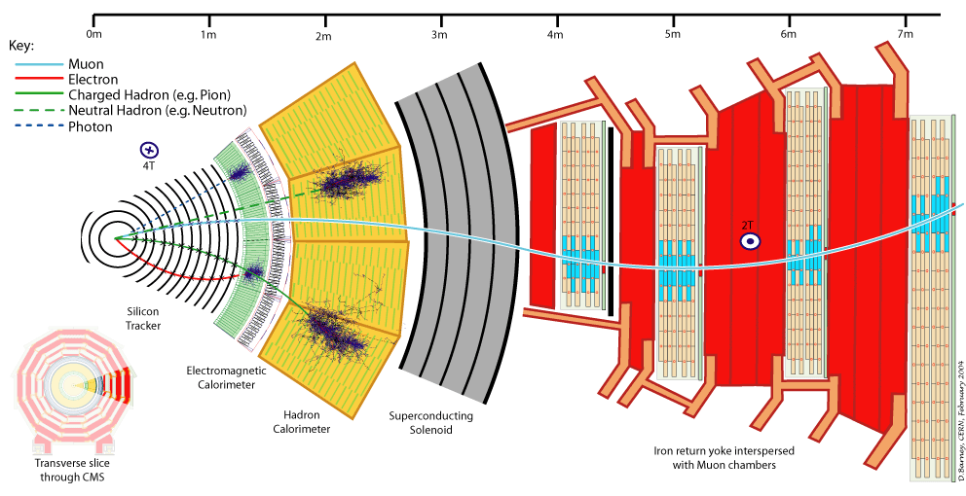

Slide 8
Detector Physics
Precise knowledge of the processes leading to signals in particle detectors is necessary.
The detectors are nowadays working close to the limits of theoretically achievable measurement accuracy – even in large systems.
Due to available computing power, detectors can be simulated to within 5-10% of reality, based on the fundamental microphysics processes (atomic and nuclear cross-sections).

Slide 9
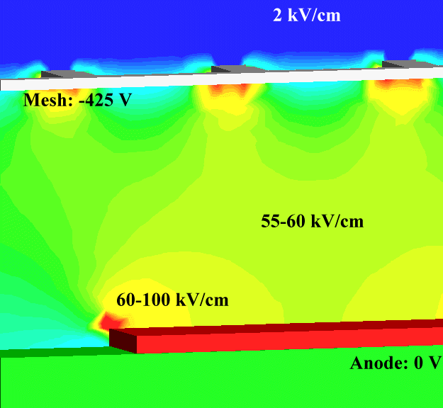
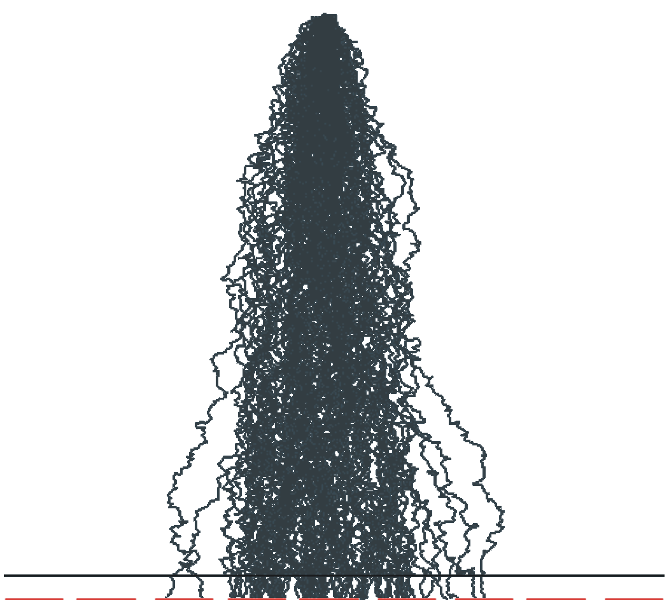
Particle Detector Simulation
CMS detector simulation GEANT
ATLAS detector simulation GEANT
Electrons avalanche multiplication, GARFIELD++
Electric Fields in a Micromega detector, e.g. COMSOL
Silicon sensor simulation, TCAD

Slide 10
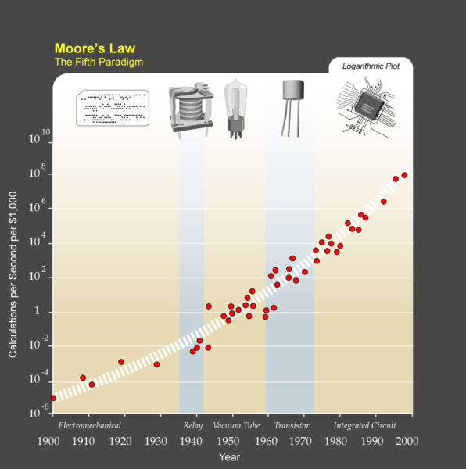
Particle Detector Simulation
I) C. Moore’s Law:
Computing power doubles 18 months.
II) W. Riegler’s Law:
The use of brain power for solving a problem is inversely proportional to the available computing power.
→ I) + II) = ...
Knowing the basics of particle detectors is essential …

Slide 11
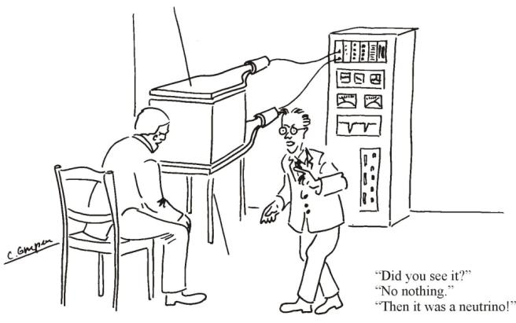
Interaction of Particles with Matter
Any device that is to detect a particle must interact with it in some way → almost …
In many experiments neutrinos are measured by missing transverse momentum.
E.g. e⁺e⁻ collider. P_{tot}=0,
If the Σ p_{i} of all collision products is ≠0 → neutrino escaped.
Claus Grupen, Particle Detectors, Cambridge University Press, Cambridge 1996 (455 pp. ISBN 0-521-55216-8)

Slide 12
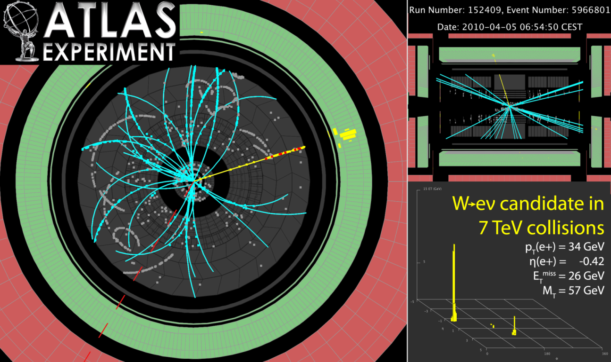
Neutrinos and other invisible particles
They are seen by missing momentum vectors – if you are sure your detector is hermetic !

Slide 13
Electromagnetic Interaction of Particles with Matter
Z₂ electrons, q=-e₀
M, q=Z₁ e₀
Interaction with the atomic electrons. The incoming particle loses energy and the atoms are excited or ionized.
Interaction with the atomic nucleus. The particle is deflected (scattered) causing multiple scattering of the particle in the material. During this scattering a Bremsstrahlung photon can be emitted.
In case the particle’s velocity is larger than the velocity of light in the medium, the resulting EM shockwave manifests itself as Cherenkov Radiation. When the particle crosses the boundary between two media, there is a probability of the order of 1% to produced and X ray photon, called Transition radiation.

Slide 14
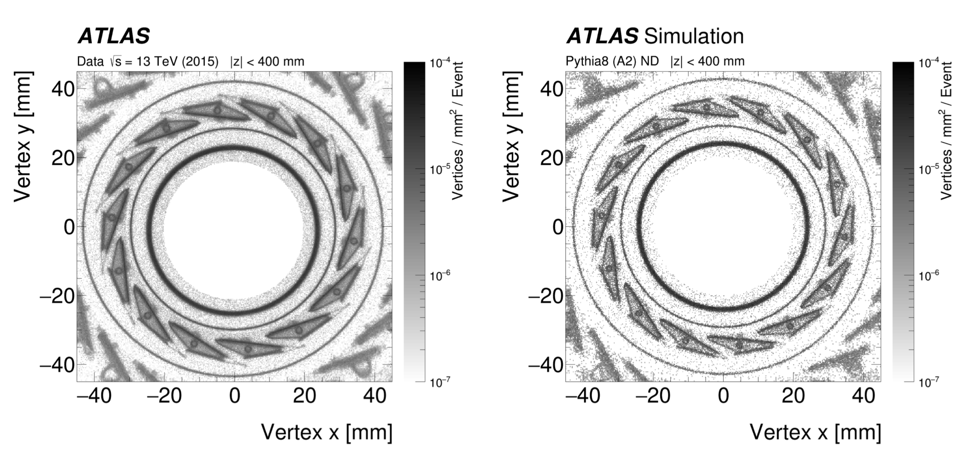
Hadronic Interaction of Particles with Matter
Z₂ electrons, q=-e₀
M, q=Z₁ e₀
Hadronic interactions with the nuclei produce a complex sequence of secondary particles. This is at the basis of hadron calorimetry.
Hadronic interactions taking place in the trackers are of course having bad an impact on the tracker measurements !
Tracing back these secondary particles to their origin gives the place of interaction. Making a map of these points we can image our detectors !

Slide 15
Electromagnetic Interaction of Particles with Matter
Z₂ electrons, q=-e₀
M, q=Z₁ e₀
Interaction with the atomic nucleus. The particle is deflected (scattered) causing multiple scattering of the particle in the material. During this scattering a Bremsstrahlung photon can be emitted.
In case the particle’s velocity is larger than the velocity of light in the medium, the resulting EM shockwave manifests itself as Cherenkov Radiation. When the particle crosses the boundary between two media, there is a probability of the order of 1% to produced and X ray photon, called Transition radiation.
Interaction with the atomic electrons. The incoming particle loses energy and the atoms are excited or ionized.

Slide 16
Ionization and Excitation
The charged particles leave a trail of excited and ionized atoms.
The electrons and holes produced in these interactions do themselves have sufficient energy ionize the gas or solid, but because there energy is small the loose all their energy over a very small distance, so in we get a trail of ionization-clusters along the way.
The de-excitation of the excited atoms and the movement of the electrons/holes/ions in electric field are the basis for signals in our particle detectors.
Let’s make a more quantitative assessment of this …
Electrons and ions in gases
Electrons and holes in solids
Primary interactions
Clusters of ionization

Slide 17



Ionization and Excitation
F
b
x
While the charged particle is passing another charged particle, the Coulomb Force is acting, resulting in momentum transfer
The relativistic form of the transverse electric field doesn’t change the momentum transfer. The transverse field is stronger, but the time of action is shorter
The transferred energy is then
→ The incoming particle transfer energy only (mostly) to the atomic electrons !

Slide 18


Ionization and Excitation
Target material: mass A, Z₂, density ρ [g/cm³], Avogadro number N_{A}
A gramm → N_{A} Atoms: Number of atoms/cm³ n_{a} =N_{A} ρ/A [1/cm³]
Number of electrons/cm³ n_{e} =N_{A} ρZ₂/A [1/cm³]
With ΔE(b) → db/b = -1/2 dE/E → E_{max}= ΔE(b_{min}) E_{min} = ΔE(b_{max})
E_{min} ≈ I (Ionization Energy)

Slide 19









Relativistic Collision Kinematics, E_{max}
θ
φ
1)
2)
1+2)

Slide 20
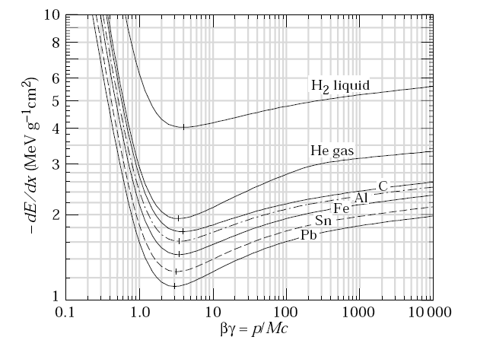
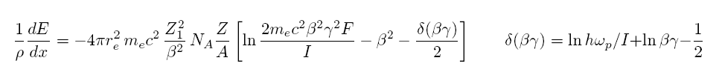
Classical Scattering on Free Electrons
This formula is up to a factor 2 and the density effect identical to the precise QM derivation →
Bethe Bloch Formula
1/ρ
Density effect. Medium is polarized
Which reduces the log. rise.
Electron Spin

Slide 21
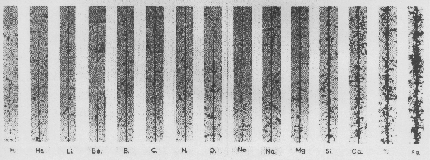
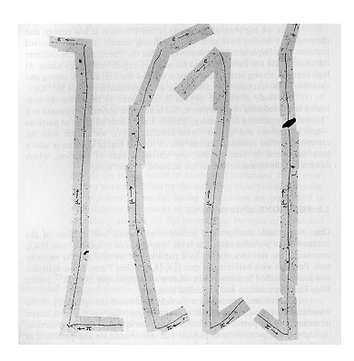
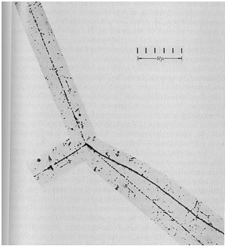
Bethe-Bloch formula
Small energy loss
→ Fast Particle
Cosmis rays: dE/dx α Z²
Small energy loss
→ Fast particle
Pion
Large energy loss
→ Slow particle
Pion
Discovery of muon and pion
Kaon
Pion

Slide 22
Bethe-Bloch formula
Bethe Bloch Formula, a few Numbers:
For Z ≈ 0.5 A
1/ρ dE/dx ≈ 1.4 MeV cm ²/g for ßγ ≈ 3
Example:
Iron: Thickness = 100 cm; ρ = 7.87 g/cm³
dE ≈ 1.4 * 100* 7.87 = 1102 MeV
→ A 1 GeV Muon can traverse 1m of Iron
1/ρ

Slide 23
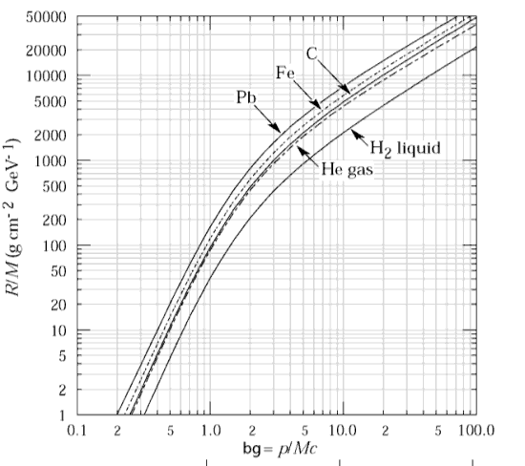

Range of Particles in Matter
Particle of mass M and kinetic Energy E₀ enters matter and looses energy until it comes to rest at distance R.
independent of the material
Bragg Peak:
For βγ>3 the energy loss is ≈ constant (Fermi Plateau)
If the energy of the particle falls below βγ=3 the energy loss rises as 1/β²
Towards the end of the track the energy loss is largest → Cancer Therapy.

Slide 24
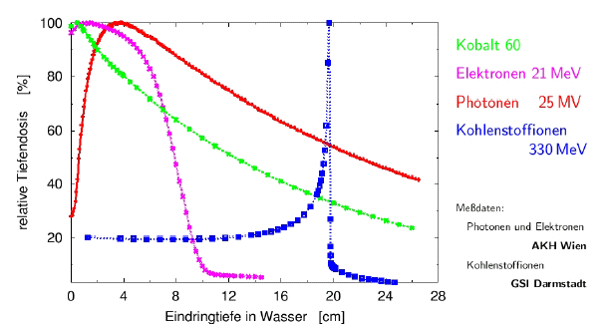
Range of Particles in Matter
Average Range:
Towards the end of the track the energy loss is largest → Bragg Peak → Cancer Therapy
Photons 25MeV
Carbon Ions 330MeV
Relative Dose (%)
Depth of Water (cm)

Slide 25
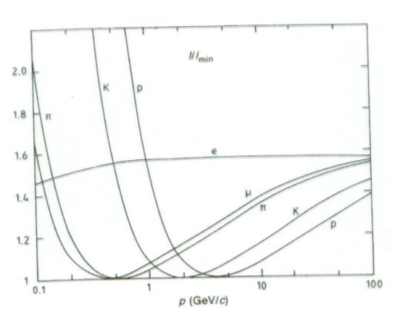
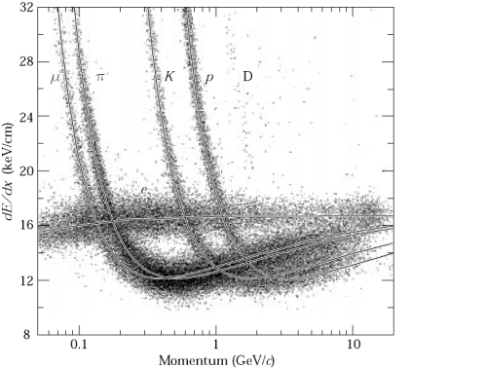
Energy loss as a function of the momentum
Energy loss depends on the particle velocity and is ≈ independent of the particle’s mass M.
The energy loss as a function of particle
momentum p = Mcβγ IS however
depending on the particle’s mass
By measuring the particle momentum
(deflection in the magnetic field) and
measurement of the energy loss on can
measure the particle mass
→ Particle Identification !

Slide 26
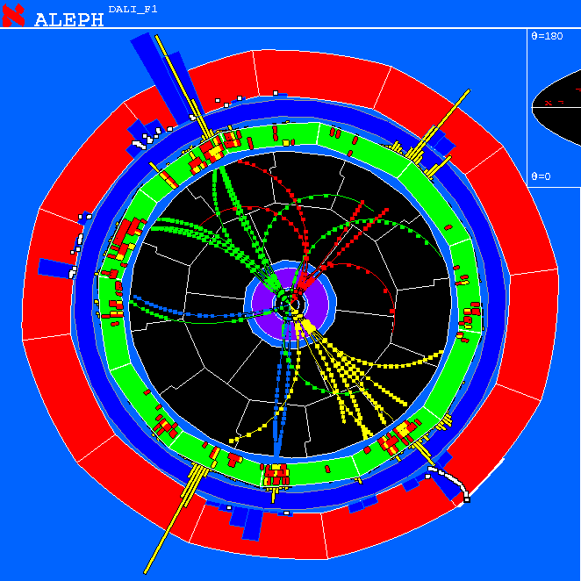
Energy loss as a function of the momentum
Measure momentum by curvature of the particle track.
Find dE/dx by measuring the deposited charge along the track.
→Particle ID

Slide 27
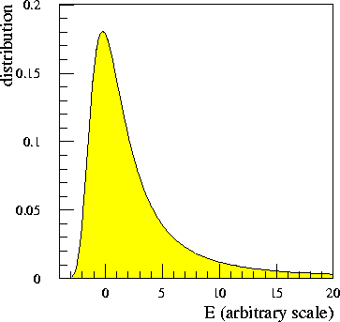
Landau Distribution
P(Δ): Probability for energy loss Δ in matter of thickness D.
Landau distribution is very asymmetric.
Average and most probable energy loss must be distinguished !
Measured Energy Loss is usually smaller that the real energy loss:
3 GeV Pion: E’_{max} = 450MeV → A 450 MeV Electron usually leaves the detector.

Slide 28
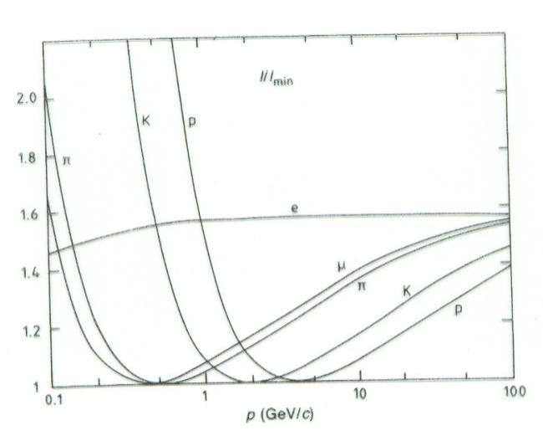

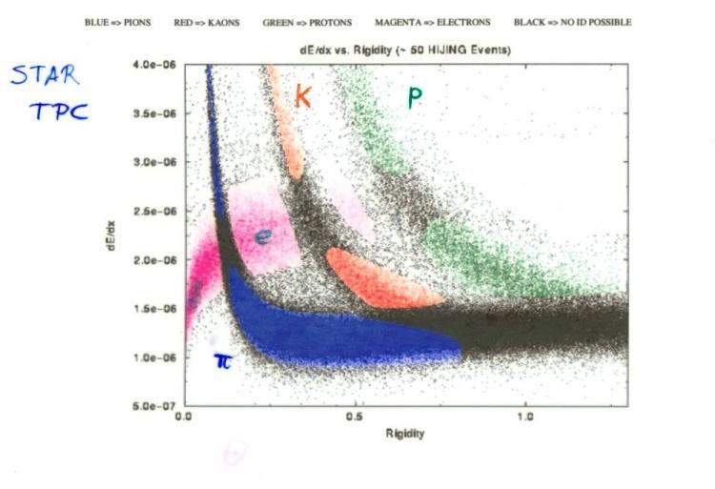
Particle Identification
Measured energy loss
‘average’ energy loss
In certain momentum ranges, particles can be identified by measuring the energy loss.

Slide 29
Electromagnetic Interaction of Particles with Matter
Z₂ electrons, q=-e₀
M, q=Z₁ e₀
Interaction with the atomic nucleus. The particle is deflected (scattered) causing multiple scattering of the particle in the material. During this scattering a Bremsstrahlung photon can be emitted.
In case the particle’s velocity is larger than the velocity of light in the medium, the resulting EM shockwave manifests itself as Cherenkov Radiation. When the particle crosses the boundary between two media, there is a probability of the order of 1% to produced and X ray photon, called Transition radiation.
Interaction with the atomic electrons. The incoming particle loses energy and the atoms are excited or ionized.

Slide 30
Bremsstrahlung
A charged particle of mass M and charge q=Z₁e is deflected by a nucleus of charge Ze which is partially ‘shielded’ by the electrons. During this deflection the charge is ‘accelerated’ and it therefore radiated → Bremsstrahlung.
Z₂ electrons, q=-e₀
M, q=Z₁ e₀

Slide 31
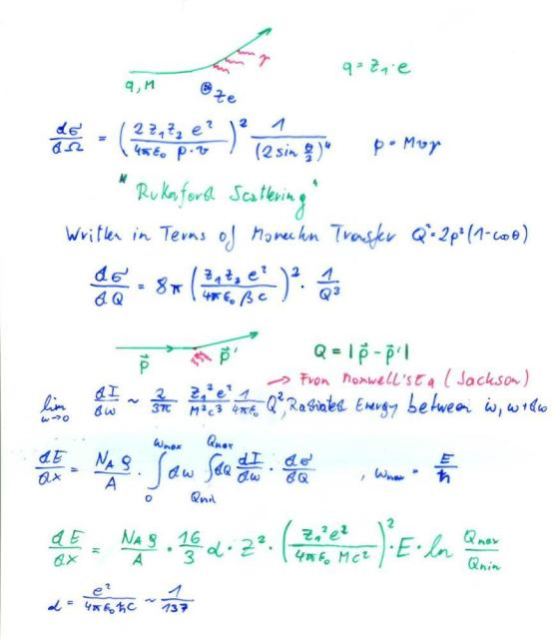
Bremsstrahlung, Classical
A charged particle of mass M and charge q=Z₁e is deflected by a nucleus of Charge Ze.
Because of the acceleration the particle radiated EM waves → energy loss.
Coulomb-Scattering (Rutherford Scattering) describes the deflection of the particle.
Maxwell’s Equations describe the radiated energy for a given momentum transfer.
→ dE/dx

Slide 32
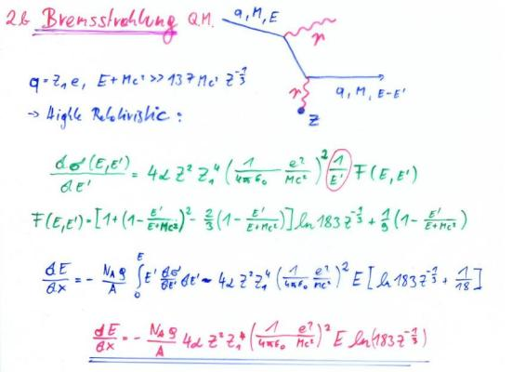
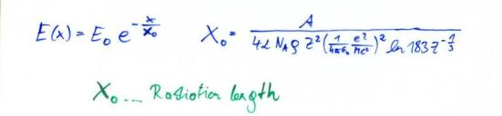
Bremsstrahlung, QM
Proportional to Z²/A of the Material.
Proportional to Z₁⁴ of the incoming particle.
Proportional to ρ of the material.
Proportional 1/M² of the incoming particle.
Proportional to the Energy of the
Incoming particle →
E(x)=Exp(-x/X₀) – ‘Radiation Length’
X₀ ∝ M²A/ (ρ Z₁⁴ Z²)
X₀: Distance where the Energy E₀ of the incoming particle decreases E₀Exp(-1)=0.37E₀ .

Slide 33
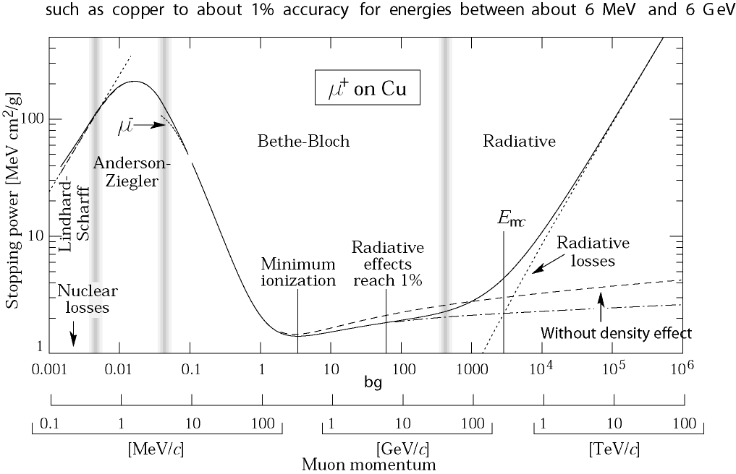
Critical Energy
For the muon, the second lightest particle after the electron, the critical energy is at 400GeV.
The EM Bremsstrahlung is therefore only relevant for electrons at energies of past and present detectors.
Electron Momentum 5 50 500 MeV/c
Critical Energy: If dE/dx (Ionization) = dE/dx (Bremsstrahlung)
Myon in Copper: p ≈ 400GeV
Electron in Copper: p ≈ 20MeV

Slide 34
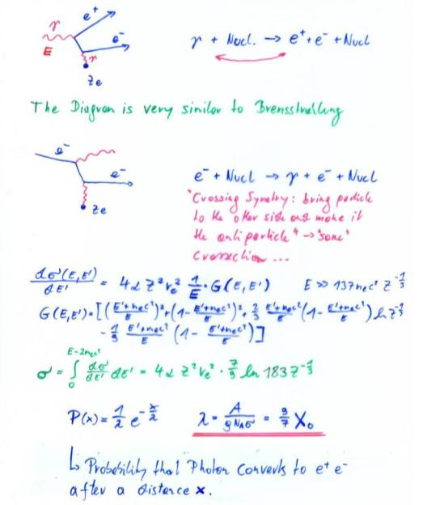
Pair Production, QM
For Eγ>>m_{e}c²=0.5MeV : λ = 9/7X₀
Average distance a high energy photon has to travel before it converts into an e⁺ e⁻ pair is equal to 9/7 of the distance that a high energy electron has to travel before reducing it’s energy from E₀ to E₀*Exp(-1) by photon radiation.

Slide 35
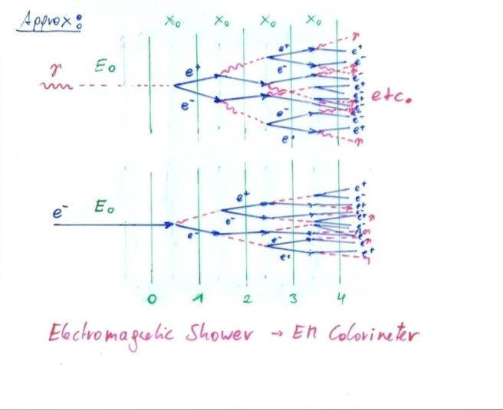
Bremsstrahlung + Pair Production → EM Shower

Slide 36
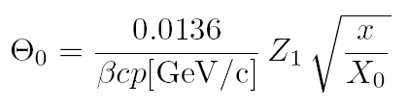
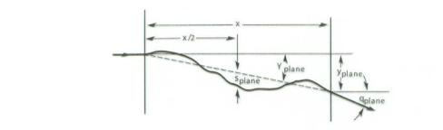
Multiple Scattering
Statistical (quite complex) analysis of multiple collisions gives:
Probability that a particle is defected by an angle θ after travelling a distance x in the material is given by a Gaussian distribution with sigma of:
X₀ ... Radiation length of the material
Z₁ ... Charge of the particle
p ... Momentum of the particle

Slide 37
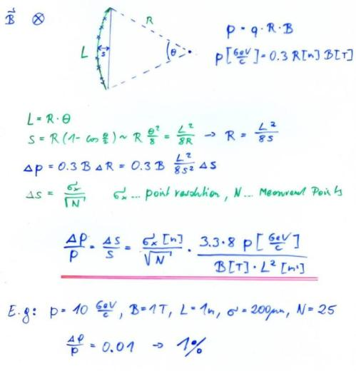
Multiple Scattering
Magnetic Spectrometer: A charged particle describes a circle in a magnetic field:
Limit → Multiple Scattering

Slide 38
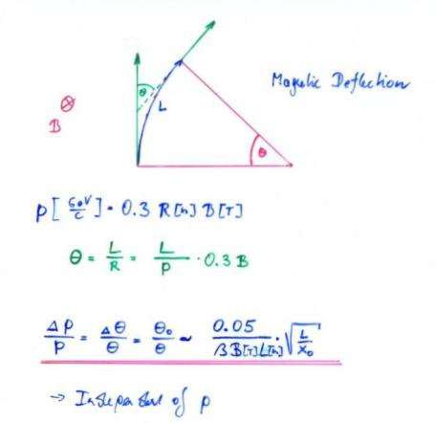
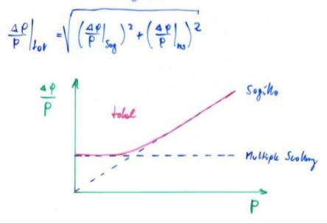
Multiple Scattering

Slide 39
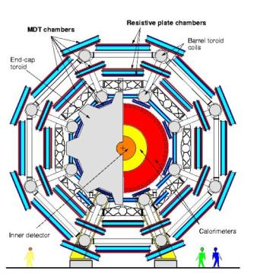
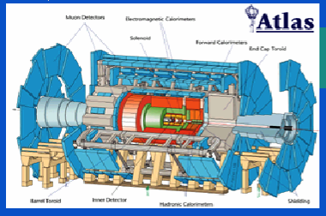
Multiple Scattering
ATLAS Muon Spectrometer:
N=3, sig=50μm, P=1TeV,
L=5m, B=0.4T
∆p/p ~ 8% for the most energetic muons at LHC

Slide 40

Cherenkov Radiation
If we describe the passage of a charged particle through material of dielectric permittivity ε (using Maxwell’s equations) the differential energy cross-section is >0 if the velocity of the particle is larger than the velocity of light in the medium is
N is the number of Cherenkov Photons emitted per cm of material. The expression is in addition proportional to Z₁² of the incoming particle.
The radiation is emitted at the characteristic angle θ_{c} , that is related to the refractive index n and the particle velocity by
M, q=Z₁ e₀

Slide 41
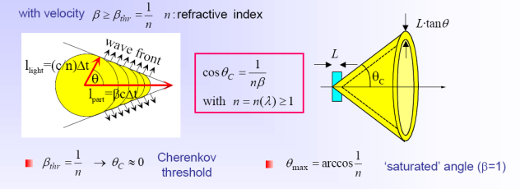
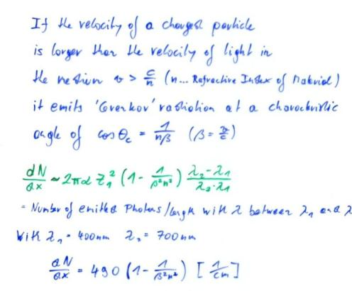
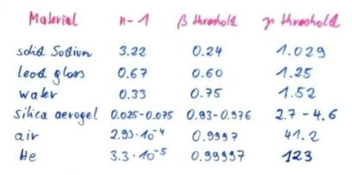
Cherenkov Radiation

Slide 42
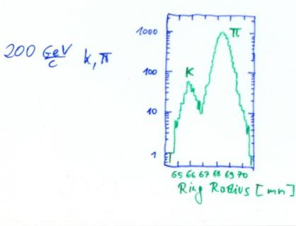
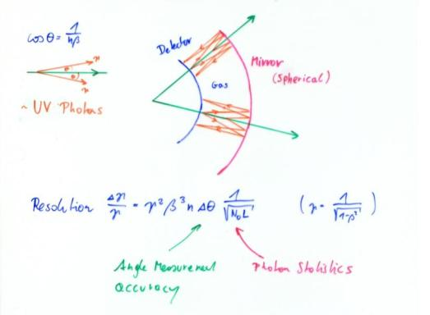
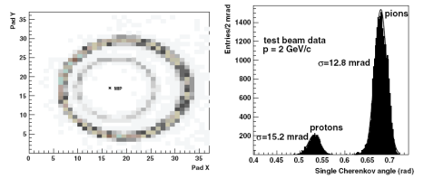
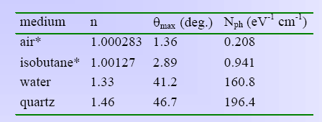
Ring Imaging Cherenkov Detector (RICH)
There are only ‘a few’ photons per event →one needs highly sensitive photon detectors to measure the rings !

Slide 43
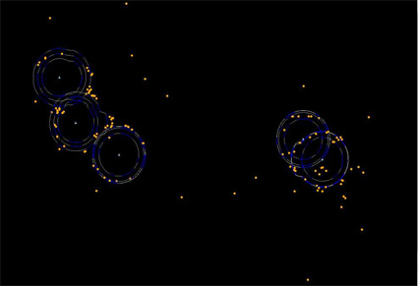
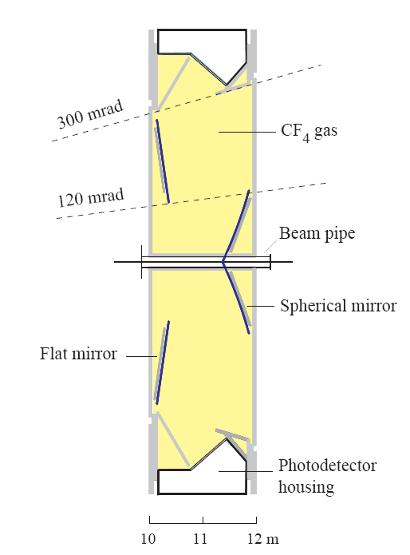
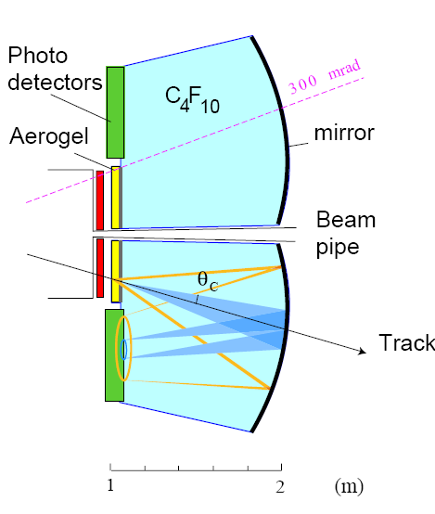
LHCb RICH

Slide 44
Superkamiokande Cherekov Detector

Slide 45
IceCube Cherekov Detector

Slide 46
Transition Radiation
Z₂ electrons, q=-e₀
M, q=Z₁ e₀
When a highly relativistic particle crosses the boundary between two media, there is a probability of the order of 1% to produce an X ray photon, called Transition radiation.

Slide 47
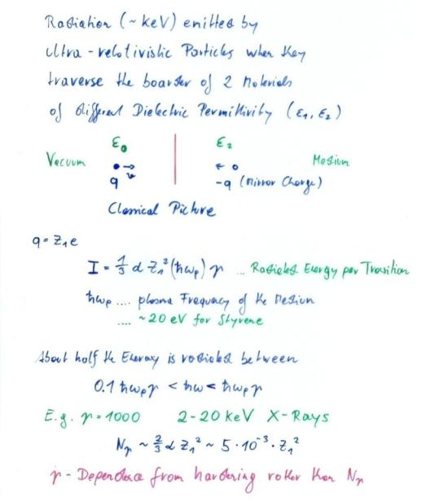
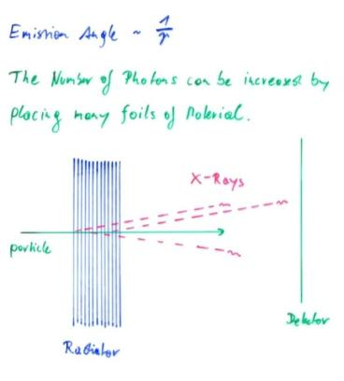
Transition Radiation

Slide 48
Electromagnetic Interaction of Particles with Matter
Ionization and Excitation:
Charged particles traversing material are exciting and ionizing the atoms.
The average energy loss of the incoming particle by this process is to a good approximation described by the Bethe Bloch formula.
The energy loss fluctuation is well approximated by the Landau distribution.
Multiple Scattering and Bremsstrahlung:
The incoming particles are scattering off the atomic nuclei.
Measuring the particle momentum by deflection of the particle trajectory in the magnetic field, this scattering imposes a lower limit on the momentum resolution of the spectrometer.
The deflection of the particle on the nucleus results in an acceleration that causes emission of Bremsstrahlungs-Photons. These photons in turn produced e+e- pairs in the vicinity of the nucleus, which causes an EM cascade. This effect depends on the 2nd power of the particle mass, so it is only relevant for electrons.

Slide 49
Electromagnetic Interaction of Particles with Matter
Cherenkov Radiation:
If a particle propagates in a material with a velocity larger than the speed of light in this material, Cherenkov radiation is emitted at a characteristic angle that depends on the particle velocity and the refractive index of the material.
Transition Radiation:
If a charged particle is crossing the boundary between two materials of different dielectric permittivity, there is a certain probability for emission of an X-ray photon.
→ The strong interaction of an incoming particle with matter is a process which is important for Hadron calorimetry and will be discussed later.

Slide 51
Electromagnetic Interaction of Particles with Matter
Z₂ electrons, q=-e₀
M, q=Z₁ e₀
Now that we know all the Interactions we can talk about Detectors !
Interaction with the atomic electrons. The incoming particle loses energy and the atoms are excited or ionized.
Interaction with the atomic nucleus. The particle is deflected (scattered) causing multiple scattering of the particle in the material. During this scattering a Bremsstrahlung photon can be emitted.
In case the particle’s velocity is larger than the velocity of light in the medium, the resulting EM shockwave manifests itself as Cherenkov Radiation. When the particle crosses the boundary between two media, there is a probability of the order of 1% to produced and X ray photon, called Transition radiation.

Slide 52
Now that we know all the Interactions we can talk about Detectors !

Slide 53
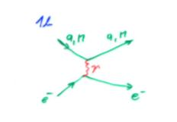


Crossection σ: Material with Atomic Mass A and density ρ contains
n Atoms/cm³
E.g. Atom (Sphere) with Radius R: Atomic Crossection σ = R²π
A volume with surface F and thickness dx contains N=nFdx Atoms.
The total ‘surface’ of atoms in this volume is N σ.
The relative area is p = N σ/F = N_{A} ρ σ /A dx =
Probability that an incoming particle hits an atom in dx.
What is the probability P that a particle hits an atom between distance x and x+dx ?
P = probability that the particle does NOT hit an atom in the m=x/dx material layers and that the particle DOES hit an atom in the m^{th} layer
Mean free path
Average number of collisions/cm
Intermezzo: Crossection
F
dx

Slide 54






Intermezzo: Differential Crossection
Differential Crossection:
→ Crossection for an incoming particle of energy E to lose an energy between E’ and E’+dE’
Total Crossection:
Probability P(E) that an incoming particle of Energy E loses an energy between E’ and E’+dE’ in a collision:
Average number of collisions/cm causing an energy loss between E’ and E’+dE’
Average energy loss/cm:

Slide 55


Fluctuation of Energy Loss
Up to now we have calculated the average energy loss. The energy loss is however a statistical process and will therefore fluctuate from event to event.
x=0 x=D
E
Δ
E - Δ
X X X X X
XX X X
X X X
XXX X XX
X XXX X
P(Δ) = ? Probability that a particle loses an energy Δ when traversing a material of thickness D
We have see earlier that the probability of an interaction occuring between distance x and x+dx is exponentially distributed

Slide 56
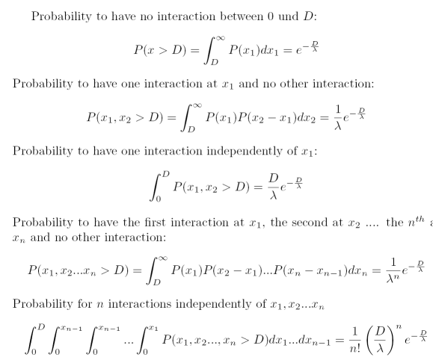
Probability for n Interactions in D
We first calculate the probability to find n interactions in D, knowing that the probability to find a distance x between two interactions is P(x)dx = 1/ λ exp(-x/λ) dx with λ = A/ N_{A}ρ σ

Slide 57



Probability for n Interactions in D
For an interaction with a mean free path of λ , the probability for n interactions on a distance D is given by
Poisson Distribution !
How do we find the energy loss distribution ?
If f(E) is the probability to lose the energy E’ in an interaction, the probability p(E) to lose an energy E over the distance D ?

Slide 58





Fluctuations of the Energy Loss
Probability f(E) for loosing energy between E’ and E’+dE’ in a single interaction is given by the differential crossection dσ (E,E’)/dE’/ σ(E) which is given by the Rutherford crossection at large energy transfers
dσ (E,E’)/dE’/ σ(E)
Excitation and ionization
Scattering on free electrons
P(E,Δ)

