Slide 1
CERN Summer Student Lecture - 2024
Accelerator Technology Challenges:
Superconducting magnets (1/2)
Susana Izquierdo Bermudez
(susana.Izquierdo.Bermudez@cern.ch)
European Organization for Nuclear Research (CERN)

Slide 2
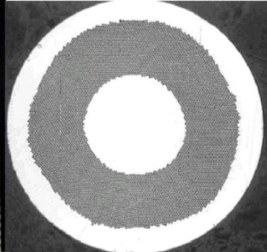

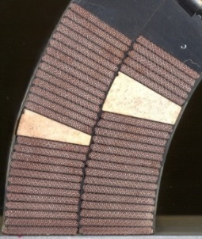
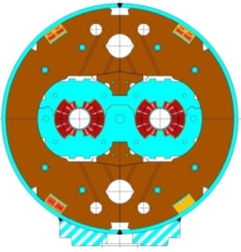
Goal of the course
Overview of superconducting magnets for particle accelerators (dipoles and quadrupoles)
Exciting, fancy and dirty mixture of physics, engineering, and chemistry
  Chemistry and material science: superconducting materials
  Quantum physics: the key mechanisms of superconductivity
  Classical electrodynamics: magnet design
  Mechanical engineering: support structures
  Electrical engineering: powering of the magnets and their protection
  Cryogenics: keep them cool …
  Cost optimization also plays a relevant role
Superconducting strand
Superconducting cable
Superconducting coil
Superconducting magnet

Slide 3
References
Superconducting magnets for particle accelerators are a vast domain. This lecture will be especially focused on magnets for colliders, with a special eye on the CERN high energy infrastructures (LHC and HL-LHC). They are based on:
  P. Ferracin, E. Todesco, S. Prestemon, “Superconducting accelerator magnets”, US Particle Accelerator School, www.uspas.fnal.gov.
  E. Todesco, “Masterclass -Design of superconducting magnets for particle accelerators”, https://indico.cern.ch/category/12408/
Many thanks to Paolo F., Ezio T. and Luca B., for all the material I took from them for this course, and for everything I learnt from them on superconducting magnets!

Slide 4
Outline
Part I
  Particle accelerators, magnets and the need of superconductors
  Magnetic design and coil fabrication
Part II
  Mechanical design and assembly
  Quench, training and protection
  Outlook, what brings the future

Slide 5
Outline
Part I
  Particle accelerators, magnets and the need of superconductors
  Magnetic design and coil fabrication
Part II
  Mechanical design and assembly
  Quench, training and protection
  Outlook, what brings the future

Slide 6
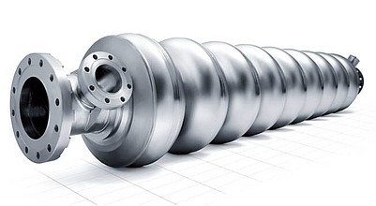
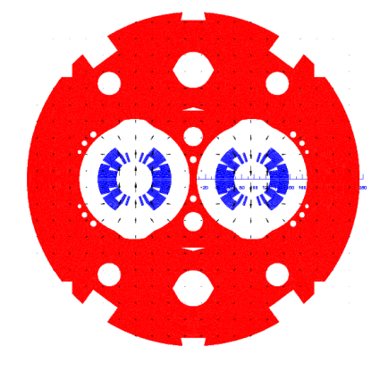
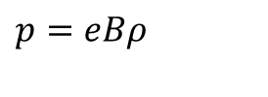


Particle accelerators
Principle of synchrotrons:
  Driving particles in the same accelerating structure several times.
Electro-magnetic field accelerates particles
Magnetic field steers the particles in a ∼ circular orbit
Particle accelerated → energy increased → magnetic field increased (“synchro”) to keep the particles on the same orbit of curvature ρ
$$\vec{F}=e\vec{E}$$
$$\vec{F}=e\vec{v}×\vec{B}$$
B
$$p=eBρ$$
Constant

Slide 7
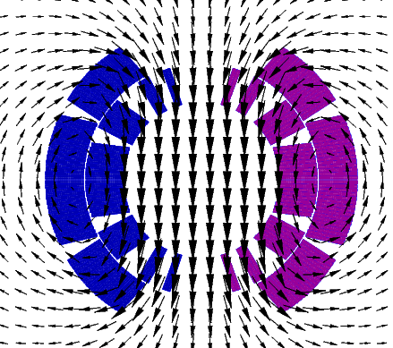
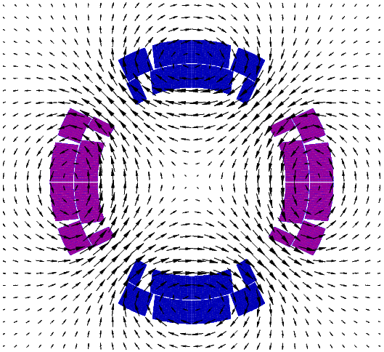


Particle accelerators and magnets
How do we keep the particles in a cycle? MAGNETS!
  Dipole magnets provide a constant field, to be increased with time to follow the particle acceleration, steering (bends) the particles in ≈ circular orbit
  Quadrupole magnets keep the particles in the orbit, providing a linear force that keep them focused acting as a spring. They provide a field
    Equal to zero in the center
    Increasing linearly with the radius
$$B_{y}=B_{1}$$
$$B_{x}=0$$
$$B_{y}=Gx$$
$$B_{x}=Gy$$

Slide 8
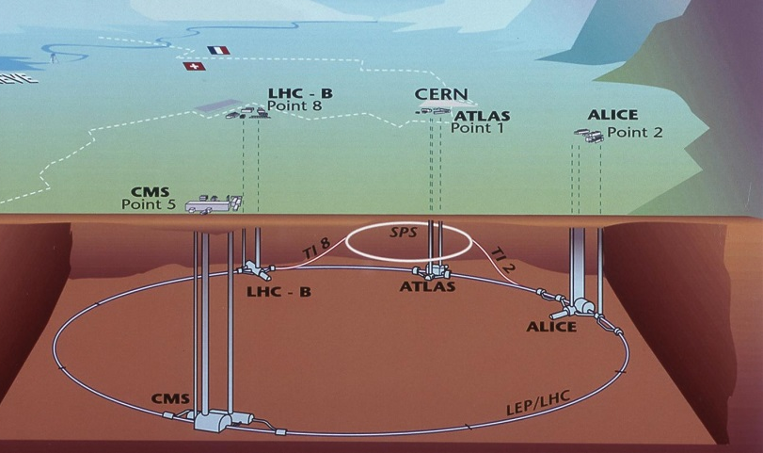
Particle accelerators: the LHC
“The Arc (20.7 km)”
Dipoles: magnetic field steers (bends) the particles in a ∼circular orbit
Quadrupoles: magnetic field provides the force necessary to stabilize linear motion.
  They act as a spring: focus the beam
  Prevent protons from falling to the bottom of the aperture due to the gravitational force (it would happen in less than 60 ms!)
Correctors
“Long straight sections (7.2 km)”
Interaction regions (IR) where the experiments are housed
  Quadrupoles for strong focusing in interaction point
  Dipoles for beam crossing in two-ring machines
Regions for other services
  Beam injection (dipole kickers)
  Accelerating structure (RF cavities)
  Beam dump (dipole kickers)
  Beam cleaning (collimators)

Slide 9


Electromagnets
Dipoles: the larger B, the larger the energy ($p=eBρ$)
Quadrupoles: the larger B, the larger the focusing strength ($G=B/r$)
For an electro-magnet, the larger B, the larger must be J
In normal conducting magnets, J ~ 5 A/mm²
In superconducting magnets, J_{e} ~ 600-700 A/mm²
$$G=−\frac{μ_{0}J_{0}}{2}ln\frac{r_{out}}{r_{in}}$$
w
If we want magnets with B>2T and a reasonable size (and energy consumptions), superconductors are needed

Slide 10
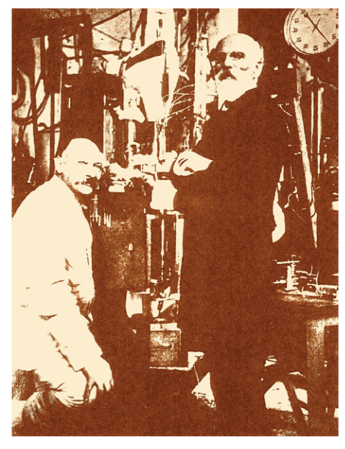
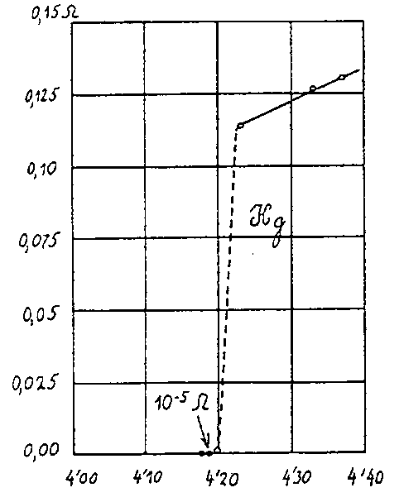
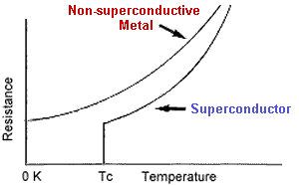
Superconductivity
In 1911, Kammerling-Onnes, discovered superconductivity (ZERO resistance of mercury wire at 4.2 K)
The temperature at which the transition takes place is called critical temperature T_{c}
Observed in may materials
  but not in the typical best conductors (Cu, Ag, Au)
At T > T_{c} , superconductor very poor conductor

Slide 11
Superconductivity
For 40-50 years, only “Type I” superconductors were known.
  Perfect diamagnetism. With T<T_{c} magnetic field is expelled
  But, the B must be < critical field B_{c}. Otherwise, superconductivity is lost
  Unfortunately, B_{c} very low (≤ 0.1 T), not practical for electro-magnets
by L. Bottura
B
B
Increase of field
Cool-down
Superconducting state
Normal state
Then, in the 50’s, “Type II” superconductors
  Between B_{c1} and B_{c2} : mixed phase
      B penetrates as flux tubes: fluxoids
Much higher fields and link between T_{c} and B_{c2}
by L. Bottura
B<B_{c1}
B_{c1}<B<B_{c2}

Slide 12
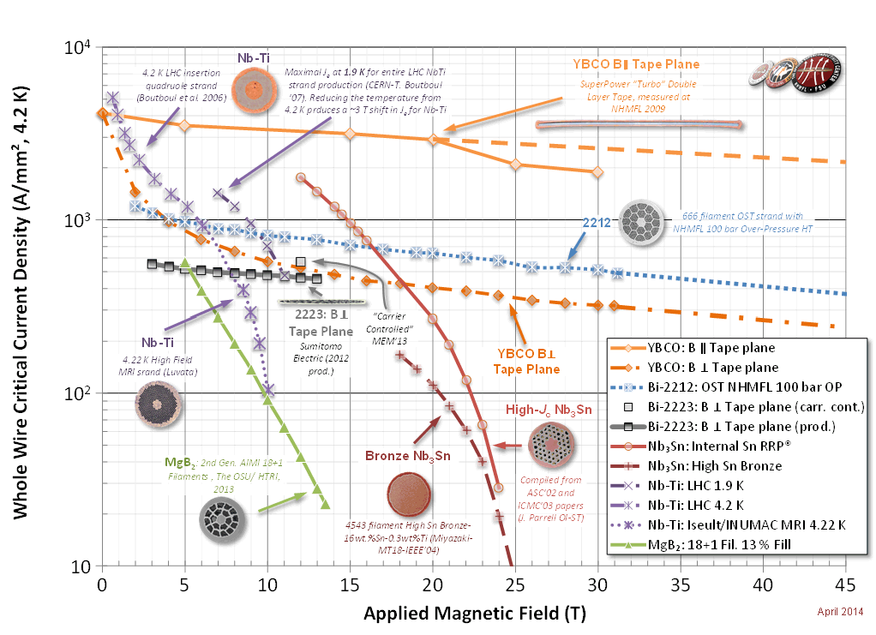
Practical superconductors
BSCCO and YBCO
Critical current density in the superconductor versus field for different materials at 4.2 K [P. J. Lee, et al]
https://nationalmaglab.org/images/magnet_development/asc/plots/JeChart041614-1022x741-pal.png

Slide 13
BSCCO and YBCO
BSSCO and YBCO are the two main HTS (high temperature superconductors)
  Discovered in 1988/86
  Large critical temperature ≈100 K
  Very large critical field above 150 T
  Flat critical surface (little dependence on field)
  Large progress in reaching good current density
  Both expensive (more than 10 times Nb-Ti …)
  Drawbacks:
    YBCO round wires are not trivial – most application on tapes
    BSCCO requires a heat treatment at 800 C , and 100 bar of oxygen to increase j
  NMR/MRI solenoids with HTS tapes have been developed
  Projects of dipole inserts for accelerator magnets are ongoing in many labs (LBNL, BNL, CERN, CEA, …)

Slide 14
Practical superconductors
Nb₃Sn
NbTi
Critical current density in the superconductor versus field for different materials at 4.2 K [P. J. Lee, et al]
https://nationalmaglab.org/images/magnet_development/asc/plots/JeChart041614-1022x741-pal.png

Slide 15
NbTi and Nb₃Sn
Nb and Ti (1961) → ductile alloy
Extrusion + drawing
T_{c} is ~ 9.2 K at 0 T
B_{C2} is ~ 14.5 T at 0 K
Use in Tevatron (80s), then all the other
~50-200 US$ per kg of wire
(1 euro per m)
Nb and Sn (1954) → intermetallic compound
Brittle, strain sensitive, formed at ~650-700°C
T_{C} is ~ 18 K at 0 T
B_{C2} is ~ 28 T at 0 K
Used in NMR, ITER, now HL-LHC
~700-1500 US$ per kg of wire
(5 euro per m)
Critical surface for Nb-Ti and Nb₃Sn

Slide 16
Practical superconductors
Typical operation parameters
(for a 0.85 mm diameter strand)
By P. Ferracin
Cu
Nb-Ti
Nb₃Sn
J_{e} ~ 5 A/mm²
I ~ 3 A
B = 2 T
J_{e} ~ 600-700 A/mm²
I ~ 300-400 A
B = 8-9 T
J_{e} ~ 600-700 A/mm²
I ~ 300-400 A
B = 12-13 T

Slide 17
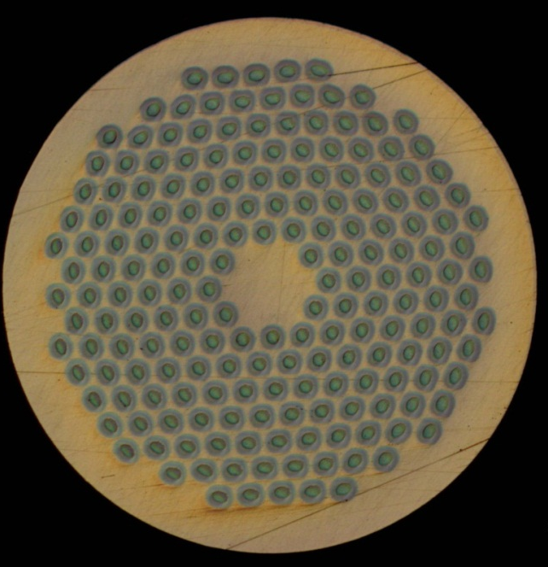
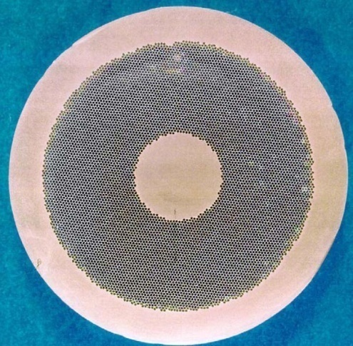
Practical superconductors
Typical operation parameters
(for a 0.85 mm diameter strand)
By P. Ferracin
Cu
Nb-Ti
Nb₃Sn
J_{e} ~ 5 A/mm²
I ~ 3 A
B = 2 T
J_{e} ~ 600-700 A/mm²
I ~ 300-400 A
B = 8-9 T
J_{e} ~ 600-700 A/mm²
I ~ 300-400 A
B = 12-13 T

Slide 18

Strand: multifilament wire
Superconducting materials are produced in small filaments and surrounded by a stabilizer (typically copper) to form a “multi-filament wire” o “strand”

Slide 19
The strand: multifilament wire
WHY a multi-filament wire in a stabilizing matrix?
1. Flux jumps
Thermal disturbance → the local change in J_{c} → motion or “flux jump” → power dissipation
Stability criteria for a slab (adiabatic condition)
  a is the half-thickness of the slab
  j_{c} is the critical current density [A m⁻²]
  γ is the density [kg m⁻³]
  C is the specific heat [J kg⁻¹]
  θ_{c} is the critical temperature.
B_{c1}<B<B_{c2}
2. Quench protection
Superconductors have a very high normal state resistivity.
If quenched, could reach very high temperatures in few ms.
If embedded in a copper matrix, when a quench occurs, current redistributes in the low-resisitivity matrix → lower peak temperature
Cu
SC

Slide 20
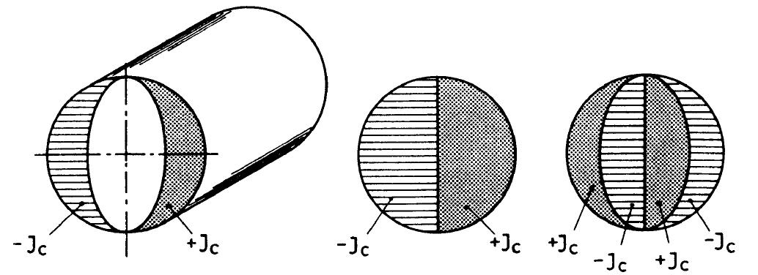
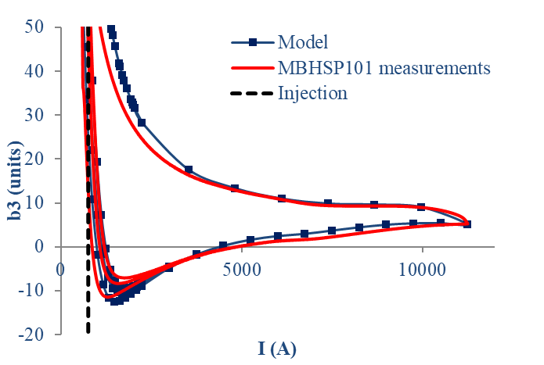

The strand: multifilament wire
3. Persistent currents
When a filament is in a varying B_{ext}, its inner part is shielded by currents distribution in the filament periphery
They do not decay when B_{ex}is held constant → persistent currents
Strand magnetization
mT
by K.-H. Mess, et al.
External magnetic field
Tesla
These currents produce field errors that are particular important at low energy (when the beam is injected), which are proportional to the filament diameter (d_{sub}) and the current density.
$$M(B)∝d_{sub}{∙J}_{c}(B)$$
Allowable limits

Slide 21
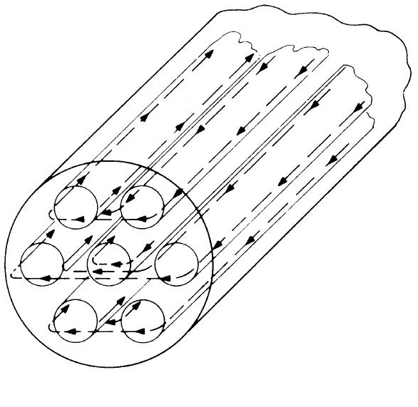
The strand: multifilament wire
4. Inter-filament coupling
  When a multi-filamentary wire is subjected to a time varying magnetic field, current loops are generated between filaments.
  If filaments are straight, large loops with large currents → ac losses
  If the strands are magnetically coupled the effective filament size is larger → flux jumps
To reduce these effects, filaments are twisted
  twist pitch of the order of 20-30 times of the wire diameter.
by M. Wilson
by L. Bottura

Slide 22
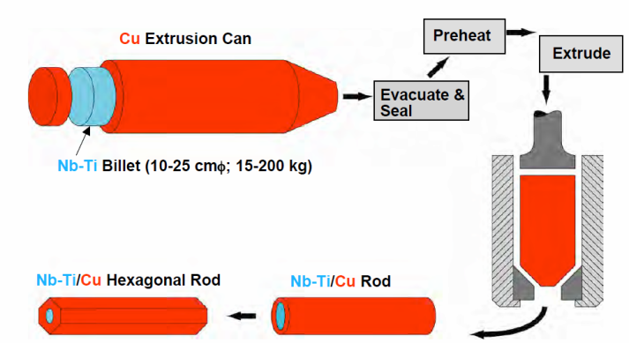
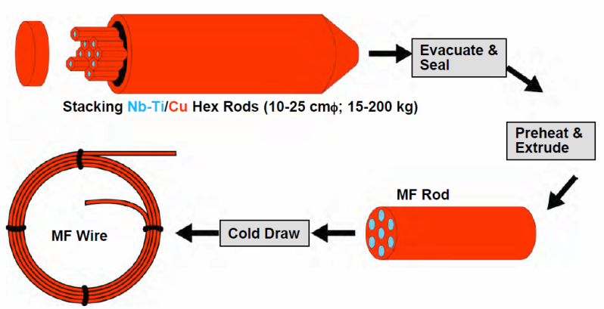
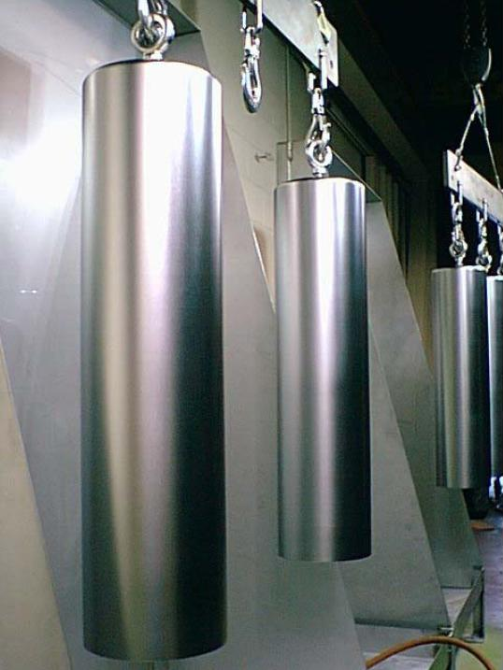
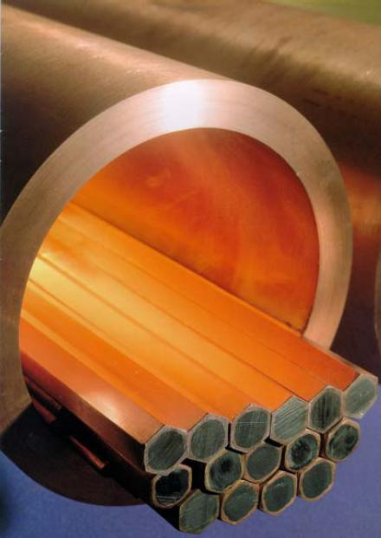
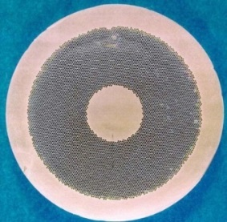
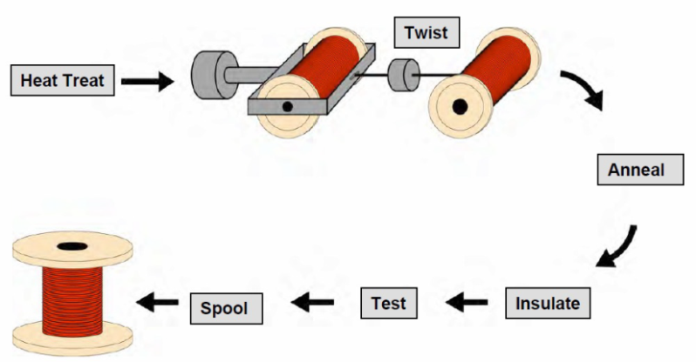
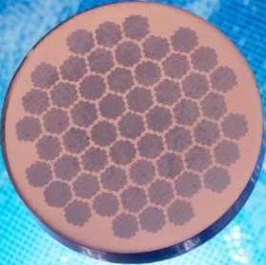
Strand: Manufacturing process (NbTi)
Nb-Ti ingots
  200 mm ∅, 750 mm long
Monofilament rods are stacked to form a multifilament billet
  then extruded and drawn down
  can be re-stacked: double-stacking process

Slide 23
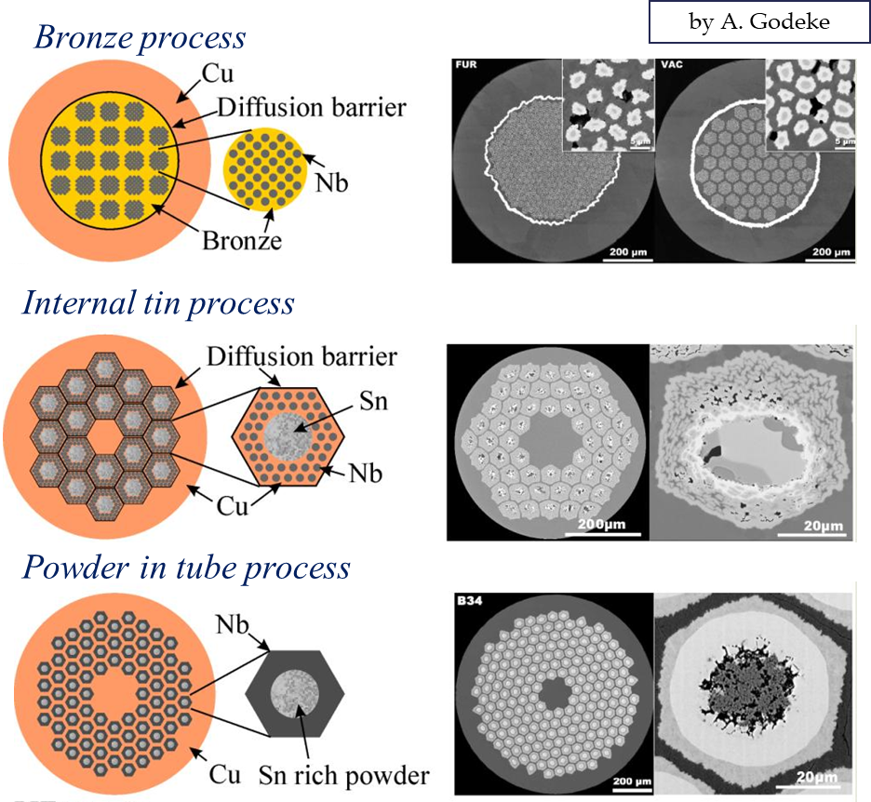
Strand: Manufacturing process (Nb₃Sn)
Since Nb₃Sn is brittle
  It cannot be extruded and drawn like Nb-Ti. It must be formed at the end of the fabrication of the cable (or the coil).
Process in several steps
  Fabrication of the wire, assembling multifilament billets from with Nb and Sn separated. Different processes tried in industrial scale (bronze process, internal tin process, powder in tube process)
  Fabrication of the cable
  Fabrication of the coil. Two different techniques:
      Wind & react” (more common). First coil winding and then formation of Nb₃Sn
      “React & wind”. First formation of Nb₃Sn and then coil winding
  Reaction. Heating to about 600-700 C in vacuum or inert gas (argon) atmosphere, and the Sn diffuses in Nb and reacts to form Nb₃Sn.

Slide 24
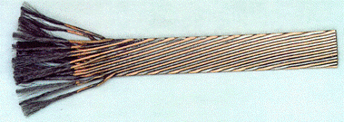
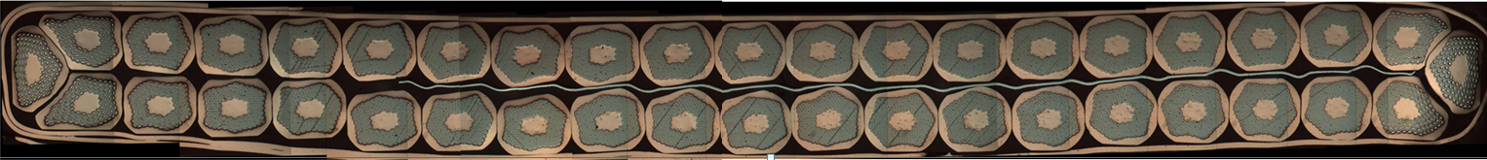
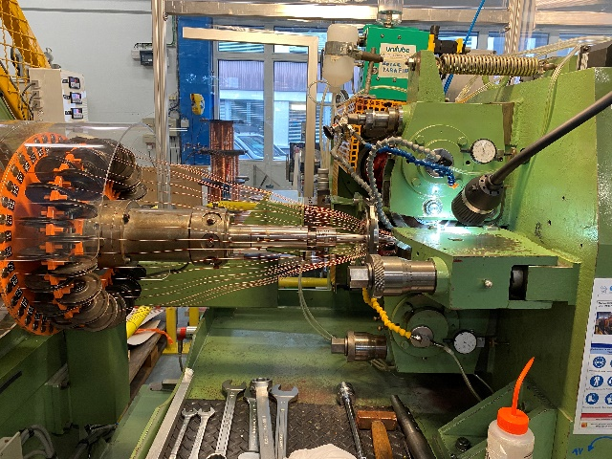
The cable
Most of the superconducting coils for particle accelerators wound from a multi-strand cable (Rutherford cable). The strands are twisted to
  Reduce inter-strand coupling currents
    Losses and field distortions.
  Provide more mechanical stability
  Current redistribution (in case a defect in one strand)
  Reduction the number of turns (easier winding, lower inductance)
  Reduction strand piece length
Strands wound on spools mounted on a rotating drum
Strands twisted around a conical mandrel into rolls
The rolls compact the cable and provide the final shape

Slide 25
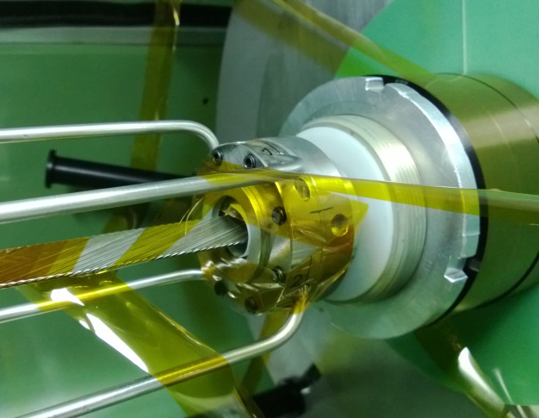
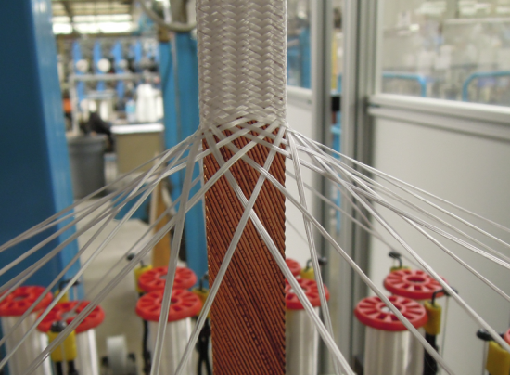
The cable insulation
The cable insulation must feature
  Good electrical properties to withstand turn-to-turn V after a quench
  Good mechanical properties to withstand high pressure conditions
  Porosity to allow penetration of helium (or epoxy)
  Radiation hardness
Polyimide insulation for Nb-Ti
Fiber glass insulation for Nb₃Sn

Slide 26
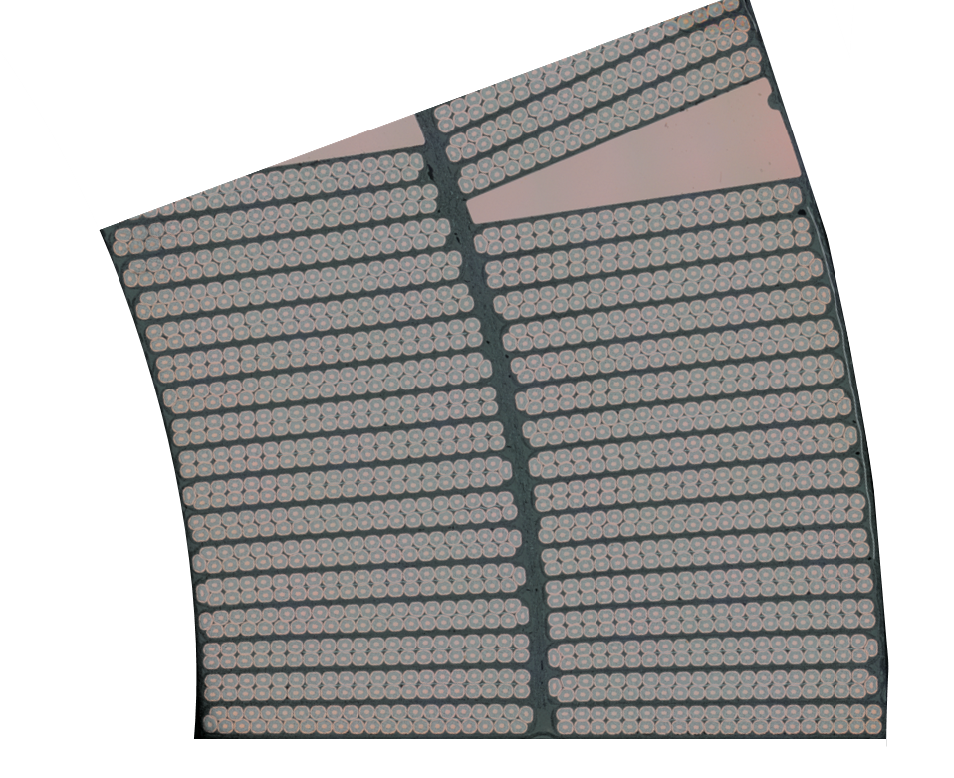
Filling ratio and current density
Coil :
≈ 1/3 superconductor
≈ 1/3 copper
≈ 1/3 insulation
Engineering current density is the current divided by the strand area (Cu+sc)
Overall current density is the current divided by the total area (Cu+sc+ins)
Current density (A/mm²)
 | LHC-MB |  | 11 T DS
 | IL | OL
J_{sc} | 1259 | 1817 | 1655
J_{engineering} | 475 | 616 | 770
J_{overall} | 349 | 430 | 522

Slide 27
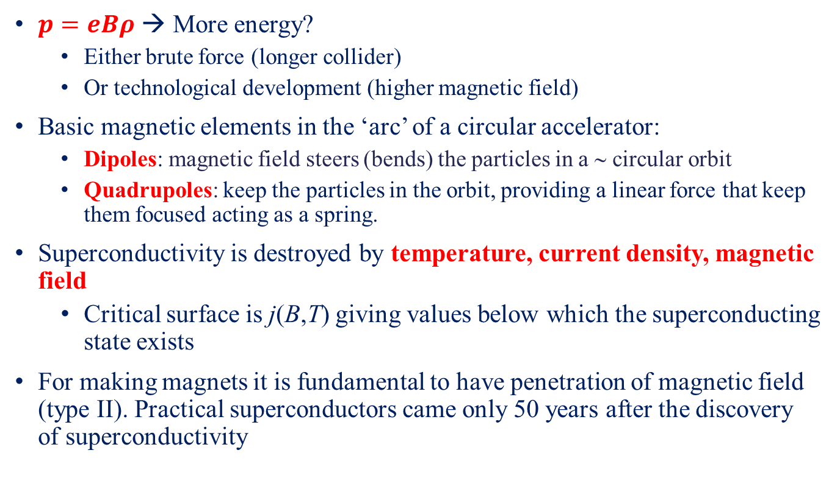
Summary
$p=eBρ$ → More energy?
  Either brute force (longer collider)
  Or technological development (higher magnetic field)
Basic magnetic elements in the ‘arc’ of a circular accelerator:
  Dipoles: magnetic field steers (bends) the particles in a ∼ circular orbit
  Quadrupoles: keep the particles in the orbit, providing a linear force that keep them focused acting as a spring.
Superconductivity is destroyed by temperature, current density, magnetic field
  Critical surface is j(B,T) giving values below which the superconducting state exists
For making magnets it is fundamental to have penetration of magnetic field (type II). Practical superconductors came only 50 years after the discovery of superconductivity

Slide 28
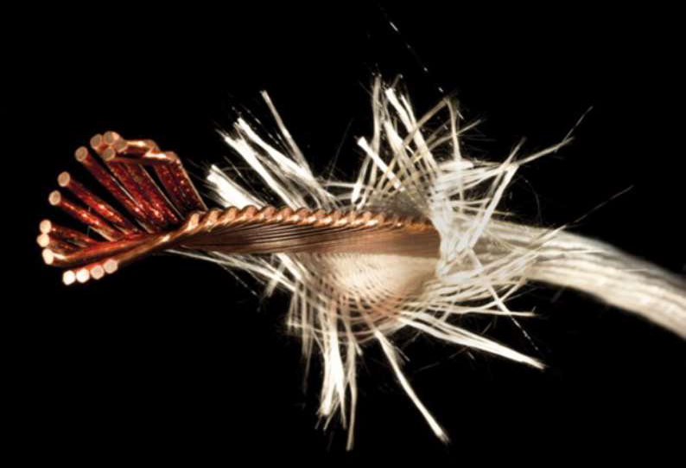
Summary
Strand made from twisted filaments in a stabilizing matrix (stability, protection, field quality)
Cable is insulated (dielectric strength, mechanical robustness)
Cable made from twisted wires (stability, protection, field quality)

Slide 29
References
K.-H. Mess, P. Schmuser, S. Wolff, “Superconducting accelerator magnets”, Singapore: World Scientific, 1996.
Martin N. Wilson, "Superconducting Magnets", 1983.
Fred M. Asner, "High Field Superconducting Magnets", 1999.
P. Ferracin, E. Todesco, S. Prestemon, “Superconducting accelerator magnets”, US Particle Accelerator School, www.uspas.fnal.gov.
E. Todesco, “Masterclass -Design of superconducting magnets for particle accelerators”, https://indico.cern.ch/category/12408/
A. Devred, “Practical low-temperature superconductors for electromagnets”, CERN-2004-006, 2006.
Presentations from Luca Bottura and Martin Wilson

Slide 30
Outline
Part I
  Particle accelerators, magnets and the need of superconductors
  Magnetic design and coil fabrication
Part II
  Mechanical design and assembly
  Quench, training and protection
  Outlook, what brings the future

Slide 31
Introduction
The magnetic design is one of the first steps in the design of a superconducting magnet development
It starts from the requirements(from accelerator physicists, researchers, medical doctors…others)
A field shape: Dipole, quadrupole, etc
A field magnitude usually with low temperature superconductors from 5 to 20 T
A field homogeneity, uniformity inside a solenoid, harmonics in a accelerator magnet
A given aperture (and volume), some cm diameter for accelerator magnets, much more for detectors and fusion magnets

Slide 32
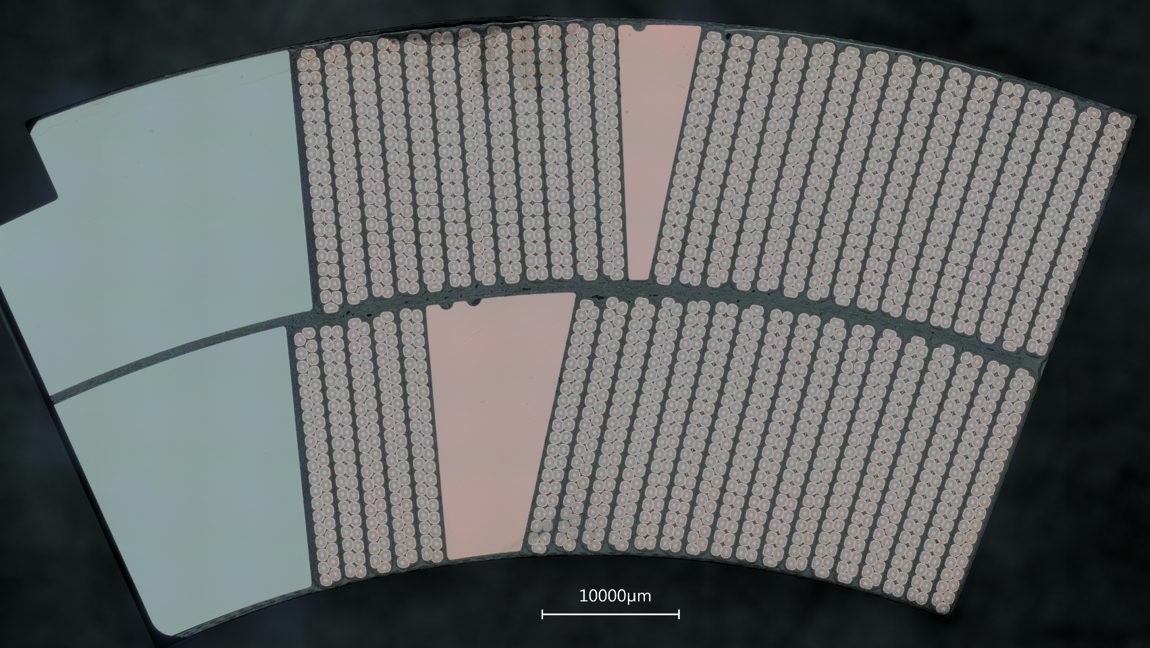
Magnetic design and coil
How do we create a perfect field?
How do we express field and its “imperfections”?
How do we design a coil to minimize field errors?

Slide 33

How to create a dipole field?
Perfect dipole: intercepting circle/ellipses
Within a cylinder carrying j₀, the field is perpendicular to the radial direction and proportional to the distance to the centre r:
Combining the effect of two intersecting cylinders
-J₀
+J₀
-J₀
+J₀
$$B_{y}=\frac{μ_{0}j_{0}r}{2}\left\{−r_{1}\cos{θ_{1}}+r_{2}\cos{θ_{2}}\right\}=−\frac{μ_{0}j_{0}}{2}w$$
But…
The aperture is not circular
Not easy to simulate with a flat cable
Similar proof for intercepting ellipses

Slide 34
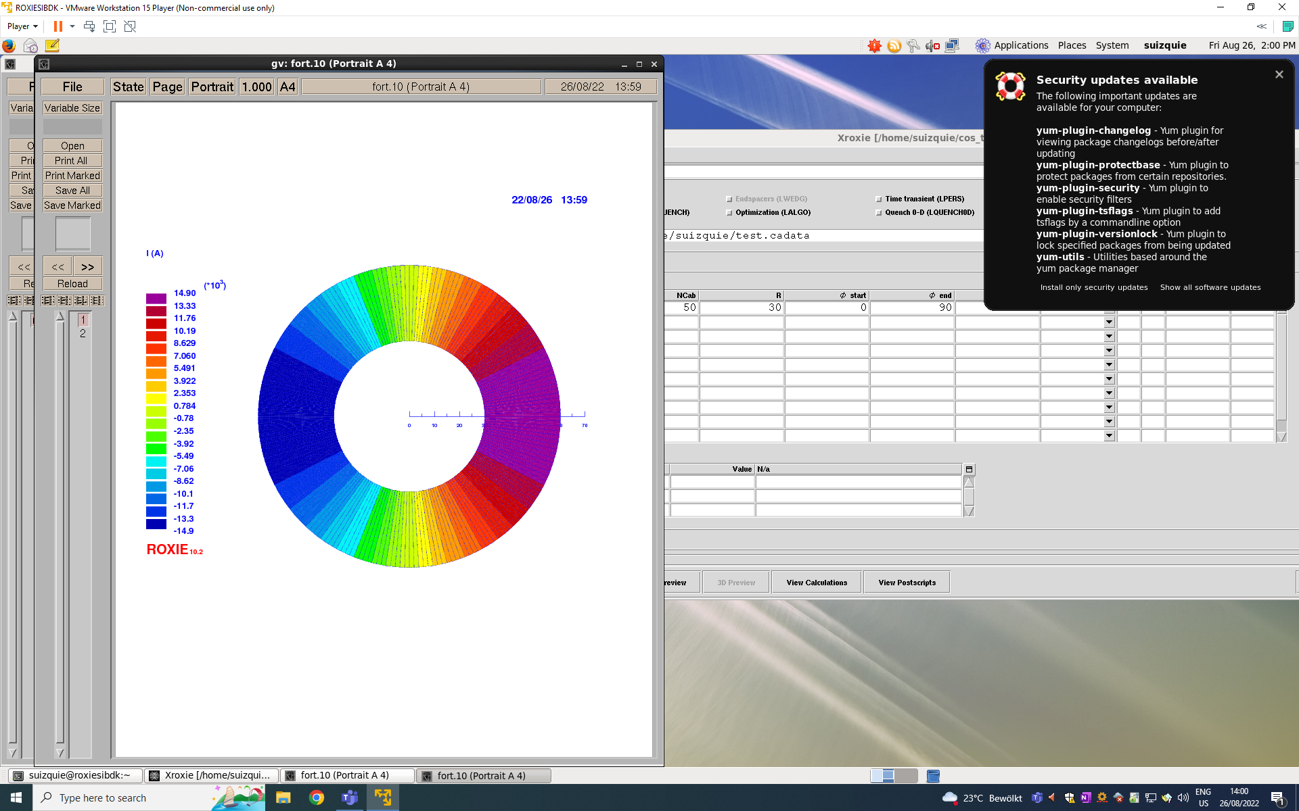
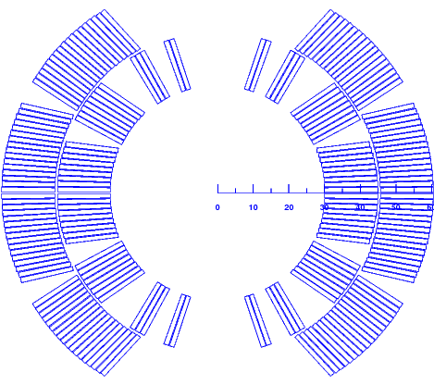
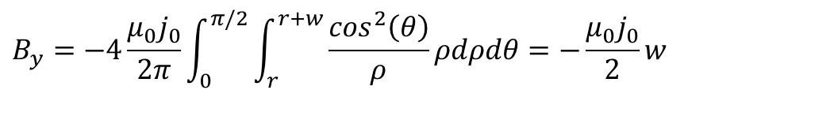

How to create a dipole field?
Perfect dipole: thick shell with cosθ current distribution
If we assume a current distribution proportional to the angle
j₀
r
w
$$j\left(θ\right)=j_{0}cos\left(θ\right)$$
0
The generated dipole field is
$$B_{y}=−4\frac{μ_{0}j_{0}}{2π}\int_{0}^{π/2}{\int_{r}^{r+w}{\frac{\cos^{2}\left(θ\right)}{ρ}}}ρdρdθ=−\frac{μ_{0}j_{0}}{2}w$$
-j₀
From ideal to practical configuration
In a dipole:
B ∝ current density (obvious)
B ∝ coil width w (less obvious)
B independent of the aperture r (surprising)
A bit easier to reproduce with a flat cable (Rectangular cross-section and constant J)
  More layers and wedges to reduce J towards the 90 degrees plane
  It will not be a perfect field…but it can be pretty close!

Slide 35
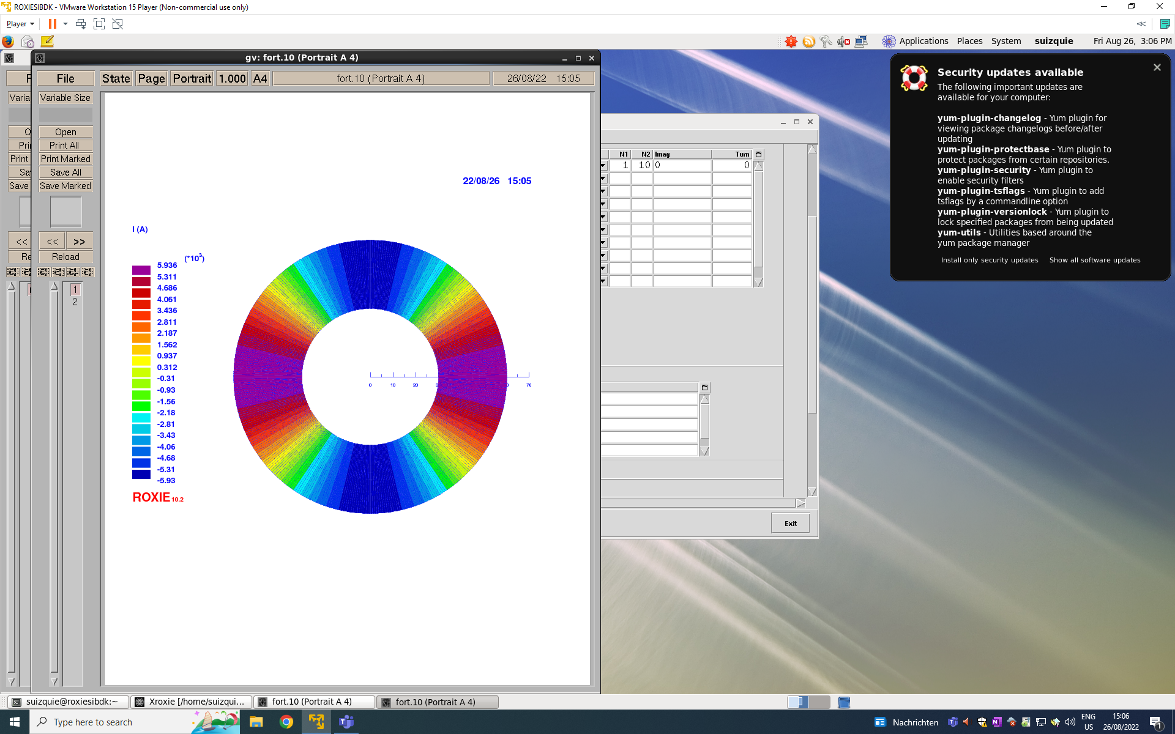
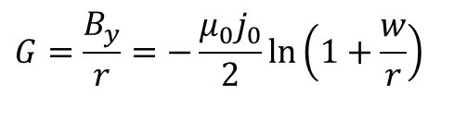
Perfect 2n-pole field
Four intercepting circles/ellipses and a cos2θ current distribution generate a perfect quadrupole field
j₀
$$G=\frac{B_{y}}{r}=−\frac{μ_{0}j_{0}}{2}ln⁡\left(1+\frac{w}{r}\right)$$
r
w
0
-j₀
And so on…
  Perfect sextupole: cos3θ or 3 intersecting ellipses
  Perfect 2n-poles: cos(nθ) or n intersecting ellipses

Slide 36
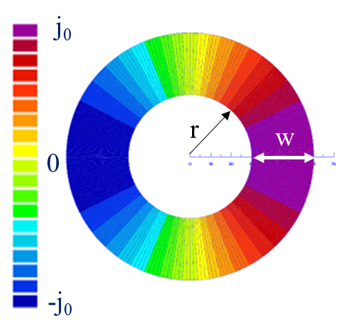
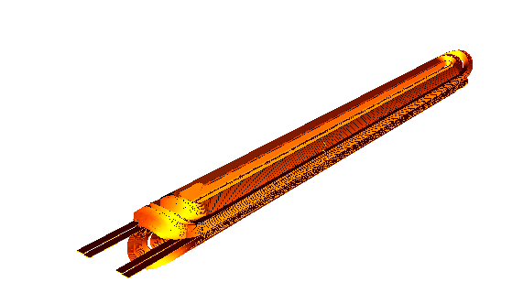
From ideal to real configurations
‘The solution’ to go from the ideal cosθ current distribution to a windable configuration → Approximation of the cos-theta layout by sectors with uniform current density
Now we can use the multipolar expansion to optimize our “practical” cross-section
  The first allowed harmonic in a dipole configuration is B₃
  The second allowed harmonic in a dipole configuration is B₅
  for α=π/3 (i.e. a 60° sector coil) one has B₃=0
  for α=π/5 (i.e. a 36° sector coil) or for α=2π/5 (i.e. a 72° sector coil)
  one has B₅=0

Slide 37

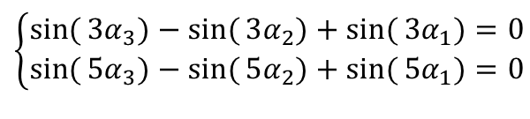


Dipole sector coils
With one sector, we can only set to zero one multipole
With two sectors, equations to set to zero B_{3,} B₅ and B₇
With three sectors, one can set to zero 5 multipoles
$$\left\{\begin{matrix}\sin{(}3α_{3})−\sin{(}3α_{2})+\sin{(}3α_{1})=0 \\ \sin{(}5α_{3})−\sin{(}5α_{2})+\sin{(}5α_{1})=0\end{matrix}\right.$$
$$α_{3}$$
  for instance (48°,60°,72°) or (36°,44°,64°) are solutions
$$α_{2}$$
$$α_{1}$$
~[0°-33.3°, 37.1°- 53.1°, 63.4°- 71.8°]

Slide 38
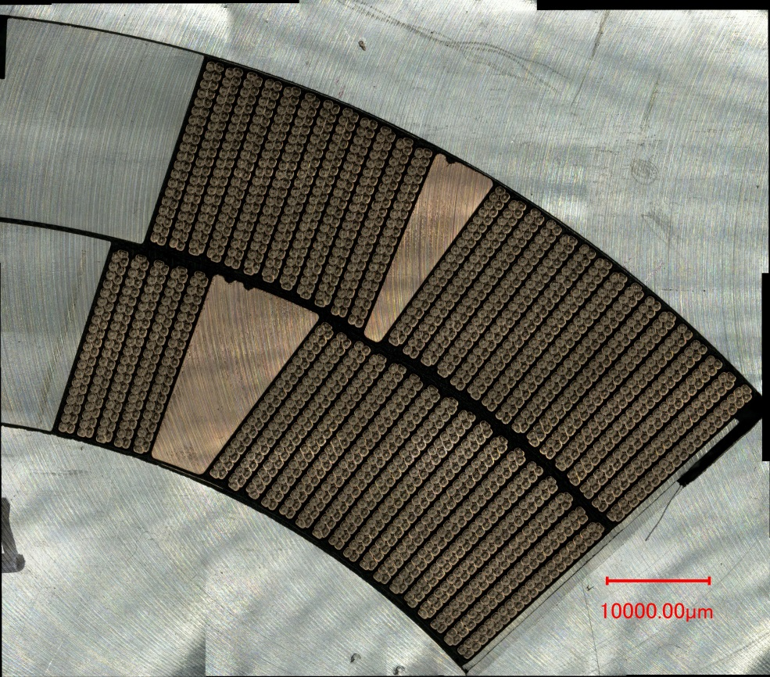
Coil fabrication
The coil: most critical component of a superconducting magnet
Cross-sectional accuracy of few tens of micrometers over ~15 m
Manufacturing tolerances (~30 µm on blocks position) are accounted as random components for field quality.
Cross section of a Nb₃Sn practice coil

Slide 39
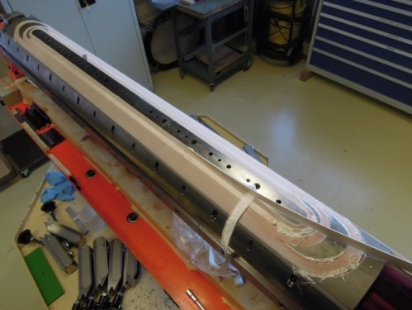
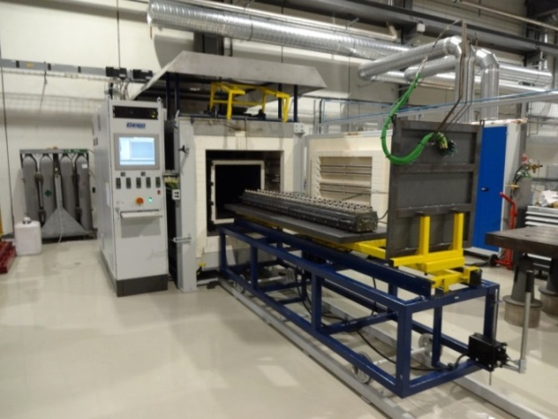
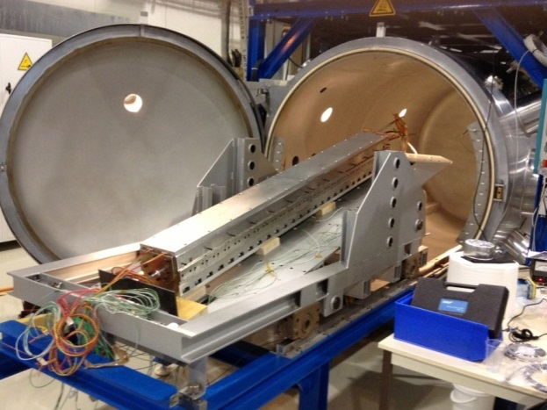
Coil fabrication (Nb₃Sn)
Winding & Curing
Reaction
Impregnation
The cable is wound around a pole on a mandrel.
A ceramic binder is applied and cured (T~ 150 C) to have a rigid body easy to manipulate.
Sn and Nb are heated to 650-700 C in vacuum or inert gas (argon) →Nb₃Sn
The cable becomes brittle
In order to have a solid block, the coil placed in a impregnation fixture
The fixture is inserted in a vacuum tank, evacuated → epoxy injected

Slide 40



Coil at different manufacturing steps
After curing
After reaction
After impregnation

Slide 41

The iron yoke
Keep the return magnetic flux close to the coils, thus avoiding fringe fields
In some cases the iron is partially or totally contributing to the mechanical structure
Considerably enhance the field for a given current density
The increase is relevant (10-30%), getting higher for thin coils
This allows using lower currents, easing the protection
11 T Double Aperture Magnet

Slide 42

Peak Field, Aperture Field and Margin
The margin of a magnet is defined with respect to its weakest point, i.e. the peak field
What matters for the margin is the peak field in the coil, not the field in the aperture
B_{p} = 11.6 T
current density
(A/cm )
2
7
10
critical surface
6
10
5
10
4
B_{ap} = 11.2 T
10
3
5
10
5
10
T_{op}
10
15
15
20
20
Temperature
magnetic field
(K)
(T)

Slide 43
Margin
The margin of a magnet is defined with respect to its weakest point, i.e. the peak field
Short sample(SS) corresponds to the intersection of the load line for the peak field and the critical current density curve: ideally is the maximum performance of the magnet
Among magnet engineers, a commonly used concept is the loadline margin
  The concept is always criticized (not physical) but never replaced: the success of a magnet judged on its ability of reaching the max performance
    LL_{margin} = 1−I_{𝑜𝑝}/I_{𝑆𝑆}
High field accelerator magnets typically are design to operate at ≈ 80% of the short sample level (20 % margin)
Operation point

Slide 44
Summary
B ∝ J∙w → Two ways to increase the field:
  Larger current density (up to a certain level, then hard limits in terms of stress and protection)
  Larger coils (cost)
The coil is most critical component of a superconducting magnet.
  Typically, 1/3 of the coil material is superconductor, 1/3 copper and 1/3 insulation/resin
The iron keeps the return magnetic flux and considerably enhances the field. In some cases it also has a mechanical function.
The margin of a magnet is defined with respect to its weakest point, i.e. the peak field

Slide 45
References
K.-H. Mess, P. Schmuser, S. Wolff, “Superconducting accelerator magnets”, Singapore: World Scientific, 1996.
Martin N. Wilson, "Superconducting Magnets", 1983.
Fred M. Asner, "High Field Superconducting Magnets", 1999.
S. Russenschuck, “Field computation for accelerator magnets”, J. Wiley & Sons (2010).
P. Ferracin, E. Todesco, S. Prestemon, “Superconducting accelerator magnets”, US Particle Accelerator School, www.uspas.fnal.gov.
E. Todesco, “Masterclass -Design of superconducting magnets for particle accelerators”, https://indico.cern.ch/category/12408/
A. Jain, “Basic theory of magnets”, CERN 98-05 (1998) 1-26
L. Rossi, E. Todesco, “Electromagnetic design of superconducting quadrupoles”, Phys. Rev. ST Accel. Beams 10 (2007) 112401.
L. Rossi and Ezio Todesco, “Electromagnetic design of superconducting dipoles based on sector coils”, Phys. Rev. ST Accel. Beams 9 (2006) 102401.
CAS 2023 on Normal and Superconducting Dipoles https://indico.cern.ch/event/1227234/

Slide 46
Thank you
For questions, don’t hesitate!
susana.izquierdo.bermudez@cern.ch

Slide 47
Maxwell equations
Maxwell equations for magnetic field
In absence of charge and magnetized material
  (inside a magnet)
If (constant longitudinal field), then
  x and y perpendicular to the beam (transverse coordinates), z along the beam

Slide 48
Analytic functions
If Maxwell gives
Cauchy-Riemann conditions
and therefore, the function B_{y}+iB_{x} is analytic
where C_{n} are complex coefficients
Advantage: we reduce the description of the field to a (simple) series of complex coefficients

Slide 49

Field harmonics
The field can be described as a (simple) series of complex coefficients, each coefficient corresponds to a “pure” multipolar field
Magnets usually aim at generating a single multipole
  Dipole, quadrupole, sextupole, octupole, decapole, dodecapole …
By K.-H. Mess et al.

Slide 50
Field harmonics
The field harmonics are rewritten as
  We factorize the main component (B₁ for dipoles, B₂ for quadrupoles)
  We introduce a reference radius R_{ref} to have dimensionless coefficients (usually chosen as 2/3 of the aperture radius)
  We factorize 10⁻⁴ since the deviations from ideal field in superconducting magnets for particle accelerators have to be ∼0.01%
The coefficients b_{n}, a_{n} are called normalized multipoles
  b_{n} are the normal, a_{n} are the skew (adimensional)

Slide 51

Considerations on margin
For Nb₃Sn and Nb-Ti the temperature margin depends only on the loadline margin and very weakly on the field.
For a given a material and an operational temperature, load line margin and temperature margin are equivalent
For a given LL margin, Nb₃Sn T margin is about 2.5 times greater than NbTi T margin
Temperature margins at 20% on loadline
Operational temperature | 1.9 K | 4.2 K
Nb-Ti | 2.1 K | 1.2 K
Nb₃Sn | 4.5 K | 3.0 K

