Slide 1
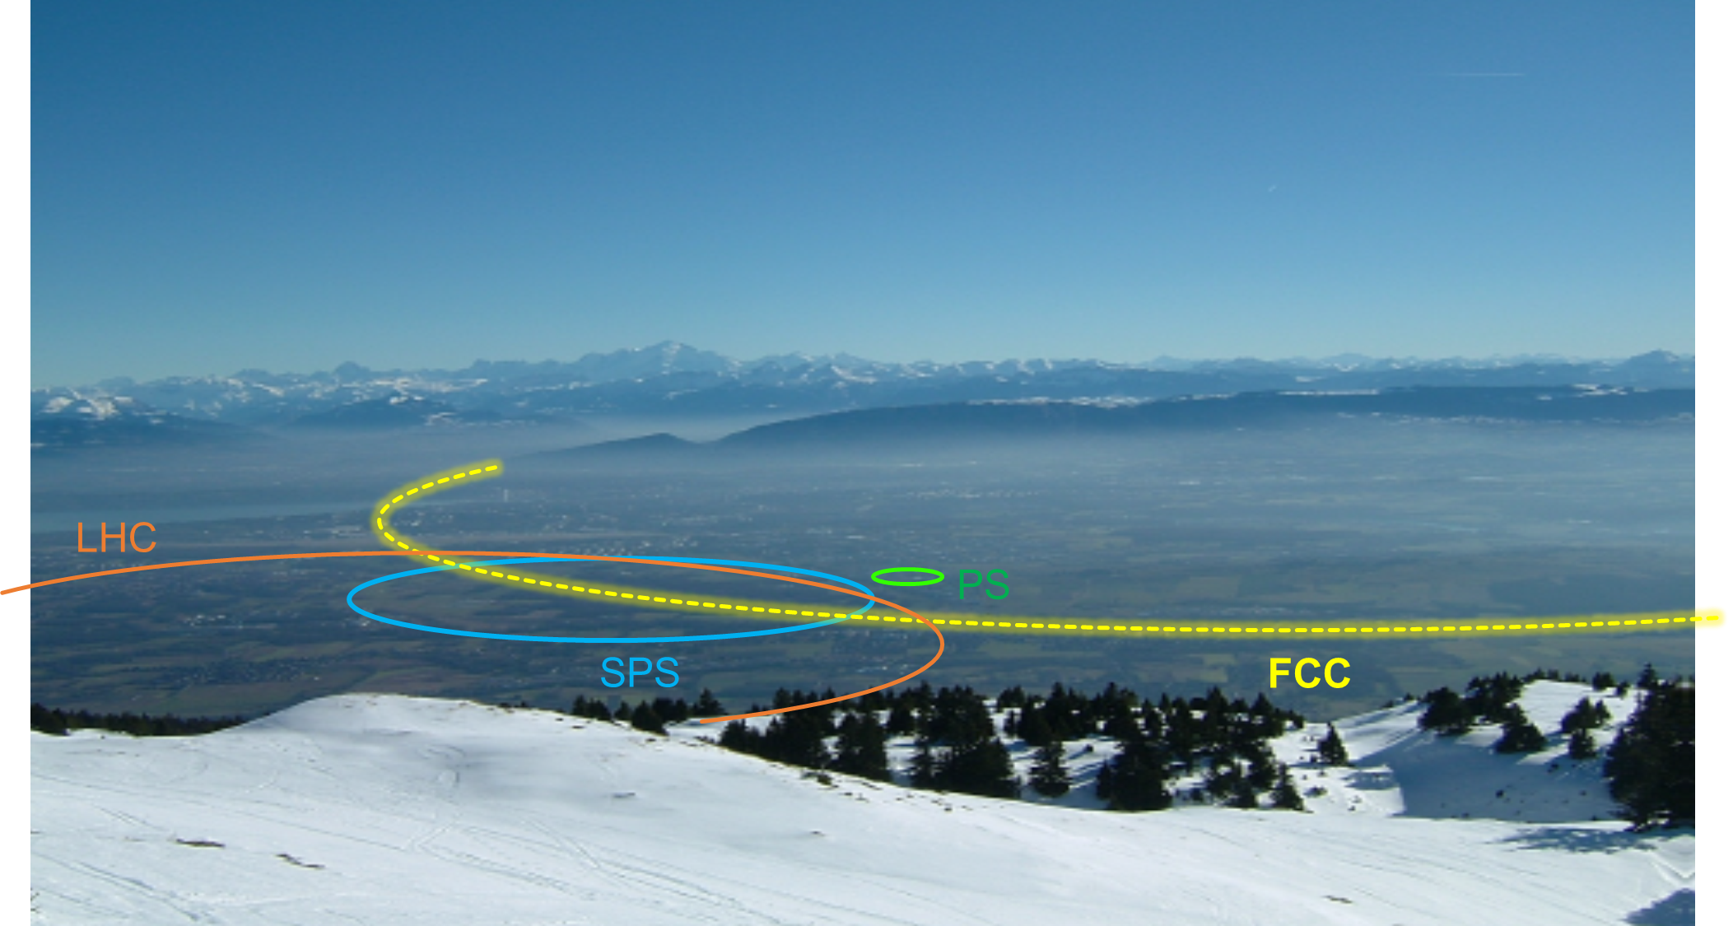
Future High-Energy Collider Projects
Part 1
Roderik Bruce

Slide 2
Introductory remarks
This lecture is based on a collection of materials from many colleagues that I would like to acknowledge:
  W. Bartmann, M. Benedict, M. Boscolo, H. Burkhardt, R. Corsini, B. Dalena, O. Etisken, F. Gianotti, M. Giovannozzi, B. Harer, B. Holzer, J. Jowett, R. Kersevan, A. Lechner, M. Lamont, J. Pfingstner, T. Pieloni, M. Rakic, S. Redaelli, D. Schulte, L. Rossi, R. Ruber, M. Schaumann, J. Wenninger, F. Zimmermann
  In particular, a lot of material comes from D. Schulte – thanks! – who in turn used material from S. Stapnes, L. Rossi, Ralph Assmann, J-P. Delahaye, L. Linssen, S. Doebert, A. Grudiev, F. Tecker, W. Wuensch, S. Poss, J. Strube, J. Wenninger, M. Benedikt, F. Zimmermann, B. Holzer, R. Kersevan, Ph. Lebrun
  This is an accelerator lecture. For particle physics, e.g., physics goals etc., please see physics lectures
  I will use concepts introduced in other lectures:
    Foteini Asvesta: Accelerators and Beam Dynamics
    Susana Izquierdo Bermudez: Magnet Superconductivity
  Focus on machines studied at CERN

Slide 3
Outline
Introduction
  Considerations for collider design: particle type, energy, circular/linear…
  Limitations for future colliders
  European strategy for particle physics
ILC (International Linear Collider)
CLIC (Compact Linear Collider)
HL-LHC (High-Luminosity Large Hadron Collider)
FCC-hh (Future Circular collider, hadrons)
FCC-ee (Future Circular collider, e+e-)
CEPC/SppC (Chinese Electron-Positron Collider /
Super proton-proton Collider)
Muon collider
First lecture
Linear
Second lecture
Circular

Slide 4
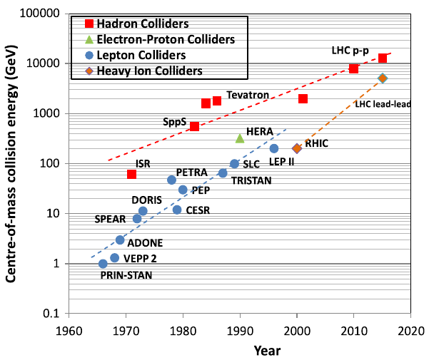
Particle colliders
Particle colliders have been instrumental for scientific discoveries in high energy physics for more than half a century
  Key for establishing the standard model in particle physics
Technological innovation made it possible to increase energy at a much faster pace than the costs
LHC has the highest energy among colliders built so far
  Circular collider, designed to collide
  7 TeV protons and heavy ions
“Livingstone plot” of collider energy vs time (source)

Slide 5
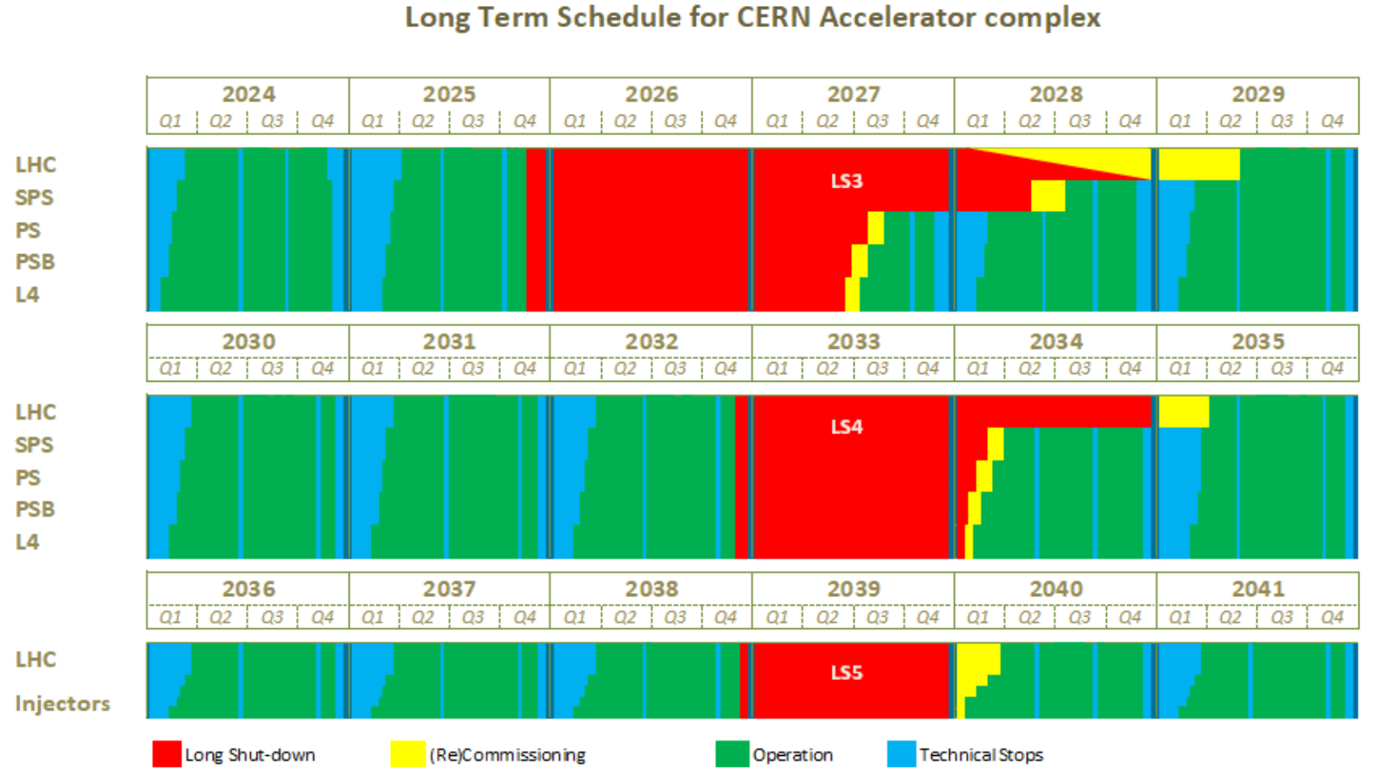
LHC timeline
Present LHC will operate for a few more years
High-Luminosity LHC (HL-LHC) upgrades foreseen for next long shutdown
HL-LHC planned to operate into early 2040’s
What happens next?
  Nobody knows, but there are many ideas on the table
It took ~25 years to design and build the LHC, so need to start thinking now about future options
Tentative schedule, could well change
(source https://edms.cern.ch/document/2311633/4.0 )
Run 3
Run 3
HL-LHC installation
Run 4
Run 4
Run 5
Run 6
Run 5
Run 6

Slide 6
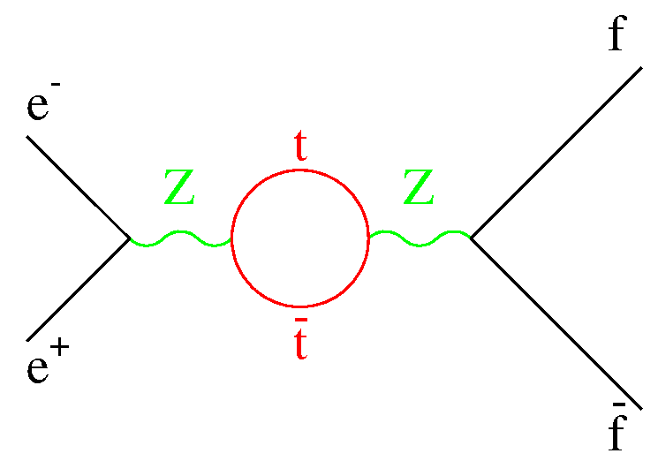
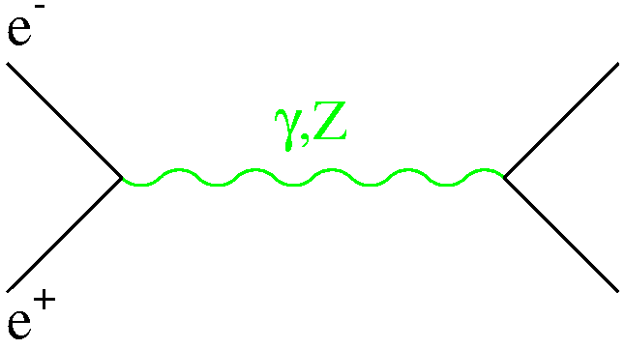
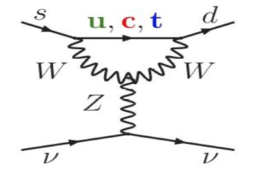
3 main complementary ways to search for (and study) new physics at accelerators
Direct
production of a given (new or known) particle
e.g.: Higgs production at future e⁺e⁻ linear/circular colliders
at √s ~ 250 GeV through the HZ process
→ need high E and high L
Indirect
precise measurements of known processes
Main focus
look for (tiny) deviations from SM expectation from quantum effects (loops, virtual particles)
sensitivities to E-scales Λ>> √s → need high E and high L
√s ~ 90 GeV
● ⁻
E.g. top mass predicted by LEP1 and SLC in 1993:
m_{top} = 177 ± 10 GeV; first direct evidence
at Tevatron in 1994: m_{top} = 174 ± 16 GeV
X*
● ⁺
Rare processes
suppressed in SM → could be enhanced by New Physics
e.g. neutrino interactions, rare decay modes → need intense beams and/or ultra-sensitive (massive)
detectors (“intensity frontier”)
E.g. K⁺ → π⁺νν decay (NA62 experiment)
Proceeds via loops → suppressed in the SM : BR~ 10⁻¹⁰
Can be enhanced by new particles running in the loop.
Theoretically very clean.
Slide from
F. Gianotti

Slide 7
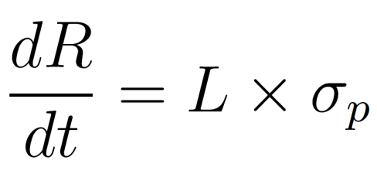
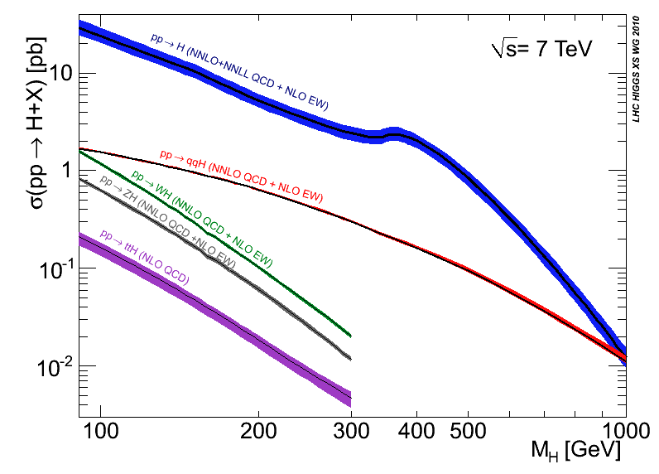
Considerations for new colliders
So, we want high energy and high luminosity
  When we say high luminosity, we implicitly mean high event rate
  Reminder: The luminosity directly determines the event rate
How do we get there? Several choices to be made:
  What to collide: lepton vs hadron
  How to collide:
    fixed target or colliding beams
    linear vs circular collider
  Acceleration technology
    DC, RF, wakefield…
  Magnet technology
    Superconducting (what conductor?), normal conducting
  Acceptable cost of construction, power consumption, site
Think about various limitations to energy and luminosity and how to overcome them
Event rate
Cross section
(given by physics,
cannot be
influenced)
Luminosity
(determined by
and collider design:
can be influenced)
Higgs cross section:
(Centre-of-mass energy)
Notes:
Cross section for hadronic Higgs production is order of pico barn
LHC total integrated lumi : Run1 28/fb, Run2 160/fb, Run 3 (2022 39/fb, 2023 32/fb July 2024 45/fb) => Total 304/fb
Total number of Higgs produced ~3E5

Slide 8
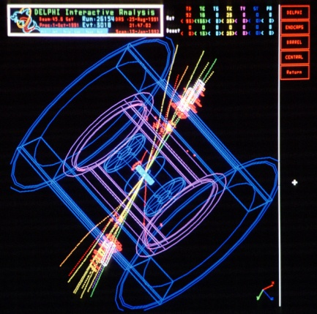
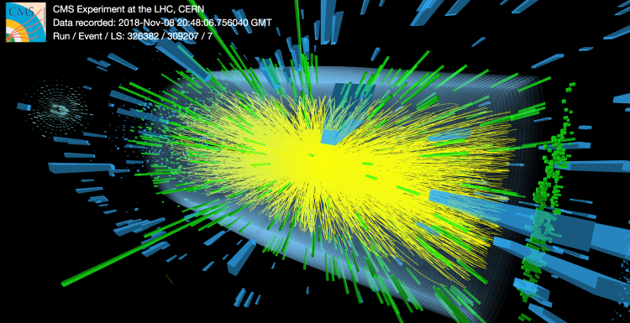
Leptons vs hadrons
Hadrons (protons or ions)
Mix of quarks, anti-quarks and gluons:
  variety of processes
  not all nucleon energy available in collision
  Energy spread between partons – spread in collision energy
  huge QCD background
Can typically achieve highest collision energy
Good for discoveries at the frontier of new physics
Leptons (electrons, positrons, maybe muons)
Elementary particles colliding - very well defined centre-of-mass energy
Low background
Good for high-precision measurements
Higher energy loss from synchrotron radiation influences accelerator design → see next slides
e+
e-
p
p
LHC Pb-Pb
collision, CMS
LEP II e+e-
collision, DELPHI

Slide 9
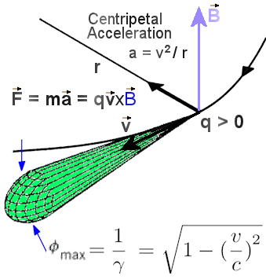
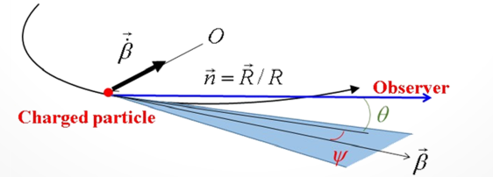
Synchrotron radiation
Classical electrodynamics: an accelerating charge radiates
  Radiation carries off energy, which is taken away from the kinetic energy
  Radiated energy needs to be replenished by accelerating RF cavities => could lead to very high power consumption
  Radiated photons impact on vacuum chamber => causes heating, maybe even damage for high power loads
For a relativistic charged particle, radiation is forward – it sweeps around like a locomotive's headlight as the particle moves
Imposes limitations on
collider design
Notes:
Griffiths p11:16 p481 pdf,
Jackson p688 eq 14.13-14.14

Slide 10
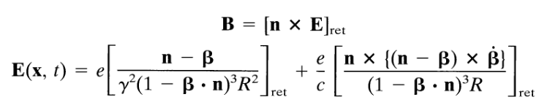


Radiated power
For full derivation, see e.g. Jackson, Classical electrodynamics, chapter 14
Very short summary
  Write down electric and magnetic fields of moving point charge (at relativistic speed)
  Power radiated is given by integral of Poynting vector over closed surface around charge, let R→∞ (only 1/R terms in fields contribute)
  Integrate …. don’t be in a hurry
Result:
  Energy loss is negligible for longitudinal acceleration, except for extreme (unphysical) gradients
  For transverse acceleration (as in circular colliders), energy loss could be significant - 4th power dependence on energy and mass
  Effect is much more limiting for light particles, such as electrons/positrons
    Electrons are 2000 times lighter than protons!
Longitudinal
acceleration
Transverse
acceleration
force
Energy loss per turn
from radiation
force
… meaning…

Slide 11
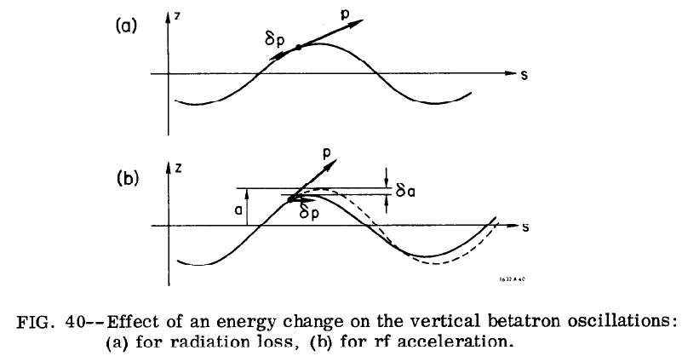
Radiation damping
Emitted photons along betatron trajectory – particle loses both longitudinal and transverse momentum
Energy losses compensated by RF, giving purely longitudinal momentum kick
Increases longitudinal momentum and not transverse => decrease in angle
  Smaller betatron amplitudes => smaller emittance, “radiation damping”
  Remember: emittance determines phase space area occupied by beam
On the other hand: photon emission gives small random energy (and very small angle) change => blowup, “quantum excitation”
Equilibrium between radiation damping and quantum excitation exists: equilibrium emittance
  Time needed for the beam to reach the equilibrium emittance: “Damping time”
  Equilibrium emittance is typically smaller in vertical than horizontal plane => “flat” lepton beams
M. Sands, SLAC-121 UC-28

Slide 12
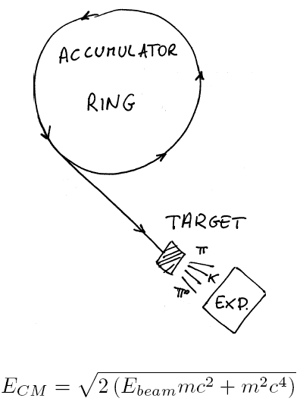
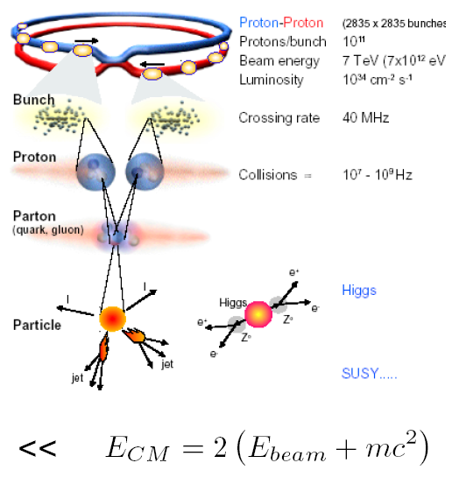

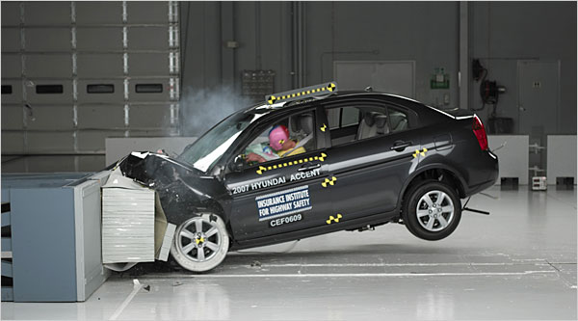
Collider vs fixed target experiments
Fixed Target
Collider
To achieve the highest possible centre-of-mass energy, need a collider

Slide 13
Circular vs linear collider
Circular Collider
multi-pass => Accelerate beam in many turns, let beam collide many times
many magnets, few accelerating cavities
Bending of beam trajectory => synchrotron radiation losses important for light particles
accelerating cavities
N
N
S
S
Linear Collider
single pass => need to be very efficient
few magnets, many accelerating cavities
Not limited by synchrotron radiation – promising choice for reaching highest lepton energies
source
main linac

Slide 14
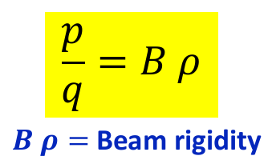
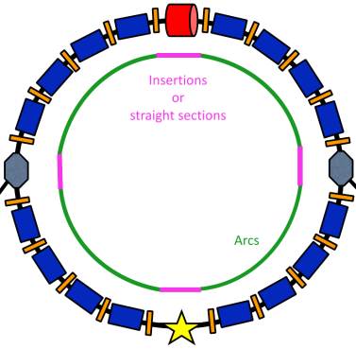
Increasing beam energy
Circular Collider
Linear Collider
Hadron beams: energy limited by ability of to keep particle on circular orbit
  Maximum achievable dipole field (superconductor technology)
  Radius of ring (cost, site)
Lepton beams: radiation losses
  RF power consumption
  Disposal of radiated power
  Radius of ring (cost, site)
Energy depends on
  Accelerating gradient (RF technology)
    Plasma wakefield acceleration promises large advancement, but not yet mature to produce required beam quality
  Length (cost, site)
(see lecture F. Asvesta)
E_{cm} ≈ L_{linac} G_{acc}
For protons:
To push energy boundary: improve technology (B-fields, RF gradient) or build a larger machine
Notes:
9 gev lost per turn in FCC-ee 182.5 GeV

Slide 15

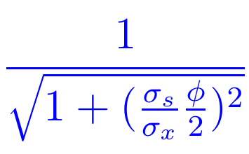
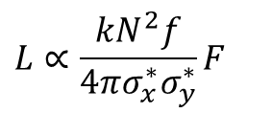
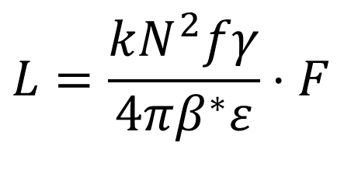
Increasing luminosity
Reminder: luminosity depends on beams and optics (see lecture F. Asvesta)
Expression for round beams:
Higher intensity
Increase F: shorter bunches, smaller crossing angle
In addition:
Potential limitations on luminosity from losses and showers from the collisions
Increase number of bunches
Increase bunch intensity
$$L=\frac{kN^{2}fγ}{4πβ^{∗}ε}⋅F$$
$$L∝\frac{kN^{2}f}{4πσ_{x}^{∗}σ_{y}^{∗}}F$$
Elliptic beams:
Smaller β*
Smaller normalized emittance
Smaller beam size

Slide 16
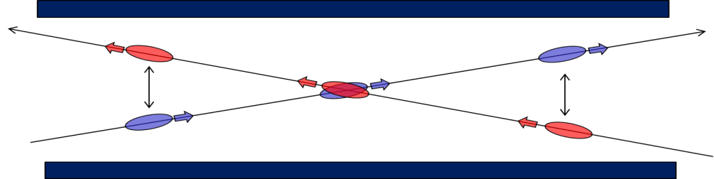
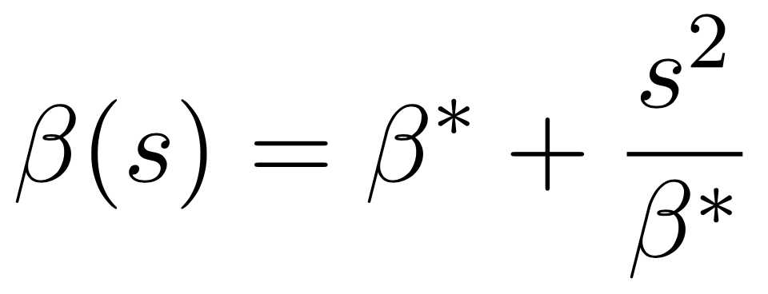
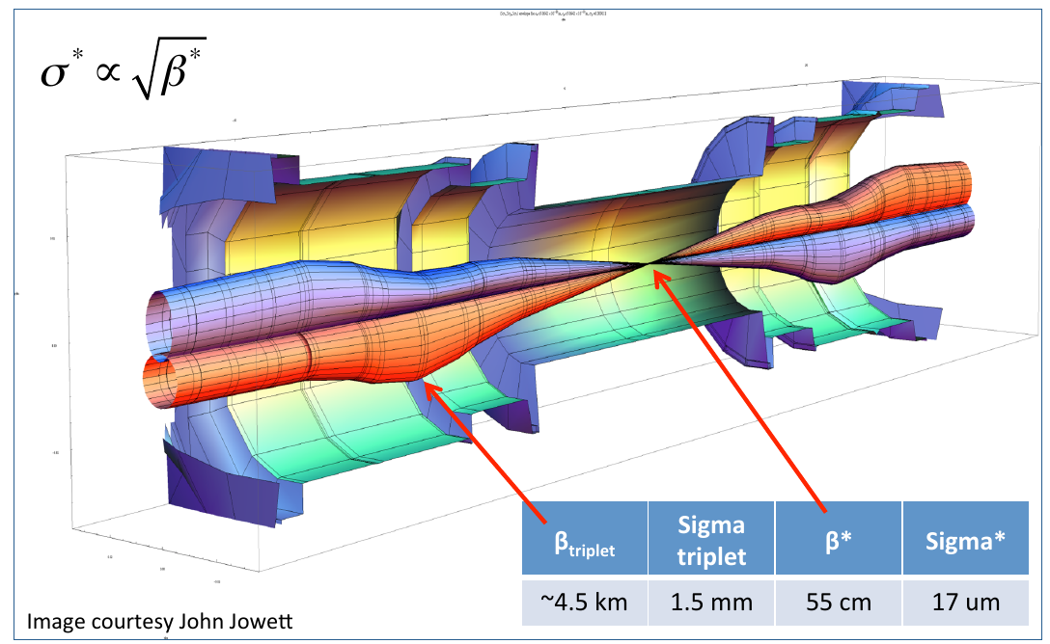
Some limitations on intensity and beam size
(not exhaustive list)
Intensity
  Limitations in beam production scheme
  Collective effects and instabilities, e.g. space charge, impedance effects, electron cloud, beam-beam effects (detrimental non-linear electromagnetic field acting on opposing beam)
  In circular lepton machines, limitations on RF power (compensate synchrotron radiation losses)
  Detrimental effects of beam losses
Beam size
  β* (β-function around collision point) limited by magnet focusing strength and aperture in final focus quadrupoles
  Emittance: limitations in beam production, larger risk for instabilities, blowup (intra-beam scattering); not easy to reduce emittance of existing beam, need dedicated cooling
    Lepton machines: equilibrium emittance determined by accelerator lattice
    Can use damping rings to shrink emittance
  Beam-beam effects
Long-range
Head-on
β-function around collision point:

Slide 17
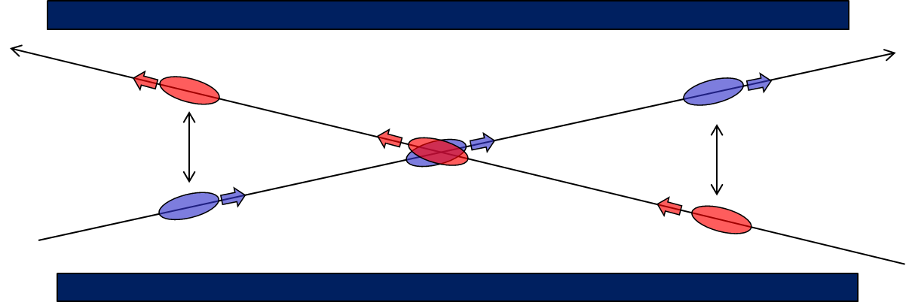
Geometric reduction factor
Long-range
Head-on
Bunches typically collide with an angle, ”crossing angle” – otherwise we get unwanted collisions outside interaction point if they arrive closely in time
  Crossing angle need to be large enough so that bunches are not perturbed by electromagnetic field at parasitic encounters (long-range beam-beam effect)
Fewer collisions when overlap is not perfect – geometric reduction factor
  Depends on crossing angle, bunch length, and transverse size

Slide 18
Considerations for future collider choices
Physics potential
D. Schulte
The collider energy
The collider luminosity
Particle type
Feasibility
The technical maturity
The risk
The schedule
Affordability
The collider cost
The collider power consumption
Availability of site

Slide 19

European strategy for particle physics
Common strategy worked out in Europe to guide future decision-making in field: “European strategy for particle physics”
  endorsed by the CERN council
Based on bottom-up approach:
physics community is invited to submit proposals for near-term, mid-term and longer-term projects → community discussion in open symposium, Physics briefing book
  Based on this input, the European Strategy Group formulates the strategy
    consists of scientific delegates from CERN Member States, Associate Member States, directors of major European laboratories, representatives of various European organizations, some invitees from outside the European Community
Initiated in 2006, updated in 2013 and 2020, next update foreseen around 2027
  2020 update: Key takeaway messages

Slide 20
Some recommendations in European strategy
Some points relevant to future high-energy colliders - see full document here
[about LHC] “The successful completion of the high-luminosity upgrade …. should remain the focal point of European particle physics, together with continued innovation in experimental techniques. The full physics potential of the LHC and the HL-LHC …. should be exploited. “
“An electron-positron Higgs factory is the highest-priority next collider”
“Europe, together with its international partners, should investigate the technical and financial feasibility of a future hadron collider at CERN with a centre-of-mass energy of at least 100 TeV and with an electron-positron Higgs and electroweak factory as a possible first stage. “
“The particle physics community should ramp up its R&D effort focused on advanced accelerator technologies, in particular that for high-field superconducting magnets, including high-temperature superconductors”
Notes:
Summary from DG presentation to personnel, sept 2020

Slide 21
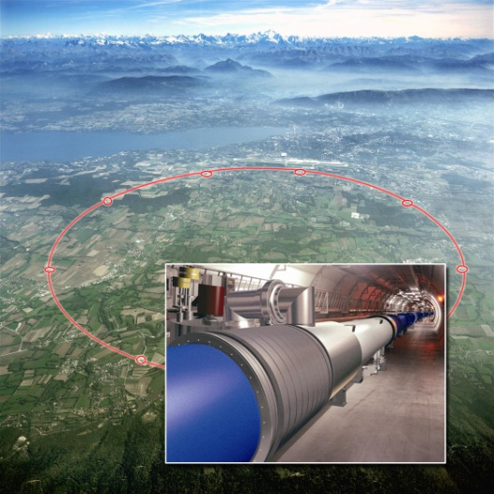
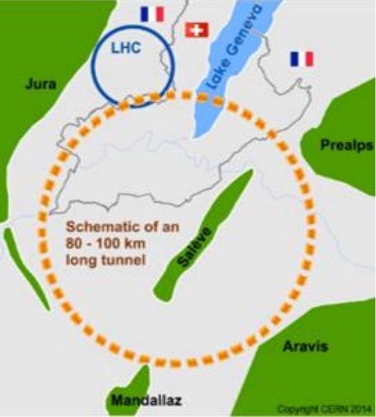
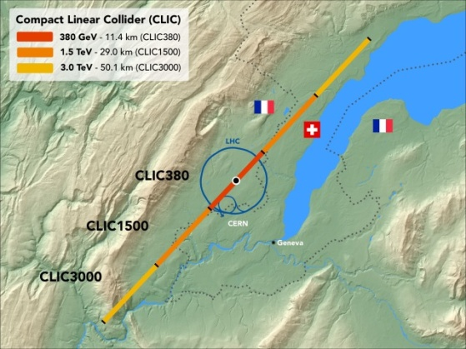
High-energy colliders studied at CERN
HL-LHC: luminosity upgrade of the LHC.
  Approved and financed - production and installation of upgrades already in full swing
  pp collisions with 14 TeV energy in centre-of-mass system (CMS) and heavy ions as in LHC, 27 km ring
Future Circular Collider (FCC) in different stages
  Conceptual design report released
  Circular e+e- collider in ~100 km tunnel, up to 365 GeV CMS: FCC-ee
  Re-use tunnel for 100 km hadron collider, ~100 TeV pp CMS: FCC-hh
  2-step approach inspired by successful LEP – LHC programs at CERN
Compact Linear Collider (CLIC)
  Linear e+e- collider, conceptual design report released
  Up to ~50 km and 3 TeV CMS energy
Other projects that are being studied
  Muon collider
  LHeC (hadron-electron collisions at the LHC)
LHC
FCC
CLIC

Slide 22
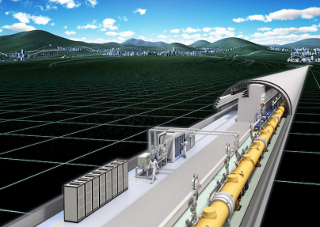
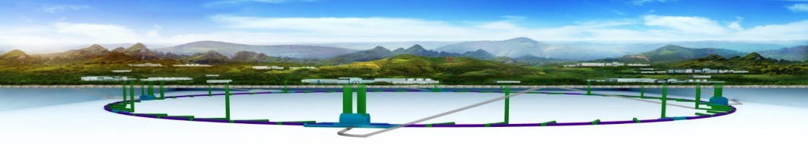
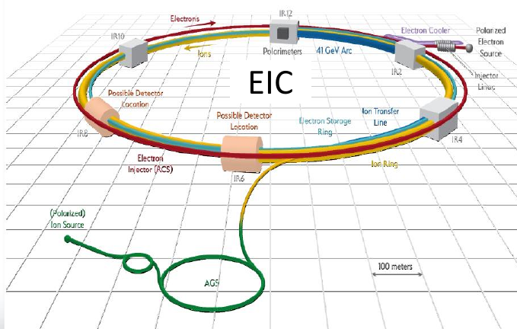
Initiatives in the rest of the world
International Linear Collider (ILC)
  Linear e+e- collider, technical design report released – mature design
  up to 500 GeV CMS, 31 km
  Potentially hosted by Japan – waiting for political decisions
Chinese initiative for circular collider
  First: e+e- collider (CEPC), up to 240 GeV CMS energy, 100 km ring
  followed by a 100 km hadron collider (SppC),
  75 TeV CMS energy (proposals for extensions to ~150 TeV)
Electron-Ion Collider (EIC) to be built at Brookhaven, US
  Circular, up to 140 GeV CMS energy, ~3.4 km
  Range of ions: p-U
  Use existing RHIC with some upgrades for ions
  New electron storage ring and injector
  Project approved, announced timeline to completion of ~10-15 years
ILC
CEPC / SppC

Slide 23

ILC

Slide 24
ILC basics
International Linear Collider: e+e- collider, aiming at 100-250 GeV beam energy (up to 500 GeV centre of mass)
  Extendable to 1 TeV (requires doubling the length)
Foreseen length at 500 GeV CMS energy of 31 km
Possibly to be built in Japan – waiting for political decisions and agreements on funding

Slide 25
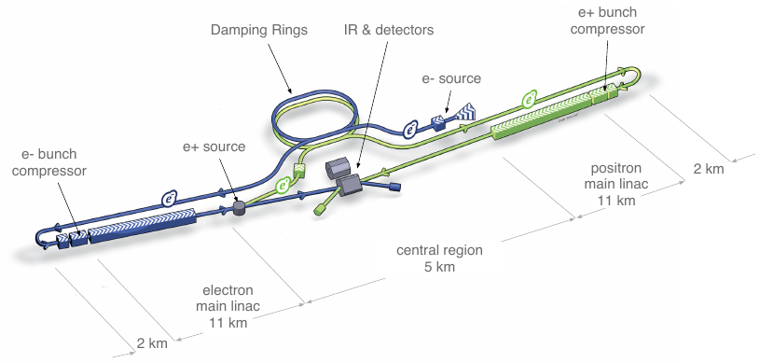
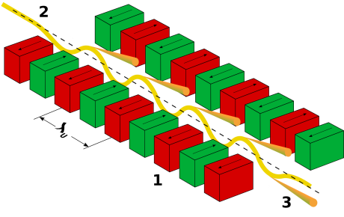
ILC layout and concept
From ILC design report
First, create e- (photocathode DC gun)
Accelerate, send to circulate in 3.2 km damping ring
  Shrinking emittance under radiation damping
e- sent to main linac, accelerate
To create e+: Electrons pass undulator – magnets with many periodic bends
  Radiated photons impact on Ti-alloy target, creating e+e- pairs.
  Capture e+, accelerate, send to damping ring
Send e+ to main linac, accelerate
Collide e+e- inside detector
Undulator
CC BY-SA 3.0, https://commons.wikimedia.org/w/index.php?curid=537945

Slide 26
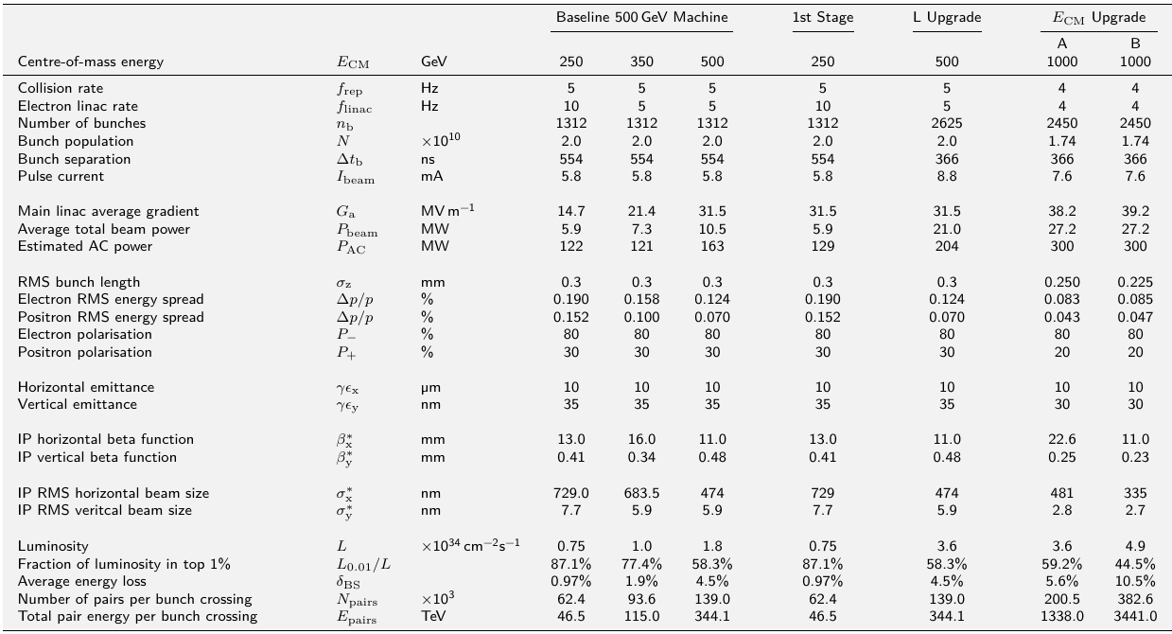
ILC main parameters
From ILC design report

Slide 27
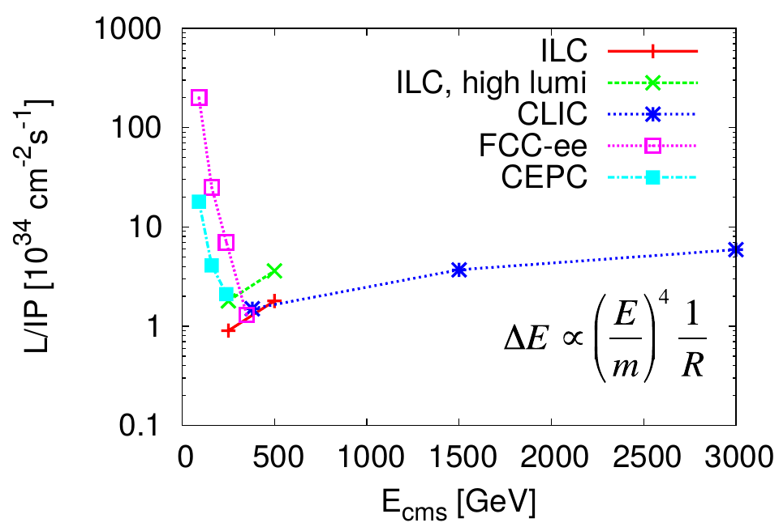
Luminosity comparison
Comparing luminosity between different future lepton colliders
  Circular and linear
At high energies, linear lepton colliders can achieve higher luminosity than circular ones
  Intensity in circular colliders limited by synchrotron radiation

Slide 28
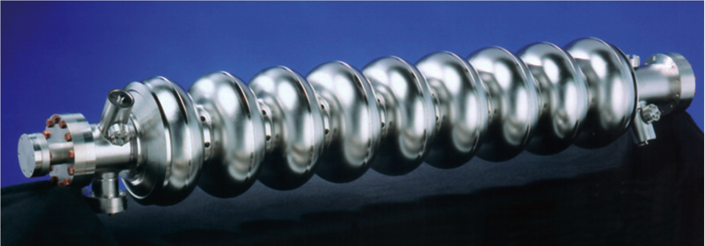
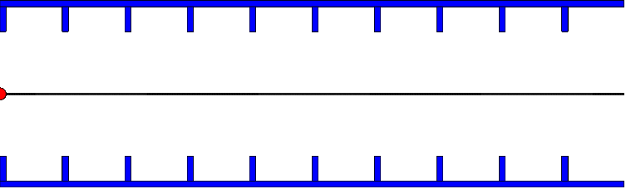
ILC Cavities
Superconducting cavity (Ni at 2 K)
RF frequency is 1.3 GHz, 23 cm wavelength
Length is 9 cells = 4.5 wavelengths = 1 m
Standing wave structure, achieving gradients of 31.5 MV/m
Theoretical field limit around 50-60 MV/m
  In reality, reaching about 30-40 MV/m with imperfections
Need about 8000 cavities

Slide 29
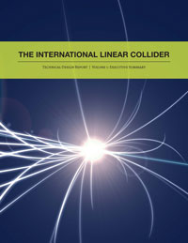
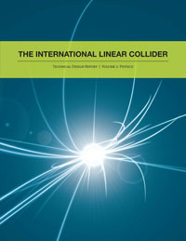
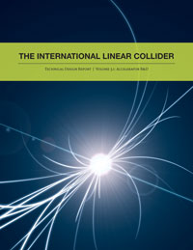
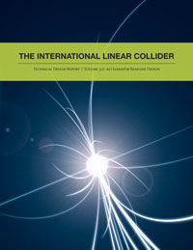
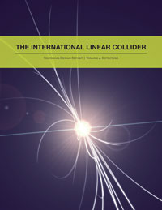
Further documentation
ILC technical design report

Slide 30
CLIC

Slide 31
CLIC basics
Linear e+e- collider, to be built in stages of increasing centre-of-mass energy:
  380 GeV – 3 TeV
  Length between ~11 km and ~50 km
Aiming at highest lepton energies
30 MW of beam power at 3TeV

Slide 32
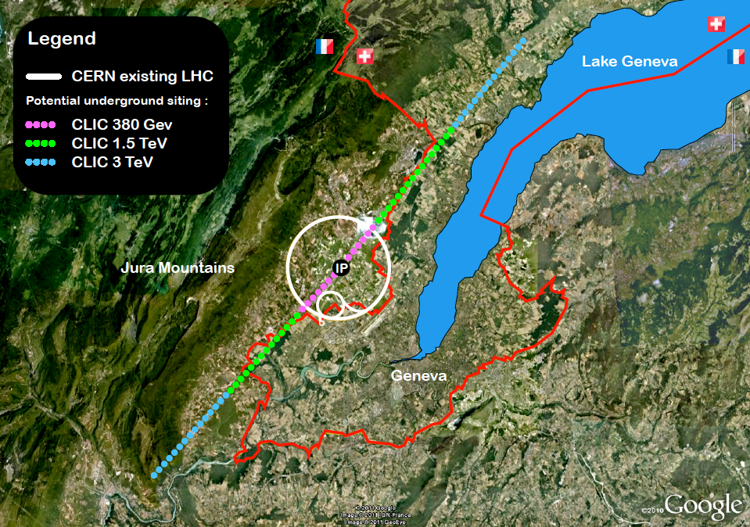
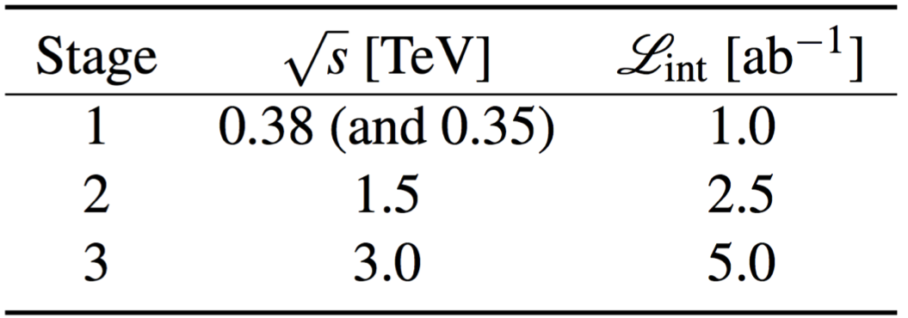
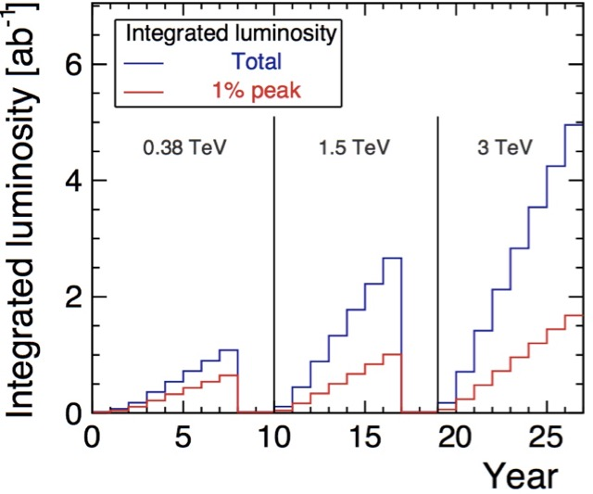
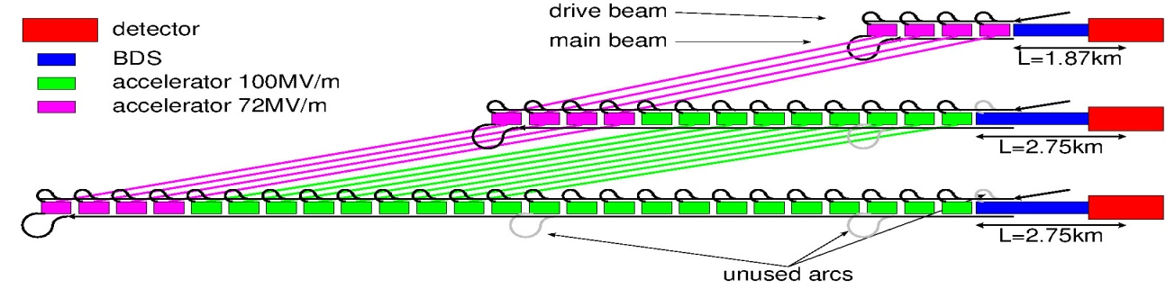
CLIC Staged Scenario
3 stages foreseen:
Central complex on Prevessin site
Luminosity evolution

Slide 33
CLIC parameters
Parameter | Symbol [unit] | ILC 250 | CLIC | CLIC
Centre of mass energy | E_{cm} [GeV] | 250 | 380 | 3000
Luminosity | L [10³⁴cm⁻²s⁻¹] | 1.35 | 1.5 | 6
Luminosity in peak | L_{0.01} [10³⁴cm⁻²s⁻¹] | 1 | 0.9 | 2
Gradient | G [MV/m] | 31.5 | 72 | 100
Particles per bunch | N [10⁹] | 20 | 5.2 | 3.72
Bunch length | σ_{z} [μm] | 300 | 70 | 44
Collision beam size | σ_{x,y} [nm/nm] | 516/7.7 | 149/2.9 | 40/1
Vertical emittance | ε_{x,y} [nm] | 35 | 30 | 20*
Bunches per pulse | n_{b} | 1312 | 352 | 312
Bunch distance | Δz [mm] | 554 | 0.5 | 0.5
Repetition rate | f_{r} [Hz] | 5 | 50 | 50
D. Schulte

Slide 34
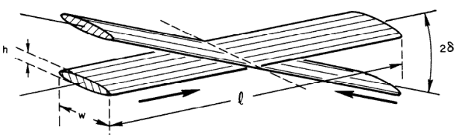
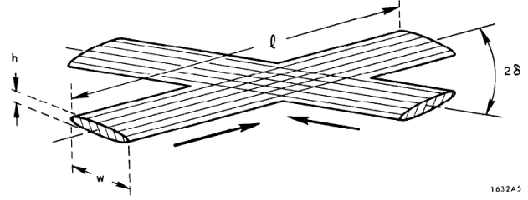

Flat beams in lepton colliders
Naturally smaller vertical beam size from radiation damping
  Often true also for linear colliders due to horizontal bending in damping rings, transfer lines etc.
Beam-beam effect
  Focusing of e+e- beams due to each others’ fields => higher luminosity
  Bending of particles => synchrotron radiation, “beamstrahlung” => unwanted energy spread in collisions
To avoid energy spread and keep luminosity high: collide “flat” beams, with much smaller beam size in one plane
M. Sands, SLAC-121 UC-28
Luminosity depends on product of beam sizes:
average number of photons per collision depends on sum of beam sizes:
M.A. Valdivia García et al.,
doi:10.18429/JACoW-IPAC2019-MOPMP035

Slide 35
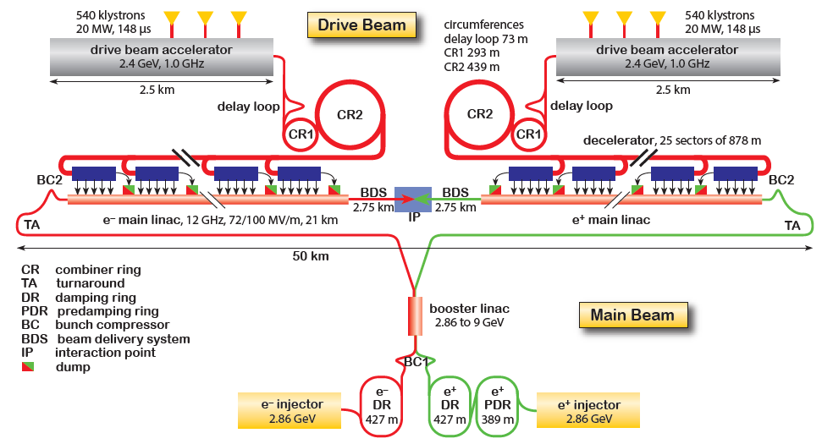
CLIC layout
Concept:
beam generation
→ pre-acceleration
→ damping rings
→ booster linac
→ main linacs →collisions
CLIC aims at gradients of 100 MV/m, 20 times higher than the LHC
  Compare 30 MV/m at ILC
Different acceleration concept in main LINAC from ILC :
  drive-beam acceleration, with RF power taken from another e- beam

Slide 36

CLIC cavities
D. Schulte
To reach 100 MV/m: different type of cavity from ILC
12 GHz, 23 cm long, normal conducting
  Much worse conductor than SC, but allows reaching higher fields
  Problem: power is very rapidly lost in the walls
  Need to put in very intense and short RF pulses timed to the passage of the beam
Power flow
1/3 lost in cavity walls
1/3 in filling the structure and into load
1/3 into the beam
Average RF power about 3 kW/m
About 1 kW/m into beam

Slide 37
Drive beam acceleration
To produce very rapid pulses: use two-beam acceleration scheme
A very long beam pulse at 4A, 140 us produced in LINAC
Use combiner rings to decrease bunch spacing of drive beam => produce very short and intense 100 A pulse
Send to decelerating structure
Drive Beam Accelerator
efficient acceleration in fully loaded linac
Delay Loop x 2
gap creation, pulse compression & frequency multiplication
RF Transverse
Deflectors
Combiner Ring x 3
pulse compression &
frequency multiplication
Combiner Ring x 4
pulse compression &
frequency multiplication
Drive Beam Decelerator Sector
Power Extraction
R. Ruber
Drive beam time structure - initial
Drive beam time structure - final
240 ns
240 ns
5.8 µs
140 µs train length - 24 x 24 sub-pulses - 4.2 A
2.4 GeV - 60 cm between bunches
24 pulses – 100 A – 2.5 cm between bunches

Slide 38


Two-beam acceleration scheme
The high-current drive beam is decelerated in special power extraction structures (PETS)
Generated EM field can be transferred in RF waveguides to the other beam => power is used to accelerate the main beam

Slide 39

CLIC Test Facility (CTF3)
Experimental tests carried out in test facility at CERN to demonstrate drive beam concept
Accelerating gradient of >100 MV/m achieved

Slide 40

CLIC power consumption
Power and energy consumption at
380 GeV is well within the existing parameters and installations at CERN
At 1.5 TeV: power will surpass the current CERN usage (2017) by ~30%
At 3 TeV the energy consumption will be a factor two of the current CERN usage (2017)
Development work ongoing to further improve energy efficiency
Estimated power consumption of CLIC in MW at 380 GeV (total: 252 MW)
https://clic.cern

Slide 41


CLIC reference documents
More information:
  Conceptual design report (2012)
  Updated CLIC baseline document (2016)

Slide 42
Outline
Introduction
  Considerations for collider design: particle type, energy, circular/linear…
  Limitations for future colliders
  European strategy for particle physics
ILC (International Linear Collider)
CLIC (Compact Linear Collider)
HL-LHC (High-Luminosity Large Hadron Collider)
FCC-hh (Future Circular collider, hadrons)
FCC-ee (Future Circular collider, e+e-)
CEPC/SppC (Chinese Electron-Positron Collider /
Super proton-proton Collider)
Muon collider
First lecture
Linear
Second lecture
Circular

Slide 43

Coffee break – some fruit?
Source: https://xkcd.com/1949/

