Slide 1

A next generation rare pion decay experiment
Quentin Buat (University of Washington) — Nov 14, 2023
Notes:
My goal in this talk is to review the way tau leptons are detected with the ATLAS detector. Before going into the specifics,I wanted to give a bit of a broad overview of the tau lepton, starting with an historical perspective

Slide 2
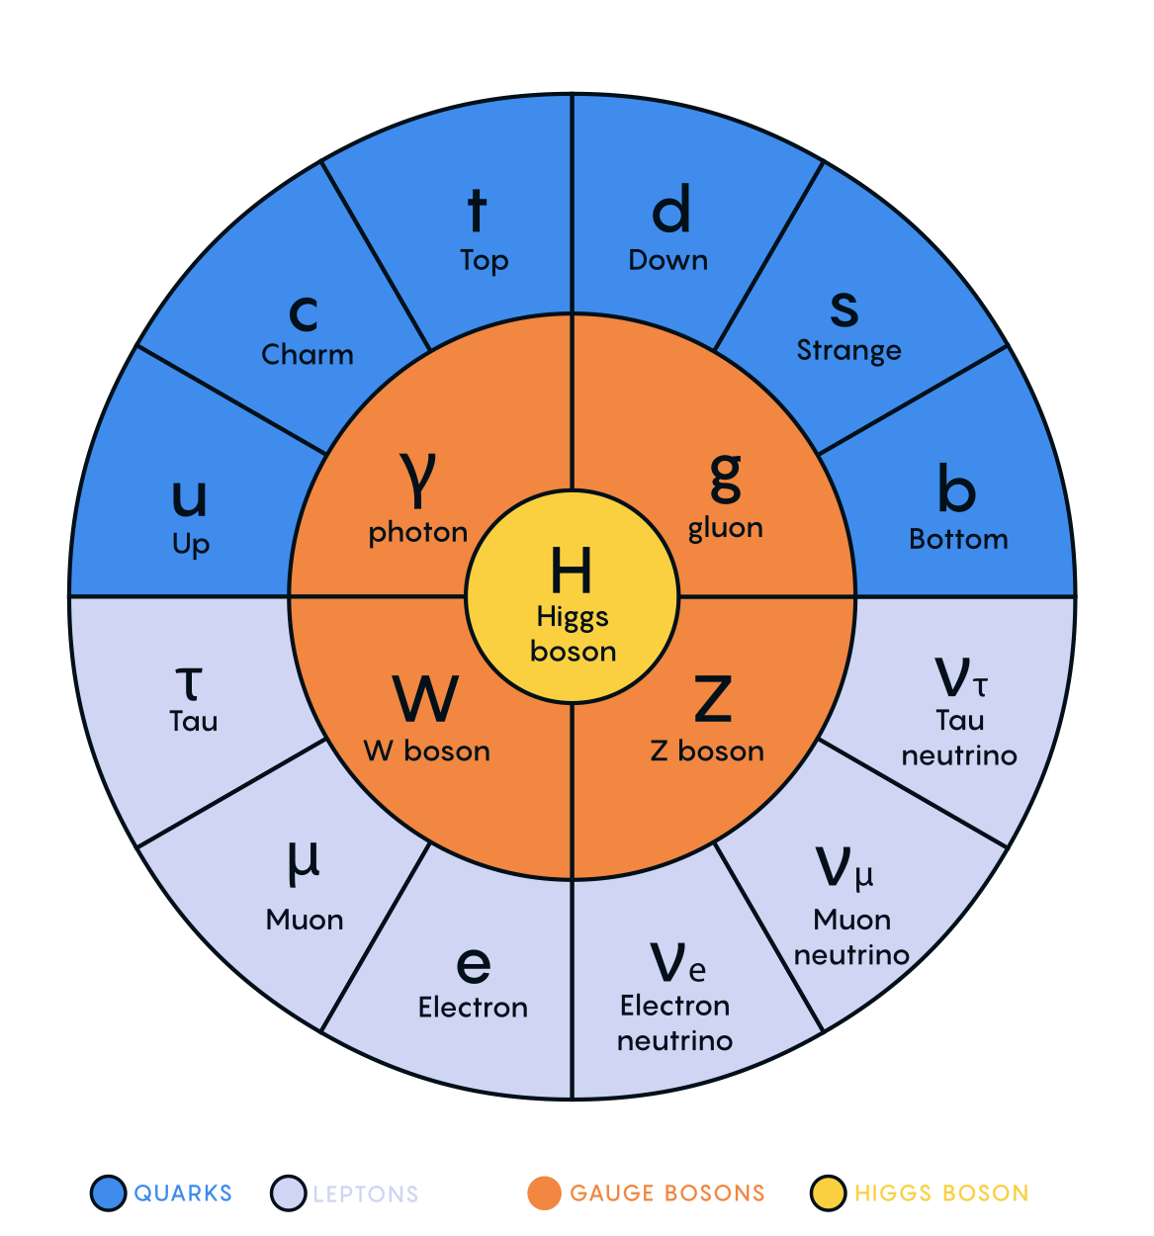
The SM of Particle Physics

Slide 3
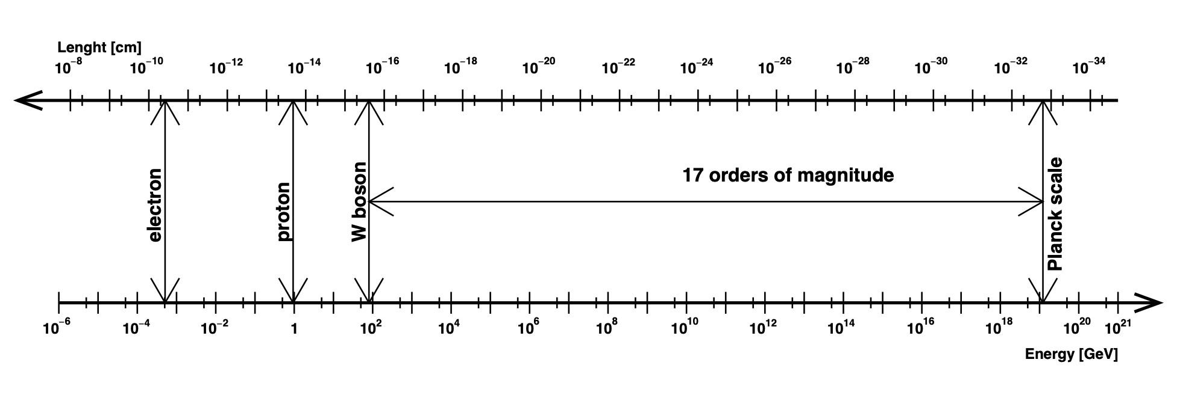
Fundamental interactions
QED
QCD
EW
Gravity
Known forces in Nature and their associated energy scale
Explore the gap between EW and Gravity scales
Look for feeble interactions below the EW scale

Slide 4

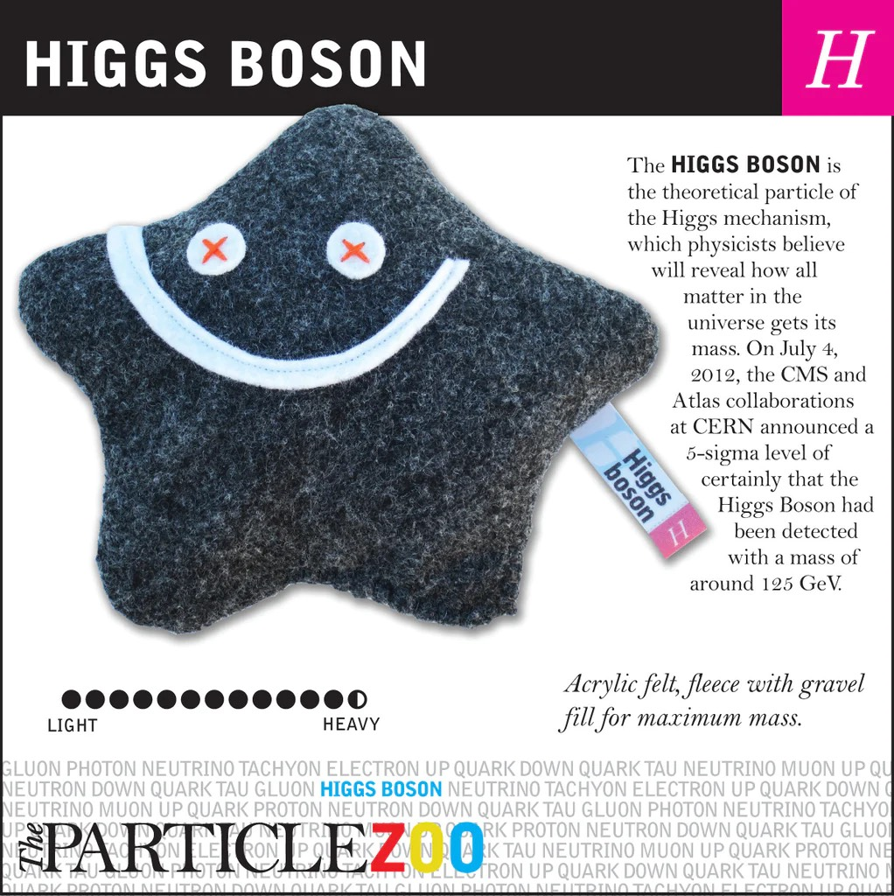
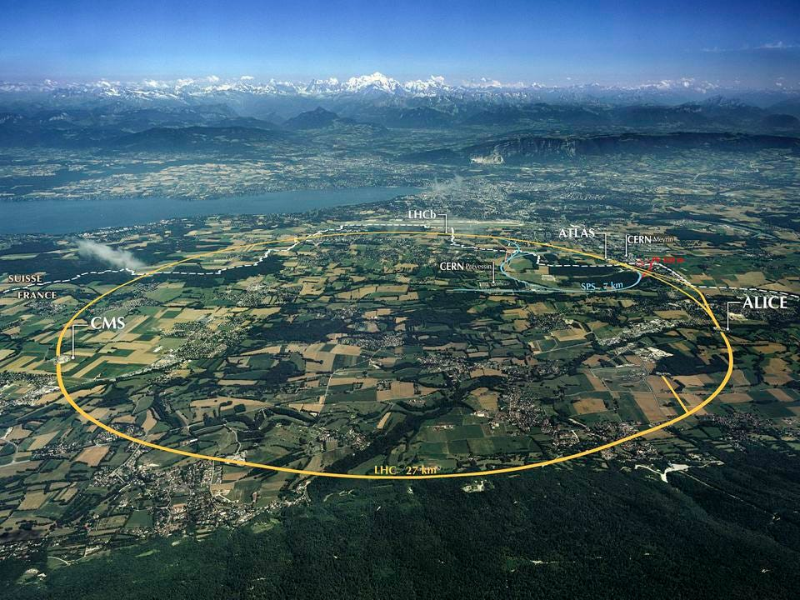
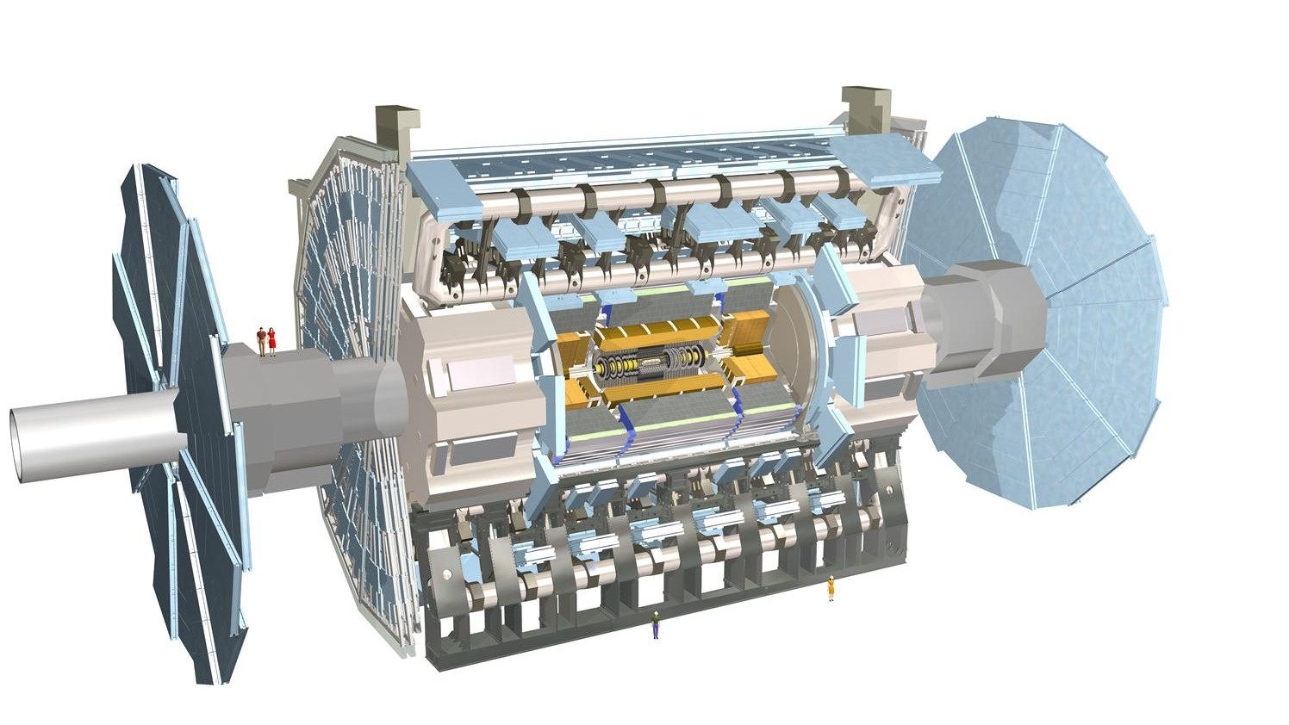

The direct approach
Collide particles at the highest possible energy
Discovered the Higgs boson and deploy a comprehensive measurement program to understand the EWSB mechanism
However, no sign of deviations from the SM and no large collision energy increase foreseen anytime soon
Large Hadron Collider

Slide 5

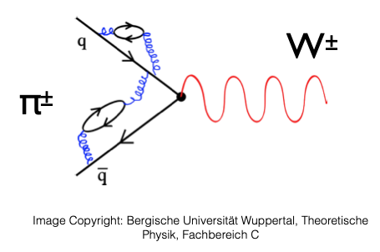
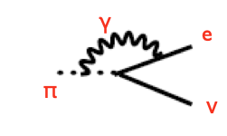
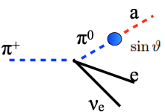
What else can we do?
Consider “well-defined” SM quantities and measure them very precisely
High energy particles can have an impact at lower energy through quantum effects
Precision measurements require large datasets: opportunity to discover feeble interactions
e⁺
π⁺
νe
Contribution from off-shell new heavy particles
Hadronic corrections
EW corrections
Feeble interactions with new light particles

Slide 6
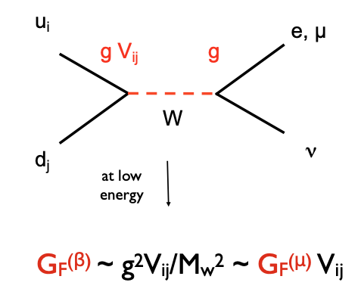
Rare Pion Decays
Probing weak universality
Charged currents in the SM are mediated by the exchange of a W boson between left-handed fermions and right-handed anti-fermions
  The coupling is the same for all fermions
Lepton Flavour Universality
$${\left[G_{F}^{(β)}\right]}_{e}/{\left[G_{F}^{(β)}\right]}_{μ}=1$$
Cabbibo Universality
$$|V_{ud}|^{2}+|V_{us}|^{2}+|V_{ub}|^{2}=1$$
PIONEER will test both!

Slide 7
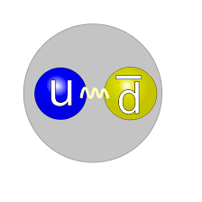
PIONEER Studies charged pions
$$π^{+}$$
Mass = $\text{139.57039}±\text{0.00018}$ MeV [ppm]
Lifetime =$\text{26.033}±\text{0.005}$ ns [~0.02%]
Decay Modes:
  $π^{+}→μ^{+}ν_{μ}$ Branching Ratio $\text{99.98770}±\text{0.00004 \%}$
  $π^{+}→e^{+}ν_{e}$ B. R. $\left(1.230±0.004\right)×$ ${10}^{−4}$ [~0.3%]
  $π^{+}→π^{0}ν_{e}e^{+}$ B. R. $\text{(1.036}±\text{0.006)}×{10}^{−8}$ [~0.6%]
  $π^{+}→e^{+}ν_{e}e^{+}e^{−}$ B. R. $\left(3.2±0.9\right)×{10}^{−9}$
Quark model

Slide 8
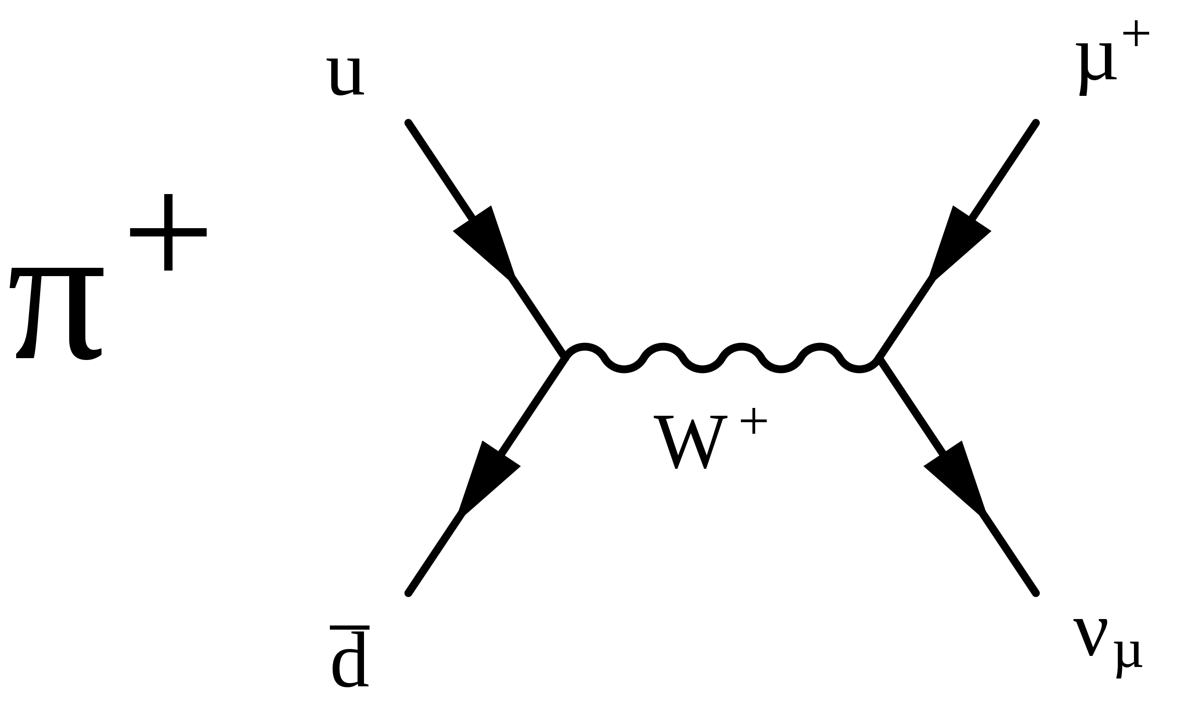
Rare Pion Decays
Lepton Flavour Universality
$$R_{e/μ}=Γ(π→eν(γ))÷Γ(π→μν(γ))$$
$$e^{+}$$
➗
$$ν_{e}$$
$$R_{e/μ}=\frac{m_{e}^{2}}{m_{μ}^{2}}×{\left(\frac{m_{π}^{2}-m_{e}^{2}}{m_{π}^{2}-m_{μ}^{2}}\right)}^{2}×\left[1+\text{EW corrections}\right]=1.23524(015)×{10}^{-4}$$
Fully computed at NLO
O(10⁻⁴) uncertainties at NNLO
‘Helicity suppression’
term: ~2.3 x10⁻⁵
Phase space term: ~ 5.5

Slide 9
Rare Pion Decays
$$R_{e/μ}=\frac{Γ(π→eν(γ))}{Γ(π→μν(γ))}$$
Lepton Flavour Universality
$$R_{e/μ}=\frac{m_{e}^{2}}{m_{μ}^{2}}{\left(\frac{m_{π}^{2}-m_{e}^{2}}{m_{π}^{2}-m_{μ}^{2}}\right)}^{2}×\left[1+\text{EW corrections}\right]=1.23524(015)×{10}^{-4}$$
The π→eν branching ratio is so small that for a while it was excluded
$\text{BR}(π→μν)≈0.9998770$, meaning ~1 out of every 10⁴ pions decay to an electron
Lokanathan and Steinberger (1955):
Range telescope at Columbia Nevis cyclotron: $R_{e/μ}<1.2×{10}^{-4}$ (90% CL)
Anderson and Lattes (1957):
Magnetic spectrometer at Chicago cyclotron: $R_{e/μ}<1.3×{10}^{-5}$ (90% CL)

Slide 10
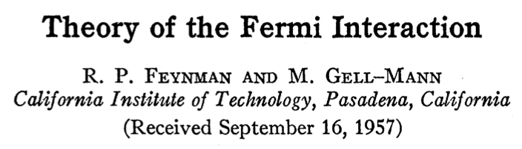

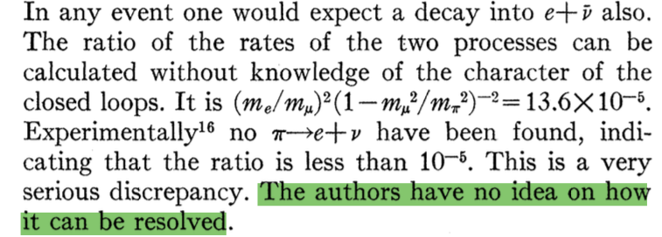
Rare Pion Decays
$$R_{e/μ}=\frac{Γ(π→eν(γ))}{Γ(π→μν(γ))}$$
Lepton Flavour Universality
$$R_{e/μ}=\frac{m_{e}^{2}}{m_{μ}^{2}}{\left(\frac{m_{π}^{2}-m_{e}^{2}}{m_{π}^{2}-m_{μ}^{2}}\right)}^{2}×\left[1+\text{EW corrections}\right]=1.23524(015)×{10}^{-4}$$
Causing a lot of confusion…
PR 109, 193 (1958)

Slide 11
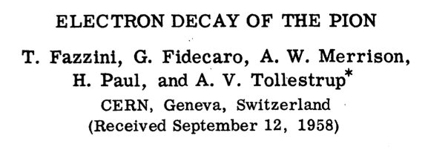

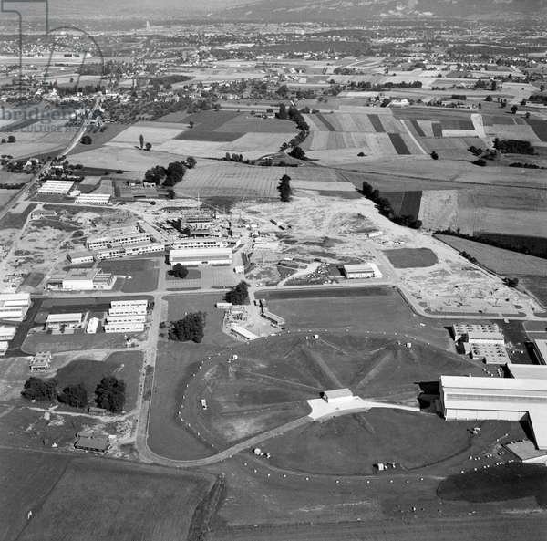
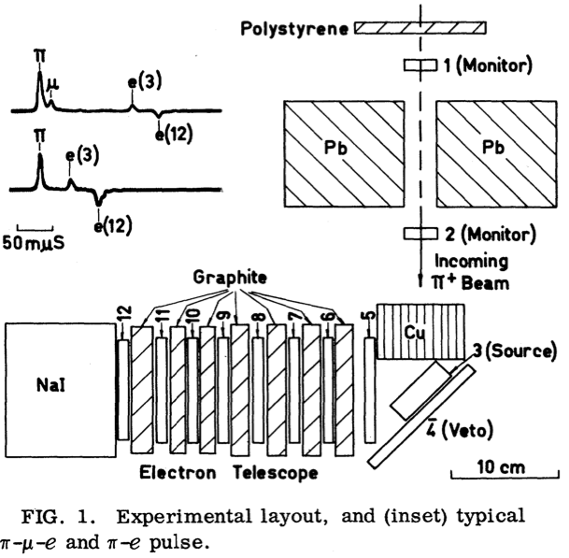
Rare Pion Decays
$$R_{e/μ}=\frac{Γ(π→eν(γ))}{Γ(π→μν(γ))}$$
Lepton Flavour Universality
DISCOVERY!
At a small lab that opened 4 years prior on the outskirts of Geneva, Switzerland
CERN circa 1958
~ 40 $π→eν$ events

Slide 12

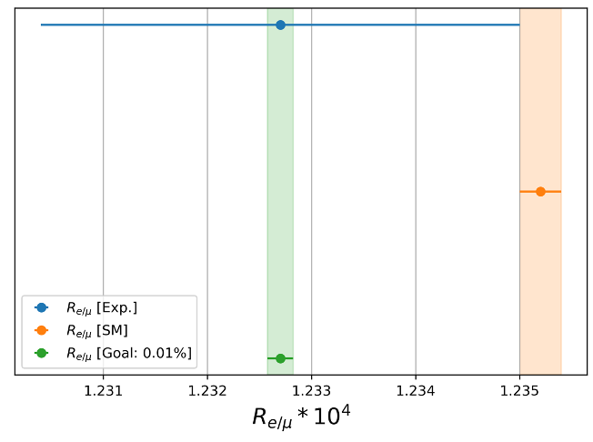

Rare Pion Decays
Lepton Flavour Universality
Best measurement from PIENU at TRIUMF
tested charged LFU at $O\left({10}^{-3}\right)$
We call this measurement
PHASE I
$$R_{e/μ}[\text{Exp.}]=1.23270(230)×{10}^{-4}$$
$$R_{e/μ}[\text{SM}]=1.23524(015)×{10}^{-4}$$
PRL 115, 071601 (2015)
To match the precision of the SM prediction
PIONEER aims to measure
$R_{e/μ}$ to 0.01% precision
15-fold improvement over
the current world best
EFT analysis (JHEP. 2013, 46 (2013))
BSM constraints:
Up to ~330 TeV (pseudo scalar)
~5.5 TeV (axial currents)
Notes:
The first physics goal of PIONEER experiment is to test the lepton flavor universality assumption in the Standard Model. Here the lepton flavor universality means that the weak interaction coupling “g” is the same for different flavor of leptons, electron, muon, and tau.
Among various channels sensitive to the lepton flavor universality, the pion decay channel gives the leading precision. Remu, the ratio between branching ratios of pienu and pimunu has tested the charged lepton flavor universality at 10^-3.
Theoretically, the Remu is known to the 10^-4 precision, making it one of the most precise weak interaction calculations involving hadrons. Such a precision is about a factor of 15 better than the current experimental precision led by the TRIUMF PIENU experiment.
This gap between the experimental precision and theoretical precision gives rise an excellent opportunity for a new experimental program to test lepton flavor university. As shown by this plot, the PIONEER experiment is proposed to measure Remu to the 0.01% level, matching the SM precision. This would improve the test of lepton flavor universality by one order of magnitude.

Slide 13

Rare Pion Decays
Probing weak universality
Charged currents in the SM are mediated by the exchange of a W boson between left-handed fermions
  The coupling is the same for all fermions
Lepton Flavour Universality
$${\left[G_{F}^{(β)}\right]}_{e}/{\left[G_{F}^{(β)}\right]}_{μ}=1$$
Cabbibo Universality
$$|V_{ud}|^{2}+|V_{us}|^{2}+|V_{ub}|^{2}=1$$

Slide 14
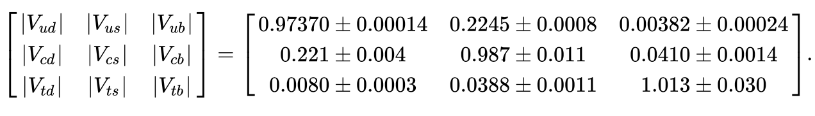
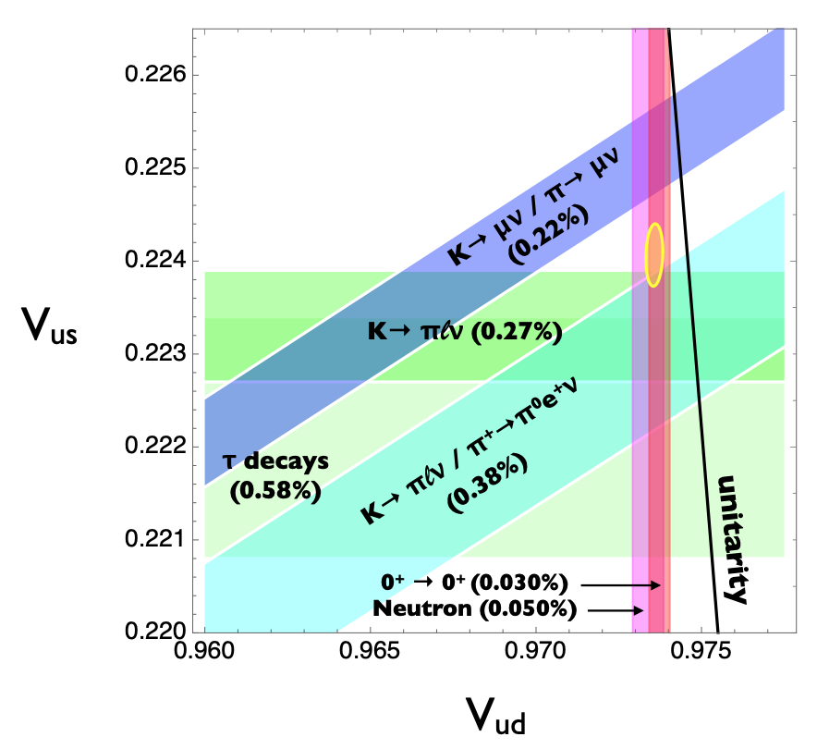
Rare Pion Decays
Testing CKM Unitarity
$$|V_{ud}|^{2}+|V_{us}|^{2}+|Vub|^{2}=1$$
D. Bryman et al.
arXiv:2111.05338
Since$|V_{ub}|≪|V_{us}|$, the third term can be neglected and the first row can be studied in a 2D plane
~3σ tension in the first-row of CKM unitarity test
Often referred to as the
Cabbibo Angle Anomaly (or CAA)
Notes:
Beside the measurement of Remu, PIONEER experiment also aims at the precision measurement of the Pionbeta decay branching ratio. Due to the limitation of phase space, the Pion beta decay is further suppressed with a branching ratio of 10^-8.
Nevertheless, since pion are in both initial and final state, the Pion beta decay provides the theoretically cleanest determination of the CKM matrix element Vud, and allows for a precision test of the unitarity of CKM matrix.
This will be done in two steps. In the first step, we aims to improve the experimental precision of Rpionbeta by a factor of 3. This would allow for a 0.2% determination of the ratio Vus/Vud when combine with the Kaon-semileptonic decay. Essentially, the goal is to shrink this band to a precision matching that of the axial channels, so that we can examine the tension between these two approaches.
In the second step, we aims for a 10-fold improvement of Rpionbeta allowing for a 0.02% determination of Vud. This precision is going to be comparable to that of the super-allowed beta decay, allowing for another stringent test of the CKM unitarity.

Slide 15
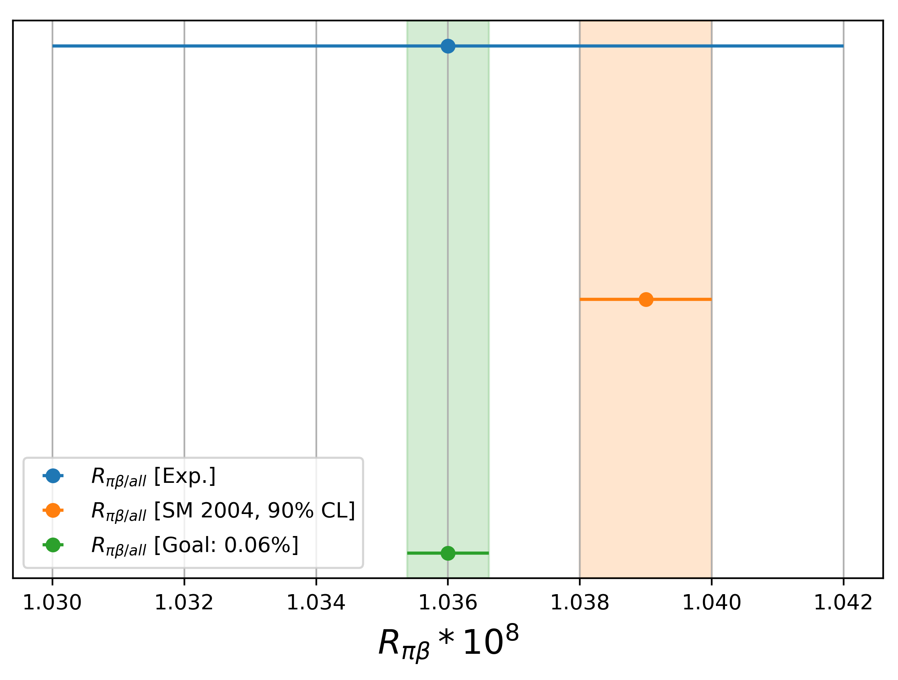

Rare Pion Decays
Testing CKM Unitarity
$$R_{πβ}=\frac{Γ(π^{+}→π^{0}e^{+}ν_{e})}{Γ(π^{+}→\text{all})}$$
Pion beta decay provides the theoretically cleanest determination of $|V_{ud}|$
Current best measurement
from PIBETA at PSI
$$R_{πβ}^{Exp}=1.036(0.006)×{10}^{-8}$$
PIONEER aims to measure
$R_{πβ}$ to 0.06% precision
Ten-fold improvement
over current world best
Constraint on $|V_{ud}|$ comparable
to super-allowed beta decay
We call this measurement
PHASE II
PRL 93, 181803 (2004)
Notes:
Beside the measurement of Remu, PIONEER experiment also aims at the precision measurement of the Pionbeta decay branching ratio. Due to the limitation of phase space, the Pion beta decay is further suppressed with a branching ratio of 10^-8.
Nevertheless, since pion are in both initial and final state, the Pion beta decay provides the theoretically cleanest determination of the CKM matrix element Vud, and allows for a precision test of the unitarity of CKM matrix.
This will be done in two steps. In the first step, we aims to improve the experimental precision of Rpionbeta by a factor of 3. This would allow for a 0.2% determination of the ratio Vus/Vud when combine with the Kaon-semileptonic decay. Essentially, the goal is to shrink this band to a precision matching that of the axial channels, so that we can examine the tension between these two approaches.
In the second step, we aims for a 10-fold improvement of Rpionbeta allowing for a 0.02% determination of Vud. This precision is going to be comparable to that of the super-allowed beta decay, allowing for another stringent test of the CKM unitarity.

Slide 16
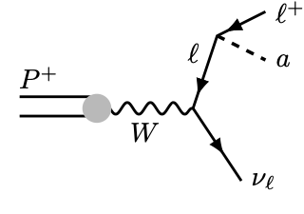
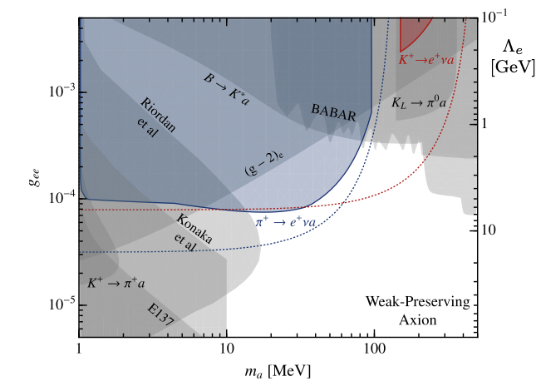
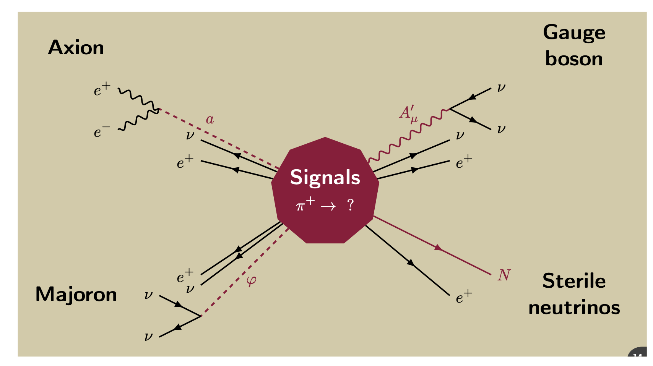
Rare Pion Decays
Direct searches for new physics
Collecting very large samples of rare pion decay
  Search for new weakly coupled particle in the MeV range
  Popular models involve sterile neutrinos or axion-like particles
Lepto-philic axion
J. Dror review at 2022 Rare Pion Decays Workshop
indico contribution
W. Altmannshofer, J. Dror, and S. Gori
Phys. Rev. Lett. 130, 241801
Notes:
Beside the measurement of Remu, PIONEER experiment also aims at the precision measurement of the Pionbeta decay branching ratio. Due to the limitation of phase space, the Pion beta decay is further suppressed with a branching ratio of 10^-8.
Nevertheless, since pion are in both initial and final state, the Pion beta decay provides the theoretically cleanest determination of the CKM matrix element Vud, and allows for a precision test of the unitarity of CKM matrix.
This will be done in two steps. In the first step, we aims to improve the experimental precision of Rpionbeta by a factor of 3. This would allow for a 0.2% determination of the ratio Vus/Vud when combine with the Kaon-semileptonic decay. Essentially, the goal is to shrink this band to a precision matching that of the axial channels, so that we can examine the tension between these two approaches.
In the second step, we aims for a 10-fold improvement of Rpionbeta allowing for a 0.02% determination of Vud. This precision is going to be comparable to that of the super-allowed beta decay, allowing for another stringent test of the CKM unitarity.

Slide 17
Introducing PIONEER
Outline
Phase I measurement strategy
PSI Pion beam line
Detector developments
Simulation studies
e⁺
π⁺

Slide 18
Introducing PIONEER
Phase I measurement strategy
$$e^{+}$$
Counts
$$ν_{e}$$
$$m_{π^{+}}=139.6\text{MeV}$$
Positron Energy [MeV]
The pion stops in the target and decay

Slide 19
Introducing PIONEER
Phase I measurement strategy
$$e^{+}$$
Counts
$$ν_{e}$$
69
$$m_{π^{+}}=139.6\text{MeV}$$
Positron Energy [MeV]
The pion stops in the target and decay

Slide 20
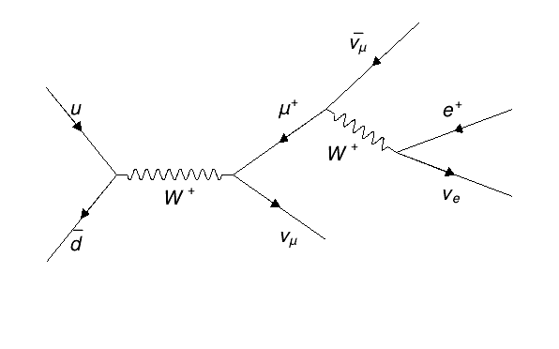
Introducing PIONEER
Phase I measurement strategy
Counts
$$π^{+}$$
$$m_{π^{+}}=139.6\text{MeV}$$
$$m_{μ^{+}}=105.7\text{MeV}$$
The pion stops in the target and decay
69
Positron Energy [MeV]
Then the muon stops in the target and decay

Slide 21
Introducing PIONEER
Phase I measurement strategy
Counts
$$m_{π^{+}}=139.6\text{MeV}$$
$$m_{μ^{+}}=105.7\text{MeV}$$
The pion stops in the target and decay
53
69
Positron Energy [MeV]
Then the muon stops in the target and decay

Slide 22
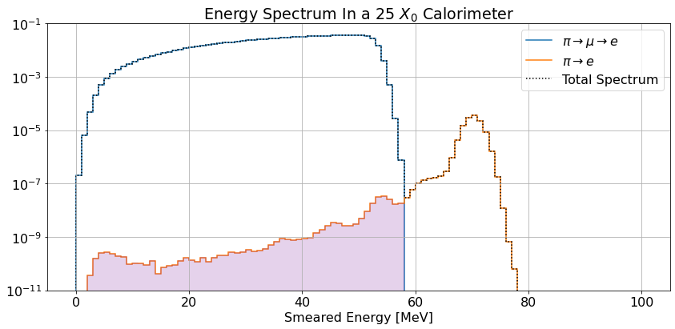
Facing experimental reality
pi-mu-e

Slide 23
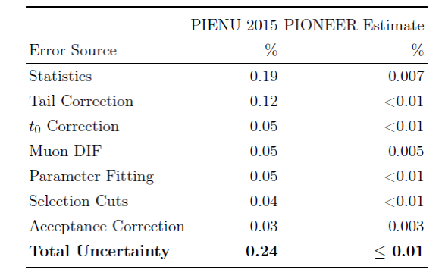
Facing experimental reality
$$R_{e/μ}=\frac{N_{right}}{N_{left}}\left[1+C_{tail}\right]$$
Guiding principles to the design of the experiment:
Collect very large datasets of rare pion decays (2e8 $π^{+}→e^{+}ν_{e}$ during Phase I)
Tail must be less than 1% of total signal → Shower containment in the calorimeter
Tail must be measured with a precision of 1% → Event identification in the active target

Slide 24
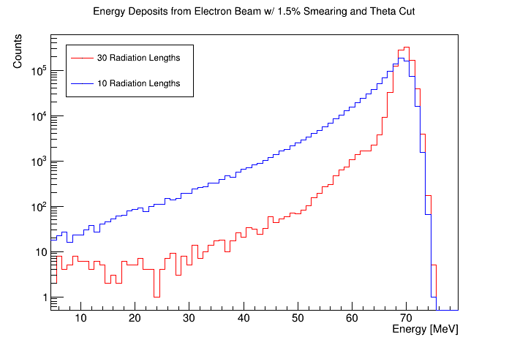
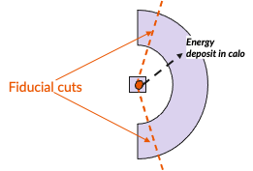
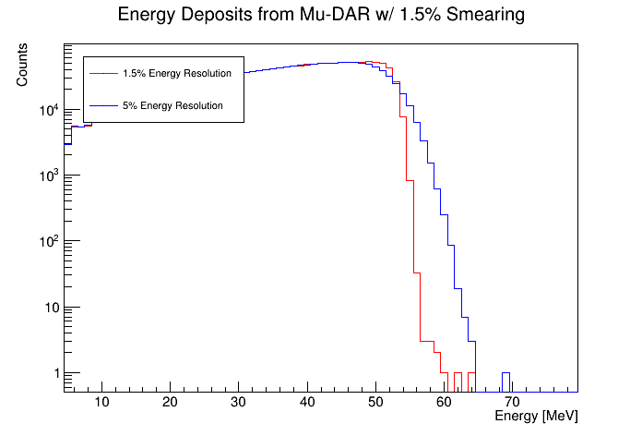
Calorimeter
$π→eν$ signal
Requirements
Collect large samples:
  Large solid angle: 3π sr
Maintain a tail fraction of 1%
  Depth of ~ 25 X0
  Very good uniformity
  Energy resolution of ~2% at 70 MeV
Reduce pileup:
  Fast scintillator response
$π-μ-e$ background

Slide 25
Introducing PIONEER
Outline
Phase I measurement strategy
PSI Pion beam line
Detector developments
  Calorimeter
  Active target
Simulation studies
e⁺
π⁺

Slide 26
Facing experimental reality
$$R_{e/μ}=\frac{N_{right}}{N_{left}}\left[1+C_{tail}\right]$$
Guiding principles to the design of the experiment:
Collect very large datasets of rare pion decays (2e8 $π^{+}→e^{+}ν_{e}$ during Phase I)
Tail must be less than 1% of total signal → Shower containment in the calorimeter
Tail must be measured with a precision of 1% → Event identification in the active target

Slide 27
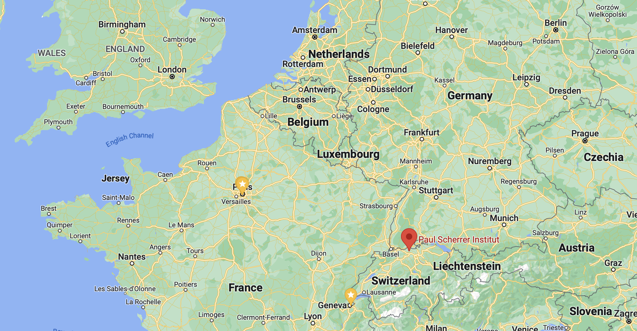

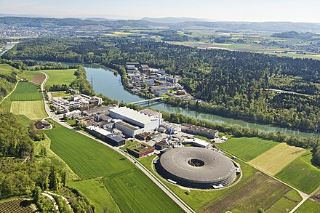
Located near Zurich, Switzerland
World most intense low-energy pion beamline
Guiding principles to the design of the experiment:
Collect very large datasets of rare pion decays (2e8 $π^{+}→e^{+}ν_{e}$ during Phase I)
Tail must be less than 1% of total signal → Shower containment in the calorimeter
Tail must be measured with a precision of 1% → Event identification in the active target
Notes:
The pie5 beamline at PSI, where the MEG experiment locates, is expected to match the requirements of PIONEER experiment.
The momentum range of interest is between 55 and 70 MeV. The lower limit is set to minimize the Michel positron in the beam. At higher moment, the pion rate is expected to be larger, but with a larger divergence and bigger beam spot. An ExB separator is expected to be used to suppress muon and positron in the beam. To reach the expected precision of PIONEER experiment, a tight beam spot, small divergence and narrow momentum bin is crucial.
For phase I experiment, we expect to run at 55 MeV/c with 300 kHz rate. A 3 years data taking will give us 2e8 pienu events.
For phase II, we expect to run at higher momentum setting to collect 7e5 pionbeta events in about 4 years.
This year, we have 2 weeks of beam time at piE5 beamline to experimentally verify these beam specifications.

Slide 28
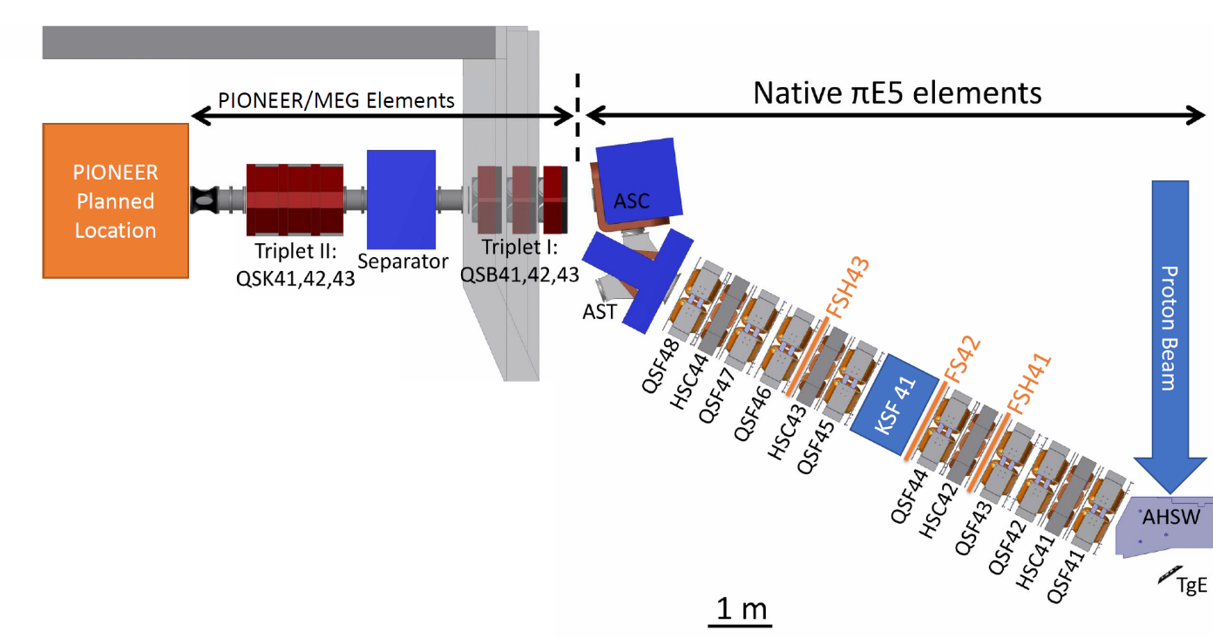
Pion Beamline at PSI
$$π$$
 | Phase 1 | Phase 2
Pion Decay of Interest | π⁺→e⁺νe | π⁺→π⁰e⁺νe
Rate (Hz - pion/s) | 3 .10⁵ | 3 .10⁷
Momentum bite | dp/p=1% | dp/p=3%
Statistics/yr | 10⁸ | 10⁶
Measurement precision | 0.015% | 0.1%
Notes:
The pie5 beamline at PSI, where the MEG experiment locates, is expected to match the requirements of PIONEER experiment.
The momentum range of interest is between 55 and 70 MeV. The lower limit is set to minimize the Michel positron in the beam. At higher moment, the pion rate is expected to be larger, but with a larger divergence and bigger beam spot. An ExB separator is expected to be used to suppress muon and positron in the beam. To reach the expected precision of PIONEER experiment, a tight beam spot, small divergence and narrow momentum bin is crucial.
For phase I experiment, we expect to run at 55 MeV/c with 300 kHz rate. A 3 years data taking will give us 2e8 pienu events.
For phase II, we expect to run at higher momentum setting to collect 7e5 pionbeta events in about 4 years.
This year, we have 2 weeks of beam time at piE5 beamline to experimentally verify these beam specifications.

Slide 29
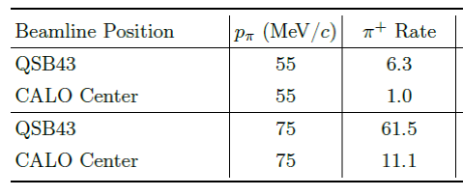
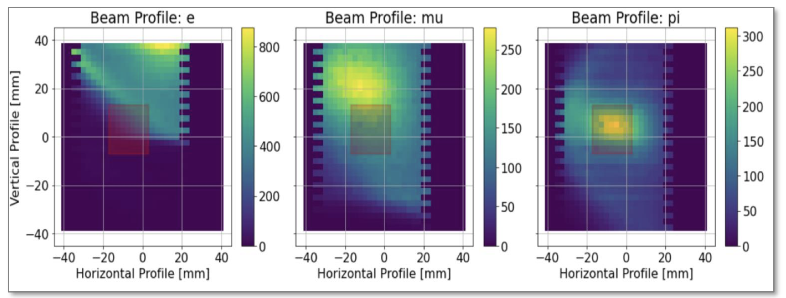
Pion Beamline at PSI
Specifications:
  Rate: O(10⁷ Hz)
  Momentum p=55-70 MeV/c
  $E×B$ separation of π from µ and e
  Tight beam spot (< 2 cm²) and small divergence
  Narrow momentum bite (dp/p <2%) to stop π+ in 3±0.5mm silicon target
2022 test beam study
X 10⁶ Hz
POSITRONS
VERTICAL [mm]
VERTICAL [mm]
PIONS
Notes:
The pie5 beamline at PSI, where the MEG experiment locates, is expected to match the requirements of PIONEER experiment.
The momentum range of interest is between 55 and 70 MeV. The lower limit is set to minimize the Michel positron in the beam. At higher moment, the pion rate is expected to be larger, but with a larger divergence and bigger beam spot. An ExB separator is expected to be used to suppress muon and positron in the beam. To reach the expected precision of PIONEER experiment, a tight beam spot, small divergence and narrow momentum bin is crucial.
For phase I experiment, we expect to run at 55 MeV/c with 300 kHz rate. A 3 years data taking will give us 2e8 pienu events.
For phase II, we expect to run at higher momentum setting to collect 7e5 pionbeta events in about 4 years.
This year, we have 2 weeks of beam time at piE5 beamline to experimentally verify these beam specifications.

Slide 30
Introducing PIONEER
Outline
Phase I measurement strategy
PSI Pion beam line
Detector developments
Simulation studies
e⁺
π⁺

Slide 31
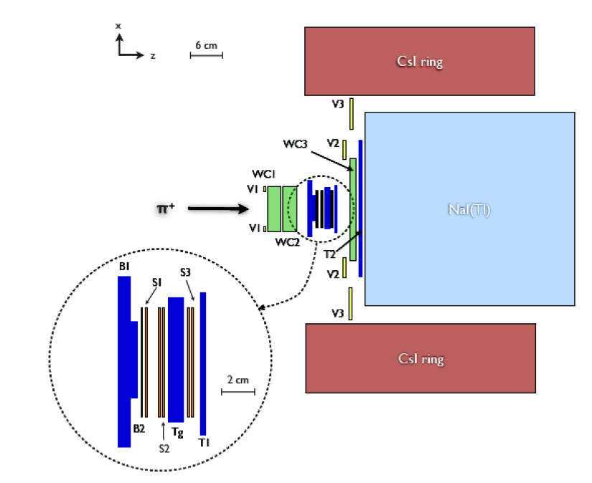
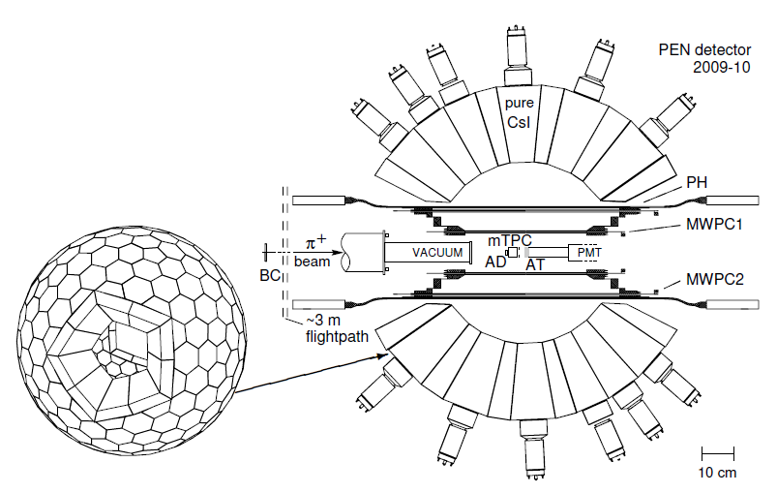
Two recent Pion Decay Experiments
PIENU PEN/PIBETA
CsI
3π
CsI
12 X₀
0.8π
NaI(Tl)
19 X₀
@TRIUMF
Experiment at TRIUMF
NaI slow, but excellent resolution
Single large crystal not uniform enough (material and effective “depth”)
Small solid angle
Experiment at PSI
Large acceptance but calorimeter depth of 12X₀ too small to resolve tail under the π-μ-e spectrum.
Both experiments took data a while ago but have (known) challenges to overcome before final results

Slide 32
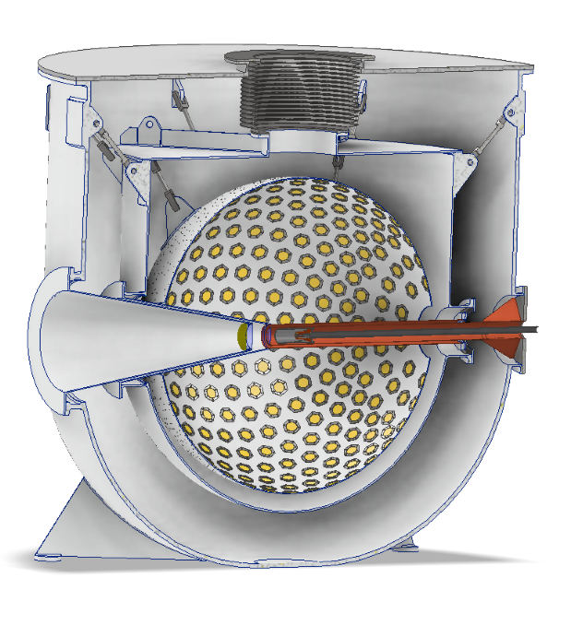
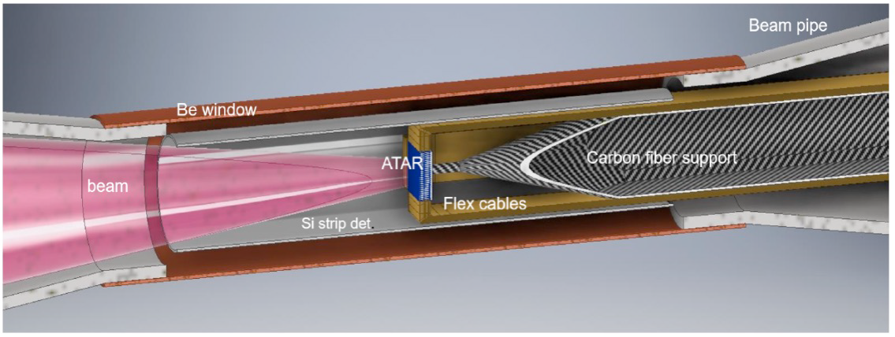
PIONEER Detector
best of both worlds
Building on PIENU and PEN/PIBETA experiences and
use emerging technologies (LXe, LGAD)
Intense Pion beam at PSI
Calorimeter: 25 X₀, 3π sr calorimeter
  Improve uniformity (x5)
  reduce tail correction (x5)
  reduce pile-up uncertainties with fast scintillator response (x5)
Active target (“4D”) based on LGAD technology
  reduce tail correction uncertainty (x10)
  Fast pulse shape: allow π → µ → e decay chain observation
State-of-the-art additional instrumentation:
  µRWell Tracker
  Fast triggering
  High speed digitization
LXe calorimeter
LGAD Fully Active Tracking Target (ATAR)
Notes:
The conceptual design of PIONEER is built upon the experience from both PIENU and PEN/PiBeta experience. Emerging technologies are going to be employed for a better performance.
On the calorimeter side, we are going to have a 25-X0 LXe calorimeter covering 3pi acceptance. Compared to the PIENU experiment, the LXe detector is expected to be more uniform, and we are aiming to reduce the tail correction by a factor of 5.
With only the optical readout, the fast scintillation response of Lxe calorimeter will reduce the pile-up uncertainty.
On the stopping target side, we are going to have an active target based on the LGAD silicon technology. The high position and timing resolution allows us to measure the low-energy tail for the pienu decay, so that we can reduce the tail correction uncertainty.
In addition, fast electronics and pipeline DAQ will increase the overall efficiency of the experiment to match the intense pion beam at PSI.

Slide 33
Facing experimental reality
$$R_{e/μ}=\frac{N_{right}}{N_{left}}\left[1+C_{tail}\right]$$
Guiding principles to the design of the experiment:
Collect very large datasets of rare pion decays (2e8 $π^{+}→e^{+}ν_{e}$ during Phase I)
Tail must be less than 1% of total signal → Shower containment in the calorimeter
Tail must be measured with a precision of 1% → Event identification in the active target

Slide 34
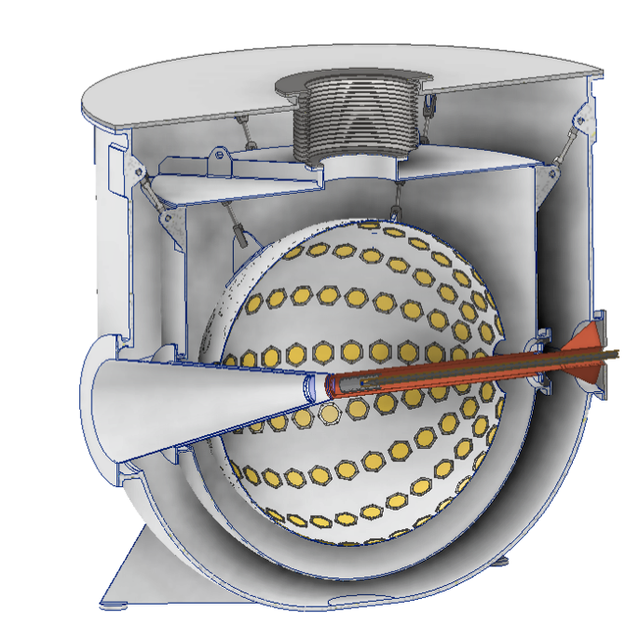
Facing experimental reality
Liquid Xenon
$π→eν$ signal
Fast response
Highly homogeneous response
Detector can be reshaped
At least 25 X0
Guiding principles to the design of the experiment:
Collect very large datasets of rare pion decays (2e8 $π^{+}→e^{+}ν_{e}$ during Phase I)
Tail must be less than 1% of total signal → Shower containment in the calorimeter
Tail must be measured with a precision of 1% → Event identification in the active target

Slide 35
Facing experimental reality
Liquid Xenon
$π-μ-e$ background
Fast response
Highly homogeneous response
Detector can be reshaped
Targeted resolution:
2% for positrons with 70 MeV/c
Guiding principles to the design of the experiment:
Collect very large datasets of rare pion decays (2e8 $π^{+}→e^{+}ν_{e}$ during Phase I)
Tail must be less than 1% of total signal → Shower containment in the calorimeter
Tail must be measured with a precision of 1% → Event identification in the active target

Slide 36
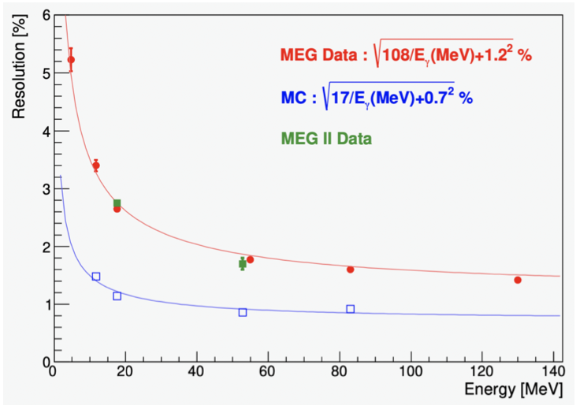
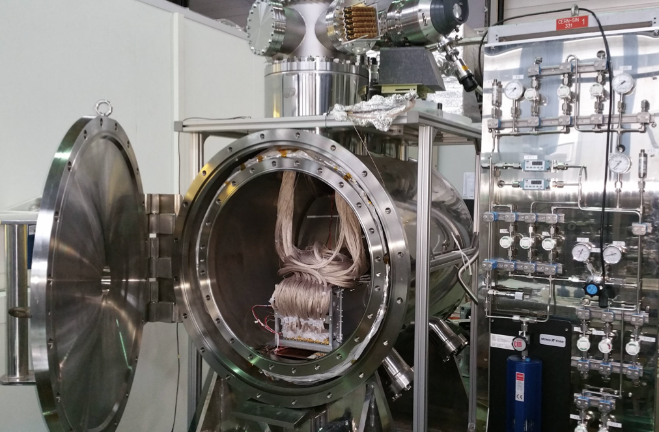
Calorimeter Developments
Liquid Xenon Prototype
Series of prototypes leading to a large 100L, 28X0 cylinder
  Measure resolution for 70 MeV positrons
  Check and correct simulations
Build expertise with LXe handling
Bonus: prototype could set stringent limits on μ→eeeee (arXiv:2306.15631)

Slide 37
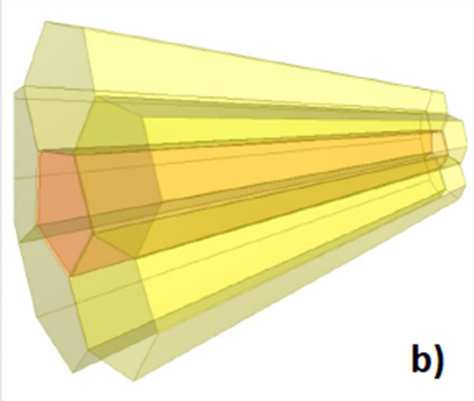
Calorimeter Alternative
Liquid Xenon
LYSO Crystals
Fast response
Highly homogeneous response
Detector can be reshaped
Fast response
High stopping power
Intrinsically segmented
BUT
BUT
Expensive?
Unsegmented calorimeter impacts pileup rejection
Resolution better than 4% has not been demonstrated for an array of LYSO crystals at 70 MeV
Growing long homogeneous crystals is a challenge

Slide 38
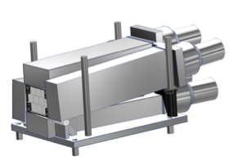
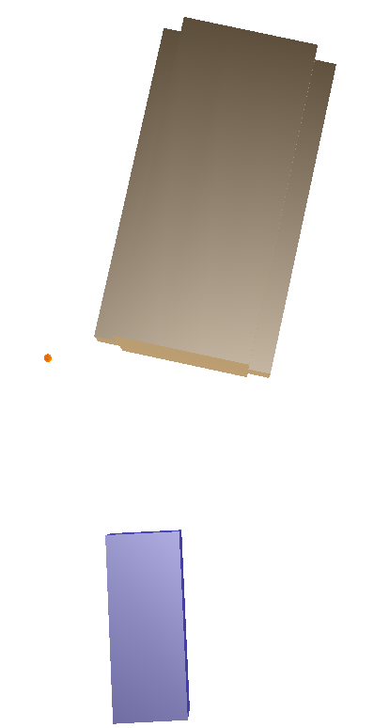
Calorimeter Developments
LYSO Test Beam studies
3-4-3 LYSO array
Beam
(4.92,18.35)
Goals:
  LYSO resolution for 70 MeV positrons
  Albedo modelling validation
Ongoing prep work at UW with the in-house accelerator
  Testing with a sharp 17.6 MeV gamma from a Li-7 source
  Moving setup at PSI for test beam at the end of November
15°
18°
10 cm
(0,0)
Target
(LYSO/NaI/Lead)

Slide 39
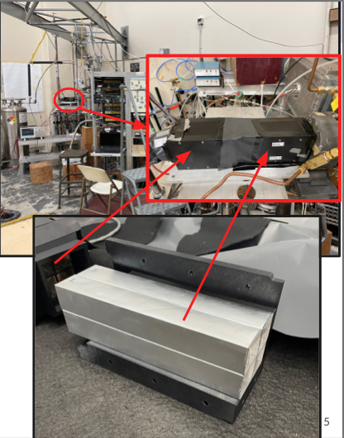
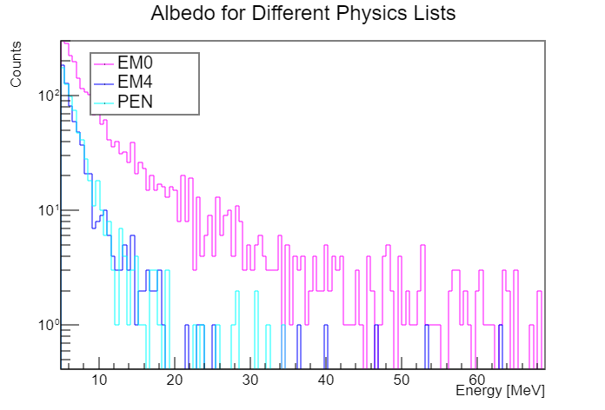
Calorimeter Developments
LYSO Test Beam studies
Large discrepancies of the albedo effect
between different simulation models
Will be tested

Slide 40
Facing experimental reality
$$R_{e/μ}=\frac{N_{right}}{N_{left}}\left[1+C_{tail}\right]$$
Guiding principles to the design of the experiment:
Collect very large datasets of rare pion decays (2e8 $π^{+}→e^{+}ν_{e}$ during Phase I)
Tail must be less than 1% of total signal → Shower containment in the calorimeter
Tail must be measured with a precision of 1% → Event identification in the active target

Slide 41
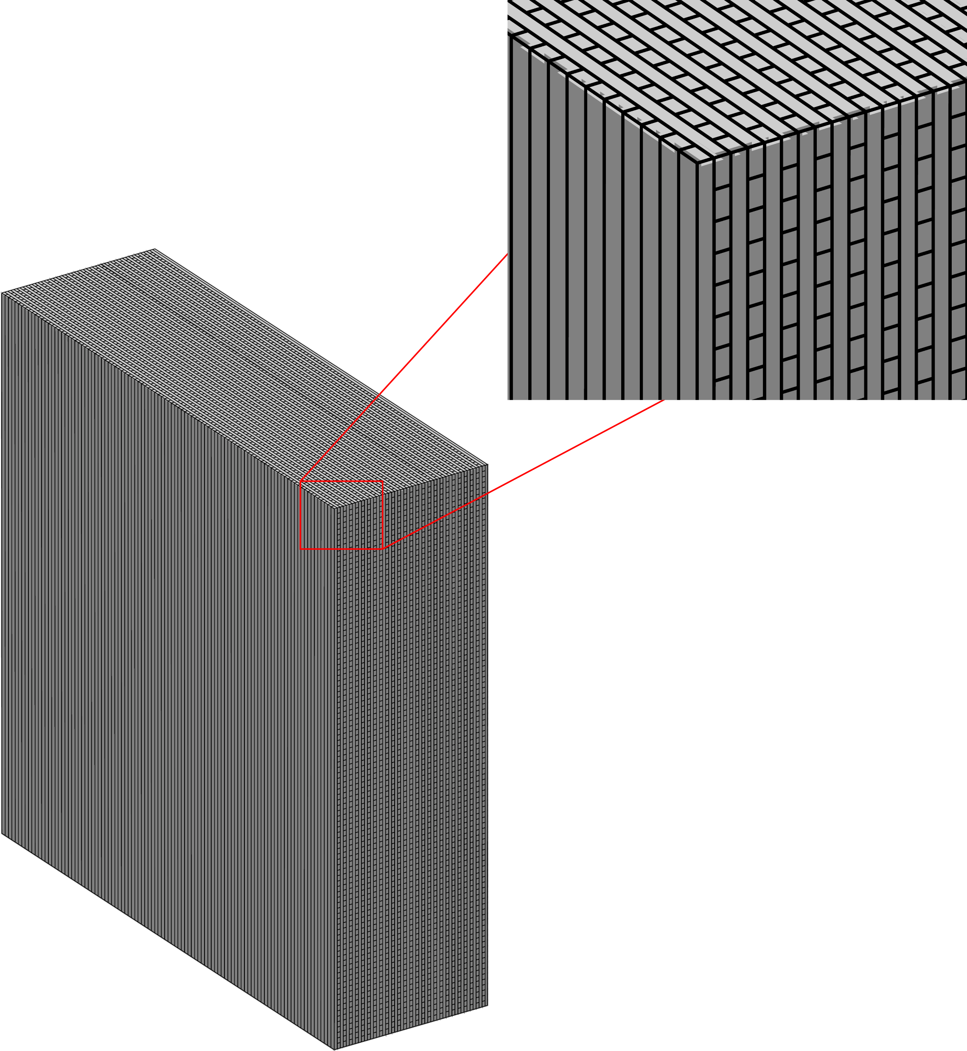
Facing experimental reality
📍
Active target (“4D”) based on
low-gain avalanche diode (LGAD) technology
Tentative design
  48 layers X/Y strips: 120 μm thick
  100 strips with 200 μm pitch covering 2x2 cm² area
  Sensors are packed in stack of two with facing HV side and rotate 90
2cm
2cm
Guiding principles to the design of the experiment:
Collect very large datasets of rare pion decays (2e8 $π^{+}→e^{+}ν_{e}$ during Phase I)
Tail must be less than 1% of total signal → Shower containment in the calorimeter
Tail must be measured with a precision of 1% → Event identification in the active target

Slide 42
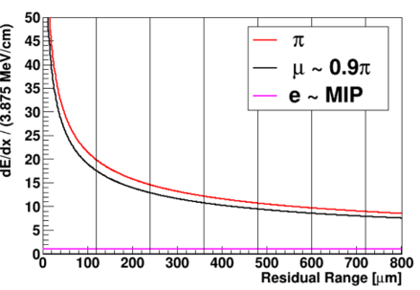
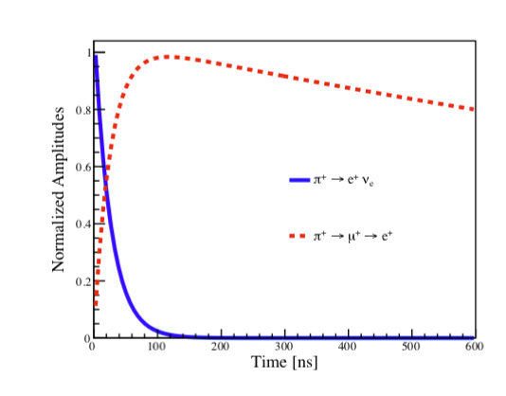
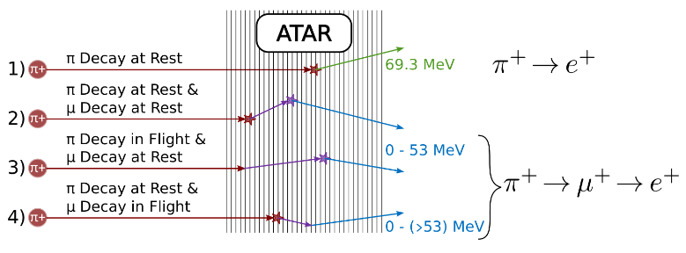
Active Target
Requirements
Thick and highly segmented target to
  stop the pion
  tag and measure the decay chain
Measure energy, time and position
Energy loss of particles through silicon
Device needs to accommodate
large range of energy scales
Decay chain time is very different
between $π→eν$ and $π-μ-e$ events
Device needs to separate
signal within 1 ns apart
Pattern Recognition

Slide 43

Active Target
Pion Decay tagging
Glossary:
  DAR: Decay At Rest — particle stops in material before decaying
  DIF: Decay In Flight — particle decays before depositing all its kinetic energy
  MIP: Minimum Ionizing Particle — particle at the threshold of being detectable through ionisation
  (i.e. a positron through silicon)
Notes:
This slide shows the event displays from the simulation study. Here, we show the position and the energy information without showing the timing information.
The first row shows the pienu decay with two tracks one pion, and one decay electron. This is our signal.
The second row shows the pimunu decay with three tracks, the 4.5 MeV muon will travel about 800 um in average.
The major background for the pienu measurement is the decay-in-flight of either pion or muon. In this case, the excellent positron resolution becomes really important in rejecting backgrounds.

Slide 44

Active Target
Low Gain Avalanche Diodes
In silicon sensors, when applying a very large electric field (300 kV/cm),
electrons (and holes) acquire kinetic energy and can generate
additional e/h pairs by impact ionisation → ‘avalanche’ effect
  Obtained by implanting an appropriate acceptor or donor layer
  when depleted, generate a very high field
The signal amplification allows for thin sensors and very high timing resolution
The gain mechanism saturates for large energy deposit
Notes:
This slide illustrates the current design of the active target. The requirements of the active target includes high sementation with less dead materials. This allows us to use the pattern recognition to separate different pion decay mode. The excellent timing resolution of the LGAD technology is advantageous in detecting pion/muon/positron signals. Another requirement is to have large dynamic range. The decay positron in active target is going to be minimal ionizing. On the other hand, the stopping pion/muon will has a dE/dx of about 100 times of MIP.
The current design is to have 48 layers of LGAD detector with 120 um per layer. This allows us to cover 0.6 cm.
In each layer, there will be 100 X or Y strips. With 200 um strip pitch, it is going to cover 2x2 cm^2 area.
The sensors are going to be packed in the stack of two with rotated strip orientations.

Slide 45


Active Target
Low Gain Avalanche Diodes
TCAD Simulations:
Large gain suppression effect with high input charge density
Gain suppression reduced if input charges are spread more evenly
Gain of LGAD produced by impact ionization in high field region of gain layer
  Very sensitive to electric field magnitude
Critical for PIONEER’s feasibility to understand the MeV-scale response of LGADs
Performing our own tests
Notes:
This slide illustrates the current design of the active target. The requirements of the active target includes high sementation with less dead materials. This allows us to use the pattern recognition to separate different pion decay mode. The excellent timing resolution of the LGAD technology is advantageous in detecting pion/muon/positron signals. Another requirement is to have large dynamic range. The decay positron in active target is going to be minimal ionizing. On the other hand, the stopping pion/muon will has a dE/dx of about 100 times of MIP.
The current design is to have 48 layers of LGAD detector with 120 um per layer. This allows us to cover 0.6 cm.
In each layer, there will be 100 X or Y strips. With 200 um strip pitch, it is going to cover 2x2 cm^2 area.
The sensors are going to be packed in the stack of two with rotated strip orientations.

Slide 46


Active Target
Tandem Accelerator at the University of Washington
Test beam this summer at CENPA to understand LGAD response of MeV-scale deposit
Tandem Van de Graaf Accelerator
Notes:
This slide illustrates the current design of the active target. The requirements of the active target includes high sementation with less dead materials. This allows us to use the pattern recognition to separate different pion decay mode. The excellent timing resolution of the LGAD technology is advantageous in detecting pion/muon/positron signals. Another requirement is to have large dynamic range. The decay positron in active target is going to be minimal ionizing. On the other hand, the stopping pion/muon will has a dE/dx of about 100 times of MIP.
The current design is to have 48 layers of LGAD detector with 120 um per layer. This allows us to cover 0.6 cm.
In each layer, there will be 100 X or Y strips. With 200 um strip pitch, it is going to cover 2x2 cm^2 area.
The sensors are going to be packed in the stack of two with rotated strip orientations.

Slide 47




Active Target
1mmx1mm sensor with 50μm thickness
Test beam setup
Proton beam

Slide 48

Active Target
LGAD gain saturation studies
Studied sensor response at various energy from 1.8 to 5 MeV
Expected gain increase with increasing bias voltage
Observed large gain reduction compared to the response from a beta source
Impact of charge localisation: angular dependency of the response

Slide 49

Active Target
LGAD gain saturation studies
54º
75º
Trying to reproduce observed behaviour in simulations

Slide 50
Introducing PIONEER
Outline
Phase I measurement strategy
PSI Pion beam line
Detector developments
Simulation studies
Timeline of the project
e⁺
π⁺

Slide 51


Simulation efforts
Geant4 simulation
  Spec the detector
  Study sensitivity
Precise model of the experiment
  Dead material, electronic response, etc
  Critical to reach the 10⁻⁴ level of precision!

Slide 52

Simulation studies
Realistic detector geometry
e⁺
π⁺

Slide 53

Simulation studies
Prototyping the data analysis
This is what real data could look like
Finding the signal in a ‘sea’ of backgrounds

Slide 54

Simulation studies
Prototyping the data analysis
Pileup
Spatial resolution
in the target
Time separation
from the pion stop
This is what real data could look like
Finding the signal in a ‘sea’ of backgrounds

Slide 55


Simulation studies
Prototyping the data analysis
Pileup
Spatial resolution
in the target
Time separation
from the pion stop
This is what real data could look like
Finding the signal in a ‘sea’ of backgrounds

Slide 56
Simulation studies
Prototyping the data analysis
Pileup
Spatial resolution
in the target
Time separation
from the pion stop
Measuring the tail fraction: Select background-free sample
with minimal bias while maintaining a decent (>1%) efficiency

Slide 57

Simulation studies
Prototyping the data analysis
Muon Decay At Rest
Excellent pulse shape separation should
provide O(10-7) rejection
Pileup
Spatial resolution
in the target
Time separation
from the pion stop
Measuring the tail fraction: Select background-free sample
with minimal bias while maintaining a decent (>1%) efficiency

Slide 58

Simulation studies
Prototyping the data analysis
Muon Decay At Rest
Excellent pulse shape separation should
provide O(10-7) rejection
Pileup
Spatial resolution
in the target
Time separation
from the pion stop
Muon Decay In Flight
‘The hard ones’
need O(10-2) rejection
Measuring the tail fraction: Select background-free sample
with minimal bias while maintaining a decent (>1%) efficiency

Slide 59
Simulation studies
Prototyping the data analysis
Muon Decay At Rest
Excellent pulse shape separation should
provide O(10-7) rejection
Pileup
Spatial resolution
in the target
Time separation
from the pion stop
Muon Decay In Flight
Same timing
structure as signal
need O(10-2) rejection
Measuring the tail fraction: Select background-free sample
with minimal bias while maintaining a decent (>1%) efficiency

Slide 60

Simulation studies
An easy case: pion and muon decay at rest

Slide 61

Simulation studies
A difficult case: muon decaying in flight
Notes:
This slide shows the event displays from the simulation study. Here, we show the position and the energy information without showing the timing information.
The first row shows the pienu decay with two tracks one pion, and one decay electron. This is our signal.
The second row shows the pimunu decay with three tracks, the 4.5 MeV muon will travel about 800 um in average.
The major background for the pienu measurement is the decay-in-flight of either pion or muon. In this case, the excellent positron resolution becomes really important in rejecting backgrounds.

Slide 62


Simulation studies
A difficult case: muon decaying in flight
This event:
The μ+ only travels through a single strip and leaves a positron-like energy deposit
With timing information we can easily remove incoming pion and use first positron-like hit in the same strip
With timing information we can easily remove incoming pion and use first positron-like hit in the same strip
Notes:
This slide shows the event displays from the simulation study. Here, we show the position and the energy information without showing the timing information.
The first row shows the pienu decay with two tracks one pion, and one decay electron. This is our signal.
The second row shows the pimunu decay with three tracks, the 4.5 MeV muon will travel about 800 um in average.
The major background for the pienu measurement is the decay-in-flight of either pion or muon. In this case, the excellent positron resolution becomes really important in rejecting backgrounds.

Slide 63
Simulation studies
A difficult case: muon decaying in flight
A Particle enters ATAR here
We can learn a lot about a particle travel through material from measuring its energy!
Notes:
This slide shows the event displays from the simulation study. Here, we show the position and the energy information without showing the timing information.
The first row shows the pienu decay with two tracks one pion, and one decay electron. This is our signal.
The second row shows the pimunu decay with three tracks, the 4.5 MeV muon will travel about 800 um in average.
The major background for the pienu measurement is the decay-in-flight of either pion or muon. In this case, the excellent positron resolution becomes really important in rejecting backgrounds.

Slide 64


Simulation studies
A difficult case: muon decaying in flight
Step 1: Precisely determining the pion stopping position
RMS ~ 1μm
π⁺
dx = (E0/5.56)^{1.69}

Slide 65



Simulation studies
A difficult case: muon decaying in flight
Step 2: measuring the dE/dx of the outgoing particle
dE
➗
dx (along z)

Slide 66

Simulation studies
A difficult case: muon decaying in flight
The instrumented active target is a fantastic tool to understand the backgrounds and achieve our target sensitivity

Slide 67
Introducing PIONEER
Outline
Phase I measurement strategy
PSI Pion beam line
Detector developments
Simulation studies
Timeline of the project
e⁺
π⁺

Slide 68

Timeline of the project
The next 5 years
Detector R&D in calorimetry and tracking
Simulation studies to model a high precision experiment
  i.e. we need to understand π→eν and π→μν acceptance difference to 10⁻⁴…
Putting an experiment together from concept to first data:
  Civil engineering, beam optics, detector manufacturing, LXe acquisition, electronics, …

Slide 69



A growing collaboration
Proposal submitted last year at PSI
First collaboration meeting mid October at CENPA

Slide 70
Conclusion
Unofficial logo, ongoing contest
PIONEER is a new proposal for a rare pion decays experiment at PSI
  Stringent tests of flavour universality
  Up to PeV scale sensitivity to BSM effects
Concept of the experiment has been established and is very promising
Ongoing effort to move from concept to serious prototype
  Lots of opportunities for new collaborators to get involved!
  Get in touch:
  Quentin Buat: qbuat@uw.edu ,
  Chloé Malbrunot: cmalbrunot@triumf.ca,
  David Hertzog: hertzog@uw.edu,
  Doug Bryman: doug@triumf.ca
Uncovered in this talk:
Degrader
Tracker
Trigger/DAQ
…

Slide 71
Additional slides

Slide 72
To be verified by simulations and prototype measurements.
(Calorimeter/ATAR)
(ATAR timing/dE/dx)
(ATAR)
(Calorimeter/ATAR)
(Calorimeter/ATAR)
(Calorimeter)
*
*Pion lifetime uncertainty not included
Newly proposed measurement at TRIUMF
PiBeta PIONEER (Phase II)
Statistics 0.4% 0.1%
Systematics 0.4% <0.1% (ATAR (β), MC, Photonuclear, π→e ν)
Total 0.64% 0.2%
Notes:
This slide summarizes the projected systematic uncertainty budget and illustrate how we can reach 0.01% precision for the Remu measurement.
We have said enough for the low-energy tail correction. For the t0 correction, the good timing resolution in the ATAR allows for a significant reduction in systematic uncertainties.
The high segmentation and timing resolution allows for a better rejection of muon decay-in-flight events.
We also project to have a better uncertainty in parameter fitting as well as event selection. The 3 pi acceptance of the calorimeter will reduce uncertainty in the acceptance correction.
For Phase II, the ATAR also allows a better measurement of positron in the pion beta decay. With an improved measurement of Pienu, we are expecting to achieve an uncertainty of Pibeta at 0.2%.

Slide 73


