Slide 1
CernVM: 15 17 Years After
Predrag Buncic, Gerardo Ganis (CERN/EP-SFT)
Notes:
‹#›

Slide 2
Introduction
This is actually 17th (!) anniversary of CernVM project
  It officially started in 2007 when funding for a software R&D project in the Physics department was secured (prototyping started one year earlier)
What follows is a short history of the project
CERN, 16/09/24 - ‹#›

Slide 3
The Problem (2008)
LHC was still under construction
  Amazon WS was just starting, about two years old
  Grid developments in a full swing, everything is based on traditional batch
Software @ LHC
  Millions of lines of code that frequently change
  Different packaging and software distribution models
  Complicated software installation/update/configuration procedure
  Long and slow validation and certification process
  Very difficult to roll out major OS upgrade (SLC4 -> SLC5)
Novel approaches to virtualization might have provided a solution
  Build minimal OS & bundle OS and applications into Virtual Machine image
Not really
  Updating, building and distributing large (>10GB) images was equally complicated problem
Still, an opportunity to do some innovative R&D and look for practical and pragmatic solutions
CERN, 16/09/24 - ‹#›

Slide 4
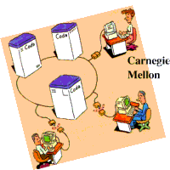

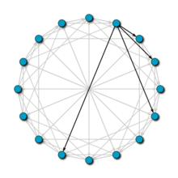
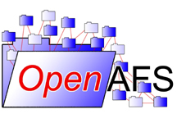
Distributed File Systems
CODA
Chirp/Parrot/Grow-FS
http://www.coda.cs.cmu.edu/
https://ccl.cse.nd.edu/
IgorFS
https://www.openafs.org/
http://doi.ieeecomputersociety.org/10.1109/P2P.2008.19
CERN, 16/09/24 - ‹#›

Slide 5
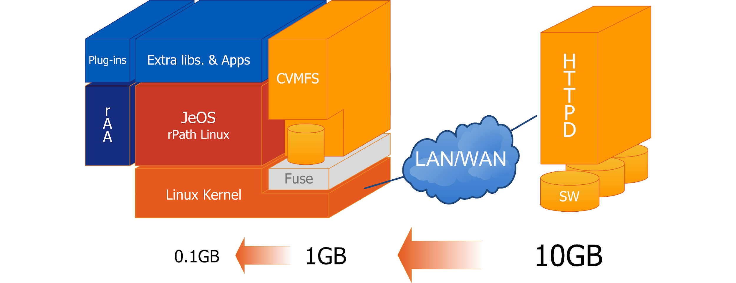
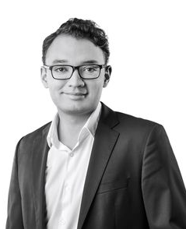
CernVM R&D
Prototype CernVM File System (CernVM-FS) was derived from Parrot (http://www.cctools.org) and its GROW-FS code base and adapted to run as a FUSE kernel module adding extra features like:
  possibility to use multiple file catalogs on the server side
  transparent file compression under given size threshold
  dynamical expansion of environment variables embedded in symbolic links
Using rPath tools, packaged with minimal OS into CernVM appliance
Leandro Franco
CERN, 16/09/24 - ‹#›
Notes:
‹#›

Slide 6
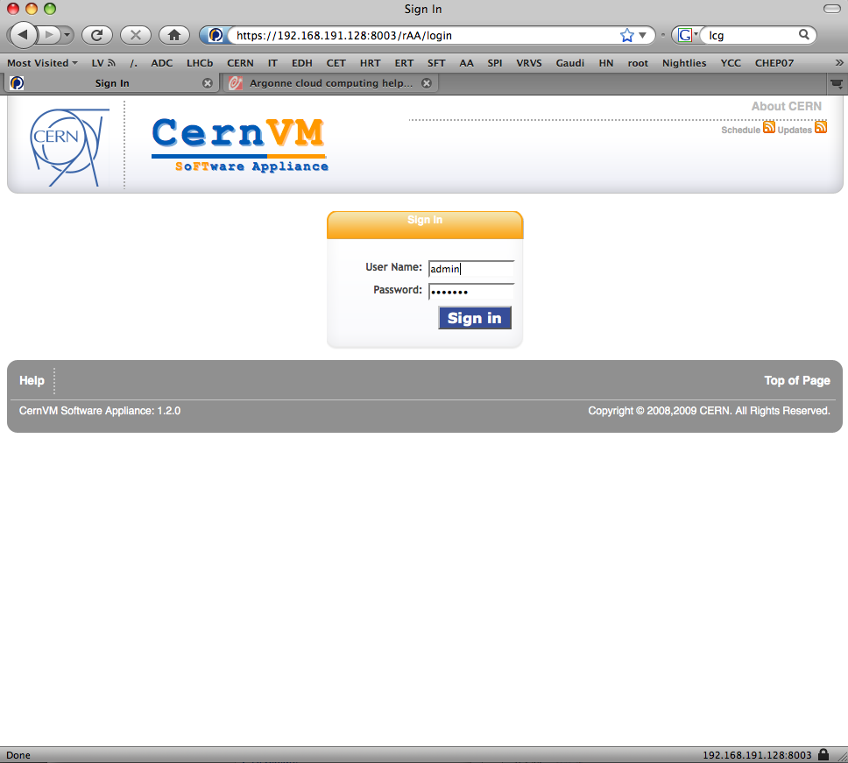
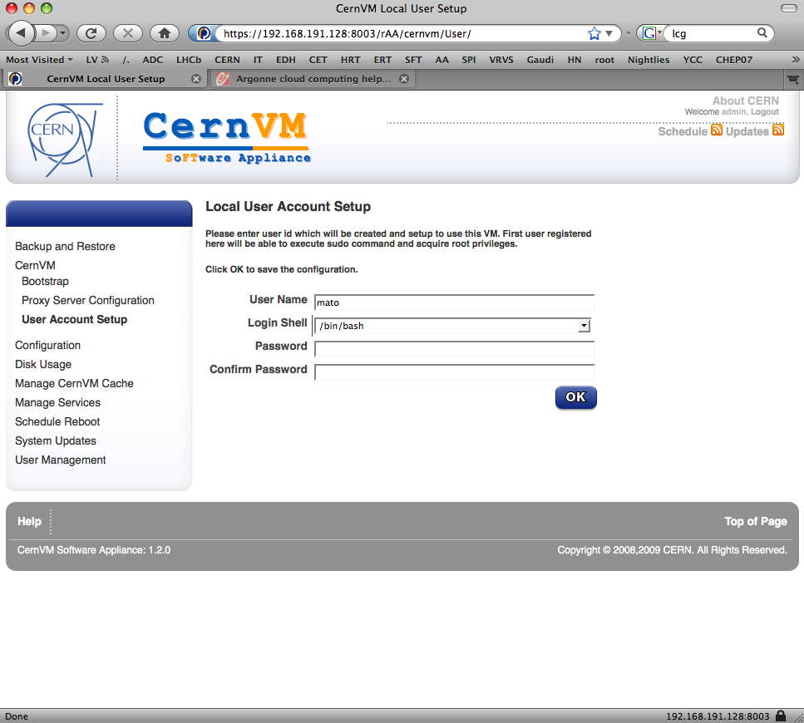
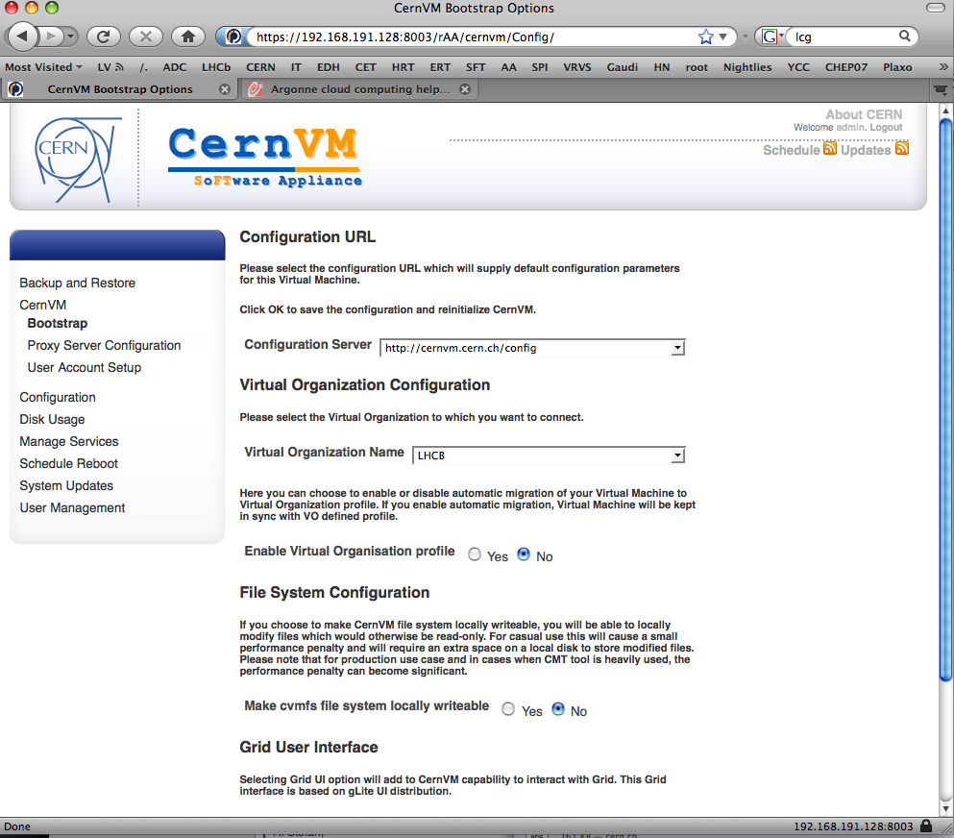
As easy as 1,2,3
Login to Web interface
Create user account
Select experiment, appliance flavor and preferences
CERN, 16/09/24 - ‹#›

Slide 7

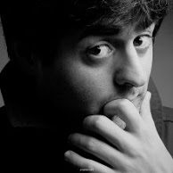
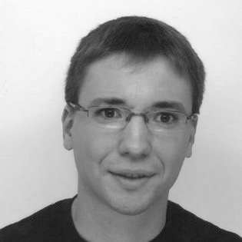
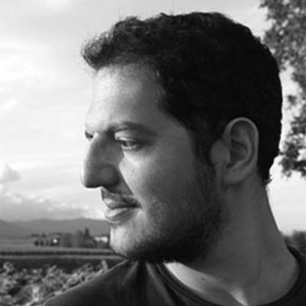
CernVM Team (2008)
Carlos Aguado
Service Infrastructure Development and Support
System Development Engineer at Amazon Web Services
Artem Harutyunyan
Co-Pilot Architect and Developer
Co-Founder and CTO at bardeen.ai
Jakob Blomer
CernVM-FS developer
Now CERN staff in EP-SFT
Ioannis Charalampidis
CernVM Online, micro CernVM, Test4Theory..
Now Software Engineer at bardeen.ai
Under the wise supervision of Predrag Buncic
CERN, 16/09/24 - ‹#›

Slide 8
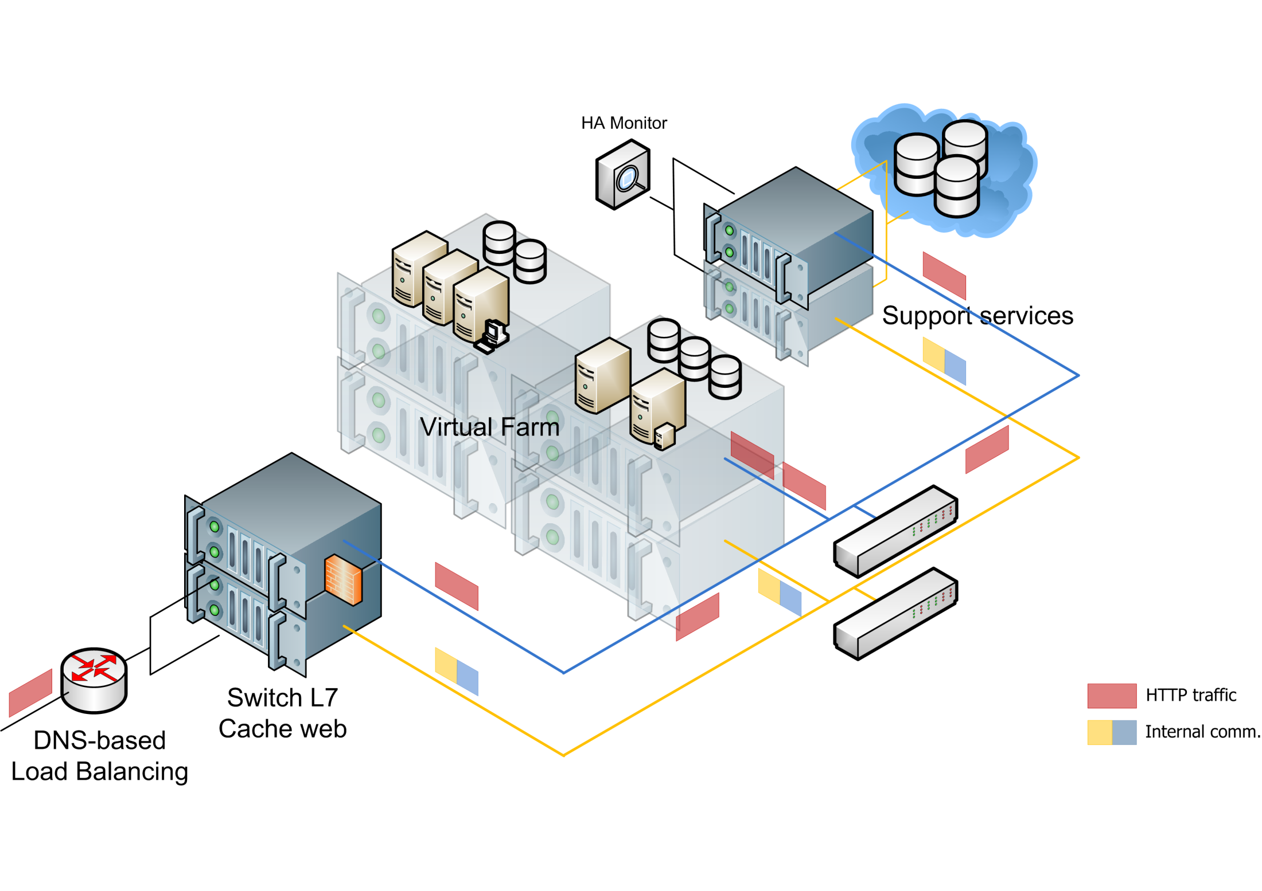
Scalable infrastructure
CERN, 16/09/24 - ‹#›

Slide 9
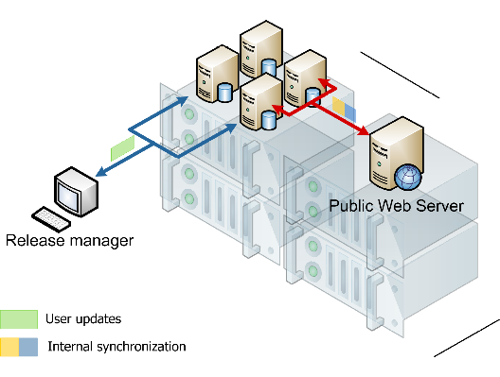
Publishing releases
CERN, 16/09/24 - ‹#›

Slide 10
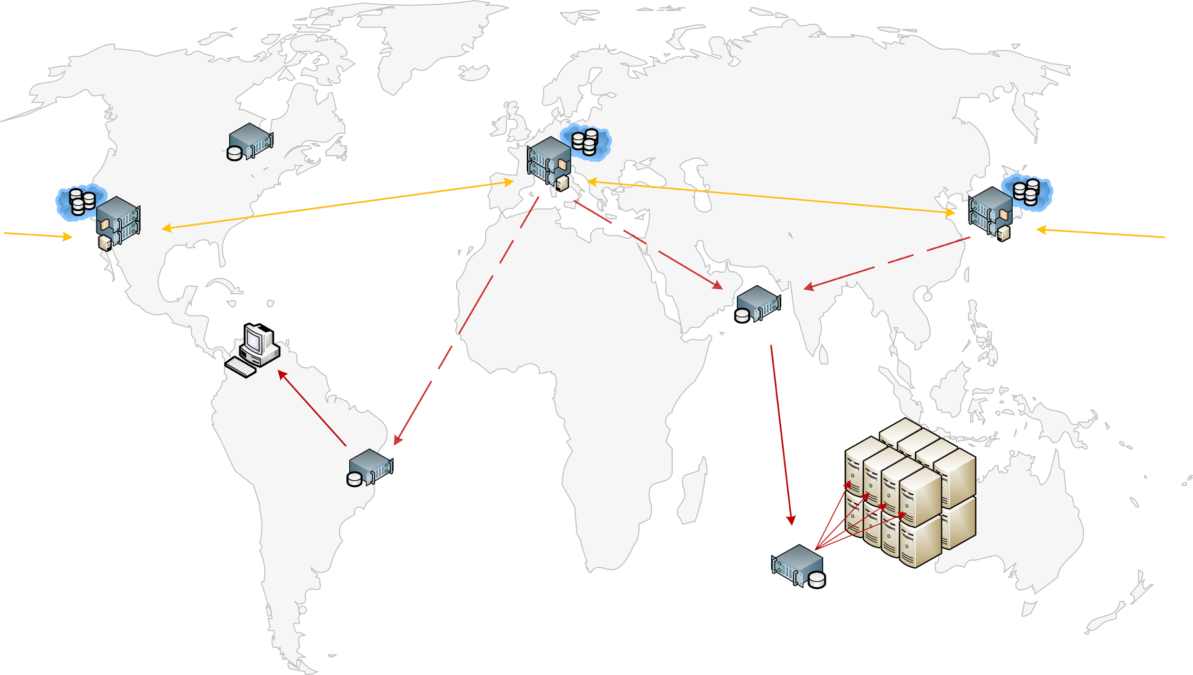
Deployment picture
Primary (master) software
repository
Secondary software
repository
Load
Balancing
Reverse Proxy
Secondary software
repository
Reverse Proxy
Load
Balancing
Reverse Proxy
Load
Balancing
Reverse Proxy
Regional
Reverse Proxy
CernVM
(thin client)
Reverse Proxy
Site
Reverse Proxy
CERN, 16/09/24 - ‹#›
Notes:
‹#›
‹#›

Slide 11
Sales pitch (2009)
If you believe that it is time to jump on bandwagon and explore direction in which major software industry players are going and if you have one of these problems:
  You work for LHC experiment and its software is not compatible with your favorite hardware or s/w platform running on your laptop/desktop
  You do not want to spend time to manually keep software up to date
  Your want to profit from the latest developments in CPU technology and use your multi/many core CPU to its maximal potential without modifying your application
  You want to share spare CPU cores/cycles with others
  You want to run your software on voluntary resources beyond the current Grid
…then CernVM might be what you are looking for.
CERN, 16/09/24 - ‹#›
Notes:
‹#›

Slide 12
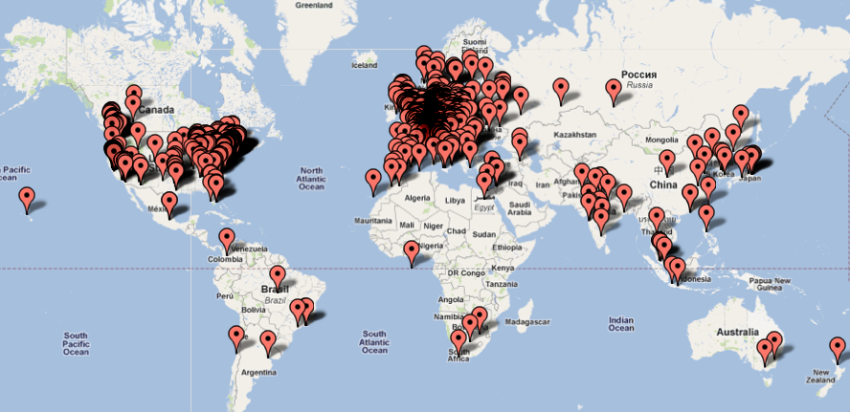
CernVM Users
~6000 unique IP addresses (~2009?)
CERN, 16/09/24 - ‹#›

Slide 13
Expanding use cases
How can we profit from the user workstations' modern (multi and many-core) CPU power and use them at least as a development platform?
How do we decouple application and infrastructure lifecycles and ensure a homogeneous job execution environment compatible with the one in which the application was developed?
How can we preserve experiment software and keep it usable and accountable over many years?
How can unmodified HEP software be used to harvest CPU cycles in a volunteer computing environment?
CERN, 16/09/24 - ‹#›

Slide 14
CernVM-FS
By the end of 4 four-year R&D project, we were still struggling to get clear support from at least two LHC experiments
  We had many users from across all four collaborations using CernVM, but only LHCb would speak loudly about that
Ian Collier from RAL approached us suggesting to factor out CernVM-FS from CernVM project
  It was a hard pill to swallow, but we accepted it under the condition that it remains officially called the CernVM File System.
  He did excellent work on convincing the HEPIX community that CernVM-FS meets the security requirements. He put convincing arguments backed up by operational evidence that it solves many problems for large sites.
  That is what finally cut it. CernVM-FS was accepted across the board, and CernVM just won’t die ☺
CERN, 16/09/24 - ‹#›

Slide 15
CernVM/FS Today
LHC Run3 is in a full swing
  Experiments have collected exabytes of data, routinely processed across WLCG sites that are seamlessly virtualized or containerized.
The problem of distributing software is almost universally solved using CernVM-FS
  All LHC experiments, many others in HEP and the broader scientific community rely critically on it.
Today, fully virtualized infrastructure is often replaced with lightweight containers
  CernVM-FS can be used from within the container image to reduce image size or to distribute the container root file system itself.
CernVM still has an important role in the context of data preservation
  That is how we can access ALEPH data today, and the same might happen to LHC data in 30 years.
There is a growing interest outside HEP to apply the same technology to possible different use cases
  Using CernVM-FS as a scalable namespace while accessing multi-PB datasets via other channels.
CERN, 16/09/24 - ‹#›

Slide 16
Summary
CernVM (including CernVM-FS) is one of the baseline projects within the EP-SFT group at CERN
  That assures necessary support for the LHC experiments and continuous development to address performance improvement and possible new requirements.
  The aim is to keep the support and development team at about 4 FTEs.
We are engaging with external partners (e.g. JumpTrading) to help them address some of the use cases and performance improvements beyond what we need in traditional deployment scenarios for LHC experiments
  That is beneficial for our community as it helps to uncover and fix the bugs that would otherwise rarely be seen.
While CernVM–FS was designed with scalability and resilience as primary goals, improving performance is for everyone’s benefit
  We are willing to extend engagements in joint projects aimed at performance improvements, providing that this is not disruptive to our primary goals and obligations towards the LHC experiments and HEP community.
CERN, 16/09/24 - ‹#›

Slide 17
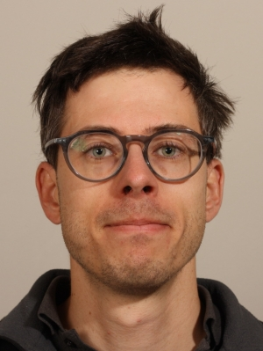
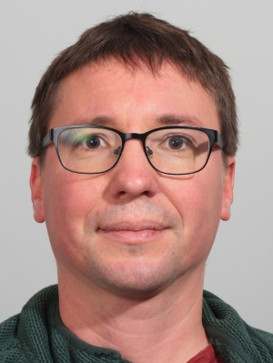
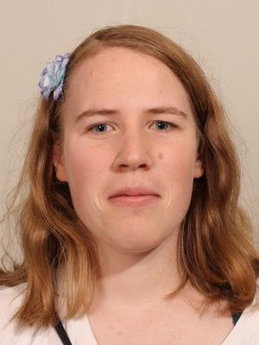
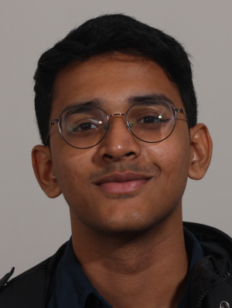
CernVM Core Team Today
Valentin Völkl
Developer and Project lead
EP-SFT staff
Jakob Blomer
Developer and advisor
EP-SFT staff
Laura Promberger
CernVM-FS developer
EP-SFT Fellow funded by JT
Amal Thundiyil
CernVM-FS containerization developer
EP-SFT Technical student, co-funded by JT
+ crucial external contributors and invaluable help from Stratum {0,1} operation teams
CERN, 16/09/24 - ‹#›

