Slide 1
Hadronic Cross-Section at the Z-pole
FCC Feasibility Study
Marina Malta Nogueira
November 20, 2023

Slide 2
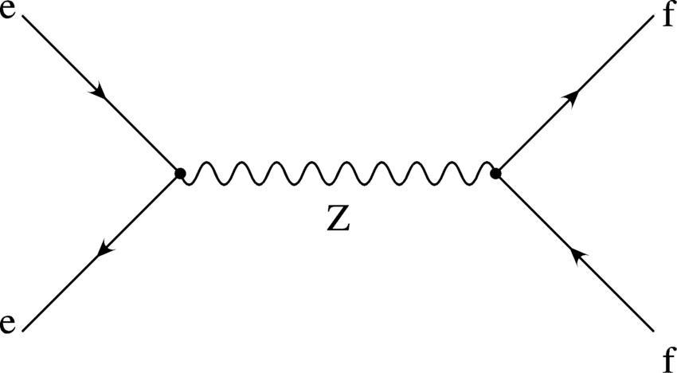
Introduction
The Future Circular Collider is a projected e+e- collider with a circumference of 90.7 km. The FCC feasibility study is being developed to optimize the physics potential of the collider.
We have been studying hadronic decays at the Z pole in FCC-ee conditions. Our goal is to minimize systematic uncertainties of the cross-section so that we can take full advantage of FCC statics.
Hadronic decays are the most copiously produced decays.
Electroweak radiative corrections in Z boson decays - Scientific Figure on ResearchGate. Available from: https://www.researchgate.net/figure/The-Z-boson-as-a-resonance-in-e-e-annihilations-A-fermion-antifermion-pair-in-the_fig8_2032467 [accessed 14 Aug, 2023]

Slide 3
Motivation
Z pole running will result in an enormous data set (6x10¹² events) with unprecedented precision; At FCC-ee it takes about a minute to accumulate an entire LEP Z pole dataset;
At LEP, the motivation was measure crucial fundamental parameters of the standard model and find discrepancies in the measurements indicating the SM is broken or better that there is physics beyond the standard model (BSM);
At FCC-ee, all standard model parameters are known and look to be consistent. Consistency between all measurements will be tested about 3 orders of magnitude more stringently than before, inconsistencies will immediately invoke new physics;

Slide 4
Goals of our analysis
Adapt and compare FCC-ee simulations of Z→ qq decays to previous results from L3;
Compare Whizard and KKMC event generators to see whether they agree within uncertainty limits;
Study the acceptance generally and as a function of the of the detector hole (where the beam pipe enters);

Slide 5
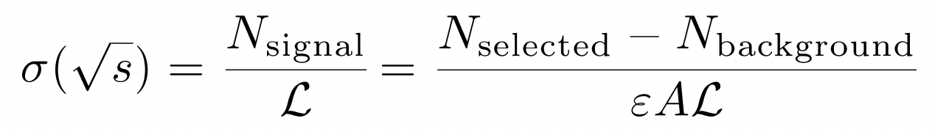
The Z lineshape
The Cross-Section:
What can we extract?
Z mass (m_{Z} ), Z width (Γ_{Z} )
Hadronic peak cross section (σ_{0, hadr})
And others
Dependency on
CM Energy
Luminosity
Event counts
Acceptance, efficiency

Slide 6
Importance of Monte Carlo
Number of background events
Monte Carlo is used for most backgrounds;
Monte Carlo can predict it precisely in most cases;
Acceptance
Crucial to calculating the cross-section and its uncertainty;
Two event generators are in significant disagreement about the Z→qq acceptance, which makes it harder to derive systematic uncertainties;
This is the focus of our analysis.

Slide 7
Monte Carlo Samples
The event generation used nominal FCC parameters for the Beam Energy Spread (0.132 %) and Bunch dimensions
Detector simulation used the IDEA detector with Delphes (Winter 2023 campaign).
Process | Event Generator | Cross-Section (pb) | Events
e⁺e⁻ → uū | KKMC | 5353.596845 | 1×10⁶
e⁺e⁻ → dd | KKMC | 6752.078 | 2×10⁶
e⁺e⁻ → cc | KKMC | 5325.479 | 2×10⁶
e⁺e⁻ → ss | KKMC | 6763.653 | 2×10⁶
e⁺e⁻ → bb | KKMC | 6586.846 | 2×10⁶
e⁺e⁻ → uū | Whizard (Pythia 6) | 5353.596845 | 1×10⁶
e⁺e⁻ → uū | Whizard (Pythia 8) | 5353.596845 | 1×10⁶
e⁺e⁻ → μ⁺μ⁻ | Whizard | 1717.852 | 2×10⁷
e⁺e⁻ → 𝜏⁺𝜏⁻ | Whizard | 1716.135 | 8.45×10⁶
e⁺e⁻ → e⁺e⁻ hadrons | Whizard | 11367.36 | 4×10⁶
e⁺e⁻ → e⁺e⁻ | Pythia | 1462.09 | 1×10⁷

Slide 8
L3 Comparison

Slide 9
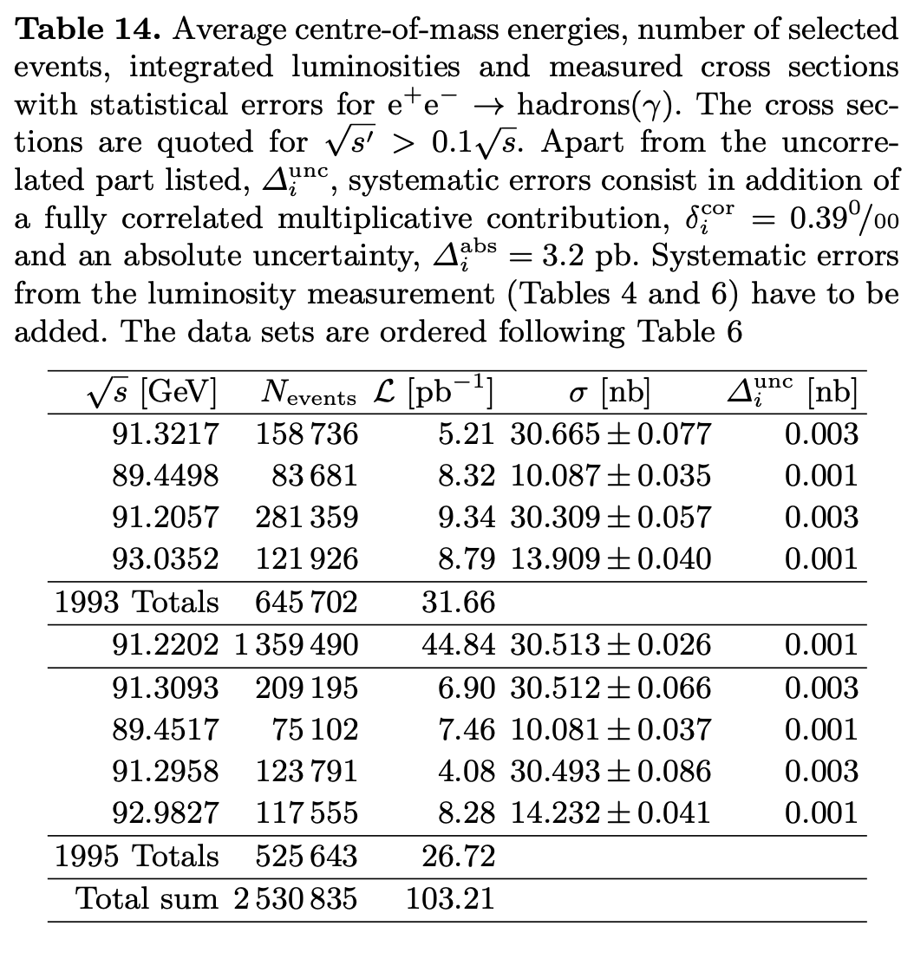
L3 Data Taking
Focus on the data taken in 1994 to reproduce the plots presented in the paper.
The analysis was performed on peak with luminosity of 44.84 pb⁻¹ which we are going to be adopting for our simulations of the L3 results.
The L3 Collaboration., Acciarri et al., M. Measurements of cross sections and forward-backward asymmetries at the Z resonance and determination of electroweak parameters. Eur. Phys. J. C 16, 1–40 (2000). https://doi.org/10.1007/s100520050001

Slide 10
Cuts Utilized
The total energy observed in the detector, Evis, normalised to the centre-of-mass energy must satisfy 0.5 < Evis/√s < 2.0;
The energy imbalance along the beam direction, E∥, must satisfy |E∥|/Evis < 0.6;
The transverse energy imbalance, E⊥, must satisfy E⊥/Evis < 0.6;
The number of particles per event, Nparticles, is required to be:
  Nparticles ≥13 for |cosθ_{t}| ≤0.74 (barrel region),
  Nparticles ≥ 17 for | cos θ_{t} | > 0.74 (end-cap region), where θt is the polar angle of the event thrust axis.
The last cut differs from L3 as they used the number of clusters from energy depositions in the calorimeter while we used the number of particles reconstructed from the tracker, the calorimeter and the muon chamber.

Slide 11
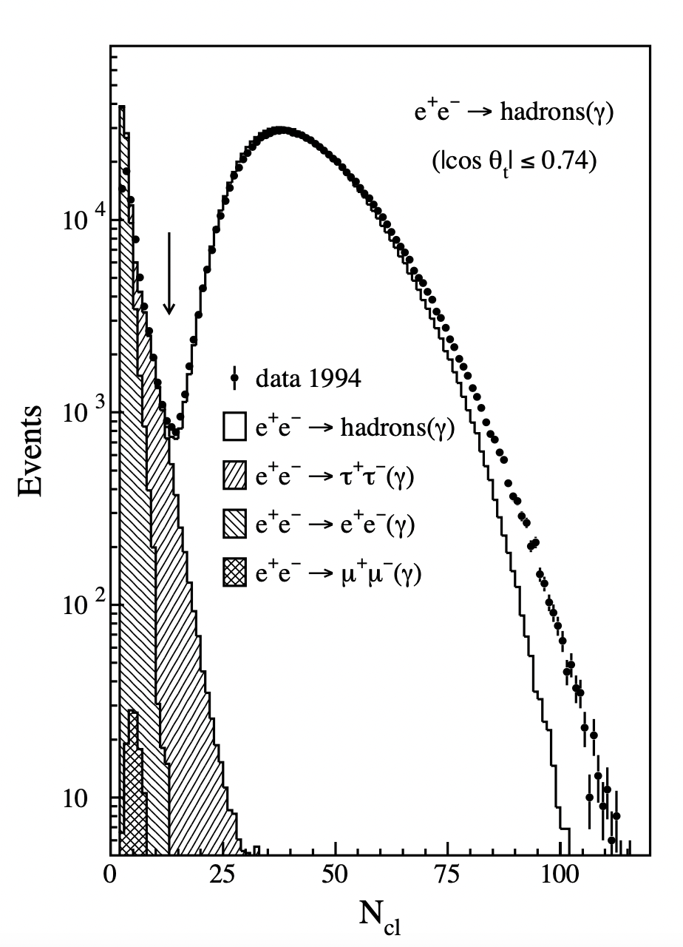
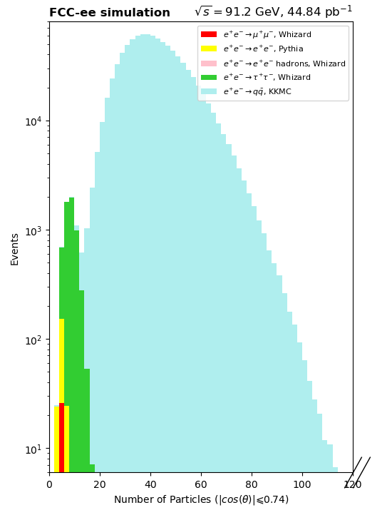
Number of Particles/Clusters (Barrel Region, N-1 Plot)
The difference in the physical quantities being plotted are apparent.
Electrons and taus have significantly less particles than clusters.
There is good agreement between FCC-ee simulations and the data.

Slide 12
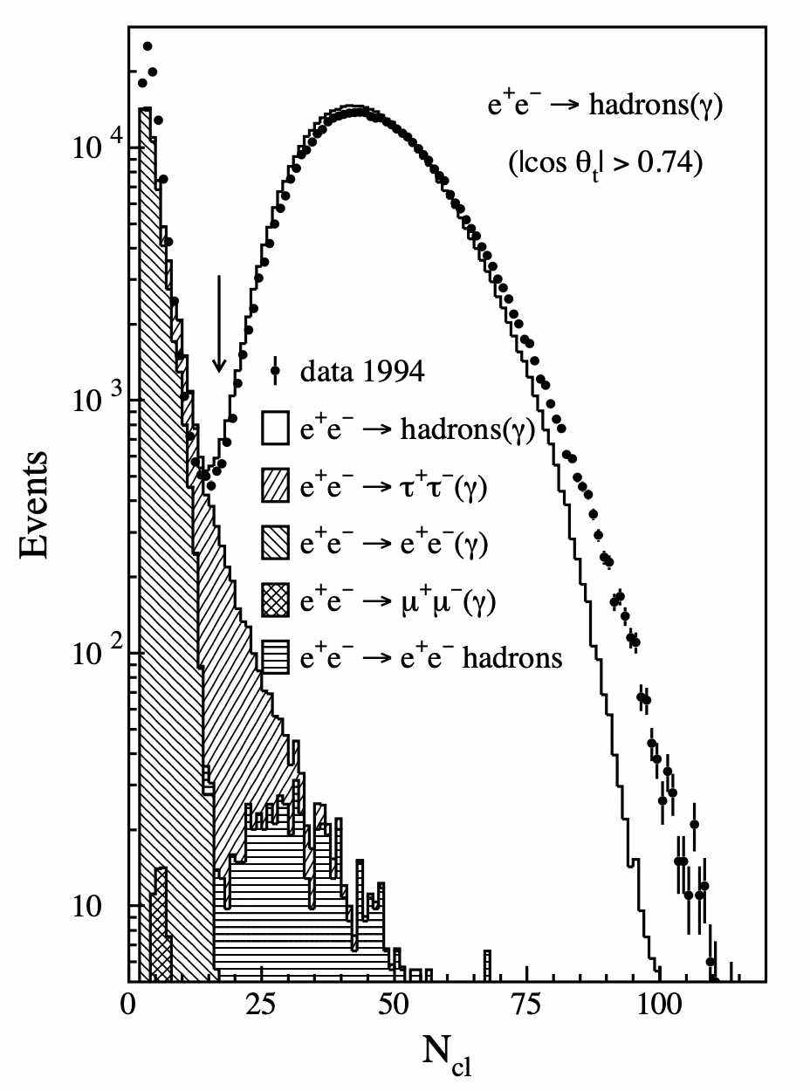
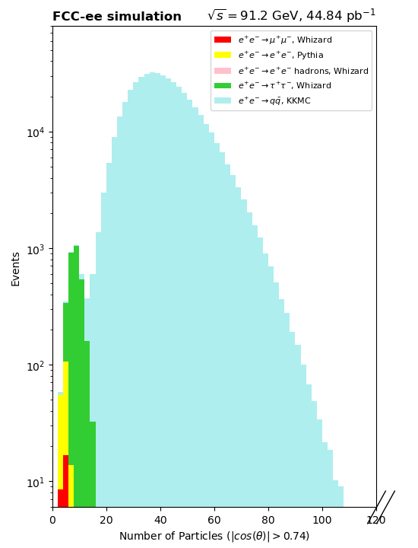
Number of Particles/Clusters (End-Cap Region, N-1 Plot)
The difference in the physical quantities being plotted are apparent. Here you can see that the two photon background, which is hard to simulate, is completely removed by other cuts.

Slide 13
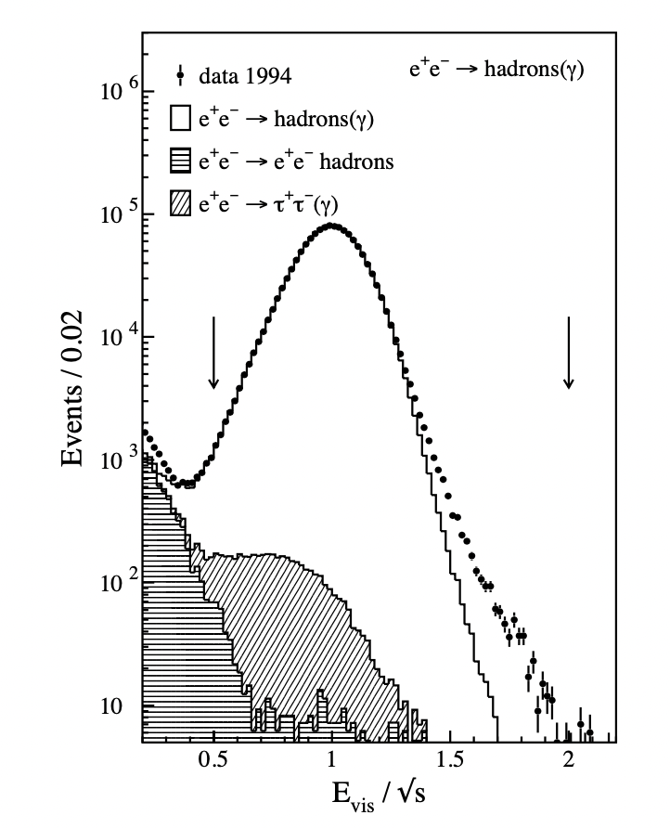
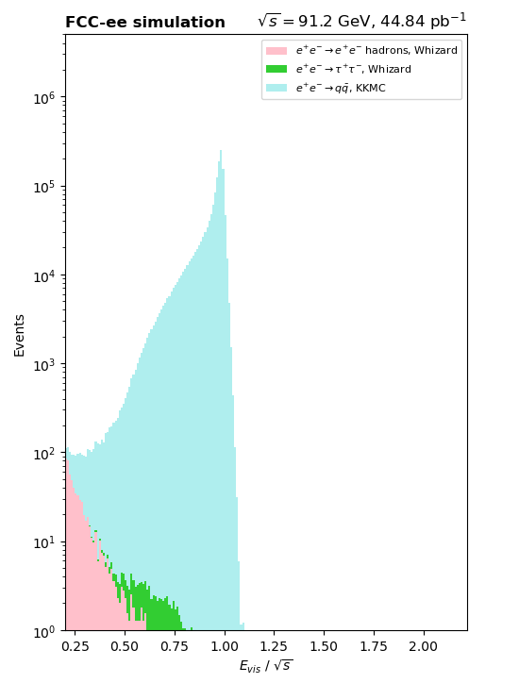
Normalized Scalar Energy (N-1 Plot)
Almost all two photon background does not satisfies the requirement 0.5<Evis/√s, which explains the discrepancy in the previous plot.
You can also see the effect of this difference between N_{clusters} and N_{particles} had in the number of taus.
The sharp peak instead of a broad smoother curve is due to much improved detector. The energy resolution of the IDEA detector is significantly better than for all LEP detectors and in particular the L3 detector.

Slide 14
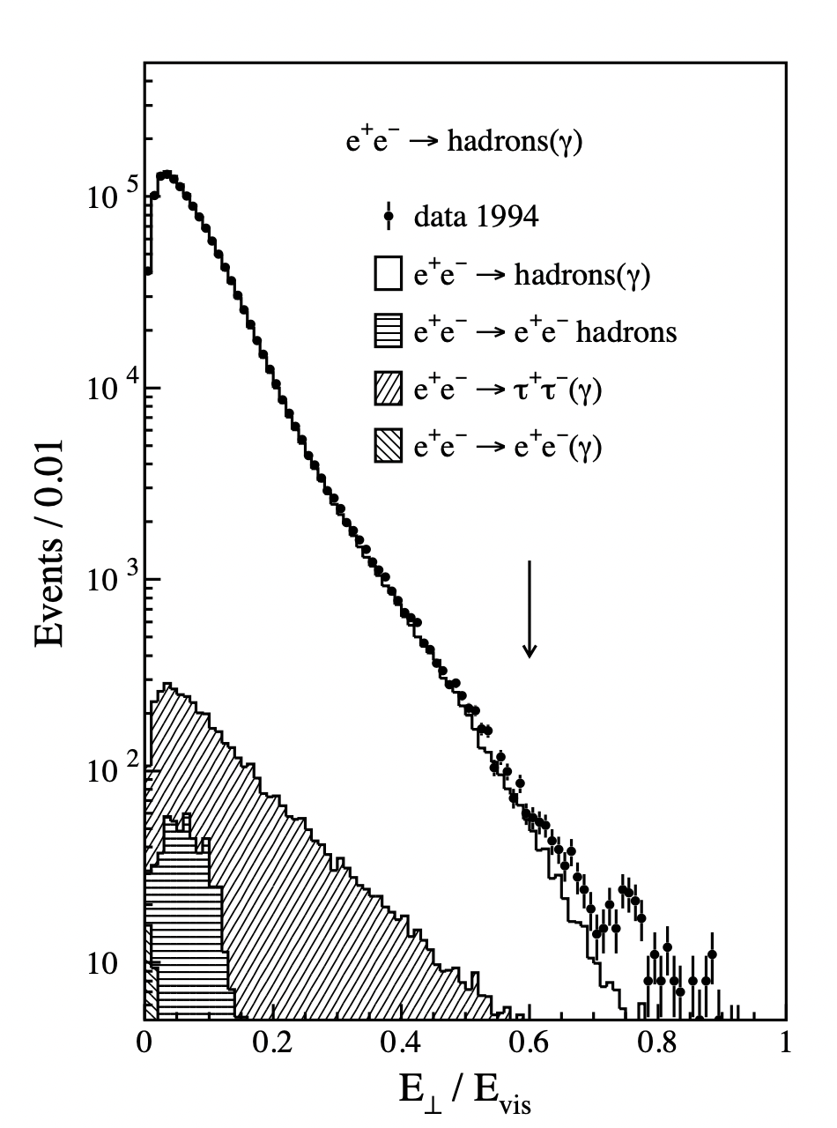
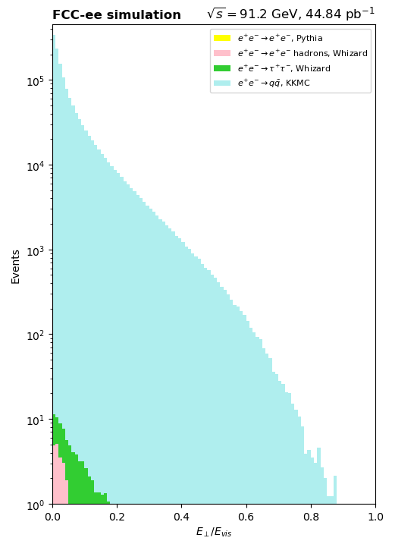
Transverse Energy Imbalance (N-1 Plot)
The differences in the filters impact the amount of background, to the point that there is no visible e⁺e⁻.
Improvements in the detector also justify the sharper peaking behavior towards 0. of the curve.
The transverse energy imbalance helps to reject backgrounds not described by Monte Carlo like noise.

Slide 15
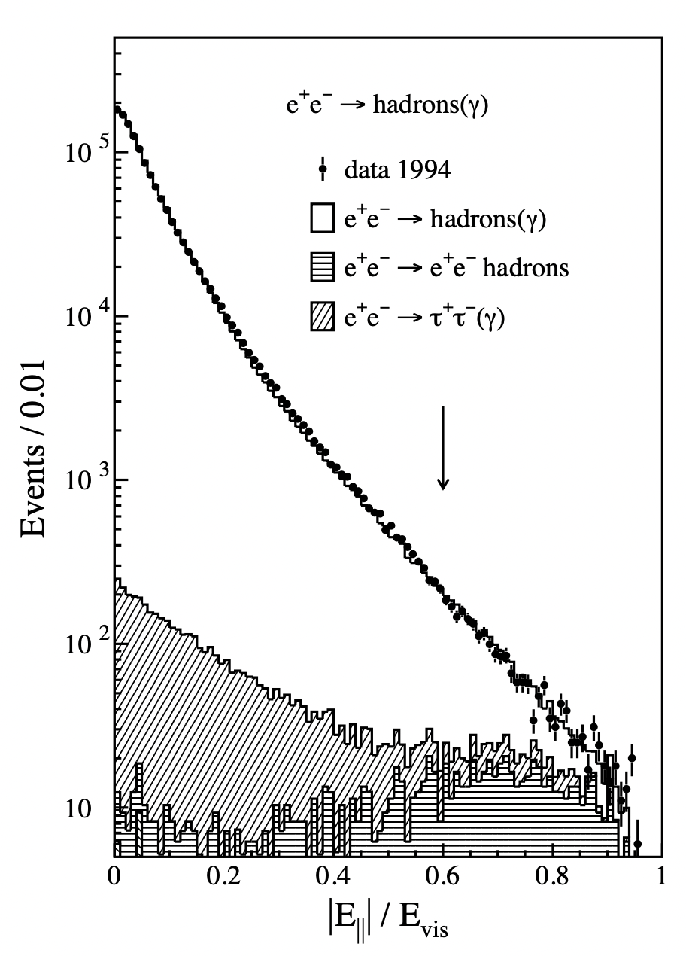
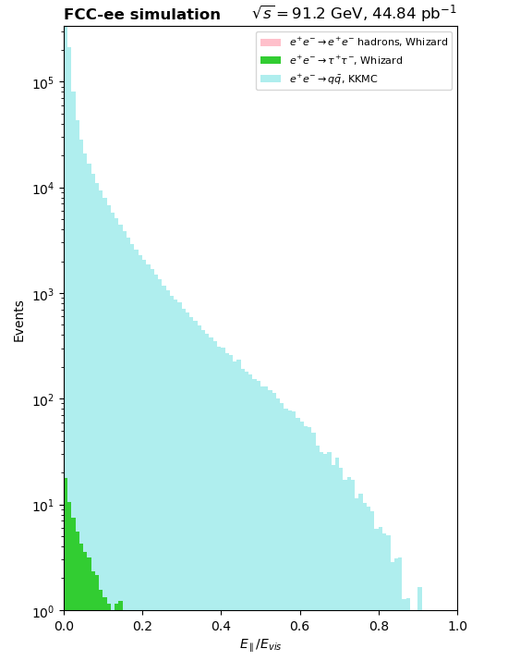
Longitudinal Energy Imbalance (N-1 Plot)
The differences in the filters and possibly the accuracy of the Monte Carlo description impacts the amount of background: there is no visible two photon background.
Improvements in the detector also justify the sharper peaking behavior towards 0.

Slide 16
Optimization for FCC-ee
Since improvements were made in the detector, we are using different filters to better suit the conditions of our simulation and improve the significance (cutting more background while retaining signal events).
The luminosity now considered is a projected FCC-ee one of 75 ab⁻¹.
Need to choose between Z→hadrons event generators
  Pythia for showering
  Pythia 8 versus 6
  KKMC versus Whizard
    Different orders implemented
(For now, we are only going to analyse Z → uu. Further studies will also look at other flavors.)

Slide 17
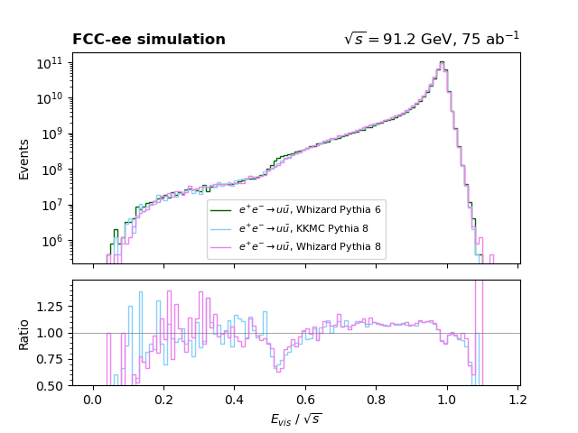
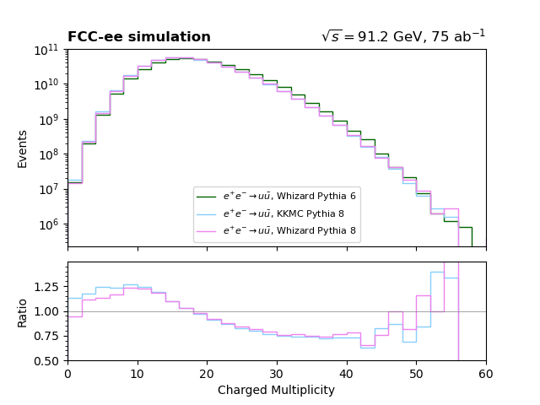
Different Event Generators

Slide 18
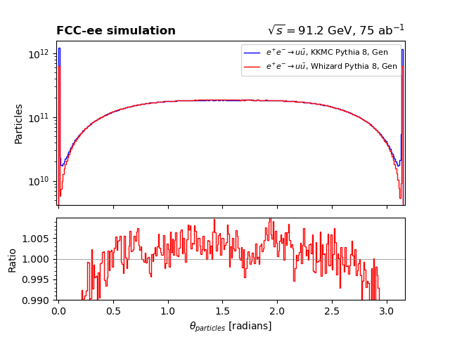
Comparing KKMC and Whizard (Pythia 8) at gen level particles
Significant discrepancy between the generators in the θ_{particles} distribution in the very forward region affects the analysis.
We suppose the different description of Initial State Radiation (ISR) is causing this discrepancy, but this needs confirmation.

Slide 19
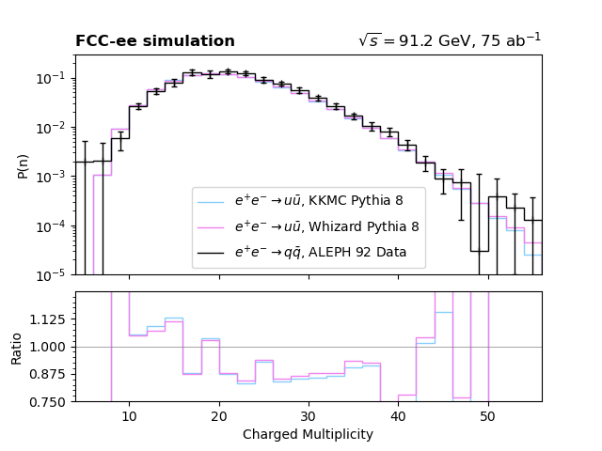
ALEPH Comparison
Both generators are in good agreement with ALEPH data, even though they might differ from each other in other measurements.
Studies of Quantum Chromodynamics with the ALEPH detector, Physics Reports, Volume 294, Issues 1–3, 1998, Pages 1-165, ISSN 0370-1573,
https://doi.org/10.1016/S0370-1573(97)00045-8.
(https://www.sciencedirect.com/science/article/pii/S0370157397000458)
Generator level particles

Slide 20
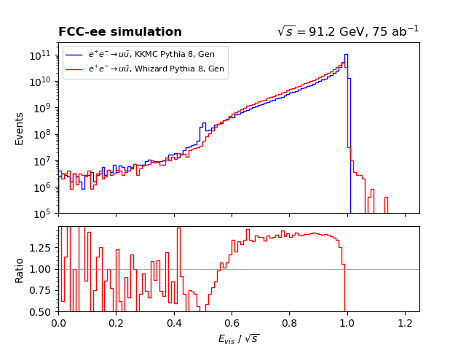
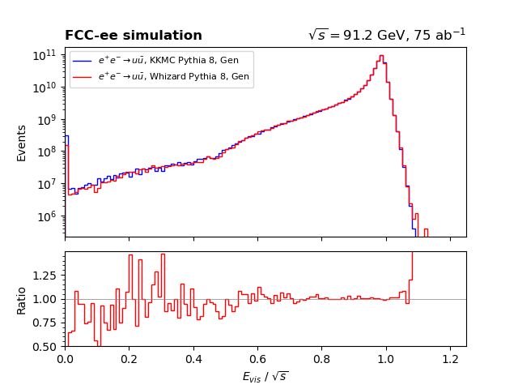
Visible Energy in different detector hole definitions
Large discrepancy between generators. It decreases as you select only particles away from the end of the detector, but it is still significant.
This is likely due to different implementations and should not account as a systematic uncertainty.
Generator level particles
No cut on radius of detector hole
Hole of radius 0.1 radians

Slide 21
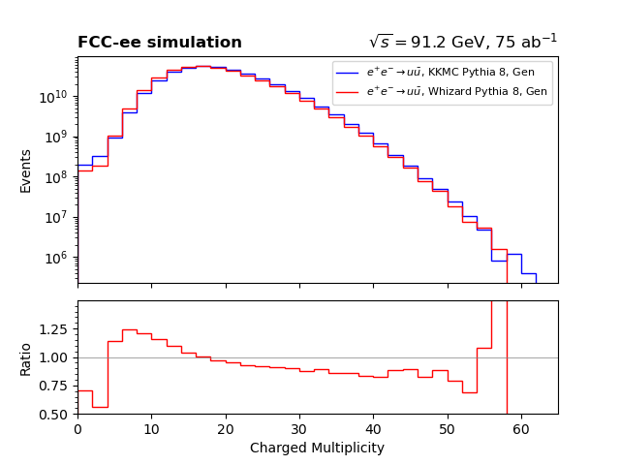
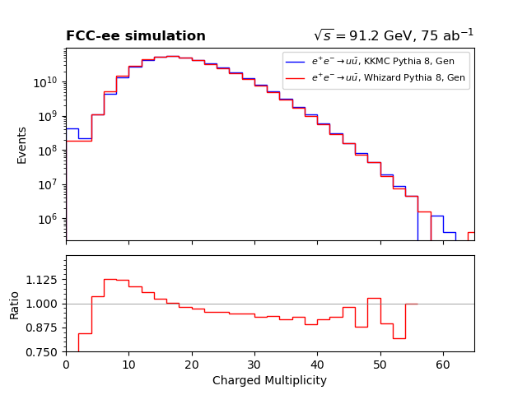
Charged Multiplicities in different detector hole definitions
The charged multiplicity is in better agreement than the visible energy, but there are still significant differences present, even though both agree with ALEPH.
No cut on radius of detector hole
Hole of radius 0.1 radians
Generator level particles

Slide 22
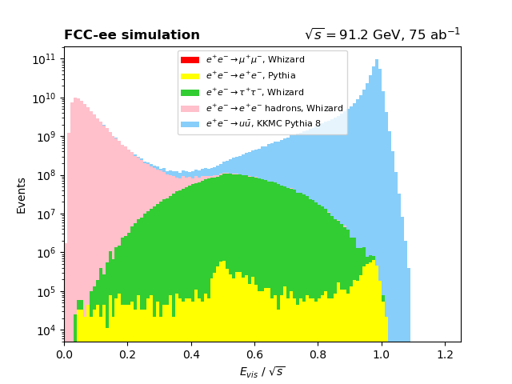
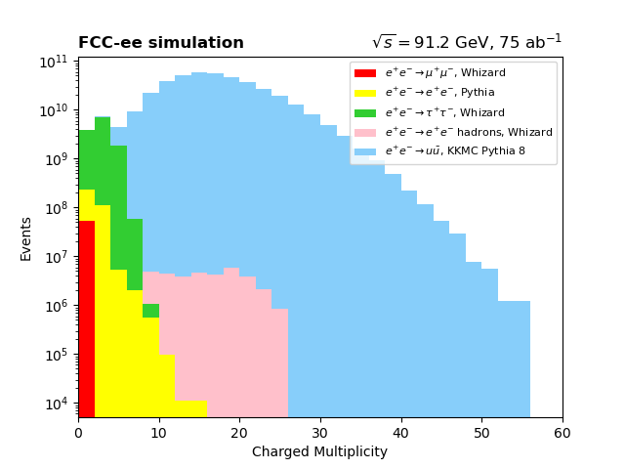
N-1 Plots
Filters selected: Evis/√s ≥ 0.52, Charged Multiplicity ≥ 4.

Slide 23
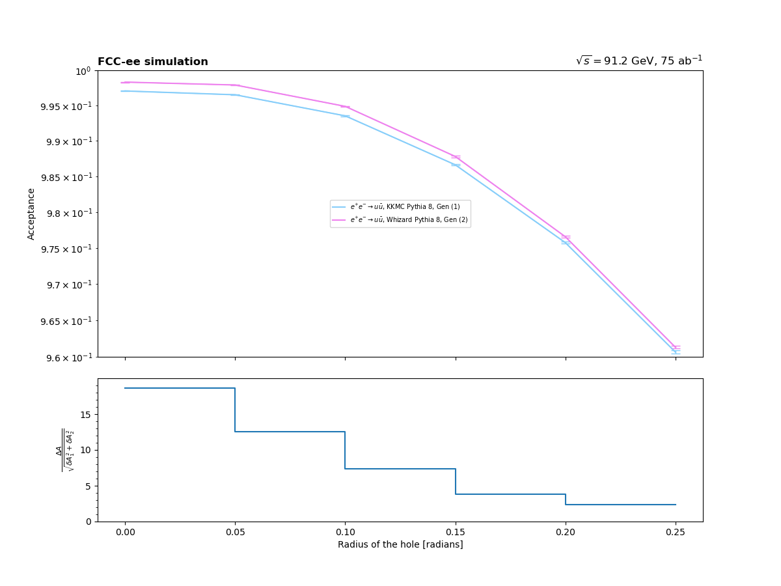
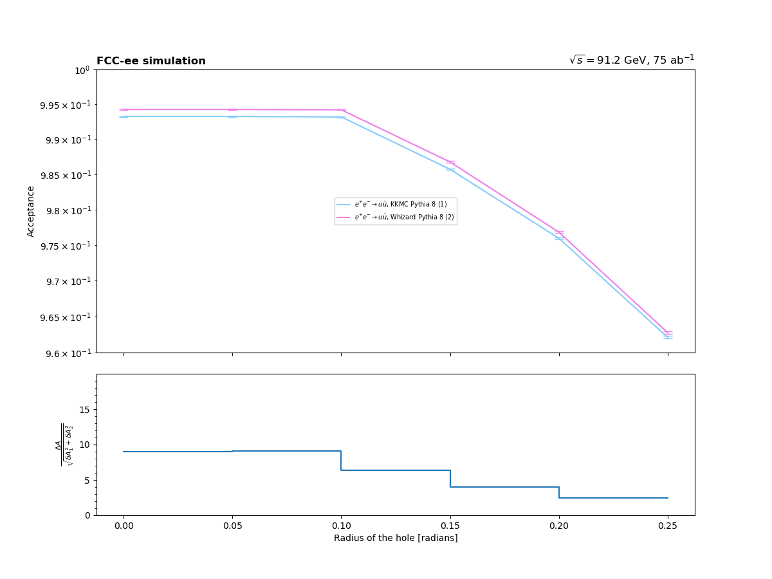
Acceptance & Definition of the detector hole
Great dependence of acceptance with the detector definition that is present in both generators. The simulations are significantly different.

Slide 24
Conclusion & Next Steps
FCC-ee simulations agree nicely with previous results;
KKMC and Whizard are in clear disagreement;
  We need to understand better the reason. Following studies will be performed;
Extend the FCC-ee simulation analysis for different quark flavors.

Slide 25
Thank you!
Work on lineshape analyses
Christoph Paus, Jan Eysermans, Luca Lavezzo
Tim Neumann, Sofia Lara, Casey Lawson, Bella Torres, Denis Siminiuc, Brenda Chow, Rujuta Sane

Slide 26
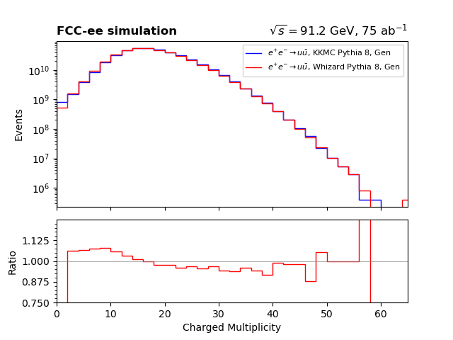
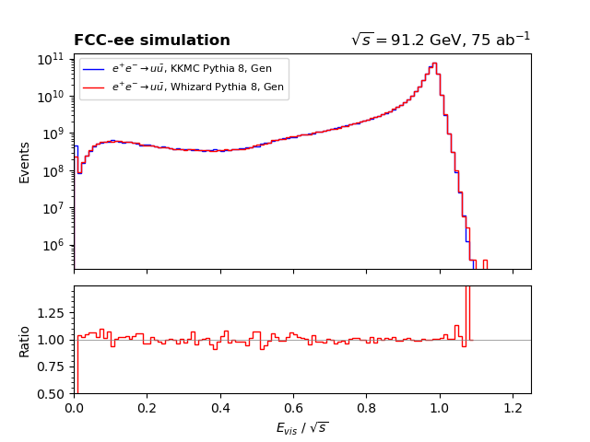
Gen level particles with detector definition on 0.3 radians
You can see much better agreement between KKMC and Whizard away from the edges of the detector.

Slide 27
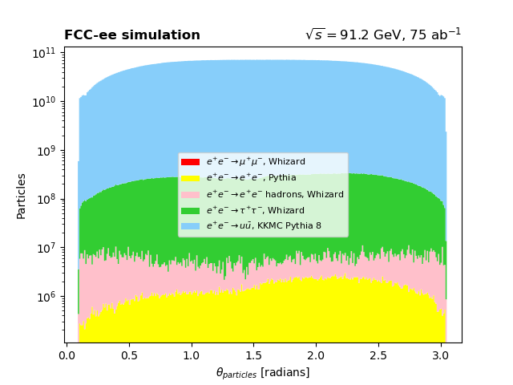
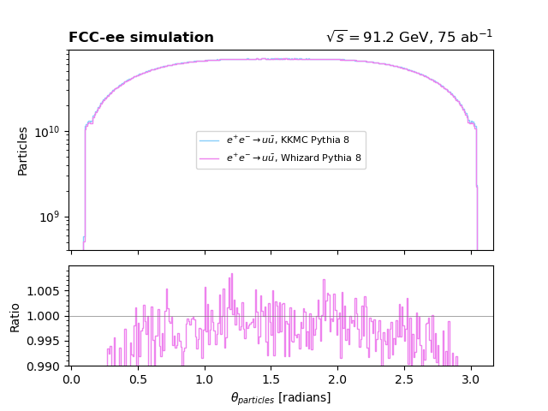
Theta distribution with detector definition on 0.1 radians

Slide 28
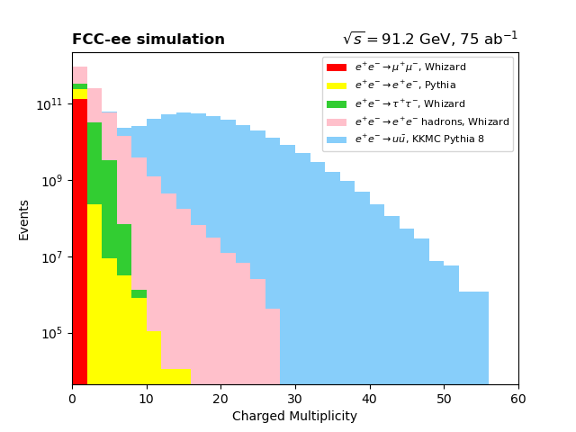
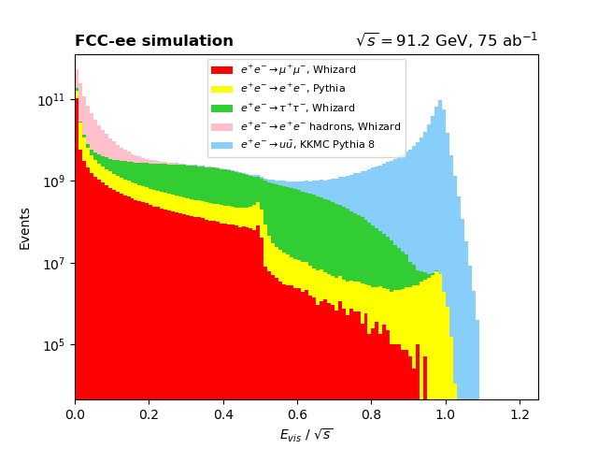
Distributions with no filters applied

