Slide 1
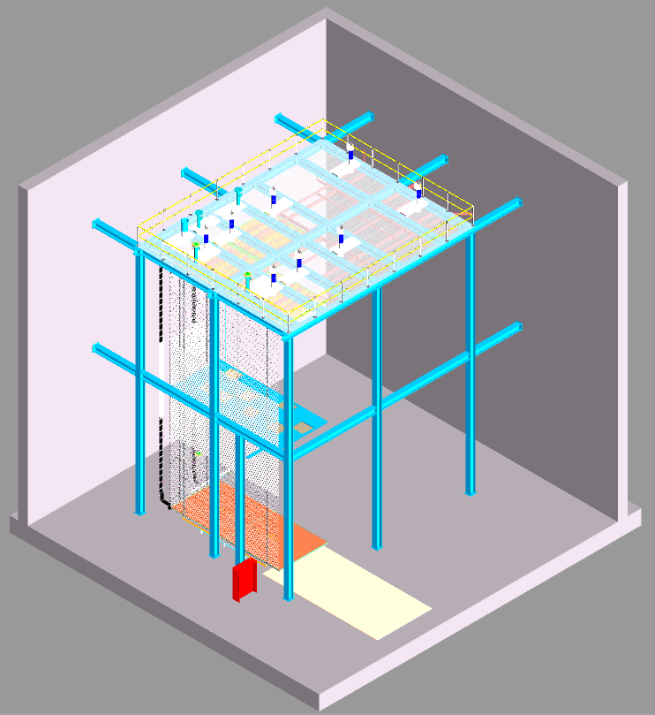
CERN Installation Test BDE Deliverables
Cheng-Ju Lin
Nov 14, 2023

Slide 2
Deliverables from BDE
Deliverable | Delivery Date CERN | Notes
Four bundles of 27-m cables | 1-April-2024 | Already at CERN. Available for B185 mechanical test after the completion of CRP6 cold box run
Cable reel (~1.5m diameter) and stand | 1-June-2024 | Will order the reel after the cable tray design is finalized
Cables and cable tray installation jig | 1-June-2024 | Should this be I&I or BDE deliverable?
Cryostat penetration and cable strain relief | 1-June-2024 | Only needed if we want to also exercise the integration of PD cable/fiber and BDE installation

