Slide 1
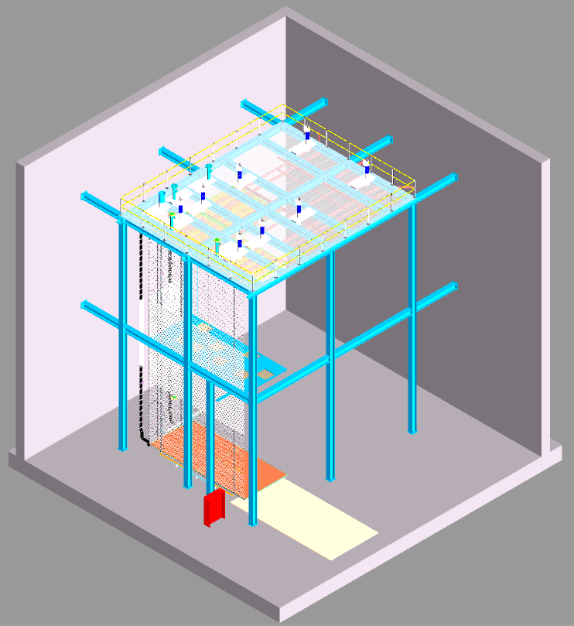
CERN Installation Test I&I Deliverables
Jim Stewart
Nov 14, 2023
11/13/23
CERN installaiton test

Slide 2
Deliverables from I&I
Deliverable | Delivery Date CERN | Relevant PRR date If applicable
Lift table | 7/1/24 | NA
Scaffold requirements | 12/22/23 | 8/1/25
Small CRP Support structure | 6mo after drawings are avail. | 6/17/25
Test cable tray | 9/1/23 | 8/1/25
Counterbalance crane requirements | 3/1/24
Roof penetration assembly for cable tray | 8/1/24 | 9/14/24
Jib Crane for Row 20 CRP installation | 11/1/24 | 8/1/25
Cable tray installation tooling | 9/1/24 | 8/1/25
We expect CRP contract processing to take 3 months as bids are required then one month to fabricate and 2 mo to ship to CERN.
The PRR dates assume FD2 is built second.
11/13/23
CERN installaiton test

Slide 3
Deliverables from PDS
Deliverable | Delivery Date CERN | Relevant PRR date If applicable
8 Mockup XARAPUCA Modules (for Cathode), each completed w/ | 7/1/24 | NA
Mockup electronics box (8) and real FC connectors (5) for PoF&SoF | 7/1/24
8 fiber tubes w/ 6 (mockup or real, tbd) fiber-optics for PoF&SoF, terminated w/ FC connectors | 7/1/24
Test C-channel (fibres conduit onto FC wall) - by HV Consortium? | <7/1/24
Fiber Tubes Guide Assembly (sliding&bending) from bottom edge of septum in Roof penetration assembly to C-channel onto FC panel | 8/1/24
Fiber Tubes installation tooling | 9/1/24
Recent (after SURF I&I Mtg) development of the fiber tube routing and scaffolding have been pursued.
There are some still undefined details and/or items that need to be fully understood and then tested at CERN I&I test.
Fiber Tubes Guide Assembly: 3D model and engineering requires ME effort (currently not included in planning and resources not allocated)
Cost of mockup components to be evaluated and fabrication responsibility to be assigned.
11/13/23
CERN installation test

