Slide 1
WP2 - Communication
Steering Committee | 14 December 2023
Antoine Le Gall (CERN) & Yiota Foka (GSI/CERN)

Slide 2
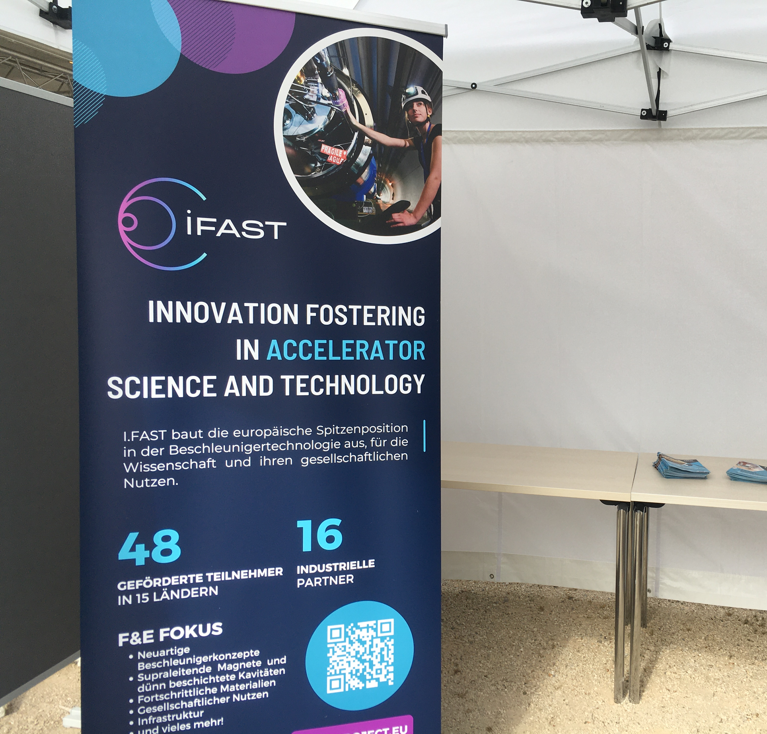
Exhibition and conferences
I.FAST was presented at:
Greece - several exhibitions.
July: GSI Open Day (Germany).
September: Medicon (Bosnia & Herzegovina).
Banners EN & GE are available for download and for rent (@ Valérie).

Slide 3
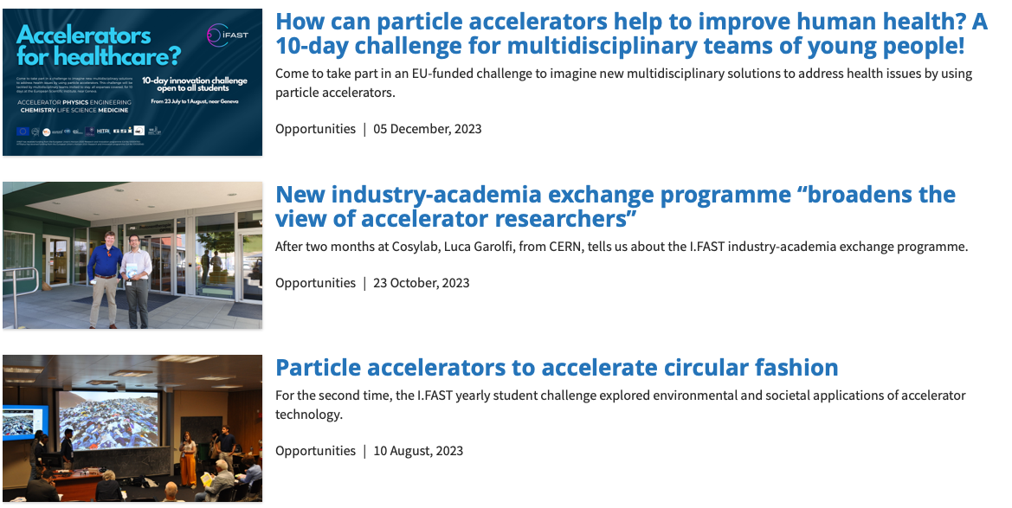
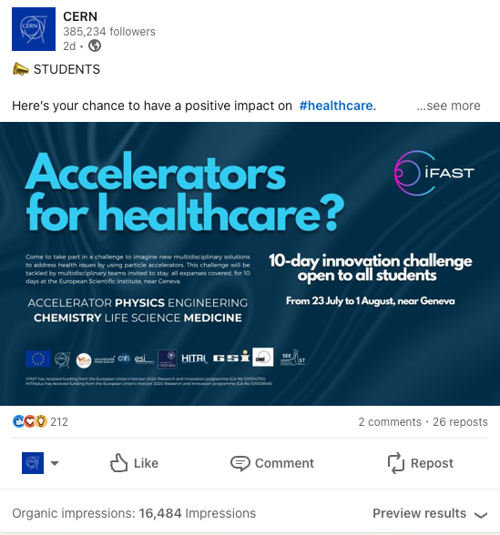
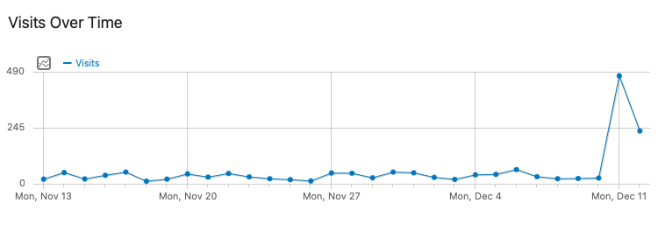
Articles
Published on CERN, Accelerating News, partners, specialised press, etc.
Impactful comms since two leads are being explored at CERN.

Slide 4


Challenge-based innovation 2024
Launched 5 December.
Deadline: 26 February.
News on:
  I.FAST, CERN, Accelerating News (special issue), partners.
In the future:
  Video w/ former students, media push.

Slide 5
Accelerating News
October:
  Last issue of Accelerating News (#45).
  Included the articles mentioned previously.
December:
  Special issue to announce the CBI.
January:
  Next issue of Accelerating News (#46).
  Will include an article about environmental applications and another topic (TBD).

Slide 6
Website
Updated to the latest version of Drupal (#10).
CERN is slowly moving away from this infrastructure and might recommend to use WordPress from the end of 2024.
More info to come next year!

Slide 7




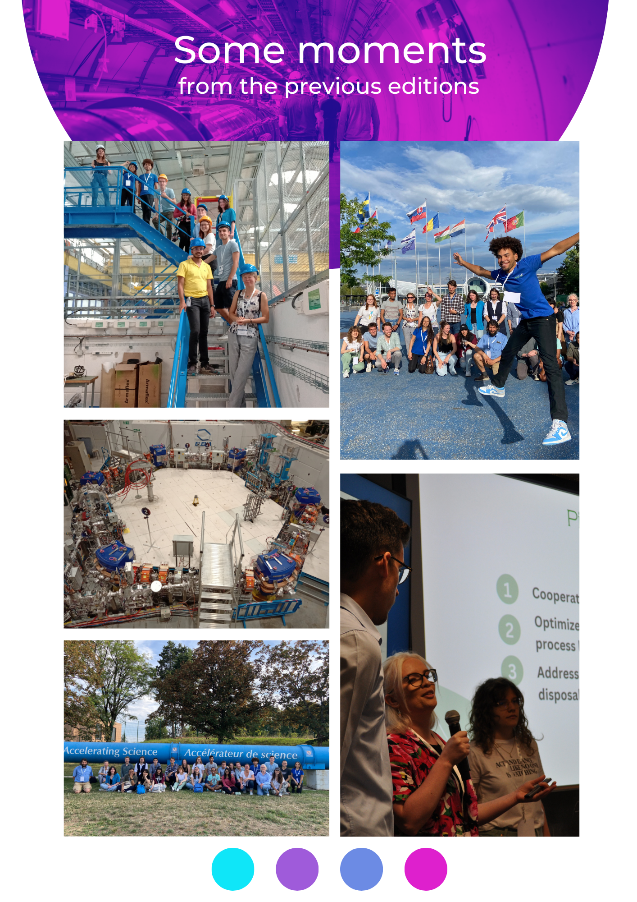

Posters / Leaflets
Posters for
events
Leaflets for programmes
Roll-up banners for
conferences

Slide 8



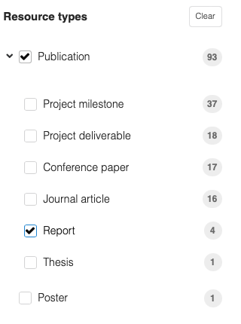
Monographs
Zenodo, under "Reports".
Physical format similar to ARIES'.

Slide 9
Some announcements
Communication Workshop:
  Topic: Communication on accelerator upgrades, and impact of accelerators (econimicla, societal and SDGs).
  Date: February 2024.
  Indico: To be added.
Particle Therapy Masterclass:
  Topic: Use of accelerator technology for cancer tumour therapy
  Date: 12 February – 30 March 2024
  Indico: https://indico.cern.ch/e/PTMC

Slide 10

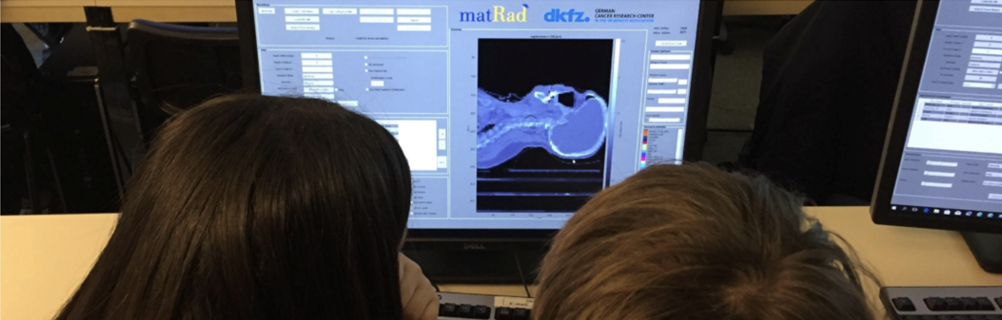
Particle Therapy Masterclass
46 institutes registered so far:
  Interested institutes may register via the following
  LINK or the following FORM
PTMC 2024 Schedule and Video Conference indico pages:
  12 February: https://indico.cern.ch/event/1246300/
  24 February: https://indico.cern.ch/event/1246302/
  27 February: https://indico.cern.ch/event/1246303/
  28 February: https://indico.cern.ch/event/1246649/
  4 March: https://indico.cern.ch/event/1246638/
  8 March: https://indico.cern.ch/event/1345194/
  15 March: https://indico.cern.ch/event/1355597/
  23 March: https://indico.cern.ch/event/1246651/
  Upon request additional dates may be offered, please send an email to: yiota.foka@cern.ch

Slide 11
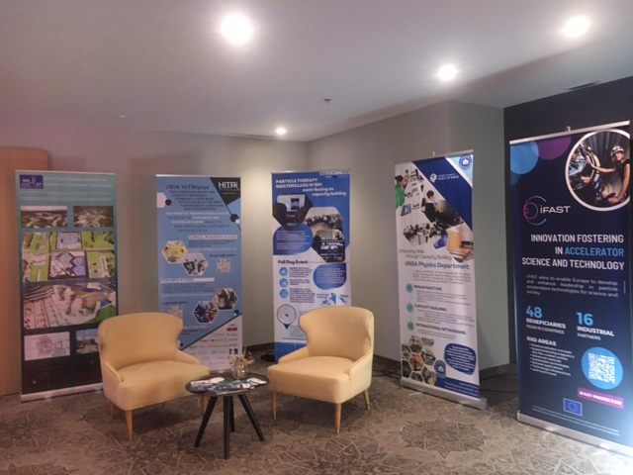
I.FAST @ Medicon
Sarajevo, 12 September 2023
Main message:
Innovation in accelerator technologies
and capacity building projects
support societal applications
such as future cancer therapy facilities with ion beams.
Synergies: I.FAST, HITRIplus (magnets)
Format
Exhibition corner next to the main entrance to the plenary hall.
Banners, leaflets, TV screen
Invited presentation.
  MEDICON, Sarajevo 12 sep 2023

Slide 12
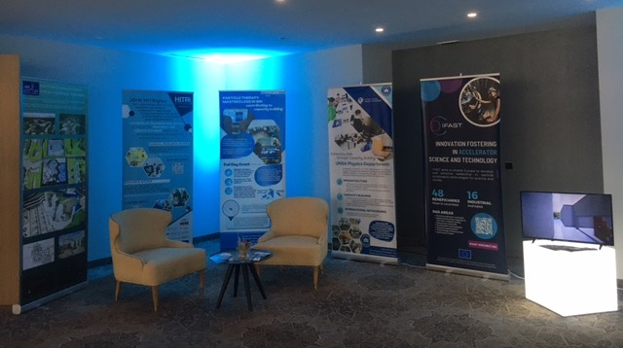
I.FAST @ Medicon
Sarajevo, 12 September 2023
Main message:
Innovation in accelerator technologies
and capacity building projects
support societal applications
such as future cancer therapy facilities with ion beams.
Synergies: I.FAST, HITRIplus (magnets)
Format
Exhibition corner next to the main entrance to the plenary hall.
Banners, leaflets, TV screen
Invited presentation.
  MEDICON, Sarajevo 12 sep 2023

Slide 13
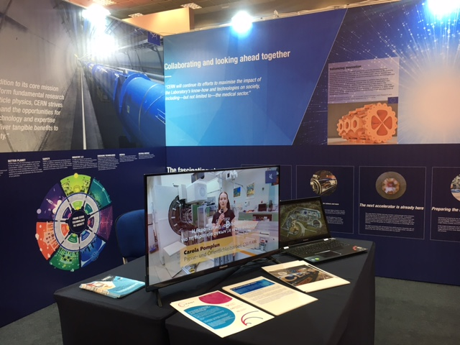
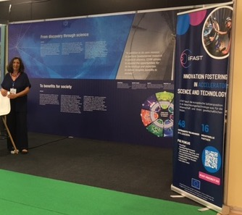
I.FAST @ Beyond & Forward Green
Thessaloniki, 2023
Main message:
Innovation and technical developments pushed by requirements of fundamental research find applications with direct benefit to society.
Highlight RFQ as example.
Leaflets, 3D printed RFQ samples

Slide 14
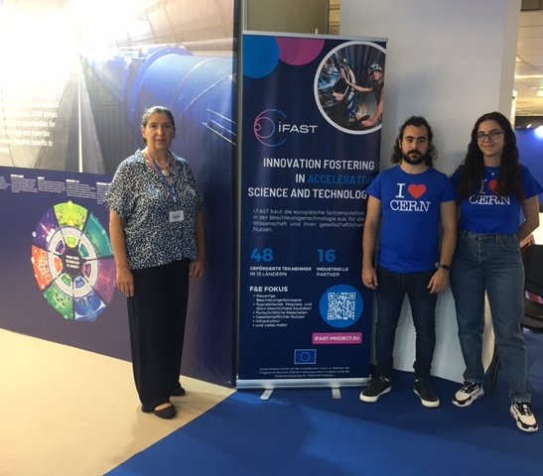
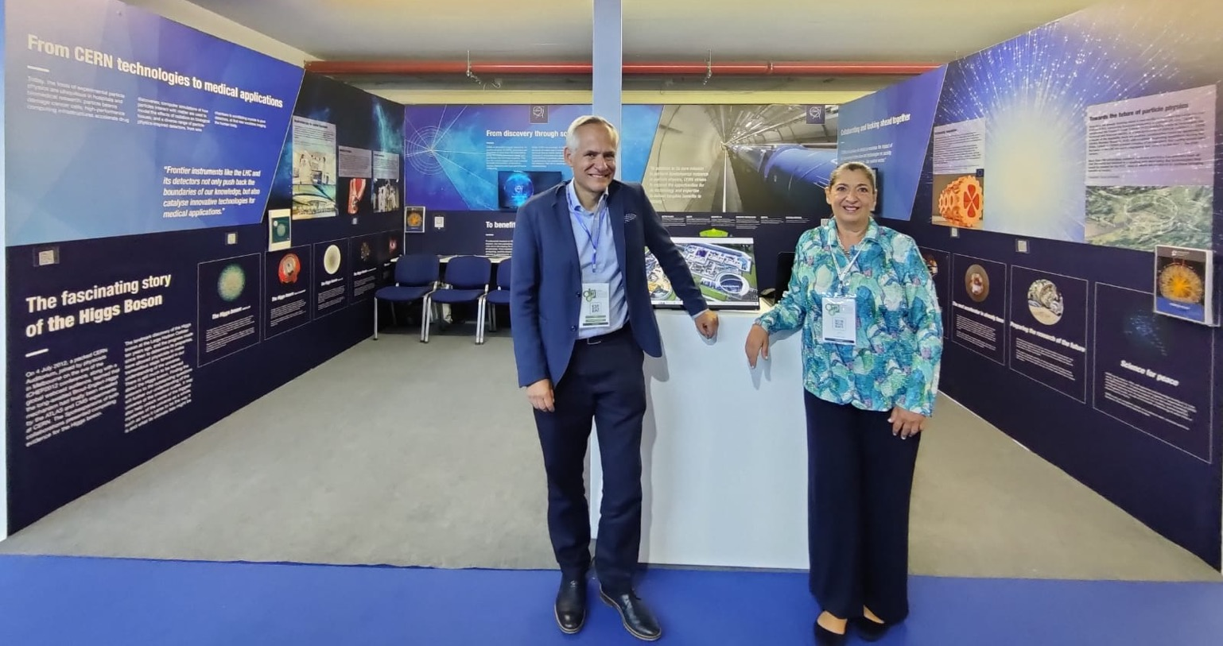
I.FAST @ TIF expos, Thessalonniki
  TIF, Thessaloniki, sep 2023
Outcome:
Participation to 5 exhibitions in Thessaloniki motivated a large number of students
  TIF, Thessaloniki, sep 2022

Slide 15
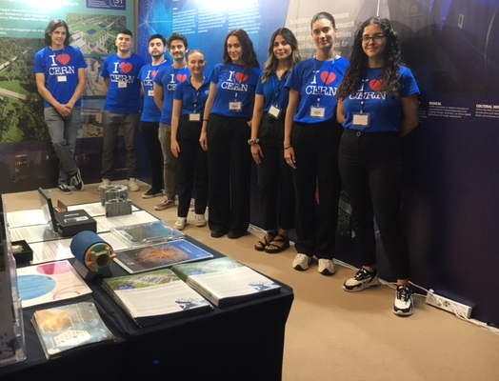
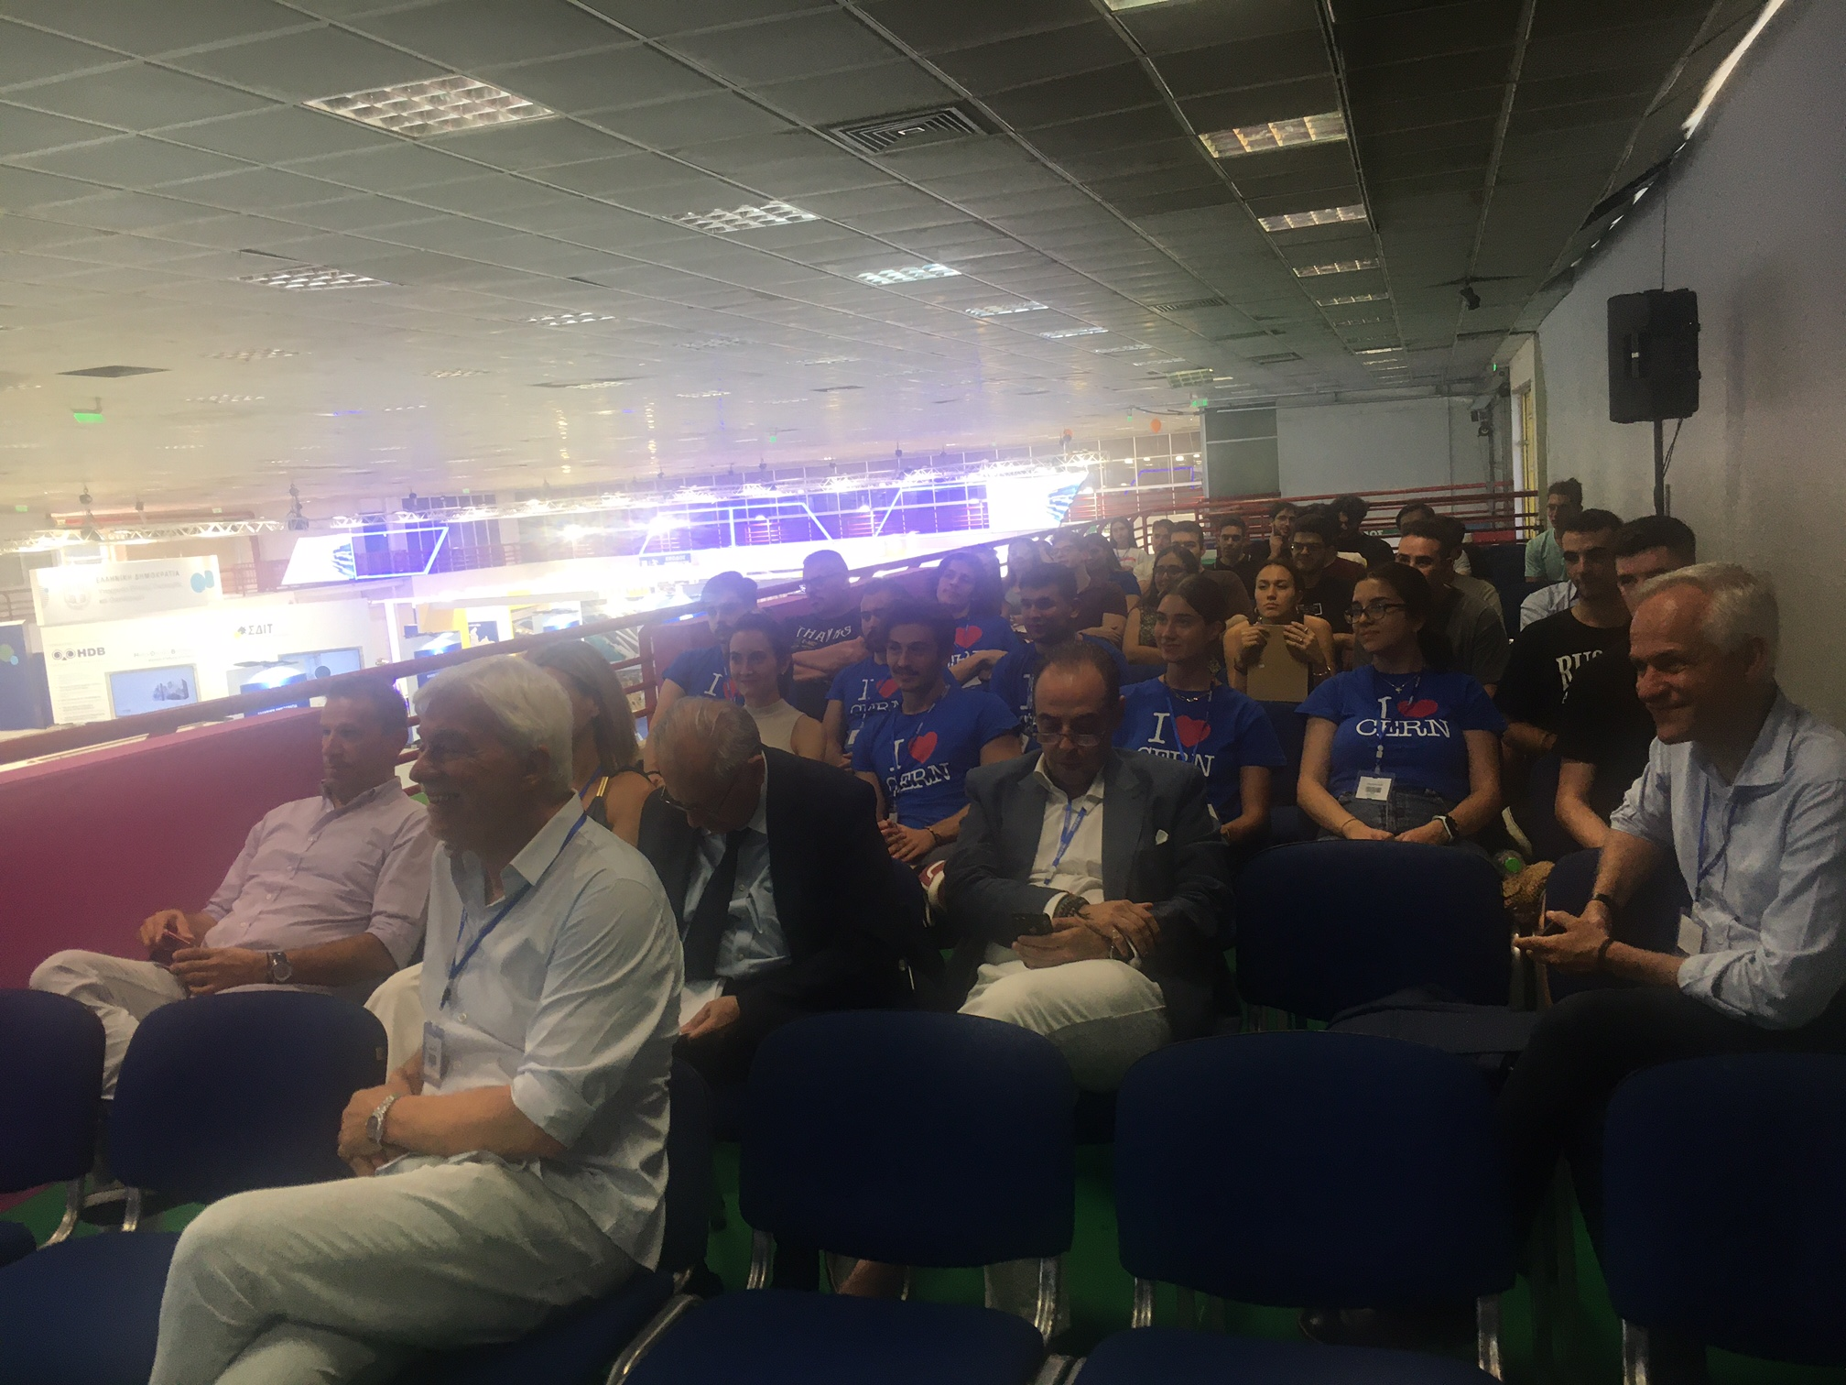
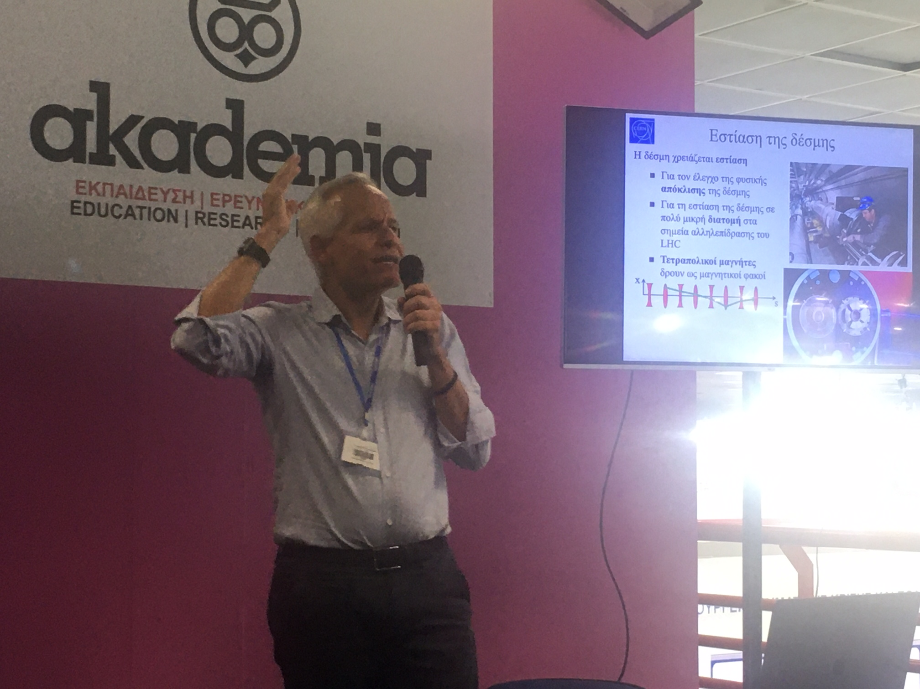
I.FAST @ TIF expos, Thessalonniki
Outcome:
Participation to 5 exhibitions in Thessaloniki motivated a large number of students
  TIF, Thessaloniki, sep 2023

Slide 16
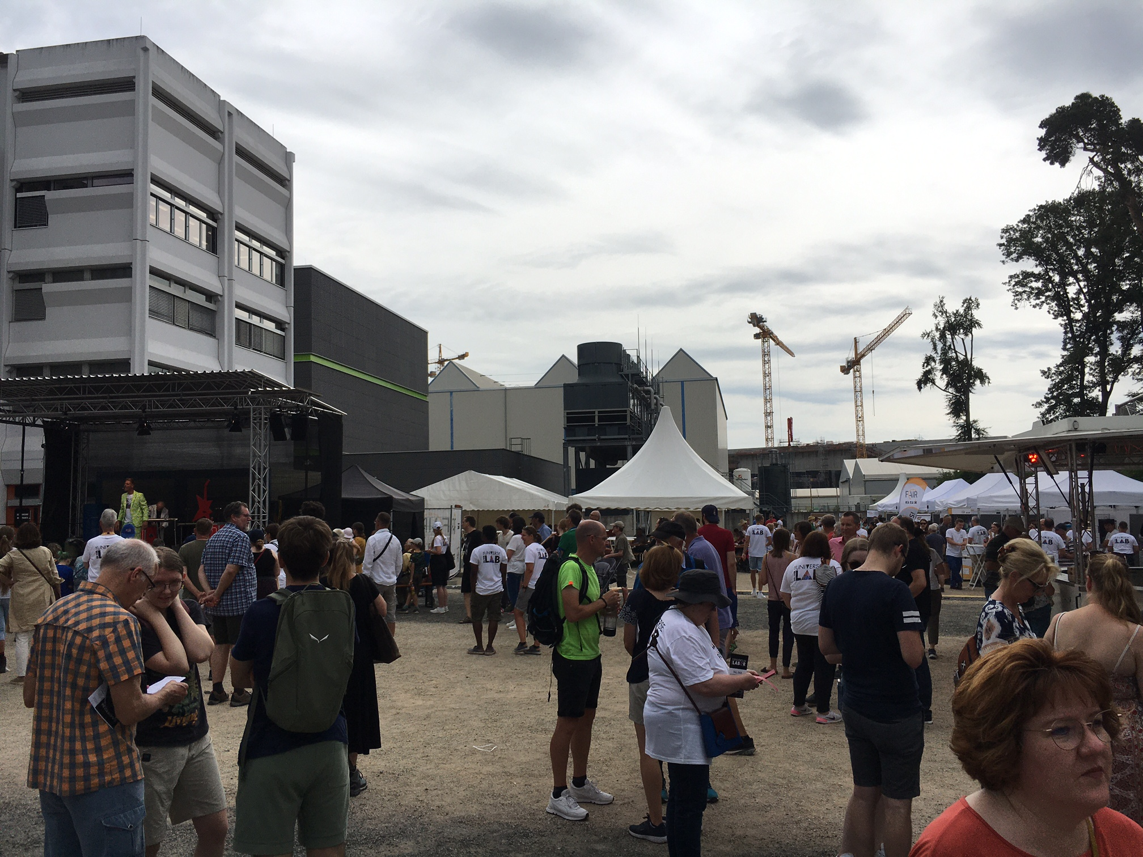
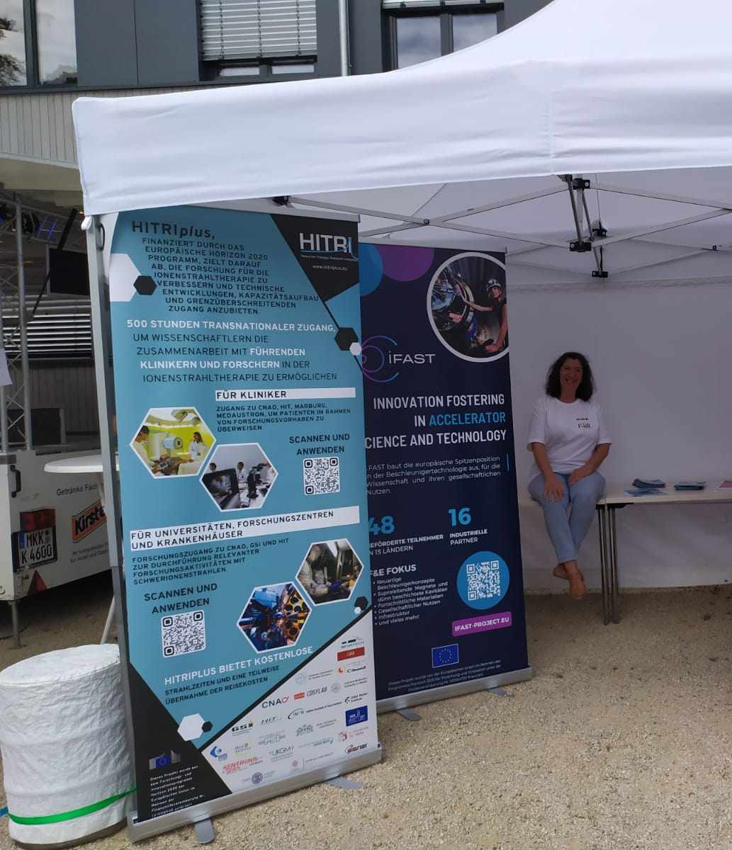
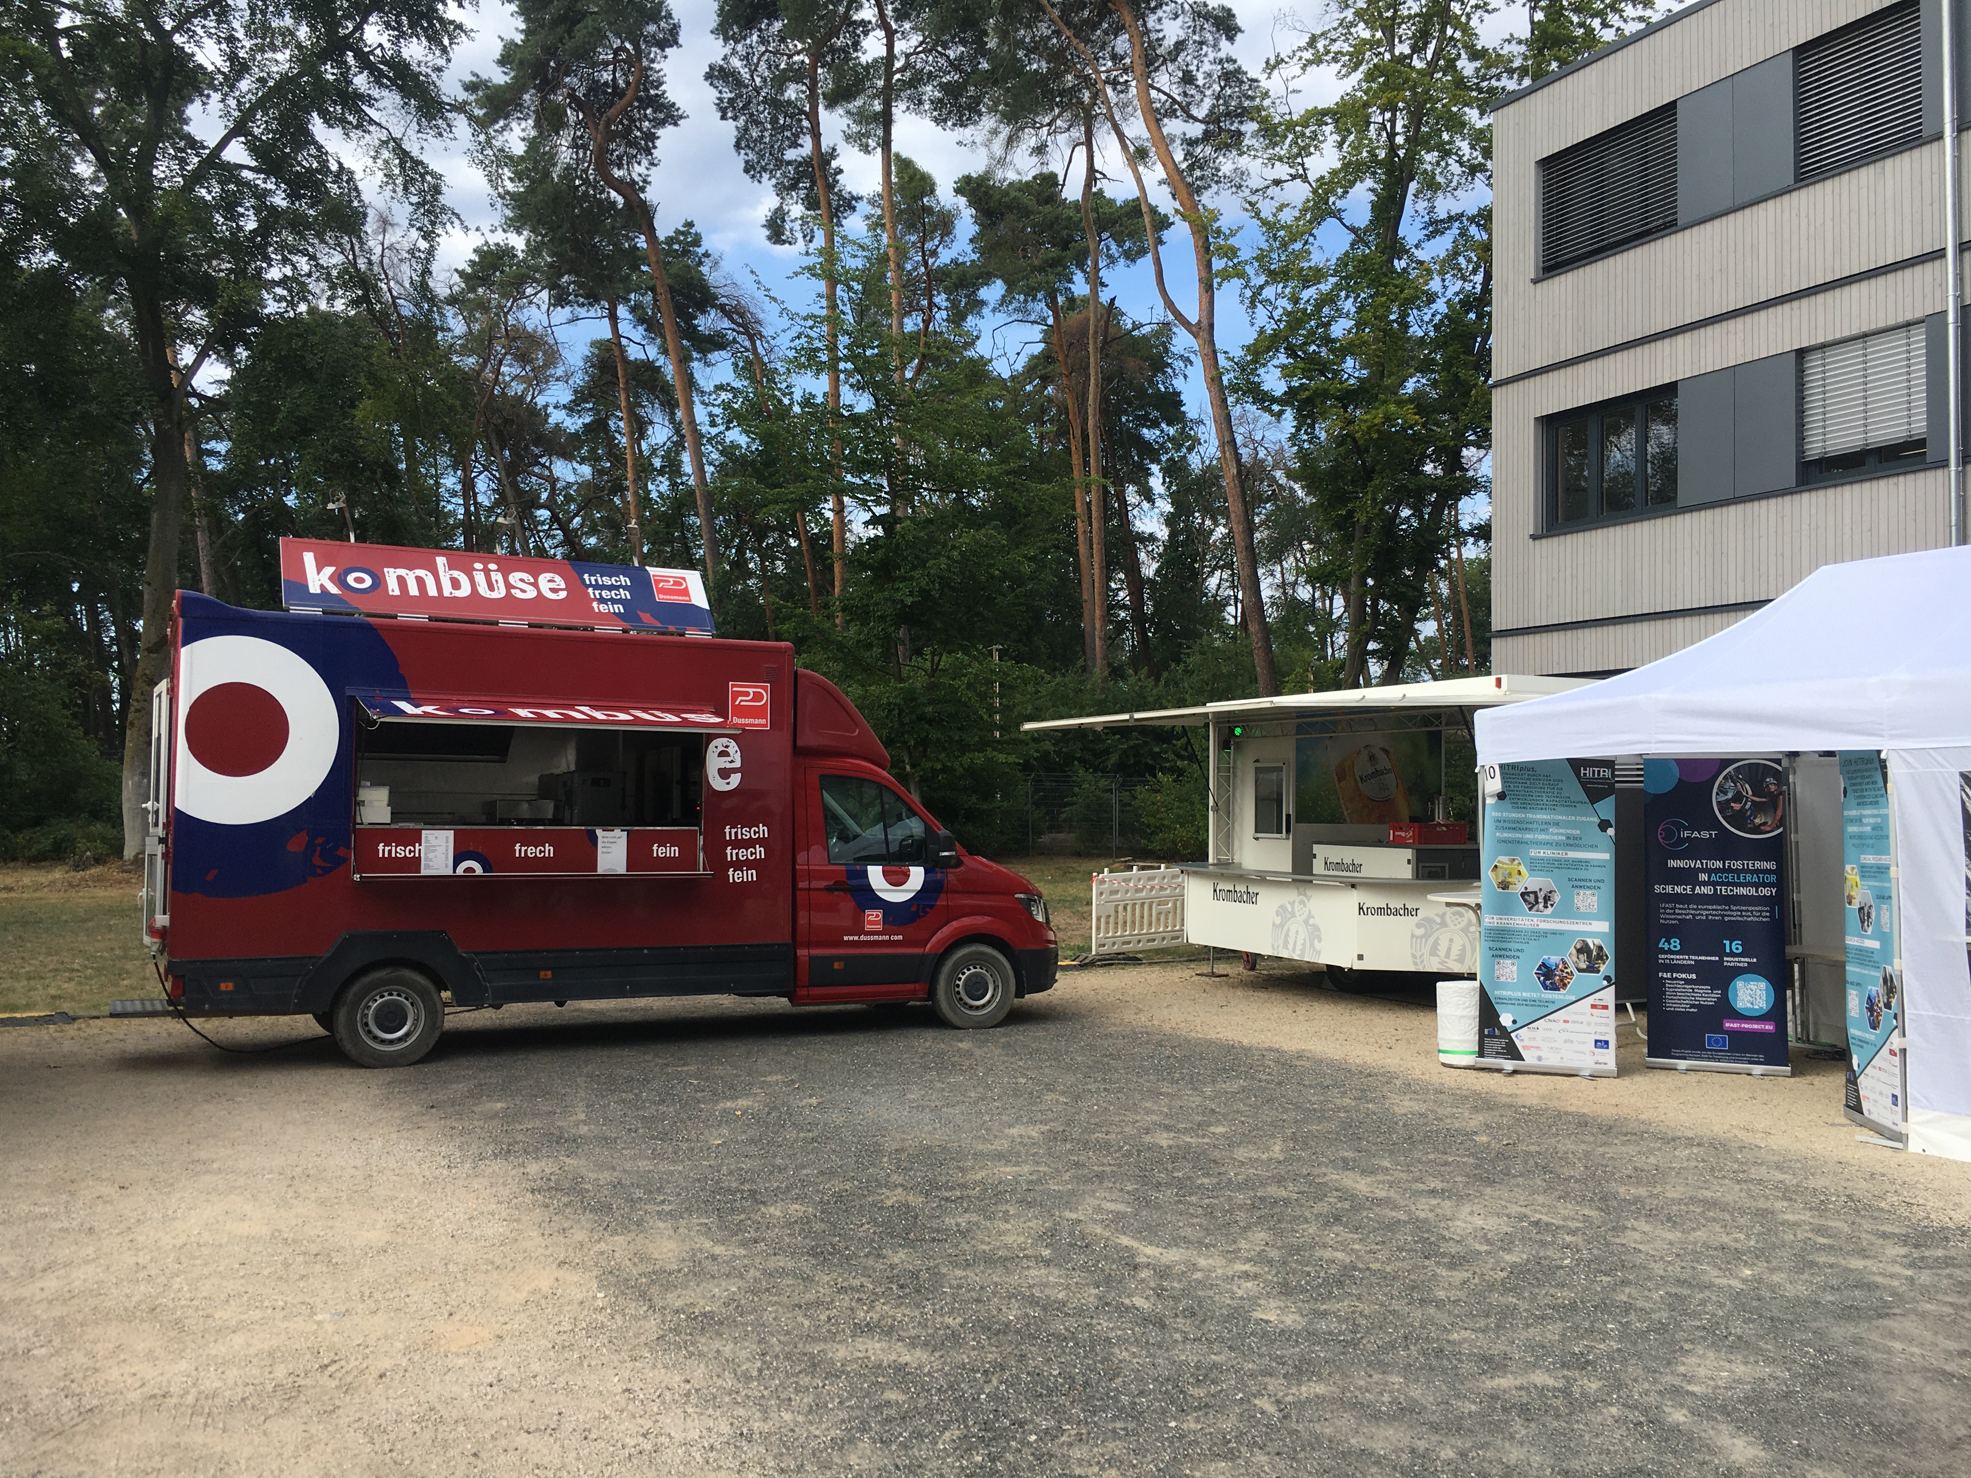
I.FAST @ GSI Open Days
GSI, July 2023

