Slide 1
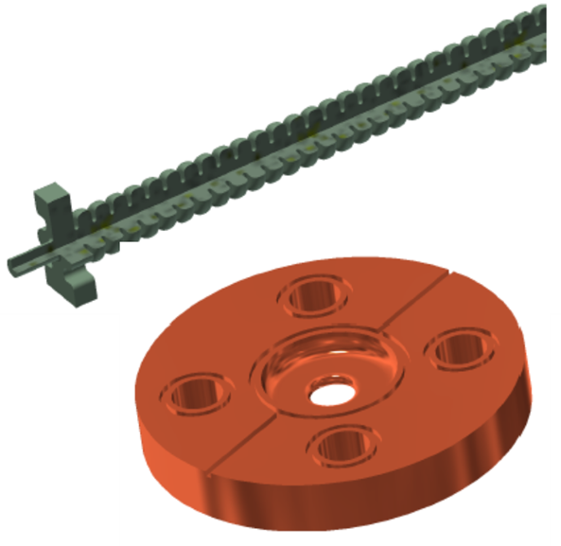
iFast task 7.5 status
Objective
Build and test two prototypes of the X-band (12 GHz) accelerating structure designed for the CompactLight project.
Mockup of the first prototype:
Three trials were carried out under different conditions to check:
- Machinability
- Alignment
- Brazing materials
- Leak tightness
- Weight
Courtesy Pedro Morales sanchez

Slide 2
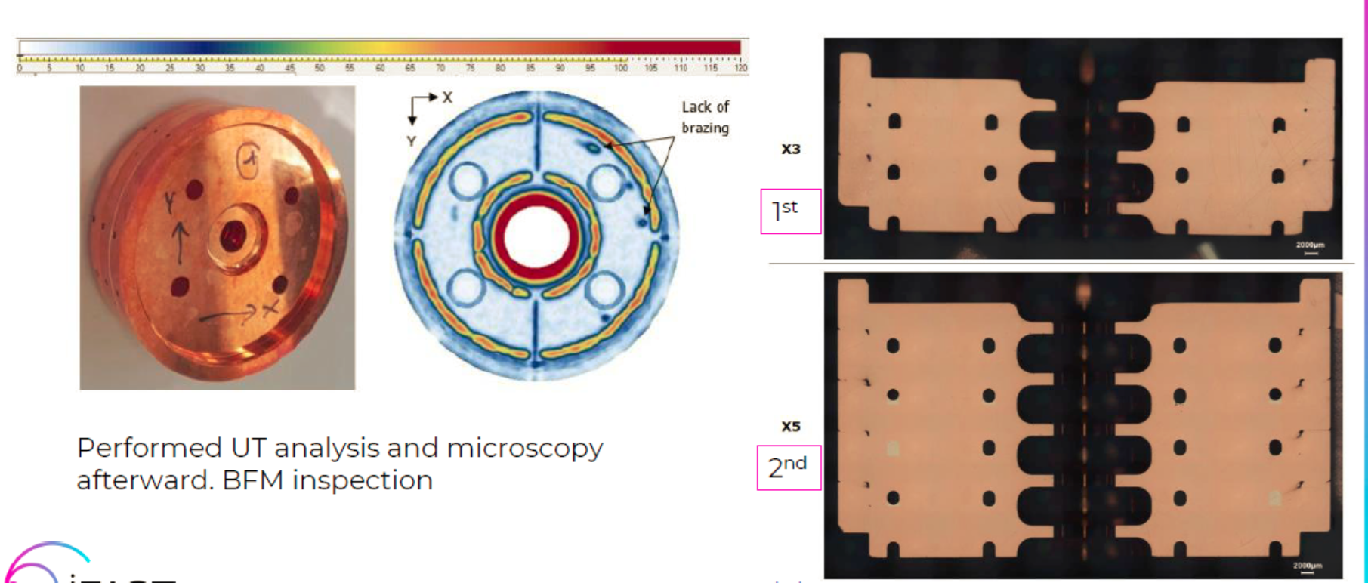
iFast task 7.5
Performed
- UT analysis,
- microscopy and
- Brazing Filler Material (BFM) inspection.
The alignment and flatness of the structure were kept as expected after the cycle
Courtesy Pedro Morales sanchez

Slide 3
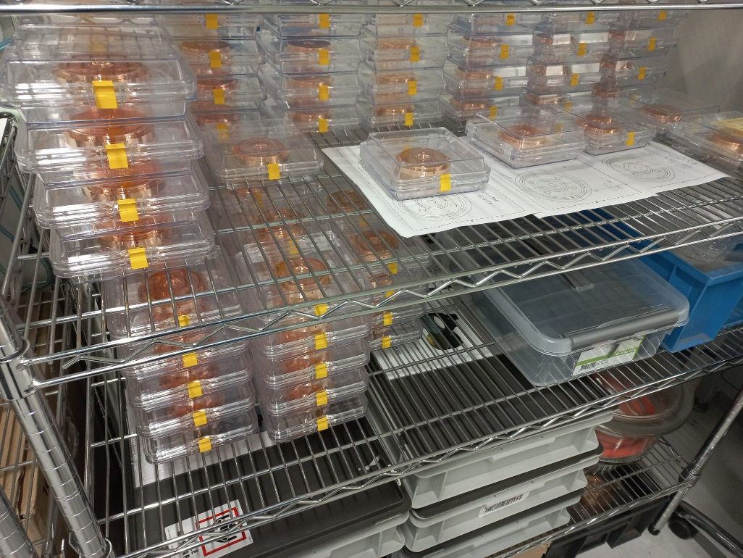
iFast task 7.5
First prototype production
The first structure
will be brazed in January 2024
with low power RF tests
beginning of February 2024.

