Slide 1
WP7: high brightness accelerators for light sources
Scope: WP7 pursues the R&D on new technical solutions for the design and construction of accelerator-based light sources, exceeding the performance of present machines. The research embraces both storage ring based synchrotron light sources and free electron laser driven by Linacs.
Fostering networking activities building on the previous EU networks funded within the ARIES and EuCARD2 projects
Tasks 7.2: enabling technologies for ultra-low emittance rings
Supporting R&D and prototypes on cutting edge technological aspects, critical in the construction of new, compact, and sustainable accelerators
Tasks 7.3: Longitudinal variable dipole for the ELETTRA upgrade (Y. Papaphilippou, CERN)
Tasks 7.4: High gradient RF guns with C-band technology (D. Alesini, INFN Frascati)
Tasks 7.5: X-band accelerating structure prototype (G. D’auria, ELETTRA, Trieste) – see next slides
Most deliverables in year 4 – no major issue to report

Slide 2
Task 7.2 Activties: workshops on magnet technology
Workshop on permanent magnet based magnets for ultra low emittance rings (Trieste, 14-15th November 2023)
Recent trends in the design, construction and operation of PM based magnets
Joint LEAPS/I-FAST workshop
https://indico.cells.es/event/1373/ (E. Karantzoulis, F. Perez)
Mini-workshop on resistive magnets for ultra low emittance rings (DESY 1st-2nd June)
Investigate challenges and recent trends in the design, construction and operation of resistive magnets for ultra low emittance rings
https://indico.desy.de/event/39184/ (M. Thede, R. Bartolini)

Slide 3
Task 7.2: summary of upcoming activities
Regular meetings: scheduled for Task. 7.2 chaired by A. Mochihashi (KIT)
Upcoming workshops:
General workshop ultra low emittance rings
12th-16th February, CERN
one day dedicated to Sustainability, efficiency and power consumption
https://indico.cern.ch/event/1326603/
Workshop on Bunch-by-Bunch Feedback Systems and Related Beam Dynamics (KIT)
4th-5th March 2024 (moved from November 23)
https://indico.scc.kit.edu/event/3742
Workshop on Injectors for Storage Ring Based Light Sources (KIT)
6th-7th March 2024
https://indico.scc.kit.edu/event/3948/

Slide 4



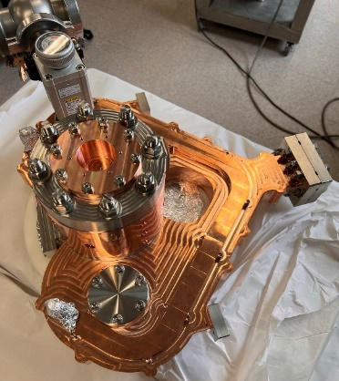
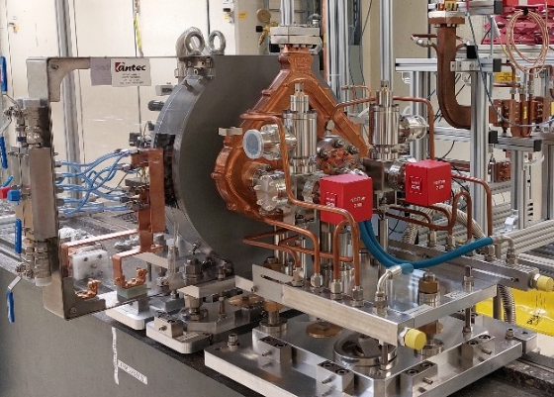
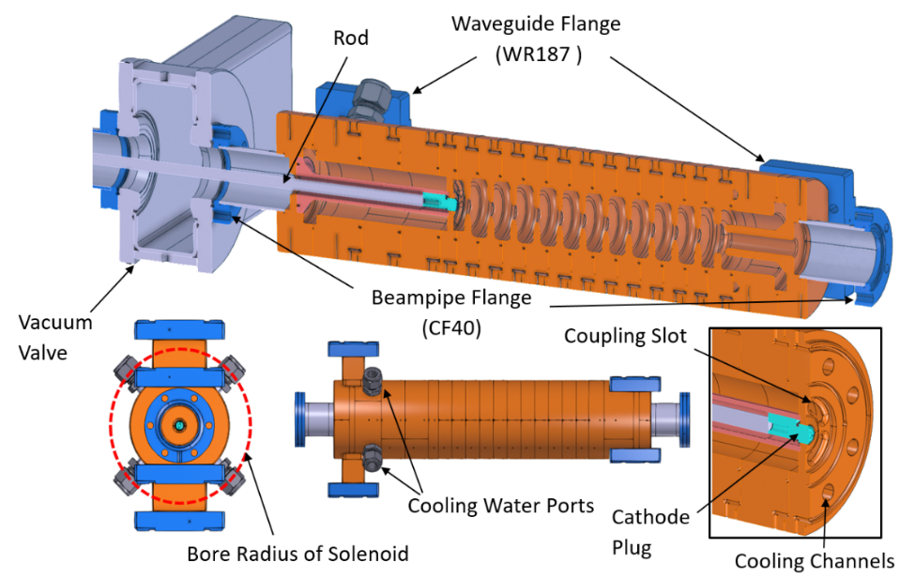
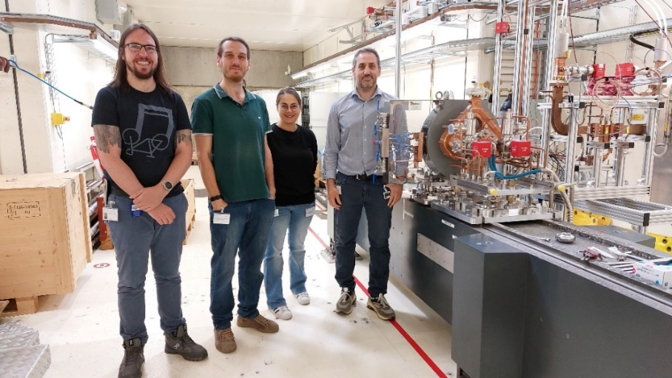
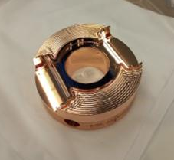
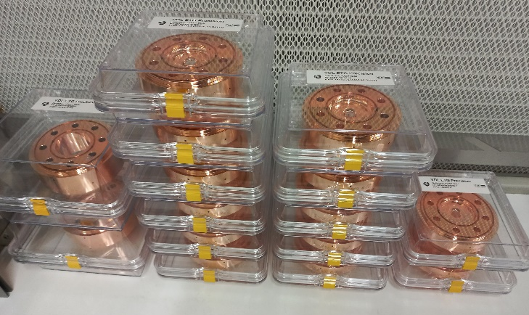
Task 7.4: very high gradient RF guns with C-band technology
SW GUN
TW GUN
Standing Wave gun realized, assembled in the module and installed at PSI C-band test facility: ready to start the high power RF conditioning (Jan. 24)
Travelling Wave gun design completed: cells and couplers under construction at VDL (expected final brazing at PSI in May 24)
Courtesy D. Alesini (INFN)

Slide 5
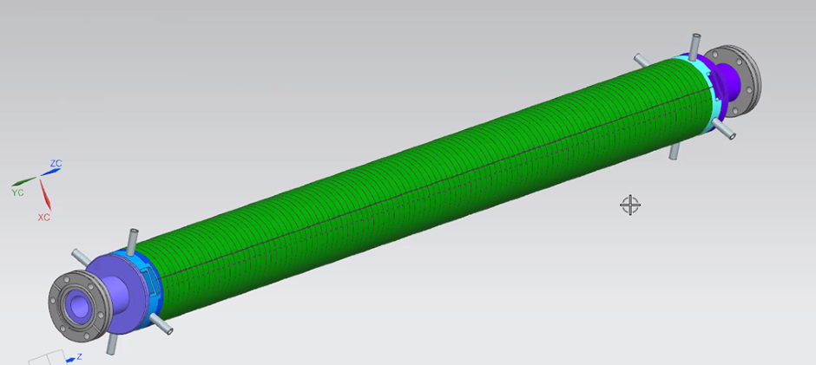
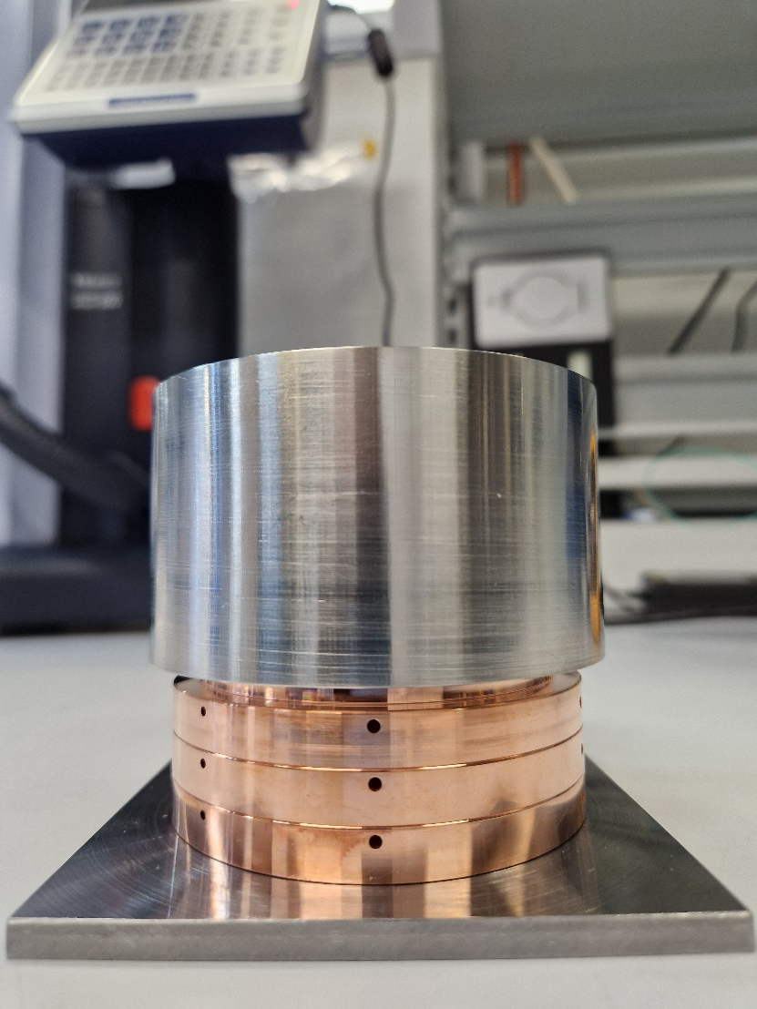
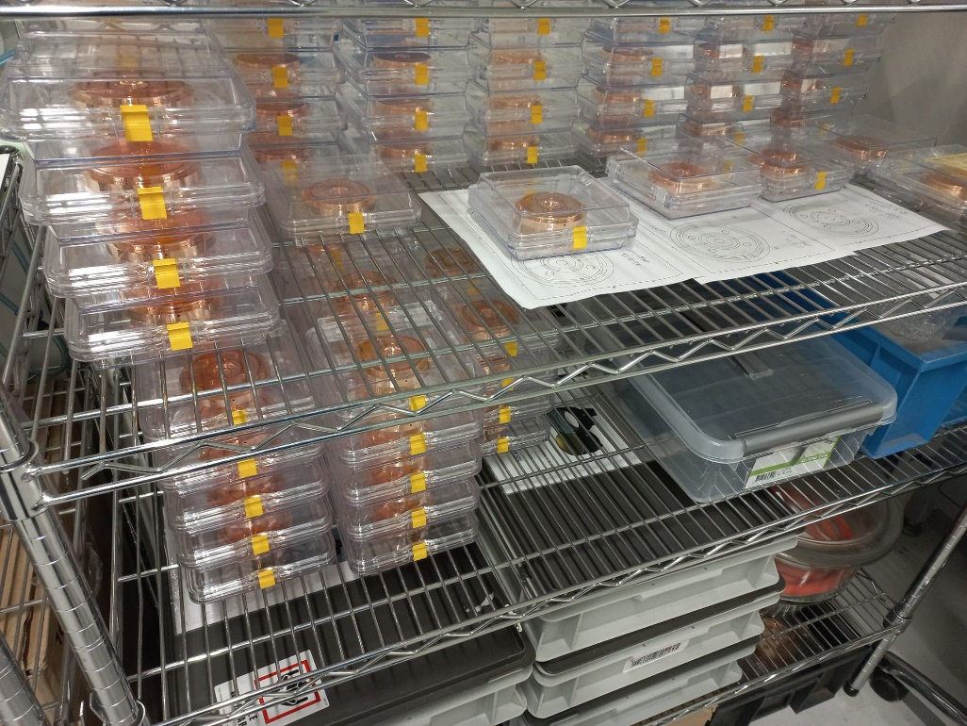
Task 7.5: X-band cavity prototype for compact light sources
Objective:
Build and test two prototypes of the X-band (12 GHz) accelerating structure designed for the CompactLight project.
1. Design phase
2. Mock-up phase
3. Prototype production phase
The first structure will be brazed in January 2024 with low power
RF tests beginning of February 2024.

