Slide 1
WP11: Sustainable Concepts and Technologies
iFAST Open Steering Committee Meeting, December 14, 2023
Denise Völker, DESY (filling in for Mike Seidel, PSI/EPFL)

Slide 2
WP11 Overview
task 1: Sustainable Concepts for RIs: networking, workshops on selected topics
deliverable: report
System Efficiency of Accelerator Concepts (N.Catalan Lasheras, CERN)
Key Technologies and Components for High Efficiency (C.Martins ESS)
Cross Linking Accelerator R&D with Industrial Approaches (P.Spiller GSI)
Ecological Concepts (D. Voelker DESY)
task 2: High Efficiency Klystron (O.Brunner CERN, THALES, ULANC)
deliverable: industrial prototype
replacing klystrons in LHC
task 3: Permanent Combined Function Magnets for Light Sources (B.Shepherd, UKRI, DLS, KYMA, DESY)
deliverable: magnet prototype, applicable for Diamond upgrade,PETRA-4
several advantages of permanent magnets, not just power consumption

Slide 3
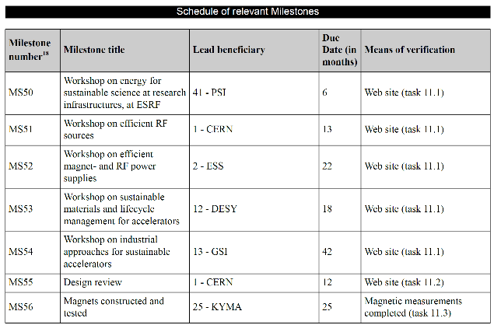
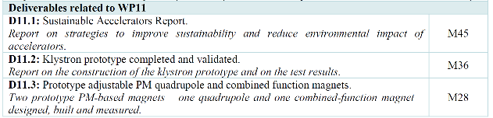
Milestones & Deliverables
September 2022, done → next ESSRI Sept. 2024 Ciemat https://agenda.ciemat.es/event/4431/
July 2022, done → follow up workshop in 2024
Delayed to 2024, → New Developments in Power Converters for Sustainable Operation, planned for April 8-10 2024 https://indico.esss.lu.se/event/3396/overview
February 2023, done → promotion of results at REPM (Birmingham) and Low Emittance Ring – Permanent Magnets Workshop (WP 11 Task 3)and others → follow up workshop in 2024
October 2023, done, results: https://indico.gsi.de/event/17548/overview
June 2022, done
Prototype to be completed in mid-2024

