Slide 1


WP number, Title
Name (Affiliation)
RADNEXT 3rd Annual Meeting – 10-11 June 2024
https://indico.cern.ch/e/radnext-2024

Slide 2
Outline

Slide 3
Third year achievements and ongoing activities

Slide 4
Conclusion

Slide 5
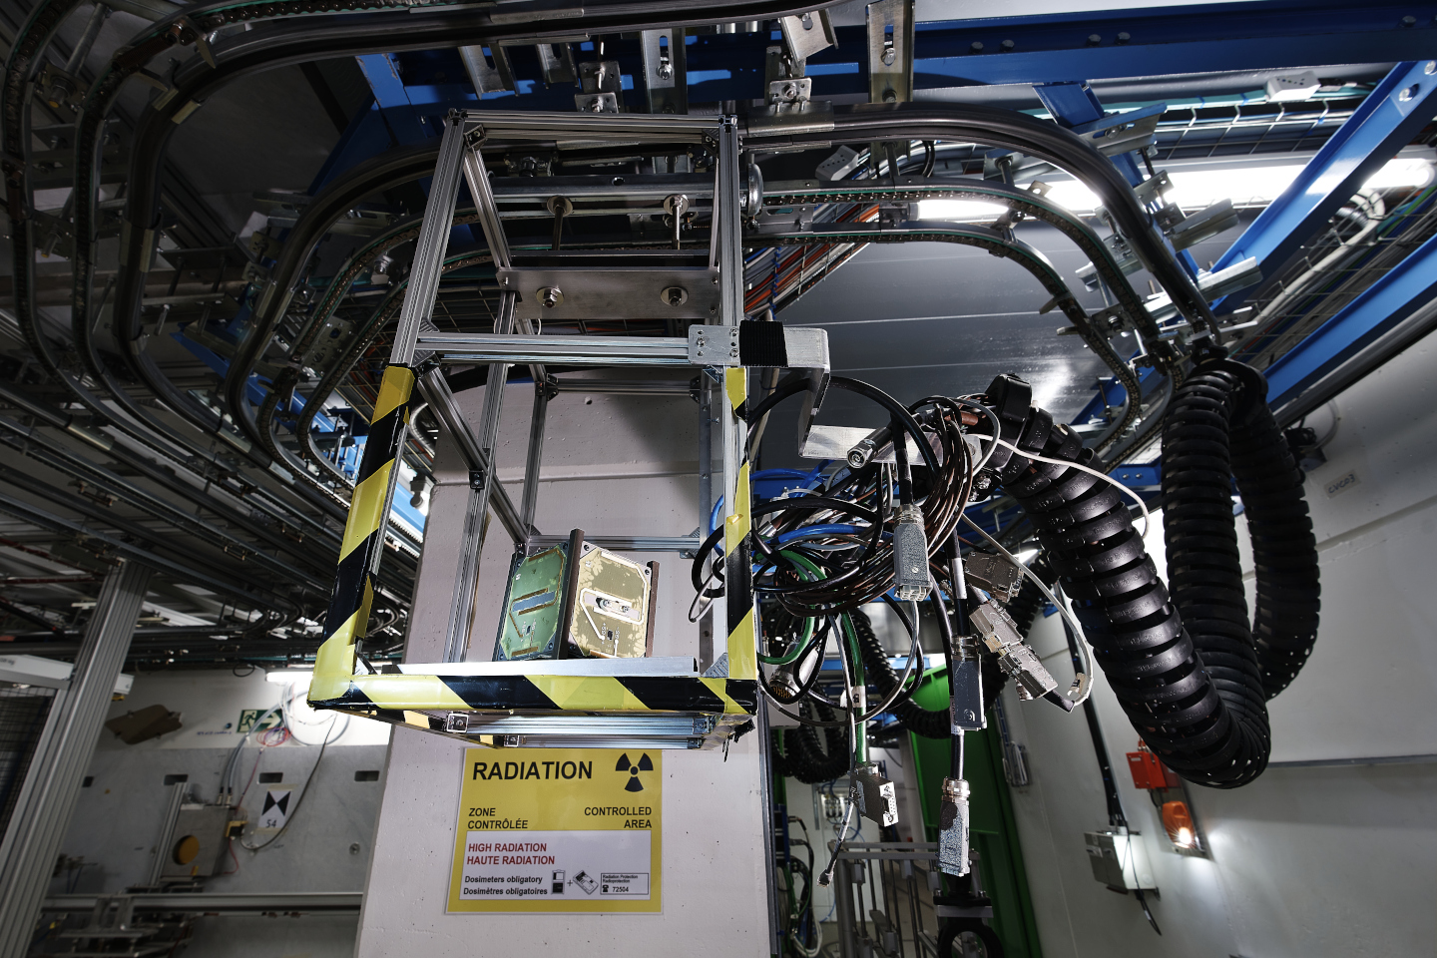
Thanks for your attention!
Image Source: CERN

