Slide 1

Project Consortium Board Meeting #6
Pablo Lopez, RADNEXT Project Management Office
11 June 2024
https://indico.cern.ch/event/1411113/

Slide 2
Agenda
Welcome, quorum verification and agenda approval
Recent approval of the Grant Agreement amendment
Upcoming events
Reminder of RADNEXT P2 reporting timeline
Information on upcoming item(s) to vote on electronically
TA provision overview and reallocation discussion
AOBs

Slide 3
Recent approval of the Grant Agreement amendment (1/4)
Content:
12-month project extension request to the EU → RADNEXT will continue up to month 60 (31 May 2026) mostly for TA activities
Addition of HollandPTC (HPTC) to the consortium as from 15 February 2024
Change of reporting periods → The 3rd and last reporting period now covers month 37 to 60 (1 June 2024 to 31 May 2026)
Change of Annex 1 (description of the action) – see next slides
Change of Annex 2 (estimated budget) – see next slides
The request has been approved and the signature finalised on 22 May 2024. Link to report on EDMS

Slide 4
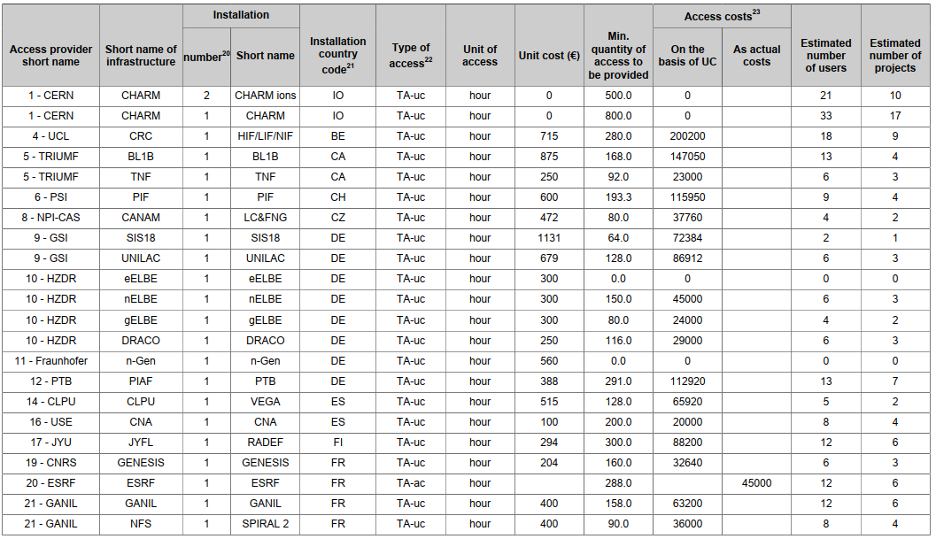
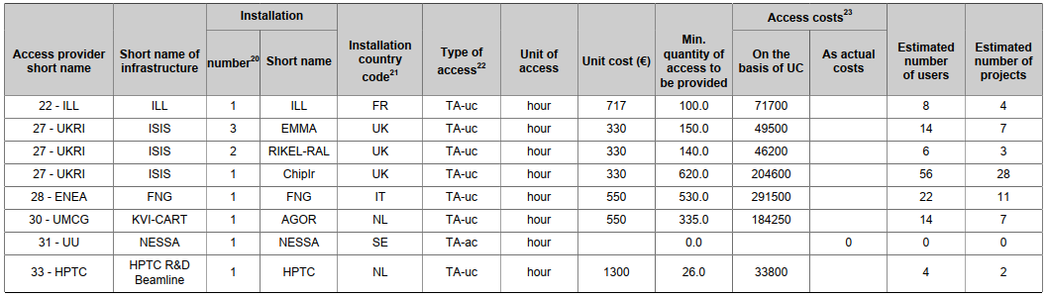
Recent approval of the Grant Agreement amendment (2/4)
Main updates on Annex 1:
WP1, WP2, WP3, WP9 and WP10 end date postponed from Month 48 to Month 60
D2.4, D2.5, D3.2, D3.3, D9.1, D9.2, D10.1, D10.2 due date postponed from Month 48 to Month 60
Redistribution of beamtime under WP9 and WP10 as follows:

Slide 5
Recent approval of the Grant Agreement amendment (3/4)
Main updates on Annex 2:
Financial changes (related to WP3, WP9, or WP10) for the following beneficiaries:
1. CERN, 5. TRIUMF, 6. PSI, 10. HZDR, 11. Fraunhofer, 12. PTB, 14. CLPU,
30. UMCG, 31. UU, 33. HPTC
Please refer to the latest Annex 2.
If you need detailed budget table with breakdown per WP for your institute, please contact cloe.levointurier-vajda@cern.ch

Slide 6
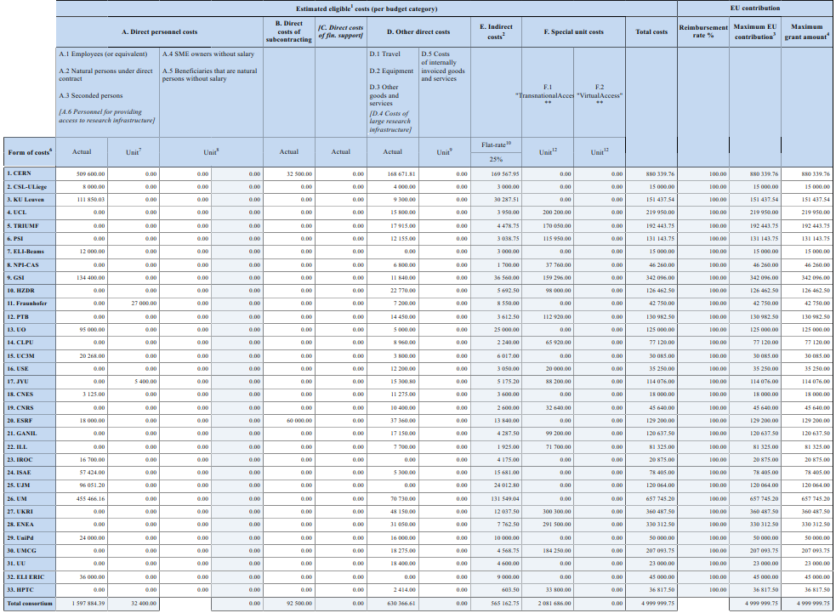
Recent approval of the Grant Agreement amendment (4/4)

Slide 7
Upcoming events (1/2)
GB-RADNEXT, « Future Facilities – Future Perspectives », 12-13 June, RAL, UK:
Has been promoted as in-person event to stimulate on-site participation
~100 people registered, mostly from industry and academia
7 sessions
NSREC, 22-26 July, Ottawa, Canada:
The booth #504 has been booked for RADNEXT/PAC-G as last year. Gerd and Ennio as booth coordinators.
RADNEXT and RADECS 2024 promotion material (flyers, posters, pens, etc.)

Slide 8
Upcoming events (2/2)
RADECS, 16-20 September, Gran Canaria, Spain:
Registrations are open! Early bird prices until 31 July
RADNEXT booth managed by Gerd, Ennio and Pablo
RADNEXT promotional material (flyers, posters, pens, etc.)

Slide 9
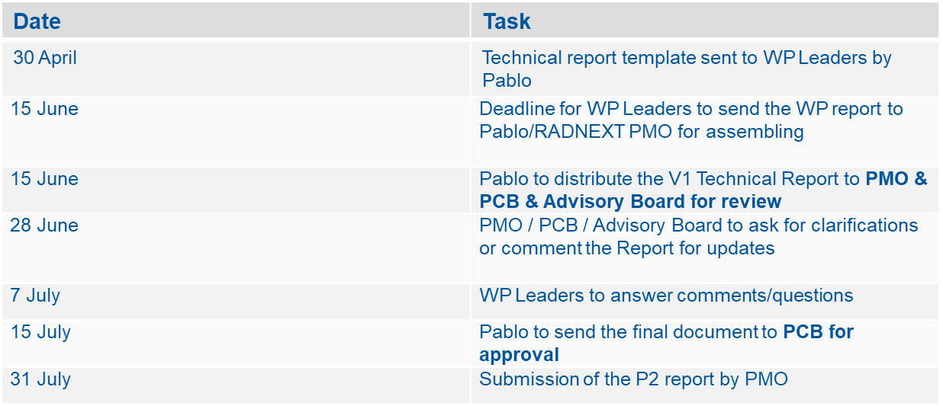
Reminder of RADNEXT P2 reporting timeline (1/2)
Period 2 (1 December 2022 to 31 May 2024) Technical report timeline:

Slide 10
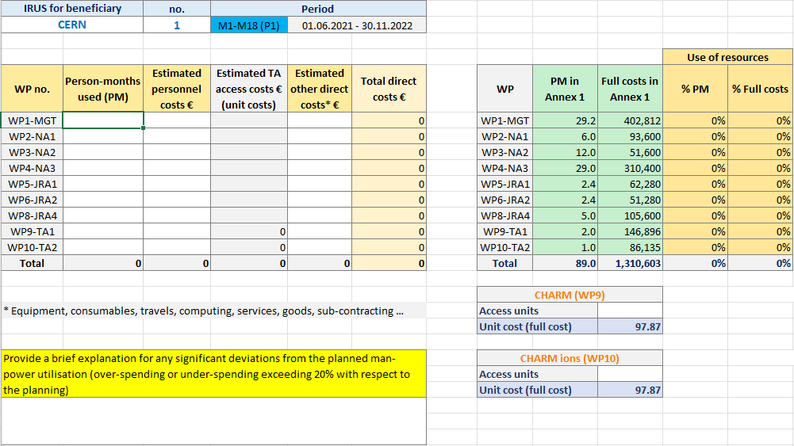
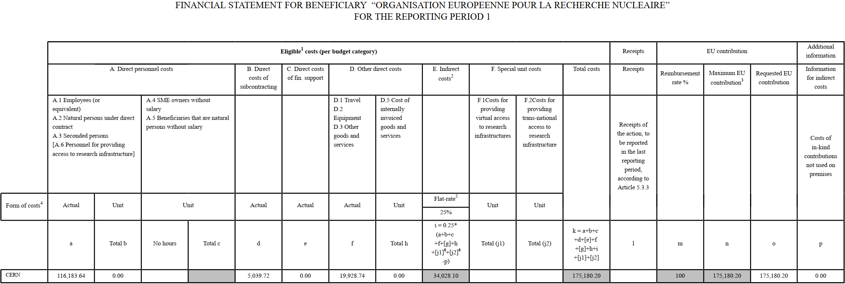
Reminder of RADNEXT P2 reporting timeline (2/2)
Period 2 Financial report timeline (at Beneficiary level - Financial contacts):
IRUS & Justification for deviations from the estimated full costs budget
→ For internal reporting, to the Consortium only
By June, 15th
Financial Statement & Use of resources
Justification for deviations from Annex 2
→ For official reporting, to the EU.
By June, 30th
NB: Justifications for deviations from Annex 2 will be included in the relevant section of the Technical Report

Slide 11
Take-home messages related to P2 reporting
The PMO asks the WP Leaders & the RADNEXT Consortium for anticipation and preparation, due to reporting during the summer holiday period.
PCB will be contacted in a few days for the Technical report review
PCB will be contacted in July for the Technical report approval
P2 report will be submitted on July 31 latest
A P2 review meeting (with EU Project Officer and external expert reviewer) is scheduled on 23.08.2024: we cannot afford much delay in the submission.
Enrique García Michel (Universidad Autónoma de Madrid & Lawrence Berkeley National Laboratory) has been chosen as reviewer. If you disagree with the selected expert, feel free to let us know. We have to confirm the COI topic to the PO the soonest possible.
The PMO (radnext-pmo@cern.ch) remains available may you have any further questions

Slide 12
Information on upcoming item(s) to vote on electronically
Transnational Access activities could be redistributed depending on the needs and on the following discussion. For more information, refer to Rubén’s presentation from yesterday.

Slide 13
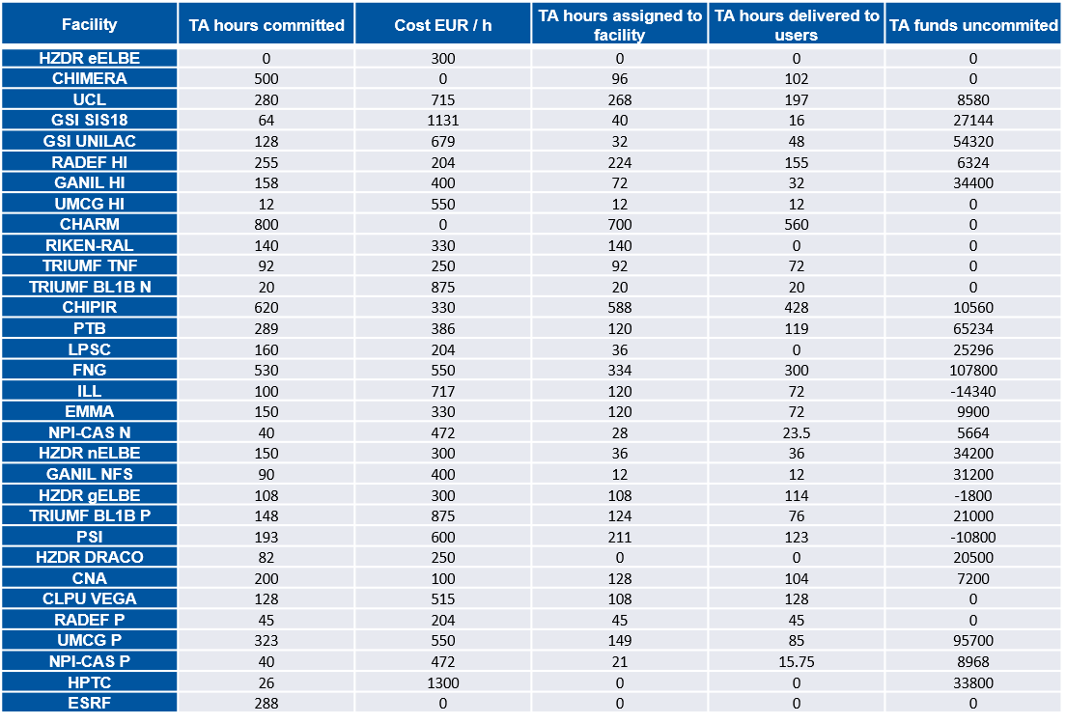
TA provision overview and reallocation discussion
For more information, refer to Rubén’s presentation from yesterday and Daniel’s upcoming presentation.
TA hours:

Slide 14
AoBs

Slide 15
Thank you for your attention
Questions?

