Slide 1


JYU’s updates for RADEF facility
Arto Javanainen (JYU)
Heikki Kettunen (JYU)
RADNEXT 3rd Annual Meeting – 10-11 June 2024
https://indico.cern.ch/e/radnext-2024

Slide 2
Outline
RADEF Facility intro
RADNEXT Beam Time Status @ RADEF
Feedback
Suggestions/thoughts for the future “RADNEXT2.0”

Slide 3

RADEF Facility
https://www.jyu.fi/accelerator/radef
@ Accelerator Laboratory of University of Jyväskylä, Finland
Heavy-ion cocktails
  (9.3) / 10.0 / 16.3 / 22 MeV/u
Protons
  Up to 55 MeV

Slide 4
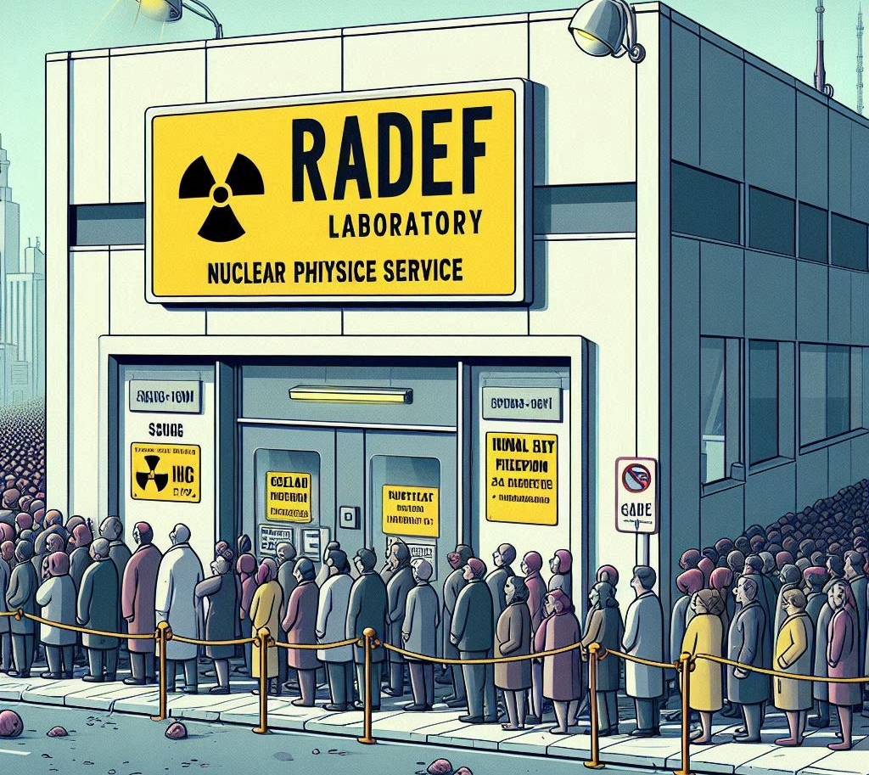
RADNEXT Beam Time Status
Total quota of 300 hours to be provided
Status until May 2024
  280 hours allocated
    20 hours remaining from the quota
  256 hours completed
    35 hours (14%) for protons and 220 hours (86%) of heavy-ions

Slide 5
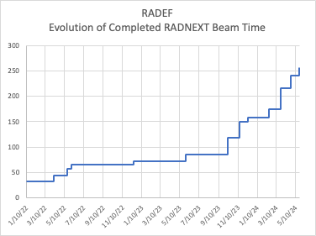
RADNEXT Beam Times at RADEF
Slow start with some user cancellations
Currently good progress
  Planned quota will be filled

Slide 6
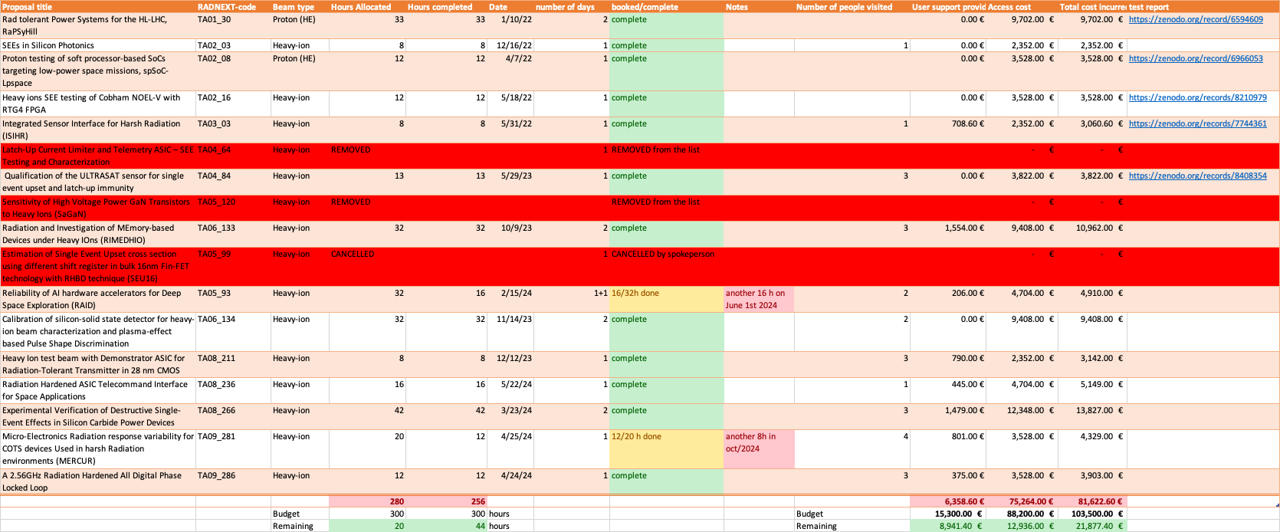
Breakdown of beam time status (until May 2024)

Slide 7


Feedback

Slide 8

Last minute cancellations
Extra hassle for the facility without any penalty to the user
Lost “income”

Slide 9

Something to think for “RADNEXT2.0”

Slide 10


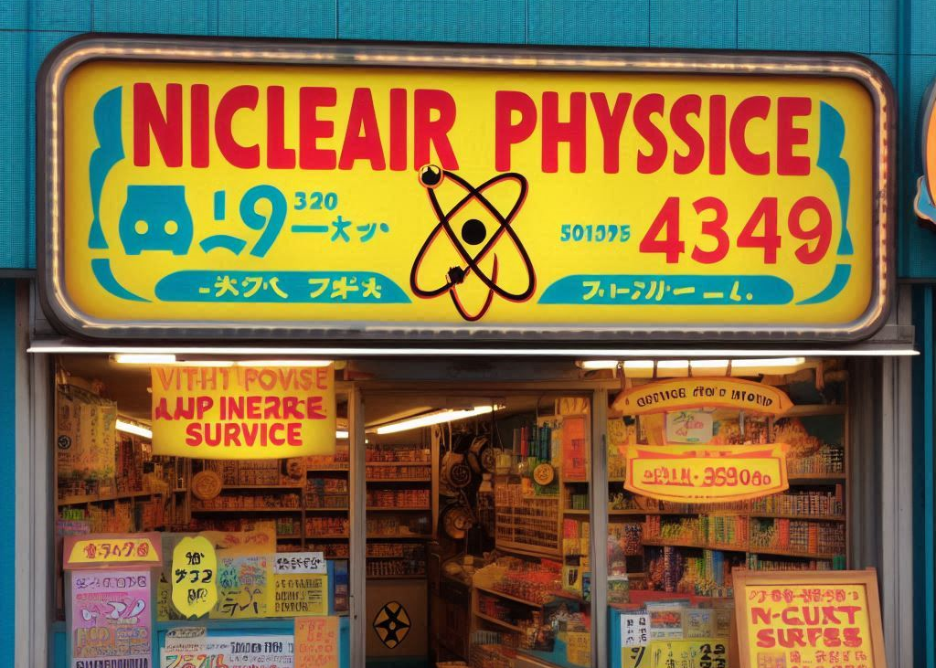
Incentive for the facilities?
From a “conventional” facility’s point of view
How to ”compensate”?
  Beam time offered at “discounted rate”
  Some extra work compared to “normal” users
Peer-review publications
  Current outcome: Very few, if any
  Requirement for users to include facility people in the publications?
    Not just recommendation

Slide 11

How to handle last minute cancellations?
Some consequences for the user for cancelling “too late” (or not showing up)?
  Not clear what it should be

Slide 12
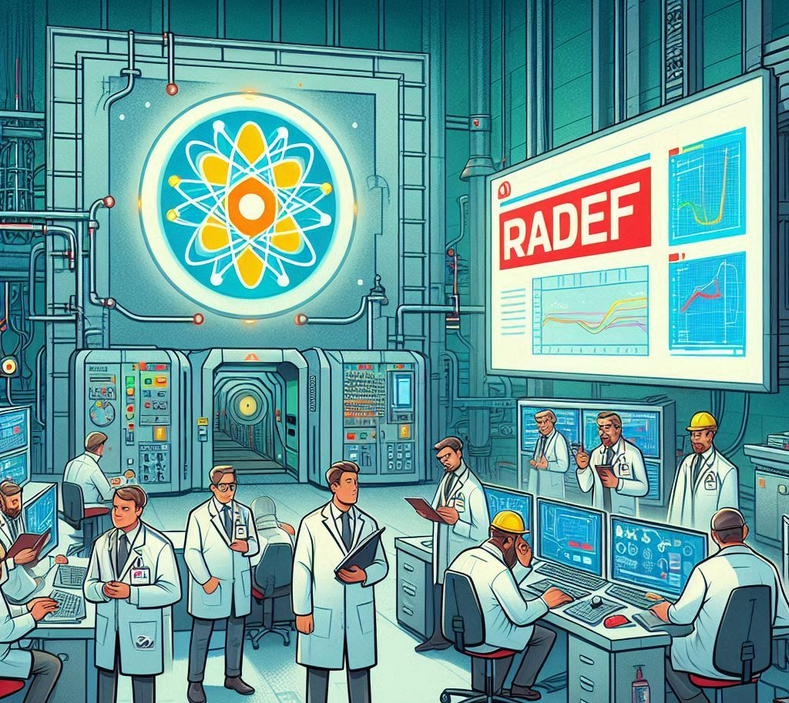
THANK YOU FOR YOUR ATTENTION
arto.javanainen@jyu.fi
Facility inquiries: heikki.i.kettunen@jyu.fi

